Slide 1
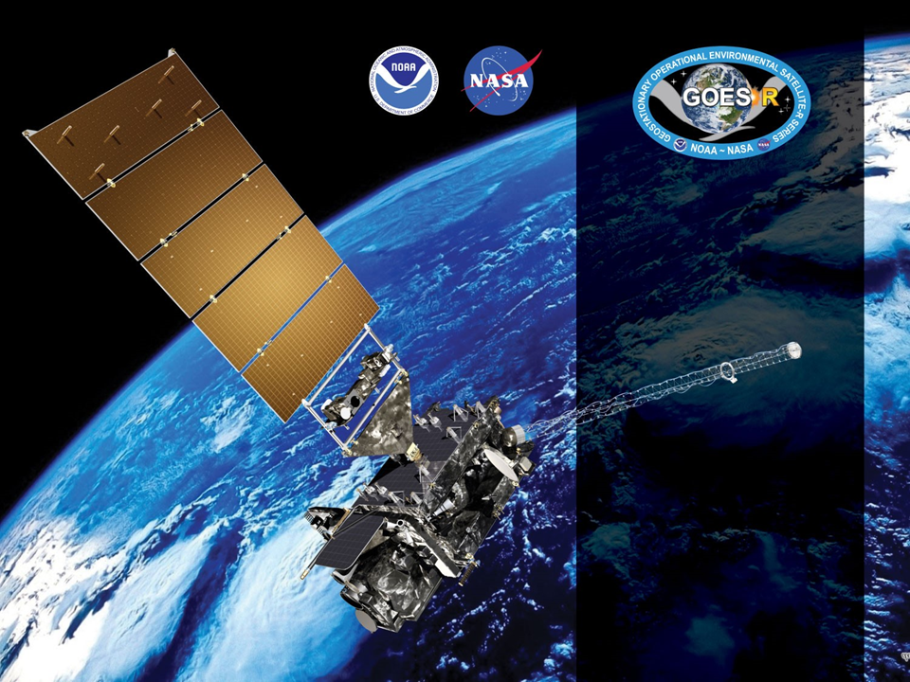
GOES-16 ABI L2+ SW Radiation Budget (SRB)
Provisional PS-PVR
October 23, 2018
GOES-R AWG
Istvan Laszlo¹, Hye-Yun Kim², Hongqing Liu², Rebekah Esmaili², Rachel Pinker³, Kathy Lantz⁴, Tianxu Yu², Kerrie Allen²
and the PRO Team
¹NOAA/NESDIS/STAR, ²IMSG, ³University of Maryland, ⁴NOAA/OAR/ESRL

Slide 2
Outline
Product/Algorithm Overview
Review of Beta Maturity
Updates for provisional
Provisional Maturity Assessment
  Empirical NTB
  Impact of B2 L1b calibration bias
Path to Full Validated Maturity
  PLPTs
  Risks
Summary and Recommendations
Notes on Direct Path and Product Resolution

Slide 3
Product Overview: RSR
Reflected Shortwave Radiation: Top-Of-Atmosphere
  instantaneous SW (0.2-4.0 µm) flux emerging at the Earth’s TOA,
  produced on a global latitude/longitude grid at
    0.25 degree (25 km) resolution for Full Disk and
    0.25 degree (25 km) resolution for CONUS.
  produced once per hour.
Table 5.25.1 in Product Definition and User’s Guide (PUG) Vol 5: Level 2+ Products, Revision 1.2 (4/11/2018)
 | Measurement |  |  |  | Mapping
Region | Range | Accuracy | Precision | Performance Conditions | Accuracy
Full Disk & CONUS | 0 to 1300 W/m² | 85 W/m² at high end of range (1000 W/m²) 65 W/m² at middle of range (350 W/m²) 110 W/m² at low end of range (<200 W/m²)^{[2]} | 100 W/m² for high end of range (1000 W/m²) 130 W/m² for middle of range (350 W/m²) 100 W/m² for low end of range (<200 W/m2^{)[2]} | LZA ≤ 70 degrees, daytime ^{[1]} | Full Disk: 4 km CONUS: 2 km
[1] Conditions for good quality prescribed by the algorithm are for SZA ≤ 70 degrees.
[2] NOTE: Low end specs are missing from PUG!

Slide 4
Product Overview: DSR
Downward Shortwave Radiation: Surface
  instantaneous total SW (0.2-4.0 µm) flux received at the Earth’s surface,
  produced on a global latitude/longitude grid at
    0.50 degree (50 km) resolution for Full Disk,
    0.25 degree (25 km) resolution for CONUS, and
    0.05 degree (05 km) resolution for Mesoscale,
  produced once per hour.
Table 5.24.1 in Product Definition and User’s Guide (PUG) Vol 5: Level 2+ Products, Revision 1.2 (4/11/2018)
 | Measurement |  |  |  | Mapping
Region | Range | Accuracy | Precision | Performance Conditions | Accuracy
Full Disk, CONUS, & Mesoscale | 0 to 1500 W/m² | 85 W/m² at high end of range (1000 W/m²) 65 W/m² at middle of range (350 W/m²) 110 W/m² at low end of range (100 W/m²) | 100 W/m² for high end of range (1000 W/m²) 130 W/m² for middle of range (350 W/m²) 100 W/m² for low end of range (100 W/m²) | LZA ≤ 70 degrees, daytime, solar elevation angle > 25 degrees ^{[1]} | Full Disk: 4 km CONUS: 2 km Mesoscale: 1 km
[1] Conditions for good quality prescribed by the algorithm are for SZA ≤ 70 degrees.

Slide 5
SRB Algorithm Overview
RSR = (Broadband TOA albedo, A) x (TOA Solar Irradiance)
DSR = (Broadband Transmittance, T) x (TOA Solar Irradiance)
A/T = f ( optical depth of cloud/aerosol/molecular, TPW, O₃, surface albedo, etc. )
SRB algorithm uses either of two paths to determine A and T:
  Direct path: calculates A and T from inputs needed in f using RT model,
  Indirect path: estimates A from narrowband ABI reflectances, and determines T from A and TPW, O₃, pressure.
Current GS algorithms do not provide surface albedo product; DSR and RSR are retrieved using Indirect path.

Slide 6
Determining A in Indirect Path
Narrow-to-Broadband Conversion
In Indirect Path A is determined by
  Estimating broadband bidirectional (BD) reflectance a_{bb} from narrowband ABI reflectances a_{i} by applying narrowband-to-broadband (NTB) conversion.
  Applying angular distributional models to convert broadband bidirectional reflectances to broadband albedo A.
Illustration of NTB conversion

Slide 7
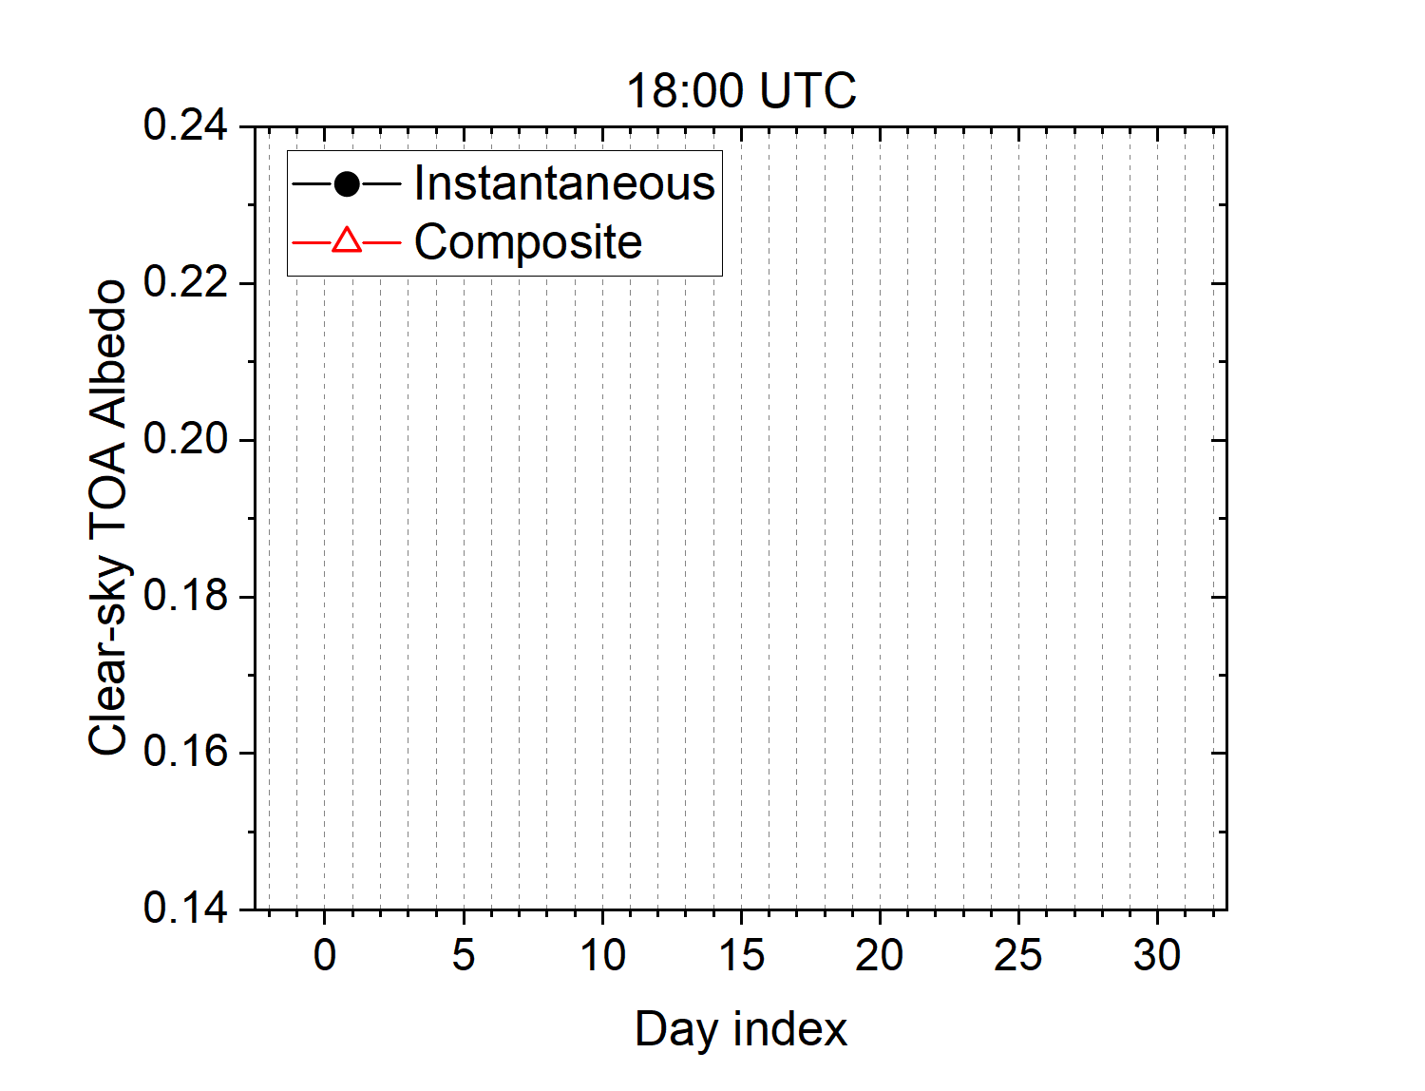
Clear-Sky Composite TOA Albedo
In Indirect Path surface albedo is determined from a clear-sky composite TOA albedo calculated as the median of clear-sky TOA broadband albedos over 28 days.

Slide 8
GOES-R DSR/RSR Product
Precedence Chain
4-level Cloud Mask
Cloud & Moisture Imagery
Snow Mask
ABI FSC product
IMS/SSMI snow ice mask
DSR
RSR
TPW
ABI product
GFS product
Climatology

Slide 9
Pre-Beta Time-Line
19 Nov 2016 GOES-R Launch
29 Nov 2016 GEO orbit attained (became GOES-16)
03 Jan 2017 ABI aperture door opened; 1st light for visible/near-infrared channels
Mid Jan 2017: AWG established access to GS L2 products.
01 Mar 2017: Cloud mask reached Beta and SRB product validation began.
23 June 2017 DSR/RSR PS-PVR Beta

Slide 10
Review of Beta Maturity
GOES-16 Shortwave Radiation Budget L2 Product Provisional PS-PVR

Slide 11
Beta PLPTs Under Review
PLPT ID | Descriptive Title | % Complete | Results | POC
ABI-FD_DSR01 ABI-FD_RSR01 | Verify M3 hourly products (DSR and RSR) are within range | 100 | Complete | AWG
ABI-CONUS_DSR02 ABI-CONUS_RSR02 | Verify M3 hourly products (DSR and RSR) are within range | 100 | Complete | AWG
ABI-MESO_DSR03 | Verify M3 product (DSR) is within range | 100 | Complete | AWG
ABI-FD_DSR04 ABI-FD_RSR04 | Verify M4 products (DSR and RSR) are within range | 100 | Complete | AWG
ABI-CONUS_DSR05 ABI-CONUS_RSR05 | Verify M4 products (DSR and RSR) are within range | 100 | Complete | AWG
ABI-FD_DSR06 ABI-FD_RSR06 | Initial assessment of FD products accuracy and precision | 100 | Complete | AWG
ABI-CONUS_DSR07 ABI-CONUS_RSR07 | Initial assessment of CONUS products accuracy and precision | 100 | Complete | AWG
ABI-MESO_DSR08 | Initial assessments of Mesoscale product accuracy and precision | 100 | Complete | AWG
Indicates task was completed

Slide 12
Risks to Reaching Provisional
(Summary Status at PS-PVR Beta)
Risk Name | Description | Impact | Mitigation and Schedule
Displaced CONUS | CONUS displacement is still observed in M4 CONUS product. | Major | ADR 242
Incorrect scale_factor and add_offset for all scaled variables in IP | The same scale_factor (0.003052037) and add_offset (-100.0) make variables within approximately [-100, 100] range. | Major | WR 2566, 2701 / PTRSW 12079
Incorrect ClearCompAlb in IP | ClearCompAlb should have median value of 29-days (including current) of clear-sky composite time series, but currently it seems just instantaneous clear-sky TOA albedo. | Major | WR 1978
Incorrect ClearInstAlb in IP | Zero and certain value (65521) are repeated in ClearInstAlb. It is supposed to have instantaneous clear sky TOA albedo. | Medium | ADR 298, WR 1978 / PTR 15968
Albedo mode dependent | There are two instances of 28-day composite albedo in the system; one is in Mode 3 and the other is Mode 4. Likely to see discontinuities in the product when a mode change occurs. Make clear-sky albedo time-series and composite mode agnostic. | Medium | ADR 272, WR 4247
Fill values in PQI2 | PQI2 is filled with _FillValue. | Medium | ADR 297, WR4510
Incorrect fill values for Scaled variables in IP | “Missing/Fill” values are zero; possible initialization problem. | Medium | ADR 233, WR1944
CONUS, FD, and MESO incorrect fill values | “Missing/Fill” values are zero; possible initialization problem. | Minor
Incorrect statistics in SZA metadata | SZA statistics in metadata are not consistent with their unit (degrees). | Minor | ADR 256
Risks resolved in DO.07 implementation.

Slide 13
Risks to Reaching Provisional
(Summary Status at PS-PVR Beta)
Risk Name | Description | Impact | Mitigation and Schedule
Incorrect statistics in CONUS metadata | DSR and RSR statistics (mean, max, min, standard deviation) in metadata are likely incorrect in CONUS product. | Medium. | Issue is now only present in M4 CONUS.
Unresolved risk.
  Mean, max, min and standard deviation in GS M4 CONUS file cannot be reproduced from DSR data in file.
  Example: M4 CONUS DSR statistics for 2018271_1615 UTC
Source | Min. (W m⁻²) | Max. (W m⁻²) | Mean (W m⁻²) | StdDev (W m⁻²)
GS | 7.06 | 1074.77* | 493.90 | 256.43
AWG (All DQF) | 7.07 | 944.18 | 450.38 | 258.77
AWG (Good DQF) | 7.35 | 944.18 | 459.95 | 255.10
*Value is not found in the DSR data.
Notes:
Need to check these! PUG issue should be “minor”

Slide 14
Issues Needing Resolution for
Provisional Maturity (1/3)
Title | Description | Impact | Mitigation | Status
ADR409 WR4907 | Time changes negatively affect computation of clear-sky composite top-of-atmosphere albedo. | SZA changed depending on time, which resulted in different clear-sky albedo value. | PR.06.02.00 DO.07.00 | Installed, resolved
ADR511 WR5472 | ClearCompAlb should be the median of ClearInstAlb time series if it is not the first day, but currently ClearCompAlb is just the current day ClearInstAlb. | Incorrect ClearCompAlb value causes incorrect retrievals. | PR.06.10.00 DO.07.00 | Installed Not fully resolved (ADR 640 created)
ADR640 | ClearCompAlb is incorrectly calculated when grid has mixed (clear and cloudy) scenes for current day. TOA albedo from the clear portion is used to calculate ClearCompAlb, but not entered in the timeseries of clear-sky TOA albedos. | Incorrect ClearCompAlb value causes incorrect retrievals in indirect path. [Unresolved (leftover) from ADR511 installed in PR.06.10.00.] | PR.06.11.00 DO.07.00 | Installed, resolved
ADR693 | Discontinuous flux retrievals at upper left corner of CONUS products were observed after PR.06.11 implementation. | Confuses users: user may think they are valid retrievals. | DO.07.00 | Installed, resolved
ADR497 | Updates needed to reach provisional status. | SRB algorithm and ABI LUT should be updated to get correct retrievals. | PR.06.17.00 DO.07.00 | Installed, resolved
Little Impact
Moderate Impact
Big Impact
Notes:
Many of the issues associated with these ADRs were found after the SRB Beta PS-PVR held June 23, 2017.

Slide 15
Issues Needing Resolution for
Provisional Maturity (2/3)
Title | Description | Impact | Mitigation | Status
ADR553 WR5747 | Semi-static monthly climatologies used by SRB are not updated. Climatology files are pre-processed offline to resample them to the fixed grid, but not implemented as function of DOY (or month) in ground system. | Climatology data should be used depending on location and month. Incorrect climatology data causes incorrect retrievals in indirect path. | PR.06.11.00 DO.07.00 | Installed, but cannot be verified from EP or IP
ADR716 WR6179 | Semi-static climatology data were updated properly in DE by ADR553, but not in OE. This ADR is to install the proper semi-static data in OE. | Incorrect climatology data causes incorrect retrievals in indirect path. | PR.06.15.00 DO.07.00 | Installed, but cannot be verified from EP or IP.
Little Impact
Moderate Impact
Big Impact
Notes:
Many of the issues associated with these ADRs were found after the SRB Beta PS-PVR held June 23, 2017.

Slide 16
Issues Needing Resolution for
Provisional Maturity (3/3)
Title | Description | Impact | Mitigation | Status
ADR617 | ClearCompAlb is incorrect in MESO product. Time series has only a single value (one day). | Incorrect ClearCompAlb value causes incorrect retrievals in indirect path. | N/A On hold until removing reprojection issue is decided | Not Installed
WR4938 Item#217 | MESO DSR is filled with _FillValue during local daytime. Issue has only been intermittent since Mar 2018. | Hinders validation. | N/A | Not Installed
ADR408/393 | At beta PSPVR, reprojection was reported to be detrimental to the usability of the product by the community by AWG lead and PSPVR chair supported the change. | Reprojection is detrimental to the usability of the product by the community. | N/A | Not Installed
ADR678 | Missing flag_meanings attribute for PQI3. | Hinders usage and getting information from it. | N/A | Not installed
ADR743 | PQIs are not initialized with _FillValue. | One may assume that provided values are valid. | N/A | Not installed
Little Impact
Moderate Impact
Big Impact
Notes:
Many of the issues associated with these ADRs were found after the SRB Beta PS-PVR held June 23, 2017.

Slide 17
Post-Beta Timeline
30 Nov–11 Dec 2017 Spacecraft Drift to East Slot
2 Nov 2017 Delivery of science updates to ASSISTT
26 Feb 2018 ASSISTT started implementing changes in framework and ATT
22 Jun 2018 DAP delivery
31 July 2018 PR.06.17 (Critical update for DRS/RSR Products)
30 Aug 2018 Begin data collection and analysis for Provisional
15 Oct 2018 DO.07.00 (critical build including all PR.06.xx upgrades)
23 Oct 2018 PS-PVR Provisional

Slide 18
Algorithm Update for Provisional
GOES-16 Shortwave Radiation Budget L2 Product Provisional PS-PVR

Slide 19
SRB algorithm update
Corrected
  calculation of Clear-sky Composite TOA Albedo.
Replaced
  previous non-ABI narrow-to-broad (NTB) conversion coefficients with ones generated for ABI.
Added
  check of NTB conversion related input (TOA reflectance) and output (TOA broadband albedo),
  additional flag to indicate quality of cloud mask input.
Used DSR and RSR products from OE (beta quality) and PR.06.17 data (updated for provisional) available at the same observation time on the same day (July 26, 2018) to demonstrate improvements.

Slide 20
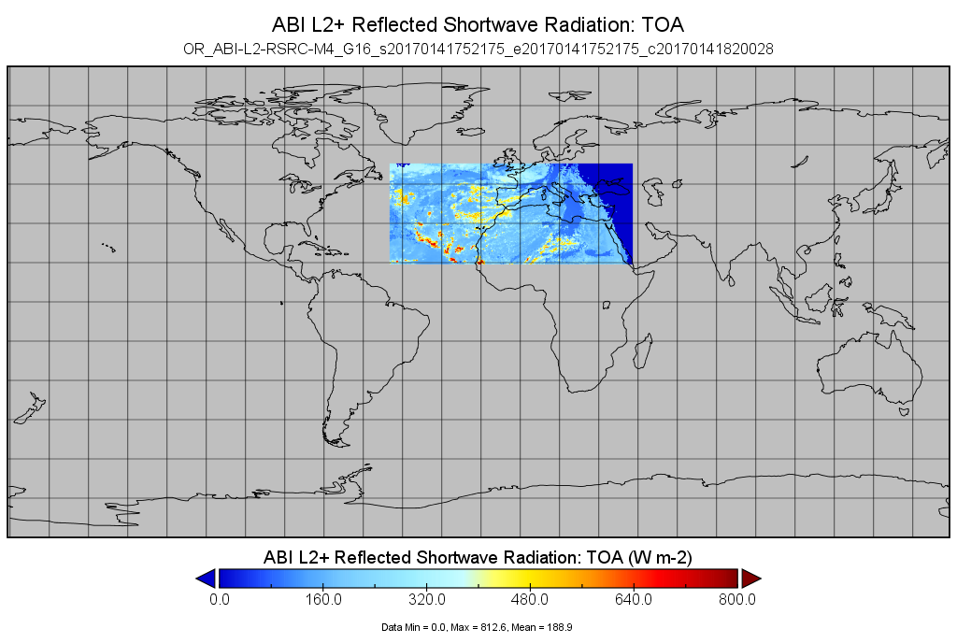
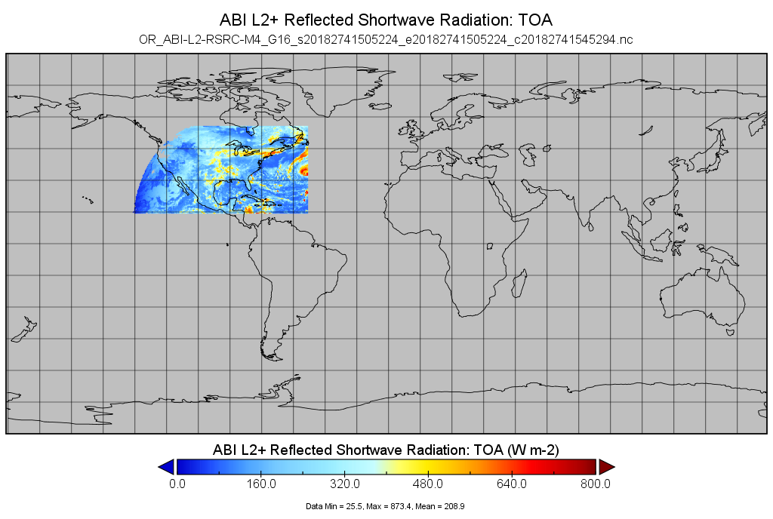
Displaced M4 CONUS
Beta M4 CONUS product had incorrect longitude offset placing it in wrong location.
Current M4 CONUS product is placed on correct location.
Note: Beta and Current product examples are from different days at different times.
Nighttime values are zero instead of missing
Wrong geographical location
Beta
01/14/2017, 17:52 UT
Correct geographical location
Nighttime values are zero instead of missing
Current
10/01/2018, 15:05 UT

Slide 21
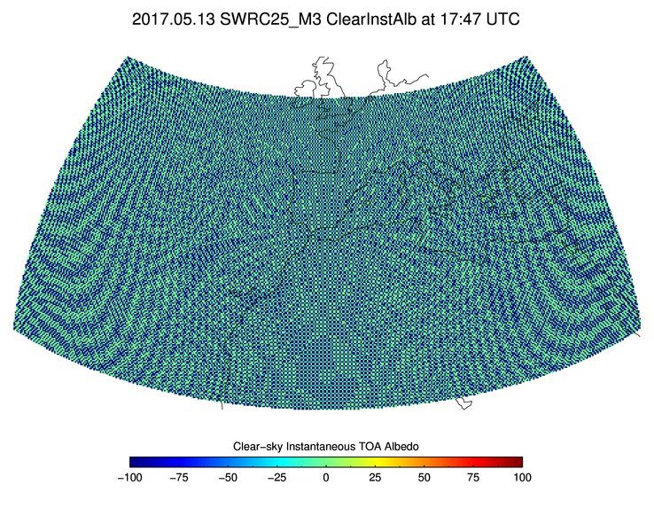
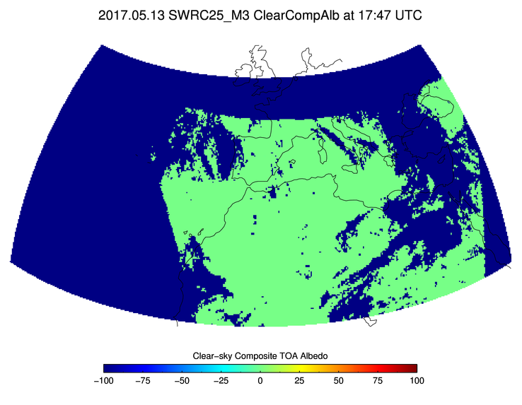
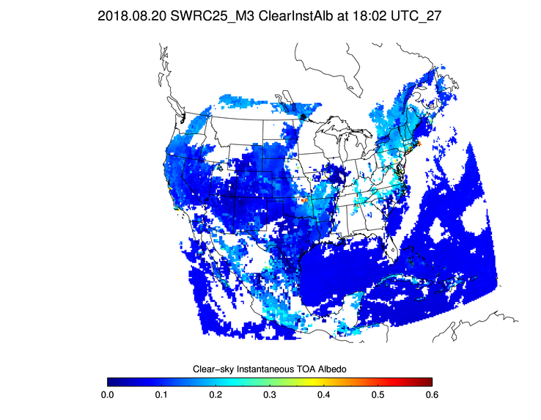
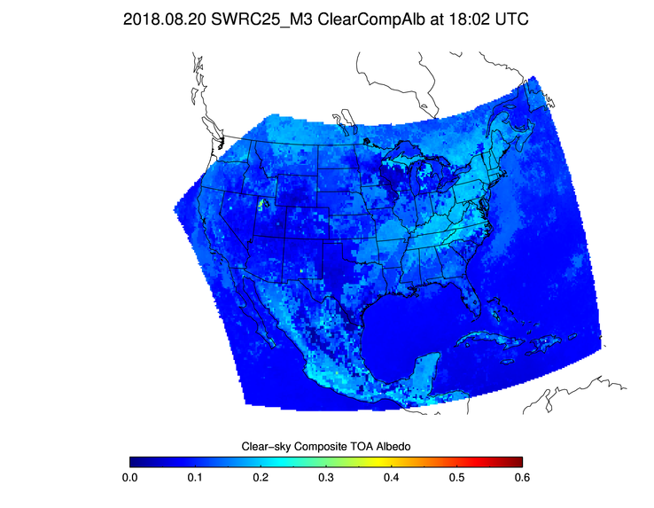
Clear-sky Composite TOA Albedo
Instantaneous Clear-Sky TOA albedo
Clear-Sky Composite TOA albedo
Both instantaneous and composite clear-sky TOA albedos had incorrect values in Beta IP product.
  (Example for 5/13/2017at 17:47 UTC)
Changes made in PR.06.11 (installed on 5/7/18) corrected both instantaneous and composite clear-sky TOA albedos.
  (Example for 8/20/2018 at 18:02 UTC)

Slide 22
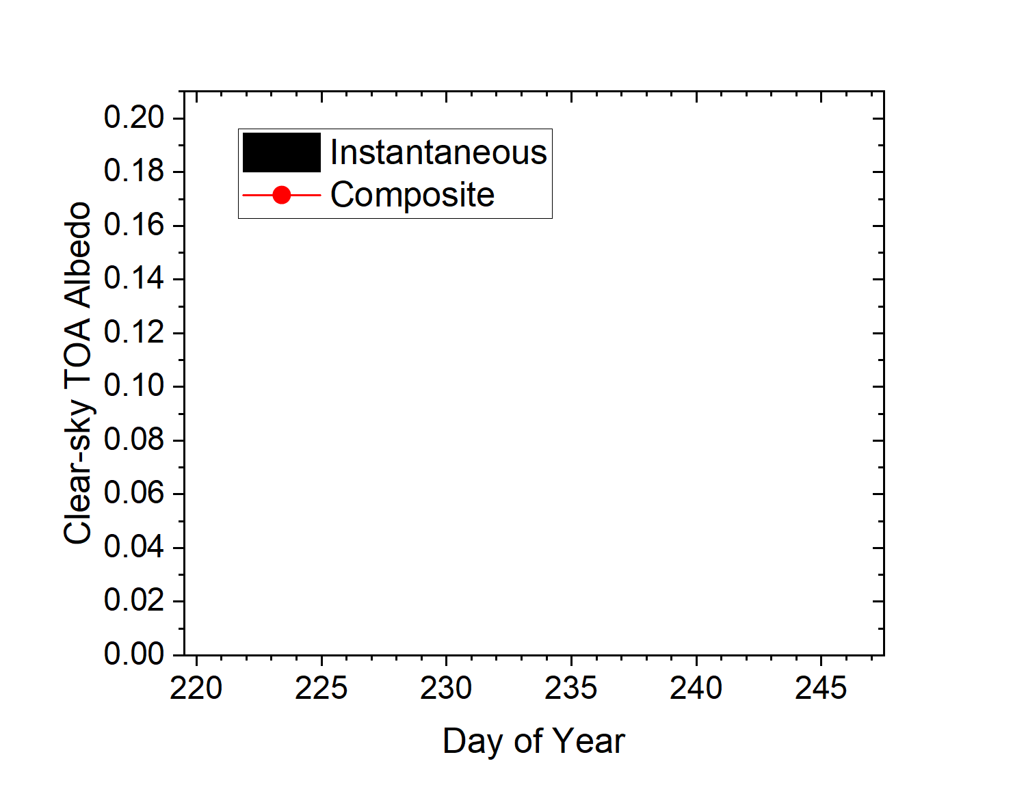
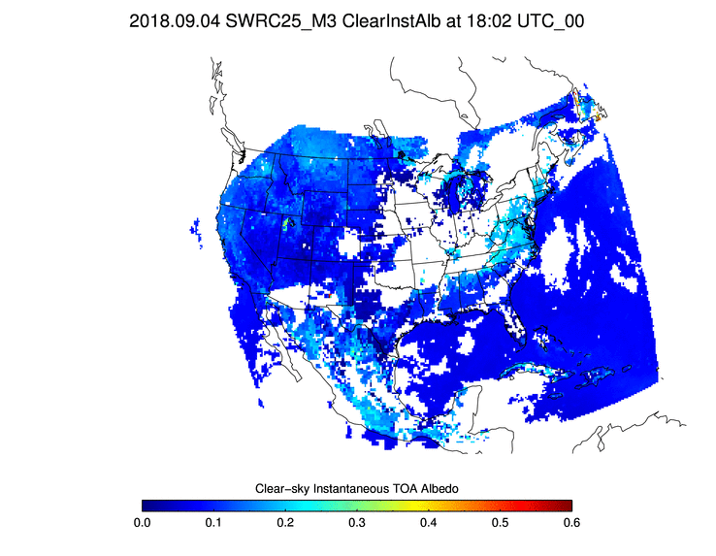
Clear-sky Composite TOA Albedo
Clear-sky instantaneous albedos (ClearInstAlb) and clear-sky composite albedo (ClearCompAlb ) from CONUS for a single grid cell (87.875°W, 41.875°N, around 18 UTC):
  28 days of ClearInstAlb (days 220 – 247); day 220 is 8 days after SRB update.
  ClearInstAlb varies from day to day as expected; ClearCompAlb is now correctly calculated as the median of available instantaneous clear-sky albedos.
  ClearCompAlb has a valid value, as it should, even on days when ClearInstAlb is not available due to overcast sky.

Slide 23
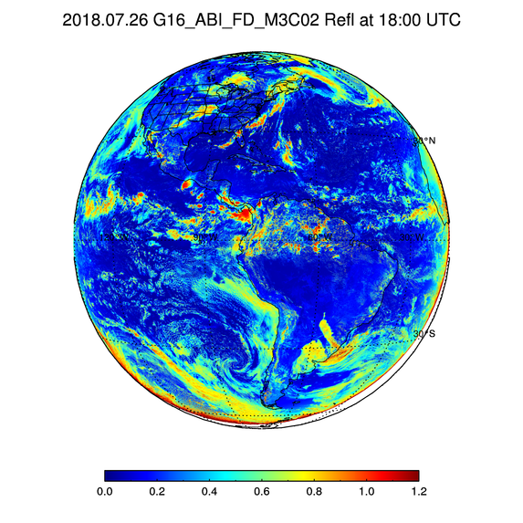
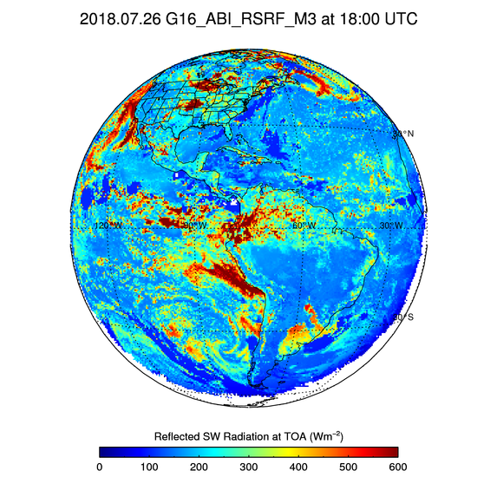
NTB update (1)
The case of “missing” clouds in beta RSR.
Bright clouds seen in Ch 2 reflectance (left) erroneously have small beta RSR (right).

Slide 24
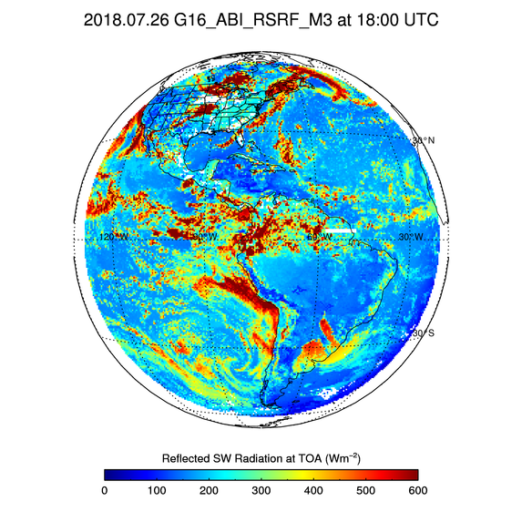
NTB update (2)
Update for provisional recovers “missing” clouds in RSR.
Bright clouds seen in Ch 2 reflectance (left) have large RSR (right) as they should.

Slide 25
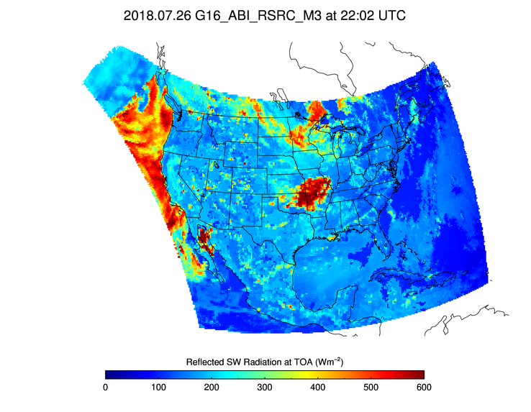
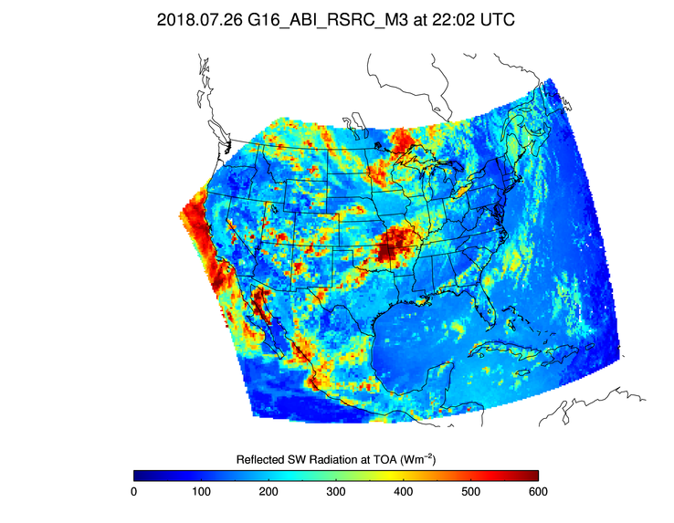
Input cloud mask quality flag
Beta RSR in CONUS (left) has discontinuous field (highlighted area) due to invalid cloud mask.
Updated algorithm ingests cloud mask QF and skips retrieval when cloud mask QF is invalid (right). (From PR.06.17)
Retrieval domain now corresponds only to valid cloud mask.
Notes:
ADR 693

Slide 26
Other changes since Beta:
Product Quality Indicator
PQIs in intermediate products:
  PQI1: input data, availability and source,
  PQI2: selection and performance,
  PQI3: retrieval quality.
PQI2 was _FillValue in Beta product; now it has valid information
  analysis by scene type possible.
Remaining issue in PQIs:
  PQIs are not initialized with _FillValue; addressed in ADR743.

Slide 27
Product Quality Evaluation
GOES-16 Shortwave Radiation Budget L2 Product Provisional PS-PVR

Slide 28
Provisional PLPTs
Test ID | Test Title
ABI-FD_DSR09 ABI-FD_RSR09 | Assess precision and accuracy of FD product for an extended period that includes some but not all seasonal variability
ABI-CONUS_DSR10 ABI-CONUS_RSR10 | Assess precision and accuracy of CONUS product for an extended period that includes some but not all seasonal variability
ABI-MESO_DSR11 | Assess precision and accuracy of MESO product for an extended period that includes some but not all seasonal variability

Slide 29
Application of PLPT Analysis
Tests to Domains
CERES: Clouds and the Earth Radiant Energy System
GSIP: Geostationary Surface and Insolation Product
SURFRAD: Surface Radiation Budget Network (US)
SOLRAD: Solar radiation network (US)
Analysis Method |  | FD | CONUS | MESO
Visual | Comparison G16 RSR and DSR with GSIP DSR and RSR
Quantitative | Comparison of G16 RSR with CERES RSR
 | Comparison of G16 DSR with ground measurements (SURFRAD and SOLRAD)

Slide 30
GOES-16 Data Used in this Review
Time period: 08/30 – 09/30, 2018; Days: 242 – 273.
  SRB algorithm update in OE on 7/31/2018.
  Needed to wait 28 days after reset of clear-sky TOA albedo time-series with new ABI NTB coefficients.
G16 DSR in CONUS, FD, MESO, and RSR in CONUS and FD domains.
Matchups (set of quasi coincident and collocated G16 and reference data):
  RSR retrievals in CONUS and FD with CERES observations.
  DSR retrievals in CONUS, FD, and MESO with SURFRAD and SOLRAD measurements.
    G16 data averaged spatially within an area of 25-km radius centered on ground site.
    Reference data averaged temporally within ±30-min time window centered on G16 retrieval time.

Slide 31
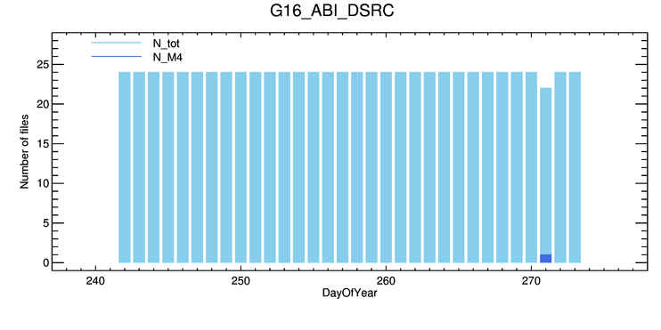
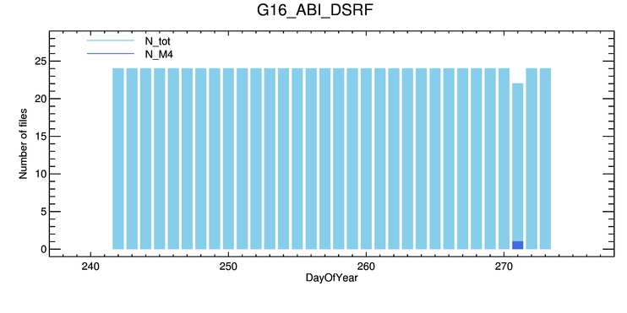
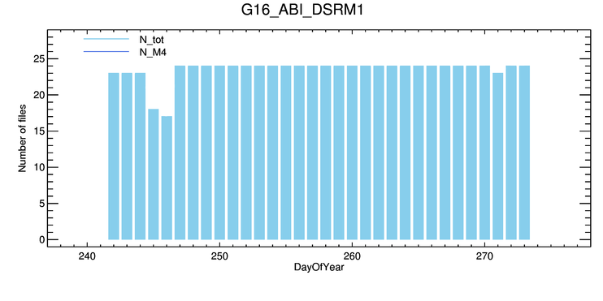
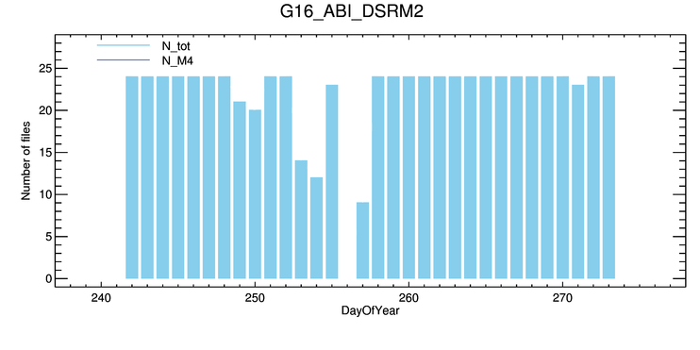
GOES-16 Data Used in this Review: Data Availability
  CONUS & FD: 2 files were missing on 9/28, 2018, 4 & 9 UTC,
  only one M4 file, on 9/28, 2018, at 16 UTC,
  MESO: availability depends on scan mode and/or date.
CONUS
FD
M1
M2
Notes:
N_tot = N_mode_3 + N_mode_4

Slide 32
Quantitative Comparison
GOES-16 Shortwave Radiation Budget L2 Product Provisional PS-PVR

Slide 33
Definitions of Metrics for Quantitative Comparisons
Passed: Accuracy and Precision meet or slightly exceed requirements. Potential contributors for deviations are identified.
Partial-Passed: Accuracy/Precision deviates significantly from requirements, but potential contributors for deviations are identified.
Failed: Accuracy/Precision deviates significantly from requirements and source of poor performance is unknown, or source known and correction requires new algorithm.

Slide 34
Quantitative Comparison of RSR with CERES
GOES-16 Shortwave Radiation Budget L2 Product Provisional PS-PVR

Slide 35
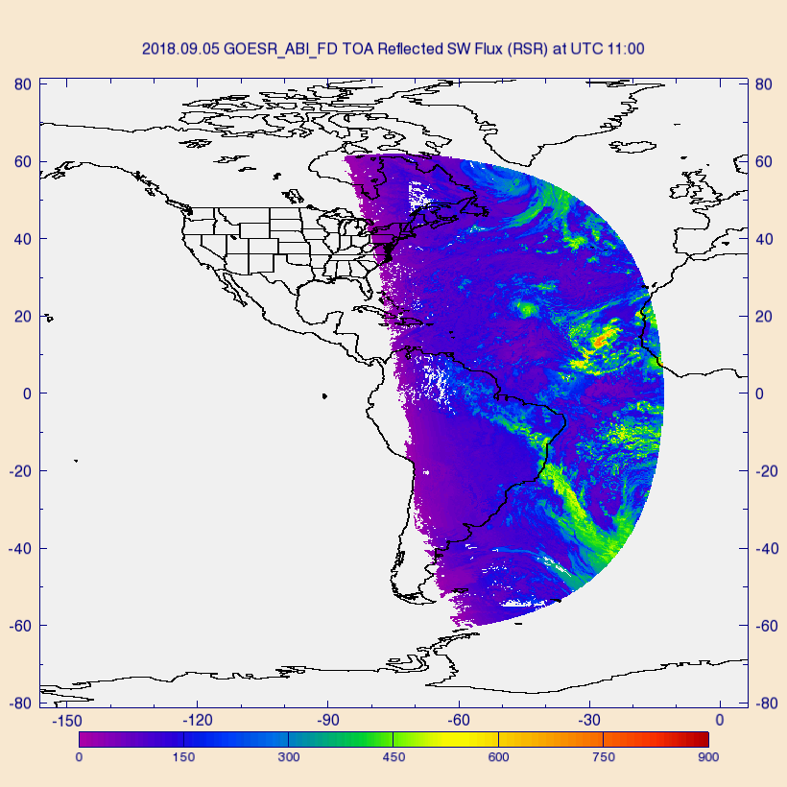
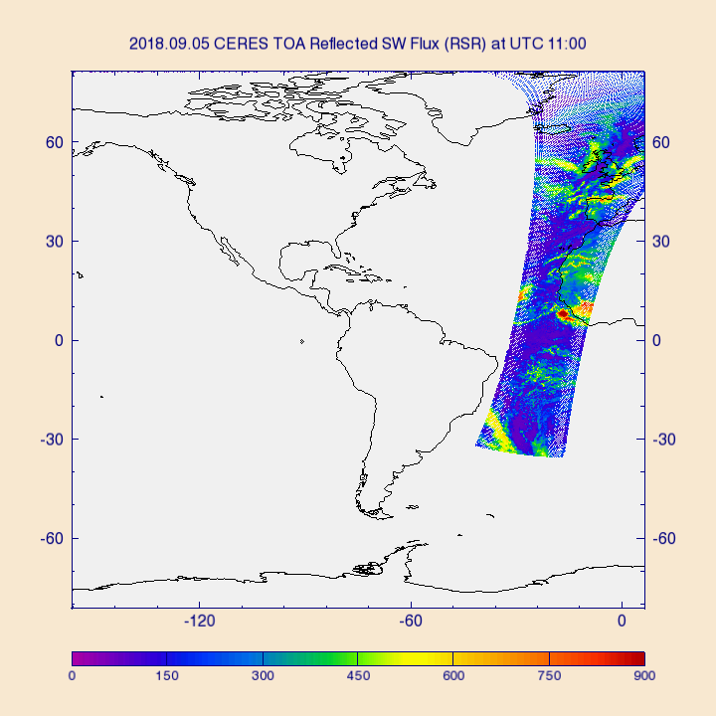
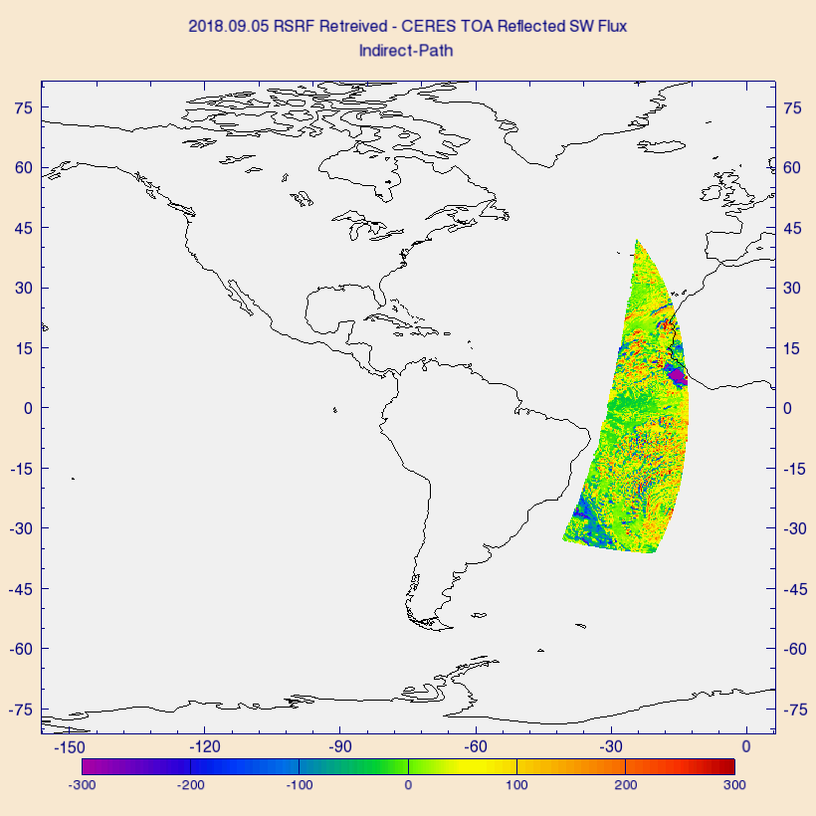
PLPT Task ABI-FD_RSR09
Comparison of G16 RSR with CERES/Terra TOA reflected flux on 9/5/2018 over full disk:
  G16 (left), CERES (middle), and G16 – CERES difference (right).
  Largest differences (± 300 Wm⁻²) are over clouds.

Slide 36
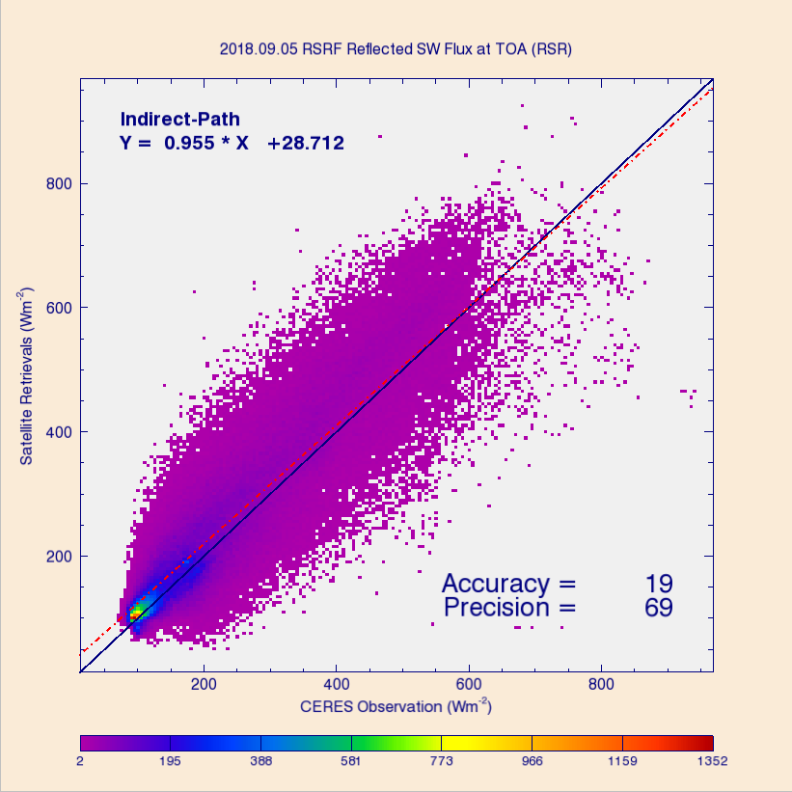
PLPT Task ABI-FD_RSR09
Comparison of G16 FD RSR product with CERES/Terra TOA fluxes for 9/5/18 over full disk (over 197K points).
Range | A | P | N
CERES < 200 | 18 (110) | 44 (100) | 110643
[200, 500] | 27 (65) | 81 (130) | 74882
CERES > 500 | -26 (85) | 129 (100) | 12216
Requirements are in parenthesis. Units: W m⁻².
Accuracy (A) and precision (P) are within specs except for high range P (cloudy sky).
Accuracy (A): mean bias (satellite – reference)
Precision (P): standard deviation of biases

Slide 37
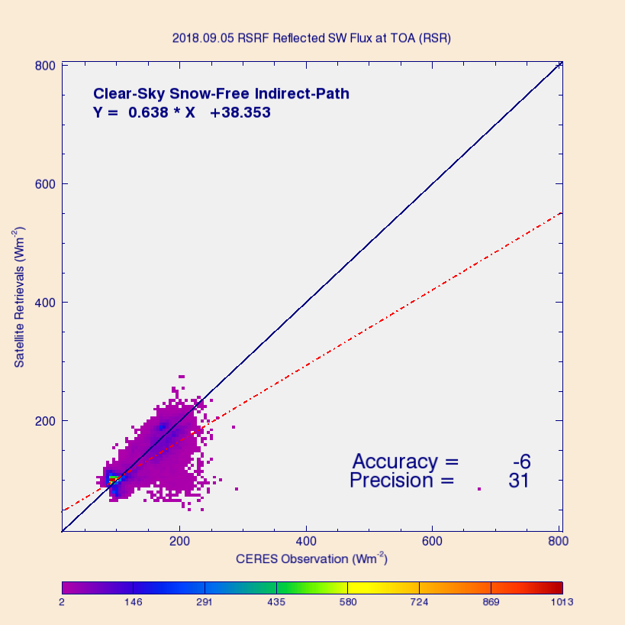
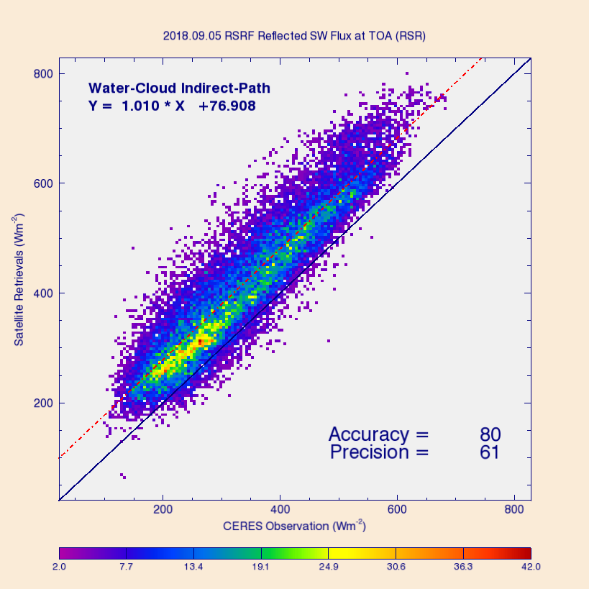
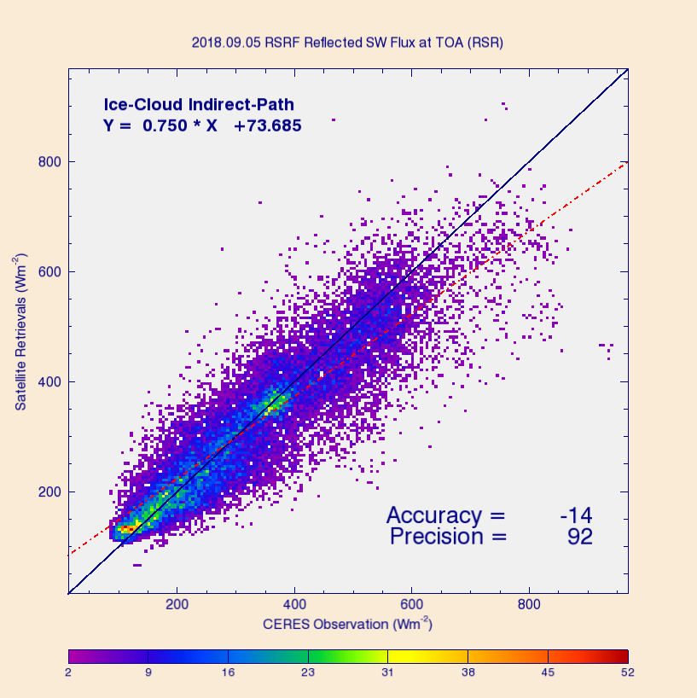
PLPT Task ABI-FD_RSR09
Comparison of G16 FD RSR with CERES/Terra TOA reflected flux for 3 scene types on 9/5/2018:
  Clear sky (left), water cloud (middle), and ice cloud (right).
  Largest biases are for water and ice clouds.
Accuracy: mean bias (satellite – reference)
Precision: standard deviation of biases

Slide 38
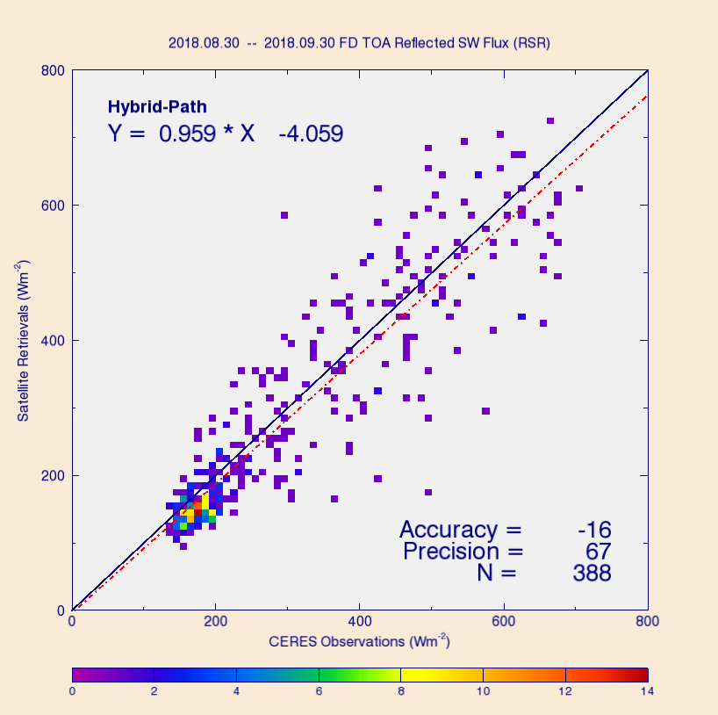
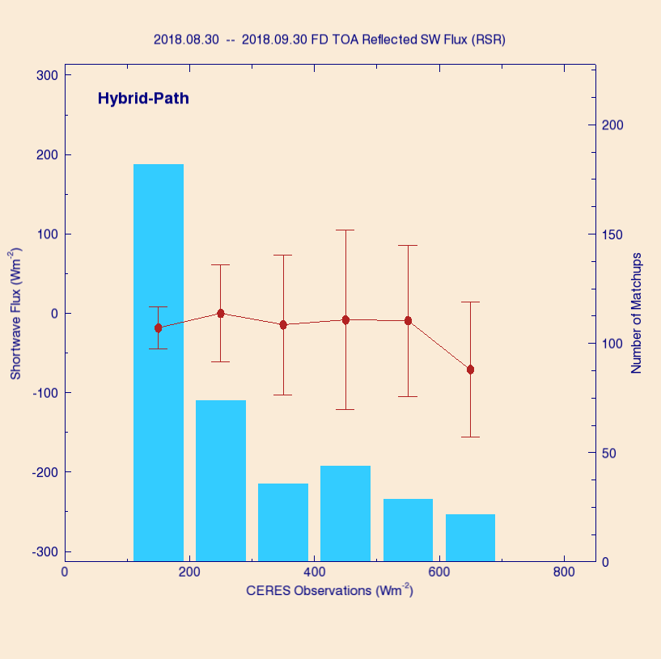
PLPT Task ABI-FD_RSR09
Comparison of G16 FD RSR product with CERES/Terra TOA fluxes for 8/30 – 9/30/2018, but over selected sites only.
Underestimation on average; largest bias is again at high RSR (cloud).
Sites: SURFRAD and SOLRAD (see later).

Slide 39
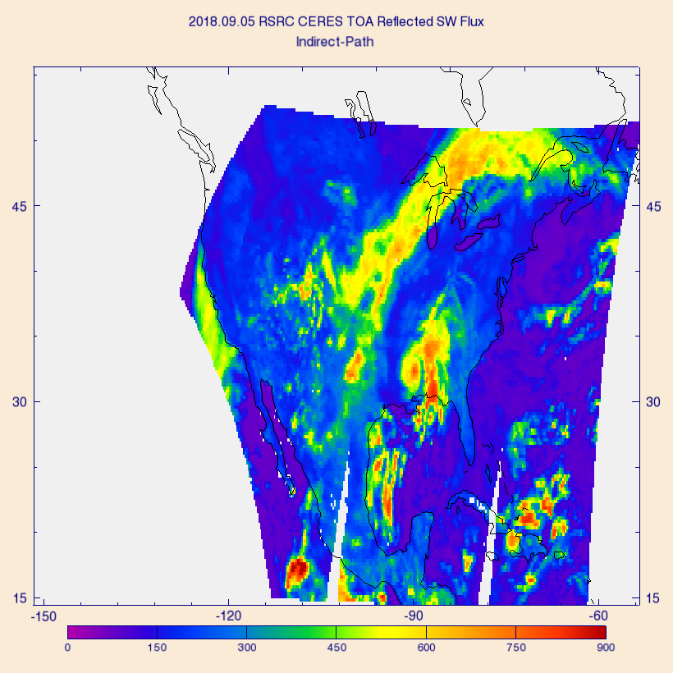
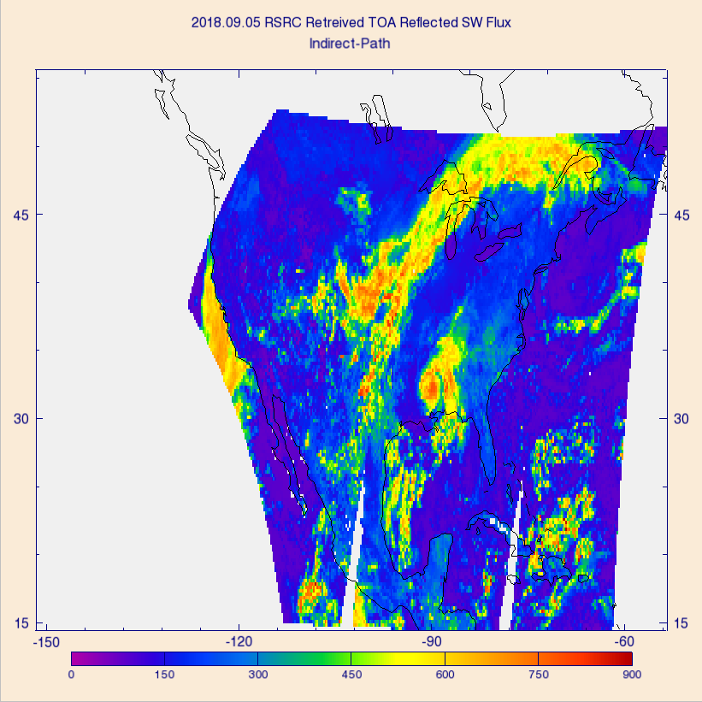
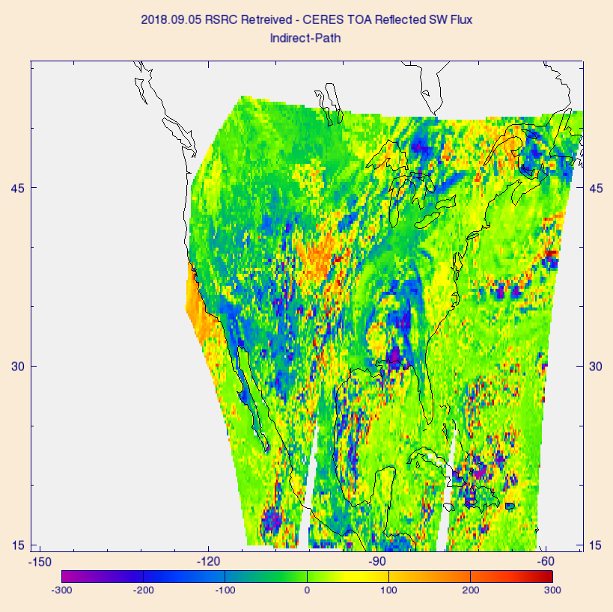
PLPT Task ABI-CONUS_RSR10
Comparison of G16 RSR with CERES/Terra TOA reflected flux on 9/5/2018 over CONUS:
  CERES (left), G16 (middle), and G16 – CERES difference (right).
  Largest differences (± 300 Wm⁻²) are over clouds.

Slide 40
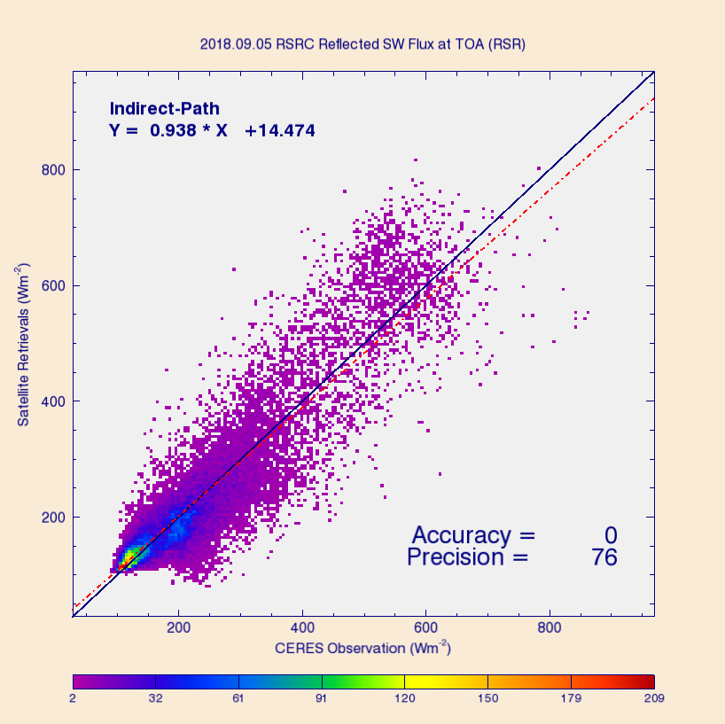
PLPT Task ABI-CONUS_RSR10
Comparison of G16 RSR product with CERES/Terra TOA fluxes for 9/5/18 over CONUS (over 35K points).
Range | A | P | N
CERES < 200 | 5 (110) | 39 (100) | 18703
[200, 500] | -2 (65) | 95 (130) | 13870
CERES > 500 | -26 (85) | 126 (100) | 3203
Requirements are in parenthesis. Units: W m⁻².
Accuracy (A) and precision (P) are within specs except for high range P (cloudy sky).
Accuracy (A): mean bias (satellite – reference)
Precision (P): standard deviation of biases

Slide 41
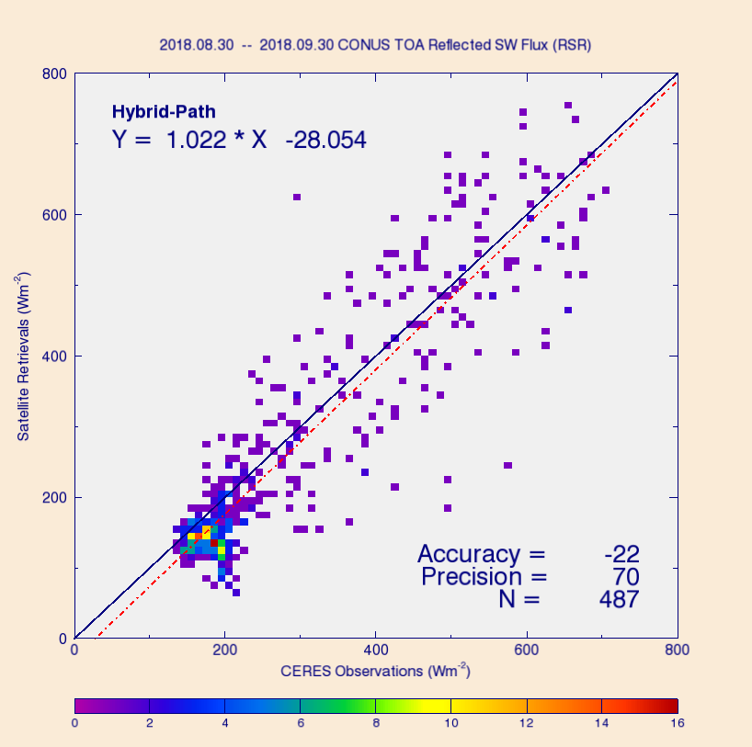
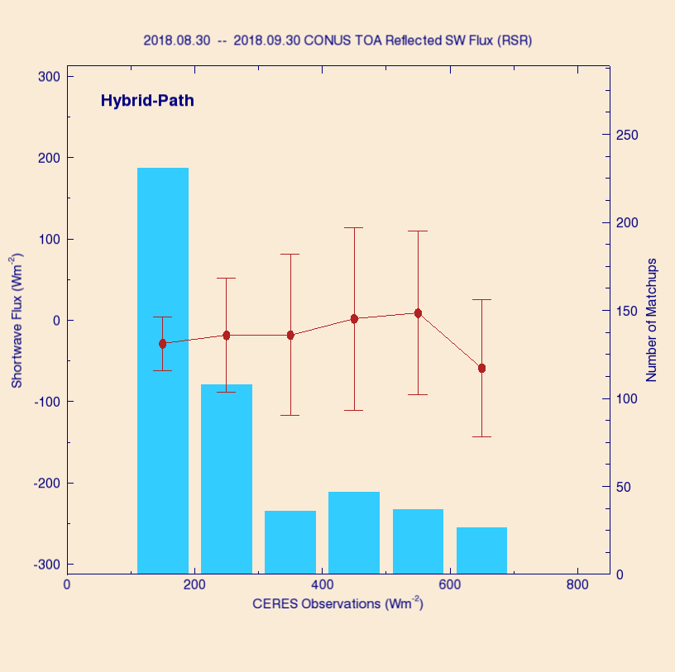
PLPT Task ABI-CONUS_RSR10
Comparison of G16 CONUS RSR product with CERES/Terra TOA fluxes for 8/30 – 9/30/2018, but over selected sites only.
Underestimation on average; largest bias is again at high RSR (cloud).
Sites: SURFRAD and SOLRAD (see later).

Slide 42
Quantitative Comparison of DSR with SURFRAD and SOLRAD
GOES-16 Shortwave Radiation Budget L2 Product Provisional PS-PVR

Slide 43
Reference Data for
Quantitative Evaluation of DSR
Surface Radiation Network (SURFRAD)
  Accurate, long-term, continuous measurements.
  7 permanent sites in climatologically diverse regions in the US.
Integrated Surface Irradiance Study (SOLRAD)
  Monitors surface radiation in the US, in collaboration with SURFRAD.
  Currently 7 stations are available, but Seattle, WA is not within G16 SRB product domain.

Slide 44
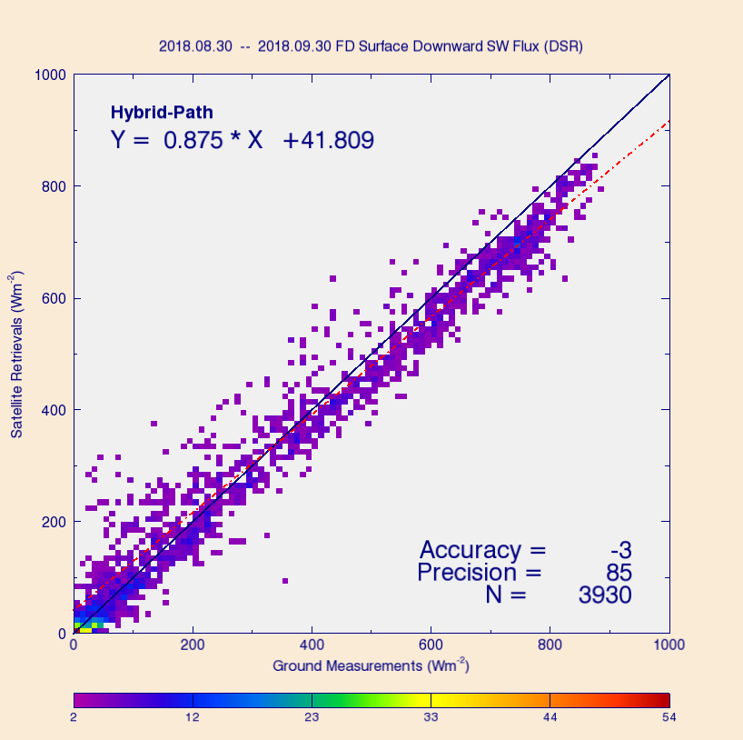
PLPT Task ABI-FD_DSR09
Comparison of FD DSR product (50 km) with SURFRAD and SOLRAD for 8/30 – 9/30, 2018.
Range | A | P | N
Ground < 200 | 26 (110) | 73 (100) | 1430
[200, 500] | 9 (65) | 93 (130) | 1193
Ground > 500 | -47 (85) | 69 (100) | 1307
Requirements are in parenthesis. Units: W m⁻².
Accuracy (A) and precision (P) values meet requirements in all ranges.
Accuracy (A): mean bias (satellite – reference)
Precision (P): standard deviation of biases

Slide 45
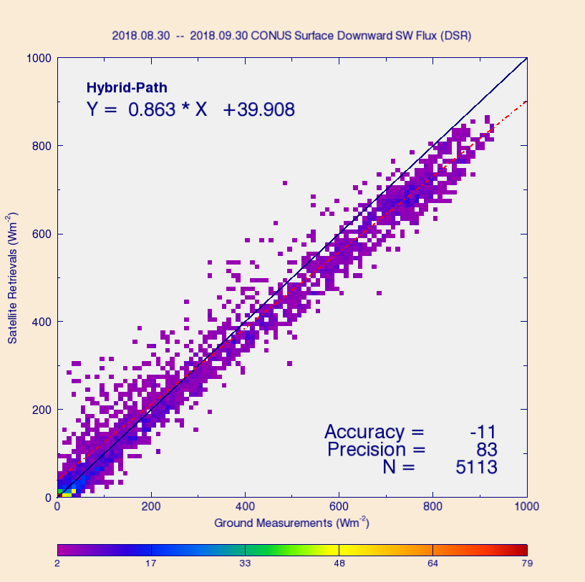
PLPT Task ABI-CONUS_DSR10
Comparison of CONUS DSR product (25 km) with SURFRAD and SOLRAD for 8/30–9/30, 2018.
Range | A | P | N
Ground < 200 | 24 (110) | 77 (100) | 1834
[200, 500] | 2 (65) | 88 (130) | 1459
Ground > 500 | -58 (85) | 67 (100) | 1820
Requirements are in parenthesis. Units: W m⁻².
Accuracy (A) and precision (P) values meet requirements in all ranges.
Accuracy (A): mean bias (satellite – reference)
Precision (P): standard deviation of biases

Slide 46
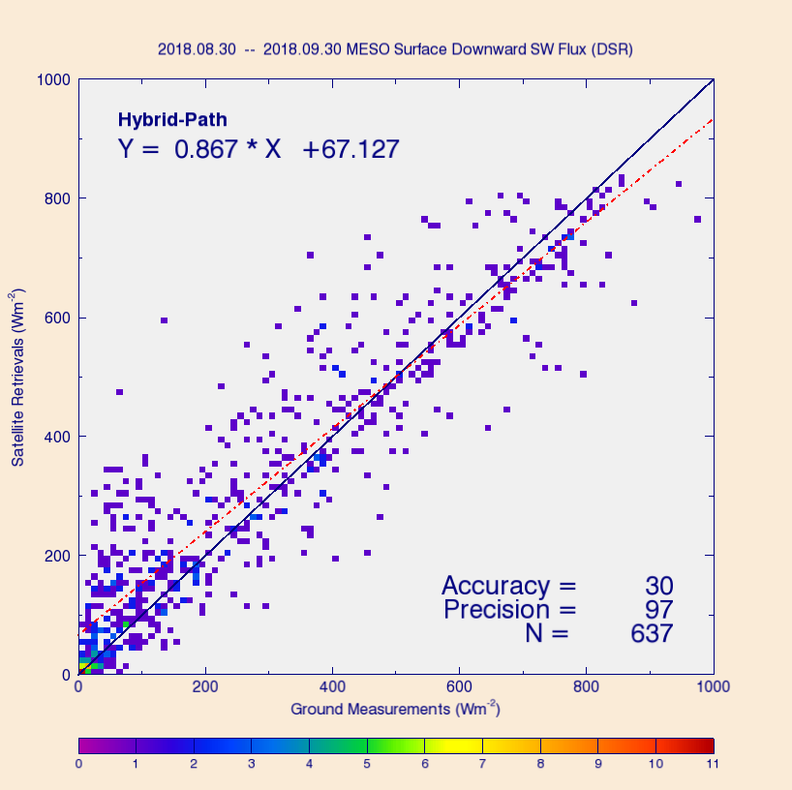
PLPT Task ABI-MESO_DSR11
Comparison of DSRM1 product (5 km) with SURFRAD and SOLRAD for 8/30 – 9/30, 2018.
Range | A | P | N
Ground < 200 | 51 (110) | 84 (100) | 311
[200, 500] | 35 (65) | 105 (130) | 188
Ground > 500 | -26 (85) | 89 (100) | 138
Requirements are in parenthesis. Units: W m⁻².
Accuracy (A) and precision (P) values meet requirements in all ranges.
Accuracy (A): mean bias (satellite – reference)
Precision (P): standard deviation of biases

Slide 47
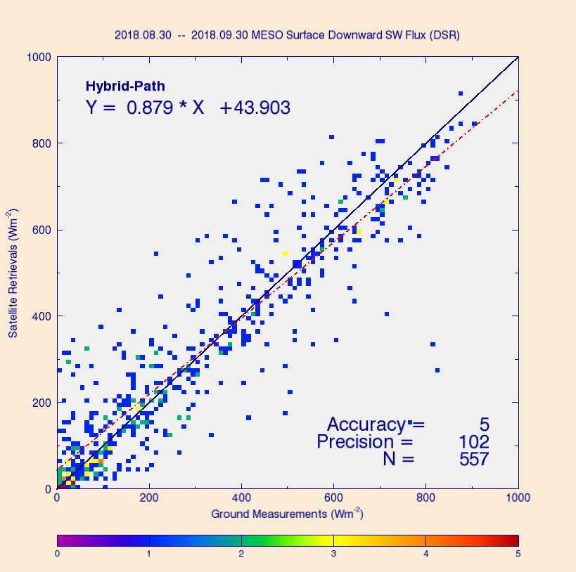
PLPT Task ABI-MESO_DSR11
Comparison of DSRM2 product (5 km) with SURFRAD and SOLRAD for 8/30 – 9/30, 2018.
Range | A | P | N
Ground < 200 | 29 (110) | 83 (100) | 240
[200, 500] | 10 (65) | 105 (130) | 166
Ground > 500 | -37 (85) | 114 (100) | 151
Requirements are in parenthesis. Units: W m⁻².
Accuracy (A) and precision (P) values meet requirements in all ranges except high-range P.
Accuracy (A): mean bias (satellite – reference)
Precision (P): standard deviation of biases

Slide 48
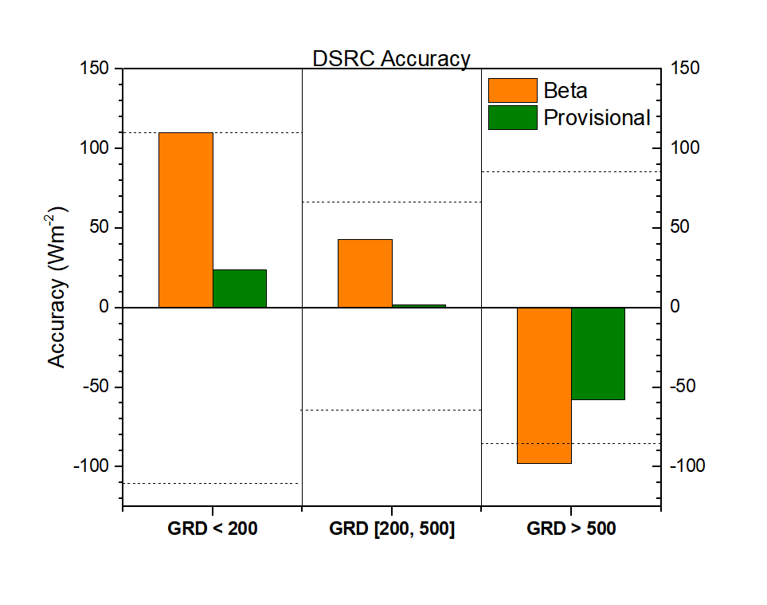
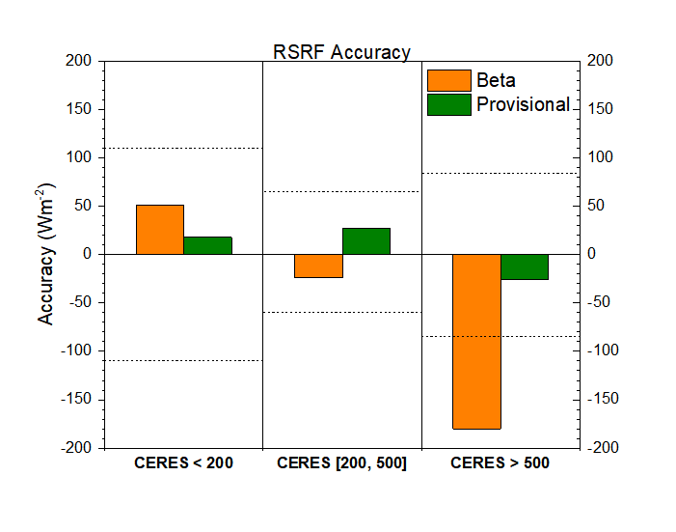
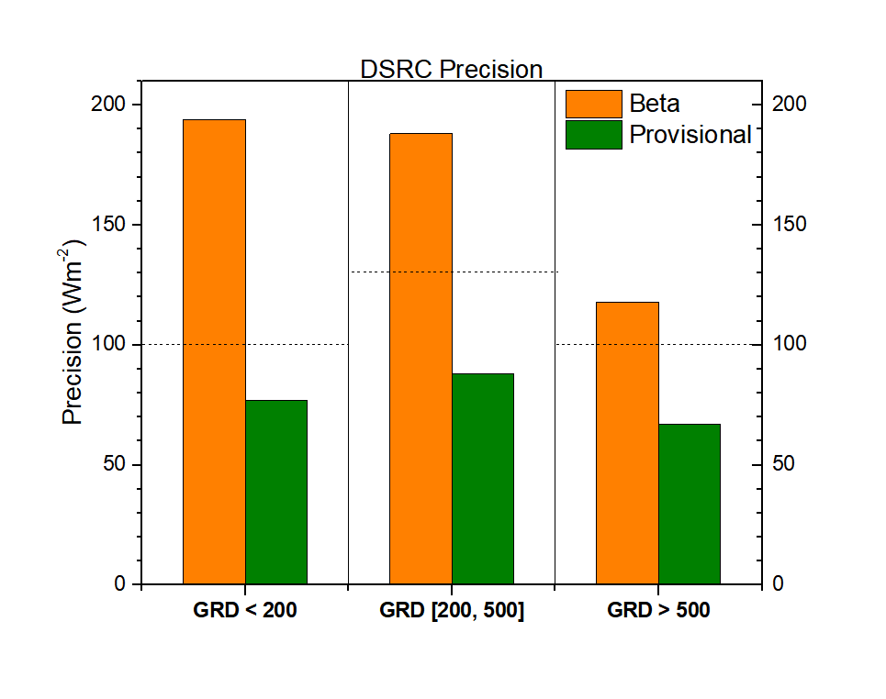
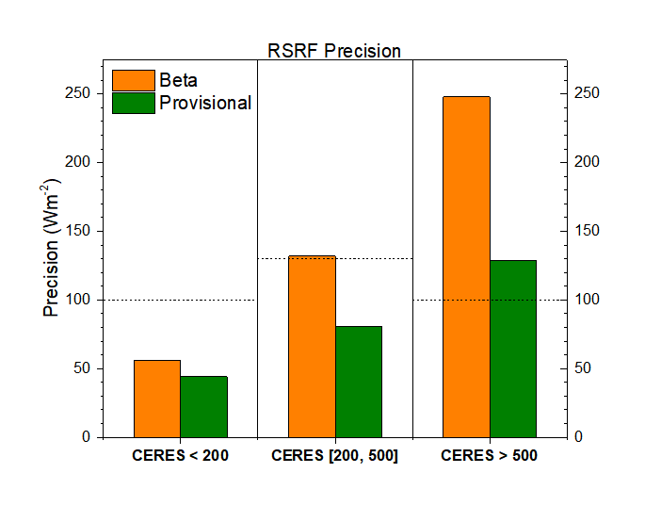
Summary Statistics

Slide 49
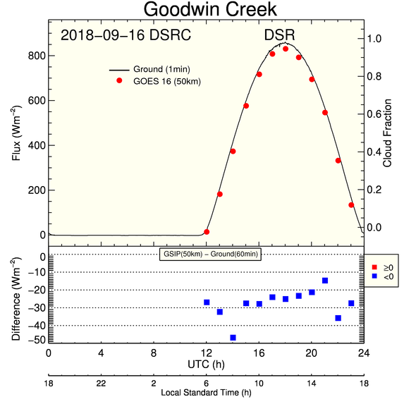
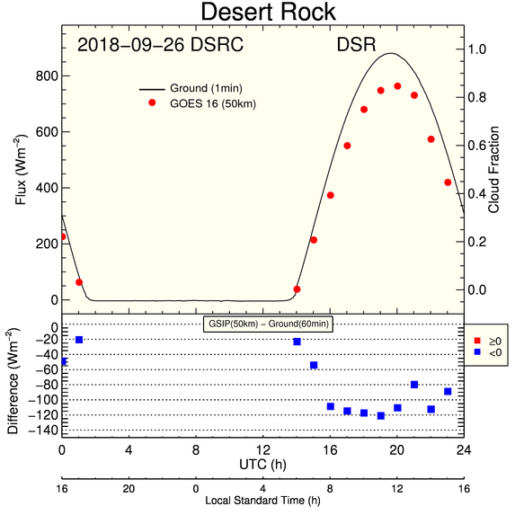
Diurnal Cycle of DSRC - Clear
Clear-sky examples: the “good” and the “bad”.
Under predominantly clear skies G16 DSR follows the diurnal change in ground-measured DSR, but degree of agreement can vary with location.

Slide 50
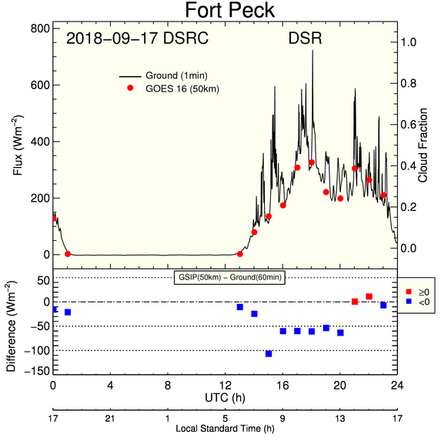
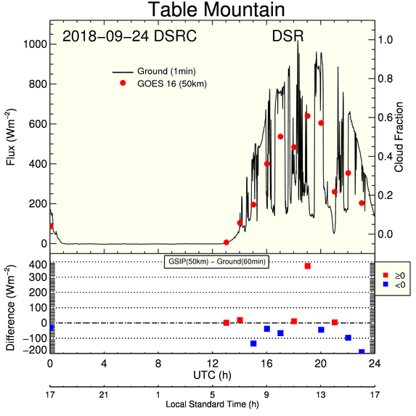
Diurnal Cycle of DSRC - Cloudy
Cloudy-sky examples: the “good” and the “bad”.
G16 DSR follows the diurnal change in ground-measured DSR even under cloudy or partly cloudy skies (“very difficult” scene), but degree of agreement varies with location.

Slide 51
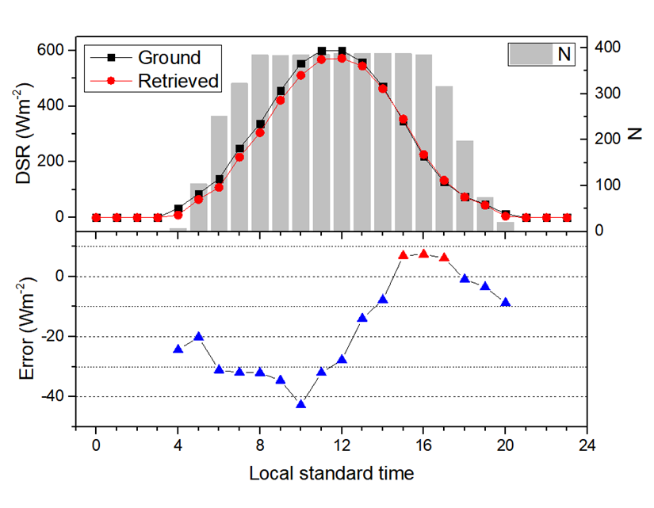
Diurnal Cycle of Hourly DSR
Hourly average DSR from data combined from all 13 sites for period 8/30 – 9/30, 2018.
G16 average diurnal cycle tends to underestimate, but follows closely the average diurnal cycle from ground.
Notes:
Instantaneous retrieved flux (DSRC) was scaled with the ratio of mean cos(SZA) to the instantaneous one.

Slide 52
Comparison with GSIP
GOES-16 Shortwave Radiation Budget L2 Product Provisional PS-PVR

Slide 53
Geostationary Surface and
Insolation Product (GSIP)
Independent RSR and DSR from GOES West, GOES 15.
  Uses an algorithm similar to the ABI indirect path algorithm.
  Nominal spatial resolution: 4 km (!)
  Not used as reference data due to lack of maintenance of good calibration of G15 Imager in GSIP.
GSIP/G15 full disk (GWDISK) RSR and DSR plots are centered on GOES East position for comparison with G16 RSR and DSR.
  CONUS and MESO comparisons are not included.

Slide 54
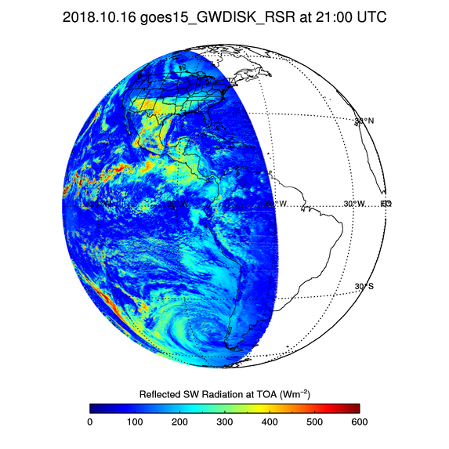
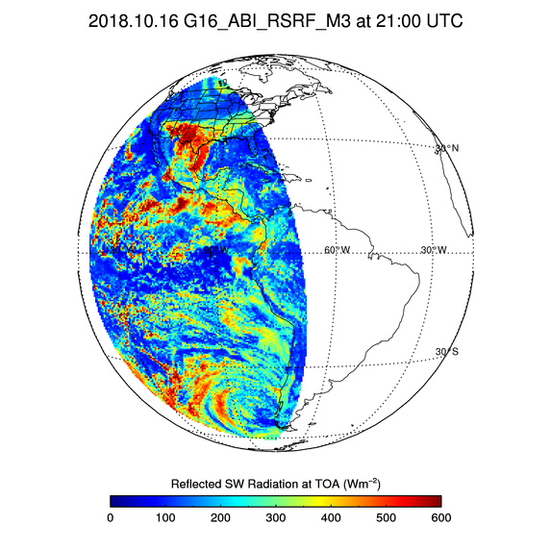
GSIP vs. G16 RSR
G15/GSIP (L) and G16 FD (R) RSR on Oct 16, 2018 at 21 UTC.
Difference in spatial resolution of GSIP and G16 RSR is obvious.
In spite of difference in resolution fidelity of RSR fields is good.
G16 clouds reflect more solar radiation.

Slide 55
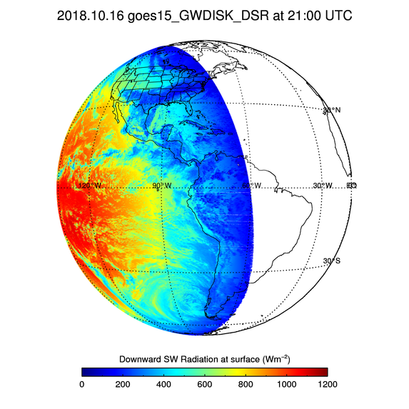

GSIP vs. G16 DSR
G15/GSIP (L) and G16 FD (R) DSR on Oct 16, 2018 at 21 UTC.
Difference in spatial resolution of GSIP and G16 DSR is obvious.
In spite of difference in resolution fidelity of DSR fields is good.
G16 DSR is smaller than GSIP DSR.

Slide 56


GSIP/G15 and G16 DSR vs. SURFRAD DSR
GSIP/G15 DSR
G16 DSR
Overall, G16 accuracy is better than GSIP/G15 bias; precisions are comparable.
G16 retrievals significantly reduce overestimation at low end seen in GSIP/G15.

Slide 57
Summary of G16 vs. Reference RSR and DSR Comparison
G16 RSR is evaluated with CERES RSR (Passed).
  Both FD and CONUS G16 RSR meet requirements except for precision at high RSR (> 500 W m⁻²).
  NTB transformation for clouds (mainly ice) should be improved.
G16 DSR is evaluated with SURFRAD and SOLRAD ground data (Passed). (MESO: Partial-Passed)
  CAVEAT: only over US.
  G16 DSR meet requirements for all 3 domains, except for MESO2 precision at high DSR (> 500 W m⁻²).
  Clear-sky composite TOA albedo should be maintained for MESO domains.
  G16 retrievals are better or at least as good as currently operational GSIP/G15 retrievals.

Slide 58
Empirical NTB coefficients
GOES-16 Shortwave Radiation Budget L2 Product Provisional PS-PVR

Slide 59
Empirical NTB coefficients from CERES/ABI matchup
Challenges:
  CERES/ABI being on a polar/geostationary platform, severely limits angularly and temporally matched ABI and CERES data pairs.
  Coincident CERES broadband and ABI narrowband bidirectional reflectances are usually observed at different satellite angles.
Our solution:
  Use CERES broadband albedos and the CERES Angular Distribution Model (ADM) to estimate broadband bidirectional reflectances that would be observed by CERES at ABI view angles,
  generate pairs of these estimated CERES broadband reflectances and ABI narrowband reflectances, and establish relationships between them (NTB coefficients from linear regression ).
Test runs:
  Used data from April 1-29, 2018 to build time series of clear-sky TOA albedos every 30 minutes at 2-km, ABI pixel resolution in offline,
  Ran offline SRB algorithm for April 30, 2018.

Slide 60


Empirical NTB coefficient test:
RSR and DSR with Current NTB
RSR and DSR retrievals for April 30, 2018.
Retrievals used current (GS) NTB coefficients.

Slide 61


Empirical NTB coefficient test:
RSR and DSR with Empirical NTB
RSR and DSR retrievals for April 30, 2018.
Retrievals used empirical NTB coefficients.

Slide 62


Empirical NTB coefficient test:
Empirical - Current Difference
Using empirical NTB coefficients significantly changes both RSR and DSR.
Change is most noticeable for clouds; brings water cloud RSR closer to CERES.

Slide 63


Empirical NTB coefficient test:
G16 RSR vs. CERES RSR
Current NTB
Empirical NTB
Incorrect ABI snow mask
Using empirical NTB improves G16 RSR accuracy and precision.
Brings high (cloudy-sky) G16 RSR closer to CERES RSR.

Slide 64


Empirical NTB coefficient test:
G16 DSR vs. SURFRAD DSR
Current NTB
Empirical NTB
Using empirical NTB significantly improves G16 DSR accuracy and precision.

Slide 65


Empirical NTB coefficient test:
G16 DSR vs. SOLRAD DSR
Current NTB
Empirical NTB
Using empirical NTB significantly improves G16 DSR accuracy and precision.

Slide 66
Summary of Empirical NTB Coefficients Test
Applying Empirical NTB
  improves accuracy and precision of G16 RSR and DSR,
    Evaluation for one day indicates a decrease in DSR/RSR bias by 12/3 Wm⁻²,
    RSR also meets Precision requirement at high end.
  results in slightly more valid retrievals.
Accuracy (A) and precision (P) of G16 RSR derived with current and empirical NTB vs. CERES RSR
RSR error | Current NTB |  |  | Empirical NTB
 | A | P | N | A | P | N
CERES < 200 | 13 | 63 | 22,009,769 | 15* | 59 | 22,055,427
[200, 500] | 17 | 118 | 16,122,897 | 1 | 84 | 16,229,585
CERES > 500 | -50 | 153 | 3,320,392 | -32 | 90 | 3,335,212
All | 9 | 99 | 41,453,058 | 6 | 73 | 41,620,224
* Low range RSR overestimation with empirical NTB is partly because of incorrect ABI snow mask (GFS did not indicate snow.) Units: W m⁻².

Slide 67

Upstream Algorithm Issue Confirmed After Beta PS-PVR
Impact of 7% ABI Band 2 Bias
GOES-16 Shortwave Radiation Budget L2 Product Provisional PS-PVR

Slide 68
Methodology
“Current Reflectance”: current Band 2 L1b reflectance (assumed to be biased high by 7%).
“Reduced Reflectance”: Reduced Band 2 L1b reflectance by 7%.
Retrieved DSR from current and reduced Band 2 L1b reflectances
  offline SRB algorithm was run every 30 minutes with GOES-16 ABI FD data at ABI fixed grid (2 km),
  Inputs, other than Band 2 L1b reflectance, were identical.
Time period: Apr 1 – 30, 2018
  Apr 1 – 29 was used for generating time series of clear sky TOA albedo,
  RSR and DSR for Apr 30 were compared with reference data.

Slide 69
Impact of Band 2 bias on SRB:
SRB from “current” Band 2 reflectance
RSR and DSR for April 30, 2018 from current reflectance.

Slide 70


Impact of Band 2 bias on SRB:
SRB from “reduced” Band 2 reflectance
RSR and DSR for April 30, 2018 from reduced reflectance.

Slide 71


Impact of Band 2 bias on SRB:
Reduced-Current SRB Difference
Largest changes are over cloudy regions as expected.

Slide 72

Impact of Band 2 bias on SRB:
Scatter plot for FD
RSR from current reflectance
RSR from reduced reflectance
RSR from reduced reflectance agrees somewhat better with CERES RSR.

Slide 73

Impact of Band 2 bias on SRB:
G16 DSR vs. SURFRAD DSR
DSR from current reflectance
DSR from reduced reflectance
DSR from reduced reflectance agrees somewhat less with SURFRAD DSR.

Slide 74
Summary of Band 2 L1b Reflectance Impact on SRB
Cloudy-sky flux retrievals (high RSR range) are impacted the most.
Validation with retrievals from one day indicates slightly better (worse) RSR (DSR) from reduced reflectance
  DSR bias increased by 3 Wm⁻² from reduced reflectance
  RSR bias from reduced reflectance is smaller, except for high range; small change in RSR precision.
Accuracy (A) and precision (P) of G16 RSR derived from current and reduced ref. vs. CERES RSR
RSR | Current Reflectance |  |  | Reduced Reflectance
 | A | P | N | A | P | N
CERES < 200 | 13 | 63 | 22,009,769 | 10 | 62 | 22,012,101
[200, 500] | 17 | 118 | 16,122,897 | 9 | 115 | 16,120,143
CERES > 500 | -50 | 153 | 3,320,392 | -65 | 152 | 3,319,212
All | 9 | 99 | 41,453,058 | 4 | 97 | 41,451,456
Units: W m⁻²

Slide 75
Provisional Maturity Assessment
GOES-16 Shortwave Radiation Budget L2 Product Provisional PS-PVR

Slide 76
Provisional Validation
Preparation Activities | Assessment
Validation activities are ongoing and the general research community is now encouraged to participate. | Validation activities are ongoing. The general research community has been participating and providing feedback.
Severe algorithm anomalies are identified and under analysis. Solutions to anomalies are in development and testing. | Operational and algorithm anomalies have been identified. Critical ones have been resolved (PR.06.17 and DO.07). Four ADRs remain open (MESO composite albedo and intermittent retrievals, bad initialization of PQI3 in IP, and missing IP flag_meaning); only one (incorrect MESO composite albedo impacts accuracy.
Incremental product improvements may still be occurring. | Incremental product improvements are expected.

Slide 77
Provisional Validation
End State | Assessment
Product performance has been demonstrated through analysis of a small number of independent measurements obtained from select locations, periods, and associated ground truth or field campaign efforts. | This has been demonstrated using CERES, SURFRAD and SOLRAD as truth and independent statellite reterivals from GSIP.
Product analysis is sufficient to communicate product performance to users relative to expectations (Performance Baseline). | This has been communicated in PS-PVR.
Documentation of product performance exists that includes recommended remediation strategies for all anomalies and weaknesses. Any algorithm changes associated with severe anomalies have been documented, implemented, tested, and shared with the user community. | These are documented in this PS-PVR presentation and will be documented in a separate ReadMe file.
Product is ready for operational use and for use in comprehensive cal/val activities and product optimization. | We concur.

Slide 78
Path to full Validation Maturity
GOES-16 Shortwave Radiation Budget L2 Product Provisional PS-PVR

Slide 79
Issues and Status
ADRs Needing Resolution for Full VAL
ADR | Title | Status | Build
617 | ClearCompAlb is incorrect in MESO product. Time series has only a single value (one day). | On hold | --
678 | Missing flag_meanings attribute for PQI3. | Submitted | --
743 | PQIs are not initialized with _FillValue. | Submitted | --
408/393 | Remove unnecessary lat/lon re-proj from Radiation | On hold | --
N/A | Incorrect statistics in CONUS metadata | On hold | --

Slide 80
Issues and Status
Other Actions Needed for Full VAL
Action | Title | Desired Implementation Date into OE
New ADR(s) needed | L2 SRB algorithm - further update of the narrow-to-broadband (NTB) albedo conversion | ≧6 month prior to PS-PVR FULL
New ADR(s) needed | Update, add more levels to quality flags using information currently only in IP. | ≧6 month prior to PS-PVR FULL

Slide 81
Path to Full Validation - PLPTs
PLPT ID | Descriptive Title
ABI-FD_DSR12 ABI-FD_RSR12 | Assess precision and accuracy of FD product for an extended period that includes seasonally representative number of independent measurements
ABI-CONUS_DSR13 ABI-CONUS_RSR13 | Assess precision and accuracy of FD product for an extended period that includes seasonally representative number of independent measurements
ABI-MESO_DSR14 | Assess precision and accuracy of FD product for an extended period that includes seasonally representative number of independent measurements
AWG SRB Team will conduct these tests to further evaluate the L2 SRB product quality.
Full test plans and procedures are given in the ABI L2+ DSR and RSR Readiness, Implementation, and Management Plan (RIMP v1.0; 416-R-RIMP-0327)

Slide 82
Path to Full Validation – Risks
Risk Name | Description | Impact | Mitigation and Schedule
Update NTB coefficients | as discussed; Priority 1 | Moderate | New WR/ADR needed
Update, expand quality flags | as discussed; Priority 2 | Little | New WR/ADR needed
No SRB product in Scan Mode 6 | During G17 Mode 6 test no SRB products were generated. There is a risk that the same thing could happen if/when G16 is operated in Mode 6; Priority TBD | Big Impact | New WR/ADR needed
Little Impact
Moderate Impact
Big Impact

Slide 83
Summary & Recommendations
GOES-16 Shortwave Radiation Budget L2 Product Provisional PS-PVR

Slide 84
Summary
Overall, the RSR and DSR product performance is significantly improved since the Beta PS-PVR (June 23, 2017).
  Improvements came with the PR.06.02, PR.06.10, PR.06.11, PR.06.17 and DO.07 builds.
  RSR and DSR products are useable starting 09/01/2018.
  In general, the good quality retrievals are recommended for quantitative applications due to their better overall performance.
Measured RSR and DSR performance against reference data
  Accuracy specs are met for all domains and ranges of RSR and DSR.
  Precision specs are met for all domains and ranges of RSR and DSR except for high range of RSR and of MESO2 DSR.
  Low-quality clear-sky composite albedo negatively impacts quality of MESO DSR.
  Updates will be needed for the narrow-to-broadband (NTB) transformation to further improve performance. (The empirical NTB is promising, but requires collection of more ABI and CERES data.)

Slide 85
Recommendation
AWG SRB Team believes that the GOES-16 L2 RSR and DSR products have reached the Provisional Maturity as defined by the GOES-R Program for the Full Disk and CONUS domains.
MESO DSR products, although meet (or close to meeting) requirements, have known deficiencies related to the clear-sky composite albedo.

Slide 86
Note Regarding Direct Path Retrieval
It is expected the (previously day-2) surface albedo product will become available in the GS.
This is expected to have an impact on the radiation product, since the radiation algorithm will use the direct path whenever other products necessary to run it are also available.
RSR and DSR from the direct path may be viewed as a "mostly new" product that did not go through the beta/provisional reviews.
Recommend preventing GS/OE to run the direct path by inputting only missing surface albedo values until AWG has a chance to evaluate the product generated with the direct path in the GS/DE or in the AWG Framework.

Slide 87
Comments on spatial and temporal
GOES-R DSR and RSR resolutions
Spatial resolutions of GOES-R FD/CONUS DSR: 50/25 km.
These represent a step back from the 4-km spatial resolution in current GSIP.
Many users need higher resolution radiation products:
  North American Land Data Assimilation System (NLDAS): 0.125º (~12.5 km) (Mitchell et al., 2004; Xia et al., 2012),
  Coral reef health modeling: 5 km (SPSRB request #0905-0004, “Upgrades in GOES Solar Radiation Product Suite for Coral Reef Watch Products”),
  Solar energy applications: 1-10 km.
Temporal resolution of GOES-R DSR and RSR product is 1 hour. Some applications (coral reef health modeling) use daily total values; more accurate values can be obtained using 15-min data.
Going to 2 km in GOES-R DSR and RSR would:
  eliminate the need for the complex gridding/mapping done now,
  allow generation of the clear-composite TOA albedo needed for MESO.

Slide 88


Gridded vs. pixel-level DSR
AWG Radiation Team Results
50 km FD DSR (GS)
2 km FD DSR (AWG)
Retrieval every hour
Retrieval every 30 minutes
Notes:
July 29?

