Slide 1
Peer Stakeholder-Product Validation Review (PS-PVR) Full Maturity GOES-16 SEISS SGPS L1b Product PS-PVR
March 18, 2020
GOES-R Calibration Working Group (CWG)
Presenter: Brian Kress
Contributors: Athanasios Boudouridis, Juan Rodriguez
NOAA NCEI / CIRES
This review incorporates results from Assurance Technology Corporation PLTs.

Slide 2
Outline
SGPS Overview
Review of Provisional Maturity Assessment
Product Quality Evaluation
Summary of SGPS Anomalies and Resolution Status
PLPTs Supporting Assessment for Full Status
Full Maturity Assessment
Path to <next> Validation Maturity Next Steps
Summary and Recommendations

Slide 3
SGPS OVERVIEW
GOES-16 SGPS L1b Product Provisional PS-PVR

Slide 4
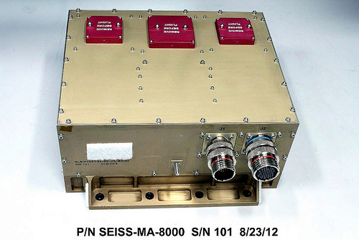
Space Environment In-Situ Suite (SEISS) Solar and Galactic Proton Sensor (SGPS)
2 Units, one looking East (+X) and one West (-X)
3 solid state telescopes on each unit: T1, T2 and T3.
1-500 MeV protons in 13 differential channels, plus >500 MeV integral channel
4-500 MeV alphas in 12 energy bands (not processed)
GOES-16 SEISS sensors turned on Jan. 8th 2017
SEISS SGPS designed, built, tested and calibrated by Assurance Technology Corporation (ATC)

Slide 5
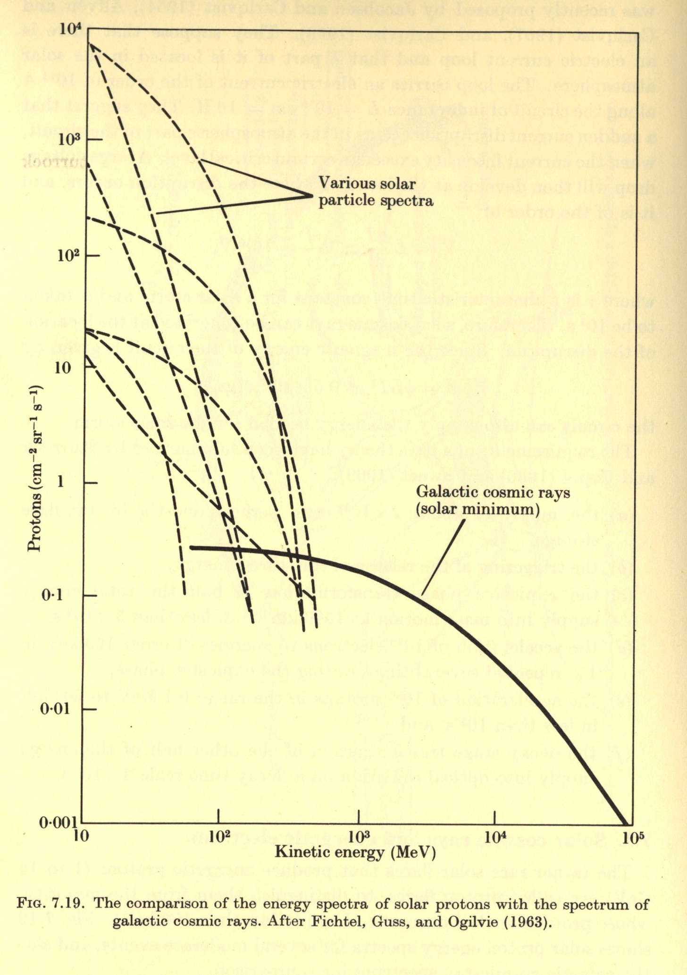
Introductory Material
Energetic Ions In Space
From Solar Terrestrial Physics,
Akasofu and Chapman, 1972.
GCRs (Galatic Cosmic Rays)
Always present in space
Energies up to and > 10¹¹ GeV
Flux ≈ 0.6 particles / cm² / sec
≈ 99.5% H & He
SEPs (Solar Energetic Particles)
Produced during Solar Particle Events (SPEs) lasting one to several days.
Mostly < 500 MeV protons
Flux up to 10⁵ particles / cm² / sec
Most are shielded by the earths magnetic field at latitudes < 60º.

Slide 6
Detector Response Function Introductory Material
The total counts/sec. in the channel is the convolution of the channel response function G(E) and the ambient flux spectrum j(E)
$$C=\int{G\left(E\right) j\left(E\right) dE}$$
The measured/reported flux is j_{m} = C / G , where C is counts and G [cm2-s-sr-keV] is a channel/energy integrated geometric factor
$$G=\int_{E_{L}}^{E_{U}}{G\left(E\right)dE}$$
G(E)
SEP spectrum $j\left(E\right)=j_{0}E^{−γ}$
Log j(E)
GCR spectrum
E_{L}
E_{U}
Energy
Log Energy

Slide 7
SGPS Primary Operational Use
Data stream for NOAA-NWS SWPC Solar Proton Event Detection and Radiation Storm Alerts
Level 1b
Level 2
1 sec.
The NOAA Space Weather Scales communicate to the general public current and future space weather conditions and possible effects on people and systems.
Numbered levels, analogous to hurricanes, tornadoes, and earthquakes that convey severity.

Slide 8
A Few Comments on Solar Particle Event Activity Since G16 Launch
16-17 July 2017 solar energetic particle (SEP) event – Very “soft” (low energy) event, with significant response only in SGPS T1, and little to no response in T2 and T3.
Sept. 2017 SEP events on: Sept. 4th, 6th (First measured response in T3), and 10th (Ground Level Event, indicating significant proton fluxes up to and >500 MeV).
When there is no solar particle event in progress, SGPS channels P1-P9 record Galactic Cosmic Ray (GCR) counts. The actual GCR flux is well below the instrument background level.
It is not (necessarily) possible to determine if there is a problem with channels P1-P9 by looking only at GCR/background measurements, so the results included below are mainly focused on the Sept. 2017 SEP event.
P10 (differential channel) and P11 (integral channel) provide calibrated measures of GCR fluxes.

Slide 9
REVIEW OF PROVISIONAL MATURITY ASSESMENT (G16 SEISS PROVISIONAL PS-PVR, 18 JULY 2017)
GOES-16 SGPS L1b Product Provisional PS-PVR

Slide 10
Summary of SGPS Anomalies
SGPS-X (West) L1b 5m averages
During Sep. 2017 Solar Proton Event
Temperature dependent Drops in SGPS-X T1 fluxes
SGPS-X T3 temperature dependence
L1b data dropouts
Temperature Dependence in SGPS-X T1 & T3 -- Instrument issue addressed with ADR 405 and correction algorithm downstream of L1b.
ADR 517, small but routine L1b gaps, mostly for SEISS.

Slide 11
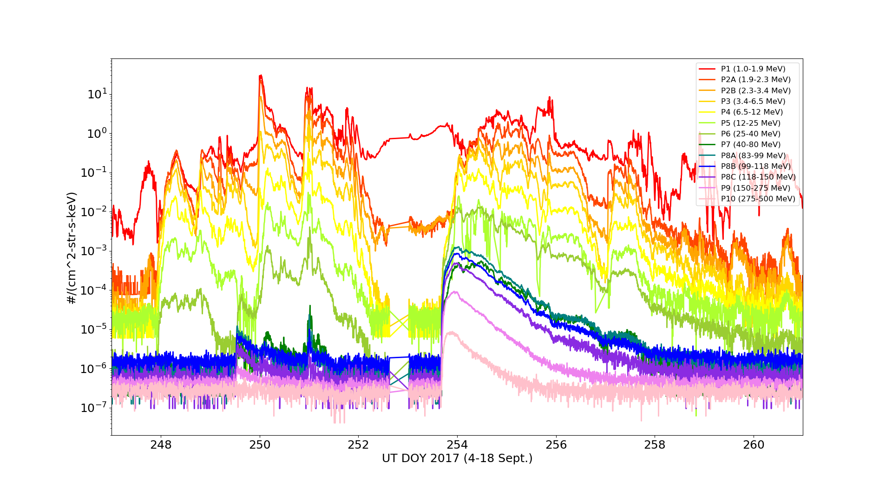
Summary of SGPS Anomalies
SGPS+X (East) L1b 5m averages
During Sep. 2017 Solar Proton Event
SGPS+X P7 too low (dark green)
Overcorrection (neg. fluxes) in SGPS+X P5
SGPS+X P7 approximately an order of magnitude low in L0 data. (Instrument issue, not understood.)
SGPS+X P5 negative fluxes (L1b processing issue, addressed w/ ADR 900 after Provisional PS-PVR.)

Slide 12
Summary of SGPS Anomalies
Additional issues not seen in Sept. 2017 Solar Particle Event figures – examples to follow.
Electron contamination in SGPS+X P5 – Instrument issue that could be addressed with correction scheme using SGPS singles rates, but effect is small – No ADR needed.
SEP Channel Cross-Comparison PLPT indicates some channels are not performing as characterized with beam calibrations (e.g., SGPS +X and -X P4 differ by about a factor of 4 during 16-17 July 2017 SPE). Geometric factors may need adjustment (No associated ADR, additional analysis needed).
During the September 2017 SEP event, SGPS fluxes are about a factor of two higher than GOES-13 and -15 fluxes in the T3 energy range (83-500MeV). T1 and T2 fluxes are not systematically high or low, but have significant differences with GOES -13 and -15 in some cases.

Slide 13
Complete List of ADRs/WRs Impacting G16 SGPS to date
ADR# | WR# | Short Description | Status | Closure
267 | 5370 | LUT Filenames not Traceable to Metadata | Closed | DO 07.00.00
342 | 4502 | Inaccurate SWx Instrument_ID Fields | Closed | DO 06.03.00
405 | 4864 | Add temperatures to L1b data | Closed | DO 06.03.00
427 | 5010 & 5716 | Remove divide by 2 from P11 L1b processing | Closed | DO 06.03.00
491 | 5371 | SGPS T2 fluxes systematically ≈10% low (L1b processing error) | Closed | DO 06.03.00
517 | 5484 | Small but routine L1b gaps, mostly for SEISS. | Closed | Closed in DO.06.02​ and ​DO 06.03.00
676 | 6100 | G17 ground LUT has SGPS–X dead time = 8e+07 s instead of 8e-07 s. | Closed | PR.06.12.00 5/22/2018
900 | 7049 | G16 & G17 SGPS P5 correction coefficients LUT update | Closed | PR.07.10.02 4/10/2019
1025 | 7579 | Implement SGPS He processing in L1b | Hold | “after GOES-T launch”
TBD | TBD | SGPS+X P7 Correction (G16 SGPS LUT update) | To be submitted | Unknown
* ADRs up to 900 (all closed) identified as needed for Provisional and Full Maturity

Slide 14
From GOES-16 SEISS SGPS Level 1b (L1b) Data Release Provisional Data Quality Read-Me for Data Users, July 11, 2018
No SGPS L1b data processed prior to declaration of Provisional Maturity (e.g., those available from CLASS) should be used. NCEI will reprocess and release the early mission data using the Provisional Maturity algorithm and look-up tables.
SGPS-X T1 and T3 exhibit temperature dependent variations in count rates up to approximately 50%. The variations appear as sudden step changes in flux (2 per day) in T3 P8C-P11 and more gradual drops in T1 flux centered near 19h local time. A temperature correction scheme is being implemented downstream of L1b processing. The one- and five-minute averages output from level 2 (L2) processing will be temperature corrected. The L2 data is not available yet.
3. During the September 2017 solar energetic particle (SEP) events, SGPS+X P7 flux was anomalously low. It was about an order of magnitude low in comparison with SGPS-X P7 and with respect to the spectrum inferred from neighboring channels. The cause is yet unknown. Measurements from this channel should not be used.
SGPS+X P5 is low due to an overcorrection in L1b processing. The out-of-band removal coefficients are set too high. L1b flux from this channel should not be used until the coefficients are adjusted.
SGPS+X P5 is contaminated with electrons when radiation belt fluxes are elevated. The magnitude of the contamination with respect to solar proton fluxes during a SPE has not been fully characterized yet.
Some channels are not performing as characterized with beam calibrations; as a result, some geometric factors may need adjustment. For example, SGPS +X and -X P4 differ by about a factor of 4 during the 16-17 July 2017 SEP event, during a period when high solar wind dynamic pressure is expected to suppress geomagnetic cutoffs sufficiently that we should observe similar SEP fluxes in the east and west facing units.
There are frequent gaps in L1b data.
During the September 2017 SEP event, SGPS fluxes are about a factor of two higher than GOES-13 and -15 fluxes in the T3 energy range (83-500MeV). T1 and T2 fluxes are not systematically high or low, but have significant differences with GOES -13 and -15 in some cases.
Outside of SEP events, when SGPS observes galactic cosmic ray protons, the processed fluxes are too high for channels below P10, since the processing uses geometric factors derived for SEP spectra, in the derivation of which the high-energy response is neglected.

Slide 15
PRODUCT QUALITY EVALUATION - Temperature Correction - SGPS+X P7 Anomalously Low - P5 Overcorrection - P5 Electron Contamination - Significant Unexplained Differences Between -X and +X Units
GOES-16 SGPS L1b Product Provisional PS-PVR

Slide 16
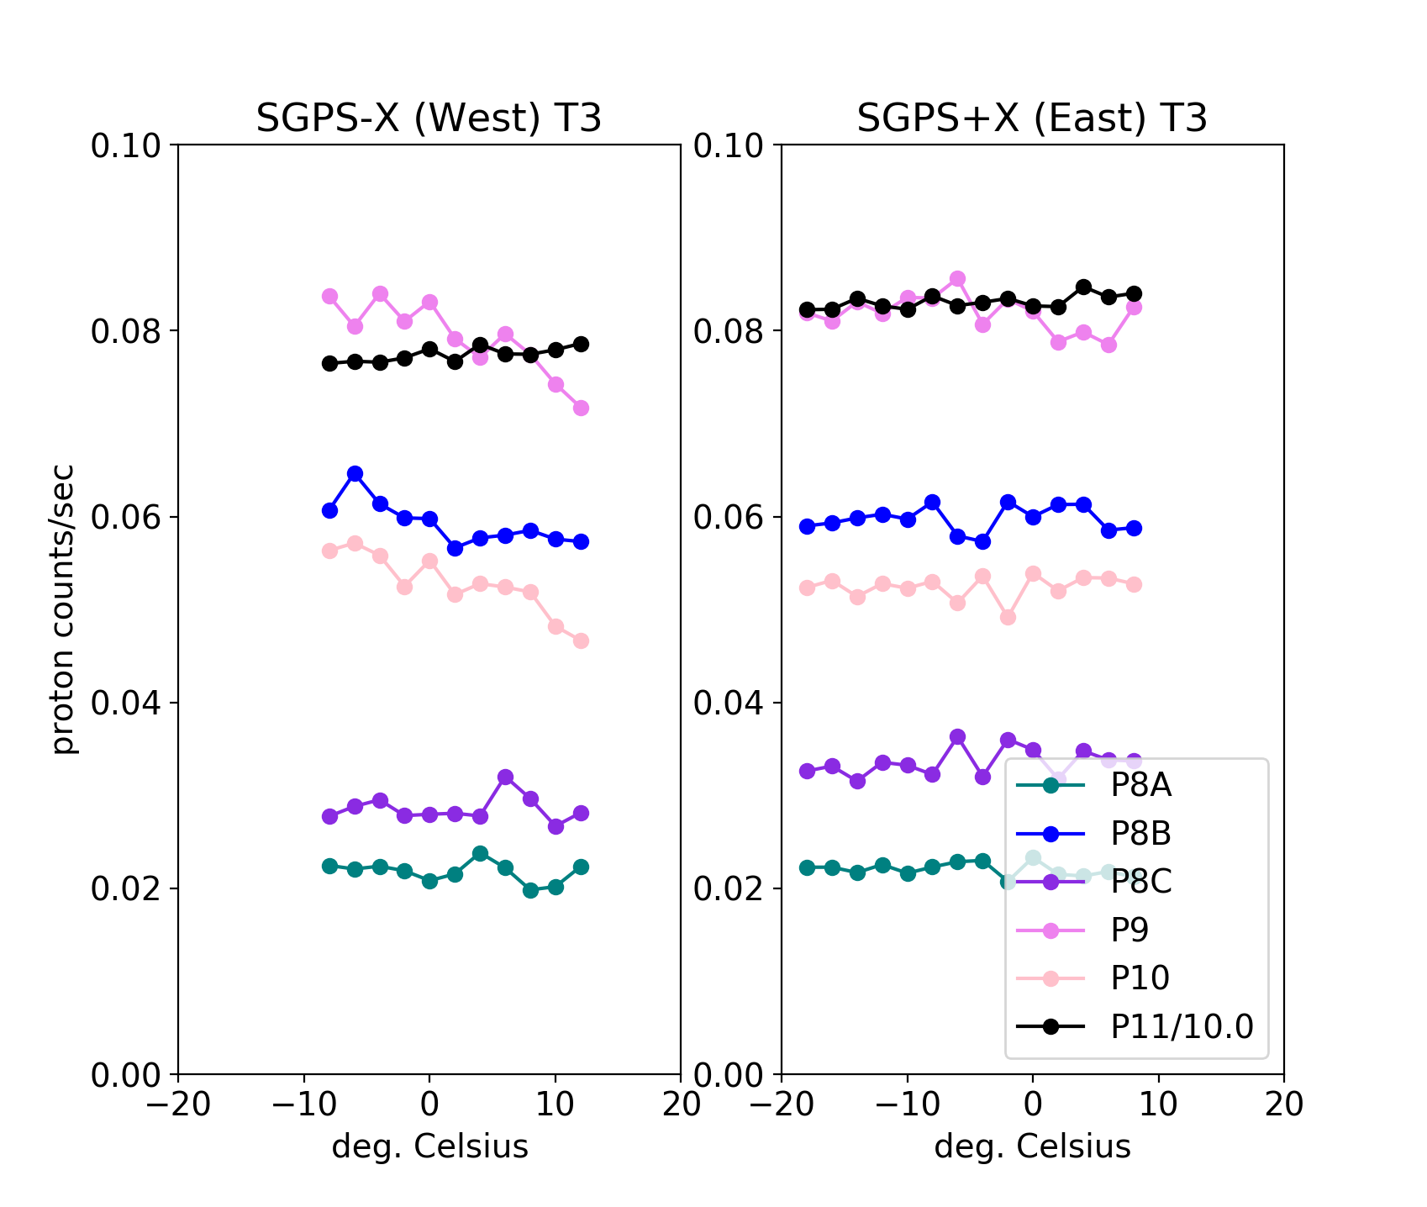
SGPS T3 Temperature Dependence
GOES-16
GOES-17
Quiet conditions (steady) GCR counts from L0 data binned in 2 deg. temp. bins 2018 DOYs 114-120.
In general, GOES-17 SGPS T3 temperature variations are over a smaller temperature range and there is significantly less temperature dependence than in GOES-16 SGPS T1 (not shown here) and T3.
GOES-16 SGPS T1 also shows temperature dependence (seen on slide 20), but exhibits gradual decrease in response at energies above ~0◦C rather than step change seen in G16 T3.

Slide 17
Temperature Correction Scheme
A rectangular function is used to model the energy channel response function and a power law is used to model the ambient spectrum
The total counts/sec. in the channel is the convolution of the channel response function and the ambient spectrum
$$C=\int_{E_{L}}^{E_{U}}{G_{0}}j_{0}E^{−γ}dE =G_{0}j_{0}\frac{(E_{U}^{1−γ}−E_{L}^{1−γ})}{1−γ}$$
A temperature and spectrum dependent correction is used to determine the counts expected in the fixed/calibrated channel (at 25ºC), given counts from temp. dep. chan.
$$C_{fixed}=X∗C\left(t\right),$$
where $X=\frac{G_{0}(t={25}^{o}C)[E_{U}^{1−γ}(t={25}^{o}C)−E_{L}^{1−γ}(t={25}^{o}C)]}{G_{0}\left(t\right)[{E\left(t\right)}_{U}^{1−γ}−{E\left(t\right)}_{L}^{1−γ}]}$
G(E)
Log j(E)
$$j\left(E\right)=j_{0}E^{−γ}$$
$$G_{0}$$
Energy
Log Energy
$$E_{L}$$
$$E_{U}$$

Slide 18
Temperature Correction Scheme
Empirical determination of temperature dependent channel response function boundaries
Minimize the function
$$f\left(E_{L}\left(t\right),E_{U}\left(t\right),G_{0}(t)\right)=\sum_{i=1}^{N}{{\left\{\log\left(X_{i}(γ,t)\right)−\log{C_{i}}\right\}}^{2}}$$
with respect to E_{L}(t), E_{U}(t), and G₀(t) for many different spectra ($γ$_{i}) and temperatures (t_{i}).
X_{i} is the analytic correction from the previous slide, and C_{i} is an empirically determined correction (needed to remove temperature dependent fluctuations), obtained using the Sept. 2017 SPE and GCR background data.
By minimizing the residual calculated with the log(counts), we sum over the square of relative errors, so that a case with high flux is not weighted more heavily than a case with low flux.
Tables describing temperature dependence of the response functions are determined for each temp. dep. channel, e.g., t = [-25◦C, -24◦C,…] and E_{L}(t) = [2300 keV, 2400 keV,…].
The resulting temp. dep. response functions are not necessarily solutions for actual response functions, but provide sufficient freedom to model the $γ,$ $t$ dependent correction.
G(E)
$$G_{0}$$
t=0◦C
t=25◦C
Energy
$$E_{L}$$
$$E_{U}$$

Slide 19
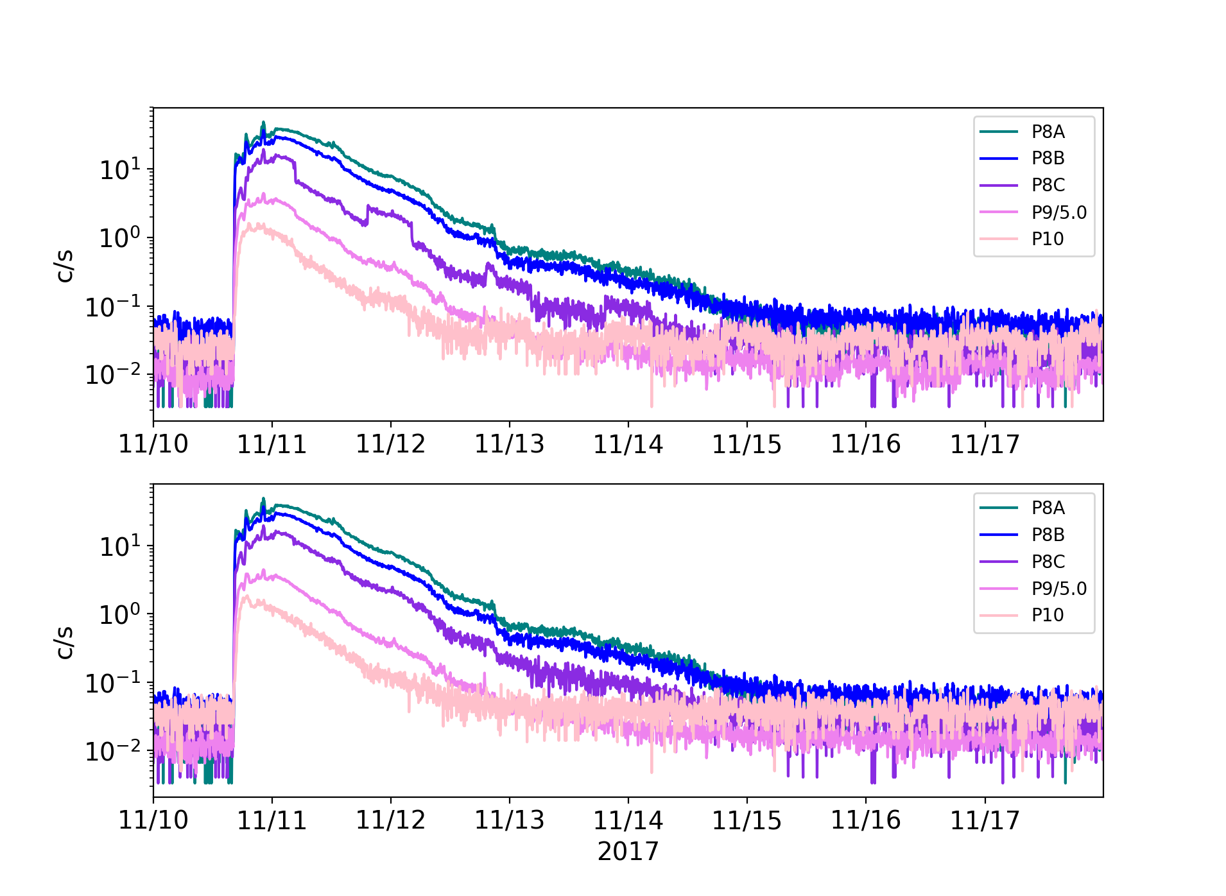
G16 SGPS T3 Temperature Correction
SGPS-X T3
Uncorrected
Corrected
SGPS-X T3 5 minute averaged counts per second during Sept. 2017 SEP event, showing uncorrected c/s in top panel and temperature corrected c/s in bottom panel.

Slide 20
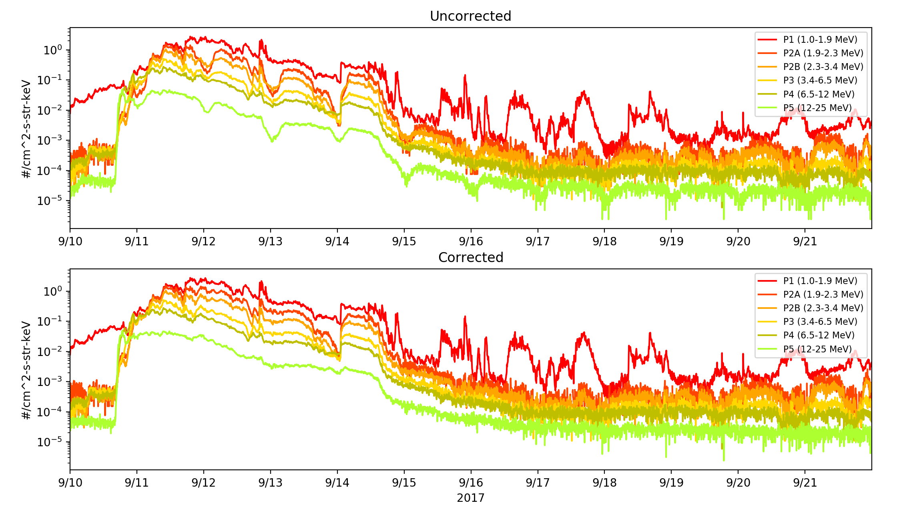
G16 SGPS T1 Temperature Correction
SGPS-X T1 5 minute averaged fluxes during Sept. 2017 SEP event showing uncorrected flux in top panel and temperature corrected flux in bottom panel (from L0 data).

Slide 21
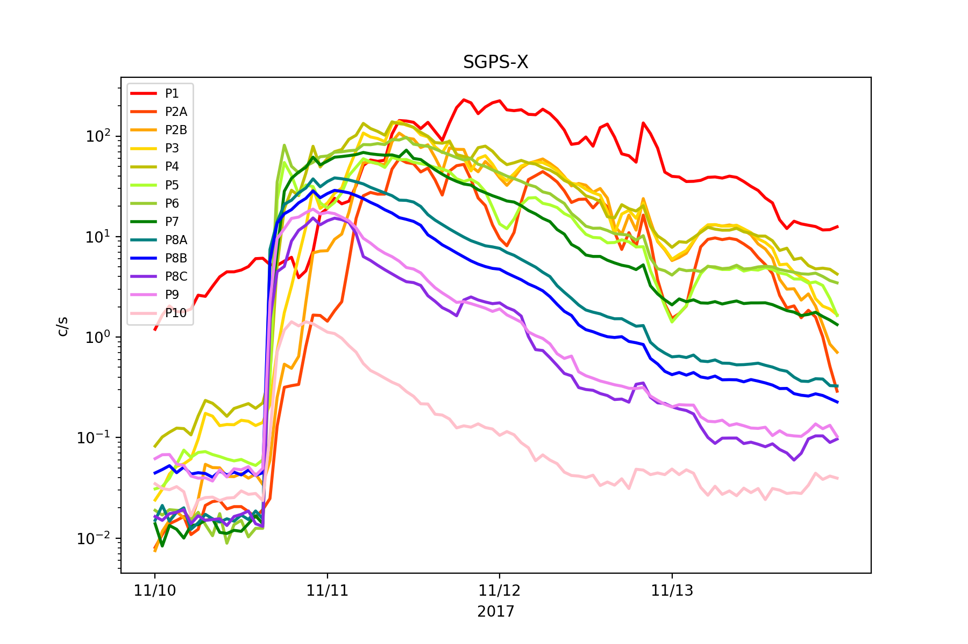
SGPS+X P7 Rates Low
During SEP event, SGPS+X P7 (dark green trace) count rate is about a factor of 6-8 lower in SGPS+X than in SGPS-X.
However, pre-event P7 GCR count rates are similar in +X and –X units.
Count rate is low in L0 data (i.e., this is not an L1b processing problem).
SGPS-X and +X geometric factors (in CDRL79) are the same: G△E = 0.48 cm²-str x 33.1 MeV. Thus, +X P7 reported flux is also about a factor of 6-8 lower than the -X P7 reported flux.
Instrument issue; Cause unknown; Still in analysis.
P7

Slide 22
SGPS+X P7 Rates Low
From SGPS SN101 On-Orbit P7 Performance Analysis (CDRL 031), 11 Sept. 2018.
Done (Per WR 6877, 5/14/19 15:17z.)
We are here.

Slide 23
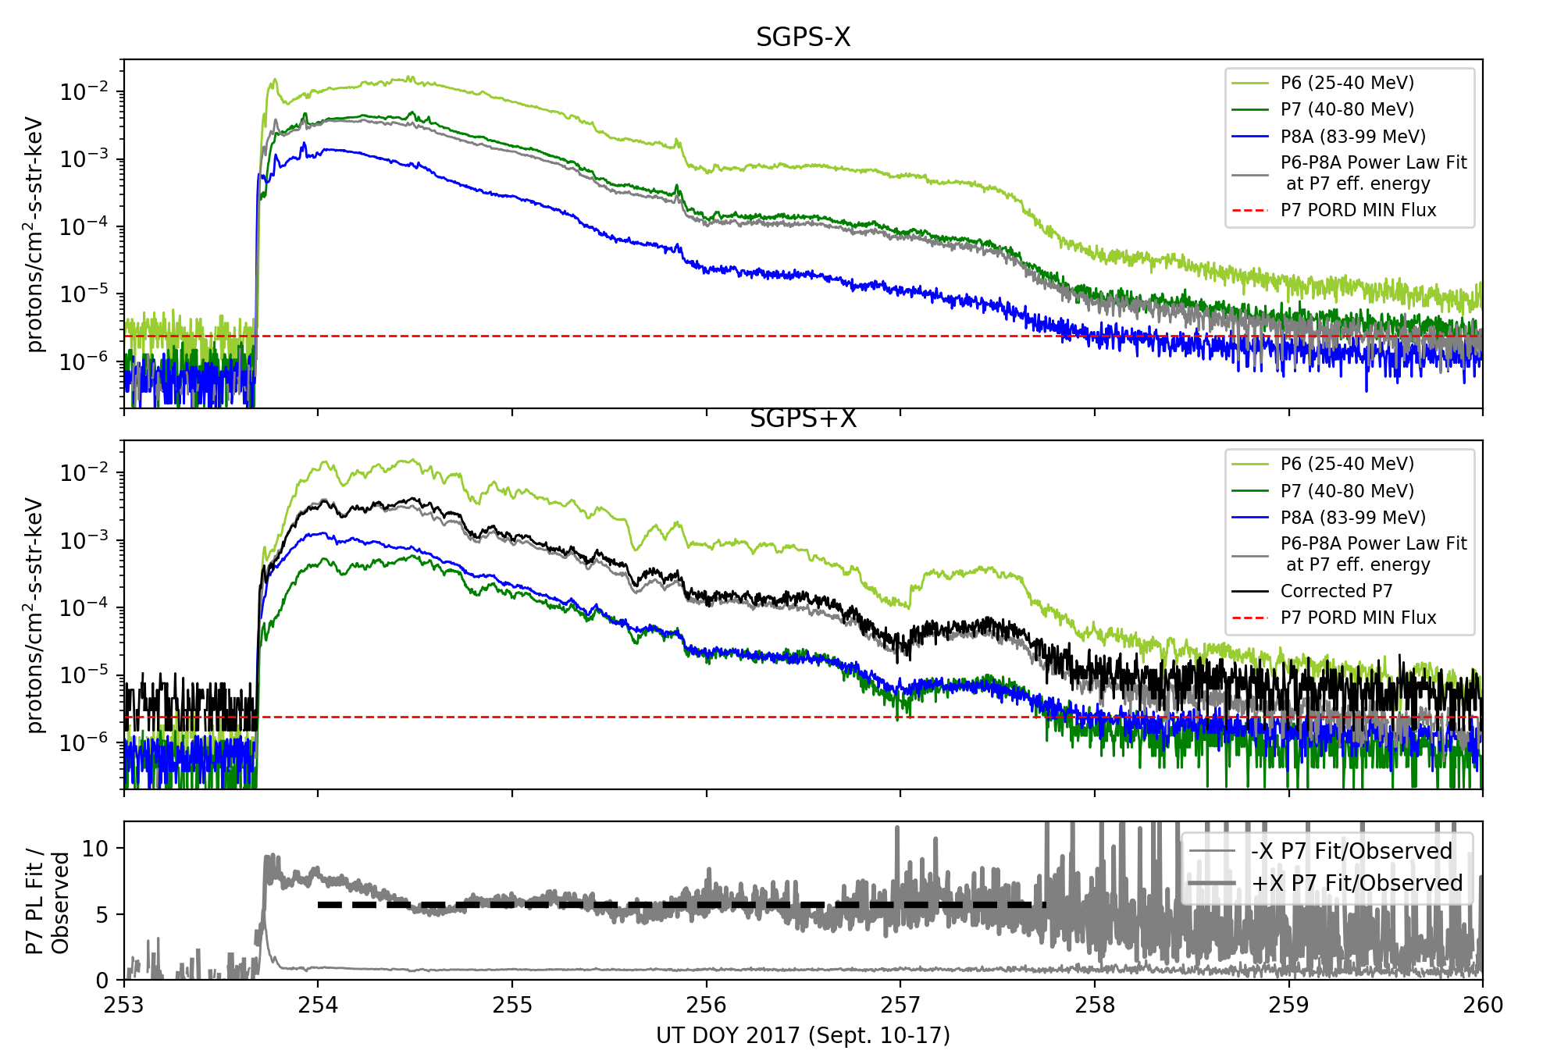
SGPS+X P7 Rates Low – Temporary/approximate Fix
P7_Corrected =
7.1 x P7_Observed
P7 Observed
DOYs 254-257.75 Avg. = 5.7
DOYs 254-257.75 Avg. = 0.8
An approximate value for the SGPS+X P7 flux (black trace in middle panel) is obtained using power law fits between P6 and P8A fluxes at the P7 effective energies.
The correction factor is the +X P7 fit/observed fluxes times the -X P7 observed/fit fluxes: 5.7/0.8 = 7.1

Slide 24
P5 Out-Of-Band Correction (L1b processing correction)
P5 out-of-band
High energy islands
GEANT simulations indicate left island is due to rear entry particles and right is due to front-side entry.
In-band (desired)
P5 channel response
function
Goal is to remove contribution from P5 high energy islands:
Corrected P5 counts = total P5 counts – ($α_{P7}∗P7 flux+α_{P8A}∗P8A flux$)

Slide 25
SGPS P5 Overcorrection
Pre ADR900: 𝛼_𝑃7=8366 and 𝛼_𝑃8𝐴=0
Post ADR900: 𝛼_𝑃7=0 and 𝛼_𝑃8𝐴=0
i.e., no correction
Sept. 2017 DOY
- Created Using NCEI L0 to L1b
Analysis needed: $α_{P7}$ and $α_{P8A}$ should be adjusted so that P5 is not over corrected, and error in reported flux is minimized over the broadest possible range of SEP spectra.
Additional SPE data is needed to obtain good estimates for these parameters.

Slide 26
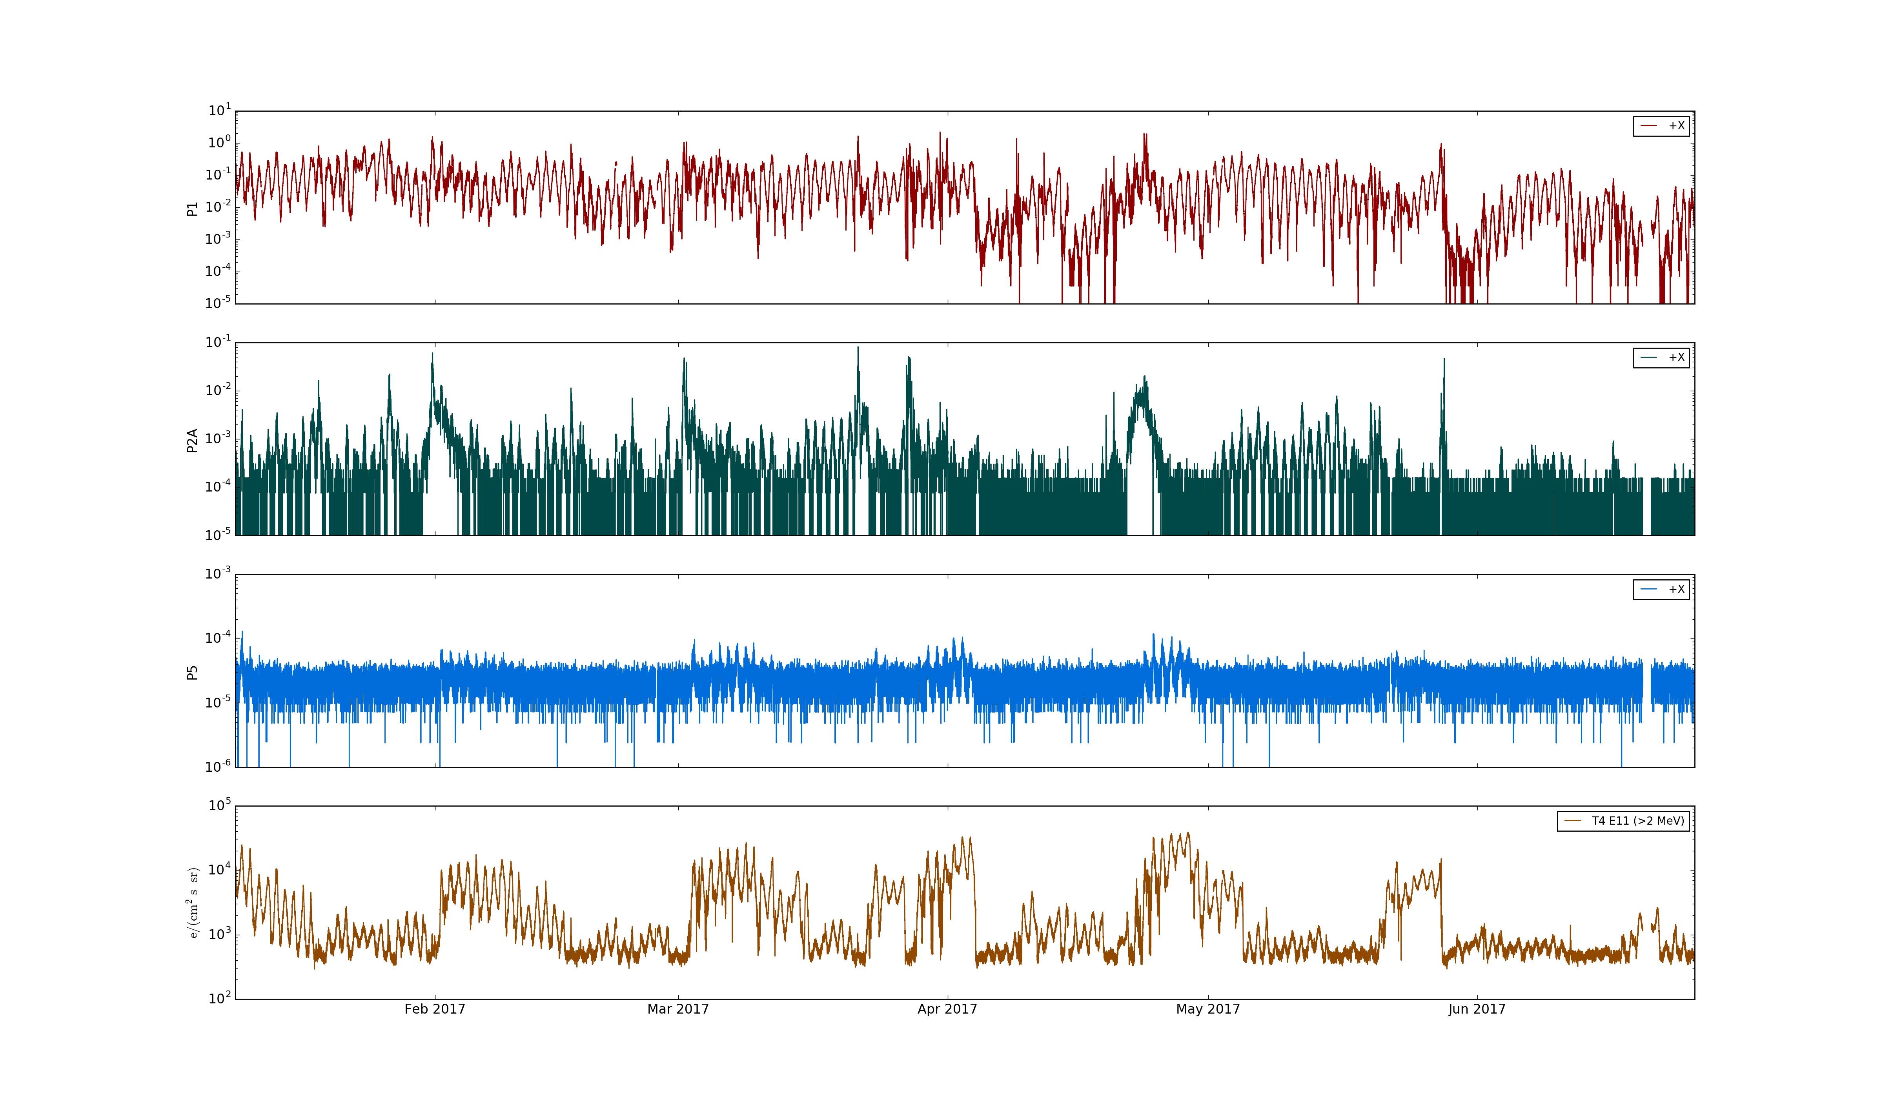
SGPS P5 Electron Contamination
SGPS+X
P1
(1-2 MeV)
CIR events in SGPS P2A
SGPS+X
P2A
(2-2.3 MeV)
Heightened SGPS P5 flux, delayed with respect to start of CIR event, due to contamination by radiation belt electrons.
SGPS+X
P5
(12-25 MeV)
MPS-HI
>2MeV
electrons
Feb. 2017
Mar. 2017
Apr. 2017
May 2017
June 2017
Top 3 panels: SGPS +X (east) P1, P2A, and P5 fluxes during Jan-June 2017. Bottom: MPS-HI E11 (>2MeV) showing enhanced radiation belt electron fluxes associated with CIR events.

Slide 27
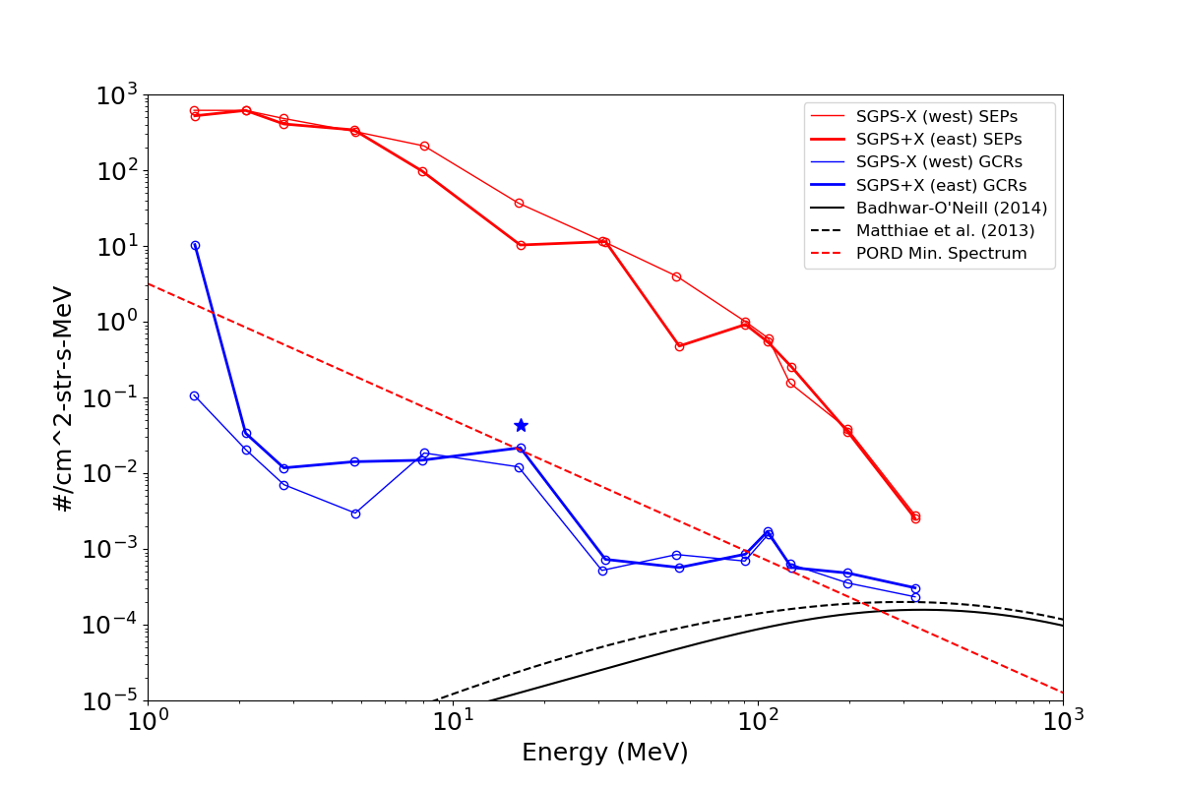
Magnitude of Contamination
G16 SGPS 5m (red) and 1-day (blue) averaged spectra (energy channels P1-P10)
11 Sept. 2017
SPE/GLE, 7:30 UT
SGPS+X P5
(overcorrection)
Effect of P5 electron contamination less than 1% contribution to flux during a small to moderate solar particle event.
SGPS+X P7
(anomalously low)
P5 w/ ele. contamination
P5 w/out ele. contamination
Backgrounds (from GCRs)
GCR model fluxes
Points from left to right are energy channels P1, P2A, P2B, P3-P7, P8A, P8B, P8C, P9, and P10.

Slide 28
Example of Inconsistency Between Ground Calibration Result and On-orbit Observations
Period with SW P_{dyn} > 10nP.
(west facing unit)
(east facing unit)
SGPS and MPS-HI 5m averaged fluxes during 16-17 July 2017 Solar Particle Event. Fluxes from east and west facing units are expected to be the same during period of high solar wind dynamic pressure. SGPS +X and –X P4 differ by about a factor of 4.

Slide 29
SGPS PLPTs Supporting Provisional Maturity
User Community Questions/Requests (illustrate importance of following PLPT results).
PLPT-SEI-001 SGPS D3-D1 Contamination Correction
PLPT-SEI-004 SEP Channel Cross-Comparison
PLPT-SEI-006 Backgrounds Trending
* These should not be viewed as pass/fail tests – Their purpose is to fully characterize the instrument performance and measurements, especially with respect to previous GOES measurements (i.e., G13-G15).

Slide 30
User Community Questions/Requests
Sample of requests for calibration data, cross calibrations with G13-G15, and Sept. 2017 event data:
“I work for the Chandra X-ray observatory, I am responsible for monitoring the radiation environment… we noticed a distinct drop in the reported flux… through changeover to GOES-16. Can you please explain what has changed?” – Senior Astrophysicist, Chandra X-Ray Center, Harvard-Smithsonian Center for Astrophysics.
“…in preparations to switch over to SEISS/SGPS, is there any documentation (energy channels, geometric factors, cross-calibrations to HEPAD) available?” – Professor of space physics and head of Space Research Laboratory (SRL), Dept. of Physics and Astronomy, University of Turku, Finland.
“We have begun the transition from the GOES-14 NOP particle data to GOES-16 SEISS… we have no idea yet how to recalibrate it to work with our models (eg, NAIRAS)… I was wondering if you have publications or some sort of data dictionary that may help us understand how to re-calibrate the data for our applications.” – Chief Engineer, Space Environment Technologies, Los Angeles, CA.
“Last year I was looking at the ICAO advisories each of the global centers issued for a test event (Sept 2017). I found there were a lot of differences…, some of which could be attributed to one center using GOES 13 data and one center using GOES 15 data… we’re [also] interested in including data from the GOES 16 satellite. We’re wondering if you’ve got any internal reports comparing data from the different satellites…” – Scientist, Canadian Hazard Information Service, Natural Resources Canada / Government of Canada.
“We're working with Kyle Copeland of the FAA on implementing his aviation radiation model, and one of the tasks is to make his code compatible with the GOES-R series. Kyle asked if he could get the calibration data for the proton channels.” – from NOAA/NWS/Space Weather Prediction Center.

Slide 31
PLPT-SEI-001 SGPS D3-D1 Contamination Correction
Comparison of SGPS+X and SGPS-X count rates from P7 and P8C with different on/off configurations of D3-D1 rear entry removal circuit.
Accumulated counts from G16 L0 data:
Cumulative Summary:
G16 SGPS-X P7 w/ D3-D1 off rate = 2115. counts/day
G16 SGPS-X P7 w/ D3-D1 on rate = 1107. counts/day
On-off Ratio = 1347./2176. = 0.52
G16 SGPS+X P7 w/ D3-D1 off rate = 2076. counts/day
G16 SGPS+X P7 w/ D3-D1 on rate = 798. counts/day
On-off Ratio = 1463./2242. = 0.38
G16 SGPS-X P8C w/ D3-D1 off rate = 3285. counts/day
G16 SGPS-X P8C w/ D3-D1 on rate = 1602. counts/day
On-off Ratio = 2466./4650.=0.49
G16 SGPS+X P8C w/ D3-D1 off rate = 3722. counts/day
G16 SGPS+X P8C w/ D3-D1 on rate = 1671. counts/day
On-off Ratio = 2980./4042.=0.45
P8C and -X P7 GCR rates drop by approx. 1/2 when d3-d1 circuit is turned on.
+X P7 rate w/ D3-D1 on anomalously low.

Slide 32
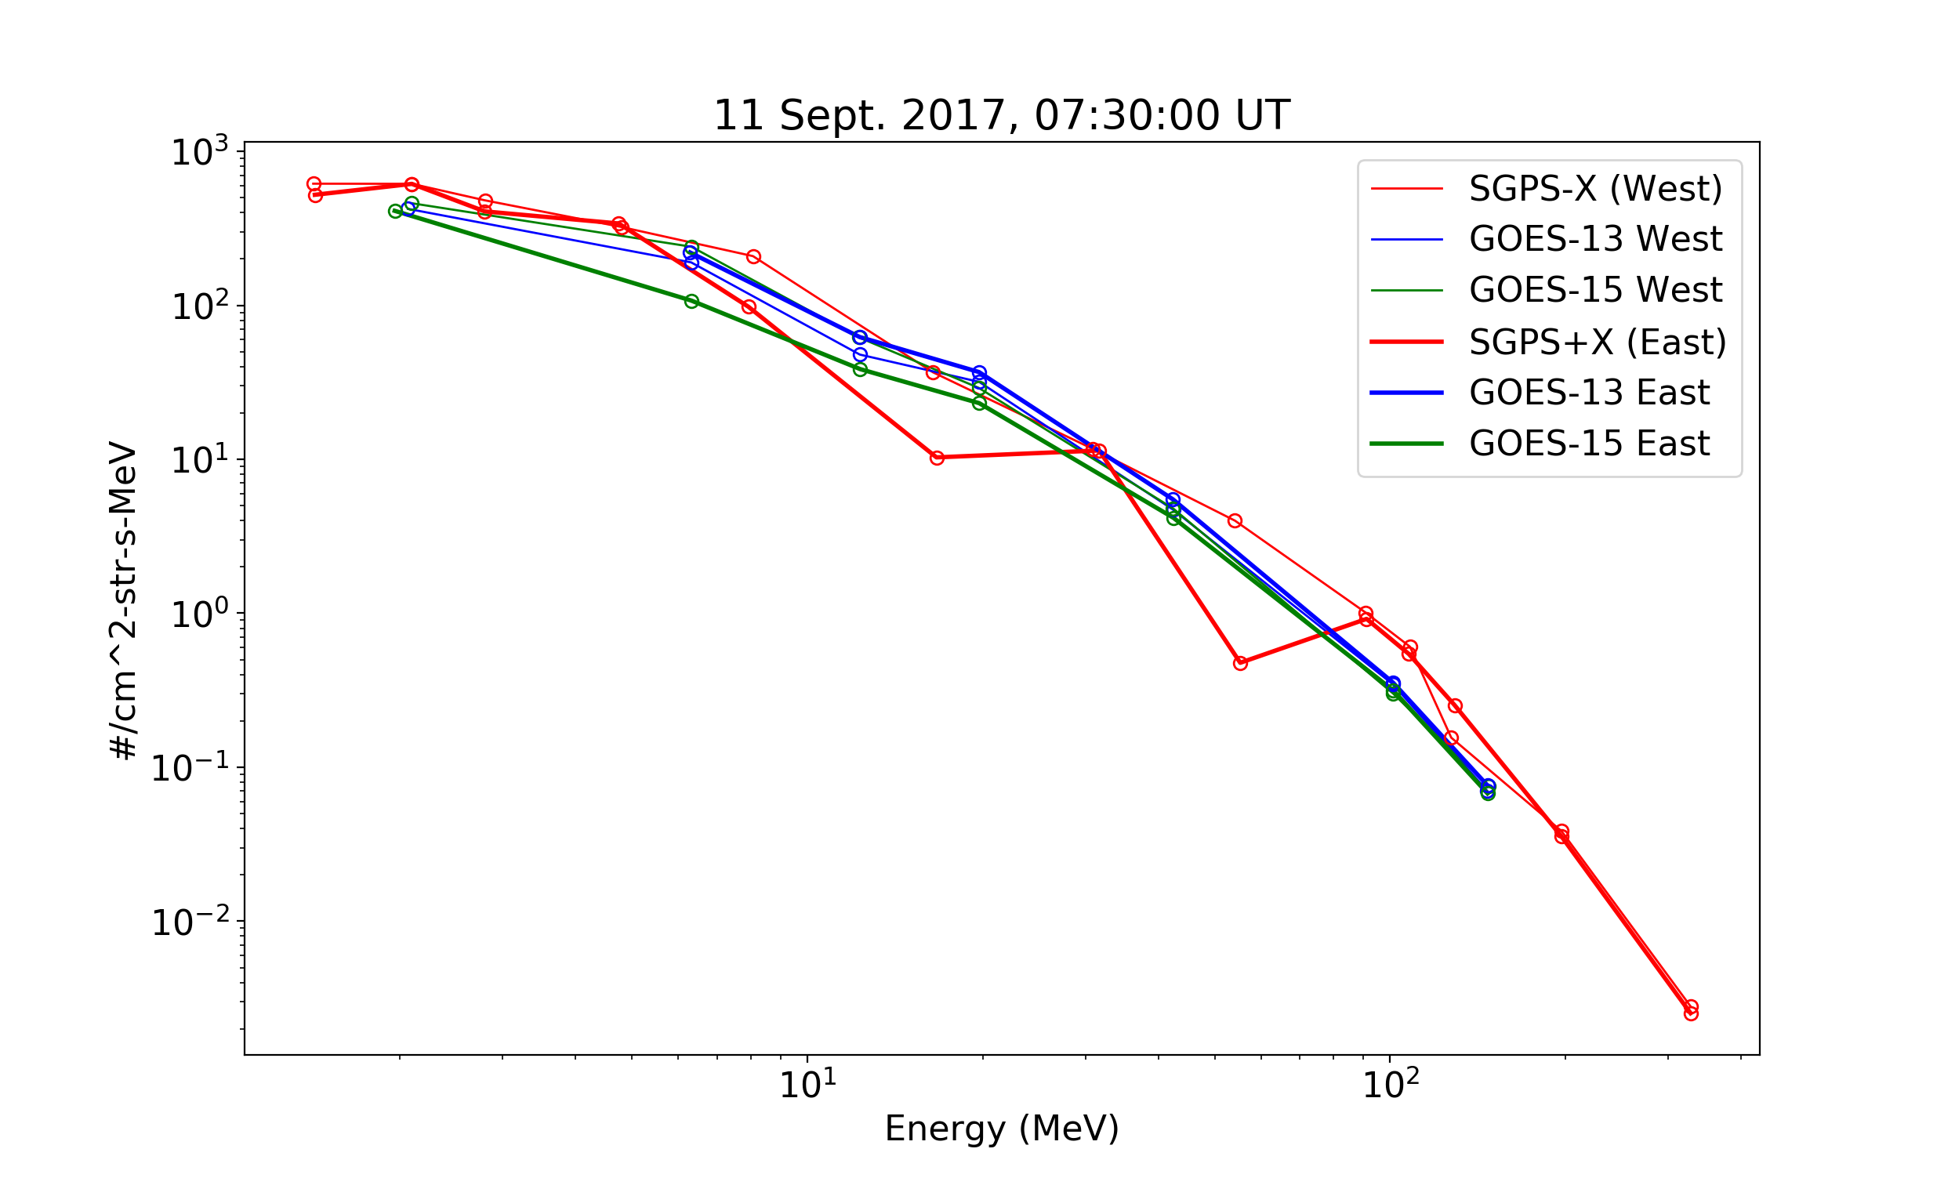
PLPT-SEI-004 SEP Channel Cross-Comparison
5m average of L1b fluxes
Unexplained deference between SGPS -X and +X P4
SGPS+X P5
overcorrection
SGPS T3 channels ~2 times higher than G13 and G16 EPS
SGPS+X P7
anomalously low
During the Sep 2017 SEP event, at T3 energies (83-500MeV), SGPS fluxes are about a factor of two higher than GOES-13 and -15 fluxes.
SEP Channel Cross-Comparison PLPT indicates numerous channels are not performing as characterized with beam calibrations (e.g., SGPS +X and –X P4 differ by about a factor of four during 16-17 July 2017 SPE). Geometric factors may need adjustment.

Slide 33
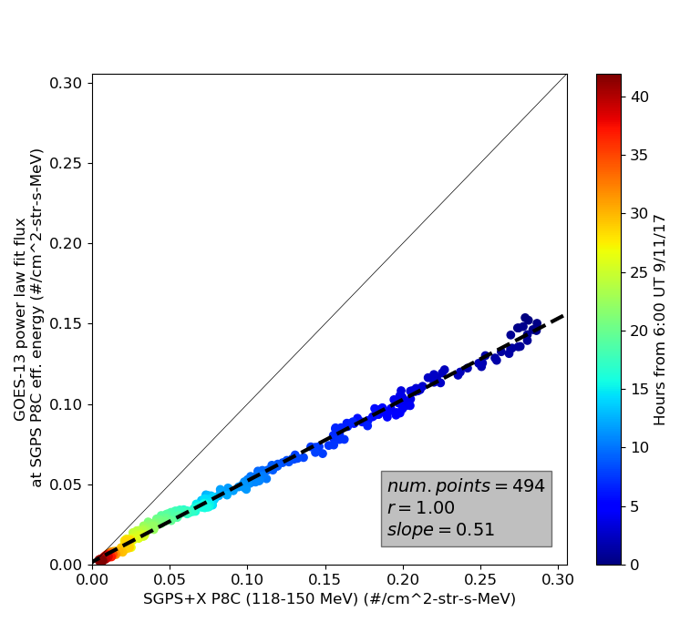
PLPT-SEI-004 SEP Channel Cross-Comparison
SGPS – GOES-13 Cross Comparison
Power law fit to G13 EPS vs. SGPS-X Flux,
at SGPS channel effective energies
11-12 Sept. 2017; L1b 5 min. averages
Channel | Slope | Intercept | r
SGPS+X P6 (25-40 MeV) | 0.96 | 0.531 | 0.958
SGPS+X P7 (40-80 MeV) | 4.329 | 0.069 | 0.977
SGPS+X P8A (83-99 MeV) | 0.510 | 0.009 | 0.995
SGPS+X P8B (99-118 MeV) | 0.511 | 0.003 | 0.998
SGPS+X P8C (118-150 MeV) | 0.503 | 0.002 | 0.997
SGPS+X P9 (150-275 MeV) | 0.607 | 0.0 | 0.991
SGPS+X P10 (275-500 MeV) | 0.99 | 0.0 | 0.956
SGPS – GOES-15 Cross Comparison
Power law fit to G15 EPS vs. SGPS-X Flux,
at SGPS channel effective energies
Channel | Slope | Intercept | r
SGPS+X P6 (25-40 MeV) | 0.845 | -0.067 | 0.995
SGPS+X P7 (40-80 MeV) | 0.514 | 0.025 | 0.994
SGPS+X P8A (83-99 MeV) | 0.397 | 0.005 | 0.997
SGPS+X P8B (99-118 MeV) | 0.389 | 0.002 | 0.998
SGPS+X P8C (118-150 MeV) | 0.760 | -0.002 | 0.956
SGPS+X P9 (150-275 MeV) | 0.684 | 0.0 | 0.993
SGPS+X P10 (275-500 MeV) | 1.483 | 0.0 | 0.964
P1-P5 (1-25 MeV) not included due to longitudinal and directional differences caused by magnetospheric effects.
Similar results obtained for SGPS-X, also, direct comparisons between SGPS-X and SGPS+X.
Complete results and analysis included in: G16 SGPS Sept. 2017 SEP Event Cross Satellite Comparisons Report, to be made available on NCEI GOES-R website.

Slide 34
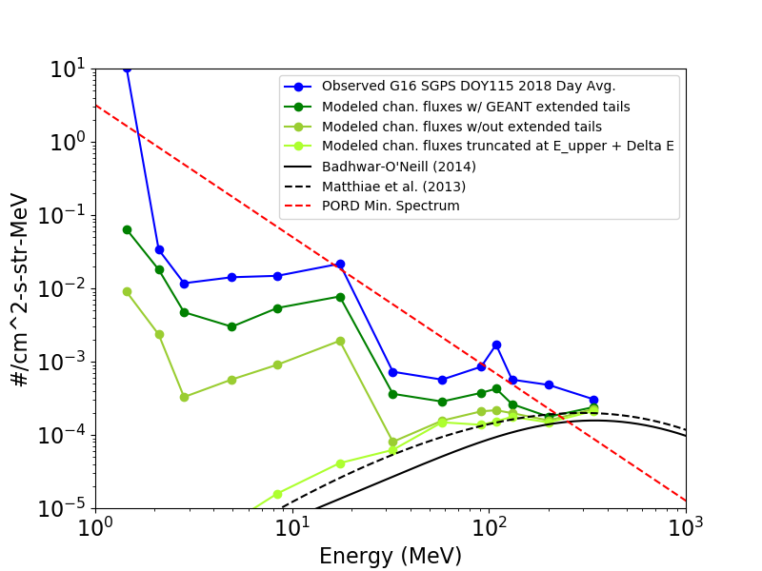
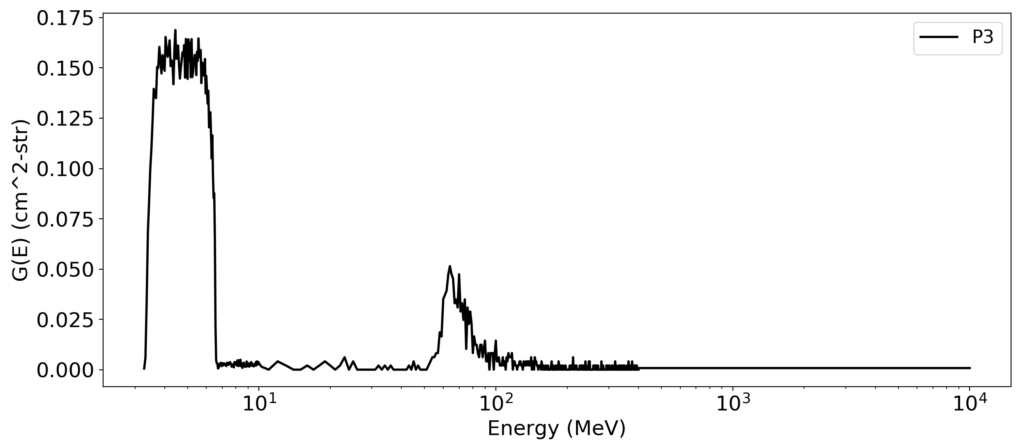
PLPT-SEI-006 Backgrounds Trending
Observed vs. Modeled GCR Backgrounds
Day avg. L1b
GEANT Response Function
Truncated at chan.
E_upper + △E
PORD minimum
SEP spectrum
without extended tail
with extended
tail
High energy island
GCR models
Calibrated channel
Source of SGPS backgrounds is GCR counts.
“Backgrounds” (from GCR counts) are significantly higher than GCR fluxes.
The GCRs are mainly in high energy tail region of response function, not part of calibrated channel. Differential channels calibrated for observing SEPs; P11 (>500 MeV integral chan.) measures GCRs.
Backgrounds below PORD spectrum do not violate requirements.

Slide 35
FULL MATURITY ASSESSMENT
GOES-16 SGPS L1b Product Provisional PS-PVR

Slide 36
Full Validation Assessment
Preparation Activities | Assessment
Validation, QA, and anomaly resolution activities are ongoing. | Validation activities are ongoing. Results have been discussed with SWPC. Research community participation is ongoing.
Incremental product improvements may still be occurring. | Continuing work on P7, P5 and other channels.
Users are engaged and user feedback is assessed. | Yes (e.g., User Questions/Requests on slide 30 and NCEI responses).
* GOES-R product maturity level preparation activities from 416-R-RIMP-0318 Version 1.0 06/02/2016,
Responsible Organization: GOES-R Ground Segment/Code 416

Slide 37
Full Validation Assessment
End State | Assessment
Product performance for all products is defined and documented over a wide range of representative conditions via ongoing ground truth and validation efforts. | SGPS fluxes compared with observations from MPS-HI, GOES-13, and -15. Both units (SN101 and SN102) ground/beam calibrated.
Products are operationally optimized, as necessary, considering mission parameters of cost, schedule, and technical competence as compared to user expectations. | Yes, this is true of L1b. (There are continuing efforts to accommodate some L1b issues in L2 processing, e.g., modification of L2 event detection.)
All known product anomalies are documented, and shared with the user community. | Yes, in L1b README and through direct communications with user community.
Product is operational. | Yes.
* GOES-R product maturity level end states from 416-R-RIMP-0318 Version 1.0 06/02/2016,
Responsible Organization: GOES-R Ground Segment/Code 416

Slide 38
SGPS Performance Baseline Status
MRD ID | Description | Related PLPTs | Status
MRD2005 | Product Orthogonality/Coverage | -04, -06 | Ongoing
MRD2009 | Product Measurement Range | -04, -06 | Ongoing
MRD2010 | Product Measurement Accuracy | -04, -06 | Ongoing
MRD2005: Orthogonality/Coverage
Requirement: 2 directions
Currently being met
MRD2009: Measurement Range:
Requirement: Protons: 1 MeV - 500 MeV, > 500 MeV
SEP Channel Cross-comparisons with legacy instruments on GOES-13 and -15 indicate that energy range is being covered.
MRD2010: Measurement Accuracy
Requirements: 25% when flux level above background is greater than 10x minimum flux; 45% when flux level above background is between minimum flux and 10x minimum flux
Absolute accuracy cannot be verified on-orbit
Differences up to a factor of 2-4 are found for some channels in SEP Channel Cross-comparisons between -X and +X units (P4) and with GOES-13 and -15 (P8A,P8B,P8C,P9), excepting channels with known anomalies.

Slide 39
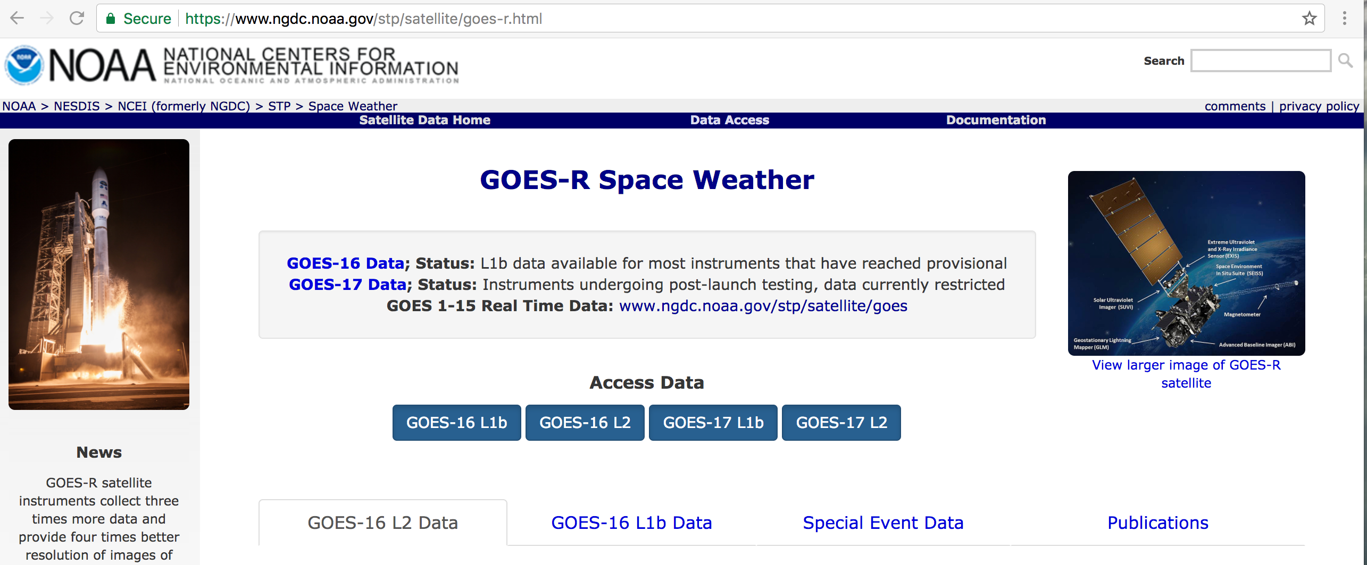
Next Steps (Beyond Full Validation – Replaces “Path to <next> Validation” Sections in Beta and Provisional PS-PVR presentations. )
Submit ADR for SGPS+X P7 Geometric Factor correction (LUT update).
Additional analysis needed to determine if there is a viable correction for P5 channel high energy island – additional SEP event data is needed.
Analysis of future SEP events
Cross instrument calibrations and analysis with possibility of corrections to geometric factors [continuation of PLPT-SEI-004 SEP].
Analysis aimed at full understanding of channel response functions [continuations of PLPTs -SEI-001, -SEI-004, and -SEI-006].
Consider (in consultation with SWPC), and possibly implement, modifications to L2 processing Solar Particle Event Detection to mitigate (negative) impact of anomalous channels.
Post report on SGPS cross calibrations with G13-15 and post on NCEI’s GOES-R data website.
Post reprocessed/corrected Sept. 2017 event data set on NCEI’s GOES-R data website.

Slide 40
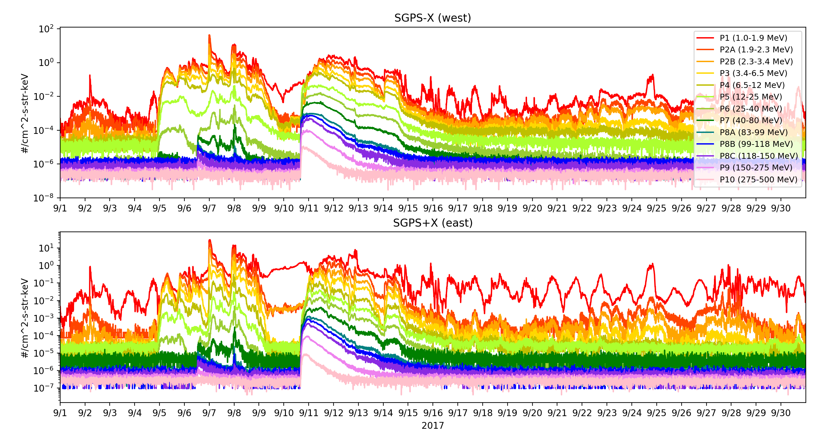
Corrected/Reprocessed Sept. 2017 SEP Event Data
Electron contamination in +X P5 near background level.
Sept. 2017 SEP event SGPS 5m avg. data, to be made available on NCEI’s GOES-R website.
• Temperature corrected • P5 out-of-band correction not performed
• Correction factor applied to +X P7 • Gaps filled using L0 data

Slide 41
SUMMARY & RECOMMENDATIONS
GOES-16 SGPS L1b Products Provisional PS-PVR

Slide 42
Summary
Main issues identified and resolution status:
Temperature Dependence in SGPS-X T1 & T3. ✅ Correction Implemented in Level-2 processing. Additional testing and tuning will occur.
SGPS+X P7 count rate anomalously low. – Geometric factor correction pending, plus ongoing work to characterize response function.
SGPS+X P5 overcorrection in L1b processing. ✅ ADR 900 (LUT update) Closed, ongoing work.
Electron contamination in SGPS+X P5. ✅ Effect small – No ADR needed.
Some channels not performing as characterized in beam calibrations (e.g., SGPS+X P4) – Geometric factors may need adjustment. ✅ Full Val. PLPT-SEI-004 SEP Channel Cross-Comparison work completed, report to be posted, plus ongoing work.
L1b data gaps/dropouts. ✅ ADR 517, Small but routine L1b data gaps, Closed.
There are some anomalous channels with unknown root cause (e.g., SGPS+X P4 and P7), but overall SGPS is performing well.
In our view, “Products are operationally optimized, as necessary, considering mission parameters of cost, schedule, and technical competence as compared to user expectations.” Other Full validation criteria are also met.

Slide 43
Recommendations
The Solar Particle Event Detection code uses integral flux computed by fitting a power law to SGPS’s 13 differential channels plus the >500 MeV integral channel flux. Three steps to mitigate the effect of anomalous channels are
Temperature correction downstream of L1b processing (✅ done).
In Level-2 processing, implement an option to remove any particular channel from the integral flux calculation and event detection in L2 processing.
In Level-2 processing, Implement an option to use any combination of SGPS+X and SGPS-X channels in a single integral flux calculation and event detection. (Currently, event detection is done separately for each unit.)
(* Recommendations 1-3 concern L2 processing, however, are relevant to L1b Full Validation since they (1) resolve L1b issues, and (2) relevant to the L1b Full Validation criterion “Products are operationally optimized…” . )
NCEI recommends SGPS L1b for transition to Full Validation status, with understanding that additional testing and tuning of the SGPS temperature correction and Solar Particle Event Detection codes is needed.

Slide 44
BACKUP SLIDES
GOES-17 SGPS L1b Product Provisional PS-PVR

Slide 45
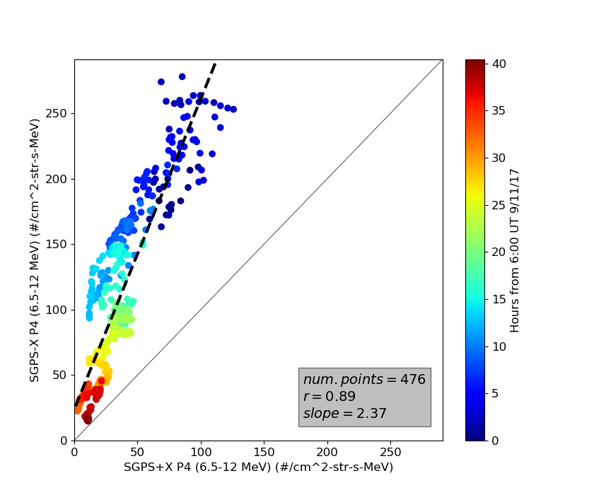
SGPS -X/+X P4 Comparison
During 11-12 Sept. 2017, there is a factor of >2 difference between SGPS-X P4 and SGPS+X P4. When G16 is on the day side we expect some differences due to directional anisotropies, but significant differences are not expected on the night side.

Slide 46
SGPS P1 and MPS-HI P8
(west facing unit)
(east facing unit)
Period with SW P_{dyn} > 10nP.
During geomagnetically quiet periods, the westward flux is higher then eastward flux, and MPS-HI flux lies in between.

Slide 47
SGPS P2 and MPS-HI P9
Interesting that MPSH P9 is very close to SGPS P2B.

Slide 48
SGPS P3 and MPS-HI P10

Slide 49
16-17 July 2017 SGPS & MPS-HI 1-12 MeV Channels Comparison Summary
SGPS-X P1 and MPS-HI P8 GFs are a little high or SGPS+X P1 is a little low.
SGPS-X P2A GF is a little high or SGPS+X P2A GF is a little low.
SGPS P2B and P3 GFs look good.
MPS-HI P9, P10, and P11 GFs appear to be significantly high, higher at higher energies. Or perhaps the channel energy boundaries are shifted with respect to their expected values.
SGPS-X P4 GF is too low or SGPS+X P4 GF is too high.

