Slide 1
Peer Stakeholder-Product Validation Review (PS-PVR) For the Provisional Maturity of GOES-17 SEISS SGPS L1b Product
February 27, 2019
GOES-R Calibration Working Group (CWG)
Presenter: Brian Kress
Contributors: Athanasios Boudouridis, Juan Rodriguez
NOAA NCEI / CIRES
This review incorporates results from Assurance Technology Corporation PLTs.
These GOES-17 data are preliminary, non-operational data and are undergoing testing. Users bear all responsibility for inspecting the data prior to use and for the manner in which the data are utilized.

Slide 2
Outline
SGPS Overview
Review of Beta Maturity
Product Quality Evaluation
Comments on evaluation of G17 SGPS without SEP event data
Analysis and PLPTs Supporting Assessment for Provisional Status
Provisional Maturity Assessment
Path to Full Validation Maturity
Summary and Recommendations
These GOES-17 data are preliminary, non-operational data and are undergoing testing. Users bear all responsibility for inspecting the data prior to use and for the manner in which the data are utilized.

Slide 3
SGPS OVERVIEW
GOES-17 SGPS L1b Product Provisional PS-PVR
These GOES-17 data are preliminary, non-operational data and are undergoing testing. Users bear all responsibility for inspecting the data prior to use and for the manner in which the data are utilized.

Slide 4
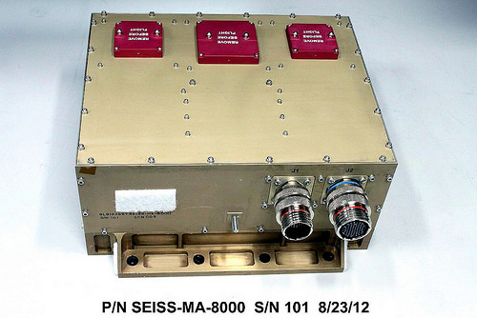
Space Environment In-Situ Suite (SEISS) Solar and Galactic Proton Sensor (SGPS)
2 Units, one looking East (+X) and one West (-X)
3 solid state telescopes on each unit
1-500 MeV protons in 13 differential channels, plus >500 MeV integral channel
4-500 MeV alphas in 12 energy bands
(not processed)
GOES-17 SEISS sensors turned on 24 April 2018
SEISS SGPS designed, built, tested and calibrated by Assurance Technology Corporation (ATC)
These GOES-17 data are preliminary, non-operational data and are undergoing testing. Users bear all responsibility for inspecting the data prior to use and for the manner in which the data are utilized.

Slide 5
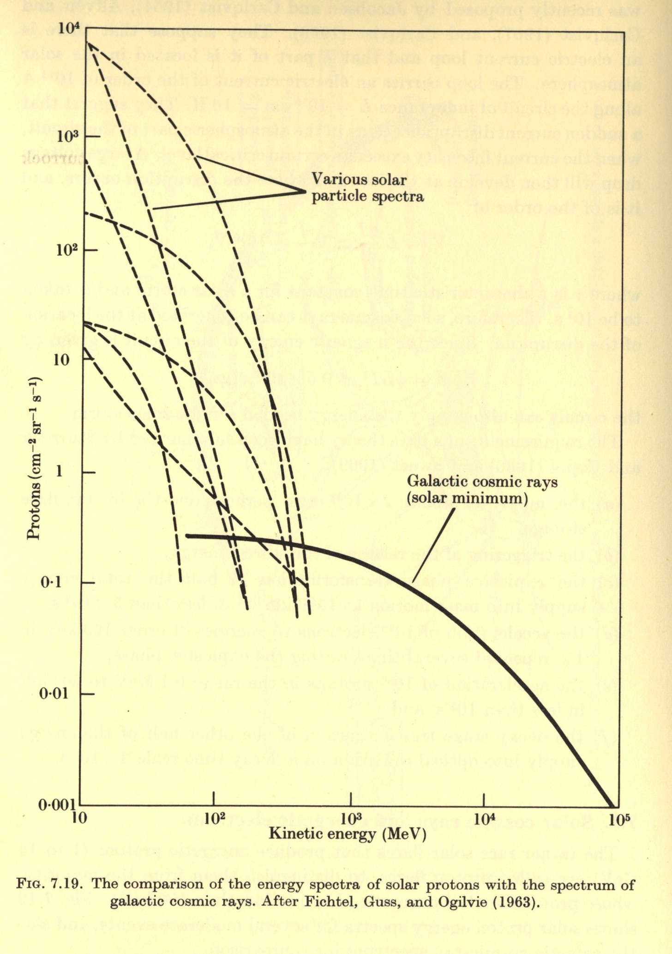
Introductory Material
Energetic Ions In Space
From Solar Terrestrial Physics,
Akasofu and Chapman, 1972.
GCRs (Galatic Cosmic Rays)
Always present in space
Energies up to and > 10¹¹ GeV
Flux ≈ 0.6 particles / cm² / sec
≈ 99.5% H & He
SEPs (Solar Energetic Particles)
Produced during Solar Particle Events (SPEs) lasting one to several days.
Mostly < 500 MeV protons
Flux up to 10⁵ particles / cm² / sec
Most are shielded by the earths magnetic field at latitudes < 60º.

Slide 6
SGPS Primary Operational Use
Data stream for NOAA-NWS SWPC Solar Proton Event Detection and Radiation Storm Alerts
Level 1b
Level 2
1 sec.
The NOAA Space Weather Scales communicate to the general public current and future space weather conditions and possible effects on people and systems.
Numbered levels, analogous to hurricanes, tornadoes, and earthquakes that convey severity.
These GOES-17 data are preliminary, non-operational data and are undergoing testing. Users bear all responsibility for inspecting the data prior to use and for the manner in which the data are utilized.

Slide 7
REVIEW OF BETA MATURITY (G17 SEISS Beta PS-PVR, Aug. 10, 2018)
GOES-17 SGPS L1b Product Provisional PS-PVR
These GOES-17 data are preliminary, non-operational data and are undergoing testing. Users bear all responsibility for inspecting the data prior to use and for the manner in which the data are utilized.

Slide 8
G17 SGPS Beta PS-PVR Overview
Vendor PLTs all passed (Missing thresholds captured by subsequent IFC table uploads)
GOES-17 SGPS turned on 24 April 2018
PLT-SEI-006 SGPS+X and -X Initial IFCs 26 and 28 Apr 2018
PLT-SEI-008 SGPS+X and -X D3-D1 Logic Test 08 May 2018
PLT-SEI-007 Cross-Calibration SGPS+X and -X [passive] 20-30 May 2018
One SGPS PLPT supporting beta maturity (PLPT-SEI-006: SGPS GCR Backgrounds) presented during G17 Beta PS-PVR. The G17 SGPS backgrounds are well characterized and their source is understood.
3 ADRs/WRs Impacting SGPS L1b presented during beta review:
ADR | WR | Short Description | Status | Expected Closure
267 | 5370 | LUT Filenames not Traceable to Metadata | Closed | DO.07.00.00
676 | TBA | G17 ground LUT has SGPS–X dead time = 8e+07 s instead of 8e-07 s. | Closed | w/ LUT change
900 | TBA | G16 & G17 SGPS P5 correction coefficients LUT update | Submitted | w/ LUT change
These GOES-17 data are preliminary, non-operational data and are undergoing testing. Users bear all responsibility for inspecting the data prior to use and for the manner in which the data are utilized.

Slide 9
* Path to Provisional Maturity (presented at G17 Beta PS-PVR)
Five PLPTs to be conducted by NCEI-CO for Provisional Maturity
PLPT tools ready
4 PLPTs already underway
Data being collected for SEI-001 since 18 May 2018 (Full Maturity)
Tools for SEI-004, -005 and -006 being used with L0 and L1b data
in contrast to G16, the magnetometer L1b data will be ok for provisional analysis once the MAG LUT is updated in September with the results of their calibration maneuvers (updated biases).
Currently outstanding issues, unless fixed by handover, will be recommended by NCEI-CO as liens against Provisional Maturity:
G16 and G17 MPS-LO High Backgrounds requires GPA changes and associated LUT changes. The new LUT parameters require analysis by NCEI (background removal coefficients) and ATC (crosstalk correction coeff. (done)).
G17 MPS-HI non-physical dropouts due to L1b matrix inversion, to be replaced by bowtie coefficients (NCEI analysis (done) and LUT update).
G17 MPS-HI background removal coefficients need to be adjusted (NCEI analysis and LUT update).
* No outstanding SGPS issues called out
These GOES-17 data are preliminary, non-operational data and are undergoing testing. Users bear all responsibility for inspecting the data prior to use and for the manner in which the data are utilized.

Slide 10
PRODUCT QUALITY EVALUATION
GOES-17 SGPS L1b Product Provisional PS-PVR
These GOES-17 data are preliminary, non-operational data and are undergoing testing. Users bear all responsibility for inspecting the data prior to use and for the manner in which the data are utilized.

Slide 11
What can we say about G17 SGPS performance based on Galactic Cosmic Ray (background) count rates?
GOES-17 SGPS L1b Product Provisional PS-PVR
These GOES-17 data are preliminary, non-operational data and are undergoing testing. Users bear all responsibility for inspecting the data prior to use and for the manner in which the data are utilized.

Slide 12
Detector Response Function Introductory Material
The total counts/sec. in the channel is the convolution of the channel response function G(E) and the ambient flux spectrum j(E)
$$C=\int{G\left(E\right) j\left(E\right) dE}$$
The measured/reported flux is j_{m} = C / G , where C is counts and G [cm2-s-sr-keV] is a channel/energy integrated geometric factor
$$G=\int_{E_{L}}^{E_{U}}{G\left(E\right)dE}$$
G(E)
SEP spectrum $j\left(E\right)=j_{0}E^{−γ}$
Log j(E)
GCR spectrum
E_{L}
E_{U}
Energy
Log Energy
These GOES-17 data are preliminary, non-operational data and are undergoing testing. Users bear all responsibility for inspecting the data prior to use and for the manner in which the data are utilized.

Slide 13
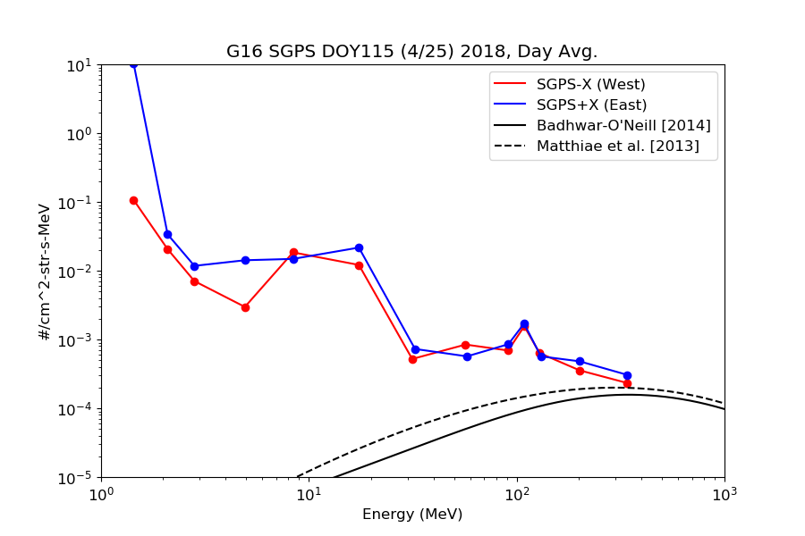
Observed GCR Backgrounds (Figures From G17 Beta PS-PVR)
Agreement not expected at lowest energies due to geophysical east-west effect.
One day averaged GCR backgrounds from GOES-16 and -17 L0 data.
GOES-17 GCR background count rates are similar to GOES-16, and in general there is better agreement between GOES-17 SGPS-X and SGPS+X units.
Reported GCR fluxes are significantly higher than accepted empirical models.
These GOES-17 data are preliminary, non-operational data and are undergoing testing. Users bear all responsibility for inspecting the data prior to use and for the manner in which the data are utilized.

Slide 14
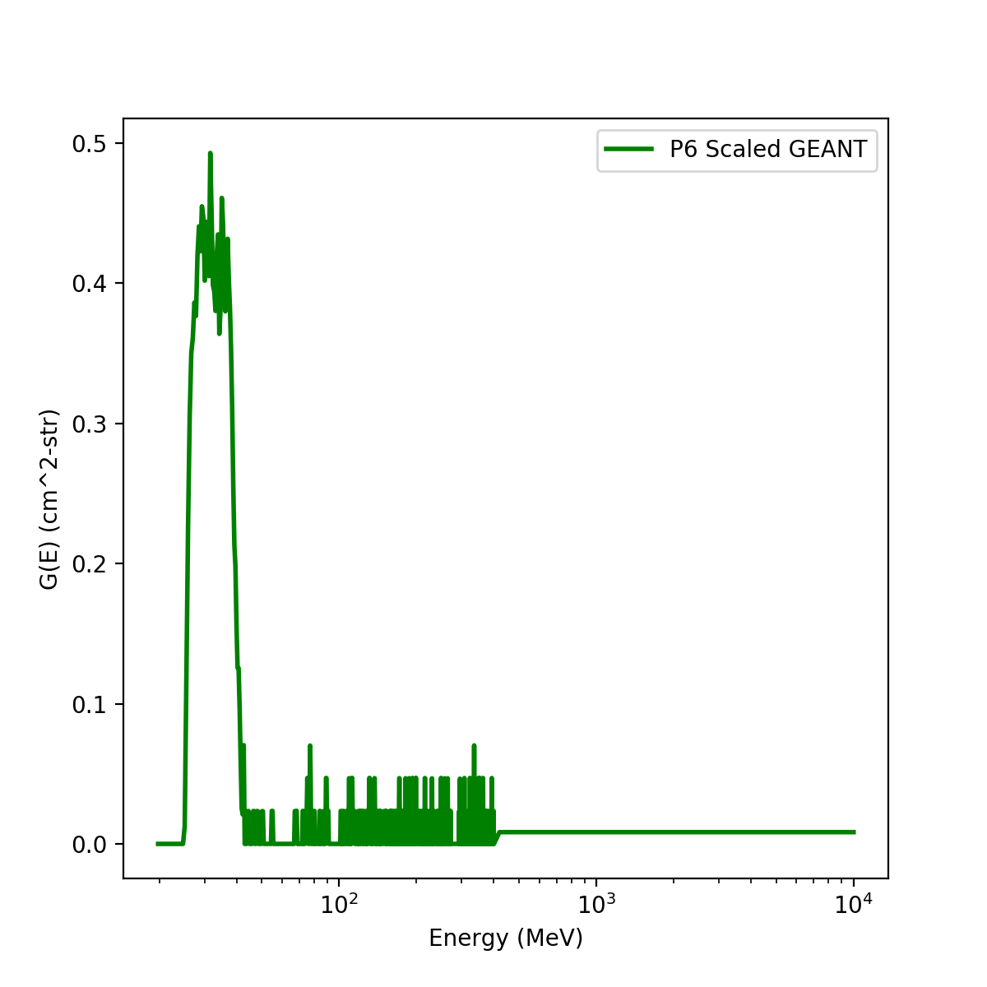
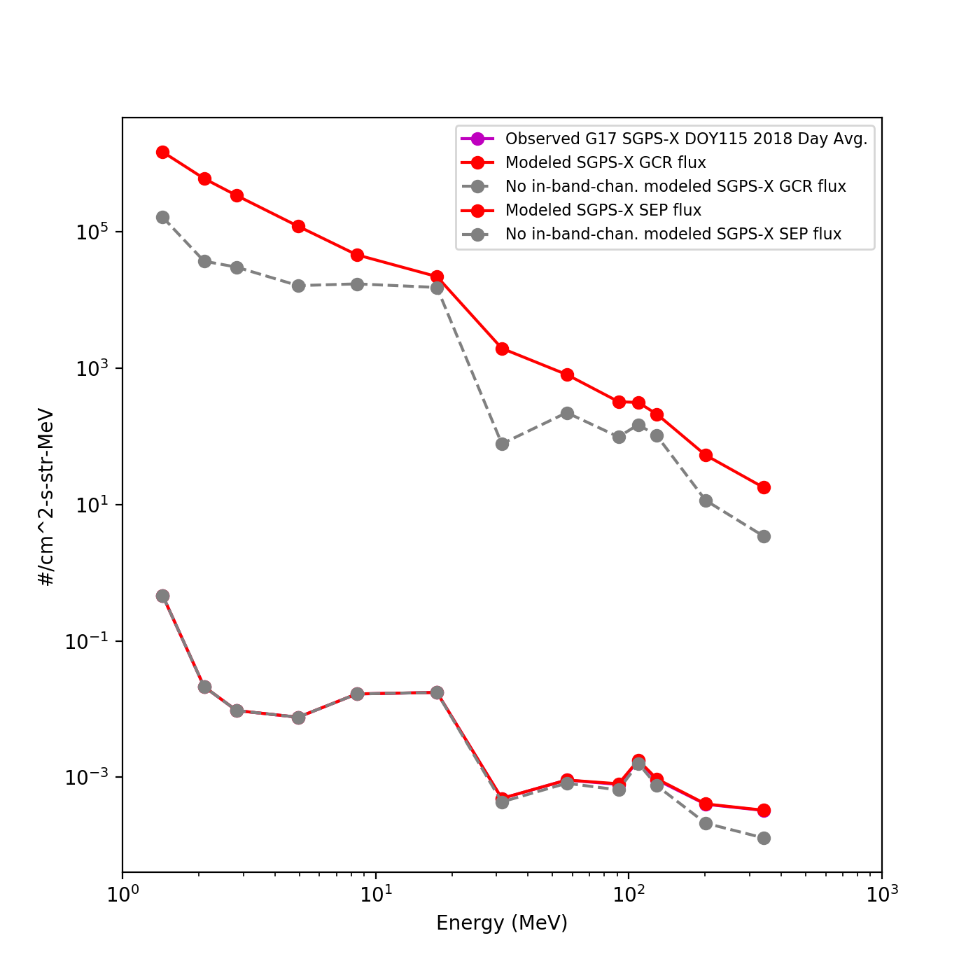
Modeled SEP and GCR fluxes, with and without in-band part of response function
Scaled GEANT (simulated) Response
Modeled flux = $\frac{\int{j(E)G\left(E\right)de}}{G∗∆E}$
In band portion scaled to agree with CDRL79 (ground LUT) geometric factor.
SEP model
“No in-band…” (gray trace) in figure to the left means this portion of the response function is not included.
Upper portion of GEANT scaled so that modeled GCR flux agrees with observed backgrounds.
Modeled lies on top of Observed, since upper portion of GEANT is scaled so that modeled flux agrees with observed GCR rates
GCR model
* GCR counts are from high energy tail portion of response function, not part of calibrated channel –
A problem with the in-band portion of the response function can not be detected by looking at GCR rates.
These GOES-17 data are preliminary, non-operational data and are undergoing testing. Users bear all responsibility for inspecting the data prior to use and for the manner in which the data are utilized.

Slide 15
SGPS PLPTs Supporting Provisional Maturity
PLPT-SEI-001 SGPS D3-D1 Contamination Correction
PLPT-SEI-004 SEP Channel Cross-Comparison
PLPT-SEI-006 Backgrounds Trending
These GOES-17 data are preliminary, non-operational data and are undergoing testing. Users bear all responsibility for inspecting the data prior to use and for the manner in which the data are utilized.

Slide 16
PLPT-SEI-001 SGPS D3-D1 Contamination Correction
Accumulated counts from G17 L0 data
Cumulative Summary:
G17 SGPS-X P7 w/ D3-D1 off rate = 2176. counts/day
G17 SGPS-X P7 w/ D3-D1 on rate = 1347. counts/day
On-off Ratio = 1347./2176. = 0.62
G17 SGPS+X P7 w/ D3-D1 off rate = 2242. counts/day
G17 SGPS+X P7 w/ D3-D1 on rate = 1463. counts/day
On-off Ratio = 1463./2242. = 0.65
G17 SGPS-X P8C w/ D3-D1 off rate = 4650. counts/day
G17 SGPS-X P8C w/ D3-D1 on rate = 2466. counts/day
On-off Ratio = 2466./4650.=0.53
G17 SGPS+X P8C w/ D3-D1 off rate = 4042. counts/day
G17 SGPS+X P8C w/ D3-D1 on rate = 2980. counts/day
On-off Ratio = 2980./4042.=0.74
* P7 GCR rates drop by almost one-half when d3-d1 circuit is turned on.
These GOES-17 data are preliminary, non-operational data and are undergoing testing. Users bear all responsibility for inspecting the data prior to use and for the manner in which the data are utilized.

Slide 17
PLPT-SEI-004 SEP Channel Cross-Comparison
No solar particle event since G17 launch –
SEP Channel Cross-Comparison not performed
These GOES-17 data are preliminary, non-operational data and are undergoing testing. Users bear all responsibility for inspecting the data prior to use and for the manner in which the data are utilized.

Slide 18
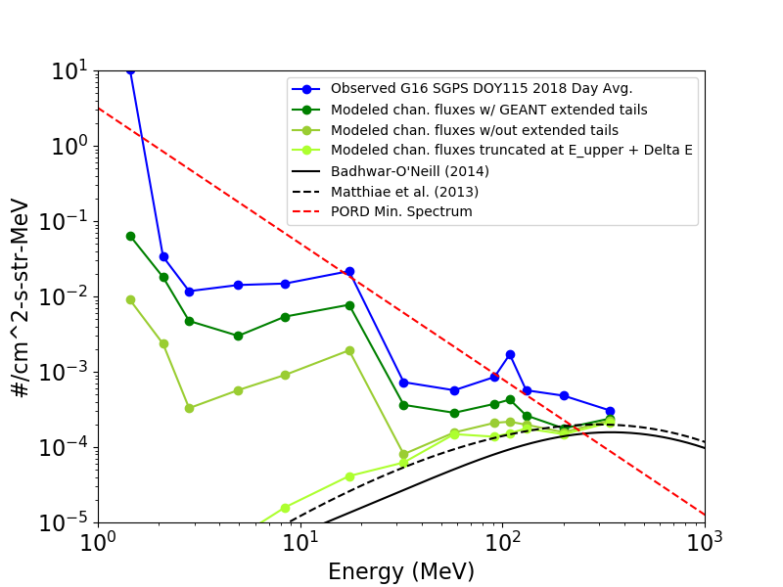
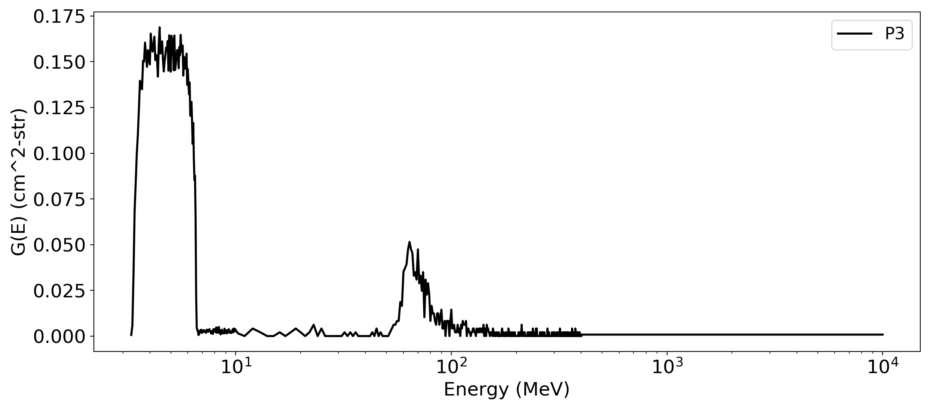
PLPT-SEI-006 Backgrounds Trending
Observed vs. Modeled GCR Backgrounds
GEANT Response Function
Truncated at chan.
E_upper + △E
PORD minimum
SEP spectrum
without extended tail
with extended
tail
High energy island
GCR models
Calibrated channel
Source of SGPS backgrounds is GCR counts.
Reported GCR fluxes are significantly higher than accepted empirical models.
High GCR fluxes are due to high energy tail portion of response function, not part of calibrated channel.
Differential channels calibrated for observing SEPs; P11 (>500 MeV integral chan.) measures GCRs.
These GOES-17 data are preliminary, non-operational data and are undergoing testing. Users bear all responsibility for inspecting the data prior to use and for the manner in which the data are utilized.

Slide 19
Additional Instrument Health Tests (Not covered by PLPTs)
Tests for G17 SGPS temperature dependence
SGPS P5 electron contamination
(Next 3 charts)
These GOES-17 data are preliminary, non-operational data and are undergoing testing. Users bear all responsibility for inspecting the data prior to use and for the manner in which the data are utilized.

Slide 20
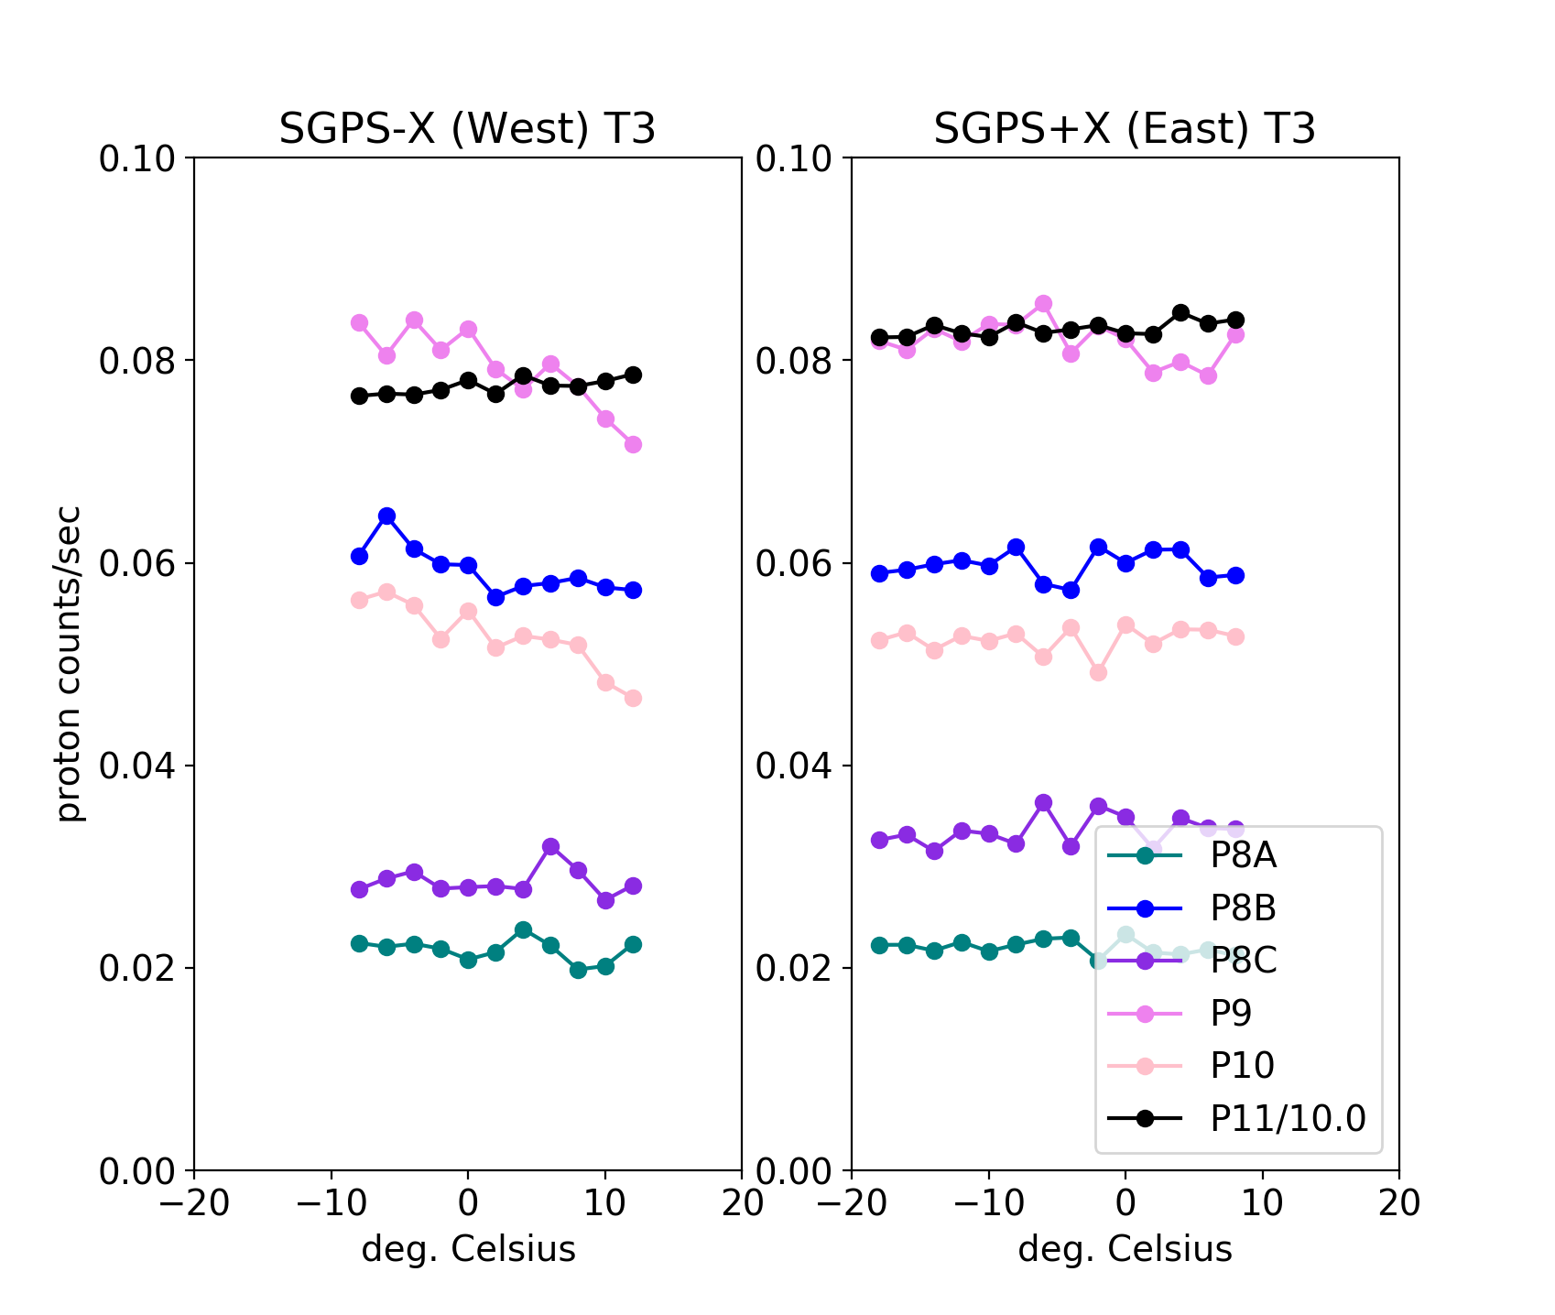
SGPS Temperature Dependence
GOES-16
GOES-17
Quiet conditions (steady) GCR counts from L0 data binned in 2 deg. temp. bins 2018 DOYs 114-120.
In general, GOES-17 SGPS T3 temperature variations are over a smaller temperature range and there is significantly less temperature dependence than in GOES-16 SGPS T3 .
GOES-17 SGPS T1 does not show temperature dependence (shown in backup charts).
These GOES-17 data are preliminary, non-operational data and are undergoing testing. Users bear all responsibility for inspecting the data prior to use and for the manner in which the data are utilized.

Slide 21
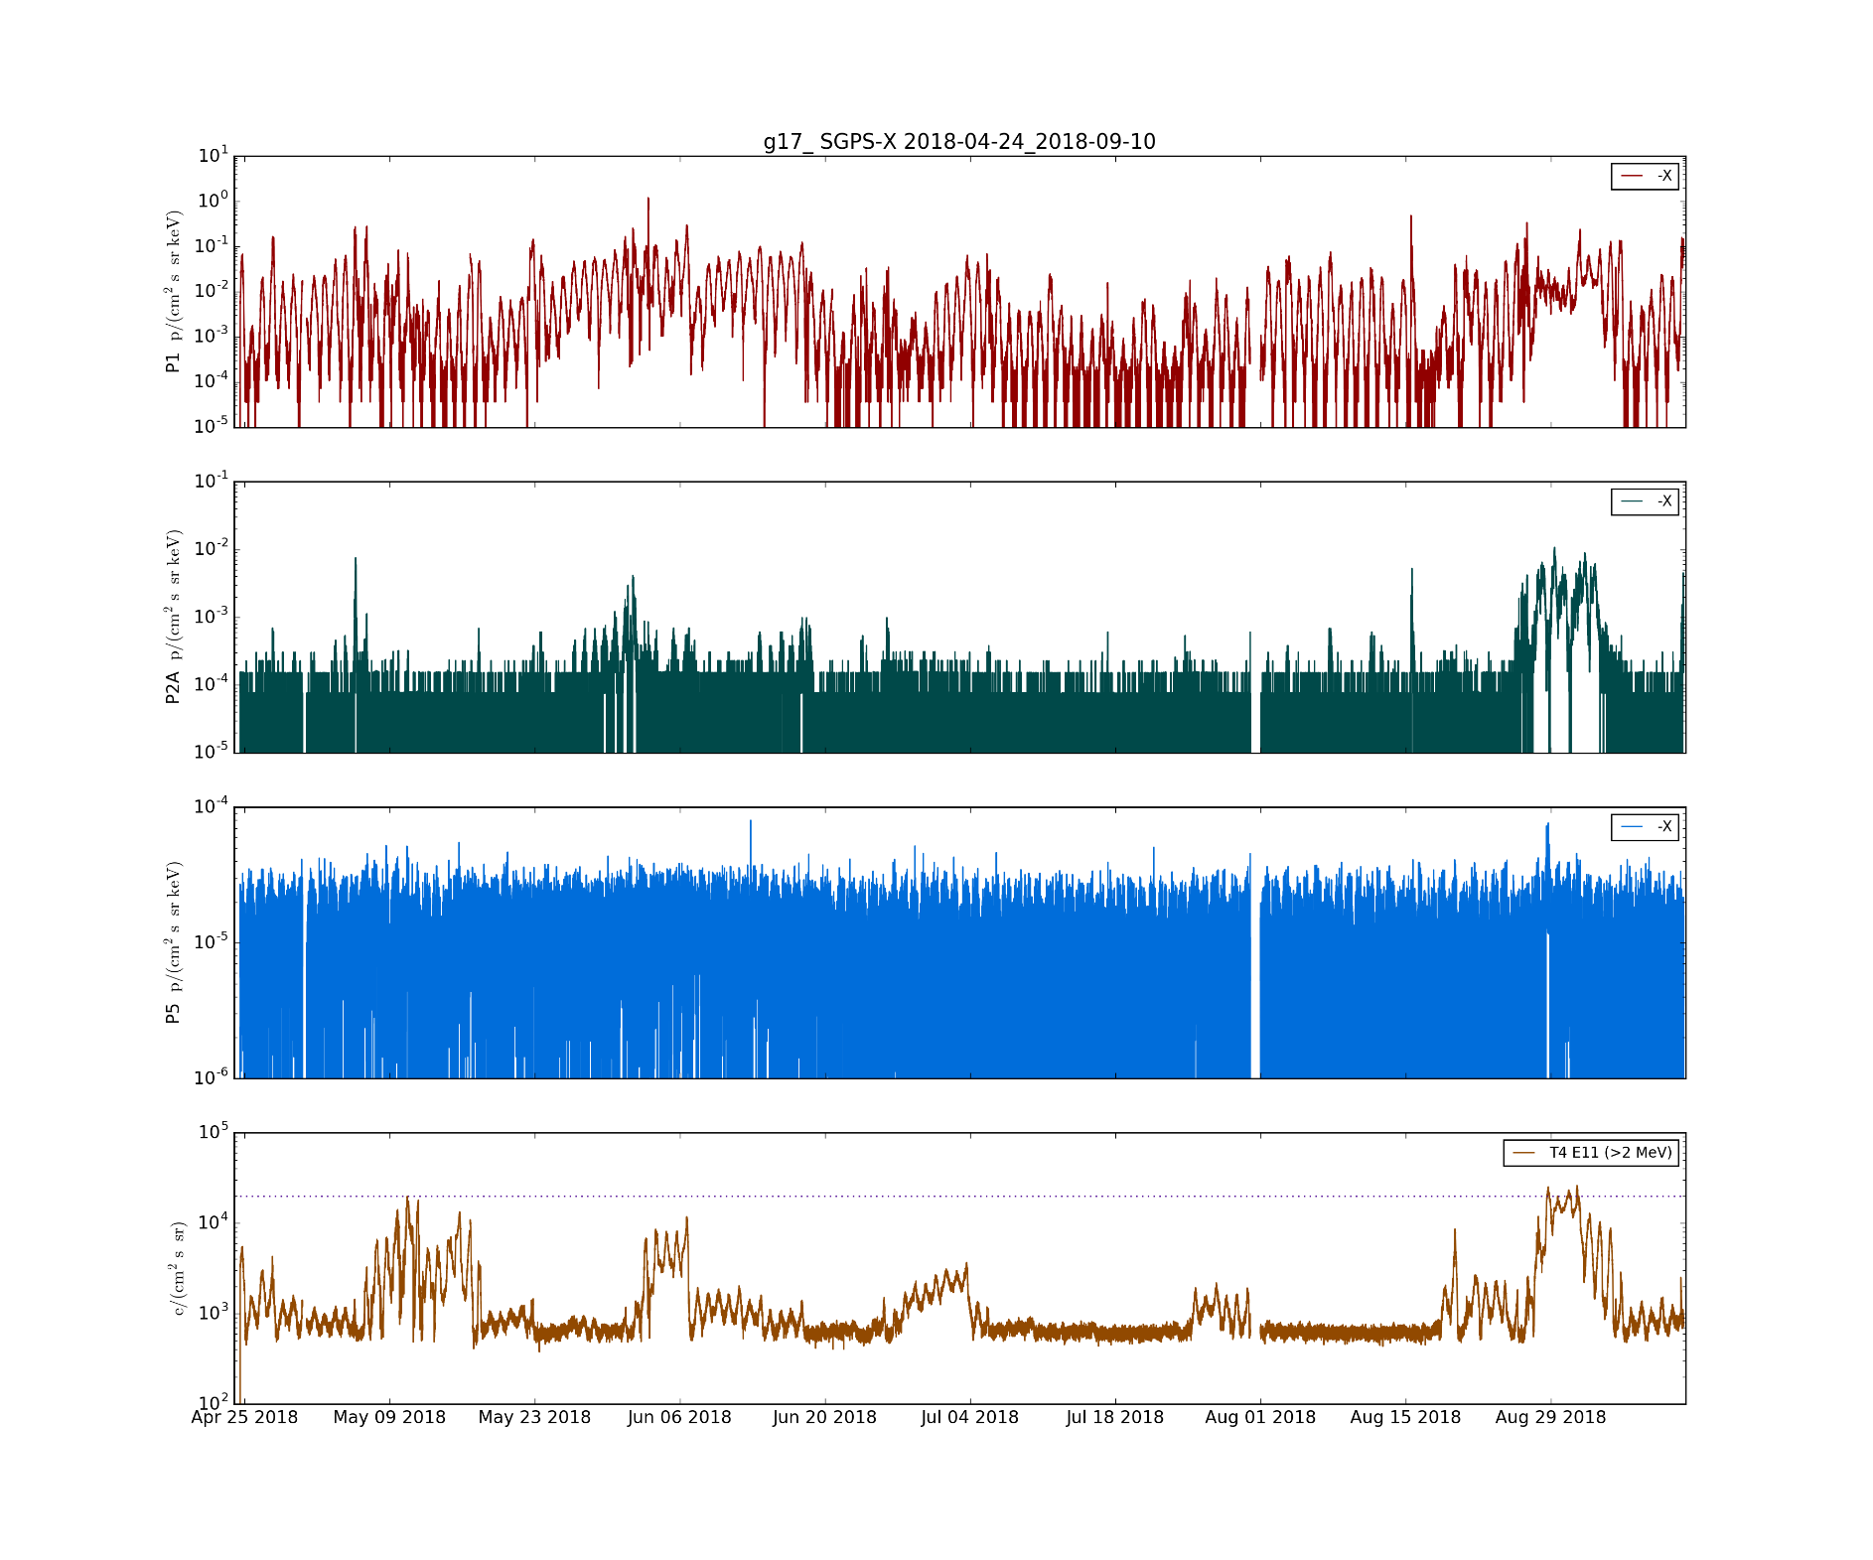
G17 SGPS P5 Electron Contamination
SGPS+X
P1
(1-2 MeV)
SGPS-X P1 p/(cm² s sr keV)
SGPS+X
P2A
(2-2.3 MeV)
SGPS-X P2A p/(cm² s sr keV)
SGPS+X
P5
(12-25 MeV)
SGPS-X P5 p/(cm² s sr keV)
Electron contamination
MPS-HI Tel.4 E11 >2 MeV e⁻/(cm² s sr)
Apr. 2017
May 2017
June 2017
These GOES-17 data are preliminary, non-operational data and are undergoing testing. Users bear all responsibility for inspecting the data prior to use and for the manner in which the data are utilized.

Slide 22
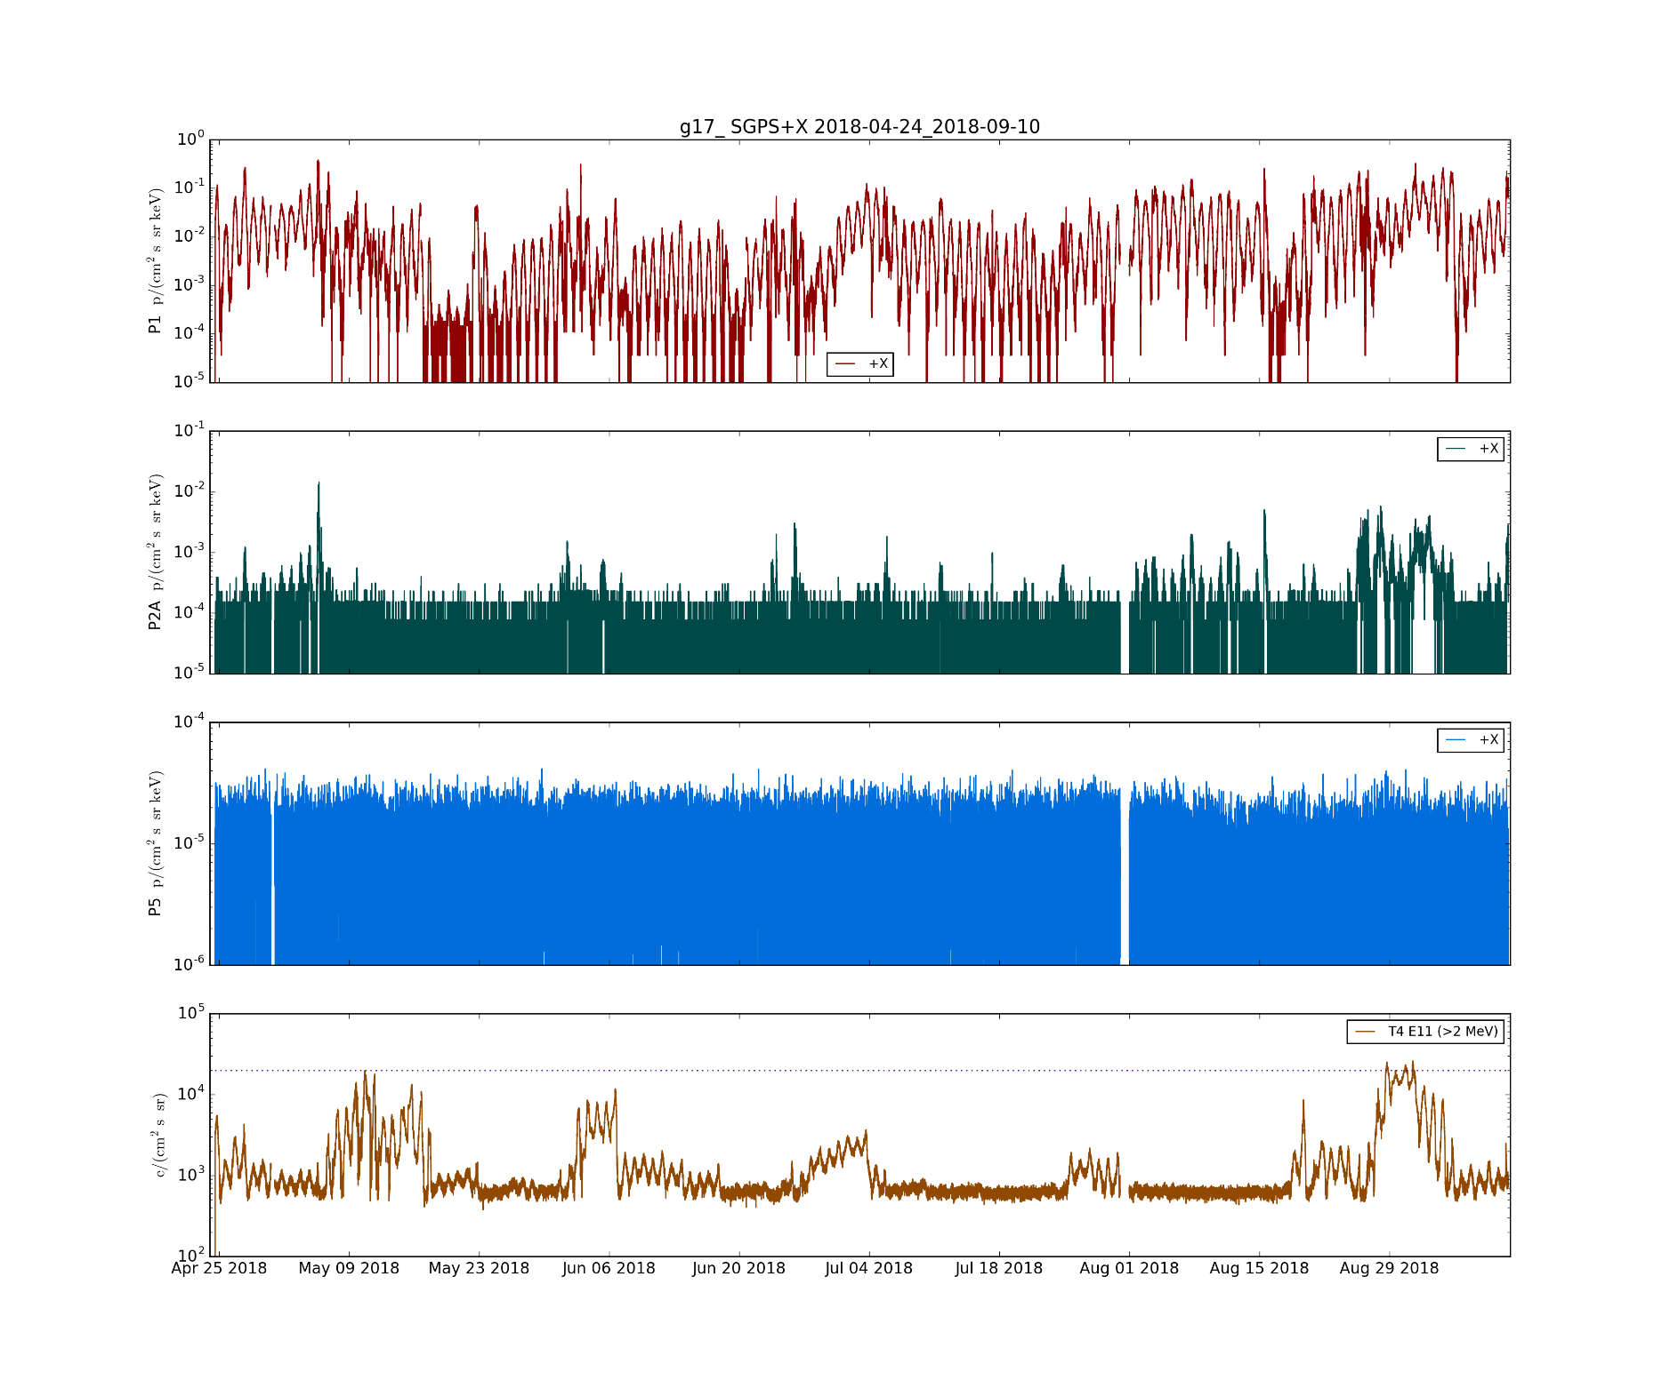
G17 SGPS P5 Electron Contamination
SGPS+X P1 p/(cm² s sr keV)
SGPS+X P2A p/(cm² s sr keV)
No electron contamination evident
SGPS+X P5 p/(cm² s sr keV)
MPS-HI Tel.4 E11 >2 MeV e⁻/(cm² s sr)
These GOES-17 data are preliminary, non-operational data and are undergoing testing. Users bear all responsibility for inspecting the data prior to use and for the manner in which the data are utilized.

Slide 23
PROVISIONAL MATURITY ASSESSMENT
GOES-17 SGPS L1b Product Provisional PS-PVR
These GOES-17 data are preliminary, non-operational data and are undergoing testing. Users bear all responsibility for inspecting the data prior to use and for the manner in which the data are utilized.

Slide 24
Instrument/GPA Issues Identified and Resolution Status
No G17 specific instrument or GPA issues have been identified independent of general GOES-R series SGPS issues
ADR 517, small but routine L1b gaps
SGPS+X P5 overcorrection (L1b processing/LUT issue)
Possible Electron contamination in SGPS+X P5 – Instrument issue, could be addressed with correction scheme using MPS-HI fluxes. No associated ADR yet.
ADRs/WRs Impacting Validation of G17 SGPS L1b
ADR# | WR# | Short Description | Status | Expected Closure
267 | 5370 | LUT Filenames not Traceable to Metadata | Closed | DO.07.00.00
676 | 6100 | G17 ground LUT has SGPS–X dead time = 8e+07 s instead of 8e-07 s. | Closed | w/ LUT change
900 | TBA | G16 & G17 SGPS P5 correction coe. LUT update | Submitted | w/ LUT change
517 | 5484 | Small but routine L1b gaps, mostly for SEISS. | Closed | Closed in DO.06.02​ and ​DO.06.03
TBA | TBA | Electron contamination in SGPS-X P5 | TBD if ADR is needed | TBD
Included in
beta review
These GOES-17 data are preliminary, non-operational data and are undergoing testing. Users bear all responsibility for inspecting the data prior to use and for the manner in which the data are utilized.

Slide 25
Provisional Validation
Preparation Activities | Assessment
Validation activities are ongoing and the general research community is now encouraged to participate. | Validation activities are ongoing. Results have been discussed with SWPC. Release of data by NCEI will enable research community participation.
Severe algorithm anomalies are identified and under analysis. Solutions to anomalies are in development and testing. | No additional GPA anomalies identified.
Incremental product improvements may still be occurring. | Product improvements will result from steps to mitigate known (on previous chart) and yet to be discovered anomalies.
These GOES-17 data are preliminary, non-operational data and are undergoing testing. Users bear all responsibility for inspecting the data prior to use and for the manner in which the data are utilized.

Slide 26
Provisional Validation
End State | Assessment
Product performance has been demonstrated through analysis of independent measurements obtained from select locations, periods, and associated ground truth or field campaign efforts. | Both units (SN103 and SN104) ground/beam calibrated. Additional validation will have to wait for a Solar Particle Event
Product analysis is sufficient to communicate product performance to users relative to expectations (Performance Baseline). | Yes, to the limited extent that the Performance Baseline can be verified without Solar Particle Event data.
Documentation of product performance exists that includes recommended remediation strategies for all anomalies and weaknesses. Any algorithm changes associated with severe anomalies have been documented, implemented, tested, and shared with the user community. | PUG and/or CDRL80 will need to be updated to reflect some changes, e.g., ADR427 Remove divide by two. A complete description of known anomalies will be included in readme file with release of data to public.
Testing has been fully documented. | In this presentation and supplemental materials.
Product is ready for operational use and for use in comprehensive cal/val activities and product optimization. | Readiness for operational use TBD at provisional PS-PVR review.
These GOES-17 data are preliminary, non-operational data and are undergoing testing. Users bear all responsibility for inspecting the data prior to use and for the manner in which the data are utilized.

Slide 27
PATH TO FULL VALIDATION MATURITY
GOES-17 SGPS L1b Product Provisional PS-PVR
These GOES-17 data are preliminary, non-operational data and are undergoing testing. Users bear all responsibility for inspecting the data prior to use and for the manner in which the data are utilized.

Slide 28
Path to Full Validation
ADRs/WRs to be resolved prior to Full Validation.
PLPTs to be conducted prior to Full Validation.
Performance Baseline status.
Risks to getting to Full, both from L1b product definition and user (SWPC) feedback
These GOES-17 data are preliminary, non-operational data and are undergoing testing. Users bear all responsibility for inspecting the data prior to use and for the manner in which the data are utilized.

Slide 29
ADRs/WRs Impacting Full Validation of G17 SGPS L1b
ADR# | WR# | Short Description | Status | Expected Closure
517 | 5484 | Small but routine L1b gaps, mostly for SEISS | Closed | DO.07.00.00
900 | TBA | SGPS P5 correction coefficients LUT update | Anticipated | TBD
TBA | TBA | Electron contamination in SGPS+X P5 | TBD if ADR is needed | TBD
Will need to analyze SEP event data with sufficient enhancement at energies >100 MeV to reach full validation – May find instrument and/or calibration anomalies.
These GOES-17 data are preliminary, non-operational data and are undergoing testing. Users bear all responsibility for inspecting the data prior to use and for the manner in which the data are utilized.

Slide 30
Path to Full Validation - PLPTs
Title | Activity | Data Needed | Success Criteria
A.2.4 SEP Channel Cross-Comparison [PLPT-SEI-004] * This is a Provisional PLPT | On-orbit cross-calibration of SEP channels. | One SPE with sufficient enhancement at energies >100 MeV for cross-calibration of SGPS T3. | Quantify difference in response of SEP channels.
A.3.3 SEP Channel Cross-Comparison [PLPT-SEI-004] | On-orbit cross-calibration of SGPS with EHIS above 10 MeV and MPS-HI with SGPS 1-12 MeV protons, and both SGPS units with GOES 13-15 EPEAD. | Two Solar Energetic Particle (SEP) events. | [Full] Differences quantified on data taken through validation phase.
A.3.5 Backgrounds Trending [PLPT-SEI-006] | Evaluate SGPS backgrounds in terms of expected galactic cosmic ray (GCR) fluxes. | Four months of continuous data. | [Full] Perform analysis during validation phase.
From RIMP v1.0 (02 June 2016)
Full PLPTs are ongoing continuations of Provisional PLPTs.
Need to analyze SEP event data with sufficient enhancement at energies >100 MeV to reach full validation.
These GOES-17 data are preliminary, non-operational data and are undergoing testing. Users bear all responsibility for inspecting the data prior to use and for the manner in which the data are utilized.

Slide 31
G17 SGPS Performance Baseline Status
MRD ID | Description | Related PLPTs | Status
MRD2005 | Product Orthogonality/Coverage | -04, -06 | Requirement met
MRD2009 | Product Measurement Range | -04, -06 | Requirement met
MRD2010 | Product Measurement Accuracy | -04, -06 | Ground calibrations meet 25/45% Accuracy requirement. On-orbit tests are ongoing.
MRD2005: Orthogonality/Coverage
Requirement: 2 directions
Currently being met
MRD2009: Measurement Range:
Requirement: Protons: 1 MeV - 500 MeV, > 500 MeV
SEP Channel Cross-comparisons with legacy instruments on GOES-13 and -15 indicate that energy range is being covered.
MRD2010: Measurement Accuracy
Requirements: 25% when flux level above background is greater than 10x minimum flux; 45% when flux level above background is between minimum flux and 10x minimum flux
Absolute accuracy cannot be verified on-orbit
These GOES-17 data are preliminary, non-operational data and are undergoing testing. Users bear all responsibility for inspecting the data prior to use and for the manner in which the data are utilized.

Slide 32
Path to Full Validation – Risks
Risk Name | Description | Impact | Mitigation and Schedule
Need to complete PLPT-SEI-004 SEP Channel Cross-Comparison | Analysis of solar particle event data needed to verify all channels are working as expected. | Overall instrument performance unknown without on-orbit solar particle measurements. | Wait for solar particle event.
SGPS+X P5 overcorrection in L1b processing | Overcorrection in SGPS P5 out-of-band removal. | Will degrade accuracy of reported fluxes and Solar Proton Event monitoring. | Perform analysis (NCEI or ATC) and update coefficients in LUT. Should be done prior to full validation, but additional SEP events needed for adequate analysis.
Electron contamination in G17 SGPS P5 | Electron contamination in SGPS+X P5 – full impact yet to be evaluated. | Will degrade accuracy of reported fluxes and Solar Proton Event monitoring. | Full impact of this needs to be evaluated and correction scheme developed if necessary.
L1b data gaps/dropouts | Almost every day, a handful of L1b files are missing for SEISS's EHIS, MPSL, and MPSH instruments. | May lose critical Solar Proton Event data. | ADR 517 closed, but we still occasionally have missing L1b data – Need to document cases and possibly submit another ADR.
Applies to all: Mitigation: Assess impacts on data accuracy and SPE detection prior to full validation.
These GOES-17 data are preliminary, non-operational data and are undergoing testing. Users bear all responsibility for inspecting the data prior to use and for the manner in which the data are utilized.

Slide 33
SUMMARY & RECOMMENDATIONS
GOES-17 SGPS L1b Products Provisional PS-PVR
These GOES-17 data are preliminary, non-operational data and are undergoing testing. Users bear all responsibility for inspecting the data prior to use and for the manner in which the data are utilized.

Slide 34
Summary
There are no known problems with G17 SGPS channels aside from general GOES-R series SGPS issues being worked (e.g., P5 overcorrection in L1b processing).
The lack of a solar energetic particle (SEP) event has prevented us from testing the response of SGPS under the conditions that SWPC uses the data for their alerts. G17 SGPS instrument and calibration anomalies will be unknown until G17 SGPS solar particle event data can be analyzed.
G16 SGPS instrument/channel anomalies are
Temperature Dependence in SGPS-X T1 & T3
SGPS+X P7 count rate anomalously low
Electron contamination in SGPS+X P5
G17 SGPS does not exhibit significant temperature dependence. G16 SGPS P7 low count rate and P5 Electron contamination are G16 full validation items.
There is no reason to expect significant instrument issues with more than one or two G17 SGPS channels (e.g., as with G16 SGPS+X P7 and P5)
Need to analyze SEP event data with sufficient enhancement at energies >100 MeV to reach full validation.
These GOES-17 data are preliminary, non-operational data and are undergoing testing. Users bear all responsibility for inspecting the data prior to use and for the manner in which the data are utilized.

Slide 35
Recommendations
NCEI recommends G17 SGPS L1b data for transition to provisional status with the caveat that G16 SGPS be relied on for Solar Particle Event (SPE) Detection until analysis of G17 SGPS SPE data is performed.
The SPE Detection code uses integral flux computed by fitting a power law to SGPS’s 13 differential channels plus the >500 MeV integral channel flux. Three recommended steps to mitigate the effect of anomalous channels are
Temperature correction downstream of L1b processing.
Implement an option to remove any particular channel from the integral flux calculation and event detection in L2 processing.
Implement an option to use any combination of SGPS+X and SGPS-X channels in a single integral flux calculation and event detection.
(In current L2 processing, event detection is done separately for each unit.)
These GOES-17 data are preliminary, non-operational data and are undergoing testing. Users bear all responsibility for inspecting the data prior to use and for the manner in which the data are utilized.

Slide 36
BACKUP SLIDES
GOES-17 SGPS L1b Product Provisional PS-PVR
These GOES-17 data are preliminary, non-operational data and are undergoing testing. Users bear all responsibility for inspecting the data prior to use and for the manner in which the data are utilized.

Slide 37
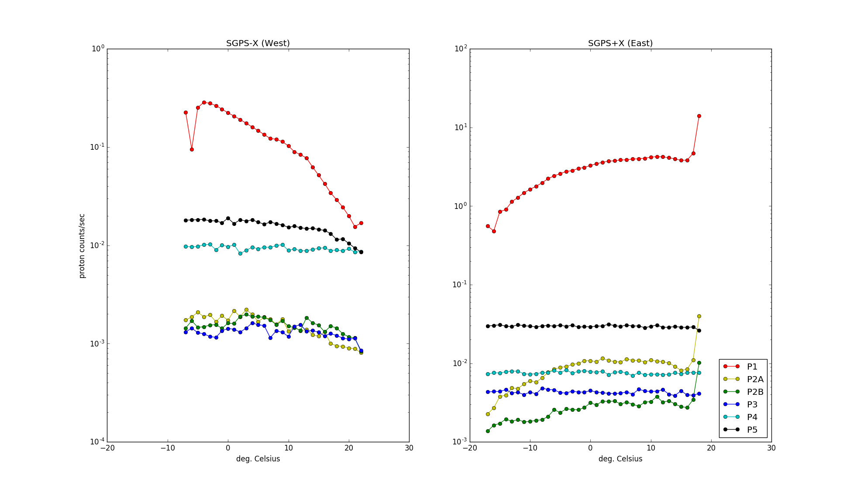
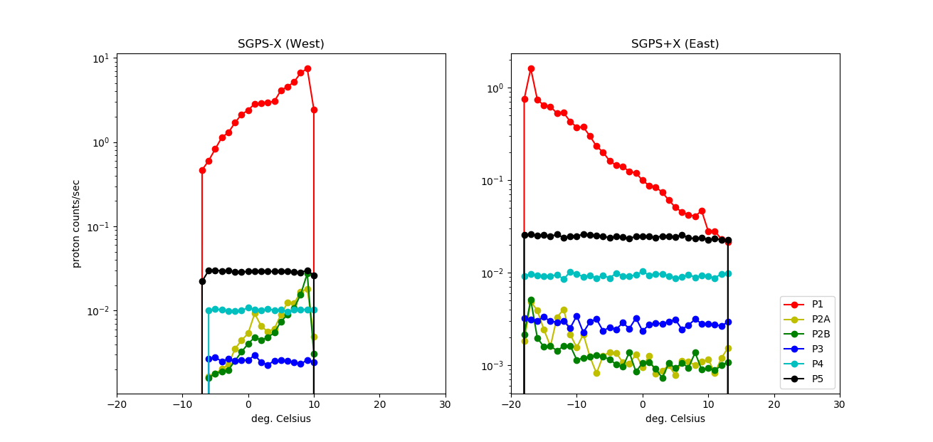
Counts/sec in 1ºC Temperature Bins
GOES-16
45 day averages of counts/sec, from G16 SGPS L0 data, in 1º temperature bins between -20º and +30º C.
Apparent temperature dependence in SGPS+X P1, P2A and P2B (right panel) is because of LT dependence on temperature. LT and temperature dependence are mixed in SGPS-X P1, P2A and P2B (left panel).
P5 has no LT dependence, thus P5 variation in SGPS-X due solely to temp. dependence, showing a drop in counts/sec at approximately 12ºC.
GOES-17
24 day averages of counts/sec, from G17 SGPS L0 data, in 1º temperature bins.
Apparent temperature dependence in SGPS+X P1, P2A and P2B (right panel) is because of LT dependence on temperature. There is no temperature dependence in P3, P4 and P5 and no apparent temperature dependence in P1, P2A and P2B.

Slide 38
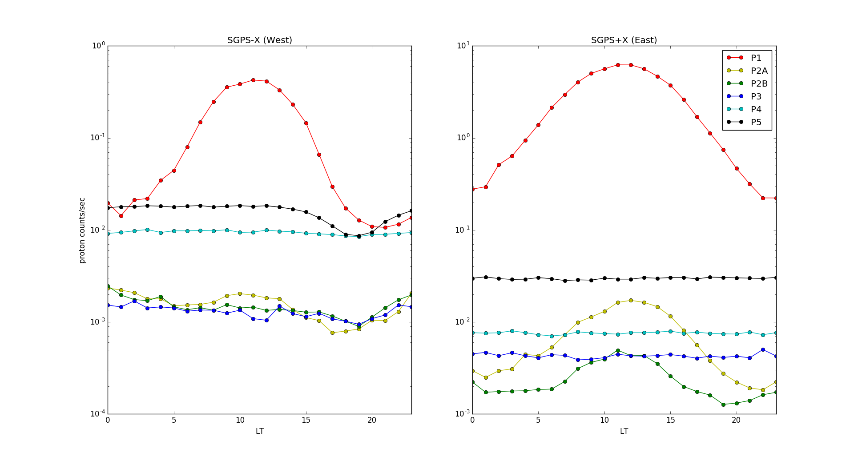
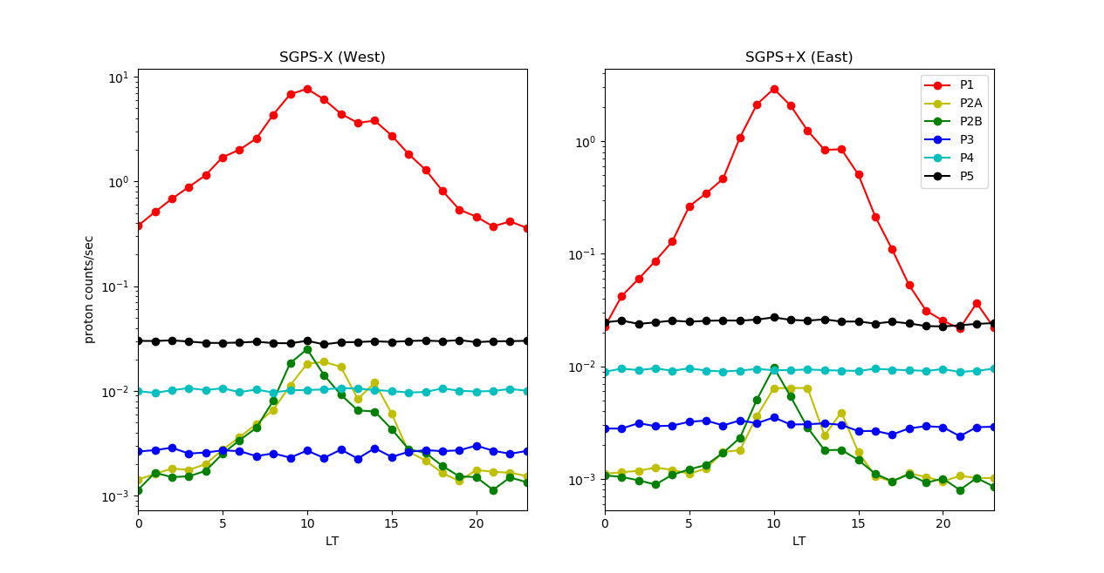
Counts/sec binned in LT
GOES-16
45 day averages of counts/sec in 1 hour local-time (LT) bins. P1, P2A and P2B in +X (right panel) have maxima at noon LT due to natural/geomagnetic effect of compressed magnetosphere. There is not LT dependence in P3, P4 and P5. SGPS-X (left panel) has a dip in fluxes near 18 LT, in all but P4.
GOES-17
24 day averages of counts/sec in 1 hour local-time (LT) bins. P1, P2A and P2B in +X (right panel) have maxima at noon LT due to natural/geomagnetic effect of compressed magnetosphere. There is not LT dependence in P3, P4 and P5.

Slide 39
Errata
Modifications to G17_SEISS_SGPS_Provisional_PSPVR_v2.pptx (presented version) to generate this version, G17_SEISS_SGPS_Provisional_PSPVR_v4.pptx (for the record version)
Slide 22: Changed SGPS-X to SGPS+X in legends in top 3 panels of figure.
Slide 24: changed “ADRs/WRs Impacting Provisional Validation of L1b” to “ADRs/WRs Impacting Validation of G17 SGPS L1b”.
Slide 29: ADR# for 2nd item in table “TBA” changed to “900”.
“Differences up to a factor of two are found for some channels in SEP Channel Cross-comparisons with GOES-13 and -15, excepting channels with known anomalies.” is deleted from the bottom of slide 31.
Finally, Addition of this errata to the backup slides.
* This presentation does not contain a complete list of ADRs/WRs needed for SEISS full validation (i.e., impacting some or all SEISS instruments, available on Clearquest). The ADRs/WRs noted are G17 SGPS instrument issues critical to G17 SGPS full validation.

