Slide 1
Peer Stakeholder-Product Validation Review (PS-PVR)
GOES 18 EXIS XRS: User Perspective
1 December 2023
Rodney Viereck
University of Colorado, CIRES
NOAA/NWS Space Weather Prediction Center
Outline:
Sensors
Applications
Issues
Status
Special Presentation: Space Weather Today
Notes:
based on PLT reports from LASP

Slide 2
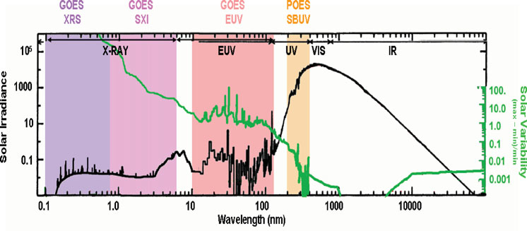
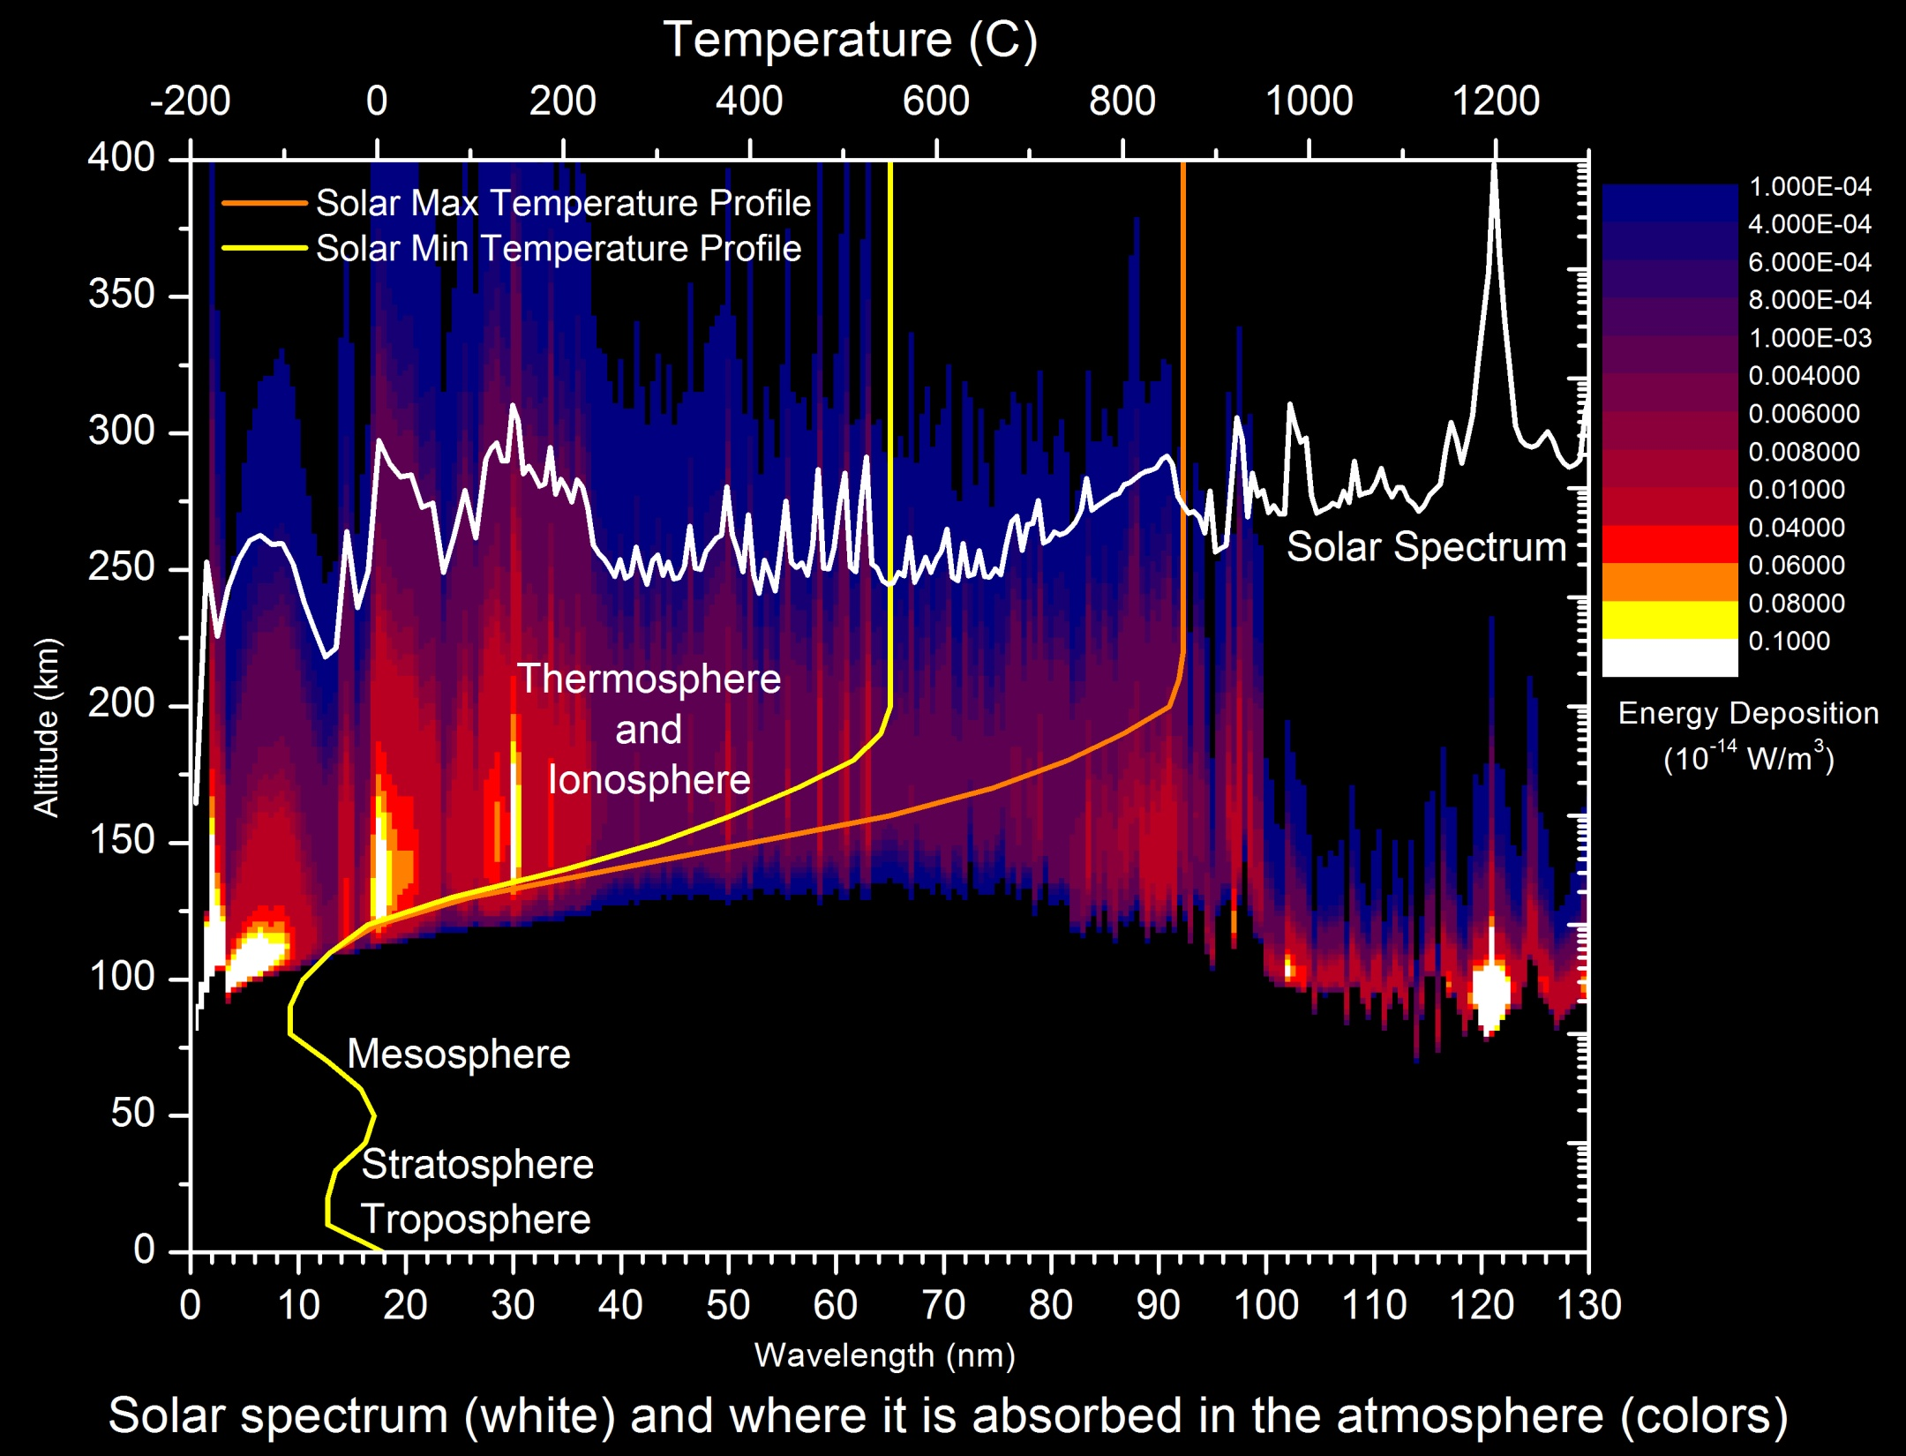
Solar X-Ray and EUV Irradiance
Highly Variable
X-Ray Variations of order 10⁵
EUV Variations of order 2 to 50
Absorbed in the Upper Atmosphere
Between 80 and 1000 km.
Results in very large changes in the thermosphere (neutral density) and ionosphere (electron density)
Direct Impacts:
Radio communication
Satellite orbits and drag
Indirect Impacts
Satellite navigation (GPS)
Other space weather (geomagnetic storms and solar radiation storms)
Plot from Lean (NRL)

Slide 3
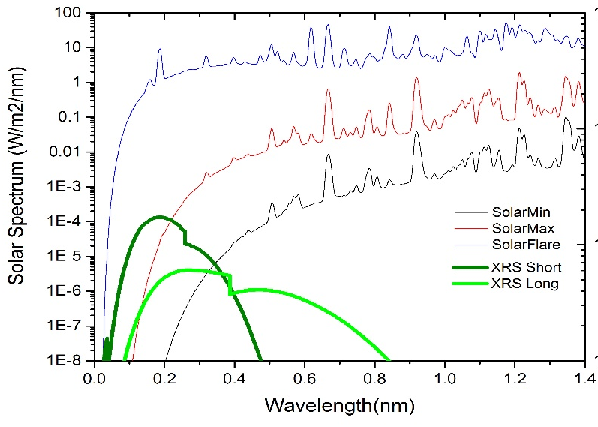
GOES Solar X-Ray Sensor (XRS)
Provide measurement of the magnitude and location* of solar flares.
Requirements: Monitor the disk-integrated solar flux in two x-ray wavelengths.
XRSA 0.05 nm – 0.4 nm
XRSB 0.1 nm – 0.8 nm
Three second cadence
10 second latency (actual latency is 30 sec.)
Solar X-Rays:
Change by several orders of
magnitude in just a few minutes.
Are absorbed in the lower ionosphere
where the flare enhanced electron
density blocks HF communication.
* Note: Flare location is new to the GOES R series XRS.

Slide 4
Applications of the XRS .
Nearly 50-years of continuous measurement of solar x-ray irradiance.
Definitive measurement of the magnitude of solar flares.
Critical for operations.
Fundamental for solar research.
Early warning for other space weather.
Most major space weather events start with a large solar flare.
Flare location and magnitude provide an estimate of the geo-effectiveness of an event.
The size of a flare is strongly correlated with the magnitude of the resulting major space weather… e.g. solar proton events and geomagnetic storms.
The XRS data drive one of the three NOAA Space Weather Scales.
R-Scale or Radio Blackouts - driven GOES solar x-rays
S-Scale or Solar Radiation Storm – driven by GOES solar protons
G-Scale or Geomagnetic Storm – Driven by USGS ground magnetometers
Input to Space Weather Models
D-Region Absorption Model (Specification of HF Radio Blackouts)
Proton Prediction Model (Prediction of Radiation Storms).
Ionosphere/Thermosphere models (to be added soon)

Slide 5
XRS Issues:
Data latency
GOES XRS 1-second data have latency of more than 30 seconds (due to data aggregation in the GRB).
Impact: major (modifications to correct this are under consideration)
Electron contamination
GOES XRS data have significant electron contamination.
Impact: minor with correction that is currently implemented.
Proton contamination
GOES XRS data have significant
proton contamination.
Impact: minor (when corrected)
Need a few good proton events to further quantify the correction parameters.

Slide 6
GOES XRS Status
GOES 16 is currently the primary for XRS sensors for operations.
GOES 17 XRS is turned off (standby?)
GOES 18 XRS data have been used in operations for nearly a year
Sensor performance is good.
Software to generate Level 2+ products is running on the NWS operational IDP system. XRS data and products look good.
Parameters for more accurate proton contamination correction probably still needs to be implemented in the L2 software.
GOES 18 XRS data are ready to be made operational (officially)

Slide 7
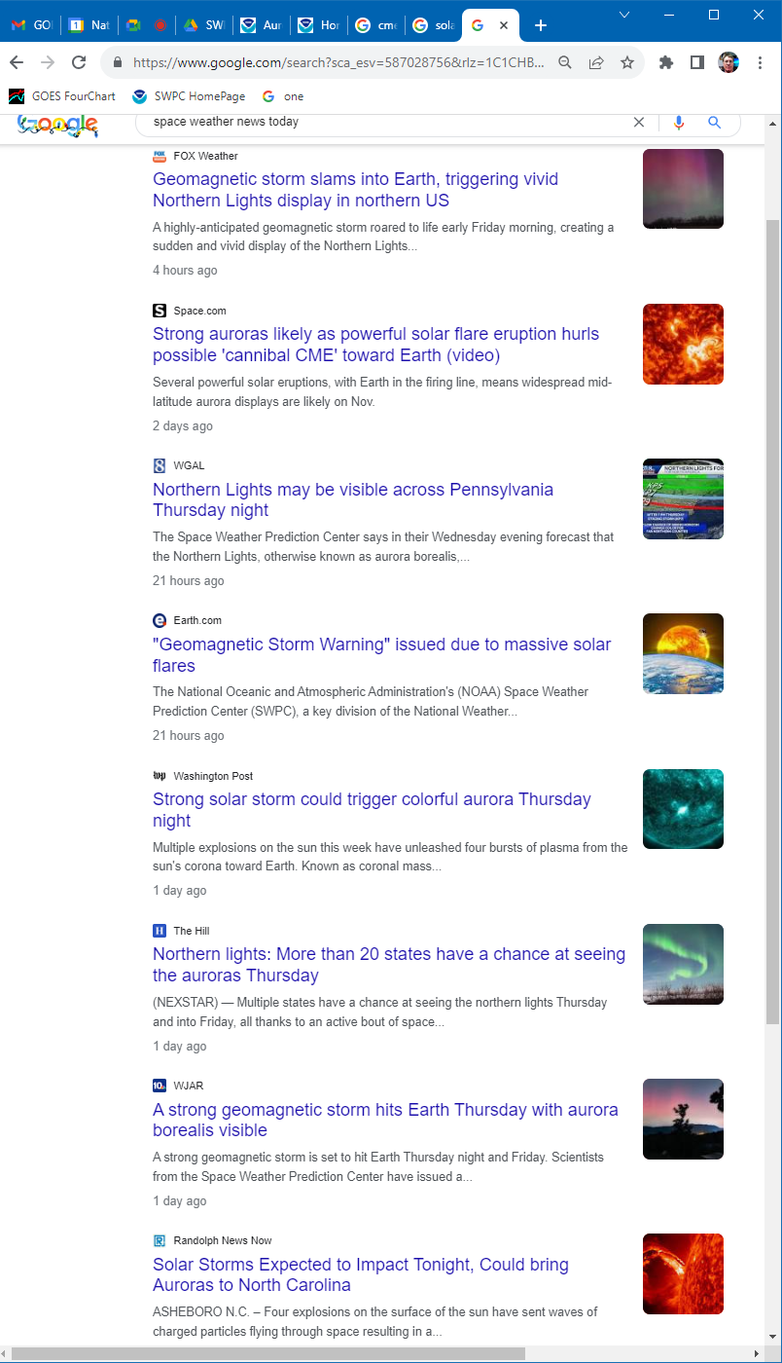
Space Weather in the News Today

Slide 8
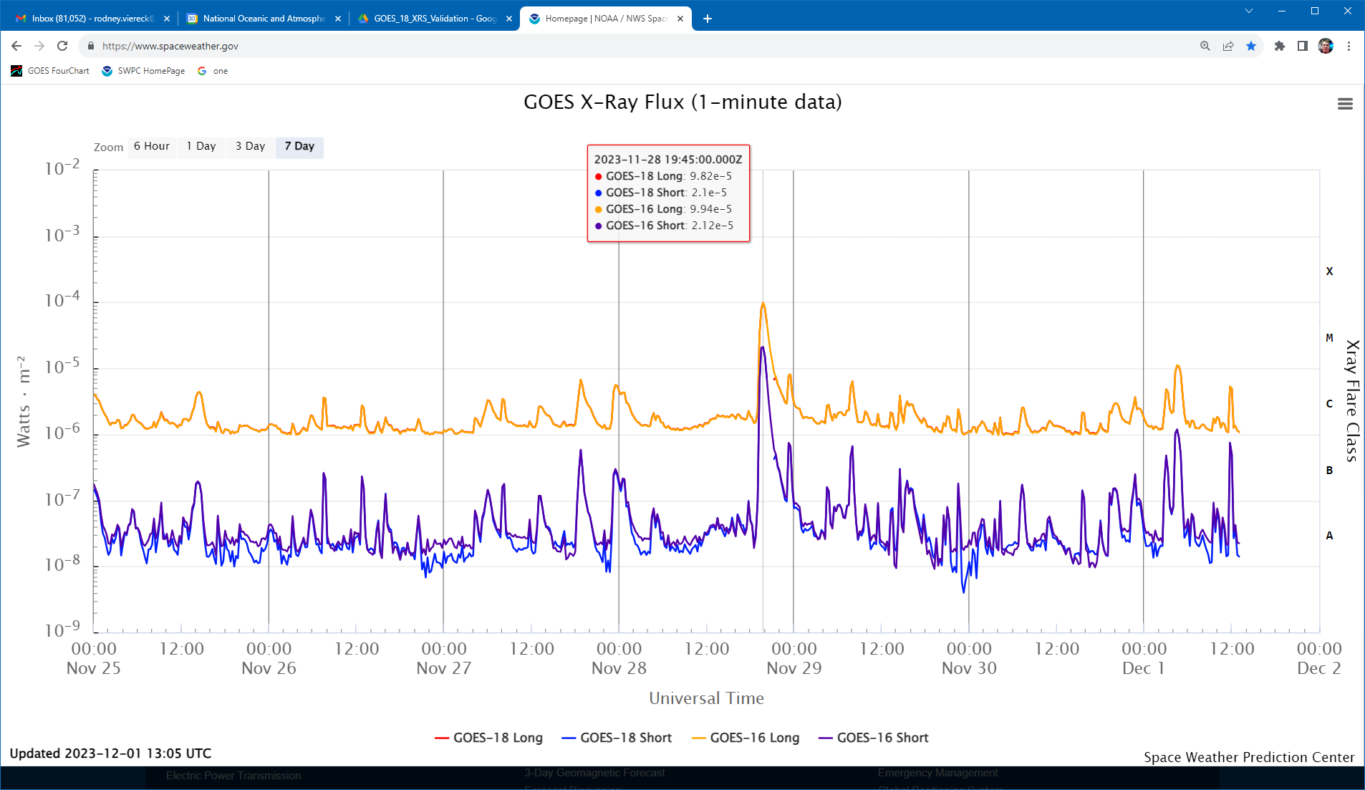
Today’s Space Weather
Seven days of GOES XRS Data
Note M9.9 Flare
Also note the smaller flares on the 7th-28th
Simultaneous with the detection of the flare, the GOES XRS also provides the flare location.
Note excellent agreement between GOES 16 and GOES 18

Slide 9
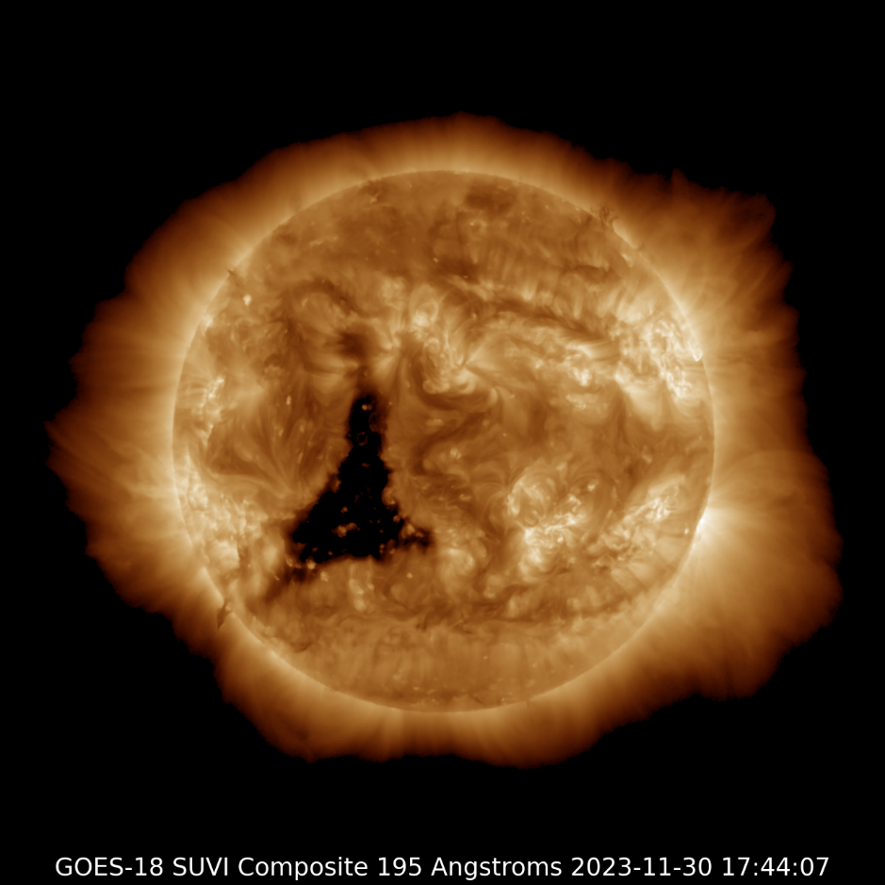
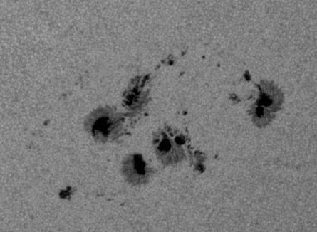
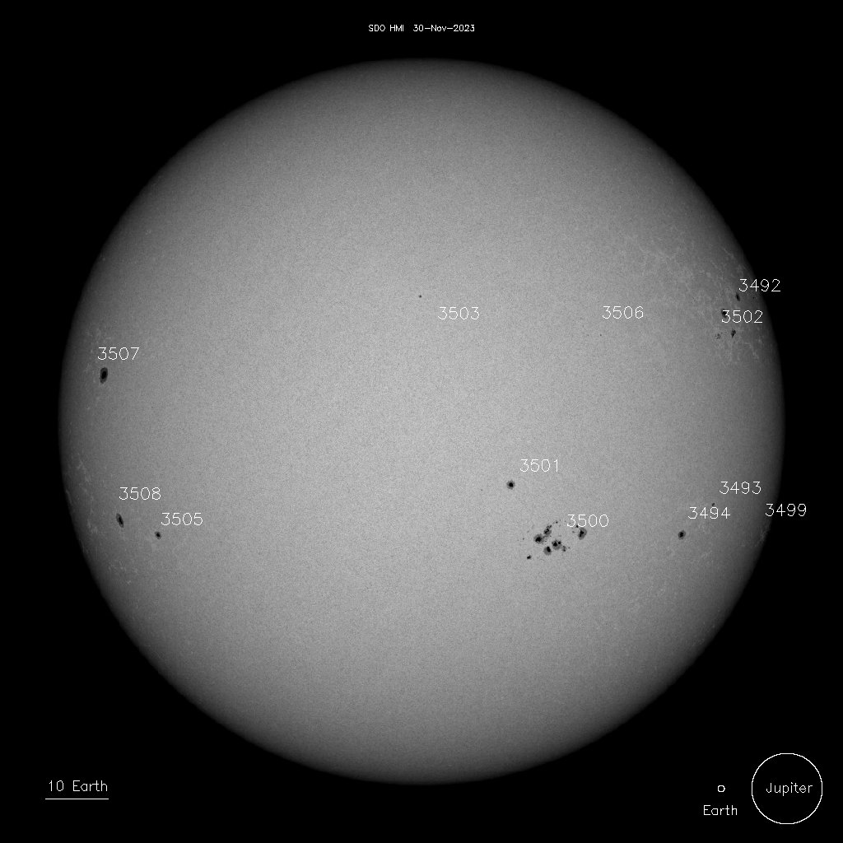
The EUV and Visible Sun

Slide 10
First Impact: HF Radio Blackout NOAA Space Weather R-Scale from 1 to 5

Slide 11
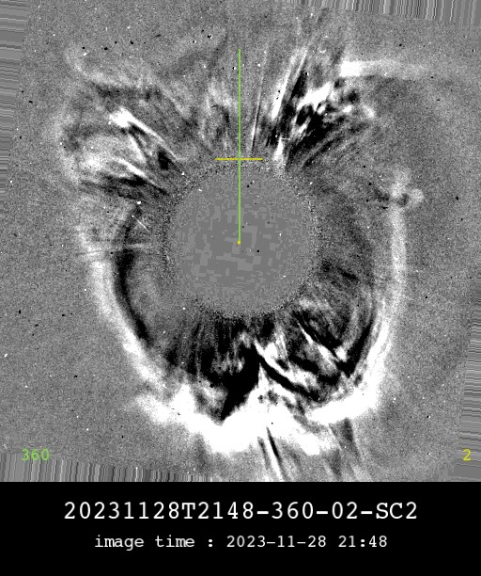
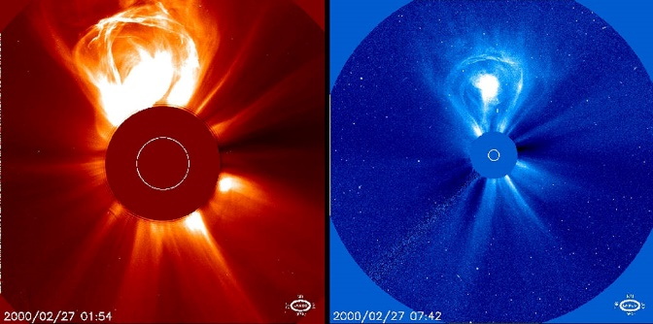
Next Event: The Coronal Mass Ejection (CME)
Earth Directed Halo
Data are analyzed to determine size, direction, and speed of CME
Traveling about 815 km/sec
Sun-Earth 150 Million km
52 hour travel time
Estimated arrival early on 1 December (today!)
Full Halo CME
A different CME going away from Earth
SOHO LASCO Image
Note SOHO was launched in 1996

Slide 12
Sizes and Distances
Total Perspective Vortex
(Hitchhikers Guide to the Galaxy)
Sun to Earth Travel Times
Light – 8 Minutes
Protons – 30 Minutes
CME – 20 Hours (fast CME)
Earth
0.012 Million km
0.0079 Million Miles
CME
80 Million km
50 Million Miles
L1
Sun
1.38 Million km
0.86 Million Miles
.
Magnetosphere
6.3 Million km
4 Million Miles
Sun to Earth
147 Million km
92 Million Miles

Slide 13
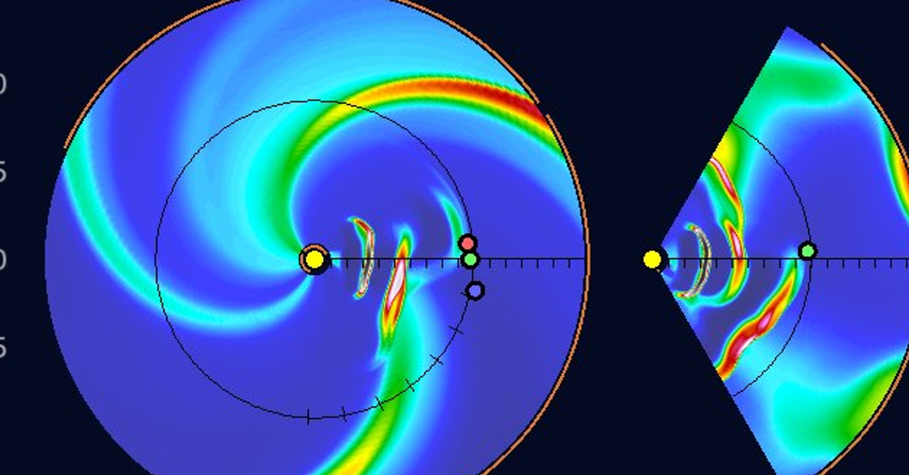
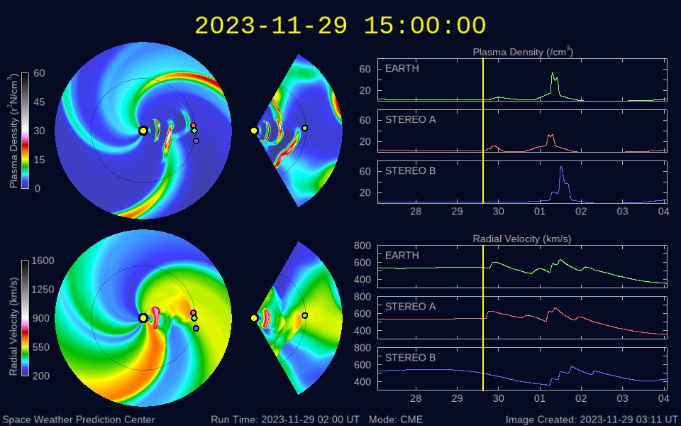
Space Wx/Ops: WSA Enlil Solar Wind Model Multiple CMEs “Canibal CMEs”
CME “Cone” TRACKER
CME1 : Early 27 Nov filament eruption from SW
CME2 : Late 27 Nov eruption to SE associated with flaring near N20E15
CME3 : Late 27 Nov partial halo CME associated with flaring from AR 3503 and subsequent filament eruption
CME4: M9.8 flare from AR 3500 on 28 Nov associated with full halo CME
Top View
Side View
Density
CME4
CME1
CME2+3+4
Sun
CME2+ 3
Earth
Density
Velocity
FORECAST from 29 November

Slide 14
Wang-Sheeley-Arge Enlil Model Ambient solar wind with added CMEs

Slide 15
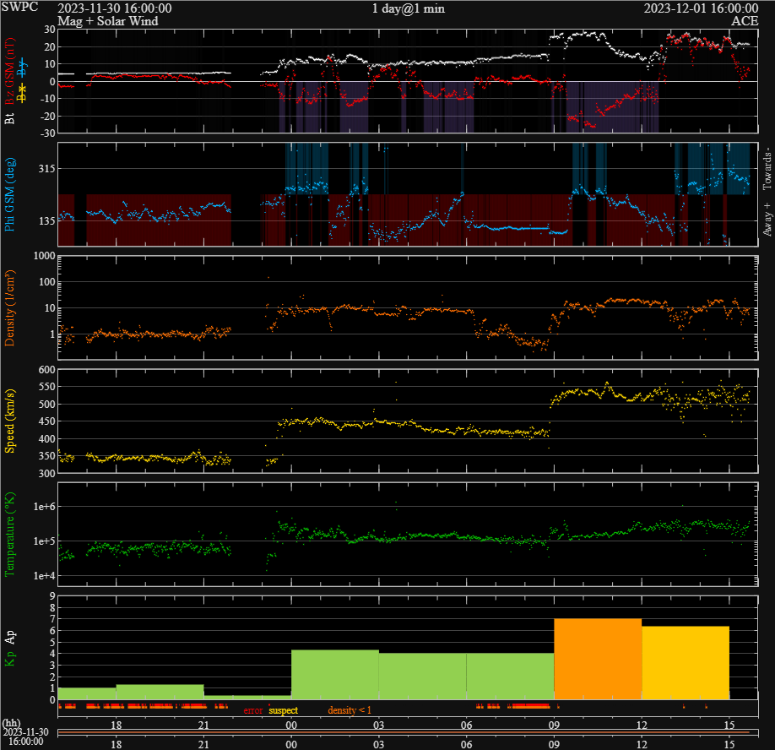
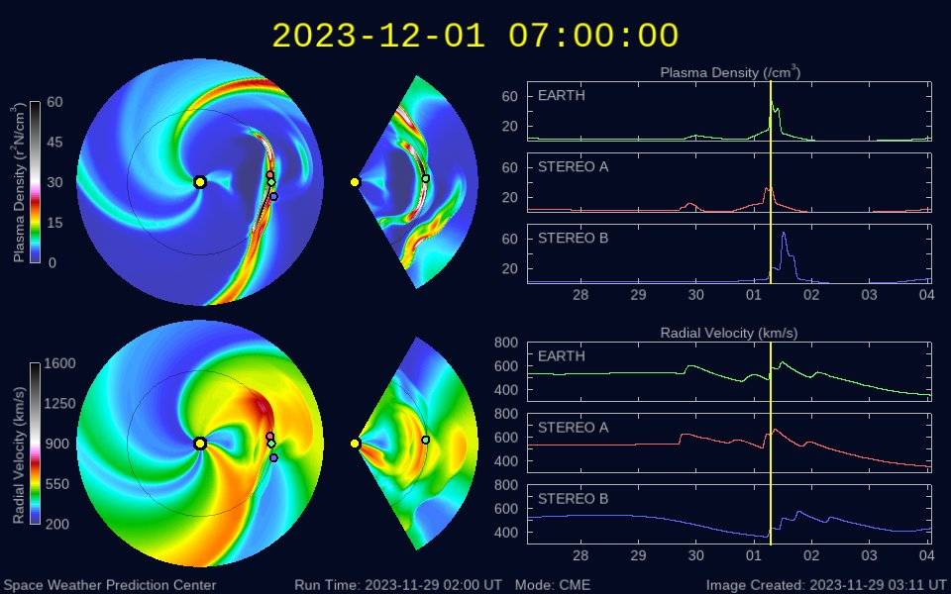
Forecast Verification: Arrival within a few hours of prediction. Geomagnetic Storm Magnitude Accurately Forecasted.
28 Nov CME from M9.9 flare
Initial CME
Halo CME arrival
Nov 30 2335z
Dec 01 0853z

Slide 16
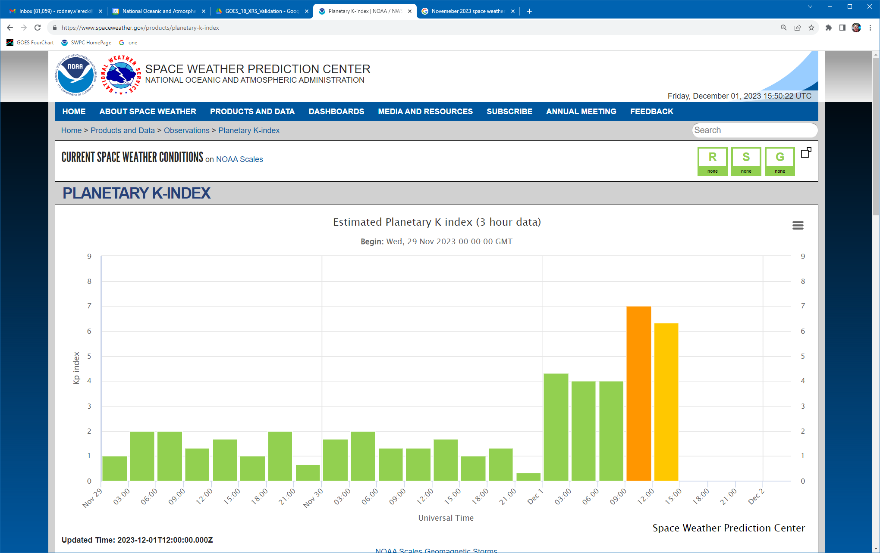
Planetary K Index (Kp) A measure of the disturbance of Earth’s Magnetic Field

Slide 17
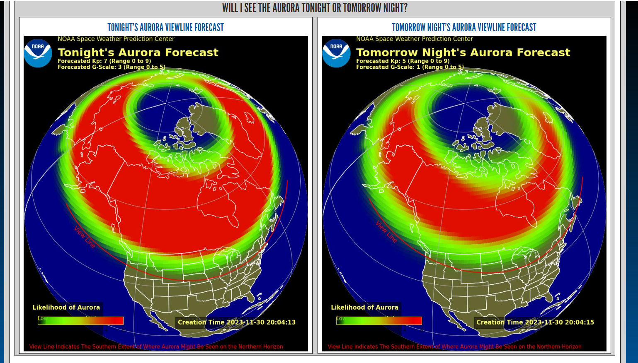
Yesterday’s Aurora Forecast Assumes CME arrival near midnight in the US
Last Night’s
Tonight’s

Slide 18
Last Night’s Aurora
Aurora Movie
https://www.spaceweather.gov/products/aurora-30-minute-forecast

Slide 19
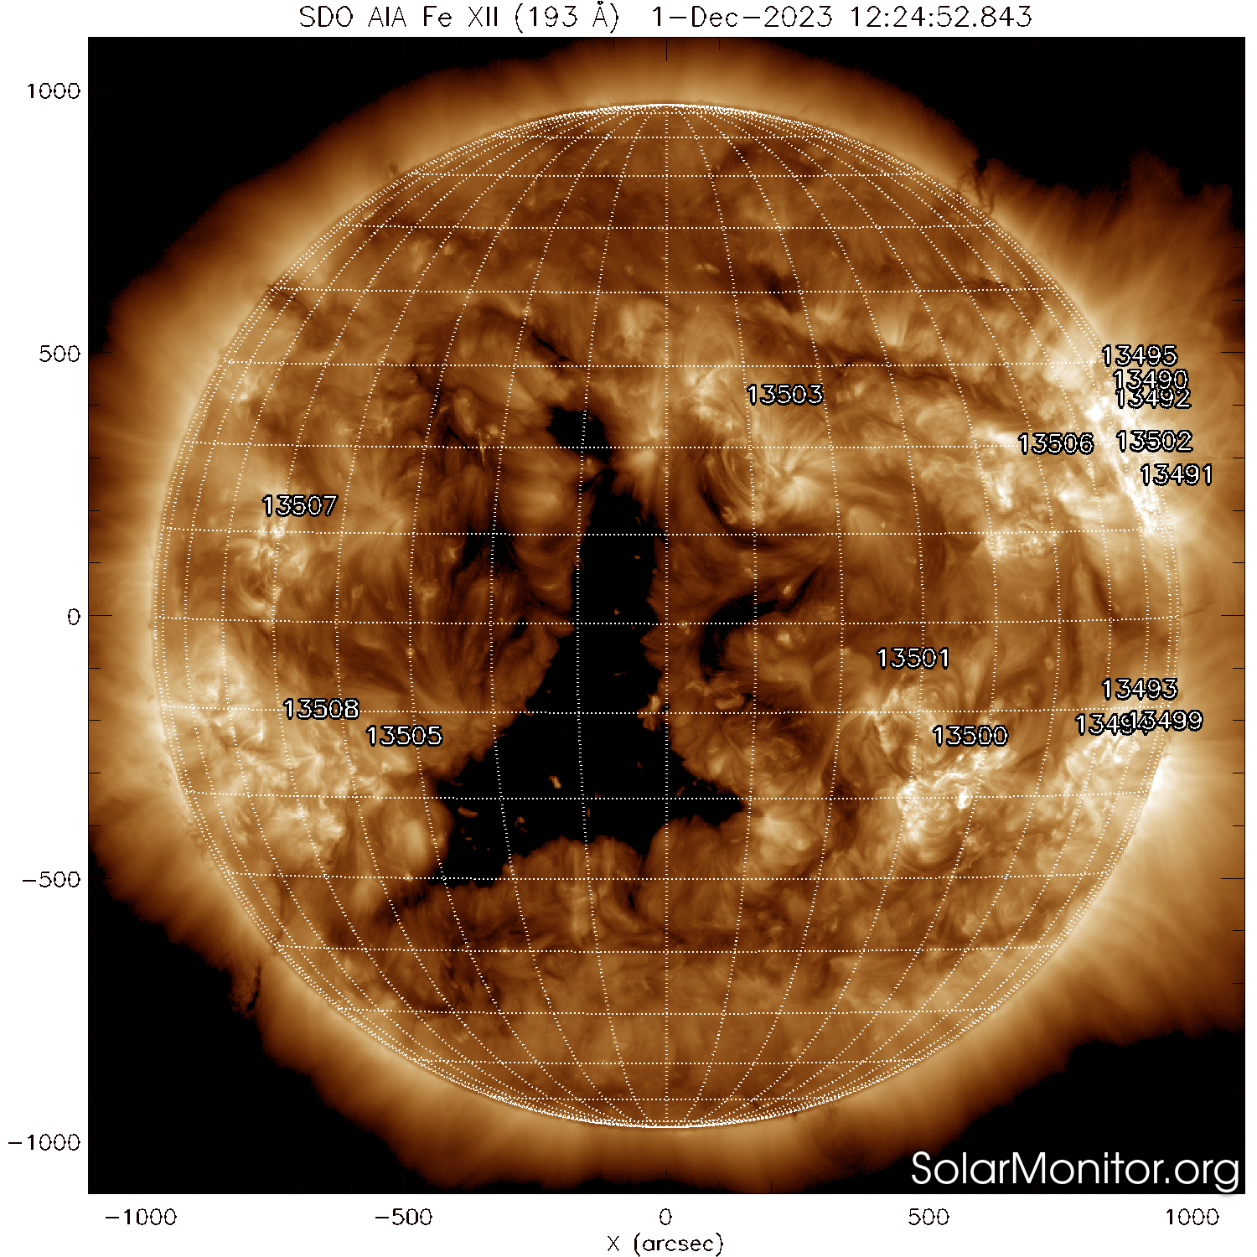
Space Wx/Ops: 3 Day Forecast for Today (1 Dec)
Day | Ap | Max Kp | F10.7 | M% | X% | Proton%
01 Dec | 50 | 7 (CME) | 165 | 35 | 10 | 15
02 Dec | 22 | 5 (CME) | 160 | 35 | 10 | 15
03 Dec | 10 | 3 | 160 | 35 | 10 | 15
04 Dec | 12 | 4 | 160 | 35 | 10 | 15
CME in progress and likely to continue into 02 Dec.
(-)CH76 due on 05 Dec. G1-G2 Possible.
M1 flare at 01/0439z from Rgn 3502.

Slide 20
Questions?

