Slide 1
Peer Stakeholder-Product Validation Review (PS-PVR) For the Provisional Maturity of GOES-18 SEISS MPS-HI L1b Product
October 11, 2022
GOES-R Calibration Working Group (CWG)
Presenter: Athanasios Boudouridis
Contributors: Juan Rodriguez, Brian Kress, Kevin Hallock, William Rowland
CIRES and NOAA NCEI
The NCEI team wish to thank the MPS-HI vendor Assurance Technology Corporation, the MIT Lincoln Labs, the Space Weather Prediction Center, and the GOES-R Program

Slide 2
Outline
Introduction
Review of Beta Maturity
Beta PLTs
ADR/WR status
Product Quality Evaluation
PLPTs for Provisional Maturity
Status at Provisional Validation Review
Discussion of additional considerations
Provisional Maturity Assessment
Status
Performance
Risks
Path to Full Validation Maturity
Summary and Recommendations
Backup Slides

Slide 3
GOES-R program
Satellites launched to date:
GOES-16 (R): launched 19 November 2016
GOES-East (75.2ºW) since 18 December 2017
GOES-17 (S): launched 01 March 2018
GOES-West (137.2ºW) since 12 February 2019
GOES-18 (T): launched 01 March 2022
Currently undergoing post-launch product tests
Each GOES-R-series observatory carries a Space Environment In-Situ Suite (SEISS)
GOES-18 SEISS turned on 25 April 2022

Slide 4
Magnetospheric Particle Sensor – High Energy (MPS-HI)
MRD 3.3.6.1.3 Magnetospheric Electrons and Protons: Medium and High Energy
Primary purpose: measure radiation belt particle fluxes in the energy range responsible for internal charging
5 electron telescopes and 5 proton telescopes
30 deg full-width conical FOVs, centers separated by 35 deg
Each electron telescope:
10 differential channels, 50 keV – 4 MeV
2 integral channels, >2 MeV and >4 MeV (latter not part of L1b)
Each proton telescope:
11 differential channels
7 channels, 80 keV – 1 MeV (trapped)
4 channels, 1-12 MeV (solar protons)
Two dosimeters (250 and 100 mil Al)
Distinguish particles depositing < 1 MeV and >1 MeV
Credit: SEISS-TR-MH074-2 Rev C, Figure 3-1

Slide 5
ALERT: Electron 2 MeV Integral Flux exceeded 1000 pfu
Space Weather Prediction Center (SWPC) alert at 1000 electrons/(cm² sr s) [pfu] was developed in consultation with the satellite industry
Based on GOES-East observations
Fluxes systematically lower than at GOES-West by factor of 2.5 [Meredith et al., 2015]
First alert issued 18 May 1995
MeV electron fluxes have been very elevated starting in 2015
Primarily owing to the action of stream interaction regions (interface between solar wind of coronal hole and quiet sun origins) on the magnetosphere
Space Weather Message Code: ALTEF3 Serial Number: 2516 Issue Time: 2017 Jan 09 0501 UTC
CONTINUED ALERT: Electron 2MeV Integral Flux exceeded 1000pfu Continuation of Serial Number: 2515 Begin Time: 2017 Jan 05 1520 UTC Yesterday Maximum 2MeV Flux: 25537 pfu www.swpc.noaa.gov/noaa-scales-explanation Potential Impacts: Satellite systems may experience significant charging resulting in increased risk to satellite systems.

Slide 6
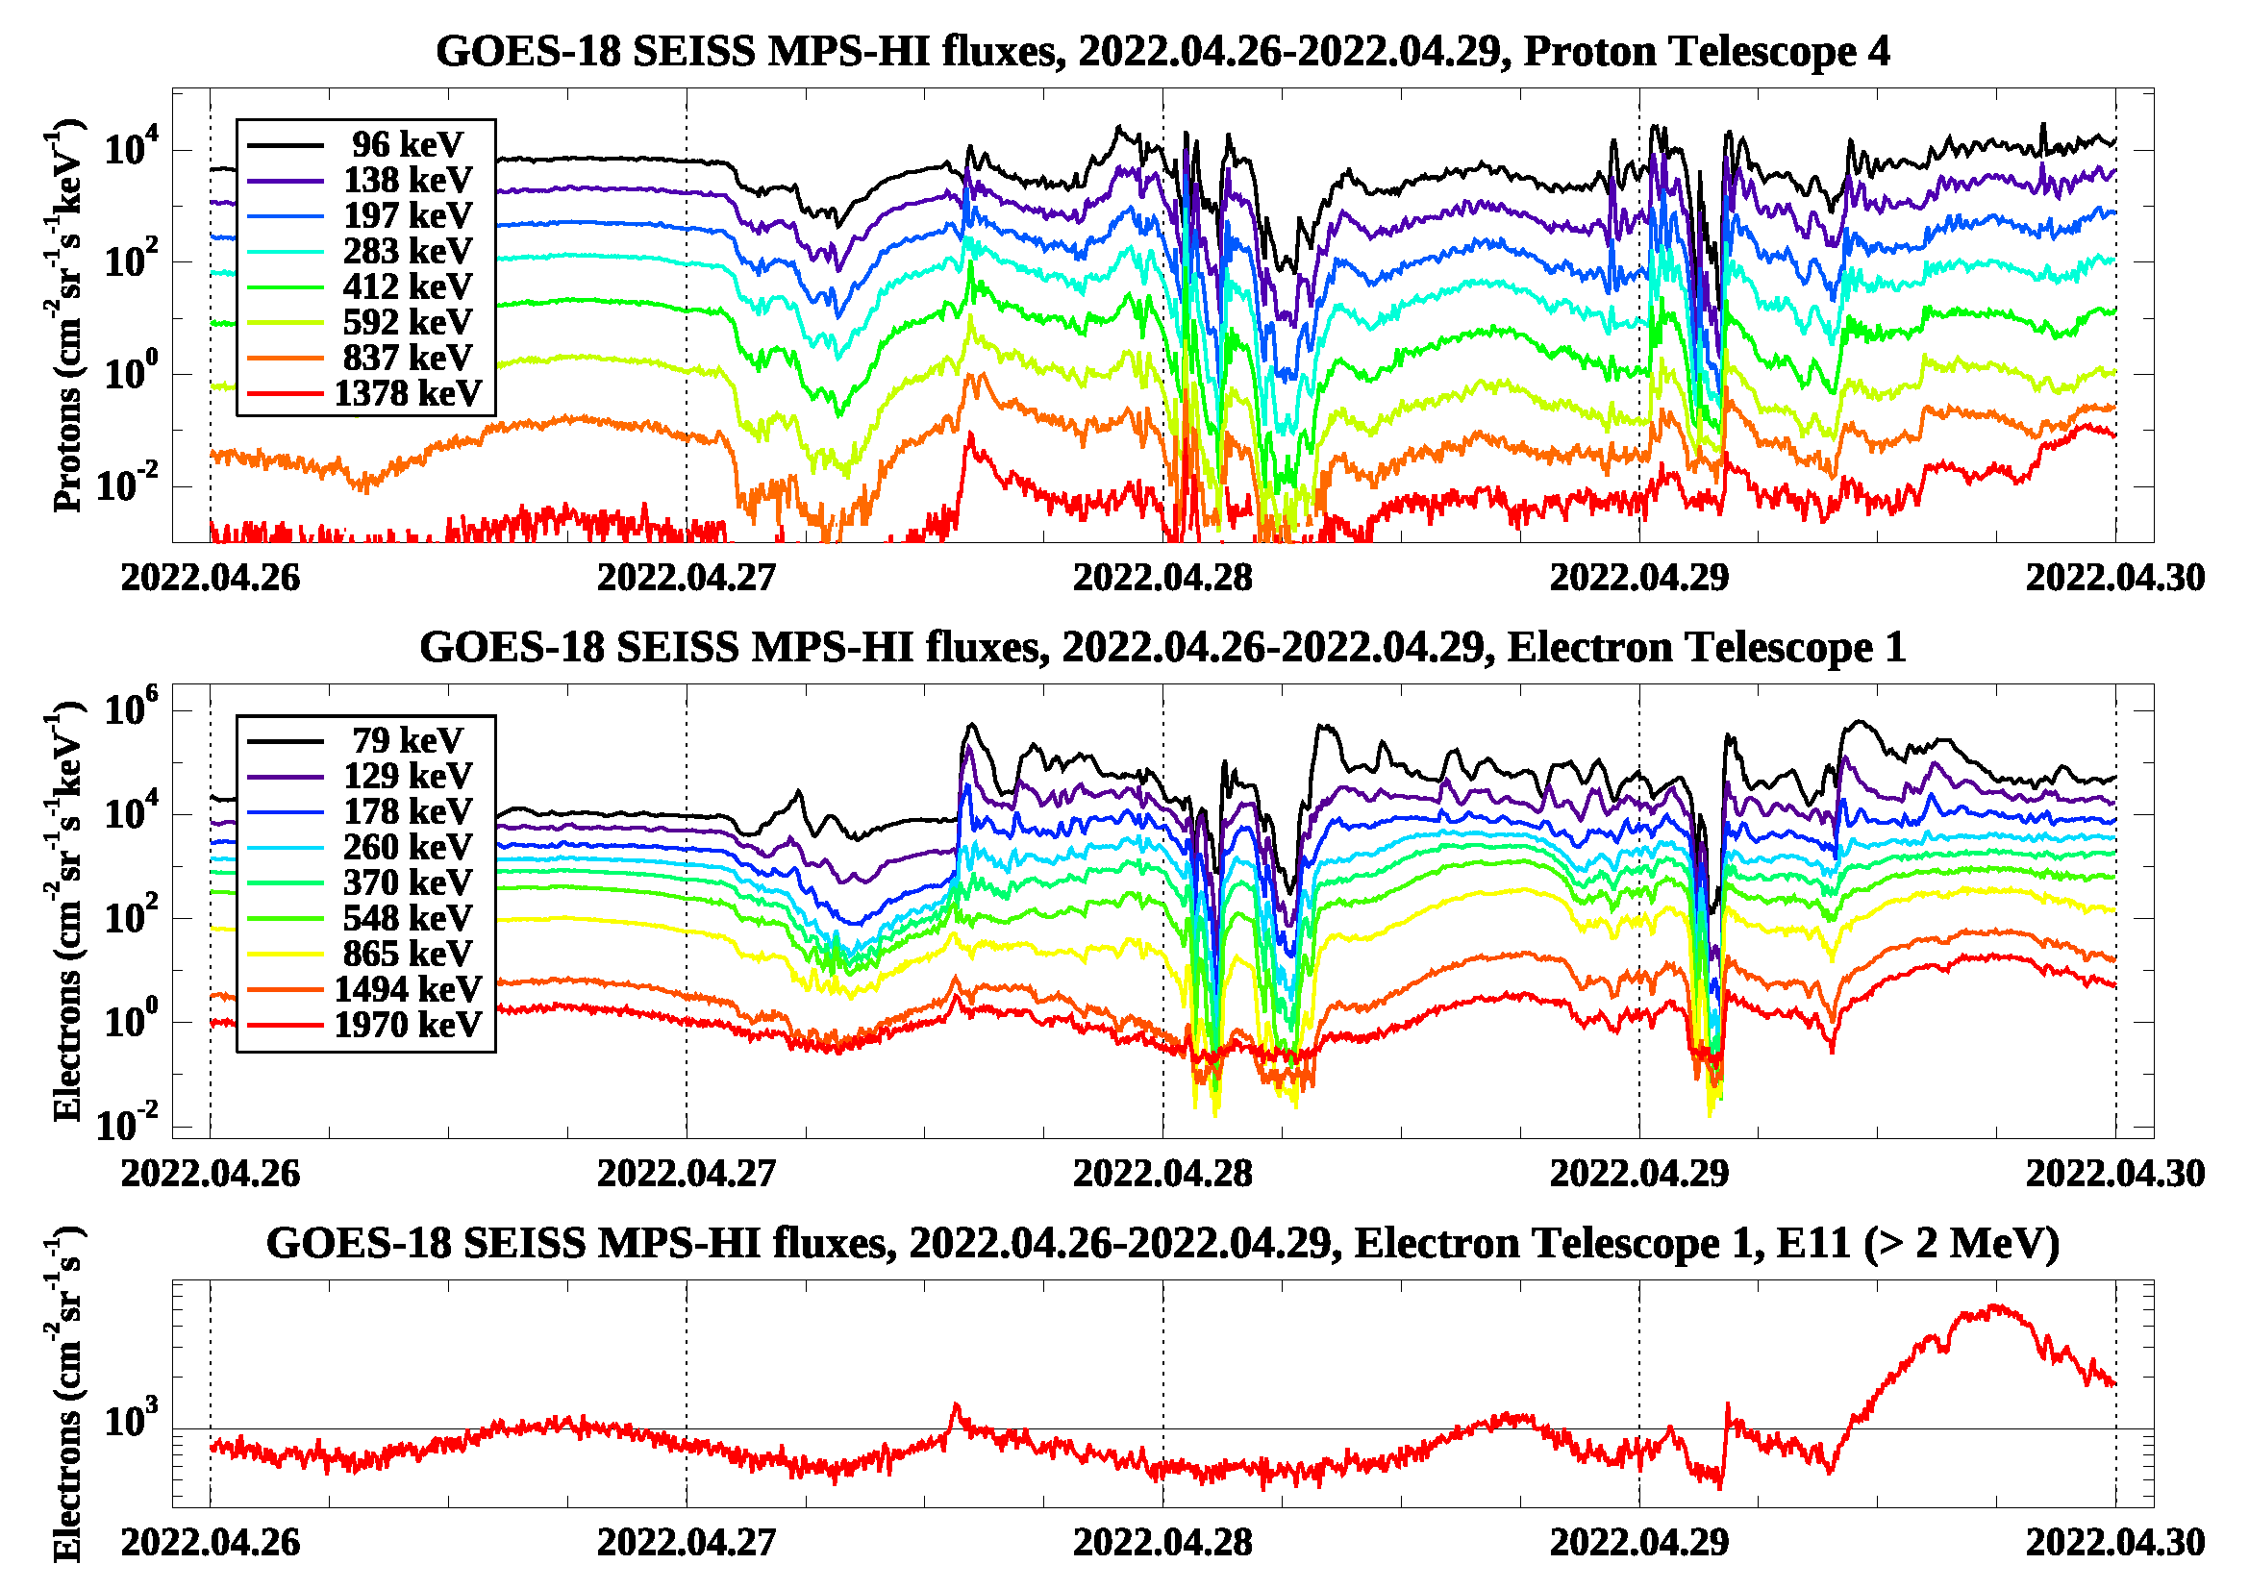
GOES-18 SEISS
First Public Image (MPS-HI)
These GOES-18 data are preliminary, non-operational data and are undergoing testing. Users bear all responsibility for inspecting the data prior to use and for the manner in which the data are utilized.

Slide 7
GOES-18: Status at Provisional
Summary of remaining issues
Solar Proton channels
Comparison of MPS-HI channels P8-P11 with SGPS P1-P4 for a suitable Solar Energetic Particle (SEP) event
Disagreement of MPS-HI P8-P10 fluxes with those of SGPS P1-P3
Similar flux levels in MPS-HI channel P11 and SGPS channel P4
Comparison of GOES-18 MPS-HI with other operational GOES-R series satellites
Good agreement between GOES-17 and GOES-18 for most cases
Much higher GOES-18 P11 channel fluxes compared to GOES-16
Requires a more suitable SEP event
Requires beam calibration of MPS-HI and SGPS (has been agreed by the program, planned by the instrument vendor)
Background Removal
Modification of the background removal coefficients is successful in yielding appropriate background levels, consistent with Galactic Cosmic Ray (GCR) fluxes
Complication: the space environment is changing
Requires continued monitoring
Possible revision of the background removal coefficients in the future
These GOES-18 data are preliminary, non-operational data and are undergoing testing. Users bear all responsibility for inspecting the data prior to use and for the manner in which the data are utilized.

Slide 8
Review of BETA Maturity G18 SEISS Beta, Aug. 1, 2022
GOES-18 MPS-HI L1b Products Provisional PS-PVR

Slide 9
G18 MPS-HI Vendor PLTs
PLT | CDRL | PLT Name | Start Date | End Date | Prelim Report Due (+2 Weeks) | Final Report Due (+2 Months)
 | SEISS-TR-Y121-3-2 | Sensor Activation | 4/25/2022 | 4/25/2022 | 5/9/2022 | 6/24/2022
SEI-003 | SEISS-TR-Y121-3-4 | MPS-HI Initial IFCs | 4/26/2022 | 4/27/2022 | 5/11/2022 | 6/27/2022
SEI-011 | SEISS-TR-Y121-3-13 | MPS-HI Cross Sensor Comparison | 4/25/2022 | 6/13/2022 | 6/27/2022 | 8/11/2022
IFC – In-flight Calibration
No SEISS PLPTs supporting Beta maturity.
NCEI verified G18 MPS-HI science measurements in L1b data.
These GOES-18 data are preliminary, non-operational data and are undergoing testing. Users bear all responsibility for inspecting the data prior to use and for the manner in which the data are utilized.

Slide 10
Instrument/GPA Issues Identified and Progress Status: MPS-HI
Following is a list of ADRs that directly or indirectly affect the GOES-18 MPS-HI.
ADR# | WR# | Short Description | Current Status | Expected Closure
780 | 6568 6845 | G16 & G17 MPS-HI and MPS-LO L1b IFC Leakage | Fix Fail In Analysis | DO.09.01.00 DO.12
781 | 6477 8404 | G16 & G17 MPS-HI and SGPS L1b data gaps near IFCs | Fixed In Analysis | DO.09.02.00 DO.12
863 | 6736 9318 | Graceful degradation when SGPS data not generated | On Hold In Analysis | DO.13
1209 | TBD | G18 SEISS LUTs | Closed | PR.09.08.14
1253 | TBD | Update to G18 MPS-HI LUT | Closed | PR.11.00.01
These GOES-18 data are preliminary, non-operational data and are undergoing testing. Users bear all responsibility for inspecting the data prior to use and for the manner in which the data are utilized.

Slide 11
ADR 1253: Modification of the GOES-18 MPS-HI LUT
L1b overcorrection of MPS-HI electrons, resulting in artificial dropouts and unphysical fluxes
Affects all electron channels, differential and integral
Result of the inverse matrix technique to determine fluxes
Solution: diagonal matrix derived using the Bowtie technique
L1b insufficient background correction for MPS-HI electrons, resulting in higher background levels
Affects electron channels E9-E11
Especially important for integral channel E11, as it affects the Space Weather Prediction Center alerts
Result of small background removal coefficients
Solution: calculate new background removal coefficients (PLPT-SEI-006)
These GOES-18 data are preliminary, non-operational data and are undergoing testing. Users bear all responsibility for inspecting the data prior to use and for the manner in which the data are utilized.

Slide 12
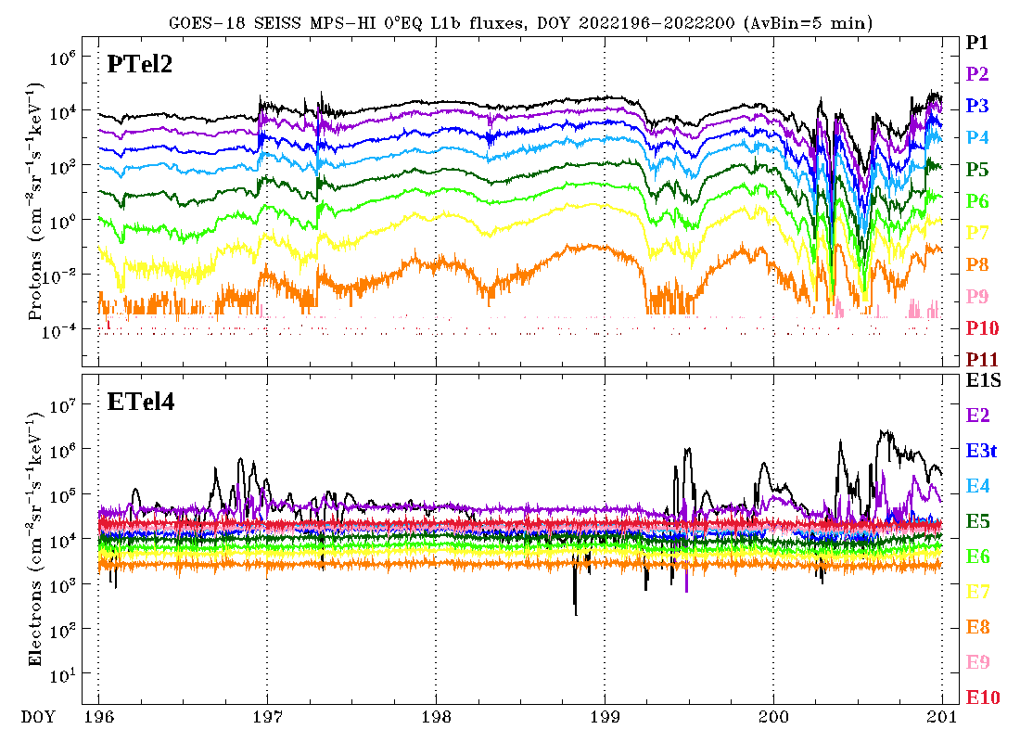
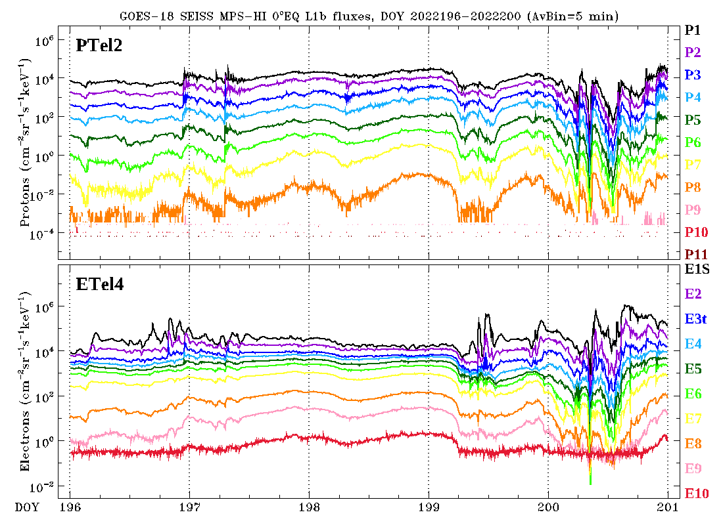
ADR 1253: Modification of the GOES-18 MPS-HI LUT
OPS L1b, July 15-19, 2022
Bowtie technique, July 15-19, 2022
Application of the bowtie analysis to produce L1b electron fluxes from L0 counts
Uses a diagonal matrix with Geometric Factors (GF) and channel Effective Energies derived from the minimalization of the variation of the GF for a variety of spectra, using a proxy dataset (CRRES)
The bowtie technique is successful in producing good quality L1b electron data from L0 counts
Boudouridis, A., Rodriguez, J. V., Kress, B. T., Dichter, B. K., & Onsager, T. G. (2020). Development of a bowtie inversion technique for real‐time processing of the GOES‐16/‐17 SEISS MPS‐HI electron channels. Space Weather, 18, e2019SW002403. https://doi.org/10.1029/2019SW002403
These GOES-18 data are preliminary, non-operational data and are undergoing testing. Users bear all responsibility for inspecting the data prior to use and for the manner in which the data are utilized.

Slide 13
ADR 1253: Modification of the GOES-18 MPS-HI LUT
T3
GOES-18 channel E11 $(>2$ MeV)
T1
1000 electrons per (cm² sr s)
T4
SWPC alert level very close to uncorrected backgrounds
T2
T5
Corrected backgrounds more representative of the GCR spectrum
DOS
These GOES-18 data are preliminary, non-operational data and are undergoing testing. Users bear all responsibility for inspecting the data prior to use and for the manner in which the data are utilized.

Slide 14
Product quality EVALUATION
GOES-18 MPS-HI L1b Products Provisional PS-PVR

Slide 15
Path to Provisional Validation - PLPTs
Title | Activity | Data Needed | Success Criteria
A.2.1 MPS-Hi Telescope Cross-Comparison [PLPT-SEI-002] | Determine the relative sensitivity/response among MPS-HI telescopes. | One month of continuous data. (MAG, MPS-HI) | Telescopes agree to within 25%.
A.2.3 SEP Channel Cross-Comparison [PLPT-SEI-004] | On-orbit cross-calibration of MPS-HI with SGPS 1-12 MeV protons, and all operational GOES-R Series SEISS sensors. | One Solar Energetic Particle (SEP) event. | Differences quantified on data taken through validation phase.
A.2.4 Cross Satellite Comparison of Trapped Particles [PLPT-SEI-005] | To inter-calibrate MPS-HI with the same measurements on other operational GOES-R Series satellites. The MPS-HI inter-calibration part of the test is critical for establishing the consistency of the NOAA real-time >2 MeV electron flux alerts between operational GOES-R Series satellites. | One month of continuous data. (MAG, MPS-HI) | Differences quantified on data taken through validation phase.
A.2.5 Backgrounds Trending [PLPT-SEI-006] | To evaluate MPS-HI backgrounds in terms of expected galactic cosmic ray (GCR) fluxes. | Two months of continuous data. (MPS-HI, SGPS) | Perform analysis during validation phase. Natural backgrounds preliminarily correlated with solar protons and GCRs.
MPS-HI Provisional Validation PLPTs from RIMP v 2.0 (09 July 2021).

Slide 16
Use of Reprocessed Data in Provisional Validation PLPTs
Due to the date of changes to OE (ADR 1253 for GOES-18), the Provisional Validation PLPTs used reprocessed data
We have reprocessed L0 data using software that has been demonstrated to reproduce L1b results to ‘machine precision’ (ADR 1253 verification)
This demonstrated equivalence allowed us to perform Provisional PLPTs using reprocessed MPS-HI data
These GOES-18 data are preliminary, non-operational data and are undergoing testing. Users bear all responsibility for inspecting the data prior to use and for the manner in which the data are utilized.

Slide 17
Demonstration of equivalence of reprocessed NCEI data and OE L1b (ADR 1253)
Goal: verify that ADR 1253 (GOES-18) was successfully implemented in the OE
Compared to fluxes and flux errors calculated from L0 by NCEI
MPS-HI and SGPS L0 data aggregated into separate day files
L0 day files processed into L1b day files based on CDRL79/CDRL80
MPS-HI electron fluxes were derived using the bowtie diagonal matrix
For each L1b file (30 samples per channel):
Calculate ratio of OE to NCEI products (flux and flux error, both in flux units)
Take mean and standard deviation of ratios
This gives a mean and a standard deviation for each L1b file
Ideally, mean = 1.0 and standard deviation = 0.0
Results are good: ratio mean = 1.0, ratio standard deviation = 0.0 or ≲10⁻⁷ (latter observed when quantity involves special function such as square root)
These GOES-18 data are preliminary, non-operational data and are undergoing testing. Users bear all responsibility for inspecting the data prior to use and for the manner in which the data are utilized.

Slide 18
2 September 2022
Demonstration of equivalence of reprocessed NCEI data and OE L1b (ADR 1253, GOES-18)
In general:
Mean = 1.0
StDev ≲ 10⁻⁷
These GOES-18 data are preliminary, non-operational data and are undergoing testing. Users bear all responsibility for inspecting the data prior to use and for the manner in which the data are utilized.

Slide 19
PLPTs for Provisional Validation
PLPT-SEI-002: MPS-HI Telescope Cross-Comparison (Hallock, Rowland)
PLPT-SEI-004: Solar Energetic Particle (SEP) Cross-Comparison (Kress)
PLPT-SEI-005: Cross-Satellite Comparison of Trapped Particles (Boudouridis, Rodriguez)
PLPT-SEI-006: Backgrounds Trending (Boudouridis, Rodriguez)
These GOES-18 data are preliminary, non-operational data and are undergoing testing. Users bear all responsibility for inspecting the data prior to use and for the manner in which the data are utilized.

Slide 20
PLPT-SEI-002: MPS-HI Telescope Cross-Comparison: Introduction
Pass
Pitch Angle definition and telescope orientations
Pitch angle (PA) is angle between the particle velocity and the magnetic field (B-field).
G18 Upright
Etel.3
Expected
approx. PAs:
Etel.3: 150○
Etel.1: 115○
Etel.4: 80○
Etel.2: 45○
Etel.5: 10○
B-field
Etel.1
$≈$100○
Etel.4 particle velocity
$≈$80○
Etel.4
+z
Etel.4 look direction
Supplementary angle (SPA) = 180-PA
Particles return to the equator after bouncing near the poles with SPA
-x
Etel.2
+y
Etel.5
Body Reference Frame (BRF) coordinate system: +X East, +Y South, +Z Earthward
These GOES-18 data are preliminary, non-operational data and are undergoing testing. Users bear all responsibility for inspecting the data prior to use and for the manner in which the data are utilized.

Slide 21
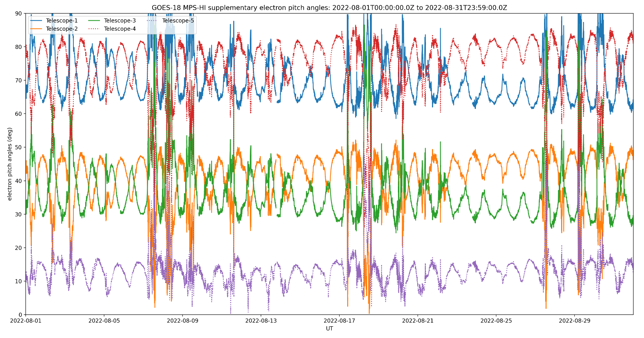
PLPT-SEI-002: MPS-HI Telescope Cross-Comparison: Method
Pass
Compares responses of MPS-HI telescopes when central pitch angle is the same
Under such conditions, telescopes should be measuring the same flux for the same effective energy
The technique has been validated twice: 1) G17 MPS-LO zone intracal, and 2) G13/G15 MAGED/PD cross-telescope comparisons (Rodriguez et al., [2020], JSWSC)
GOES-18
Electrons
Procedure steps:
Input MPS-HI fluxes and pitch angles calculated from MAG L1b BRF
Identify whenever a pair of telescopes has pitch angles within 1 degree
Fold pitch angles > 90 degrees to get enough matches
Report measured fluxes for each pitch angle match
Estimate scaling factors with respect to a reference telescope
Ref: Rowland, W., and R. S. Weigel (2012), Intra-calibration of particle detectors on a three-axis stabilized geostationary platform, Space Weather, 10, S11002, doi:10.1029/2012SW000816.
These GOES-18 data are preliminary, non-operational data and are undergoing testing. Users bear all responsibility for inspecting the data prior to use and for the manner in which the data are utilized.

Slide 22
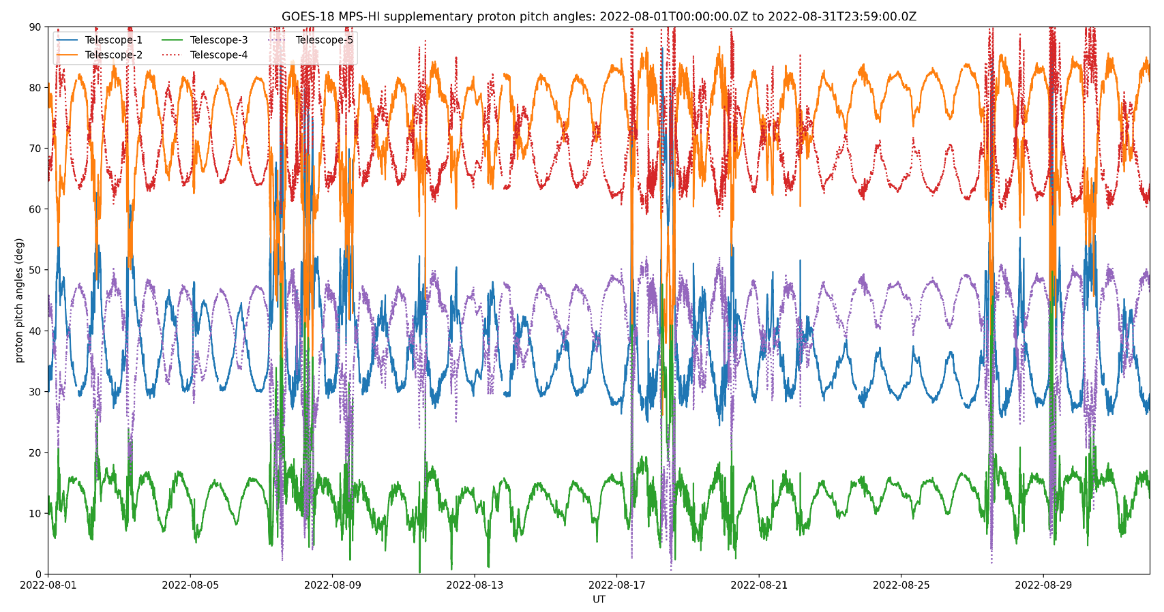
PLPT-SEI-002: MPS-HI Telescope Cross-Comparison: Method
Pass
Improvements over the years
Larger data sample (3 months in this case)
Use of supplementary angles
Thresholding to eliminate low fluxes
GOES-18
Protons
Remaining Caveats
Account for variation in channel energies across telescopes
GOES-18 GMAG issue: Missing 1 sample every 10 data points (ADR 1232, GMAG irregular timestamps)
MPS-HI uses 1-min averages, therefore 540 points instead of 600
Does not significantly affect the results of PLPT-002
These GOES-18 data are preliminary, non-operational data and are undergoing testing. Users bear all responsibility for inspecting the data prior to use and for the manner in which the data are utilized.

Slide 23
PLPT-SEI-002: MPS-HI Telescope Cross-Comparison: Results
Pass
Electron Scale Factors
June 7-September 6, 2022
Proton Scale Factors
June 7-September 6, 2022
Energy band | Count threshold | T1 | T2 | T3 | T4 | T5
E1 | 1000/min | 1.050 | 0.857 | 0.925 | 1.000 | 0.962
E2 | 1000/min | 0.971 | 1.151 | 1.070 | 1.000 | 1.138
E3 | 1000/min | 0.928 | 0.727 | 0.773 | 1.000 | 1.037
E4 | 1000/min | 1.009 | 0.871 | 0.915 | 1.000 | 1.033
E5 | 1000/min | 0.966 | 0.903 | 0.861 | 1.000 | 0.980
E6 | 1000/min | 0.980 | 0.971 | 0.901 | 1.000 | 0.963
E7 | 1000/min | 0.983 | 0.874 | 1.008 | 1.000 | 1.104
E8 | 100/min | 0.953 | 0.748 | 0.742 | 1.000 | 0.926
E9 | 100/min | 0.593 | 0.556 | 0.602 | 1.000 | 0.608
E10 | 100/min | 0.777 | 0.861 | 1.004 | 1.000 | 0.763
E11 | 100/min | 0.677 | 0.704 | 0.849 | 1.000 | 0.673
Energy band | Count threshold | T1 | T2 | T3 | T4 | T5
P1 | 1000/min | 0.798 | 1.000 | 0.752 | 0.986 | 1.253
P2 | 1000/min | 1.052 | 1.000 | 0.986 | 1.060 | 0.998
P3 | 1000/min | 0.994 | 1.000 | 1.007 | 1.077 | 1.063
P4 | 1000/min | 1.071 | 1.000 | 1.142 | 1.090 | 0.987
P5 | 100/min | 0.950 | 1.000 | 1.030 | 1.034 | 1.005
P6 | 100/min | 1.037 | 1.000 | 1.310 | 1.167 | 1.383
P7 | 100/min | 1.035 | 1.000 | 1.154 | 1.069 | 1.269
Technique not applicable to solar proton channels P8-P11
Electron scale factors are mostly within the 25% requirement.
Proton scale factors are mostly within the 25% requirement.
Lower scale factors occur mostly for higher energy channels with less count rates.
Blue: <10%, Green: 10-25%, Red: >25%
Pink: <100 PA matches
Orange: <1000 PA matches
These GOES-18 data are preliminary, non-operational data and are undergoing testing. Users bear all responsibility for inspecting the data prior to use and for the manner in which the data are utilized.

Slide 24
PLPT-SEI-002: MPS-HI Telescope Cross-Comparison: Summary
Found Telescope Pitch Angle matches
Used the technique of Rowland and Weigel (2012) to calculate scale factors for all energies and telescopes
The electron scale factors are mostly < 25%, the telescopes agree within 25% accuracy
The proton scale factors are mostly < 25%, the telescopes agree within 25% accuracy
PLPT-SEI-002 for GOES-18 is a resounding
Pass
These GOES-18 data are preliminary, non-operational data and are undergoing testing. Users bear all responsibility for inspecting the data prior to use and for the manner in which the data are utilized.

Slide 25
PLPT-SEI-004: Solar Energetic Particle (SEP) Channel Cross-Comparison: Event
Pass
27-30 August 2022 Solar Particle Event
Period of moderately elevated solar wind dynamic pressure
This event is used for the GOES-18 vs. GOES-17 MPS-HI SEP Channel Cross-Comparison PLPT
The above figure shows fluxes from the GOES-18 MPS-HI SEP channels (P8-P11) in thin gray traces (all 5 telescopes), and SGPS P1, P2A, P3 and P4 with thick colored traces.
MPS-HI P8 and P11 have identical energy bands to SGPS P1 & P4, while MPS-HI P9 and P10 energy bands differ somewhat from SGPS P2A & P3.
We do not necessarily expect identical fluxes from MPS-HI and SGPS during this event since they have different viewing directions (explained further on the next slide).
These GOES-18 data are preliminary, non-operational data and are undergoing testing. Users bear all responsibility for inspecting the data prior to use and for the manner in which the data are utilized.

Slide 26
PLPT-SEI-004: SEP Channel
Cross-Comparison: Considerations
Pass
During 2022, after the GOES-18 drift, GOES-17 and GOES-18 are approximately 0.4 degrees longitude apart (~300 km at geosynchronous).
A 1 MeV proton gyro radius at geosynchronous is significantly larger than the GOES-17 and GOES-18 August 2022 spacecraft separation (~1400 vs. ~300 km); thus, we expect identical flux measurements from like channels with same telescope look directions.
During periods when the solar wind dynamic pressure, P_{dyn} >10 nPa, the cutoff is suppressed sufficiently for cross-calibration of GOES Energetic Particle Sensors (EPS) channels ≳ 4.2–8.7 MeV [Rodriguez et al., 2014].
On August 27th, moderate P_{dyn} ≅ 2 nPa ~10–15 UT, with max. ≅ 6 nPa ~10–11 UT; thus, we should not necessarily expect good agreement between telescopes with different look directions and at different longitudes.
All SGPS units show good agreement during this period, so we expect that MPS-HI telescopes (arranged in north-south fan in meridional plane between east and west) will agree with SGPS and each other; However, MPS-HI P8-P10 fluxes are significantly low with respect to similar SGPS P1, P2A, P3 and P4 channels (shown in the following slides).
Will cross calibrate GOES-17 and GOES-18 MPS-HI SEP channels from telescopes with same look directions.
These GOES-18 data are preliminary, non-operational data and are undergoing testing. Users bear all responsibility for inspecting the data prior to use and for the manner in which the data are utilized.

Slide 27
PLPT-SEI-004: SEP Channel
Cross-Comparison: G17 vs G18 MPS-HI
Pass
Scatter plot of 5 min averaged GOES-17 and GOES-18 MPS-HI L1b PTel2 P9 fluxes, on linear scales in left panel and log scales in right panel (the same data and fit is shown in both plots.)
There is significant systematic difference between G17 and G18 MPS-HI PTel2 P9 (1.9-3.2 MeV).
This is one of the 2 worst cases.
These GOES-18 data are preliminary, non-operational data and are undergoing testing. Users bear all responsibility for inspecting the data prior to use and for the manner in which the data are utilized.

Slide 28
PLPT-SEI-004: SEP Channel
Cross-Comparison: G17 vs G18 MPS-HI
Pass
In general, GOES-17 and GOES-18 MPS-HI like telescope-channel pairs agree well, with <10% difference in most cases.
Some telescope-channel pairs do not agree well. Worst cases are PTel2 (central telescope) P9 and P11, which differ by approximately a factor of 2.
Worst cases are approximately a factor of 2 difference between GOES-17 and GOES-18 MPS-HI PTel2 P11 channels (i.e., 50-100% error).
These GOES-18 data are preliminary, non-operational data and are undergoing testing. Users bear all responsibility for inspecting the data prior to use and for the manner in which the data are utilized.

Slide 29
PLPT-SEI-004: SEP Channel
Cross-Comparison: Results
Pass
During the period of somewhat elevated solar wind dynamic pressure, all MPS-HI units P8-P10 fluxes are significantly lower than SGPS P1-P3 fluxes from all SGPS units.
MPS-HI P11 fluxes are similar to SGPS P4 fluxes.
All MPS-HI units report similar fluxes in the P8-P10 channel range.
The GOES-18 MPS-HI P11 fluxes are higher than the P11 fluxes on the GOES-16 MPS-HI unit.
All SGPS-X units are looking west during this event, SGPS+X units are looking east, and MPS-HI telescopes look directions are in the meridional plane normal to the east and west axis.
For channels with the same energy bands, we expect highest fluxes from west viewing telescopes and lowest fluxes from east viewing telescopes.
These GOES-18 data are preliminary, non-operational data and are undergoing testing. Users bear all responsibility for inspecting the data prior to use and for the manner in which the data are utilized.

Slide 30
PLPT-SEI-004: SEP Channel
Cross-Comparison: Summary
In general, GOES-17 and GOES-18 MPS-HI SEP channels agree well (≲10% error) with a few exceptions (up to a factor of 2 difference).
GOES-R series MPS-HI SEP channels are in general reporting significantly low with respect to SGPS units. However, a suitable SEP event during a period of high solar wind dynamic pressure, P_{dyn} >10 nPa, when the SEP fluxes are isotropic, has not yet been observed.
Work to resolve the above discrepancy is ongoing
Upcoming ground/beam calibrations of MPS-HI and SGPS spare units (MPS-HI SEP channels have never been beam calibrated). The current schedule is:
MPS-HI SN104 at the National Institute of Standards and Technology (NIST): January 2023
MPS-HI SN104 at the Brookhaven National Laboratory (BNL): November 2023
SGPS SN110 at the Massachusetts General Hospital (MGH): March 2023
SGPS SN110 at the Brookhaven National Laboratory (BNL): November 2023
Continuing cross calibrations during SEP events. Waiting (and hoping) for an SEP event during high solar wind dynamic pressure.
PLPT-SEI-004 for GOES-18 is a
Pass
These GOES-18 data are preliminary, non-operational data and are undergoing testing. Users bear all responsibility for inspecting the data prior to use and for the manner in which the data are utilized.

Slide 31
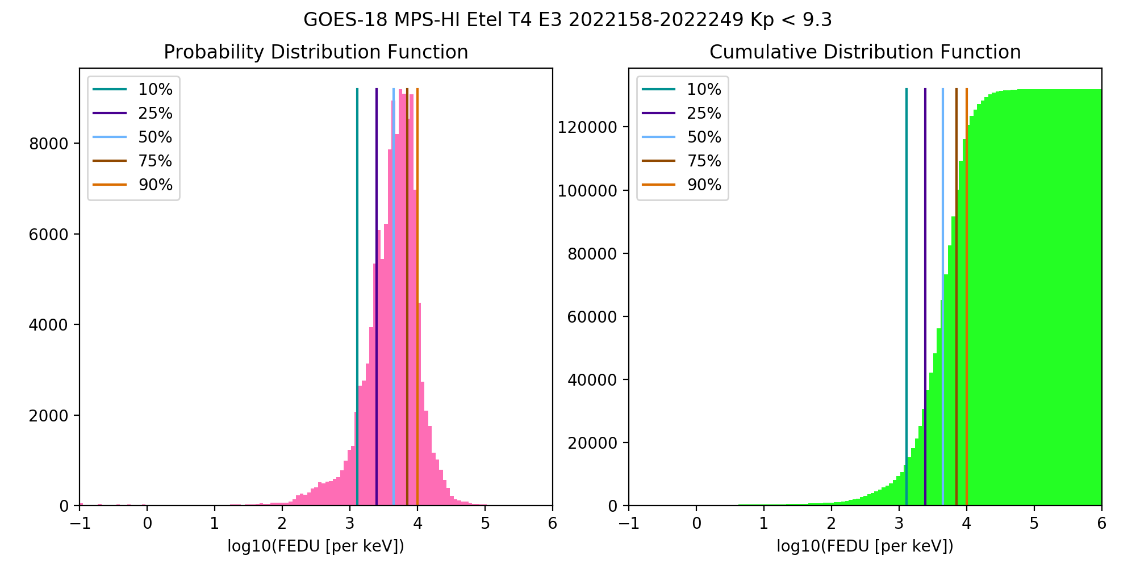
PLPT-SEI-005: Cross-Satellite Comparison of Trapped Particles: Technique
Pass
Compare statistical differential flux spectra from GOES-17 and GOES-18, separated by only 0.4 degrees longitude:
GOES-17 (137.2W) to GOES-18 (136.8W), 06/07/2022-09/05/2022 (3 months)
Calculate the particle distributions for all channels and telescopes
Compare flux percentile spectra for telescopes of the same orientation
0, ±35, ±70 deg from zenith (radially outward)
PDF: Number of fluxes in each flux bin
CDF: Number of fluxes up to a flux bin
Percentile fluxes: Flux at which number of fluxes < percentile
50% is the median of the distribution
These GOES-18 data are preliminary, non-operational data and are undergoing testing. Users bear all responsibility for inspecting the data prior to use and for the manner in which the data are utilized.

Slide 32
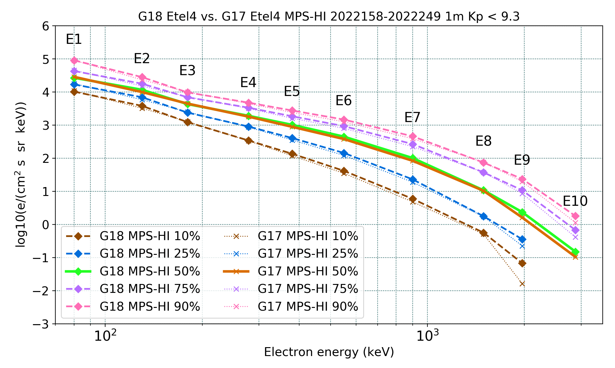
PLPT-SEI-005: Cross-Satellite Comparison of Trapped Particles: Results
Pass
GOES-18 vs GOES-17 Electrons , 06/07/2022– 09/05/2022
GOES-17 fluxes are a little lower: the spacecraft has been on orbit for more than 4 years
Excellent agreement!
Missing or significantly lower fluxes are at residual background levels
Boudouridis, A., Rodriguez, J. V., Kress, B. T., Dichter, B. K., & Onsager, T. G. (2020). Development of a bowtie inversion technique for real‐time processing of the GOES‐16/‐17 SEISS MPS‐HI electron channels. Space Weather, 18, e2019SW002403. https://doi.org/10.1029/2019SW002403
These GOES-18 data are preliminary, non-operational data and are undergoing testing. Users bear all responsibility for inspecting the data prior to use and for the manner in which the data are utilized.

Slide 33
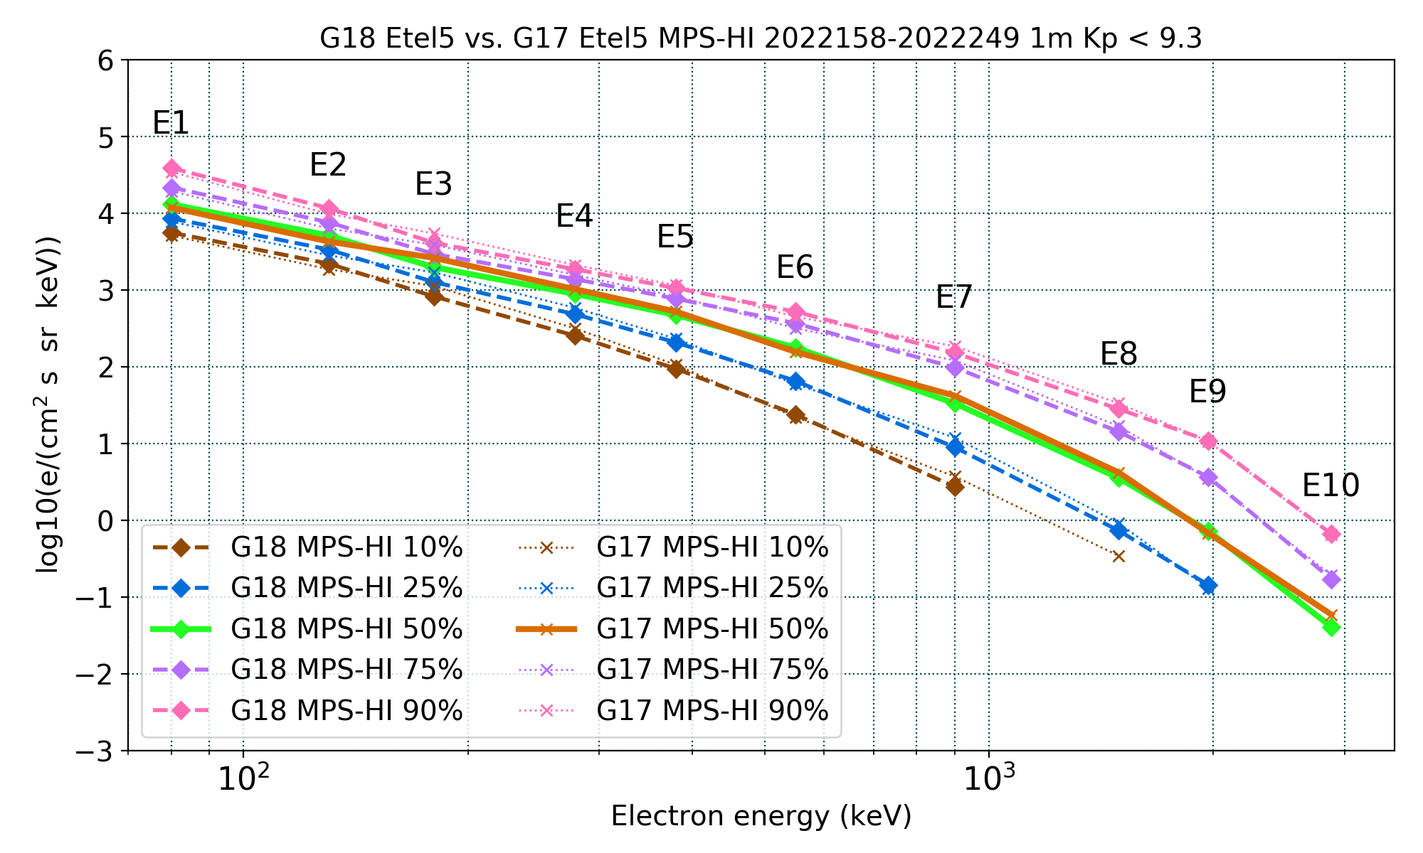
PLPT-SEI-005: Cross-Satellite Comparison of Trapped Particles: Results
Pass
GOES-18 vs GOES-17 Electrons , 06/07/2022– 09/05/2022
GOES-18 ETel5 exhibits lower than GOES-17 fluxes in certain channels. NCEI will keep monitoring.
Missing or significantly lower fluxes are at residual background levels
Boudouridis, A., Rodriguez, J. V., Kress, B. T., Dichter, B. K., & Onsager, T. G. (2020). Development of a bowtie inversion technique for real‐time processing of the GOES‐16/‐17 SEISS MPS‐HI electron channels. Space Weather, 18, e2019SW002403. https://doi.org/10.1029/2019SW002403
These GOES-18 data are preliminary, non-operational data and are undergoing testing. Users bear all responsibility for inspecting the data prior to use and for the manner in which the data are utilized.

Slide 34
PLPT-SEI-005: Cross-Satellite Comparison of Trapped Particles: Results
Pass
GOES-17 over GOES-18 Electrons, 06/07/2022– 09/05/2022
 |  | G17 ET3 | : | G18 ET3 |  |  | G17 ET1 | : | G18 ET1 |  |  | G17 ET4 | : | G18 ET4 |  |  | G17 ET2 | : | G18 ET2 |  |  | G17 ET5 | : | G18 ET5
 |  |  | Q |  |  |  |  | Q |  |  |  |  | Q |  |  |  |  | Q |  |  |  |  | Q
Energy (keV) | 10 | 25 | 50 | 75 | 90 | 10 | 25 | 50 | 75 | 90 | 10 | 25 | 50 | 75 | 90 | 10 | 25 | 50 | 75 | 90 | 10 | 25 | 50 | 75 | 90
80 | 0.94 | 0.95 | 0.95 | 0.93 | 0.91 | 0.81 | 0.84 | 0.86 | 0.83 | 0.77 | 1.05 | 1.06 | 1.07 | 1.05 | 1.00 | 1.05 | 1.04 | 1.04 | 1.03 | 1.03 | 0.92 | 0.91 | 0.90 | 0.89 | 0.89
130 | 0.92 | 0.92 | 0.92 | 0.91 | 0.91 | 0.69 | 0.71 | 0.72 | 0.72 | 0.70 | 0.85 | 0.84 | 0.85 | 0.86 | 0.83 | 1.02 | 1.01 | 1.01 | 1.00 | 0.99 | 0.85 | 0.84 | 0.84 | 0.83 | 0.84
180 | 0.93 | 0.93 | 0.93 | 0.93 | 0.93 | 1.05 | 1.06 | 1.07 | 1.07 | 1.05 | 1.03 | 1.04 | 1.04 | 1.04 | 1.03 | 0.92 | 0.93 | 0.91 | 0.91 | 0.91 | 1.36 | 1.34 | 1.32 | 1.32 | 1.33
278 | 0.88 | 0.87 | 0.87 | 0.86 | 0.87 | 1.03 | 1.02 | 0.99 | 0.98 | 0.97 | 0.98 | 0.96 | 0.95 | 0.95 | 0.94 | 0.99 | 0.98 | 0.96 | 0.96 | 0.96 | 1.25 | 1.21 | 1.15 | 1.13 | 1.14
380 | 0.86 | 0.88 | 0.88 | 0.88 | 0.88 | 0.87 | 0.88 | 0.88 | 0.87 | 0.87 | 0.87 | 0.87 | 0.87 | 0.87 | 0.87 | 0.96 | 0.96 | 0.95 | 0.96 | 0.96 | 1.12 | 1.12 | 1.11 | 1.08 | 1.09
550 | 0.93 | 0.91 | 0.90 | 0.89 | 0.88 | 0.87 | 0.88 | 0.87 | 0.88 | 0.87 | 0.84 | 0.84 | 0.85 | 0.86 | 0.86 | 0.96 | 0.96 | 0.96 | 0.97 | 0.97 | 0.92 | 0.91 | 0.88 | 0.86 | 0.86
900 | 1.22 | 1.19 | 1.13 | 1.11 | 1.10 | 0.75 | 0.76 | 0.76 | 0.77 | 0.76 | 0.81 | 0.83 | 0.83 | 0.84 | 0.85 | 0.88 | 0.88 | 0.88 | 0.88 | 0.88 | 1.37 | 1.34 | 1.26 | 1.24 | 1.22
1493 | 0.93 | 0.88 | 0.88 | 0.88 | 0.91 | 0.95 | 0.94 | 0.90 | 0.95 | 0.95 | 0.90 | 0.98 | 0.97 | 1.00 | 1.02 | 0.93 | 0.96 | 0.94 | 0.93 | 0.94 |  | 1.25 | 1.18 | 1.18 | 1.19
1969 | 0.20 | 0.89 | 0.91 | 0.93 | 0.95 | 0.34 | 0.74 | 0.74 | 0.79 | 0.80 | 0.24 | 0.63 | 0.69 | 0.80 | 0.84 | 0.74 | 0.82 | 0.83 | 0.86 | 0.91 |  | 0.90 | 0.93 | 0.95 | 0.98
2880 |  |  | 1.00 | 0.92 | 0.91 |  |  | 0.86 | 0.70 | 0.72 |  |  | 0.70 | 0.61 | 0.64 |  |  | 0.64 | 0.56 | 0.62 |  |  | 1.45 | 1.12 | 0.98
GOES-17 higher than GOES-18: <10% 10-25% >25%
The comparisons are made by taking the ratio of the GOES‐17 to the GOES‐18 percentile fluxes, following interpolation to 10 common energies (80, 130, 180, 278, 380, 550, 900, 1,493, 1,969, and 2,880 keV) assuming a piecewise power‐law distribution.
Boudouridis, A., Rodriguez, J. V., Kress, B. T., Dichter, B. K., & Onsager, T. G. (2020). Development of a bowtie inversion technique for real‐time processing of the GOES‐16/‐17 SEISS MPS‐HI electron channels. Space Weather, 18, e2019SW002403. https://doi.org/10.1029/2019SW002403
These GOES-18 data are preliminary, non-operational data and are undergoing testing. Users bear all responsibility for inspecting the data prior to use and for the manner in which the data are utilized.

Slide 35
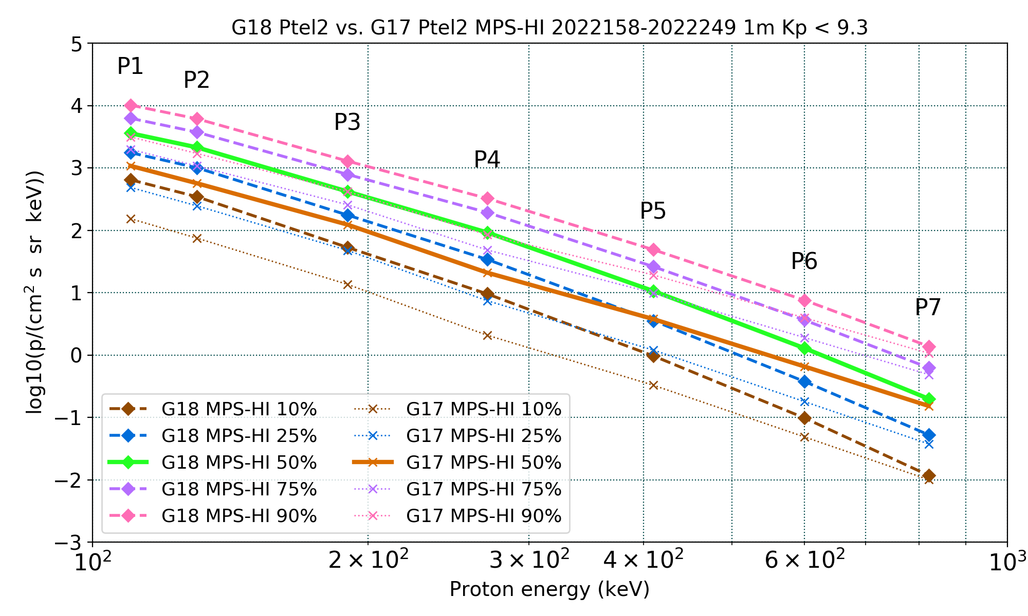
PLPT-SEI-005: Cross-Satellite Comparison of Trapped Particles: Results
Pass
GOES-18 vs GOES-17 Protons , 06/07/2022– 09/05/2022
GOES-17 fluxes are significantly lower than GOES-18 in channels P1-P5 and all telescopes)
Still lower in channels P6-P7 (except for PTel1)
This observation has been documented extensively (G16/G17 Full PS-PVR, G18 PLT SEI-011, and multiple NCEI and MIT studies)
Also observed with G16
A degradation of the proton detectors is actively being investigated
Apply only to P1-P7
Boudouridis, A., Rodriguez, J. V., Kress, B. T., Dichter, B. K., & Onsager, T. G. (2020). Development of a bowtie inversion technique for real‐time processing of the GOES‐16/‐17 SEISS MPS‐HI electron channels. Space Weather, 18, e2019SW002403. https://doi.org/10.1029/2019SW002403
These GOES-18 data are preliminary, non-operational data and are undergoing testing. Users bear all responsibility for inspecting the data prior to use and for the manner in which the data are utilized.

Slide 36
PLPT-SEI-005: Cross-Satellite Comparison of Trapped Particles: Results
Pass
GOES-17 over GOES-18 Protons, 06/07/2022– 09/05/2022
 |  | G17 PT1 | : | G18 PT1 |  |  | G17 PT4 | : | G18 PT4 |  |  | G17 PT2 | : | G18 PT2 |  |  | G17 PT5 | : | G18 PT5 |  |  | G17 PT3 | : | G18 PT3
 |  |  | Q |  |  |  |  | Q |  |  |  |  | Q |  |  |  |  | Q |  |  |  |  | Q
Energy (keV) | 10 | 25 | 50 | 75 | 90 | 10 | 25 | 50 | 75 | 90 | 10 | 25 | 50 | 75 | 90 | 10 | 25 | 50 | 75 | 90 | 10 | 25 | 50 | 75 | 90
110 | 0.41 | 0.45 | 0.48 | 0.55 | 0.61 | 0.41 | 0.44 | 0.49 | 0.50 | 0.55 | 0.24 | 0.28 | 0.30 | 0.32 | 0.31 | 0.44 | 0.48 | 0.51 | 0.55 | 0.68 | 0.42 | 0.46 | 0.48 | 0.55 | 0.54
130 | 0.37 | 0.40 | 0.43 | 0.47 | 0.54 | 0.35 | 0.37 | 0.40 | 0.41 | 0.46 | 0.22 | 0.25 | 0.27 | 0.29 | 0.28 | 0.31 | 0.34 | 0.35 | 0.38 | 0.48 | 0.35 | 0.38 | 0.39 | 0.44 | 0.44
190 | 0.29 | 0.30 | 0.29 | 0.32 | 0.37 | 0.31 | 0.32 | 0.34 | 0.33 | 0.37 | 0.26 | 0.27 | 0.29 | 0.33 | 0.32 | 0.25 | 0.26 | 0.25 | 0.27 | 0.32 | 0.38 | 0.38 | 0.37 | 0.40 | 0.41
270 | 0.28 | 0.28 | 0.26 | 0.28 | 0.31 | 0.32 | 0.31 | 0.32 | 0.32 | 0.35 | 0.22 | 0.22 | 0.23 | 0.25 | 0.26 | 0.27 | 0.26 | 0.25 | 0.26 | 0.28 | 0.39 | 0.38 | 0.37 | 0.39 | 0.40
410 | 0.31 | 0.32 | 0.31 | 0.32 | 0.33 | 0.44 | 0.42 | 0.41 | 0.42 | 0.44 | 0.34 | 0.34 | 0.35 | 0.38 | 0.39 | 0.37 | 0.37 | 0.36 | 0.37 | 0.37 | 0.35 | 0.37 | 0.39 | 0.40 | 0.40
600 |  | 0.95 | 0.96 | 1.00 | 1.01 | 0.59 | 0.59 | 0.59 | 0.60 | 0.61 | 0.50 | 0.48 | 0.51 | 0.52 | 0.52 |  | 0.66 | 0.64 | 0.65 | 0.67 |  | 0.63 | 0.60 | 0.63 | 0.64
820 |  | 0.53 | 0.85 | 0.97 | 0.89 | 0.51 | 0.66 | 0.68 | 0.67 | 0.69 | 0.85 | 0.71 | 0.77 | 0.78 | 0.77 |  | 0.57 | 0.80 | 0.83 | 0.90 |  | 0.93 | 0.72 | 0.67 | 0.67
GOES-17 lower than GOES-18: <10% 10-25% 25-50% 50-75% >75%
The comparisons are made by taking the ratio of the GOES‐17 to the GOES‐18 percentile fluxes, following interpolation to 7 common energies (110, 130, 190, 270, 410, 600, and 820 keV) assuming a piecewise power‐law distribution.
Boudouridis, A., Rodriguez, J. V., Kress, B. T., Dichter, B. K., & Onsager, T. G. (2020). Development of a bowtie inversion technique for real‐time processing of the GOES‐16/‐17 SEISS MPS‐HI electron channels. Space Weather, 18, e2019SW002403. https://doi.org/10.1029/2019SW002403
These GOES-18 data are preliminary, non-operational data and are undergoing testing. Users bear all responsibility for inspecting the data prior to use and for the manner in which the data are utilized.

Slide 37
PLPT-SEI-005: Cross-Satellite Comparison of Trapped Particles: Results
T3
GOES-18 channel E11 $(>2$ MeV)
T1
1000 electrons per (cm² sr s)
T4
T2
T5
DOS
These GOES-18 data are preliminary, non-operational data and are undergoing testing. Users bear all responsibility for inspecting the data prior to use and for the manner in which the data are utilized.

Slide 38
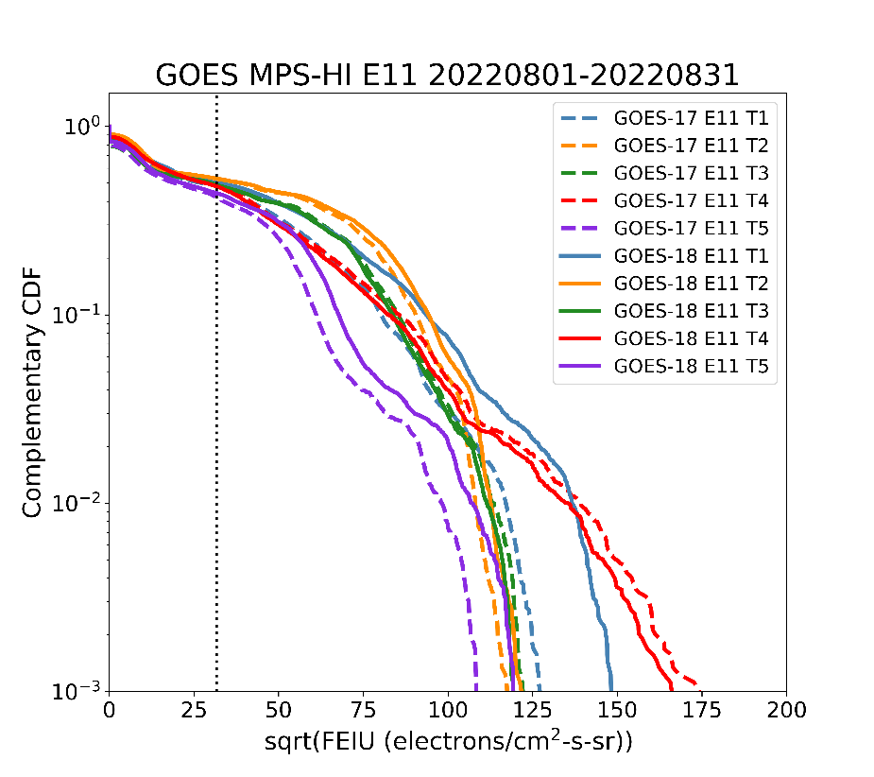
PLPT-SEI-005: Cross-Satellite Comparison of Trapped Particles: Results
Comparison of >2 MeV electron fluxes for the month of August 2022: Use a rigorous method to compare two time series at different satellites: ‘Statistical Asynchronous Regression’ [O’Brien et al., JGR, 106, 2001].
Finds the time-invariant function that relates two time-varying but non-simultaneous quantities X, Y: Y = u(X)
Uses cumulative distribution functions (CDFs): F(x), G(y)
To determine u(X) from data:
Map each x to y such that F(x) = G(y)
The resulting tabular relationship between mapped y and x defines u(X)
Plot complementary CDFs because electron flux distributions are biased toward low values: F>(x) = 1-F(x)
O’Brien, T. P., Sornette, D., & McPherron, R. L. (2001) Statistical asynchronous regression: Determining the relationship between two quantities that are not measured simultaneously, Journal of Geophys. Res., Space Phys. 106, 13,247‒13,259. https://doi.org/10.1029/2000JA900193.
These GOES-18 data are preliminary, non-operational data and are undergoing testing. Users bear all responsibility for inspecting the data prior to use and for the manner in which the data are utilized.

Slide 39
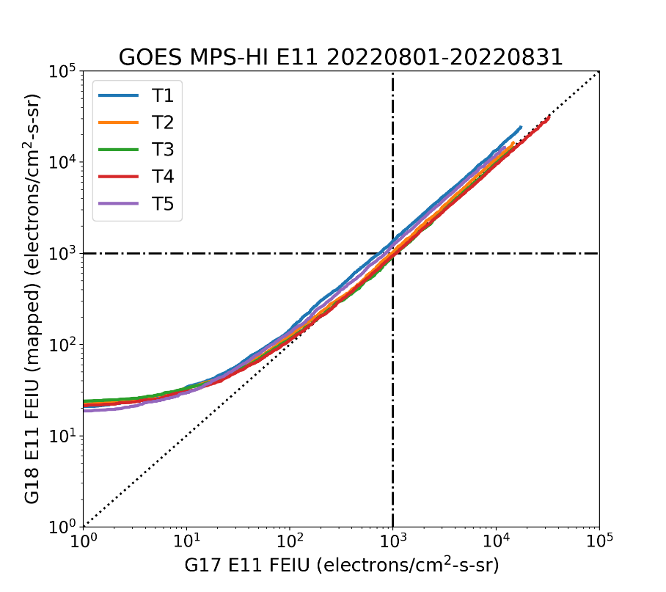
PLPT-SEI-005: Cross-Satellite Comparison of Trapped Particles: Results
Comparison of >2 MeV electron fluxes for the month of August 2022: Use a rigorous method to compare two time series at different satellites: ‘Statistical Asynchronous Regression’ [O’Brien et al., JGR, 106, 2001].
Calculate the percentile ratios of the G17/G18 E11 integral flux (note different E11 energies)
Good agreement for the central telescope T4 that is used by SWPC for its alerts
Not so good agreement for T1 and T5, G17 lower
G17/G18 MPS-HI E11 Integral Flux Ratio
Percentile | T1 | T2 | T3 | T4 | T5
25 | 0.56 | 0.74 | 0.40 | 0.72 | 0.46
50 | 0.74 | 0.98 | 1.08 | 1.05 | 0.81
75 | 0.73 | 0.92 | 1.03 | 1.06 | 0.81
90 | 0.74 | 0.92 | 1.04 | 1.08 | 0.81
O’Brien, T. P., Sornette, D., & McPherron, R. L. (2001) Statistical asynchronous regression: Determining the relationship between two quantities that are not measured simultaneously, Journal of Geophys. Res., Space Phys. 106, 13,247‒13,259. https://doi.org/10.1029/2000JA900193.
These GOES-18 data are preliminary, non-operational data and are undergoing testing. Users bear all responsibility for inspecting the data prior to use and for the manner in which the data are utilized.

Slide 40
PLPT-SEI-005: Cross-Satellite Comparison of Trapped Particles: Summary
Differential fluxes (3 months)
Compared GOES-18 to GOES-17 when the two are only 0.4 degrees longitude apart (06/07/2022-09/05/2022)
Calculated particle distributions and flux percentile spectra
The electron spectra are mostly identical
Some lower G17 fluxes as expected by the age of the GOES-17 detector
GOES-18 ETel5 has somewhat lower fluxes in some energy channels
The proton spectra show much lower GOES-17 fluxes in channels P1-P5, and somewhat lower fluxes in P6-P7
Known issue with GOES-17 (and GOES-16) that is being actively investigated
Integral flux, channel E11 (1 month)
Used Statistical Asynchronous Regression to compare G17 and G18
Central telescope T4 in good agreement, G17 lower at T1 and T5
PLPT-SEI-005 for GOES-18 is a solid
Pass
These GOES-18 data are preliminary, non-operational data and are undergoing testing. Users bear all responsibility for inspecting the data prior to use and for the manner in which the data are utilized.

Slide 41
PLPT-SEI-006: Backgrounds Trending: Introduction
Pass
MPS-HI E9-E11 Background Removal
The four highest-energy electron channels from MPS-HI (E9, E10, E10A, and E11) are susceptible to contamination by 100’s of MeV protons. The baseline correction algorithm (CDRL80) uses fluxes from SGPS –X P9, P10 and P11 to estimate and remove the spurious rates due to proton contamination.
$$M_{ELE}\left(i,E11\right)=N_{ELE}^{true}\left(i,E11\right)−C_{ELE}^{obc}\left(i,E11\right)$$
$$C_{ELE}^{obc}\left(i,E11\right)=α\left(i,E11\right)F_{{SGPS−X}_{P9}}+β\left(i,E11\right)F_{{SGPS−X}_{P10}}+γ\left(i,E11\right)F_{{SGPS−X}_{P11}}$$
At launch CDRL80 sets $α=0$, $β≠0$, $γ≠0$.
Together with the values for E9, E10, and E10A, they comprise the dataset "theOutOfBandWeightingFactors" in the MPS-HI LUT.
The baseline correction derives $β$ and $γ$ for solar proton spectra from GEANT4 simulations of the proton responses of the electron channels.
The baseline algorithm is inadequate to correct for the observed slowly-varying background due presumably to Galactic Cosmic Ray (GCR) protons.
These GOES-18 data are preliminary, non-operational data and are undergoing testing. Users bear all responsibility for inspecting the data prior to use and for the manner in which the data are utilized.

Slide 42
PLPT-SEI-006: Backgrounds Trending: Methodology
Pass
G18 MPS-HI E9-E11 Revised Background Removal (ADR1253)
The background removal coefficients were corrected so as to better account for the GCR proton contamination (J. Rodriguez/A. Boudouridis). This involves a number of observations and assumptions (demonstrated for MPS-HI E11):
The first assumption is that the MPS-HI backgrounds are due to the GCRs.
SGPS P11 is the best single measure of GCR fluxes, and therefore is used exclusively for the background correction, $α=0$, $β=0$, $C_{ELE}^{obc}\left(i,E11\right)=γ\left(i,E11\right)F_{{SGPS−X}_{P11}}$.
The remaining coefficient $γ$ is calculated separately for each telescope.
Since SGPS-X P11 can track the GCR background well, we can average the SGPS-X P11 fluxes and the background fluxes in E11 due to the GCRs, yielding
$$γ\left(i,E11\right)={\overline{C_{ELE}^{obc}(i,E11)}}/{\overline{F_{{SGPS−X}_{P11}}}}=G_{P11}{\overline{C_{ELE}^{obc}(i,E11)}}/{\overline{C_{P11}}}$$
These GOES-18 data are preliminary, non-operational data and are undergoing testing. Users bear all responsibility for inspecting the data prior to use and for the manner in which the data are utilized.

Slide 43
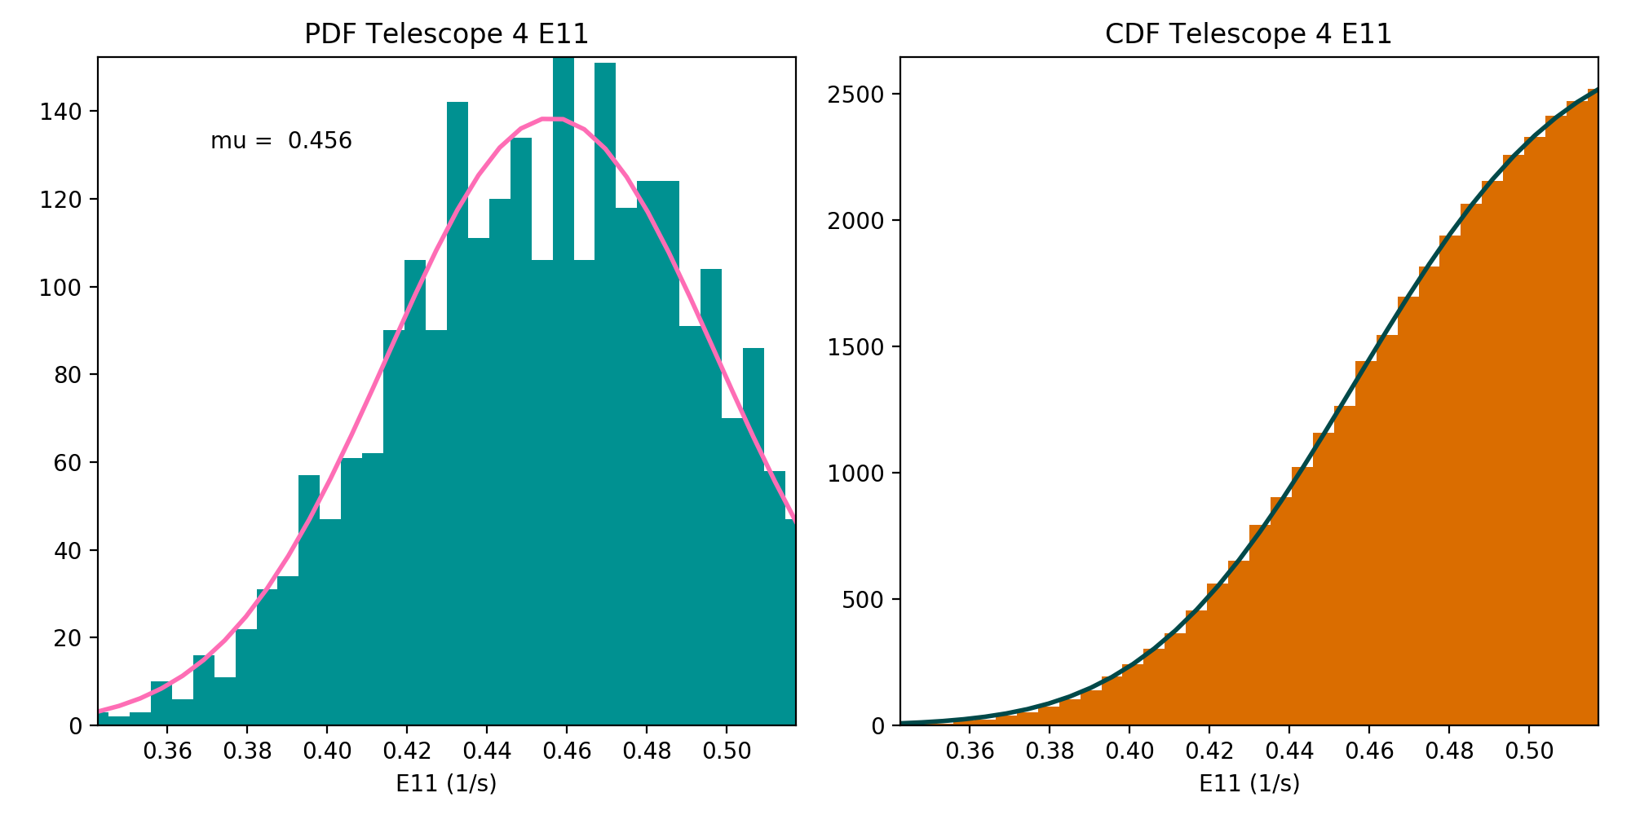
PLPT-SEI-006: Backgrounds Trending: Methodology
Pass
Modeling the GCR background
Assume that the peak and the part of the PDF below the peak are dominated by the rates due to GCRs, model as Gaussians.
Gaussian PDF: $f\left(x\right)=a exp\left[−\frac{{(x−μ)}^{2}}{2σ^{2}}\right]$
Gaussian CDF: $F\left(x\right)=aσ\sqrt{\frac{π}{2}}\left[1+erf\left(\frac{x−μ}{σ\sqrt{2}}\right)\right]$
Conduct the analysis using 5-min averages during the GOES-18 pre-drift period, 04/25/2022-05/17/2022.
Fit the CDF that is varying smoothly, instead of PDF.
$\overline{C_{ELE}^{obc}(i,E11)}=μ_{E11}$ (fitted E11 mean).
Do the same for SGPS-X P11 counts, $\overline{C_{P11}}=μ_{P11}$
Repeat for E9, E10, E10A.
Estimate gammas.
Apply to the 1s L1b data.
These GOES-18 data are preliminary, non-operational data and are undergoing testing. Users bear all responsibility for inspecting the data prior to use and for the manner in which the data are utilized.

Slide 44
PLPT-SEI-006: Backgrounds Trending: Results
Pass
GOES-18 LUT update
Gamma correction coefficient calculated for GOES-18 MPS-HI E9-E11,
incorporated into revised MPS-HI LUT on September 1, 2022 (ADR 1253)
 | E9 | E10 | E10A | E11
T1 | 0.2963 | 0.6096 | 0.6194 | 1.4499
T2 | 0.3139 | 0.6045 | 0.5876 | 1.4328
T3 | 0.3477 | 0.6456 | 0.5249 | 1.4346
T4 | 0.3869 | 0.6686 | 0.5662 | 1.5167
T5 | 0.3440 | 0.6092 | 0.5519 | 1.4253
These GOES-18 data are preliminary, non-operational data and are undergoing testing. Users bear all responsibility for inspecting the data prior to use and for the manner in which the data are utilized.

Slide 45
PLPT-SEI-006: Backgrounds Trending: Results
Pass
T3
GOES-18 channel E11 $(>2$ MeV)
T1
1000 electrons per (cm² sr s)
T4
SWPC alert level very close to uncorrected backgrounds
T2
T5
Corrected backgrounds more representative of the GCR spectrum
DOS
These GOES-18 data are preliminary, non-operational data and are undergoing testing. Users bear all responsibility for inspecting the data prior to use and for the manner in which the data are utilized.

Slide 46
PLPT-SEI-006: Backgrounds Trending: Additional Considerations
Pass
The calculated Gamma correction factors were produced from 3 weeks of pre-drift data (04/25/2022-05/17/2022)
This work was performed in June of 2022 in an expedited way in order to submit ADR 1253 to modify the MPS-HI LUT, and correct the L1b data for the bowtie analysis and the revised backgrounds, as soon as possible
The revised MPS-HI LUT went live on the OE on September 1, 2022, much earlier than for the previous two MPS-HI instruments (GOES-16/-17)
RIMP v 2.0: PLPT-SEI-006 for Provisional Validation requires two months of MPS-HI data
The SEISS team has recently revisited PLPT-SEI-006 for the post-drift period of 07/01/2022-08/31/2022 (two months)
These GOES-18 data are preliminary, non-operational data and are undergoing testing. Users bear all responsibility for inspecting the data prior to use and for the manner in which the data are utilized.

Slide 47
PLPT-SEI-006: Backgrounds Trending: Additional Considerations
Pass
Pre-drift gammas, 04/25/2022-05/17/2022 (ADR 1253)
 | E9 | E10 | E10A | E11
T1 | 0.2963 | 0.6096 | 0.6194 | 1.4499
T2 | 0.3139 | 0.6045 | 0.5876 | 1.4328
T3 | 0.3477 | 0.6456 | 0.5249 | 1.4346
T4 | 0.3869 | 0.6686 | 0.5662 | 1.5167
T5 | 0.3440 | 0.6092 | 0.5519 | 1.4253
Post-drift gammas, 07/01/2022-08/31/2022 (Provisional)
 | E9 | E10 | E10A | E11
T1 | 0.3763 | 0.6447 | 0.6313 | 1.5764
T2 | 0.4218 | 0.6462 | 0.5971 | 1.6014
T3 | 0.4226 | 0.6789 | 0.5204 | 1.5521
T4 | 0.4876 | 0.7018 | 0.5695 | 1.6545
T5 | 0.4182 | 0.6232 | 0.5497 | 1.5384
Post-drift gammas are higher than the pre-drift ones
These GOES-18 data are preliminary, non-operational data and are undergoing testing. Users bear all responsibility for inspecting the data prior to use and for the manner in which the data are utilized.

Slide 48
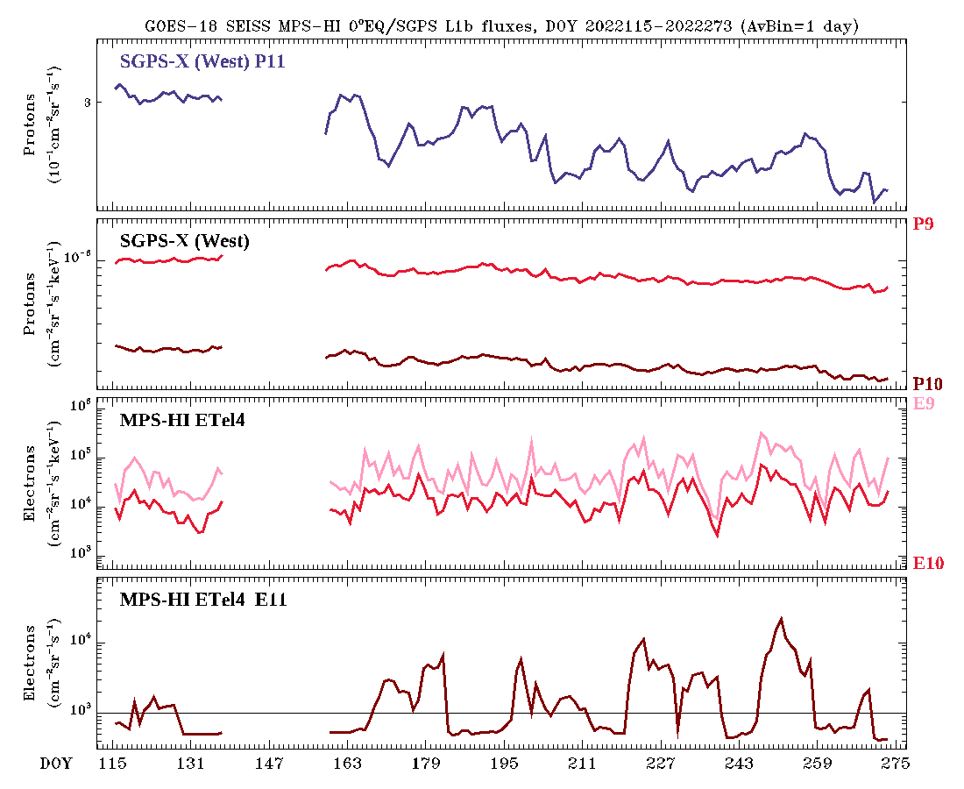
PLPT-SEI-006: Backgrounds Trending: Additional Considerations
Pass
Entire mission plot 04/25/2022-09/30/2022
$γ\left(i,E11\right)=\frac{\overline{C_{ELE}^{obc}(i,E11)}}{\overline{F_{{SGPS−X}_{P11}}}}$
SGPS-X P11 flux is dropping with time
E9-E11 fluxes are not
Post-drift gammas are higher than pre-drift gammas
Inclusion of SGPS P9 and/or P10 will not improve the situation as they are both dropping, even faster
Not an issue with G18 SGPS, shows in G16/G17
PROVISIONAL
ADR 1253
ADR 1253
PROVISIONAL
These GOES-18 data are preliminary, non-operational data and are undergoing testing. Users bear all responsibility for inspecting the data prior to use and for the manner in which the data are utilized.

Slide 49
PLPT-SEI-006: Backgrounds Trending: Additional Considerations
Pass
Electron data processed with the LUT using pre-drift data, 04/25/2022-05/17/2022
T1
GOES-18 channel E11 $(>2$ MeV)
T1 and T4 electron telescopes (equatorial telescopes most often used by SWPC)
T4
Electron data processed with the LUT using post-drift data, 07/01/2022-08/31/2022
T1
This LUT has not been delivered!
T4
1000 electrons per (cm² sr s)
Even though the background correction is different for the two cases, the background removal does not substantially affect data above the SWPC alert level
These GOES-18 data are preliminary, non-operational data and are undergoing testing. Users bear all responsibility for inspecting the data prior to use and for the manner in which the data are utilized.

Slide 50
PLPT-SEI-006: Backgrounds Trending: Summary
The baseline algorithm underestimates the backgrounds
It is inadequate to correct for the observed slowly-varying GCRs
After the correction, the background level is still too close to the SWPC E11 (> 2 MeV) alert level
Revision of the algorithm performed by Juan Rodriguez for G16/G17 can be applied to GOES-18
The revised algorithm is successful in reducing the backgrounds to appropriate levels
Caveat: the space environment is changing (impacting all spacecraft!)
The SGPS-X P11 fluxes, that the correction is based on, are decreasing
Gamma correction factors are increasing, leading to enhanced background removal
Despite the changes, the E11 fluxes above the SWPC >2 MeV alert level are not significantly affected
NCEI will monitor closely, report findings at the MPS-HI Full PS-PVR, and revise "theOutOfBandWeightingFactors" in the MPS-HI LUT accordingly
Despite the above caveat PLPT-SEI-006 is deemed a
Pass
These GOES-18 data are preliminary, non-operational data and are undergoing testing. Users bear all responsibility for inspecting the data prior to use and for the manner in which the data are utilized.

Slide 51
GOES-18 Provisional PLPTs: Summary
PLPT-SEI-002: MPS-HI Telescope Cross-Comparison
Calculated scale factors for all energy and telescope pairs, during pitch matches with significant flux levels [Rowland and Weigel, 2012]
Most electron and proton energy/telescope pairs are within 25% accuracy
PLPT-SEI-004: Solar Energetic Particle (SEP) Cross-Comparison
Compared G17 and G18 MPS-HI units, and G18 SGPS and MPS-HI units during a low dynamic pressure event (isotropy of fluxes has not been achieved)
MPS-HI units agree within ~10% (with some exceptions)
G18 MPS-HI P8-P10 not in agreement with SGPS P1-P3, but P11 agrees with SGPS P4
PLPT-SEI-005: Cross-Satellite Comparison of Trapped Particles
Compared GOES-18 to GOES-17 when they are only 0.4 degrees longitude apart, by calculating particle distributions and flux percentile spectra
Electron spectra agree well, G17 proton spectra are much lower in P1-P5, lower in P6-P7
PLPT-SEI-006: Backgrounds Trending
Calculated gamma correction factors by fitting lower part of MPS-HI E9-E11 distributions to Gaussians, and doing the same with SGPS-X P11 (considered the only source of backgrounds)
Correction leads to appropriate background levels, but the space environment is changing
Pass
Pass
Pass
Pass
These GOES-18 data are preliminary, non-operational data and are undergoing testing. Users bear all responsibility for inspecting the data prior to use and for the manner in which the data are utilized.

Slide 52
GOES-18: Status at Provisional Review
 | Observed Issue | Current Status | Future Outlook
Electron differential flux | Dropouts due to inversion matrix Problem anticipated before the launch of the GOES-R satellites Waiver (Feb 2015) led to NCEI being funded to develop new LUT with SWPC’s concurrence | Modified MPS-HI LUT installed on 09/01/2022 is working properly in OE Comparison with GOES-17 indicates reasonable agreement | Intra-calibration results will be used (if necessary) to adjust calibration coefficients in future LUT for Full validation NCEI will keep monitoring
Backgrounds (E9-E11) | Backgrounds too high in E11 for SWPC to use this channel for >2 MeV alerts Existing contamination correction coefficients are too small | Modified MPS-HI LUT installed on 09/01/2022 is working properly in OE Modified LUT provides adequate background correction | Changing space environment will determine if modified correction continues to track E9-E11 backgrounds NCEI will keep monitoring
Proton differential flux (P1-P7) | No issues evident upon initial inspection of data | Comparisons with G16/G17 indicates that G16/G17 may have degraded on-orbit due to radiation damage Expect G18 to degrade as well? | Options include modifying geometrical factors in LUTs or determining different effective energies (metadata) NCEI will keep monitoring
Solar proton channels (P8-P11) | MPS-HI channels P8-P10 lower than SGPS P1-P3 GOES-18 MPS-HI P11 higher than GOES-16/-17 | Possible root cause: Inaccurate geometric factors or energies Under investigation | Calibration of later MPS-HI and SGPS T1 units at various facilities (BNL, NIST, MGH) Already planned
These GOES-18 data are preliminary, non-operational data and are undergoing testing. Users bear all responsibility for inspecting the data prior to use and for the manner in which the data are utilized.

Slide 53
GOES-18: Remaining issues
Summary
Solar Proton channels
Comparison of MPS-HI channels P8-P11 with SGPS P1-P4 for a suitable Solar Energetic Particle (SEP) event
Disagreement of MPS-HI P8-P10 fluxes with those of SGPS P1-P3
Similar flux levels in MPS-HI channel P11 and SGPS channel P4
Comparison of GOES-18 MPS-HI with other operational GOES-R series satellites
Good agreement between GOES-17 and GOES-18 for most cases
Much higher GOES-18 P11 channel fluxes compared to GOES-16
Requires a more suitable SEP event
Requires beam calibration of MPS-HI and SGPS (has been agreed by the program, planned by the instrument vendor)
Background Removal
Modification of the background removal coefficients is successful in yielding appropriate background levels, consistent with Galactic Cosmic Ray (GCR) fluxes
Complication: the space environment is changing
Requires continued monitoring
Possible revision of the background removal coefficients in the future
These GOES-18 data are preliminary, non-operational data and are undergoing testing. Users bear all responsibility for inspecting the data prior to use and for the manner in which the data are utilized.

Slide 54
Provisional Maturity Assessment
GOES-18 MPS-HI L1b Products Provisional PS-PVR

Slide 55
Provisional Validation
Preparation Activities | Assessment
Validation and quality assurance activities are ongoing, and the general research community is now encouraged to participate. | Validation activities are ongoing. Results have been discussed with SWPC. Release of data by NCEI will enable research community participation.
Severe algorithm anomalies are identified and under analysis. Solutions to anomalies are in development and testing. | Major anomalies fixed through LUT modification (ADR 1253). Correct performance of LUT verified in OE.
Incremental product improvements may still be occurring. | Incremental product improvements are expected, primarily through updated LUTs incorporating results of cross-cal.
Users are engaged in the Customer Forums, and user feedback is assessed. | Engagement with the operational and scientific community is on an ongoing basis. User concerns and questions are routinely addressed.
From 410-R-RIMP-0318 Version 2.0 07/09/2021,
Responsible Organization: GOES-R Program/Code 410

Slide 56
Provisional Validation
End State | Assessment
Product performance has been demonstrated through analysis of a small number of independent measurements obtained from selected locations, periods, and associated ground-truth/field program efforts. | PLPTs performed on reprocessed MPS-HI fluxes from post-launch to present.
Product analysis is sufficient to communicate product performance to users relative to expectations. | Yes, to the limited extent of available resources and time, prioritized based on customer needs.
Documentation of product performance exists that includes recommended remediation strategies for all anomalies and weaknesses. Any algorithm changes associated with severe anomalies have been documented, implemented, tested, and shared with the user community. | This presentation, the L1b Readme files, the memos on background correction, and article by Boudouridis et al. [2020] in Space Weather.
Testing has been fully documented. | This presentation; memo on background correction.
Product is ready for operational use and for use in comprehensive cal/val activities and product optimization. | NCEI: yes.
From 410-R-RIMP-0318 Version 2.0 07/09/2021,
Responsible Organization: GOES-R Program/Code 410

Slide 57
Performance Baseline Status
Assessment at Provisional Validation
MRD ID | Description | Related PLPTs | Status
1996 | MPS-HI Orthogonality/Coverage | -02, -04 | PLPTs underway
2000 | MPS-HI Measurement Range | -02, -04 | PLPTs underway
2001 | MPS-HI Measurement Accuracy | -02, -04, -05, -06 | PLPTs underway
MRD1996: Data in 5 directions
Currently being met for electrons and protons
MRD2000: Measurement Range
Requirements: Electrons 50 keV to 4 MeV plus >2 MeV; Protons 80 keV to 10 MeV
Currently, all channels are functional and exhibit characteristic variation in behavior w/ energy
Ground cal & cross-cal activities indicate that energy measurement range is covered
MRD2001: Measurement Accuracy
Requirements: @min flux <45%, @10X min flux < 25%
Absolute accuracy cannot be verified on-orbit
Results of PLPT-002 indicate that the inter-telescope differences are rarely greater than 25%
Results of PLPT-004 show that GOES-18 MPS-HI P8-P10 reported fluxes are systematically low compared to SGPS channels P1-P3, and GOES-18 P11 is higher than GOES-16/-17 P11
Results of PLPT-005 indicate that GOES-18 proton fluxes are systematically higher than GOES-16/-17 fluxes
Results of PLPT-006 show that the space environment is changing, background needs to be monitored

Slide 58
Remaining Risks
Risk Name | Description | Impact | Mitigation and Schedule
MPS-HI E9-E11 Background removal variation | IF the variation of the space environment is not adequately assessed | THEN proper tracking of the backgrounds will be insufficient | NCEI will monitor the changes in the space environment Will revisit background removal and modify the LUT accordingly
MPS-HI solar proton channel disagreement | IF MPS-HI P8-P10 and SGPS P1-P3 are not both calibrated | THEN root cause of large disagreement will not be understood | Program has authorized MPS-HI and SGPS units calibration, and vendor has planned for them Wait for next SEP event to cross-calibrate with GOES-16 and/or GOES-17

Slide 59
Path to full Validation Maturity
GOES-18 MPS-HI L1b Products Provisional PS-PVR

Slide 60
Path to Full Validation
ADRs/WRs put through GOES-16 and GOES-17, that might indirectly affect GOES-18, need to be resolved prior to Full Validation.
PLPTs to be conducted prior to Full Validation.
Performance Baseline status to be re-assessed.
Risks to getting to Full, both from L1b product definition and user (SWPC) feedback, need to be assessed and addressed.

Slide 61
Path to Full Validation - PLPTs
Title | Activity | Data Needed | Success Criteria
A.3.2 MPS-Hi Telescope Cross-Comparison [PLPT-SEI-002] | Determine the relative sensitivity/response among MPS-HI telescopes. | Three months of continuous data. (MAG, MPS-HI) | [Full] Telescopes agree to within 25%.
A.3.4 SEP Channel Cross-Comparison [PLPT-SEI-004] | On-orbit cross-calibration of MPS-HI with SGPS 1-12 MeV protons, and all operational GOES-R Series SEISS sensors. | Two Solar Energetic Particle (SEP) events. | [Full] Differences quantified on data taken through validation phase.
A.3.5 Cross Satellite Comparison of Trapped Particles [PLPT-SEI-005] | To inter-calibrate MPS-HI with the same measurements on other operational GOES-R Series satellites. The MPS-HI inter-calibration part of the test is critical for establishing the consistency of the NOAA real-time >2 MeV electron flux alerts between operational GOES-R Series satellites. | Three months of continuous data. (MAG, MPS-HI) | [Full] Differences quantified on data taken through validation phase.
A.3.6 Backgrounds Trending [PLPT-SEI-006] | To evaluate MPS-HI backgrounds in terms of expected galactic cosmic ray (GCR) fluxes. | Four months of continuous data. (MPS-HI, SGPS) | [Full] Perform analysis during validation phase.
MPS-HI Full Validation PLPTs from RIMP v 2.0 (09 July 2021).

Slide 62
Summary & Recommendations
GOES-18 MPS-HI L1b Products Provisional PS-PVR

Slide 63
Summary
ADR/WR status: all ADRs identified for GOES-18 or indirectly affect it have been closed or have clear path forward
ADR 780: revisit, remedy has been identified and work is proceeding
ADR 863: back in analysis, a possible solution has been identified
Can become critical in case of catastrophic SGPS failure, as SWPC alert channel E11 will be lost
Planned Provisional PLPTs have been completed
Remaining risks that have been identified
MPS-HI and SGPS SEP channel disagreement: Beam Calibration is needed for MPS-HI P8-P11 channels and SGPS P1-P4 channels
Space environment is changing: E9-E11 background removal might need revision
780 | 6568 6845 | G16 & G17 MPS-HI and MPS-LO L1b IFC Leakage | Fix Fail In Analysis | DO.09.01.00 DO.12
863 | 6736 9318 | Graceful degradation when SGPS data not generated | On Hold In Analysis | DO.13

Slide 64
Recommendations
NCEI believes that the GOES-18 MPS-HI L1b product has reached the Provisional Maturity as defined by the GOES-R Program

Slide 65
Backup slides
GOES-18 MPS-HI L1b Products Provisional PS-PVR

Slide 66
GOES-16/GOES-17 proton sensor comparison to GOES-18
Satellite proximities permitting comparisons:
Until 16 May 2022: GOES-18 at 89.5ºW
14.3º (~1 hour LT) from GOES-16
Common separation distance for past comparisons between GOES satellites
GOES-18 drifted to near GOES-West
After 06 June 2022: GOES-18 at 136.8ºW
0.4º from GOES-17
Comparison periods: 3 weeks before drift and 3 weeks after drift
These GOES-18 data are preliminary, non-operational data and are undergoing testing. Users bear all responsibility for inspecting the data prior to use and for the manner in which the data are utilized.

Slide 67
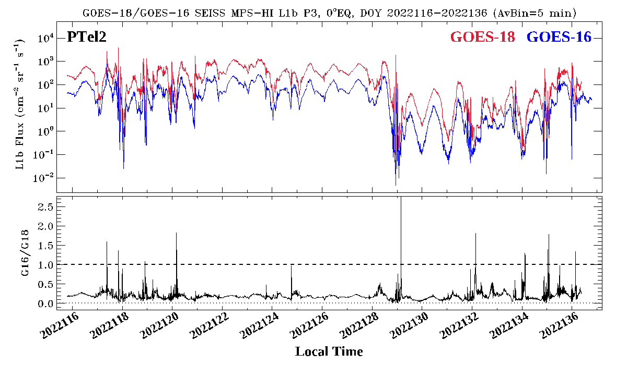
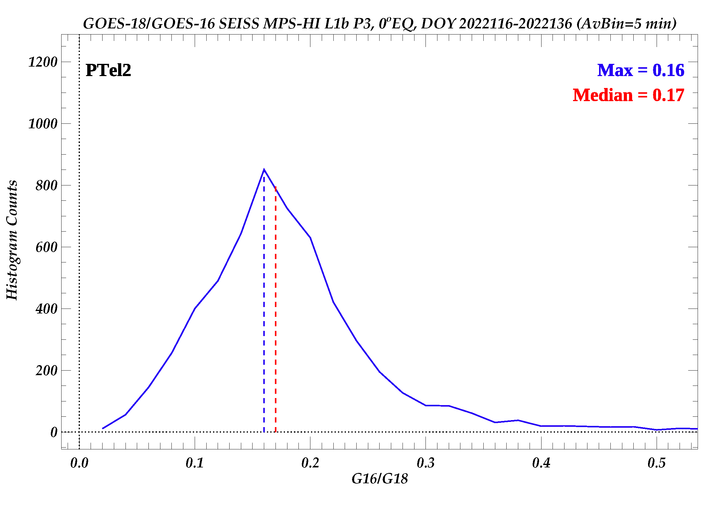
GOES-16/-18 flux comparison
Plot GOES-18 and GOES-16 MPS-HI channel P3 Proton Telescope 2 (PTel2 ) 5-min averaged fluxes for 3 weeks while the two spacecraft were in proximity, GOES-16 at 75.2W longitude and GOES-18 at 89.5W longitude, April 26 to May 16, 2022.
PTel2 is the central Proton telescope looking along the equator.
Take the ratio GOES-16/GOES-18 of P3 PTel2 5-min averaged fluxes.
Make the histogram of GOES-16/-18 MPS-HI P3 PTel2 5-min averaged fluxes for this period.
The median of the GOES-16 to GOES-18 PTel2 P3 flux ratio distribution is 0.17 (factor of 6).
The G16/G18 flux ratios are around 0.2.
These GOES-18 data are preliminary, non-operational data and are undergoing testing. Users bear all responsibility for inspecting the data prior to use and for the manner in which the data are utilized.

Slide 68
GOES-16/-18 flux comparison
Ratio medians
Protons
<10% 10-25% >25%
Channel | PTel1 | PTel4 | PTel2 | PTel5 | PTel3
P1 | 0.41 | 0.41 | 0.45 | 0.97 | 0.50
P2 | 0.28 | 0.20 | 0.21 | 0.39 | 0.33
P3 | 0.22 | 0.16 | 0.17 | 0.38 | 0.26
P4 | 0.24 | 0.15 | 0.17 | 0.36 | 0.27
P5 | 0.24 | 0.14 | 0.22 | 0.42 | 0.21
P6 | 0.33 | 0.32 | 0.26 | 0.97 | 0.54
P7 | 0.54 | 0.42 | 0.38 | 1.11 | 0.72
P8 | 0.88 | 0.69 | 0.78 | 1.22 | 0.95
P9 | 0.83 | 1.18 | 0.86 | 0.95 | 1.03
P10 | 0.84 | 0.69 | 0.69 | 0.61 | 0.78
P11 | 0.21 | 0.37 | 0.29 | 0.33 | 0.31
The GOES-16/GOES-18 proton flux ratio median is in general small, but especially small for the P1-P5 channels.
These GOES-18 data are preliminary, non-operational data and are undergoing testing. Users bear all responsibility for inspecting the data prior to use and for the manner in which the data are utilized.

Slide 69
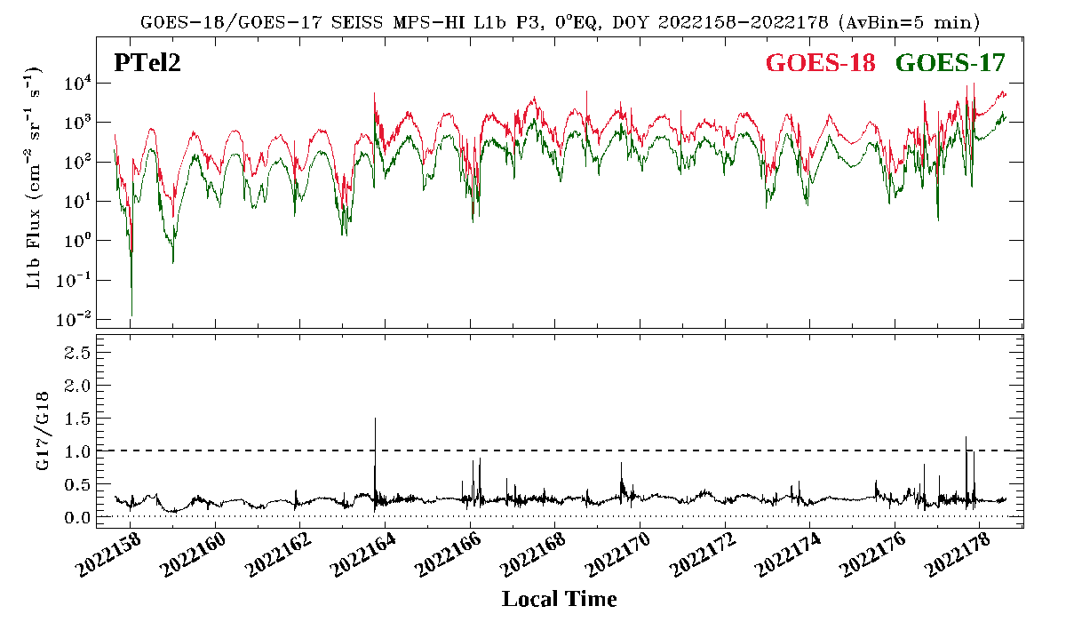
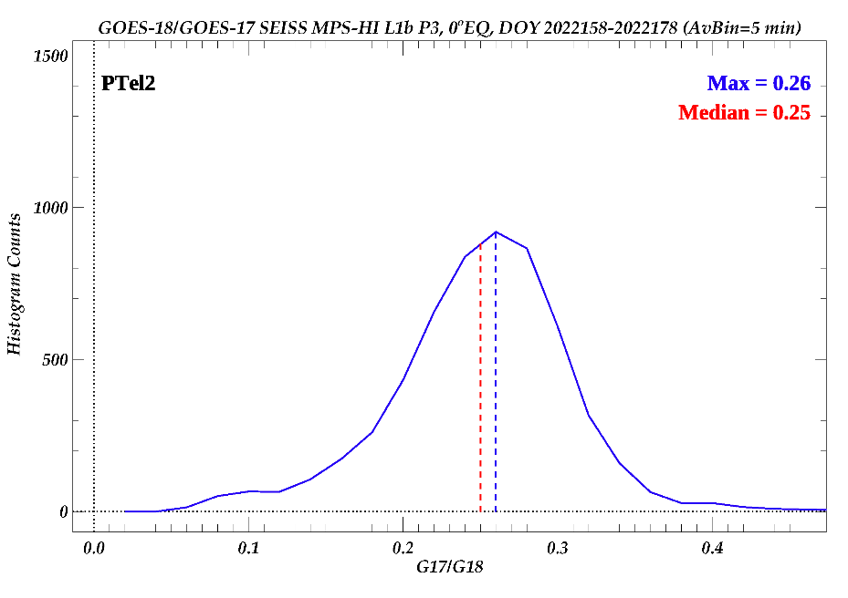
GOES-17/-18 flux comparison
Plot GOES-18 and GOES-17 MPS-HI channel P3 Proton Telescope 2 (PTel2 ) 5-min averaged fluxes for 3 weeks while the two spacecraft were in proximity, GOES-17 at 137.2W longitude and GOES-18 at 136.8W longitude, June 7 to June 27, 2022.
PTel2 is the central Proton telescope looking along the equator.
Take the ratio GOES-17/GOES-18 of P3 PTel2 5-min averaged fluxes.
Make the histogram of GOES-17/-18 MPS-HI P3 PTel2 5-min averaged fluxes for this period.
The median of the GOES-17 to GOES-18 PTel2 P3 flux ratio distribution is 0.25 (factor of 4).
The G17/G18 flux ratios are around 0.3.
These GOES-18 data are preliminary, non-operational data and are undergoing testing. Users bear all responsibility for inspecting the data prior to use and for the manner in which the data are utilized.

Slide 70
GOES-17/-18 flux comparison
Ratio medians
Protons
<10% 10-25% >25%
Channel | PTel1 | PTel4 | PTel2 | PTel5 | PTel3
P1 | 0.50 | 0.49 | 0.27 | 0.61 | 0.57
P2 | 0.37 | 0.33 | 0.21 | 0.28 | 0.35
P3 | 0.26 | 0.29 | 0.25 | 0.23 | 0.37
P4 | 0.26 | 0.29 | 0.20 | 0.23 | 0.37
P5 | 0.31 | 0.39 | 0.31 | 0.34 | 0.38
P6 | 0.99 | 0.57 | 0.46 | 0.63 | 0.62
P7 | 0.86 | 0.69 | 0.80 | 0.84 | 0.71
P8 | 1.00 | 0.83 | 1.25 | 0.76 | 0.73
P9 | 1.18 | 1.00 | 0.52 | 1.07 | 1.17
P10 | 1.16 | 1.00 | 0.86 | 1.00 | 1.00
P11 | 1.00 | 1.00 | 1.00 | 1.00 | 1.00
The GOES-17/GOES-18 proton flux ratio median is very small for the P1-P5 channels.
These GOES-18 data are preliminary, non-operational data and are undergoing testing. Users bear all responsibility for inspecting the data prior to use and for the manner in which the data are utilized.

Slide 71
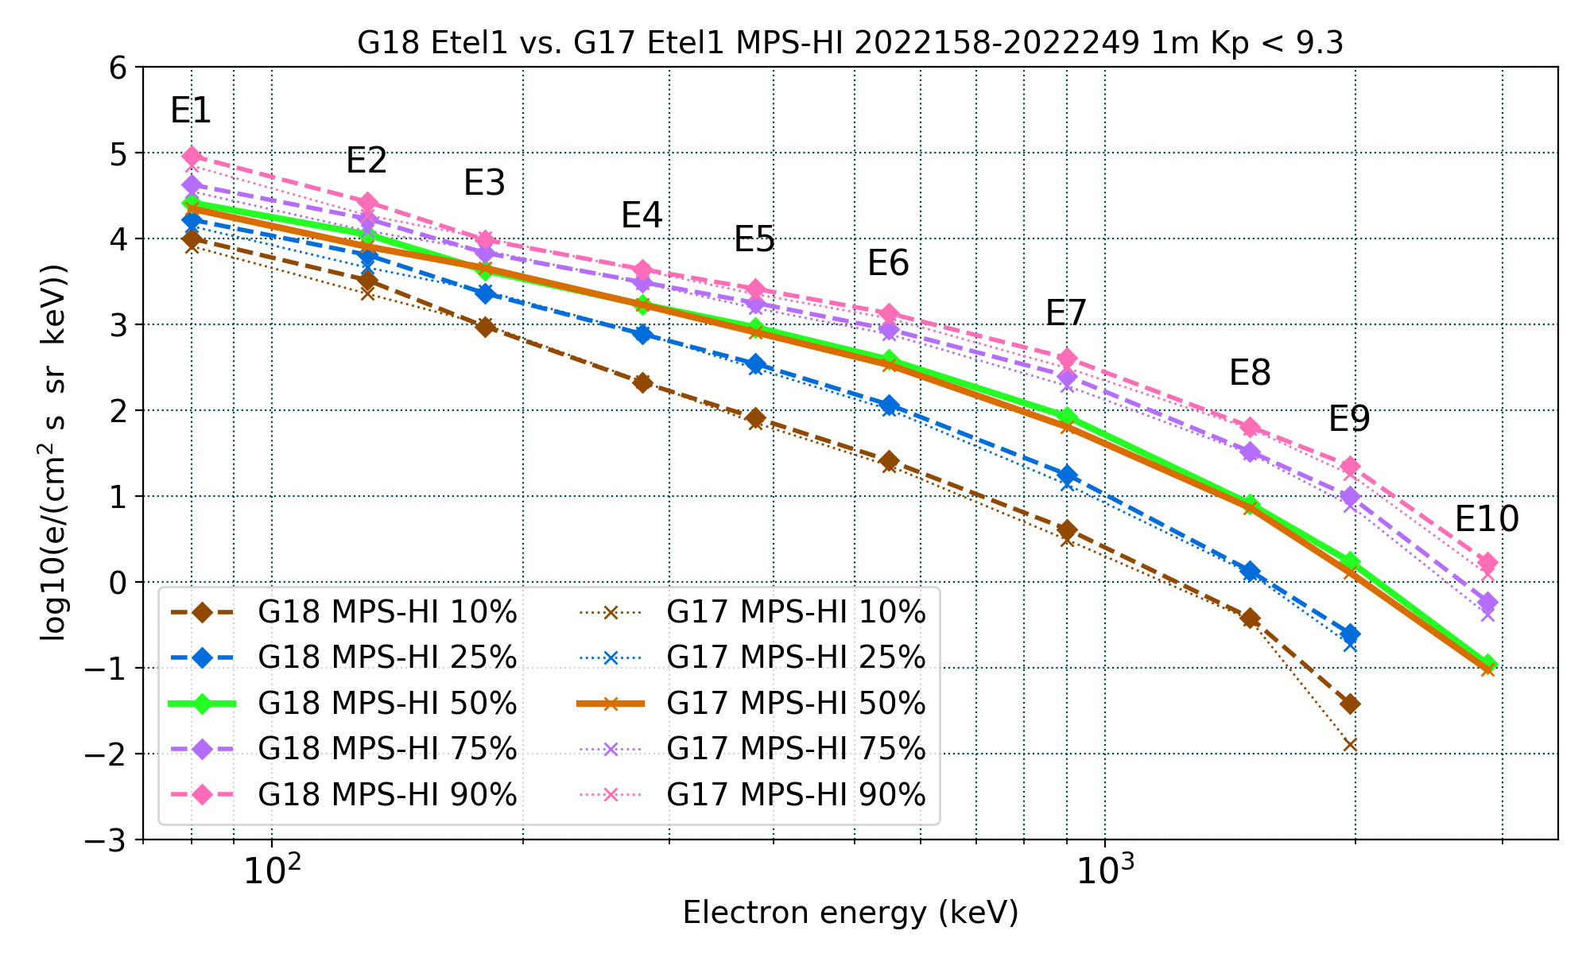
PLPT-SEI-005: Cross-Satellite Comparison of Trapped Particles: Results
Pass
GOES-18 vs GOES-17 Electrons , 06/07/2022– 09/05/2022
Missing or significantly lower fluxes are at residual background levels
Boudouridis, A., Rodriguez, J. V., Kress, B. T., Dichter, B. K., & Onsager, T. G. (2020). Development of a bowtie inversion technique for real‐time processing of the GOES‐16/‐17 SEISS MPS‐HI electron channels. Space Weather, 18, e2019SW002403. https://doi.org/10.1029/2019SW002403
These GOES-18 data are preliminary, non-operational data and are undergoing testing. Users bear all responsibility for inspecting the data prior to use and for the manner in which the data are utilized.

Slide 72
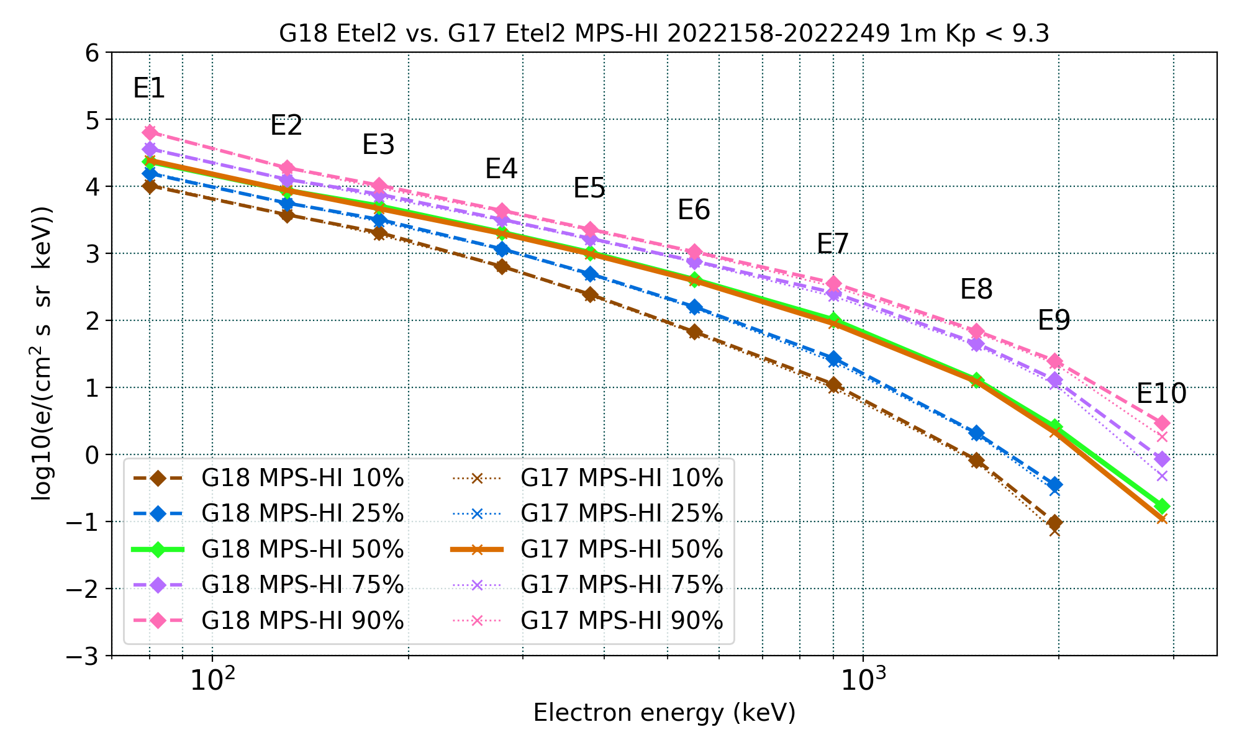
PLPT-SEI-005: Cross-Satellite Comparison of Trapped Particles: Results
Pass
GOES-18 vs GOES-17 Electrons , 06/07/2022– 09/05/2022
Missing or significantly lower fluxes are at residual background levels
Boudouridis, A., Rodriguez, J. V., Kress, B. T., Dichter, B. K., & Onsager, T. G. (2020). Development of a bowtie inversion technique for real‐time processing of the GOES‐16/‐17 SEISS MPS‐HI electron channels. Space Weather, 18, e2019SW002403. https://doi.org/10.1029/2019SW002403
These GOES-18 data are preliminary, non-operational data and are undergoing testing. Users bear all responsibility for inspecting the data prior to use and for the manner in which the data are utilized.

Slide 73
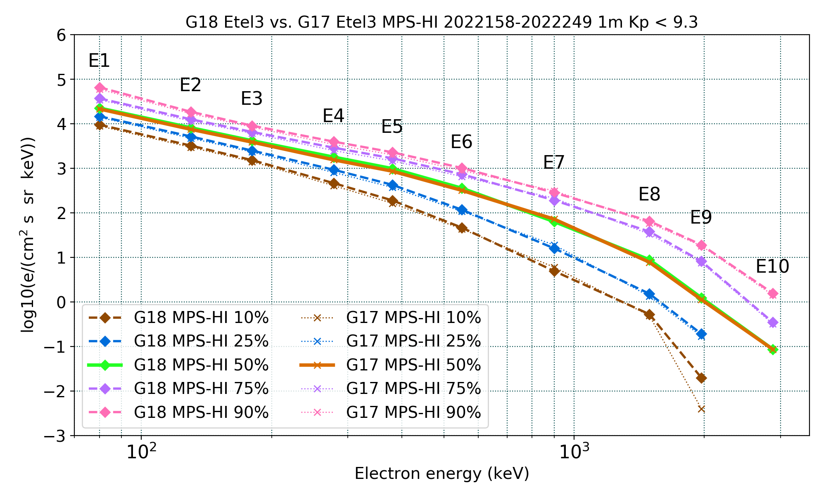
PLPT-SEI-005: Cross-Satellite Comparison of Trapped Particles: Results
Pass
GOES-18 vs GOES-17 Electrons , 06/07/2022– 09/05/2022
Missing or significantly lower fluxes are at residual background levels
Boudouridis, A., Rodriguez, J. V., Kress, B. T., Dichter, B. K., & Onsager, T. G. (2020). Development of a bowtie inversion technique for real‐time processing of the GOES‐16/‐17 SEISS MPS‐HI electron channels. Space Weather, 18, e2019SW002403. https://doi.org/10.1029/2019SW002403
These GOES-18 data are preliminary, non-operational data and are undergoing testing. Users bear all responsibility for inspecting the data prior to use and for the manner in which the data are utilized.

Slide 74
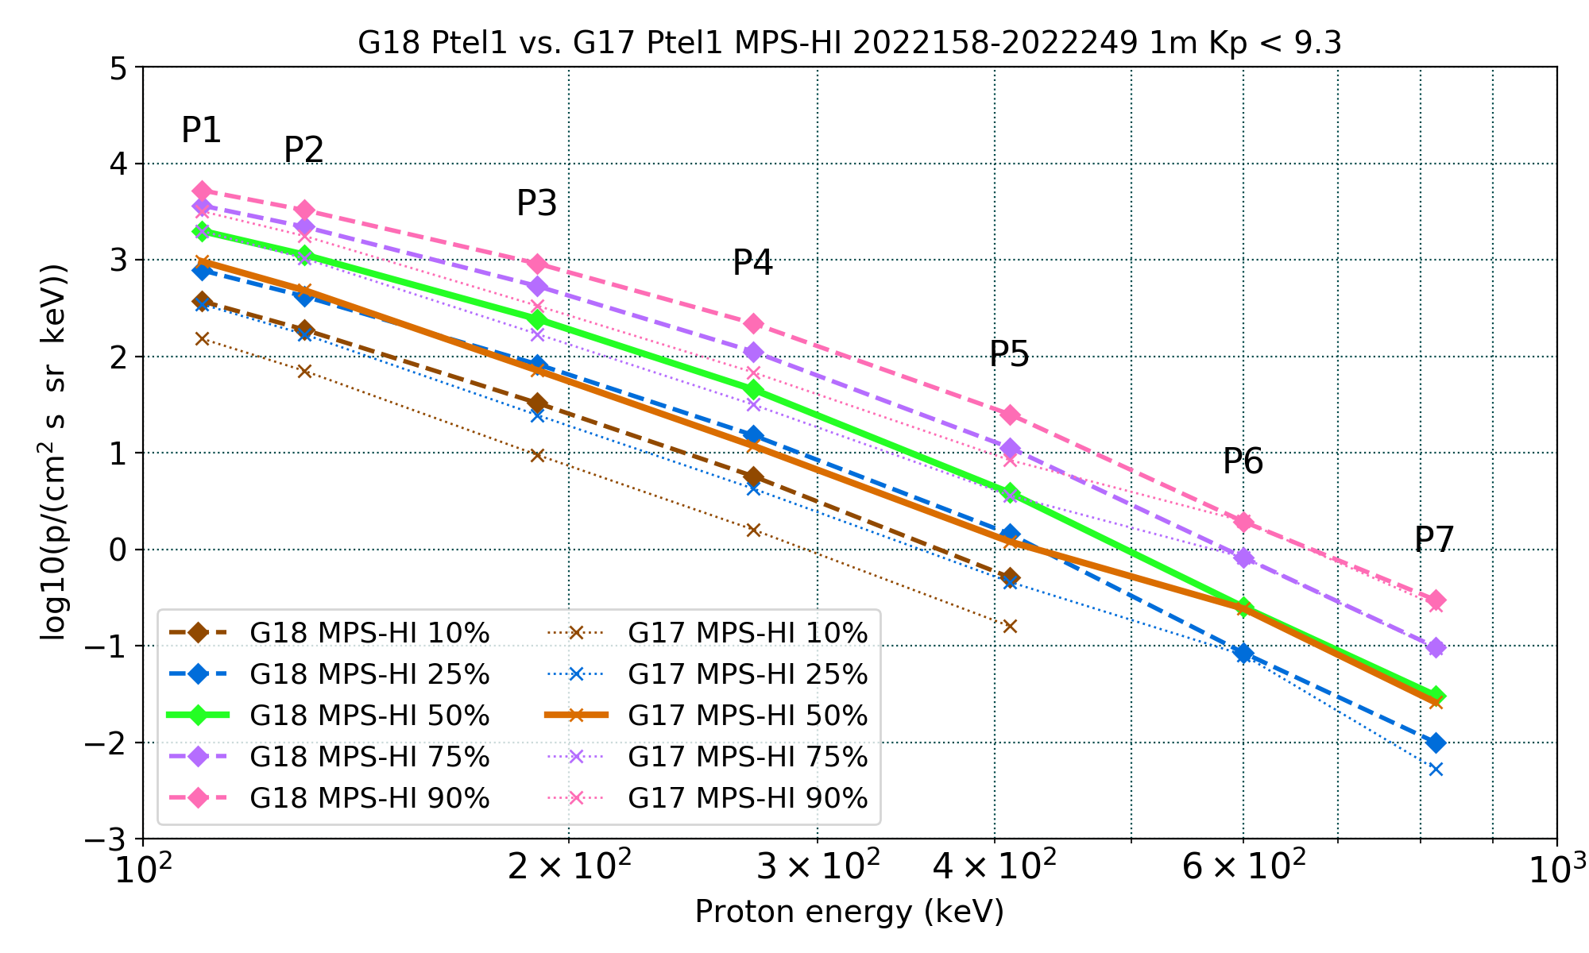
PLPT-SEI-005: Cross-Satellite Comparison of Trapped Particles: Results
Pass
GOES-18 vs GOES-17 Protons , 06/07/2022– 09/05/2022
Apply only to P1-P7
Boudouridis, A., Rodriguez, J. V., Kress, B. T., Dichter, B. K., & Onsager, T. G. (2020). Development of a bowtie inversion technique for real‐time processing of the GOES‐16/‐17 SEISS MPS‐HI electron channels. Space Weather, 18, e2019SW002403. https://doi.org/10.1029/2019SW002403
These GOES-18 data are preliminary, non-operational data and are undergoing testing. Users bear all responsibility for inspecting the data prior to use and for the manner in which the data are utilized.

Slide 75
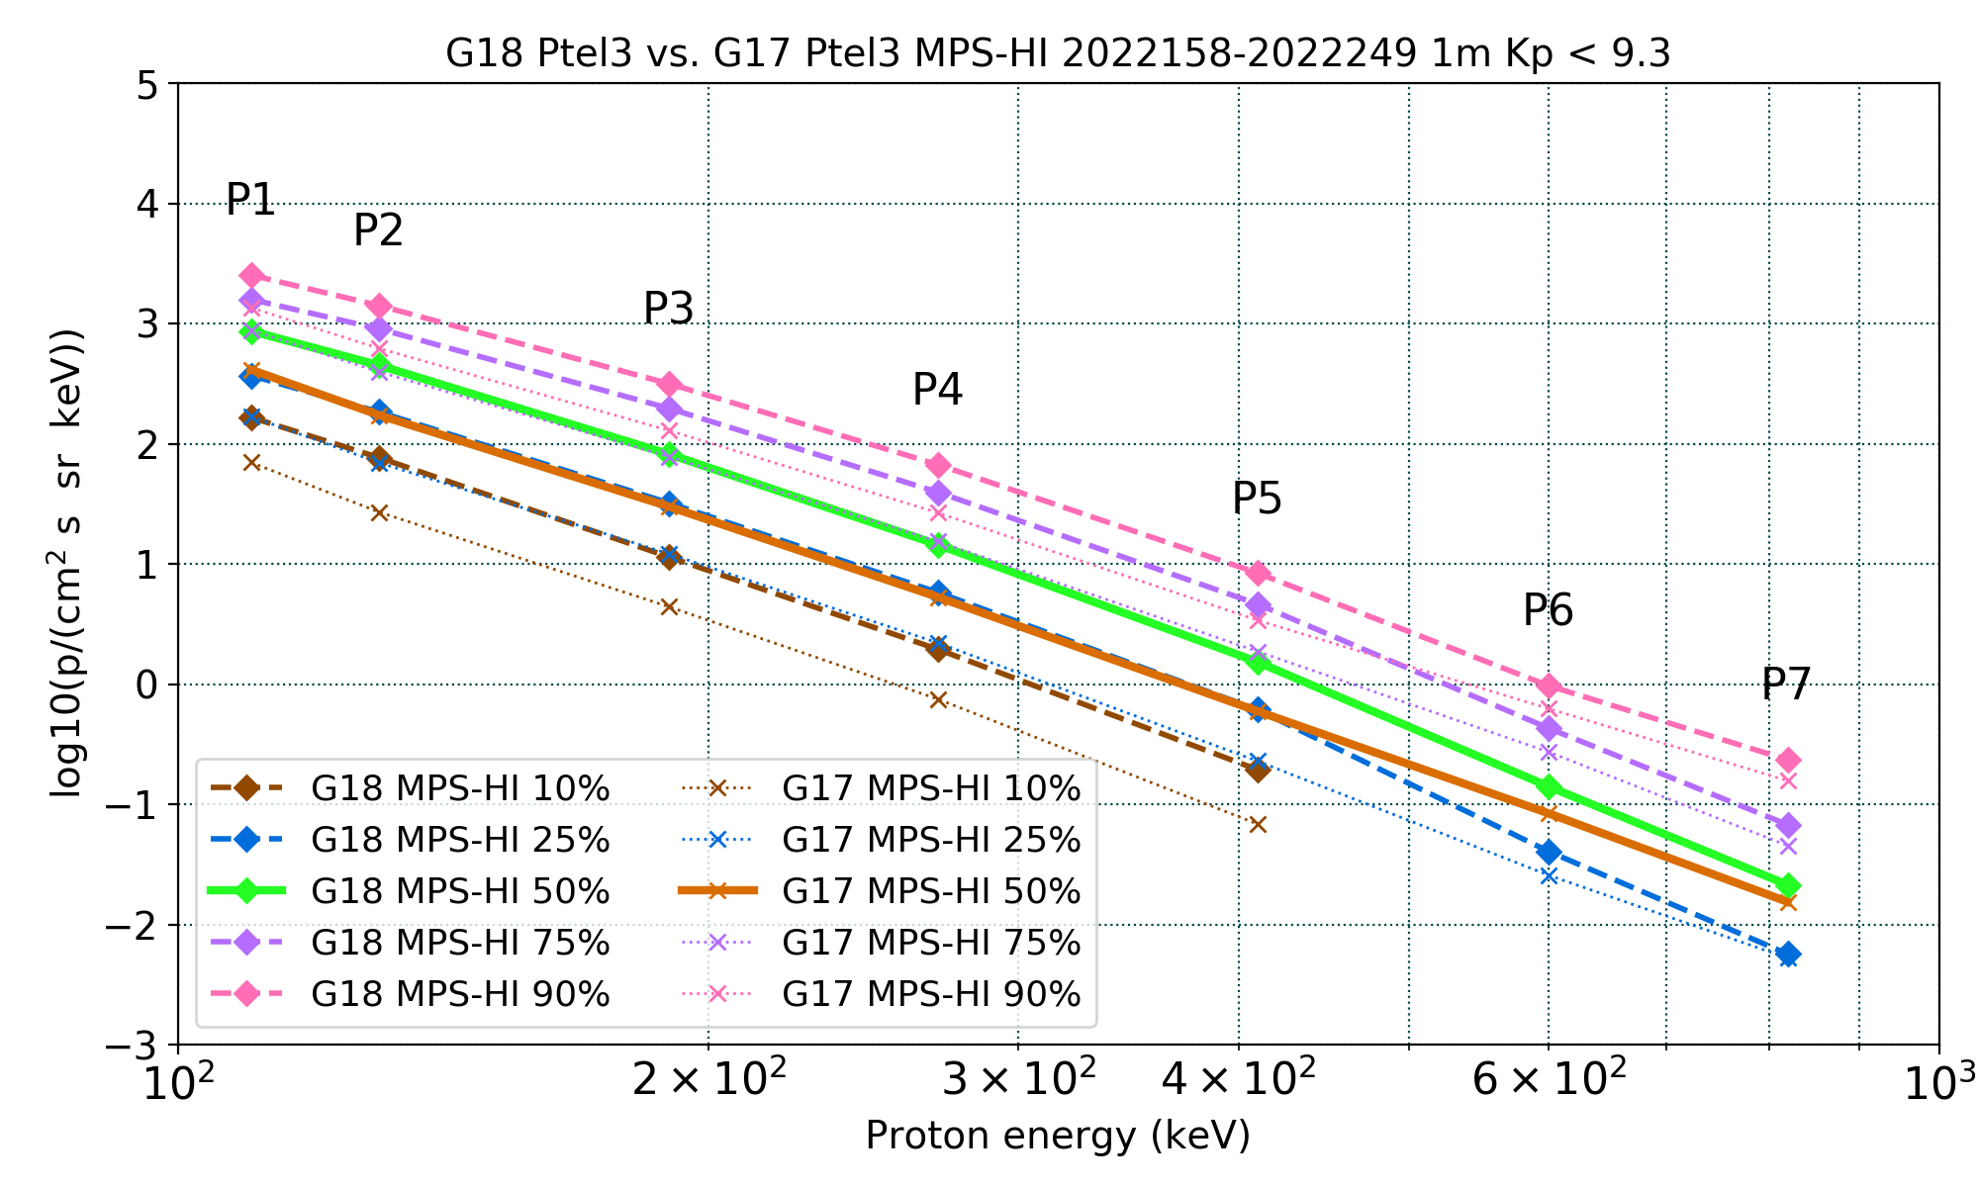
PLPT-SEI-005: Cross-Satellite Comparison of Trapped Particles: Results
Pass
GOES-18 vs GOES-17 Protons , 06/07/2022– 09/05/2022
Apply only to P1-P7
Boudouridis, A., Rodriguez, J. V., Kress, B. T., Dichter, B. K., & Onsager, T. G. (2020). Development of a bowtie inversion technique for real‐time processing of the GOES‐16/‐17 SEISS MPS‐HI electron channels. Space Weather, 18, e2019SW002403. https://doi.org/10.1029/2019SW002403
These GOES-18 data are preliminary, non-operational data and are undergoing testing. Users bear all responsibility for inspecting the data prior to use and for the manner in which the data are utilized.

Slide 76
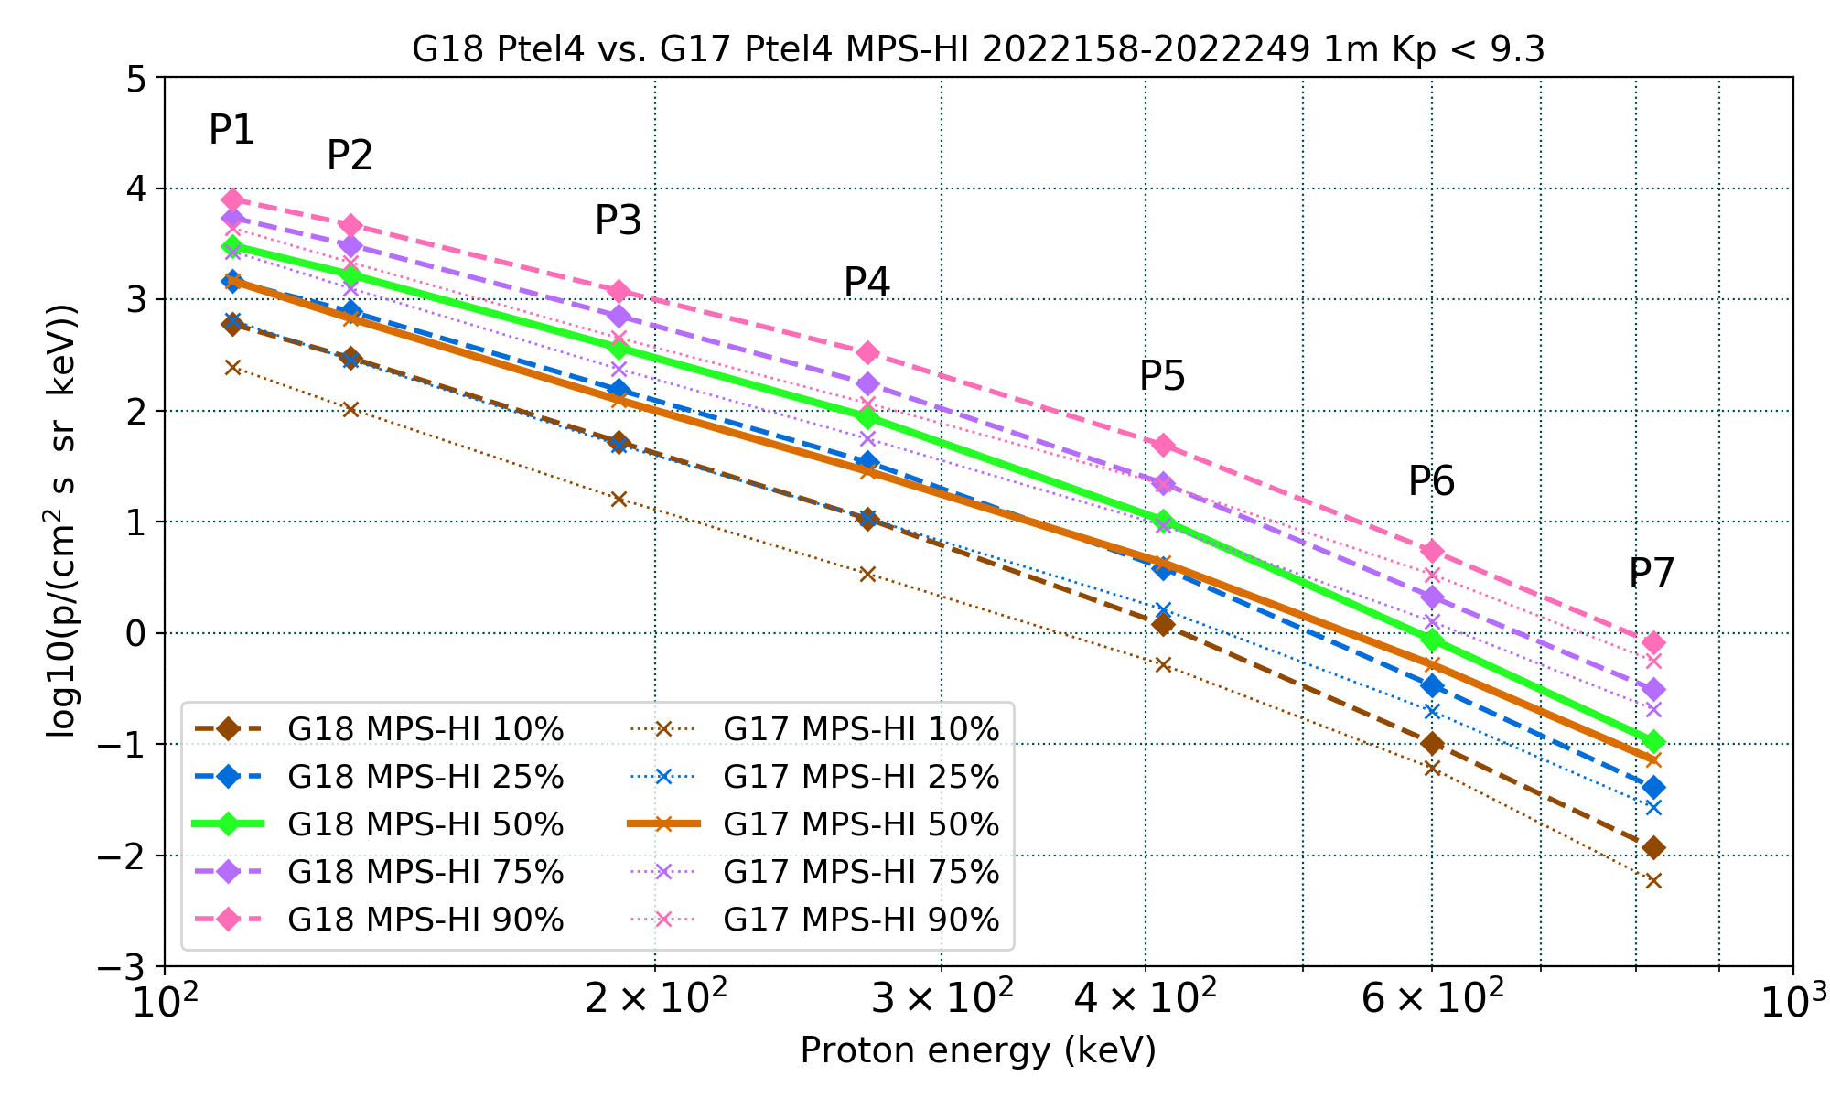
PLPT-SEI-005: Cross-Satellite Comparison of Trapped Particles: Results
Pass
GOES-18 vs GOES-17 Protons , 06/07/2022– 09/05/2022
Apply only to P1-P7
Boudouridis, A., Rodriguez, J. V., Kress, B. T., Dichter, B. K., & Onsager, T. G. (2020). Development of a bowtie inversion technique for real‐time processing of the GOES‐16/‐17 SEISS MPS‐HI electron channels. Space Weather, 18, e2019SW002403. https://doi.org/10.1029/2019SW002403
These GOES-18 data are preliminary, non-operational data and are undergoing testing. Users bear all responsibility for inspecting the data prior to use and for the manner in which the data are utilized.

Slide 77
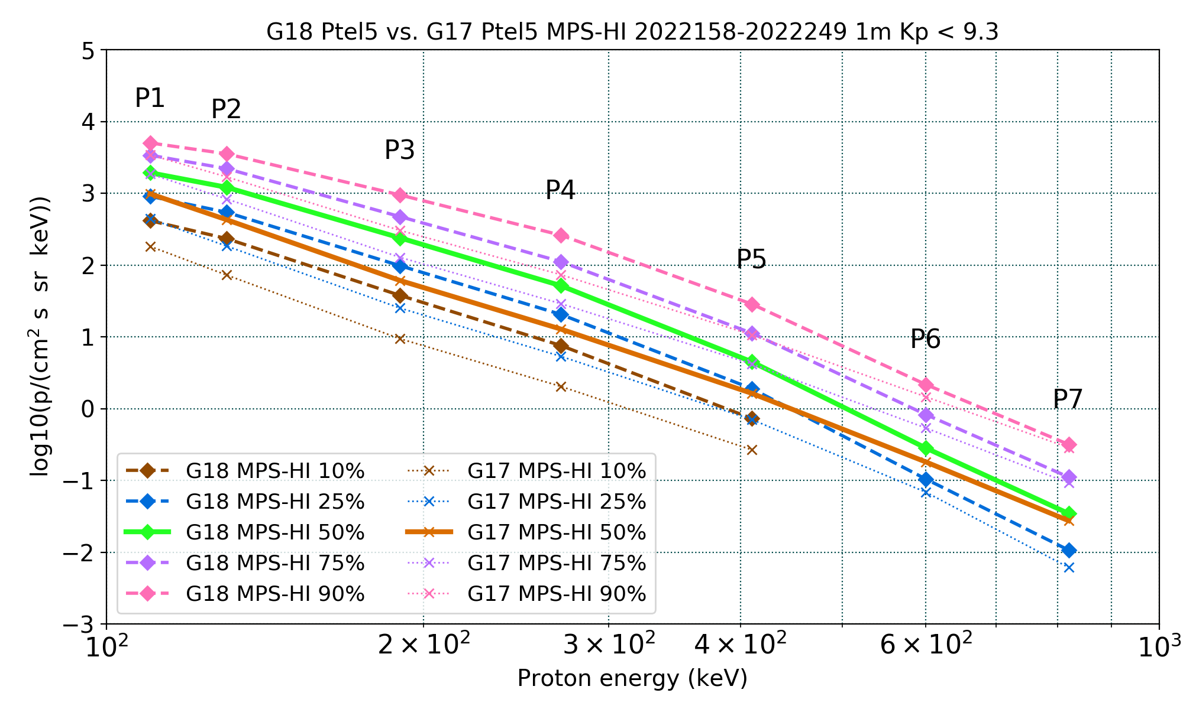
PLPT-SEI-005: Cross-Satellite Comparison of Trapped Particles: Results
Pass
GOES-18 vs GOES-17 Protons , 06/07/2022– 09/05/2022
Apply only to P1-P7
Boudouridis, A., Rodriguez, J. V., Kress, B. T., Dichter, B. K., & Onsager, T. G. (2020). Development of a bowtie inversion technique for real‐time processing of the GOES‐16/‐17 SEISS MPS‐HI electron channels. Space Weather, 18, e2019SW002403. https://doi.org/10.1029/2019SW002403
These GOES-18 data are preliminary, non-operational data and are undergoing testing. Users bear all responsibility for inspecting the data prior to use and for the manner in which the data are utilized.

