Slide 1
CSPP Geo Update
Graeme Martin, UW-Madison SSEC/CIMSS
GRB User Group Meeting, 24 October 2023

Slide 2
GRB (Ingestor) Software Package
CSPP Geo GRB Version 1.0.28 was released on October 9, 2023, with:
  Updates to bundled software libraries as required by NOAA users
  Rocky 8 and Rocky 9 operating systems are now explicitly supported
Installation at users’ sites is considered optional
The installation procedure requires running a script

Slide 3
AIT Framework Software Package for retrieved Level 2 products
AIT Framework Version 2.1 beta was released in July 2022, with
  Added products: Derived Motion Winds, Low Cloud and Fog
  GOES-17/18 support for a subset of products
  Transition to enterprise products
AIT Framework Version 2.1 production is planned for release in November 2023, with
  Science updates affecting multiple products
  Support for RAP (NWP) ingest, significantly improving fog product quality over North America region
  Change in fog processing behavior to address artifacts in the terminator region
  Change to fog product naming convention and format to match operational product
  Automatic failover to a secondary, off-site ancillary server
  Various bug fixes and minor improvements
Thanks to beta testers for your feedback!

Slide 4
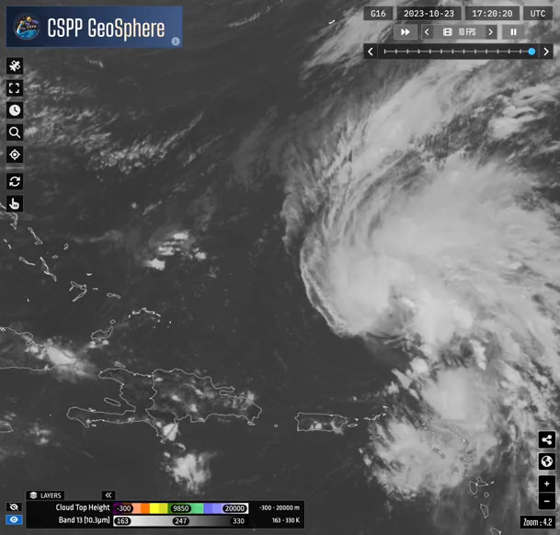
Geo2Grid Software Package for high quality imagery
Geo2Grid Version 1.1 was released in December 2022, with
  Added support for GOES-18 and other satellites
  Initial L2 product support – Cloud Top Height and Cloud Top Temperature
  Support for Gridded GLM
  Performance optimizations
Geo2Grid Version 1.2 is planned for end of 2023, with
  Additional L2 product support – Atmospheric Optical Depth (AOD), Land Surface Temperature (LST), Low Cloud and Fog
  New RGB imagery (e.g day cloud phase distinction)
  Improvements to colormaps and coastlines
  Technical updates including Python 3.11
GOES-16 Band 13 and Cloud Top Height products displayed in CSPP Geosphere (https://geosphere.ssec.wisc.edu/)

Slide 5
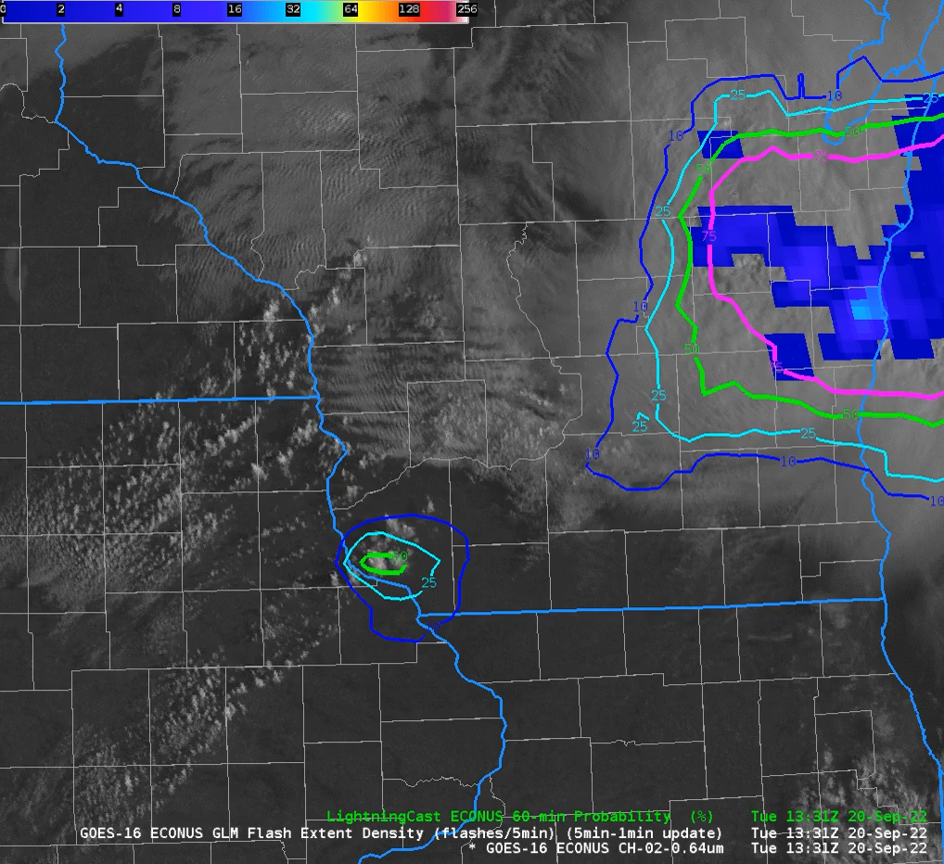
Coming up in 2024…
AIT Framework v3 beta
  Added products: Sounding, Rain Rate, Cloud Cover Layers
  Full GOES-18 support
LightningCast initial beta
ABI Flood Mapping initial beta
GOES-U
  testing will begin in early 2024; software updates will be released as needed
Users are advised to transition to Rocky 8 in advance of CentOS7 end of life (June 30, 2024)
CSPP Geo Software Downloads: https://cimss.ssec.wisc.edu/csppgeo/
CSPP Geo User Support: csppgeo.issues@ssec.wisc.edu
LightningCast product showing probability of lightning, with GLM overlaid

