Slide 1
Joint GRB-HRIT/EMWIN
Users Group Meeting
24 October 2023
Please disable your webcam
IMPORTANT NOTICE: Please note that this Webex service allows audio and other information sent during the session to be recorded, which may be discoverable in a legal matter. By joining this session, you automatically consent to such recordings. If you do not consent to being recorded, discuss your concerns with the host or do not join the session.

Slide 2
Privacy Act Notice
Privacy Act Statement
(Record Meetings and Training Sessions)
Authority: The collection of this information is authorized under 5 U.S.C. 301(Departmental regulations), 5 USC 552a (Records maintained on individuals); 15 U.S.C. 1512 (Powers and duties of Department), and 44 U.S.C. 2904 (General responsibilities for records management).
Purpose: Individual’s permission is required for use of photographs, video, and audio in any format, used for communications, outreach, interviews, and dissemination of mission products intended to promote an awareness and appreciation of the environment and NOAA's science, service and stewardship roles.
Routine Uses: The information is used for the purpose set forth above and may be: forwarded to another NOAA or non-NOAA user social media account; shared among NOAA staff for work-related purposes. Photographs, videos, audio recordings may be shared externally and displayed on NOAA websites and social media platforms, and as part of physical displays/exhibits. Disclosure of this information is permitted under the Privacy Act of 1974 (5 U.S.C. Section 552a) to be shared among Department staff for work-related purposes. Disclosure of this information is also subject to all of the published routine uses as identified in the Privacy Act System of Records Notice DEPT-18, Employees Personnel Files Not Covered by Notices of Other Agencies.

Slide 3
GRB Status

Slide 4
HRIT/EMWIN Status
24 Oct 2023
Ian Avruch
NESDIS/OSPO/DSB

Slide 5
HRIT/EMWIN Virtual Channel Listing (as of 19-Jun-2023)
VCID # | Product Name | GOES-E(16) Availability | GOES-W(18) Availability | Frequency (Minutes) | Priority on Broadcast | Guaranteed Bandwidth | Format | Resolution | Product Status
0 | Admin Text | X | X | 60 | 1 | 87% | Text Messages | N/A | Active and available
1 | Mesoscale Imagery | X | X | 15 | 12 | 87% | HRIT/LRIT | 0.5km Band 2, 2km for bands 7 and 13 | Both Meso scenes active and available
2 | CMI Band 2 | X | X | 30 | 7 | 87% | HRIT/LRIT | 2 km | Active and available
5 | (TBD)
6 | (TBD)
7 | CMI Band 7 | X | X | 30 | 6 | 87% | HRIT/LRIT | 2 km | Active and available
8 | CMI Band 8 | X | X | 30 | 8 | 87% | HRIT/LRIT | 2 km | Active and available
9 | CMI Band 9 | X | X | 30 | 9 | 87% | HRIT/LRIT | 2 km | Active and available
13 | CMI Band 13 | X | X | 30 | 5 | 87% | HRIT/LRIT | 2 km | Active and available
14 | CMI Band 14 | X | X | 30 | 10 | 87% | HRIT/LRIT | 2 km | Active and available
15 | CMI Band 15 | X | X | 30 | 11 | 87% | HRIT/LRIT | 2 km | Active and available
16 | G16 CMI Band 13 |  | X | 60 | 17 | 87% | HRIT/LRIT | 4 km | Active and available
17 | G17 CMI Band 13 | X |  | 60 | 17 | 87% | HRIT/LRIT | 4 km | Active and available
20 | EMWIN – High Priority | X | X | Continuous | 1 | 8% | Text | N/A | Active and available
21 | EMWIN - Graphics | X | X | 15 - 60 | 3 | 8% | Graphic (e.g. GIF, JPEG) | N/A | Active and available
22 | EMWIN – Low Priority | X | X | Continuous | 2 | 8% | Text | N/A | Active and available
24 | NHC Maritime Graphics | X | X | Variable | 14 | 87% | Graphic (e.g. GIF, JPEG) | N/A | Active and available
25 | GOES-E/W Level II Ancillary Products | X | X | Variable | 15 | 87% | HRIT/LRIT | 2 - 10 km | Active and available
32 | DCS Data | X | X | Continuous | 4 | 5% | DCS Formatted Text | N/A | Active and available
60 | Himawari-9 |  | X | 60 | 16 | 87% | HRIT/LRIT | 4 km | Active and available
19 June 2023: GOES-15 transferred from NOAA to US Space Force, renamed EWS-G2, over Indian Ocean
GOES-17 and GOES-14 will together take on the role of backup in case of issues with GOES-E or GOES-W.

Slide 6
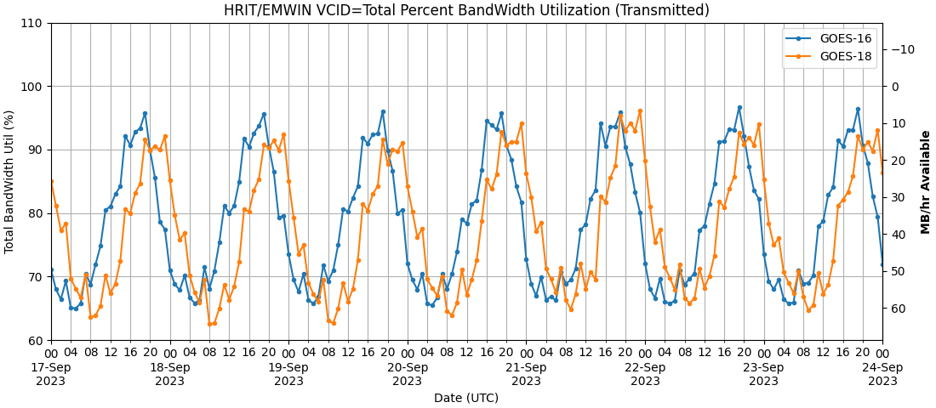
HRIT/EMWIN Broadcast Statistics
Bandwidth Utilization (hourly totals)
At peak hours (local afternoon/evening) there are ≲ 5MB/hour available on the broadcast; new products will involve trade-offs.

Slide 7
Upcoming HRIT/EMWIN Broadcast Changes
DSIF LI will be removed from broadcast
HRIT/EMWIN Broadcasts two Derived Stability Indices Full Disk (DSIF) datasets, from the five layers available in the product (once per hour on VCID 25):
Convective Available Potential Energy (CAPE)
Lifted Index (LI)
K-Index (KI)
Showalter Index (SI)
Total Totals (TT)
Due to software limitations in the HRIT/EMWIN-PDA system, they have the same filename on the broadcast
i.e. LRIT Annotation Header: Annotation is the same, for example: OR_ABI-L2-DSIF-M6_G16_s20232902350204_e20232902359512_c20232910001242.lrit
Note that the LRIT Image Data Function Header: Data Definition Block is distinguishable
LI _NAME = temperature_difference_between_ambient_air_and_air_lifted_adiabatically_from_the_surface
CAPE _NAME:=atmosphere_convective_available_potential_energy_wrt_surface
We don’t plan to fix this PDA software deficiency in the near term.
We propose to remove the DSIF LI product from the broadcast (DSIF CAPE will remain)
to avoid ambiguity for users
to free broadcast bandwidth of underutilized products
Comment Period until 1 December 2023: If you object, contact the the HRIT/EMWIN Program Manager!

Slide 8
HRIT/EMWIN 2023 User Survey
The HRIT/EMWIN Program and NOAA rely on voluntary community feedback to evaluate effectiveness.
Your feedback will:
improve the value of the current HRIT/EMWIN broadcast for its users
help NOAA gauge the impact of the broadcast and the size of the user community
help NOAA plan requirements for the evolution of the HRIT/EMWIN service for the GeoXO Mission, to begin operating in the early 2030s.
The survey will be open until 15 December 2023.
The link to the survey is here: 2023 HRIT/EMWIN User Survey
Your time and attention is very much appreciated! We look forward to receiving your feedback.
We will report the results of the survey at a future HRIT/EMWIN Users Group Meeting.

Slide 9
ESPC Notifications, Status, and Contacts
Subscribe to ESPC for notifications -- this is the primary way for you to receive notifications!
24/7 Help Desk | ESPCOperations@noaa.gov (301) 817-3880 operational concerns incl. outages, ESPC notifications (un)subscribe, administrative information
ESPC Messages | https://www.ospo.noaa.gov/Operations/messages.html archive of ESPC notifications
User Services | SPSD.UserServices@noaa.gov general public comments and inquiries
Data Access | NESDIS.Data.Access@noaa.gov for data access contact the Data Access Team
GOES Operational Status | http://www.ospo.noaa.gov/Operations/GOES/status.html
GOES User Information and Documents | http://www.ospo.noaa.gov/Operations/GOES/documents.html
POES Operational Status | http://www.ospo.noaa.gov/Operations/POES/status.html
News & Events | https://www.nesdis.noaa.gov/about/news-events
Social Media | facebook, X(Twitter), YouTube, Instagram, Linkedin

Slide 10
GRB/HRIT Contacts
Toby Hutchings, Direct Readout Program Manager
NOAA/NESDIS/OSPO/SPSD
Email: grb.pm@noaa.gov
toby.hutchings@noaa.gov
Phone: (301) 817-4422 (Office)
Ian Avruch, HRIT/EMWIN Program Manager
NOAA (NESDIS/OSPO/SPSD/DSB)
Email: hrit.manager@noaa.gov
Ian.Avruch@noaa.gov
Phone: (‪+1) 240-410-3546‬ (Office)
(+1) 301-817-4543 (Office)

Slide 11
Open Discussion

