Slide 1
Noaa grb/hrit user group Open-Source Data and Imaging Community UPDATES
Carl G. Reinemann https://usradioguy.com
October 24^{th,} 2023

Slide 2
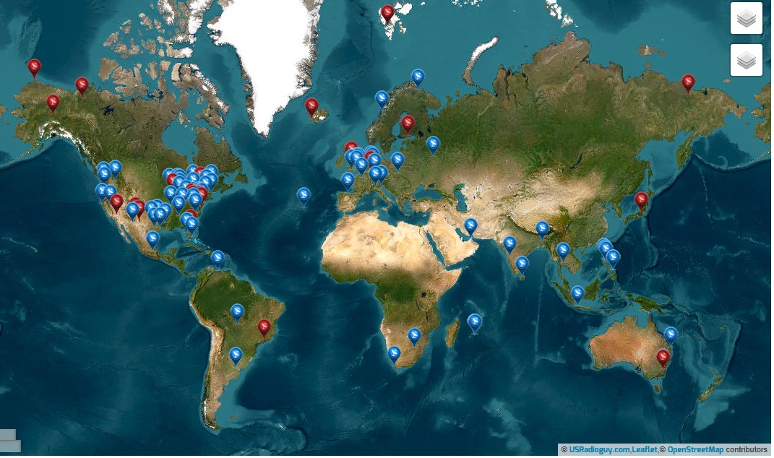
Guides, Builds
USRadioguy https://usradioguy.com/
A minimal LRIT/HRIT receiver https://pietern.github.io/goestools/guides/minimal_receiver.html
RTL-SDR.com Comprehensive Tutorial https://www.rtl-sdr.com/rtl-sdr-com-goes-16-17-and-gk-2a-weather-satellite-reception-comprehensive-tutorial/
Open Satellite Project https://osp.teske.net.br/channel/opensateliteproject
User Groups and Forums
Geo Stationary Satellite Group https://www.facebook.com/groups/gswsg Facebook Group for Geo Stationary Weather Satellites
GOESTools Users https://groups.google.com/g/goestools-users A smaller group for people who use the software Goestools
GEO-Subscribers https://groups.io/g/GEO-Subscribers The official group is for subscribers of the Group for Earth Observation (GEO)
Amateur Satellite Group on Reddit https://www.reddit.com/r/amateursatellites/ A subreddit dedicated to artificial satellites
Map of Satellite Data and Imaging Enthusiasts
https://usradioguy.com/ground-station-map/

Slide 3
Software
Goestools https://github.com/pietern/goestools Tools to work with signals and files from GOES satellites.
Goestools for Windows https://github.com/JVital2013/goestools-win J Vital has ported the original Goestools to now operate on Windows systems
SATDUMP https://github.com/altillimity/ A multi satellite decoder and image processor. New Version 1.1.0 Released 9/23/23
GK-2A Decoder https://github.com/sam210723/xrit-rx LRIT/HRIT Downlink Processor for GK-2A
Sanchez https://github.com/nullpainter/sanchez Designed for processing of greyscale IR images from geostationary satellites, can also be used to reproject full color images.
Vitality GOES https://github.com/JVital2013/vitality-goes A Web App for showcasing Geostationary Weather Satellite Data.
Raydel XRIT Decoder http://www.geo-web.org.uk/XRITDecoder.php A software solution for decoding and extracting files from GOES LRIT/HRIT streams
XRIT Decoder for GOES https://usa-satcom.com/ XRIT Decoder (HRIT from GOES on L-Band), XView, WX Sandwich Maker
GRB Play https://usa-satcom.com/ Processes NetCDF files for GOES GRB SUVI, does animations, Electron and X-Ray flux as well
SUVI Play https://usa-satcom.com/ Displays and does animations with CSPP GEO images from GOES GRB
GRB Streamer and Imager- Bret Casebolt
CSPP Geo software https://cimss.ssec.wisc.edu/csppgeo/
XRIT Decoder Open Satellite Project https://github.com/opensatelliteproject/xritdemod

Slide 4
New Developments in Software SatDump Current Revision is 1.1.0 (Nightly builds available as well.)
SatDump is a multi platform (Mac, Windows, Linux, Android) satellite data receiver, decoder and image processor, able to receive many, many LEO, POE and GEO satellites, and demodulate/decode the signals. ie GOES, GK-2A, Himawari, Elektro, FY and more!
GOES HRIT Support (HRIT, DCP, EMWIN, CDA, etc.)
GOES GRB Support (GRB, SUVI)
Via software demodulation, using C-Band LNB and SDR, no need for DVB-S2 or KenCast Software.
GOES GVAR Support (EWS-G1 and EWS-G2)
GeoNetCast Support (WIP)
Initial support for this service has been added to SatDump, but is not yet fully completed. It is currently WIP. First tests look very promising though, and full support will be implemented in the near future.
GOES RAW
Using raw X-Band Data from GOES-16/18, Aang23 was able to develop a decoder for raw SUVI images from GOES.
Himawari Support (WIP)
Via software demodulation using C-Band LNB and SDR, no need for DVB-S2 or KenCast Software.

Slide 5
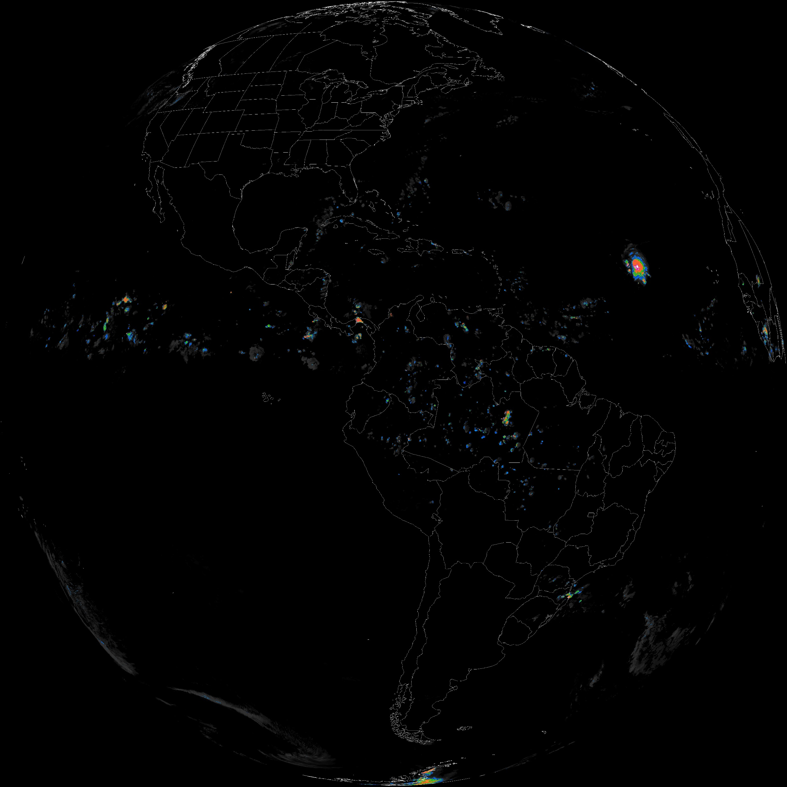
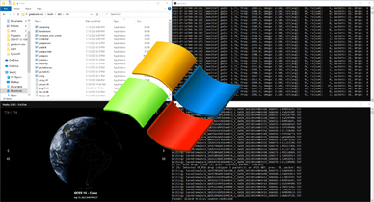
New Developments in Software (continued)
GOESTOOLS Updates
Handles GOES 18 and will handle GOES-U (19).
Small issue discovered in HRIT/EMWIN on both GOES-E and -W broadcasts - two DSIF products per hour are relayed: DSIF LI and DSIF CAPE. Both files are received back on the broadcast downlink. However, Like GOESTOOLS, NOAA’s independent Dartcom XRIT systems at NSOF only displays one DSIF file per hour on disk. The files are given unique temporary names, one of the files was archived with the same filename as the first, thus overwriting it. The general repo for GOEStools has not been altered, so it is still only processing one DSIF file at this time.
New Gradient for Non CMIP RRQPE LRIT imagery written . The new gradient seems to more closely match the data in the Image headers.
GOESTOOLS for Windows
Jamie Vital, author of VitalityGOES has ported GOESTOOLS to run on Windows Systems.
Corrected RRQPE Gradient

Slide 6
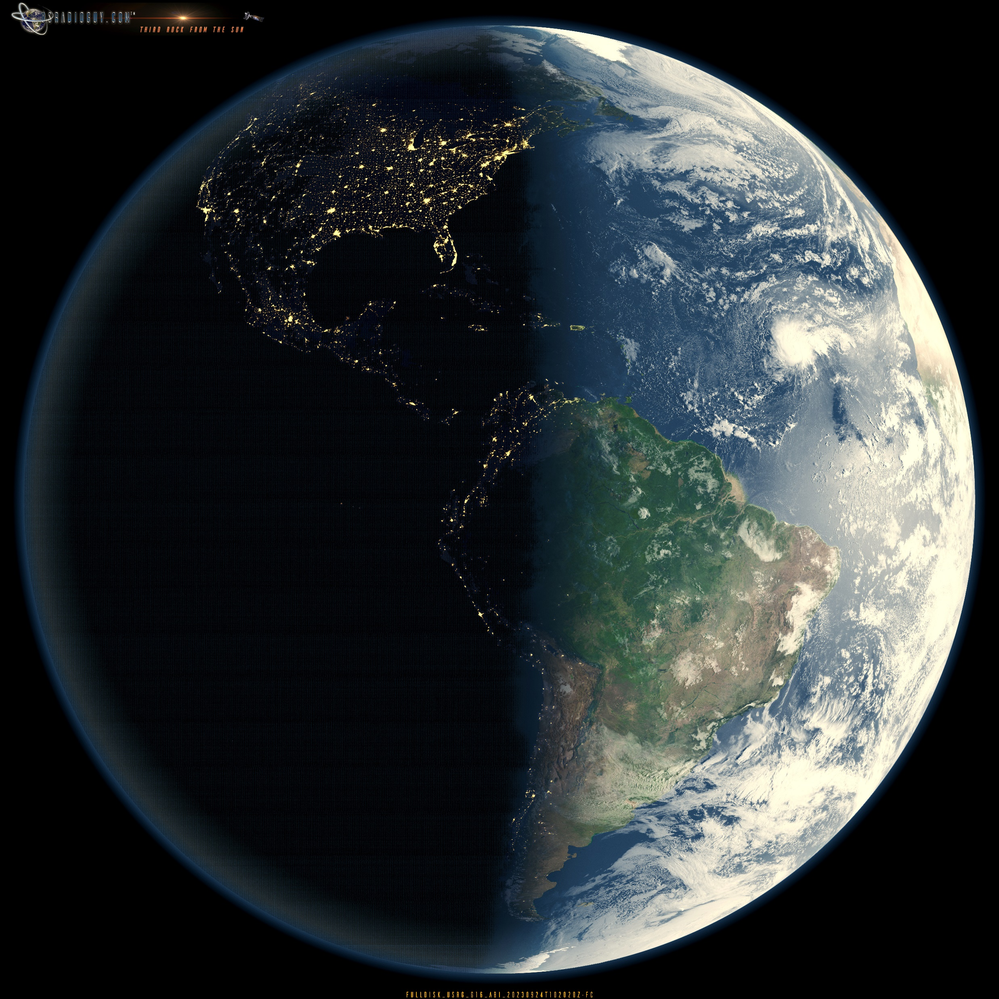
Imagery Created using all open-source software:
GOESTOOLS: For HRIT Reception, Bands 02.
WMIC: Processing and creation of timestamps.
Xplanet: for timestamped processing of full color/night layer with specular lighting, Rayleigh lighting , 3d bump mapping and terrestrial shadows.
ImageMagick: For Imagery Processing and refinement, color optimization and downscaling.
JIMP: Processing and refinement of alpha cloud layer only.
Sanchez: For rendering of Band 2 onto Xplanet rendered Day night imagery.
EXIFtool for image labeling.
October 24^{th,} 2023

