Slide 1
CSPP Geo Update
Graeme Martin
Joint GRB-HRIT/EMWIN Users Group Meeting
10 September 2024

Slide 2
GOES-19 Support in CSPP Geo software
Available CSPP Geo software packages
Package | Description | Satellite |  |  |  |  |  |  |  |  | GOES-19 status and plans
 |  | GOES-16 | GOES-17 | GOES-18 | Himawari-9 | GK2A | FY4A | FY4B | GOES-13 | GOES-15
GRB | process raw GRB data stream | ✓ | ✓ | ✓ |  |  |  |  |  |  | Provisional G19 support in current release. Update will be released if needed
Geo2Grid | imagery, animations, reprojection | ✓ | ✓ | ✓ | ✓ | ✓ | ✓ | ✓
AXI Tools | utility package | ✓ | ✓ | ✓ | ✓
AIT Framework | Level 2 retrieved geophysical products | ✓ | ✓ | ✓ |  |  |  |  |  |  | No G19 support in current release. Update planned.
Gridded GLM | higher-level lightning products | ✓ | ✓ | ✓
GEOCAT | Level 2 retrieved geophysical products |  |  |  | ✓ |  |  |  |  |  | N/A
GVAR (legacy) | process raw GVAR data stream |  |  |  |  |  |  |  | ✓ | ✓ | N/A
GOES-19 is provisionally supported in some CSPP Geo software packages, and not yet supported in others
Updates will be developed and released as needed, before GOES-19 becomes operational as GOES-East (~early April 2025)

Slide 3
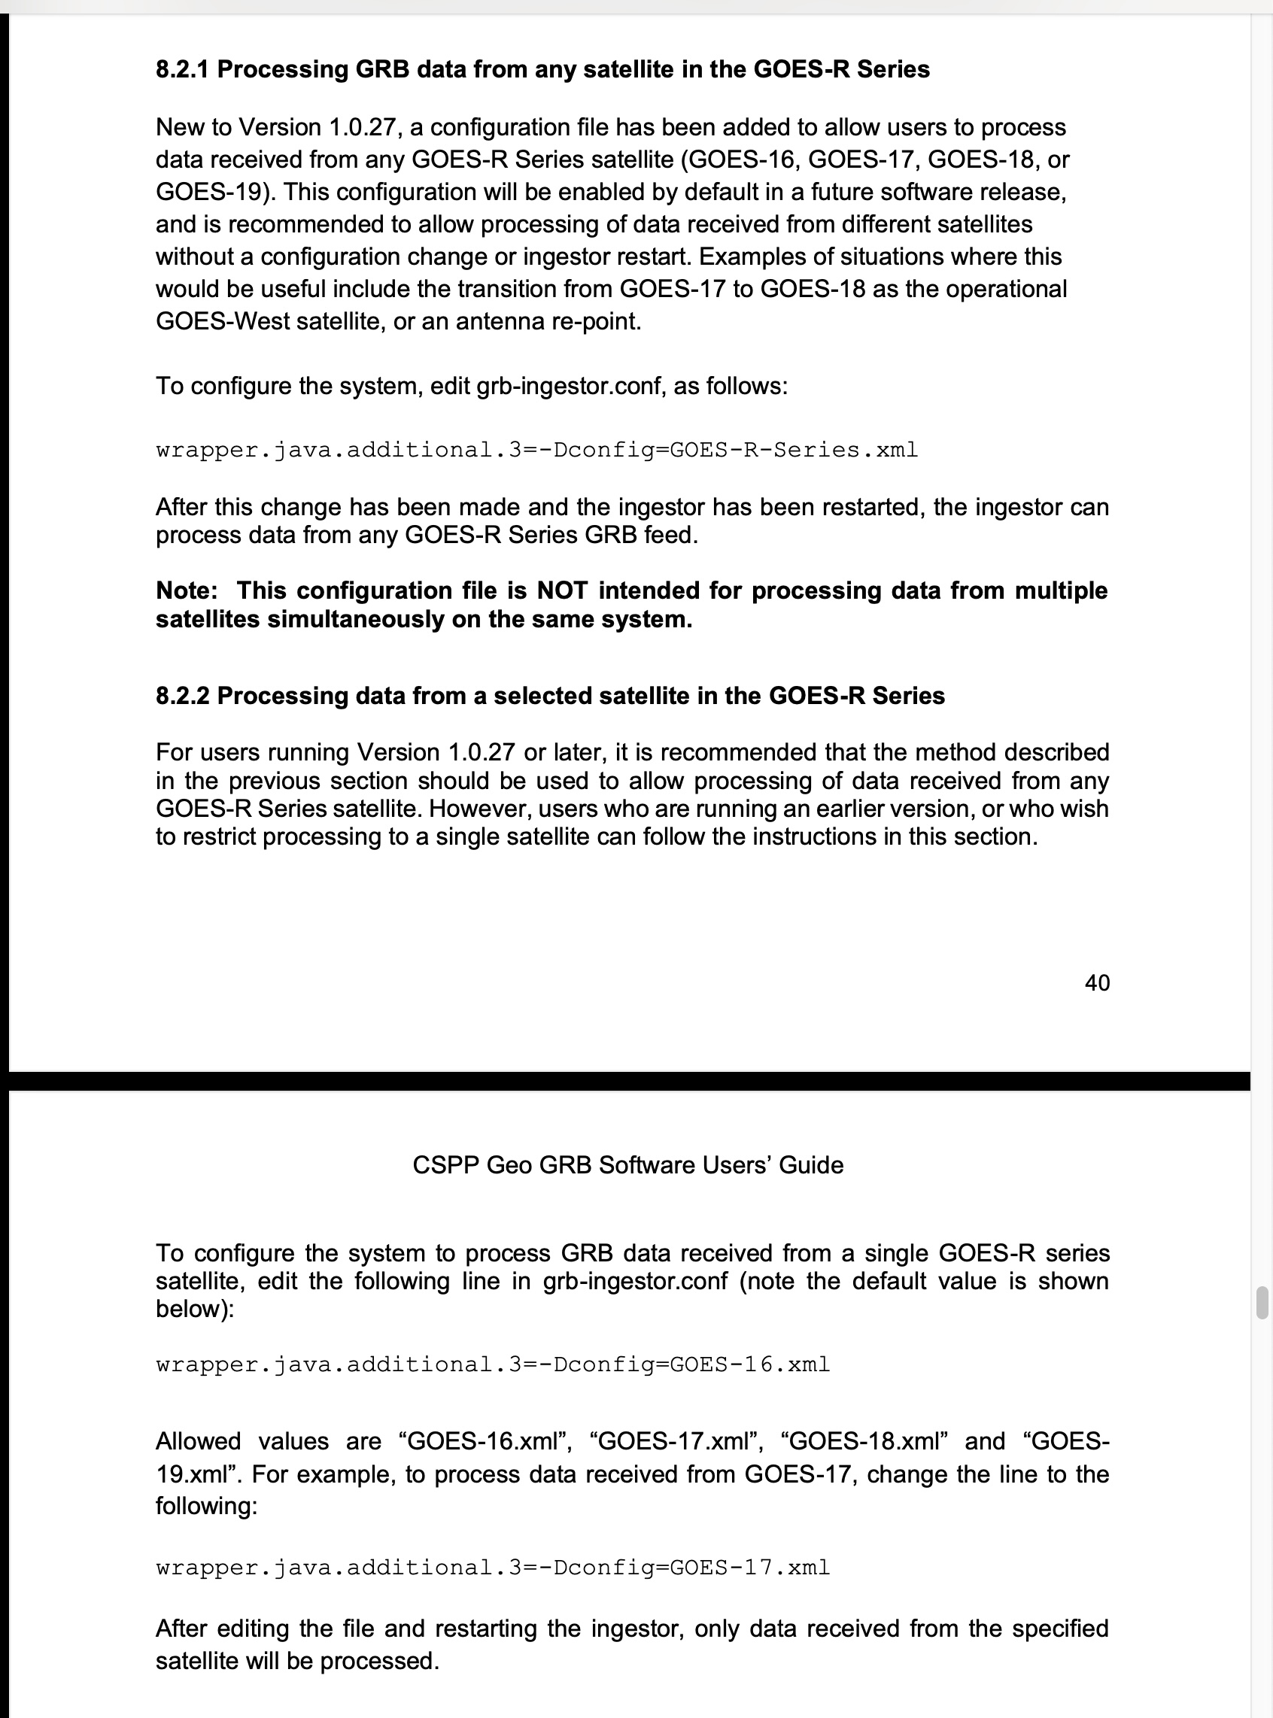
GOES-19 Support in the GRB and AITF Packages
GRB (ingestor) package
Provisional support for GOES-19 is included in the current release (v1.0.28)
A configuration change may be needed to process GOES-19 GRB
The CSPP Geo Team will participate in GOES-19 Post Launch Testing, processing the GRB stream as instruments are added, and providing metrics to the Ground System.
If an issue in the GRB software is identified, a fix will be developed and released to users
AIT Framework Level 2 package
GOES-19 support is not included in the current AITF release (v2.1.0)
Over the coming months we are expecting algorithm / LUT updates from NOAA ASSISTT.
A v2.3 release is planned for early 2025 which will add support for GOES-19
“Community Satellite Processing Package for Geostationary Data (CSPP Geo) GRB Software Users’ Guide”, Sections 8.2.1 and 8.2.2
User support: csppgeo.issues@ssec.wisc.edu
Notes:
The GRB software was successfully tested on simulated GOES-19 data provided by the GOES-R Ground System in January 2024

Slide 4
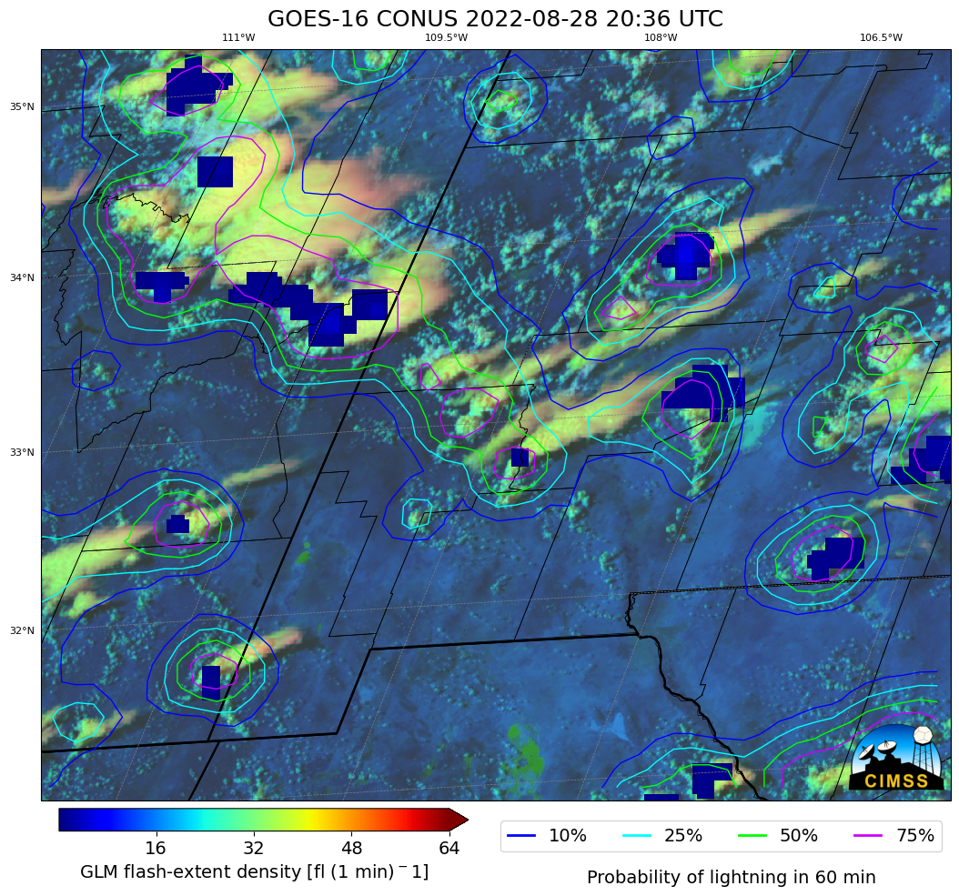
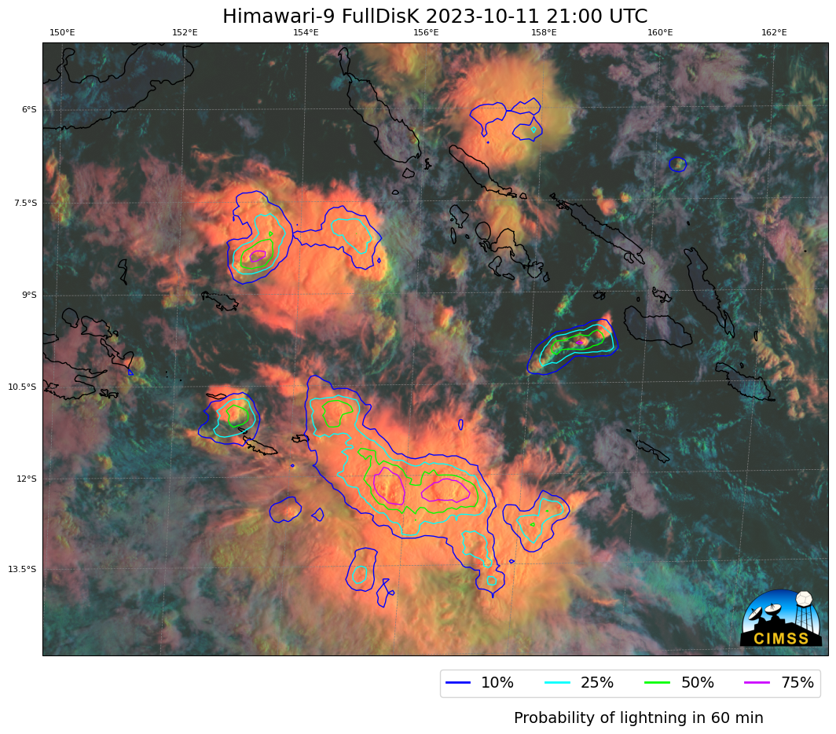
CSPP Geo news
Coming soon…
LightningCast v1.0 beta – Sept 2024
LightningCast uses machine learning to calculate the probability of lightning occurring using imager data
Core software was developed under NOAA-funding by John Cintineo, Mike Pavolonis and Justin Seiglaff
Capabilities of initial beta
GOES-R series (all domains) and Himawari-9 (Full Disk)
Output formats: GeoJSON, NetCDF, PNG
Probability contours can be overlaid on a variety of RGB and single band imagery created from ABI data
Gridded GLM data can be overlaid
AWIPS-compatible output
Optional parallax correction
GOES-16 lightning probability and GLM FED overlaid on Day Cloud Phase Distinction
Himawari-9 lightning probability overlaid on Day Cloud Phase Distinction
Notes:
LightningCast uses a convolutional neural network

Slide 5
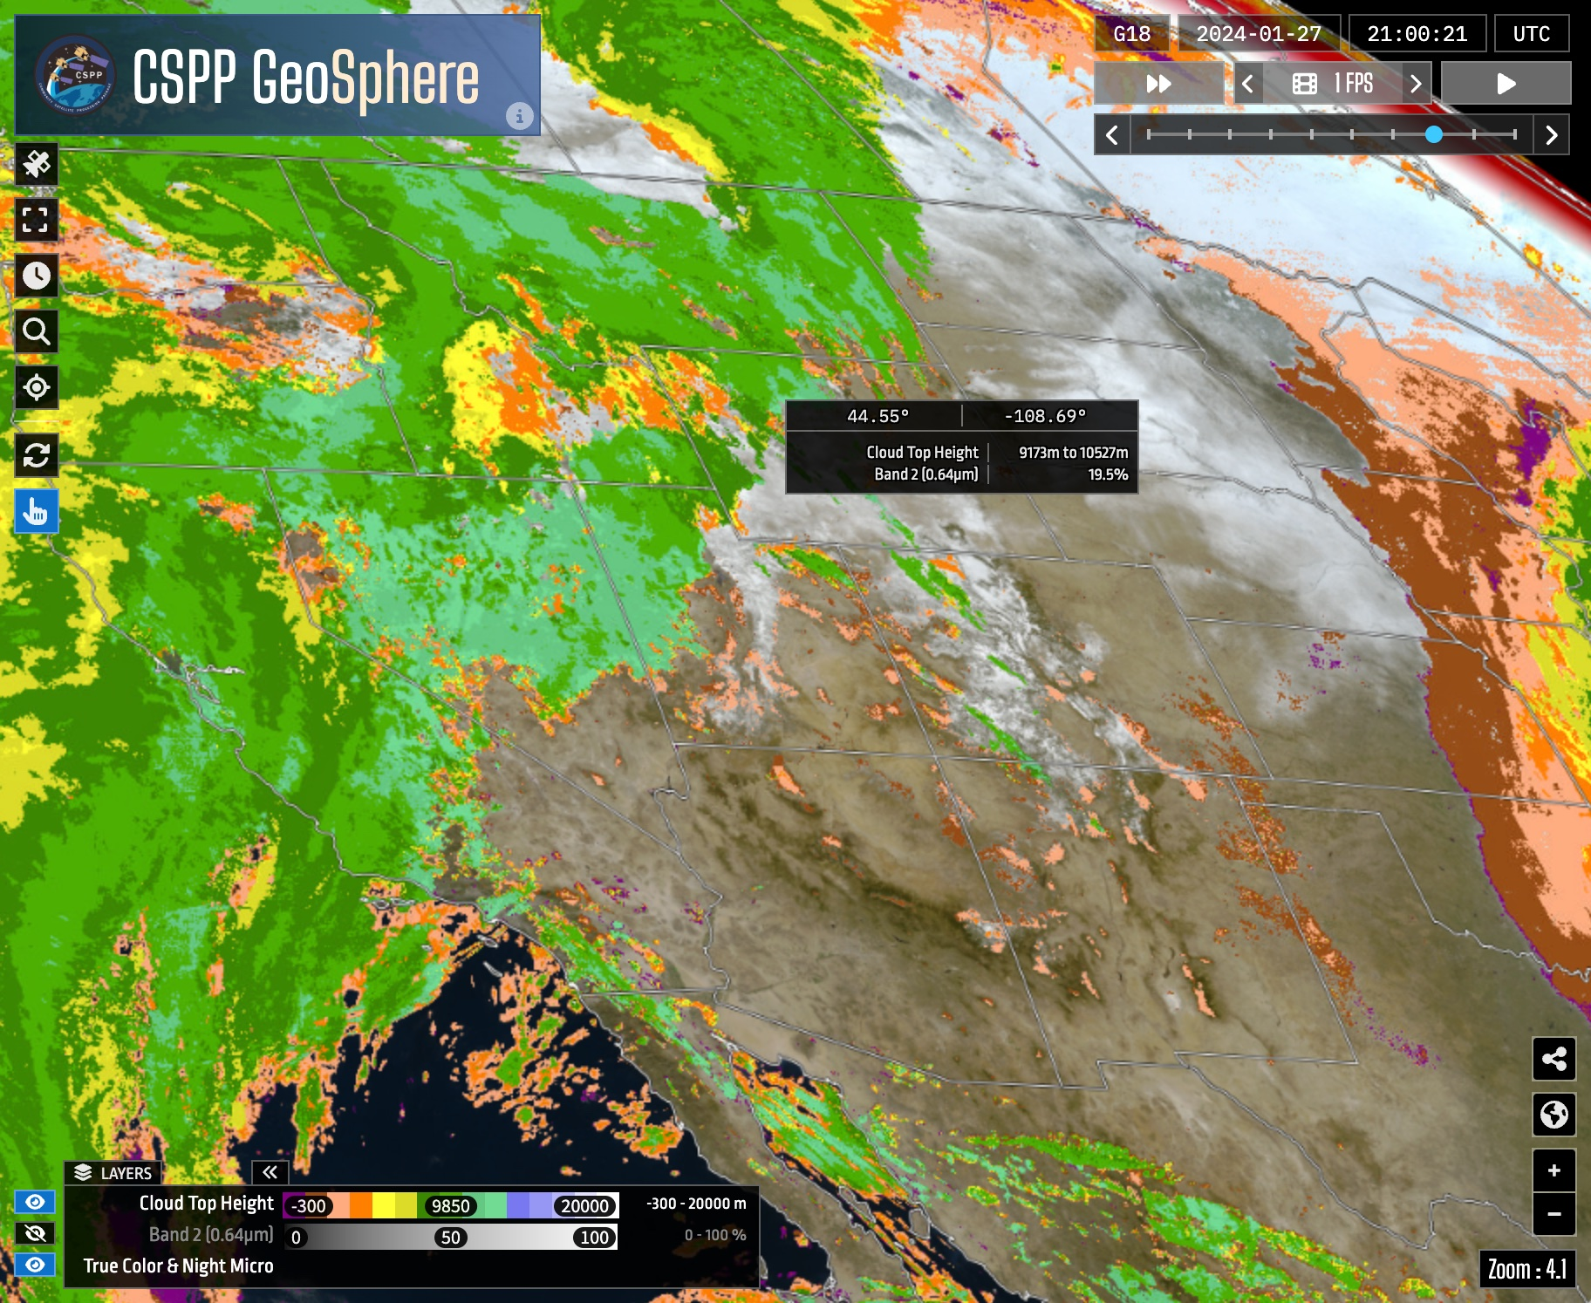
CSPP Geo news
Coming soon…
GRB v1.1 alpha - Fall 2024
Enhancements to upstream interface
Baseband frames support (in addition to CADUs)
TCP support (in addition to UDP)
ABI Flood mapping v1.0 beta - Fall 2024
GeoSphere website updates including added Level 2 products – late 2024 / early 2025
CSPP GeoSphere website https://geosphere.ssec.wisc.edu/

Slide 6
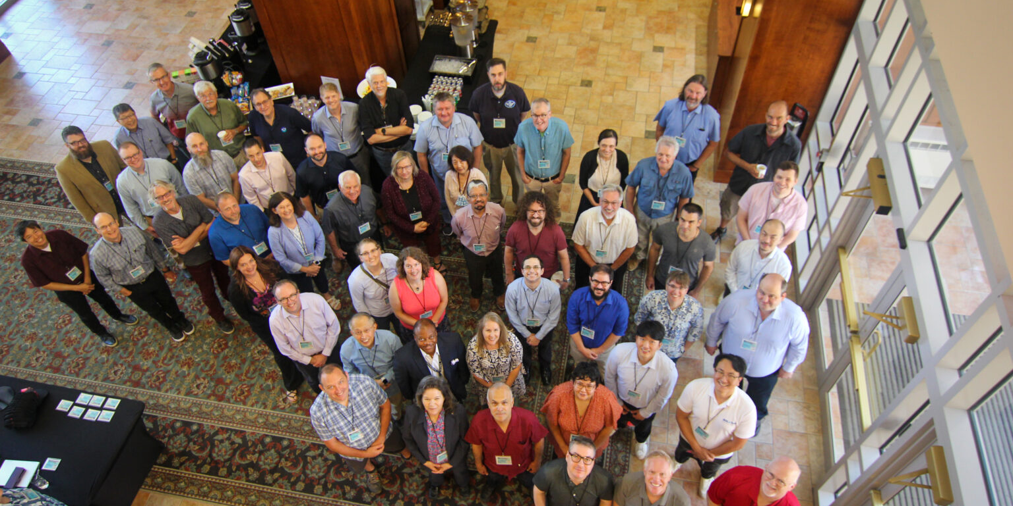
Notes:
Call for papers will be released soon!

