Slide 1
Noaa grb/hrit user group Open-Source Software/Hardware and Imaging - Community UPDATES
Carl G. Reinemann https://usradioguy.com Sept 10, 2024

Slide 2
New Developments in Software
GOESTOOLS Updates: The latest version of Goestools is configured to receive GOES-19 when it is in position in 2025. However, it will need to have the configuration changed to process GOES-19 data and imagery. The new configuration can be found here https://usradioguy.com/updating-goestools-for-goes-18-and-19/
Sanchez Updates:
The Developer of Sanchez is making changes to the processing of the software to allow for the new file naming convention that Satdump is using. It still works with files from Goestools.
Satdump Updates: To be discussed next by Jamie Vital, one of the Satdump Developers
Disclaimer: NOAA does not endorse or recommend any particular software product, either open-source or commercial

Slide 3
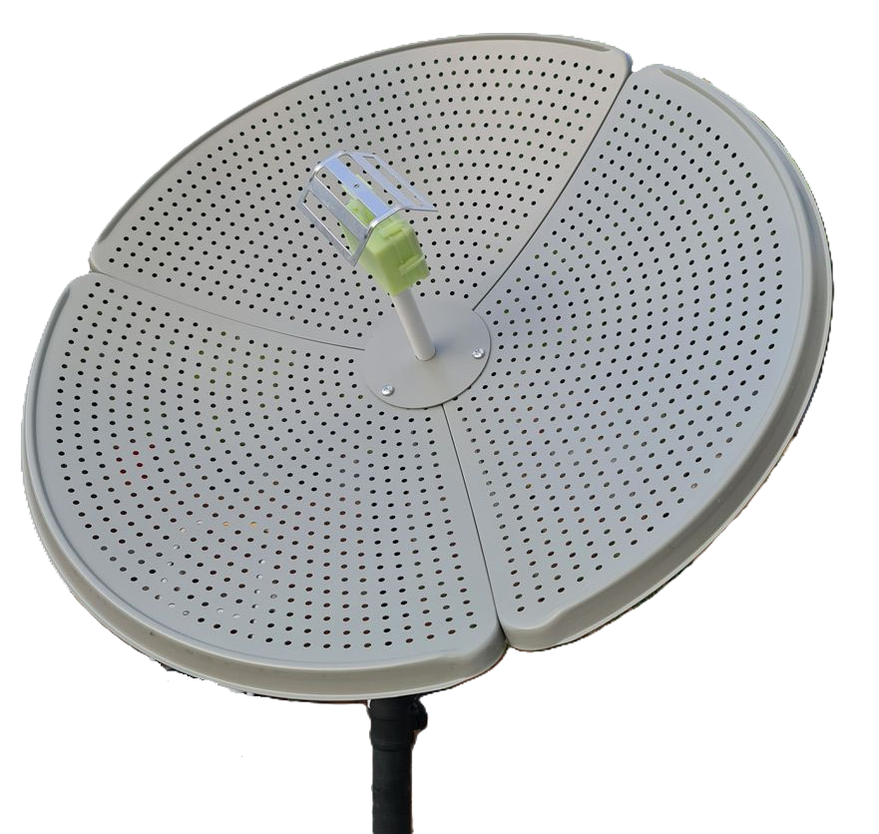
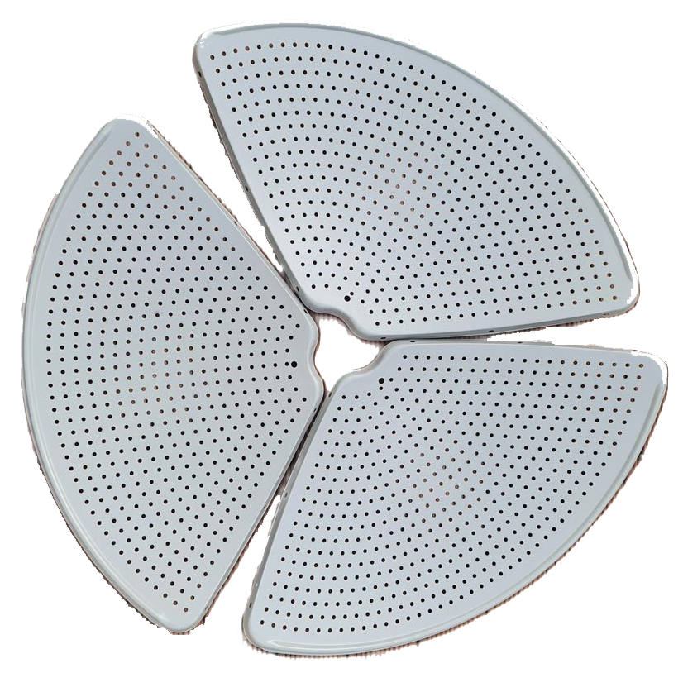
New Developments in Hardware
Discovery Dish by KrakenRF Inc
This is in production and should be available by October 2024. The dish weighs only 1.1kg
The Dish will come with a L-bracket mount and with that can be mounted it on vertical or horizontal poles. For vertical poles you have settings for 0 to 60 degrees elevation (in either infinite or 10 degree increments), and then another setting for 70 degrees, and then 90 degrees. For a horizontal boom you can mount the dish at 0 degrees and rotate the boom to any elevation. (useful for rotators)
The Feed and Feed Head Enclosure - The feed arm assembly has ruler laser etched onto it so that mounting it at the correct distance is easy. A skew angle guide has also been added around the neck. The feed head, rather than the dish is adjusted for the skew. The Feeds are sold separately from the dish.
The 1.69 GHz feed contains a built-in LNA and filter right at the feed point, which means there is almost no noise figure loss from cables or connectors. Other feeds that can be swapped out are the Inmarsat Feed, Hydrogen Line Feed, and S-Band Feed.
Disclaimer: NOAA does not endorse or recommend any particular commercial product

Slide 4
New Developments in Hardware Continued….
Comparison of Dish | Discovery Dish | Wi-Fi grid antenna + LNA + cabling
Weight & Size | 1.1kg, 70 cm diameter | 2 kg, 100 cm x 60 cm
Suitable for light-duty rotator? | YES | NO
Easily adjustable skew? | YES | NO (45° increments only)
LNA electronics waterproofed? | YES | NO (left to user)
Antenna Rotator
Kraken is coming out with a rotator as well. The prototype test setup is a Pi 5 in a weatherproof box on a mast with the rotator and a Discovery Dish sitting on top of it, and it's connected to the rotator via USB serial. The Pi 5 is powered via PoE, which also provides the network connection. There is enough power in PoE to power the Pi 5 and the rotator motors together. The Pi 5 saves images to a connected HDD, local networked NAS, or an internet storage system.
The rotator is controlled by the hamlib rotctl library controller , so it will be compatible with any program that supports rotctl, like Gpredict, Satdump, etc.
https://usradioguy.com/satellites/discovery-dish/

Slide 5
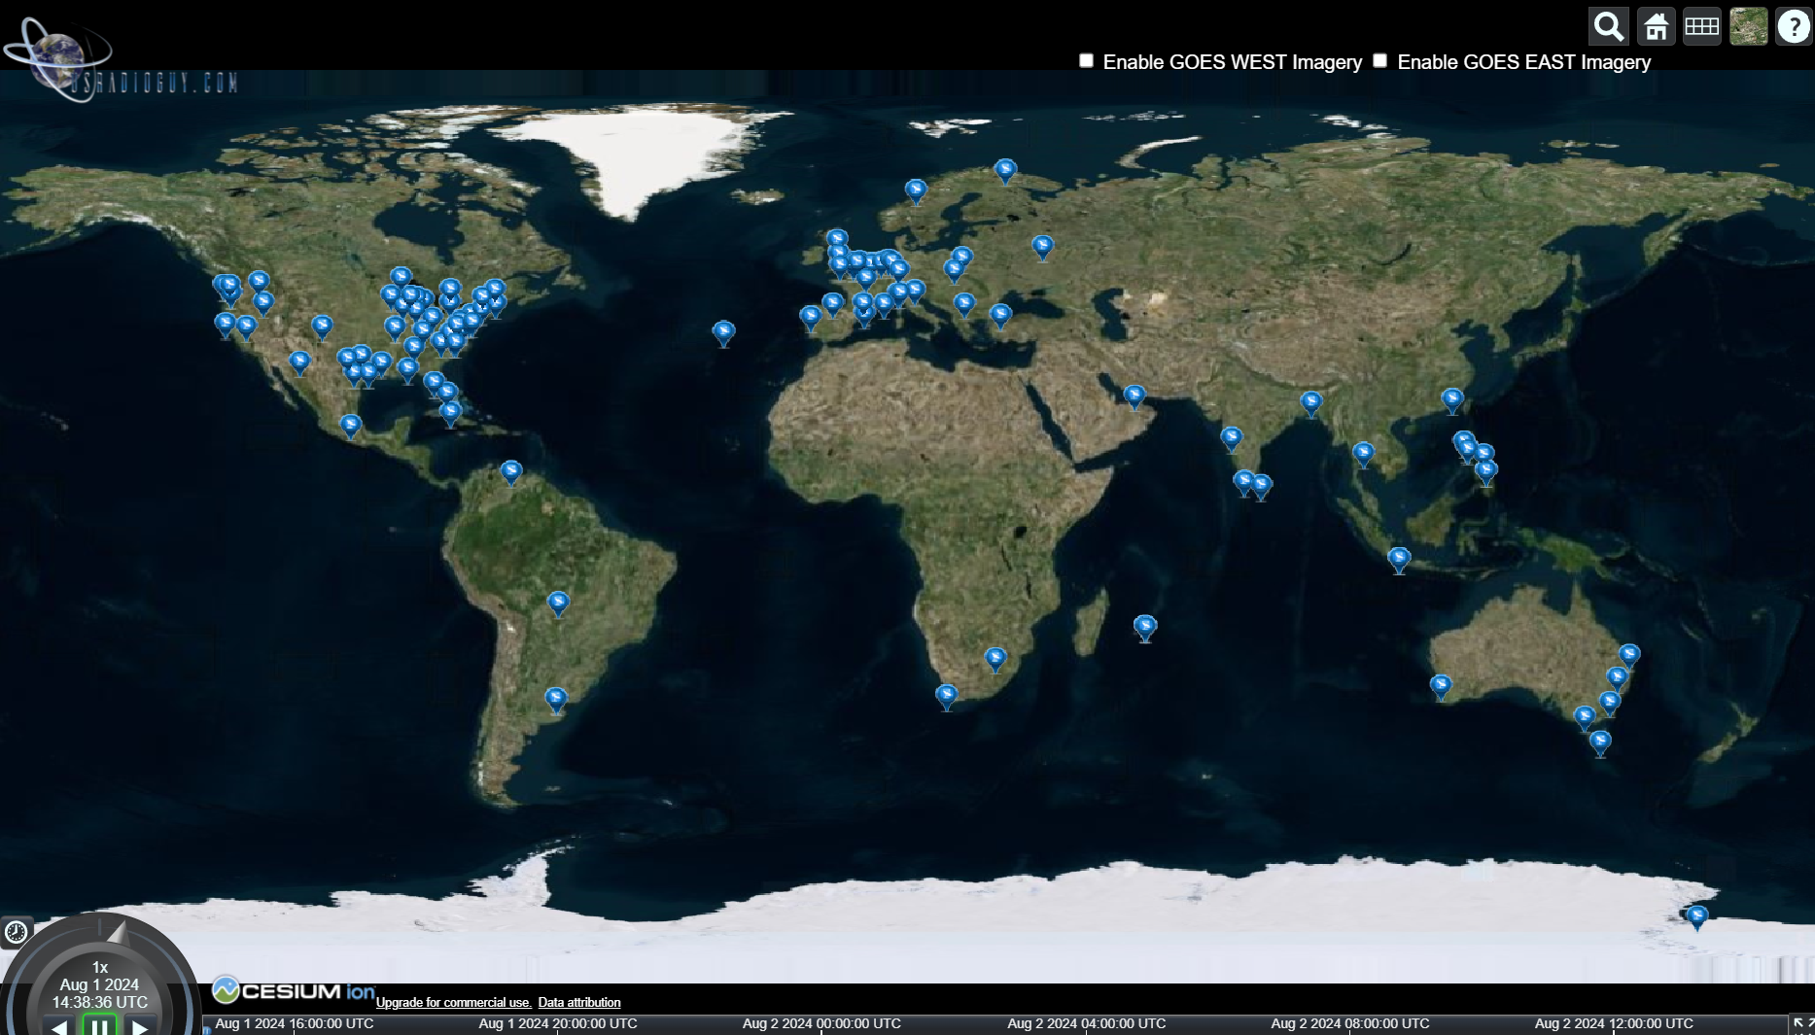
Questions?

Slide 6
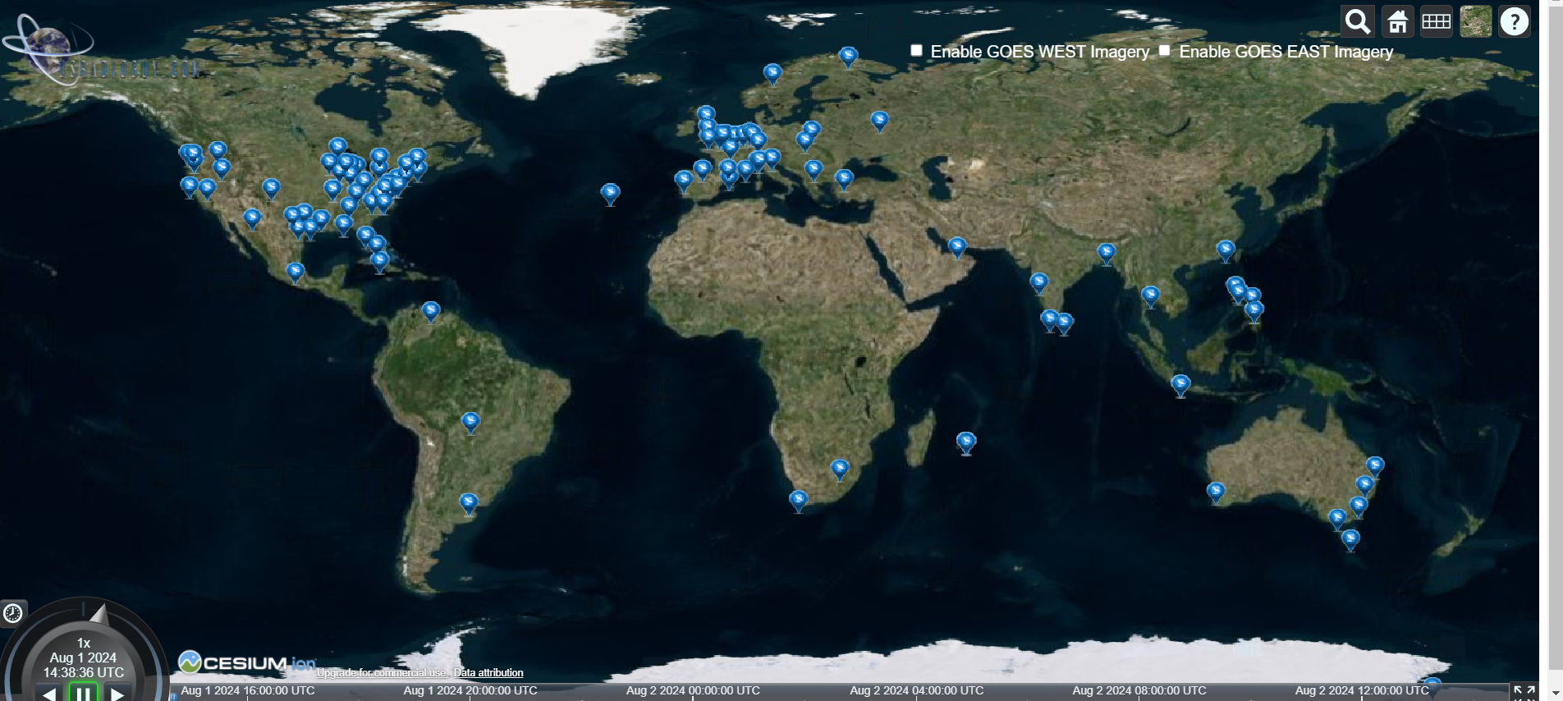
Guides, Builds
USRadioguy https://usradioguy.com/
A minimal LRIT/HRIT receiver https://pietern.github.io/goestools/guides/minimal_receiver.html (Out of Date)
RTL-SDR.com Comprehensive Tutorial https://www.rtl-sdr.com/rtl-sdr-com-goes-16-17-and-gk-2a-weather-satellite-reception-comprehensive-tutorial/ (Out of Date)
Open Satellite Project https://osp.teske.net.br/channel/opensateliteproject
User Groups and Forums
Geo Stationary Satellite Group https://www.facebook.com/groups/gswsg Facebook Group for Geo Stationary Weather Satellites
GOESTools Users https://groups.google.com/g/goestools-users A smaller group for people who use the software Goestools
GEO-Subscribers https://groups.io/g/GEO-Subscribers The official group is for subscribers of the Group for Earth Observation (GEO)
Amateur Satellite Group on Reddit https://www.reddit.com/r/amateursatellites/ A subreddit dedicated to artificial satellites
Usradioguy Newsletter Map of Satellite Data and Imaging Enthusiasts
https://usradioguy.com/ground-station-map/

Slide 7
Software
Goestools https://github.com/pietern/goestools Tools to work with signals and files from GOES satellites.
Goestools for Windows https://github.com/JVital2013/goestools-win J Vital has ported the original Goestools to now operate on Windows systems
Satdump Software https://github.com/altillimity/ A multi satellite decoder and image processor. Latest version is the nightly build.
Satdump Documentation https://docs.satdump.org/
GK-2A Decoder https://github.com/sam210723/xrit-rx LRIT/HRIT Downlink Processor for GK-2A
Sanchez https://github.com/nullpainter/sanchez Designed for processing of greyscale IR images from geostationary satellites, can also be used to reproject full color images.
Vitality GOES https://github.com/JVital2013/vitality-goes A Web App for showcasing Geostationary Weather Satellite Data.
Raydel XRIT Decoder http://www.geo-web.org.uk/XRITDecoder.php A software solution for decoding and extracting files from GOES LRIT/HRIT streams
XRIT Decoder for GOES https://usa-satcom.com/ XRIT Decoder (HRIT from GOES on L-Band), XView, WX Sandwich Maker
GRB Play https://usa-satcom.com/ Processes NetCDF files for GOES GRB SUVI, does animations, Electron and X-Ray flux as well
SUVI Play https://usa-satcom.com/ Displays and does animations with CSPP GEO images from GOES GRB
GRB Streamer and Imager- Bret Casebolt
CSPP Geo software https://cimss.ssec.wisc.edu/csppgeo/
XRIT Decoder Open Satellite Project https://github.com/opensatelliteproject/xritdemod

