Slide 1
Joint GRB-HRIT/EMWIN
Users Group Meeting
10 September 2024
Please disable your webcam
IMPORTANT NOTICE: Please note that this Webex service allows audio and other information sent during the session to be recorded, which may be discoverable in a legal matter. By joining this session, you automatically consent to such recordings. If you do not consent to being recorded, discuss your concerns with the host or do not join the session.

Slide 2
Privacy Act Notice
Privacy Act Statement
(Record Meetings and Training Sessions)
Authority: The collection of this information is authorized under 5 U.S.C. 301(Departmental regulations), 5 USC 552a (Records maintained on individuals); 15 U.S.C. 1512 (Powers and duties of Department), and 44 U.S.C. 2904 (General responsibilities for records management).
Purpose: Individual’s permission is required for use of photographs, video, and audio in any format, used for communications, outreach, interviews, and dissemination of mission products intended to promote an awareness and appreciation of the environment and NOAA's science, service and stewardship roles.
Routine Uses: The information is used for the purpose set forth above and may be: forwarded to another NOAA or non-NOAA user social media account; shared among NOAA staff for work-related purposes. Photographs, videos, audio recordings may be shared externally and displayed on NOAA websites and social media platforms, and as part of physical displays/exhibits. Disclosure of this information is permitted under the Privacy Act of 1974 (5 U.S.C. Section 552a) to be shared among Department staff for work-related purposes. Disclosure of this information is also subject to all of the published routine uses as identified in the Privacy Act System of Records Notice DEPT-18, Employees Personnel Files Not Covered by Notices of Other Agencies.

Slide 3
Agenda – 10 Sep 2024
(10 min) GOES Status (Elizabeth Kline)
(5 min) CSPP Updates (Graeme Martin)
(10 min) GeoXO Status (Daniel Gillies)
(5 min) GRB Updates (Toby Hutchinson)
(5 min) HRIT Updates (Ian Avruch)
(10 min) DCS-HRIT Updates (Matt Ceanfaglione)
(5 min) HRIT/EMWIN-GRB Community Updates (CarlReinemann)
(10 min) satDump Project Updates (Jamie Vital)
(10 min) Open Discussion

Slide 4
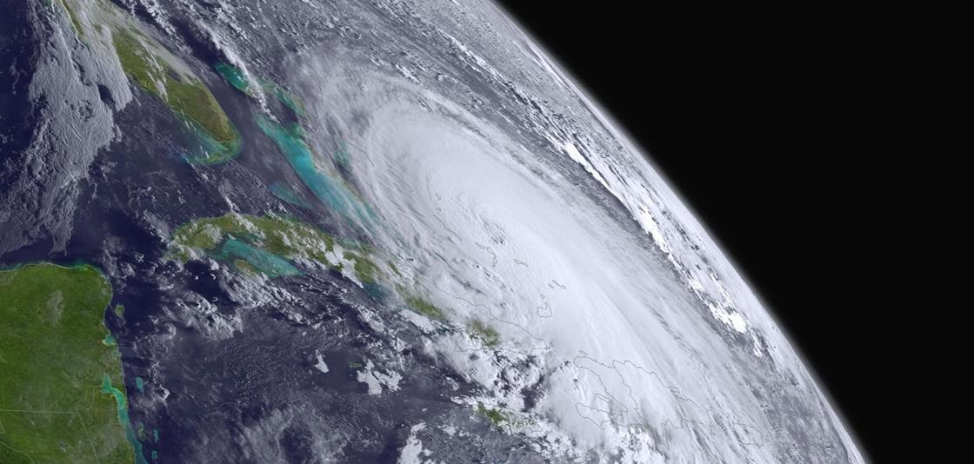
HRIT/EMWIN Status
10 Sep 2024
Ian Avruch
NESDIS/OSPO/DSB

Slide 5
HRIT/EMWIN Virtual Channel Listing (as of 19-Jun-2023)
VCID # | Product Name | GOES-E(16) Availability | GOES-W(18) Availability | Frequency (Minutes) | Priority on Broadcast | Guaranteed Bandwidth | Format | Resolution | Product Status
0 | Admin Text | X | X | 60 | 1 | 87% | Text Messages | N/A | Active and available
1 | Mesoscale Imagery | X | X | 15 | 12 | 87% | HRIT/LRIT | 0.5km Band 2, 2km for bands 7 and 13 | Both Meso scenes active and available
2 | CMI Band 2 | X | X | 30 | 7 | 87% | HRIT/LRIT | 2 km | Active and available
5 | GOES-14 WV Imagery | X | X | 30-180 | 13 | 87% | LRIT | 4 km | Only in GOES-E,W contingency
6 | GOES-14 IR Imagery | X | X | 30-180 | 13 | 87% | LRIT | 4 km | Only in GOES-E,W contingency
7 | CMI Band 7 | X | X | 30 | 6 | 87% | HRIT/LRIT | 2 km | Active and available
8 | CMI Band 8 | X | X | 30 | 8 | 87% | HRIT/LRIT | 2 km | Active and available
9 | CMI Band 9 | X | X | 30 | 9 | 87% | HRIT/LRIT | 2 km | Active and available
13 | CMI Band 13 | X | X | 30 | 5 | 87% | HRIT/LRIT | 2 km | Active and available
14 | CMI Band 14 | X | X | 30 | 10 | 87% | HRIT/LRIT | 2 km | Active and available
15 | CMI Band 15 | X | X | 30 | 11 | 87% | HRIT/LRIT | 2 km | Active and available
16 | G16 CMI Band 13 |  | X | 60 | 17 | 87% | HRIT/LRIT | 4 km | Active and available
17 | G17 CMI Band 13 | X |  | 60 | 17 | 87% | HRIT/LRIT | 4 km | Active and available
20 | EMWIN – High Priority | X | X | Continuous | 1 | 8% | Text | N/A | Active and available
21 | EMWIN - Graphics | X | X | 15 - 60 | 3 | 8% | Graphic (e.g. GIF, JPEG) | N/A | Active and available
22 | EMWIN – Low Priority | X | X | Continuous | 2 | 8% | Text | N/A | Active and available
24 | NHC Maritime Graphics | X | X | Variable | 14 | 87% | Graphic (e.g. GIF, JPEG) | N/A | Active and available
25 | GOES-E/W Level II Ancillary Products | X | X | Variable | 15 | 87% | HRIT/LRIT | 2 - 10 km | Active and available
32 | DCS Data | X | X | Continuous | 4 | 5% | DCS Formatted Text | N/A | Active and available
60 | Himawari-9 |  | X | 60 | 16 | 87% | HRIT/LRIT | 4 km | Active and available

Slide 6
HRIT/EMWIN Status
GOES-East broadcast will transition from GOES-16 to GOES-19 on 04 April 2025
We’re evaluating the addition of some products to the broadcast, all in progress
          A form of GLM FED imagery
              Notifications of spacecraft anomalies to the EMWIN stream
Space weather warnings of impacts on satellite communications
Some issues with the current broadcast content have been raised by users:
LRIT Navigation Header metadata [LOFF,LFAC, COFF,CFAC]
There’s a question whether they conform to the LRIT specification in some mesoscale images – checking
The slight difference in EMWIN graphics product content between GOES-E and GOES-W,
probably for bandwidth management reasons, or perhaps an oversight. We’re reviewing.

Slide 7
HRIT/EMWIN User Survey
The HRIT/EMWIN Program and NOAA rely on voluntary community feedback to evaluate effectiveness.
Your feedback will:
improve the value of the current HRIT/EMWIN broadcast for its users
help NOAA gauge the impact of the broadcast and the size of the user community
help NOAA plan requirements for the evolution of the HRIT/EMWIN service for the GeoXO Mission, to begin operating in the early 2030s.
The survey was opened in 2023 and is still taking responses (24 to date).
The link to the survey is here:
ENGLISH: 2023 HRIT/EMWIN User Survey
(https://docs.google.com/forms/d/e/1FAIpQLSdcfLLwRaARMIi8DPT4t4SbdDCMEYHC2UaSq-62GDtWKkSj4g/viewform)
SPANISH: Encuesta para usuarios de HRIT/EMWIN 2023:
(https://docs.google.com/forms/d/e/1FAIpQLSf5go6Qs3XHm2uEoNigzbl8PJ56jhrO-v7CHsUuPAULtzrl_Q/viewform)
Your time and attention is very much appreciated! We look forward to receiving your feedback.
We will report the results of the survey at a future HRIT/EMWIN Users Group Meeting.

Slide 8
ESPC Notifications, Status, and Contacts
Subscribe to ESPC for notifications -- this is the primary way for you to receive notifications!
24/7 Help Desk | ESPCOperations@noaa.gov (301) 817-3880 operational concerns incl. outages, ESPC notifications (un)subscribe, administrative information
ESPC Messages | https://www.ospo.noaa.gov/Operations/messages.html archive of ESPC notifications
User Services | SPSD.UserServices@noaa.gov general public comments and inquiries
Data Access | NESDIS.Data.Access@noaa.gov for data access contact the Data Access Team
GOES Operational Status | http://www.ospo.noaa.gov/Operations/GOES/status.html
GOES User Information and Documents | http://www.ospo.noaa.gov/Operations/GOES/documents.html
POES Operational Status | http://www.ospo.noaa.gov/Operations/POES/status.html
News & Events | https://www.nesdis.noaa.gov/about/news-events
Social Media | facebook, X(Twitter), YouTube, Instagram, Linkedin

Slide 9
GRB/HRIT Contacts
Toby Hutchings, Direct Readout Program Manager
NOAA/NESDIS/OSPO/SPSD
Email: grb.pm@noaa.gov
toby.hutchings@noaa.gov
Phone: (301) 817-4422 (Office)
Ian Avruch, HRIT/EMWIN Program Manager
NOAA (NESDIS/OSPO/SPSD/DSB)
Email: hrit.manager@noaa.gov
Ian.Avruch@noaa.gov
Phone: (‪+1) 240-410-3546‬ (Office)
(+1) 301-817-4543 (Office)

Slide 10
Open Discussion

