Slide 1
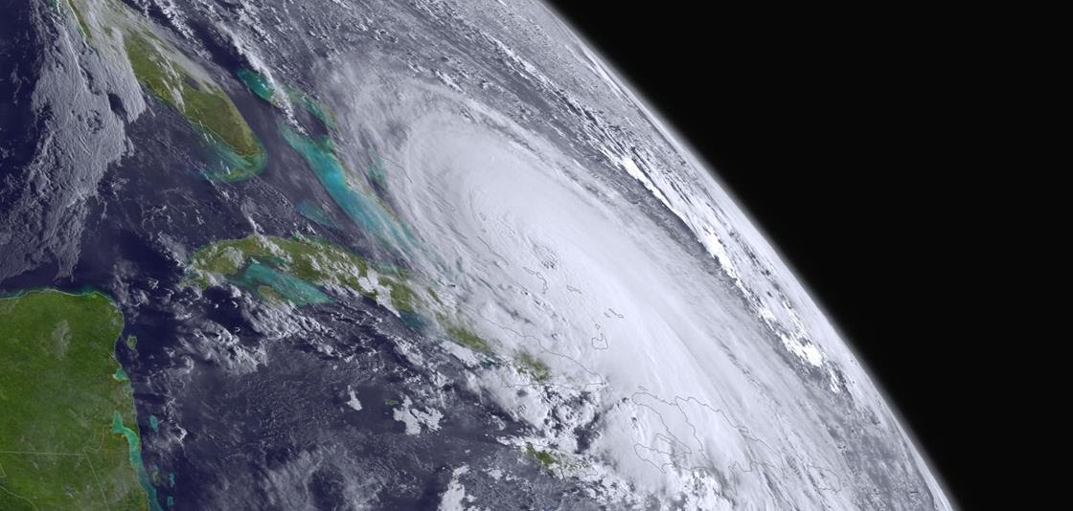
HRIT/EMWIN Status
15 Mar 2023
Ian Avruch
NESDIS/OSPO/DSB

Slide 2
HRIT/EMWIN Virtual Channel Listing (as of 10-Mar-2023)
VCID # | Product Name | GOES-E(16) Availability | GOES-W(18) Availability | Frequency (Minutes) | Priority on Broadcast | Guaranteed Bandwidth | Format | Resolution | Product Status
0 | Admin Text | X | X | 60 | 1 | 87% | Text Messages | N/A | Active and available
1 | Mesoscale Imagery | X | X | 15 | 12 | 87% | HRIT/LRIT | 0.5km Band 2, 2km for bands 7 and 13 | Both Meso scenes active and available
2 | CMI Band 2 | X | X | 30 | 7 | 87% | HRIT/LRIT | 2 km | Active and available
5 | GOES-15 WV Imagery |  | X | 30 - 180 | 13 | 87% | LRIT | 4 km | Only during Suppl Ops and not after 03/2023
6 | GOES-15 IR Imagery |  | X | 30 - 180 | 13 | 87% | LRIT | 4 km | Only during Suppl Ops and not after 03/2023
7 | CMI Band 7 | X | X | 30 | 6 | 87% | HRIT/LRIT | 2 km | Active and available
8 | CMI Band 8 | X | X | 30 | 8 | 87% | HRIT/LRIT | 2 km | Active and available
9 | CMI Band 9 | X | X | 30 | 9 | 87% | HRIT/LRIT | 2 km | Active and available
13 | CMI Band 13 | X | X | 30 | 5 | 87% | HRIT/LRIT | 2 km | Active and available
14 | CMI Band 14 | X | X | 30 | 10 | 87% | HRIT/LRIT | 2 km | Active and available
15 | CMI Band 15 | X | X | 30 | 11 | 87% | HRIT/LRIT | 2 km | Active and available
16 | G16 CMI Band 13 |  | X | 60 | 17 | 87% | HRIT/LRIT | 4 km | Active and available
17 | G17 CMI Band 13 | X |  | 60 | 17 | 87% | HRIT/LRIT | 4 km | Active and available
20 | EMWIN – High Priority | X | X | Continuous | 1 | 8% | Text | N/A | Active and available
21 | EMWIN - Graphics | X | X | 15 - 60 | 3 | 8% | Graphic (e.g. GIF, JPEG) | N/A | Active and available
22 | EMWIN – Low Priority | X | X | Continuous | 2 | 8% | Text | N/A | Active and available
24 | NHC Maritime Graphics | X | X | Variable | 14 | 87% | Graphic (e.g. GIF, JPEG) | N/A | Active and available
25 | GOES-E/W Level II Ancillary Products | X | X | Variable | 15 | 87% | HRIT/LRIT | 2 - 10 km | Active and available
32 | DCS Data | X | X | Continuous | 4 | 5% | DCS Formatted Text | N/A | Active and available
60 | Himawari-9 |  | X | 60 | 16 | 87% | HRIT/LRIT | 4 km | Active and available

Slide 3
HRIT/EMWIN Broadcast Issue 7-8 Feb 2023
Unexpected change in the DCS & EMWIN filenames on the HRIT broadcast, due to a bug introduced in the latest PDA release. It didn’t trigger any of our alerts in testing or monitoring. Some user software couldn’t parse the filenames and experienced an outage.
We’re adding explicit checks to the install procedure to prevent a similar problem in the future
Through user contact on the morning of 08 Feb we understood the problem and put a workaround in place
We warned of short disruptions on 07 Feb associated with the PDA installation, but I will endeavor in future to also send ‘work complete’ notifications during PDA installations.
Thanks to detailed email on the problem from a software developer / user, the workaround was quick. We’re grateful to have a diverse community of users and enthusiasts!
Please don’t hesitate to contact the 24/7 ESPC Helpdesk or the HRIT Manager if you have any issues with the HRIT/EMWIN Broadcast.

Slide 4
No Upcoming HRIT/EMWIN Broadcast Changes
GOES-15 will no longer be available for supplemental operations – role is now GOES-14,17
GLM has been requested, we’re evaluating possibility within available HRIT bandwidth
Any changes to virtual channels will be announced well in advanced

Slide 5
HRIT & GeoXO
Given the decision to employ commercial satellite broadcasts for an HRIT/EMWIN equivalent during the GeoXO mission, the tasks are
Based on user needs recommend reliability, availability, and latency requirements
The same for broadcast band, satellite visibility, receiver hardware
Engage with manufacturers and suppliers early
We plan to reach out to the user community. Your input is welcome and needed.

Slide 6
ESPC Notifications, Status, and Contacts
Subscribe to ESPC for notifications -- this is the primary way for you to receive notifications!
24/7 Help Desk | ESPCOperations@noaa.gov (301) 817-3880 operational concerns incl. outages, ESPC notifications (un)subscribe, administrative information
ESPC Messages | https://www.ospo.noaa.gov/Operations/messages.html archive of ESPC notifications
User Services | SPSD.UserServices@noaa.gov general public comments and inquiries
Data Access | NESDIS.Data.Access@noaa.gov for data access contact the Data Access Team
GOES Operational Status | http://www.ospo.noaa.gov/Operations/GOES/status.html
GOES User Information and Documents | http://www.ospo.noaa.gov/Operations/GOES/documents.html
POES Operational Status | http://www.ospo.noaa.gov/Operations/POES/status.html
News & Events | https://www.nesdis.noaa.gov/about/news-events
Social Media | facebook, Twitter, YouTube, Instagram, Linkedin

Slide 7
GRB/HRIT Contacts
Toby Hutchings, Direct Readout Program Manager
NOAA/NESDIS/OSPO/SPSD
Email: grb.pm@noaa.gov
toby.hutchings@noaa.gov
Phone: (301) 817-4422 (Office)
Ian Avruch, HRIT/EMWIN Program Manager
NOAA (NESDIS/OSPO/SPSD/DSB)
Email: hrit.manager@noaa.gov
Ian.Avruch@noaa.gov
Phone: ‪(240) 410-3546‬ (Office)
Paul Seymour
NOAA (NESDIS/OSPO/SPSD/DSB) Affiliate
Systems Integration & Development, Inc (SID)
Email: paul.seymour@noaa.gov

