Slide 1
LRIT Project Status Update
STIWG/TWG, Boise, ID
Mark Bushnell
NOAA/NOS/CO-OPS
May 02, 2012
Definitions
LRIT – Low Rate Information Transmission
LRGS – Local Readout Ground Station
Latency – Δt, xmit to resident on LRGS

Slide 2
LRIT - Low Rate Information Transmission
An existing NOAA rebroadcast of DCS data as well as
other products, replaces WEFAX, LRIT PM Paul Seymour
Data received at Wallops, Internet to NSOF, value added
products generated, Internet back to Wallops, rebroadcast
to both GOES East + West, products received hemisphere
vs. CONUS
GOES DCS East + West are combined into a single data stream,
other LRIT products are East / West specific (2 LRIT streams)
http://www.noaasis.noaa.gov/LRIT/

Slide 3
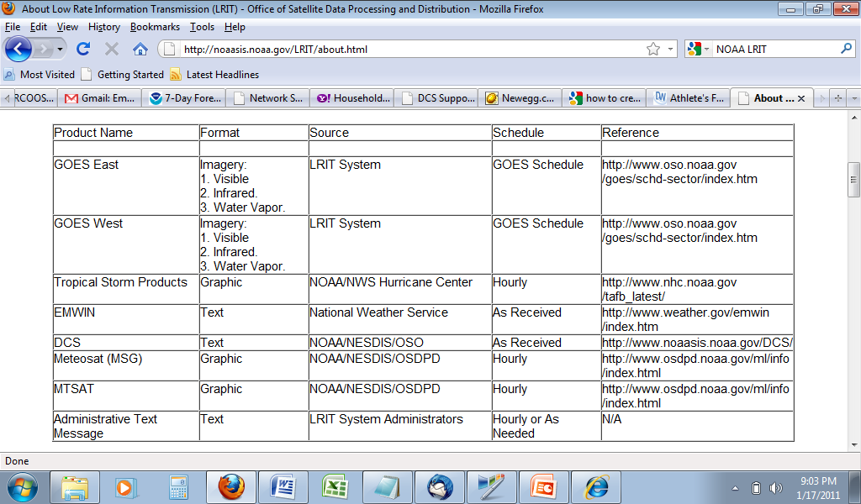
LRIT Products

Slide 4
We wish to replace Domsat with LRIT
Pros
NOAA supported product
Hemispheric coverage
Multiple products
Small dish receiver
No annual user costs
No contract
No MOUs
Cons
Increased data latency
Double single point of failure
Unknown outage rate
Unknown unknowns
Double single point of failure
NSOF backup capability at Wallops
DRGS receive at NSOF

Slide 5
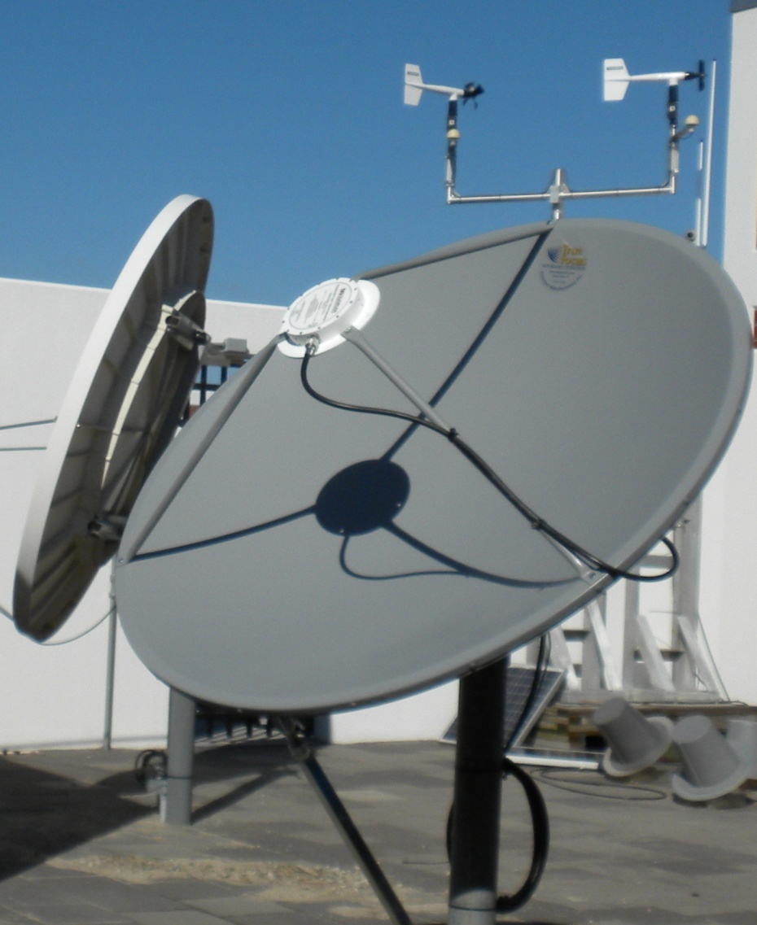
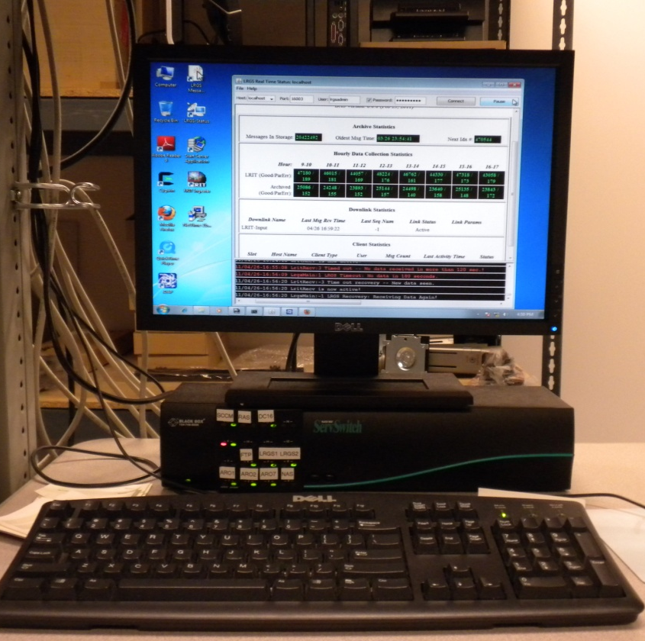

Slide 6
TEST PLAN DRAFTED, PARTNERS SOUGHT
Test 1A–Select several GOES Platform Identifications (PIDs) and search for all expected data over several days
Test 1B–Compare DOMSAT and LRIT like files to see that file sizes are similar
Test 1C–Compare LRIT file creation time stamps with DADDS reception time stamps
Test 1D–Spot check comparisons of Chesapeake LRIT and Seattle LRIT data sets
Test 2A–Quantify data latency for some/many/all? CO-OPS PIDs. Look for latency patterns that correlate with time of transmission.
Test 2B–Identify and quantify data gaps and compare to DOMSAT
Test 3A–Rain fade
Test 3B–Physical obstruction of antenna – step ladders, birds, etc.
Test 3C–Antenna misalignment sensitivity
Test 3D–Local radio frequency (RF) interference – introduce common RF sources in the vicinity of the antenna

Slide 7
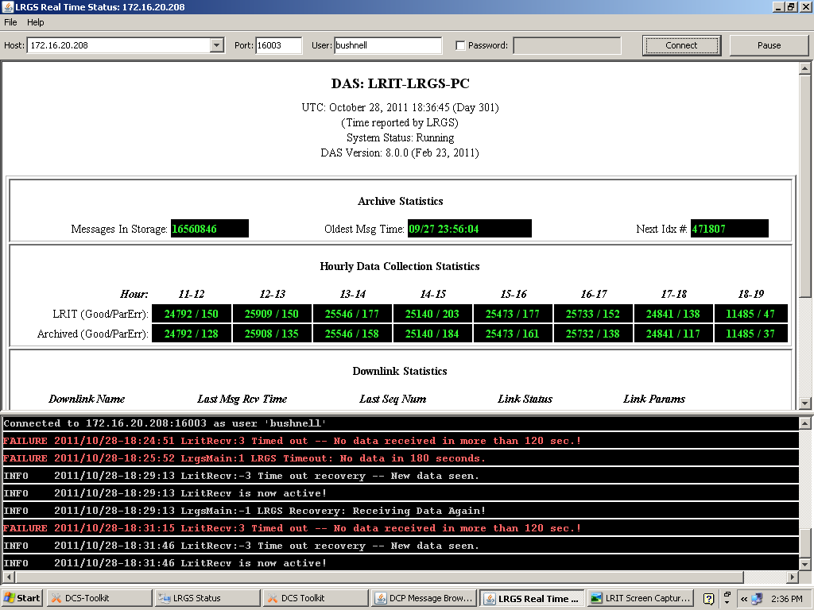

Slide 9
INITIAL DATA LATENCY (Maloney)
Minutes
Latency, sorted high to low

Slide 10
Charleston Water Level Station
17:24
18:24
Latency (minutes)
6 min sample number

Slide 11
Test 1
Spread the load
Certain NWS products created and transmitted by LRIT
servers in the LRIT Domain 2/3 and 4 caused a peak load
at 16 minutes past the hour, resulting in latencies as great
as 18 minutes. Product generation and transmission were
adjusted so as to spread the system load throughout the
3 hours. Tests conducted on 1/26/12 showed that this
rescheduling greatly reduced latency to 2-6 minutes.
Notes:
These tests were conducted in response to configuration changes implemented by NESDIS. Weekly telcons were conducted to plan for reconfigurations and discuss test findings. Excellent support by the NESDIS team!

Slide 12
Test 2
Expedite
The LRIT data entering Domain 4 are placed into a
queue, in part to ensure that product components
are processed and transmitted properly. To test the
impact of the queue on latency, the DCS data were
temporarily directed to the front of the queue.
Tests conducted on 02/09/12 (JD 040) showed this
expedited queue had no impact. Average latency
before the change was 3.5 minutes, and with the
expedited queue in place it was 3.6 minutes for 11
data points collected during a one hour period.

Slide 13
Test 3
Low priority threshold adjustment
Most DCS data are assigned a low priority, with file
transmissions triggered by either 1000 messages
compiled or 2 minutes elapsed time since the
previous transmission. To test the impact of this
on latency, the thresholds for low priority DCS files
only were temporarily reset to 30 seconds or 500
messages. This adjustment was made at Wallops
Island (Domain 1). Tests conducted on 02/15/12
(JD 047) showed that latencies remained between
1:51 and 9:35 with most still just above 2 minutes.

Slide 14
Test 4
Channel 159 high priority
To examine the very best case, least latency available
through LRIT, Channel 159 was placed in the high priority
bin by itself. In this case, each single DCS message on
channel 159 was processed without delay. Tests
conducted on 02/29/12 showed latencies ranging from
as low as 1:25 to 2:26, with an average of 1:57.

Slide 15
Errors, warnings, info msgs
FAILURE 2011/06/09-00:16:11 LritRecv:3 Timed out -- No data received in more than 120 sec.!
INFO 2011/06/09-00:16:22 LritRecv:-3 Time out recovery -- New data seen.
INFO 2011/06/09-00:16:22 LritRecv is now active!
FAILURE 2011/06/09-06:29:59 LritRecv:3 Timed out -- No data received in more than 120 sec.!
FAILURE 2011/06/09-06:31:00 LrgsMain:1 LRGS Timeout: No data in 180 seconds.
INFO 2011/06/09-06:31:05 LritRecv:-3 Time out recovery -- New data seen.
INFO 2011/06/09-06:31:05 LritRecv is now active!

Slide 16
Errors, warnings, info msgs

Slide 17
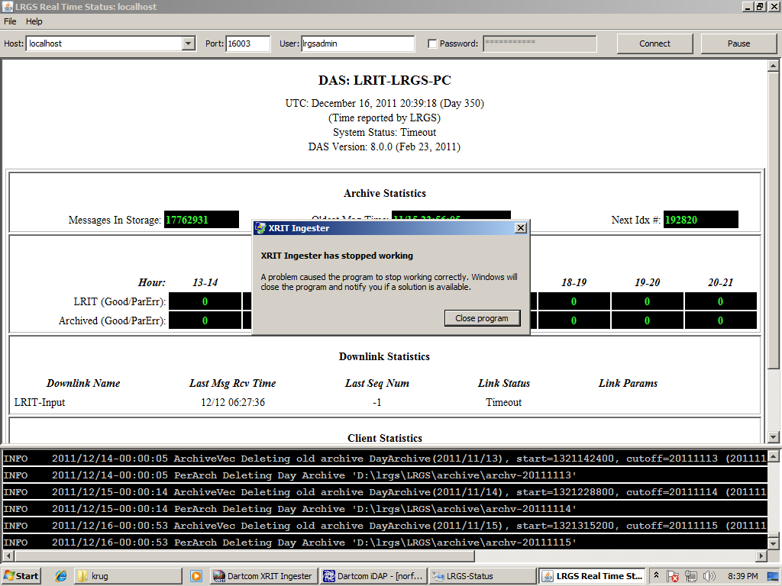

Slide 18
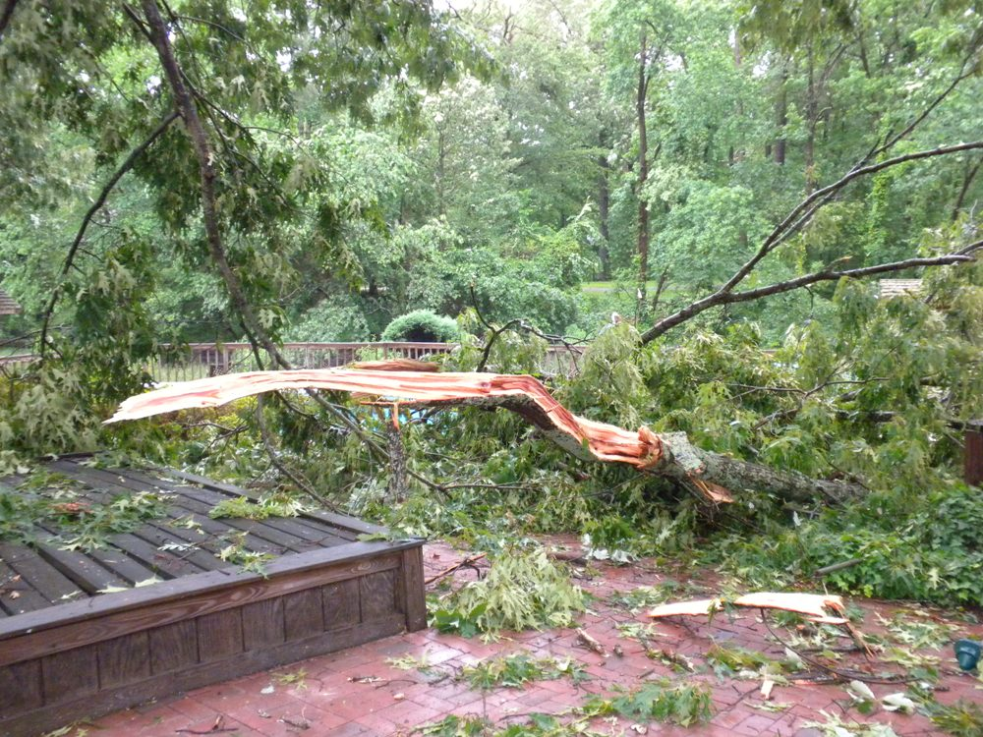
Rain Fade Test
05/24/11 20:20 UTC

Slide 19
Immediate future
Work w/ NESDIS to reduce latency
Alert DCS community of our findings
Standalone DOMSAT, no internet feed
Continue testing
Share LRIT LRGS access outside of TCN

Slide 20
Longer term activity
Build latency alarm & other tools
Prepare for HRIT
Support a virtual channel
Monitor GOES R dev/launch/ops
The End - Questions?

