Slide 1


Platform Description Table Updates
Within the
DCS Administrative and Data Distribution System (DADDS)

Slide 2
DADDS Training Topics
DADDS Access Levels
Platform Description Table (PDT) Updates
  Manual
  Batch file submission
DADDS Message Retrieval and Export

Slide 3
DADDS Web Pages
DADDS is available on 4 different replicating web pages…
https://dcs1.noaa.gov
https://dcs2.noaa.gov
https://dcs3.noaa.gov or
https://dcs4.noaa.gov

Slide 4
DADDS Access Levels
 | View All DCPs | View All DCP Messages | Edit PDT for DCPs within Group Code | Assign Users to their Group Code
Standard User
Master User
Group Manager (Role)
Each Group code should have a Group Manager responsible for requesting additional Users to their group, as well as requesting additional platform assignments.
  Master User privileges are typically requested by Group Manager.
  We need to work on identifying Group Managers for each group code.

Slide 5
Platform Description Table (PDT) Updates
All Master Users have the responsibility to regularly login into the DADDS to update the metadata within the Details, Shef Codes and Contact tabs.
Specifically, the following fields MUST be complete with accurate information:
-Location Name
-Country/State/Province
-Radio/Manufacturer and Model number
-Latitude and Longitude converted into Degree Minute Second
-Deploy Date
-At least 1 Shef Code
-Point of Contact - must have a DADDS account and be assigned to the group code.
Goal is to complete the records, indicated by column COMPL=Y.

Slide 6
PDT Updates
Two basic ways to update the PDT:
Manual updates by entering each individual PDT.
Creating a batch file that can update multiple PDT records simultaneously.
Note: If it has been a while since logging into the system you will have to reset your password. If you need your 4 digit PIN, contact Valerie.Randall@noaa.gov or the 24/7 Wallops Help Desk at 757-824-7450.

Slide 7
Manual PDT Updates
To update PDTs, you must have Master User privileges on your DADDS account.
Click on the ‘Platforms’ tab.
Create a filter for either individual DCP IDs or Group Codes.
Once results are returned, click on the address to enter the PDT.
The ‘General’ tab cannot be changed by the User.
Users have access to update the ‘Details’, ‘Shef Codes’, and ‘Contact’ tabs.

Slide 8
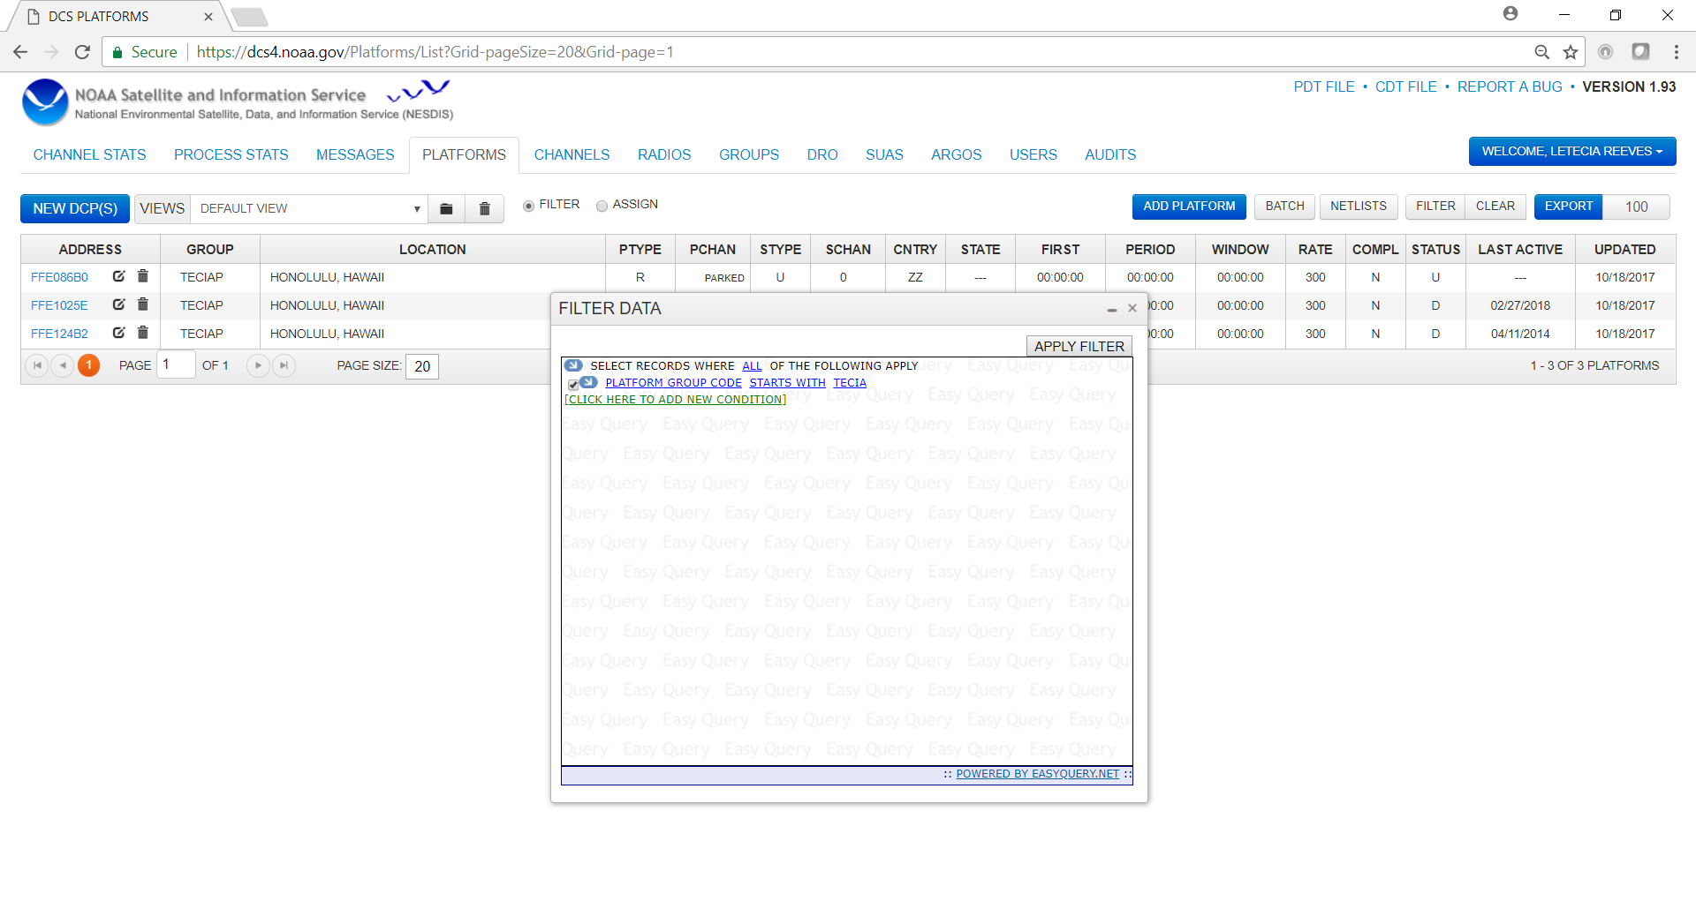

Slide 9
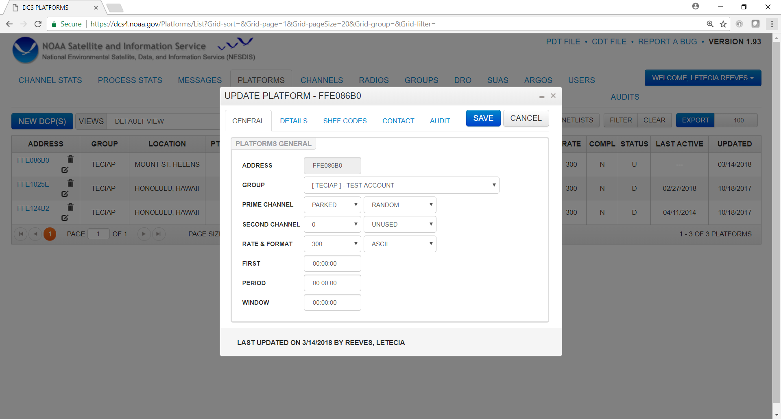
General Tab contains your channel assignment information, and cannot be edited by User.

Slide 10
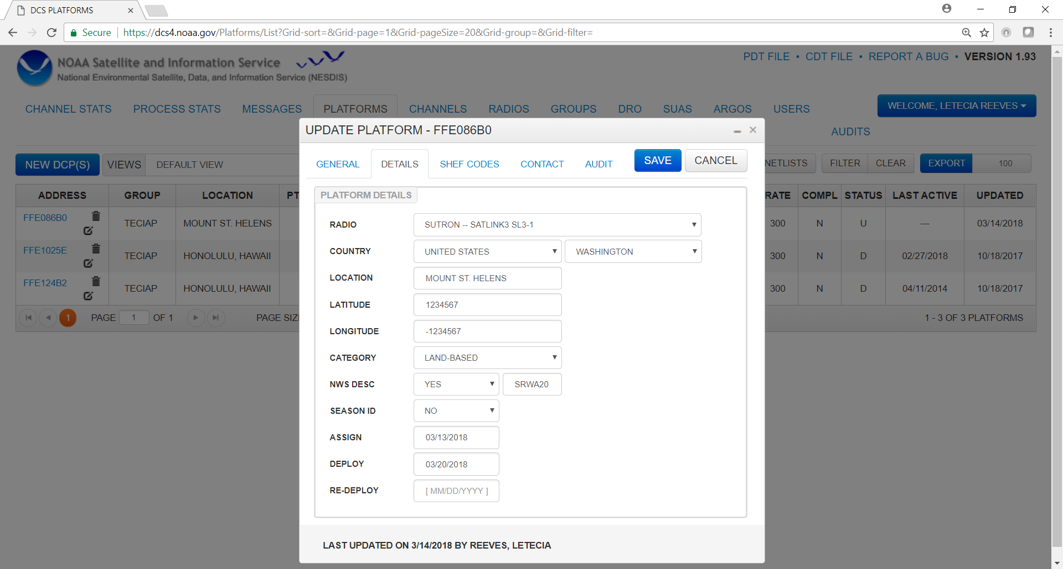
Details Tab
DDDMMSS
Enables routing to the NWSTG and GTS.

Slide 11
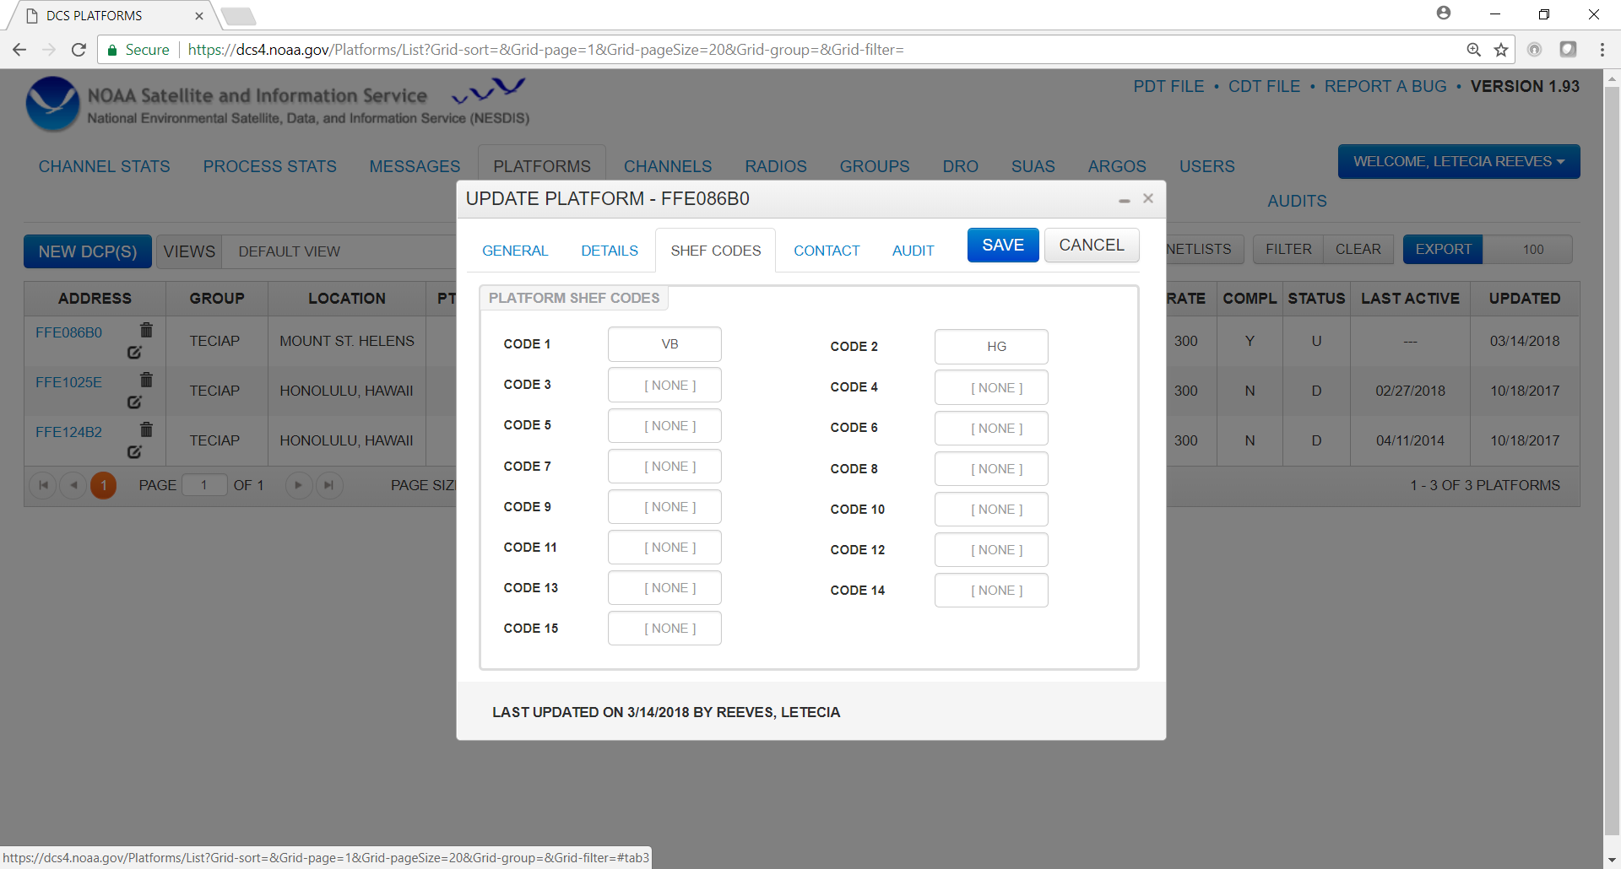
Shef Codes Tab
DADDS only accepts 2 chars
https://www.noaasis.noaa.gov/GOES/GOES_DCS/schefcodes.html

Slide 12
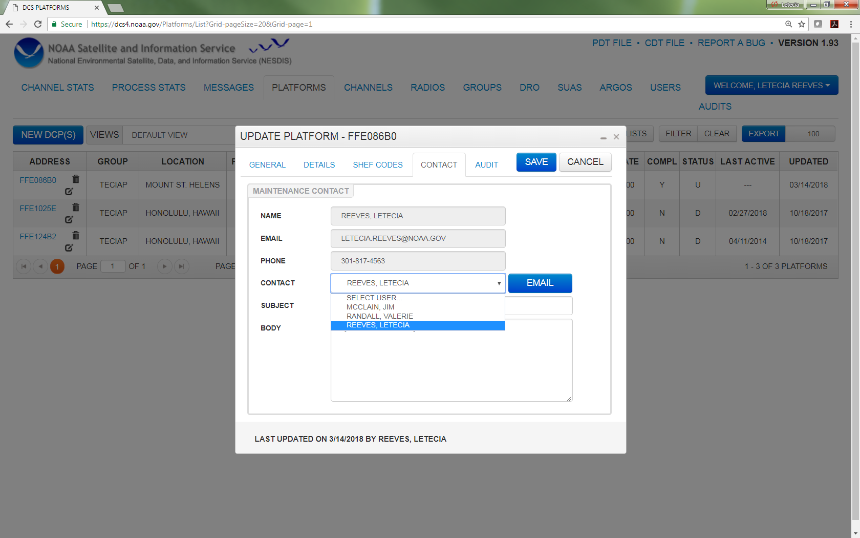
Contact Tab
Users can change the poc to anyone already listed in their group code.

Slide 13
Batch File PDT Updates
Batch file updates are a convenient way to update multiple PDTs simultaneously.
Must create a script in a text file.
Batch files can contain as little as one PDT update or upwards of 100.

Slide 14
Creating Batch Files for PDT Updates
UPDATE PDT FFE086B0 & (PDT ID must be 8 characters)
OWNER_ID = TECIAP & (Updates the group code) Please note that Group Code updates can only be submitted by NESDIS
COUNTRY_STATE_PROV = USHI & (4 CHAR max)
LOC_NAME = "MOUNT ST. HELENS" & (must have quotes if there is an embedded blank) (31 CHAR max)
LATITUDE = 352722 & (DDDMMSS) (7 CHAR)
LONGITUDE = -1152326 & (DDDMMSS) (7 CHAR)
CATEGORY = L & (1 CHAR)
SHEF_CODE1 = PC & (2 CHAR)
SHEF_CODE2 = US &
MANUFACTR_ID = SUTRON & (must be entered exactly as in DADDS)
MODEL_NO = “SATLINK3 SL3-1” & (must be entered exactly as in DADDS)
NMC_FLAG = Y &
NMC_DESCRIPTOR = SRWA20 &
SEASON_ID = N &
DATE_DEPLOY = YYYYMMDD &
PMAINT_EMAIL = "Letecia.Reeves@noaa.gov" & (poc must be registered in DADDS & in the specific group code)
END
Batch files may contain as many updates as needed. They should begin with ‘UPD’ or ‘UPDATE PDT’ FFE086B0 & and be completed with ‘END’.
Delete any lines that are not needed. A batch can be as short as...
UPD PDT FFE1025E &
LOC_NAME = "ALWAYS SUNNY USA" &
END

Slide 15
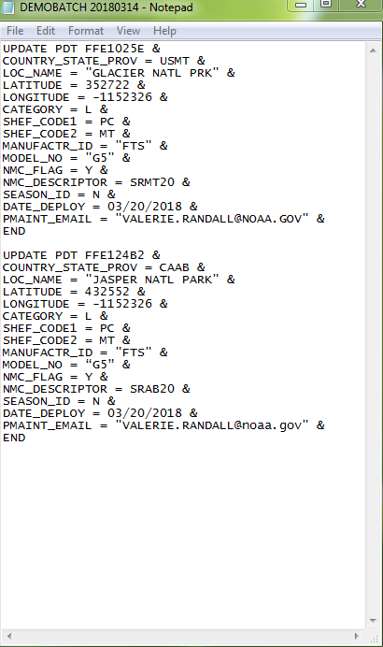
Batch file example to update two PDTs in DADDS

Slide 16
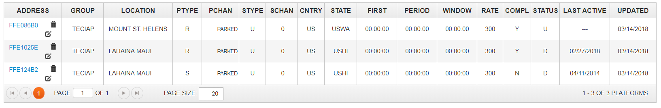
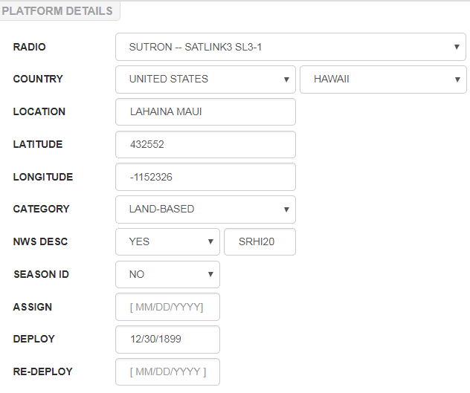
Before Batch File Submission
Notice the location name of the last two PDTs is in Maui.
Sutron is listed as the “radio” (manufacturer).

Slide 17
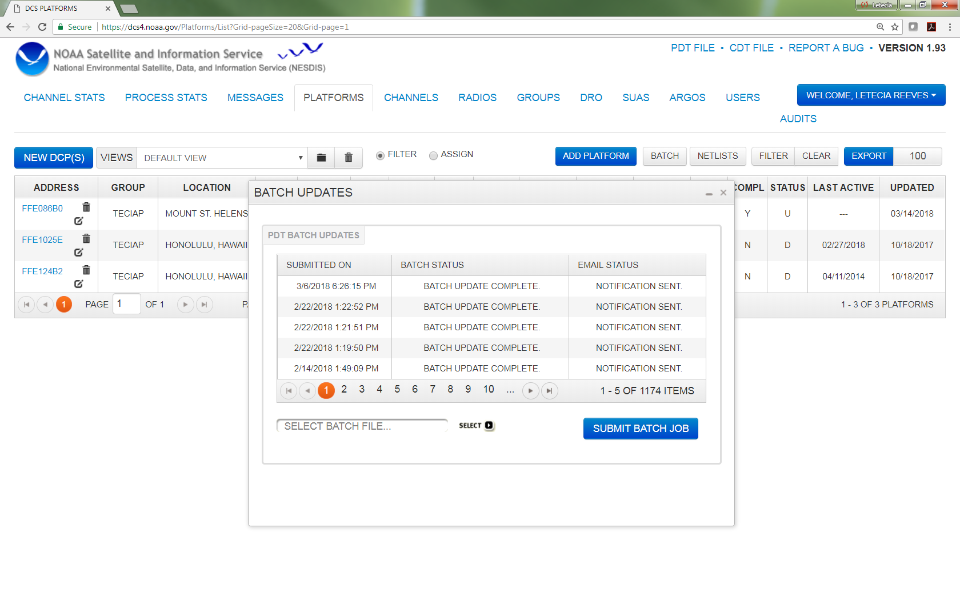
Save batch file as a text file and upload by clicking on “batch” button. It takes less than a minute to update the records. DADDS sends email confirming whether successful or not.

Slide 18
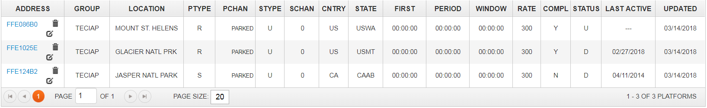
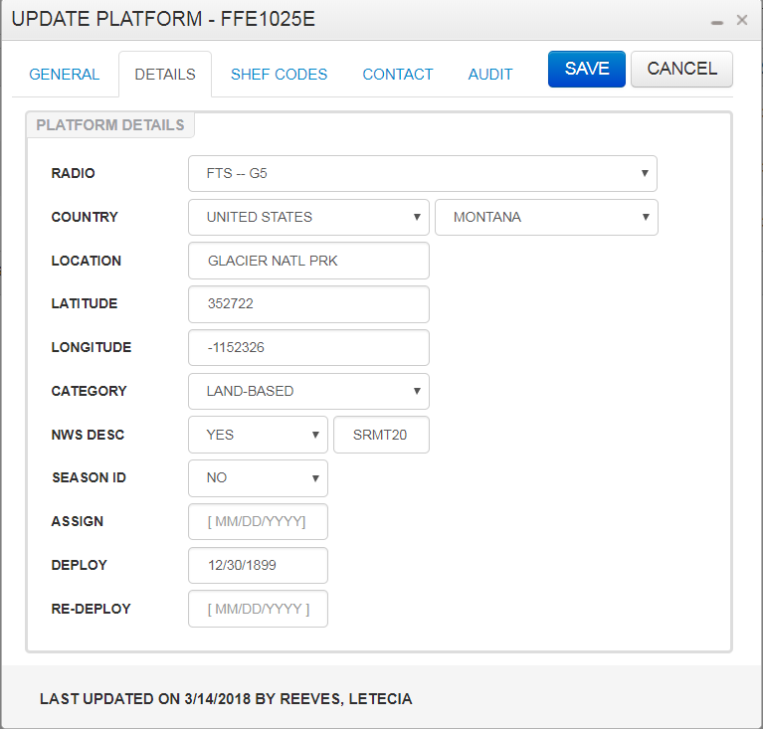
After Batch File Submission
Notice the location name changed to Glacier National Park in Montana.
FTS is now listed as the “radio”. (manufacturer).

Slide 19
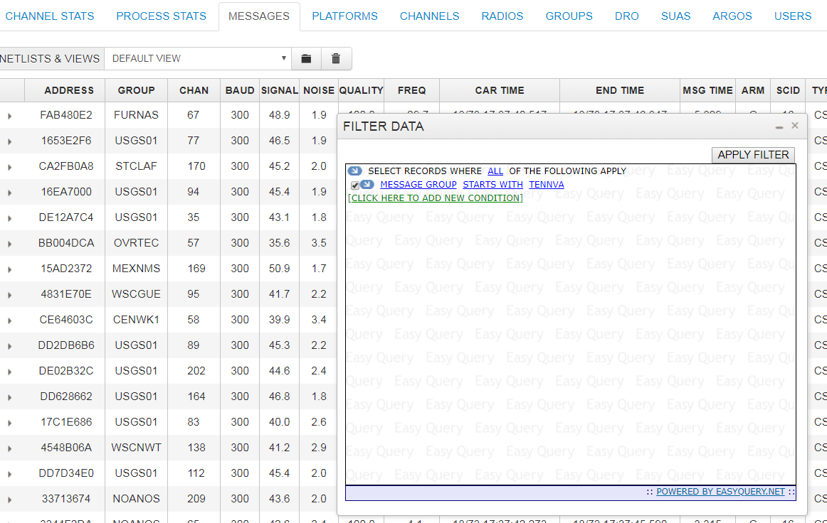
DADDS Message Retrieval and Export
Click on the “Messages” tab.
First view are all 25M+ messages received over the past 30 days.
Filter on specific addresses or group code(s).
Apply Filter

Slide 20
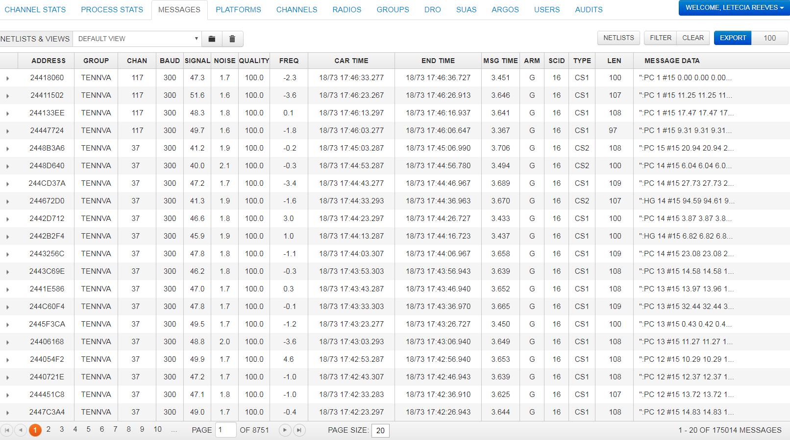
Filtering on group code TENNVA returned 175,014 records.
Add another condition to the filter to only retrieve specific days or bad messages.
DADDS allows you to export 10,000 records at a time.
Change the number to the right of the Export button, and select export.

Slide 21
GOES DCS Customer Service Team
Letecia.Reeves@noaa.gov
Valerie.Randall@noaa.gov
Wallops 24/7 Operations (757) 824-7450

