Slide 1
GOES-16 Aerosol Optical Depth Product in AWIPS-2
NWS/OBS Update to Provisional PS-PVR
Sep 14, 2018

Slide 2
GOES-16 Aerosol Optical Depth in AWIPS-2
Fielded AWIPS-2 baseline plugin handles ingest and display
Applies the Data Quality Flag (DQF=0) to retain good quality pixels
NWS transmission via the SBN started May 31, 2017
Full Disk, CONUS sectors
WMO Header IXTB99 KNES

Slide 3
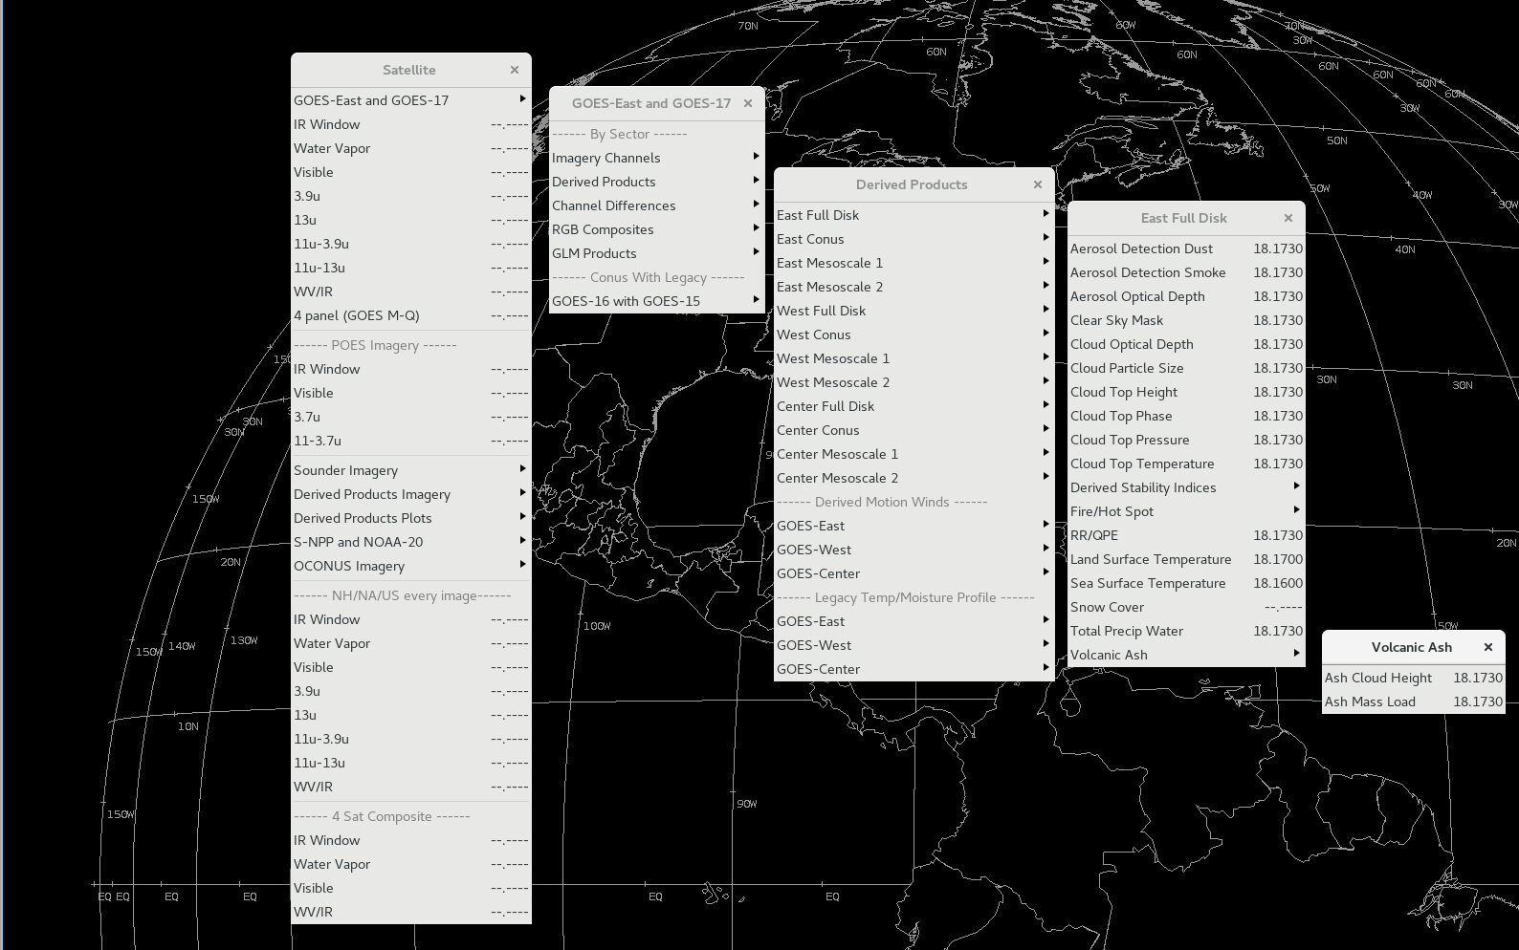
GOES-16 Product Menus

Slide 4
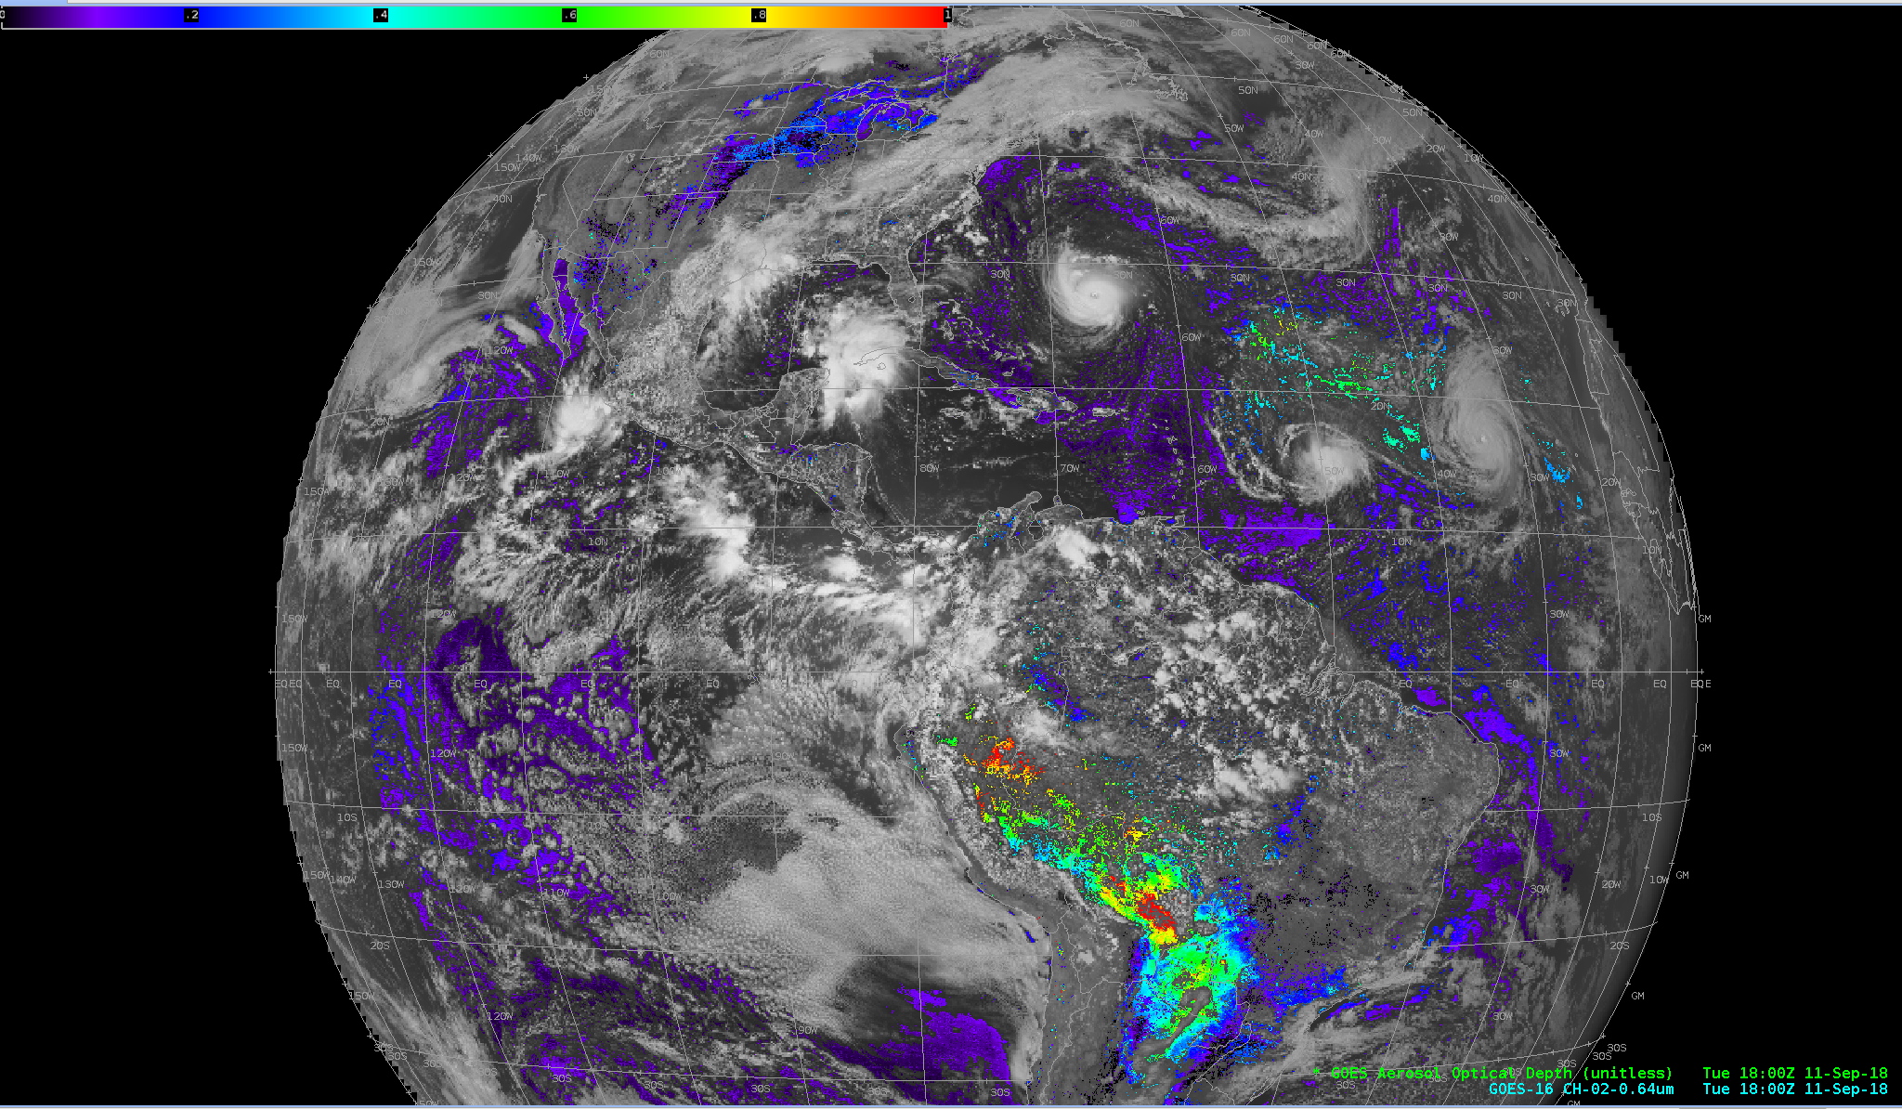
GOES-16 Aerosol Optical Depth, Full Disk

Slide 5
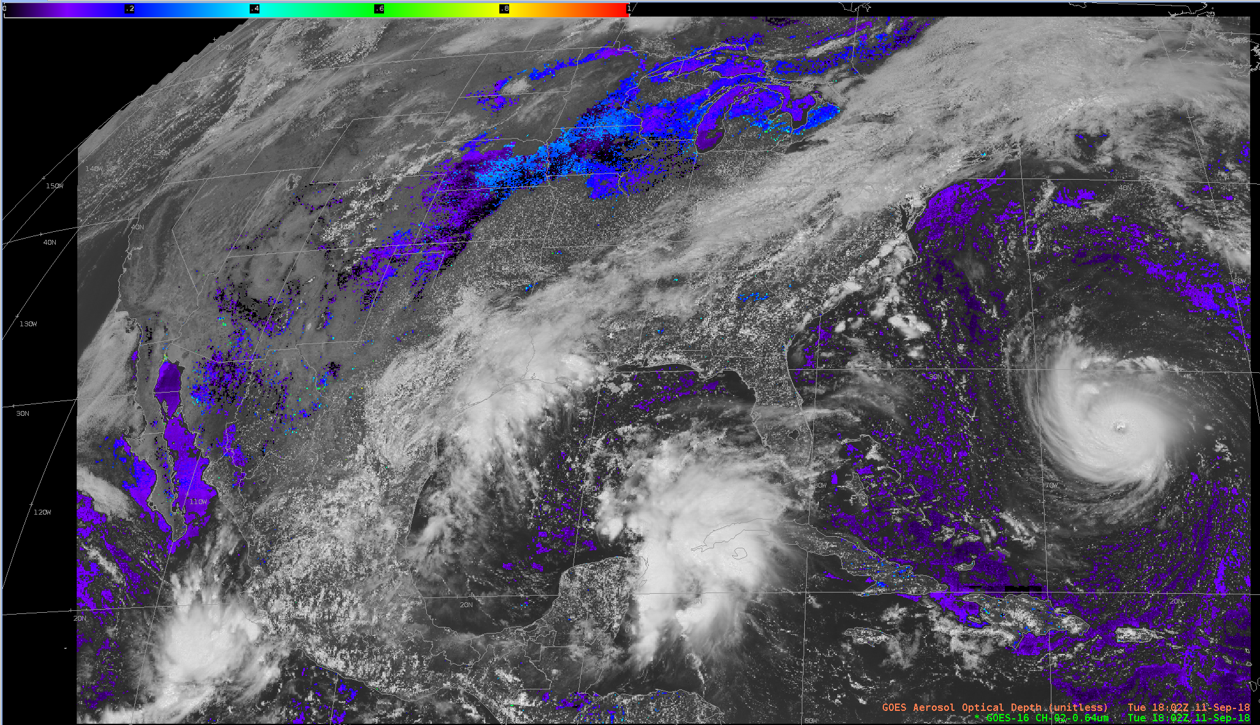
GOES-16 Aerosol Optical Depth, CONUS

Slide 6
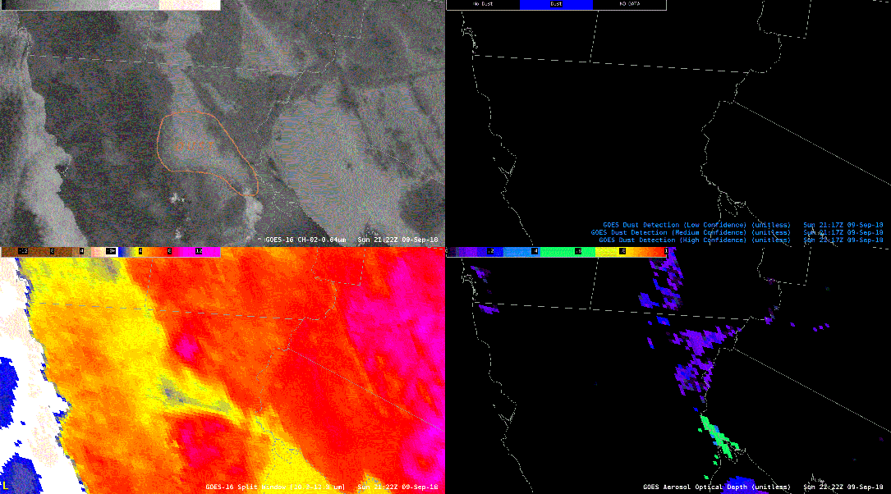
So. Cal/Baja Sep 9th, 2018. Provided by Phoenix WFO

Slide 7
Questions?

