Slide 1
Cloud Cover Layers (CCL)
Provisional
Peer/Stakeholder Product Validation Review
including a look at Cloud Base Height (CBH) impact and performance
AWG Cloud Team
NOAA: Mark Kulie (Cloud Team Lead)
CIRA: Yoo-Jeong Noh, John Haynes, Brandon Daub, Steve Miller
CIMSS: Yue Li, William Straka, Steve Wanzong, Mike Foster
May 16, 2023

Slide 2
THANK YOU!
GOES-R Product Readiness and Operations (PRO) Team
Algorithm Scientific Software Integration and System Transition Team (ASSISTT)
GOES-18 Near Real Time Products
GOES-16 Retrospective Dataset
CIRA and CIMSS Teams
CloudSat Team
DOE Atmospheric Radiation Measurement (ARM) Program
GOES-R Program

Slide 3
Outline
Introduction
Enterprise Cloud Cover Layers (CCL) Review
Summary

Slide 4
Outline
Introduction
Provisional Requirements
Enterprise Cloud Algorithm Suite
Data Used
Enterprise Cloud Cover Layers (CCL) Review
Summary

Slide 5
General Information
No formal GOES CCL reviews have been performed (new operational product)
No formal CCL Readiness, Implementation, and Maintenance Plan (RIMP)
Enterprise Cloud Top Properties (CTP) RIMP is most applicable

Slide 6
Provisional Review Requirements
From ABI L2+ Cloud Top Parameters RIMP
Notes:
Specific relevant metrics will be provided for each product

Slide 7
Validation Metrics
CCL validation accuracy threshold: 60%
CBH validation thresholds (intermediate input for CCL):
Cloud Optical Thickness < 1: 3 km
Cloud Optical Thickness > 1: 2 km
Validation specifications outlined in:
GOES CCL Algorithm Theoretical Basis Document (ATBD).
Applied to JPSS Enterprise CCL operational product reviews.
Enterprise Algorithm Working Group (AWG) CCL and CBH algorithm system and external user manuals (SMM/EUM, Sept 2022 version, used for VIIRS reviews). CBH is an intermediate product for ABI.
Notes:
Specific relevant metrics will be provided for each product

Slide 8
Post-Launch Product Tests (PLPT)# Under Review
PLPT ID | Descriptive Title | % Complete | Results | AWG POC
ABI-FD_CTP01 | Verify that CCL product is generated at the required cadence for FD in ABI Mode 6 | 100 | Complete | AWG
ABI-CONUS_CTP02 | Verify that CCL product is generated at the required cadence for CONUS in ABI Mode 6 | 100 | Complete | AWG
ABI-MESO_CTP03 | Verify that CCL product is generated at the required cadence for MESO in ABI Mode 6 | 100 | Complete | AWG
Product Cadence
Full Disk (FD): 10 minutes
CONUS: 5 minutes
MESO: 1 minute
#Official PLPT tables can be found in the Cloud Top Parameters ABI L2+ RIMP

Slide 9
Post-Launch Product Tests (PLPT)# Under Review
PLPT ID | Descriptive Title | % Complete | Results | AWG POC
ABI-FD_CTP06 | Assess the accuracy and precision of CCL product generated for FD in ABI Mode 6 | 100 | Complete | AWG
ABI-CONUS_CTP07 | Assess the accuracy and precision of CCL product generated for CONUS in ABI Mode 6 | 100 | Complete | AWG
ABI-MESO_CTP08 | Assess the accuracy and precision of CCL product generated for mesoscale in ABI Mode 6 | Visual Only | * | AWG
Full Disk (FD) sectors used in quantitative validation analyses are considered a proxy for CONUS and MESO sectors due to the nature of the validation datasets.
FD and CONUS are compared using a histogram analysis (see later slides).
MESO visual assessments were conducted
#Official PLPT tables can be found in the Cloud Top Parameters ABI L2+ RIMP

Slide 10
Post-Launch Product Tests (PLPT)# Under Review
PLPT ID | Descriptive Title | % Complete | Results | AWG POC
ABI-FD_CTP06 | Assess the accuracy and precision of CCL product generated for FD in ABI Mode 6 | 100 | Complete | AWG
ABI-CONUS_CTP07 | Assess the accuracy and precision of CCL product generated for CONUS in ABI Mode 6 | 100 | Complete | AWG
ABI-MESO_CTP08 | Assess the accuracy and precision of CCL product generated for mesoscale in ABI Mode 6 | Visual Only | * | AWG
Full Disk (FD) sectors used in quantitative validation analyses are considered a proxy for CONUS and MESO sectors due to the nature of the validation datasets.
FD and CONUS are compared using a histogram analysis (see later slides).
MESO visual assessments were conducted
#Official PLPT tables can be found in the Cloud Top Parameters ABI L2+ RIMP

Slide 11
CONUS + MESO Validation Complications
GOES-18 (G18) CONUS sector doesn’t cover the DOE ARM site (see later slides)
Rare G18 MESO validation opportunities given limited dataset used in this review (see later slides)
ASSISTT G18 output was used in quantitative validation exercises due to artifacts in the Development Environment (DE) output (FD sectors were only requested)
GOES-16 (G16) Retrospective dataset
CONUS/MESO ground-based validation would only be possible for the G16 retrospective period.
Computationally unrealistic for ASSISTT to create G16 CONUS & MESO sectors

Slide 12
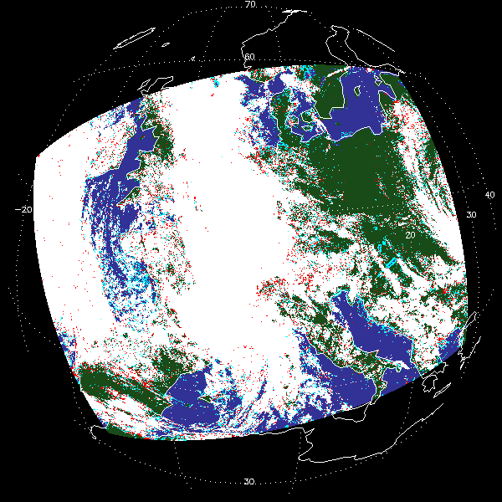
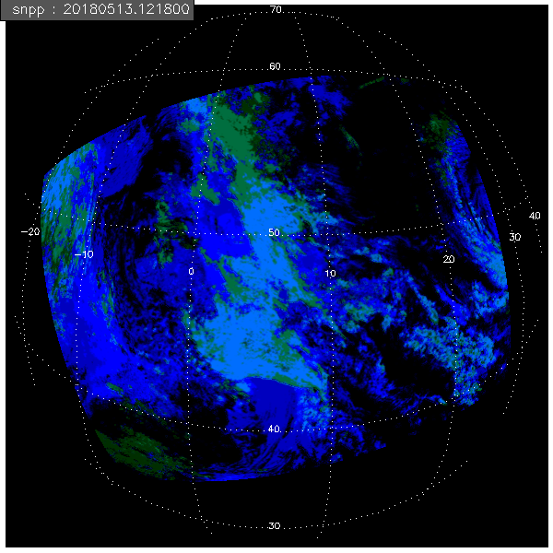
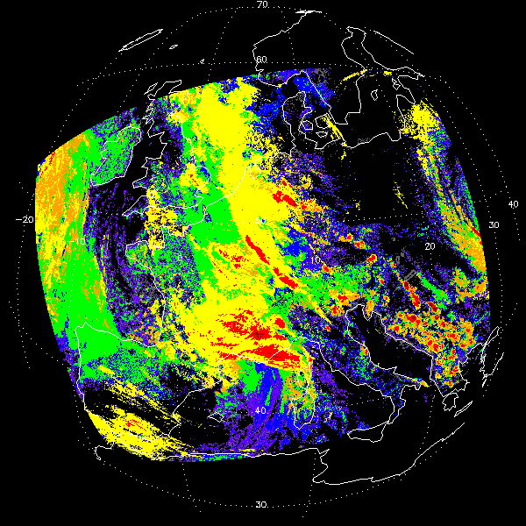
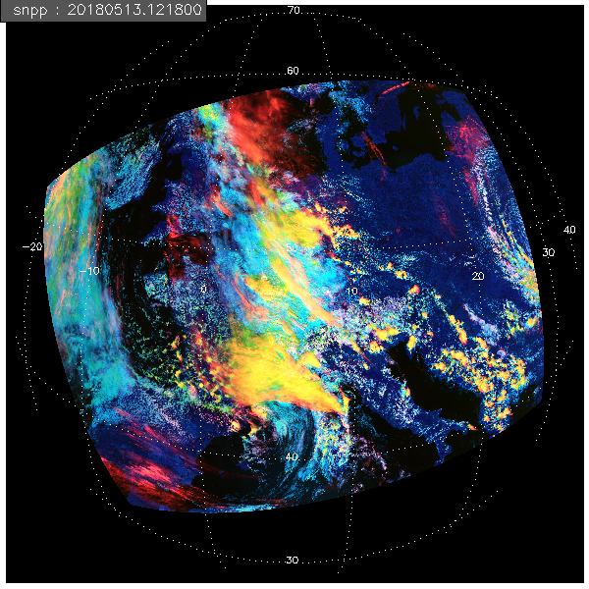
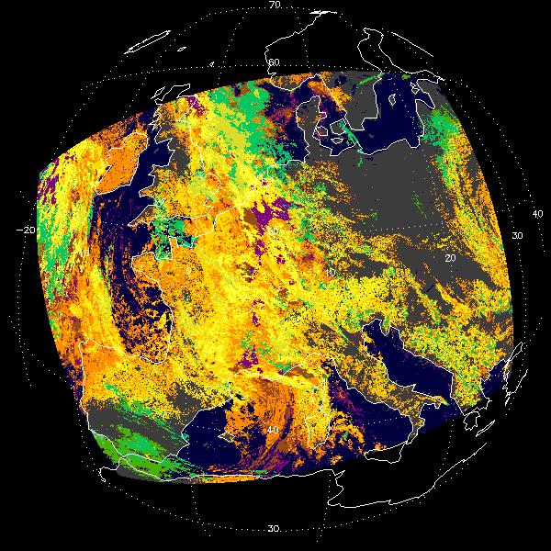
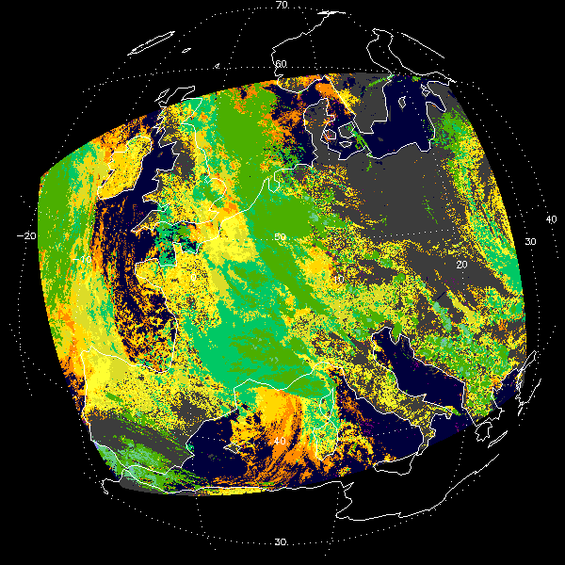
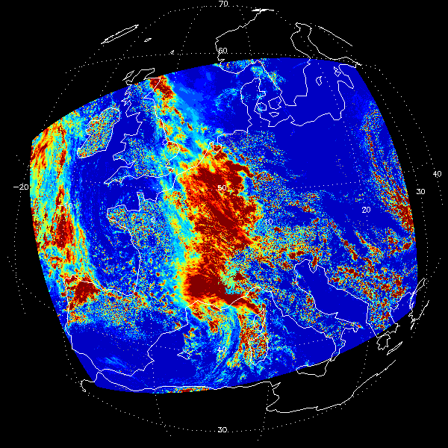
NOAA Enterprise Cloud Algorithms
Cloud Cover
Layers
Cloud Probability/Mask
Cloud Base
Height
Cloud Phase/Type
GOES -18 Sensor Data Records
Cloud Top
Height
Cloud Optical Properties
(Day, Night)

Slide 13
NOAA Enterprise Cloud Algorithms
Cloud Cover
Layers (CCL)
Cloud Probability/Mask
Cloud Base
Height
Cloud Phase/Type
GOES -18 Sensor Data Records
Cloud Top
Height
Cloud Optical Properties
(Day, Night)

Slide 14
NOAA Enterprise Cloud Algorithms
Cloud Cover
Layers (CCL)
Cloud Probability/Mask
Cloud Base
Height (CBH)
[Intermediate Product]
Cloud Phase/Type
GOES -18 Sensor Data Records
Cloud Top
Height
Cloud Optical Properties
(Day, Night)

Slide 15
NOAA Enterprise Cloud Algorithms
Cloud Cover
Layers (CCL)
Cloud Probability/Mask
Cloud Base
Height (CBH)
[Intermediate Product]
GOES -18 Sensor Data Records
Cloud Phase/Type
G18 overicing issue
Problem solved
5/18 implementation
Cloud Top
Height
Cloud Optical Properties
(Day, Night)

Slide 16
GOES Datasets
GOES-18 CCL Products
ASSISTT Framework Near Real Time (NRT)
Ground System (GS) Operational Development Environment (DE or OPS)
GOES-16 CCL Products
ASSISTT 2019 Retrospective Dataset
Allows CALIPSO/CALIOP comparisons
GOES-18 sanity check (e.g., cloud phase issue)

Slide 17
Validation Datasets
VIIRS
CALIPSO (spaceborne lidar)
CloudSat (spaceborne radar)
DOE ARM (ground-based radar/lidar)
Validation complications
Data availability/latency issues: short time fuse
Limited spatial and/or temporal availability
CloudSat & CALISPO: non-scanning instruments
DOE ARM: vertically pointing instruments at one site

Slide 18
Outline
Introduction
Enterprise Cloud Cover Layers (CCL) Review
Visual Inspection
Quantitative Analysis
Team Recommendations
Summary

Slide 19
RESULTS - VISUAL INSPECTION

Slide 20
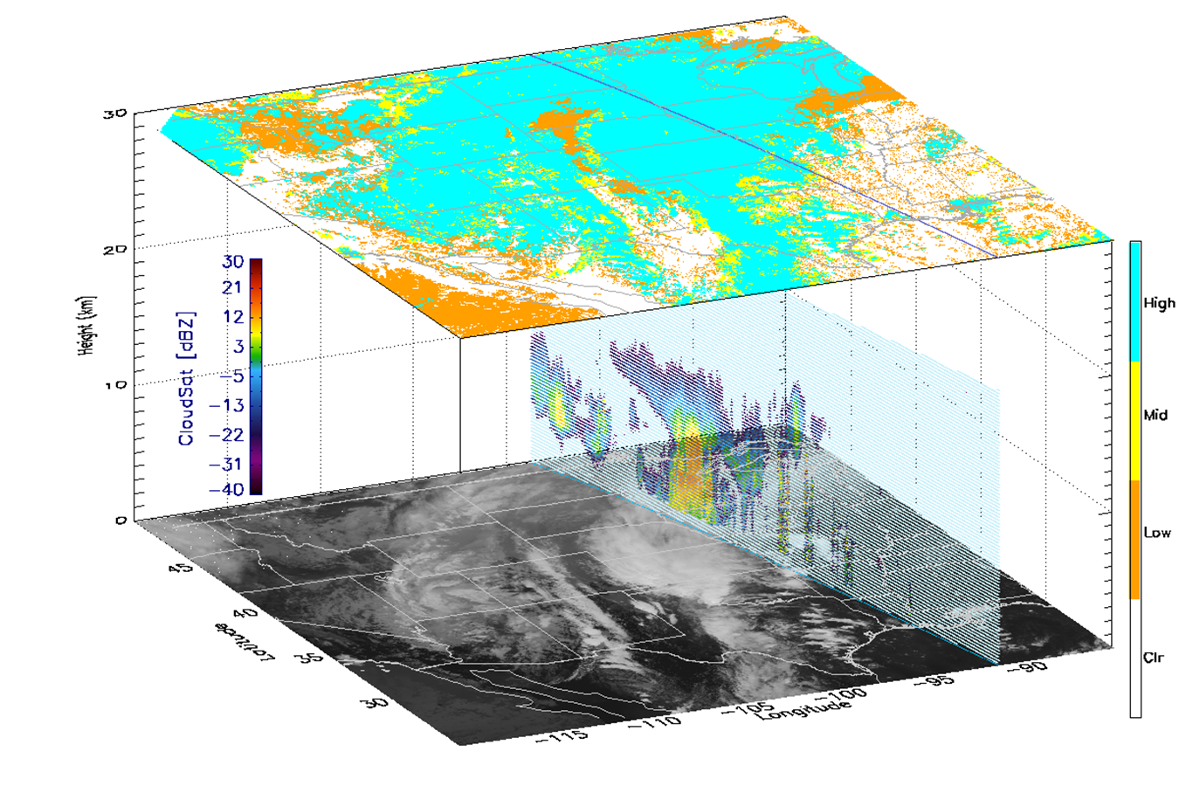
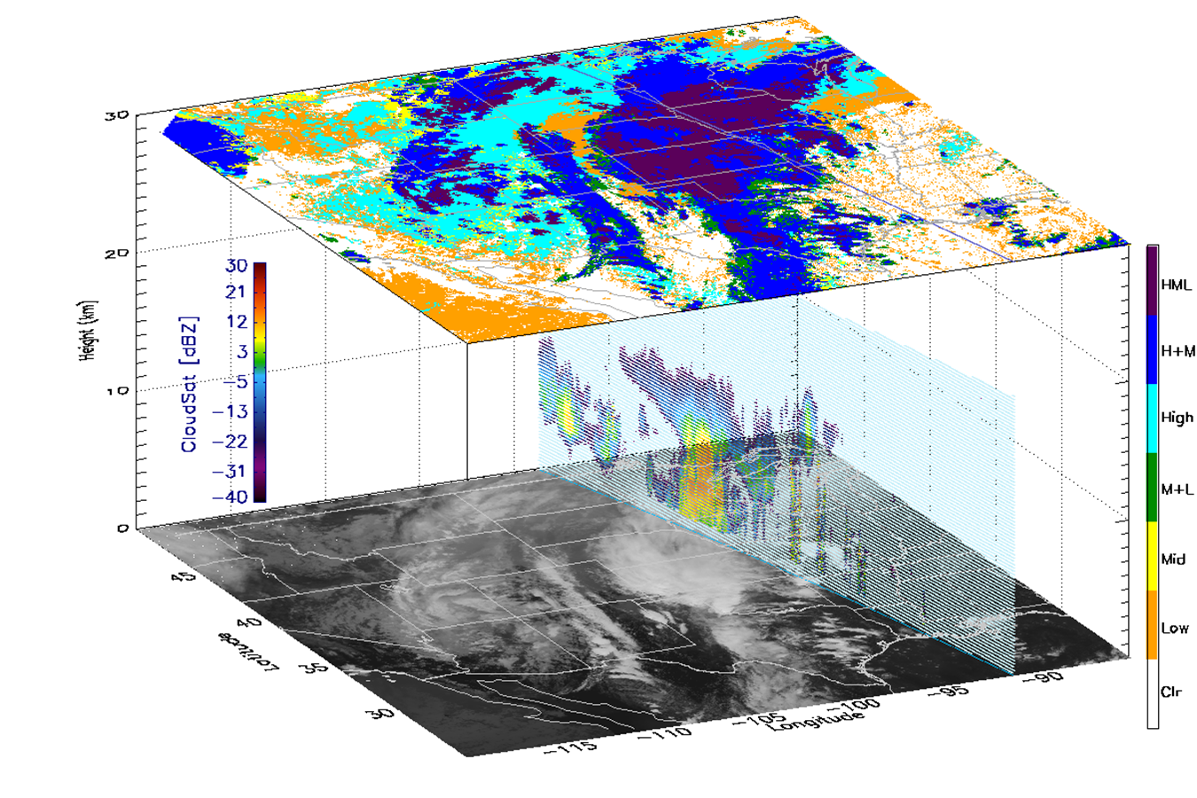
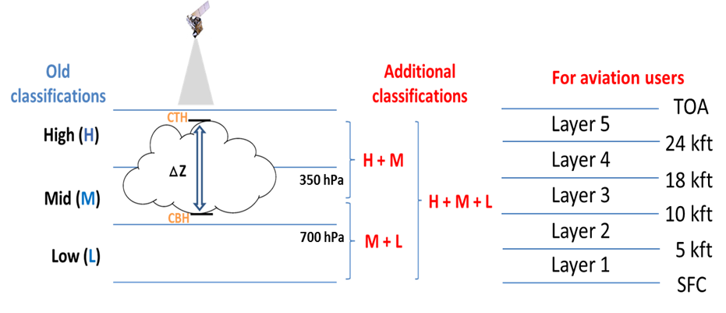
ABI Cloud Cover Layers (CCL) Products Using Cloud Base Height (CBH)
GOES-16 ABI sample CCL
Adding CBH
Cloud Top Only

Slide 21
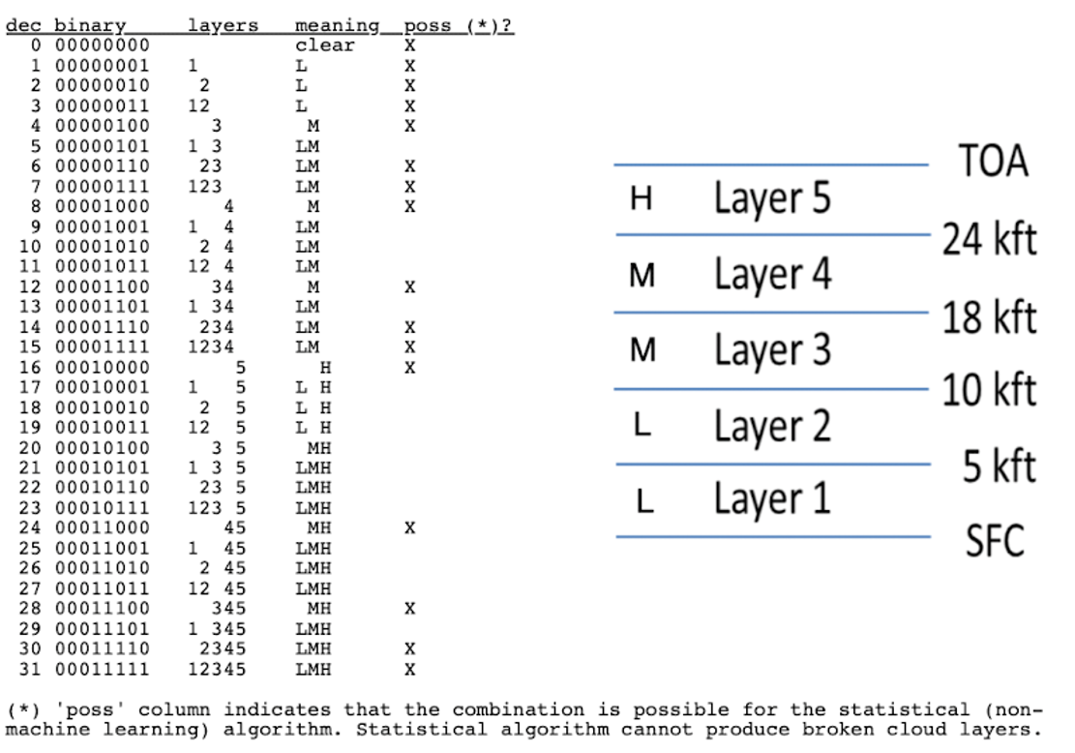
ABI Cloud Cover Layers (CCL) Products
Cloud Layer Flags - Five flight-level based cloud layers will be assessed for (H+M+L)
Layered cloud fractions (each layer)
Newer Fields (only available for 2-km resolution output)
Supercooled water cloud probabilities (total + each layer)
Convective cloud probabilities (total + each layer)
Cloud base height (CBH) - Intermediate product for CCL
Reported a few errors of the first operational CCL output to ASSISTT and GS in preparation for the review. Already fixed or under correction
CCL_mode = 2 from 3 (not ready for additional lower layers)
Removed a wrong variable CTF (Convective Total Fraction)
Repackaged CFP “Cloud Fractions Packed” for five layers
CFP (layers, y, x) (in ASSISTT (y,x,layers) -> corrected)
Cloud Layers

Slide 22
Datasets used for validation
2B-GEOPROF (cloud mask of 20, 30, or 40) and 2B-GEOPROF-LIDAR (CloudFraction value of 0.5 or greater)
ARM radar data (SGP/Oklahoma site, KAZR)
ARM lidar and ceilometer data (SGP; MPL and Ceilometer)
Visual intercomparison with JPSS VIIRS (CCL v3r2)
Comparisons for both G16 retrospective data and G18 NRT data
Cloud Base Height (CBH) is an important intermediate product which we evaluate. It is, potentially, a future operational product (currently used heavily by VIIRS aviation users, and requested by Aviation Weather Center for the ABIs).

Slide 23
Visual inspection / comparisons against similar products on other platforms

Slide 24
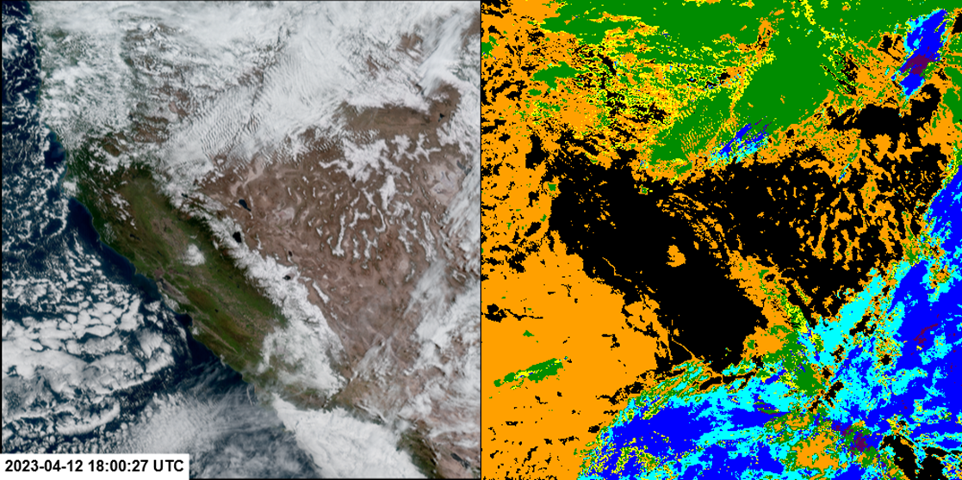
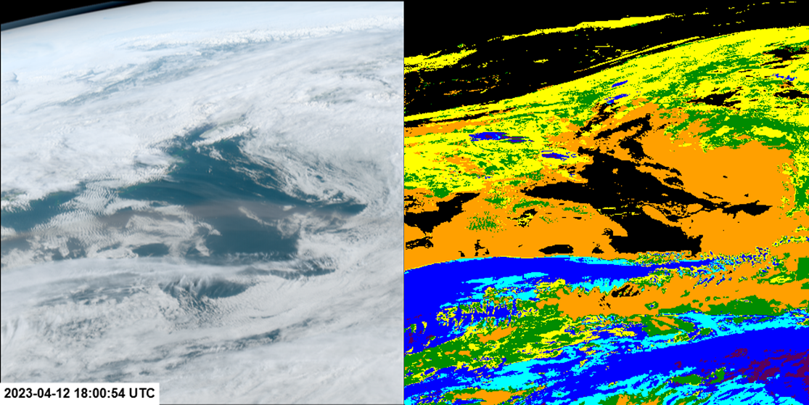
CONUS/Meso views of GOES-18 Cloud Cover Layers
20230412 1800 UTC (Ground System PRO DE NRT: DR_I_ABI-L2-CCL2KM output)
M1
M1
No issue!
M2 (Alaska)

Slide 25
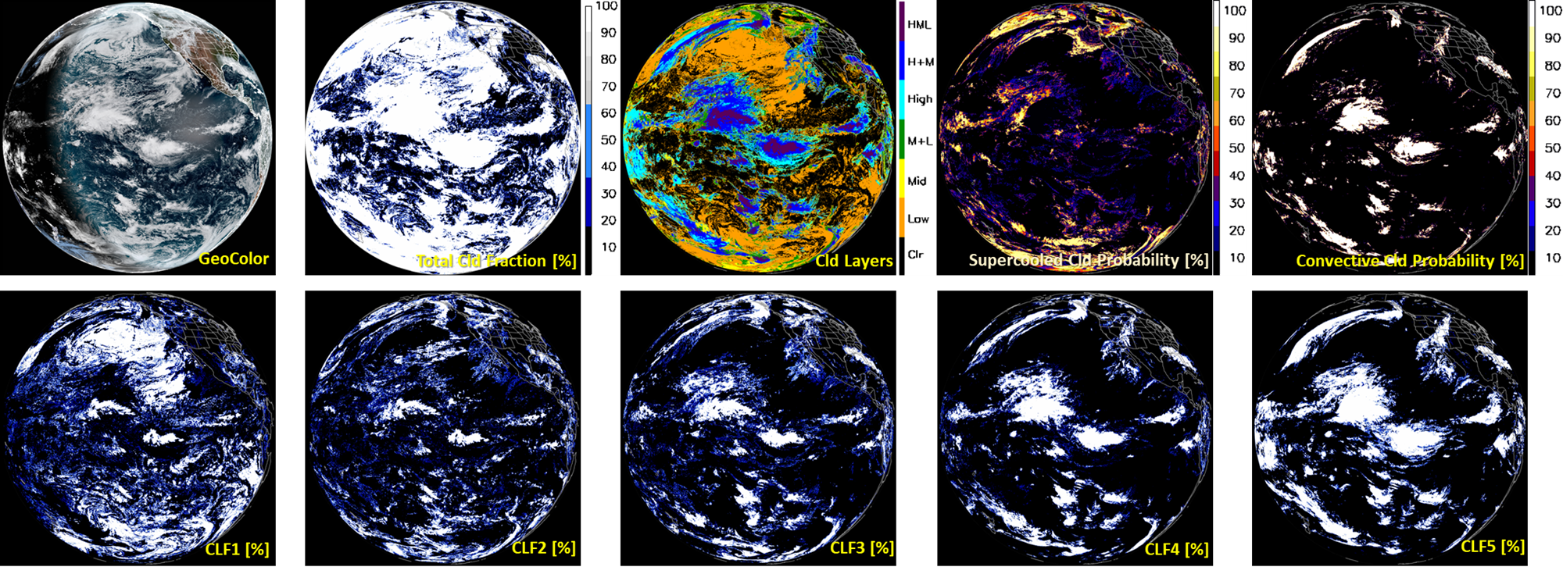
Global View of GOES-18 Cloud Cover Layers Products
20230412 1800 UTC (ASSISTT NRT)
Cloud Layer Fractions (Lowest CLF1 ~ Highest CLF5)
Notes:
ASSISTT NRT

Slide 26
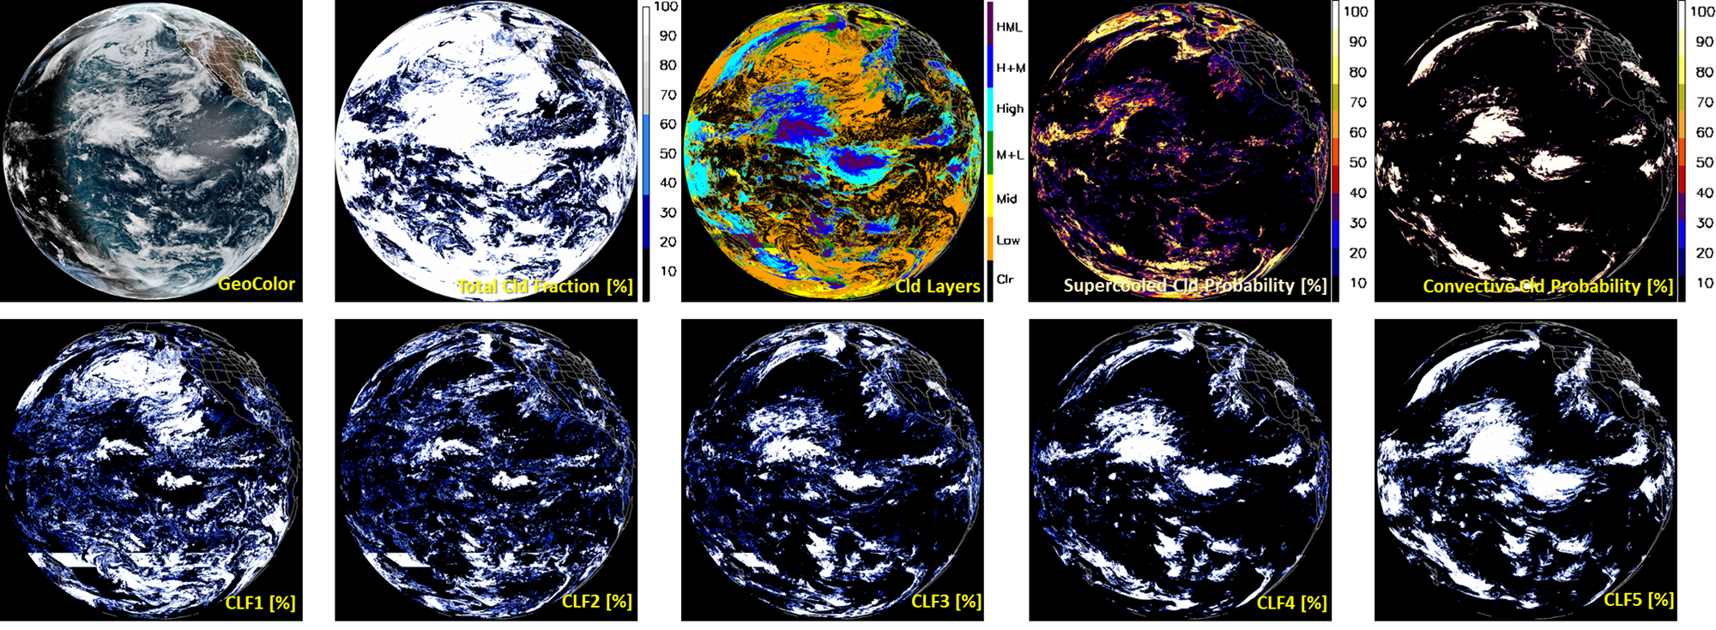
Global View of GOES-18 Cloud Cover Layers Products
This strip (1 or rarely 2) appears in all the DE full-disk CL/CLF output (propagated into 10km output; no strips in DE intermediate CBH/CTH/COD/CWP).
20230412 1800 UTC (Ground System DE NRT: DR_I_ABI-L2-CCL2KM output)
Cloud Layer Fractions (Lowest CLF1 ~ Highest CLF5)
Notes:
ASSISTT NRT

Slide 27
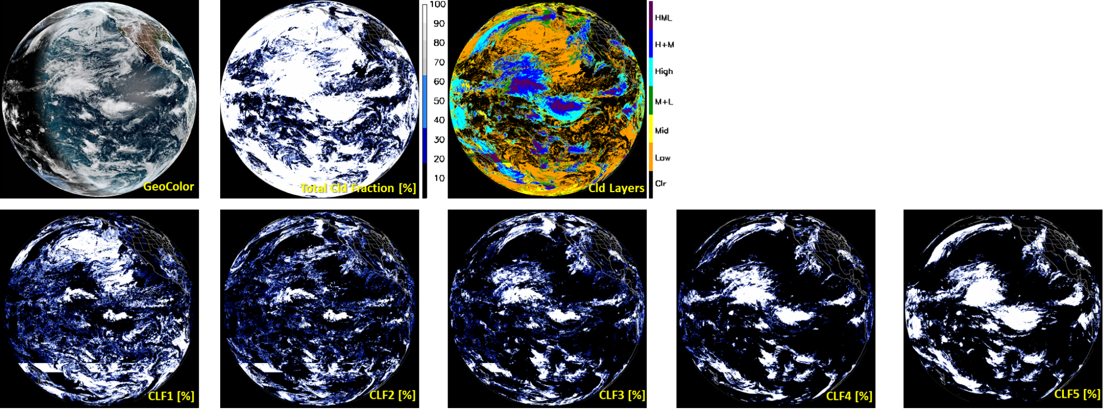
Global View of 10-km resolution Cloud Cover Layers
Smoothed but consistent with 2-km output
20230412 1800 UTC (Ground System DE NRT: DR_ABI-L2-CCLF 10-km)
Three variables are available in 10-km output:
TCF (Total CLd Fraction)
CL (Cloud Layers)
CFP (Cloud Fraction Packed for 5 layers)
Cloud Layer Fractions (Lowest CLF1 ~ Highest CLF5)
Notes:
ASSISTT NRT

Slide 28
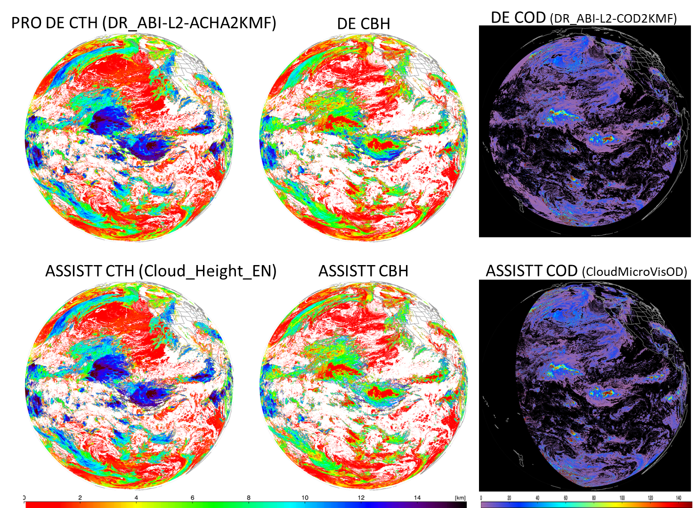
GOES-18 Upstream Cloud Products (DE vs. ASSISTT)
Agree in general but some relatively larger differences near the scan edges. A few discrepancies possibly due to differences in upstream input
CWP from COMP (day) and NWP data (night) is used for CBH
No strips in upstream data (NWP data were not provided for the eval)
20230412 1800 UTC

Slide 29
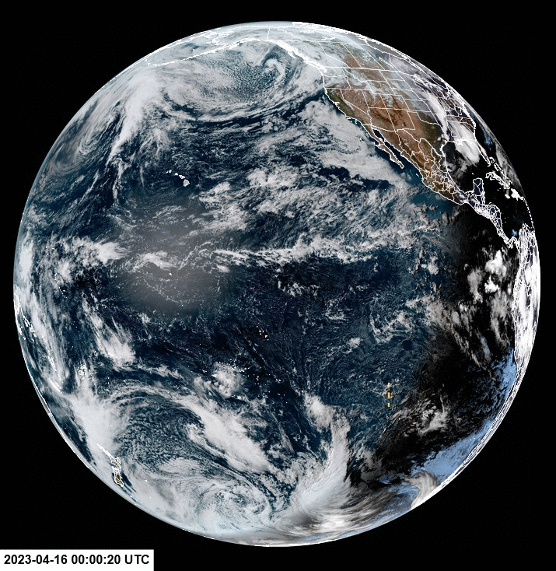
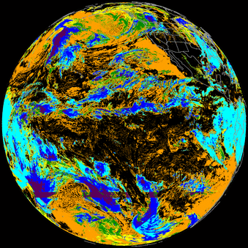
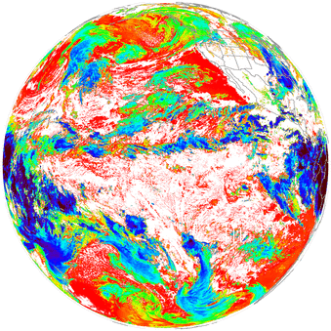
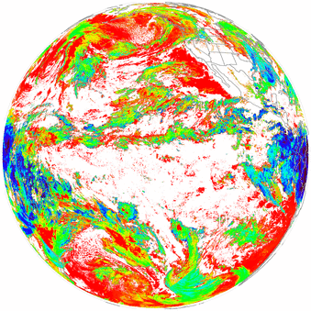
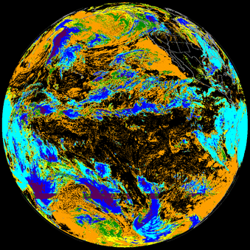
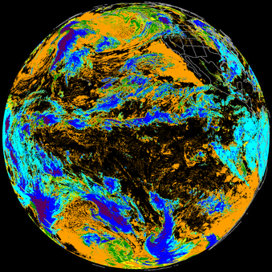
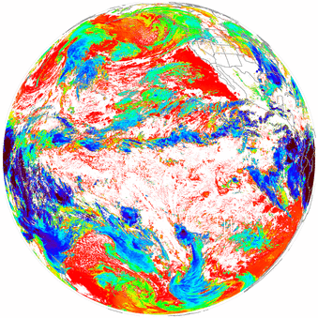
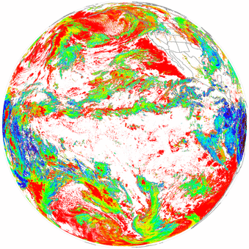
GOES-18 Cloud Layers (PRO DE vs. ASSISTT)
20230416 2 km resolution animations
(except one 10 km, as noted) (0-20 UTC, hourly)
DE CTH and CBH
DE 10 km
ASSISTT CTH and CBH
Notes:
Everything is 2 km except as marked

Slide 30
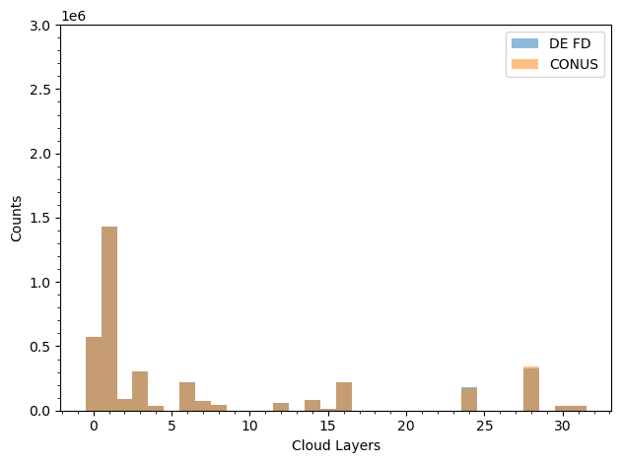
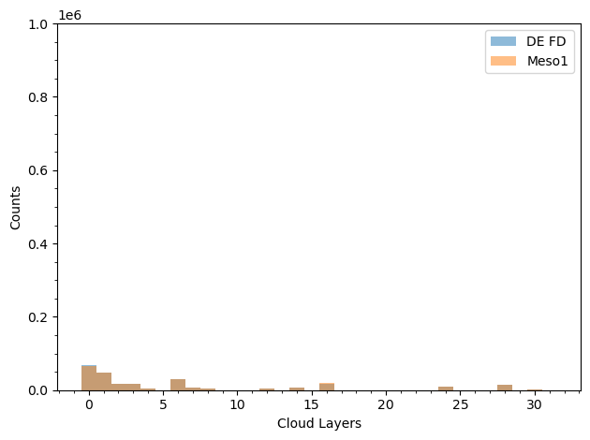
Comparisons of Cloud Cover Layers (PRO DE sectors)
Comparisons of Cloud Layer Flags (0-31 for five flight-level based layers)
20230412 1800 UTC (FD/CONUS)
20230412 1800 UTC (FD/M1)
No differences between sectors
Notes:
ASSISTT (slightly deeper at night - perhaps due to NWP differences) NRT

Slide 31
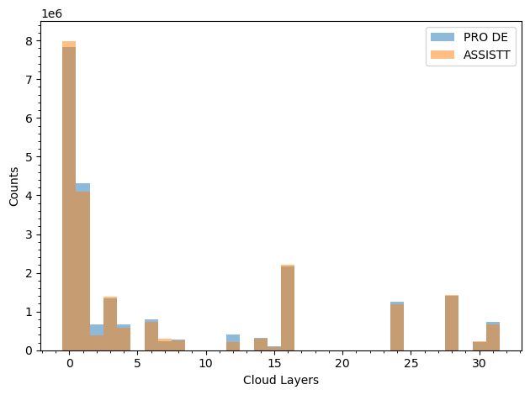
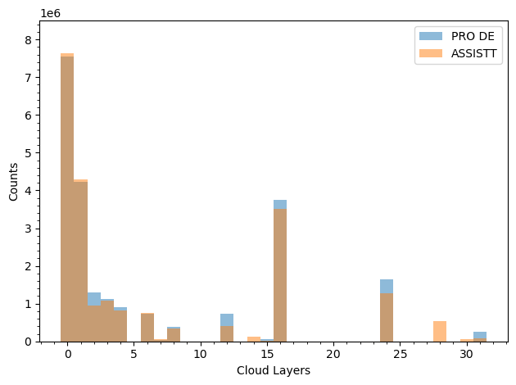
Comparisons of Cloud Cover Layers (PRO vs. ASSISTT)
Comparisons of full-disk Cloud Layer Flags (0-31 for five flight-level based layers)
20230412 2200 UTC (Day)
20230412 0700 UTC (Night)
H
M+H
(4+5)
M+H
(3+4+5)
Notes:
ASSISTT (slightly deeper at night - perhaps due to NWP differences) NRT

Slide 32
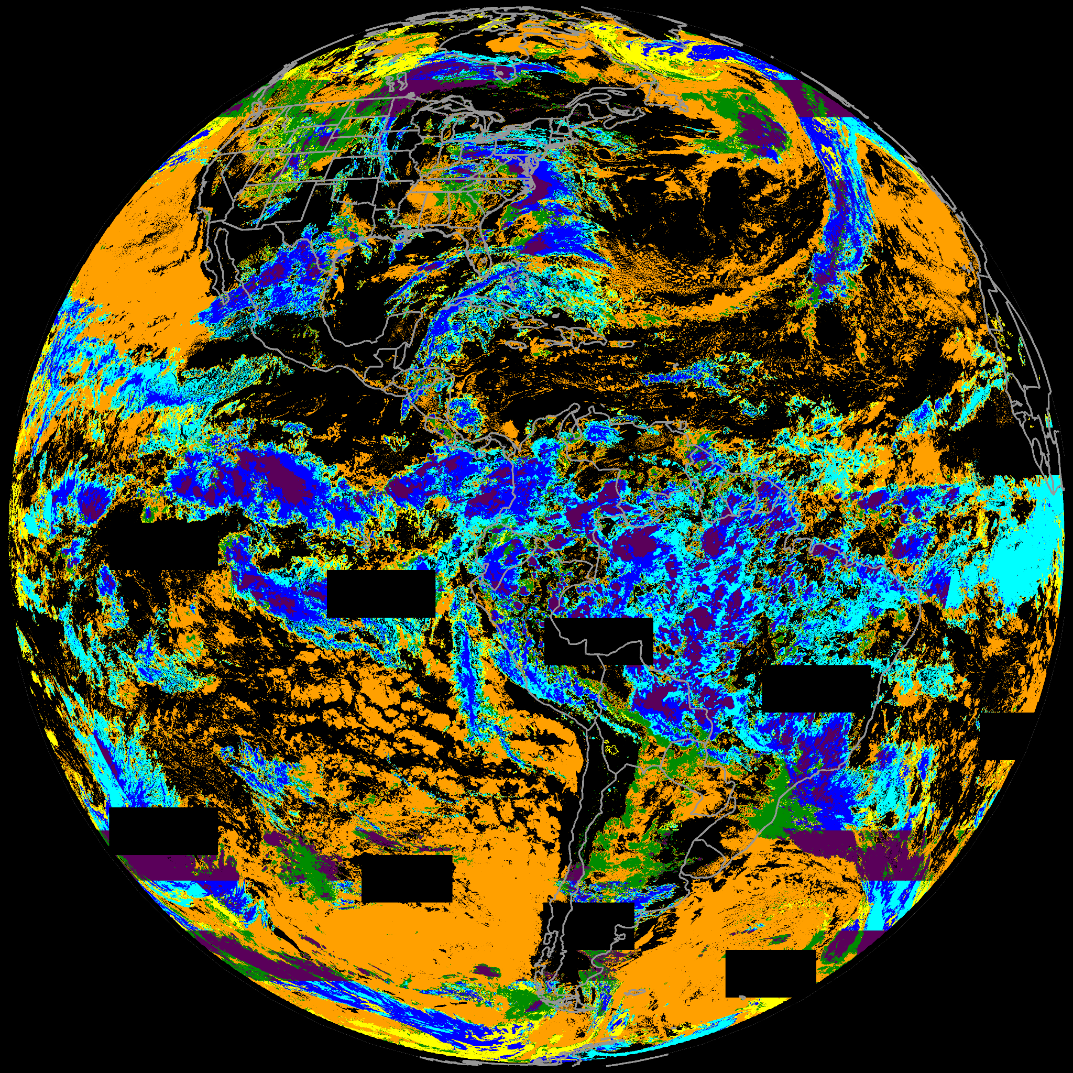
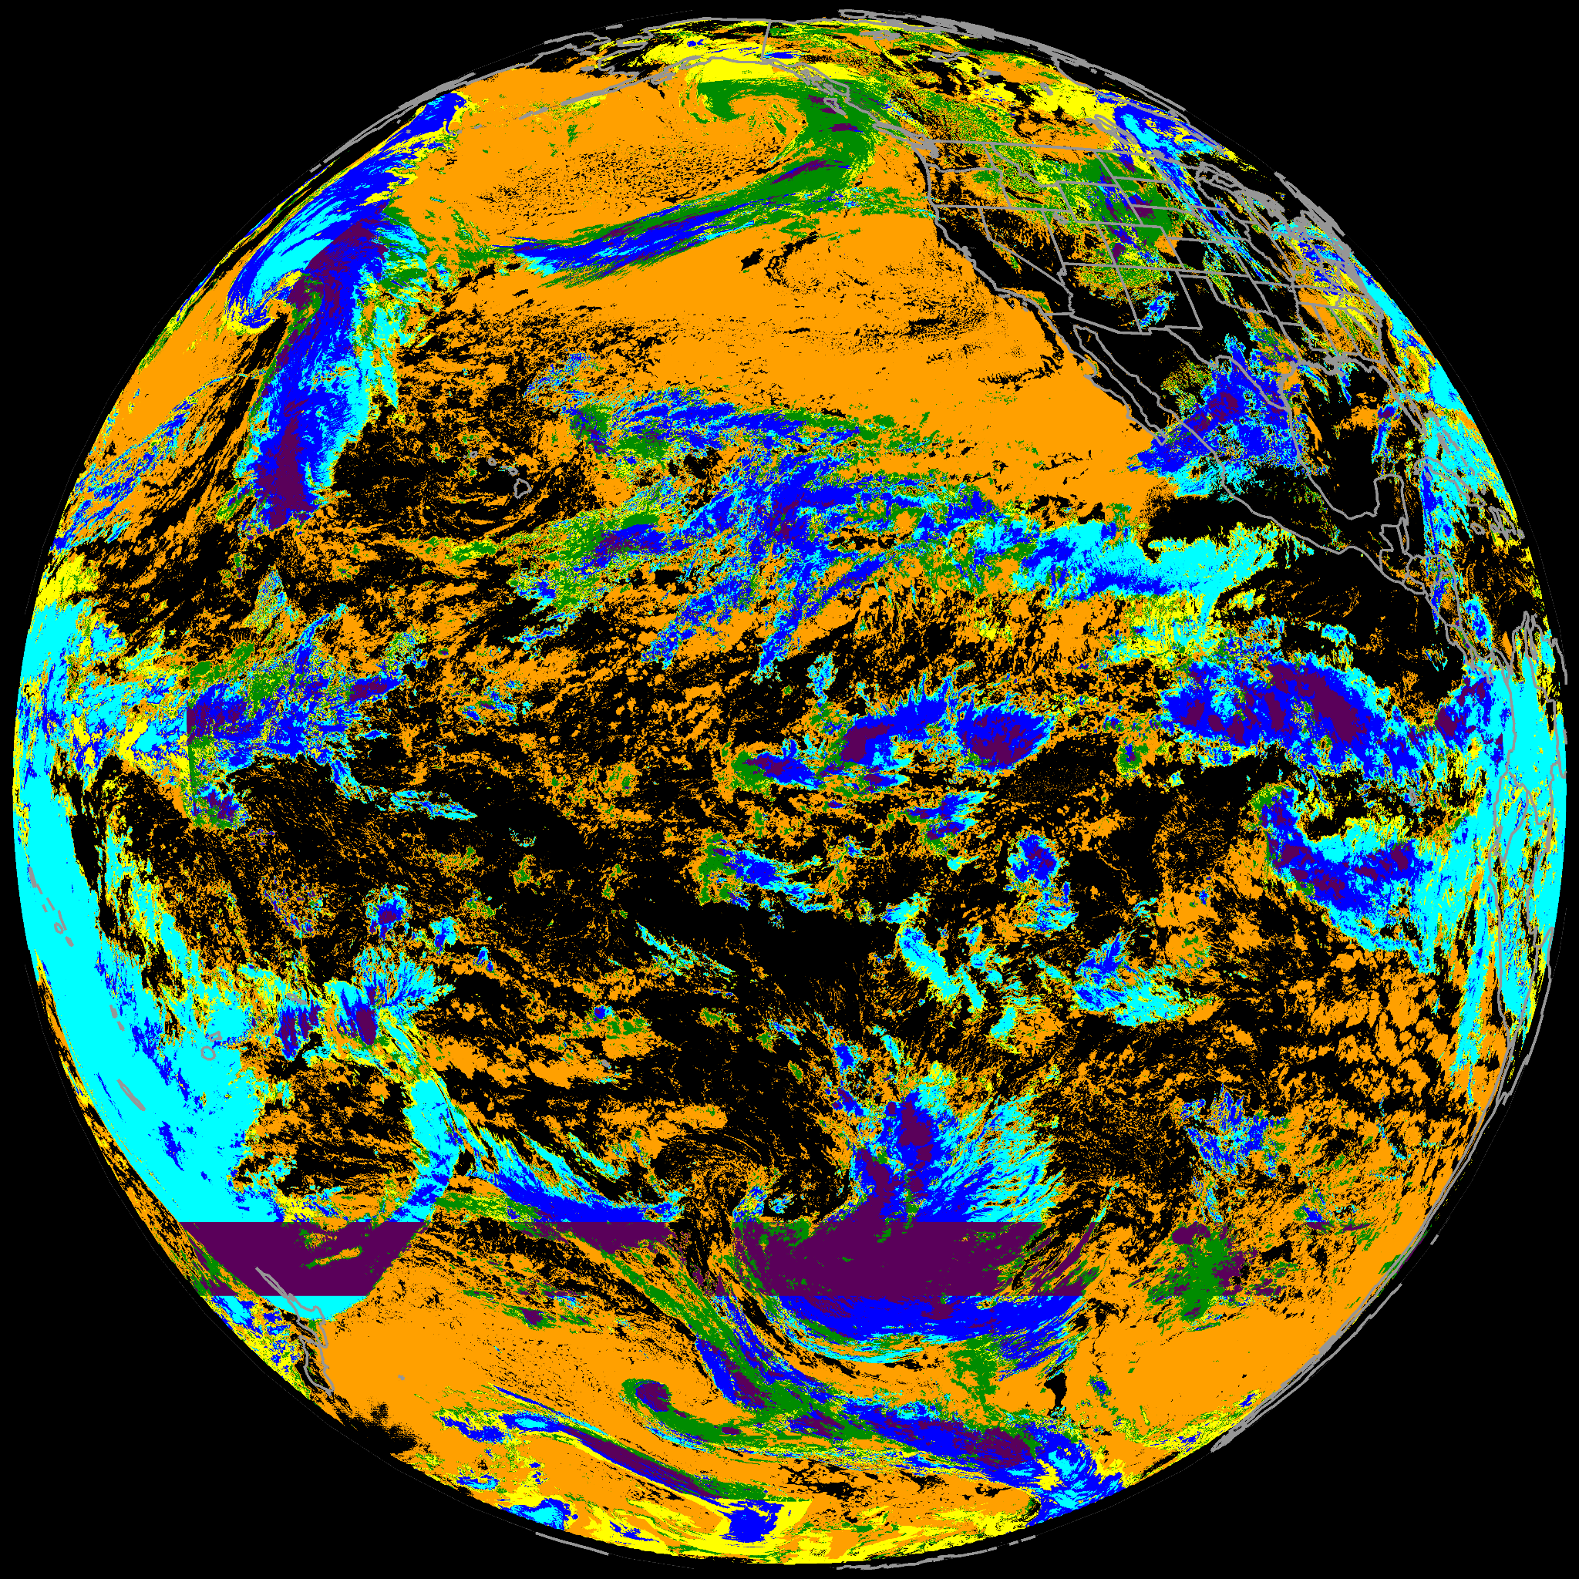
GOES-16 vs. GOES-18 (FD)
Both PRO DE outputs
G16 ABI 1900 UTC 20230414 (OR_I_ABI-L2-CCL2KMF)
G18 ABI (DR_I_ABI-L2-CCL2KMF)

Slide 33
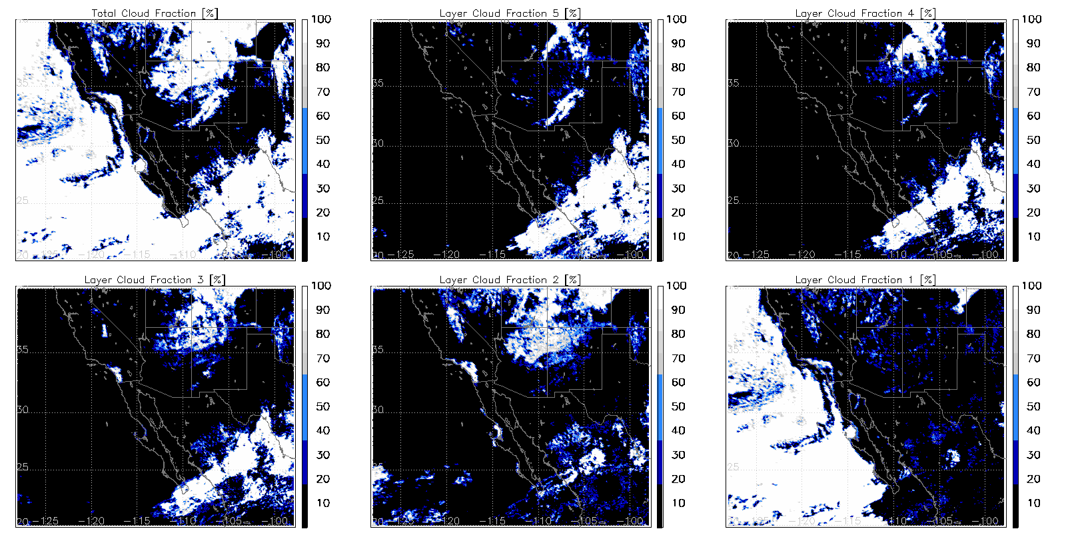
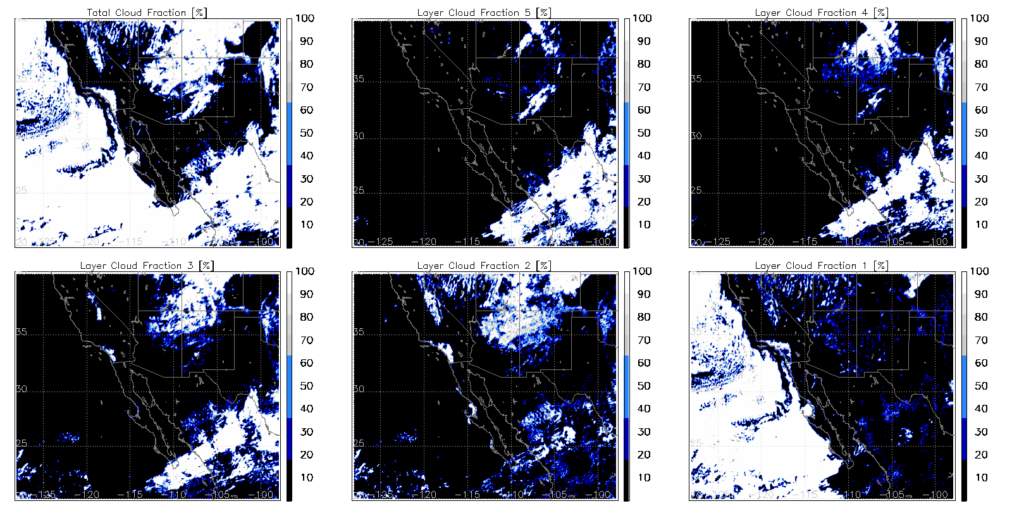
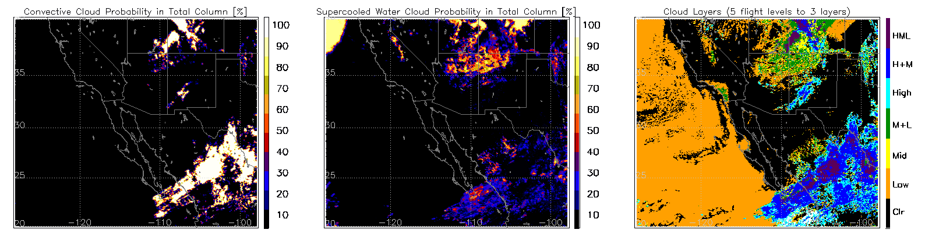
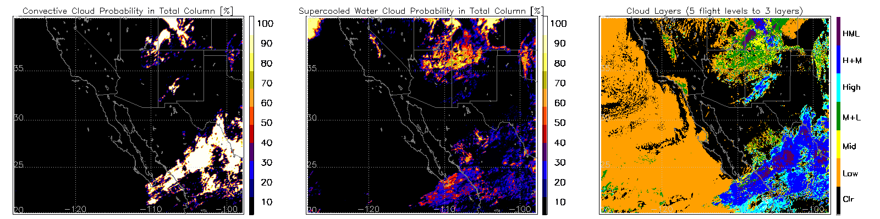
GOES-16 vs. GOES-18 (W. CONUS)
Both DE outputs
G16 ABI 1900 UTC 20230419 (OR_I_ABI-L2-CCL2KMF)
G18 ABI (DR_I_ABI-L2-CCL2KMF)

Slide 34
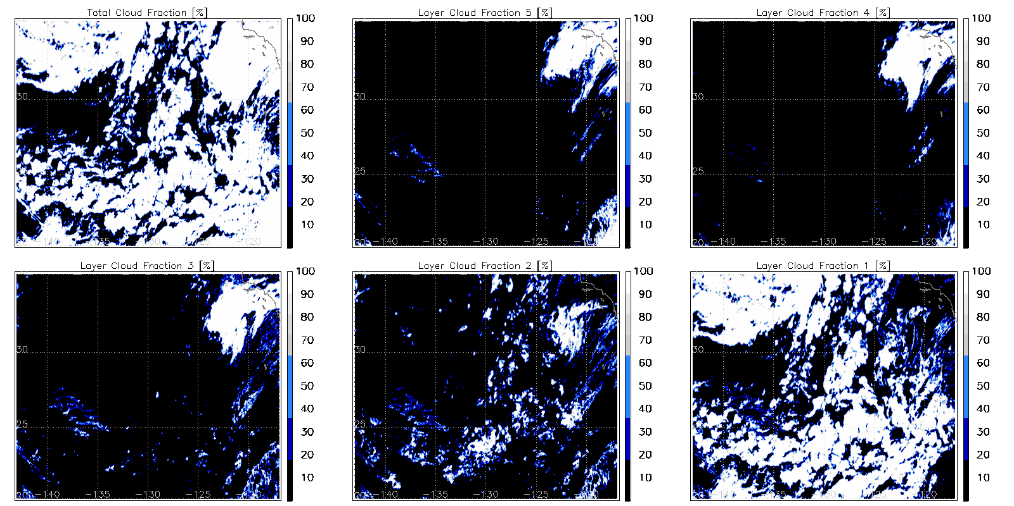
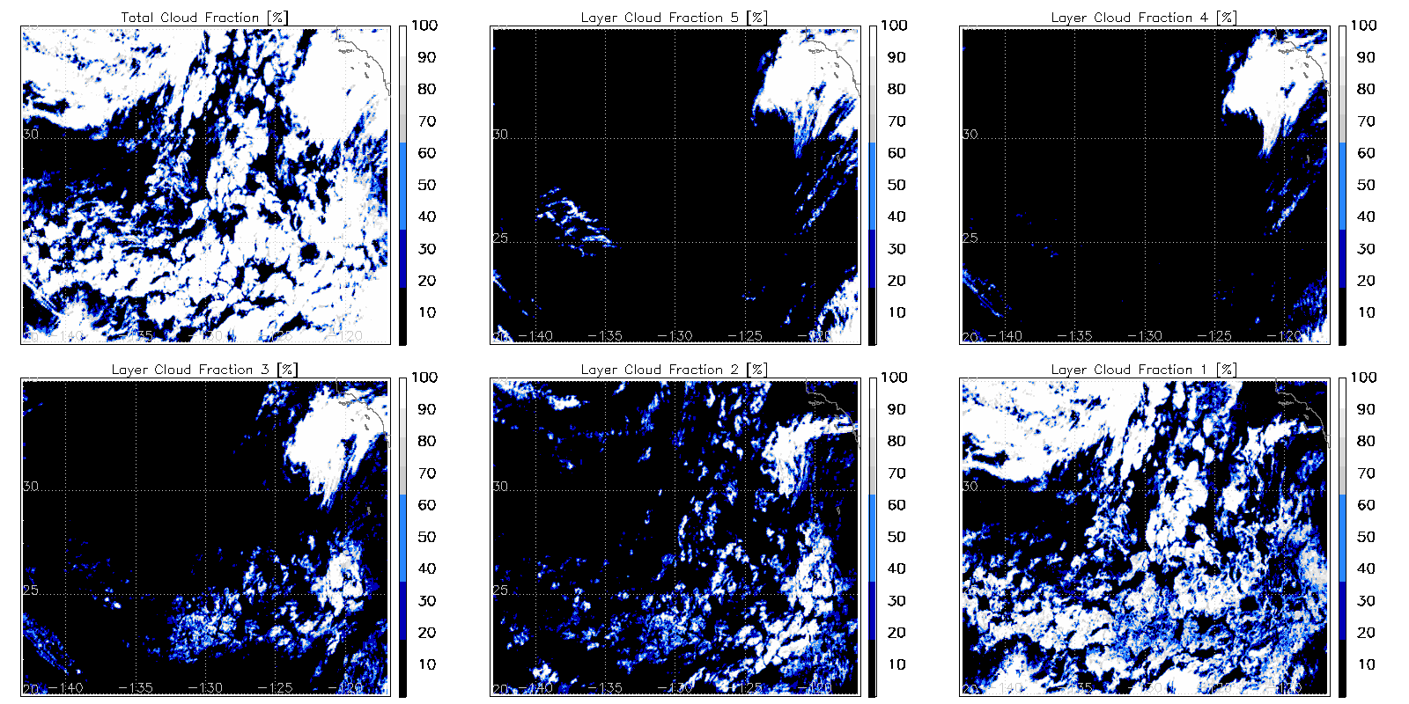
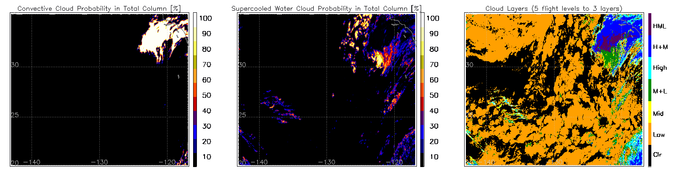
GOES-18 vs. JPSS VIIRS (Day)
Both ASSISTT outputs
G18 ABI 2200 UTC 20230331 (full disk)
S-NPP VIIRS 2150-2200 UTC (v3r2)
W. Coast CONUS

Slide 35
RESULTS - QUANTITATIVE ANALYSIS
GOES-18 NRT CALIPSO/CALIOP Comparisons
GOES-16 Retrospective Comparisons
CloudSat
CALIPSO
DOE ARM
GOES-16/18 NRT Versus Ground-based Comparisons

Slide 36
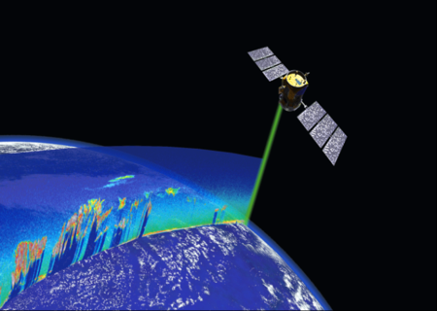
Evaluation: CALIOP vs ABI Comparison
Recap from ACHA
CALIOP is a lidar on board CALIPSO.
CALIOP Cloud Layer (5 km + 1 km) data are results considered as “truth”.
COD = column optical depth
Height, Temperature, Pressure = value of highest cloud layer adjusted for IR weighting function.
5 km cloud layer product is supplemented with 1 km cloud layer product.
1 day of CALIOP and ABI matchup data are used 2023_02_03_034.
Filters applied to GOES-18:
Scan time difference +/- 10 minutes,
Sensor Zenith Angle < 62.0 degrees.
Filters applied to CALIOP:
90N - 90S,
COD > 1.0 (EMIS > 0.8),
5km cloud fraction 0 or 1 (avoids cloud edges)

Slide 37
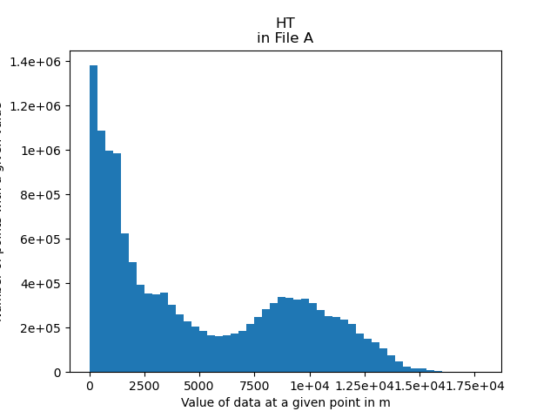
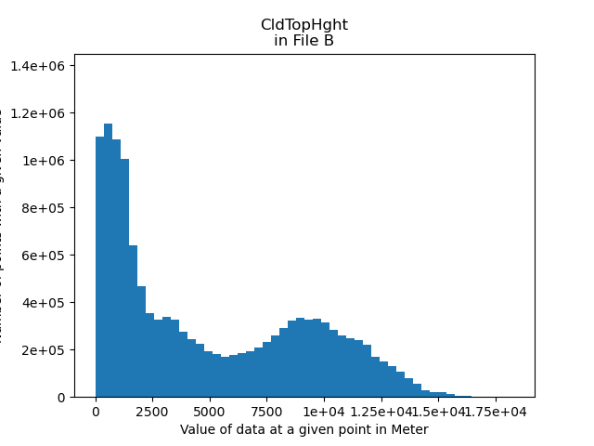
Evaluation: OPS Enterprise and ASSISTT Framework
Recap from ACHA
PRO Enterprise
GOES-18
ASSISTT Framework

Slide 38
Data
SAPF G16 reprocessing data include CCL products retrieved from G16 ABI FD scans every ten minutes for 14 days in 2019 (May 1 to May 14)
For NRT G18, data are from March 8 to April 18, 2023
For NRT G16, data are from March 5 to March 9, 2023
CALIPSO/CALIOP cloud layer products at 5 km resolution were used as validation datasets
For G16 2019 reprocessing, CALIPSO Version 4 were used; and for G18/G16 2023, CALIPSO Version 3 were used, due to data availability

Slide 39
Methods
Space and time collocations between CALIPSO and G16/18 ABI were conducted
Cloud top pressures are converted to flight levels, and correct classification ratios are computed by dividing the number of agreed pixels between ABI and CALIPSO at predefined FLs to the total number of pixels
Cloud phase matching between ABI and CALIPSO is applied to account for retrieval differences in cloud phase that impacts upstream ACHA products
Overlapping detection also affects ACHA and CCL retrieval, so additional filtering to remove multilayer clouds is also applied

Slide 40
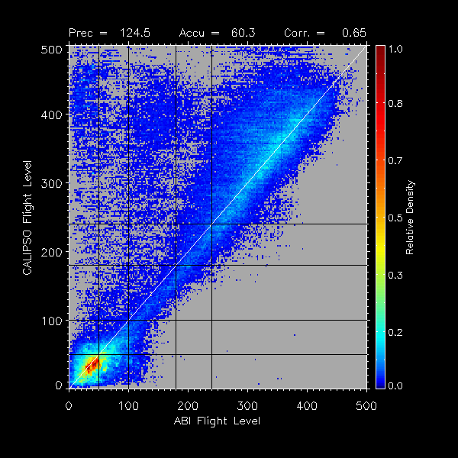
The precision and accuracy statistics computed here are to show quantitative comparisons between ABI and CALIPSO converted flight levels (FLs). However, in actual validation, as long as the collocated pixels are within the diagonal square boxes, they are considered correctly classified.
ABI FLs are shown here for demo purpose; the CloudLayer variable in the ABI CCL products, which indicates if the layer is cloudy/clear, is used in computing the accuracy
Correct classification

Slide 41
G16 2019 reprocessing
No filtering
Phase matched
Phase matched and single layer

Slide 42
G16 2019 reprocessing
Total Correct classification percentage (Spec is 60% correct)
 | No filtering | Phase matched | Phase matched and single layer
SAPF | 71.1 | 81.5 | 84.2

Slide 43
G16 2019 reprocessing
Layered correct classification percentage
 | No filtering | Phase matched | Phase matched and single layer
Layer1 | 87.7 | 89.6 | 90.3
Layer2 | 65.0 | 67.8 | 69.8
Layer3 | 65.6 | 73.9 | 79.1
Layer4 | 57.4 | 76.1 | 83.8
Layer5 | 68.8 | 81.8 | 84.8
The total number of CALIPSO pixels within each FL range is considered as truth to compute the layered classification percentage
Nearly all layers meet the specs except for one layer when no filtering is applied
CCL is directly impacted by upstream algorithms, such as cloud height (ACHA). ACHA and hence CCL’s performances improve significantly as cloud phase matching and/or single layer filtering are applied

Slide 44
G18 NRT
No filtering
Phase matched
Phase matched and single layer

Slide 45
G18 NRT
Total Correct classification percentage (Spec is 60% correct)
 | No filtering | Phase matched | Phase matched and single layer
SAPF | 68.5 | 78.8 | 83.1

Slide 46
G18 NRT
Layered correct classification percentage
 | No filtering | Phase matched | Phase matched and single layer
Layer1 | 90.0 | 92.6 | 92.5
Layer2 | 62.9 | 64.5 | 66.3
Layer3 | 62.6 | 69.0 | 74.6
Layer4 | 57.9 | 74.4 | 82.8
Layer5 | 64.9 | 78.3 | 83.7
Note: The total number of CALIPSO pixels within each FL range is considered as truth to compute the layered classification percentage.

Slide 47
G16 NRT
No filtering
Phase matched
Phase matched and single layer

Slide 48
G16 NRT
Total Correct classification percentage (Spec is 60% correct)
 | No filtering | Phase matched | Phase matched and single layer
SAPF | 63.1 | 78.6 | 79.2

Slide 49
G16 NRT
Layered correct classification percentage
 | No filtering | Phase matched | Phase matched and single layer
Layer1 | 76.3 | 78.2 | 78.6
Layer2 | 54.4 | 59.7 | 61.5
Layer3 | 56.7 | 74.4 | 78.0
Layer4 | 49.7 | 72.3 | 78.3
Layer5 | 63.9 | 82.2 | 85.7
The total number of CALIPSO pixels within each FL range is considered as truth to compute the layered classification percentage.
The layered correct classification are worse here because G16 NRT data are much less (only two days after collocation)

Slide 50
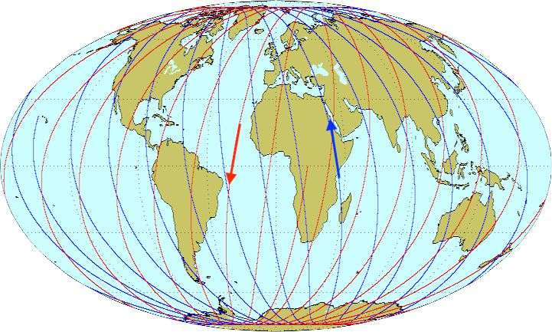
GOES-16 Retrospective Period
Evaluation against CloudSat/CALIPSO and ground-based active sensors
CloudSat radar / CALIPSO lidar are the gold standard for global vertical cloud structure studies
Vertical resolution:
240 m (CloudSat),
30 m (CALIPSO)
Most recent available data is from 2019, so a retrospective analysis is required, using GOES-16 ABI as a proxy for GOES-18 ABI
Horizontal resolution:
1.4 km (CloudSat),
70 m (CALIPSO)

Slide 51
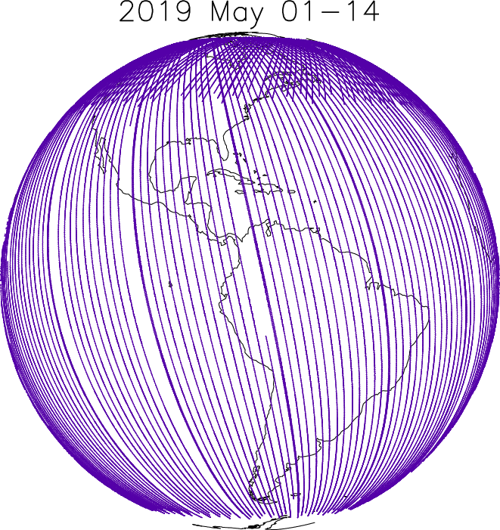
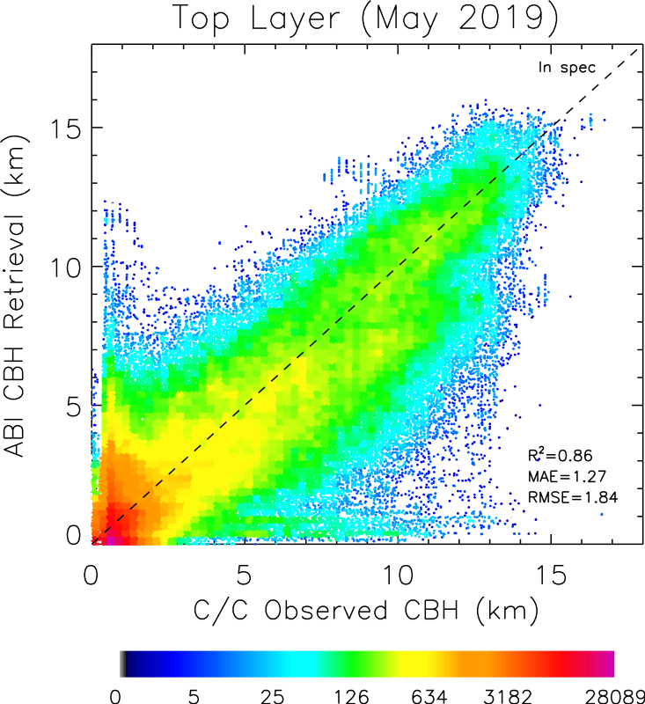
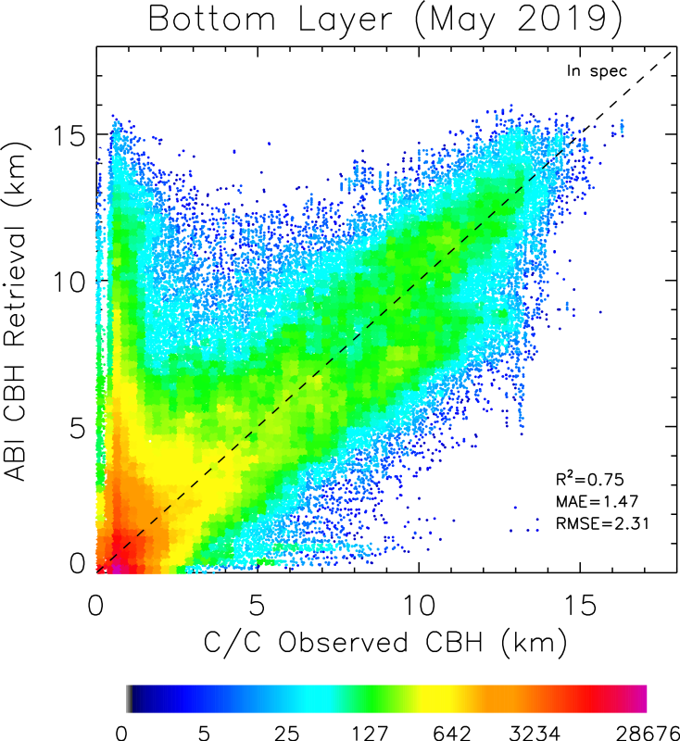
GOES-16 (ASSISTT retrospect) vs. CloudSat
(May 1-14, 2019)
Topmost Layer CBH
Lowest CBH (all clouds)
Measurement accuracy requirements for VIIIRS CBH: 2 km for COT ≥ 1 & 3 km for COT < 1
Notes:
Comparison of ABI "CldBaseHght" against the lowest cloud occurrence seen by C/C for the matched scene. The lowest C/C cloud base is defined as the lowest occurrence of either a 2B-GEOPROF cloud mask of 20, 30, or 40, OR a 2B-GEOPROF-LIDAR CloudFraction value of 0.5 or greater.

Slide 52
Contingency Table Evaluation
Correct retrieval?
Observed
ABI
TOA
For each of 5 CCL layers (j=1 to 5), create a contingency table with 4 counts (A_{j}, B_{j}, C_{j}, D_{j}):
✅
Layer 5
D
Observed by CloudSat/CALIPSO?
24 kft
Y N
❌
A_{j} B_{j}
Layer 4
Retrieved by ABI?
Y
C
18 kft
N
C_{j} D_{j}
Layer 3
✅
For each matched set of obs/retrieval, if the observations show cloud in any radar/lidar bin within the bounds of that layer, then observed=Yes; else observed=No.
Prob. of detection for layer j = A_{j}/ (A_{j}+C_{j})
False alarm ratio for layer j = B_{j}/ (A_{j}+B_{j})
Accuracy for layer j = (A_{j}+D_{j})/ (A_{j}+B_{j}+C_{j}+D_{j})
A
10 kft
Layer 2
✅
A
5 kft
Layer 1
❌
B
0 kft

Slide 53
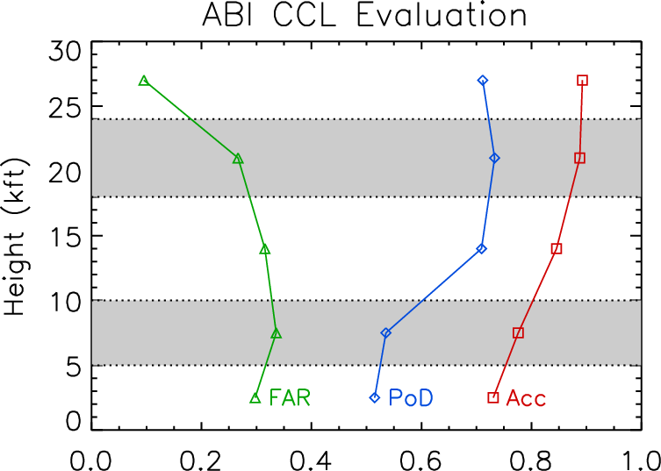
GOES-16 (ASSISTT retrospect) vs. CloudSat
(May 1-14, 2019)
Figure shows the following for each of the five levels evaluated:
Probability of detection (PoD)
target=1
False alarm ratio (FAR)
target=0
Accuracy (Acc)
target=1

Slide 54
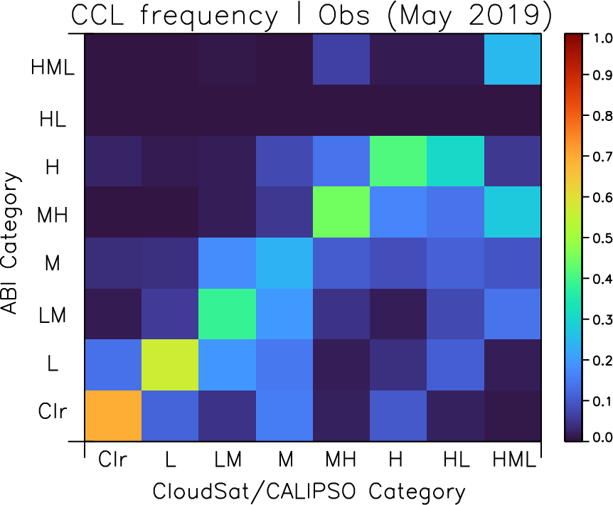
GOES-16 (ASSISTT retrospect) vs. CloudSat
(May 1-14, 2019)
Figure shows fraction of retrievals in each ABI CCL category, given a matched observation that falls in the given CloudSat/CALIPSO category.
Columns therefore add to unity.
Perfect = 1.0 on lower-left to upper-right diagonal, 0 elsewhere

Slide 55
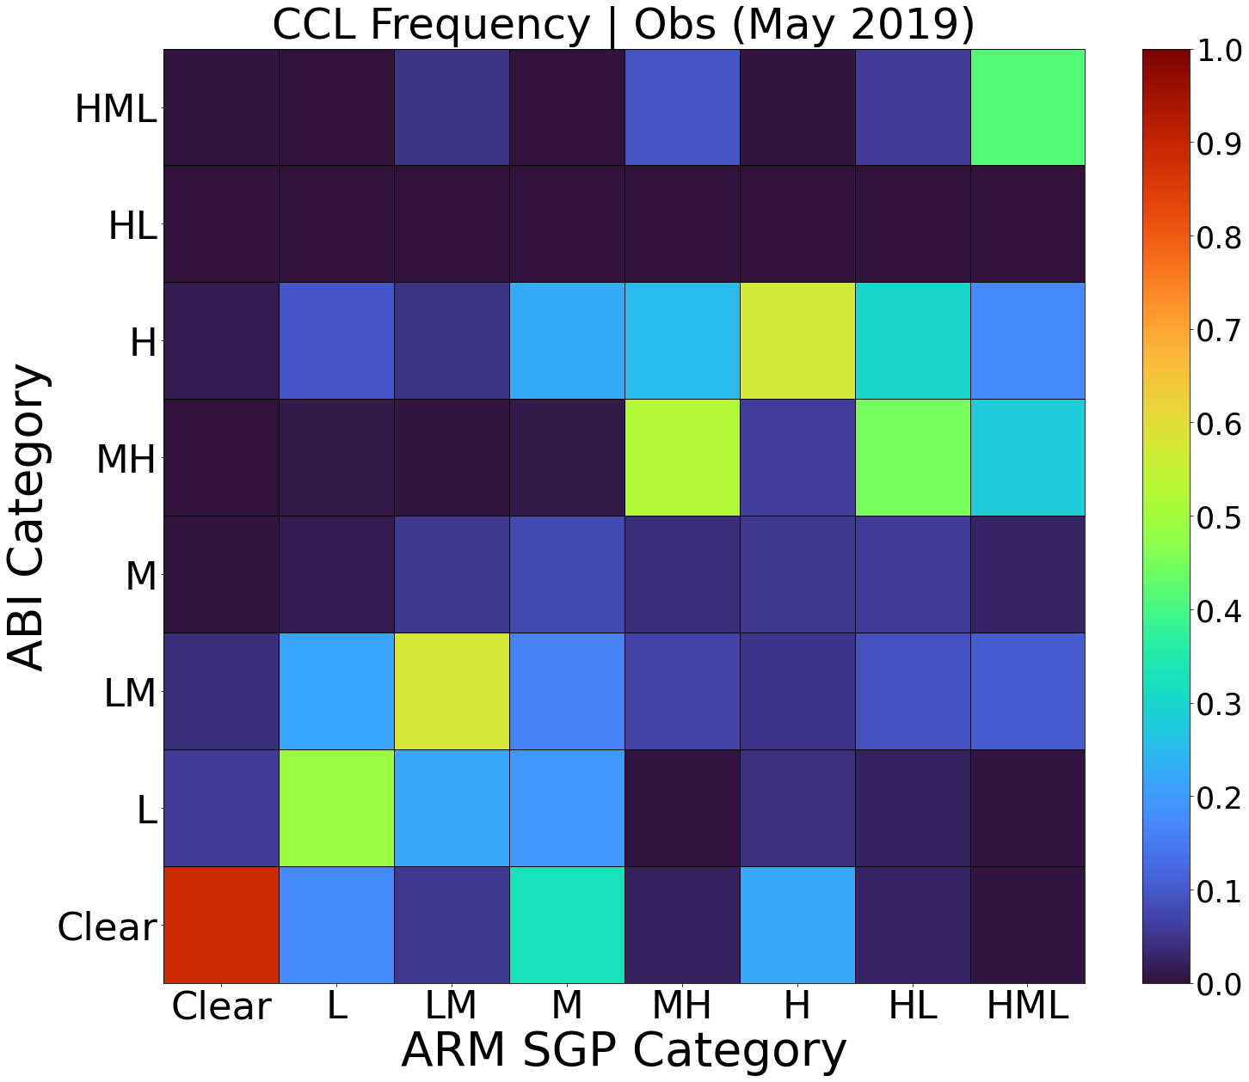
GOES-16 ABI CCL vs. ARM radar data (SGP, KAZR)
ASSIST May 1-14, 2019
Figure shows fraction of retrievals in each ABI CCL category, given a matched observation that falls in the given SGP KAZR category.
Detection of multiple CBHs possible with KAZR
Empty layers less than 480m between two cloud layers are merged to a singular cloud
Clouds less than 240m in depth are ignored
As with CloudSat/CALIPSO, H+L valid for SGP KAZR category (unlike ABI)

Slide 56
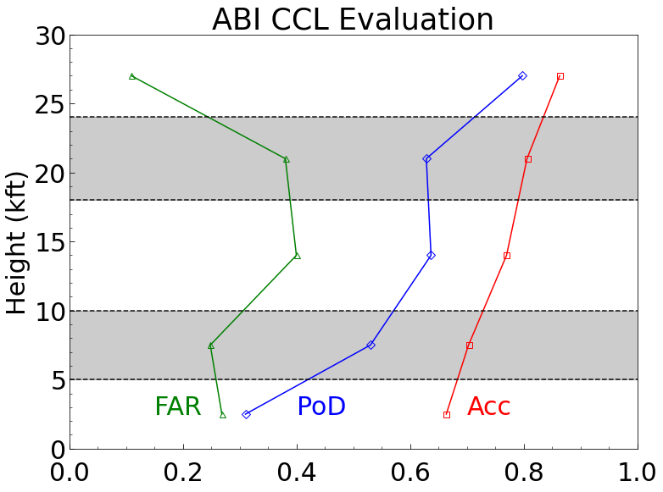
GOES-16 ABI CCL vs. ARM radar data (SGP, KAZR)
ASSIST May 1-14, 2019
Figure shows the following for each of the five levels evaluated:
Probability of detection (PoD)
target=1
False alarm ratio (FAR)
target=0
Accuracy (Acc)
target=1
Notes:
Acc > 60% for all layers
Lowest layer PoD may be small due to radar catching small cumulus ABI cannot see

Slide 57
GOES-16 ABI CBH vs. ARM radar data (SGP, KAZR)
Parallax-corrected, within spec comparisons
Measurement accuracy requirements for VIIIRS CBH: 2 km for COT ≥ 1 & 3 km for COT < 1
Single layer clouds
All clouds (including multilayers)
Notes:
Single layer clouds: Only 1 CBH layer from KAZR
Multilayers: Uses highest CBH layer available from KAZR
Validate CBHs when CTHs from ABI are within 2 km of CTHs from KAZR
ABI CTH and CBH pixels are averaged around 10 km radius of SGP (no radar averaging)
CBH1 is lowest; CBH3 is highest

Slide 58
GOES-16 ABI CBH vs. ARM lidar data (SGP, MPL)
Parallax-corrected, within spec comparisons
Measurement accuracy requirements for VIIIRS CBH: 2 km for COT ≥ 1 & 3 km for COT < 1
Single layer clouds
All clouds (including multilayers)
ARM CBHs for topmost layers (MPL clouds within spec here are likely single layered or multi-layered with relatively thin low layers)
Notes:
Single layer clouds: Only 1 CBH layer from MPL
Multilayers: Uses highest CBH layer available from ARM data
Validate CBHs when CTHs from ABI are within 2 km of CTHs from MPL lidar (therefore restricted to cases where lidar is able to view cloud top)
ABI CTH and CBH pixels are averaged around 10 km radius of SGP (no lidar averaging)
CBH1 is lowest; CBH3 is highest

Slide 59
GOES-16: Day vs. Night (Solar Zenith 82%)
Day
Night

Slide 60
GOES-18 Analysis
Evaluation against ground-based radar data

Slide 61
GOES-18 ABI CCL vs. ARM radar data (SGP, KAZR)
ASSIST Mar 30 - Apr 9, 2023
Figure shows fraction of retrievals in each ABI CCL category, given a matched observation that falls in the given SGP KAZR category.
(Methodology details on earlier equivalent slide for GOES-16)
Fewer samples for 2023 than 2019, and more clear days!

Slide 62
GOES-18 ABI CCL vs. ARM radar data (SGP, KAZR)
ASSIST Mar 30 - Apr 9, 2023
Figure shows the following for each of the five levels evaluated:
Probability of detection (PoD)
target=1
False alarm ratio (FAR)
target=0
Accuracy (Acc)
target=1
Relatively small number of points − statistically less robust than GOES-16 analysis!
(e.g. only 23 cloudy observations in the 10-18 kft layer, or 92% clear sky)
Notes:
Acc > 60% for all layers
Lowest layer PoD may be small due to radar catching small cumulus ABI cannot see

Slide 63
GOES-18 ABI CBH vs. ARM radar data (SGP, KAZR)
Parallax-corrected, within spec comparisons
Measurement accuracy requirements for VIIIRS CBH: 2 km for COT ≥ 1 & 3 km for COT < 1
Single layer clouds
All clouds (including multilayers)
ARM CBHs for topmost layers were plotted here.
Notes:
Single layer clouds: Only 1 CBH layer from KAZR
Multilayers: Uses highest CBH layer available from KAZR
Validate CBHs when CTHs from ABI are within 2 km of CTHs from KAZR
ABI CTH and CBH pixels are averaged around 10 km radius of SGP (no radar averaging)
CBH1 is lowest; CBH3 is highest

Slide 64
GOES-18 ABI CBH vs. ARM lidar data (SGP, MPL)
Parallax-corrected, within spec comparisons
Measurement accuracy requirements for VIIIRS CBH: 2 km for COT ≥ 1 & 3 km for COT < 1
Single layer clouds
All clouds (including multilayers)
ARM CBHs for topmost layers (MPL clouds within spec here are likely single layered or multi-layered with relatively thin low layers)
Notes:
Single layer clouds: Only 1 CBH layer from MPL
Multilayers: Uses highest CBH layer available from ARM data
Validate CBHs when CTHs from ABI are within 2 km of CTHs from MPL lidar (therefore restricted to cases where lidar is able to view cloud top)
ABI CTH and CBH pixels are averaged around 10 km radius of SGP (no lidar averaging)
CBH1 is lowest; CBH3 is highest

Slide 65
GOES-16/18 ABI CBH vs. ARM Ceilometer data (SGP)
Parallax-corrected, within spec comparisons (using MPL CTH)
Ceilometer measurements are limited to low levels only (up to ~ 8 km)
Measurement accuracy requirements for VIIIRS CBH: 2 km for COT ≥ 1 & 3 km for COT < 1
All clouds (including multilayers)
GOES-16
GOES-18
Notes:
Validate CBHs when CTHs from ABI are within 2km of CTHs from MPL lidar (therefore restricted to cases where lidar is able to view cloud top)
ABI CTH and CBH pixels are averaged around ~10 km radius of SGP (all ARM ceilometer data averaged for 5 min starting from the ABI scan start time)
Detection of multiple CBHs possible like KAZR

Slide 66
SUMMARY
CCL passes visual inspection
Good comparison between GOES-16 and GOES-18 ABIs products
Good comparison between GOES-18 and JPSS VIIRS products
Good comparison between 2 km and 10 km versions of DE products
(Problems unrelated to algorithm or upstream cloud inputs are noted in DE products)
CCL passes quantitative analysis
60% accuracy requirement met at all five flight levels for both day and night
Passes for both CloudSat and ARM radar/lidar
CBH “in spec” RMSE is 1.8 km for GOES-16 as compared to CloudSat (top layer)
CBH “in spec” RMSE is 1.77 km for GOES-18 as compared to ARM radar (1.37 km to lidar) (single layer)
(There is no formal CBH requirement for ABI; is 2 km for VIIRS)

Slide 67
SUMMARY (Part 2)
The Cloud Team will continue to work with downstream users to address any issues.
Based on the analysis shown, the cloud team recommends that the GOES-18 CCL is performing as expected aside from areas of striping observed in the DE product. An ADR has been opened to investigate this issue (number TBD)
QUANTITATIVE ANALYSIS: PASS
QUALITATIVE (VISUAL) ANALYSIS: PASS PENDING ADR RESOLUTION

Slide 68
Provisional Validation
Preparation Activities | Assessment
Validation activities are ongoing and the general research community is now encouraged to participate. | Ongoing validation activities. Feedback provided by both general research and user communities.
Severe algorithm anomalies are identified and under analysis. Solutions to anomalies are in development and testing. | Data striping noted in DE CCL products. PROPASS has been informed of the issue and source yet to be identified but no ADR has been attached to this issue. Missing block issue noted has ADR. Full remediation strategy for striping issue has yet to be determined.
Incremental product improvements may still be occurring. | Yes, based on continual algorithm development (e.g. improved training datasets, etc.).
L2+ only: Users are engaged in the Product Feedback Forums and user feedback is assessed. | Yes.
End State | Assessment
Product performance has been demonstrated through analysis of a small number of independent measurements obtained from select locations, periods, and associated ground truth or field campaign efforts. | Yes.
Product analysis is sufficient to communicate product performance to users relative to expectations (Performance Baseline). | Yes.
Documentation of product performance exists that includes recommended remediation strategies for all anomalies and weaknesses. Any algorithm changes associated with severe anomalies have been documented, implemented, tested, and shared with the user community. | Data striping noted in DE CCL products. PROPASS has be informed of the issue and source yet to be identified but no ADR has been attached to this issue. Missing block issue noted has ADR. Full remediation strategy for striping issue has yet to be determined.
Testing has been fully documented. | Yes.
Product is ready for operational use and for use in comprehensive cal/val activities and product optimization. | Yes, pending ADR resolution.

Slide 69
Path to Full Maturity
All Products:
Archive L1, L2, and Intermediate Products for more comprehensive analysis
Seasonal analysis
Opportunistic application-driven analyses from user interaction
Entrain other datasets of opportunity

Slide 70
Backup Slides

Slide 71
BACKUP

Slide 72
GOES-18 Cloud Layers (PRO DE vs. ASSISTT)
20230331 2-km resolution animations (00-23 UTC per hour)
DE CTH and CBH
DE 10 km
ASSISTT CTH and CBH

Slide 73
COD animation (DE vs. ASSISTT, 0100-2000 UTC 20230416)
YJ’s note: Those are supposedly daytime-only products. DE CODs show large values suddenly from 0700-1200 UTC, which would be solely NWP-based values and again back to DCOMP + IR-based NCOMP for night/terminator time frames). No good idea to show this, which may cause unnecessary debates. There is an intermediate IWP/LWP from DE (and ASSISTT as part of COMP output) but again DE outputs show odd values (order of magnitude difference compared to ASSISTT).
DE
ASSISTT

Slide 74
SCP (DE vs. ASSISTT)
Notes:
Supercooled probability

Slide 75
Global View of GOES-18 Cloud Cover Layers Products
20230412 0700 UTC (ASSISTT NRT)
Cloud Layer Fractions (Lowest CLF1 ~ Highest CLF5)
Notes:
ASSISTT NRT

Slide 76
GOES-18 vs. JPSS VIIRS (Night)
Both ASSISTT outputs
G18 ABI 0900 UTC 20230412 (full disk)
NOAA-20 VIIRS 0915-0917 UTC (v3r2 with DNB)
Notes:
Night case with DNB ; Nighttime differences for VIIRS due to DNB inclusions

Slide 77
GOES-18 vs. JPSS VIIRS (Night)
Both ASSISTT outputs
G18 ABI 1240 UTC 20230412 (full disk)
NOAA-20 VIIRS 1243-1243 UTC (v3r2 with DNB)
Notes:
Night case with DNB ; Nighttime differences for VIIRS due to DNB inclusions

Slide 78
Global View of GOES-18 Cloud Cover Layers Products
20230412 0700 UTC (Ground System DE NRT: DR_I_ABI-L2-CCL2KM output)
Cloud Layer Fractions (Lowest CLF1 ~ Highest CLF5)
Notes:
ASSISTT NRT

Slide 79
Global View of GOES-18 Cloud Cover Layers Products
20230415 2000 UTC (Ground System DE NRT: DR_I_ABI-L2-CCL2KM output) - Another sample
Cloud Layer Fractions (Lowest CLF1 ~ Highest CLF5)
Notes:
ASSISTT NRT

Slide 80
Comparisons of Cloud Cover Layers (PRO vs. ASSISTT)
Comparisons of full-disk Cloud Layer Flags (0-31 for five flight-level based layers)
20230331 2200 UTC (Day)
20230331 0700 UTC (Night)
H
M+H
(4+5)
M+H
(3+4+5)
Notes:
ASSISTT NRT

Slide 81
G18 2023 CBH Radar (Night vs Day, Solar Zenith 82%)
Night
Day

