Slide 1
Daytime Cloud Particle Size Provisional Revisit
Andi Walther (CIMSS), William Straka (CIMSS) and the AWG Cloud team
With help from : Jon Wrotny (PRO), Kerrie Allen (ASSISTT) and Tianxu Yu (ASSISTT)

Slide 2
Acronym List
DCOMP - Daytime Cloud Optical Properties
CPS - Cloud Particle Size (also referred to as REF, or Cloud Effective Radius)
COD - Cloud Optical Depth
GS - GOES-R Ground System

Slide 3
Acronym List
SAPF - Satellite Algorithm Processing Framework, also referred to as “Framework”.
  Used development and initial integration of science code from the Algorithm Working Group
ATT - Algorithm Test Tools
  Used to integrate any changes to the science algorithm as translated into the GOES-R Ground System code
  Offline test bed which runs the GOES-R Ground System code.
DE - Development Environment
  Part of the GOES-R Ground system. Used for realtime processing of any changes to the GS code before being transitioned into operations
OE - Operational Environment
  The operational system for the GOES-R Ground system

Slide 4
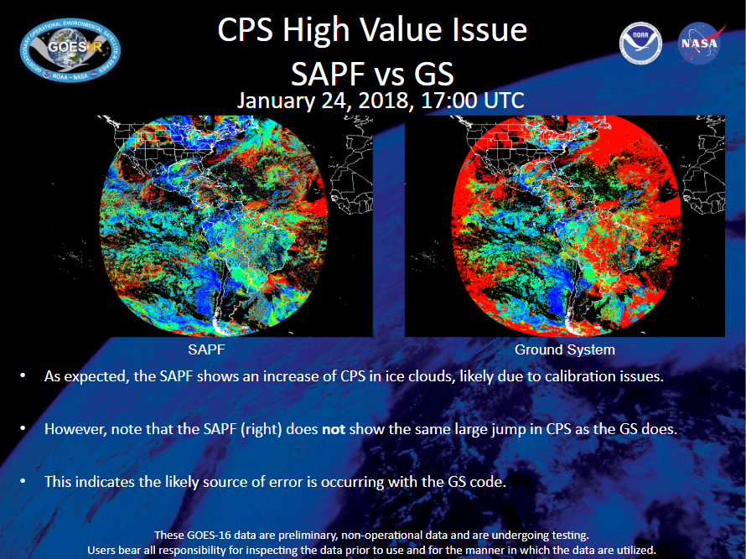
Overview
At the GOES-R Daytime Cloud Optical Depth (DCOMP) Provisional review on 22 February, 2018, it was noted that there was a drastic issue with the daytime cloud particle size, as can be seen on the figure on the below. This caused ADR 609 to be created.
This document provides a description of the issue as well as the fix and the resulting analysis

Slide 5
Results of Review in February 2018:
Summary of Metrics From Provisional
Optical Depth
  mean accuracy = 100.0 * mean ( (g16-modis)/g16))
Cloud Particle Size
  mean accuracy = mean (g16-modis)
% in spec = percentage of pixels falling with spec lines (previous figures)
Parameter | Specified Measurement Accuracy | Mean Accuracy | % in Spec
COD Water | 20% | 8.1 | 43.3
COD Water | 30% | 8.3 | 54.6
CPS Water | 4 micron | 9.4 micron | 33.5
CPS Ice | 10 micron | 18.5 micron | 38.0
PASSED
PASSED
PART. PASS
FAILED
Note the specs from CPS failed, likely due to the anomalous high CPS values

Slide 6
Description of the issue
The COD and CPS products from the Ground System (GS) exhibit large differences with their expected output, particularly for CPS.
The largest differences for CPS occur near the day/night/terminator boundaries, while the largest differences for COD occur near the terminator boundary.
The issue has been documented in ADR 609:
“After the installation of ADR 466 on 1/9/18, the COD and CPS from the DCOMP algorithm had a significant jump in size. This seems to occur primarily for ice clouds. The cause is unknown and currently under investigation by the AWG Cloud team. This issue is preventing the COMP product from reaching provisional status.
For reference, ADR 466 updated the LUTs input for DCOMP and NCOMP, and a scaling to the TPW input for DCOMP.”
All comparisons shown in this presentation use data from November 19th, 2018 at 19:15 UTC. This scene also includes some nighttime pixels along the eastern edge of the scene. The GS and ATT have only one output for DCOMP and NCOMP while the SAPF produces separate files for each algorithm.
  ADR 609 only affects DCOMP
  SAPF is considered “truth” as it does not exhibit the issues mentioned in ADR 609.

Slide 7
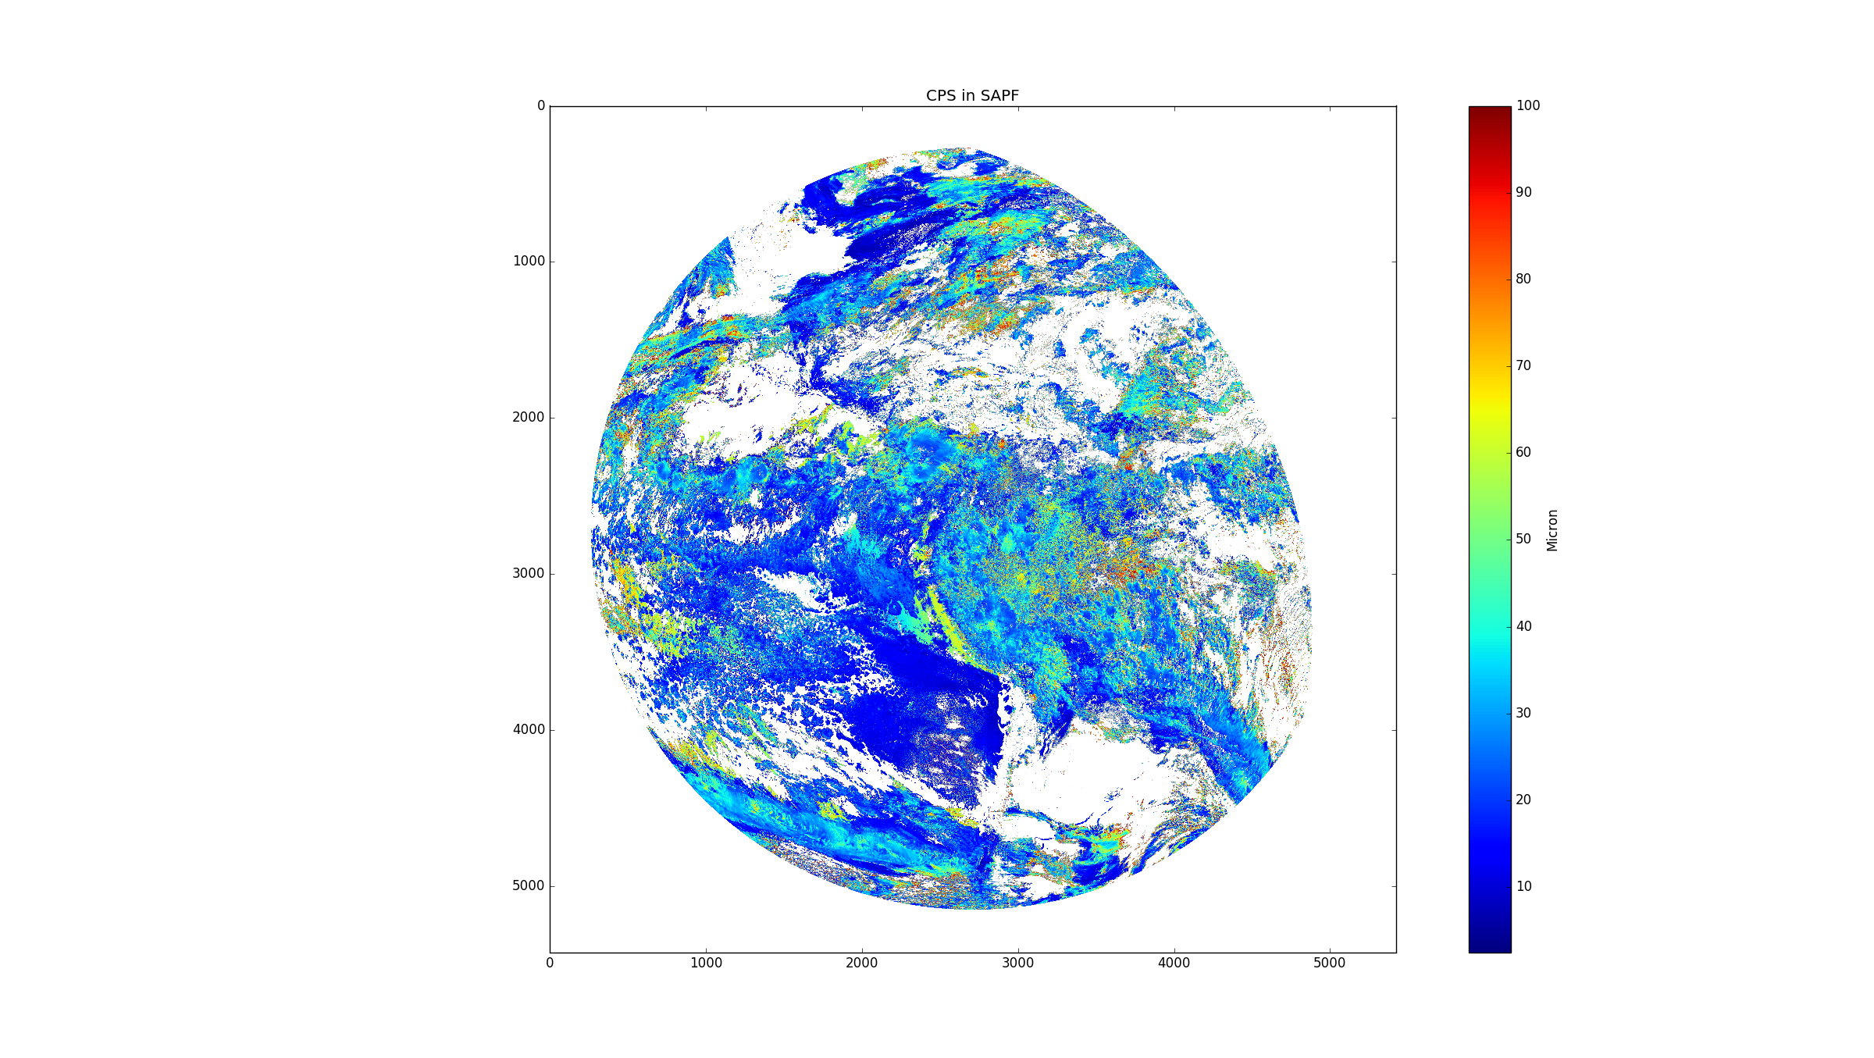
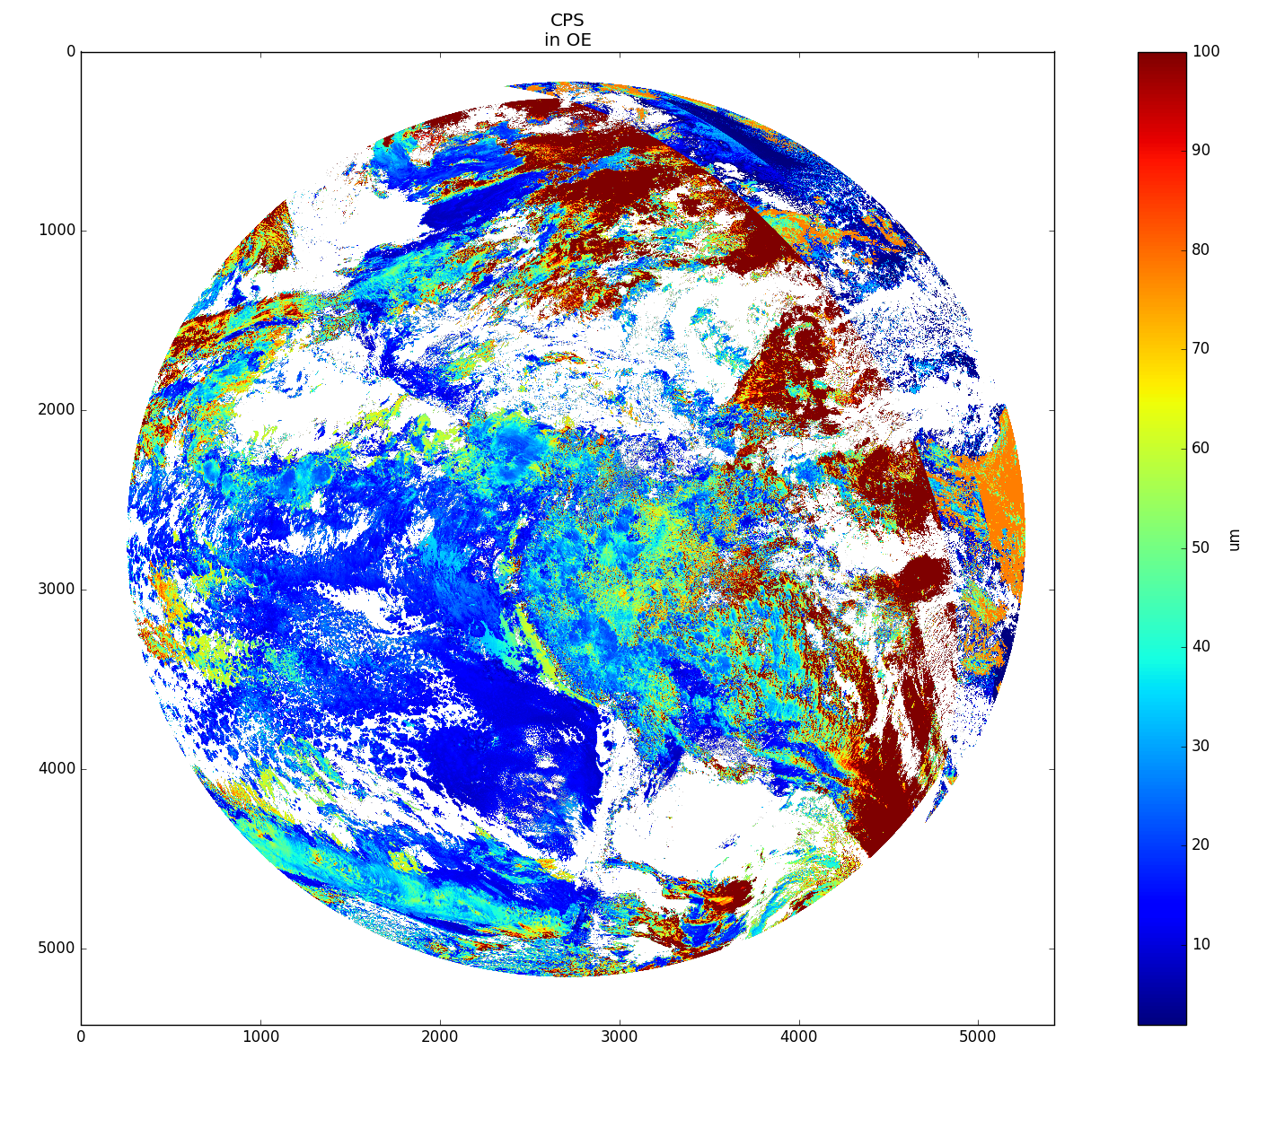
Differences in DCOMP Cloud Particle Size (CPS) Product prior to 17 Dec 2018
CPS from SAPF
CPS from Operational Environment

Slide 8
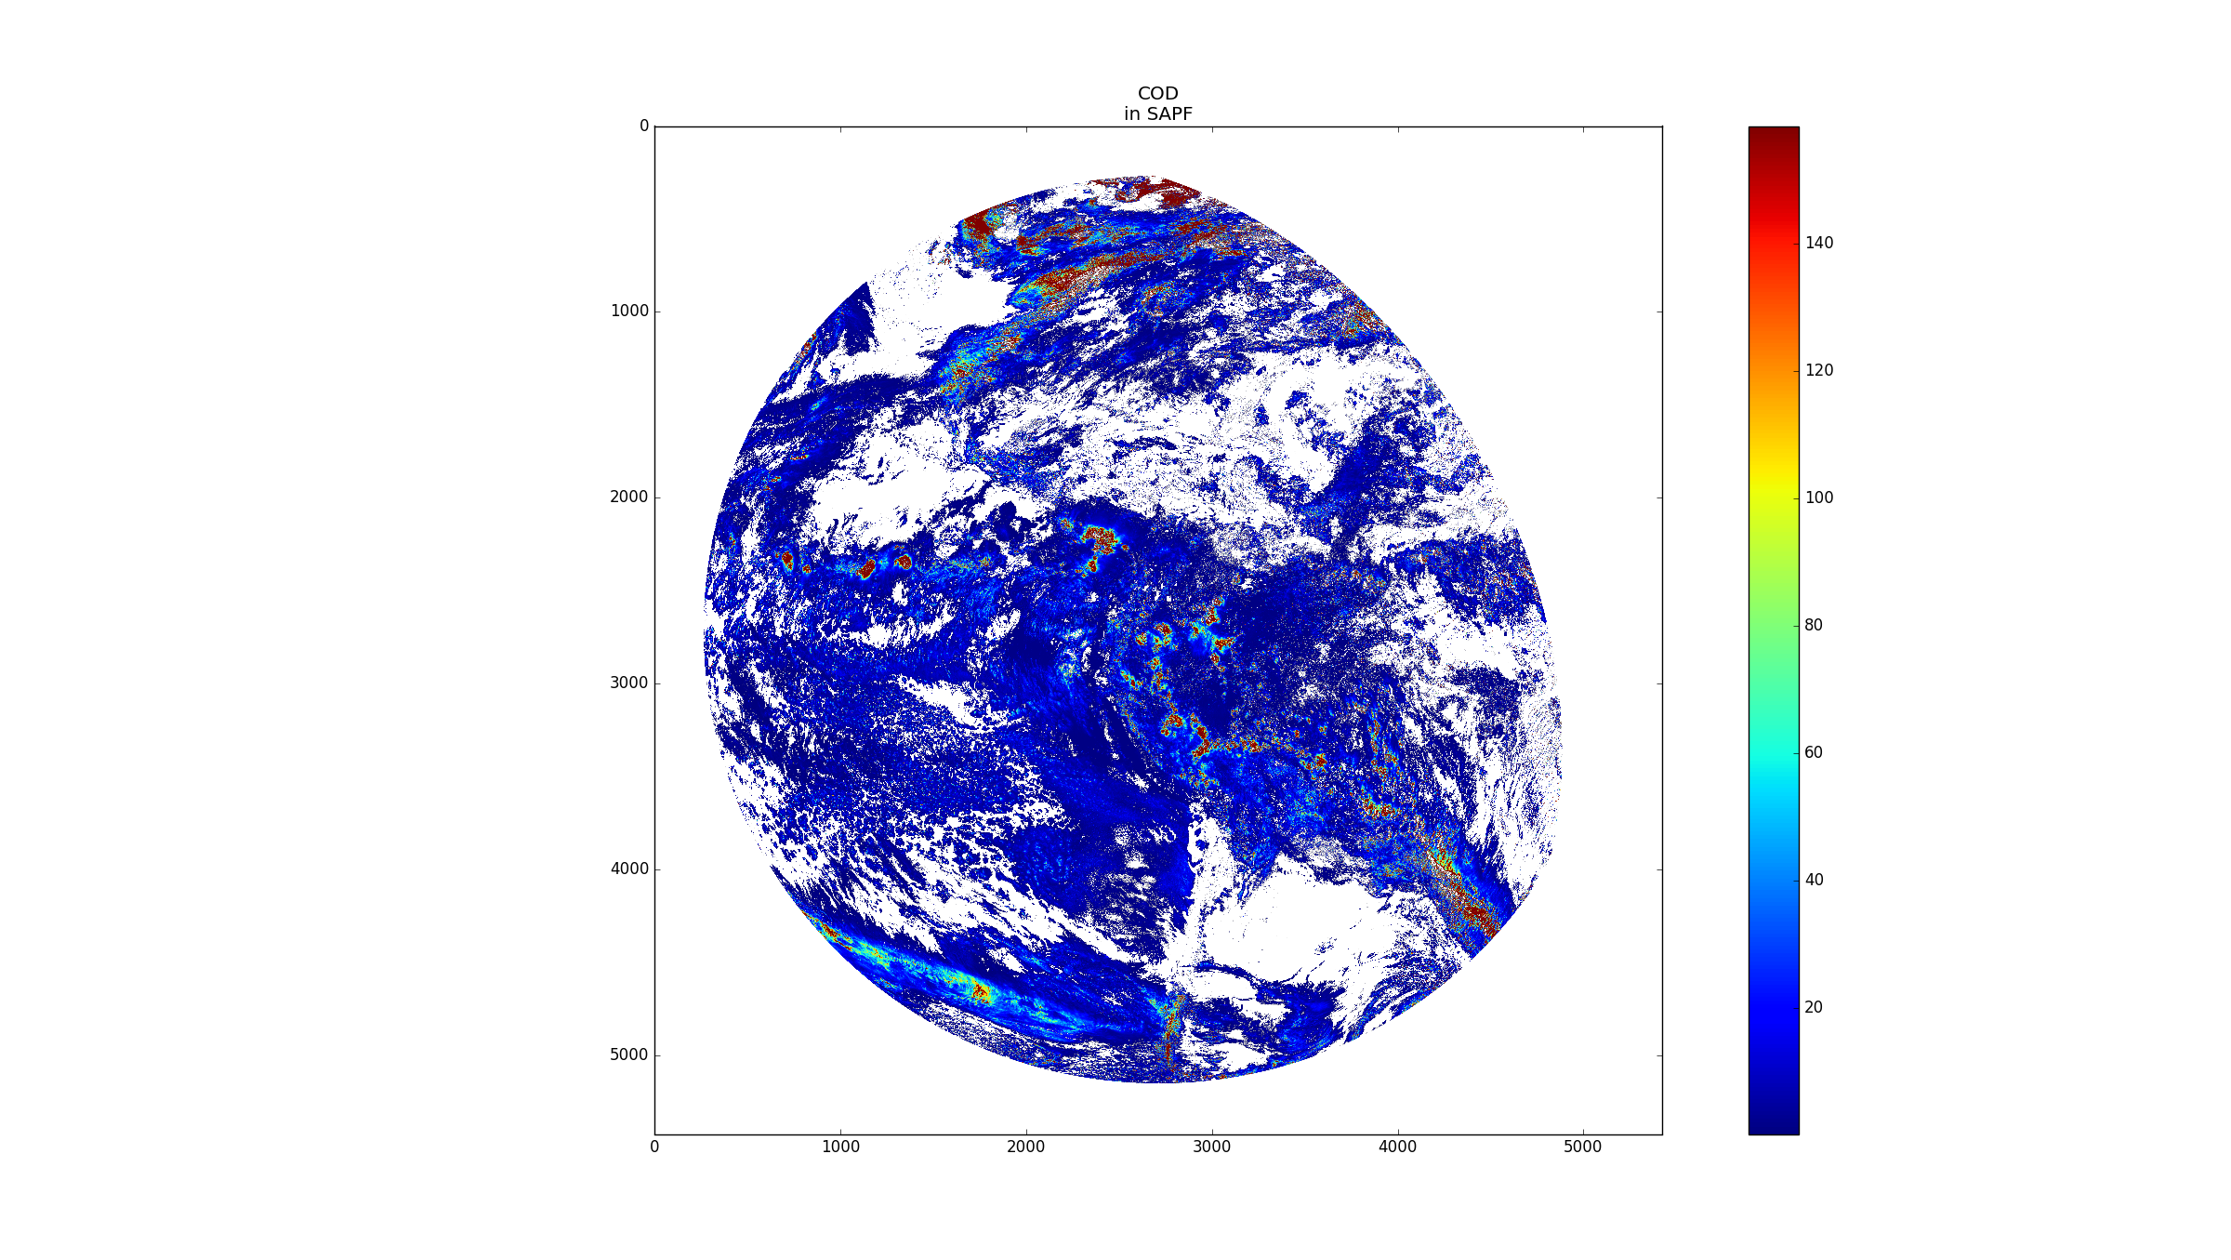
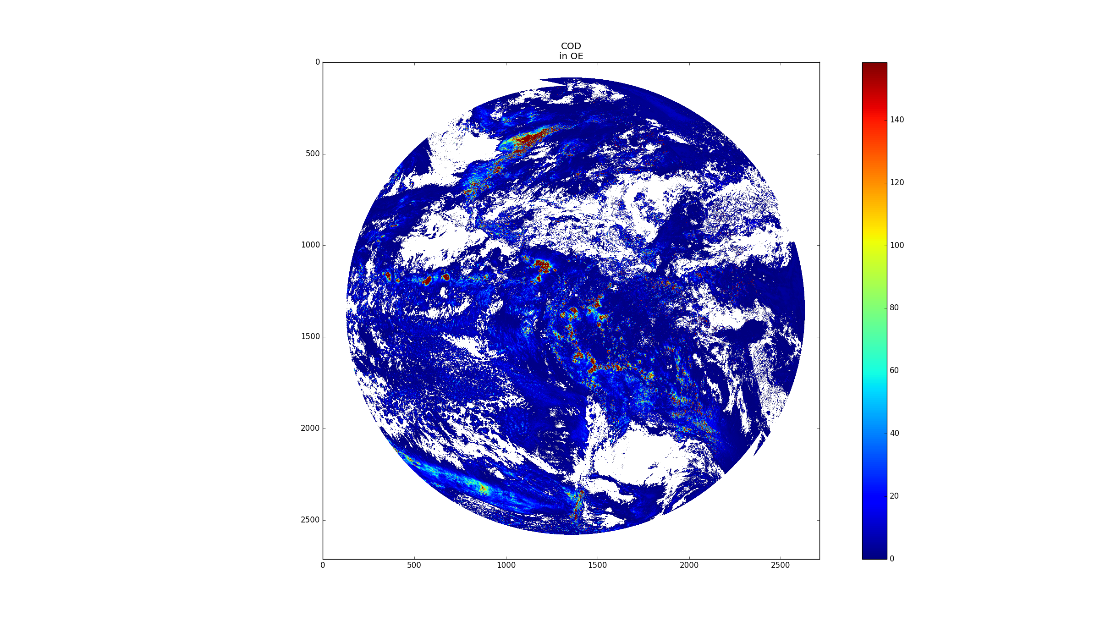
Differences in DCOMP Cloud Optical Depth (COD) Product prior to 17 Dec 2018
COD from SAPF
COD from Operational Environment

Slide 9
Analysis findings for ADR 609
ASSISTT and PRO performed a side by side comparison of the inputs, intermediate variables, and outputs from the DCOMP in the SAPF and Ground System (GS) codes.
The GS code was run in Algorithm Tests Tools (ATT) by ASSISTT with all precedent algorithms run within ATT.
An initial test case was from September 27th, 2018 at 11:30 UTC (not shown). 4 pixels with large SAPF/GS differences were selected for detailed analysis.
A total of 70 variables were printed out for the 4 pixels.
Two notable differences were discovered in the course of looking at the SAPF and GS printouts
The DCOMP algorithm in the GS is using the incorrect convention for the relative azimuth angle. The complement of the angle must be taken to match the convention used in the SAPF.
The DCOMP algorithm in the GS incorrectly outputs the retrieved COD and CPS values from the Optimal Estimation module when the Optimal Estimation retrieval loop does not converge. The correct design is to output fill values for the COD/CPS when the Optimal Estimation does not converge.
These issues were present even before being noticed during the Provisional analysis. It is likely that they were not seen due to the satellite location.

Slide 10
Initial test of the 2 fixes in the GS DCOMP code
The GS DCOMP code within ATT was modified to fix the issue with the relative azimuth angle and the incorrect output from the OE module.
The relative azimuth angle issue is calculated by the Auxiliary component of the GS. The issue was fixed by taking the complement of the angle immediately after ingest by the DCOMP code.
The OE issue was fixed by setting the COD and CPS value to a fill value if the OE retrieval did not meet its convergence criteria after the maximum number of retrieval loop iterations.
The FW and GS (in ATT) codes were run on a test case from November 19th, 2018 at 19:15 UTC.
Results of these test runs are shown on the next slide.
  Important note - the SAPF and ATT were run with product precedence. This means that there are expected differences in the cloud phase and height products between the SAPF and ATT.

Slide 11
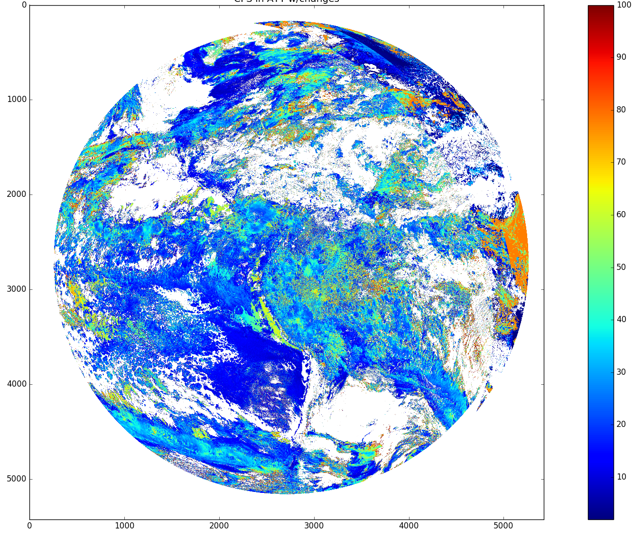
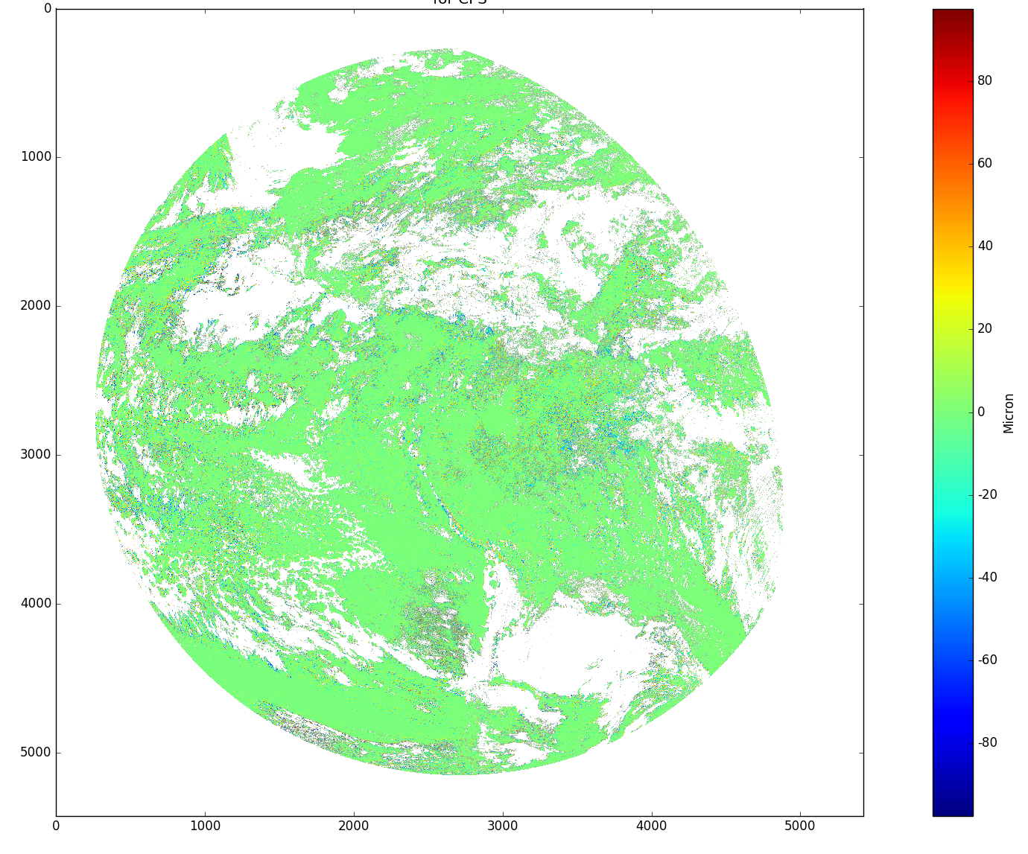
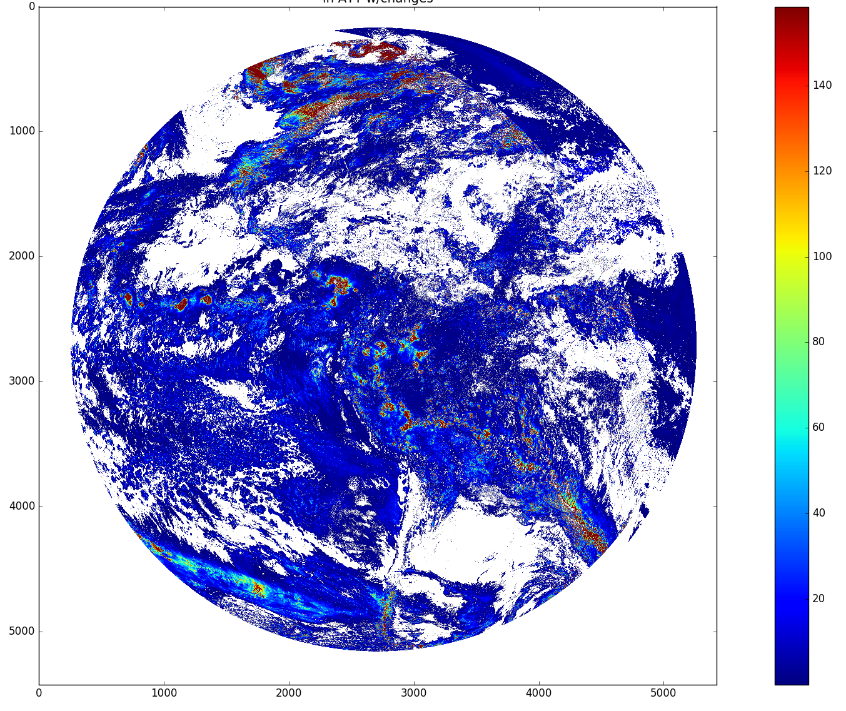
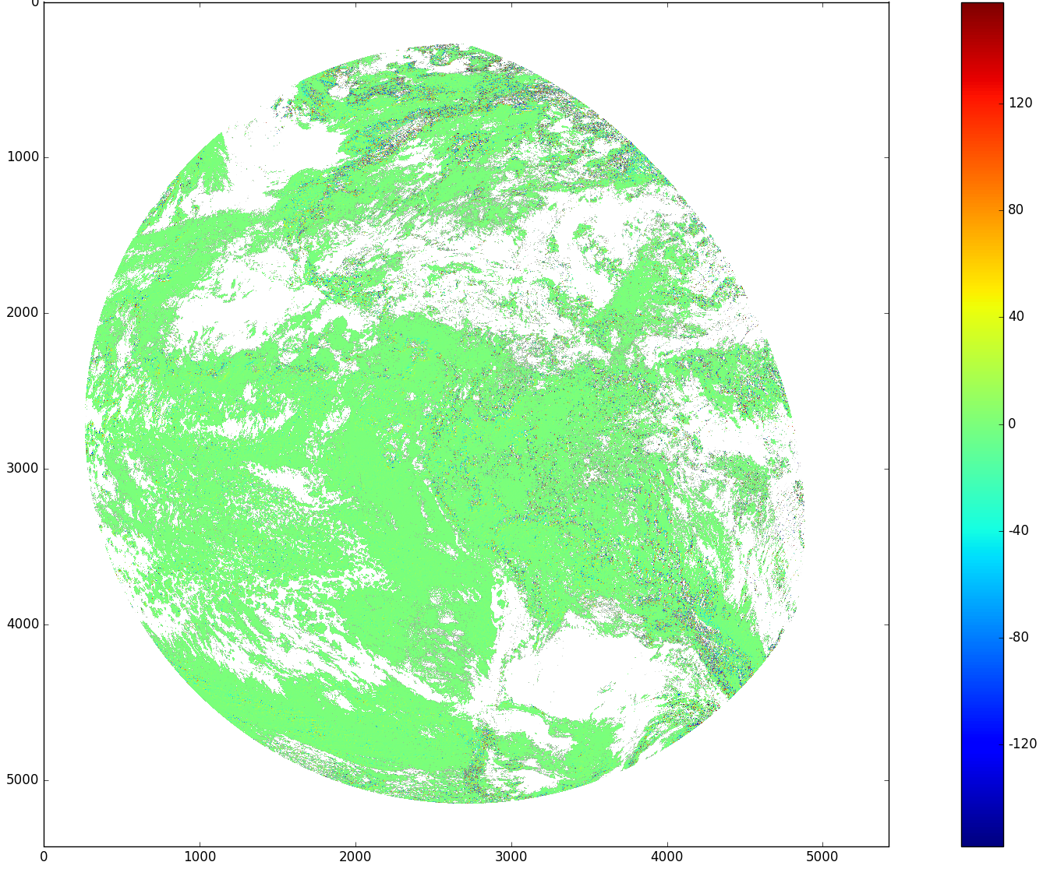
CPS in SAPF
CPS in ATT
ATT - SAPF CPS
COD in SA{F
COD in ATT
ATT - SAPF COD

Slide 12
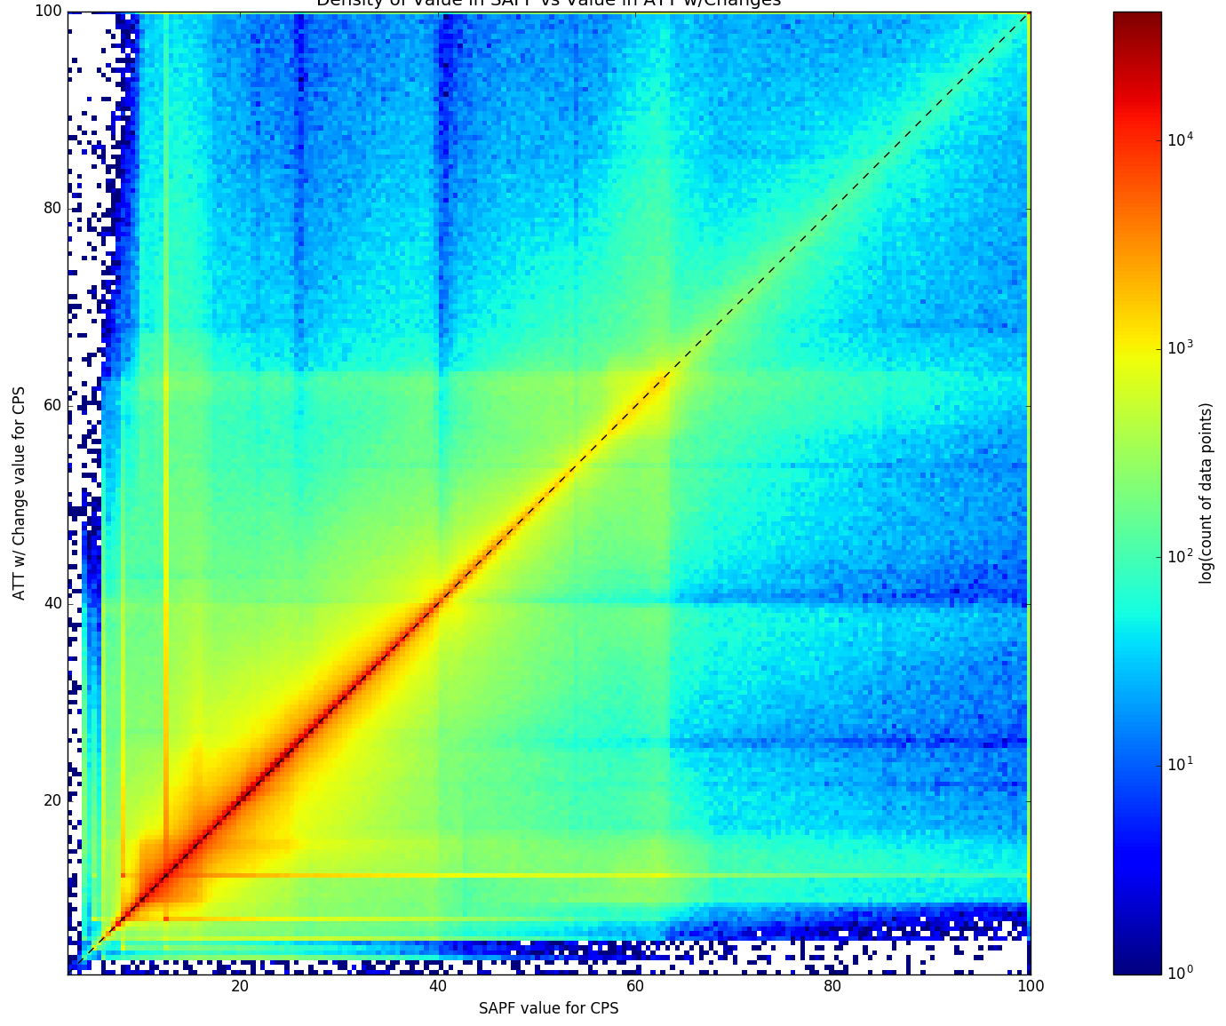
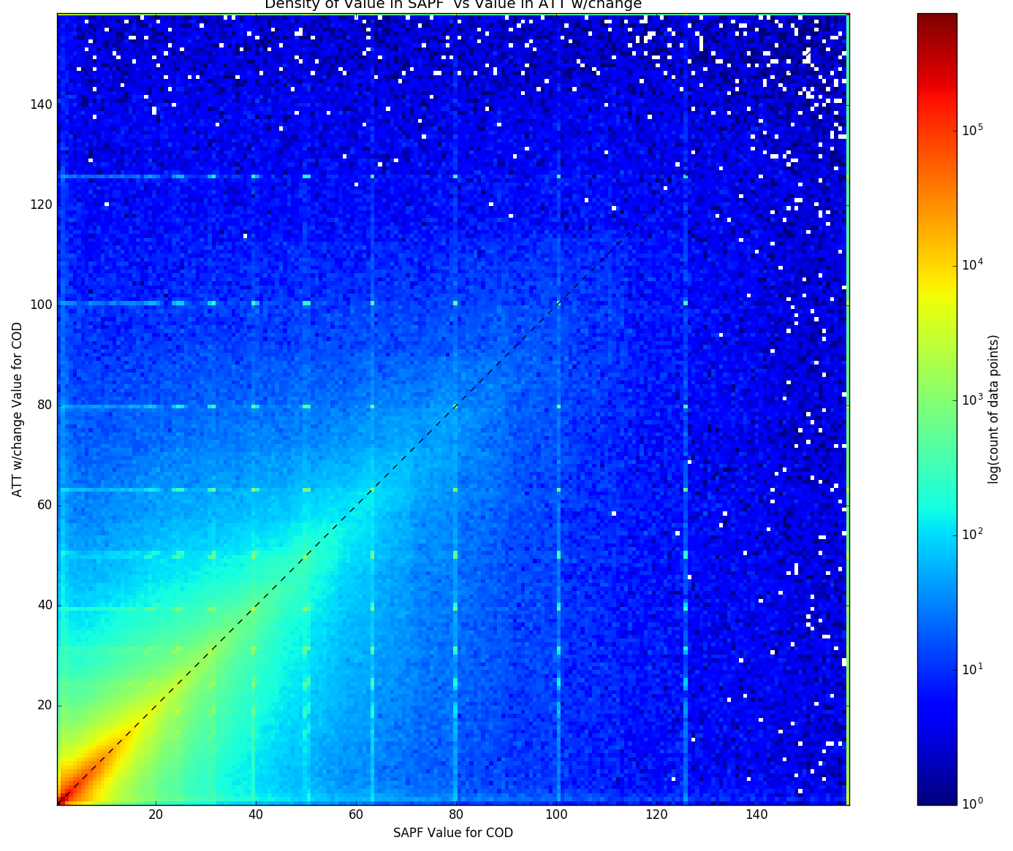
Density plots (# of observations) of the ATT to SAPF results
November 19th, 2018 at 19:15 UTC
November 19th, 2018 at 19:15 UTC
Correlation: 0.60516 (density plot)
Mean delta: -0.36606 (CPS data)
Median delta: 0.05120 (CPS data)
Correlation: 0.76530 (density plot)
Mean delta: -0.36678 (COD data)
Median delta: -0.00030 (COD data)

Slide 13
Test of the changes to DCOMP in the Ground System
The 2 fixes to DCOMP were then added to the DCOMP code running in the DE on the Ground System. The fixes were made in the same way as with the ATT updates.
DCOMP output files for the November 19th, 2018 at 19:15 UTC were pulled off the GS and compared with the equivalent files generated from the SAPF run.
Results are shown on the next slide.

Slide 14
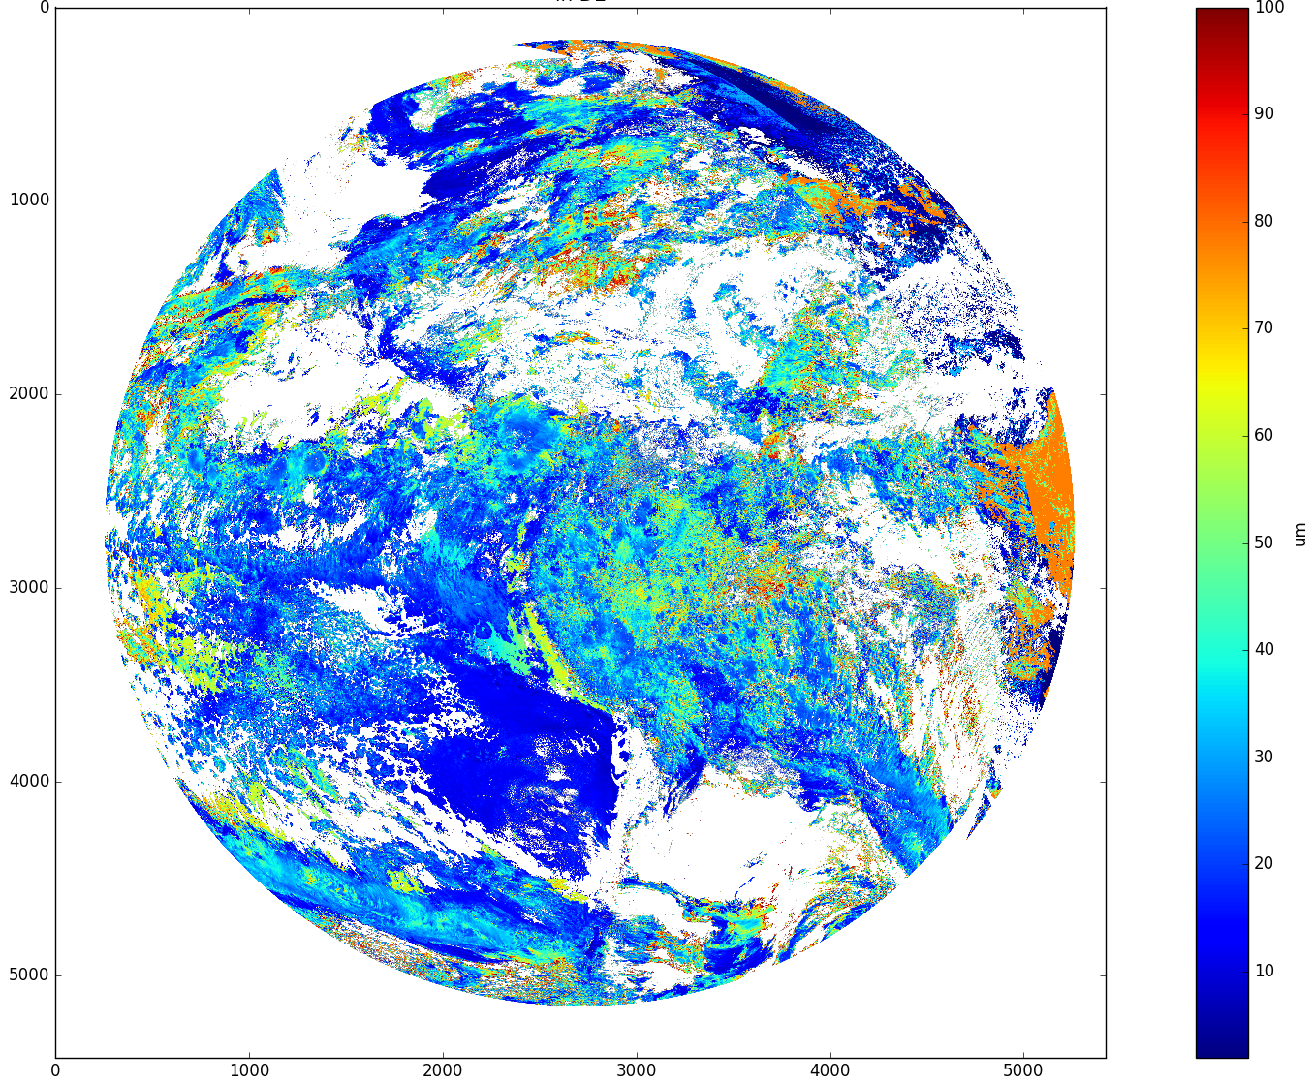

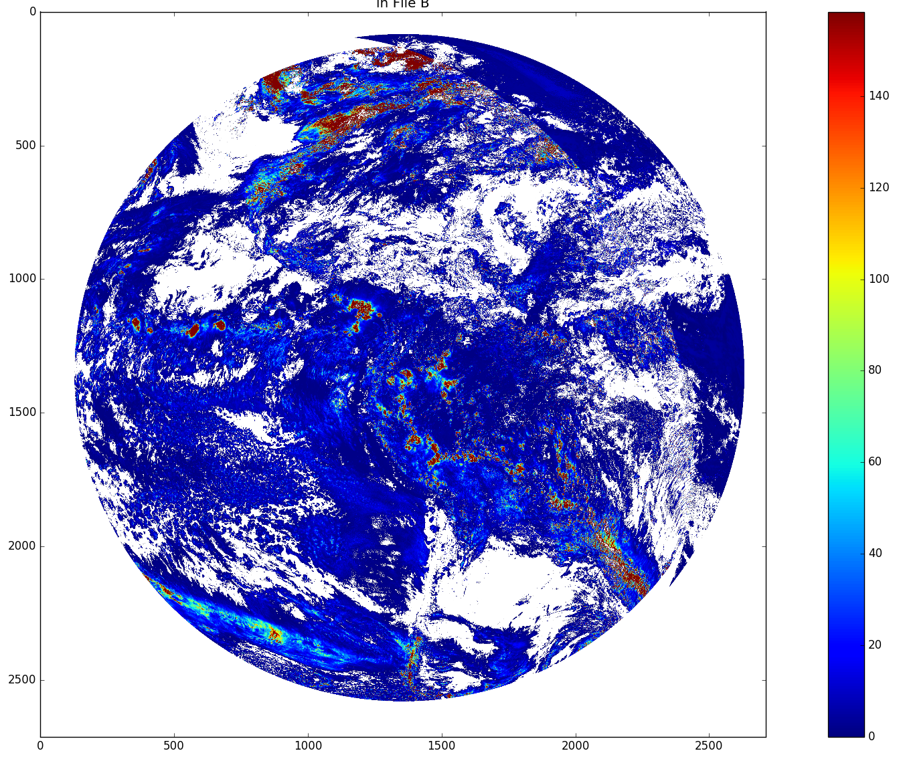
CPS in SAPF
CPS in DE
DE - SAPF CPS
COD in SAPF
COD in DE
DE - SAPF COD
COD in the GS is output on a 4 km grid.
FW COD reported on a 2 km grid, so no comparison performed.

Slide 15
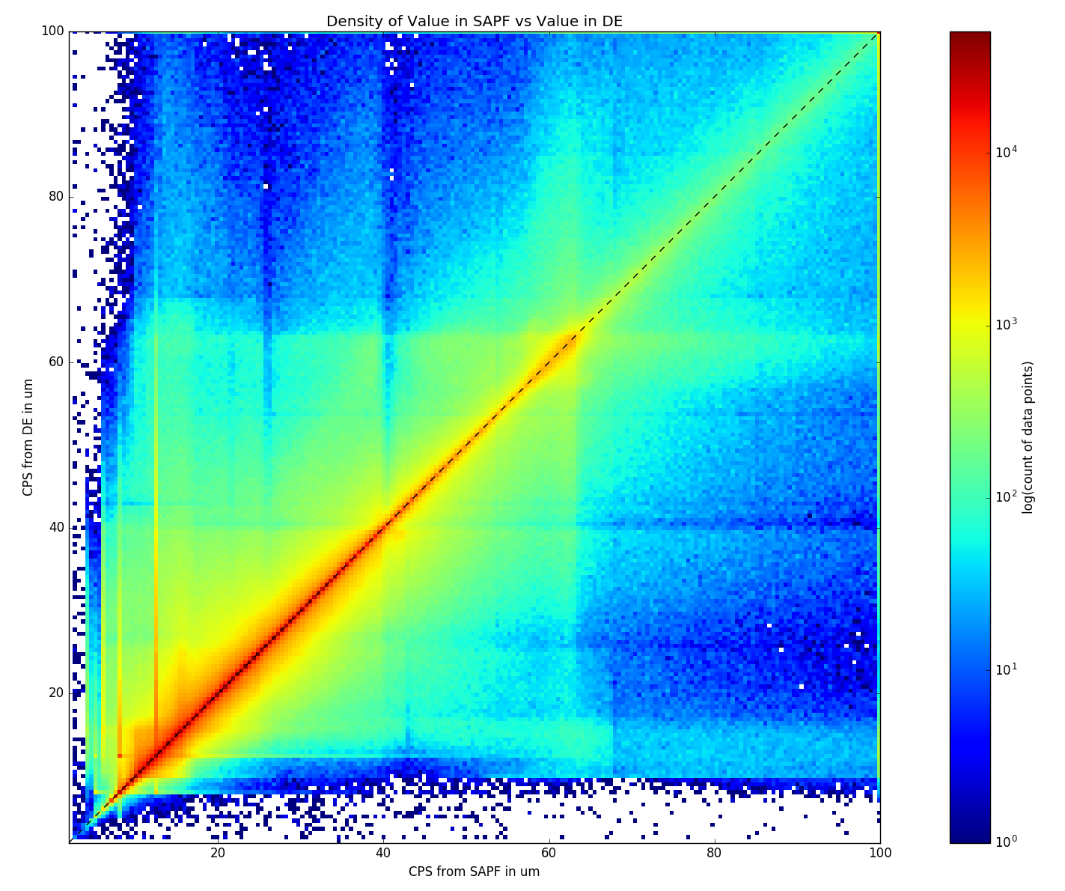
Density plots (# of observations) of the DE to SAPF results
November 19th, 2018 at 19:15 UTC
Not created due to different spatial resolution of ATT (2 km) and DE (4 km) COD data.
Correlation: 0.80382 (density plot)
Mean delta: 0.90620 (CPS data)
Median delta: 0.01148 (CPS data)

Slide 16
Product Overview
Baseline Products : Cloud Optical Thickness (COD) and Cloud Particle Size (CPS)
CPS is represented by Cloud Effective Radius which is a measure of cloud droplet distribution.
Liquid water path (LWP) and Ice Water Path (IWP) are future capabilities. They are calculated from COD and CPS and help to evaluate the provisional products above.
 | Requirements for Full Validation
Product | Range | Accuracy | Precision
COD | 0.5-50 | 2 or 20% (liquid) 3 or 30% (ice) | 2 or 20% (liquid) 3 or 30% (ice) | 65 degree solar zenith FD 4km resolution CONUS 2km
CPS | 0-50 μm | 4μm /10μm (liquid/ice) | 4μm /10μm | 65 degree solar zenith FD and CONUS 2km

Slide 17
Evaluation of DCOMP from Development Environment
As mentioned on the previous slide, the fix has only recently been implemented in the Development environment (26 November), so no routine data is was available.
Two cases were pulled from the DE for offline evaluation with MODIS
  27 November 2018 for GOES-16
Evaluation with MODIS:
We evaluated with four case studies: ( shown here 2)
  G16 DOY 331 around 18:30 UTC
  G16 DOY 331 around 16:30 UTC
All-day comparisons with more strict filtering of 10 minutes window.
Challenges: temporal and spatial colocation differences ( here we use spatial and temporal window of 5km and maximal 20 minutes)
MODIS approach is similar to DCOMP. It is not an independent validation source.
Perfect match cannot be expected.

Slide 18
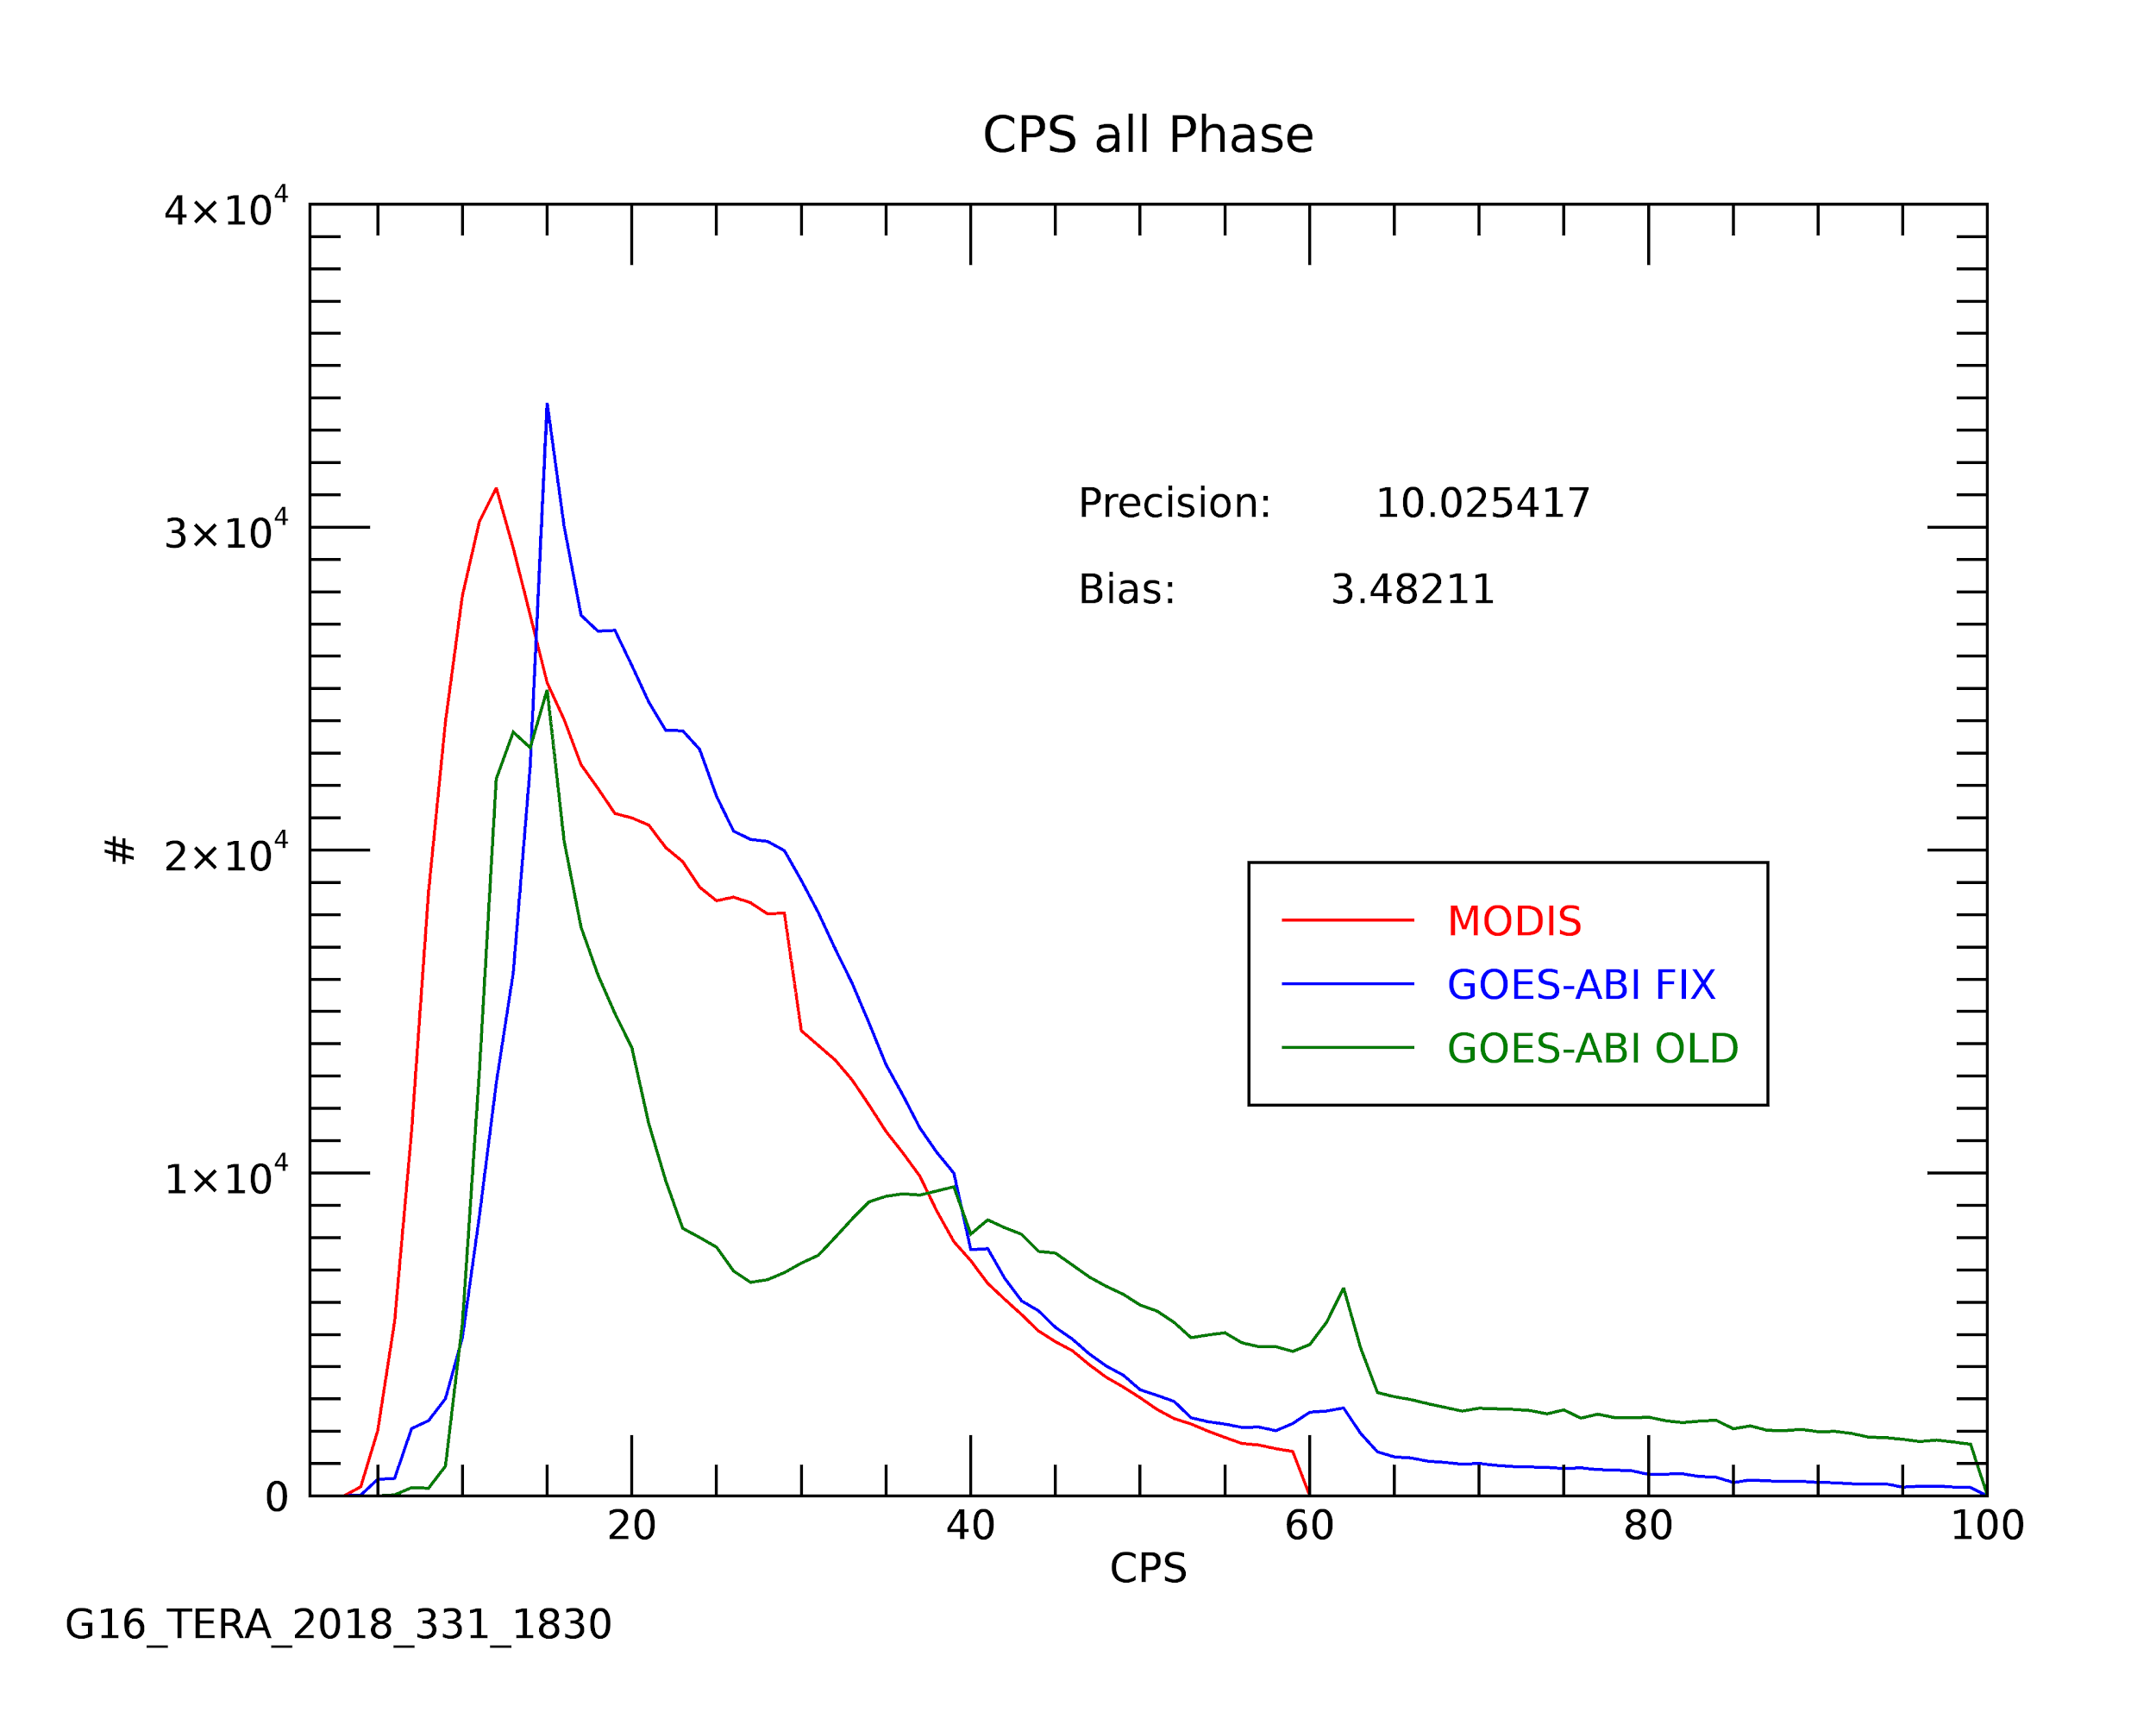
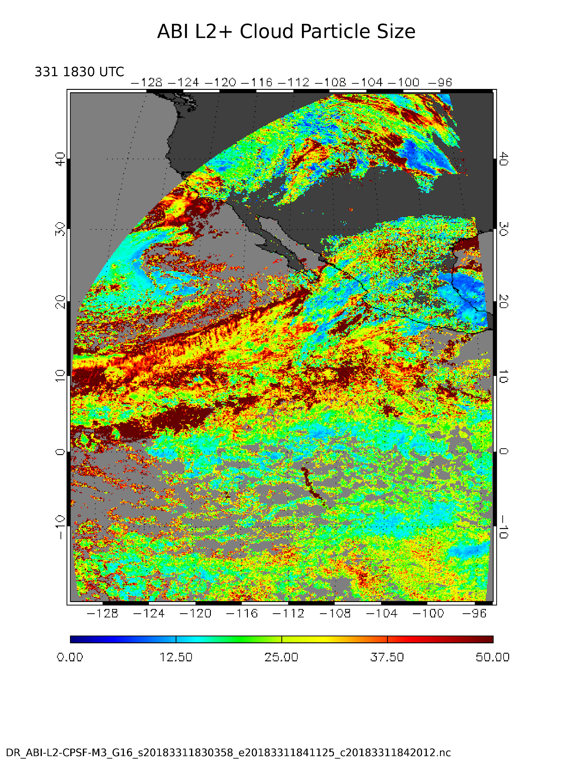
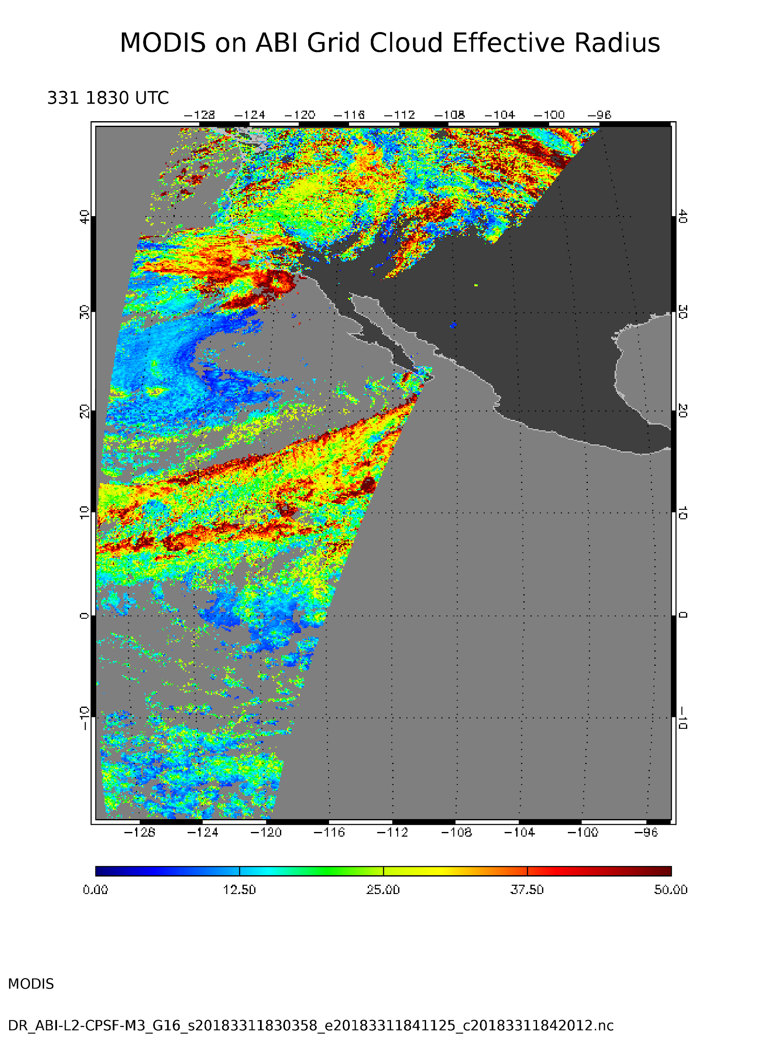
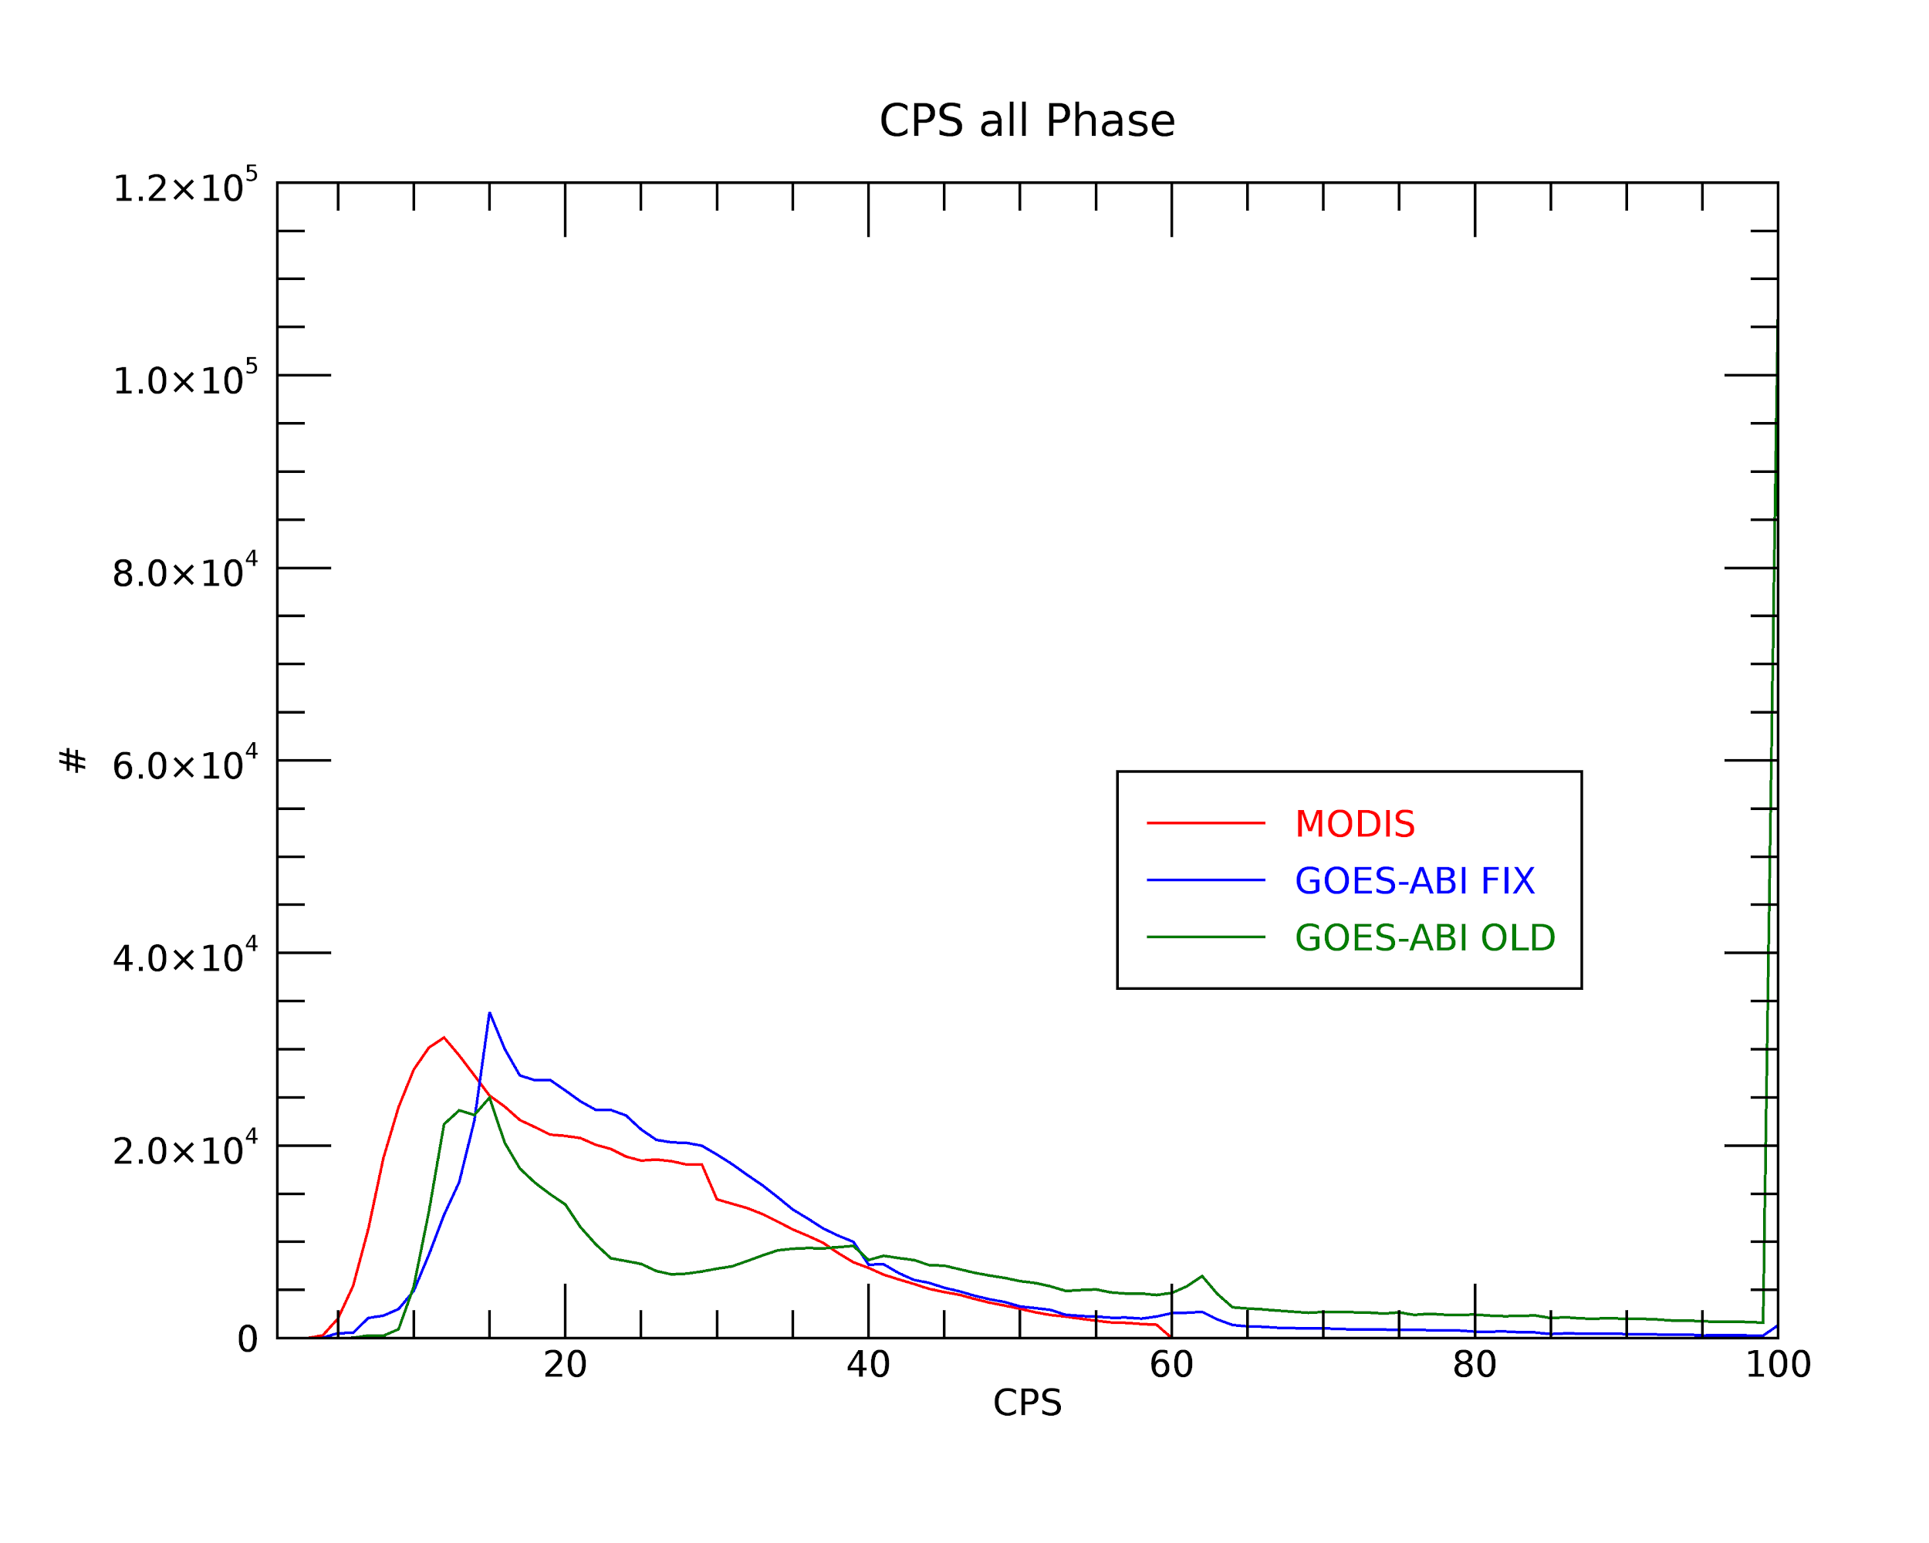
Evaluation of DCOMP from Development Environment Case 1
GOES-16
MODIS
Main erroneous artifact with many pixels with extreme value at the edge of valid range disappeared!
Notes:
Note the erroneous CPS distribution in OE as compared to MODIS. While there is a slight bias in the DE (i.e. Fixed) data, this is likely due to the high 0.64𝞵m reflectance in ABI as compared to MODIS (~6%). This is the subject of a seperate ADR unrelated to CPS.

Slide 19
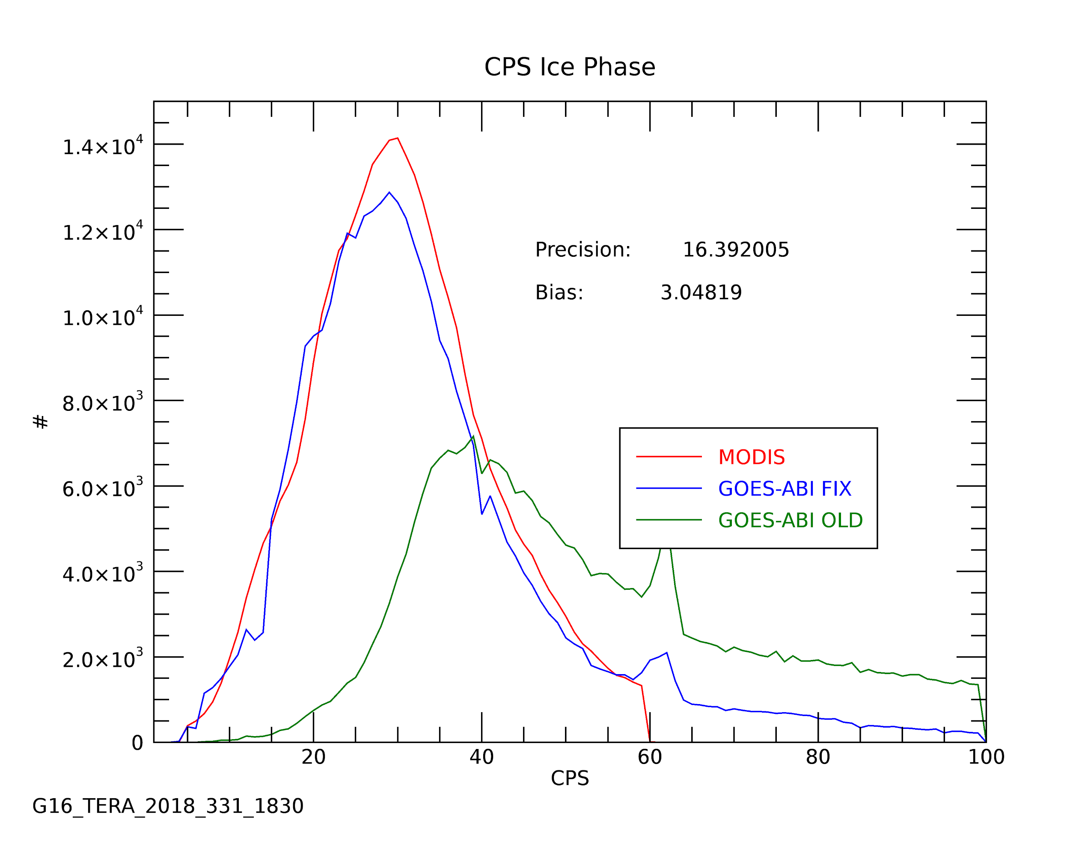
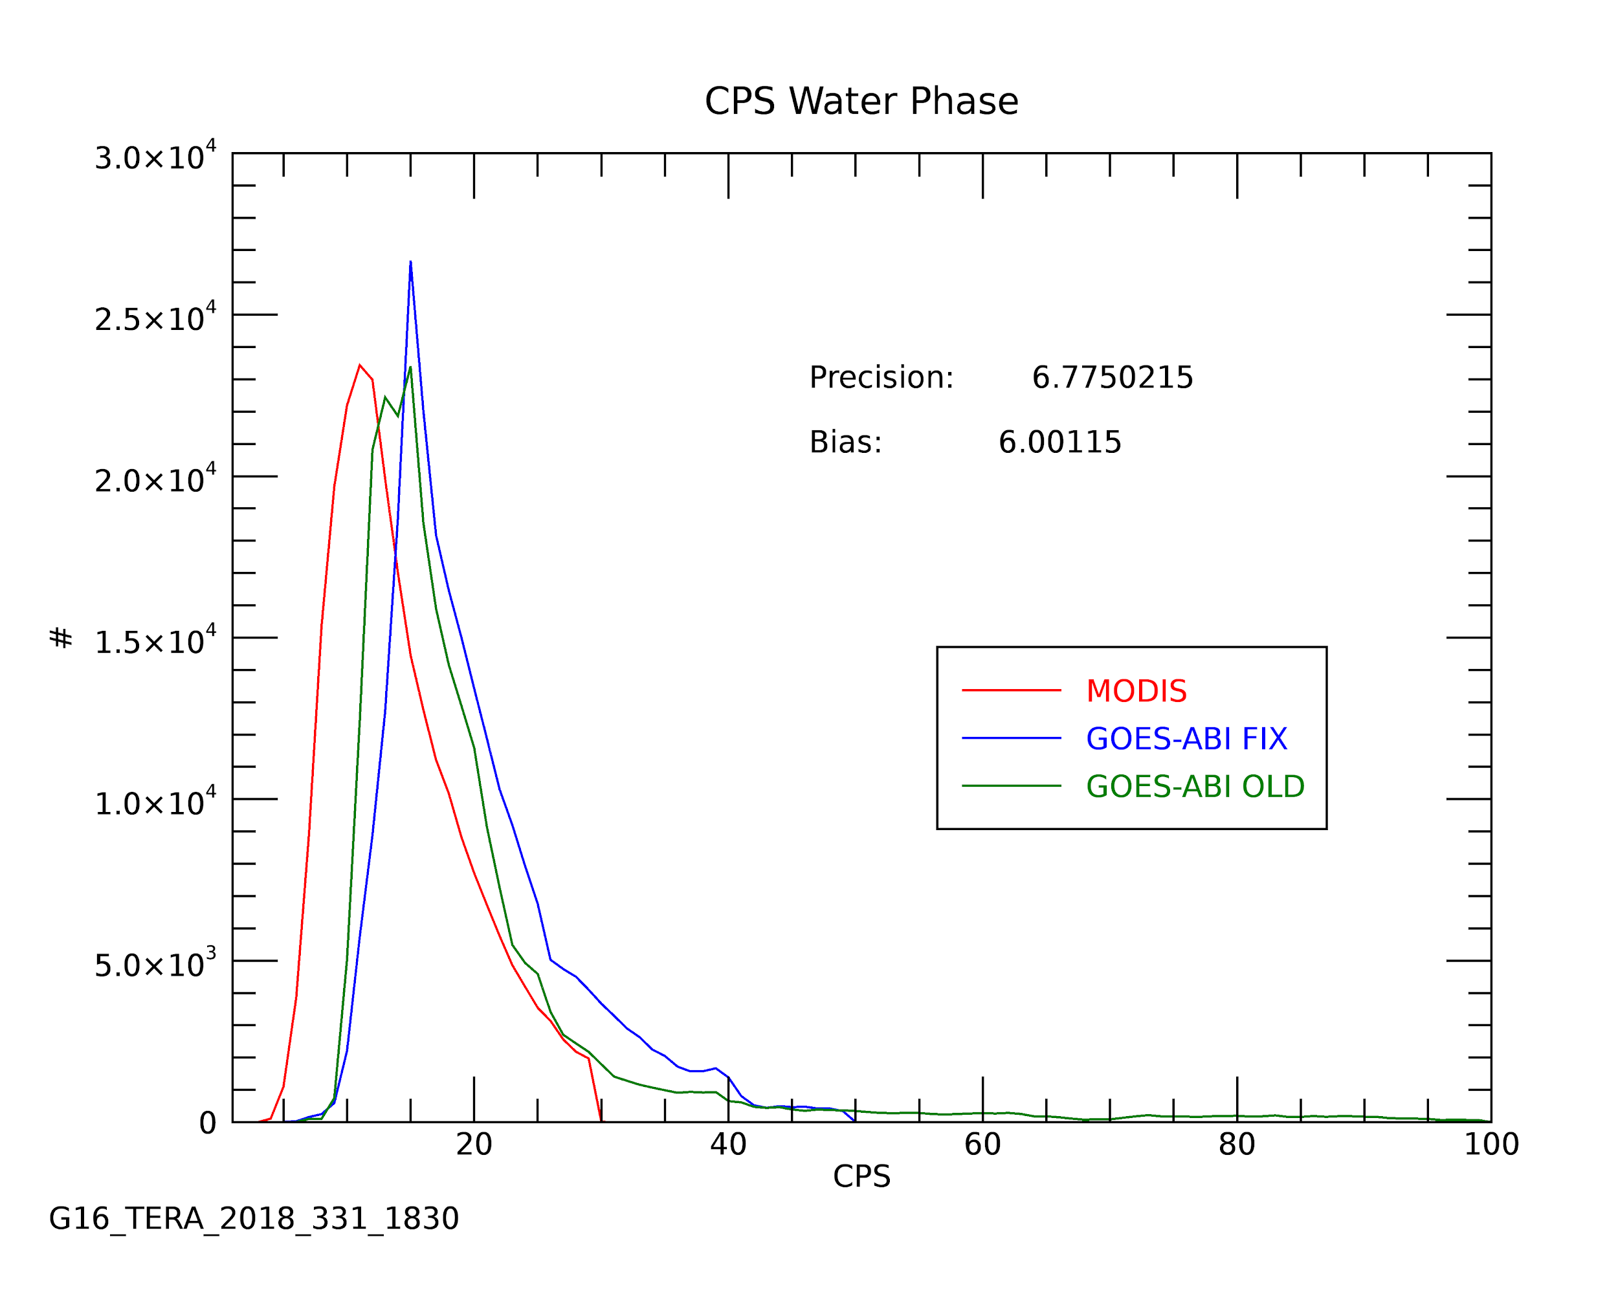
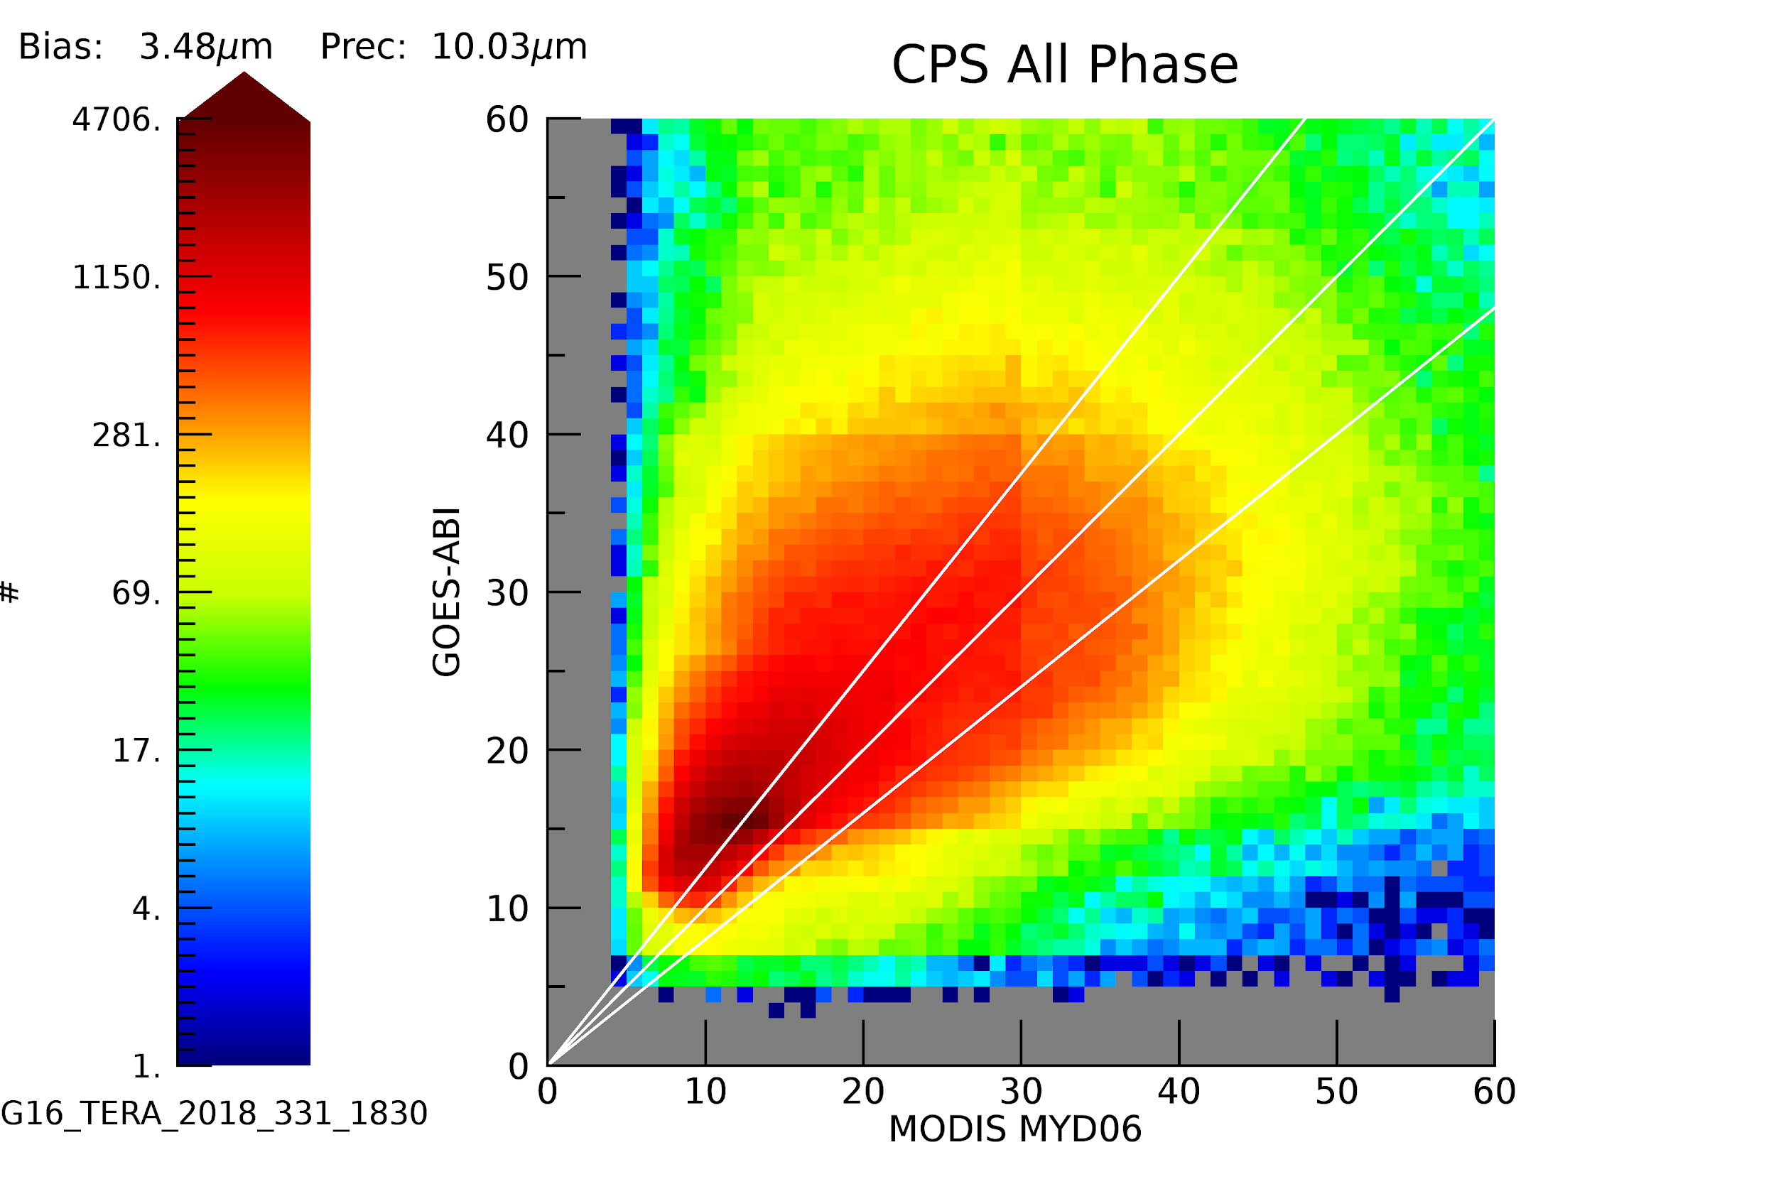
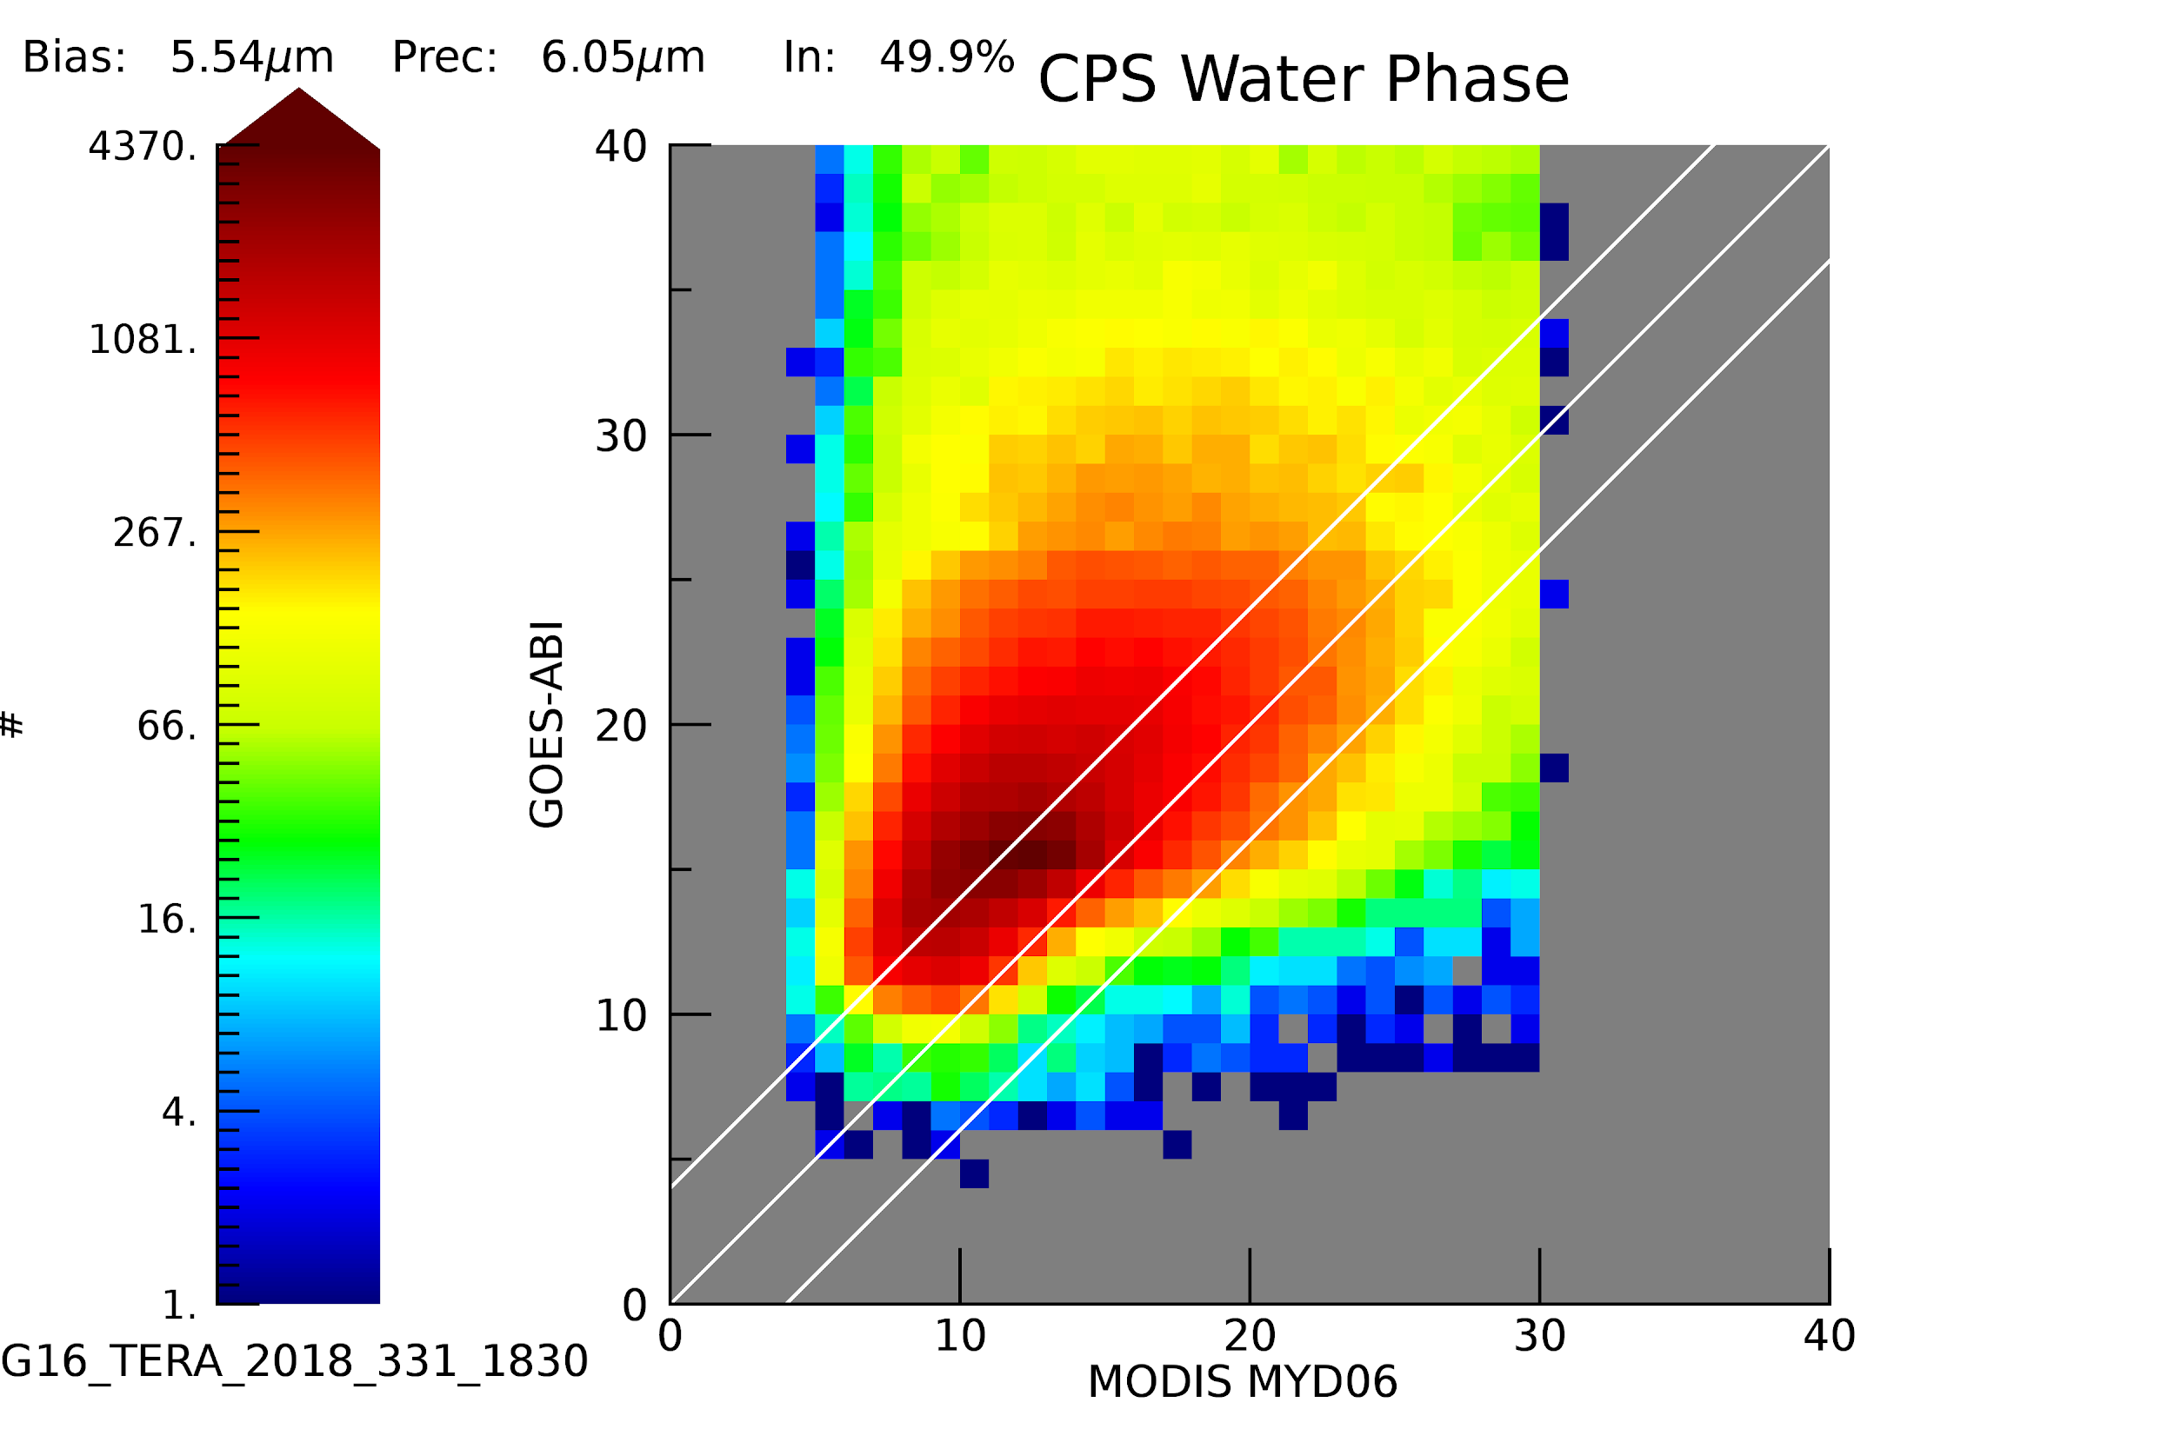
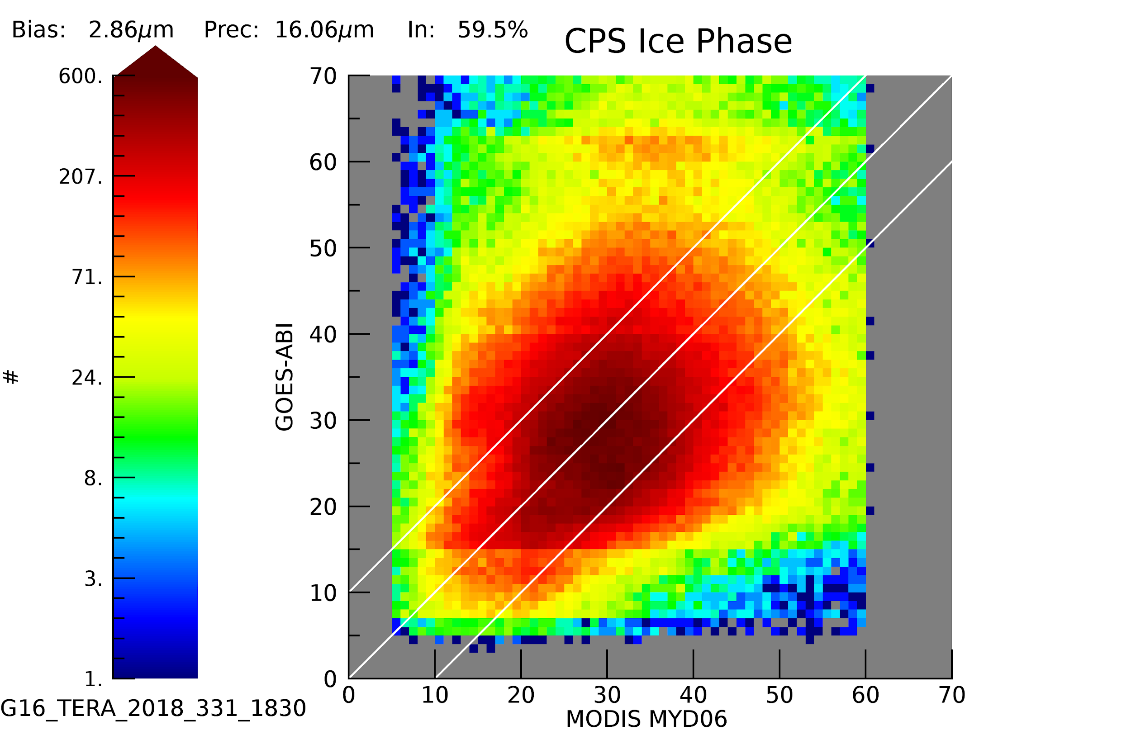
Evaluation of DCOMP from Development Environment Case 1

Slide 20
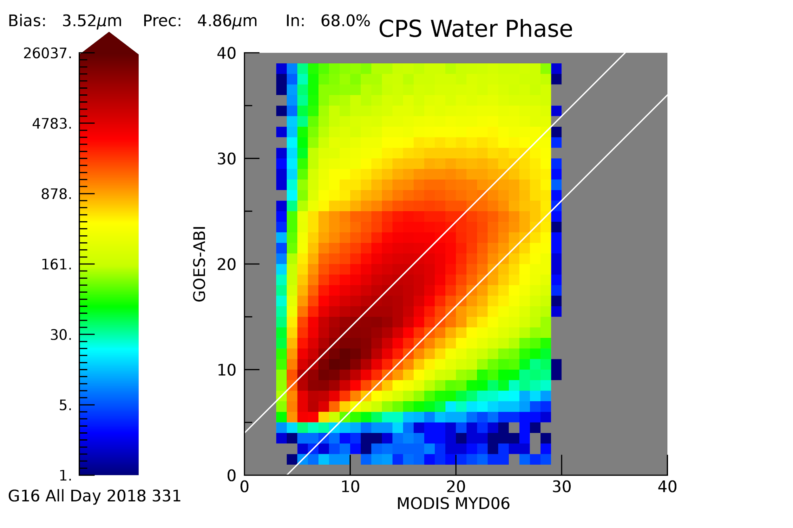
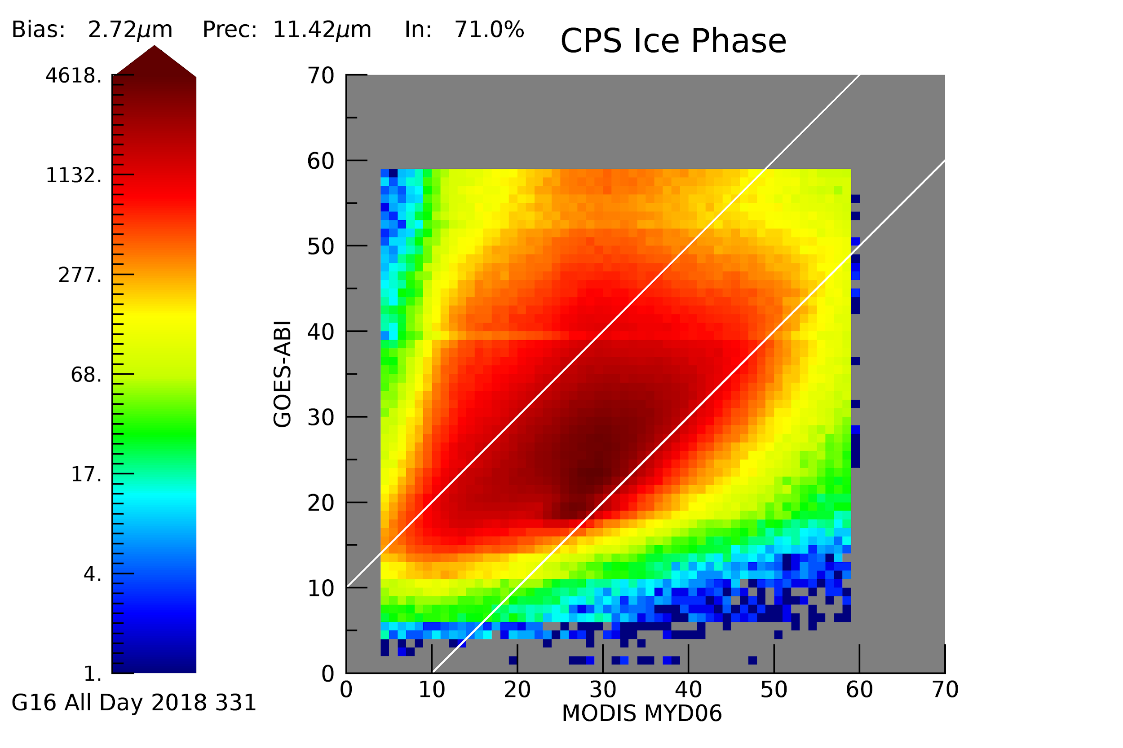
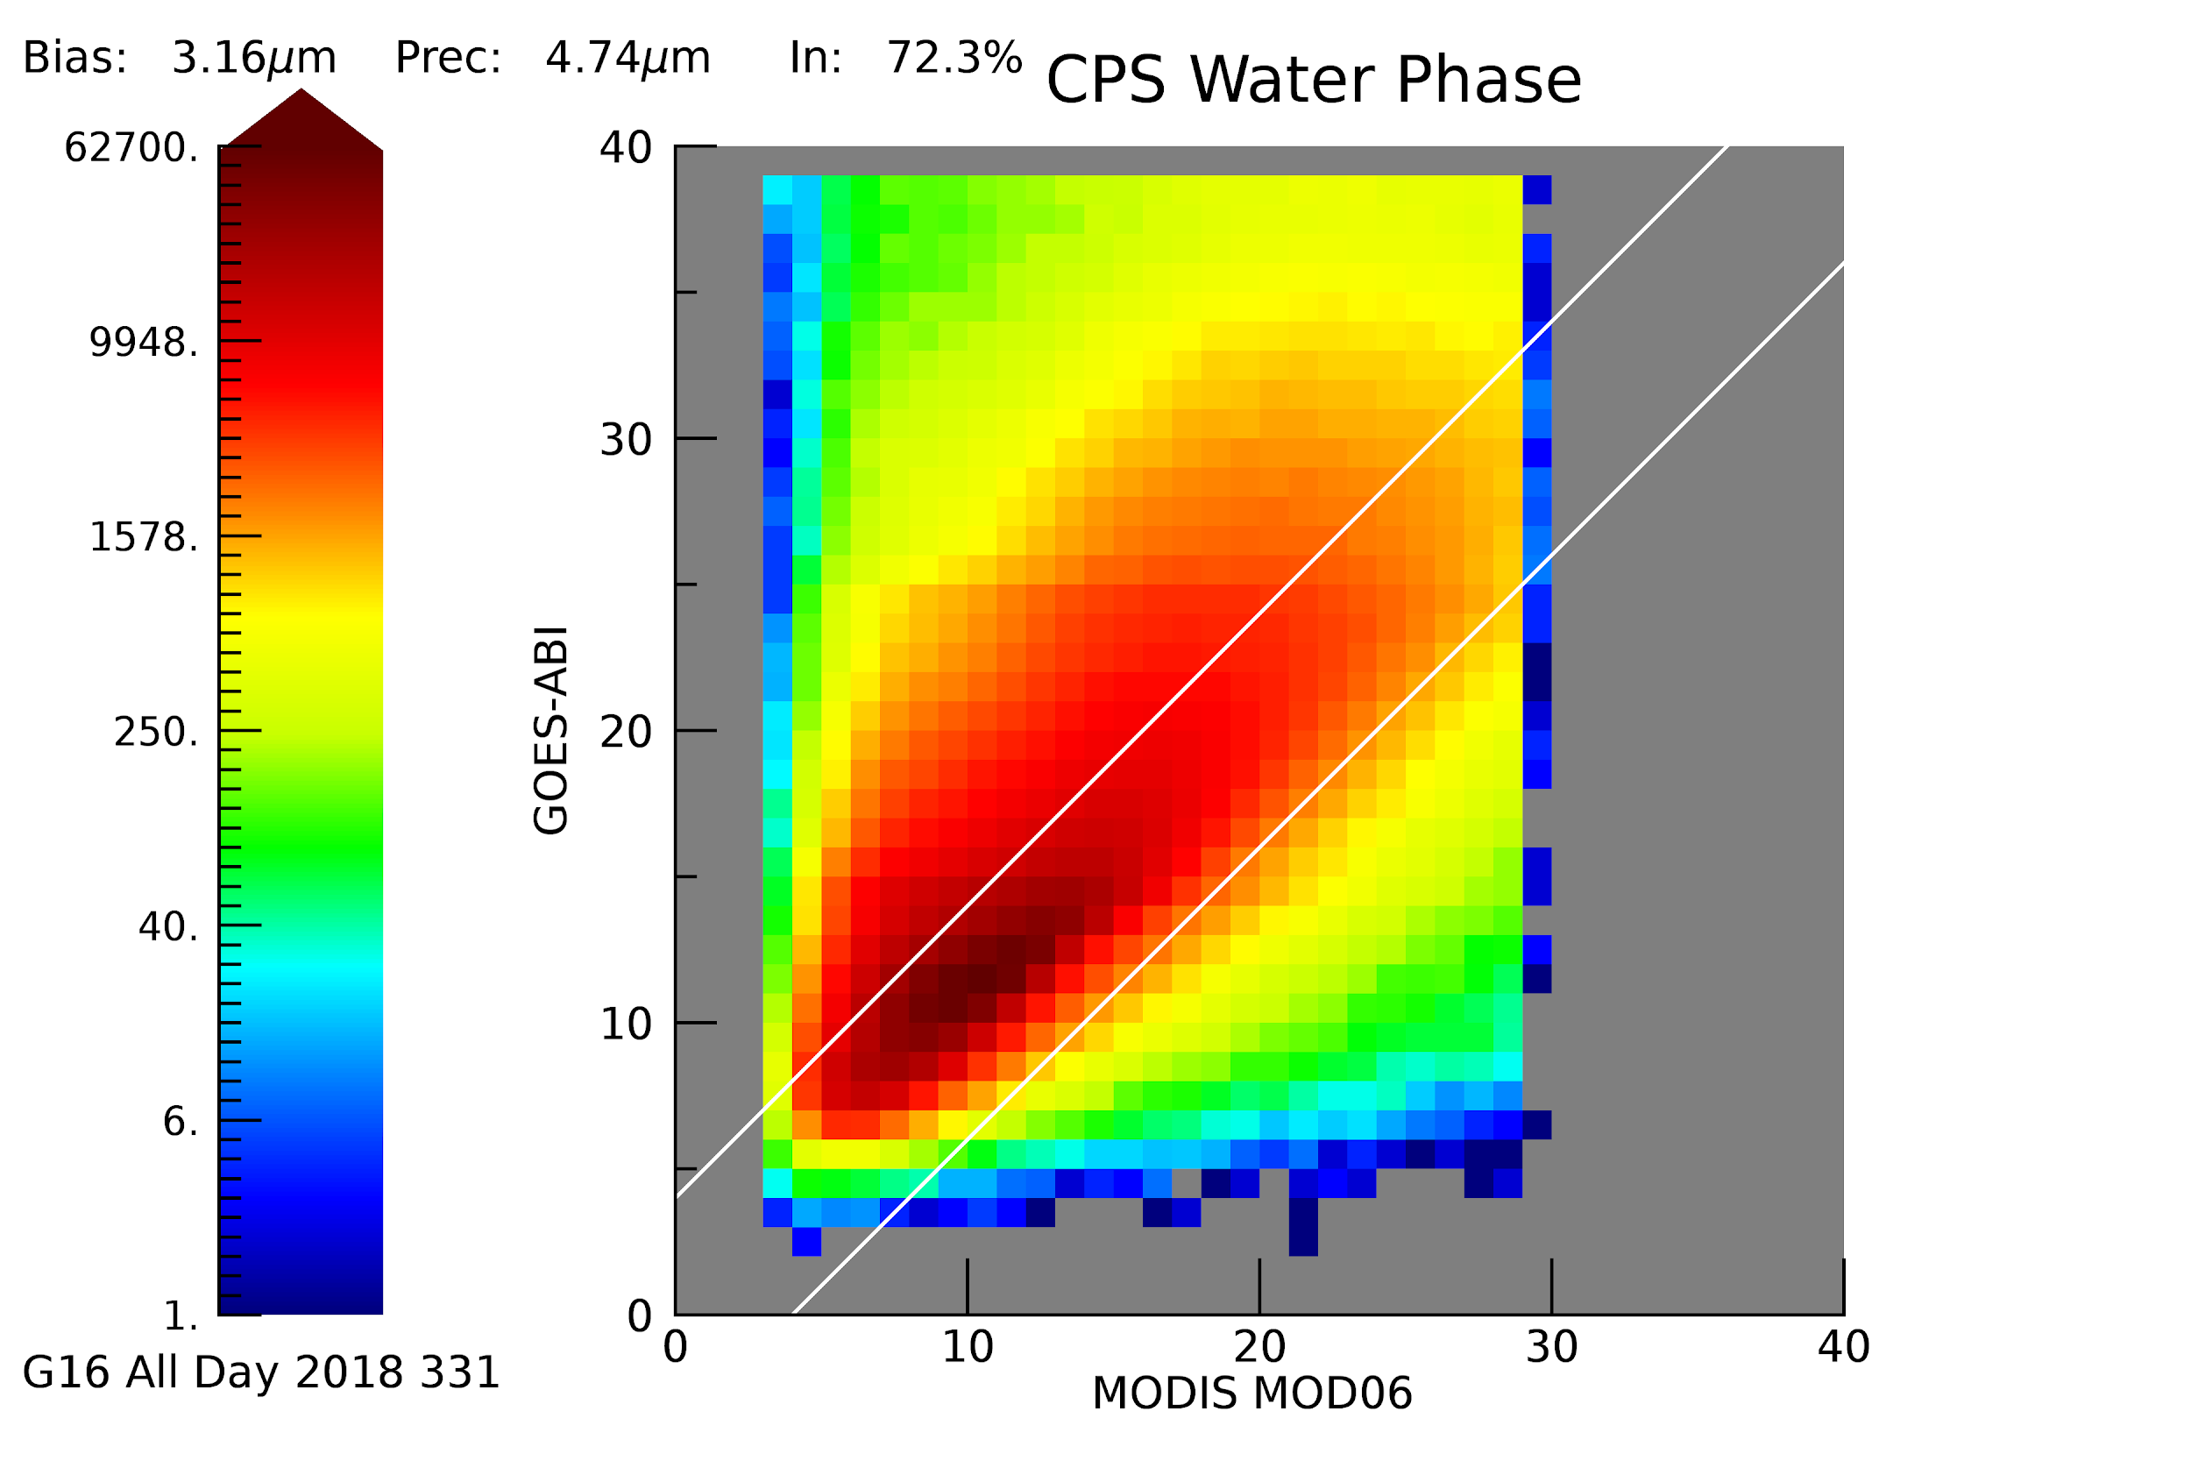
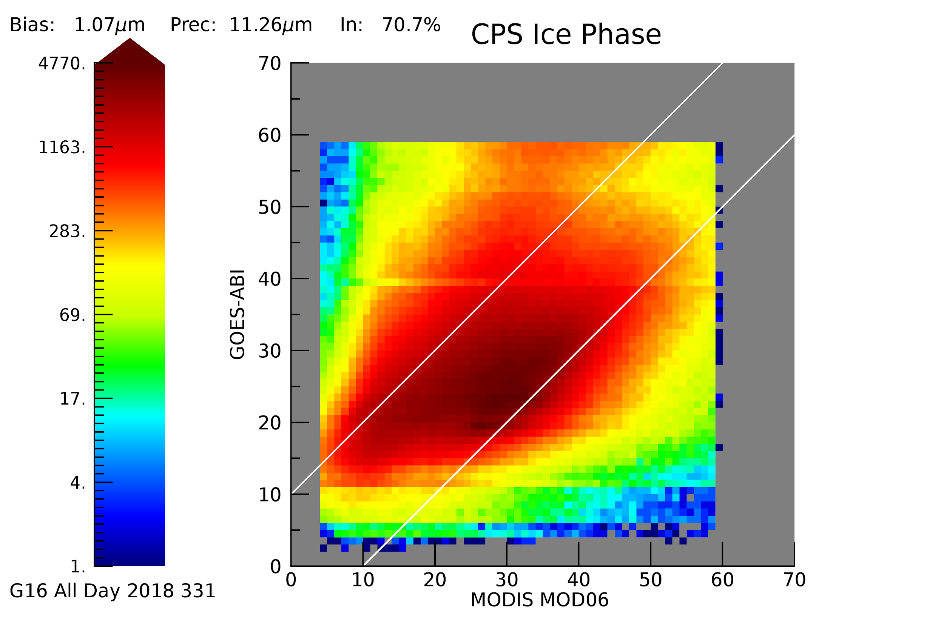
Evaluation of DCOMP from Development Environment- All Day 331 (G16)
MODIS-AQUA
MODIS-TERRA
Notes:
Again note the erroeous distribution in CPS in OE as compared to DE when compared to MODIS.

Slide 21
Evaluation of DCOMP with MODIS: Summary
Parameter/ Case | Specs accuracy | Accuracy ( AQUA / TERRA ) | Pixels inside specs ( AQUA / TERRA )
CPS water G16 | 4𝞵m | 3.52𝞵m / 3.16𝞵m | 68.0% / 72.3%
CPS ice G16 | 10𝞵m | 2.72𝞵m / 1.07𝞵m | 71.0% / 70.7%

Slide 22
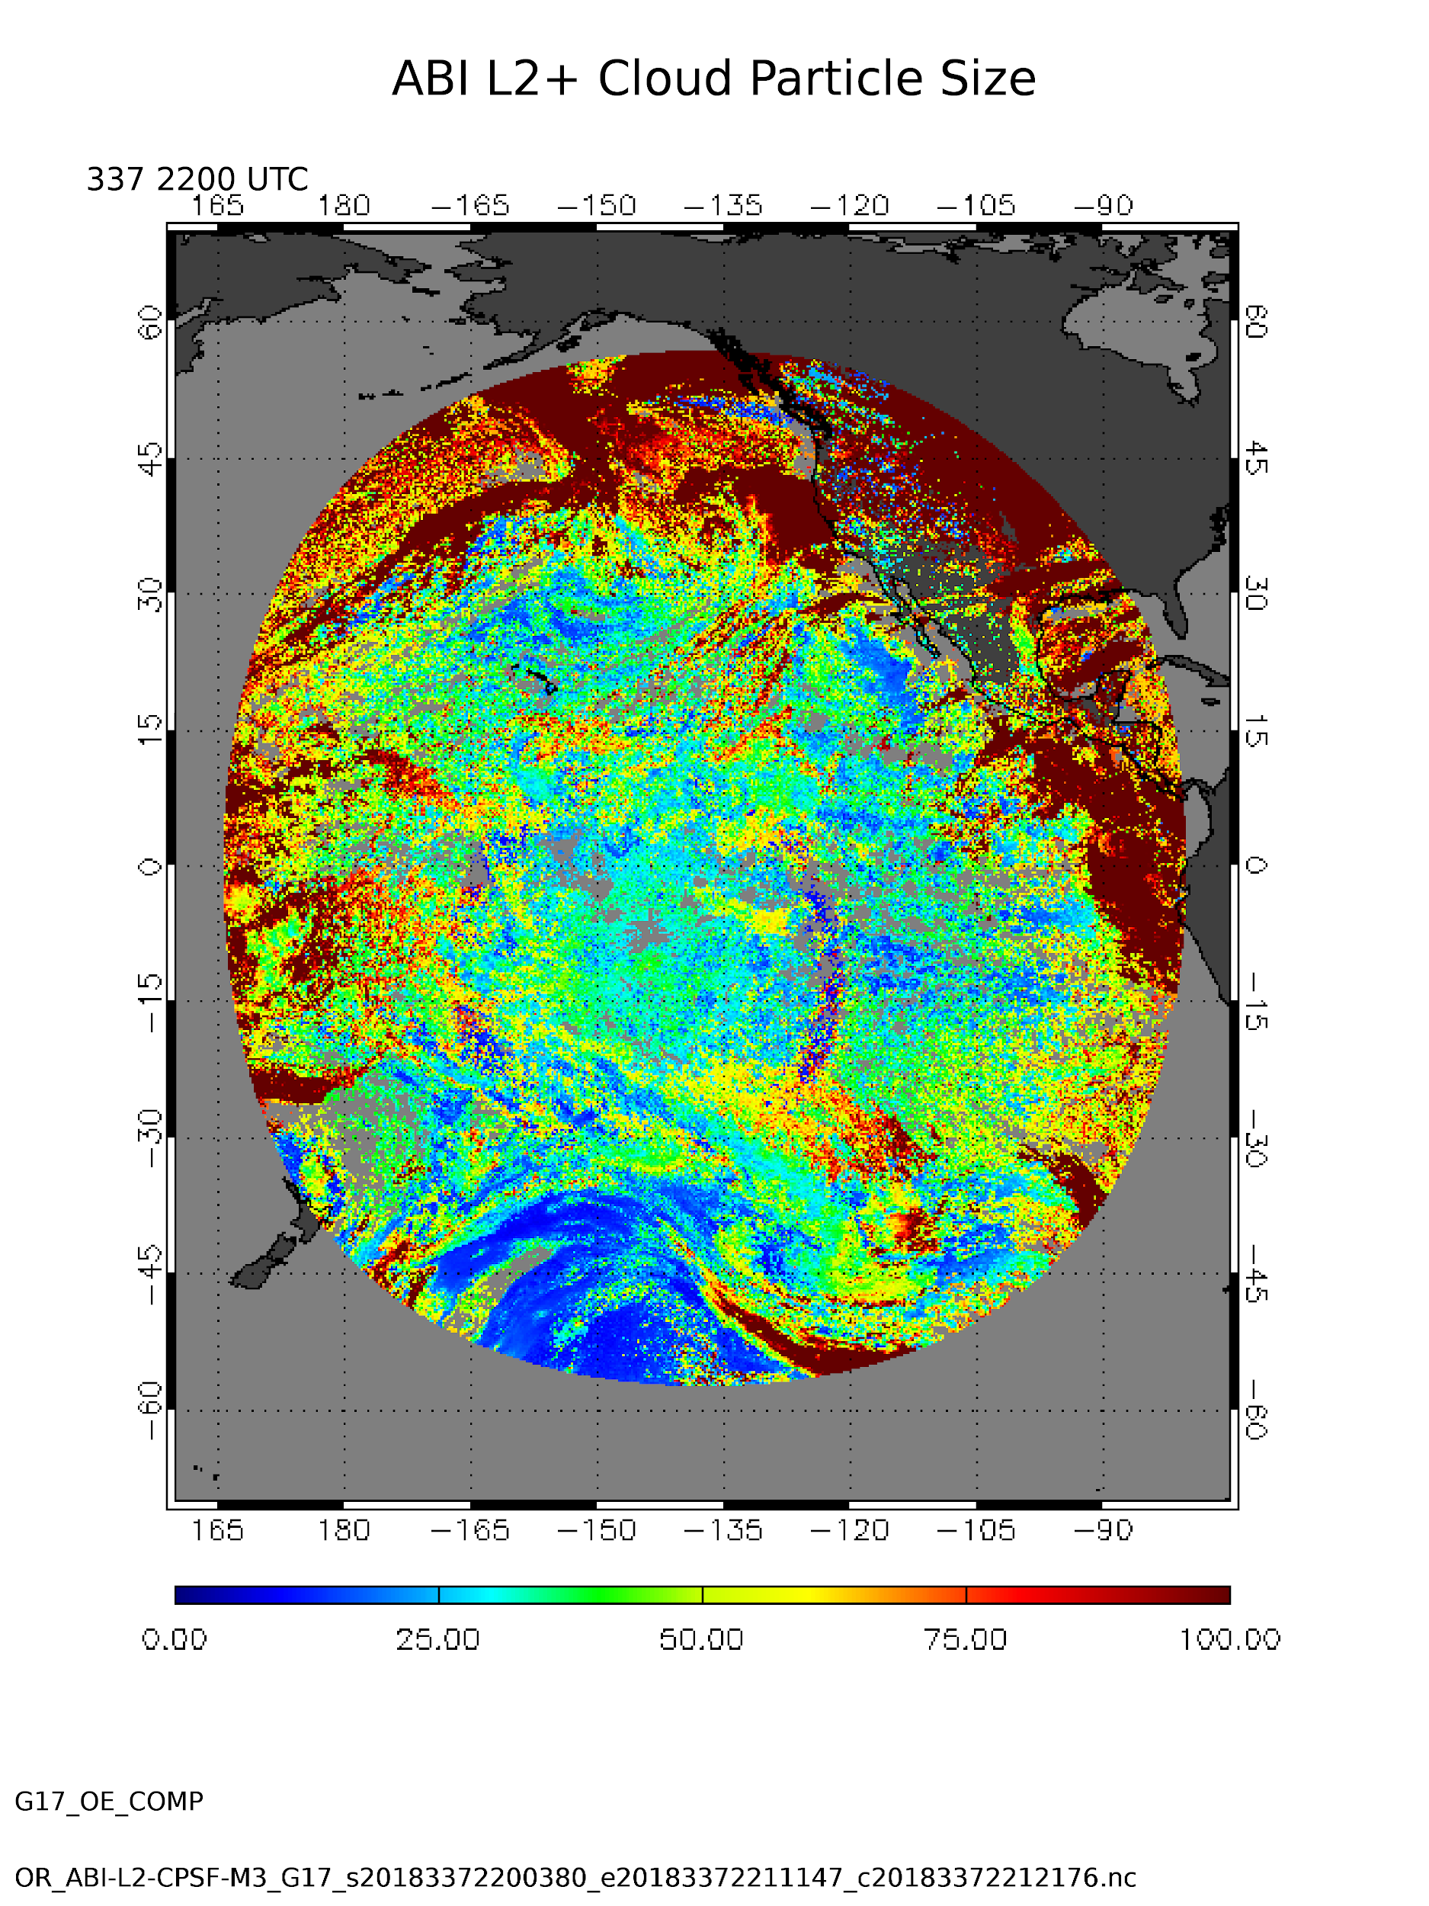
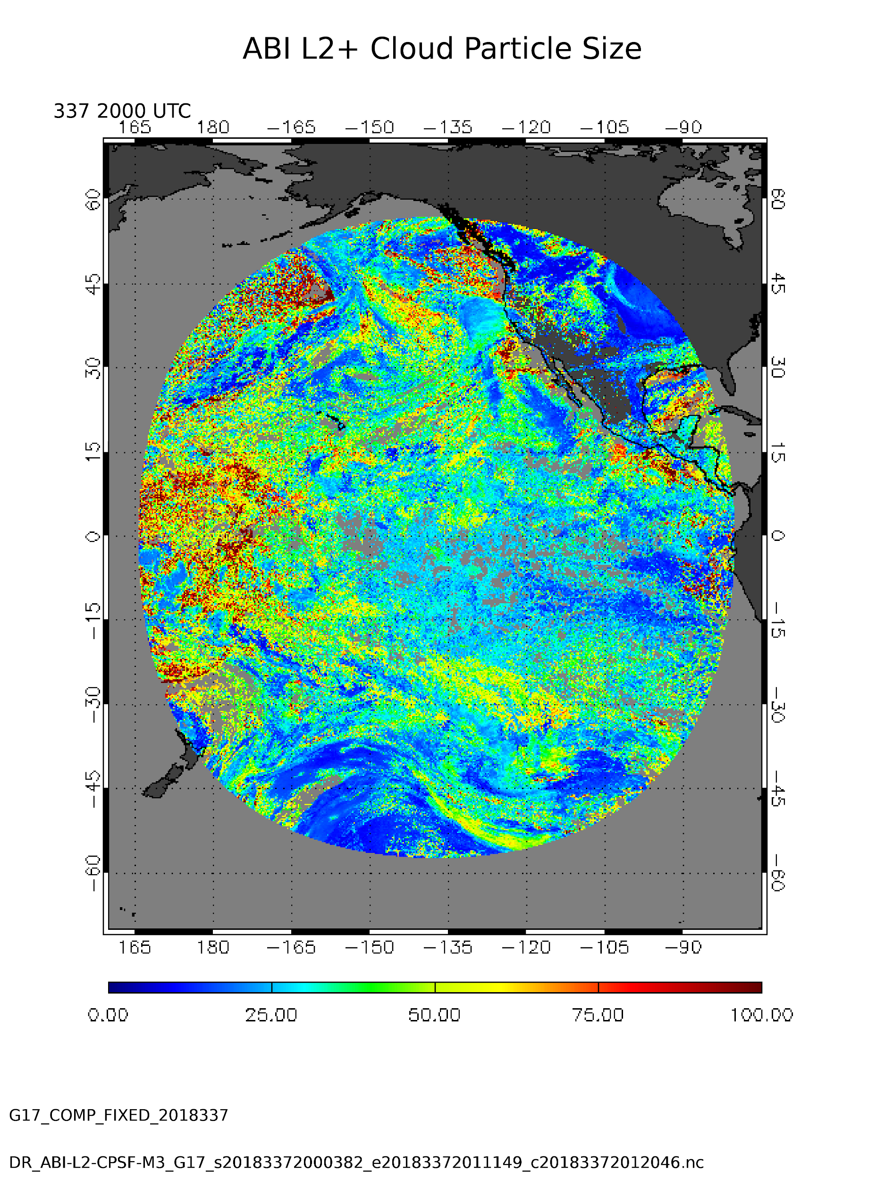
Evaluation of DCOMP
The February Review also stated that the OE- CPS results show erroneous pattern in and around glint area in CPS.
Images show that this
also disappeared in DE.
OE
DE

Slide 23
Conclusions
The application of the 2 fixes (relative azimuth angle and optimal estimation fill data issue) were made to the GS code within ATT and to the GS code within the DE on the GOES-R Ground System.
Comparison images of the ATT and GS data to the expected images for COD/CPS from the Framework show good general agreement, suggesting that the 2 fixes have removed most of the previous differences in CPS and COD.
  Again, it is important to note that DCOMP was run in the ATT and GS with full product precedence. This means that Type and Height will be different, which can result in different a priori assumptions for DCOMP.
Some FW/ATT/DE differences in COD/CPS are noted near the edges of clouds. Some of these differences are expected due differences in the processing systems and a few unresolved ADRs for upstream algorithms.

Slide 24
Conclusions
A limited dataset was evaluated for GOES-16 and GOES-17 due to the fact the fixes were only implemented in the DE (expected OE implementation on 24 December, 2018)
  Analysis shows improvement over operational environment for the same time periods.
Based on the fixes implemented in the COMP science code, the team believes that Cloud Particle Size go Provisional once ADR 609 is moved into the OE.

