Slide 1
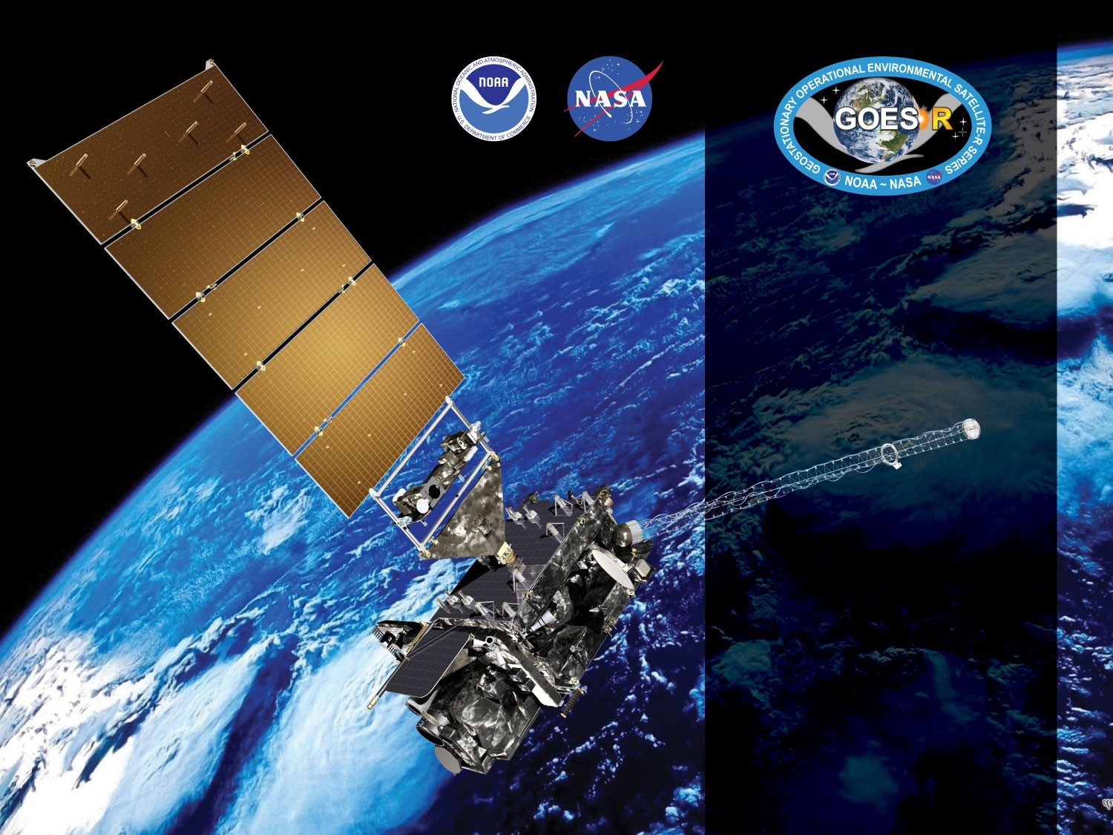
GOES-16 ABI L2+ Cloud Top Parameters Day/Night Cloud Optical and microphysical properties
Provisional PS-PVR
February 22, 2018
Andi Walther, Patrick Heck, Steve Wanzong, William Straka III
(CIMSS)
Team Lead: Andrew Heidinger (NOAA/NESDIS/STAR)
GOES-R AWG

Slide 2
Agenda
Daytime Products Overview
Daytime PLPT Tests
Daytime PLPT Results
Nighttime Products Overview
Nighttime PLPT Tests
Nighttime PLPT Results
Product-related WRs and other issues
Beta Validation Product Maturity Assessment
Path to Provisional
Summary and Recommendations

Slide 3
Cloud Optical Properties
PLPTs Under Review (Beta)
PLPT ID | Descriptive Title | % Complete | Results | AWG POC
ABI-FD_CPS/COD01 | Verify Product is generated every 15 min for FD for M3 | 100 | Complete | PRO
ABI-CONUS_CPS/COD01 | Verify Product is generated every 5 min for CONUS for M3 | 100 | Complete | PRO
ABI-MESO_CPS/COD01 | Verify Product is generated every 5 min for Meso for M3 | 100 | Complete | PRO
ABI-FD_CPS/COD02 | Verify Product is generated every 5 min for FD for M4 | 100 | Complete | PRO
ABI-CONUS_CPS/COD02 | Verify Product is generated every 5 min for CONUS for M4 | 100 | Complete | PRO
ABI-FD_CPS/COD03 | Quantitative analysis of M3 FD CPS/COD | 100 | Complete | AWG
ABI-CONUS_CPS/COD03 | Quantitative analysis of M3 CONUS CPS/COD | 100 | Complete | AWG
ABI-MESO_CPS02 | Quantitative analysis of M3 Meso CPS/COD | 100 | Complete | AWG
Notes:
PLPT=Post Launch Product Tests

Slide 4
Cloud Optical Properties
Provisional PLPTs Under Review
PLPT ID | Descriptive Title | % Complete | Results | AWG POC
ABI-FD_CPH/CPS/COD04 | Assess the accuracy and precision of the COP FD products over a large and wide range of conditions | 100 | Complete | AWG
ABI-CONUS_CPH/CPS/COD04 | Assess the accuracy and precision of the COP CONUS products over a large and wide range of conditions | 100 | Complete | AWG
ABI-MESO_CPH/CPS03 | Assess the accuracy and precision of the COP MESO products over a large and wide range of conditions | 100 | Complete | AWG
Notes:
PLPT=Post Launch Product Tests

Slide 5
Requirements for Beta COMP
Ensure consistency across all sectors.
No quantitative requirements for accuracy, range, or precision is needed to be met for Beta.
This must occur with a spatial resolution of 2km ( 4km for COD Full Disk)

Slide 6
Requirements for Provisional COMP
Assess the accuracy and precision of all Cloud Optical Parameters over a wide range of representative conditions
Document impacts from challenges with upstream dependencies
Horizontal resolution, mapping accuracy and measurement range
Product is ready for operational use and scientific publications

Slide 7
Daytime Cloud Optical and Microphysical Properties

Slide 8
Product Overview
Baseline Products : Cloud Optical Thickness (COD) and Cloud Particle Size (CPS)
CPS is represented by Cloud Effective Radius which is a measure of cloud droplet distribution.
Liquid water path (LWP) and Ice Water Path (IWP) are future capabilities. They are calculated from COD and CPS and help to evaluate the provisional products above.
 | Requirements for Full Validation
Product | Range | Accuracy | Precision
COD | 0.5-50 | 2 or 20% (liquid) 3 or 30% (ice) | 2 or 20% (liquid) 3 or 30% (ice) | 65 degree solar zenith FD 4km resolution CONUS 2km
CPS | 0-50 μm | 4μm /10μm (liquid/ice) | 4μm /10μm | 65 degree solar zenith FD and CONUS 2km

Slide 9
GOES-16 and Validation
Data Used in this Review
GOES-R data:
  10 January - 4 February 2018: 3 weeks for quantitative evaluation
  Several Days of GOES-R in January and February 2018 were used for extended visual inspection.
MODIS-AQUA MYD06 collection 6 downloaded from ladsweb.modaps.eosdis.nasa.gov
AMSR-2/GCOM JAXA downloaded from gcom-w1.jaxa.jp

Slide 10
Recent Algorithm Discrepancy reports
which may impact DCOMP
ADR COMP - 466
  Updated Look-Up-Tables ( updated Spectral Response Functions)
  Correction of Total Water Vapor input ( impacts atmospheric correction)
ADR Height - 333, 334 (PQI fix)
  We don’t assume any impact to DCOMP results.
No ADR for Cloud Phase

Slide 11
Application of PLPT Quantitative Analysis Tests to each Domain
Our 3 PLPTs dealing with analysis are comprised of the same 4 methods.
Each contains the applications of these methods on the FD, CONUS and MESO domains.
The applications of each method to each domain is summarized below.
Some methods were redundant or not possible for some domains.
Analysis Method | FD | CONUS | MESO (CPS only)
Visual Inspection
Comparison to MODIS MYD06 (all Products)
Comparison to VIIRS/PATMOS (all Products)
AMSR-E (REF and COD via LWP)
Notes:
SurfRad LST data is only over CONUS, we found no reason to repeat with FD
We used tight-time constraints for MODIS comparisons and no MESOS or CONUSs were found.
MESO images that are in-sync with CALIPSO are rare.
MESO domains over ocean where not found.
No reason to repeat CALIPSO FD analysis on CONUS.

Slide 12
Qualitative Success Definitions
PASSED
Specifications are met for product cadence and creation (No Visual artifacts).
PARTIAL-PASSED
Specifications are close to being met for product cadence and creation. Example: Products created with missing blocks or striping.
FAILED
Specifications are far from being met for product cadence and creation and cause of performance degradation is unknown

Slide 13
Quantitative Success Definitions
DCOMP
PASSED
Specifications are met for clouds with COD between 1 and 50. and where the phase matches that of the “truth” data and over non-snow or sea-ice surfaces
PARTIAL-PASSED
Specifications are close to being met for with COD between 1 and 50 and where the phase matches that of the “truth” data and over non-snow or sea-ice surfaces
FAILED
Specifications are far from being met for clouds with COD between 1 and 50 and where the phase matches that of the “truth” data and over non-snow or sea-ice surfaces

Slide 14
Evaluation of DCOMP
Cloud Optical parameters are difficult to validate! Optical properties are radiative parameters. Thus, it is not possible to validate COD directly from in-situ observations without making assumptions about the scattering properties of cloud particles. ➔ Validation sources are rare!
Retrieval uncertainties of other parameters (e.g. Cloud mask, phase, height, snow mask) will heavily affect uncertainty in DCOMP retrievals. As an example, in the event of false classification of cloud phase, COD can be wrong by 50% [Wolters et al. 2008].
Beta and Provisional evaluation strategy:
  Visual inspection of mapped images, animations and joint histograms to detect obvious artifacts.
  MODIS Science team provides COD and CPS in collection 6.
  Data from other algorithms applied to polar orbiting satellites. (For provisional).
  Only for liquid clouds, the use of passive microwave retrievals constrain the possible solutions for COD and CPS. Validation of LWP is therefore an indirect validation of COD and CPS.
MODIS-AQUA MYD06

Slide 15
Visual Inspection of All Domains

Slide 16
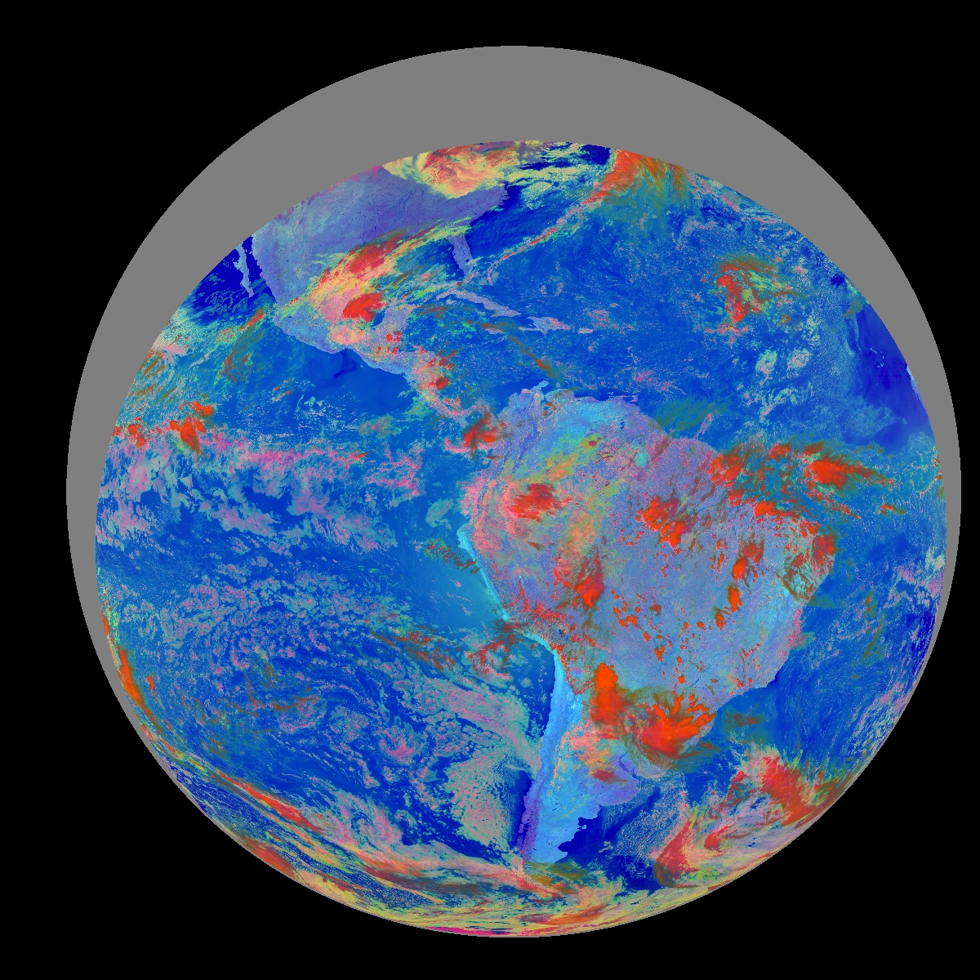
PLPT ABI-FD-COD-03:
January 24 2018,
17:00 UTC
RGB- Daytime Microphysical Composite (006/039r/108)

Slide 17
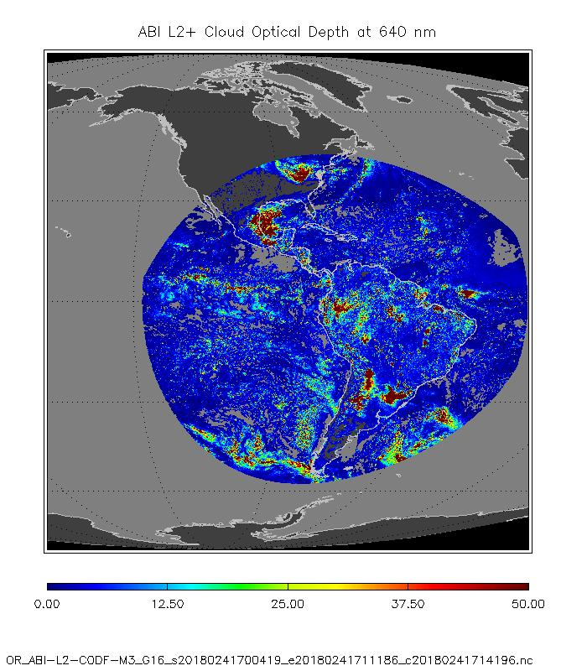
PLPT ABI-FD-COD-03:
January 24, 2018,
17:00 UTC
Cloud Optical Thickness
Only valid geometry for DCOMP (solar zenith < 65 and satellite zenith < 65 ).
Images show no obvious erroneous pattern
PASSED

Slide 18
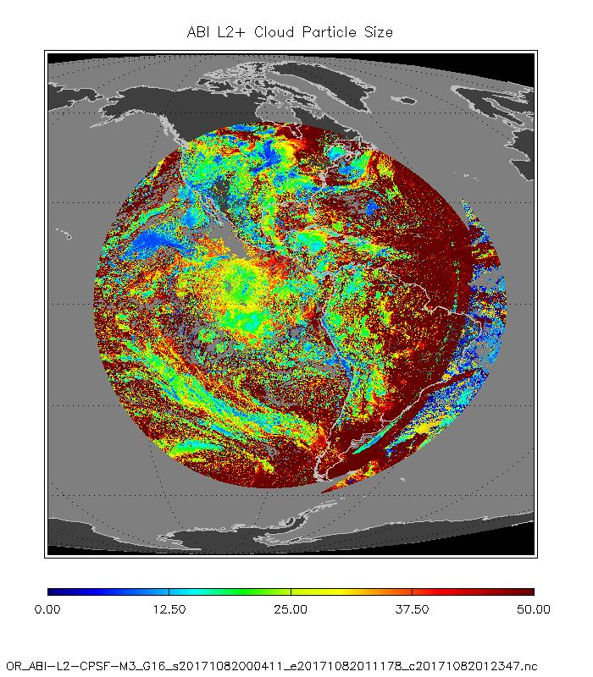
PLPT ABI-FD-COD/CPS03:
BETA
April 18th, 2017,
20:00 UTC
Cloud Particle Size
All pixels including NCOMP and outside valid solar zenith (terminator) and satellite zenith
Concern: It is not straightforward to filter valid DCOMP from NCOMP and terminator areas from the GOES-R files.

Slide 19
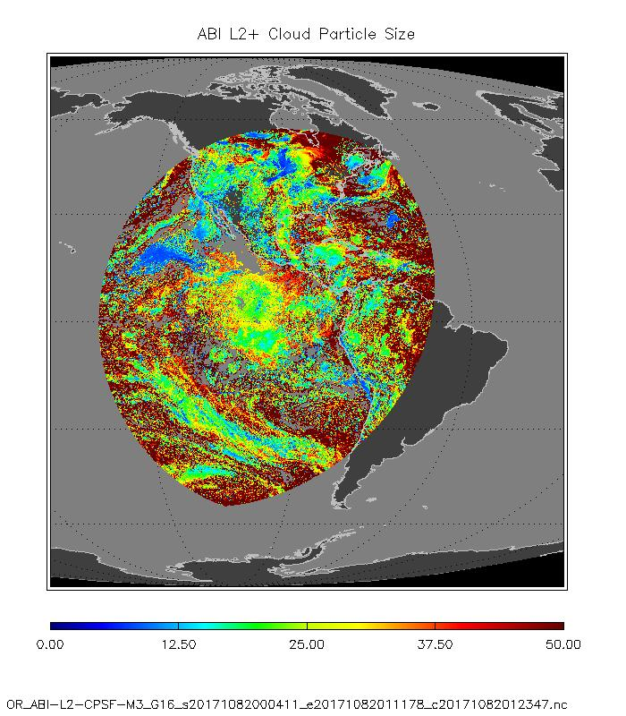
PLPT ABI-FD-COD/CPS03:
BETA
April 9th, 2017,
20:00 UTC
Cloud Particle Size
Only valid geometry for DCOMP (solar zenith < 65 and satellite zenith < 65 )
Images show no obvious erroneous pattern
PASSED

Slide 20
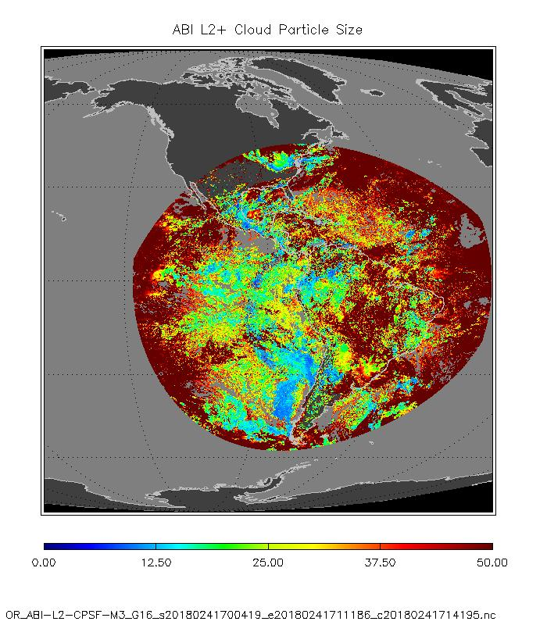
PLPT ABI-FD-COD/CPS03:
PROVISIONAL
January 24, 2018,
17:00 UTC
Cloud Particle Size
Only valid geometry for DCOMP:
New issues:
Very high values for high viewing angles
Erroneous glint pattern

Slide 21
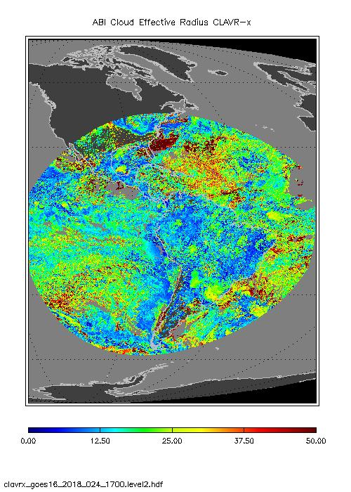
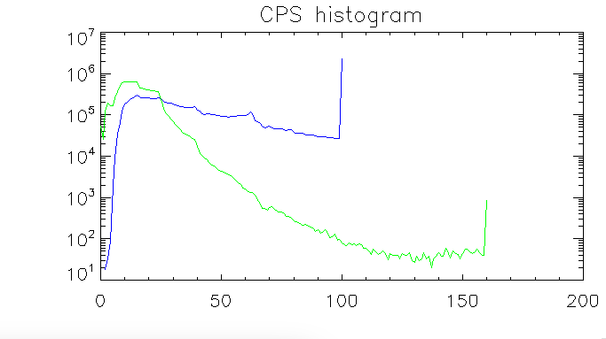
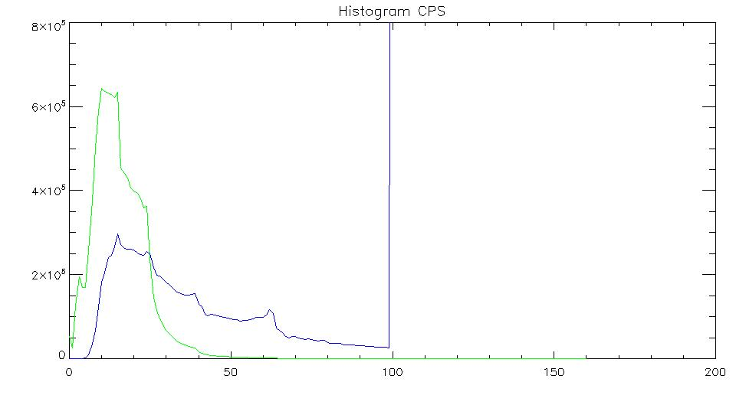
Test- Run: Current CLAVR-x
!p.color=cgcolor('black')
January 24, 2018,
17:00 UTC
Cloud Particle Size
Current Version of CLAVR-x Retrieval does not show those pattern.
CLAVR-x
PROV
CLAVR-x
PROV

Slide 22
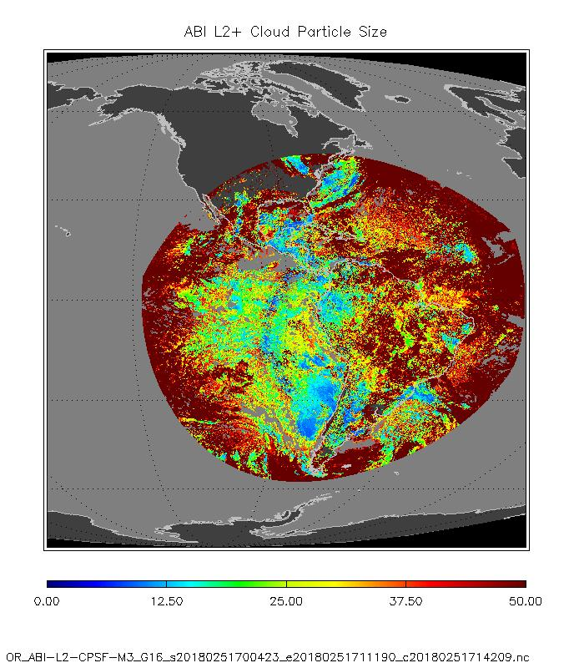
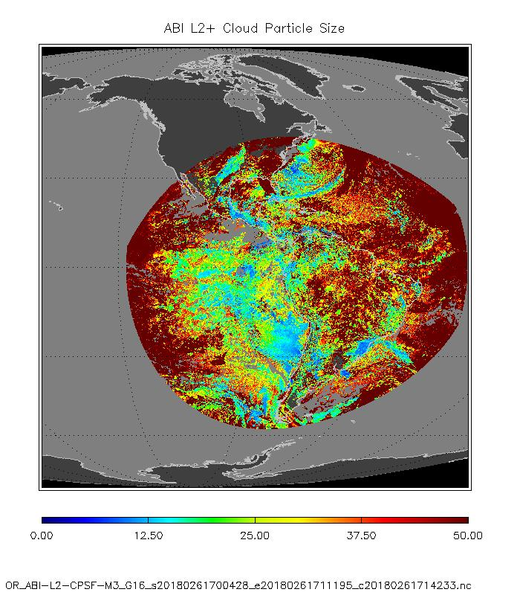
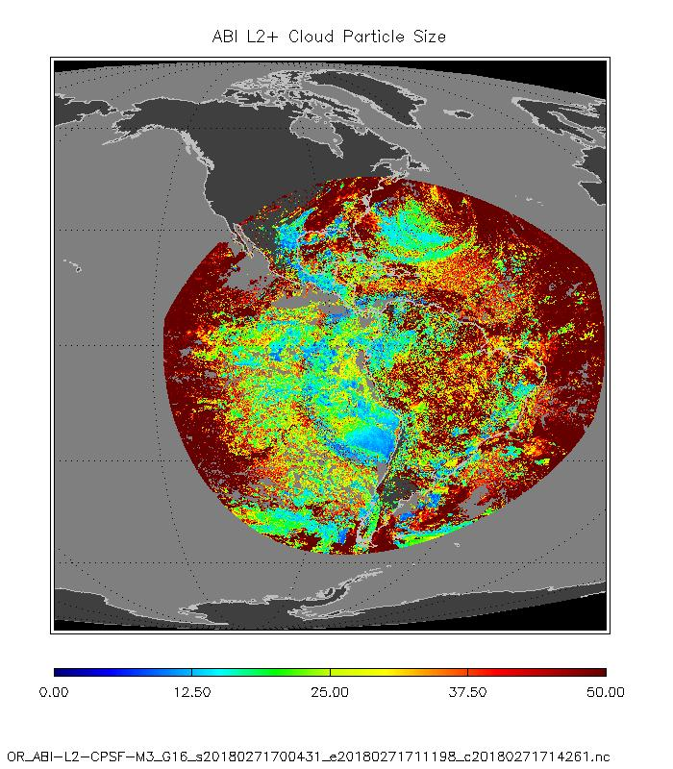
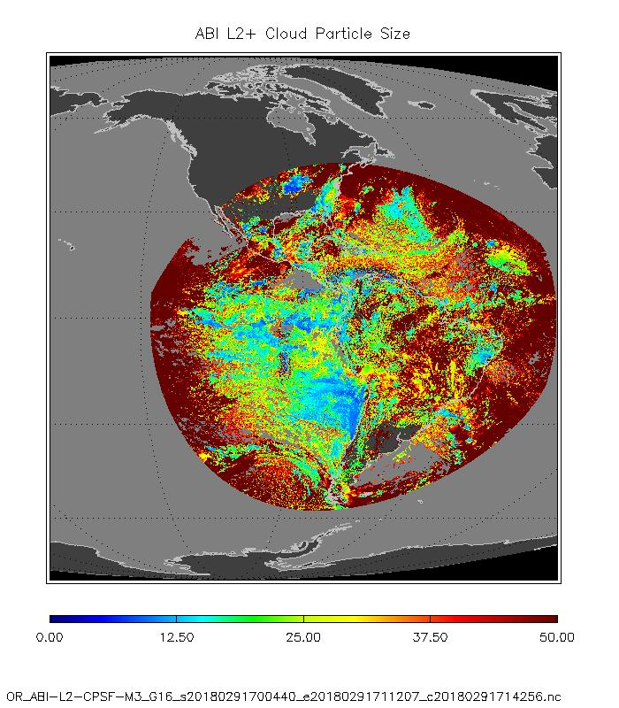
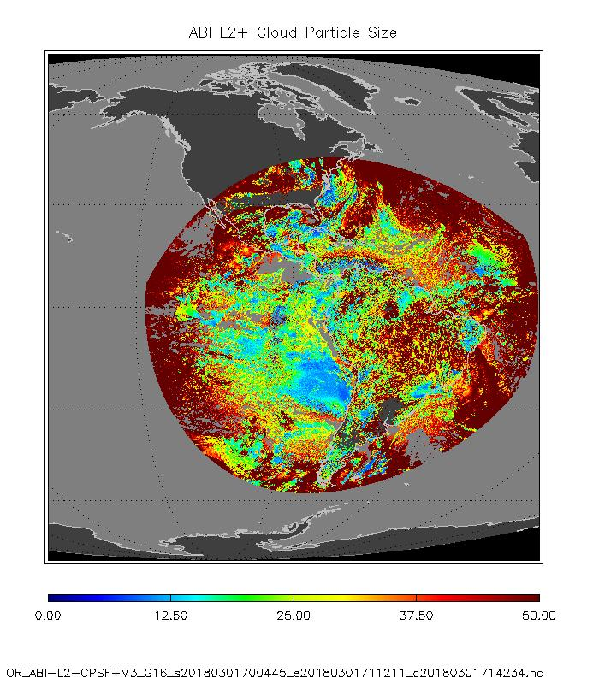
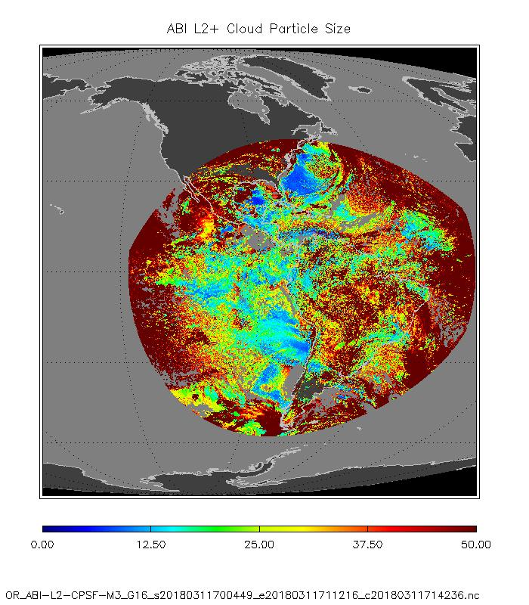
Current CLAVR-X Test-Run
25 Jan 17:00
26 Jan 17:00
27 Jan 17:00
25 Jan 1700
29 Jan 17:00
30 Jan 17:00
31 Jan 17:00

Slide 23
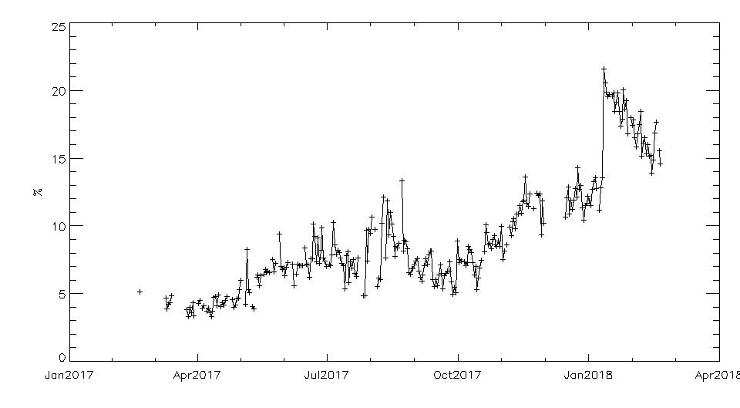
CPS High Value Issue
The CPS Full Disk results show persistently erroneous high values.
This is found for large parts of observation area, but mostly close for high viewing and solar zenith angles.
Values are identical to edge value of look-up-table range (CPS =100 micron)
It seems that something fundamental is wrong in processing. (These artifacts were not seen to the same amount in Beta review)
25 Jan 1700
A distinct jump in the time series of the number of this pattern occurred on January 9 2018
Jan 9 2018
FAILED
Percentage of pixels with CPS>100.µm out of all clouds

Slide 24
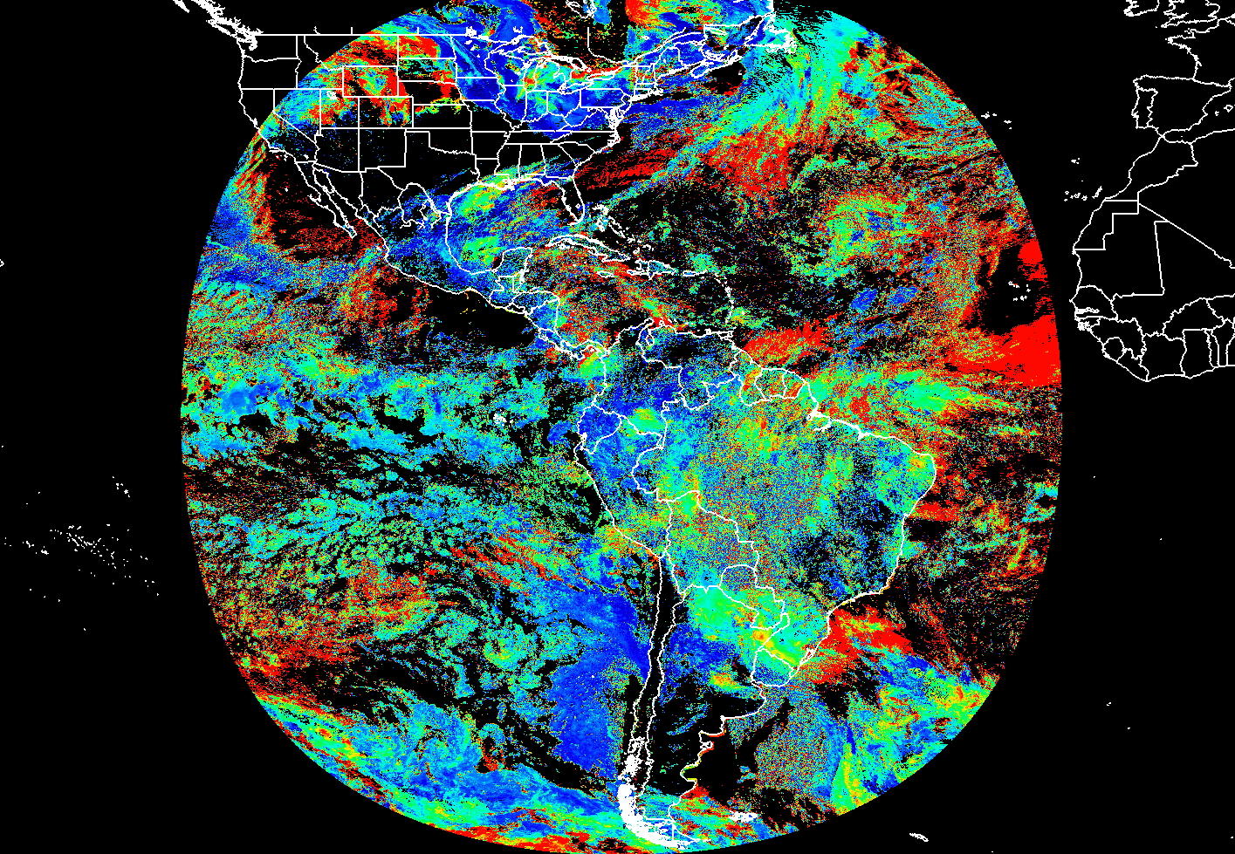
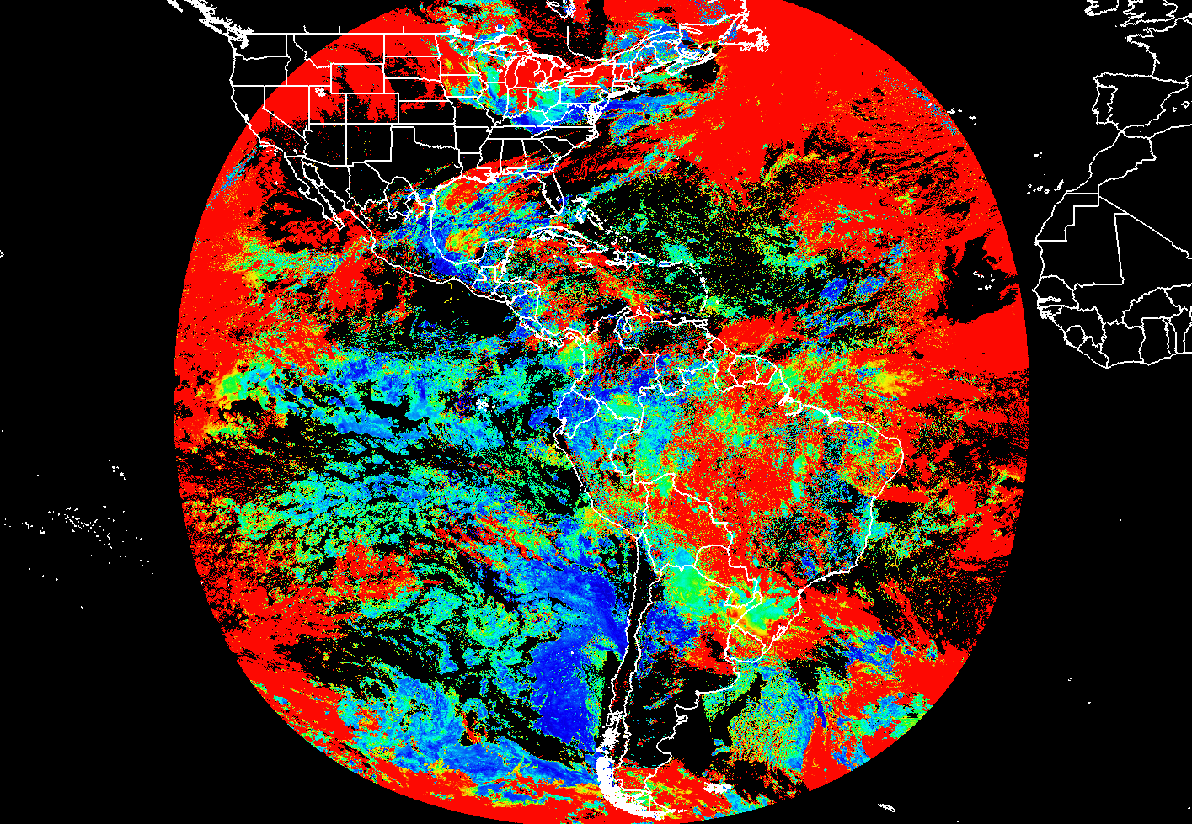
CPS High Value Issue
SAPF vs GS
January 24, 2018, 17:00 UTC
25 Jan 1700
SAPF
Ground System
As expected, the SAPF shows an increase of CPS in ice clouds, likely due to calibration issues.
However, note that the SAPF (right) does not show the same large jump in CPS as the GS does.
This indicates the likely source of error is occurring with the GS code.

Slide 25
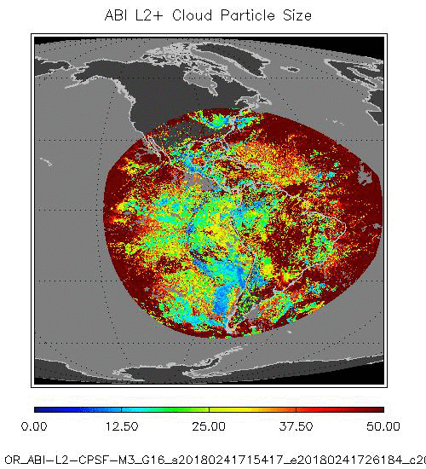
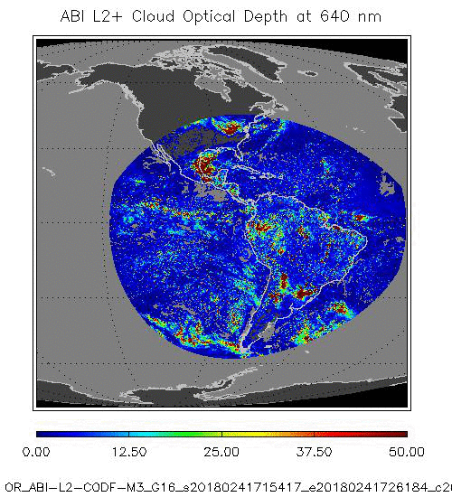
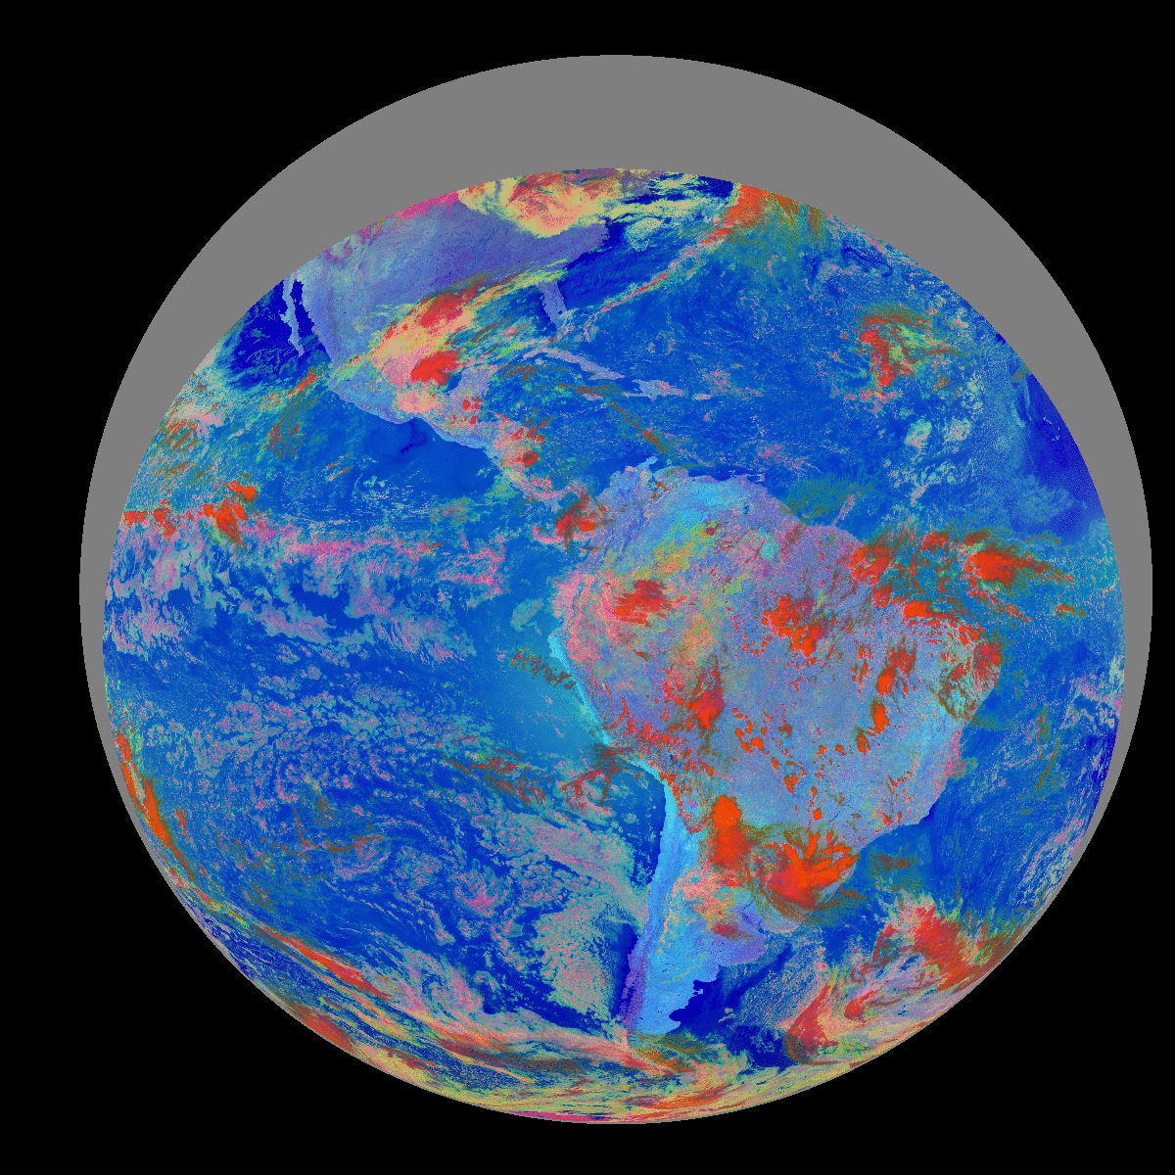
CPS Glint Area Issue
The CPS Full Disk results show erroneous pattern in and around glint area.
This was not seen in BETA review.
25 Jan 1700
NOT SEEN IN CODF Images

Slide 26
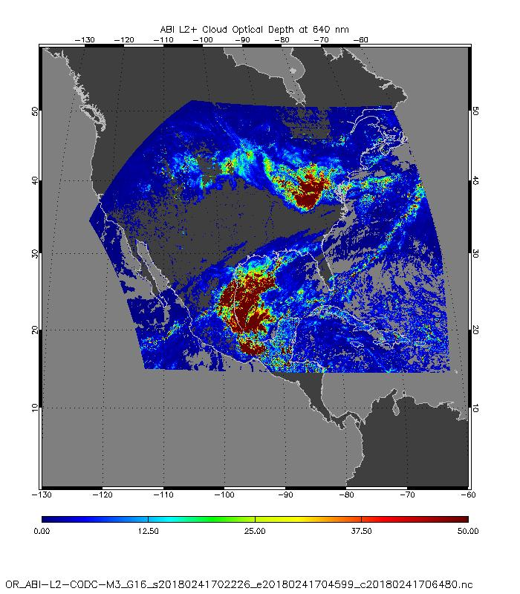
PLPT ABI-CONUS-COD-03:
January 24th, 2018,
17:02 UTC
CONUS Cloud Optical Thickness
Images show no obvious erroneous pattern
PASSED

Slide 27
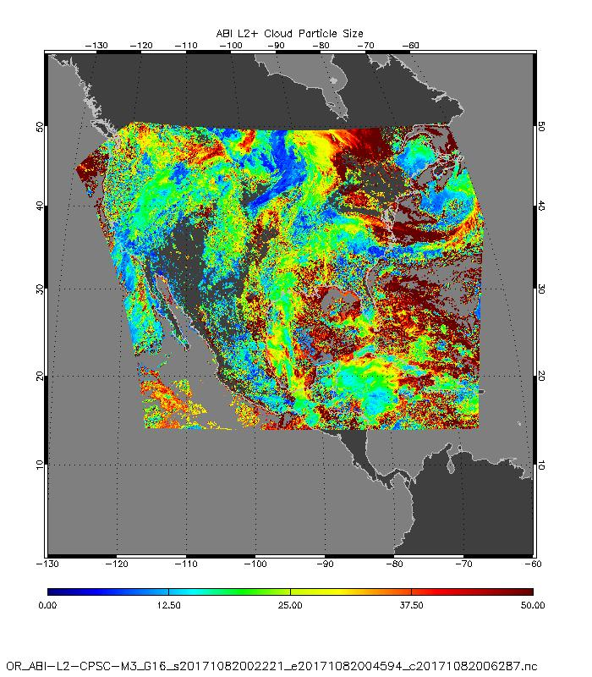
PLPT ABI-CONUS-CPS-03:
BETA
April 18th, 2017,
2002 UTC
Cloud Particle Size
Images show no obvious erroneous pattern
PASSED

Slide 28
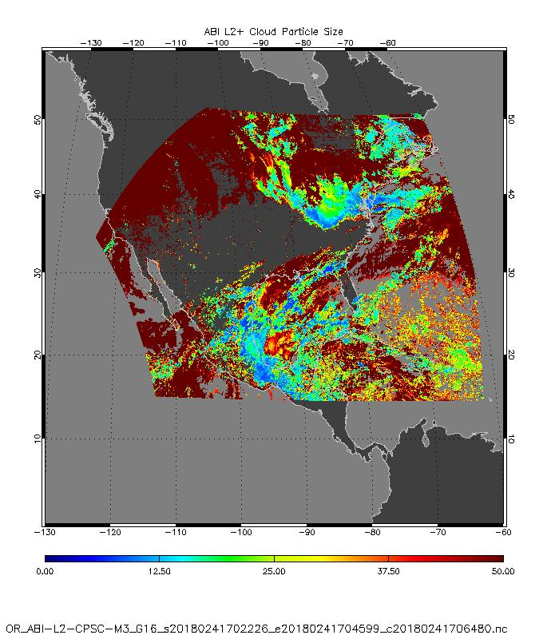
PLPT ABI-CONUS-CPS-03:
PROV
January 24th, 2018,
17:02 UTC
Cloud Particle Size
Images show obviously erroneous pattern

Slide 29
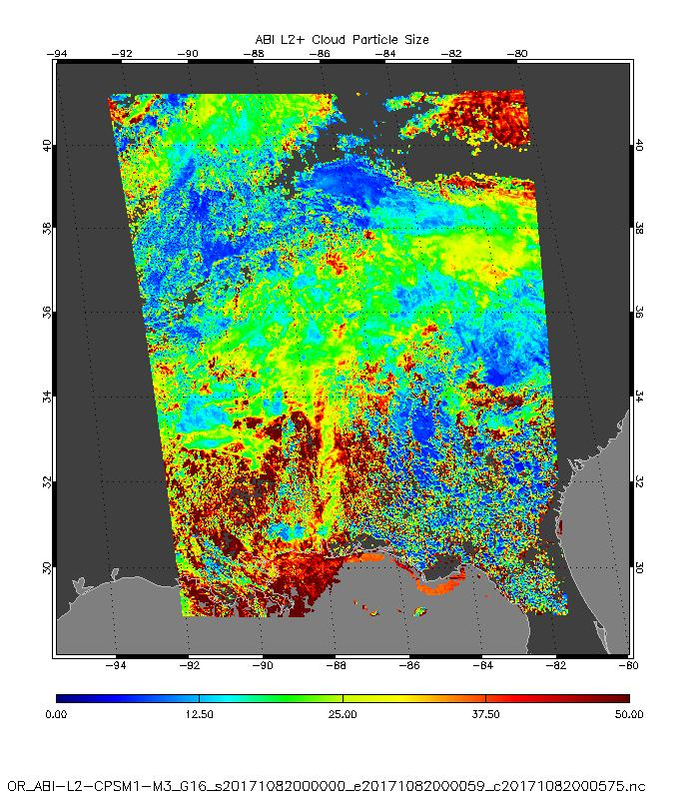
PLPT ABI-MESO-CSM-03:
BETA
April 18th, 2017,
2000 UTC
MESO Cloud Particle Size
Images show no obvious erroneous pattern
PASSED

Slide 30
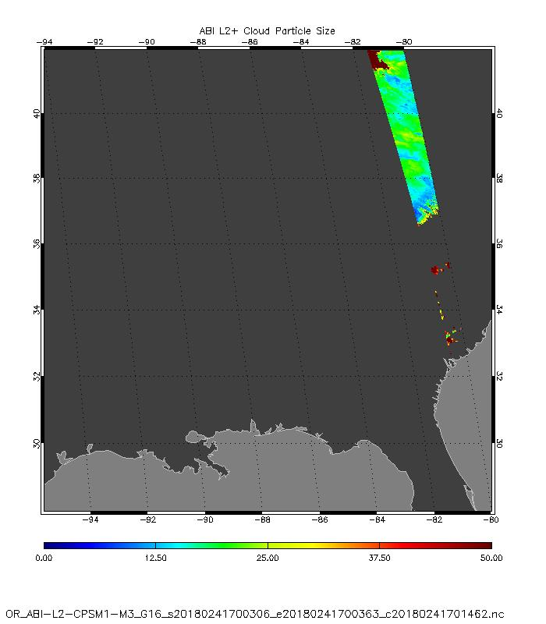
PLPT ABI-MESO-CPSM1-03:
January 24, 2018,
17:00 UTC
MESO Cloud Particle Size

Slide 31
Visual Inspection Summary
PASSED
COD Products don’t show bad pattern.
CPS Products show high percentage of pixels with the value of the upper LUT edge.
CPS Products show erroneous glint-related pattern.
CPS issues were not seen in Beta review data (and also not in former reviews).
What caused this bad results: We assume that it could be related to the software change on 9 January 2018. This included using new DCOMP LUTs, and a correction of Total Water Vapor, which is used in DCOMP for atmospheric correction. Other possible reasons are visible channel calibration (explanation some slides later). Cloud phase input could be another reason.
Mitigation will be discussed in further slide at the end of this presentation.

Slide 32
Comparison with the NASA MODIS Daytime Cloud Optical and Microphysical Products
GOES-16 Day Cloud Opt/Micro Products L2 Product Provisional PS-PVR

Slide 33
ABI/DCOMP Evaluation from MODIS
  Tasks and Challenges:
  Spatial and temporal co-location differences ( spatial and temporal windows are 5km and 600 sec)
  MODIS approach is similar to DCOMP approach. The MODIS products are therefore not an independent validation source.
  Basic assumptions may be different ( cloud phase, cloud height, surface conditions). These assumptions are beyond control of DCOMP and have to be tested/validated.
  Thus, perfect match cannot be expected. The one-to-one comparisons shouldn’t be seen as validation/performance truth.
MODIS-AQUA MYD06

Slide 34
MODIS Cloud Height Comparison Format
We looked for AQUA/MODIS Scenes within 2 minutes of GOES-16.
We used CGMS navigation tools to map GOES-16 into the MODIS swath.
We don’t expect perfect agreement at the pixel scale (parallax) so these results are more qualitative.
Phase image shown for reference. GOES-16 Phase has large impact on GOES-16 Opt/Micro EDRs.
NASA MODIS C6 MYD35 Cloud Phase
NASA MODIS C6 MYD35 EDR (using 2.1 micron for NIR)
GOES-16 False Color Mapped to MODIS Swath
GOES16 Cloud Phase
GOES-16 EDR (using 2.2 micron for NIR)
Scatter plot of GOES-16 EDR versus NASA EDR (in log/log space)
Roughly 512 colocated MODIS granules were analyzed

Slide 35
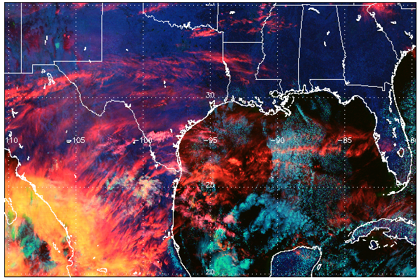
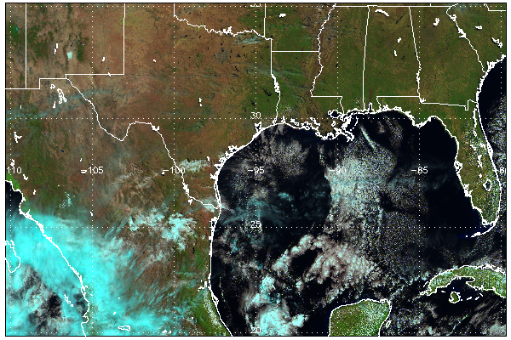
Explanation of False Color Image
cirrus
A non-standard false color image is displayed here.
Red = 1.38, Green = 0.65, Blue = 1.60 micron.
This combination separates clouds by water, thick ice and thin ice (cirrus).
Errors in cloud phase can often lead to failed or erroneous DCOMP retrievals.
For example: thin cirrus over water cloud are often classified as ice-phase but most DCOMP signal comes from the lower water clouds.
water
thick ice
EUMETSAT Natural Color Image for Reference

Slide 36
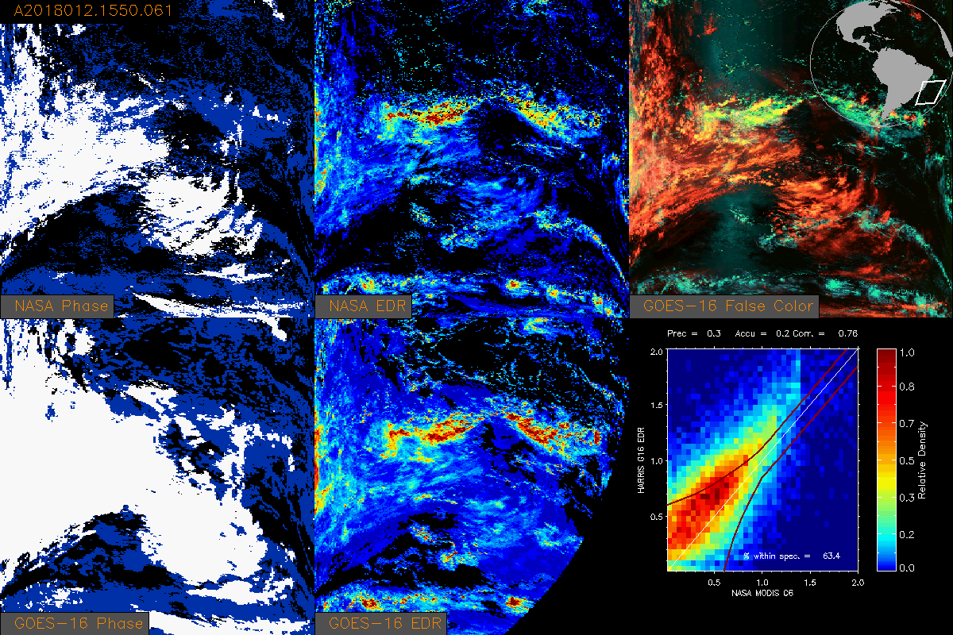

Cloud Optical Depth (2018/012)
EAST

Slide 37
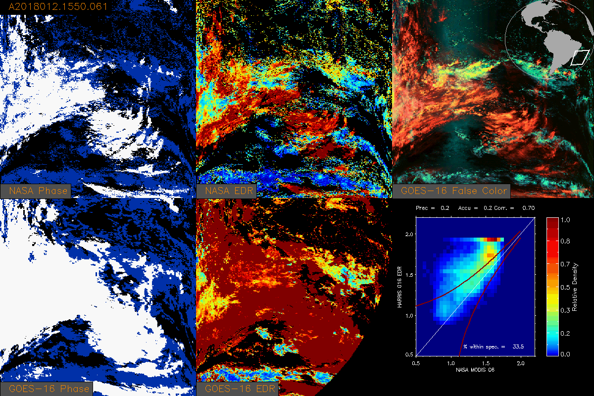

Cloud Particle Size (2018/012)
EAST

Slide 38
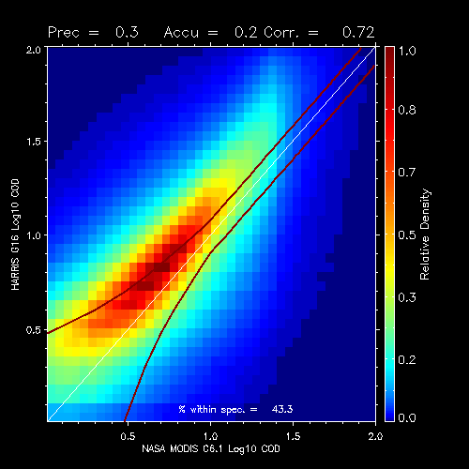
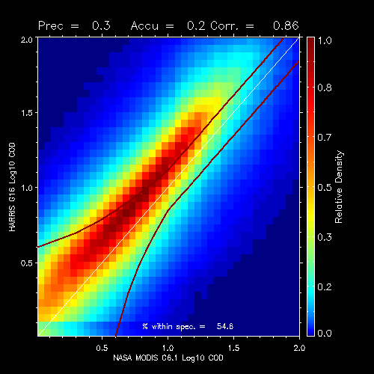
Summary of G16 vs MODIS Optical Depth
Combined scatter-plots are shown below
34 days of data: 2018_010 – 2018_035.
Red lines show the specs.
For water, 43% are in spec, for ice, 54% are in spec.
Water
Ice

Slide 39
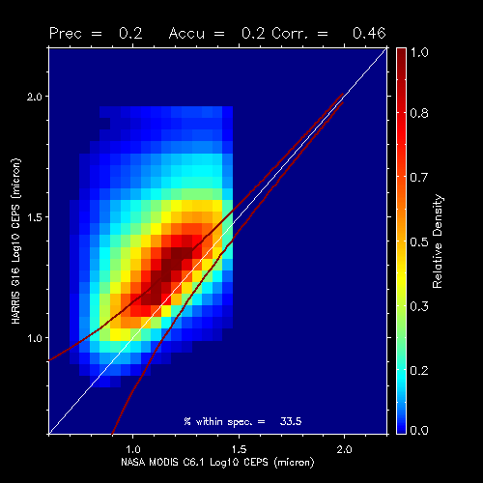
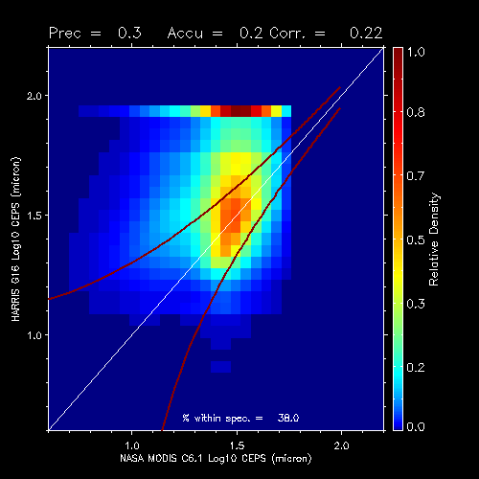
Summary of G16 vs MODIS Particle Size
Combined scatter-plots are shown below
34 days of data: 2018_002 – 2018_035.
Red lines show the specs.
For water, 34% are in spec, for ice, 38% are in spec.
Water
Ice

Slide 40
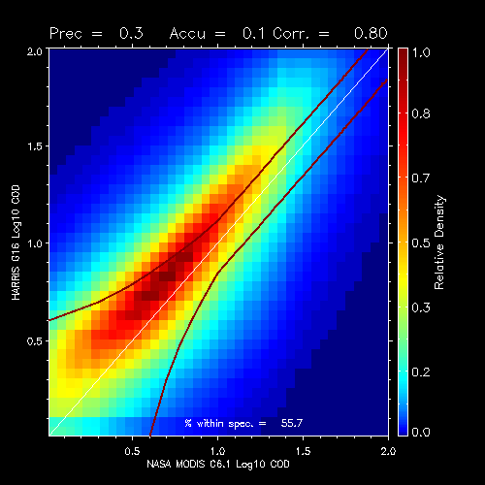
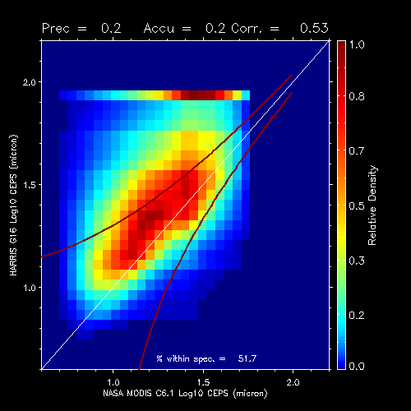
Summary of G16 vs MODIS (No Filter)
Combined scatter-plots are shown below for ice + water and no phase filtering.
34 days of data: 2018_010 – 2018_035.
Red lines show the specs for ice clouds for reference.

Slide 41
Summary of Metrics
Optical Depth
  mean accuracy = 100.0 * mean ( (g16-modis)/g16))
Cloud Particle Size
  mean accuracy = mean (g16-modis)
% in spec = percentage of pixels falling with spec lines (previous figures)
Parameter | Specified Measurement Accuracy | Mean Accuracy | % in Spec
COD Water | 20% | 8.1 | 43.3
COD Water | 30% | 8.3 | 54.6
CEPS Water | 4 micron | 9.4 micron | 33.5
CEPS Ice | 10 micron | 18.5 micron | 38.0
PASSED
PASSED
PART. PASS
FAILED
We feel that these specs will improve once the G16 calibration is fixed.
Notes:
If you can explain why DCOMP has so many high values of ICE REFF, not a failure.

Slide 42
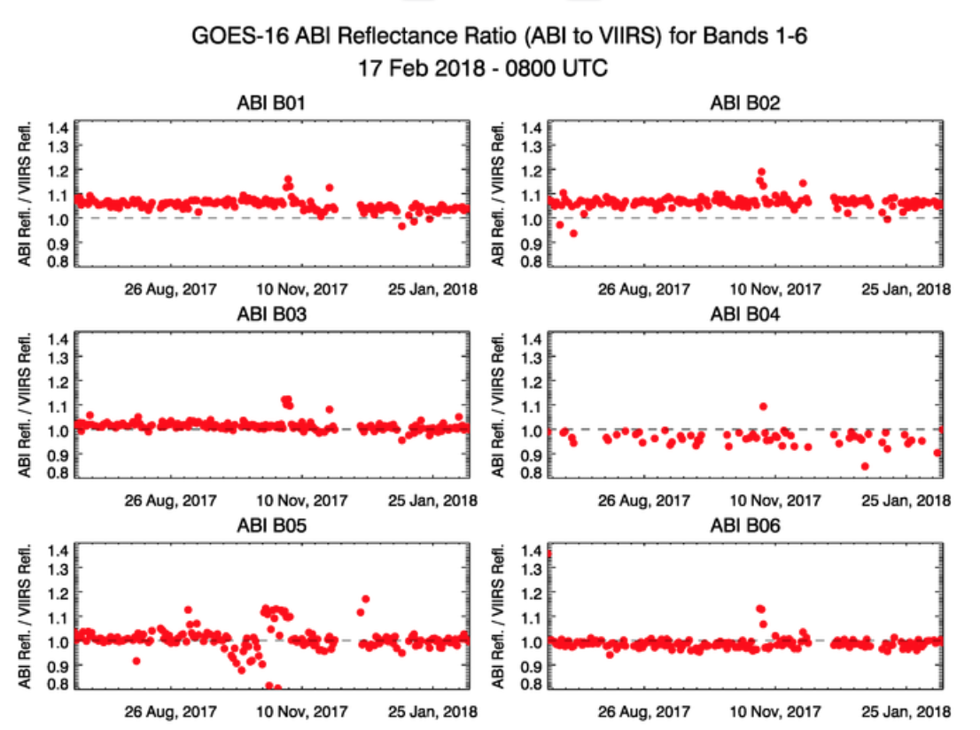
Calibration of DCOMP Bands
DCOMP uses Bands 2 and 6.
Band 2 is 7% too bright compared to SNPP VIIRS.
We think SNPP VIIRS M5 is 4% too bright.
Band 6 seems to be in-line with VIIRS.
DCOMP VIS. Channel
DCOMP NIR. Channel
https://www.star.nesdis.noaa.gov/GOESCal/G16_ABI_GEOLEOReflRatio_static.php

Slide 43
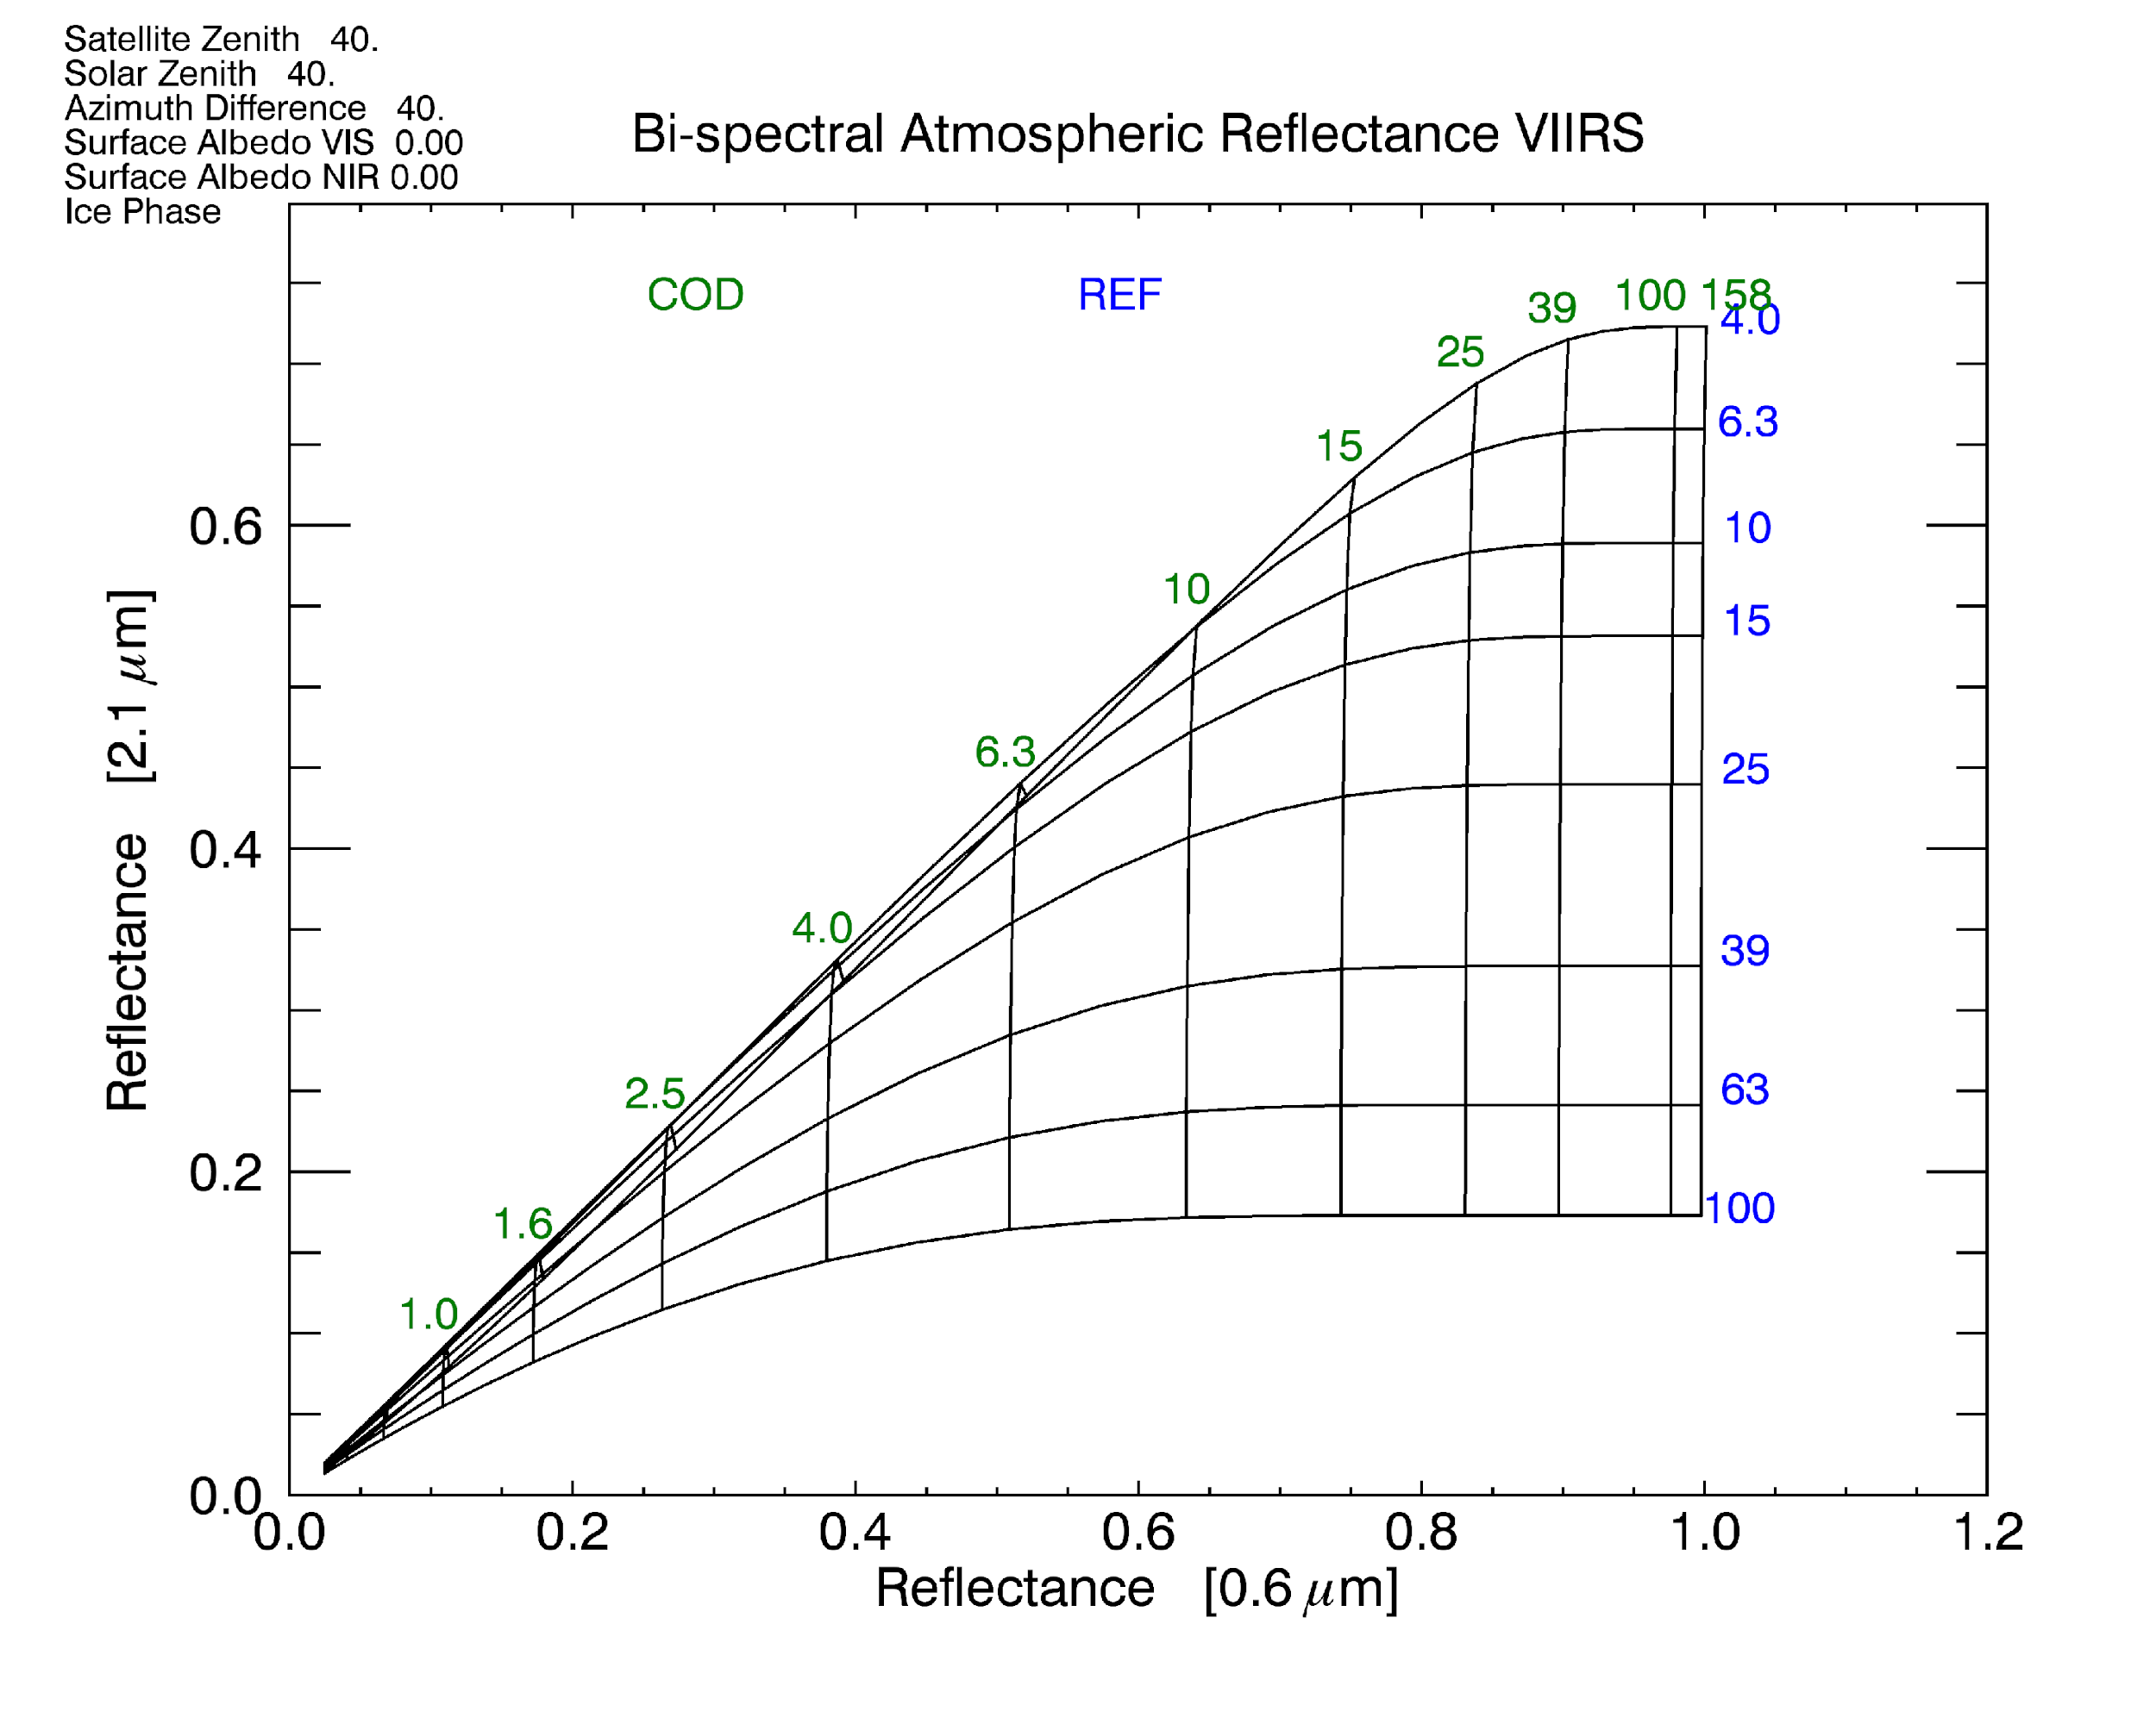
Impact of Calibration on DCOMP
The arrow indicates how we think the GOES-16 Calibration issue is impacting DCOMP.
Leads to an overestimation of optical depth and particle size.
This is what we see.

Slide 44
Predicted Impact of Calibration
Assuming a 10% calibration error in B2, we see these impacts.
We argue that B2 is major culprit in our COD over-estimation.
B2 calibration does impact CEPS and in the right direction. B2 calibration does not appear to be the sole cause of high ice CEPS.
true cloud
B2 +10%
COD = 2
CEPS 20 μm
COD = 2.4
CEPS 26 μm
COD Increase = 20%
CEPS Increase = 6 μm
COD Increase = 15%
CEPS Increase = 2 μm
COD = 10
CEPS 20 μm
COD = 11.5
CEPS 22 μm
COD Increase = 100%
CEPS Increase = 0 μm
COD = 80
CEPS 20 μm
COD = >> 100
CEPS 20 μm

Slide 45
Evaluation of LWP/ DCOMP

Slide 46
AMSR-2 on GCOM-W1 /JAXA
Liquid Water Path (LWP) is a possible future ABI product derived from DCOMP.
It is calculated from COD and CPS ( LWP = 5/9 * COD *CPS for adiabatically layered clouds).
Microwave based sensors are capable to retrieve LWP
Advantages if used as validation source:
  Different retrieval principles ➔ The only satellite-based independent validation source of DCOMP
  Link from radiative properties COD and (radiative) Effective Radius to macro-physical estimate of water mass in a cloud.
  Validation of LWP also validates COD and CPS.
Limitations:
  MW retrievals only see liquid particles.
  Coarser field of view (up to 40 ABI pixels in one GCOM pixel).
  Only over ocean.
  Several filtering and aggregation steps needed (cloud phase, homogeneity).
  ➔ Visualization is valuable tool, but exact quantitative validation is difficult.
https://www.globe.gov/web/calipso

Slide 47
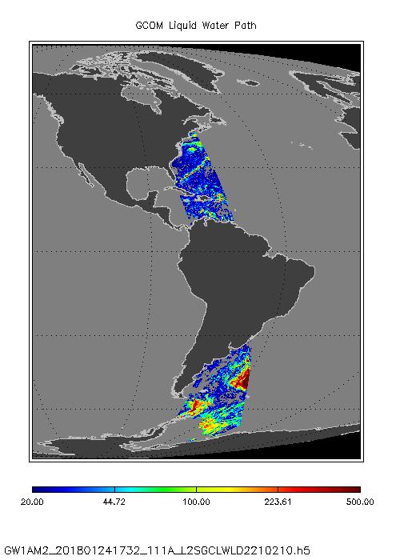
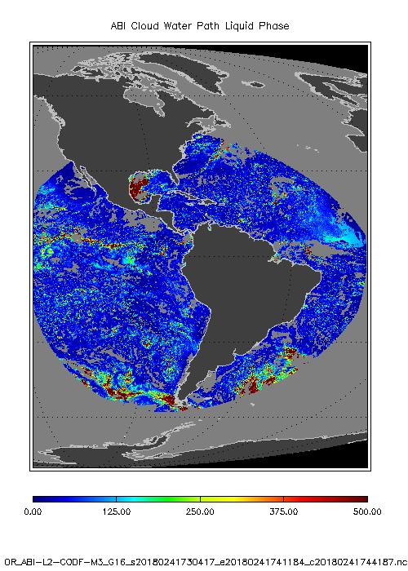
AMSR-2 on GCOM-W1 /JAXA
Day 2018 024 ( 24 January 2018)
17:32 UTC ABI File: 2018024_1730

Slide 48
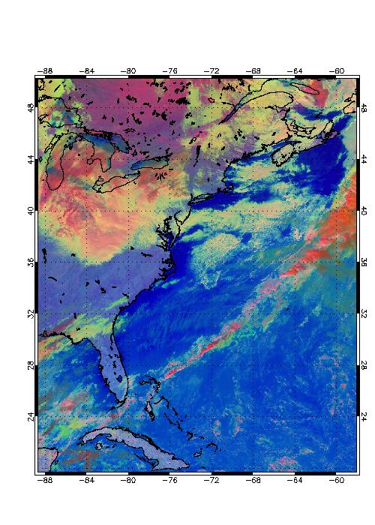
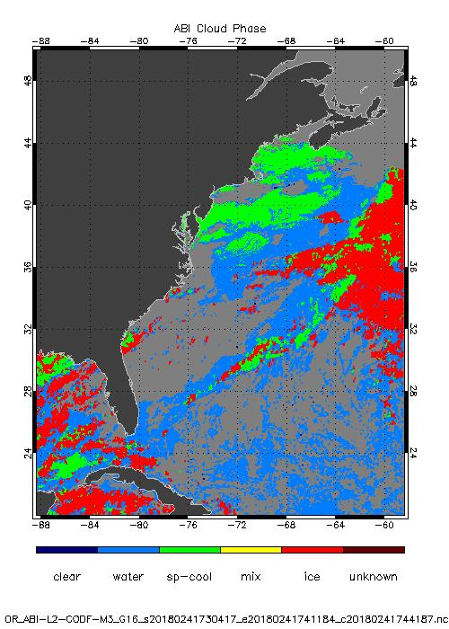
AMSR-2 on GCOM-W1 /JAXA
https://www.globe.gov/web/calipso
Day 2018 24 ( 24 January 2018) 17:00 UTC
Liquid Water Path FD is computed with adiabatic assumption on grid for Cloud Particle Size ( Full disk: 27112 x 2712.)
Microwave based algorithms are sensitive to Liquid phase clouds only.
Liquid including super-cooled phase clouds only, but averaged over entire GCOM grid box .
ABI LWP for FD is computed from two different resolutions for COD and CPS. COD is averaged over valid pixels in 2x2 box of CPS grid.
Cut off of very thick saturated clouds with COD greater than 80.
MW is insensitive to thin clouds, we exclude all clouds optically thinner than COD=5
We exclude all MW pixels with a rain flag.

Slide 49
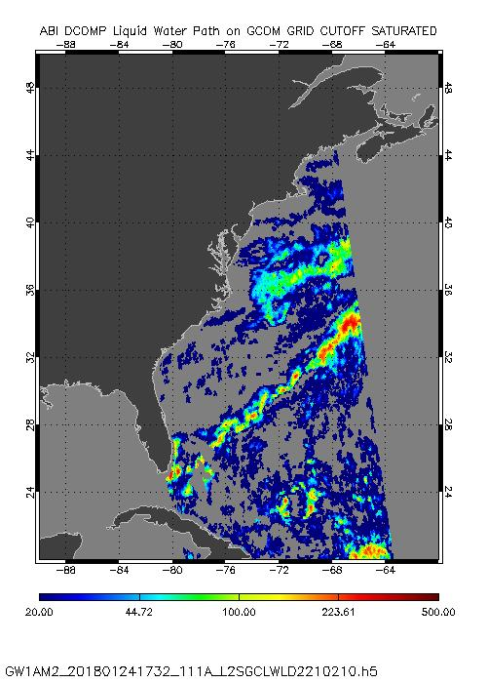
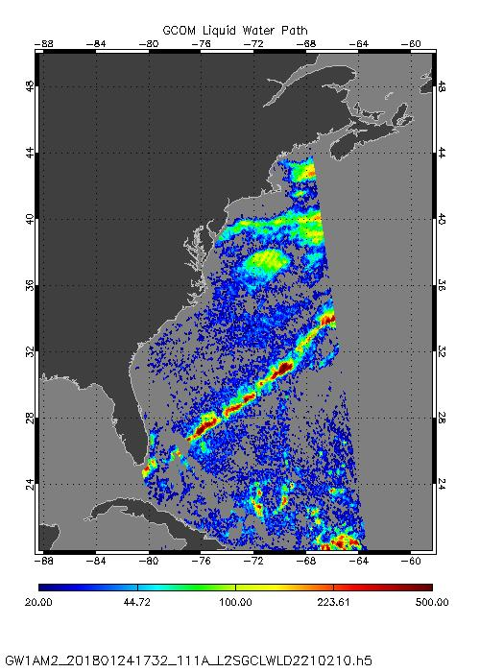
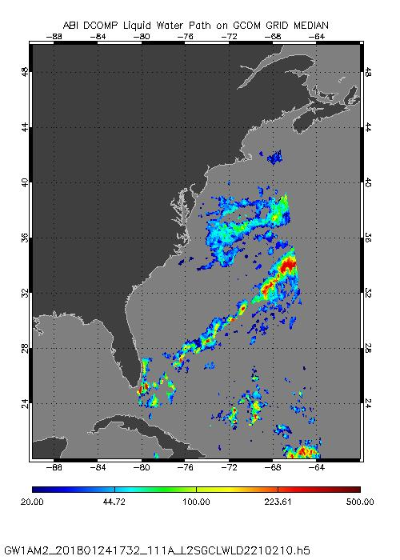
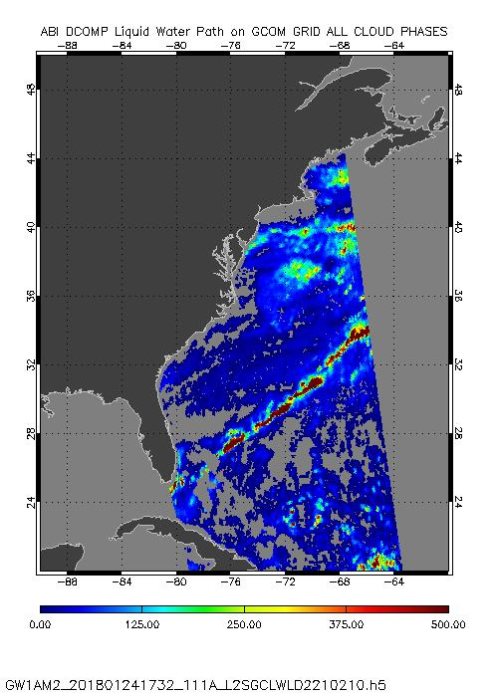
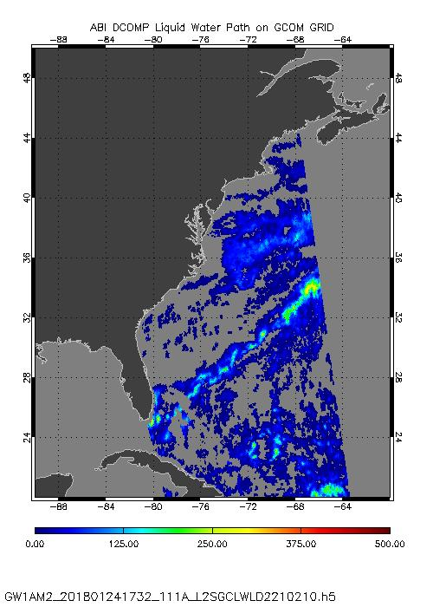
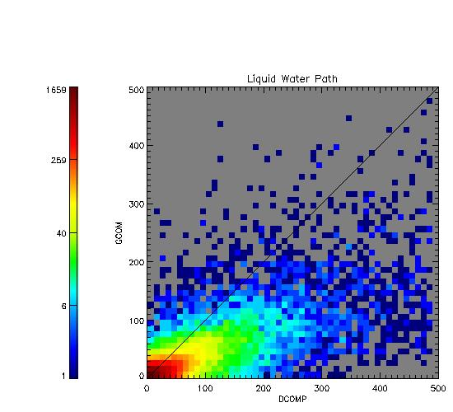
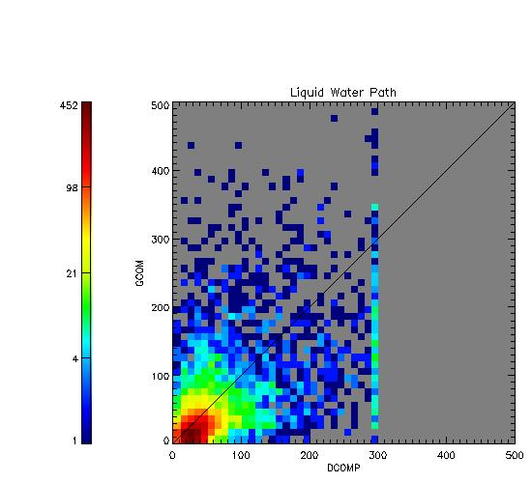
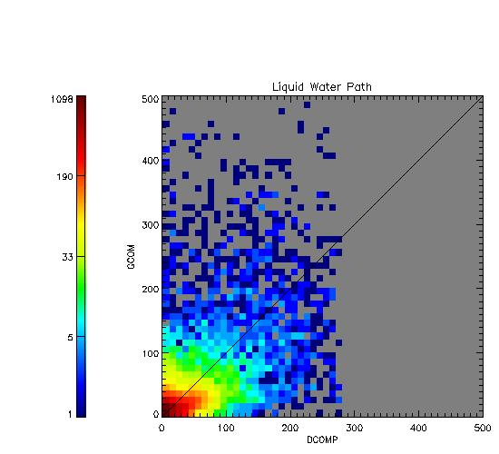
AMSR-2 on GCOM-W1 /JAXA
https://www.globe.gov/web/calipso
Day 2018 024 ( 24 January 2018) 1700 UTC
GCOM has LWP value in each pixel. Threshold for cut-off set to 20 mm.
Left Image: GCOM Cloud Water Path
Right Image: Average over all liquid phase cloud water path pixels from DCOMP in a GCOM grid box.
Accuracy : 5.64 mm , Precision: 43 mm
Notes:
This is in the specs for VIIRS project..

Slide 50
AMSR-2 on GCOM-W1 /JAXA
https://www.globe.gov/web/calipso
Summary:
Visual comparison between AMSR-2/ GCOM LWP and ABI LWP shows good agreement in spatial pattern
Challenges are different spatial resolutions and the limitation to only liquid clouds over ocean.
Despite the last point, the accuracy and precision show results within requirements.
Conclusion:
PASSED

Slide 51
DCOMP - Conclusions

Slide 52
Daytime PLPT Outcomes: Summary
All PLPT activities required to make PROVISIONAL have been completed.
Visual inspection, MODIS comparisons and AMSR-2 comparisons indicate the COD and CEPS for water phase clouds are performing as expected. We recommend PROVISIONAL Maturity for them.
Visual inspection and MODIS comparisons indicate the ice phase COD is performing as expected.
Issues with ice phase COD and water phase COD and CEPS can be attributed with high confidence to the ABI B2 calibration error.
All PLPT activities indicate an issue with the ice phase cloud CEPS. The root cause is unknown and issue is larger than what we can attribute to the B2 calibration error.
We do not recommend PROVISIONAL Maturity of the ice phase cloud CEPS.

Slide 53
Possible Reasons for CPS ice issue and Path to Operational Maturity
Visible channel calibration (B2) is assumed to be off by about 10%.
  Retest after calibration is fixed.
  Unsure if Program wants internal algorithm calibration adjustments.
Software change in early January 2018
  Re-run individual January scenes with the “old” version of processing system.
  Re-verification of new and old DCOMP LUTs
  Testing if DCOMP input of TPW is correct.
  Verification of atmospheric correction terms.
Other Changes in DCOMP input
  Provide CLAVR-x DCOMP input data and check for significant differences to ABI processing system

Slide 54
Nighttime Cloud Optical and Microphysical Properties

Slide 55
NCOMP Requirements
Product | Range | Accuracy | Precision | Latency | Horizontal resolution
Cloud Optical Depth | 1 < COD < 8 | 20% (liquid) 30% (ice) | max of 0.8 or 35% | 5min | 2km
Cloud Particle Size | liquid: 2 < CPS < 32μm ice: 2 < CPS < 50μm | 4μm (liquid) 10μm (ice) | 100% (liquid) 45% (ice) | 5min | 2km
Liquid Water Path | 25 < LWP < 100 | max of 25 gm-2 or 15% | max of 25 gm-2 or 40% | 5min | 2km
NCOMP generate for Solar Zenith angles greater than 82º but accuracy and precision requirements only apply to SZA greater than 90º
Liquid water path (LWP) and Ice Water Path (IWP) are future capabilities. They are calculated from COD and CPS and LWP, in particular, helps to evaluate the products above.

Slide 56
Updates since Beta to NCOMP
ADR COMP - 466
  Updated Look-Up-Tables ( updated Spectral Response Functions)
  Correction of Total Water Vapor input

Slide 57
Application of PLPT Quantitative Analysis Tests to each Domain
Our 3 PLPTs dealing with analysis are comprised of 4 methods.
Each contains the applications of these methods on some combination of FD, CONUS and MESO domains.
The applications of each method to each domain is summarized below.
Some methods were redundant or not feasible for some domains.
Analysis Method | FD | CONUS | MESO
Visual Inspection
Comparison to other COP algorithms
Comparison of COD to CALIPSO
Indirect comparison of CPS to other LWP (AMSR-2)
Notes:
SurfRad LST data is only over CONUS, we found no reason to repeat with FD
We used tight-time constraints for MODIS comparisons and no MESOS or CONUSs were found.
MESO images that are in-sync with CALIPSO are rare.
MESO domains over ocean where not found.
No reason to repeat CALIPSO FD analysis on CONUS.

Slide 58


PLPT ABI-CONUS_COD03:
COD CONUS
Feb 7, 2018
0702 UTC
11-micron band
PASSED

Slide 59


PLPT ABI_CONUS_CPS03:
CPS CONUS
Feb. 7, 2018
0702 UTC
3.9-micron band
PASSED

Slide 60



PLPT ABI-MESO_CPS02:
Boxes and Striping
CPS MESO-1
Jan. 23, 2018
0800 UTC
3.9-micron band
microns
PASSED

Slide 61

PLPT ABI-MESO_CPS02:
Boxes
ACHT MESO-1
Jan. 23, 2018
0800 UTC
3.9-micron band
Temperature (K)
PASSED

Slide 62

PLPT ABI-MESO_CPS02:
Boxes and Striping
ACTP MESO-1
Jan. 23, 2018
0800 UTC
3.9-micron band
Phase
PASSED

Slide 63
Visual Inspection Summary
COD inspection on all scales indicates COD is reasonable, but striping or box symptoms could impact COD if present. This is likely due to NWP effects upstream of NCOMP.
Striping is seen to a lesser degree in ACHT and is reflected in ACTP. This is dues to striping in the L1b data and we will await fixes to the calibration.
PASSED
Notes:
Beta: the product is minimally validated and may still contain significant errors; based on product quick
looks using the initial calibration parameters.

Slide 64
Comparison with the NASA Langley SIST applied to G-16

Slide 65



PLPT ABI-FD_COD03:
COD From GOES-16
Jan. 12, 2018
0800 UTC
COD from GOES-16
NASA Langley SIST
PASSED

Slide 66



PLPT ABI-FD_CPS03:
CPS from GOES-16
Jan. 12, 2018
0800 UTC
CPS from GOES-16
NASA Langley SIST
microns
Elevated
ice cloud differences
PASSED

Slide 67
Comparison to NASA
Langley SIST Summary
COD for SIST is generally larger than COD from NCOMP for thick clouds, but SIST allows much larger COD to be retrieved than SIST. CPS for NCOMP is generally larger.
    NCOMP is using different inputs than SIST, which should have minimal impact. Calibration could come into play.
    SIST is a related technique, but uses a different iteration scheme that allows cloud temperature to vary , hence results are not expected to be identical.
    SIST has not been updated with the latest G-16 response functions so its radiative transfer scheme is likely less accurate.
No issues that should prevent Provisional Maturity.
Notes:
Beta: the product is minimally validated and may still contain significant errors; based on product quick
looks using the initial calibration parameters.

Slide 68
Comparison to NASA CALIPSO/CALIOP COD

Slide 69

CALIOP vs ABI Comparison Description:
COD
CALIOP is a lidar on board of CALIPSO.
CALIOP Cloud algorithm results are considered as “Truth” for presence of clouds and some other applications, but CALIOP’s COD is less certain .
16 days of CALIOP and ABI matched data are used from 2018-009 to 2018-024 (not all orbits and segments)
Filters applied to GOES-16:
  Scan time difference ± 15 minutes
  NCOMP COD < 8
Filters applied to CALIOP
  90N - 90S
  Non-opaque ice clouds
  Varied adjacent cloud fraction requirements
https://www.globe.gov/web/calipso

Slide 70

CALIOP vs ABI Comparison: COD
Matches from all days
Accuracy results meet F&PS specs, but need to assure that all input images are valid.
Accuracy requirement for ice: 30%
Precision requirement for ice: 0.8 or 35%
Some larger NCOMP values can be eliminated with further screening

Slide 71

CALIOP vs ABI Comparison: COD
Subset obtained by removing unconstrained CALIOP retrievals
Results improve and meet F&PS accuracy specs. Precision % improves.
Accuracy requirement for ice: 30%
Precision requirement for ice: 0.8 or 35%

Slide 72

CALIOP vs ABI Comparison: COD
Further filtered CALIPSO results by requiring all CALIPSO pixels to have no neighbors within 3 pixels on either side to have multi-layer results.
Results are again improved compared to broader comparison, but some clouds that have larger COD are eliminated.
These points are often marginally single-layer according to CALIOP classification.

Slide 73



CALIOP vs ABI Comparison: COD
CALIOP backscatter image shows fairly significant beam attenuation beneath the cirrus in the boxed area.
Collocated COD retrievals:
CALIOP (black)
NCOMP (magenta)
In this case, NCOMP retrieved higher COD than CALIOP. CALIOP indicates cirrus cloud is non-opaque, but clearly the beam attenuation was significant.

Slide 74

CALIOP vs ABI Comparison: COD
CALIOP backscatter image indicates a large area of candidate cirrus clouds to the right.
CALIOP Cloud Height Retrievals
COD retrievals show excellent agreement except in multi-layer area
PASSED

Slide 75
CALIOP vs ABI Comparison Summary
As expected, COD comparisons are reasonable and either meet or are close to meeting F&PS requirements.
More CALIOP cases will be collected to increase the reliability of the validation statistics.
CALIOP retrieval version is 3.4 whereas 4.0 should provide further improvement, but was not yet available for Jan/Feb 2018
Will explore additional techniques for filtering CALIOP and NCOMP so that multi-layer and opaque clouds do not contaminate comparisons.
PASSED
Notes:
Beta: the product is minimally validated and may still contain significant errors; based on product quick
looks using the initial calibration parameters.

Slide 76
Comparison to AMSR-2 LWP

Slide 77

AMSR-2 vs ABI Comparison Description:
LWP
AMSR-2 retrieves LWP is a Future Capabilities product and is not under review.
However, LWP is directly related to COD and CPS. Examining LWP can give an indirect comparison that indicates the quality of NCOMP CPS and COD.
Same dataset as CALIOP comparisons, but water cloud segments.
Filters applied to GOES-16:
  Scan time difference ± 15 minutes
  NCOMP COD < 8
  G16 water cloud fraction = 1.0 within AMSR footprint
Filters applied to AMSR-2
  ~50N to ~50S
  Non-opaque ice clouds (from CALIOP)
https://lance.nsstc.nasa.gov/products.html

Slide 78

AMSR-2 vs ABI Comparison Description:
LWP
Comparison shows LWP accuracy meets F&PS requirements, but precision is just under (not under review).
Results indicate that COD and CPS should be considered reasonable given that LWP is close to meeting F&PS requirements of
Accuracy: 25 gm-2 or 15%
Precision: 25 gm-2 or 40%
Note that this plot is from 2017 data from the Beta review rather than 2018.
PASSED

Slide 79
CPS and COD Validation Limitations
“Truth” datasets are difficult or impossible to find for CPS, so those validations are not performed.
Field experiment data may provide some opportunities for CPS validation, but the inherent differences between FOVs, full column vs partial column or point-specific measurements are difficult to overcome.
Comparisons to both CALIOP and CloudSat results have proven to difficult due to those products being not well understood.
Water cloud COD validation sources for optically thin clouds are typically not reliable. CloudSat provides some opportunity, but for optically thin clouds, results are not few and far between.

Slide 80
NCOMP Requirements vs Validation
Product | Range | Accuracy | Precision | Latency | Horizontal resolution
Cloud Optical Depth | 1 < COD < 8 | 20% (liquid) 30% (ice) | max of 0.8 or 35% | 5min | 2km
Cloud Particle Size | liquid: 2 < CPS < 32μm ice: 2 < CPS < 50μm | 4μm (liquid) 10μm (ice) | 100% (liquid) 45% (ice) | 5min | 2km
Liquid Water Path | 25 < LWP < 100 | max of 25 gm-2 or 15% | max of 25 gm-2 or 40% | 5min | 2km
COD comparisons with CALIOP show Accuracy is met at the Provisional Level (5.5%).
COD comparisons show Precision could be met at the Provisional Level (0.52), but that is 50.7%, so more CALIOP comparisons will be conducted.
Using LWP as a proxy for CPS indicates that liquid CPS will meet F&PS requirements (Accuracy = 13.2 gm-2 and Precision = 27.6 gm-2)
PASSED

Slide 81
Conclusions

Slide 82
Product Maturity Assessment
Preparation Activities | Assessment
Initial calibration applied (L1b) | N/A
Rapid changes in product input tables / algorithms can be expected | Yes
Product quick looks and initial comparisons with ground truth data not adequate to determine product quality | Algorithm experiences striping due to due to upstream (L1b) issues.
Anomalies may be found in the product and the resolution strategy may not exist | Agreed
End State | Assessment
Products are made available to users to gain familiarity with data formats and parameters | Agree
Product has been minimally validated and may still contain significant errors | Agree
Product is not optimized for operational use | Agree

Slide 83
Nighttime PLPT Outcomes: Summary
All PLPT activities required to make Provisional have been completed.
Some PLPT on some domains were not accomplished but no reason to believe this impacts performance.
While improved, some upstream behavior still exists (striping, etc.) does not hinder validation of NCOMP.
Subsequent modifications will be based on team feedback and upstream fixes.

Slide 84
Recommendation for Provisional Maturity
Provisional: product performance has been demonstrated through a large, but still (seasonally or otherwise) limited, number of independent measurements. The analysis is sufficient for limited qualitative determinations of product fitness-for-purpose, and the product is potentially ready for testing operational use.
Cloud AWG Team therefore recommends that the Nighttime Optical Properties data be transitioned to Provisional status at this time.
PASSED

Slide 85
Path to Full Maturity
We expect to apply the same PLPTs to be conducted for Full Maturity
  We are gathering an archive of golden days where we save L1,L2 and IPs.
  Our goal is 10 golden days spread throughout March to November 2018.
  we hope to continue to engage the teams and feedback from users to begin application-specific analysis.
  We will take advantage of opportunities for threshold adjustments.
Notes:
can add as many slides as needed. Large importance

Slide 86
Summary
AWG recommends that Nighttime Optical Properties data be transitioned to Provisional status at this time.
User Feedback will determine if any issues will impact Full Validation Maturity.

