Slide 1
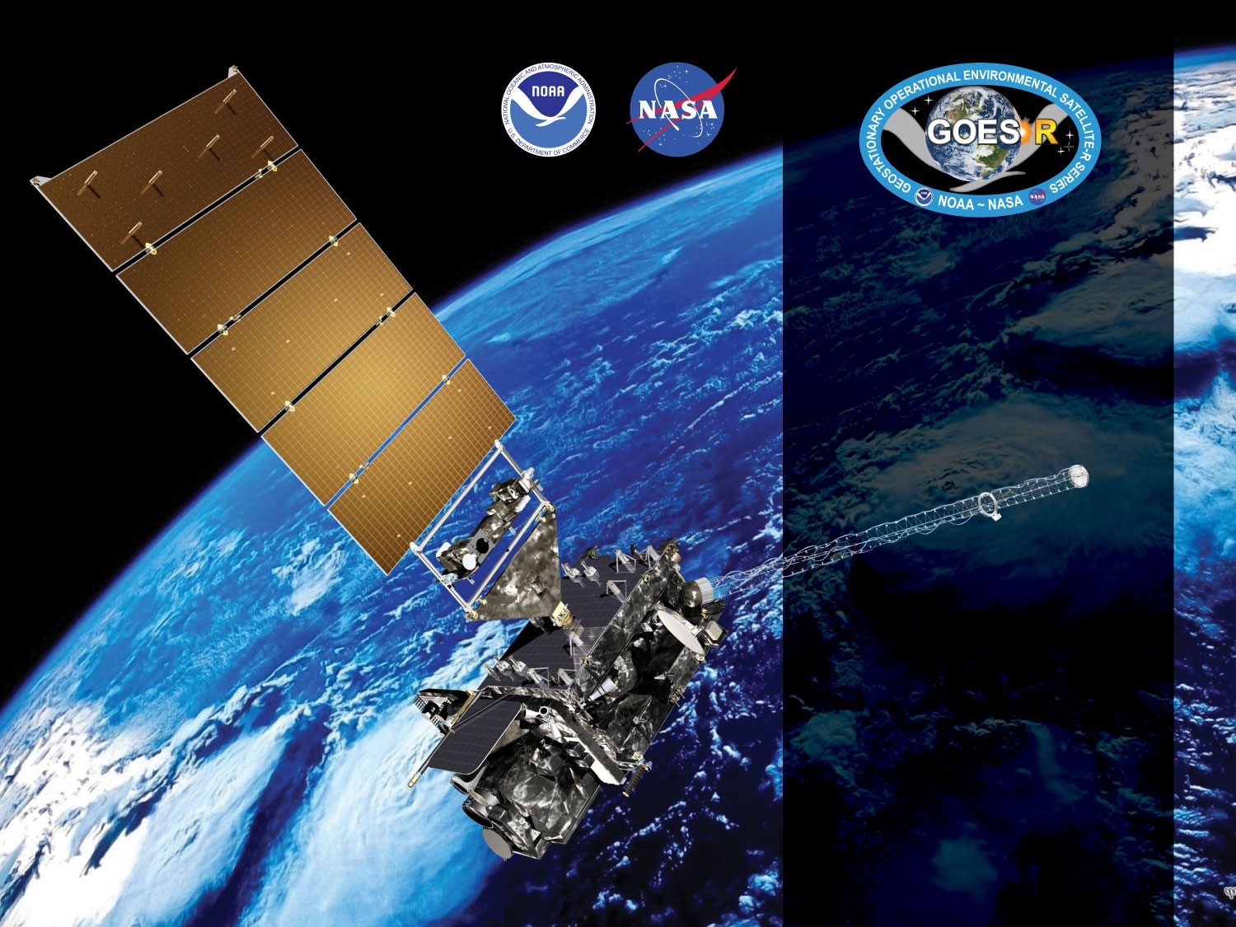
GOES-16 ABI L2+ Cloud Top Phase (CPH)
Provisional PS-PVR
February 22, 2018
Michael Pavolonis*, Corey Calvert, Jason Brunner
GOES-R AWG
NOAA/NESDIS/STAR*
CIMSS

Slide 2
Agenda
Review of Beta Maturity
Provisional Validation Product Maturity Assessment
Path to Full Validation Maturity
Summary and Recommendations
Notes:
-Time series before and after move to eastern position
-FD, CONUS, and Meso animations from eastern position
-Performance in evolving convection
-Performance for FLS
-CALIPSO comparisons, with focus on eastern position
-comparisons to MODIS with focus on eastern position
-Sensitivity to think cirrus and potential impact on height and AMV’s
-ARM analysis?

Slide 3
Review of Beta Maturity
GOES-16 Cloud Top Phase L2 Product Provisional PS-PVR

Slide 4
PLPTs Under Review
BETA
PLPT ID | Descriptive Title | % Complete | Results | AWG POC
ABI-FD_CPH01 | Verify Product is generated every 15 min for FD for M3 | 100 | Complete | PRO
ABI-CONUS_CPH01 | Verify Product is generated every 5 min for CONUS for M3 | 100 | Complete | PRO
ABI-MESO_CPH01 | Verify Product is generated every 5 min for Meso for M3 | 100 | Complete | PRO
ABI-FD_CPH02 | Verify Product is generated every 5 min for FD for M4 | 100 | Complete | PRO
ABI-CONUS_CPH02 | Verify Product is generated every 5 min for CONUS for M4 | 100 | Complete | PRO
ABI-FD_CPH03 | Quantitative analysis of M3 FD CPH | 100 | Complete | AWG
ABI-CONUS_CPH03 | Quantitative analysis of M3 CONUS CPH | 100 | Complete | AWG
ABI-MESO_CPH02 | Quantitative analysis of M3 Meso CPH | 100 | Complete | AWG
PS-PVR BETA granted on May 16, 2017

Slide 5
Requirements
Ensure consistency across all sectors
Measurement accuracy of 80% correct classification for Cloud Phase for all scan types

Slide 6
Cadence for verification
Mode | Mode 3 |  |  | Mode 4
Scan Type | FD | CONUS | MESO | FD | CONUS | MESO
Scan Freq | 15 min | 5 min | 30 sec | 5 min | 5 min | N/A
CPH - Ver Freq | 15 min | 5 min | 5 min | 5 min | 5 min | N/A

Slide 7
Risks to Reaching Provisional
Risk Name | Description | Impact | Mitigation and Schedule
Incorrect CRTM coefficients | The incorrect CRTM coefficients are being used in the GS. | Minor | (ADR 192) is scheduled to fix this issue and is scheduled for implementation on (5/5).
Wrong Seebor emissivity data being used | Currently the GS is using the June Seebor and MODIS white sky albedo. While the impact on the Height/Temperature/Pressure is minor, it is still an issue | Minor | WR 1828 is scheduled to fix this issue and is scheduled for implementation on June 2017. AWG will verify fix when it is available on the OE.
Missing data blocks during M4 testing | Large portions of the L1b data are missing during M4 causing large areas of “invalid” (fill) pixels | Major | Fixed in 2018
Threshold updates | Thresholds will need to be trained and updated | Minor | A rigorous analysis revealed that updating thresholds would not systematically improve performance

Slide 8
Upstream Algorithm Issues
Upstream Issue | Description | Impact | Algorithm Implications
ABI L1b - INR | Issues remain with ABI L1b INR issues associated with navigation and co-registration issues | Medium | Algorithm results will be compromised at cloud edges and in broken cloud decks
ABI L1b - Stripping | Image stripping is present in some imagery data | Minor | Cloud top phase product may have striping due to L1b striping and/or influences on cloud mask
ABI L1b - Calibration Issues | Calibration is still being evaluated on the system | Medium | Accurate measurements and clear sky simulations are needed for bands 10, 11, 14, and 15.
ABI L1b - GRB | Missing blocks of data in M4 due to terrestrial GRB issues | Major | Algorithm will produce invalid data in regions of missing blocks

Slide 9
Provisional Validation Product Maturity Assessment
GOES-16 Cloud Top Phase L2 Product Provisional PS-PVR

Slide 10
Requirements for FULL Validation
CPH: 80% accuracy for clouds with an optical depth > 1.0. (Same requirement for all ABI sectors)

Slide 11
PLPTs Under Review
PROVISIONAL
PLPT ID | Descriptive Title | % Complete | Results | AWG POC
ABI-FD_CPHp04 | Quantitative analysis of M3 FD CPH | 100 | Complete | AWG
ABI-CONUS_CPHp04 | Quantitative analysis of M3 CONUS CPH | 100 | Complete | AWG
ABI-MESO_CPHp03 | Quantitative analysis of M3 Meso CPH | 100 | Complete | AWG

Slide 12
Requirements
PROVISIONAL
Assess the accuracy and precision requirements for CPH.
Document impacts with upstream dependencies (Cloud Top Parameters, Cloud Optical Properties and Derived Motion Winds).
All ABI modes must meet horizontal, mapping, and range requirements.
If accuracy and precision are not met, document reasons why as an ADR.
Remediation strategies in place.
Product ready for potential operational use.

Slide 13
Application of PLPT Quantitative Analysis Tests to each Domain
Our 3 PLPTs dealing with analysis are comprised of the same 3 methods.
Each contains the applications of these methods on the FD, CONUS and MESO domains.
The applications of each method to each domain is summarized below.
Some methods were redundant or not possible for some domains.
Analysis Method | FD | CONUS | MESO
Visual Inspection
Comparison to other Clouds (e.g. MODIS, VIIRS)
ARM
CALIPSO Lidar Comparison
13
Notes:
We used tight-time constraints for MODIS comparisons and no MESOS or CONUSs were found.
MESO images that are in-sync with CALIPSO are rare.
MESO domains over ocean were not found.
No reason to repeat CALIPSO FD analysis on CONUS.

Slide 14
Qualitative Evaluation of Cloud Top Phase Product

Slide 15
Qualitative Success Definitions
PASSED
Specifications are met for product cadence and creation.
PARTIAL-PASSED
Specifications are close to being met for product cadence and creation. Example: Products created with missing blocks.
FAILED
Specifications are far from being met for product cadence and creation.

Slide 16

PLPT ABI-FD_CPH02:
CPH Full Disk Mode 4: April 23, 2017
PARTIAL
The CPH exhibit occasional missing blocks of data during Mode 4.
Issue traced back to missing blocks of L1b data from terrestrial GRB
L1b data from satellite GRB data was not missing at the same times.

Slide 17
PLPT ABI-FD_CPH02:
CPH Full Disk Mode 3: January 12, 2018
PASSED
The data dropout issue has largely been addressed.

Slide 18
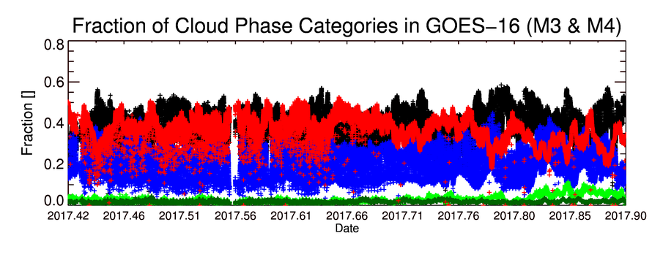
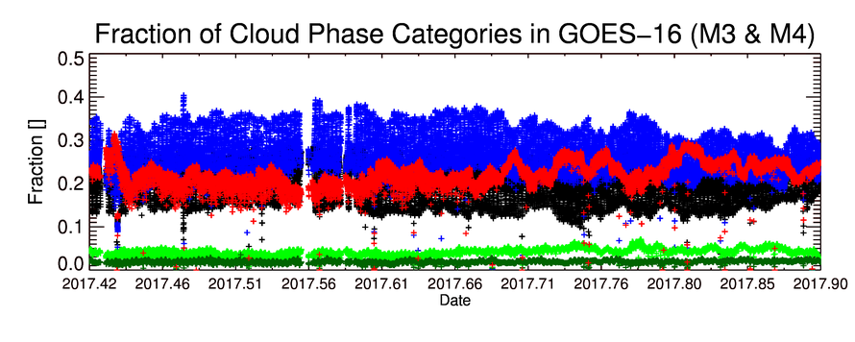
Time Series of Cloud Phase Fractions
Cloud Phase Legend
Clear Sky
Liquid Phase
Supercooled Phase
Mixed Phase
Ice Phase
Time series of the cloud phase fraction in GOES-16 (M3 & M4) for CONUS (top) and Full Disk (bottom)
Time period is June 1 – Nov. 24, 2017
Expected diurnal cycle is seen. Deviations from expected behavior are associated with data drop outs
CONUS
FD
PASSED
Notes:
Shows the fraction of GOES-16 pixels for each cloud phase. Pretty stable performance as expected.

Slide 19
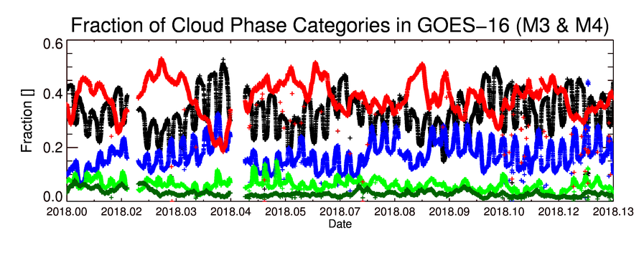
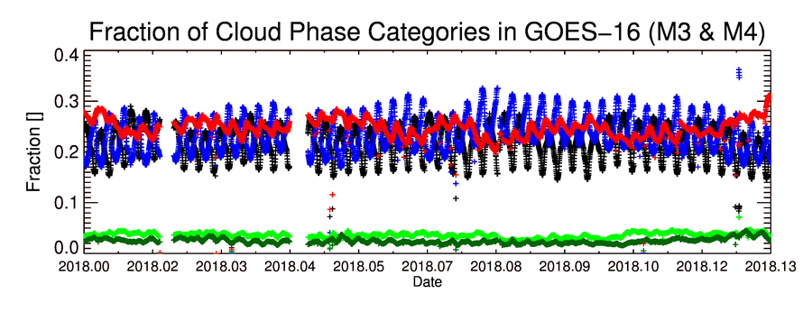
Time Series of Cloud Phase Fractions
Cloud Phase Legend
Clear Sky
Liquid Phase
Supercooled Phase
Mixed Phase
Ice Phase
Time series of the cloud phase fraction in GOES-16 (M3 & M4) for CONUS (top) and Full Disk (bottom)
Time period is January 1 – February 15, 2017
Expected diurnal cycle is seen. Deviations from expected behavior are minimal and explainable
CONUS
FD
PASSED
Notes:
Shows the fraction of GOES-16 pixels for each cloud phase. Pretty stable performance as expected.

Slide 20
Time Series of Cloud Phase Fractions
Cloud Phase Legend
Clear Sky
Liquid Phase
Supercooled Phase
Mixed Phase
Ice Phase
Time series of the cloud phase fraction in GOES-16 (M3 & M4) for CONUS (top) and Full Disk (bottom)
Time period is January 1 – February 15, 2017
Expected diurnal cycle is seen. Deviations from expected behavior are minimal and explainable
CONUS
FD
PASSED
Notes:
Shows the fraction of GOES-16 pixels for each cloud phase. Pretty stable performance as expected.

Slide 21
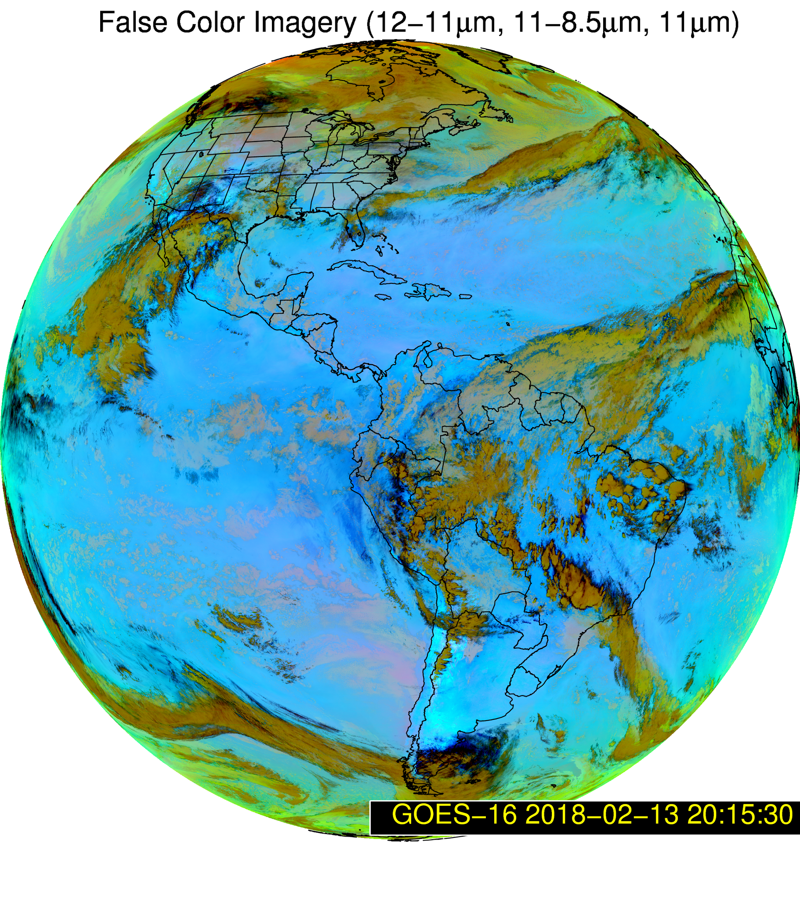
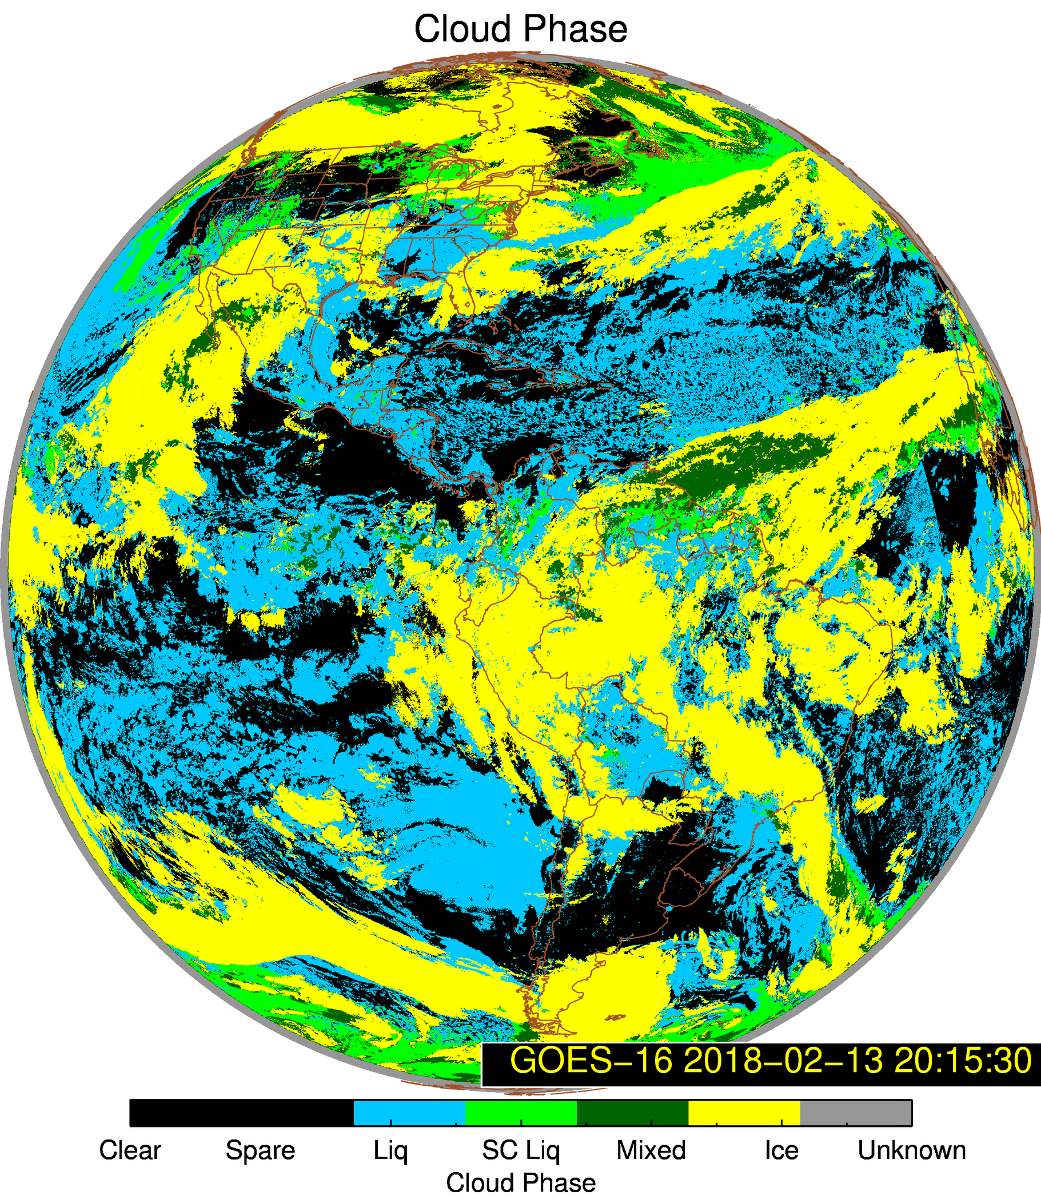
Time Series Cloud Phase Outliers
February 13, 2018 @ 20:15:30 UTC

Slide 22
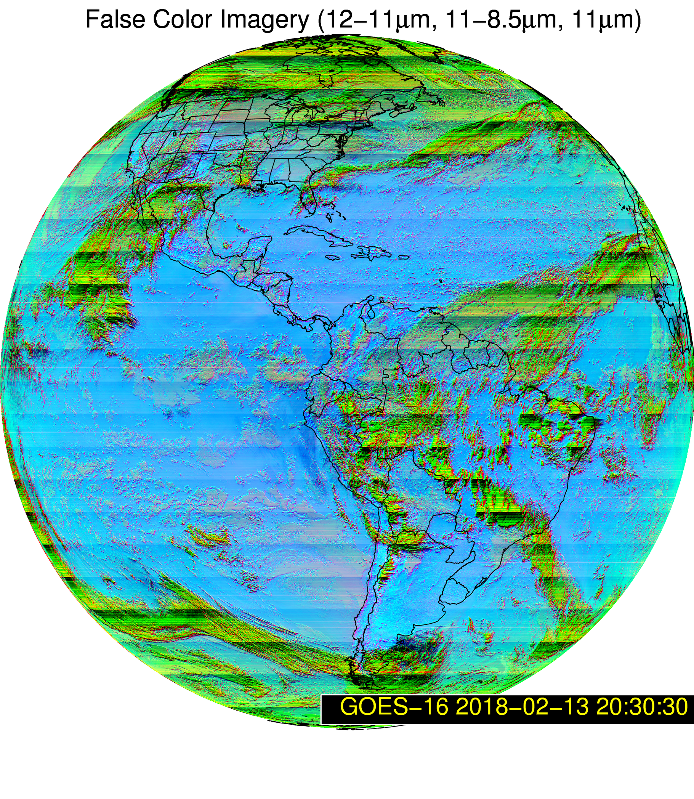
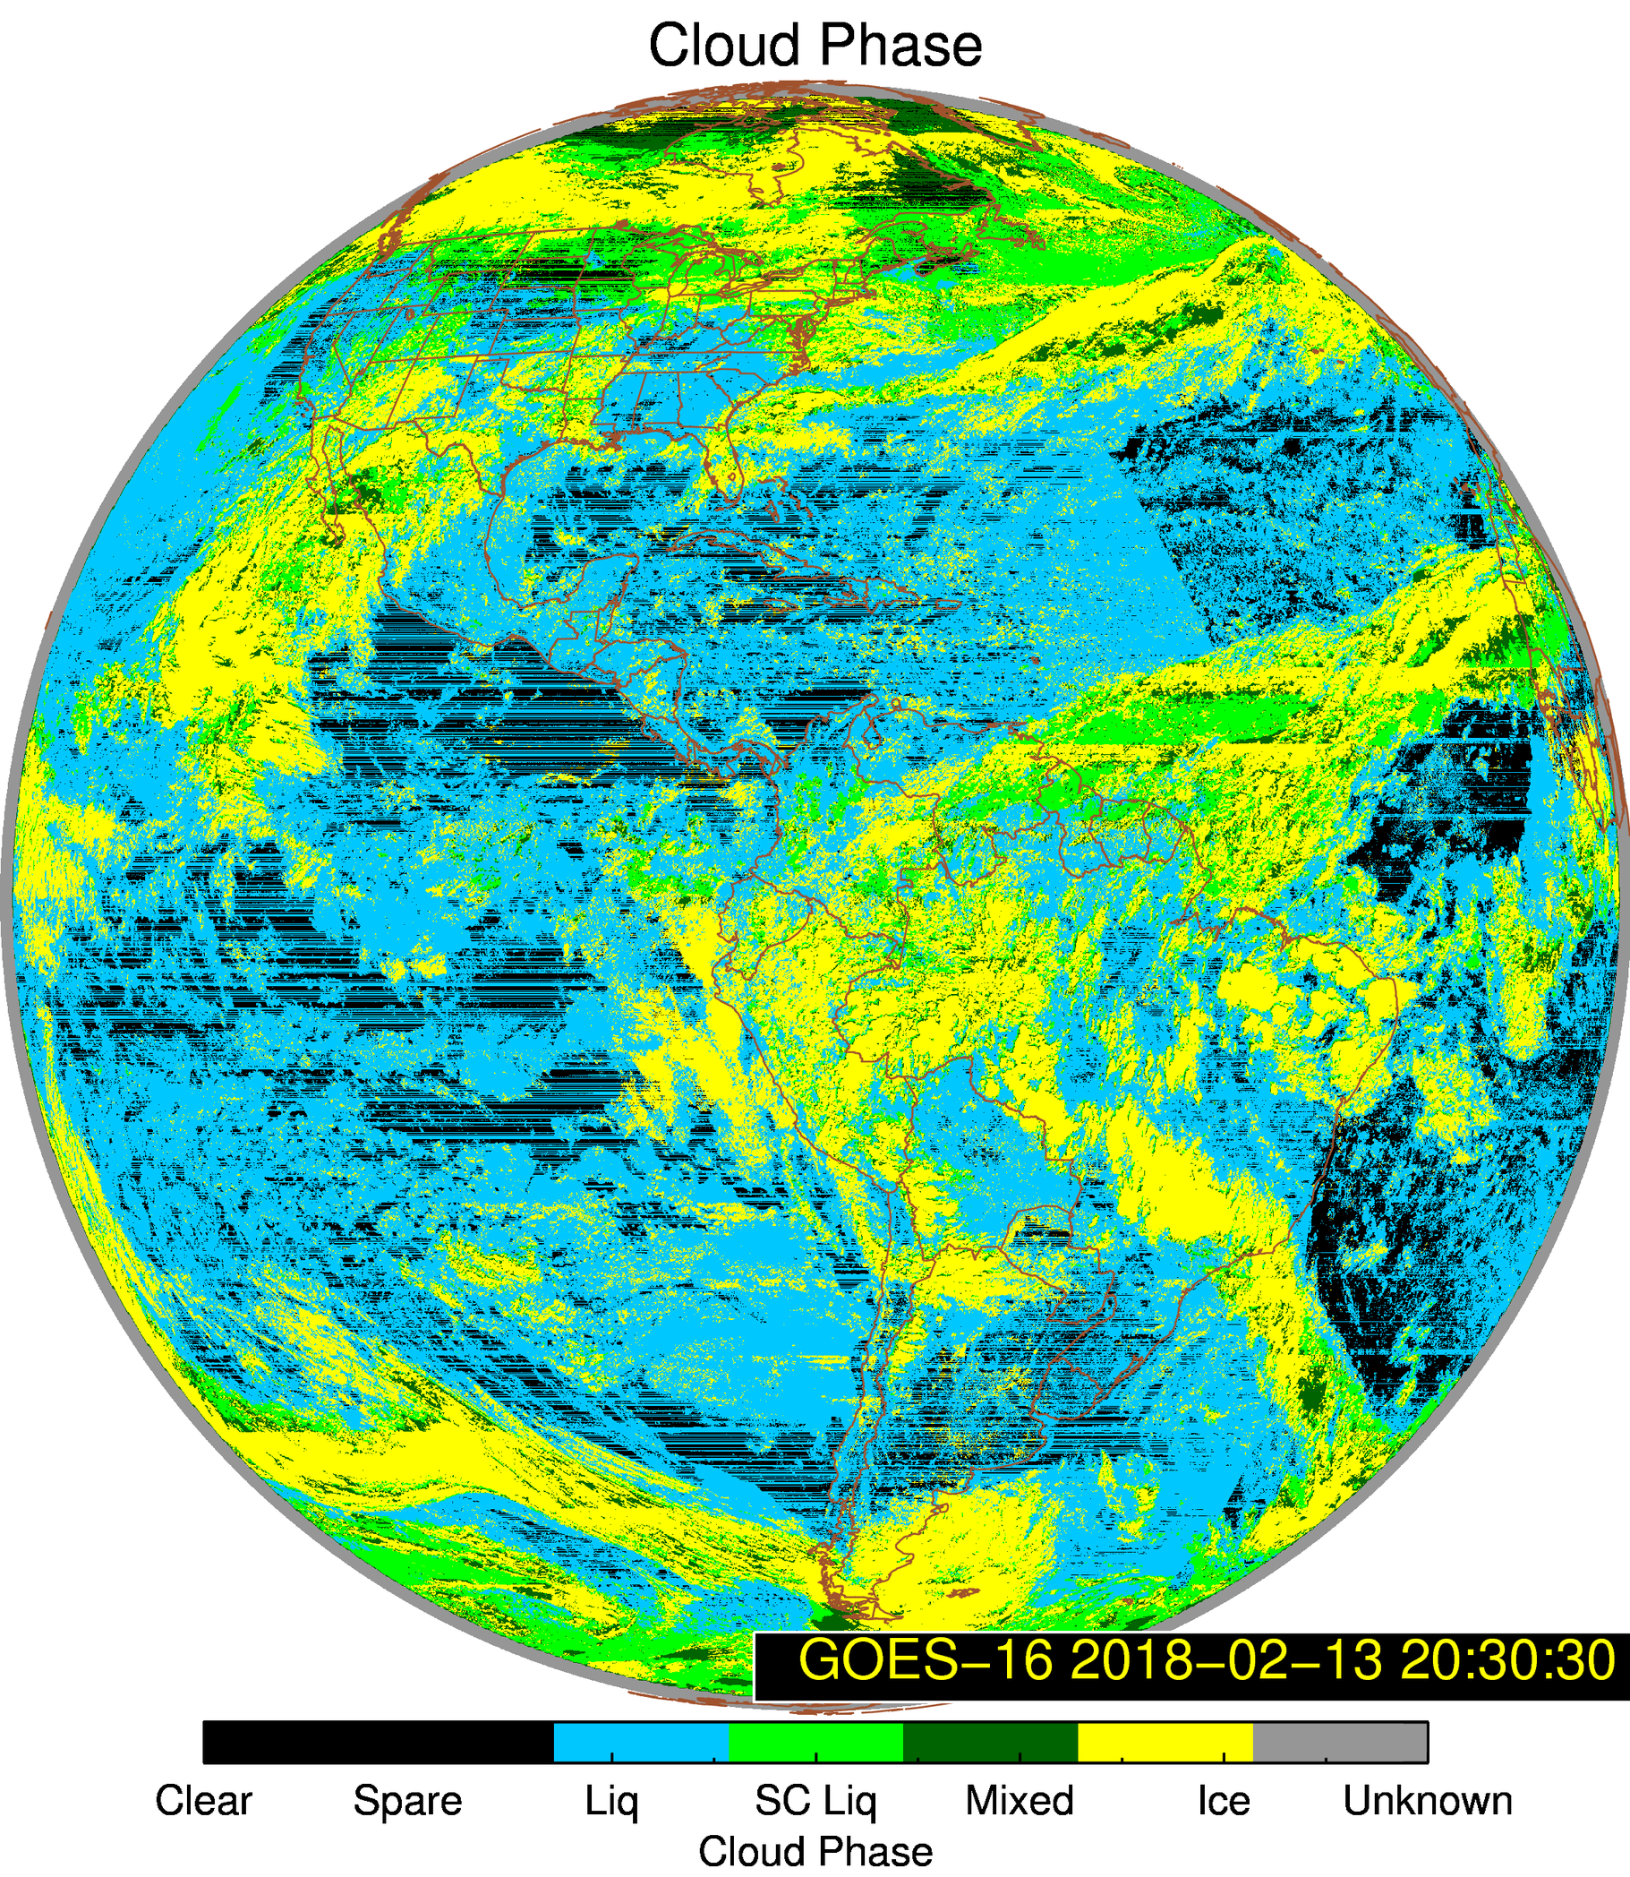
Time Series Cloud Phase Outliers
February 13, 2018 @ 20:30:30 UTC
Some outliers in time series are caused by bad L1b data

Slide 23
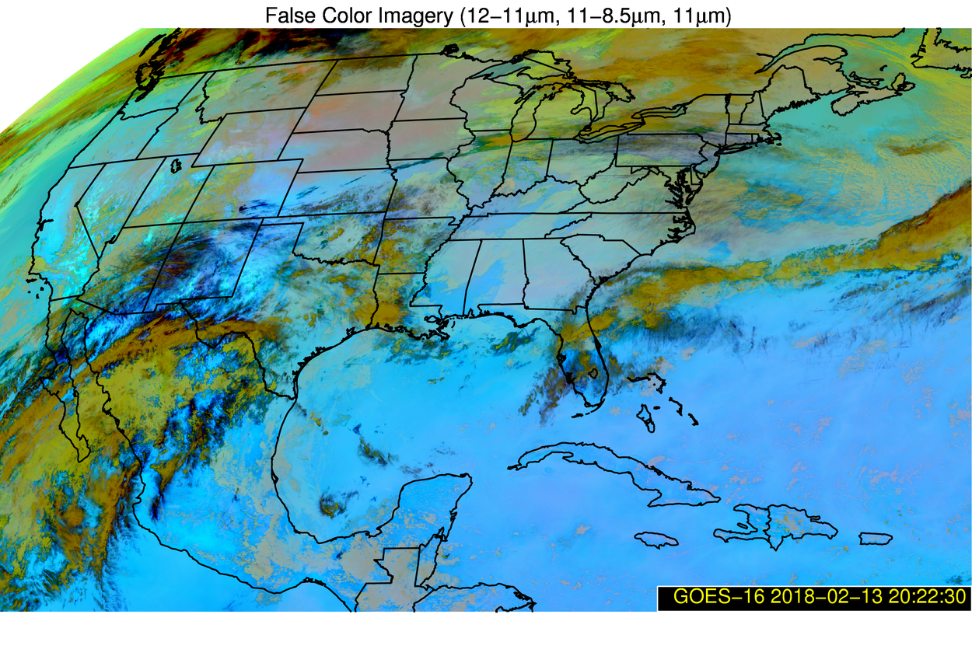
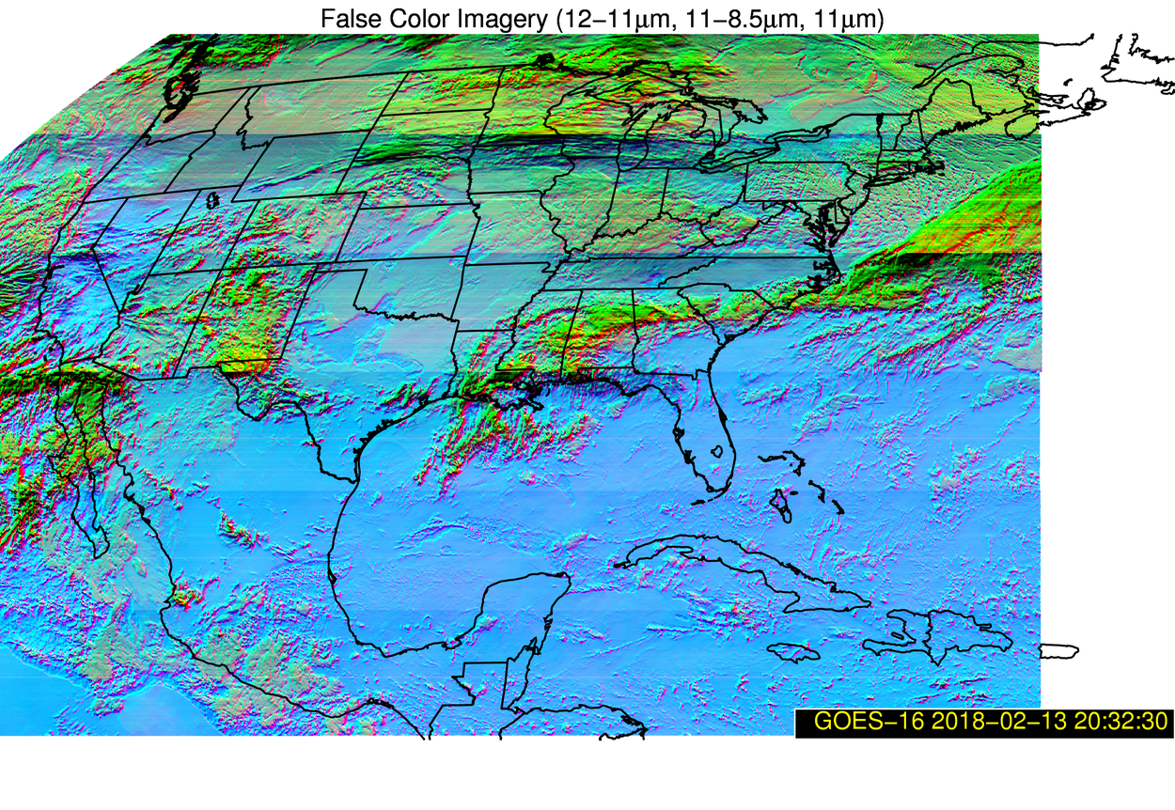
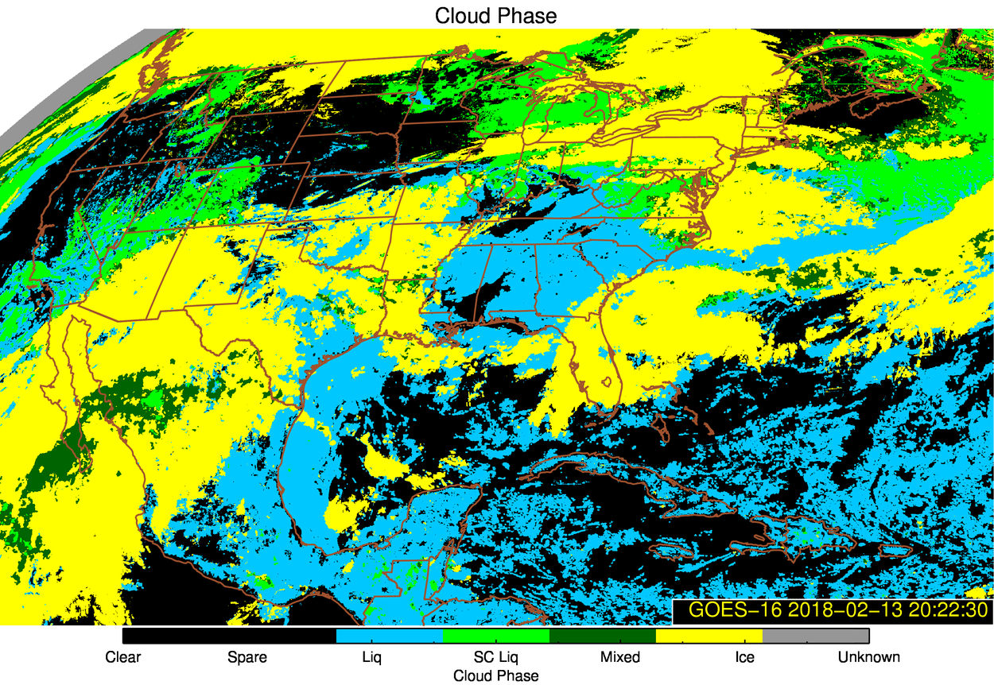
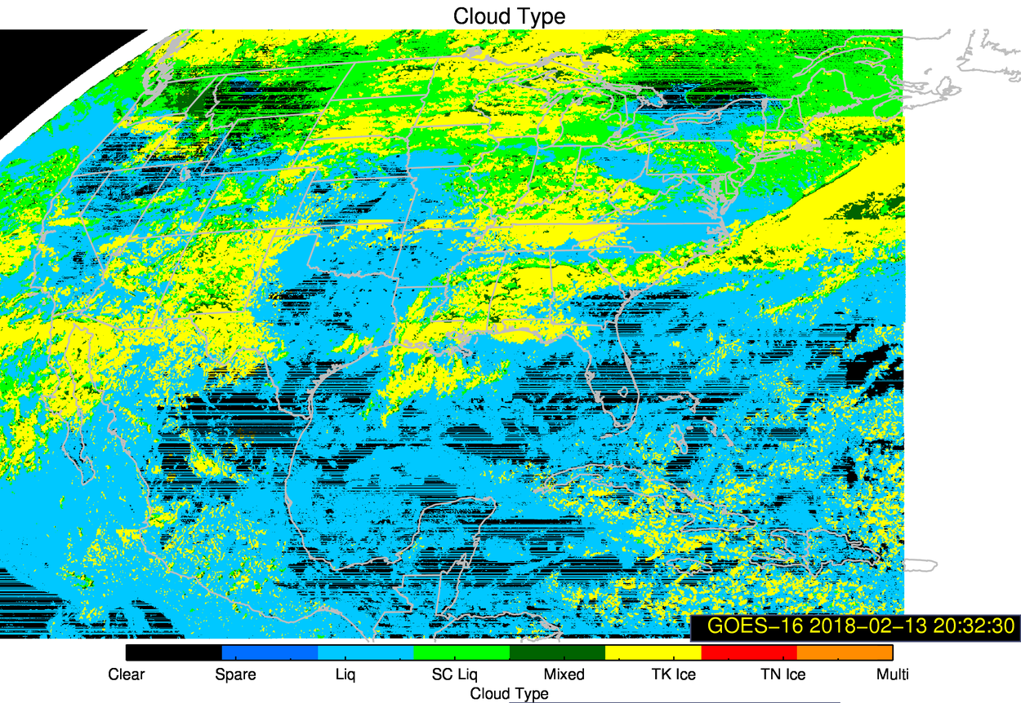
Time Series Cloud Phase Outliers
February 13, 2018
20:22:30 UTC
20:32:30 UTC

Slide 24
Time Series of Cloud Phase Fractions
Cloud Phase Legend
Clear Sky
Liquid Phase
Supercooled Phase
Mixed Phase
Ice Phase
Time series of the cloud phase fraction in GOES-16 (M3 & M4) for CONUS (top) and Full Disk (bottom)
Time period is January 1 – February 15, 2017
Expected diurnal cycle is seen. Deviations from expected behavior are minimal and explainable
CONUS
FD
PASSED
Notes:
Shows the fraction of GOES-16 pixels for each cloud phase. Pretty stable performance as expected.

Slide 25
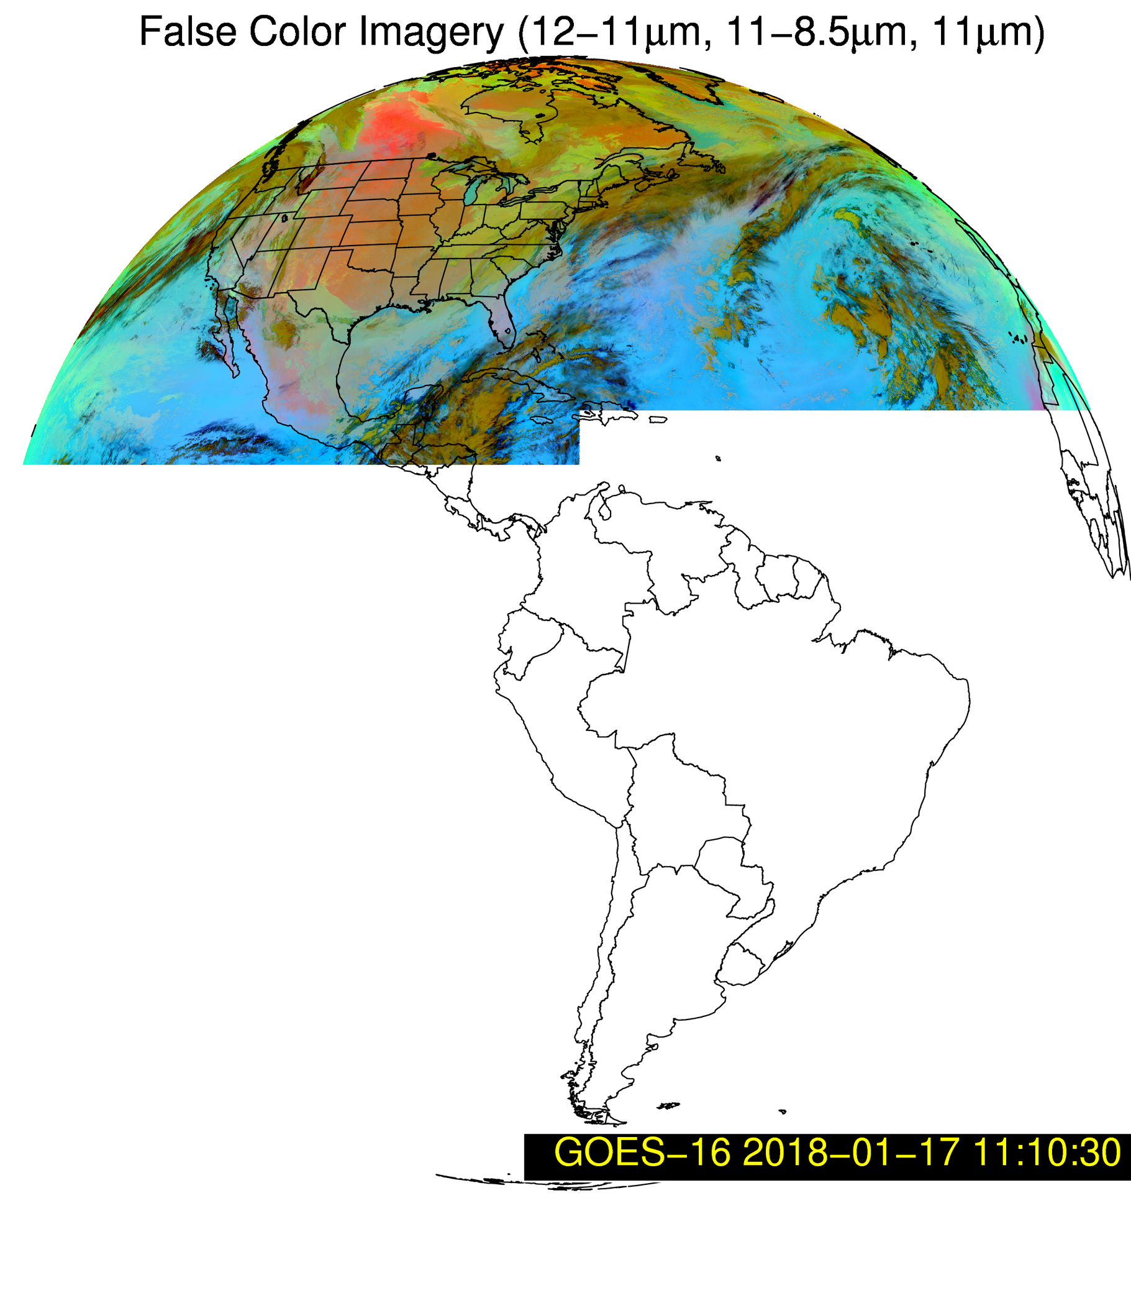
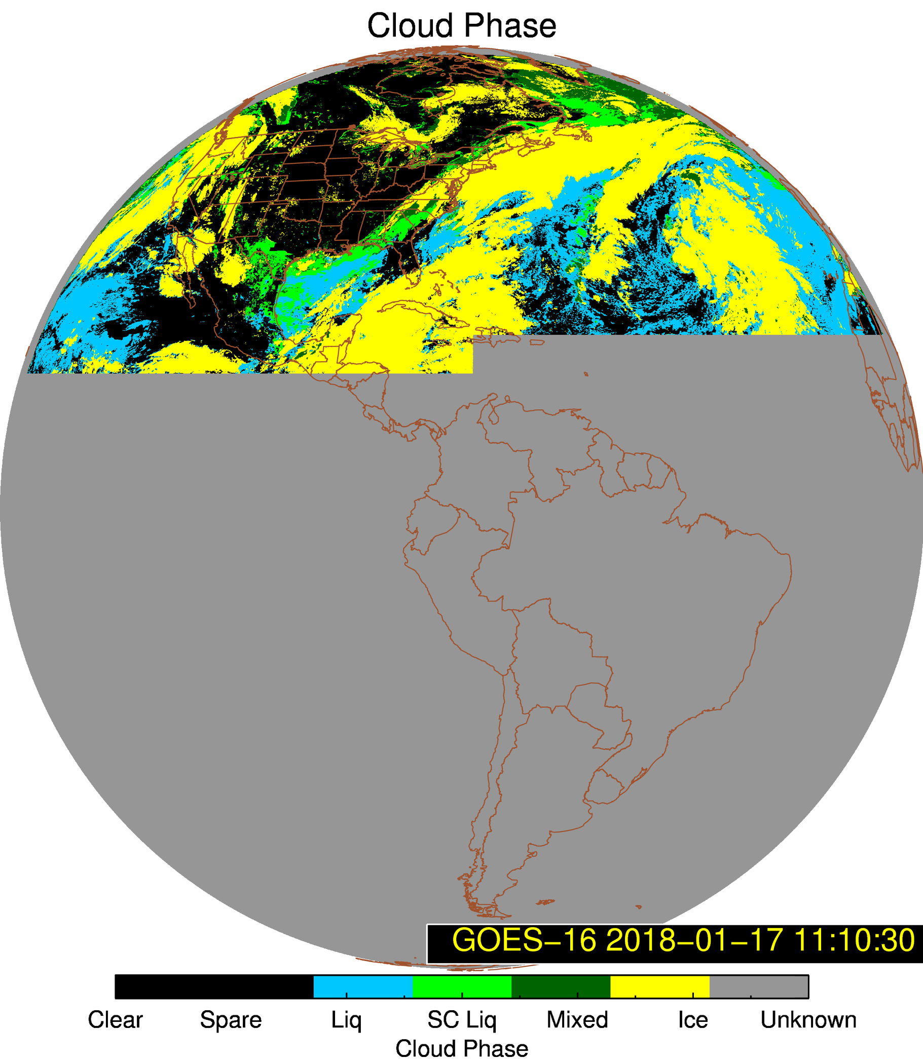
Time Series Cloud Phase Outliers
Outliers appear to be caused by missing L1 data

Slide 26
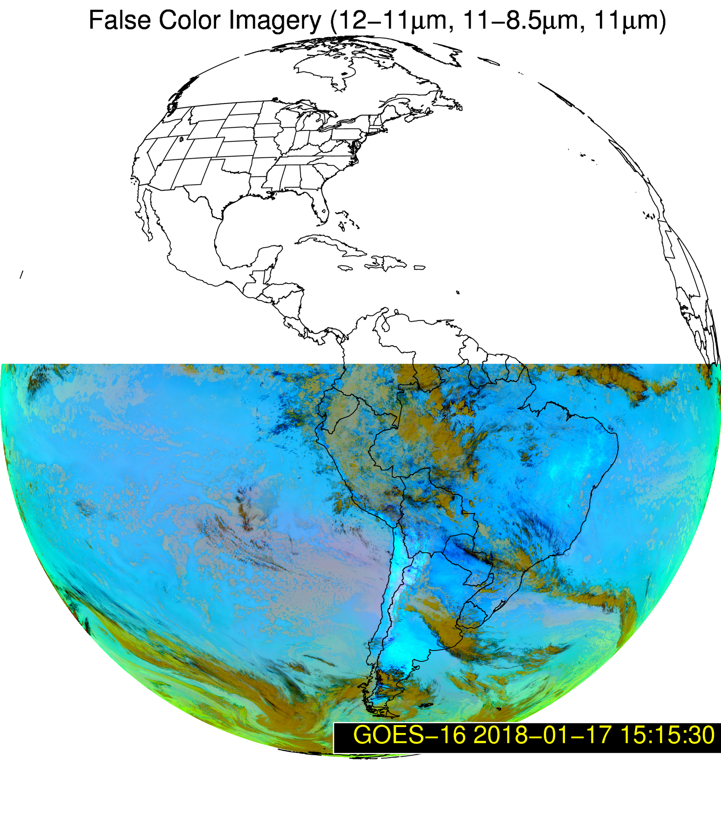
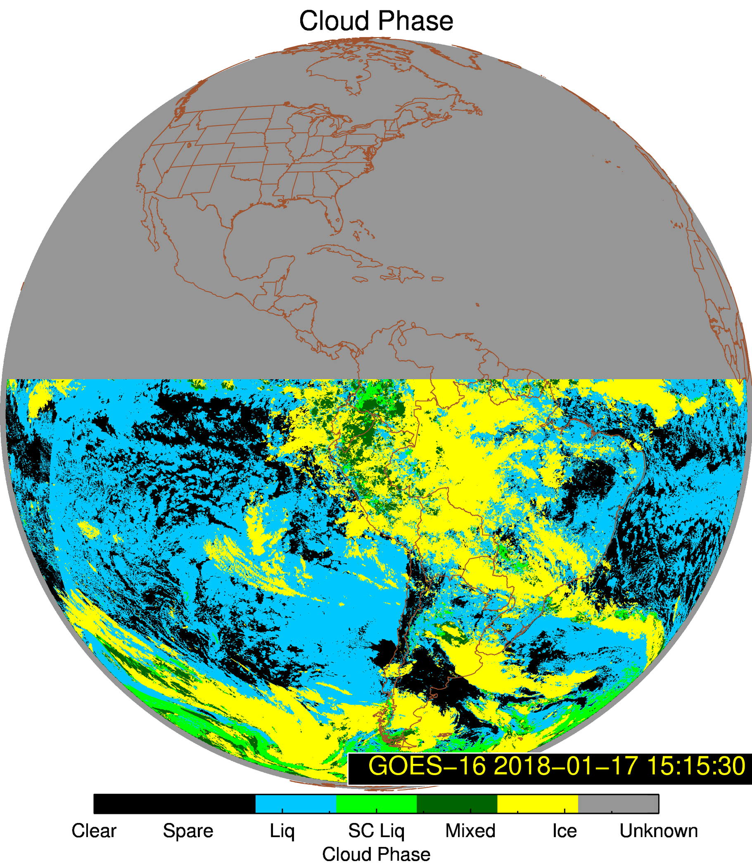
Time Series Cloud Phase Outliers
Outliers appear to be caused by missing L1 data

Slide 27
Quantitative Evaluation of Cloud Top Phase Product

Slide 28
Quantitative Success Definitions
PASSED
Specifications are met for clouds with COD > 1.0 and where the cloud mask matches that of the “truth” data.
PARTIAL-PASSED
Specifications are close to being met for clouds with COD > 1 and where the cloud mask matches that of the “truth” data.
FAILED
Specifications are far from being met for clouds with COD > 1 and where the cloud mask matches that of the “truth” data.

Slide 29
Comparison to NASA CALIPSO/CALIOP Cloud Phase

Slide 30
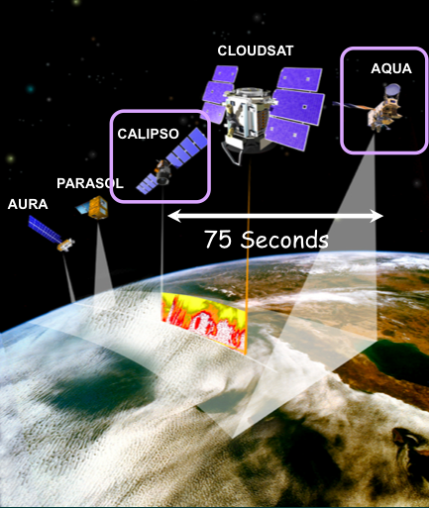
CALIOP vs ABI Comparison Description
CALIOP is a lidar, with depolarization, on board the CALIPSO satellite in the NASA A-Train.
The CALIOP 1 and 5 km vertical feature mask products are merged to derive the cloud phase of the highest cloud layer with CALIOP 532 nm optical depth > 0.01
72 days of CALIOP and ABI Matchup data are used
Filters applied to GOES-16:
  Scan time difference ± 7.5 minutes,
  Sensor Zenith Angle < 70.0
  ABI and CALIOP agree that a cloud is present
Validation analysis is a function of the CALIOP 532 nm cloud optical depth

Slide 31
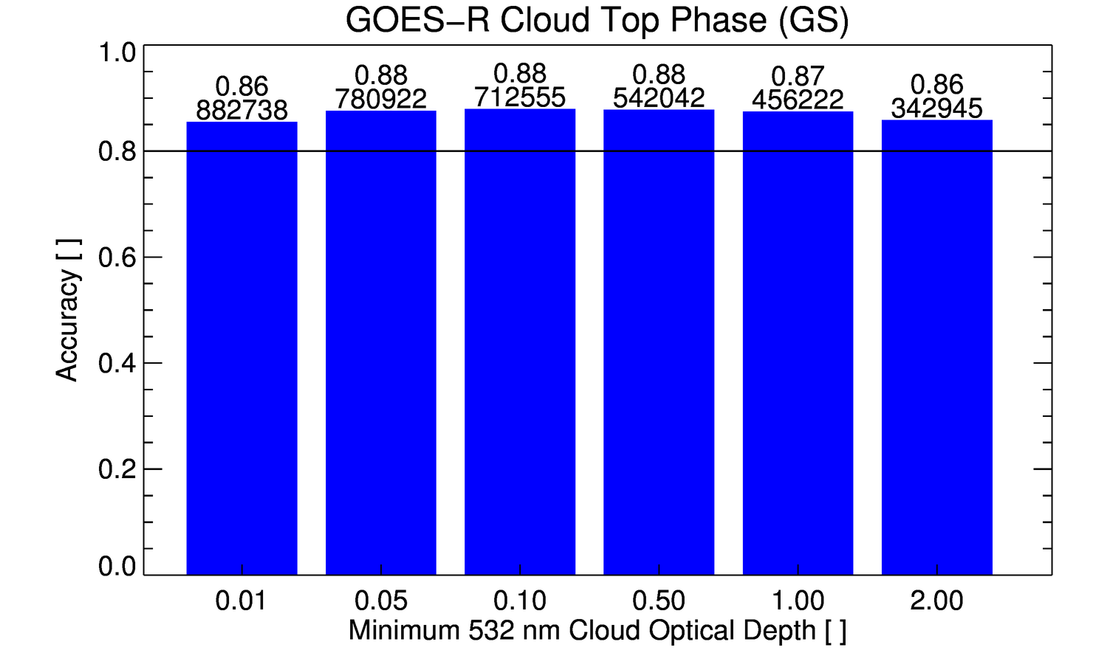
Overall Validation Against 80% Accuracy Requirement
The ABI cloud top phase product comfortably meets the accuracy specification without invoking the optical depth qualifier. Adding additional CALIOP match-ups has little impact on bulk stats (law of large numbers).
Requirement
PASSED

Slide 32
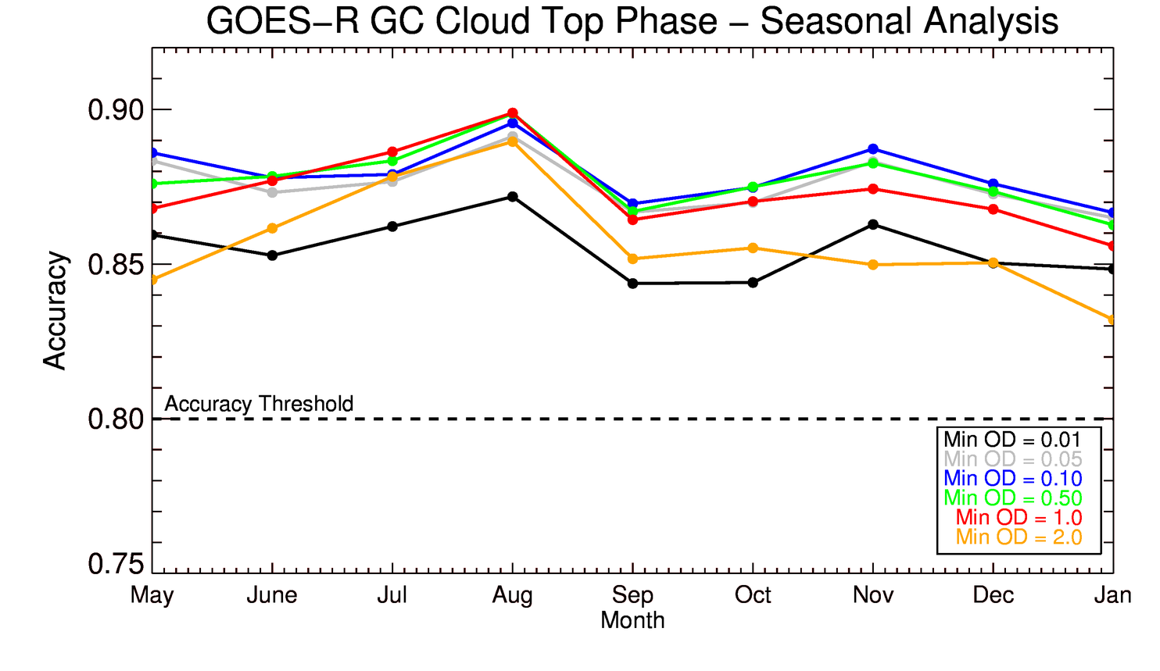
Seasonal Analysis
The ABI CPH exhibits consistent performance over the annual cycle sampled so far
PASSED

Slide 33
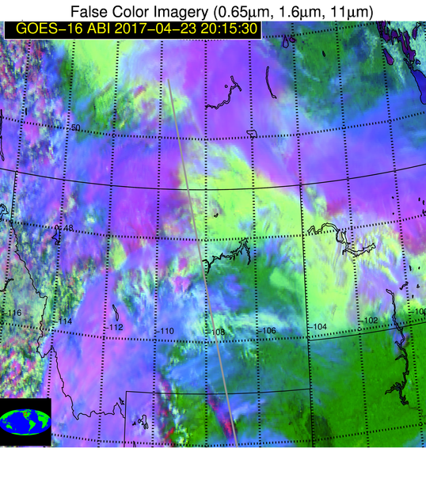
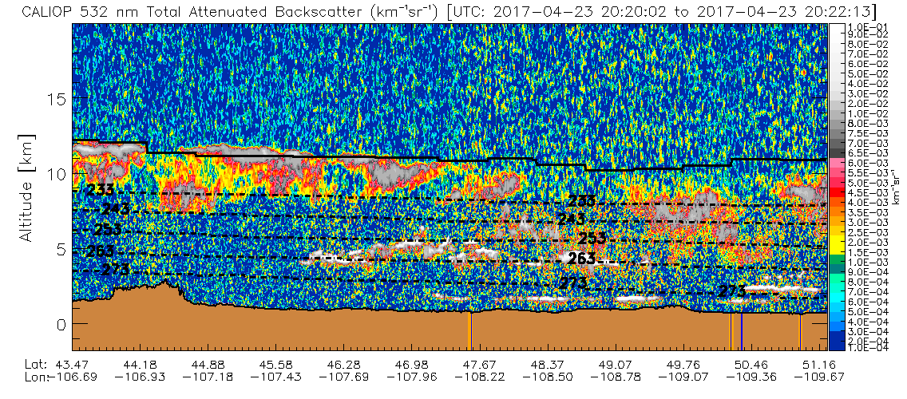
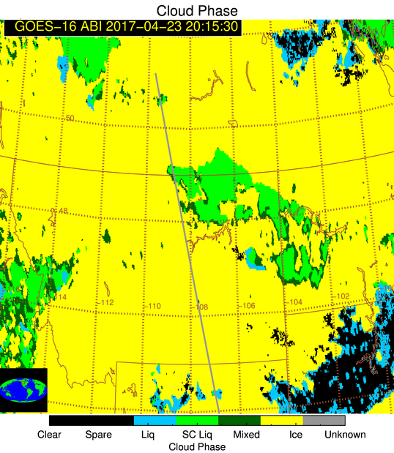
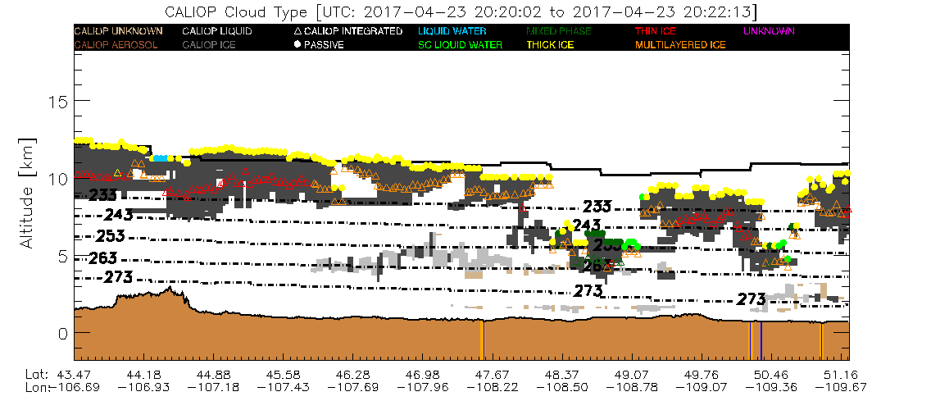
“Deep Dive” Example
Deep dive enables deeper understanding of issues and clearly demonstrates challenges
Very thin cirrus misclassified as liquid water
Differentiating between liquid, mixed, and ice can be challenging

Slide 34
CALIPSO Conclusions
The ABI cloud top phase product meets the accuracy specification without invoking the cloud optical depth qualifier.
The presence of multilayered clouds only degrades the performance slightly, but still above specification
There is little to no seasonal dependence on the performance
Targeted improvements: thin cirrus detection, broken cloud systems, and potentially mixed phase clouds (much more on this coming up)

Slide 35
DOE ARM

Slide 36
ARM Analysis
DOE ARM provides surface-based LIDAR and RADAR measurements at the central site (Oklahoma) and at various sites around the world.
We view ARM as a backup to the space-borne LIDARs (CALIPSO, CATS, EARTHCARE).
Due to the health of CALIPSO, we do not rely on ARM data.

Slide 37
Situational Performance Assessment: Downstream Algorithms and Applications

Slide 38
Feedback from Downstream Algorithms
Cloud Phase Algorithm works well.
However, when the cloud phase is wrong, it has a large impact on the cloud height retrieval.
We notice two potential phase team may want to track
  Ice cloud phase on the edges of water cloud
  Determination of ice phase when NIR imagery would indicate otherwise.
These issues may contribute to the over-estimation of height discussed in the AMV presentation.
Examples Follow

Slide 39
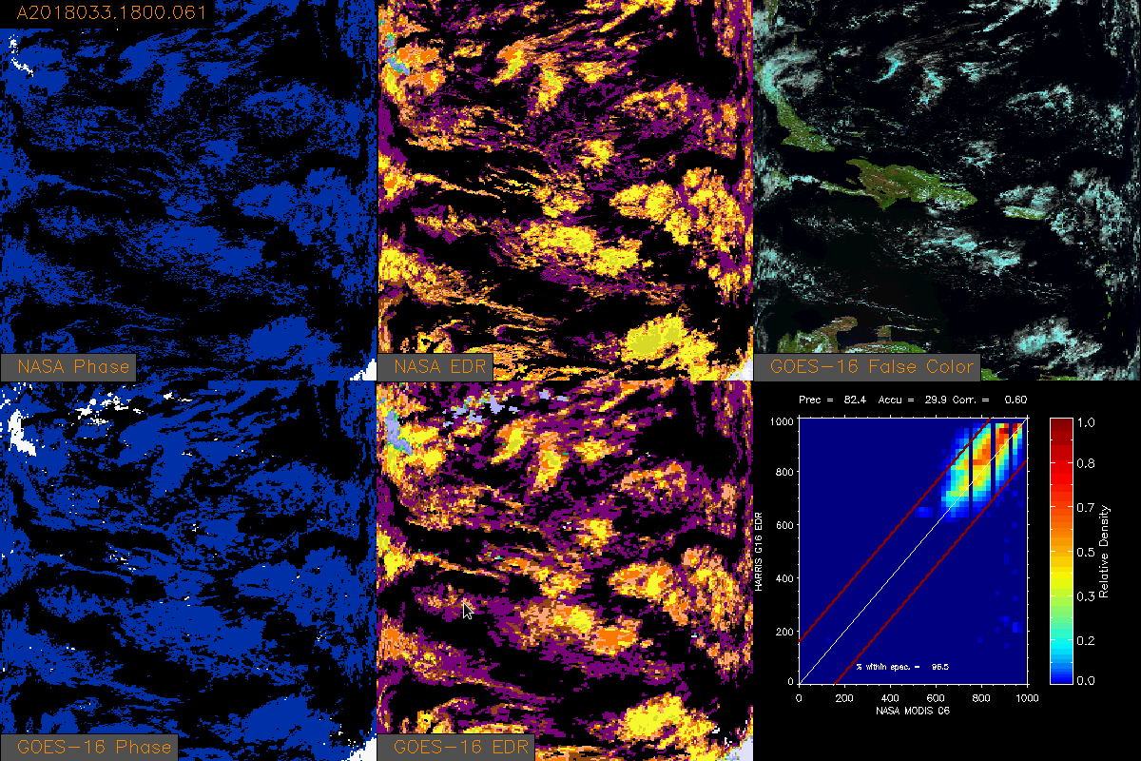
Mislabeling of Liquid Water Clouds at Edges
GOES-R CPH sometimes mislabels liquid water cloud edges as ice, leading to a significant underestimation of cloud top pressure along with profound impacts on optical properties and AMV’s

Slide 40
Cloud Phase | NASA MODIS IR 1km | NASA MODIS Optical Properties | Enterprise applied to MODIS | GOES-16
Liquid Phase | 761849 (0.41) | 826807 (0.48) | 540923 (0.27) | 597897 (0.28)
Mixed Phase | 0 (0.00) | 0 (0.00) | 43847 (0.02) | 36620 (0.02)
Ice Phase | 957183 (0.52) | 875056 (0.51) | 1421791 (0.71) | 1532388 (0.71)
Unknown Phase | 132264 (0.07) | 21711 (0.01) | 0 (0.00) | 0 (0.00)
The GOES-16 cloud phase detected more ice clouds than liquid clouds compared to the NASA MODIS cloud phase algorithms
False color imagery indicates that the MODIS cloud phase algorithms tend to be less sensitive to optically thin ice clouds

Slide 41
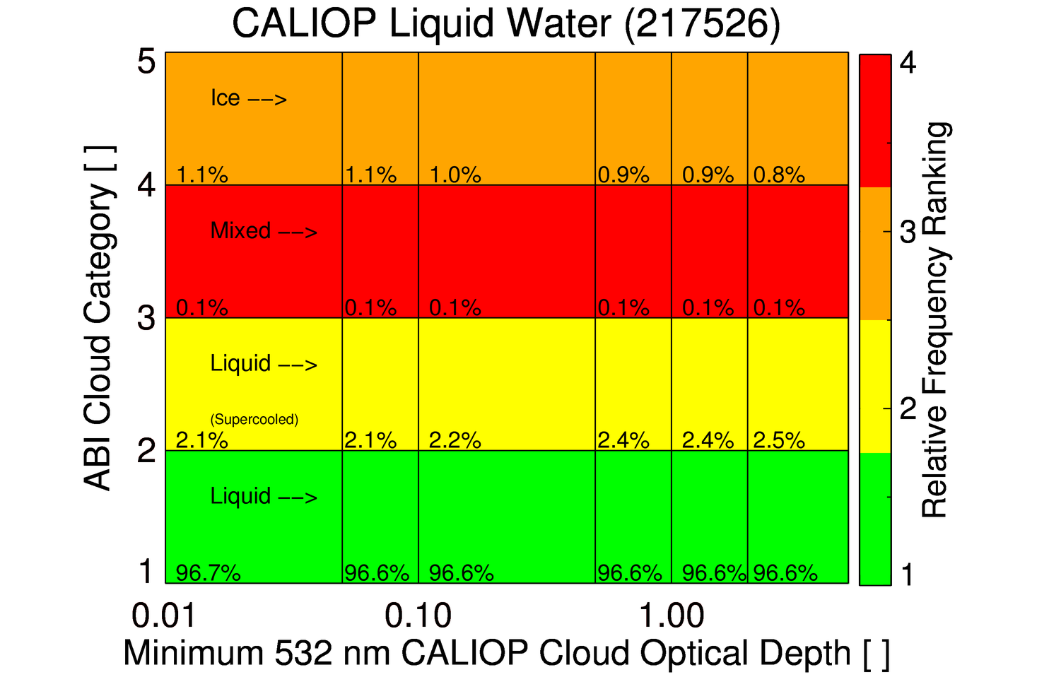
Mislabeling of Liquid Water Clouds
While only about 1% of liquid water clouds are mislabeled as ice, mislabeling some cloud edges has an impact on AMV’s
0.05
0.50
2.00

Slide 42
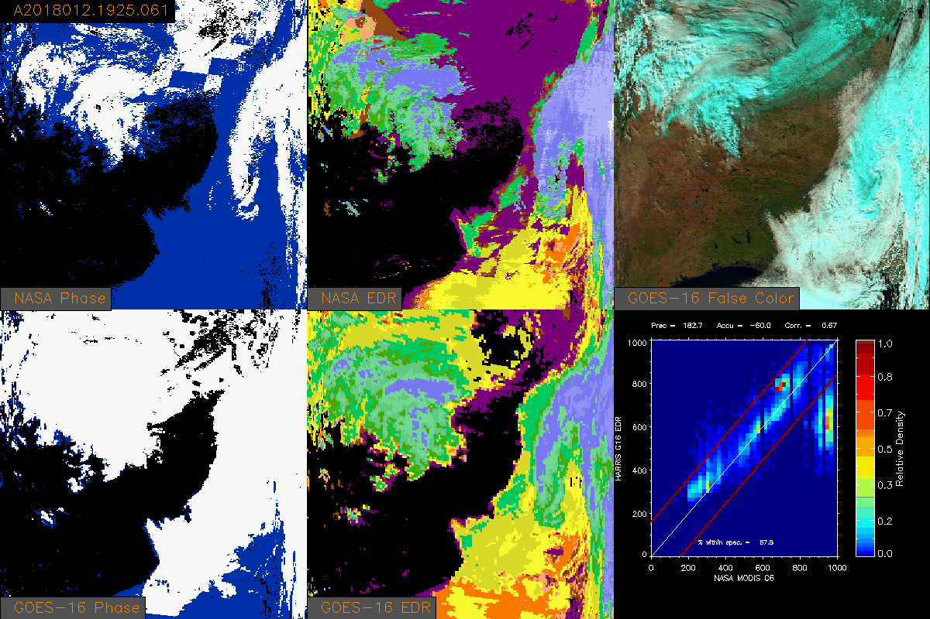
Ice Phase Detection Inconsistency with Near-Infrared
GOES-R CPH sometimes over detects ice relative to independent near-infrared measurements. Such misclassifications can lead to cloud height/pressure/temperature/optical depth/effective radius errors.

Slide 43
ABI CPH Vs. 1.6 μm Reflectance
May 10, 2017 – TX/OK

Slide 44
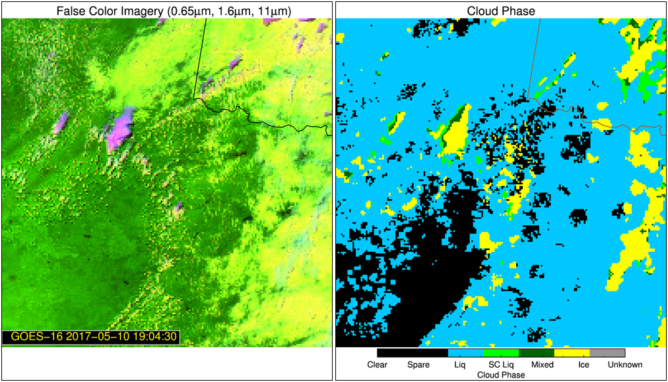
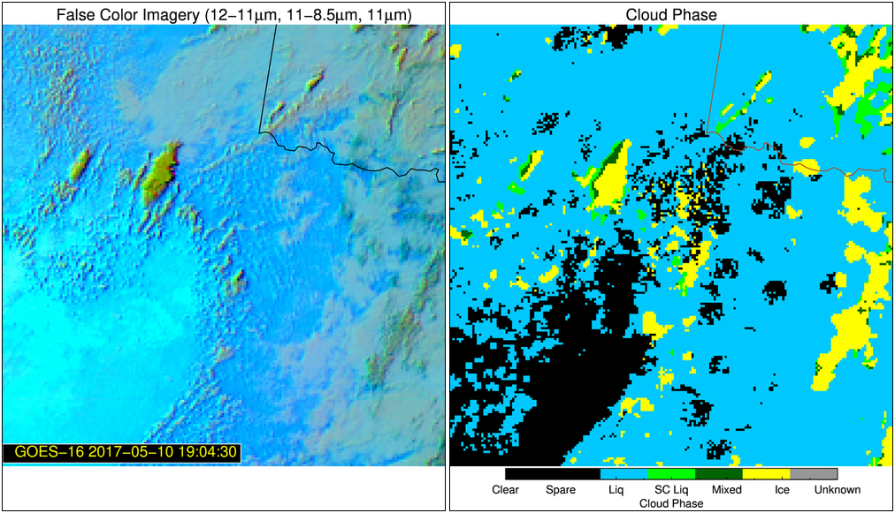
ABI CPH Vs. 1.6 μm Reflectance
May 10, 2017 – TX/OK (19:04:30 UTC)
The pixel heterogeneity associated with developing cumulus clouds can cause non-glaciated clouds to be incorrectly classified as ice.
The incorrect classification can be inferred through comparisons with near infrared reflectances
This issue impacts the downstream products and will negative impact applications that rely on cloud phase product (e.g. ProbSevere)

Slide 45
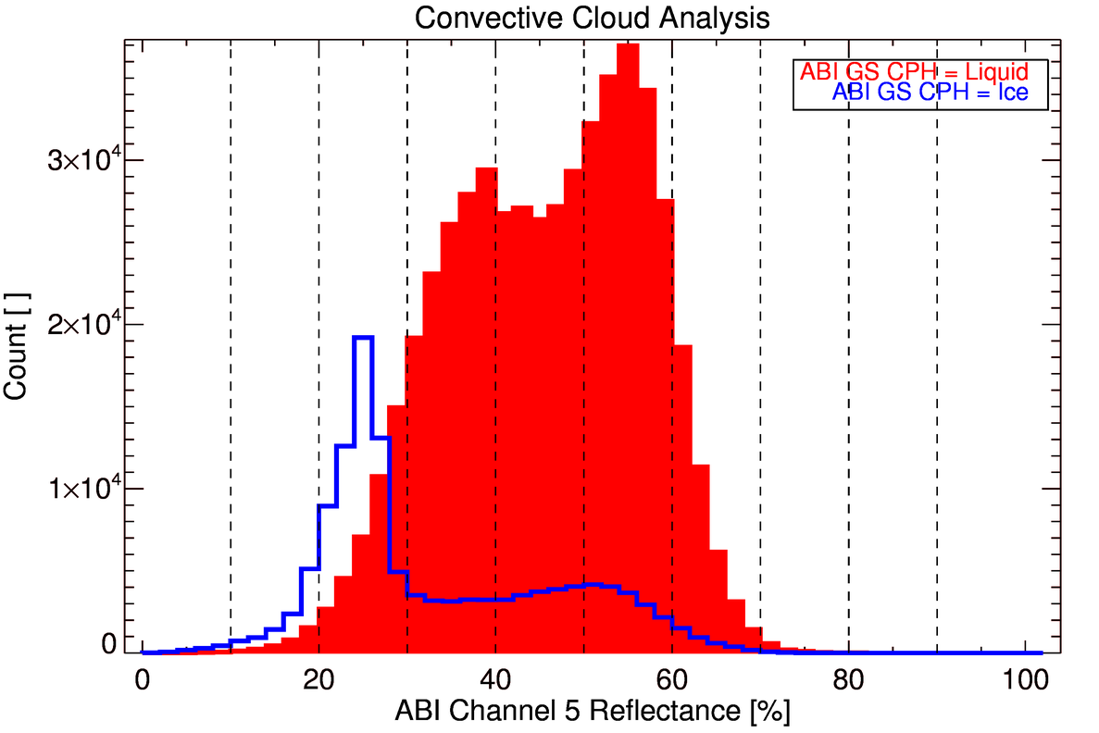
ABI CPH Vs. 1.6 μm Reflectance
May 10, 2017 – TX/OK (18-21 UTC)
Tail of 1.6 μm reflectance > 30% is mostly associated with incorrect cloud classification

Slide 46
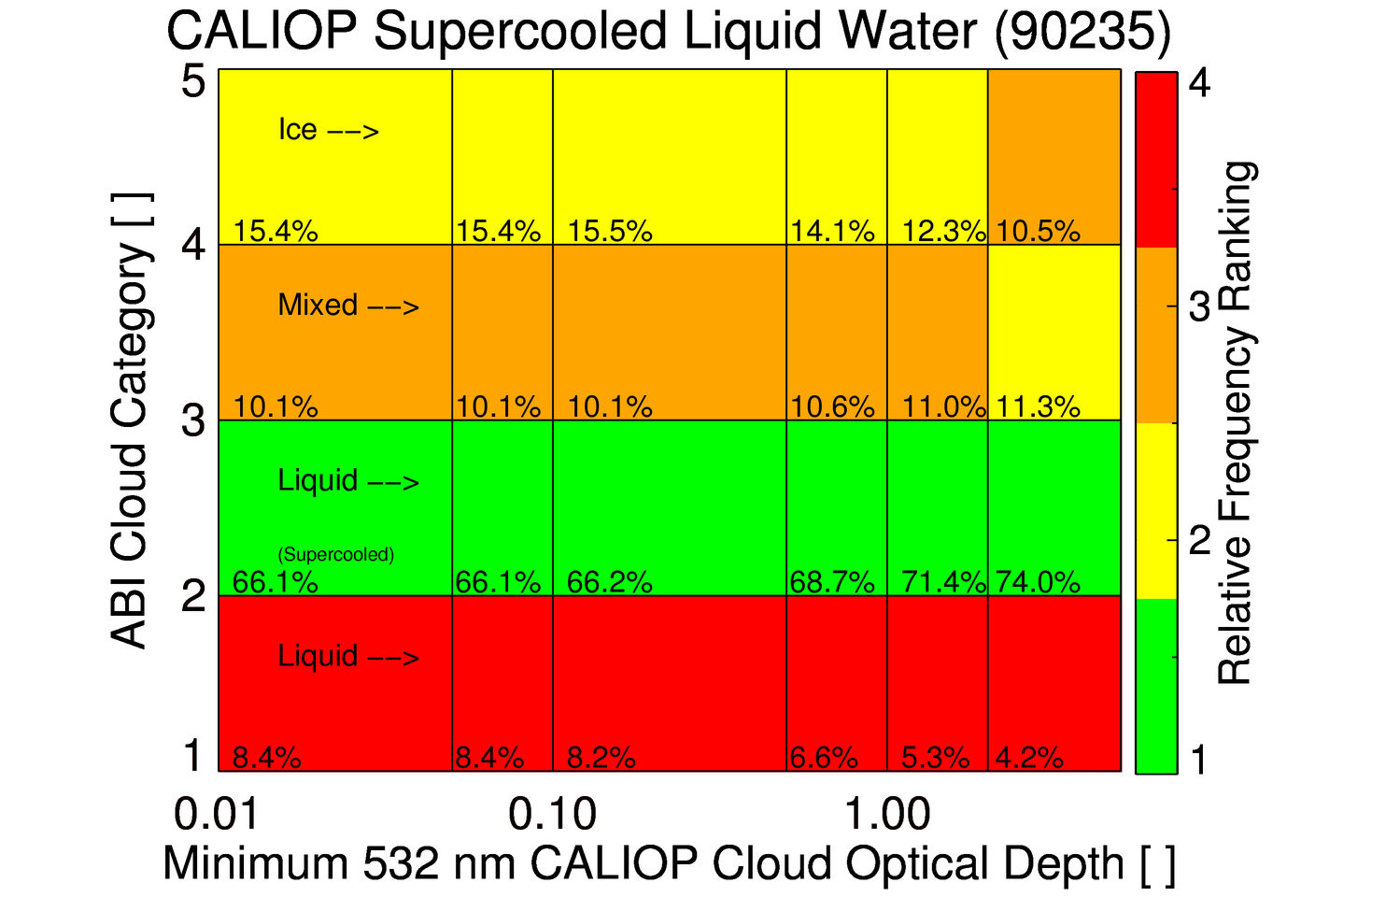
Assessment for Aircraft Icing Applications
~70% of optically thick supercooled liquid water clouds are correctly classified
Only about 5% of clouds that may have supercooled liquid are missed

Slide 47
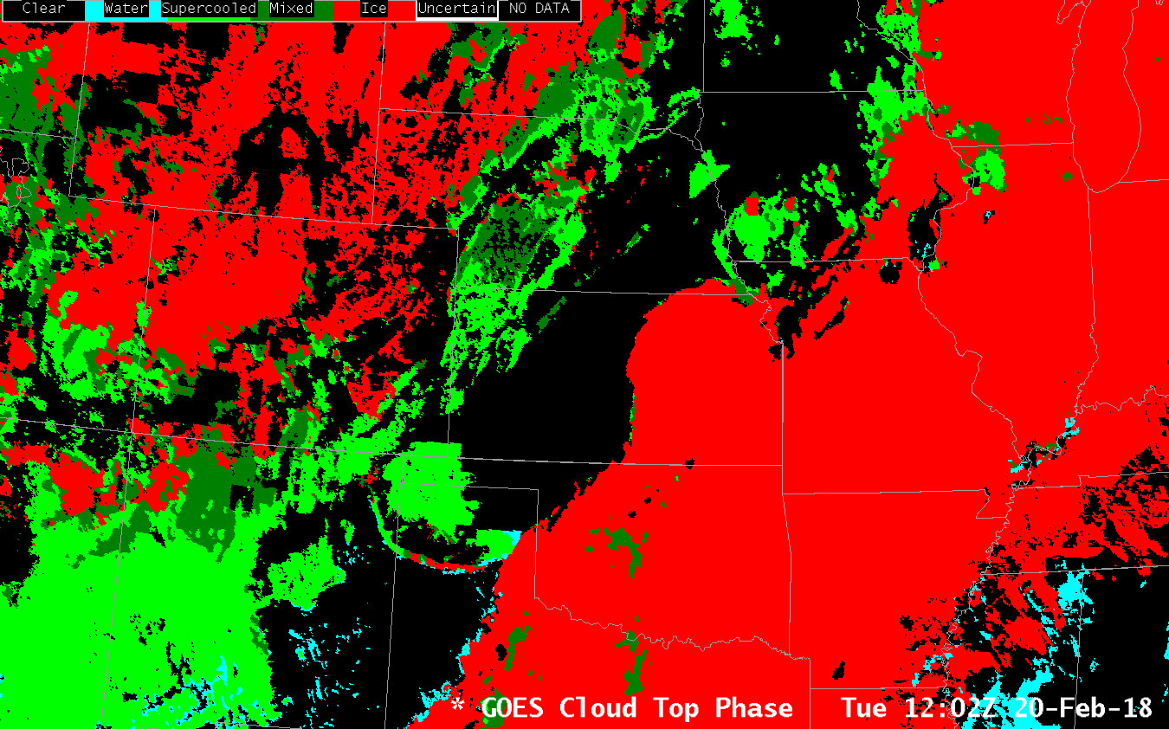
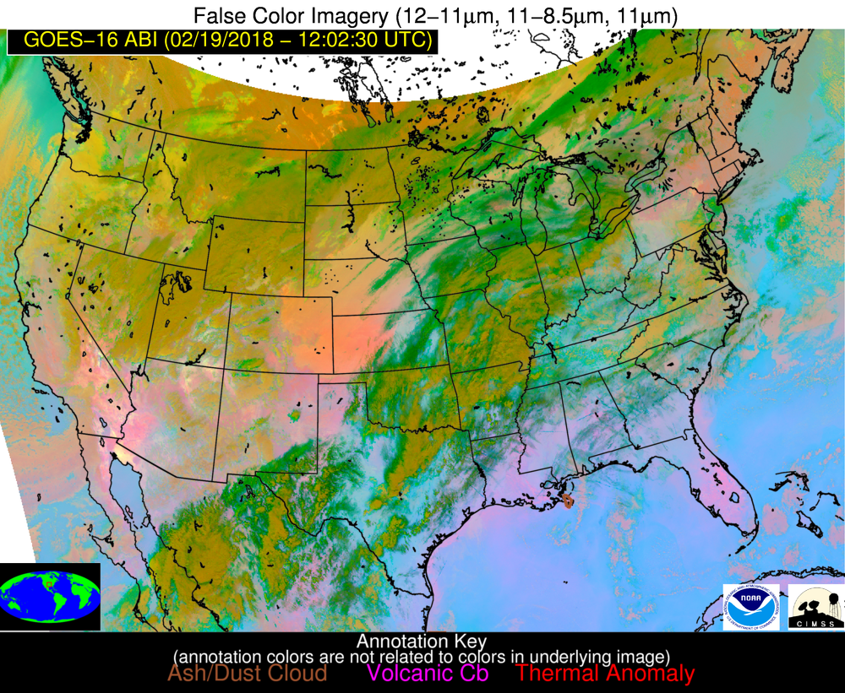
Cloud Mask Impacts
Some NWS users have asked why phase is sometimes “black” in AWIPS when clouds can be seen in imagery
Low clouds missed by cloud mask
Low clouds are often difficult to detect, so specialized algorithms used to identify hazardous low clouds

Slide 48
Use in Fog/Low Stratus Algorithm
 | Maximum CSI
 | GOES-13 | GOES-16
LIFR | 0.259 | 0.272
IFR | 0.326 | 0.348
MVFR | 0.412 | 0.448
The GOES-16 ABI cloud top phase algorithm is required by the GOES-16 FLS algorithm
Comprehensive validation shows the GOES-16 FLS products are more skillful (see table) than the previous GOES-NOP version of the FLS products
The GOES-16 FLS products were also found to be better-calibrated than the GOES-NOP version
These results show the use of the GOES-16 cloud top phase algorithm does not appear to negatively impact the GOES-16 FLS products
Validation was created using 8 days of data (1 day per month from March-October, 2017). All solar orientations and cloud types were used for this analysis.
GOES-13
GOES-16
PASSED

Slide 49
Issues and Status
ADRs Addressed
No ADR’s for CPH
Notes:
No impact on the product.

Slide 50
Provisional Maturity Assessment
GOES-16 Cloud Top Phase L2 Product Provisional PS-PVR

Slide 51
Provisional Validation
Preparation Activities | Assessment
Validation activities are ongoing and the general research community is now encouraged to participate. | Validation activities are ongoing. The general research and user community has been participating and providing feedback.
Severe algorithm anomalies are identified and under analysis. Solutions to anomalies are in development and testing. | While no severe algorithm anomalies have been identified, we are working with the rest of the cloud team and the DMV team on sporadic anomalies.
Incremental product improvements may still be occurring. | Incremental product improvements are expected.

Slide 52
Provisional Validation
End State | Assessment
Product performance has been demonstrated through analysis of a small number of independent measurements obtained from select locations, periods, and associated ground truth or field campaign efforts. | This has been demonstrated.
Product analysis is sufficient to communicate product performance to users relative to expectations (Performance Baseline). | This has been communicated in PS-PVR.
Documentation of product performance exists that includes recommended remediation strategies for all anomalies and weaknesses. Any algorithm changes associated with severe anomalies have been documented, implemented, tested, and shared with the user community. | These are documented in this slide deck and will be documented in a separate report and ReadMe file.
Testing has been fully documented. | Testing will be documented in a PLPT Report.
Product is ready for operational use and for use in comprehensive cal/val activities and product optimization. | We concur.

Slide 53
Recommendation
AWG Cloud Team believes that the GOES-16 Cloud Top Phase L2 product has reached the Provisional Maturity as defined by the GOES-R Program.

Slide 54
Path to Full Validation Maturity
GOES-16 Cloud Top Phase L2 Product Provisional PS-PVR

Slide 55
Issues and Status
ADRs Needing Resolution for Full VAL
ADR | Title | Status | Build
 |  |  | --

Slide 56
Issues and Status
Other Actions Needed for Full VAL
Action | Title | Desired Implementation Date into OE
New ADR(s) needed | Improved consistency with near-infrared phase assessment is needed. An algorithm update, including the use of additional ABI channels, is needed to address this issue. | ≧1 month prior to PS-PVR FULL

Slide 57
Path to Full Validation - PLPTs
PLPT ID | Descriptive Title
ABI-FD_CPHp05 | Assess the accuracy and precision of the CPH product over a large and wide range of representative conditions sufficient to prove all CPH product requirements have been met. 1 year. Mode 3. 15 minute FD/CONUS.
ABI-CONUS_CPHp05 | Same as above, except for 5 minute CONUS CTPs.
ABI-MESO_CPH04 | Same as above, except for 5 minute MESO CTPs.
AWG Cloud team will conduct these tests to further evaluate the L1b product quality.
Full test plans and procedures are given in the INST Readiness, Implementation, and Management Plan (RIMP v1.1; 416-R-RIMP-0338)

Slide 58
Path to Full Validation – Risks
Risk Name | Description | Impact | Mitigation and Schedule
Update Cloud Phase Algorithm | Algorithm enhancements, including the use of additional ABI channels, are needed to improve consistency between ABI CPH product and near-infrared measurements. Such consistency will mitigate certain performance issues in the downstream algorithms and improve value for user applications. | Moderate | New WR/ADR needed; ASAP

Slide 59
Summary & Recommendations
GOES-16 Cloud Top Phase L2 Product Provisional PS-PVR

Slide 60
Summary
The AWG Cloud Team recommends that GOES-16 Baseline Cloud Top Phase product be transitioned to Provisional status at this time
  A rigorous assessment showed that the algorithm comfortably meets the accuracy specification and very stable over time
The Cloud Team has found some situational performance issues that impact downstream products and may impact downstream user applications
  Liquid water cloud edges are sometimes misclassified as ice clouds.
  Developing cumulus clouds and mid level clouds are too often classified as ice.
Previously published research has shown that these issues can be mostly mitigated by incorporating near-infrared measurements. The use of near-infrared measurements is complicated by highly variable surface reflectance and sun geometry. Thus, the mitigation strategy adds complexity to the algorithm. Guidance is needed on whether to proceed with algorithm enhancements.

Slide 61
Recommendation
AWG Cloud Team believes that the GOES-16 CPH L2 product has reached the Provisional Maturity as defined by the GOES-R Program.

Slide 62
Backup Material
GOES-16 Cloud Top Phase L2 Product Provisional PS-PVR

Slide 63
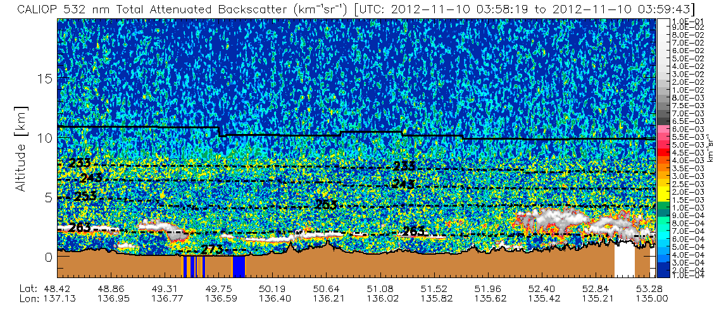
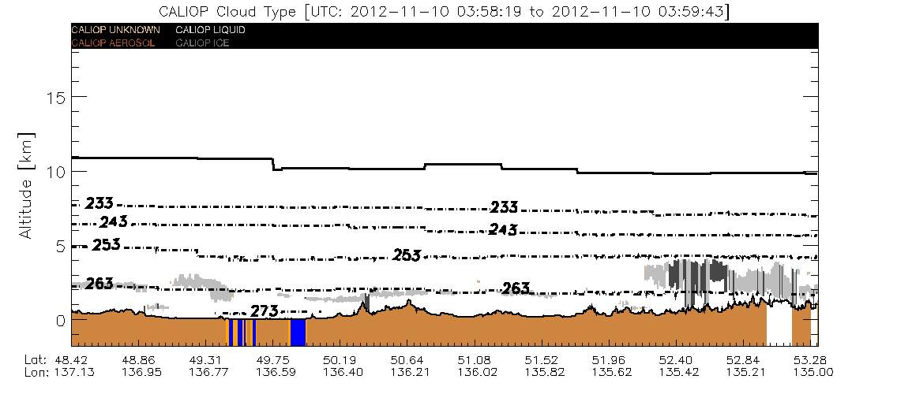
Variable cloud phase
1 km CALIOP Vertical Feature Mask

Slide 64

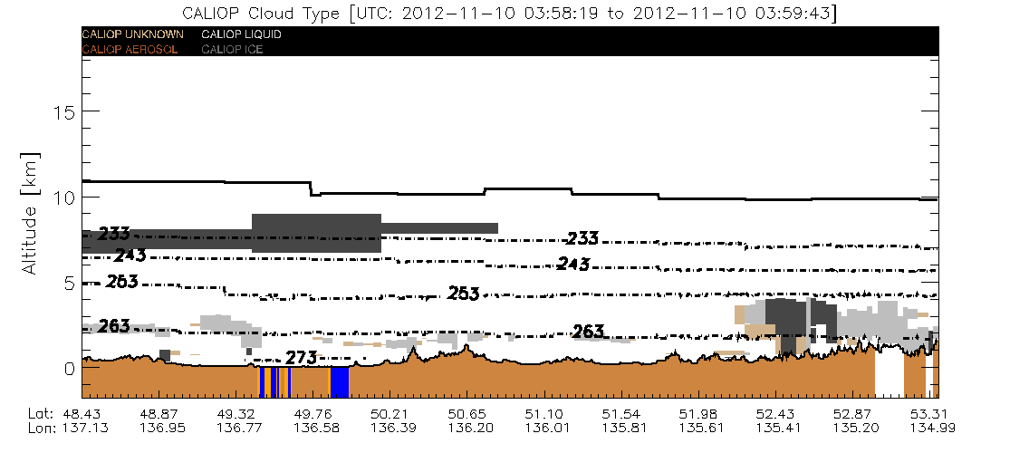
Optically thin ice cloud
5 km CALIOP Vertical Feature Mask

