Slide 1
GOES-16 Imagery
Full Validation PS-PVR
June 1, 2018
Presented by: Tim Schmit¹ & Mat Gunshor²
Special thanks to the GOES-R Algorithm Working Group Imagery Team
NOAA NESDIS STAR CORP ASPB
CIMSS/SSEC/UW-Madison

Slide 2
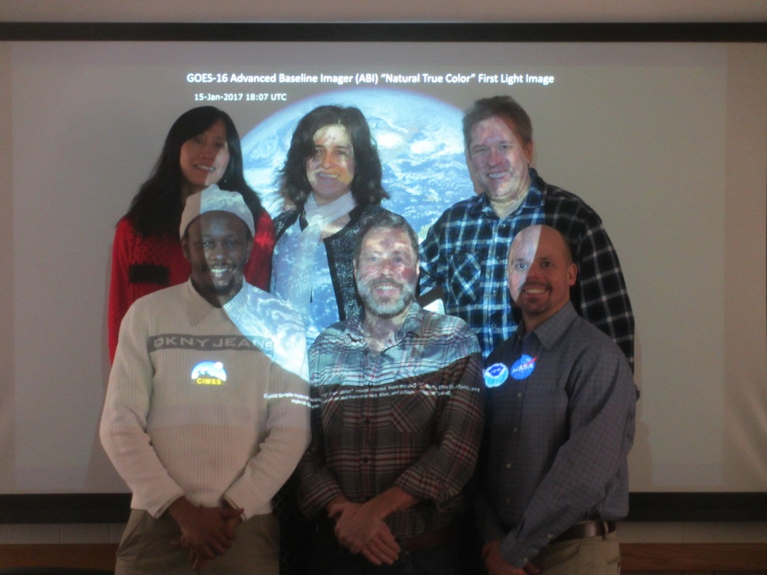
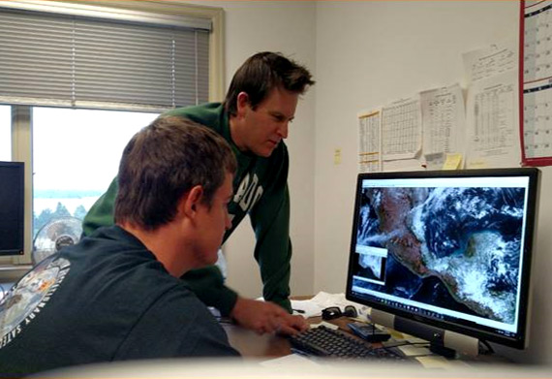
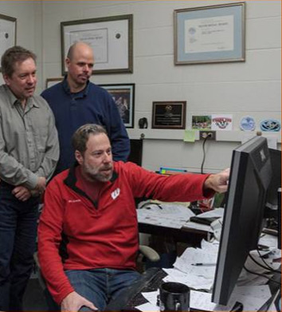
Imagery Team
Team Imagery:
WI (Mat Gunshor, Kaba Bah, Joleen Feltz, Hong Zhang and Jim Nelson, CIMSS) and
CO (Steve Miller, CIRA and Dan Lindsey)
Thanks to Cooperative Institutes and those that help us acquire the data!

Slide 3
Outline
review of provisional status, evaluation at Full (aka PLPTs), PLPT summary, remaining issues/resolutions/recommendations, user feedback
review of provisional status, evaluation at Full (aka PLPTs), PLPT summary, remaining issues/resolutions/recommendations, user feedback
Review of provisional status
Evaluation at Full (aka PLPTs)
PLPT summary
Remaining issues/resolutions/recommendations
User feedback (NWS)

Slide 4
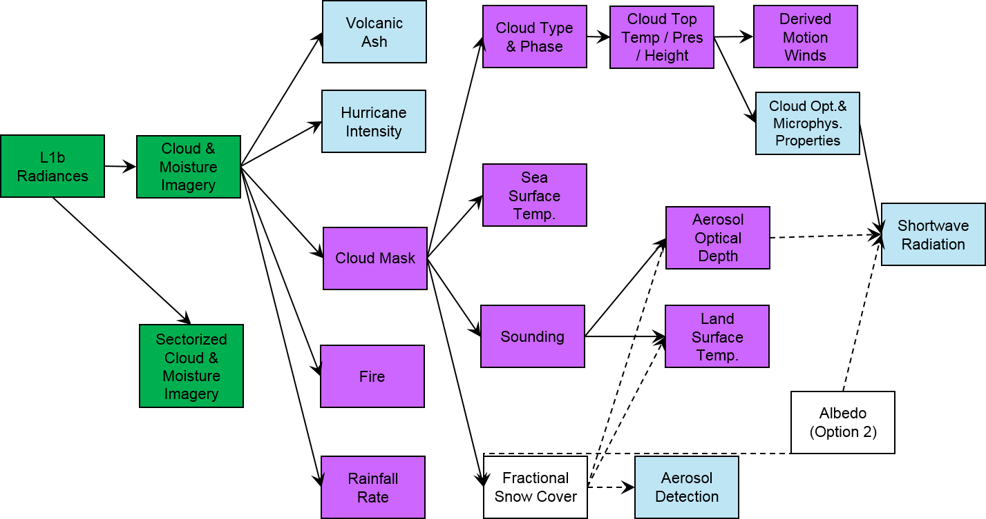
Product Precedence Tree
Green=under review, Purple=provisional, Blue=beta,
White=none
Imagery is the KPP. Most issues at the L1b level will be carried to Imagery and hence can affect other L2 products as well.

Slide 5
Provisional PLPTs from the CMI RIMP
PLPT | Description | Assessment
8 | ABI-FD_CMI04: assess the accuracy and precision of the Imagery FD product, for each ABI band, over a large and wide range of representative conditions, to include quantitative consistency between the input L1b data and the output reflectances/brightness temperatures in the Imagery output. | Passed
9 | ABI-CONUS_CMI02: assess the accuracy and precision of the Imagery CONUS product, for each ABI band, over a large and wide range of representative conditions, to include quantitative consistency between the input L1b data and the output reflectances/brightness temperatures in the Imagery output. | Passed
10 | ABI-MESO_CMI02: assess the accuracy and precision of the Imagery mesoscale product, for each ABI band, over a large and wide range of representative conditions, to include quantitative consistency between the input L1b data and the output reflectances/brightness temperatures in the Imagery output. | Passed
All Imagery tests to meet provisional were done using ground system data from the operational environment (obtained either via PDA, acquired at the UW-Madison and Colorado State Univ. via an automated rsync feed from NOAA/NESDIS/STAR or via GRB through the UW-Madison GRB ingestor).

Slide 6
Path to Full Maturity
[At Provisional PS-PVR]
AWG Imagery noted these issues at the Beta PS-PVR:
  Inconsistencies between L1b radiances and L2 CMI
    Conversion factors to CMI are not up to date in both L1b and L2 files.
    Bit depths between some bands of L1b and CMI are different.
    Min/Max ranges of L2 CMI do not match L1b files.
    Central wavelengths for bands different between L1b and L2 CMI and between single band and multiband CMI
  Co-registration
  Image to image navigation
  “Sheared” images
  Striping in several bands
  Stray Light
  Inconsistent Central Wavelengths between single and multi-band.
  Multiband does not have downscaling method.
    This was added, but incorrect
  DQF inconsistent in space
  Slightly different start times for given image set of 16 bands
  Missing “Chunks” (really from Beta, but was not listed and is under progress)
  15-min Calibration Anomaly (PICA)
  Min/Max/Mean/Std metadata in CMI does not always match file contents
  Extremely hot pixels in band 07 (3.9um) have artificially cold pixels next to them.
  Scan Start Times “slip” from day to day
  Bad Navigation after data outages (Kalman Filter Issues)
  AWIPS SCMI imagery is remapped twice, causing distortions
  GRB: Metadata sometimes comes before the end of the image is sent
Resolved
Progressing
Unresolved
Since Beta
(As of Provisional PS-PVR)

Slide 7
“quantitative consistency between the input L1b data and the output reflectances/brightness temperatures in the Imagery output.”
L1b files contain radiances stored as scaled integers (sometimes referred to as “counts”)
L2 CMIP files contain Cloud and Moisture Imagery (CMI) values stored as scaled integers (sometimes referred to as “counts”)
  Bands 1-6 CMI values are Reflectance Factor (RF)
  Bands 7-16 CMI values are Brightness Temperature (TBB)
It should be possible to generate the values in a CMIP file from the corresponding L1b file using the metadata stored in either file.
  Bands 1-6 use constants that change as the earth-sun-distance-anomaly stored in the files changes.
  Bands 7-16 use constants that should not change for the life time of the instrument.
To test the “quantitative consistency between L1b and L2 CMIP” we generated our own CMIP-like files from L1b files for sample FD, CONUS, and MESO sectors to compare with the corresponding ground-system generated CMIP files.
  Convert Radiances to CMI (RF & TBB) using metadata stored in the files.

Slide 8
Quantitative Consistency
CMI (reflectance factor and brightness temperature) produced by the Ground System
Level 1b (radiance) for all 16 ABI bands
Glance comparison
CMI (reflectance factor and brightness temperature) produced locally using L1b file metadata
Notes:
Solid line is Ground System, dashed line is at CIMSS.

Slide 9
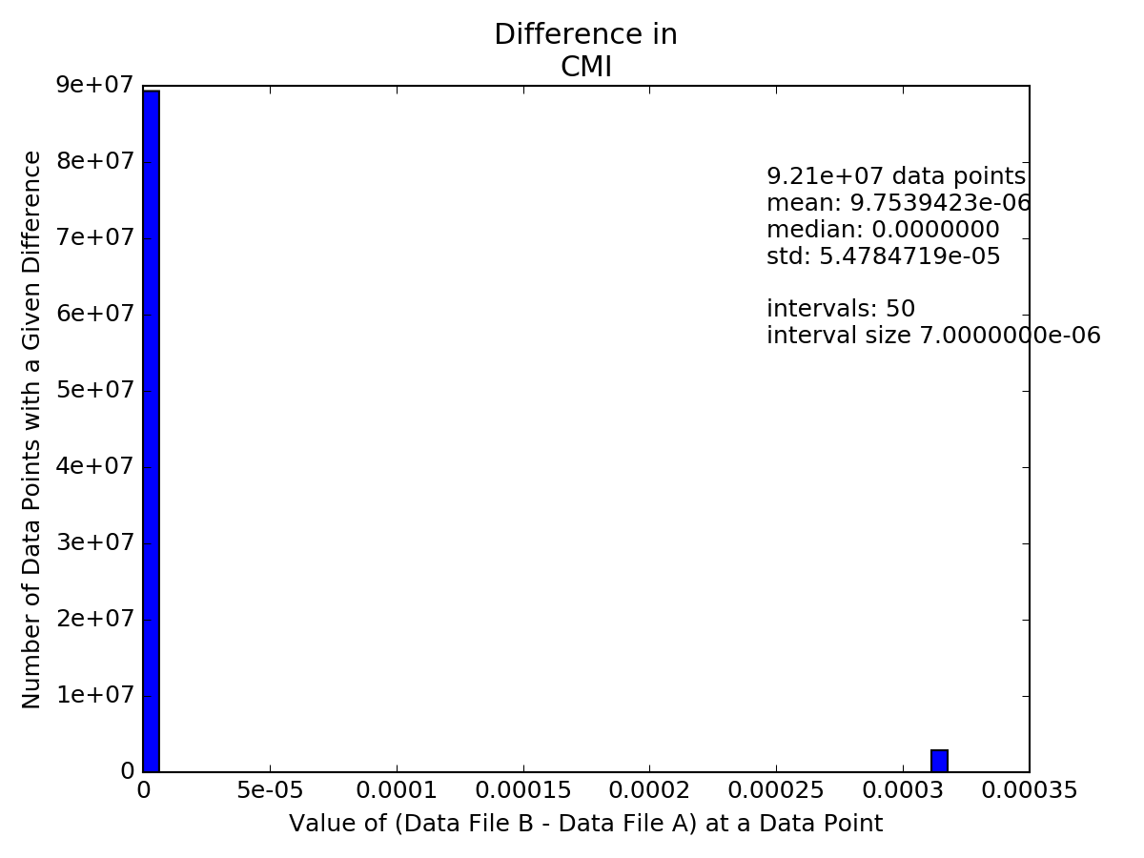
Band 01 (Visible) Example
After the software changes to change the scale factor metadata, good agreement (e.g., sometimes just one count different)!
From 13 December 2017, 13:45 UTC

Slide 10
Major Obstacles to CMIP Full Validation
[at Provisional Review]
Band 02 Reflectances are much too bright
  At least 8%(?) too bright across entire images.
Band 07 Cold Pixels Around Fires (CPAF)
  The remapping algorithm causes extremely erroneous cold values in pixels near a very hot ones, such as near a fire. Sometimes even negative radiances are reported.
Stray Light During Bright Object Avoidance (BOA)
  Also called Solar Avoidance Zones or “Cookie Monster Effect”
  BOA is not aggressive enough to avoid stray light with a big impact in Band 07.
Navigation analyses are FD only.
  CWG did a thorough job on FD, but no detailed analysis done for CONUS, M1, or M2.

Slide 11
PICA Addressed
PICA effect is clearly seen in OE Meso1 files (bands 8-16)
PICA effect seems to be (mostly) eliminated in DE Meso1 files (bands 8-16)
  Radiances are more smoothly varying in DE files
  We don’t know if the vales are absolutely “more correct”
  For most times, OE and DE file radiances are very different, equivalent of 0.1 to 0.15K (greater than spec noise in all bands but 16).
Band 7 we don’t see PICA and radiances are barely changed between DE and OE files.
Bands 1-6 we don’t see PICA, but DE file radiances are very different from OE file radiances

Slide 12
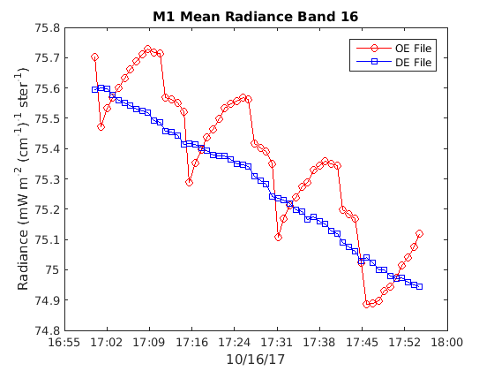
PICA Addressed

Slide 13
Risks to Reaching Full Validation
Risk Name | Description | Impact | Mitigation and Schedule
Inconsistent between L1b and CMI values | The CMI values are currently not being accurately converted from L1b radiances for bands 1-6 | High | TBD
NWS Using Imagery Operationally | Striping, co-registration(?), navigation issues, missing data, missing chunks of images, inconsistent start times for 16 bands, etc. all may be issues the NWS deems unacceptable to using operationally. | Medium | Many L1b issues (cal and INR) go to image quality and need to be fixed over time.
These issues have been addressed.

Slide 14
Outline
Review of provisional status
Evaluation at Full (aka PLPTs)
PLPT summary
Remaining issues/resolutions/recommendations
User feedback (NWS)

Slide 15
High Quality ABI GOES-16 Imagery
As at the provisional stage, the GOES-16 ABI continues to provide high quality imagery
GOES-16 Imagery became operational on December 18, 2017 at approximately 75W
Three sectors types
Many phenomena scanned

Slide 16
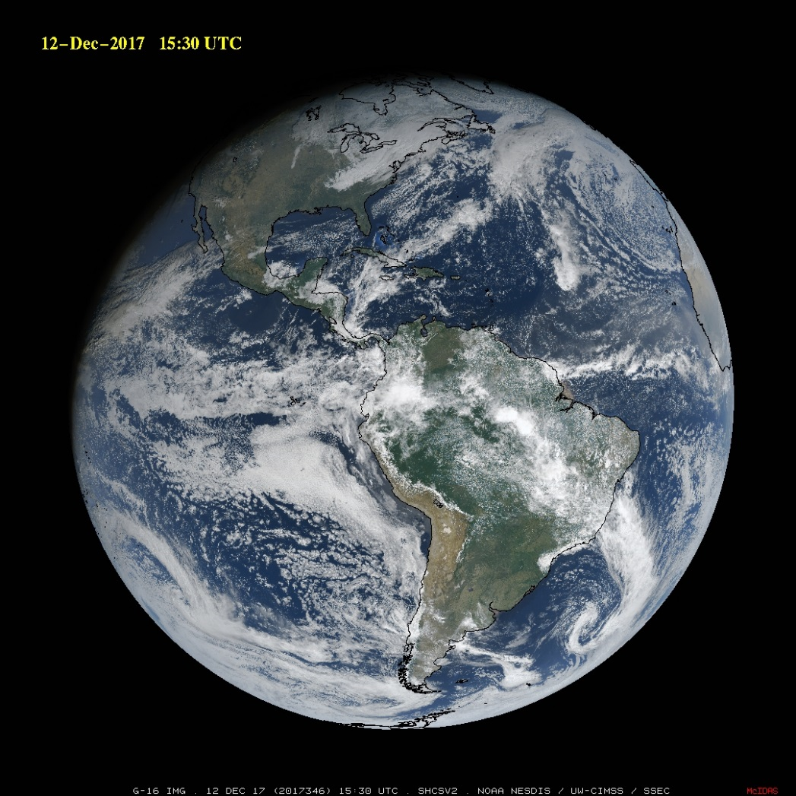
75W

Slide 17
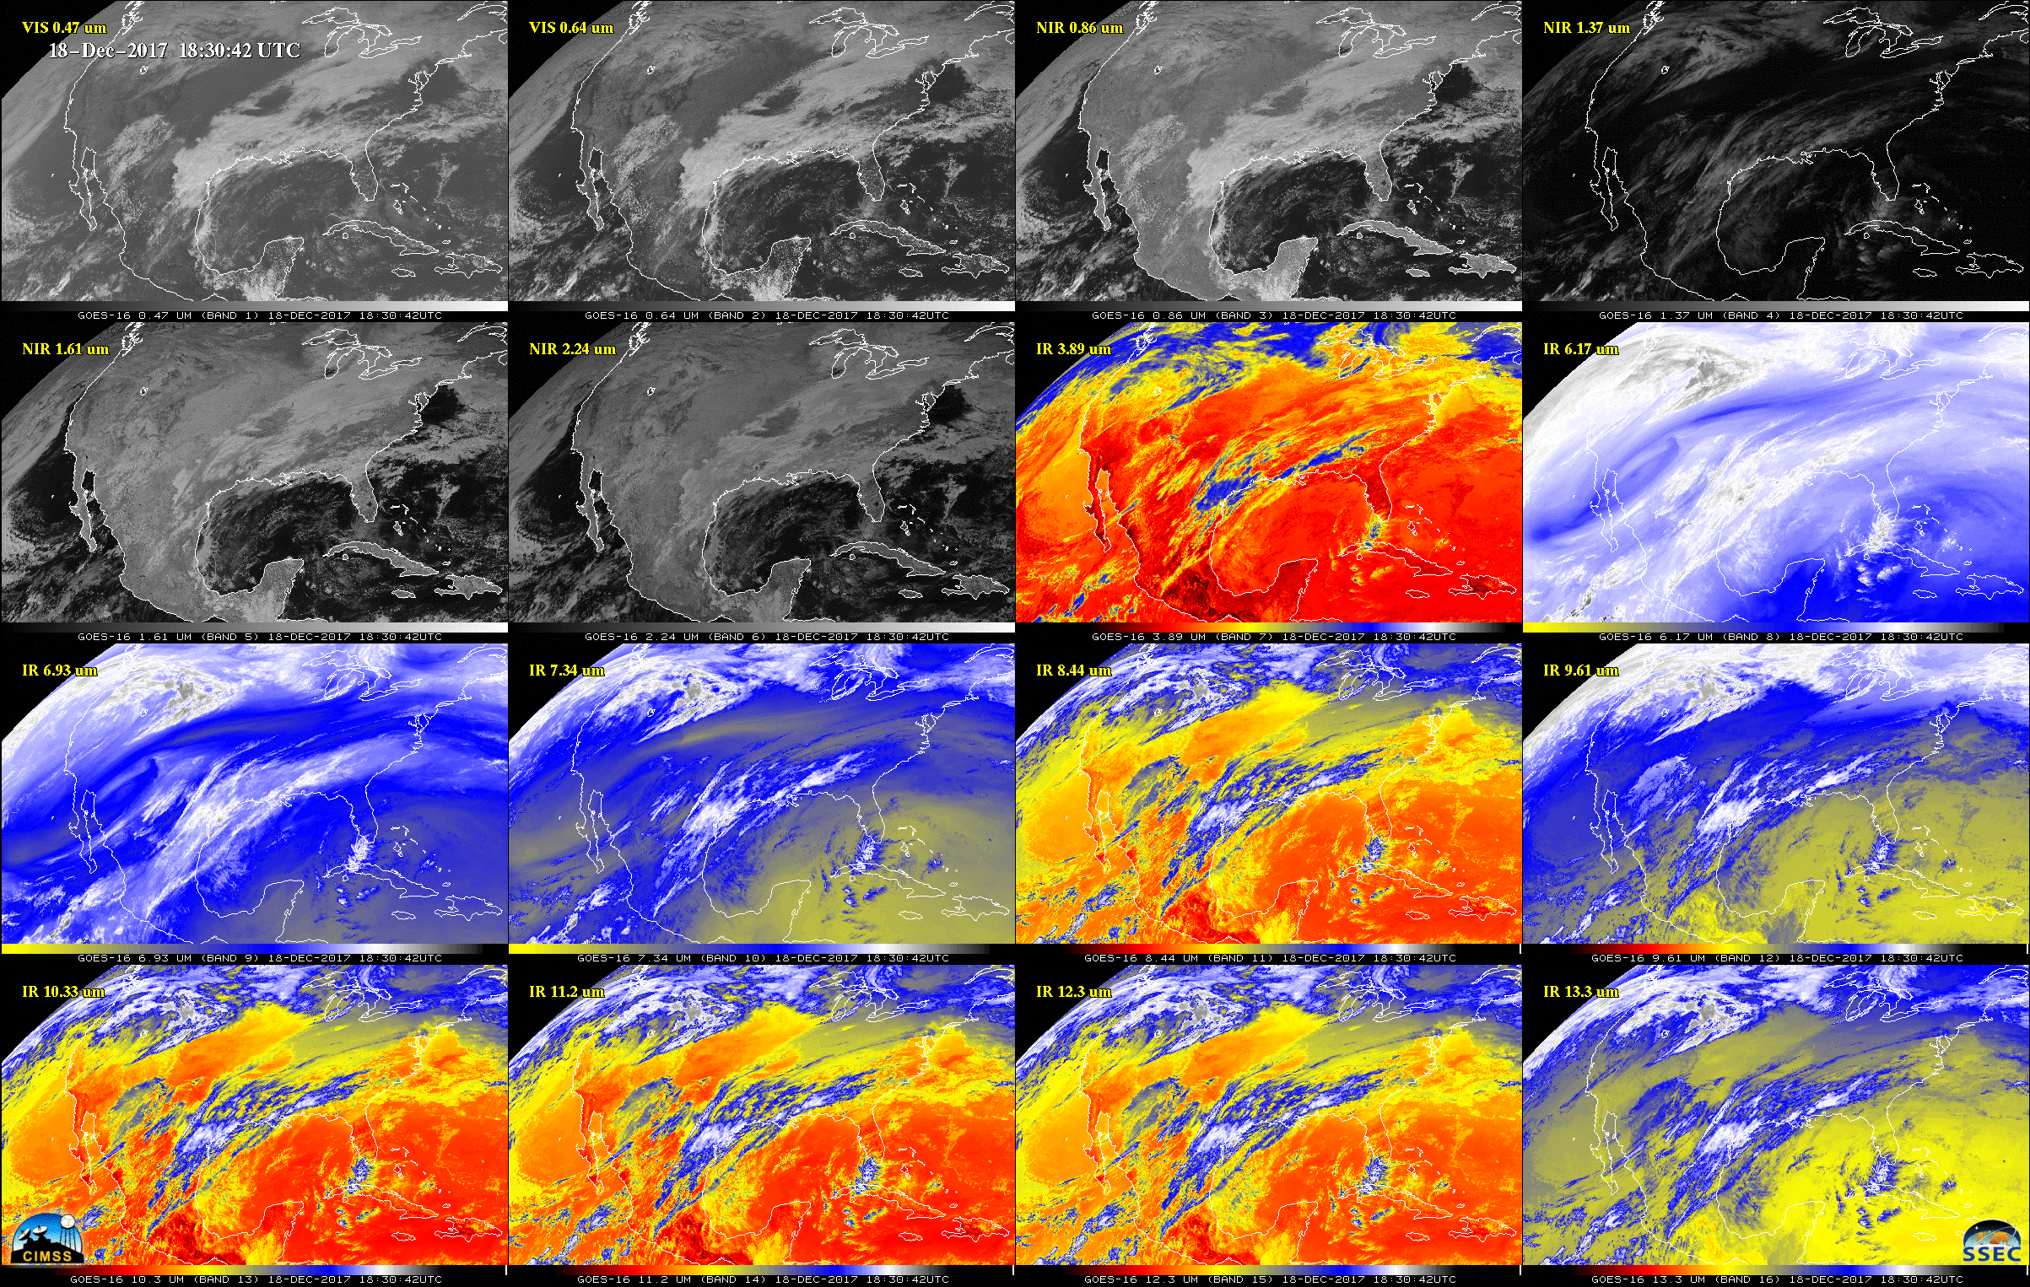
16-channels: G-16
During time of overlap between GOES-13 and -16.

Slide 18
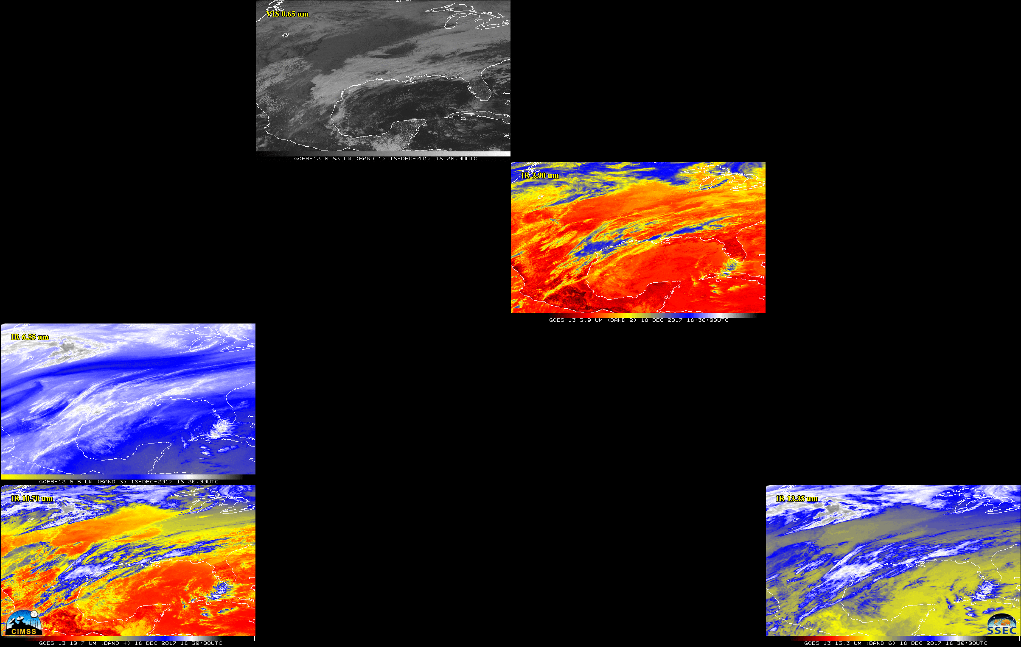
5-channels: G-13
During time of overlap between GOES-13 and -16.
(Native projection)

Slide 19
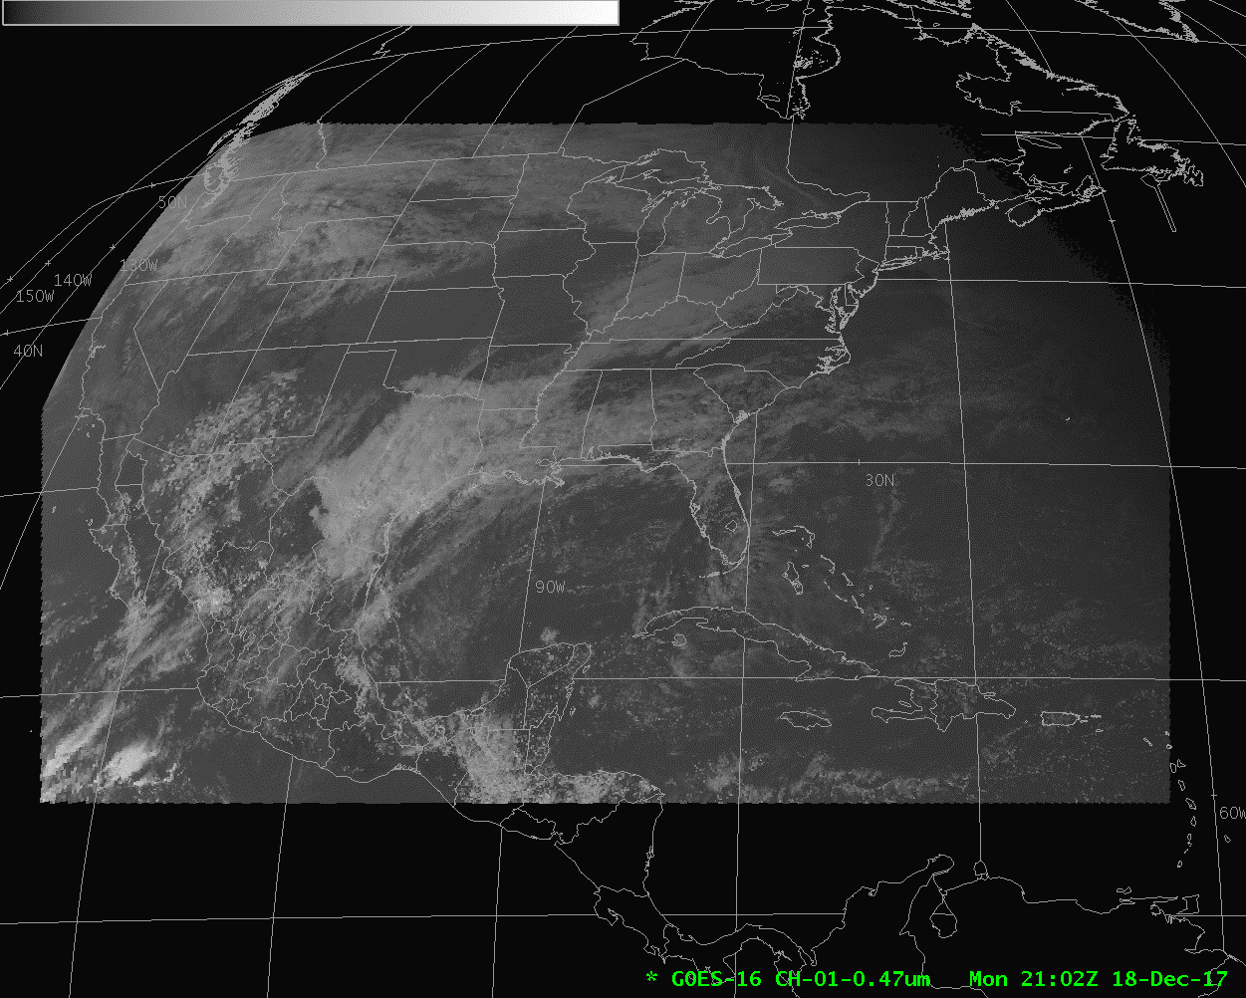
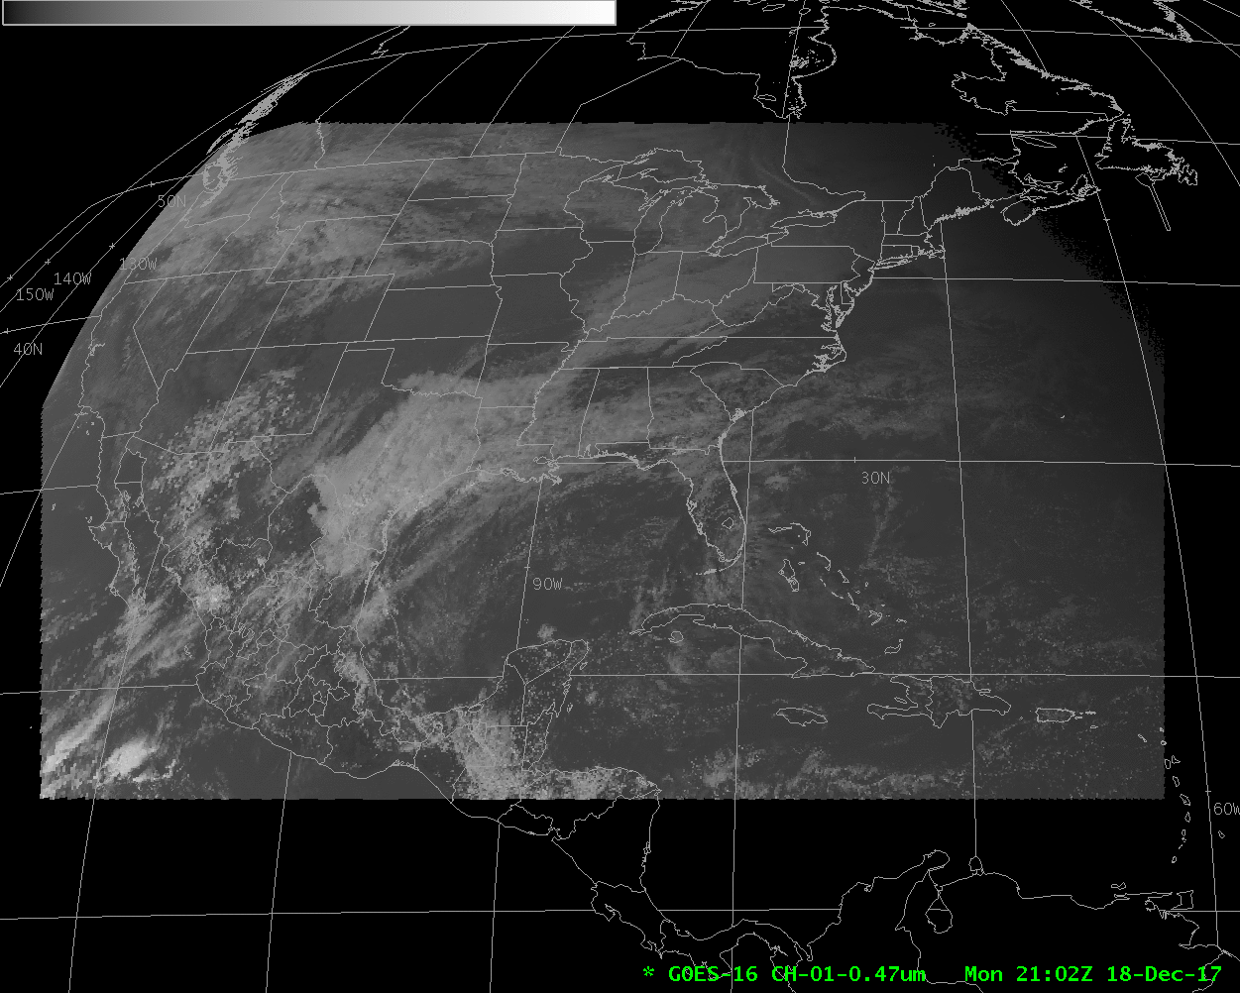
GOES-16 Operational East!
animation
Shown in AWIPS

Slide 20
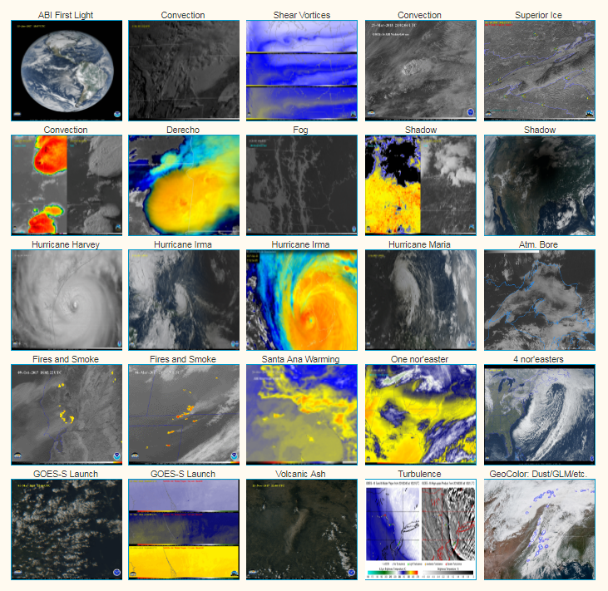
ABI GOES-16 Imagery
Sample GOES-16 Imagery: https://cimss.ssec.wisc.edu/goes/abi/youtube/ABI_loops25.html
http://rammb.cira.colostate.edu/ramsdis/online/loop_of_the_day/

Slide 21
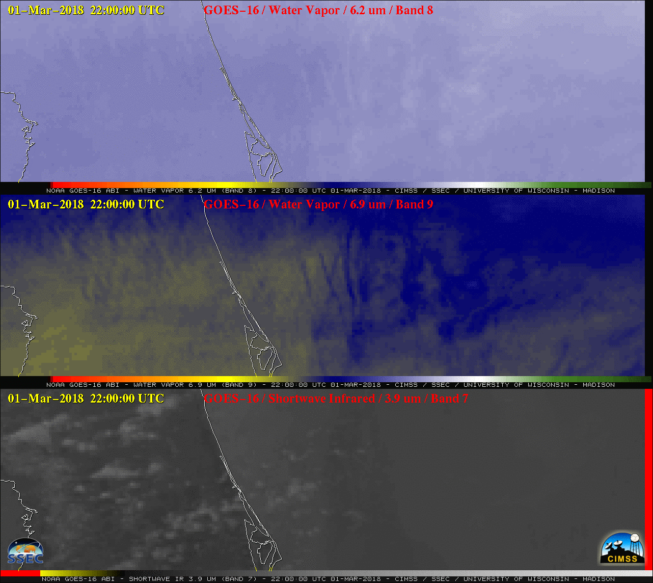

ABI GOES-16 Imagery (GOES-S Launch)
animation

Slide 22
Outline
review of provisional status, evaluation at Full (aka PLPTs), PLPT summary, remaining issues/resolutions/recommendations, user feedback
review of provisional status, evaluation at Full (aka PLPTs), PLPT summary, remaining issues/resolutions/recommendations, user feedback
Review of provisional status
Evaluation at Full (aka PLPTs)
PLPT summary
Remaining issues/resolutions/recommendations
User feedback (NWS)

Slide 23
“Fully” Validated PLPTs from the CMI RIMP
PLPT | Description | Assessment
11 | ABI-FD_CMI06: assess the accuracy and precision of the Imagery FD product, for each ABI band, over the entire range of representative conditions, to include quantitative consistency between the input L1b data and the output reflectances/brightness temperatures in the Imagery output; a minimum of six months’ worth of Imagery output is required for this assessment. | Passed
12 | ABI-CONUS_CMI03: assess the accuracy and precision of the Imagery CONUS product, for each ABI band, over the entire range of representative conditions, to include quantitative consistency between the input L1b data and the output reflectances/brightness temperatures in the Imagery output; a minimum of six months’ worth of Imagery output is required for this assessment. | Passed
13 | ABI-MESO_CMI02: assess the accuracy and precision of the Imagery mesoscale product, for each ABI band, over the entire range of representative conditions, to include quantitative consistency between the input L1b data and the output reflectances/brightness temperatures in the Imagery output; a minimum of six months’ worth of Imagery output is required for this assessment. | Passed
All Imagery tests to meet Full Validation were done using ground system data from the operational environment (obtained either via PDA, acquired at the UW-Madison and Colorado State Univ. via an automated rsync feed from NOAA/NESDIS/STAR or via GRB through the UW-Madison GRB ingestor).

Slide 24

From @NWSDirector:
GOES 16 (and soon GOES 17) allows us to observe amazing atmospheric details. In this loop you can see a pyrocumuls cloud form over a wildfire near Childress, Texas. This information is critical for forecasters and first responders alike.
GOES 16 data 30 sec was remarkable.
Since its launch as GOES-R in 2016, I’ve been blown away by the operational impacts of GOES-16 & GOES East.
As the hurricane season officially ends and we begin to move #GOES16 to its operational position, I can’t stress enough how invaluable GOES 16 data was for this historic hurricane season.
"GOES-16 is redefining mesoscale meteorology" when talking about Hurricane #Harvey
GOES-16 was being used for fire situations in Texas. They knew they had a fire because NWSFO was using GOES-16

Slide 25
Outline
review of provisional status, evaluation at Full (aka PLPTs), PLPT summary, remaining issues/resolutions/recommendations, user feedback
review of provisional status, evaluation at Full (aka PLPTs), PLPT summary, remaining issues/resolutions/recommendations, user feedback
Review of provisional status
Evaluation at Full (aka PLPTs)
PLPT summary
Remaining issues/resolutions/recommendations
User feedback (NWS)

Slide 26
Remaining Issues
Too bright ABI Band 2 (high resolution “red” visible band)
Cold pixels around hot fires (CPAF)
Stray light near Solar Avoidance Zones (e.g., Bright Object Avoidance)
Other issues (time slips, metadata order, etc.)

Slide 27
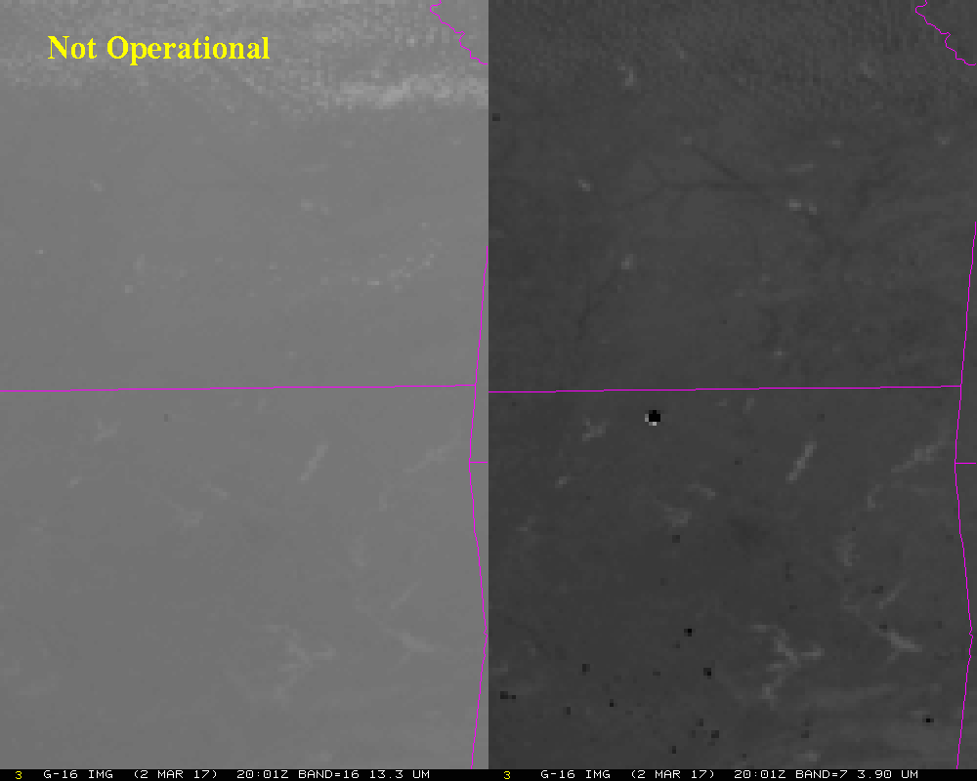
Fire Creates Artificially Cold Pixel?

Slide 28
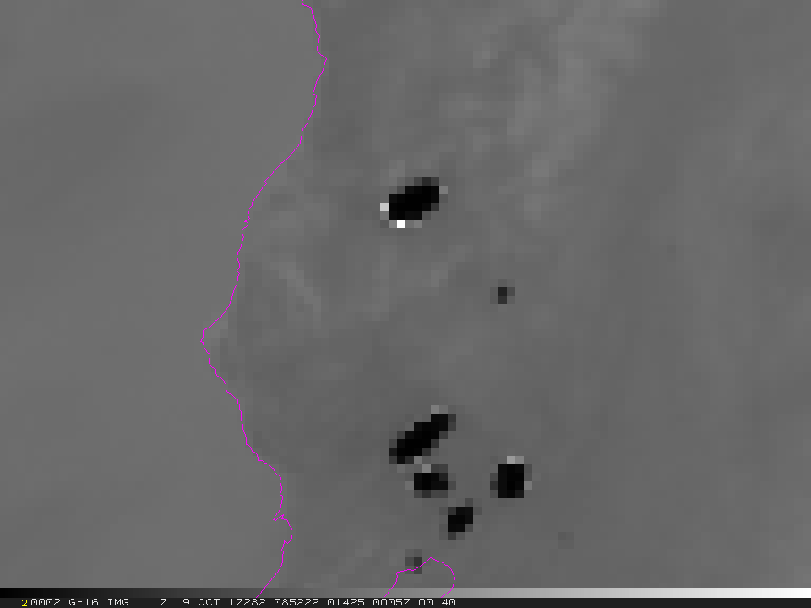
Fire Creates Artificially Cold Pixel?

Slide 29
Band 07 Temp values for small area around fire
Brightness Temperature (K)
Red boxes indicate pixels reporting the maximum Band 07 value.
Blue boxes indicate artificially cold Band 07 pixels near the fire
Select pixels off by between 50 – 289K.
285.01 | 286.69 | 286.14 | 283.12 | 278.88 | 280.14 | 285.72 | 285.93 | 285.29 | 286.21 | 288.35 | 288.22 | 285.08 | 284.42
286.90 | 286.56 | 284.79 | 282.57 | 281.17 | 286.42 | 292.22 | 302.79 | 316.31 | 306.50 | 290.08 | 288.85 | 286.90 | 284.79
287.89 | 286.42 | 286.28 | 285.86 | 288.79 | 299.55 | 333.24 | 368.43 | 396.12 | 365.69 | 276.25 | 288.35 | 286.56 | 284.64
289.16 | 288.73 | 288.66 | 286.69 | 333.00 | 374.93 | 400.68 | 411.86 | 411.86 | 360.86 | 293.52 | 287.96 | 286.00 | 284.04
289.72 | 289.35 | 288.85 | 234.74 | 377.75 | 411.86 | 409.26 | 397.14 | 360.35 | 311.49 | 289.47 | 287.96 | 286.35 | 284.57
289.35 | 288.66 | 289.96 | 279.43 | 357.29 | 385.17 | 341.07 | 344.70 | 296.48 | 289.10 | 288.92 | 286.90 | 286.49 | 286.76
287.50 | 286.63 | 288.15 | 292.71 | 272.94 | 0.00 | 281.43 | 275.51 | 287.76 | 287.96 | 287.89 | 286.56 | 286.42 | 286.69
286.97 | 286.42 | 287.10 | 287.76 | 287.96 | 289.29 | 289.47 | 288.22 | 287.10 | 286.76 | 287.10 | 287.03 | 286.56 | 286.49
285.79 | 285.37 | 285.58 | 284.86 | 285.29 | 287.63 | 287.57 | 286.63 | 286.56 | 287.23 | 287.10 | 285.93 | 285.51 | 285.15
285.15 | 285.29 | 285.15 | 283.04 | 283.36 | 285.58 | 286.49 | 285.86 | 285.08 | 286.56 | 286.35 | 284.04 | 282.65 | 283.51
Band 7 (3.9um) 09 Oct 2017 08:52 UTC
ABI: A product measurements accuracy of 1 K for brightness temperature.

Slide 30
Cold Pixels: Path Forward
Vendor provided 3 alternative resamplers [for the 3.9 um] that mitigate overly cold pixels, including a best that reduces difference to < 2K
  Obtain resampler kernels and potentially processed images (requested)
Perform offline testing first to determine viability of solutions at L1b
  Testing in PWG to confirm L1b performance difference
  If adverse impacts are negligible, then perform higher level product examination to look for impacts to high level products
Increase testing scope to include L2+ products
  If GS DE unavailable for limited duration test, perform further offline testing through ATT (AWG tools) to further assess any impacts
  If GS DE available for limited duration test, perform further offline testing in DE
  If adverse impacts are negligible, consider details of implementation in GS
If PRO concurs with implementation, PRO would work promotion to GS operations through AART process

Slide 31
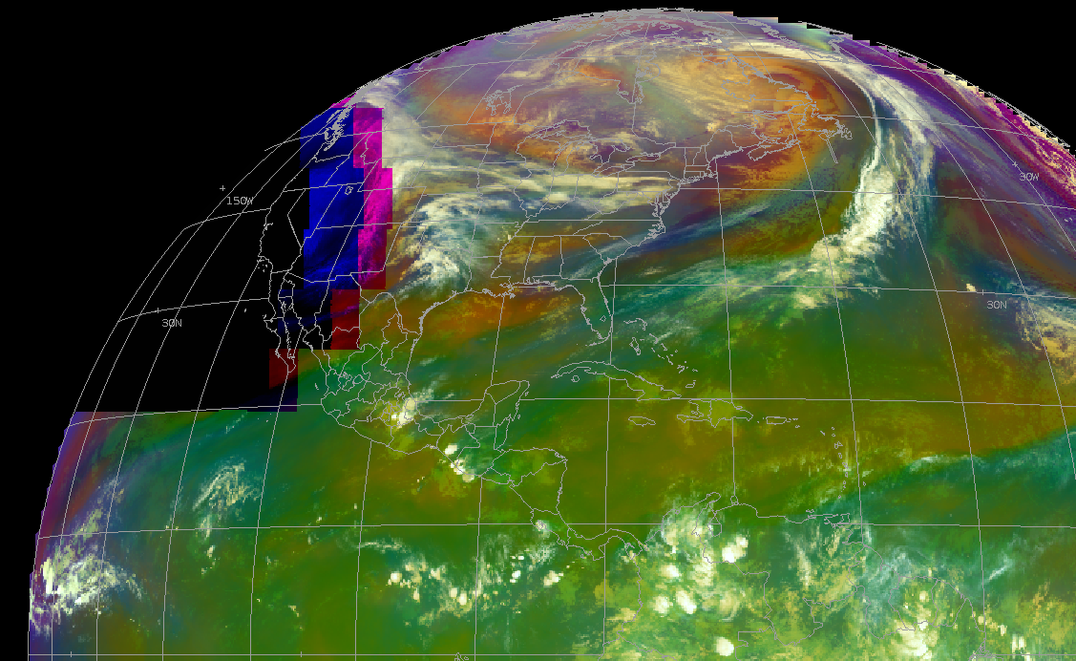
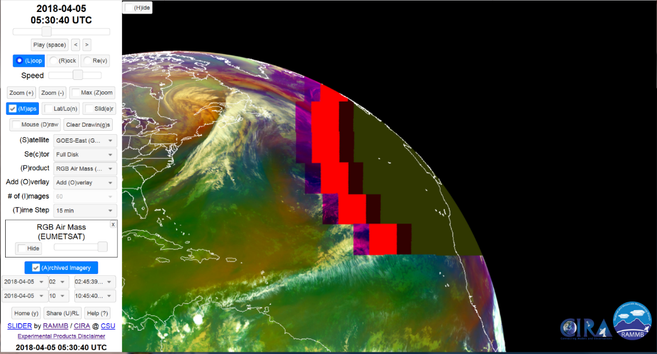
Solar Avoidance Zone
Current ABI processing causes downstream users to see some “wild” imagery when data from one or more spectral bands have different coverages.
Some of the bands provided still have solar contamination.
AWIPS
Slider

Slide 32
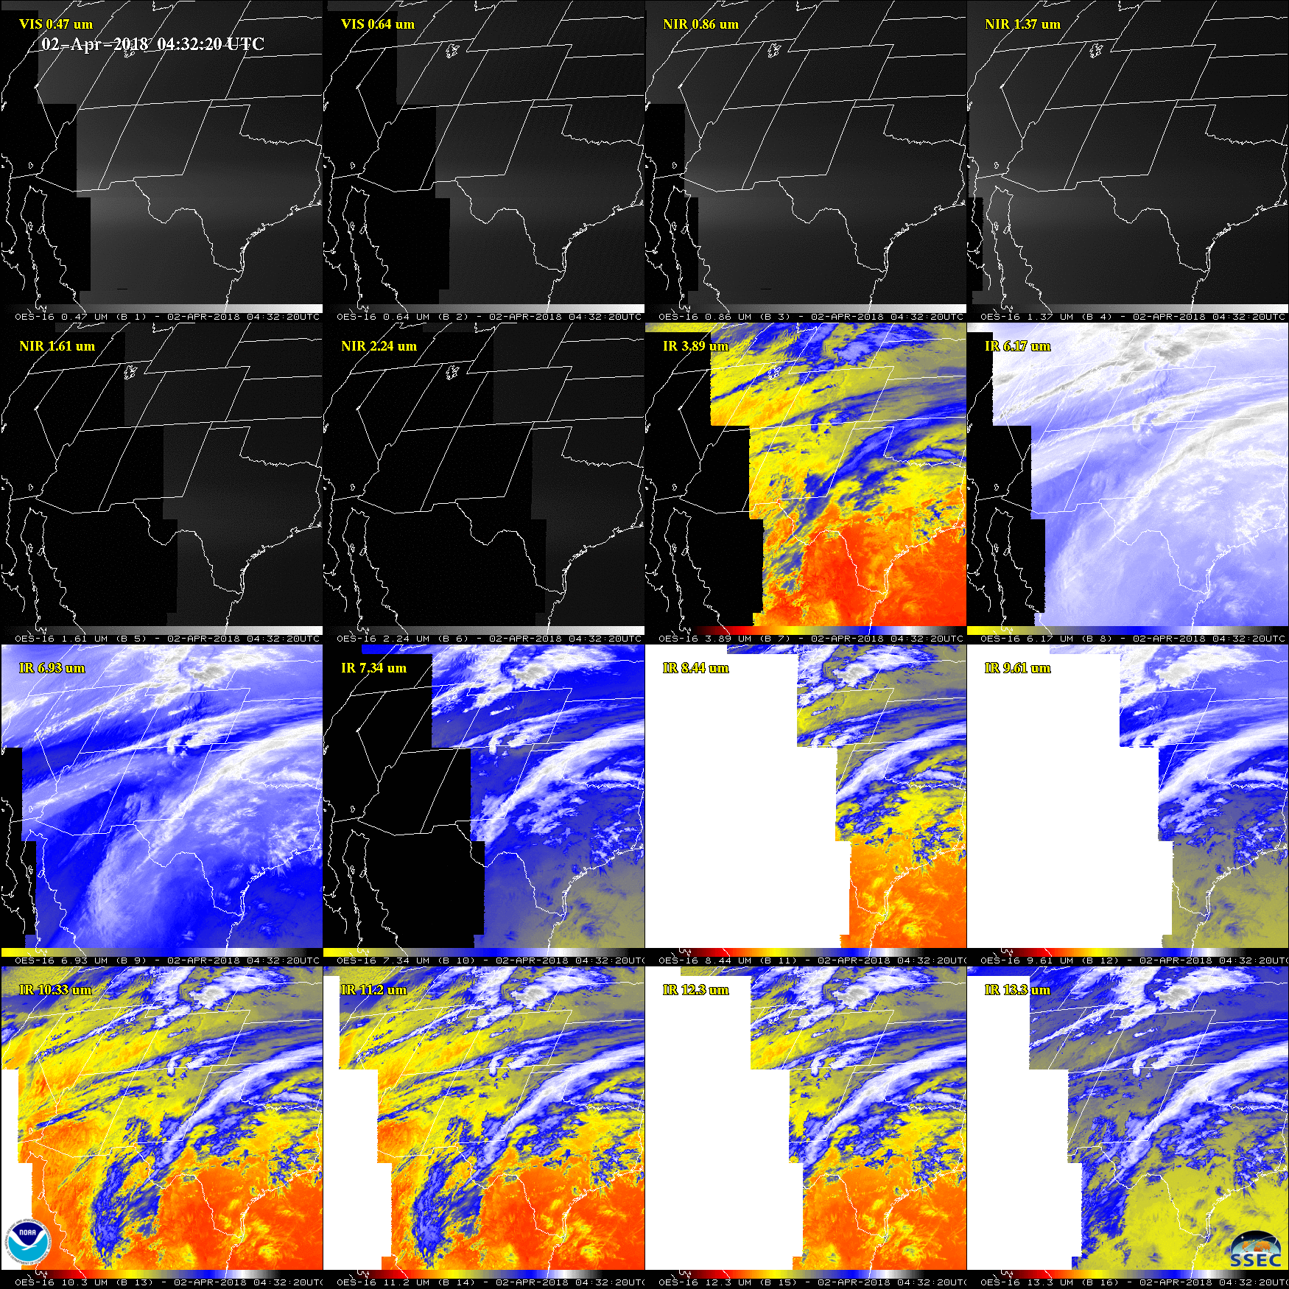
ABI 16 band coverage during a Solar Avoidance Zone
Consider cropping ABI data for all bands to the “maximum” affected area for the most affected band, given stray light
This should be documented in a user-facing location (e.g., a PUG) – a sentence has been suggested for the GOES-R Data Book.
Notes:
Black and white regions are missing data.

Slide 33
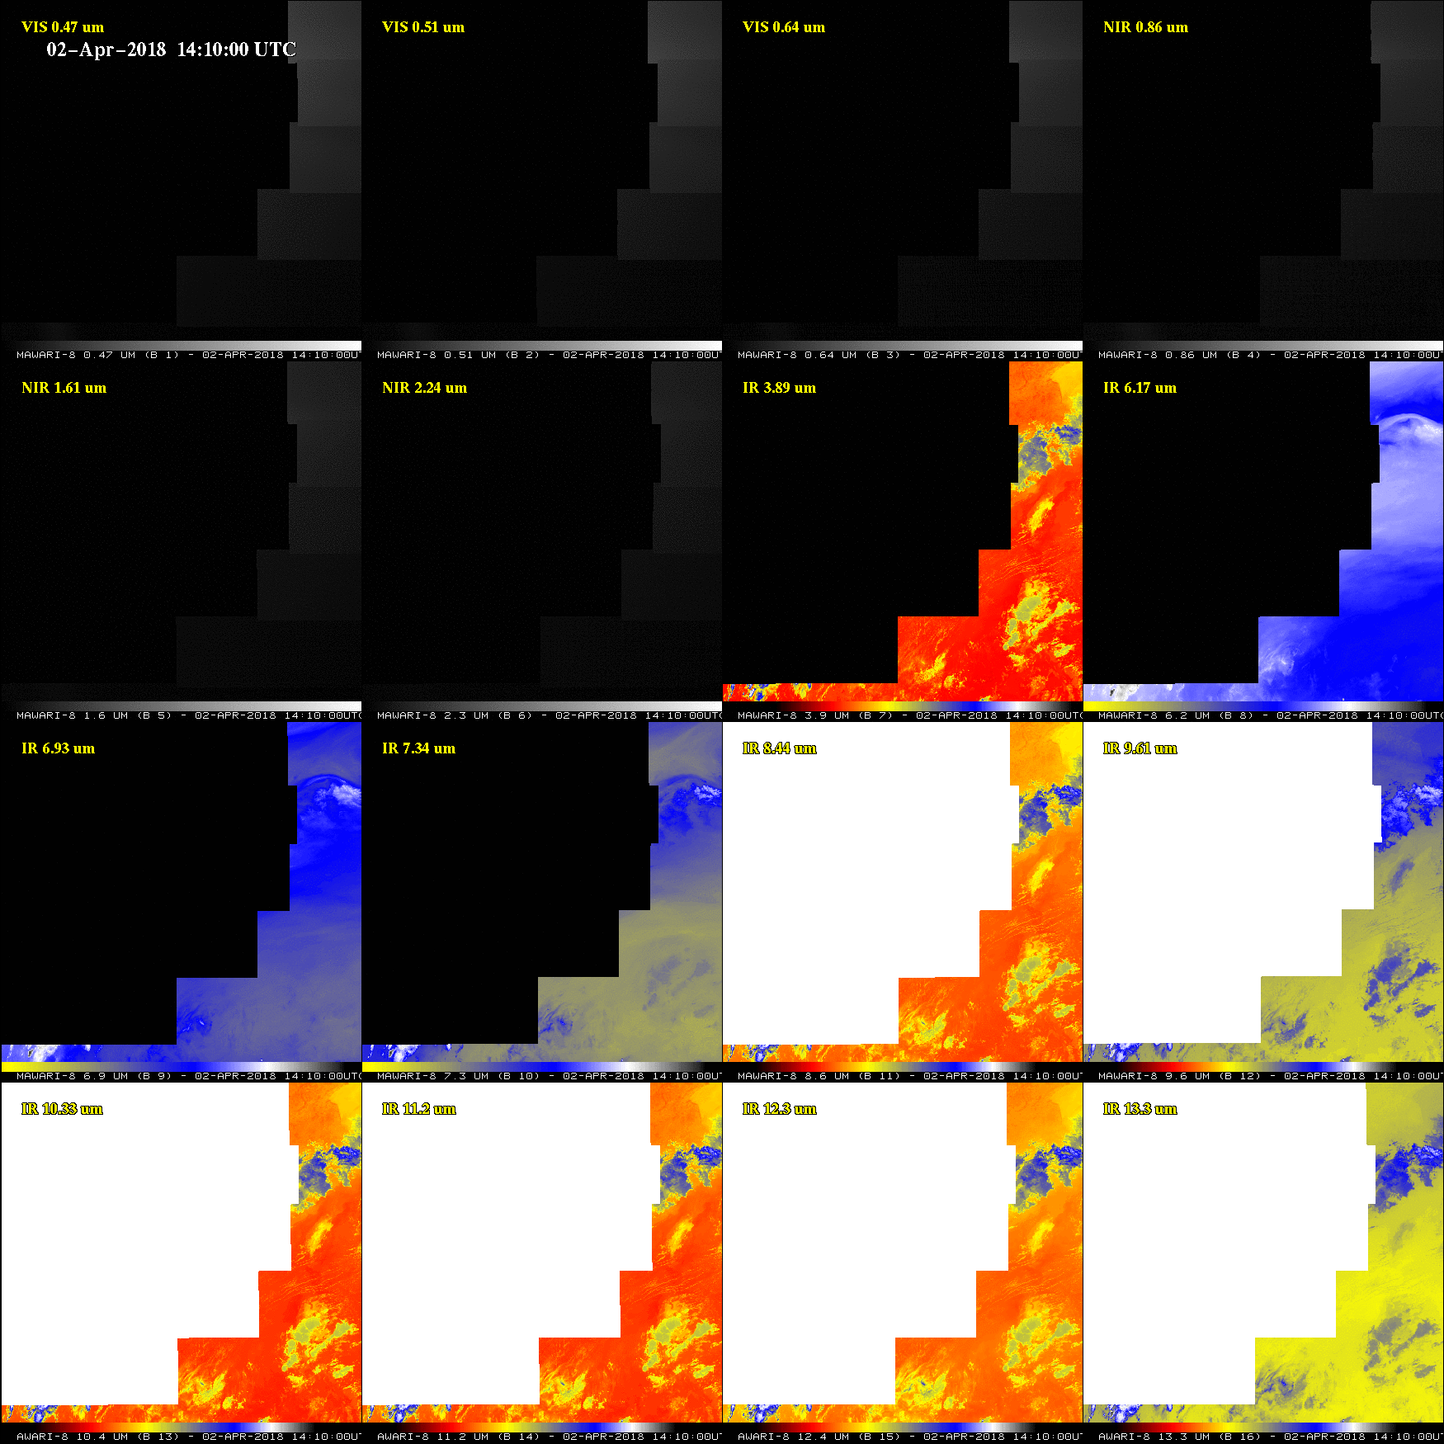
AHI 16 band coverage during a Solar Avoidance Zone
Consider cropping ABI data for all bands to the “maximum” affected area for the most affected band, given stray light, so it’s more like AHI performance
Notes:
Black and white regions are missing data.

Slide 34
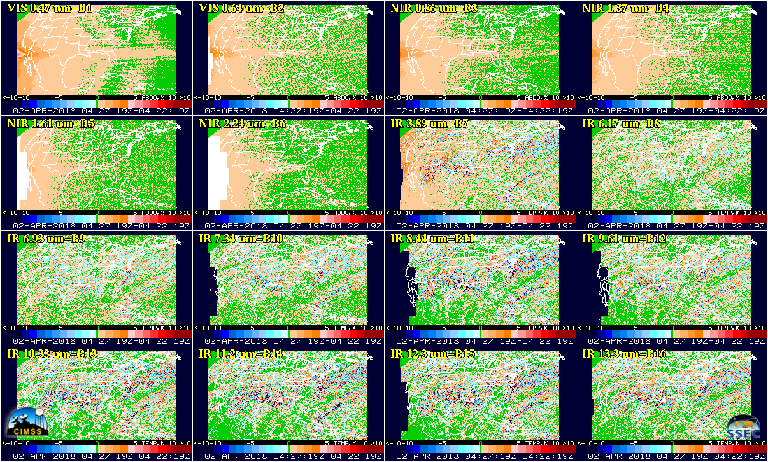
16 Bands CONUS Time Difference on 02 Apr 2018 04:27-04:22 UTC

Slide 35
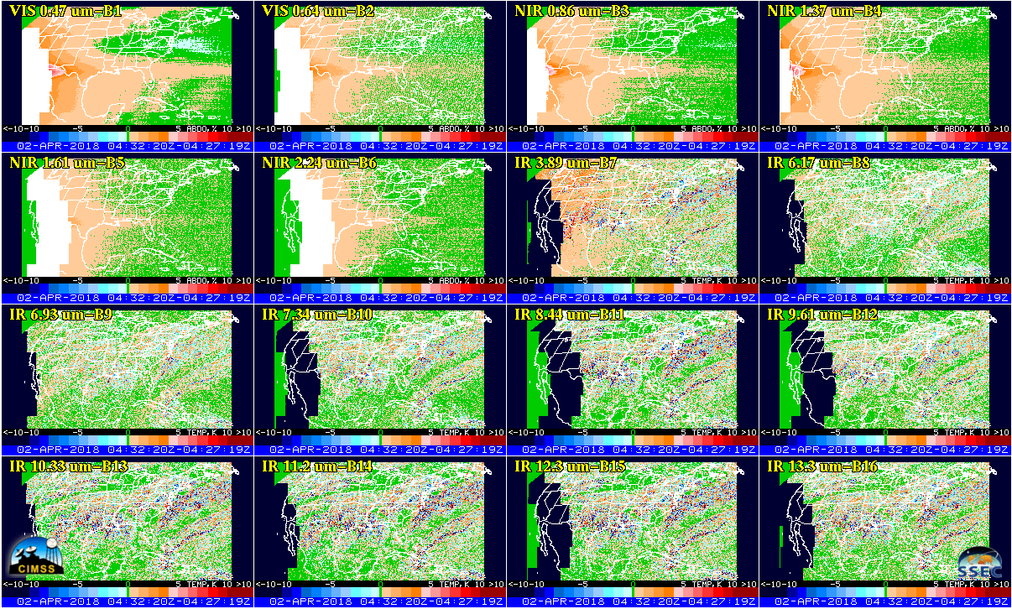
16 Bands CONUS Time Difference on 02 Apr 2018 04:32-04:27 UTC
Note the ABI band 7 Brightness Temperature value off by between 5 - 10K.

Slide 36
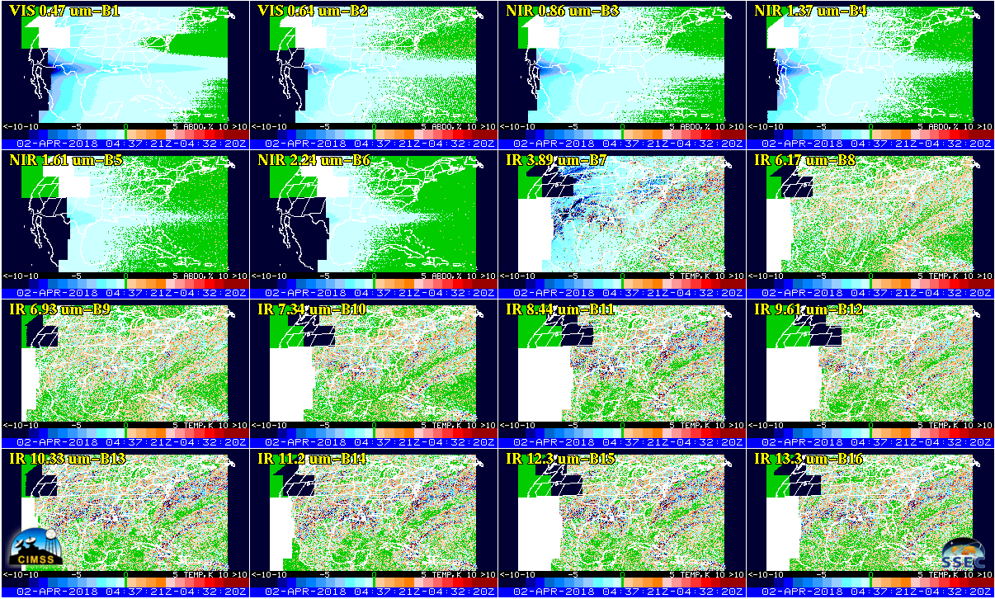
16 Bands CONUS Time Difference on 02 Apr 2018 04:37-04:32 UTC
Note the ABI band 7 Brightness Temperature value off by between 5 - 10K.

Slide 37
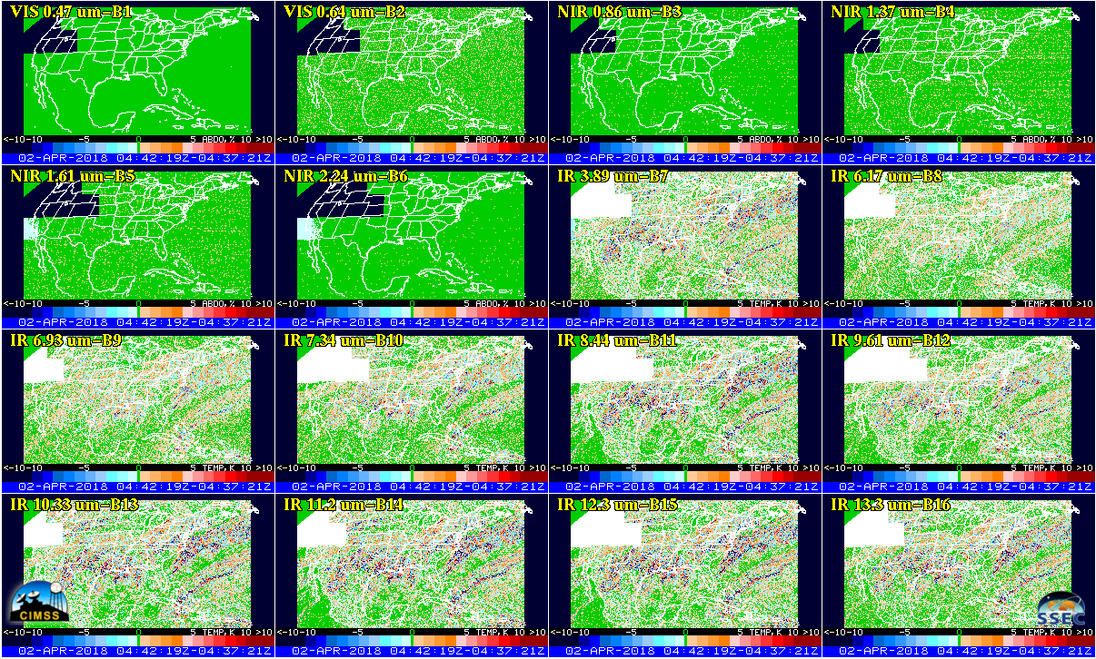
16 Bands CONUS Time Difference on 02 Apr 2018 04:42-04:37 UTC

Slide 38
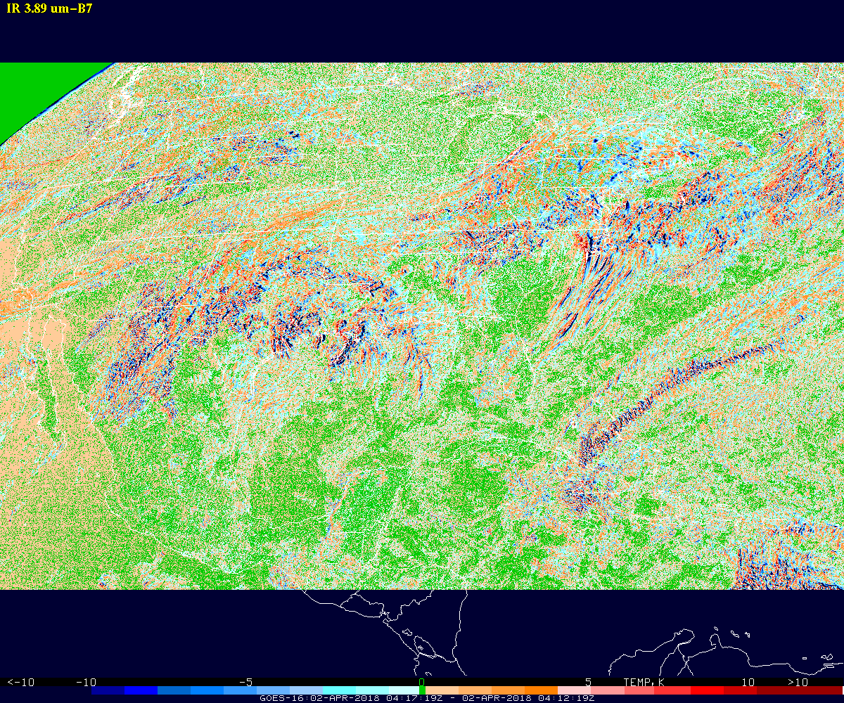
3.9 um CONUS Time Difference on 02 Apr 2018 04:17-04:12 UTC

Slide 39
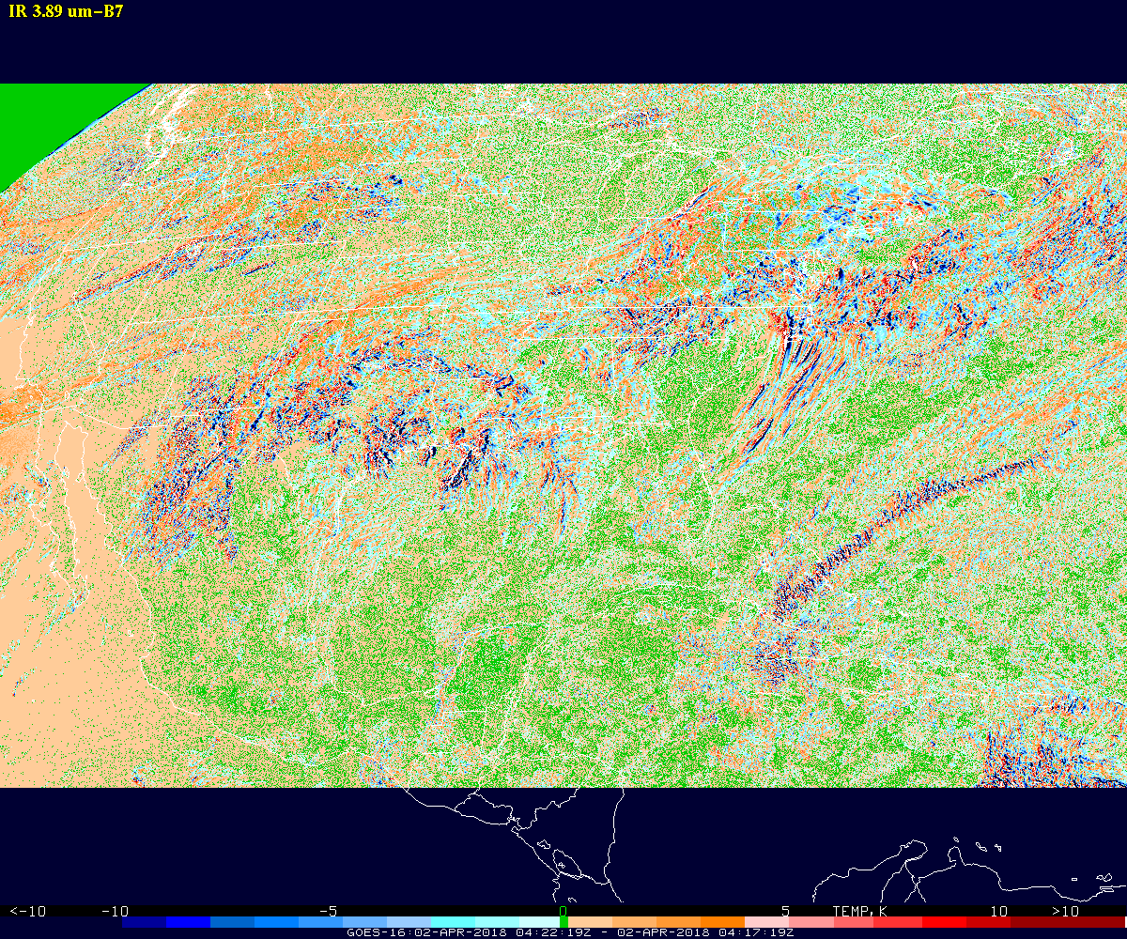
3.9 um CONUS Time Difference on 02 Apr 2018 04:22-04:17 UTC

Slide 40
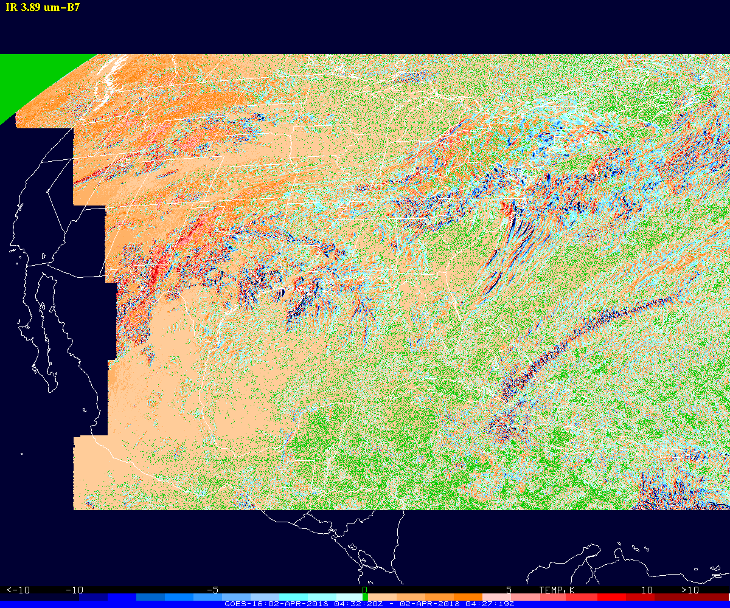
3.9 um CONUS Time Difference on 02 Apr 2018 04:32-04:27 UTC
ABI: A product measurements accuracy of 1 K for brightness temperature.

Slide 41
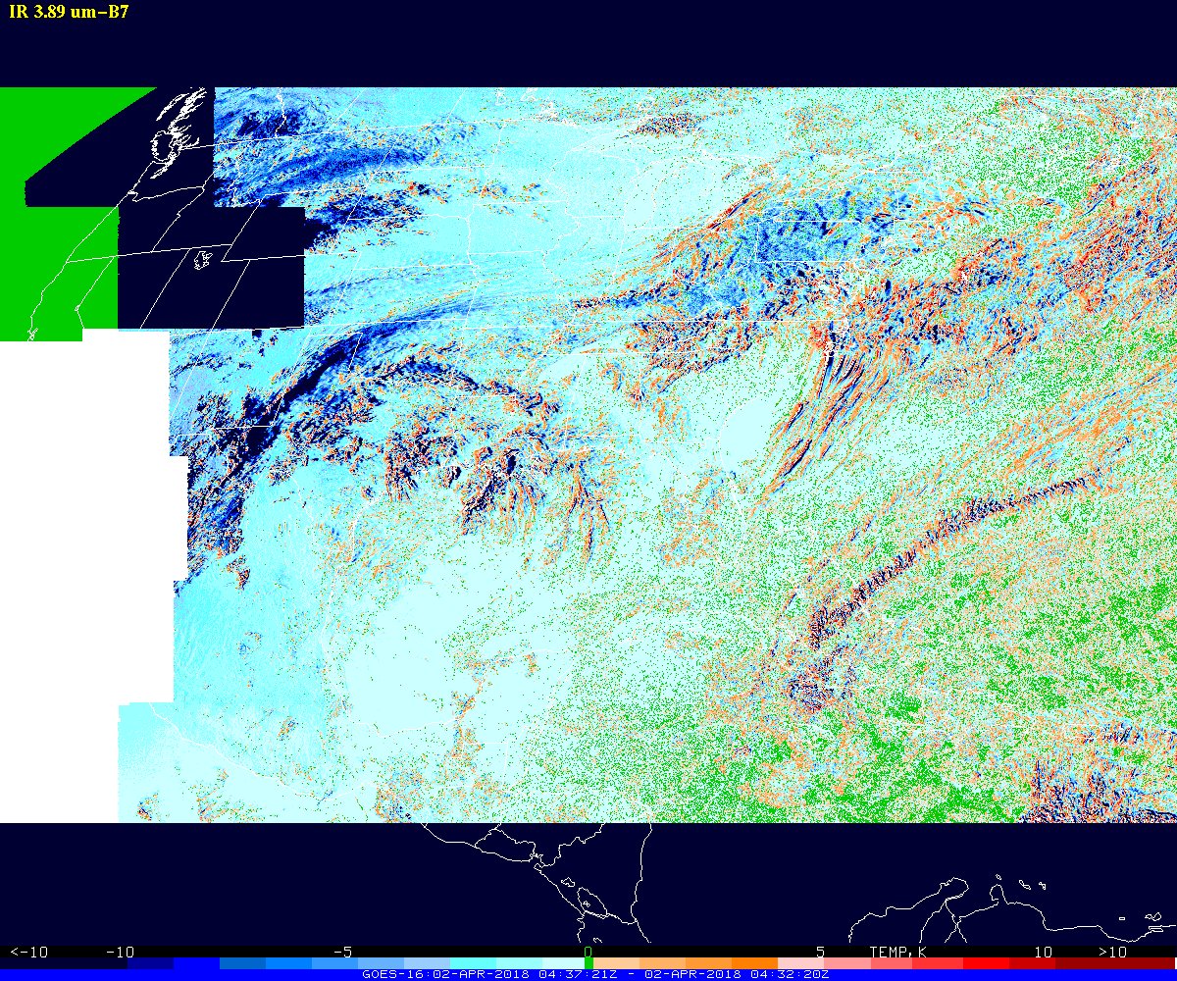
3.9 um CONUS Time Difference on 02 Apr 2018 04:37-04:32 UTC
ABI: A product measurements accuracy of 1 K for brightness temperature.

Slide 42
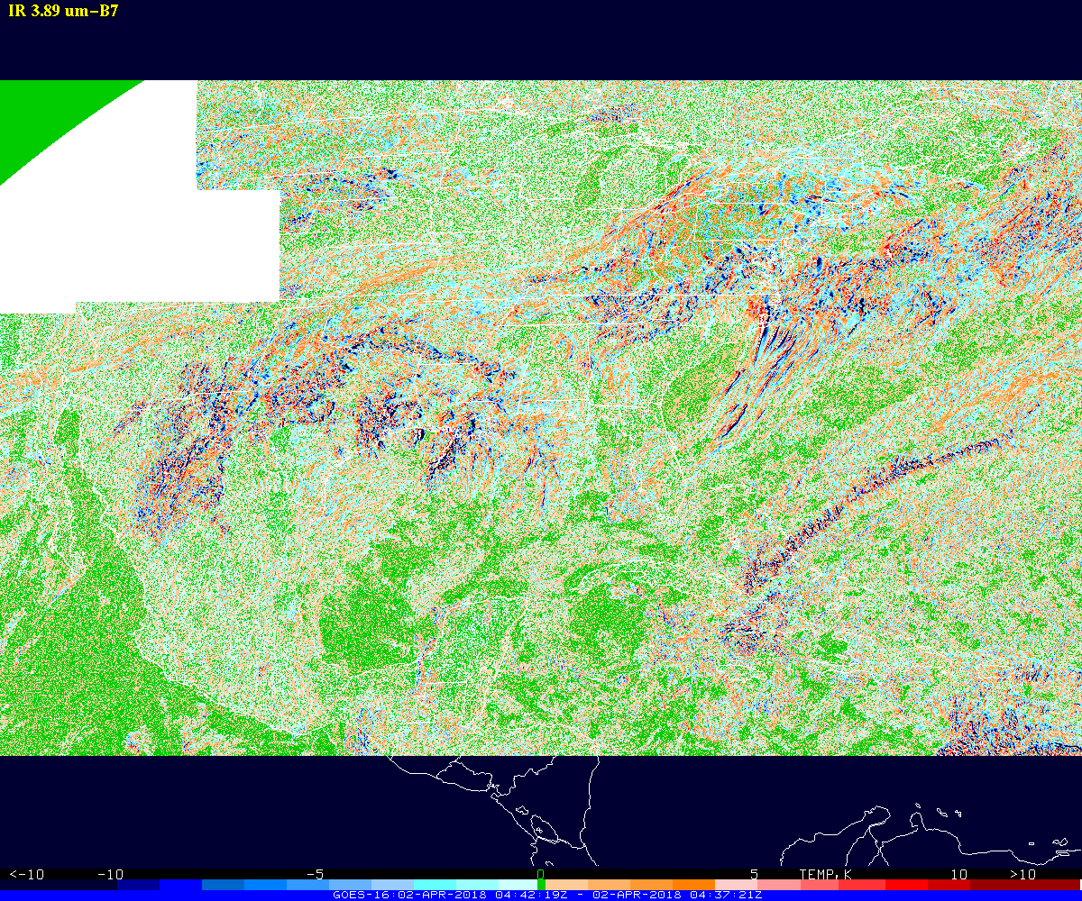
3.9 um CONUS Time Difference on 02 Apr 2018 04:42-04:37 UTC

Slide 43
Stray Light
Stray Light occurs at night, evident in visible/NIR bands.
  The NIR bands can be used for hot/bright spot detection at night and this problem should not be dismissed based on “nobody uses visible/NIR at night.”
  When looking at a full disk image, it is almost never night everywhere on the full disk and stray light in one part of the image can impact images in multiple ways.
  There is no requirement for visible/NIR band use at night.
Stray light sometimes also is evident in the 3.9um band at night.
  In general, the 3.9 um, nor other spectral bands, have not been flagged in region of stray light.
This probably would not hold up full validation and may not be easy to fix or mitigate, but should at least be a longer term goal to improve.

Slide 44
Scan Start Times “Slip”
The 18:00:xx.x file from day to day slips some seconds.
  This is going to confuse users, cause problems with reprocessing, and make it difficult to find the “same” image from day to day.
  Full Disk “18Z” images…
  IMGLIST GOES16A/FD.-19 TIME=18 18:06
  Image file directory listing for:GOES16A/FD
  Pos Satellite/ Date Time Center Band(s)
  sensor Lat Lon
  --- ------------- ------------ -------- ---- ---- ------------
  480 G-16 IMG 15 MAY 17135 18:00:22 0 89 1-16
  217 G-16 IMG 14 MAY 17134 18:00:37 0 89 1-16
  123 G-16 IMG 13 MAY 17133 18:00:25 0 89 1-16
  27 G-16 IMG 12 MAY 17132 18:00:37 0 89 1-16
  IMGLIST: done

Slide 45
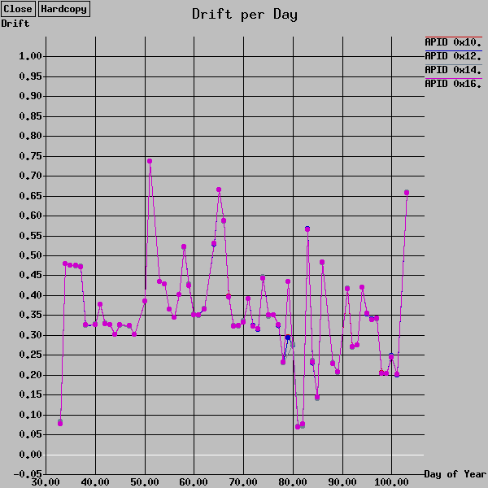
Scan Start Times “Slip”

Slide 46
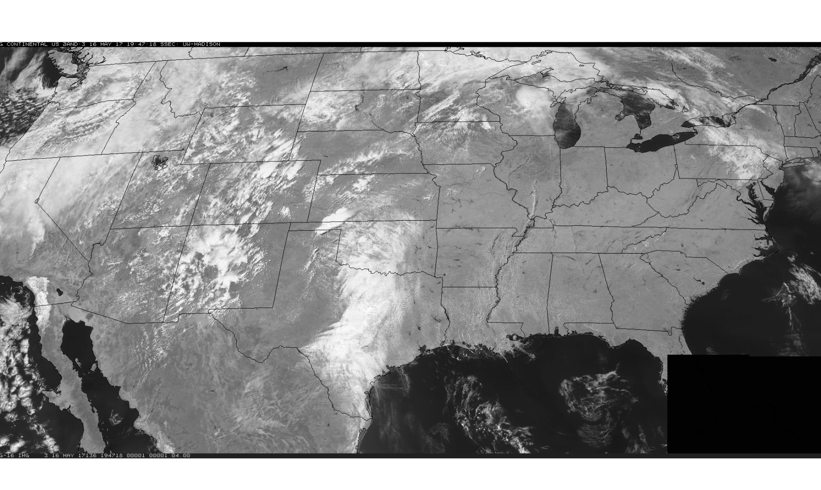
GRB Metadata Sent Too Soon
When the metadata arrives for a file, that is supposed to be the indicator that the entire file has been delivered….

Slide 47
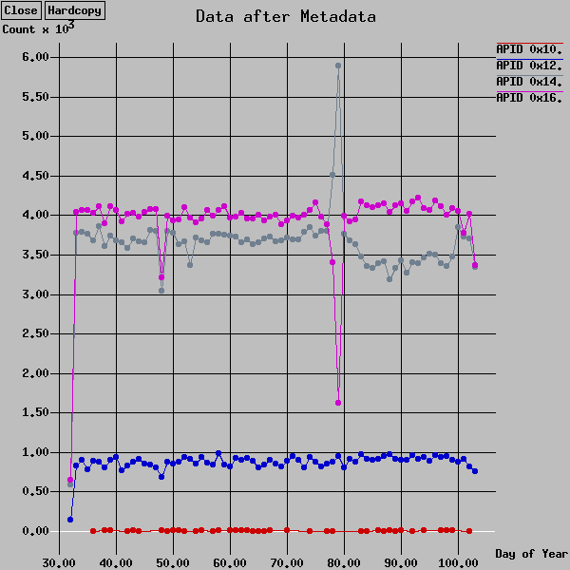
GRB Metadata Sent Too Soon

Slide 48
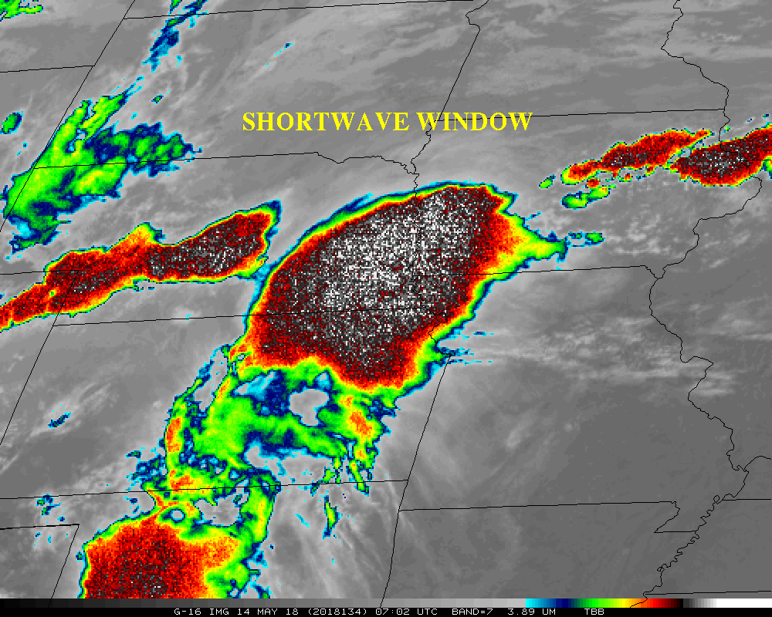
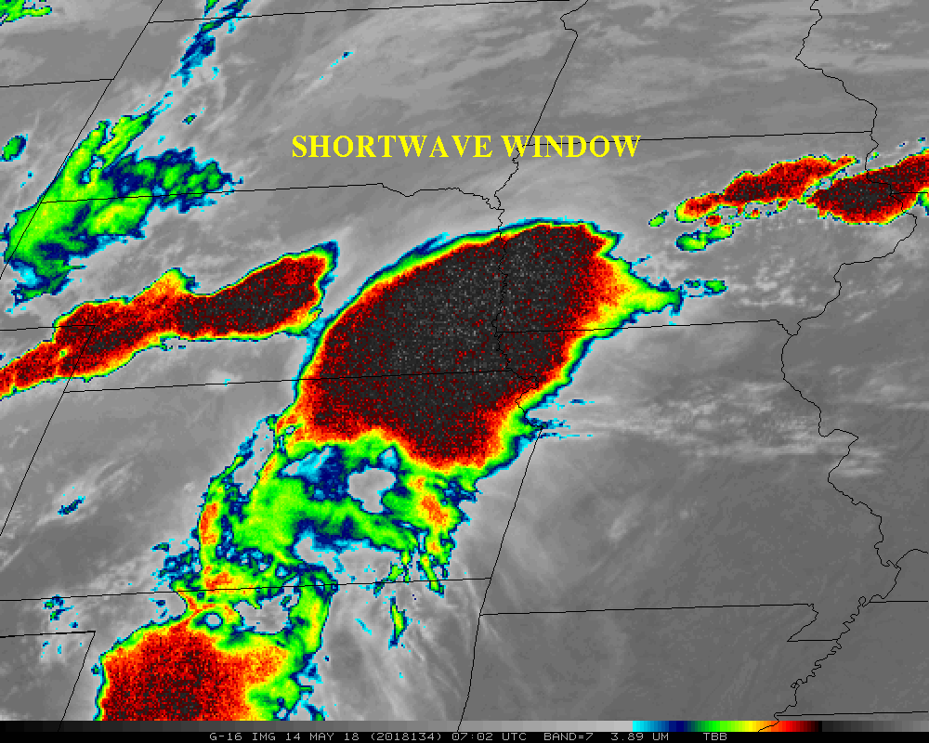
3.9 um enhancement
Enhancements Matter! Same scene, image on left highlights the noise at the cold end. (Some users thought the noise might be lightning.)

Slide 49
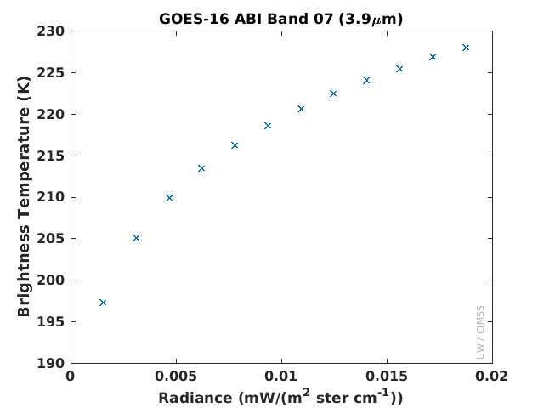
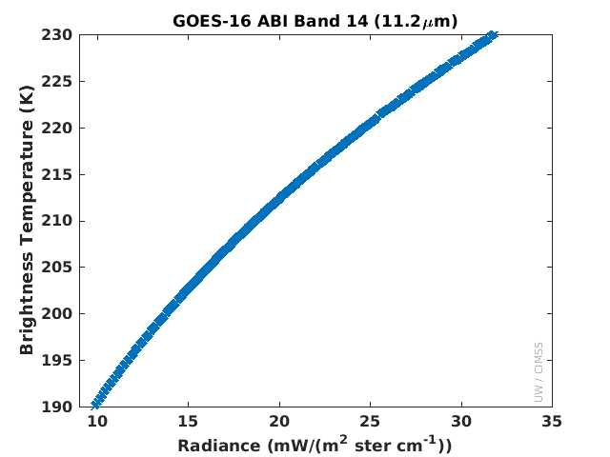
3.9 and 11.2 um
Radiance vs Brightness Temperature
Quantization on the cold end
Opportunity to Educate Users

Slide 50
Recommendation for Full Maturity
AWG Imagery recommends that CMI data be transitioned to Maturity status at this time, assuming the following issues continue to be addressed and/or documented:
Band 02 Reflectances are much too bright
Band 07 (3.9 um) Cold Pixels Around Fires (CPAF)
Stray Light During Bright Object Avoidance (BOA)
  Also called Solar Avoidance Zones or “Cookie Monster Effect”
  BOA may not be aggressive enough to avoid stray light with a big impact in Band 07.
Document for users that the BOA varies by spectral band.

Slide 51
Full Validation
Preparation Activities | Assessment
Validation, Q&A, and anomaly resolution activities are ongoing. | Agreed.
Incremental product improvements may still be occurring. | Agreed.
Users are engaged and user feedback is assessed. | Agreed.
End State | Assessment
Product performance for all products is defined and documented over a wide range of representative conditions via ongoing ground-truth and validation efforts. | Agreed.
Products are operational optimized, as necessary, considering mission parameters of cost, schedule, and technical competence as compared to user expectations (Performance Baseline). | Agreed, still working ABI Band 2 too bright and CPAF
All known product anomalies are documented and shared with the user community. | Agreed, still work to communicate ABI Band 2 too bright and CPAF and that the BOA varies by spectral band.
The product is operational. | Agreed.

Slide 52
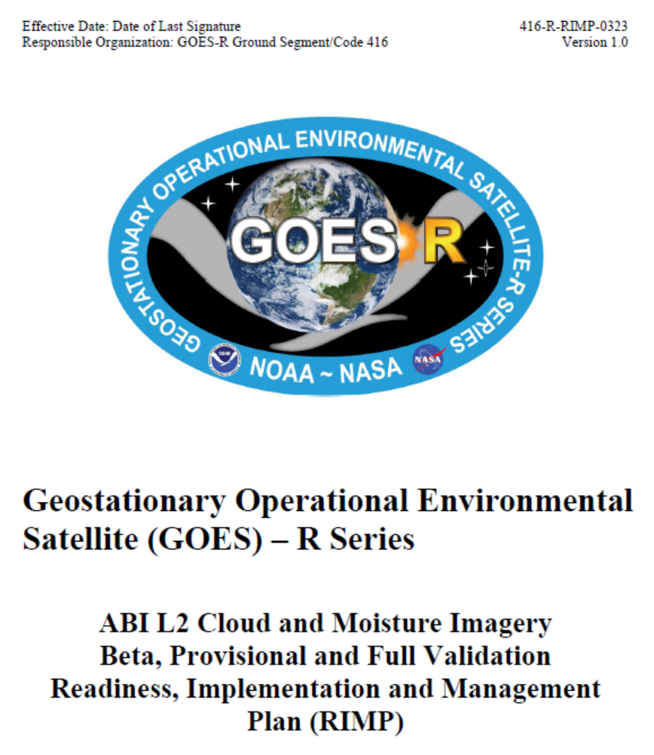
Imagery RIMP
A core assumption of the RIMP is that the AWG teams are fully funded

