Slide 1
GOES-16 Derived Motion Winds in AWIPS
NWS/OBS Update to PS-PVR
Feb 9, 2018

Slide 2
GOES-16 DMWs in AWIPS
NWS first added GOES-R DMW software to AWIPS in 15.1 (CY 2015)
  Display of wind speed and direction (barbs), selectable by channel number
  This format follows after ASCAT surface wind displays in earlier versions
Pre-launch testing and AWIPS dev were informed by Himawari DMWs
NWS provided GOES-R beginning in July 2017
  Transmitted CONUS and Meso sectors over SBN, but not Full Disk (FD)
  File size and SBN bandwidth precluded dissemination of FD
  Will re-address FD distro in future based upon user (e.g., Center) needs
Additional AWIPS enhancements have been added and/or are in progress (see following slides)

Slide 3
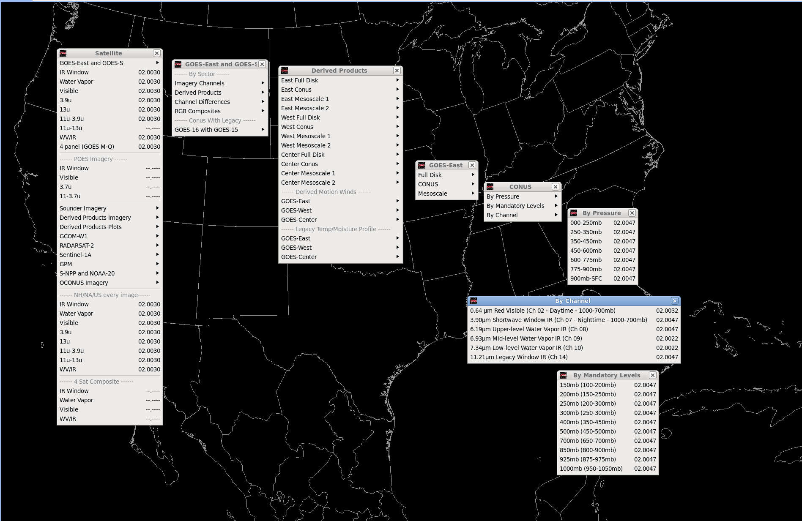
GOES-16 DMW Menus
By Pressure
By Channel
By Pressure (Mandatory Levels)

Slide 4
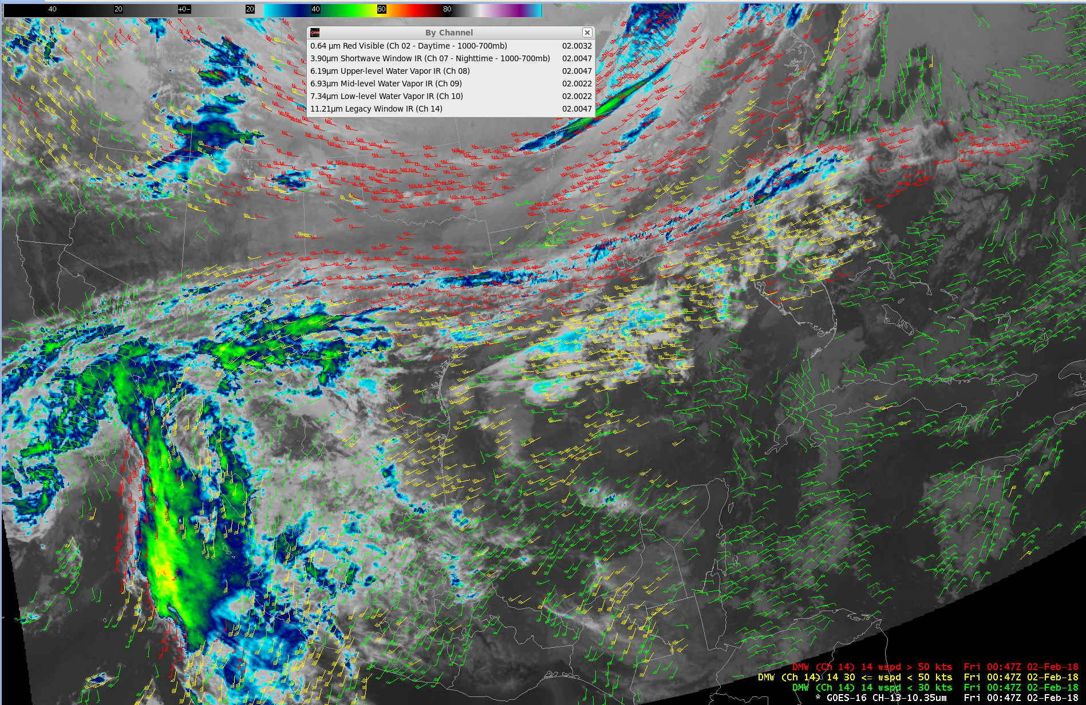
GOES-16 10.35um IR and CH 14 DMWs
, 00:47Z 02 Feb 2018

Slide 5
AWIPS Capability Enhancements
The first DMW release in AWIPS only allowed selection “by-Channel”
TOWR-S added by-Pressure level filter enhancement (AWIPS 16.4.1)
  Baselined prior to GOES-R launch
  Added option to display all available channels in a given pressure range
  Binned continuous vertical pressure values into pressure-based categories
  “By Pressure” sub-menu includes 200, 300, 400, 500, 700, 850, 925 mb
  “By Mandatory” sub-menu includes 150, 200, 250, 300, 400, 500, 700, 850, 925, 1000 mb
Latest release also maintains the “by-Channel” display option
  Includes CHs 02, 07, 08, 09, 10, 14, with color-coded speed ranges
An example of by-Pressure DMWs is in the following slide

Slide 6
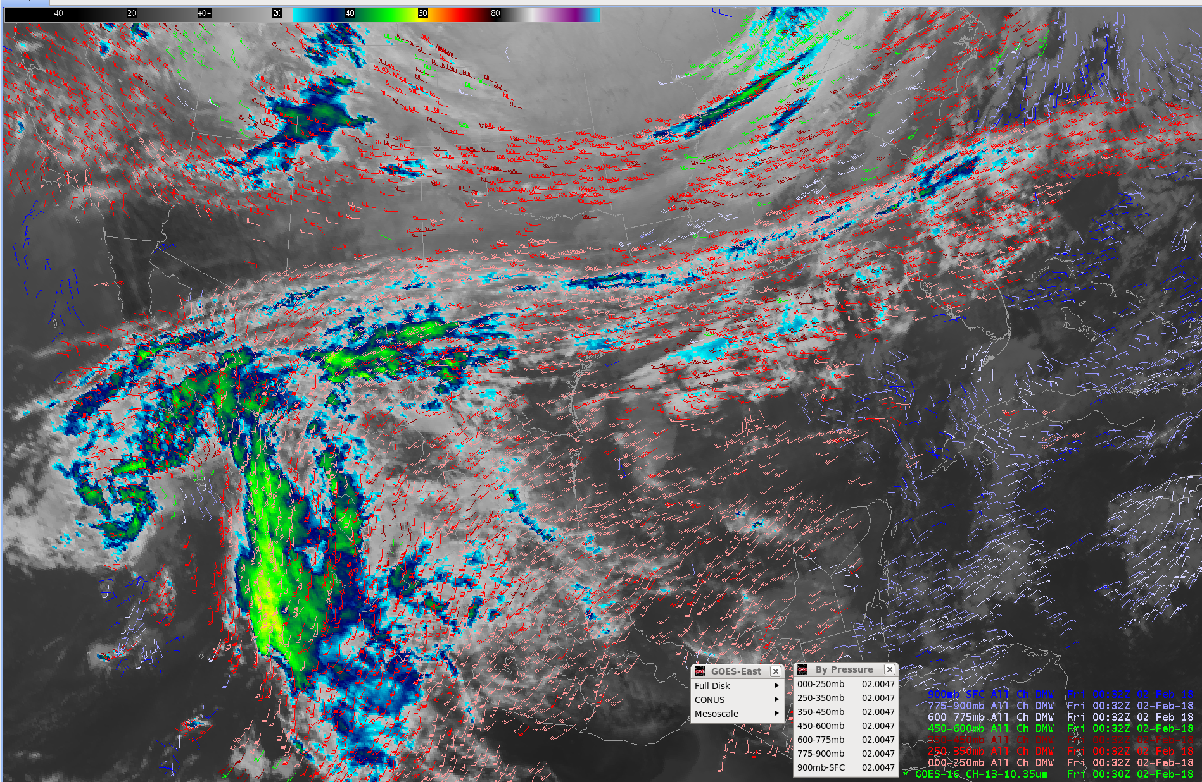
GOES-16 10.35um IR and DMWs by Pressure Levels
00:30Z 02 Feb 2018

Slide 7
Recent Enhancements and Improvement Efforts
TOWR-S implemented new configurations provided by the Pueblo WFO
  Features a single color/display for each available pressure level
  Mimics the legacy product, simplifies legend (one color per pressure level)
  Delivered field-wide via the NCF through RPM update (Jan-Feb 2018)
  A product of NWS Satellite Enhancement Team (SET) collaboration
The 3 WV channel time stamps do not align with those of other channels
  Degrades image loops
  A WR has been submitted to align times so that pressure-based displays are synchronized across channels. Planned for in PRO release ~Apr/May ‘18
Simultaneous display of meso DMWs alternates back and forth between scenes
  Attribute scene_id does not delineate Meso 1 or Meso 2 (only “Mesoscale”)
  Distinct scene_ids would solve display issue, enable better database mgt, and be consistent with other ABI L2 product scene_ids (ADR 581)

Slide 8
AWIPS DMWs Near-Term Actions
Extend “by Pressure” features to “by Pressure - Mandatory Levels” sub-menu
Integrate recent DMW display enhancements into AWIPS program baseline
Test and implement configuration updates coinciding with metadata changes (e.g., time stamp, scene_id modifications)
Update baseline AWIPS Himawari DMW configurations (menus/style rules) to be consistent with GOES-16

