Slide 1
GOES-16
Fire/Hotspot Characterization and Rain Rate in AWIPS-2
NWS/OBS Update to Provisional PS-PVR
March 30, 2018

Slide 2
GOES-16 Fire/Hotspot and Rain Rate in AWIPS-2
Fielded AWIPS-2 baseline handles ingest and display of the products
  Applies mask for good quality Fire Power/Area/Temp, RRQPE
NWS transmission via the SBN (ABI sectors* and start dates):
  Fire/Hotspot (F, C), May 31 2017
  Rain Rate (F), January 17, 2018
* ABI Sectors: F = Full Disk, C = CONUS and M = Meso
Examples are in the following slides (AWIPS2/CAVE screenshots)

Slide 3
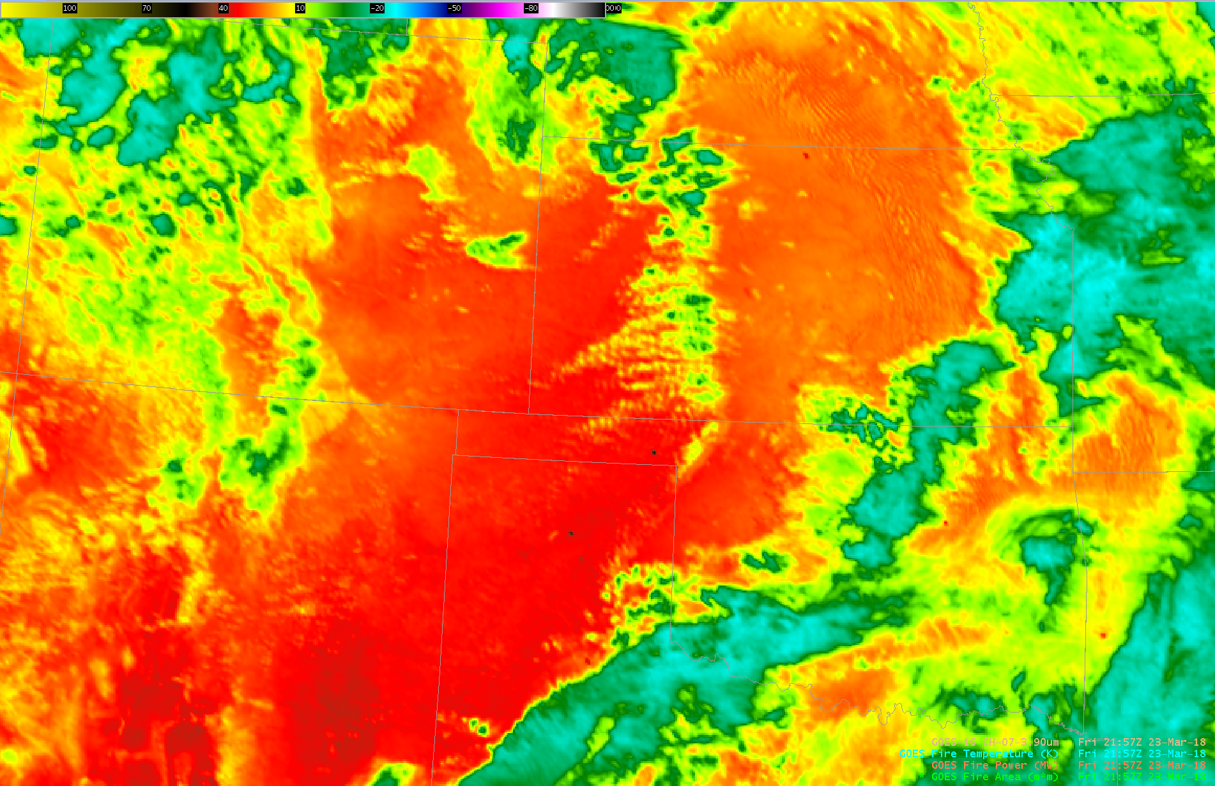
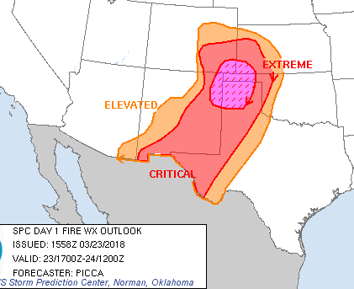
GOES-16 CH07 Imagery and Fire/Hotspot (2)
Temp: 700K
Power: 178 MW
Area: 13878 m2

Slide 4
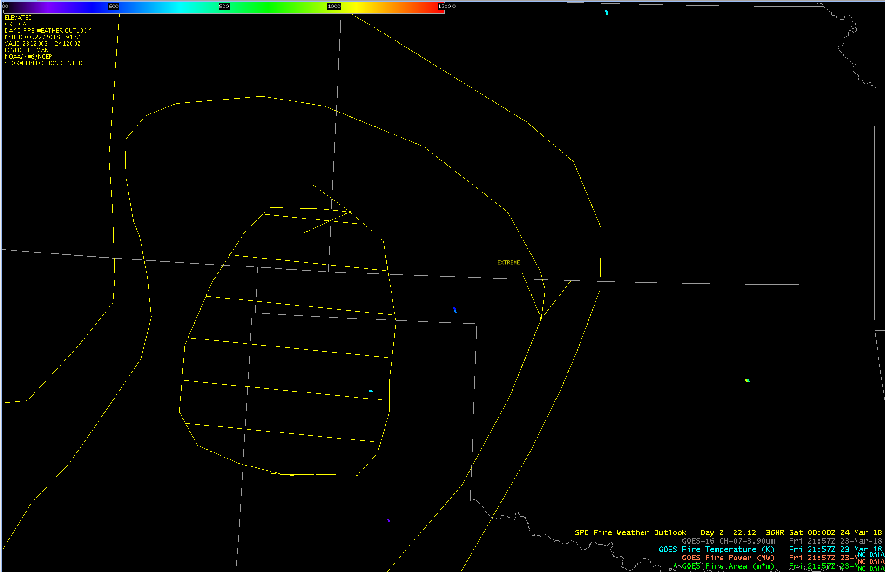
GOES-16 Fire/Hotspot (2)

Slide 5
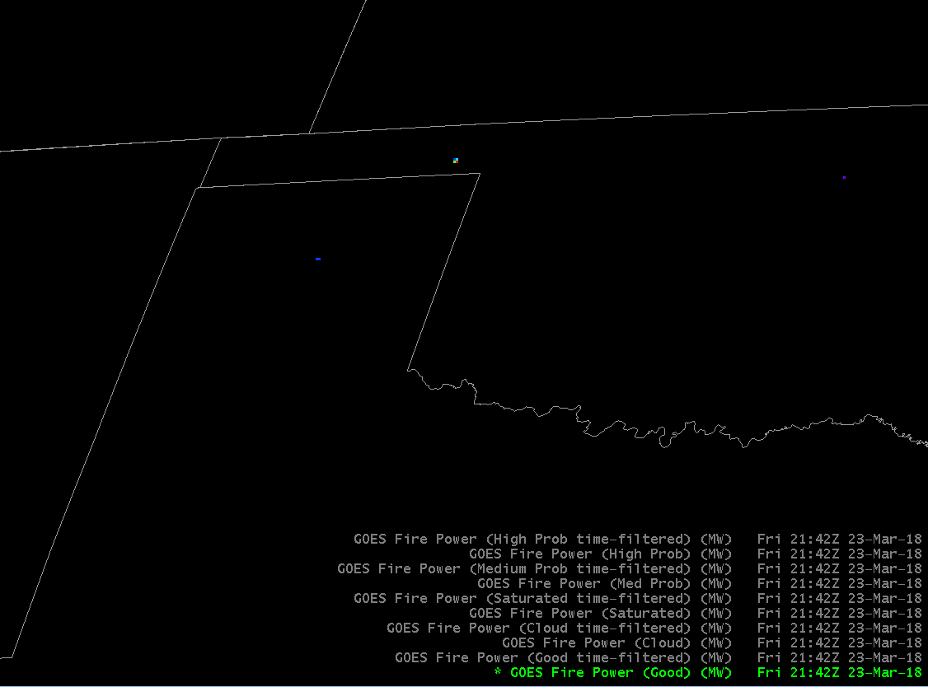
GOES-16 Fire/Hotspot (3)
Exploring application of additional Masks:

Slide 6
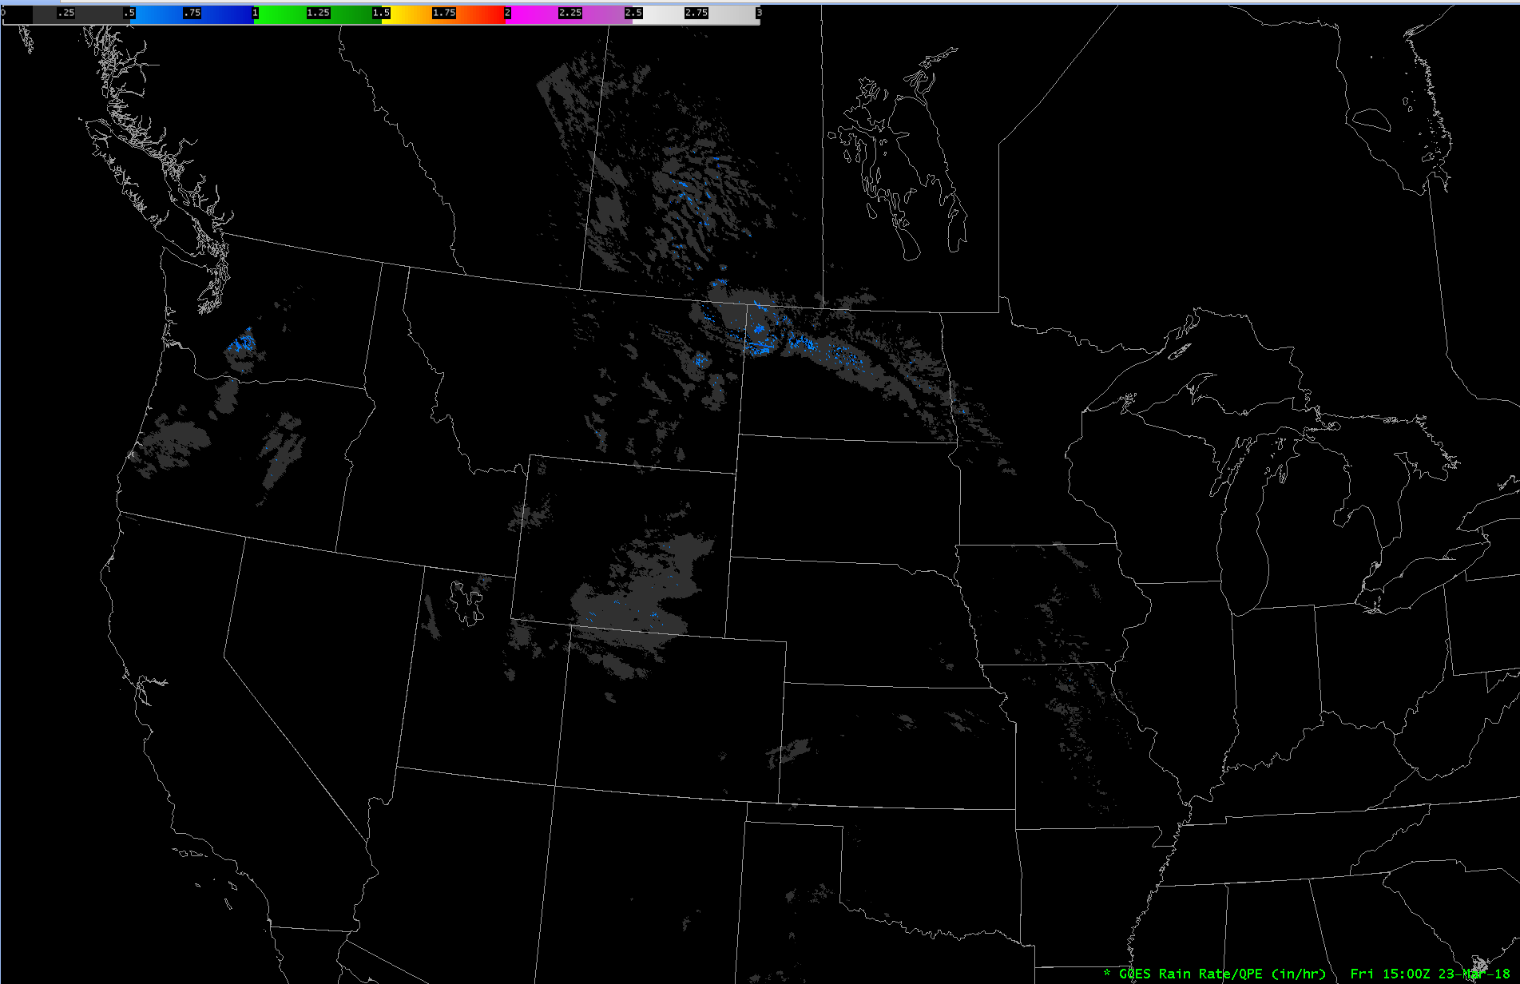
GOES-16 Rain Rate(1)
Cursor sampling:

Slide 7
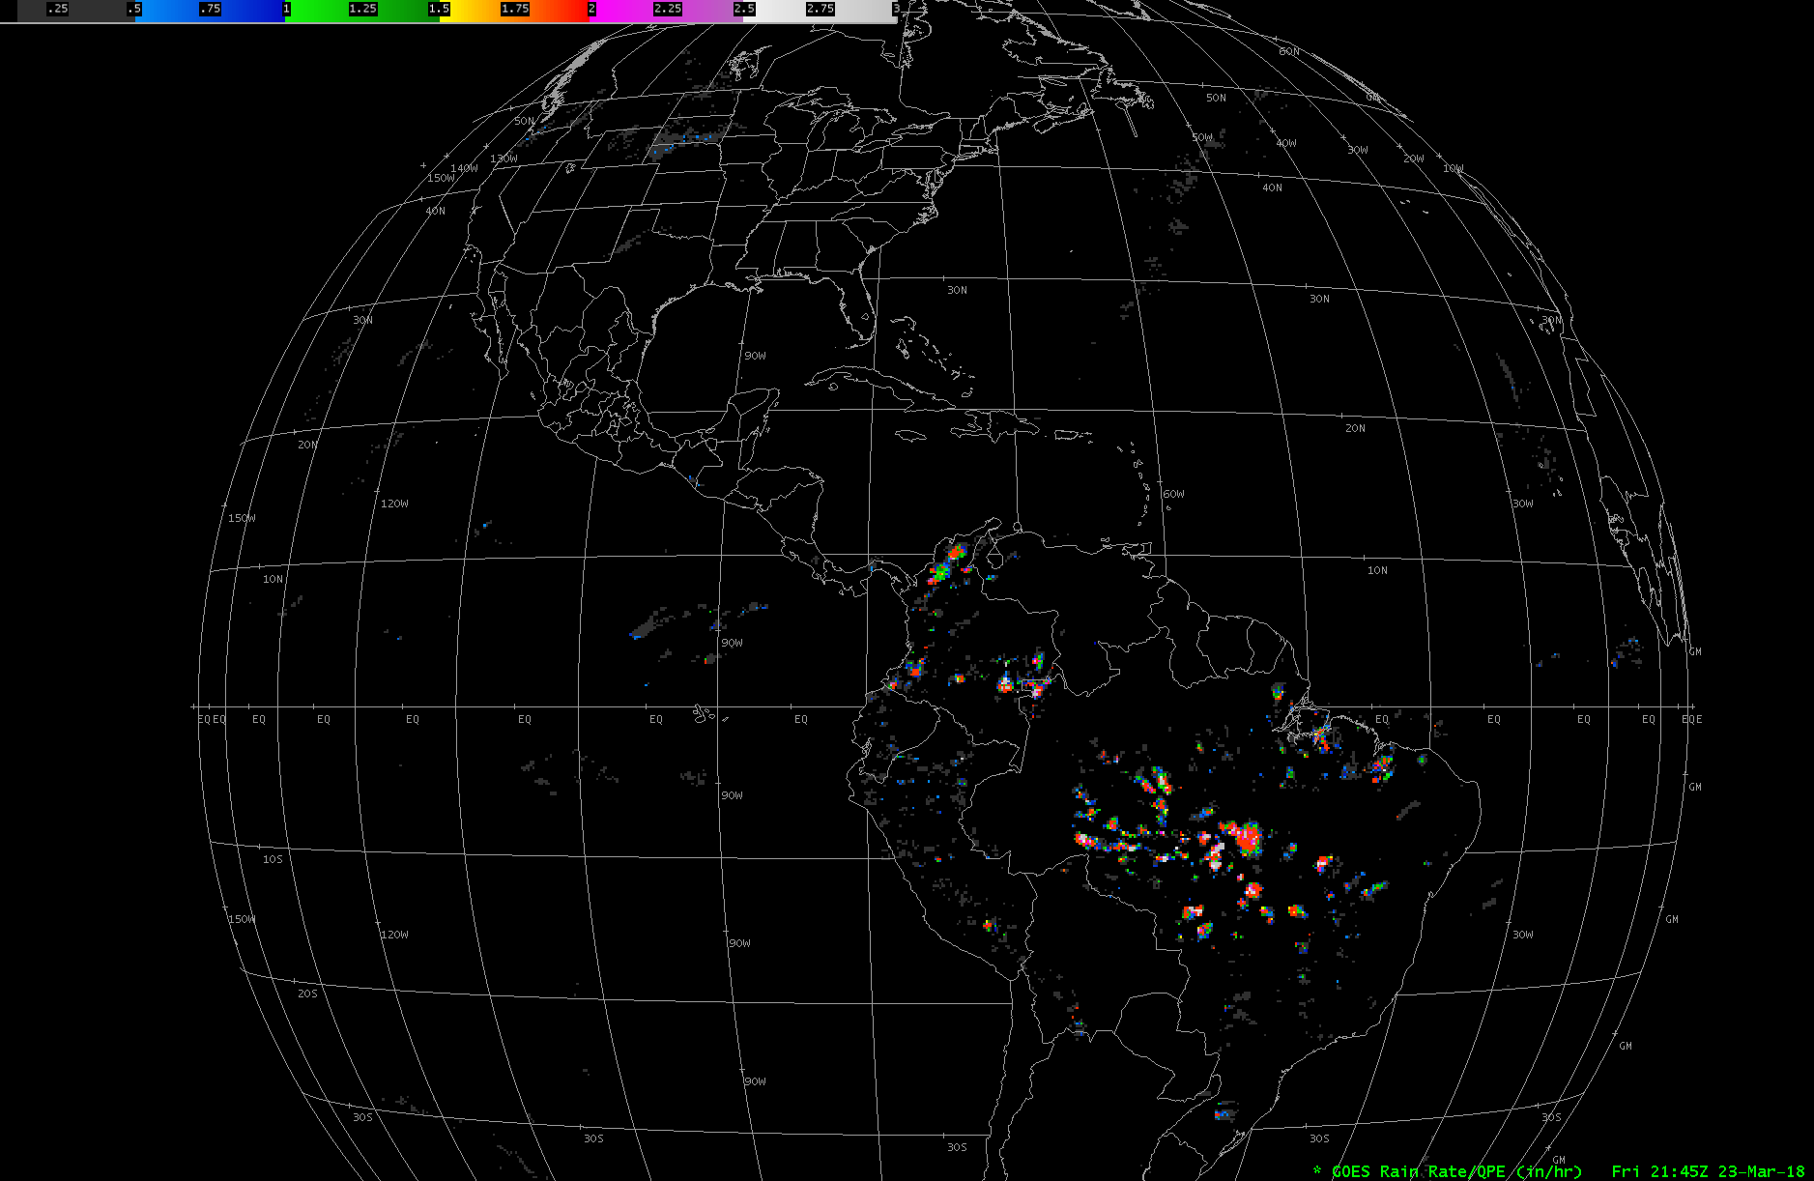
GOES-16 Rain Rate(2)

Slide 8
Questions?

