Slide 1
GOES-16 ABI L2+ LAP Products Provisional PS-PVR
Timothy J. Schmit
Chair, GOES-R series AWG LAP team
NOAA/NESDIS/STAR
22 February 2018
GOES-R AWG LAP team: Jun Li, Yong-Keun Lee,
Richard Dworak, Zhenglong Li

Slide 2
Agenda
Review of Beta Maturity
Product Quality Evaluation
- PLPT Tests and Results
Provisional Validation Product Maturity Assessment
Path to Full Maturity
Summary and Recommendations

Slide 3
REVIEW OF BETA MATURITY
GOES-16 ABI L2 LAP Product Provisional PS-PVR

Slide 4
Products Overview
The GOES-16 ABI L2 LAP algorithm includes regression and physical retrieval based on the infrared spectral bands. The algorithm is applied to 5x5 ABI pixels (~10 km) for generating LAP products over clear sky. The LAP products include LVT, LVM, TPW, and DSI.
Band Number | Wavelength (µm) | Purpose
8 | 6.19 | High-level atmospheric water vapor, winds, rainfall
9 | 6.93 | Mid-level atmospheric water vapor, winds, rainfall
10 | 7.34 | Lower-level atmospheric water vapor, winds, and SO₂
12 | 9.61* | Total ozone
13 | 10.33 | Surface and cloud
14 | 11.20 | Imagery, SST, clouds, rainfall
15 | 12.30 | Total water, ash, SST
16 | 13.30 | Air temperature, cloud heights and amounts
Notes:
* Only used in the regression step.

Slide 5
Review: Time-Line/Context
19 Nov 2016 GOES-R Launch
29 Nov 2016 GEO orbit attained (became GOES-16)
03 Jan 2017 ABI aperture door open/1st light for visible/near-infrared channels
Apr 2017: ABI L2 LAP baseline products validation begins.
16 May 2017 LAP PS-PVR Beta
30 Nov - 13 Dec 2017 Spacecraft Drift to East Slot
18 Dec 2017 Imagery operational

Slide 6
Beta PLPTs Review
PLPT ID | Descriptive Title | % Complete | Results | AWG POC
ABI-FD_TPW01 | Verify Product is generated every hour for FD for M3 | 100 | Complete* | PRO
ABI-CONUS_TPW02 | Verify Product is generated every 30 min for CONUS for M3 | 100 | Complete* | PRO
ABI-MESO_TPW03 | Verify Product is generated every 5 min for Meso for M3 | 100 | Complete* | PRO
ABI-FD_TPW04 | Verify Product is generated every hour for FD for M4 | 100 | Complete* | PRO
ABI-CONUS_TPW05 | Verify Product is generated every 30 min for CONUS for M4 | 100 | Complete* | PRO
ABI-FD_TPW06 | Quantitative analysis of M3 FD TPW | 100 | Complete | AWG
ABI-CONUS_TPW07 | Quantitative analysis of M3 CONUS TPW | 100 | Complete | AWG
ABI-MESO_TPW08 | Quantitative analysis of M3 Meso TPW | 100 | Complete | AWG
Notes:
PRO is responsible for 01 – 05.

Slide 7
Beta PLPTs Review
PLPT ID | Descriptive Title | % Complete | Results | AWG POC
ABI-FD_LVT01 | Verify Product is generated every hour for FD for M3 | 100 | Complete* | PRO
ABI-CONUS_LVT02 | Verify Product is generated every 30 min for CONUS for M3 | 100 | Complete* | PRO
ABI-MESO_LVT03 | Verify Product is generated every 5 min for Meso for M3 | 100 | Complete* | PRO
ABI-FD_LVT04 | Verify Product is generated every hour for FD for M4 | 100 | Complete* | PRO
ABI-CONUS_LVT05 | Verify Product is generated every 30 min for CONUS for M4 | 100 | Complete* | PRO
ABI-FD_LVT06 | Quantitative analysis of M3 FD LVT | 100 | Complete | AWG
ABI-CONUS_LVT07 | Quantitative analysis of M3 CONUS LVT | 100 | Complete | AWG
ABI-MESO_LVT08 | Quantitative analysis of M3 Meso LVT | 100 | Complete | AWG
Notes:
PRO is responsible for 01 – 05.

Slide 8
Beta PLPTs Review
PLPT ID | Descriptive Title | % Complete | Results | AWG POC
ABI-FD_LVM01 | Verify Product is generated every hour for FD for M3 | 100 | Complete* | PRO
ABI-CONUS_LVM02 | Verify Product is generated every 30 min for CONUS for M3 | 100 | Complete* | PRO
ABI-MESO_LVM03 | Verify Product is generated every 5 min for Meso for M3 | 100 | Complete* | PRO
ABI-FD_LVM04 | Verify Product is generated every hour for FD for M4 | 100 | Complete* | PRO
ABI-CONUS_LVM05 | Verify Product is generated every 30 min for CONUS for M4 | 100 | Complete* | PRO
ABI-FD_LVM06 | Quantitative analysis of M3 FD LVM | 100 | Complete | AWG
ABI-CONUS_LVM07 | Quantitative analysis of M3 CONUS LVM | 100 | Complete | AWG
ABI-MESO_LVM08 | Quantitative analysis of M3 Meso LVM | 100 | Complete | AWG
Notes:
PRO is responsible for 01 – 05.

Slide 9
Beta PLPTs Review
PLPT ID | Descriptive Title | % Complete | Results | AWG POC
ABI-FD_DSI01 | Verify Product is generated every hour for FD for M3 | 100 | Complete* | PRO
ABI-CONUS_DSI02 | Verify Product is generated every 30 min for CONUS for M3 | 100 | Complete* | PRO
ABI-MESO_DSI03 | Verify Product is generated every 5 min for Meso for M3 | 100 | Complete* | PRO
ABI-FD_DSI04 | Verify Product is generated every hour for FD for M4 | 100 | Complete* | PRO
ABI-CONUS_DSI05 | Verify Product is generated every 30 min for CONUS for M4 | 100 | Complete* | PRO
ABI-FD_DSI06 | Quantitative analysis of M3 FD DSI | 100 | Complete | AWG
ABI-CONUS_DSI07 | Quantitative analysis of M3 CONUS DSI | 100 | Complete | AWG
ABI-MESO_DSI08 | Quantitative analysis of M3 Meso DSI | 100 | Complete | AWG
Notes:
PRO is responsible for 01 – 05.

Slide 10
Risks to Reaching Provisional
Risk Name | Description | Impact | Mitigation and Schedule
Missing values over randomly distributed areas | Frequently, there are missing values over randomly distributed boxed areas. | Minor | The filling values indicate no value regions. This is a result of using the terrestrial GRB at NSOF. Will be moving to RF GRB by Handover which will resolve this issue.
The migration of the sun affecting the LAP products | The ABI LAP products are affected by sun-rise and sun-set. | Minor | Cloud mask may have influences on the ABI LAP products.
Wet bias of the relative humidity in upper troposphere (100 - 300 hPa) | The relative humidity in upper troposphere (100-300 hPa) shows large wetter bias than the spec. | Minor | Radiosonde has dry bias in observing the relative humidity in the upper troposphere. So the comparison with ECMWF analysis data will be included for further tests.
Slightly large discrepancy of several DSI | Several DSI show slightly larger discrepancy than the spec. | Minor | If the atmospheric conditions are unstable, the statistics results are closer to the requirements.
Little Impact
Moderate Impact
Big Impact

Slide 11
Upstream Algorithm Issues
Upstream Issue | Description | Impact | Algorithm Implications
ABI L1b - INR | Issues remain with ABI L1b INR issues associated with navigation and co-registration issues
ABI L1b – Stripping and Calibration | Image stripping is present in some imagery data. Calibration is still being evaluated on the system and seems to vary over time
ABI L2 Cloud Mask | Soundings need a high-quality upstream cloud mask
ABI L1b - GRB | Missing blocks of data | Major | Algorithm will not produce data in regions of missing blocks
Little Impact
Moderate Impact
Big Impact

Slide 12
PRODUCT QUALITY EVALUATION
GOES-16 ABI L2 LAP Product Provisional PS-PVR

Slide 13
Recommendations from Beta Review Team
Include ECMWF and GFS analysis as references (completed);
Include GOES-R field campaign data as reference (completed);
Include ABI Legacy Atmospheric Profile (LAP) spec along with validation results (completed);
Identify and understand the outliers in TPW comparisons with Suomi-Net GPS data (completed).

Slide 14
Provisional PLPTs Under Review
PLPT ID | Descriptive Title | % Complete | Results | AWG POC
ABI-FD_TPW09 | Quantitative analysis of M3 FD TPW | 100 | Complete | AWG
ABI-CONUS_TPW10 | Quantitative analysis of M3 CONUS TPW | 100 | Complete | AWG
ABI-MESO_TPW11 | Quantitative analysis of M3 Meso TPW | 100 | Complete | AWG
TPW: Total Precipitable Water

Slide 15
Provisional PLPTs Under Review
PLPT ID | Descriptive Title | % Complete | Results | AWG POC
ABI-FD_LVT09 | Quantitative analysis of M3 FD LVT | 100 | Complete | AWG
ABI-CONUS_LVT10 | Quantitative analysis of M3 CONUS LVT | 100 | Complete | AWG
ABI-MESO_LVT11 | Quantitative analysis of M3 Meso LVT | 100 | Complete | AWG
LVT: Legacy Vertical Temperature profile

Slide 16
Provisional PLPTs Under Review
PLPT ID | Descriptive Title | % Complete | Results | AWG POC
ABI-FD_LVM09 | Quantitative analysis of M3 FD LVM | 100 | Complete | AWG
ABI-CONUS_LVM10 | Quantitative analysis of M3 CONUS LVM | 100 | Complete | AWG
ABI-MESO_LVM11 | Quantitative analysis of M3 Meso LVM | 100 | Complete | AWG
LVM: Legacy Vertical Moisture profile

Slide 17
Provisional PLPTs Under Review
PLPT ID | Descriptive Title | % Complete | Results | AWG POC
ABI-FD_DSI09 | Quantitative analysis of M3 FD DSI | 100 | Complete | AWG
ABI-CONUS_DSI10 | Quantitative analysis of M3 CONUS DSI | 100 | Complete | AWG
ABI-MESO_DSI11 | Quantitative analysis of M3 Meso DSI | 100 | Complete | AWG
DSI: Derived Stability Indices

Slide 18
PLPT Tests for each Domain
Our 3 PLPTs dealing with analysis are comprised of the same 2 methods.
Each contains the applications of these methods on the FD, CONUS and MESO domains.
The applications of each method to each domain is summarized below.
Some methods were redundant or not possible for some domains.
Analysis Method | FD | CONUS | MESO
Visual Inspection
Comparison to reference data (RAOB, GPS, AMSR2, ECMWF, GDAS, AERI)
Note that ECMWF, GDAS, AERI data are new in the LAP provisional validation.
18

Slide 19
GOES-16 Data Used in this Review
April 2017-January 2018: All FD, CONUS, Meso1, and Meso2 LAP with RAOB, Suomi-Net GPS TPW, and AMSR2 TPW matchups within +/- 30 min, 20 km (RAOB and GPS) and 10 km (AMSR2), and 20 km (ECMWF and GDAS);
Day 182 (July 1, 2017), 2000 UTC: Visual images of all domains for each variable;
Day 182, 0800, 0900 UTC: To show the migration of the sun affecting TPW;
Day 182, 0000, 0230 UTC: To show missing data over randomly distributed boxed areas in TPW.
19

Slide 20
Definitions of Metrics
Passed: No visual artifacts and/or the comparison with the reference data near or above the specification.
Failed: Cause of performance degradation is unknown.
The comparisons with the reference data are computed over all data.
20

Slide 21
PROVISIONAL VALIDATION PRODUCT MATURITY ASSESSMENT
GOES-16 ABI L2 LAP Product Provisional PS-PVR

Slide 22
Examples of Visual Inspection of All Domains
22

Slide 23
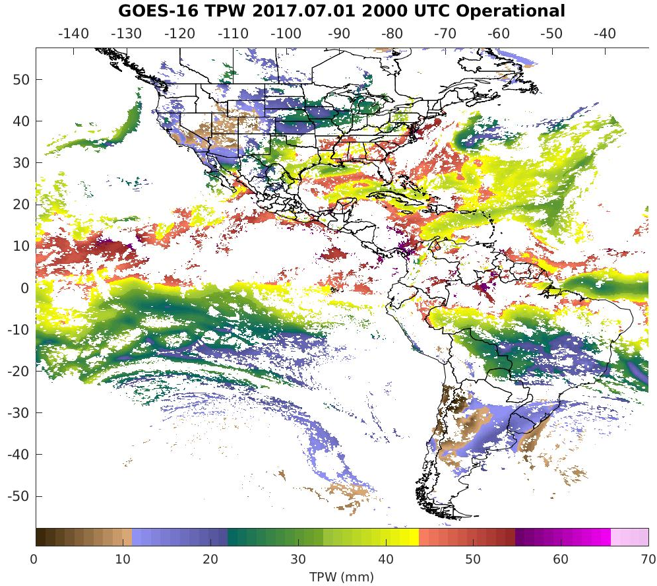
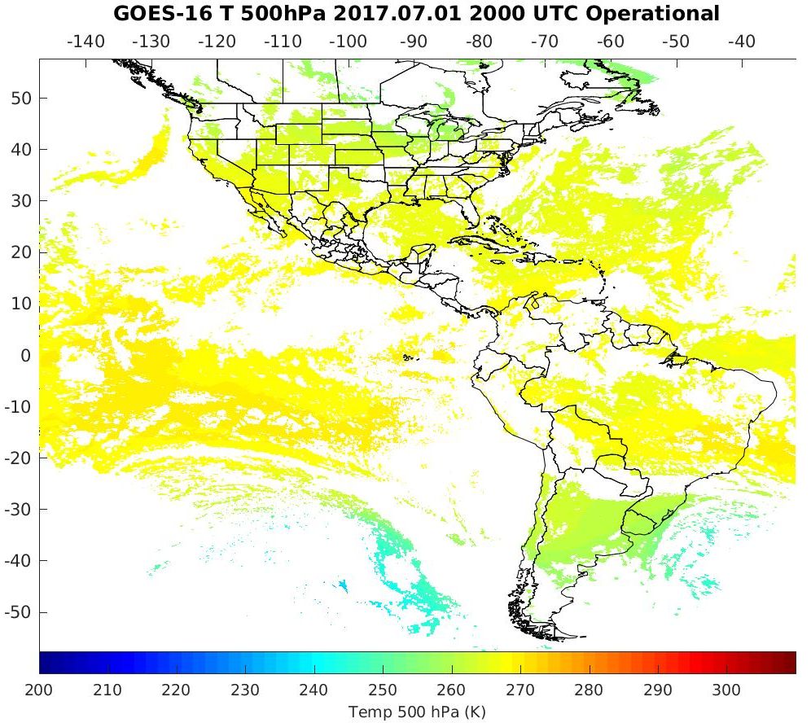
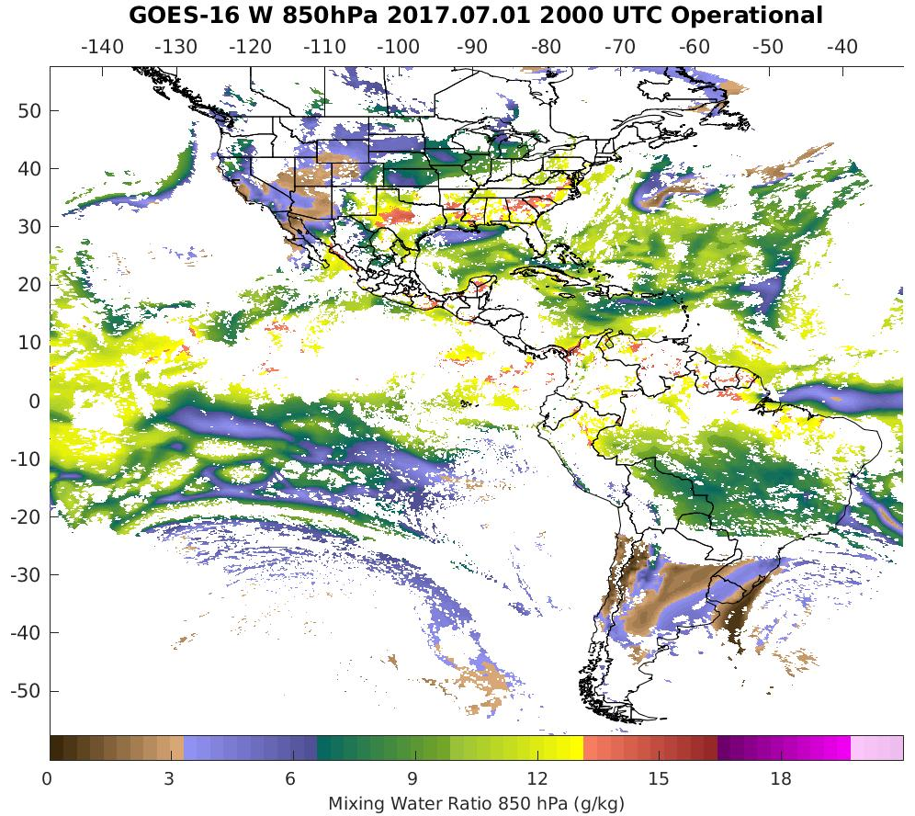
PLPT ABI-FD-TPW, LVT, LVM:
July 01, 2017, 2000 UTC
TPW (mm)
Temp (K). 500 hPa hPa
WV (g/kg) 850 hPa
TPW: Total Precipitable Water
LVT: Legacy Vertical Temperature profile
LVM: Legacy Vertical Moisture profile
PASSED
23

Slide 24
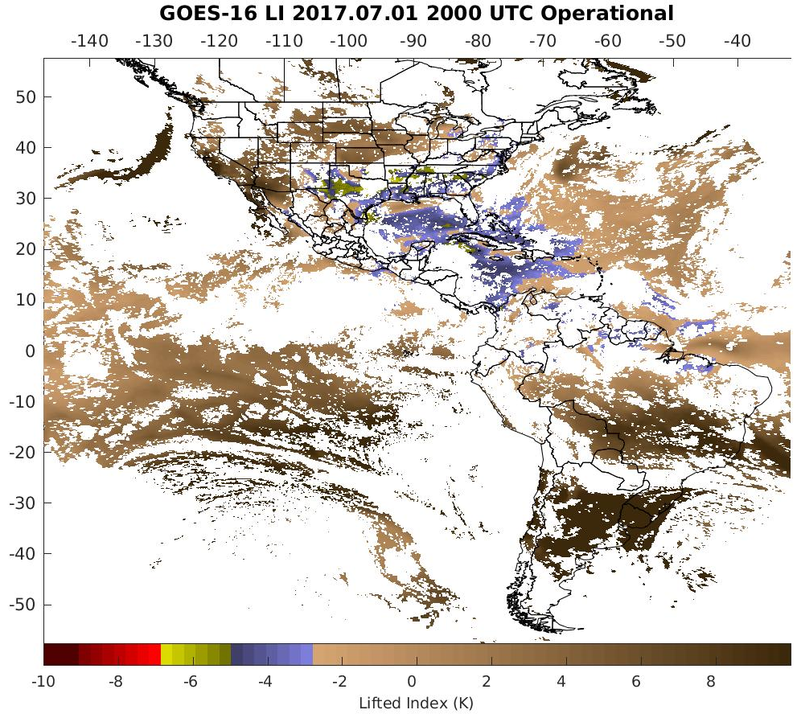
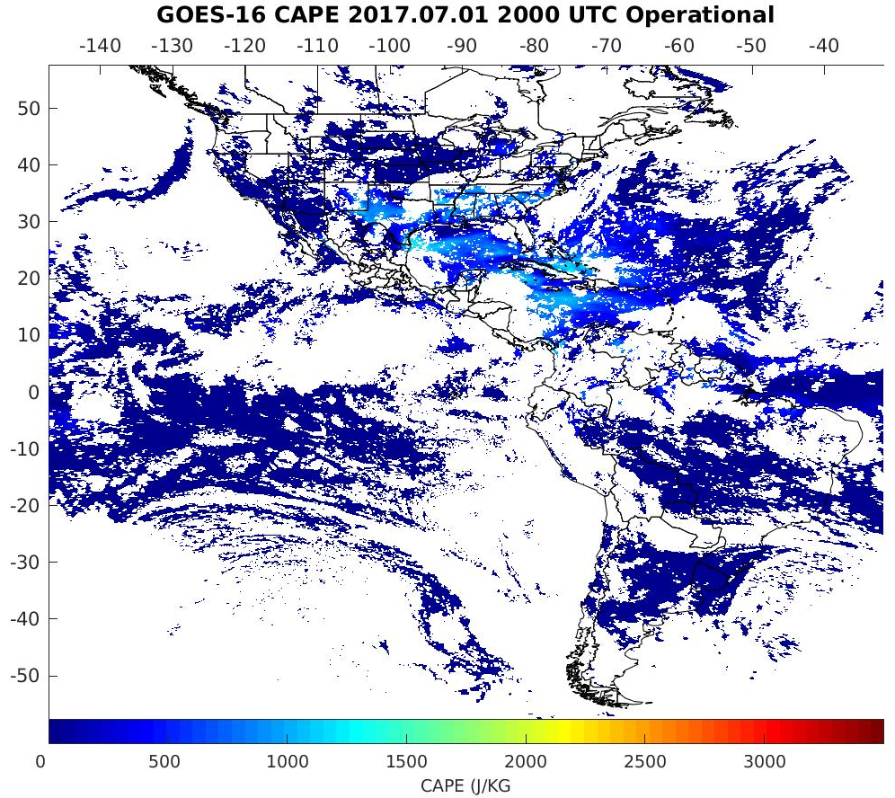
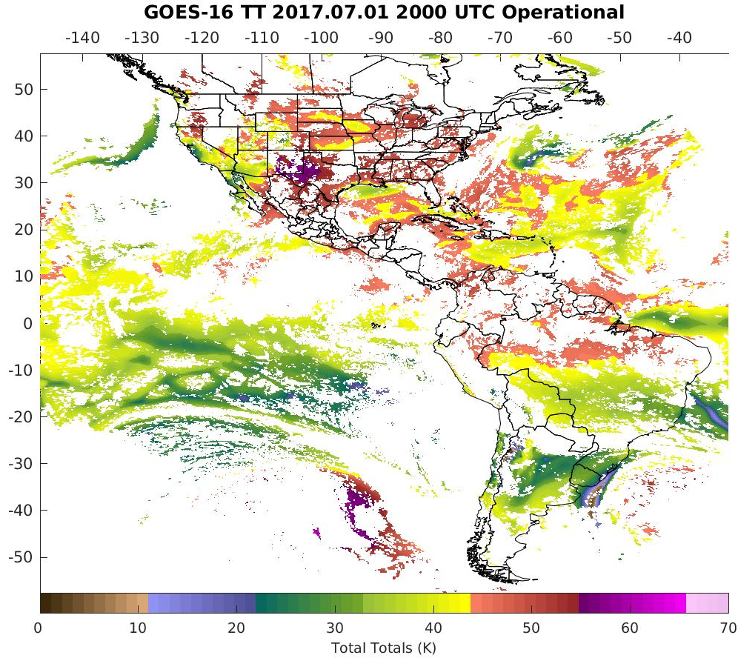
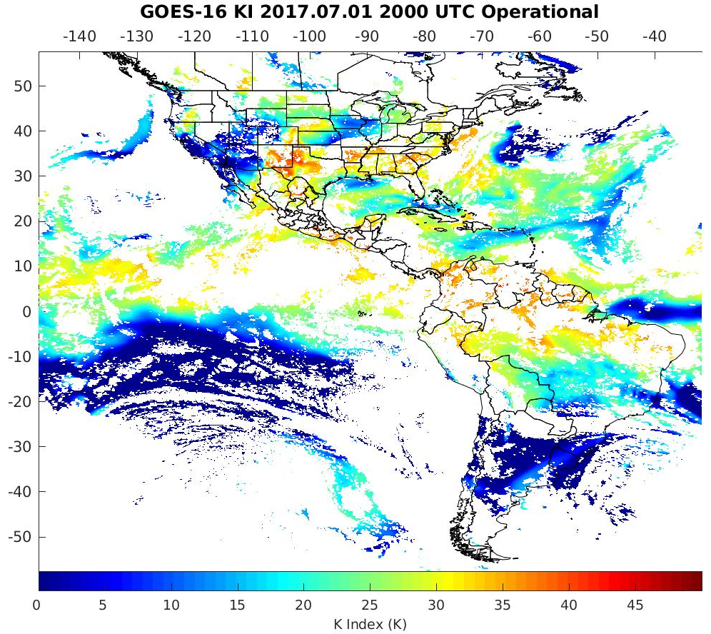
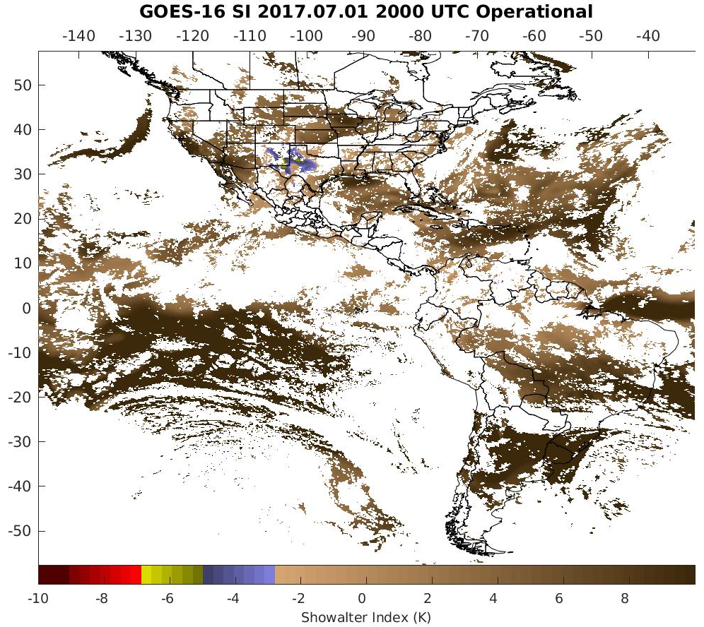
PLPT ABI-FD-DSI:
July 01, 2017, 2000 UTC
LI
CAPE
TT
KI
SI
LI: Lifted Index
CAPE: Convective Available Potential Energy
TT: Total Totals
KI: K-Index
SI: Showalter Index
PASSED
24

Slide 25
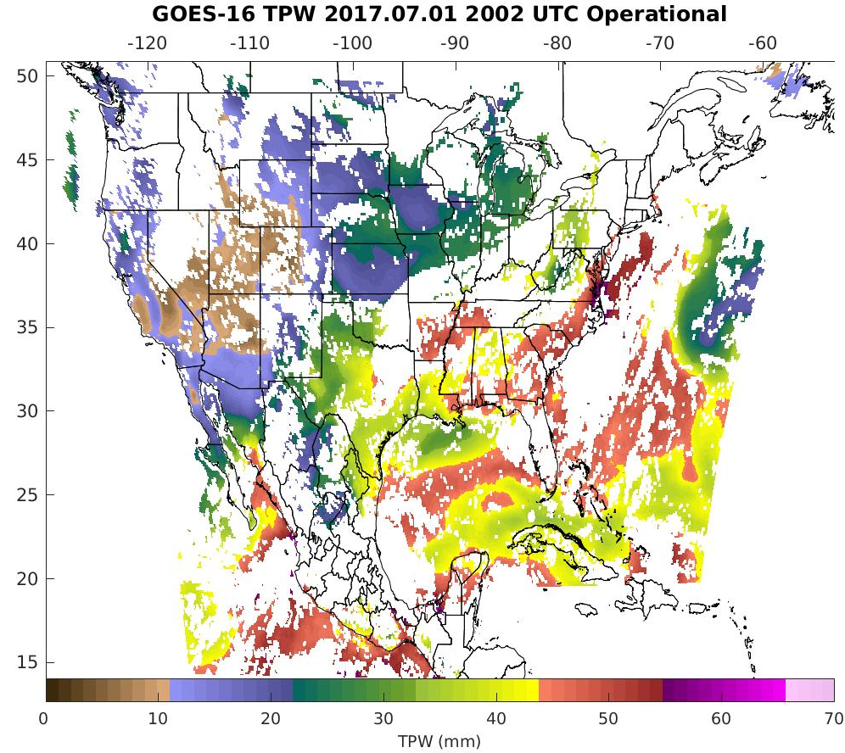
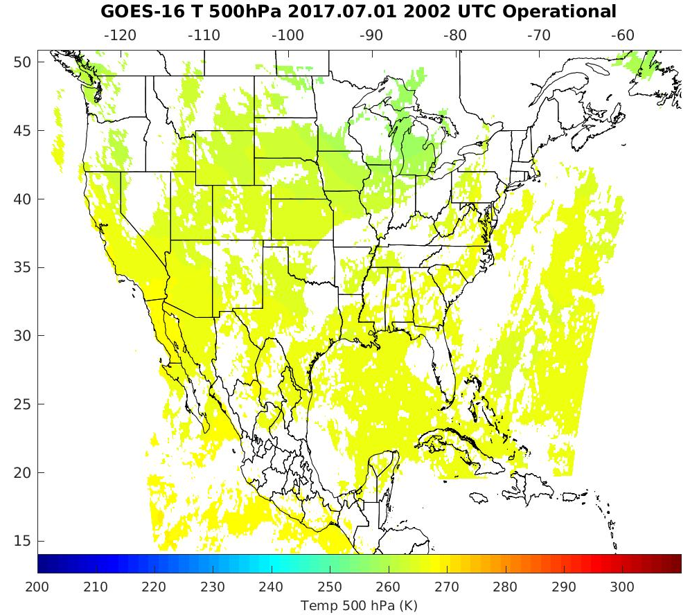
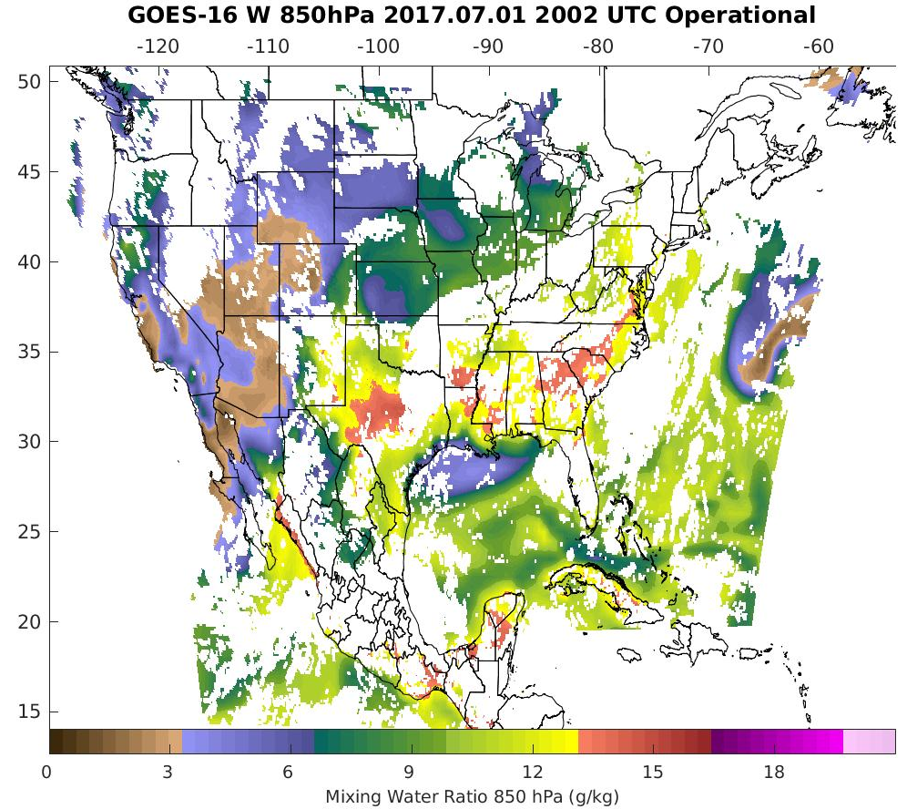
PLPT ABI-CONUS-TPW, LVT, LVM:
July 01, 2017, 2002 UTC
TPW (mm)
Temp (K). 500 hPa hPa
WV (g/kg) 850 hPa
TPW: Total Precipitable Water
LVT: Legacy Vertical Temperature profile
LVM: Legacy Vertical Moisture profile
PASSED
25

Slide 26
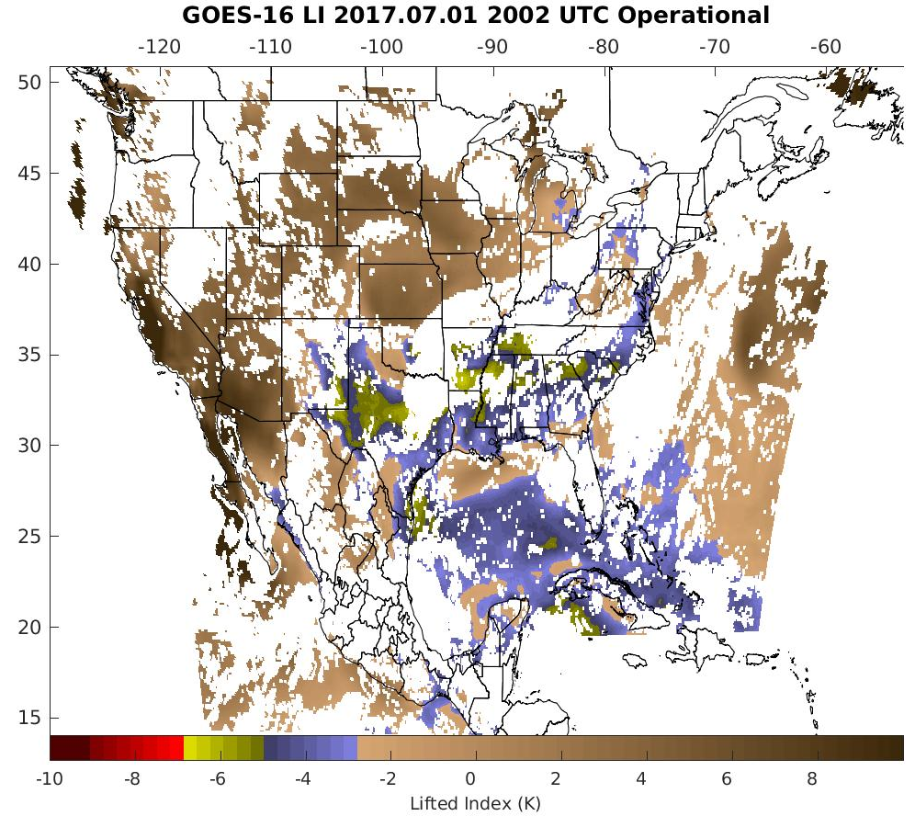
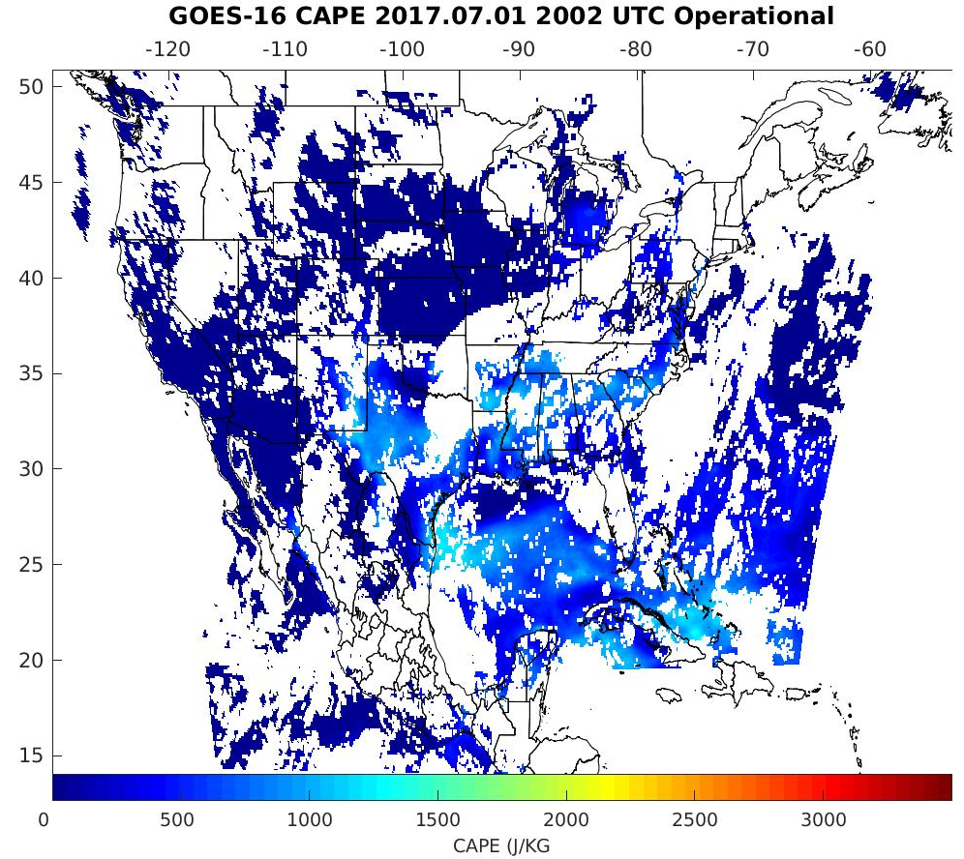
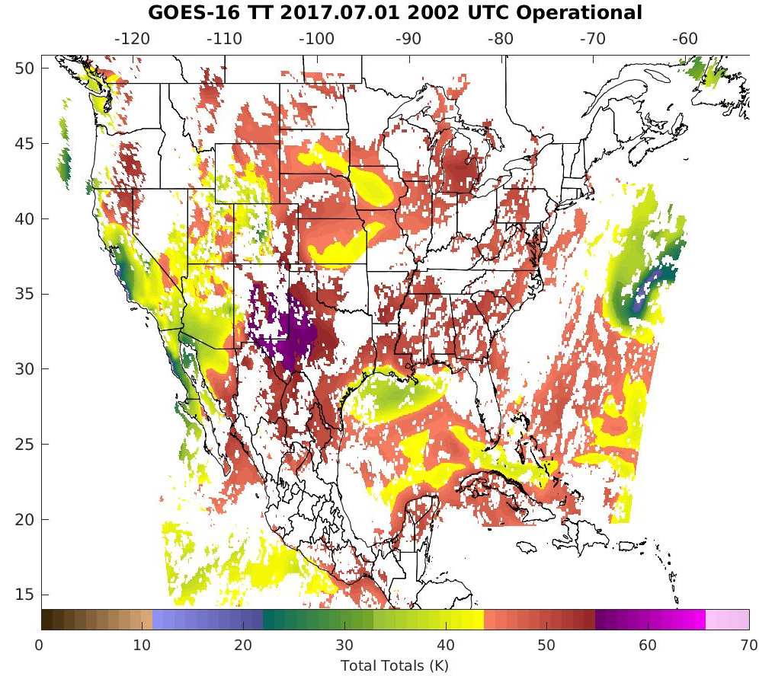
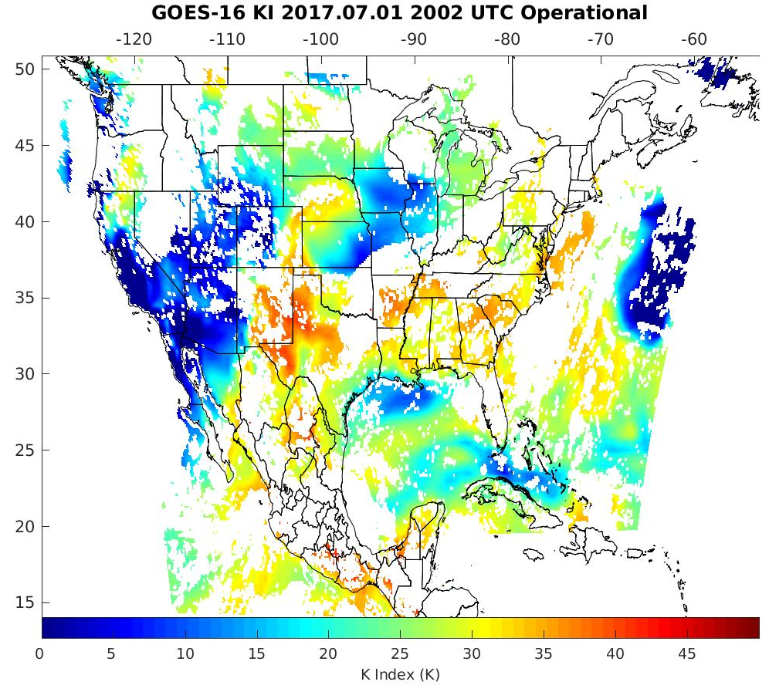
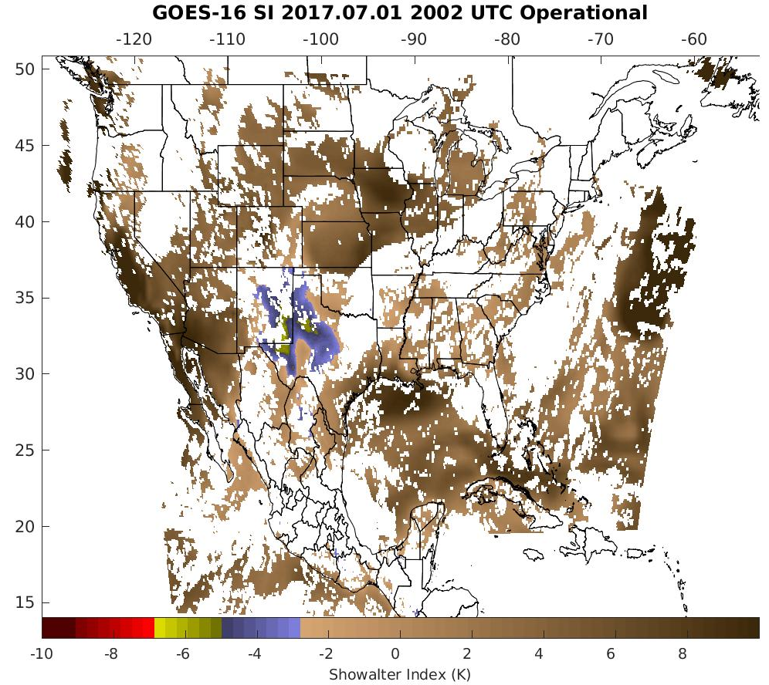
PLPT ABI-CONUS-DSI:
July 01, 2017, 2002 UTC
LI
CAPE
TT
KI
SI
LI: Lifted Index
CAPE: Convective Available Potential Energy
TT: Total Totals
KI: K-Index
SI: Showalter Index
PASSED
26

Slide 27
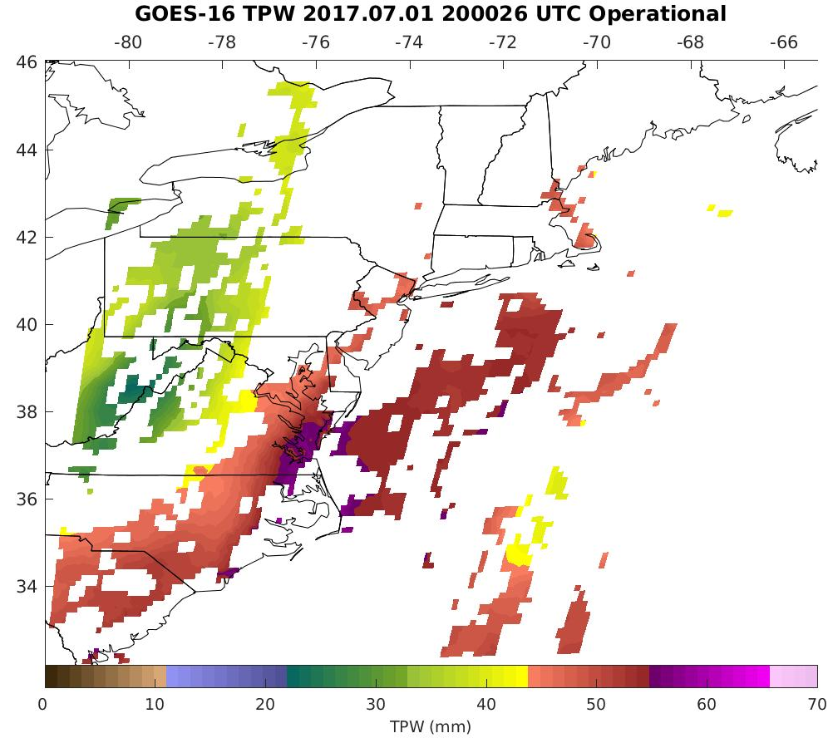
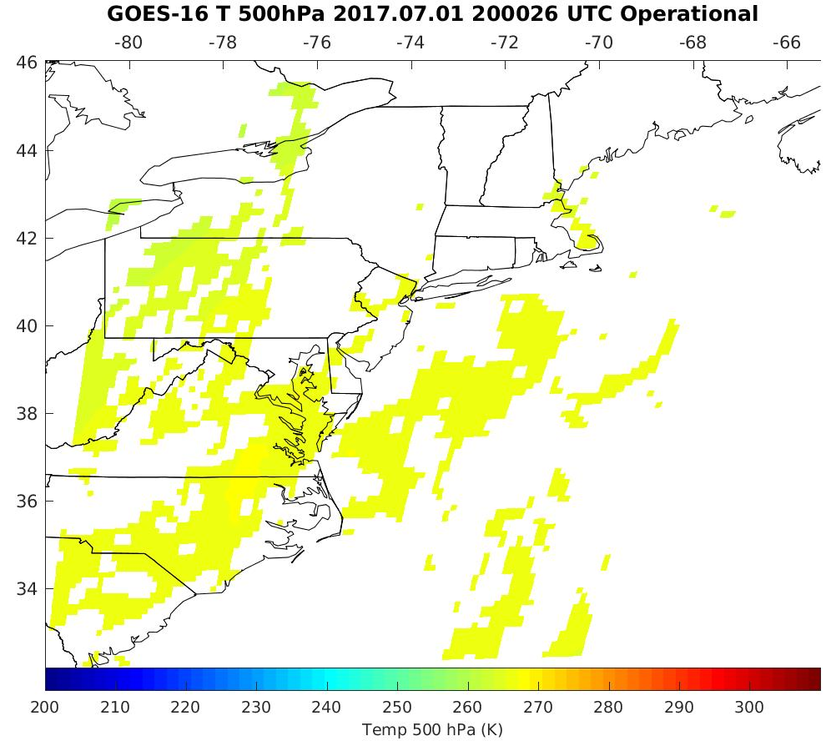
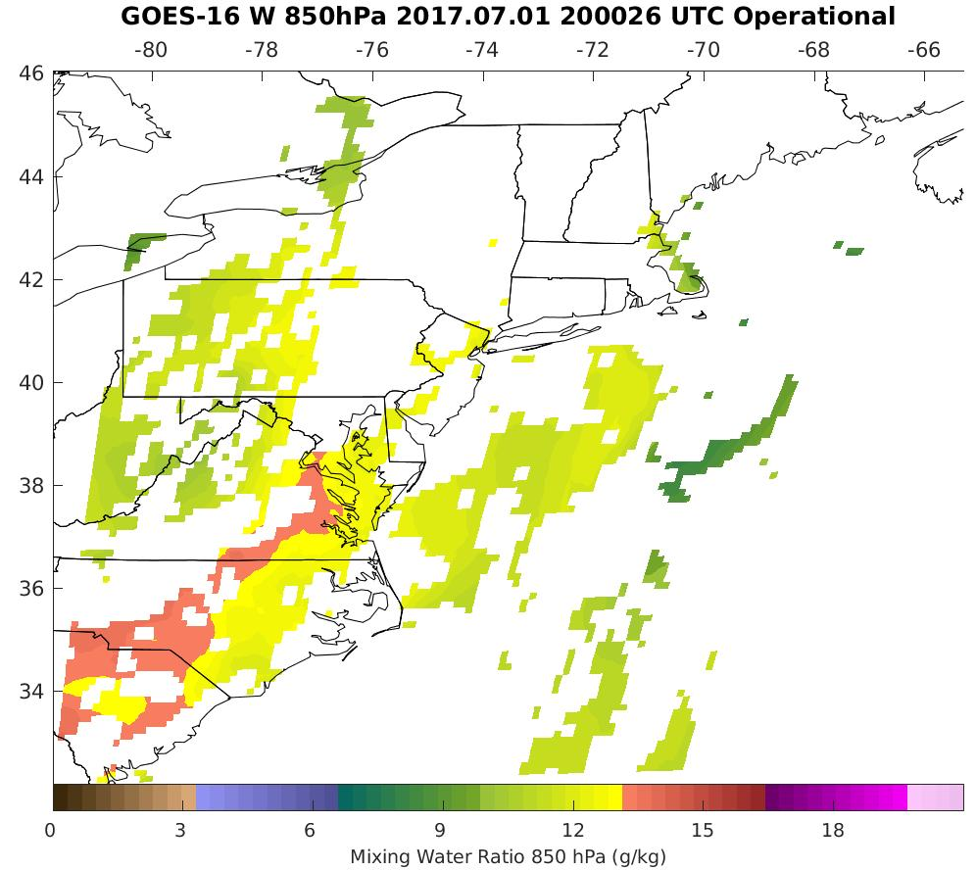
PLPT ABI-MESO1-TPW, LVT, LVM:
July 01, 2017, 2000 UTC
TPW (mm)
Temp (K). 500 hPa hPa
WV (g/kg) 850 hPa
TPW: Total Precipitable Water
LVT: Legacy Vertical Temperature profile
LVM: Legacy Vertical Moisture profile
PASSED
27

Slide 28
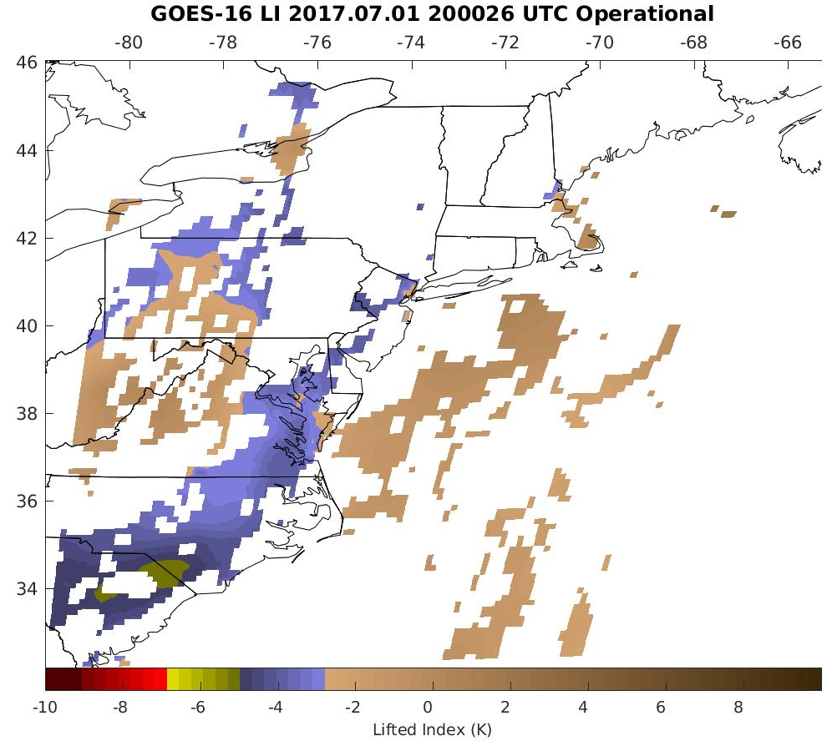
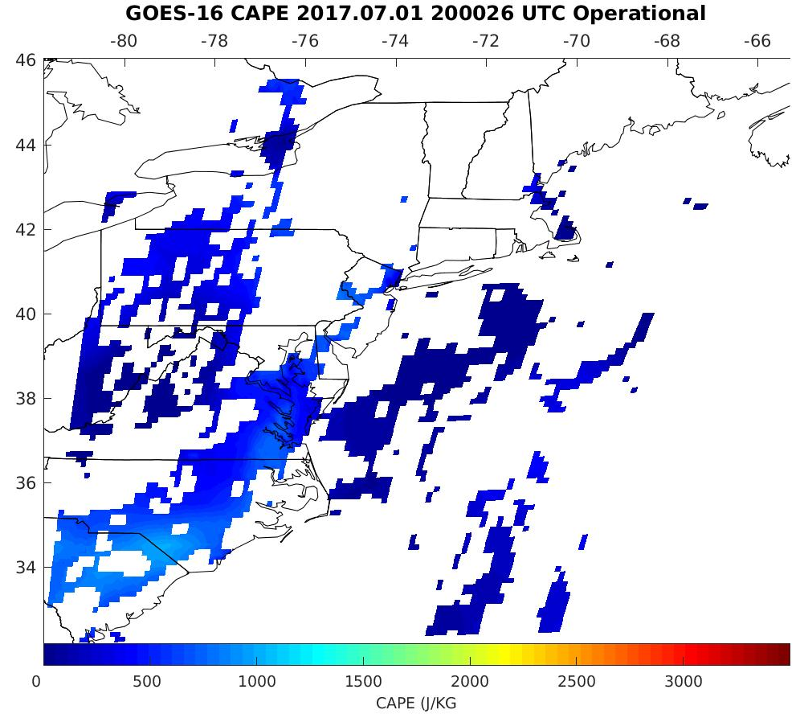
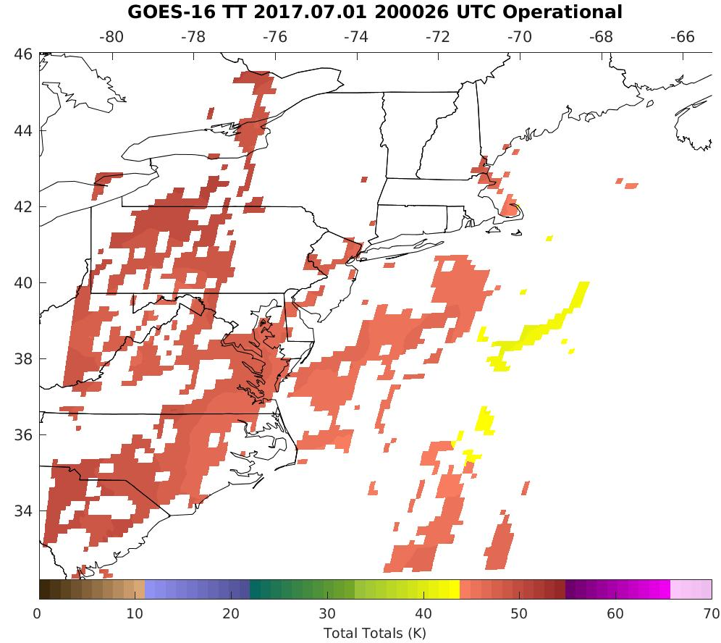
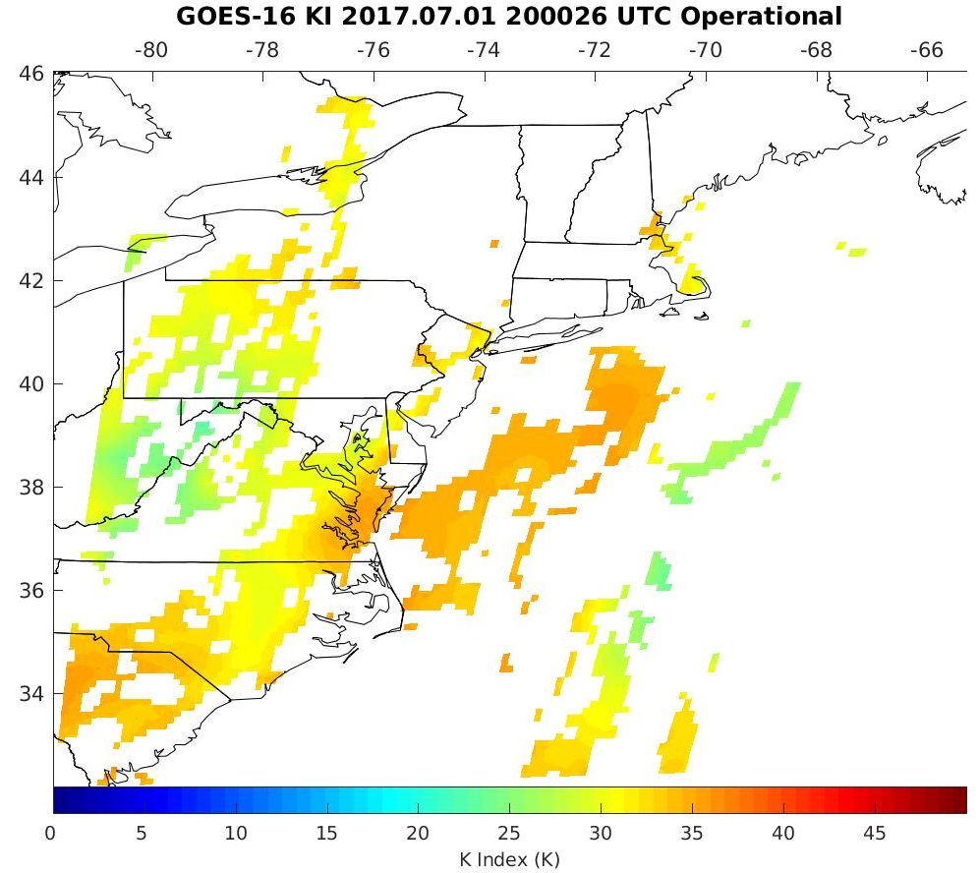
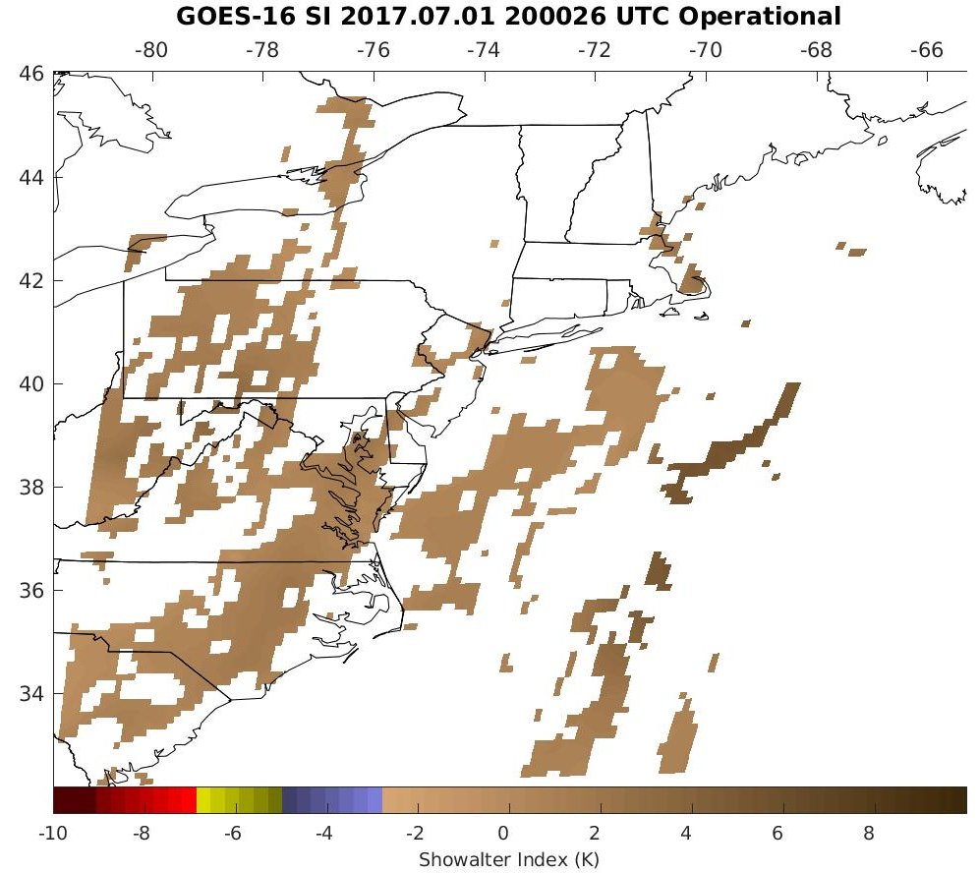
PLPT ABI-MESO1-DSI:
July 01, 2017, 2000 UTC
LI
CAPE
TT
KI
SI
LI: Lifted Index
CAPE: Convective Available Potential Energy
TT: Total Totals
KI: K-Index
SI: Showalter Index
PASSED
28

Slide 29
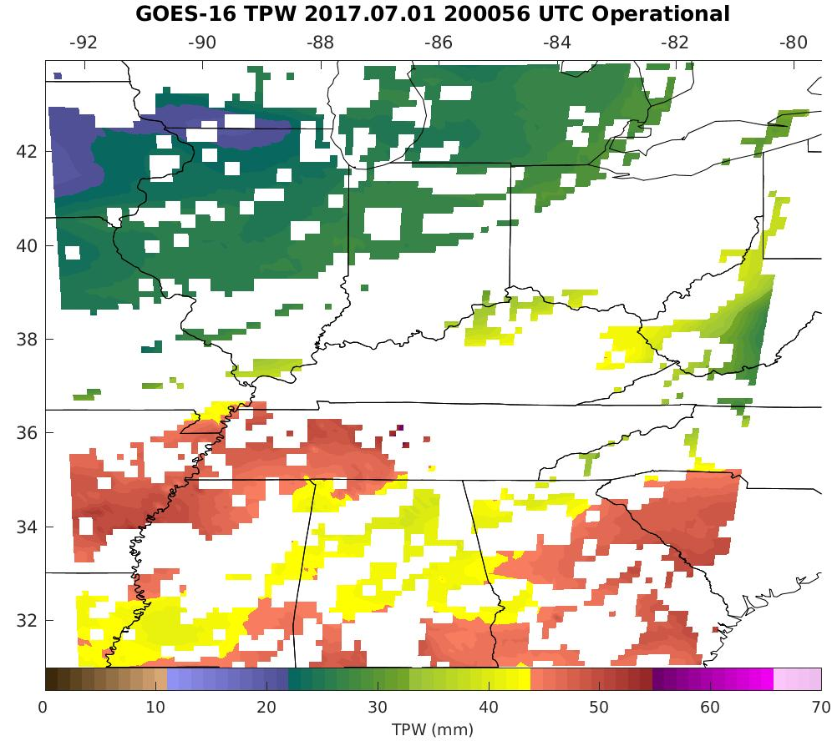
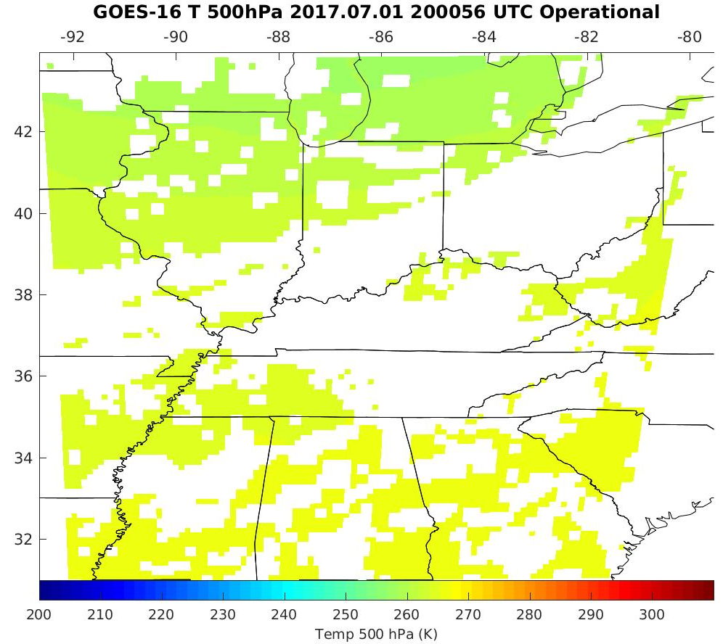
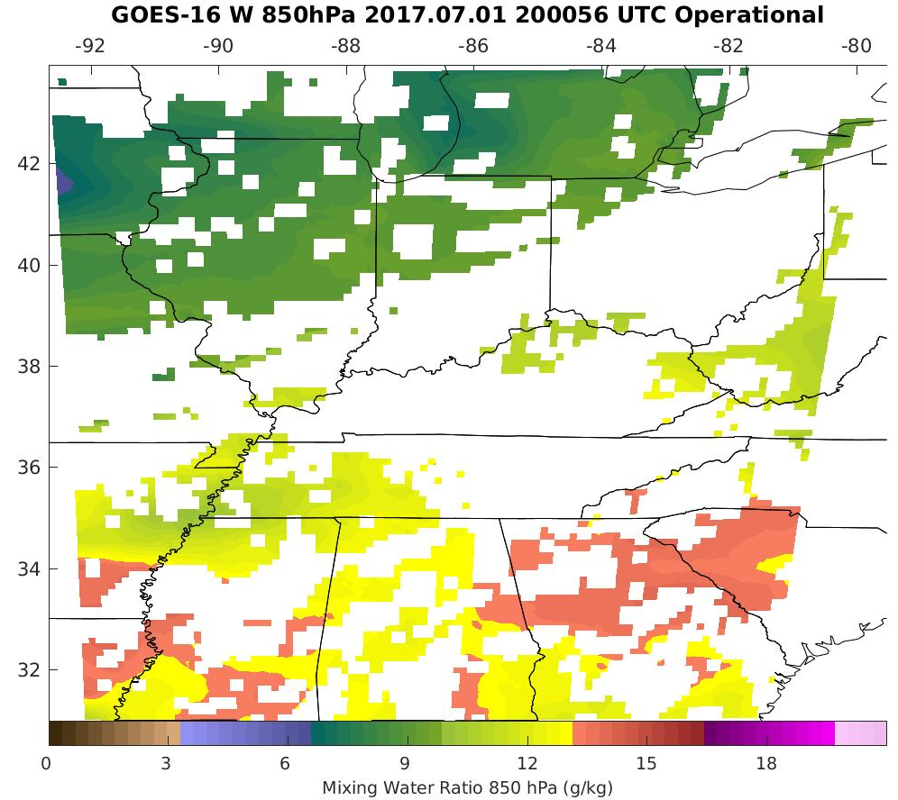
PLPT ABI-MESO2-TPW, LVT, LVM:
July 01, 2017, 2000 UTC
TPW (mm)
Temp (K). 500 hPa hPa
WV (g/kg) 850 hPa
TPW: Total Precipitable Water
LVT: Legacy Vertical Temperature profile
LVM: Legacy Vertical Moisture profile
PASSED
29

Slide 30
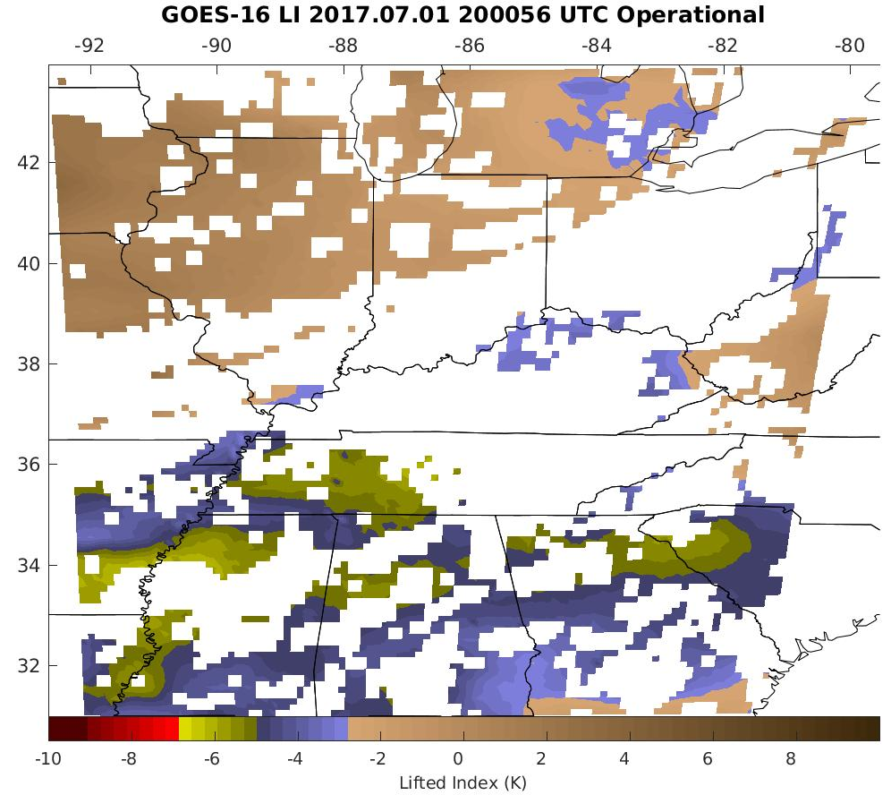
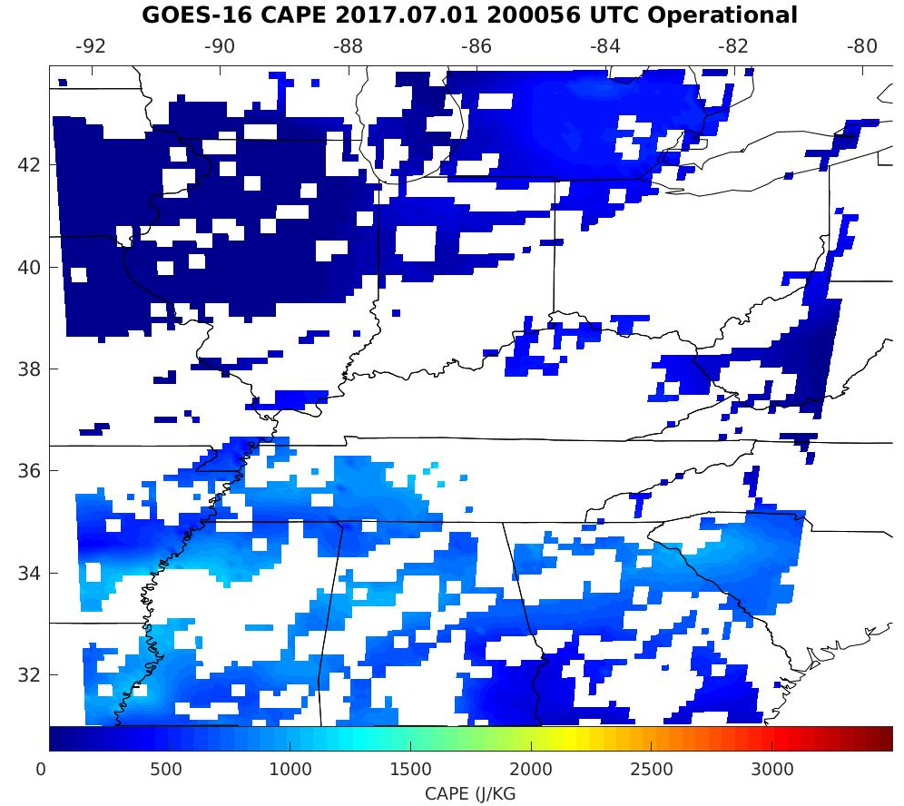
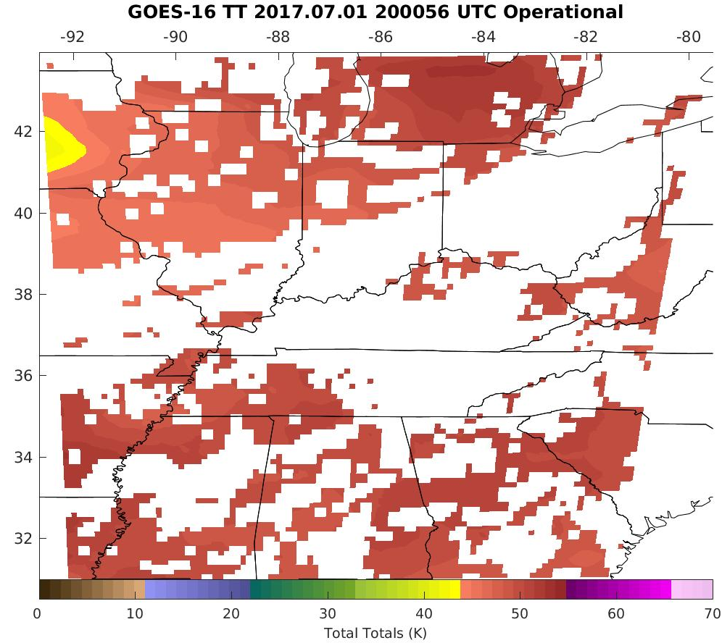
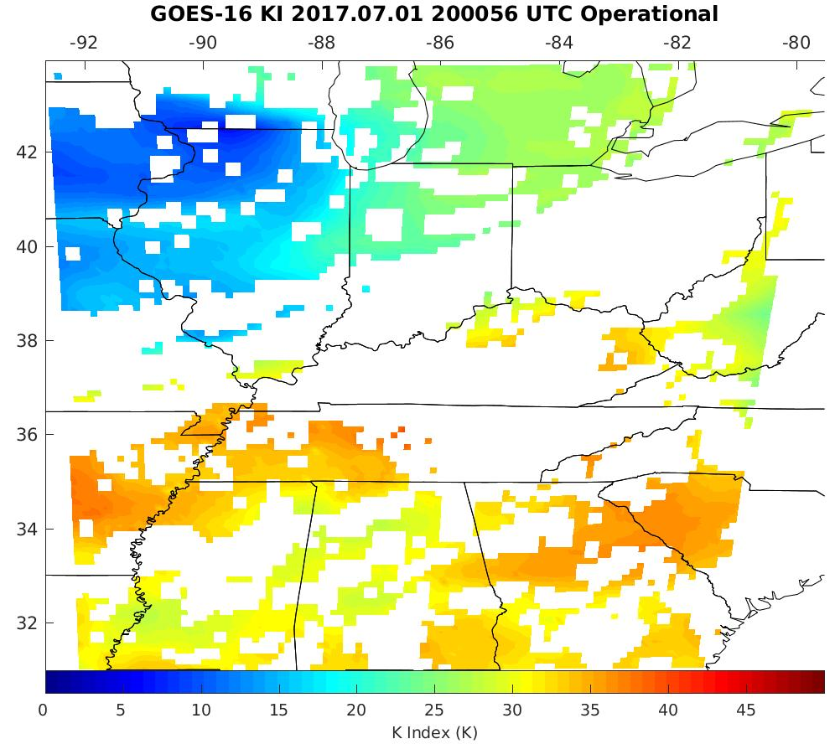
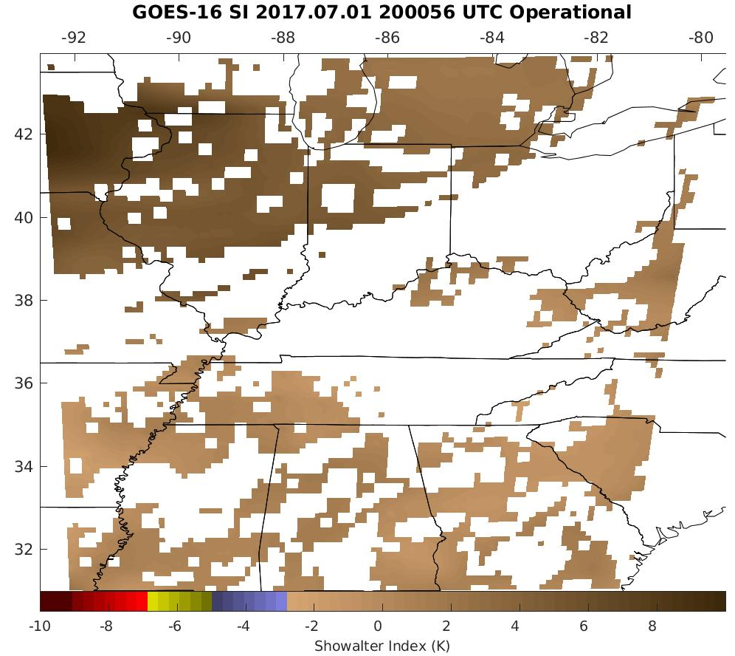
PLPT ABI-MESO2-DSI:
July 01, 2017, 2000 UTC
LI
CAPE
TT
KI
SI
LI: Lifted Index
CAPE: Convective Available Potential Energy
TT: Total Totals
KI: K-Index
SI: Showalter Index
PASSED
30

Slide 31
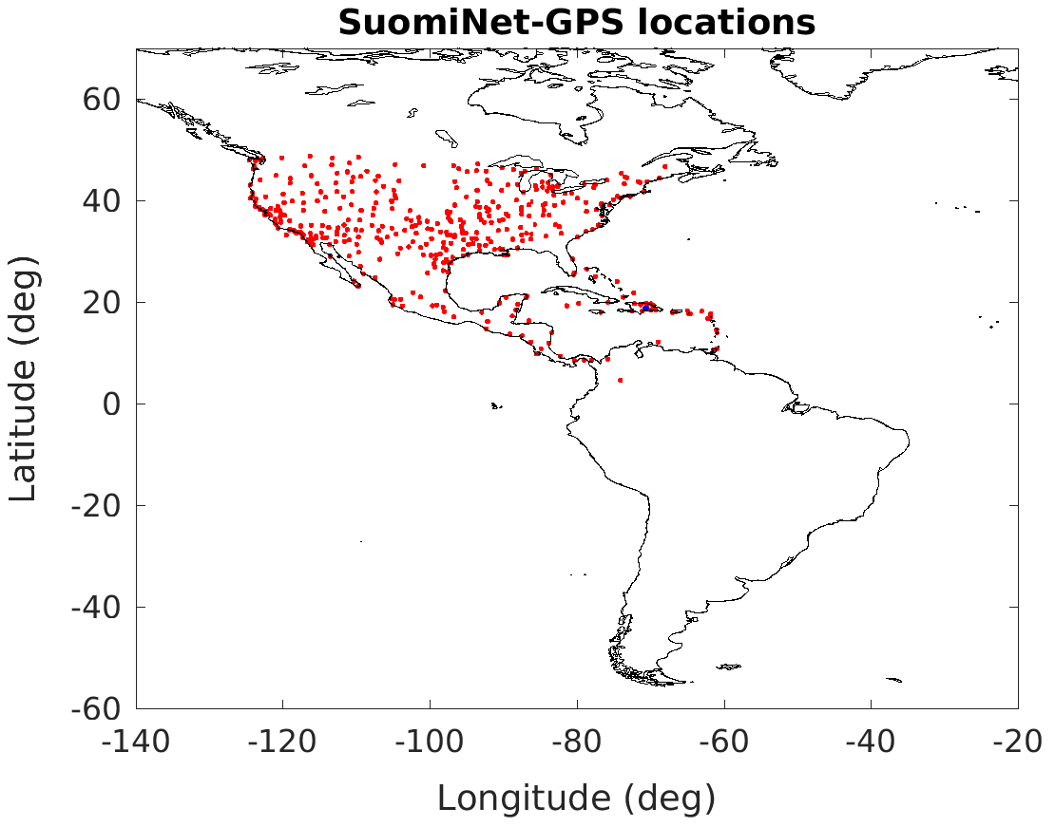
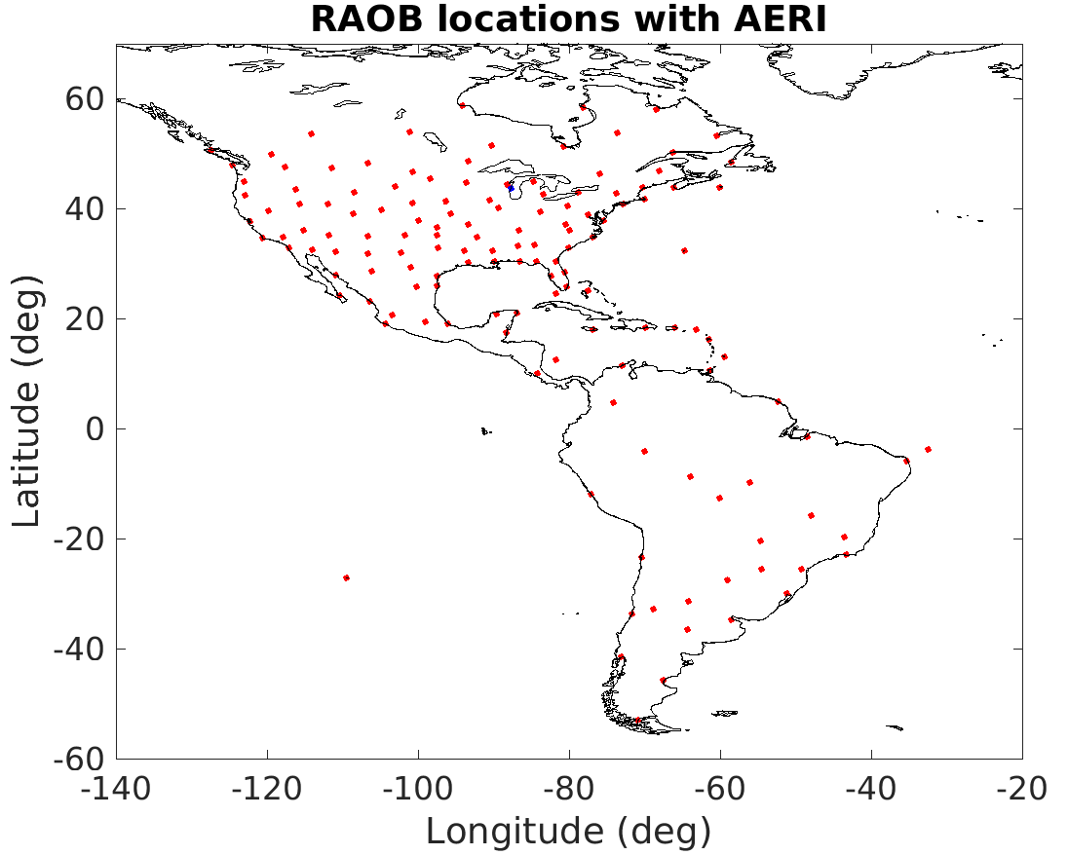
Locations of Suomi-Net GPS and RAOB
Suomi-Net GPS
RAOB (red) and AERI (blue)
31
Notes:
On the left figure, all the red dots indicate SuomiNet-GPS locations and the blue dot in Dominican Republic (lat: 18.79, lon: -70.66) indicates the location
where most of the outliers in tpw figures are located.
On the right figure, all the red dots indicate RAOB locations and the blue dot near the Michigan Lake (lat: 43.75, lon: -87.71) indicates AERI observation.

Slide 32
Comparison TPW with the GPS, RAOB, AMSR2, ECMWF, and GDAS
Note that ECMWF and GDAS data are new in the LAP provisional validation.
Both GDAS and ECMWF analysis have 0.25º X 0.25º resolution.
32

Slide 33
Requirements for ABI Legacy Atmospheric Profile (LAP) products
Product | Accuracy | Precision | Range
Temperature | 1 K below 400 hPa and above boundary layer | 2 K below 400 hPa and above boundary layer | 180 - 320 K
Moisture | Sfc - 300 hPa: 18% 300 - 100 hPa: 20% | Sfc-300 hPa: 18% 300-100 hPa: 20% | 0 - 100%
TPW | 1 mm | 3 mm | 0 - 100 mm
Lifted index | 2.0 K | 6.5 K | -10 ~ 40 K or above
CAPE | 1000 J/kg | 2500 J/kg | 0 - 5000 J/kg
SSI | 2.0 K | 6.5 K | -10 ~ 4 K or above
TT | 1 K | 4 K | -43 ~ 56 K
K index | 2 K | 5 K | 0 - 40 K
33

Slide 34
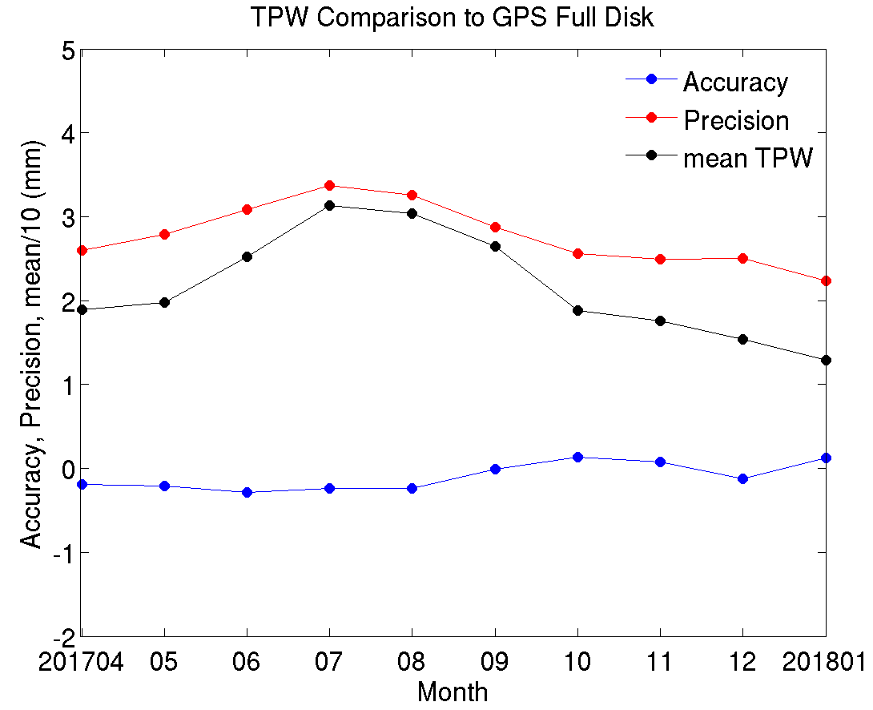
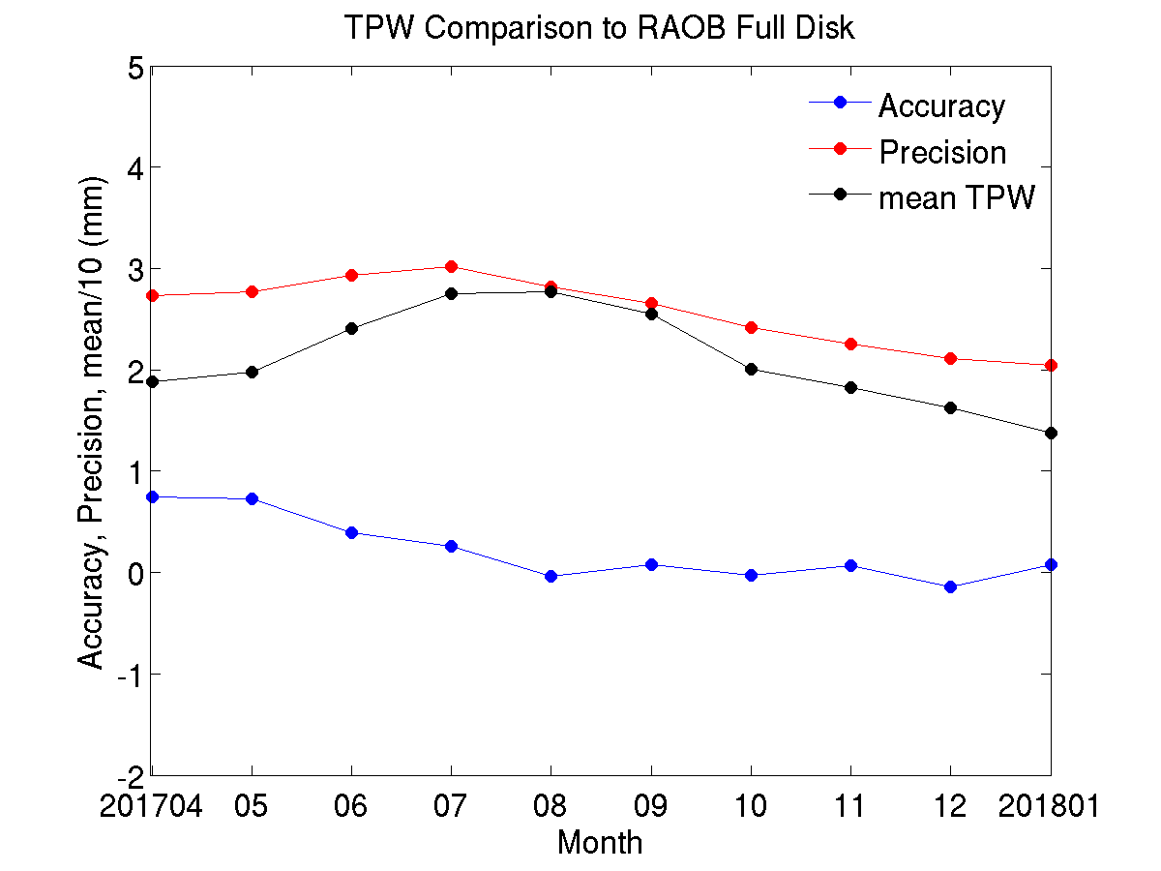
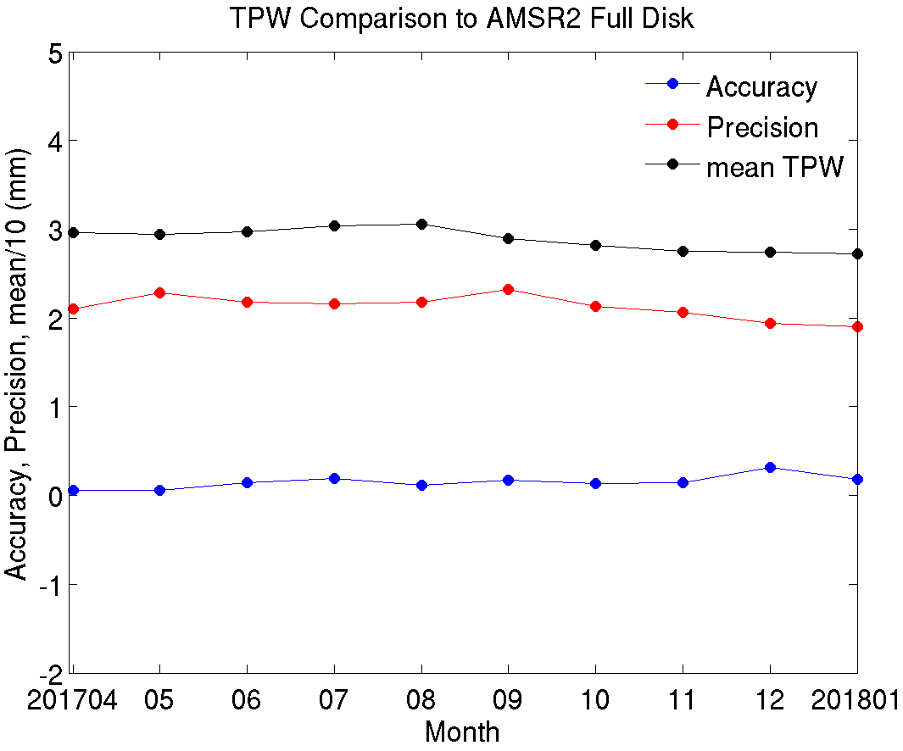
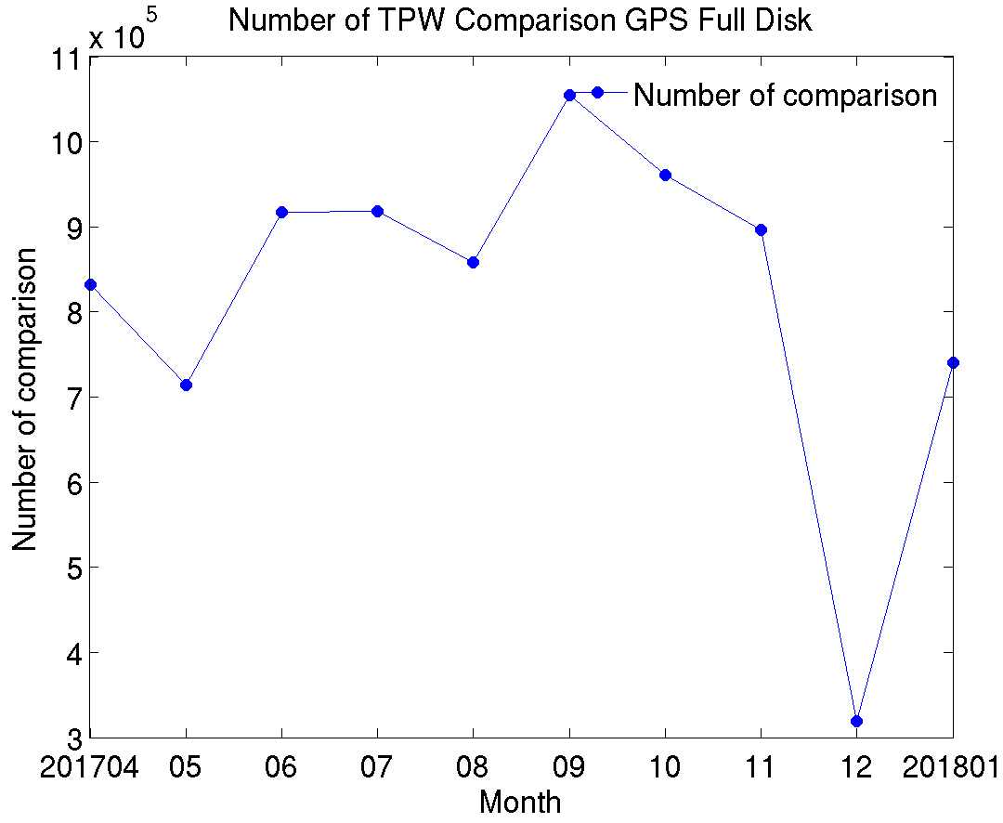
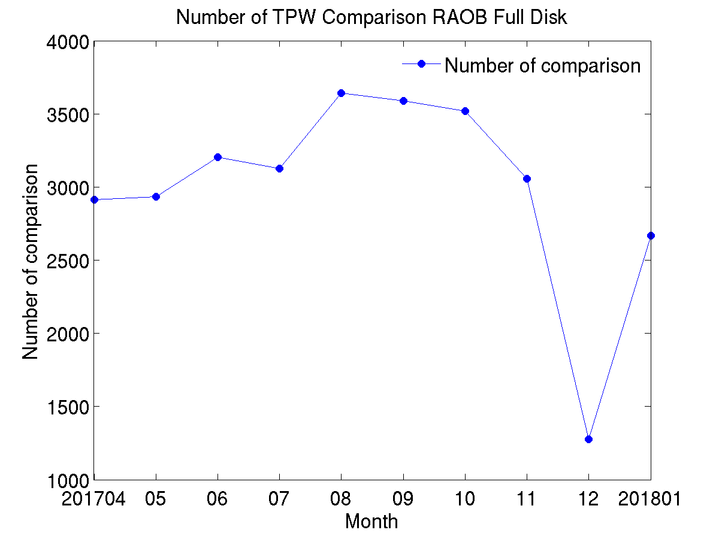
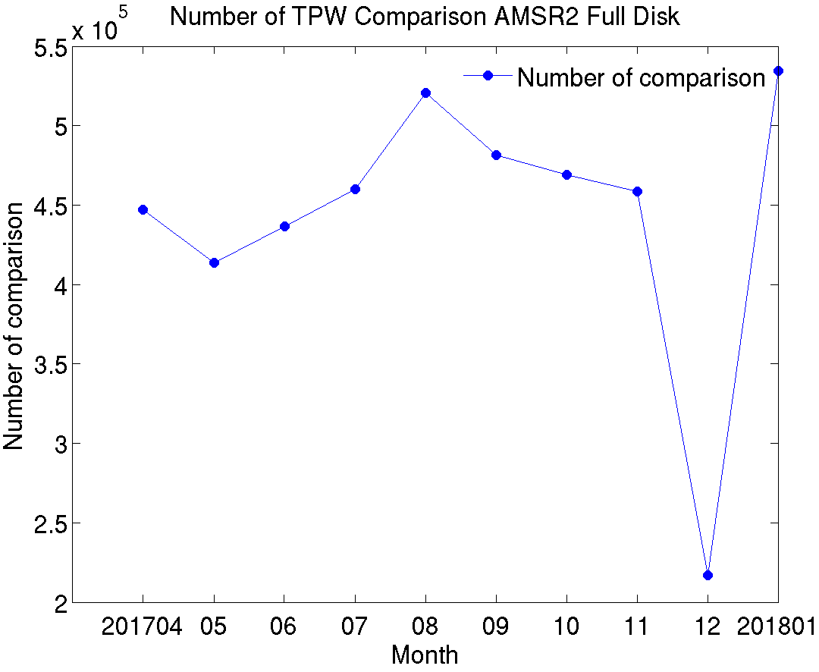
PLPT ABI-FD-TPW:
2017.04-2018.01
GPS
RAOB
AMSR2
Accuracy spec: 1 mm
Precision spec: 3 mm
PASSED
34

Slide 35
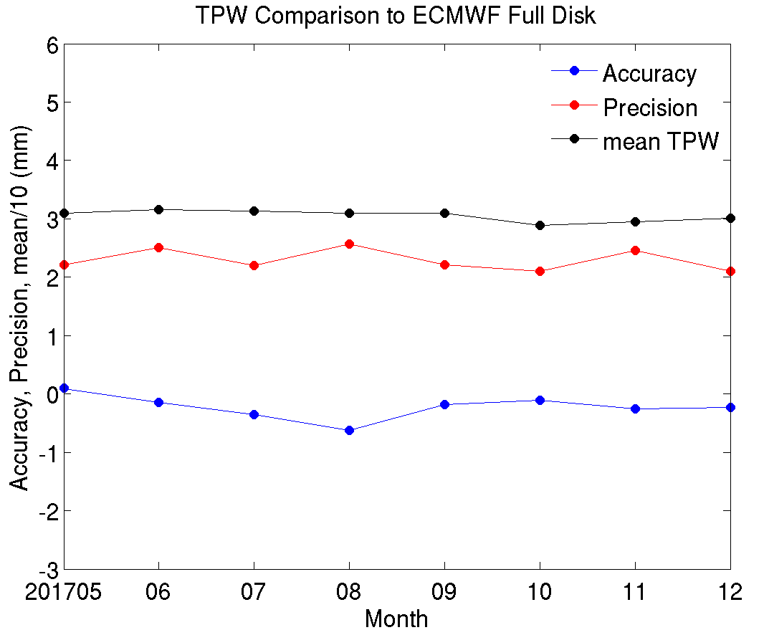
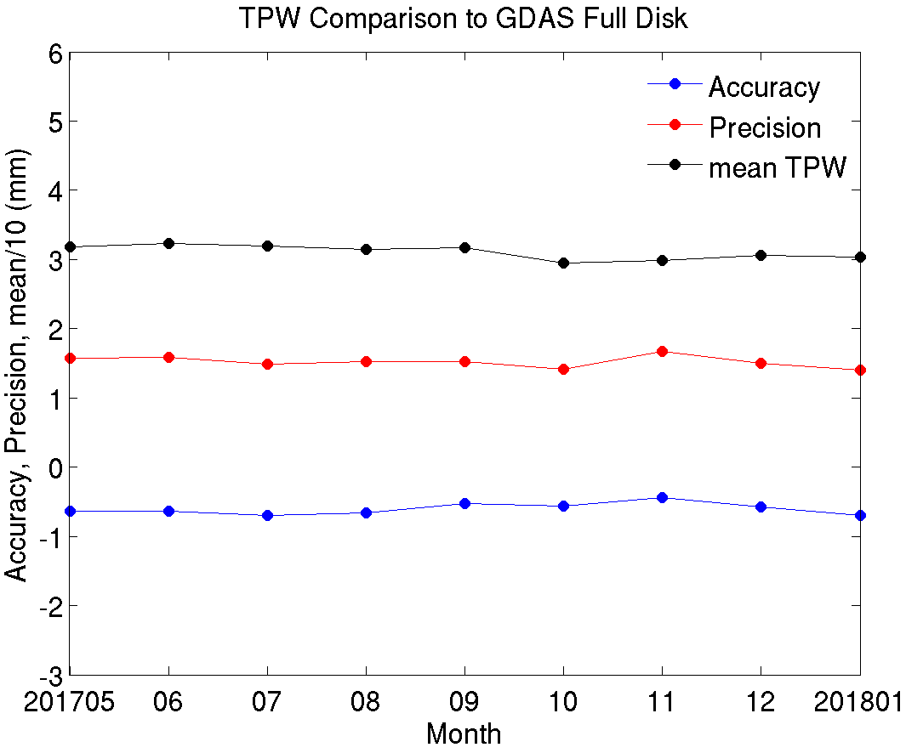
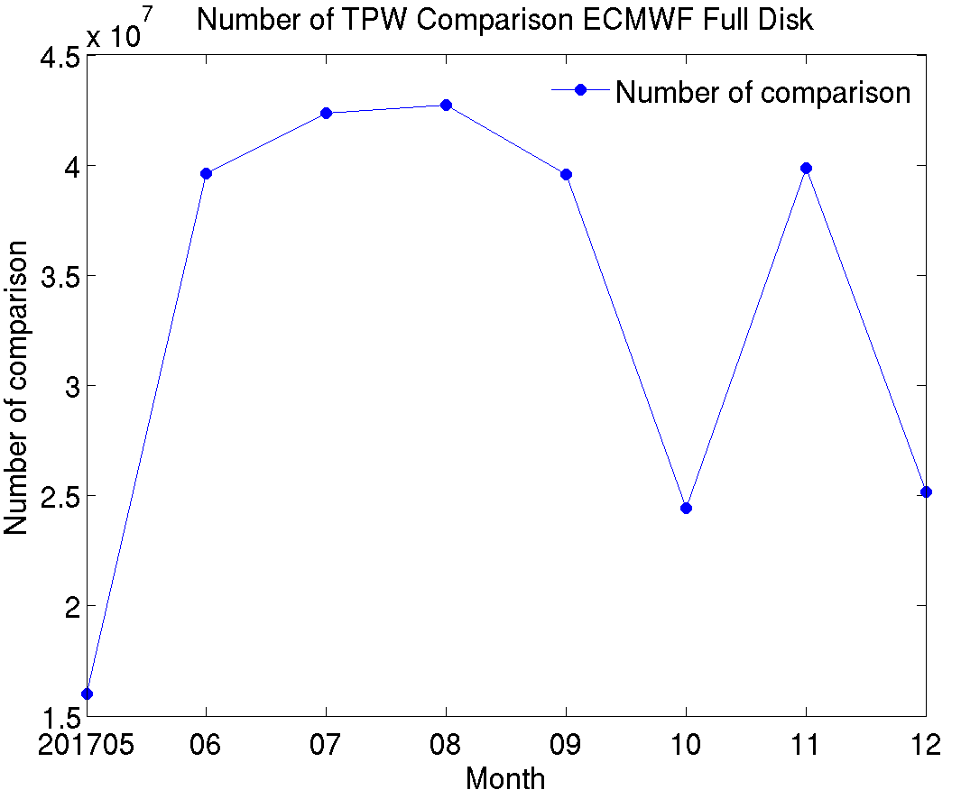
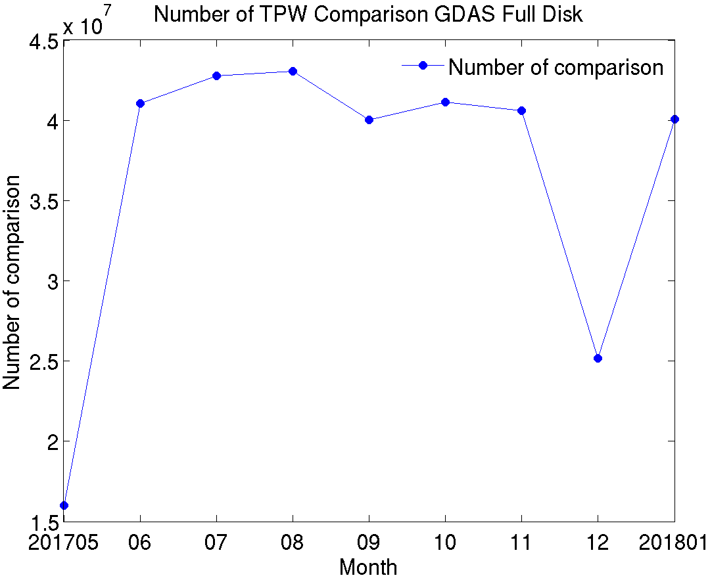
PLPT ABI-FD-TPW:
2017.05-2018.01
ECMWF
GDAS
Accuracy spec: 1 mm
Precision spec: 3 mm
PASSED
35

Slide 36
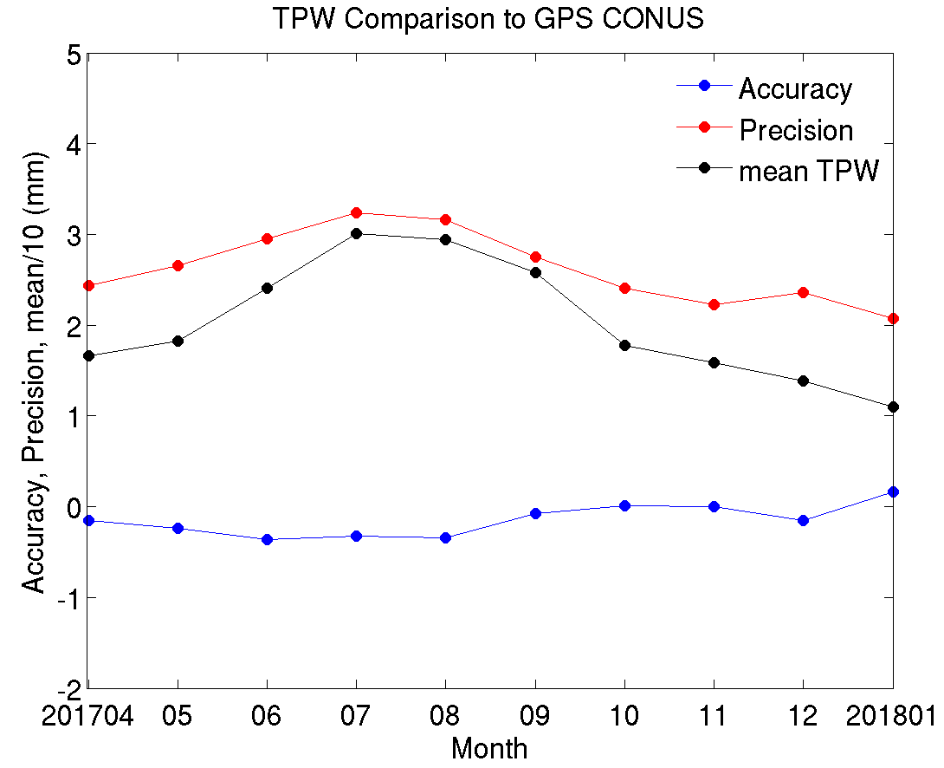
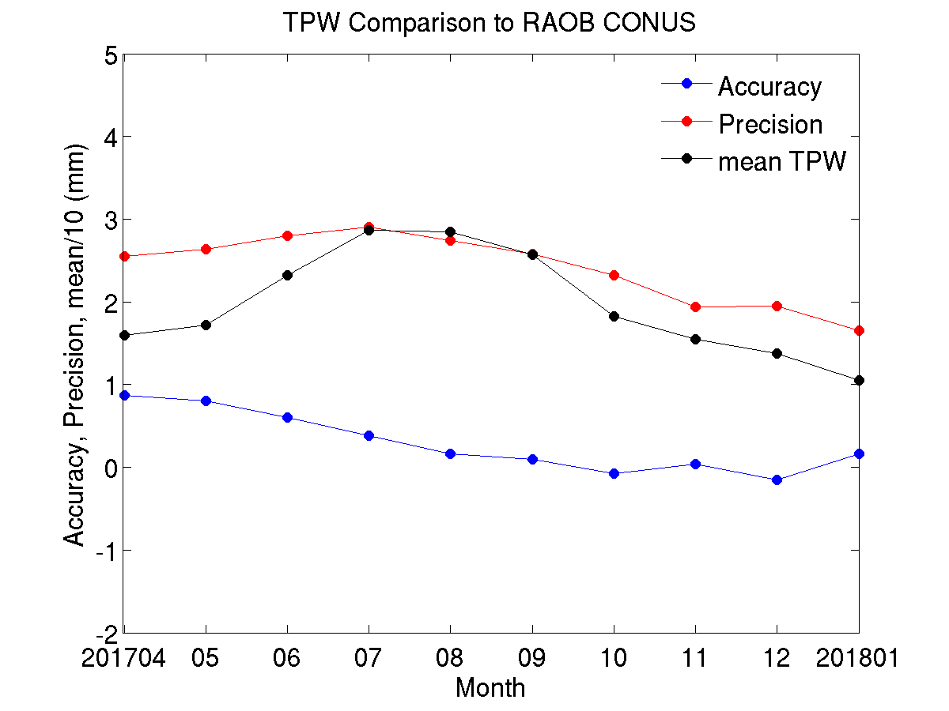
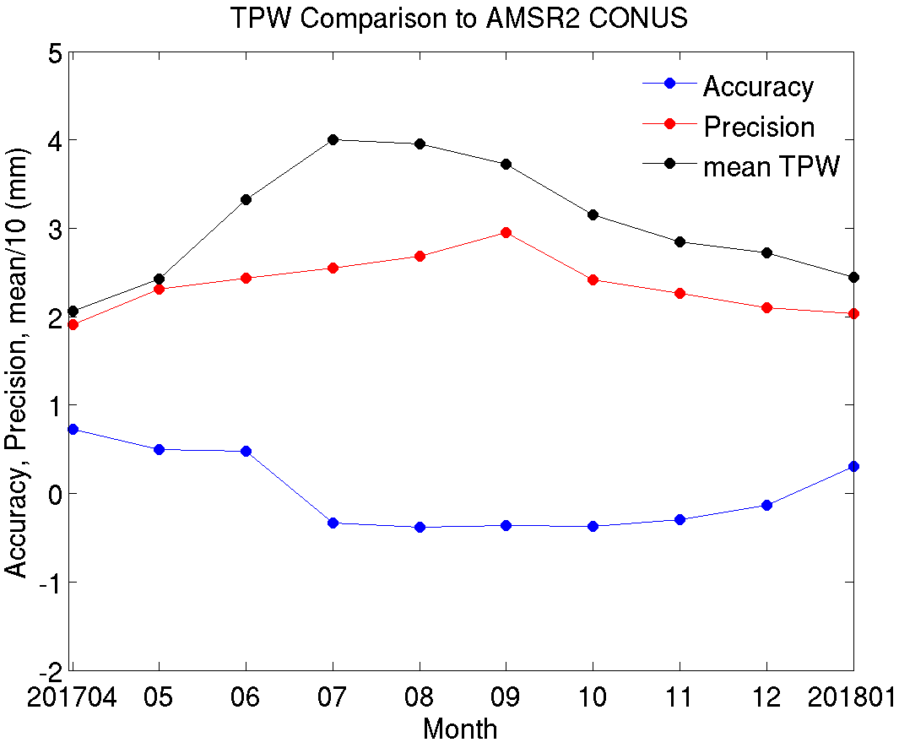
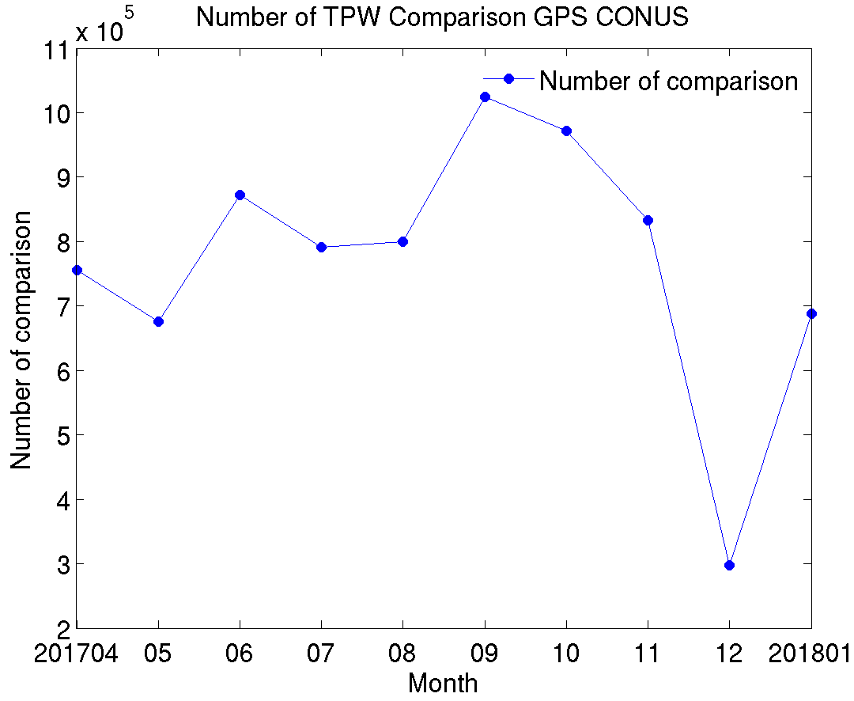
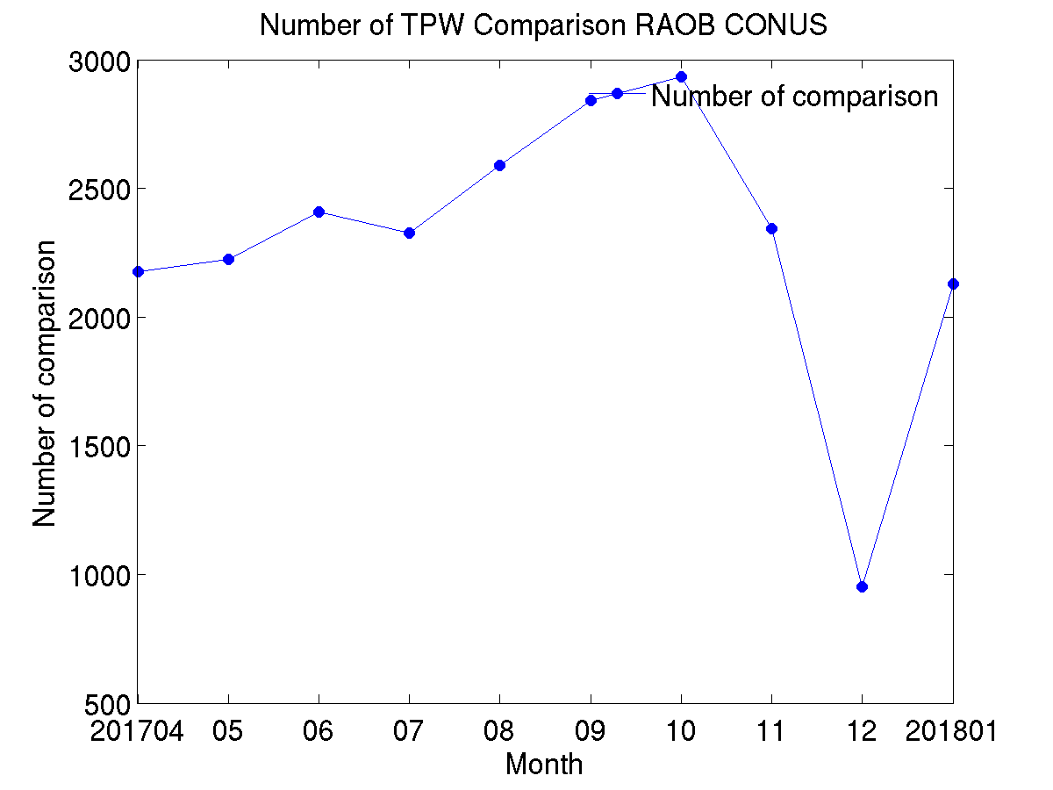
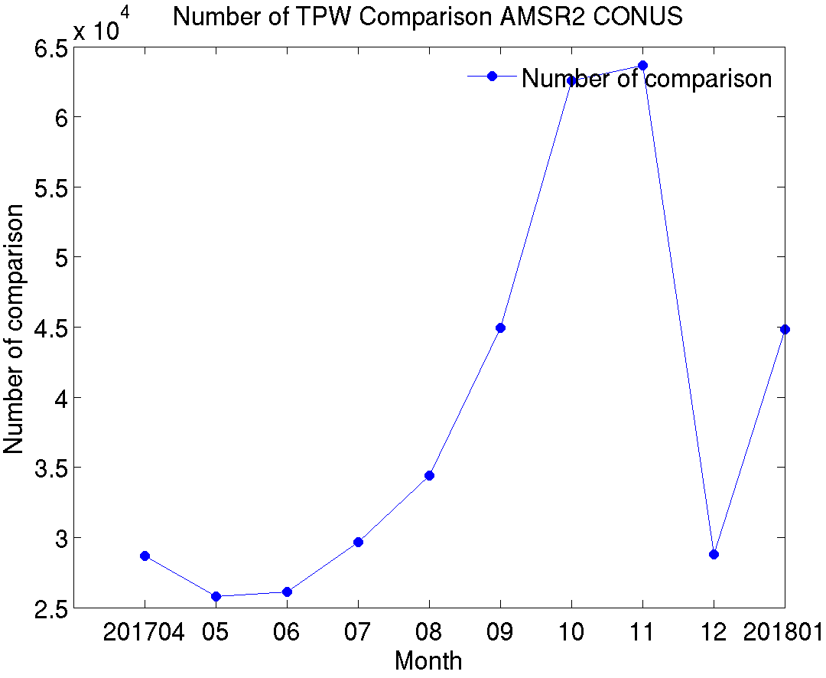
PLPT ABI-CONUS-TPW:
2017.04-2018.01
GPS
RAOB
AMSR2
Accuracy spec: 1 mm
Precision spec: 3 mm
PASSED
36

Slide 37
PLPT ABI-CONUS-TPW:
2017.05-2018.01
ECMWF
GDAS
Accuracy spec: 1 mm
Precision spec: 3 mm
PASSED
37

Slide 38
PLPT ABI-MESO1-TPW:
2017.04-2018.01
GPS
RAOB
AMSR2
Accuracy spec: 1 mm
Precision spec: 3 mm
PASSED
38

Slide 39
PLPT ABI-MESO1-TPW:
2017.05-2018.01
ECMWF
GDAS
Accuracy spec: 1 mm
Precision spec: 3 mm
PASSED
39

Slide 40
PLPT ABI-MESO2-TPW:
2017.04-2018.01
GPS
RAOB
AMSR2
Accuracy spec: 1 mm
Precision spec: 3 mm
PASSED
40

Slide 41
PLPT ABI-MESO2-TPW:
2017.05-2018.01
ECMWF
GDAS
Accuracy spec: 1 mm
Precision spec: 3 mm
PASSED
41

Slide 42
PLPT ABI-FD-DSI:
2017.06 GPS, outliers over CN06
Accuracy: -0.26 mm
Precision: 3.13 mm
Sample Size: 906864
Accuracy: -0.28 mm
Precision: 3.07 mm
Sample Size: 905772
PASSED
Most of the outliers are located at the GPS location (CN06, Dominican Republic lat:18.79, lon: -70.66). The number of pixels over CN06 is around 0.1% of the total number of the collocated pixels between GPS and GOES-16 baseline TPW.
42
Notes:
Most of the outliers are located at the GPS location (CN06, Dominican Republic lat:18.79, lon: -70.66) .
The number of pixels over CN06 is around 0.1% of the total number of the collocated pixels between GPS and baseline TPW.

Slide 43
Comparisons with GOES-15 Sounder (Case study)
The period includes September, October and November of 2017.
The overlapped TPW regions between GOES-15 Sounder and GOES-16 ABI are CONUS and full disk sectors.
ABI baseline and GOES-15 Sounder TPW products are compared with GPS TPW; they are close and comparable, both meet the requirement.

Slide 44
GOES-15 vs. GOES-16 ABI TPW overlapped coverage
Full disk and GOES-15
CONUS and GOES-15

Slide 45
Baseline (ABI) vs. GOES-15 TPW
comparison with GPS TPW
Full Disk
CONUS
Accuracy spec: 1 mm
Precision spec: 3 mm

Slide 46
TPW Performance Summary
TPW retrieval is working as expected on GOES-16 ABI data when combined with NWP short-rang forecasts (as first guess);
With a quantitative web-based tool (http://soundingval.ssec.wisc.edu) and the comparisons with RAOB, AMSR2, GPS, ECMWF and GDAS, it does indicate performances meet spec. for all the coverages (FD, CONUS, Meso1, and Meso2), except several Meso1 and Meso2 cases which do not have enough number of samples or where mean TPW is comparatively large.
For the comparisons with GPS TPW, most of the outliers are located over CN06 (lat: 18.79, lon: -70.66).
46

Slide 47
Real-time GOES-16 ABI LAP product validation webpage soundingval.ssec.wisc.edu
Imagery (Fulldisk TPW)
Station TPW Plots with deep dive capability
Regional Plots with GPS

Slide 48
Comparison LVT & LVM with the RAOB, ECMWF, GDAS, and field campaign (AERI)
Note that ECMWF, GDAS, AERI data are new in the LAP provisional validation.
48

Slide 49
Requirements for ABI Legacy Atmospheric Profile (LAP) products
Product | Accuracy | Precision | Range
Temperature | 1 K below 400 hPa and above boundary layer | 2 K below 400 hPa and above boundary layer | 180 - 320 K
Moisture | Sfc - 300 hPa: 18% 300 - 100 hPa: 20% | Sfc - 300 hPa: 18% 300 - 100 hPa: 20% | 0 - 100%
TPW | 1 mm | 3 mm | 0 - 100 mm
Lifted index | 2.0 K | 6.5 K | -10 ~ 40 K or above
CAPE | 1000 J/kg | 2500 J/kg | 0 - 5000 J/kg
SSI | 2.0 K | 6.5 K | -10 ~ 4 K or above
TT | 1 K | 4 K | -43 ~ 56 K
K index | 2 K | 5 K | 0 - 40 K
49

Slide 50
PLPT ABI-FD, CONUS-LVT, LVM:
2017.05-2018.01 RAOB
Temperature (K)
Relative Humidity (%)
Accuracy spec:
1 K (BL-400hPa)
Precision spec:
2 K (BL-400hPa)
Accuracy & Precision spec:
18% (sfc-300hPa), 20% (300-100hPa)
Sample Size: 28451
Full Disk
Sample Size: 28451
CONUS
Sample Size: 21705
Sample Size: 21705
PASSED
50
Notes:
Sample size is “maximum”, eg, if one level has a match.

Slide 51
PLPT ABI-FD, CONUS-LVT, LVM:
2017.06.01 00UTC ECMWF
Temperature (K)
Relative Humidity (%)
Accuracy spec:
1 K (BL-400hPa)
Precision spec:
2 K (BL-400hPa)
Accuracy & Precision spec:
18% (sfc-300hPa), 20% (300-100hPa)
Sample Size: 378863
Full Disk
Sample Size: 378863
CONUS
Sample Size: 56254
Sample Size: 56254
PASSED
51

Slide 52
PLPT ABI-FD, CONUS-LVT, LVM:
2017.06.01 00UTC GDAS
Temperature (K)
Relative Humidity (%)
Accuracy spec:
1 K (BL-400hPa)
Precision spec:
2 K (BL-400hPa)
Accuracy & Precision spec:
18% (sfc-300hPa), 20% (300-100hPa)
Sample Size: 378863
Full Disk
Sample Size: 378863
CONUS
Sample Size: 56254
Sample Size: 56254
PASSED
52

Slide 53
PLPT ABI-FD, CONUS-LVT, LVM:
2017.05.22 – 06.22 AERI (lat:43.75 lon:-87.71)
Temperature (K)
Relative Humidity (%)
Accuracy spec:
1 K (BL-400hPa)
Precision spec:
2 K (BL-400hPa)
Accuracy & Precision spec:
18% (sfc-300hPa), 20% (300-100hPa)
Full Disk
Sample Size: 1289
Sample Size: 1289
CONUS
Sample Size: 4393
Sample Size: 4394
PASSED
53
Notes:
AERI measurements are valid upto around 700 hPa.

Slide 54
PLPT ABI-Meso1, Meso2-LVT, LVM:
2017.05-2018.01 RAOB
Temperature (K)
Relative Humidity (%)
Accuracy spec:
1 K (BL-400hPa)
Precision spec:
2 K (BL-400hPa)
Accuracy & Precision spec:
18% (sfc-300hPa), 20% (300-100hPa)
Meso1
Sample Size: 1720
Sample Size: 1720
Meso2
Sample Size: 1853
Sample Size: 1853
PASSED
54

Slide 55
PLPT ABI-Meso1, Meso2-LVT, LVM:
2017.06.01 00UTC ECMWF
Temperature (K)
Relative Humidity (%)
Accuracy spec:
1 K (BL-400hPa)
Precision spec:
2 K (BL-400hPa)
Accuracy & Precision spec:
18% (sfc-300hPa), 20% (300-100hPa)
Meso1
Sample Size: 3100
Sample Size: 3100
Meso2
Sample Size: 6438
Sample Size: 6438
PASSED
55

Slide 56
PLPT ABI-Meso1, Meso2-LVT, LVM:
2017.06.01 00UTC GDAS
Temperature (K)
Relative Humidity (%
Accuracy spec:
1 K (BL-400hPa)
Precision spec:
2 K (BL-400hPa)
Accuracy & Precision spec:
18% (sfc-300hPa), 20% (300-100hPa)
Meso1
Sample Size: 3100
Sample Size: 3100
Meso2
Sample Size: 6438
Sample Size: 6438
PASSED
56

Slide 57
PLPT ABI-Meso1, Meso2-LVT, LVM:
2017.05.22 – 06.22 AERI (lat:43.75 lon:-87.71)
Temperature (K)
Relative Humidity (%)
Accuracy spec:
1 K (BL-400hPa)
Precision spec:
2 K (BL-400hPa)
Accuracy & Precision spec:
18% (sfc-300hPa), 20% (300-100hPa)
Sample Size: 358
Sample Size: 358
Meso1
Meso2
Sample Size: 6770
Sample Size: 6770
PASSED
57
Notes:
AERI measurements are valid upto around 700 hPa.

Slide 58
LVT and LVM Performance Summary
LVT and LVM retrievals are working as expected on GOES-16 ABI data when combined with NWP short-range forecasts (as first guess);
Retrievals are sensitive to first guess;
With a highly quantitative web-based tool (http://soundingval.ssec.wisc.edu) and the comparisons with RAOB, ECMWF, GDAS, and AERI measurements from GOES-R field campaign (Lake Michigan Ozone Study - LMOS 2017: https://www-air.larc.nasa.gov/missions/lmos/), it does indicate that performances meet spec. for all the coverages (FD, CONUS, Meso1, Meso2), except the relative humidity at upper troposphere (100 - 300 hPa) when compared with RAOB, which is likely due to the known issue of dry bias of radiosonde observations.
58

Slide 59
Comparison DSI with the RAOB, ECMWF, and GDAS
Note that ECMWF, GDAS data are new in the LAP provisional validation.
59

Slide 60
Requirements for ABI Legacy Atmospheric Profile (LAP) products
Product | Accuracy | Precision | Range
Temperature | 1 K below 400 hPa and above boundary layer | 2 K below 400 hPa and above boundary layer | 180 - 320 K
Moisture | Sfc - 300 hPa: 18% 300 - 100 hPa: 20% | Sfc - 300 hPa: 18% 300 - 100 hPa: 20% | 0 - 100%
TPW | 1 mm | 3 mm | 0 - 100 mm
Lifted index | 2.0 K | 6.5 K | -10 ~ 40 K or above
CAPE | 1000 J/kg | 2500 J/kg | 0 - 5000 J/kg
SSI | 2.0 K | 6.5 K | -10 ~ 4 K or above
TT | 1 K | 4 K | -43 ~ 56 K
K index | 2 K | 5 K | 0 - 40 K
60

Slide 61
PLPT ABI-FD-DSI:
2017.04-2018.01 RAOB
LI
CAPE
TT*
Accuracy spec: 1 K
Precision spec: 4 K
Accuracy spec: 1000 J/kg
Precision spec: 2500 J/kg
Accuracy spec: 2 K
Precision spec: 6.5 K
PASSED
*TT results are slightly larger than spec when compared with RAOBs during this time of non-operational ABI data. Of course RAOB are point data, compared to NWP models.
61

Slide 62
PLPT ABI-FD-DSI:
2017.04-2018.01 RAOB
KI*
SI
*KI results are a bit larger than spec when compared with RAOBs during this time of non-operational ABI data. RAOB are point data, compared to NWP models. See next slide for more analysis
Accuracy spec: 2 K
Precision spec: 5 K
Accuracy spec: 2 K
Precision spec: 6.5 K
PASSED
62

Slide 63
PLPT ABI-FD-CONUS-DSI:
2017.04-2018.01 RAOB
including “only unstable cases”
KI (>26 for unstable cases)
TT (>44 for unstable cases)
Full Disk
Accuracy spec: 2 K
Precision spec: 5 K
Accuracy spec: 1 K
Precision spec: 4 K
CONUS
Accuracy spec: 2 K
Precision spec: 5 K
Accuracy spec: 1 K
Precision spec: 4 K
PASSED
63
Notes:
Considering only unstable cases, most of the accuracy and precision of TT and KI are reduced in magnitude.

Slide 64
PLPT ABI-FD-DSI:
2017.05-2017.12 ECMWF
LI
CAPE
TT
Accuracy spec: 1000 J/kg
Precision spec: 2500 J/kg
Accuracy spec: 2 K
Precision spec: 6.5 K
Accuracy spec: 1 K
Precision spec: 4 K
PASSED
64

Slide 65
PLPT ABI-FD-DSI:
2017.05-2017.12 ECMWF
KI
SI
Accuracy spec: 2 K
Precision spec: 6.5 K
Accuracy spec: 2 K
Precision spec: 5 K
PASSED
65

Slide 66
PLPT ABI-FD-DSI:
2017.05-2018.01 GDAS
LI
CAPE
TT
Accuracy spec: 1000 J/kg
Precision spec: 2500 J/kg
Accuracy spec: 1 K
Precision spec: 4 K
Accuracy spec: 2 K
Precision spec: 6.5 K
PASSED
66

Slide 67
PLPT ABI-FD-DSI:
2017.05-2018.01 GDAS
KI
SI
Accuracy spec: 2 K
Precision spec: 5 K
Accuracy spec: 2 K
Precision spec: 6.5 K
PASSED
67

Slide 68
PLPT ABI-CONUS-DSI:
2017.04-2018.01 RAOB
LI
CAPE
TT
Accuracy spec: 1 K
Precision spec: 4 K
Accuracy spec: 1000 J/kg
Precision spec: 2500 J/kg
Accuracy spec: 2 K
Precision spec: 6.5 K
PASSED
68

Slide 69
PLPT ABI-CONUS-DSI:
2017.04-2018.01 RAOB
KI
SI
Accuracy spec: 2 K
Precision spec: 5 K
Accuracy spec: 2 K
Precision spec: 6.5 K
PASSED
69

Slide 70
PLPT ABI-CONUS-DSI:
2017.05-2017.12 ECMWF
LI
CAPE
TT
Accuracy spec: 2 K
Precision spec: 6.5 K
Accuracy spec: 1000 J/kg
Precision spec: 2500 J/kg
Accuracy spec: 1 K
Precision spec: 4 K
PASSED
70

Slide 71
PLPT ABI-CONUS-DSI:
2017.05-2017.12 ECMWF
KI
SI
Accuracy spec: 2 K
Precision spec: 6.5 K
Accuracy spec: 2 K
Precision spec: 5 K
PASSED
71

Slide 72
PLPT ABI-CONUS-DSI:
2017.05-2018.01 GDAS
LI
CAPE
TT
Accuracy spec: 1000 J/kg
Precision spec: 2500 J/kg
Accuracy spec: 1 K
Precision spec: 4 K
Accuracy spec: 2 K
Precision spec: 6.5 K
PASSED
72

Slide 73
PLPT ABI-CONUS-DSI:
2017.05-2018.01 GDAS
KI
SI
Accuracy spec: 2 K
Precision spec: 5 K
Accuracy spec: 2 K
Precision spec: 6.5 K
PASSED
73

Slide 74
PLPT ABI-MESO1-DSI:
2017.04-2018.01 RAOB
LI
CAPE
TT
Accuracy spec: 2 K
Precision spec: 6.5 K
Accuracy spec: 1 K
Precision spec: 4 K
Accuracy spec: 1000 J/kg
Precision spec: 2500 J/kg
PASSED
74

Slide 75
PLPT ABI-MESO1-DSI:
2017.04-2018.01 RAOB
KI
SI
Accuracy spec: 2 K
Precision spec: 5 K
Accuracy spec: 2 K
Precision spec: 6.5 K
PASSED
75

Slide 76
PLPT ABI-MESO1-DSI:
2017.05-2017.12 ECMWF
LI
CAPE
TT
Accuracy spec: 2 K
Precision spec: 6.5 K
Accuracy spec: 1000 J/kg
Precision spec: 2500 J/kg
Accuracy spec: 1 K
Precision spec: 4 K
PASSED
76

Slide 77
PLPT ABI-MESO1-DSI:
2017.05-2017.12 ECMWF
KI
SI
Accuracy spec: 2 K
Precision spec: 6.5 K
Accuracy spec: 2 K
Precision spec: 5 K
PASSED
77

Slide 78
PLPT ABI-MESO1-DSI:
2017.05-2018.01 GDAS
LI
CAPE
TT
Accuracy spec: 1000 J/kg
Precision spec: 2500 J/kg
Accuracy spec: 1 K
Precision spec: 4 K
Accuracy spec: 2 K
Precision spec: 6.5 K
PASSED
78

Slide 79
PLPT ABI-MESO1-DSI:
2017.05-2018.01 GDAS
KI
SI
Accuracy spec: 2 K
Precision spec: 5 K
Accuracy spec: 2 K
Precision spec: 6.5 K
PASSED
79

Slide 80
PLPT ABI-MESO2-DSI:
2017.04-2018.01 RAOB
LI
CAPE
TT
Accuracy spec: 1000 J/kg
Precision spec: 2500 J/kg
Accuracy spec: 1 K
Precision spec: 4 K
Accuracy spec: 2 K
Precision spec: 6.5 K
PASSED
80

Slide 81
PLPT ABI-MESO2-DSI:
2017.04-2018.01 RAOB
KI
SI
Accuracy spec: 2 K
Precision spec: 5 K
Accuracy spec: 2 K
Precision spec: 6.5 K
PASSED
81

Slide 82
PLPT ABI-MESO2-DSI:
2017.05-2017.12 ECMWF
LI
CAPE
TT
Accuracy spec: 2 K
Precision spec: 6.5 K
Accuracy spec: 1000 J/kg
Precision spec: 2500 J/kg
Accuracy spec: 1 K
Precision spec: 4 K
PASSED
82

Slide 83
PLPT ABI-MESO2-DSI:
2017.05-2017.12 ECMWF
KI
SI
Accuracy spec: 2 K
Precision spec: 6.5 K
Accuracy spec: 2 K
Precision spec: 5 K
PASSED
83

Slide 84
PLPT ABI-MESO2-DSI:
2017.05-2018.01 GDAS
LI
CAPE
TT
Accuracy spec: 1000 J/kg
Precision spec: 2500 J/kg
Accuracy spec: 2 K
Precision spec: 6.5 K
Accuracy spec: 1 K
Precision spec: 4 K
PASSED
84

Slide 85
PLPT ABI-MESO2-DSI:
2017.05-2018.01 GDAS
KI
SI
Accuracy spec: 2 K
Precision spec: 5 K
Accuracy spec: 2 K
Precision spec: 6.5 K
PASSED
85

Slide 86
DSI Performance Summary
DSI retrieval is working as expected on GOES-16 ABI data when combined with NWP short-range forecasts (as first guess);
With a highly quantitative web-based tool (http://soundingval.ssec.wisc.edu) and the comparisons with RAOB, ECMWF and GDAS, it does indicate performances mostly meet spec. for all the coverages, except comparisons of TT and KI with RAOBs. The TT and KK results are much closer to the requirements if the atmosphere is in the unstable conditions.
The beta-stage cloud mask was used for all retrievals.
86

Slide 87
PLPT Outcomes: Summary
All PLPT activities needed to make LAP products provisional have been completed.
Recommendations from Beta review are fulfilled in the provisional validation stage.
Unexpected minor issues revealed by PLPTs:
Missing values in random boxed areas
The migration of the sun affects the LAP products.
Slightly large discrepancy of some DSI products compared with RAOB.
These minor issues may not prevent the declaration of Provisional Maturity

Slide 88
PATH TO FULL MATURITY
GOES-16 ABI L2 LAP Product Provisional PS-PVR

Slide 89
Path to Full Maturity
We expect to apply the same PLPTs to be conducted for Full Maturity
We are gathering an archive of golden days where we save L1,L2 and IPs.
Our goal is extended period tests throughout May 2017 to May 2018.
This collection is underway. Will coordinate with other teams.
We are also saving L2 to enable further comparison with the reference datasets such as ECMWF and GDAS analysis data.
We hope to engage the teams in the summer and begin application-specific analysis.
Retrievals with the provisional cloud mask will be validated.
Currently minor issues may not prevent declaration of Full Maturity (3 issues identified through the PLPT work and will be mitigated during provisional stage)
Missing values are randomly discovered over some boxed areas. This will be resolved when we transition from terrestrial GRB to RF GRB at NSOF. This is scheduled to occur by Handover.
LAP products are affected by the migration of the sun which might be caused by the cloud mask.
TT and KI values have slightly large discrepancy when compared with RAOBs; when considering only unstable atmospheric conditions, the results are closer to specification.

Slide 90
Issue #1 – Missing data over randomly distributed boxed areas
Initial analysis showed missing data over randomly distributed boxed area
The missing data occur frequently and randomly in boxed shapes
Notes:
PRO team may clarify more about this.

Slide 91
An example of the missing data in boxed area over Full disk

Slide 92
An example of the missing data in boxed area over Full disk

Slide 93
An example of the missing data in boxed area over Full disk

Slide 94
Issue #2 – The migration of the sun affecting the LAP products
Initial analysis showed that the migration of the sun affects the LAP products.
Some retrievals appear abnormal in sun-set and sun-rise regions.
Notes:
PRO team may clarify more about this.

Slide 95
An example of the migration of the sun affecting LAP products over Full Disk
Notes:
Regions of sun-rise and sun-set are prone to this issue.

Slide 96
An example of the migration of the sun affecting LAP products over Full Disk
Notes:
Regions of sun-rise and sun-set are prone to this issue.

Slide 97
Full Maturity PLPTs
Test ID | Test Title
ABI-FD_TPW12 | Assess the accuracy and precision of the TPW product for an extended period.
ABI-CONUS_TPW13 | Same as for ABI-FD_TPW12 except for CONUS.
ABI-MESO_TPW14 | Same as for ABI-FD_TPW12 except for Meso.
ABI-FD_LVT12 | Assess the accuracy and precision of the LVT product for an extended period.
ABI-CONUS_LVT13 | Same as for ABI-FD_LVT12 except for CONUS.
ABI-MESO_LVT14 | Same as for ABI-FD_LVT12 except for Meso.
ABI-FD_LVM12 | Assess the accuracy and precision of the LVM product for an extended period.
ABI-CONUS_LVM13 | Same as for ABI-FD_LVM12 except for CONUS.
ABI-MESO_LVM14 | Same as for ABI-FD_LVM12 except for Meso.
ABI-FD_DSI12 | Assess the accuracy and precision of the DSI product for an extended period.
ABI-CONUS_DSI13 | Same as for ABI-FD_DSI12 except for CONUS.
ABI-MESO_DSI14 | Same as for ABI-FD_DSI12 except for Meso.
AWG Sounding Team will conduct these tests to further evaluate the L2 TPW, LVT, LVM, and DSI product quality.
Full test plans and procedures are given in the INST Readiness, Implementation, and Management Plans (RIMP v1.0; 416-R-RIMP-0339, 0340, and 0341)

Slide 98
Risks to Reaching Full Maturity
Risk Name | Description | Impact | Mitigation and Schedule
Missing values over randomly distributed areas | Frequently, there are missing values over randomly distributed boxed areas. | Minor | The filling values indicate no value regions. This is a result of using the terrestrial GRB at NSOF. Will be moving to RF GRB by Handover which will resolve this issue.
The migration of the sun affecting the LAP products | The ABI LAP products are affected by sun-rise and sun-set. | Minor | Cloud mask may have influences on the ABI LAP products.
Slightly large discrepancy of several DSI | Two DSI (TT and KI) show slightly larger discrepancy than the spec when compared to point-source raobs. | Minor | If the atmospheric conditions are unstable, the statistics results are closer to the requirements. Train forecasters to use the temporal and spatial gradients.
Little Impact
Moderate Impact
Large Impact

Slide 99
Other concerns to Full Maturity
CAPE method in GOES-R LAP is based on MLCAPE (mixed layer) which might be different from other CAPE products forecasters compare to.
Need to output the surface pressure.
Layered PW (LPW) should be considered in the enhanced products based on the feedback from forecasters during HWT demonstration.
Notes:
HWT – Hazardous Weather Testbed

Slide 100
SBCAPE vs. MLCAPE
SPC mesoscale analysis & ABI
SBCAPE: red contours
SPC
MLCAPE: red contours
SPC
ABI CAPE
Usually, MLCAPE is much lower than SBCAPE due to the averaging
SBCAPE: surface-based CAPE
MLCAPE: mean-layer CAPE (lowest 100 hPa layer)
Currently, the ABI baseline CAPE is based on MLCAPE.

Slide 101
SUMMARY AND RECOMMENDATIONS
GOES-16 ABI L2 LAP Product Provisional PS-PVR

Slide 102
Summary
AWG LAP team has validated GOES-16 LAP products (TPW, LVT, LVM, DSI) from April 2017 to January 2018 with various reference data (RAOB, Suomi-Net GPS, ECMWF analysis, GDAS, AMSR2, GOES-15 Sounder and AERI from field campaign) in real-time, the performance meet the requirements;
AWG LAP team recommend that TPW, LVT, LVM, and DSI products be transitioned to Provisional status at this time;
AWG LAP team have found the following minor issues which should not prevent Provisional status
Missing values occur frequently and randomly over boxed areas.
The migration of the sun affects the LAP products via cloud mask.
Comparisons of TT and KI with RAOBs shows a little larger than spec. The TT and KK results are much closer to the requirements when compared with RAOBs if the atmosphere is in the unstable conditions.

