Slide 1
GOES-16 Imagery
Provisional PS-PVR
June 1, 2017
Presented by: Tim Schmit¹ & Mat Gunshor²
Special thanks to the GOES-R Algorithm Working Group Imagery Team
NOAA NESDIS STAR CORP ASPB
CIMSS/SSEC/UW-Madison

Slide 2
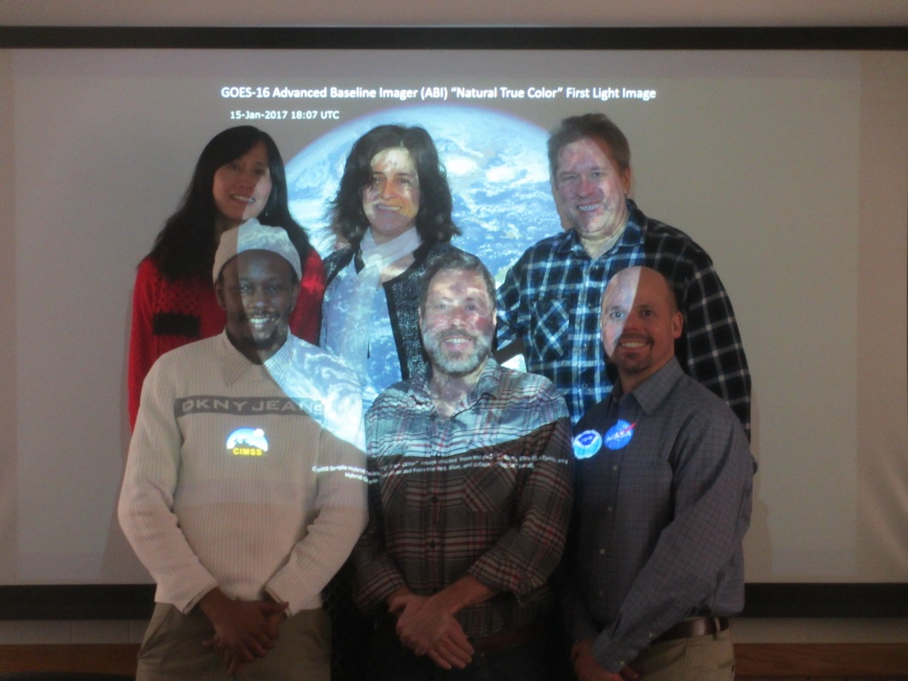
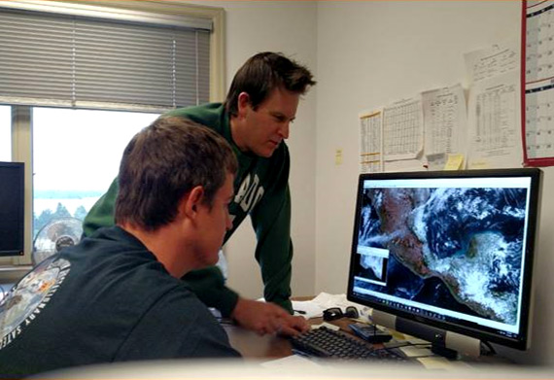
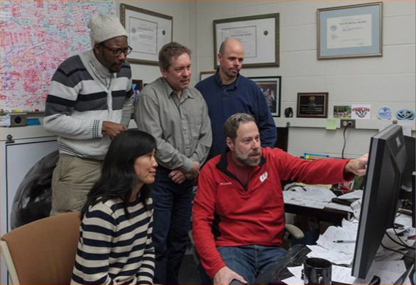
Imagery Team
Team Imagery:
WI (Mat Gunshor, Kaba Bah, Joleen Feltz, Hong Zhang and Jim Nelson, CIMSS) and
CO (Steve Miller, CIRA and Dan Lindsey)
Thanks to Cooperative Institutes!

Slide 3
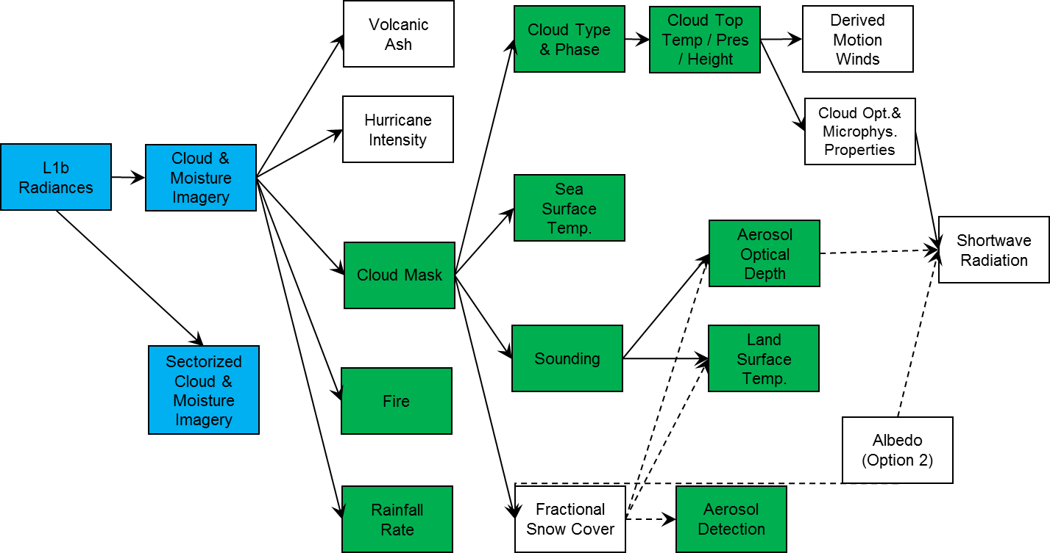
Product Precedence Tree
Blue = Under review today
Green = Beta L2 algorithms
Imagery is the KPP. Most issues at the L1b level will be carried to Imagery and hence can affect other L2 products as well.

Slide 4
“Path to Provisional” from Beta
AWG Imagery noted these issues at the Beta PS-PVR:
  Inconsistencies between L1b radiances and L2 CMI
    Conversion factors to CMI are not up to date in both L1b and L2 files.
    Bit depths between some bands of L1b and CMI are different.
    Min/Max ranges of L2 CMI do not match L1b files.
  Co-registration
  Image to image navigation
  “Sheared” images
  Striping in several bands
  Stray Light
  Inconsistent Central Wavelengths between single and multi-band.
  Multiband does not have downscaling method.
  DQF inconsistent in space
  Slightly different start times for given image set of 16 bands
Resolved
In Process
Unresolved

Slide 5
Provisional PLPTs from the CMI RIMP
PLPT | Description | Assessment
8 | ABI-FD_CMI04: assess the accuracy and precision of the Imagery FD product, for each ABI band, over a large and wide range of representative conditions, to include quantitative consistency between the input L1b data and the output reflectances/brightness temperatures in the Imagery output.
9 | ABI-CONUS_CMI02: assess the accuracy and precision of the Imagery CONUS product, for each ABI band, over a large and wide range of representative conditions, to include quantitative consistency between the input L1b data and the output reflectances/brightness temperatures in the Imagery output.
10 | ABI-MESO_CMI02: assess the accuracy and precision of the Imagery mesoscale product, for each ABI band, over a large and wide range of representative conditions, to include quantitative consistency between the input L1b data and the output reflectances/brightness temperatures in the Imagery output.
All Imagery tests to meet provisional were done using ground system data from the operational environment (obtained either via PDA, acquired at the UW-Madison and Colorado State Univ. via an automated rsync feed from NOAA/NESDIS/STAR or via GRB through the UW-Madison GRB ingestor).

Slide 6
“quantitative consistency between the input L1b data and the output reflectances/brightness temperatures in the Imagery output.”
L1b files contain radiances stored as scaled integers (sometimes referred to as “counts”)
L2 CMIP files contain Cloud and Moisture Imagery (CMI) values stored as scaled integers (sometimes referred to as “counts”)
  Bands 1-6 CMI values are Reflectance Factor (RF)
  Bands 7-16 CMI values are Brightness Temperature (TBB)
It should be possible to generate the values in a CMIP file from the corresponding L1b file using the metadata stored in either file.
  Bands 1-6 use constants that change as the earth-sun-distance-anomaly stored in the files changes.
  Bands 7-16 use constants that should not change for the life time of the instrument.
To test the “quantitative consistency between L1b and L2 CMIP” we generated our own CMIP-like files from L1b files for sample FD, CONUS, and MESO sectors to compare with the corresponding ground-system generated CMIP files.
  Convert Radiances to CMI (RF & TBB) using metadata stored in the files.

Slide 7
“quantitative consistency between the input L1b data and the output reflectances/brightness temperatures in the Imagery output.”
We have 1 Expected Source of Error
  Rounding differences due to the scaling and unscaling of values between “real” numbers and “integers”
  Ground System CMIP files are created from “the fabric” – they are not generated from L1b files.
    Radiances exist on the fabric as real numbers and are converted to CMI values as real numbers before being exported to files as scaled integers.
  For this test we:
    Unscale scaled integer radiances to real numbers from L1b file in IDL
    Convert radiances to CMI (RF or TBB) as real numbers in IDL
    Scale CMI from real numbers into integers to write to a new netCDF file (called CIMSS CMI file) in IDL
    Unscale ground system and CIMSS CMI files in another software tool (Glance) for file comparison statistics
  Every step introduces a chance for rounding errors.
    Since scale_factors and add_offsets are real numbers, there can be small differences introduced reading them into various software packages. We noticed differences between IDL, Matlab, and ncdump.
    For our final tests, we used hard-wired scale_factors and add_offsets from the latest PUG.
We anticipated errors that could be as large as 1 scaled integer (or 1 count).
  A 1 count difference means the CMI value of the difference between any scaled integer and the adjacent scaled integer should be equivalent to the scale_factor used to store CMI.
  In our Glance comparisons, we instructed the software to ignore differences greater than the scale_factor.

Slide 8
Scales and Offsets
Band | CMI: scale_factor | CMI: add_offset | Rad: scale_factor | Rad: add_offset
1 | 0.0002442 | 0 | 0.8121064 | -25.93665
2 | 0.0002442 | 0 | 0.1585924 | -20.28991
3 | 0.0002442 | 0 | 0.3769125 | -12.03764
4 | 0.0002442 | 0 | 0.07073108 | -4.522368
5 | 0.0002442 | 0 | 0.09580004 | -3.059614
6 | 0.0002442 | 0 | 0.03008847 | -0.9609507
7 | 0.01384667 | 173.15 | 0.001564351 | -0.0376
8 | 0.03931624 | 173.15 | 0.007104763 | -0.5586
9 | 0.03931624 | 173.15 | 0.0225391 | -0.8236
10 | 0.03931624 | 173.15 | 0.02004128 | -0.9561
11 | 0.03931624 | 173.15 | 0.03335779 | -1.3022
12 | 0.03931624 | 173.15 | 0.05443998 | -1.5394
13 | 0.03931624 | 173.15 | 0.04572892 | -1.6443
14 | 0.03931624 | 173.15 | 0.04949221 | -1.7187
15 | 0.03931624 | 173.15 | 0.05277411 | -1.7558
16 | 0.03931624 | 173.15 | 0.1760585 | -5.2392
Values from Ground System files obtained 5/4/2017

Slide 9
Imagery RIMP PLPT-10
(ABI-MESO_CMI02)
ABI-MESO_CMI02: assess the accuracy and precision of the Imagery mesoscale product, for each ABI band, over a large and wide range of representative conditions, to include quantitative consistency between the input L1b data and the output reflectances/brightness temperatures in the Imagery output.
The L1b files were used to generate CMIP-like files at CIMSS and then those were compared to the operationally generated CMIP files for the same time and scan type.
16 bands, May 14, 2017 at 18:00:56.8Z: http://www.ssec.wisc.edu/grafiir/goesr/IDL_GRB_CMIP/unmodified/20170514/M2_withDQFfilter_epsilon/
IR bands we can get to within 1 count (differences are either 0 counts or 1 count).
  A 1 count difference is easily understandable because of the steps we take in converting radiance to integer, unscaling, calculating a brightness temperature, and then converting the brightness temperature back into an integer, which then is unscaled to compared to an unscaled CMIP file. Slight rounding differences here and there will lead to a 1 count difference in some pixels.
VIS/NIR bands 1-6 we cannot match. We see values off by as many as 49 counts.
  We think there are incorrect kappa0 values being stored in the file (or inconsistent from what is being used to create the CMI in the files).
PASSED

Slide 10
IR bands Look Reasonable
We see differences that are either nominally 0K, or the equivalent of 1 “count”

Slide 11
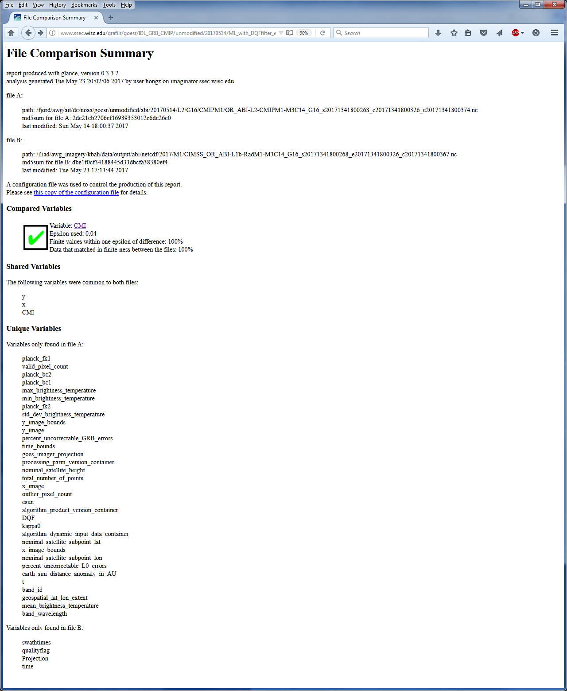
Glance Comparison tool compares the contents of any variable in a netCDF file to a variable in another netCDF file.
Green check box means the files “passed” the comparison to within the specified allowed difference (called epsilon)
This is a M2 for Band 14

Slide 12
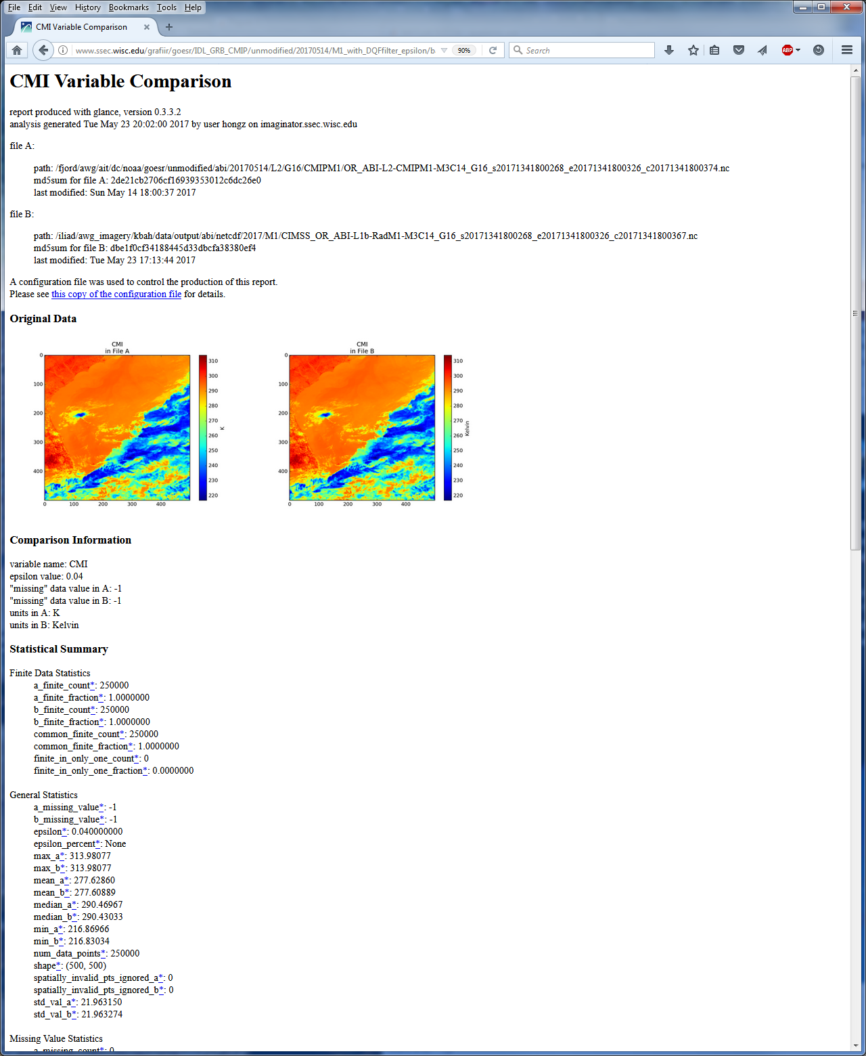
File A is GS file
File B is CIMSS file
Images of each file
Statistical Summary

Slide 13
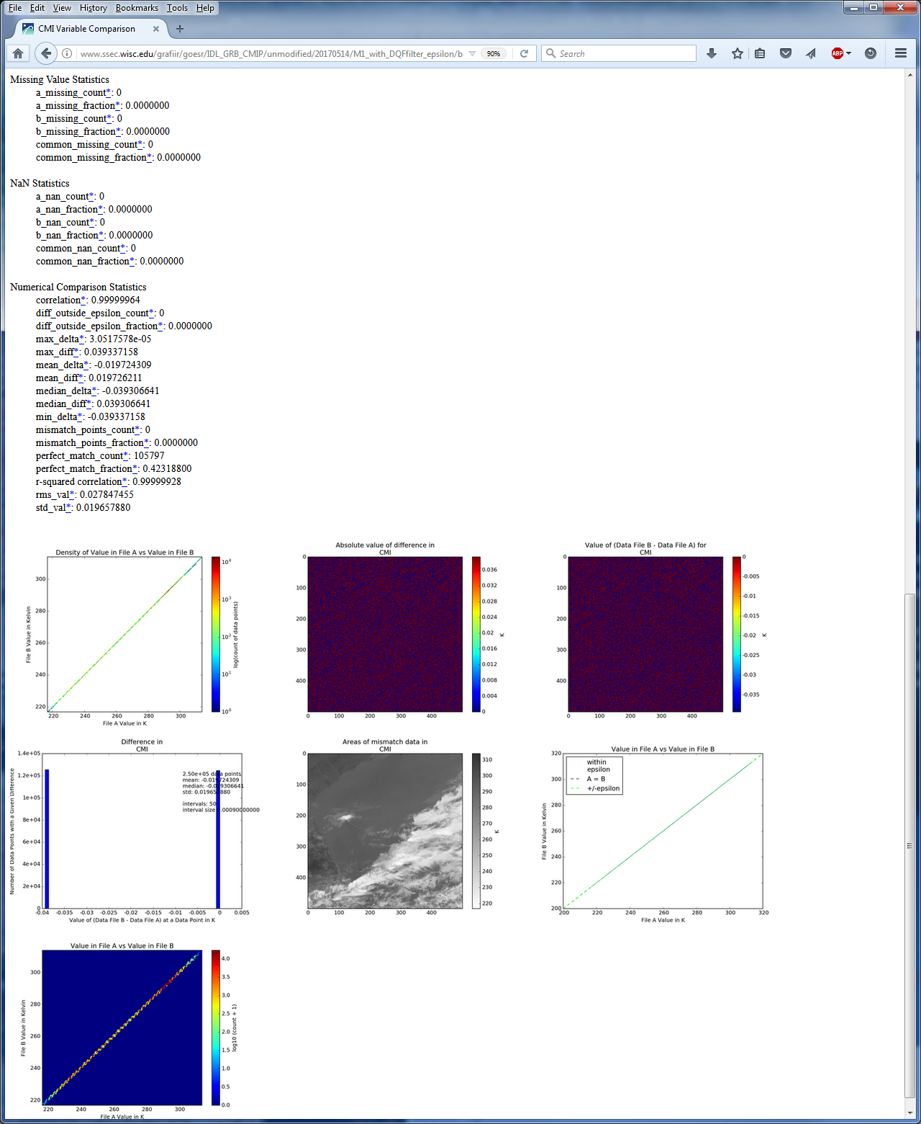
Statistical Summary cont’d
Scatter Plots,
Difference Images,
Histogram, Mismatched Pixel locations on image.

Slide 14
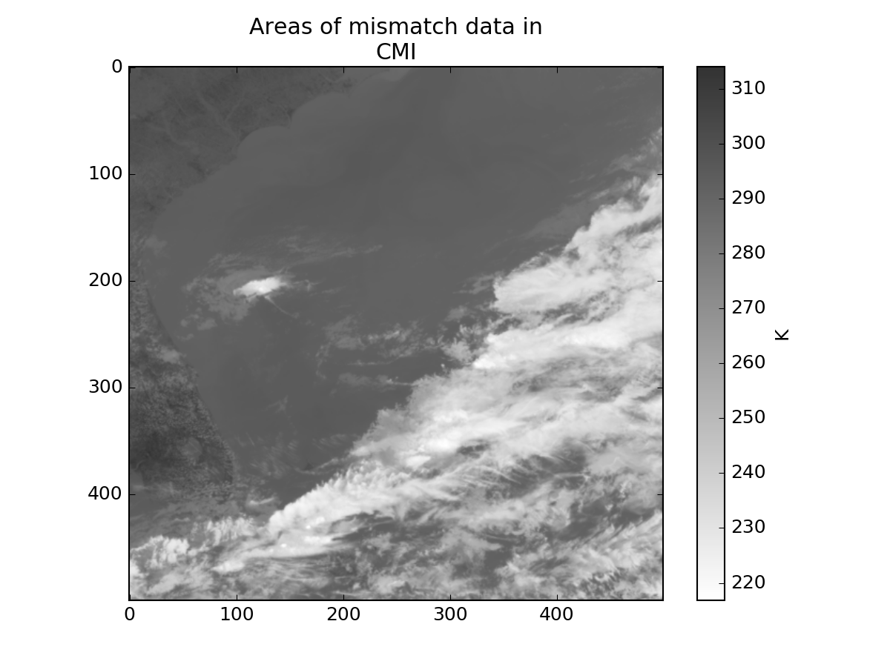
Pixels where the two files did not match would be highlighted on this image with a green dot.

Slide 15
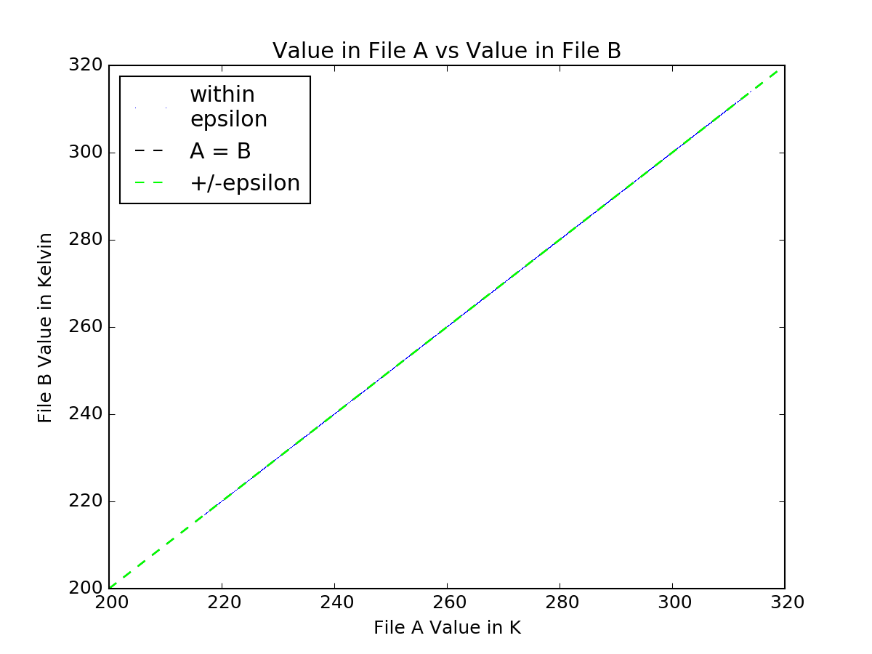
Scatter plot shows 1-to-1 line, so trends with TBB values would show up here. Since all of the data falls within the epsilon allowed, there isn’t anything to see.

Slide 16
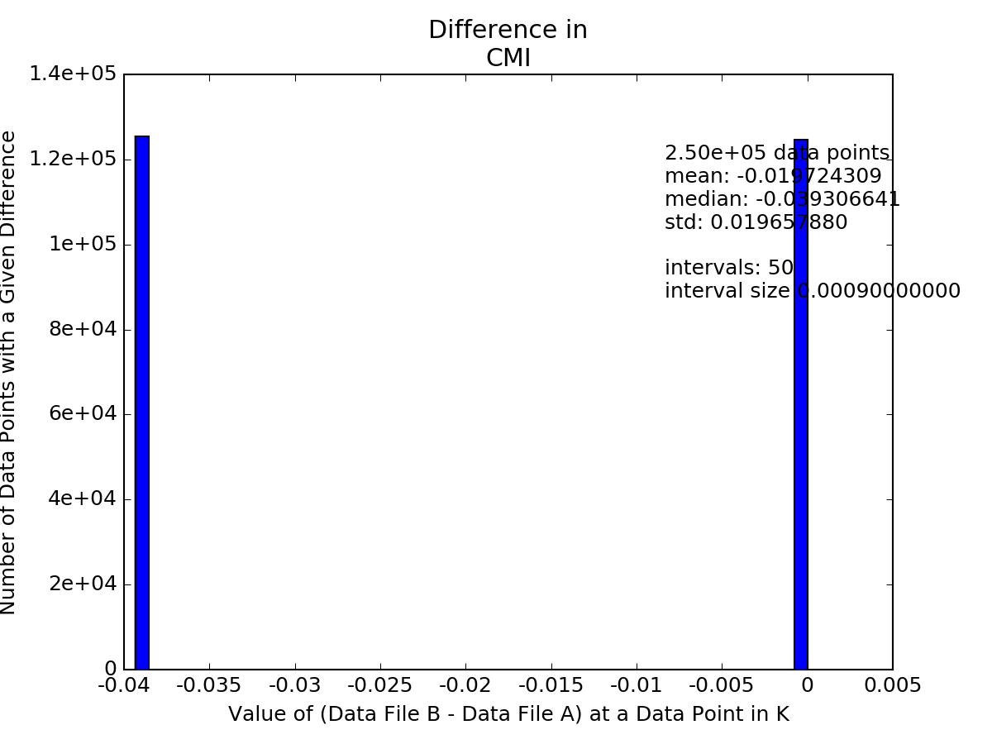
Differences are either 0 or equivalent to 1 count (scale_factor, which is just under 0.04K for this band). Every IR band for FD, CONUS, and MESO that we compared looked like this, usually with 50/50 at 0/1 count or with more at 0.

Slide 17
Vis/NIR bands are close
We see differences that are over 0.01 reflectance factor, which is 1% of the signal.
These are differences equivalent to 49 counts.
We experimented with kappa0 (multiply kappa0 by radiance to get reflectance factor)
  A small shift in kappa0 gives results like the IR with 0 or 1 count differences.
  Could kappa0 stored in the file be different from the kappa0 used to generate CMI in the ground system?

Slide 18
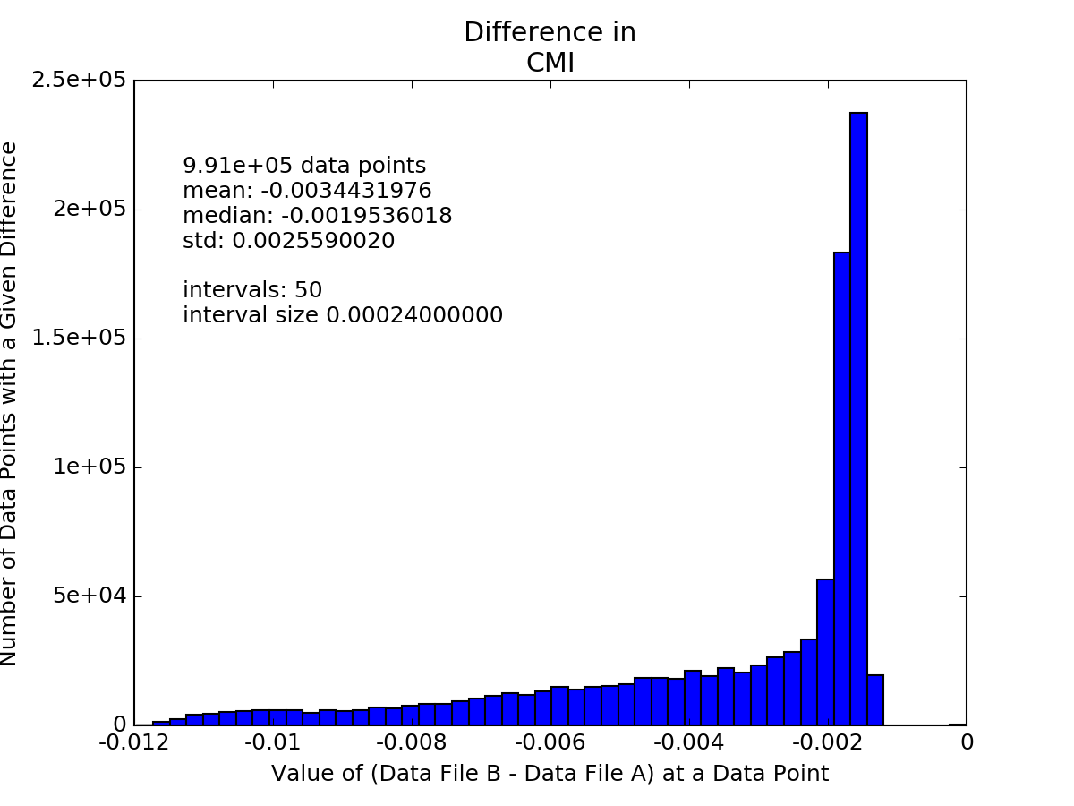
Band 01 Example
Scale Factor is 0.0002442, so a difference of 0.012 is 49 counts. The other Vis/NIR bands have a similar histogram with bands 3 and 5 flipped to positive differences. http://www.ssec.wisc.edu/grafiir/goesr/IDL_GRB_CMIP/unmodified/20170514/M2_withDQFfilter_epsilon/band01/CMI/index.html

Slide 19
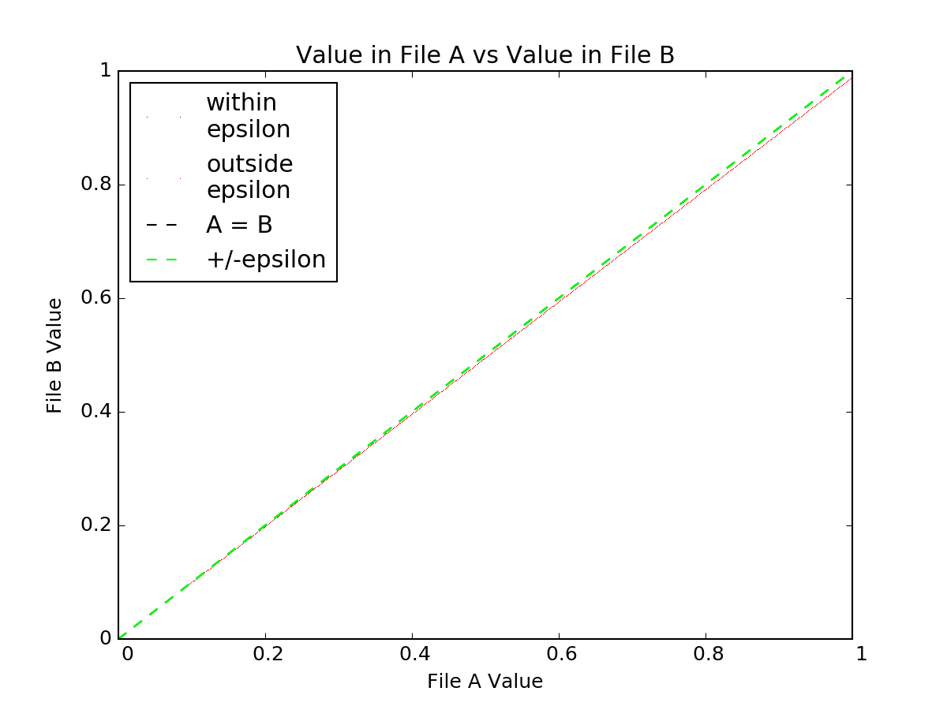
Band 01 Example
Notice how the comparisons get worse (farther from the 1-1 line) with increasing reflectance factor (red line). http://www.ssec.wisc.edu/grafiir/goesr/IDL_GRB_CMIP/unmodified/20170514/M2_withDQFfilter_epsilon/band01/CMI/index.html

Slide 20
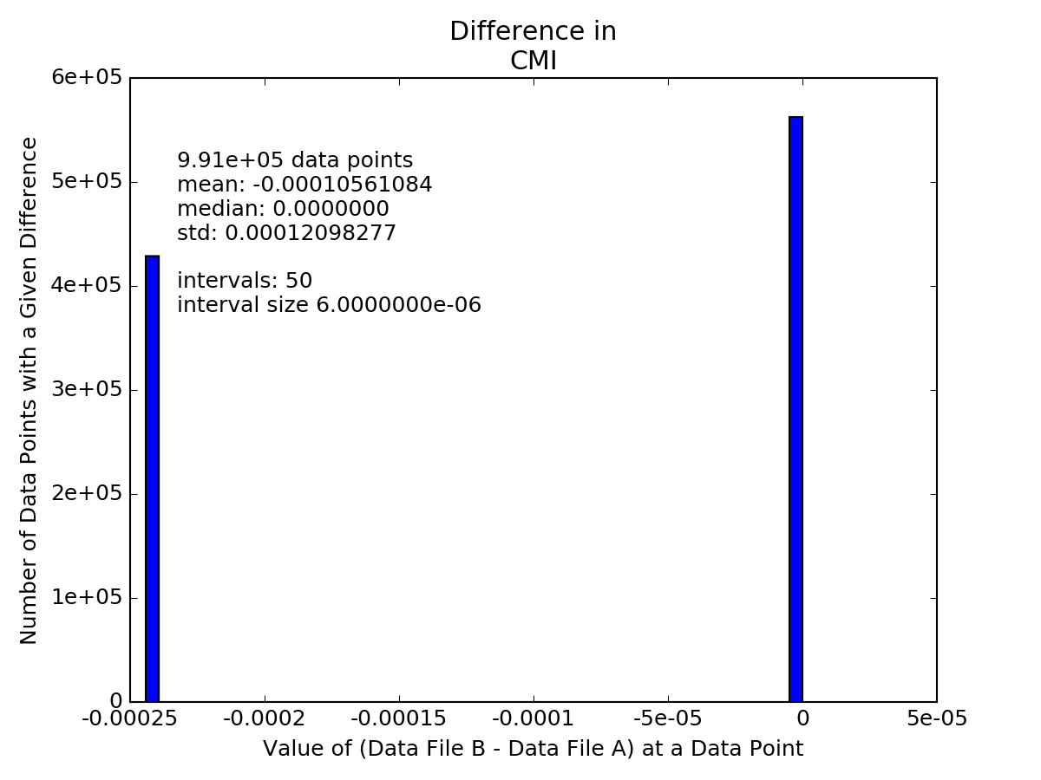
Band 01 Example with a modified Kappa0
Scale Factor is 0.0002442, so we are now seeing differences of only 0 or 1 count. We switched kappa0 from 0.0015911 (in file) to 0.001611 (empirically determined), a difference of ~0.00002.
kappa0 for band 01 at ~18z: on 5/14 is 0.0015911, on 5/15 is 0.0015918, on5/25 0.00159820
http://www.ssec.wisc.edu/grafiir/goesr/IDL_GRB_CMIP/unmodified/20170514/M2_test_epsilon/band01/CMI/index.html

Slide 21
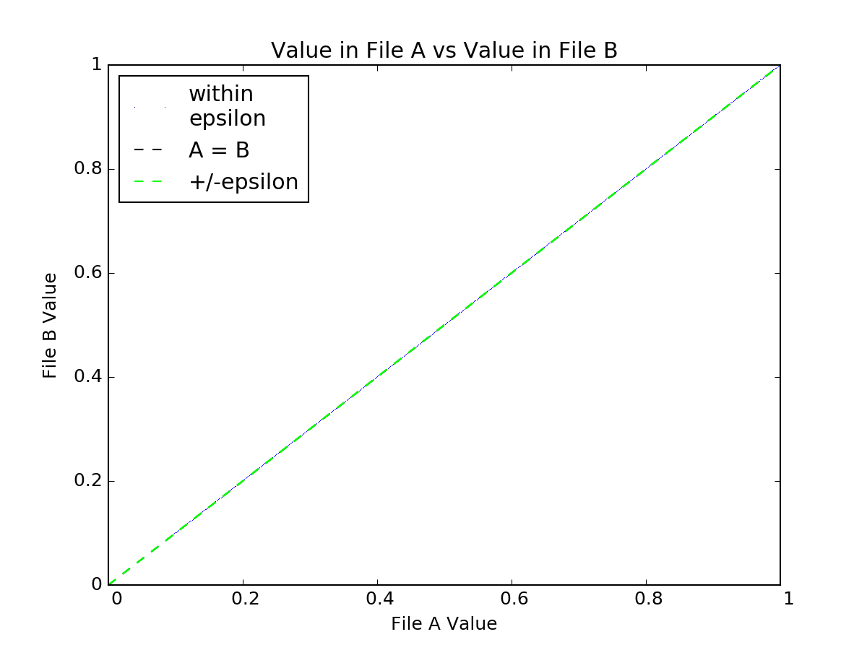
Band 01 Example with a modified Kappa0
Note the differences are back on the 1-to-1 line
http://www.ssec.wisc.edu/grafiir/goesr/IDL_GRB_CMIP/unmodified/20170514/M2_test_epsilon/band01/CMI/index.html

Slide 22
Imagery RIMP PLPT-08
(ABI-FD_CMI04)
ABI-FD_CMI04: assess the accuracy and precision of the Imagery FD product, for each ABI band, over a large and wide range of representative conditions, to include quantitative consistency between the input L1b data and the output reflectances/brightness temperatures in the Imagery output.
The L1b files were used to generate CMIP-like files at CIMSS and then those were compared to the operationally generated CMIP files for the same time and scan type.
16 bands, May 14, 2017 at 18:00:37.9Z: http://www.ssec.wisc.edu/grafiir/goesr/IDL_GRB_CMIP/unmodified/20170514/FD2_with_DQFfilter_epsilon/
IR bands we can get to within 1 count (differences are either 0 counts or 1 count).
  A 1 count difference is easily understandable because of the steps we take in converting radiance to integer, unscaling, calculating a brightness temperature, and then converting the brightness temperature back into an integer, which then is unscaled to compared to an unscaled CMIP file. Slight rounding differences here and there will lead to a 1 count difference in some pixels.
VIS/NIR bands 1-6 we cannot match. We see values off by as many as 49 counts.
  We think there are incorrect kappa0 values being stored in the file (or inconsistent from what is being used to create the CMI in the files).
No examples will be shown since they are so similar to those shown for MESO scan
PASSED

Slide 23
Imagery RIMP PLPT-09
(ABI-CONUS_CMI02)
ABI-CONUS_CMI02: assess the accuracy and precision of the Imagery CONUS product, for each ABI band, over a large and wide range of representative conditions, to include quantitative consistency between the input L1b data and the output reflectances/brightness temperatures in the Imagery output.
The L1b files were used to generate CMIP-like files at CIMSS and then those were compared to the operationally generated CMIP files for the same time and scan type.
16 bands, May 14, 2017 at 18:02:18.9Z: http://www.ssec.wisc.edu/grafiir/goesr/IDL_GRB_CMIP/unmodified/20170514/CONUS_with_DQFfilter_epsilon/
IR bands we can get to within 1 count (differences are either 0 counts or 1 count).
  A 1 count difference is easily understandable because of the steps we take in converting radiance to integer, unscaling, calculating a brightness temperature, and then converting the brightness temperature back into an integer, which then is unscaled to compared to an unscaled CMIP file. Slight rounding differences here and there will lead to a 1 count difference in some pixels.
VIS/NIR bands 1-6 we cannot match. We see values off by as many as 49 counts.
  We think there are incorrect kappa0 values being stored in the file (or inconsistent from what is being used to create the CMI in the files).
No examples will be shown since they are so similar to those shown for MESO scan
PASSED

Slide 24
Provisional PLPTs from the CMI RIMP
PLPT | Description | Assessment
8 | ABI-FD_CMI04: assess the accuracy and precision of the Imagery FD product, for each ABI band, over a large and wide range of representative conditions, to include quantitative consistency between the input L1b data and the output reflectances/brightness temperatures in the Imagery output. | Passed
9 | ABI-CONUS_CMI02: assess the accuracy and precision of the Imagery CONUS product, for each ABI band, over a large and wide range of representative conditions, to include quantitative consistency between the input L1b data and the output reflectances/brightness temperatures in the Imagery output. | Passed
10 | ABI-MESO_CMI02: assess the accuracy and precision of the Imagery mesoscale product, for each ABI band, over a large and wide range of representative conditions, to include quantitative consistency between the input L1b data and the output reflectances/brightness temperatures in the Imagery output. | Passed

Slide 25
Specific Criteria for Provisional
From the Imagery RIMP:
Assess the validity of each mode/scan type pair and each band for its Imagery over a large and wide range of representative conditions (including multiple times of the day).
The Imagery products are deemed suitable for operational use by the primary user (National Weather Service (NWS)).
Quantitative consistency exists between the L1b input data and the output reflectances/brightness temperatures in the Imagery output.
GOES-R Imagery must be at least of comparable quality to the heritage bands on GOES.
Report any incidents that are detected to the Algorithm Discrepancy Report (ADR) group for discussion by the Algorithm Action Review Team (AART).
The same criteria apply to the Full Validation stage with the following additions:
  The validity of the Imagery includes that basic operational needs are met (e.g., the imagery looks as expected).
  The Imagery derived from the GRB is consistent with that from the ground system.
  Any incidents related to Imagery in the ADR group are resolved.

Slide 26
Other Scheduled-related Aspects
From the Imagery RIMP, concerning Provisional only:
During Provisional, the proper conversion of radiance to reflectance factor or brightness temperature will be confirmed.
For Provisional only, quantitative comparisons between GOES-R Imagery produced by the ground system and that produced through the direct readout system will be used to determine if issues exist with either approach.
Straightforward access to all Imagery products will be critical to achieving Beta and Provisional, issues with data access will directly impact the schedule of Imagery validation activities.
As a Key Performance Parameter (KPP), the Imagery takes precedence over other L2+ products, since no other L2+ product is a KPP.
The determination of Imagery being Provisional is not tied to the status of any other product.
Because Imagery does not strongly depend upon the quantitative accuracy of the input L1b data, it may pass Beta and/or Provisional stages of validation before the L1b does.
Also as a KPP, Imagery is ideally to attain Provisional status at handover.

Slide 27
Analysis Methods
From the Imagery RIMP:
5.1 Method 1
Visual inspection for both feature determination and image-to-image consistency will be the primary method of validating Imagery during Beta and Provisional by the Imagery team.
Input from the NWS on ABI Imagery quality can be included as part of this method.
Imagery has no quantitative requirements regarding the quality of the Imagery.
Visual inspection will be used to identify artifacts that inhibit the use of Imagery, such as striping, banding, noise, or blur due to misalignment between bands.
Visual inspection of looped GOES-R Imagery via McIDAS effectively shows any misalignments from temporally adjacent Images.
The primary features needed for this method are coastal areas, islands, rivers, and fires.
This is the only method employed during Beta.
Examples of any artifacts or other issues (misalignments) from these inspections will be shown as part of establishing Beta.

Slide 28
SCMI vs FGF
Currently the SCMI is remapped from the Fixed Grid Format, this seems to cause loss of information:
Fires seem colder (sometimes over 3K in the 4 micrometer band)
Over-shooting tops colder (4 micrometer band)
Gas flares not as apparent (ABI 2.2 micrometer band)
Imagery seems “fuzzier”, etc.
There are plans to not do this ‘double’ remap for populating the NOAAPort ABI feeds, but maintain the ABI FGF.
Notes:
Beta: the product is minimally validated and may still contain significant errors; based on product quick
looks using the initial calibration parameters.

Slide 29
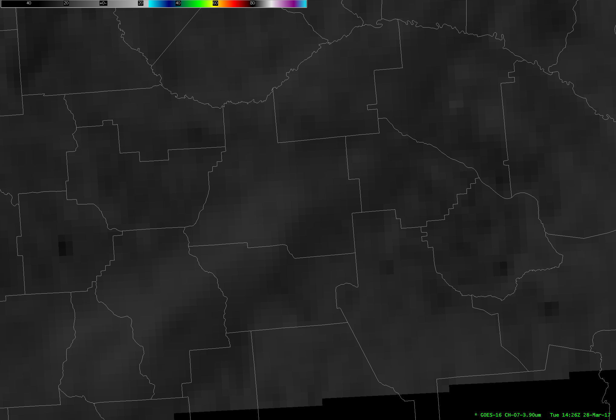
AWIPS
1
3
2
4

Slide 30
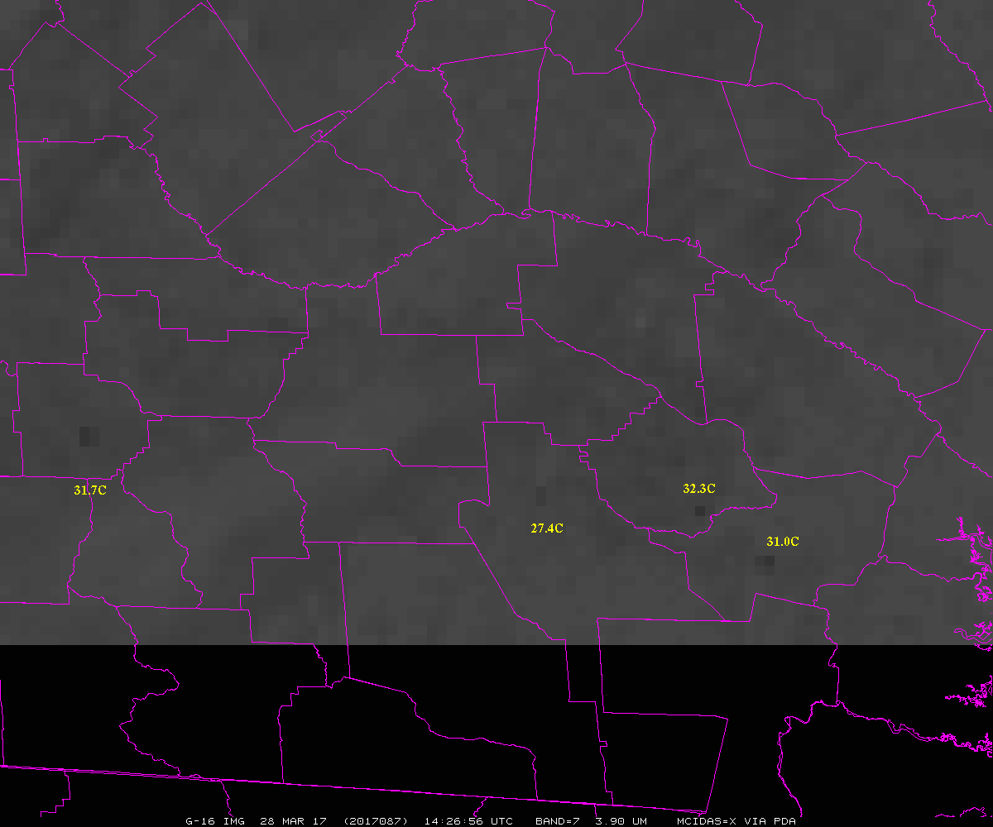
McIDAS-X

Slide 31
Max Values (C)
14:26:56 UTC 28-March-2017
ABI Band 7 (3.9 um)
Spots | CMIP | McIDAS-X | AWIPS | Difference
 |  |  |  | (X – AWIPS)
1 | 31.7 | 31.7 | 30.9 | 0.8
2 | 27.4 | 27.4 | 26.4 | 1.0
3 | 32.25 | 32.2 | 29.0 | 3.2
4 | 31.0 | 31.0 | 28.3 | 2.7
Are these differences due to the remapping of the fixed grid format, or some other issue?

Slide 32
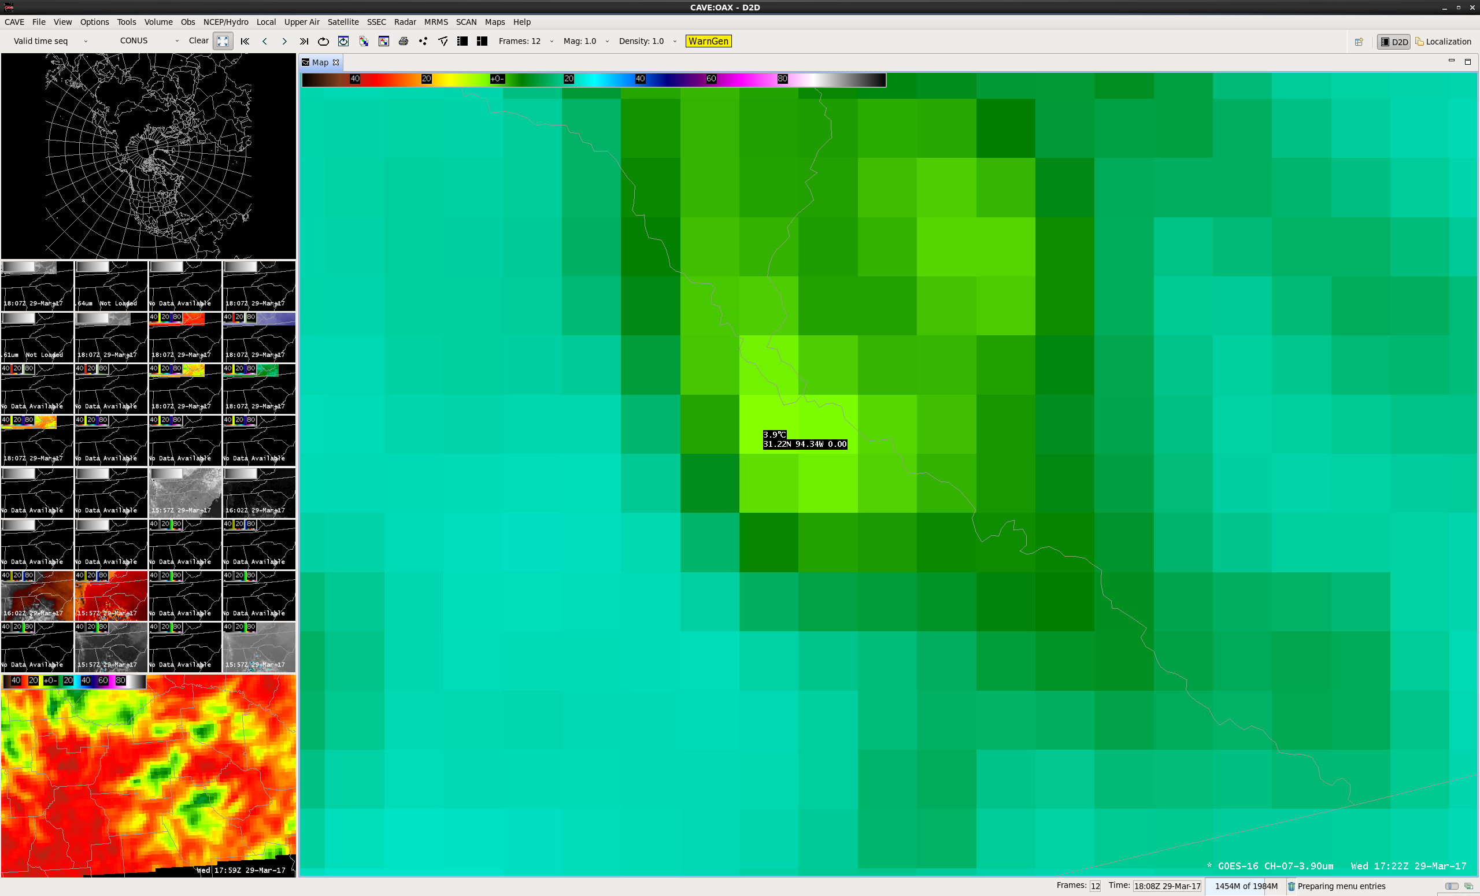

Slide 33
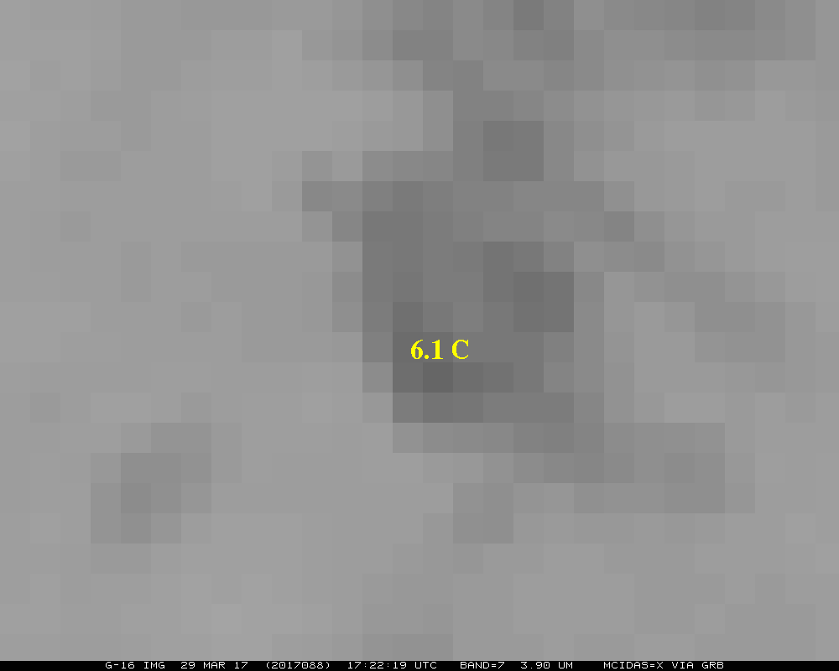
Hence more than 2C difference for this one spot

Slide 34
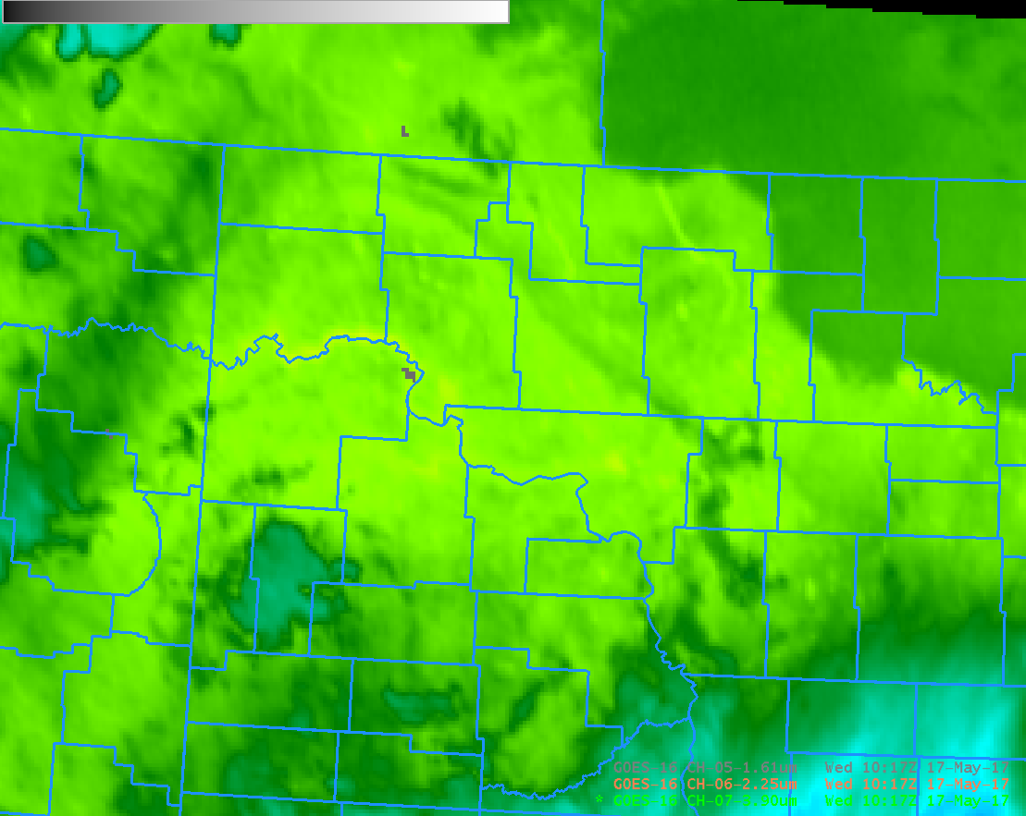
AWIPS (gray value from 2.2 um, green from 3.9 um band)
From Scott Lindstrom, SSEC

Slide 35
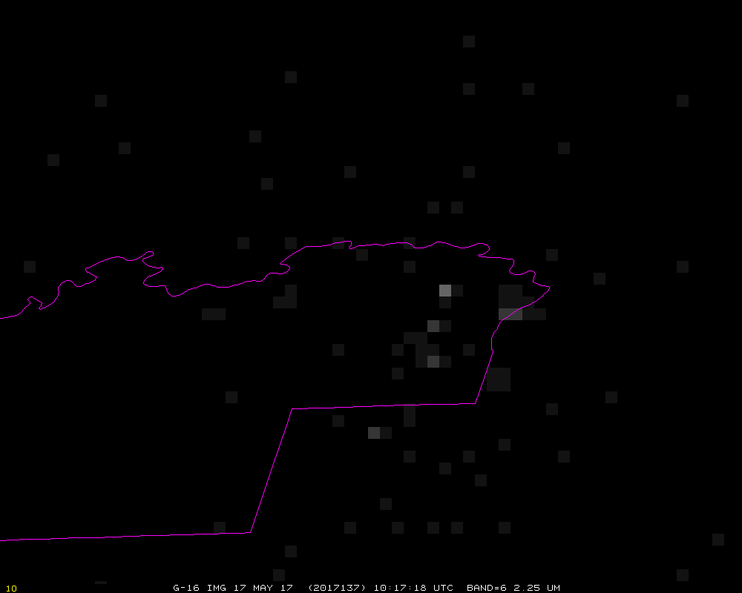
McIDAS-X
McKenzie County, ND

Slide 36
ABI SCMI vs FGF
Images shown in AWIPS-II, the ABI Sectorized Cloud and Moisture Imagery (via NOAAPort) and the Fixed Grid Format (from the Level 1b radiance files)
Ray Garcia, Jordan Gerth, Scott Lindstrom, CIMSS/SSEC

Slide 37
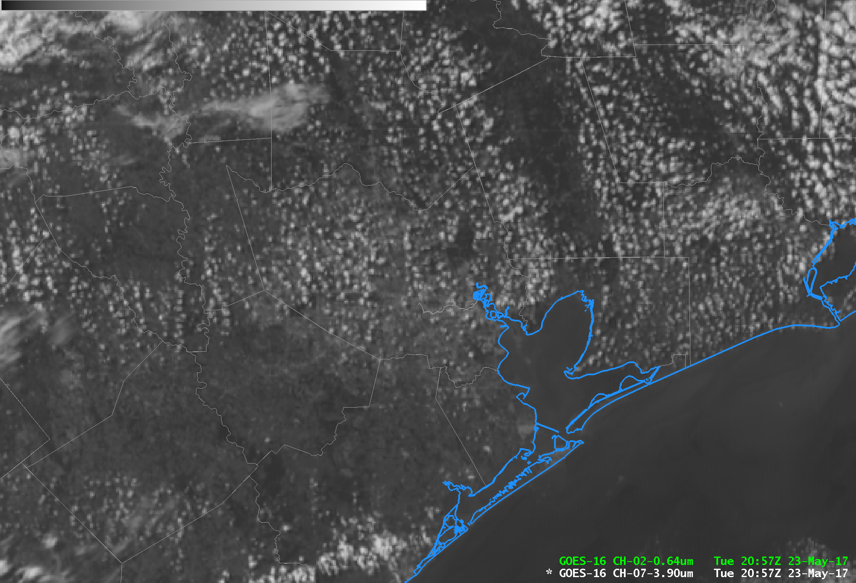
SCMI

Slide 38
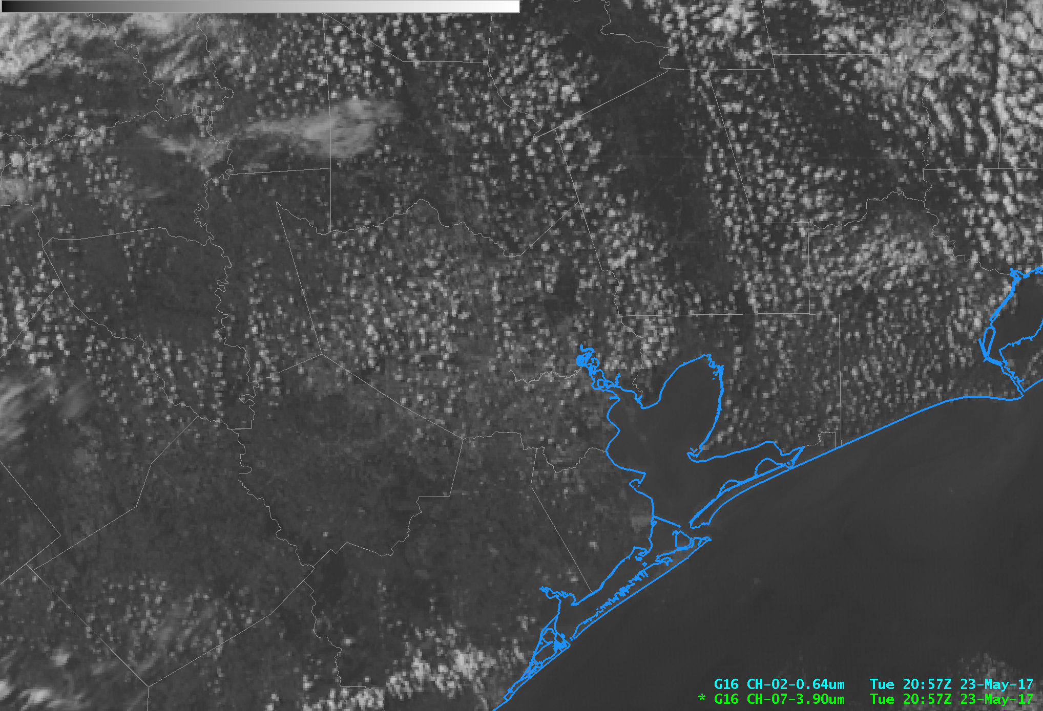
FGF

Slide 39
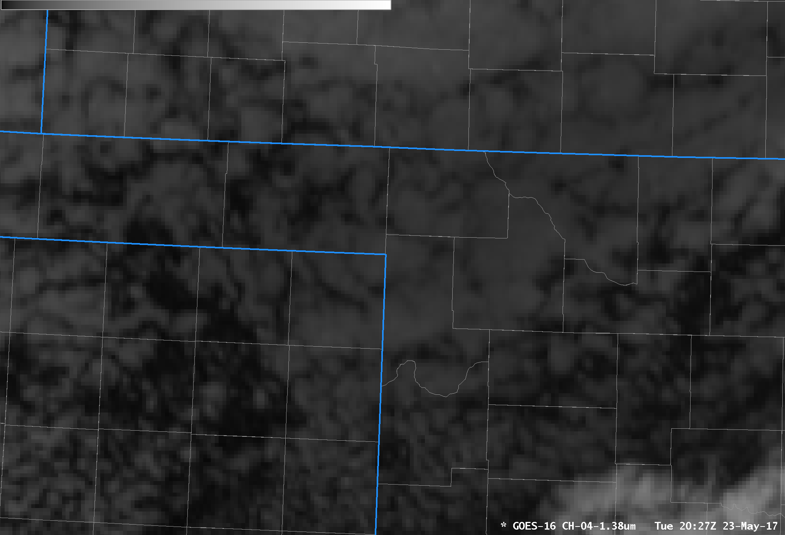
SCMI

Slide 40
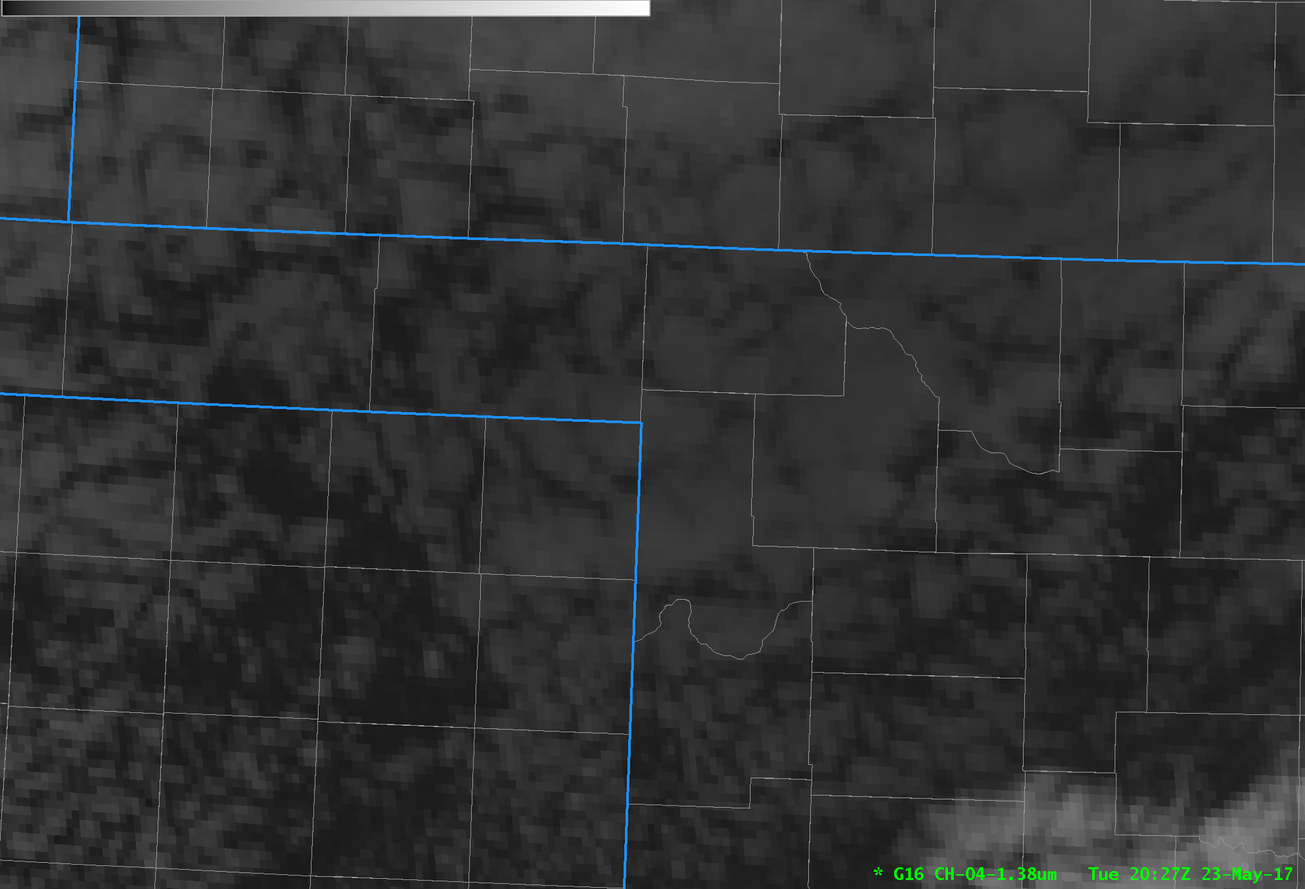
FGF

Slide 41
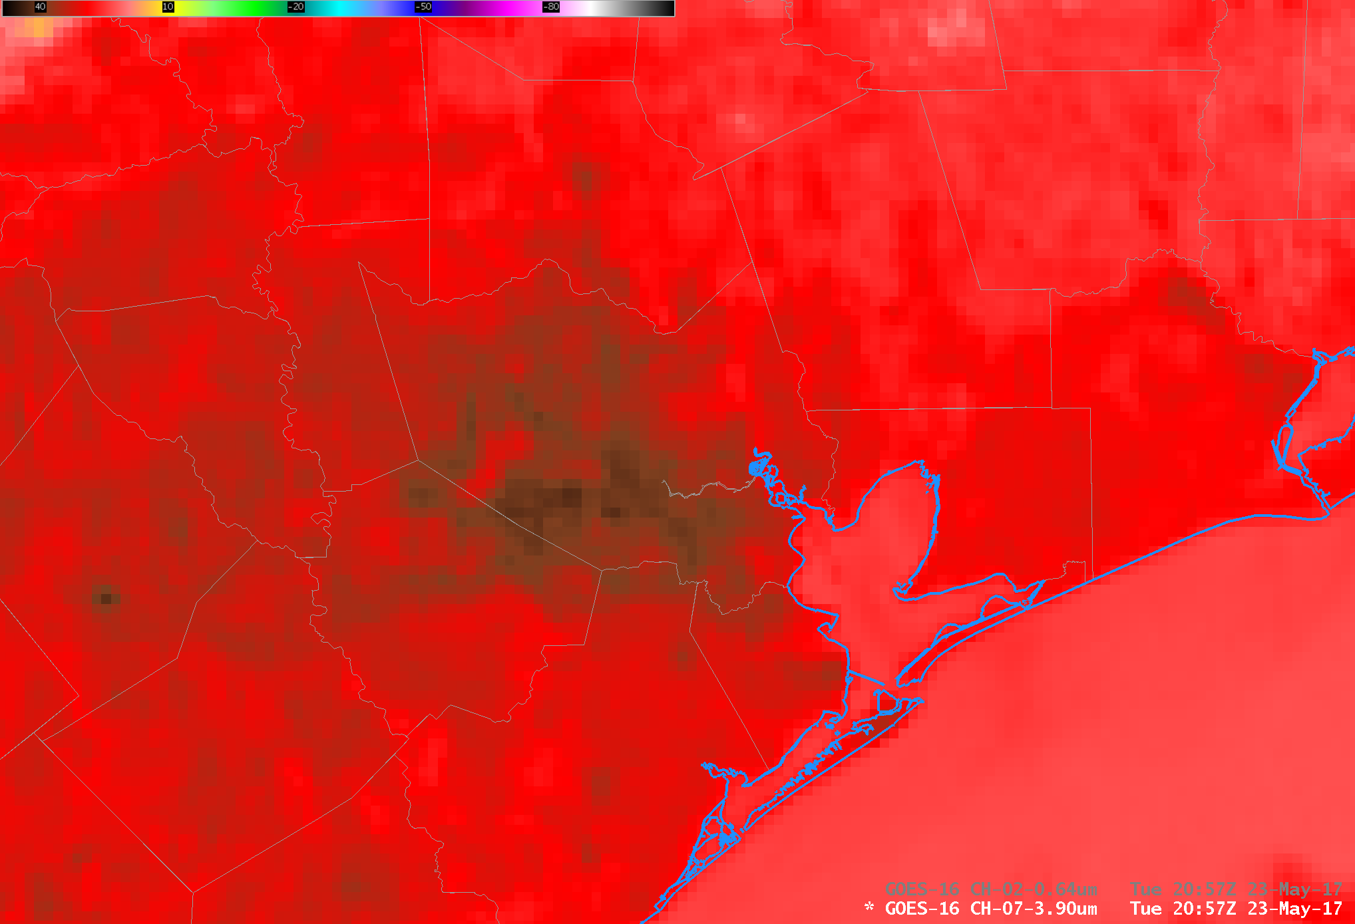
SCMI

Slide 42
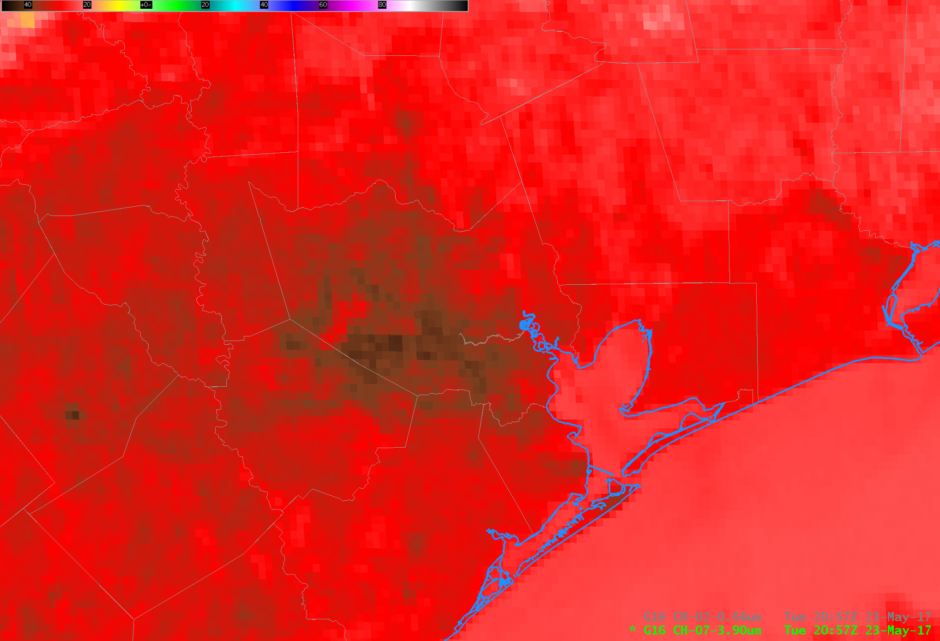
FGF

Slide 43
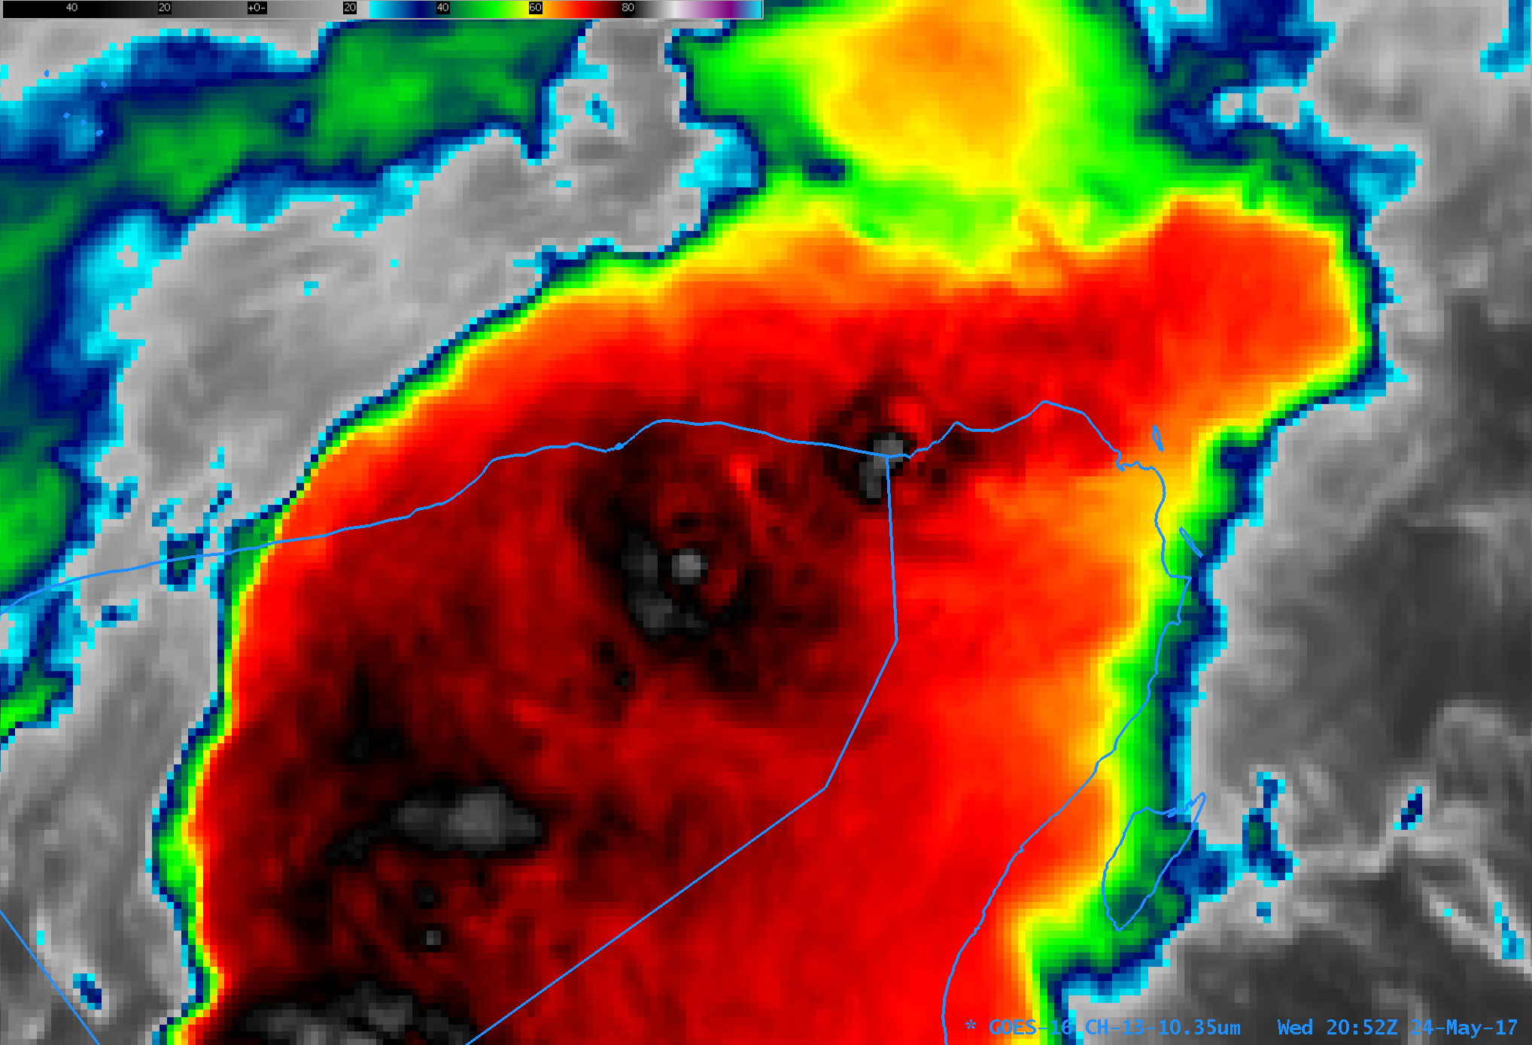
SCMI

Slide 44

FGF

Slide 45
Visual inspection for feature determination and image-to-image consistency
16 panel loop CONUS loop for example…

Slide 46
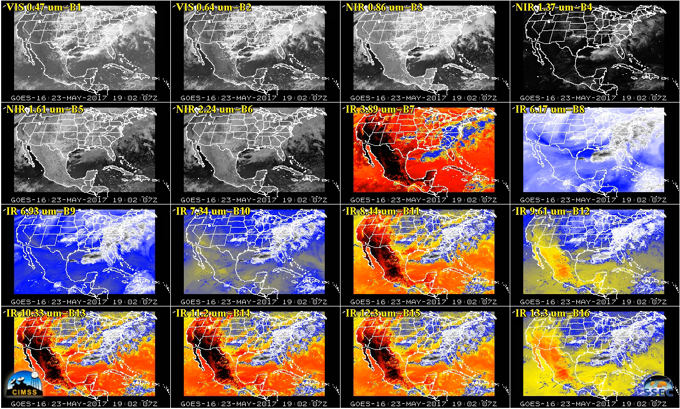
CONUS Loop 23-May-2017

Slide 47
Analysis Methods
From the Imagery RIMP:
5.2 Method 2
Qualitative comparisons with Imagery derived from GOES and polar-orbiters, Provisional and Full Validation only.
Images from polar-orbiting satellites will, at least twice a day, pass over the coverage area of GOES-R.
Qualitative comparisons between GOES-R Imagery and that from simultaneous polar-orbiting satellites are useful in revealing atmospheric and ground elements and how well or poorly GOES-R Imagery may be used to diagnose these elements.
The most critical comparison is between GOES-R and GOES, as they cover the same area at all times.
Emphasis will be given to comparing the heritage bands on GOES with its counterpart on GOES-R.
McIDAS will be used for comparing Imagery from different sources.
At a minimum, GOES-R must produce Imagery at least of similar quality to GOES for the Provisional stage to be attained.

Slide 48
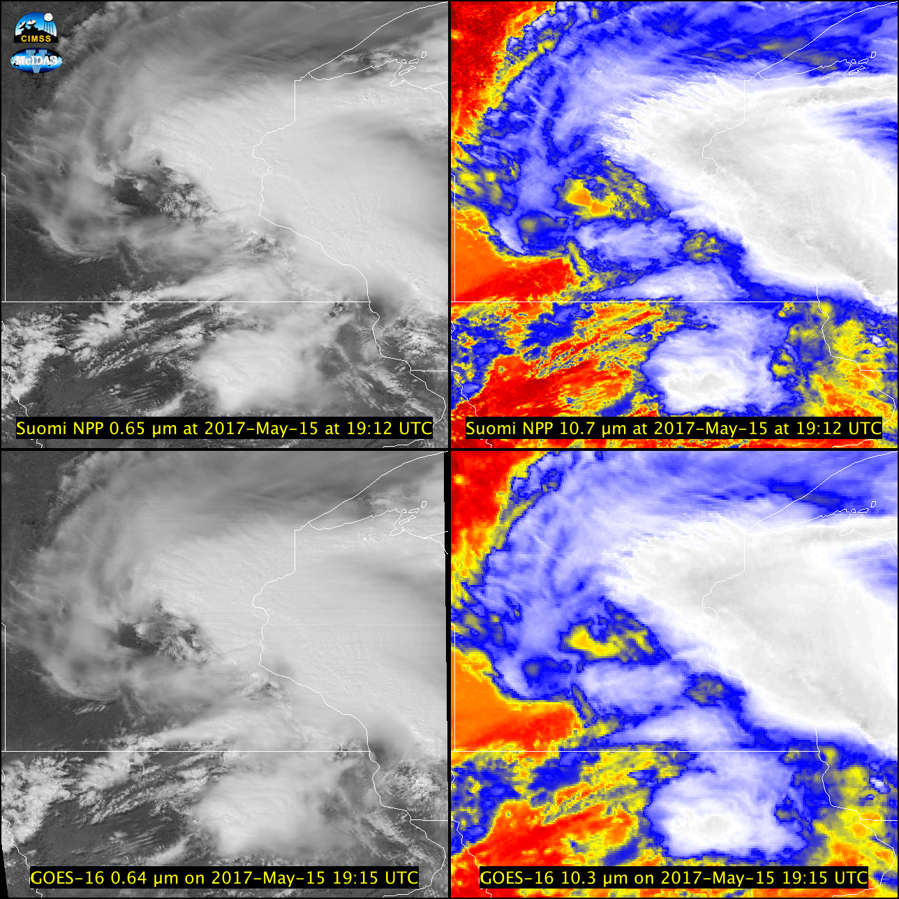
ABI compared to Suomi NPP

Slide 49
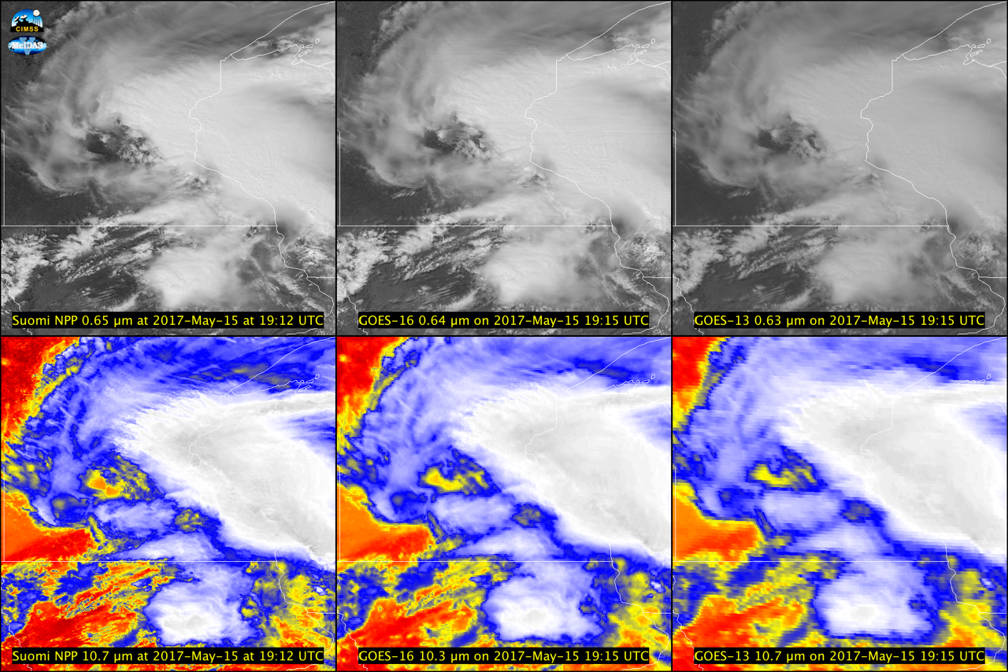
“GOES-R must produce Imagery at least of similar quality to GOES”

Slide 50
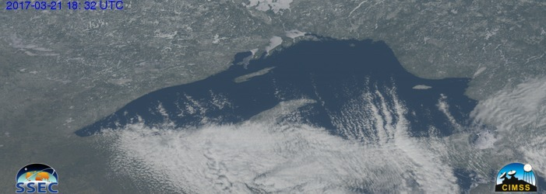
“GOES-R must produce Imagery at least of similar quality to GOES”

Slide 51
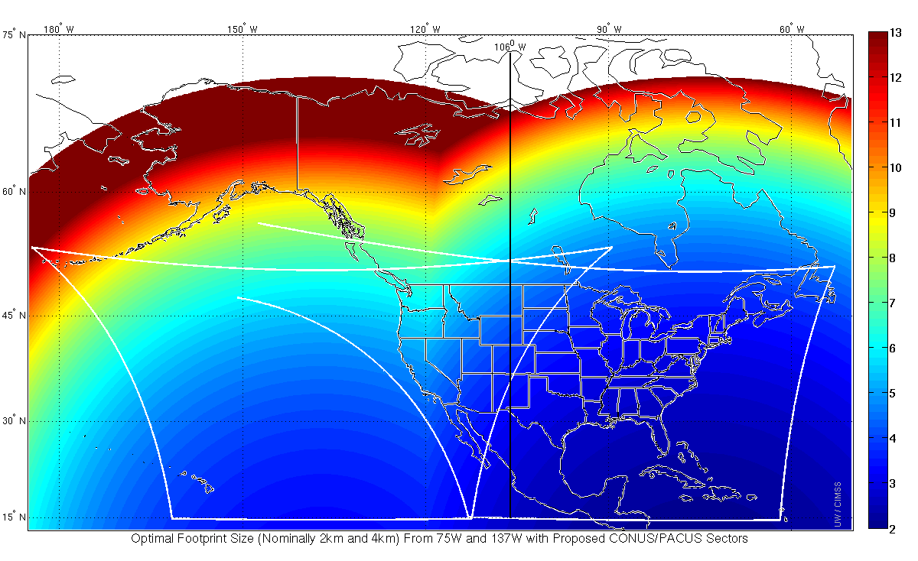
GOES-16 as GOES-East
With GOES-16 as GOES-East, the optimal satellite to use based on pixel resolution.
But of course GOES-16 has better spectral & temporal resolution, even if it does not have better spatial resolution over some locations.

Slide 52
Quantitatively compare (CMI) between CMIP files and that produced from L1b…
This was done for the PLPT tests 08-10.
  PLPT-08 Full Disk
  PLPT-09 CONUS
  PLPT-10 Mesoscale

Slide 53
Mode 4 CONUS vs Full Disk
Not an official PLPT
In Mode 4, there are CONUS files generated every 5 minutes from the full disk files.
  The CONUS is simply extracted from the full-disk, not scanned separately.
  The CONUS file should exactly match the values from the Full Disk for the same location.
This was tested on April 23 when GOES-16 was in Mode 4.
  All bands had perfect matches between CONUS and Full Disk
  Glance comparisons can be found here:
  https://www.ssec.wisc.edu/grafiir/goesr/MODE4/FD_CONUS/

Slide 54
“Path to Provisional” from Beta
AWG Imagery noted these issues at the Beta PS-PVR:
  Inconsistencies between L1b radiances and L2 CMI
    Conversion factors to CMI are not up to date in both L1b and L2 files.
    Bit depths between some bands of L1b and CMI are different.
    Min/Max ranges of L2 CMI do not match L1b files.
  Co-registration
  Image to image navigation
  “Sheared” images
  Striping in several bands
  Stray Light
  Inconsistent Central Wavelengths between single and multi-band.
  Multiband does not have downscaling method.
  DQF inconsistent in space
  Slightly different start times for given image set of 16 bands

Slide 55
“Path to Provisional” from Beta
AWG Imagery noted these issues at the Beta PS-PVR:
  Inconsistencies between L1b radiances and L2 CMI
    Conversion factors to CMI are not up to date in both L1b and L2 files.
    Bit depths between some bands of L1b and CMI are different.
    Min/Max ranges of L2 CMI do not match L1b files.
  Co-registration
  Image to image navigation
  “Sheared” images
  Striping in several bands
  Stray Light
  Inconsistent Central Wavelengths between single and multi-band.
  Multiband does not have downscaling method.
  DQF inconsistent in space
  Slightly different start times for given image set of 16 bands
Resolved
In Process
Unresolved
Since Beta

Slide 56
Instrument/GPA Issues Identified
Pre-launch and Resolution Status
Title | Description | Status | Mitigation
Inconsistencies between L1b and L2 | Conversion factors to CMI are not up to date in both L1b and L2 files. | RESOLVED | WR3804 & WR3452, DO.04.04
“ | Bit depths between some bands of L1b and CMI are different | OPEN | Needs ADR if to be updated in GS, currently CDRL-80 & CMI ATBD do not agree
“ | Min/Max ranges of L2 CMI do not match L1b files | OPEN | WR3383, DO.05.00
DQF Inconsistent in Space | There are different DQF values for “processed space pixels” | OPEN | WR2190, DO.06.00; WR3971, In Analysis
Some issues that affect Radiance product also affect CMI downstream.

Slide 57
Instrument/GPA Issues Identified
Post-launch and Resolution Status
Title | Description | Status | Mitigation
Co-registration | Not all 16 bands (at the same scan time) match in navigation. | OPEN | WR 3824, DO.04.03.01 (fixed)
Image to Image Navigation | Sometimes navigation shifts between images of the same band through time. | OPEN | At least 3 WRs related to NAV: WR3641 (In analysis), WR3898 (Submitted), WR3953 (DO.06.00)
Missing “Chunks” | For some images, there are missing “chunks” of data. | OPEN | Known issue due to terrestrial GRB; will be resolved once GRB-RF is enabled with ABI data
“Sheared” images | Sometimes images are “sheared” along swaths in the E-W direction, so they don’t line up N/S. | Resolved | WR3933, submitted: Results under analysis.
Striping | There is striping seen at different times in different bands. Fairly consistently in band 12 | OPEN | WR4016, DO.05.00
Stray Light | There is stray light fairly evident in visible bands at night UPDATE since Beta: and the 3.9um band | OPEN | Stray light within spec, but users should be aware.
15-min Cal Anomaly (PICA) | Every 15 minutes and MESO and CONUS sectors there is a noticeable shift in brightness temperatures. | OPEN | ADR288
Inconsistent Central Wavelengths | The single band files and multi-band files have different central wavelengths in the metadata for 8 of 16 bands. | OPEN | ADR321, WR4509, DO.07.00
Downscaling Method | Multiband files don’t have the correct downscaling method listed in the metadata | OPEN | ADR357
Variable Start Times | On occasion, the start time of a single band file is different from the other bands by 0.1s. | OPEN | WR3892, In Analysis
Min/Max in CMI sometimes out of range | Because CMI is currently artificially capped, say 0-1, sometimes you have a “max” that is over 1 even though that isn’t allowed in the file | OPEN | WR3383, DO.05.00
Remapping Anomaly | Extremely hot pixels in the 3.7um have artificially cold pixels next to them. | OPEN | ADR274
Kalman Filter Issues | The Nav is sometimes bad, probably due to Kalman Filter resetting. | OPEN | WR3888 deals with Kalman resetting; DO.06
SCMI Remapped | The SCMI is remapped twice, causing distortions | OPEN | WR4773

Slide 58
Product Maturity Assessment
Preparation Activities | Assessment
Validation activities are ongoing and the general research community is now encouraged to participate. | True
Severe algorithm anomalies are identified and under analysis. Solutions to anomalies are in development and testing. | Analysis of Rad->RF anomaly not done.
Incremental product improvements may still be occurring. | True
L2+ only: Users are engaged in the Product Feedback Forums and user feedback is assessed. | Users are engaged and feedback has been used to diagnose issues.
End State | Assessment
Product performance has been demonstrated through analysis of a small number of independent measurements obtained from select locations, periods, and associated ground truth or field campaign efforts. | Field Campaign Efforts ongoing.
Product analysis is sufficient to communicate product performance to users relative to expectations (performance baseline). | True. Efforts continue to improve AWIPS, etc.
Documentation of product performance exists that includes recommended remediation strategies for all anomalies and weaknesses. Any algorithm changes associated with severe anomalies have been documented, implemented, tested, & shared with the user community. | Ongoing
Testing has been fully documented. | True
Product is ready for operational use and for use in comprehensive cal/val activities and product optimization. | True. Imagery preliminarily used by NWS WFOs, etc.

Slide 59
Provisional CMI Outcomes:
Summary
All RIMP PLPTs required to make Provisional have been completed
  CMIP files can be recreated from L1b files for IR bands
  CMIP files can nearly be recreated from L1b files for Vis/NIR bands
    This should be solvable.
  Qualitative comparisons to current operational GOES Imager similar
    Current Imager has just 5 bands and GOES-16 qualitatively has similar values
    Higher spatial and temporal resolution of GOES-16 is a clear improvement.
  Imagery product is ready for operational use by NWS
    Preliminary use by NWS is already occurring

Slide 60
Recommendation for Provisional Maturity
AWG Imagery recommends that CMI data be transitioned to Provisional status at this time.

Slide 61
End Provisional Portion

Slide 62
Path to Full Maturity
3 PLPTs to be conducted by AWG Imagery for Full Maturity
  PLPT tools ready
  All 3 PLPTs already underway
    Data being collected for ABI-FD_CMI06 since 17 Jan 2017
    Data being collected for ABI-CONUS_CMI02 since 17 Jan 2017
    Data being collected for ABI-MESO_CMI02 since 17 Jan 2017
All Imagery tests to meet Full Maturity will be done using ground system data.
Currently outstanding issues, unless fixed by Handover, may prevent declaration of Full Maturity
  4 issues identified through initial PLPT work
    There are more than 4 issues, but not all would necessarily block path to Full Maturity
    Described in upcoming charts
    All are shown with ground system L1b and/or CMIP files.

Slide 63
Post-Launch Product Tests
Test ID | Test Title
ABI-FD_CMI06 | Assess the accuracy and precision of the Imagery FD product, for each ABI band, over the entire range of representative conditions, to include quantitative consistency between the input L1b data and the output reflectances/brightness temperatures in the Imagery output; a minimum of six months of Imagery output is required for this assessment.
ABI-CONUS_CMI02 | Assess the accuracy and precision of the Imagery CONUS product, for each ABI band, over the entire range of representative conditions, to include quantitative consistency between the input L1b data and the output reflectances/brightness temperatures in the Imagery output; a minimum of six months of Imagery output is required for this assessment.
ABI-MESO_CMI02 | Assess the accuracy and precision of the Imagery MESOSCALE product, for each ABI band, over the entire range of representative conditions, to include quantitative consistency between the input L1b data and the output reflectances/brightness temperatures in the Imagery output; a minimum of six months of Imagery output is required for this assessment.
Validated Success Criteria: “Imagery has been analyzed for a significant number of cases to convey to users that, for all scenarios of interest to the users, the quality of the Imagery products is sufficient to identify features critical to the user.”
Full test plans and procedures are given in the ABI L2 Cloud and Moisture Imagery Readiness, Implementation, and Management Plan (RIMP v1.0; 416-R-RIMP-0323)

Slide 64
Path to Full Maturity
AWG Imagery noted these issues at the Beta PS-PVR:
  Inconsistencies between L1b radiances and L2 CMI
    Conversion factors to CMI are not up to date in both L1b and L2 files.
    Bit depths between some bands of L1b and CMI are different.
    Min/Max ranges of L2 CMI do not match L1b files.
    Central wavelengths for bands different between L1b and L2 CMI and between single band and multiband CMI
  Co-registration
  Image to image navigation
  “Sheared” images
  Striping in several bands
  Stray Light
  Inconsistent Central Wavelengths between single and multi-band.
  Multiband does not have downscaling method.
    This was added, but incorrect
  DQF inconsistent in space
  Slightly different start times for given image set of 16 bands
  Missing “Chunks” (really from Beta, but was not listed and is under progress)
  15-min Calibration Anomaly (PICA)
  Min/Max/Mean/Std metadata in CMI does not always match file contents
  Extremely hot pixels in 3.7um have artificially cold pixels next to them.
  Scan Start Times “slip” from day to day
  Bad Navigation after data outages (Kalman Filter Issues)
  AWIPS SCMI imagery is remapped twice, causing distortions
  GRB: Metadata sometimes comes before the end of the image is sent
Resolved
Progressing
Unresolved
Since Beta

Slide 65
Comparing L1b to L2
Coefficient Difference Results
Conversion factors for L1b to L2 CMIP were updated.
  This was verified as done correctly for IR bands 7-16
  We are still unable to consistently go from L1b to L2 CMIP for bands 1-6 using the metadata stored in the files.

Slide 66
CMI Ranges are Inconsistent with L1b
WR 3383 (DO.05.00)
CMI min/max limits for bands do not match the limits of the L1b radiance min/max limits.
  In CMIP files, reflectance factors for bands 1-6 are 0-1
  In CMIP files, brightness temperatures are 173.15K to 334.15K for bands 8-16.
  In CMIP files, brightness temperatures are 173.15K to 400K for band 7
Some bit depths (of the stored integers) are different between L1b and the corresponding CMIP band.
Users will expect to have a CMI range that matches the radiance range. The following tables have CMI min/max values that match the min/max L1b radiances.
  Calculated using “offline” Rad->CMI conversion factors because the Rad->CMI conversion coefficients in the L1b and CMIP files are incorrect. For these slides we used:
    Rad->CMI for 1-6 is Esun and Kappa0 from CWG (Boryana Efremova)
    Rad->CMI for 7-16 is FK1, FK2, BC1, and BC2 from UW-Madison (Gunshor)
This affects both the min/max range and the quantization accuracy of IR bands and may be impacted by bit depth.

Slide 67
Proposed GOES-R ABI CMI RF Ranges
Band | Min Possible Rad (W/m²/ster/um) | Max Possible Rad (W/m²/ster/um) | Min RF | Max RF*
1 | -25.9366 | 804.0361 | 0 | 1.2215
2 | -20.2899 | 628.9873 | 0 | 1.1816
3 | -12.0376 | 373.167 | 0 | 1.1949
4 | -4.5224 | 140.1934 | 0 | 1.1904
5 | -3.0596 | 94.848 | 0 | 1.1984
6 | -0.961 | 29.7895 | 0 | 1.1871
* Max RF should be calculated using the kappa0 value that yields the maximum RF. This is based on the earth-sun distance. The Imagery Team does not have this information, so Max RF ideally would be calculated with this in mind.
Notes:
Brightness Temperatures calculated using Planck Function coefficients generated from March 2016 Prototype Flight Model (PFM) version 3 Spectral Response Functions (SRFs). Possible radiances are based on L1b file data. For example, min possible rad is just the add_offset for the radiances in L1b files, which corresponds to a count of 0.

Slide 68
Proposed GOES-R ABI Temperature Ranges
Band | Min Possible Rad (mW/m²/ster/cm⁻¹) | Min Possible Positive Rad (mW/m²/ster/cm⁻¹) | Max Possible Rad (mW/m²/ster/cm⁻¹) | Min Tbb* (K) | Max Tbb (K)
7 | -0.0376 | 0.001509 | 25.5896 | 197.31 | 411.86
8 | -0.5586 | 0.002676 | 28.5283 | 138.05 | 311.06
9 | -0.8236 | 0.010347 | 45.2914 | 137.70 | 311.08
10 | -0.9561 | 0.005881 | 81.0929 | 126.91 | 331.20
11 | -1.3022 | 0.032112 | 135.2646 | 127.69 | 341.30
12 | -1.5394 | 0.039359 | 109.8448 | 117.49 | 311.06
13 | -1.6443 | 0.001941 | 185.5699 | 89.62 | 341.27
14 | -1.7187 | 0.013527 | 200.9024 | 96.19 | 341.28
15 | -1.7558 | 0.038520 | 214.3014 | 97.38 | 341.28
16 | -5.2392 | 0.042555 | 174.6926 | 92.70 | 318.26
Brightness temperature limits for bands 7-16 are too narrow and do not represent the full instrument range based on the radiance ranges of the L1b files.
Users will expect to have a brightness temperature range that matches the radiance range. See table.
* Min Tbb is the minimum Brightness Temperature associated with the minimum positive radiance. Negative radiances cannot be converted to Brightness Temperature.
Notes:
Brightness Temperatures calculated using Planck Function coefficients generated from March 2016 Prototype Flight Model (PFM) version 3 Spectral Response Functions (SRFs). Possible radiances are based on L1b file data. For example, min possible rad is just the add_offset for the radiances in L1b files, which corresponds to a count of 0.

Slide 69
L1b Rad to L2 CMI is Inconsistent
Band | L1b Bit Depth | CMI Bit Depth | Min Rad | Min Pos Rad | Max Rad | Min CMI | Max CMI | Calculated Min CMI | Calculated Max CMI
1 | 10 | 12 | -25.9366 | NA | 804.0361 | 0 | 1 | -0.0394 | 1.2215
2 | 12 | 12 | -20.2899 | NA | 628.9873 | 0 | 1 | -0.0381 | 1.1816
3 | 10 | 12 | -12.0376 | NA | 373.167 | 0 | 1 | -0.0385 | 1.1949
4 | 11 | 12 | -4.5224 | NA | 140.1934 | 0 | 1 | -0.0384 | 1.1904
5 | 10 | 12 | -3.0596 | NA | 94.848 | 0 | 1 | -0.0387 | 1.1984
6 | 10 | 12 | -0.961 | NA | 29.7895 | 0 | 1 | -0.0383 | 1.1871
7 | 14 | 14 | -0.0376 | 0.001509 | 25.5896 | 173.15 | 400.00 | 197.31 | 411.86
8 | 12 | 12 | -0.5586 | 0.002676 | 28.5283 | 173.15 | 334.15 | 138.05 | 311.06
9 | 11 | 12 | -0.8236 | 0.010347 | 45.2914 | 173.15 | 334.15 | 137.70 | 311.08
10 | 12 | 12 | -0.9561 | 0.005881 | 81.0929 | 173.15 | 334.15 | 126.91 | 331.20
11 | 12 | 12 | -1.3022 | 0.032112 | 135.2646 | 173.15 | 334.15 | 127.69 | 341.30
12 | 11 | 12 | -1.5394 | 0.039359 | 109.8448 | 173.15 | 334.15 | 117.49 | 311.06
13 | 12 | 12 | -1.6443 | 0.001941 | 185.5699 | 173.15 | 334.15 | 89.62 | 341.27
14 | 12 | 12 | -1.7187 | 0.013527 | 200.9024 | 173.15 | 334.15 | 96.19 | 341.28
15 | 12 | 12 | -1.7558 | 0.038520 | 214.3014 | 173.15 | 334.15 | 97.38 | 341.28
16 | 10 | 12 | -5.2392 | 0.042555 | 174.6926 | 173.15 | 334.15 | 92.70 | 318.26
Bit Depths are different for half the bands; The final 2 columns in this table are what CMI ranges should be for each band
Notes:
Radiance and CMI units for bands 1-6 are different from the units for bands 7-16. Min Pos Rad is the minimum radiance above 0 possible based on the bit depth for the band, the scale_factor, and add_offset. Min CMI and Max CMI are calculated based on bit depth for the band, scale_factor, and add_offset. Calculated Min CMI (or Calculated Max CMI) for bands 1-6 is calculated from the Min Rad (or Max Rad) using esun (or kappa0) provided by CWG (Boryana Efremova). Calculated Min CMI for bands 7-16 is calculated from the Min Pos Rad because brightness temperatures can’t really be calculated from negative radiances. Calculated Min CMI and Calcualted Max CMI are calculated using planck_fk1, planck_fk2, planck_bc1, and planck_bc2 provided by CIMSS (Gunshor under CWG). The planck_ values, esun, and kappa0 had to be provided by CWG affiliates because the values stored in the ground system files are incorrect, based on early estimates of spectral response for the instrument. The values used for the calculations in this table were derived from the flight spectral response functions (provided by CWG).

Slide 70
Co-Registration
WR3868 (In Analysis) WR 3824 (DO.04.03.01)
There have been co-registration problems between the bands, sometimes as much as 8km.
This problem may be resolved with DO.04.03.01 (2/17/17)
Initial look at post-2/17 data we got mixed results.
  Maybe some software is incorrectly comparing ½km to 1km and 1km to 2km bands. How one downscales to compare the higher spatial resolution bands to lower spatial resolution bands makes a difference in whether there appear to be shifts. Sub-sampling from ½km or from 1km to 2km will cause the appearance of a shift. Averaging creates less of an apparent shift.
  Initially it appears that the patch fixed the most apparent co-registration errors between similar bands (2km vs 2km and 1km vs 1km).
All Navigation errors are difficult to assess with Kalman Filter issues ongoing and frequent PLT events that disrupt the system.

Slide 71
Image to Image Navigation
WRs associated with Nav: 3953, 3641, 3898
All Navigation errors are difficult to assess with Kalman Filter issues ongoing and frequent PLT events that disrupt the system.
When sufficiently zoomed in, we typically see navigation errors in most of our loops.

Slide 72
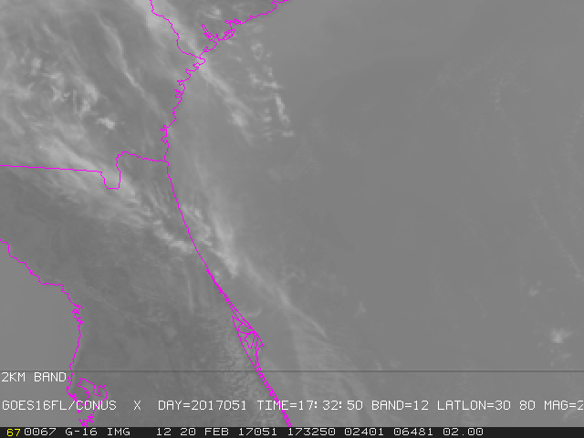
Striping
Striping and banding have both occurred multiple times a day and have been seen in every band.
Seems less pervasive after 2/17 patch, but not eliminated...
Band 12
20 Feb 2017
17:32:50 UTC

Slide 73
Stray Light
Stray Light occurs at night, evident in visible/NIR bands.
  The NIR bands can be used for hot/bright spot detection at night and this problem should not be dismissed based on “nobody uses visible/NIR at night.”
  When looking at a full disk image, it is almost never night everywhere on the full disk and stray light in one part of the image can impact images in multiple ways.
  There is no requirement for visible/NIR band use at night.
Stray light sometimes also is evident in the 3.9um band at night.
This probably would not hold up provisional and may not be easy to fix or mitigate, but should at least be a longer term goal to improve.

Slide 74
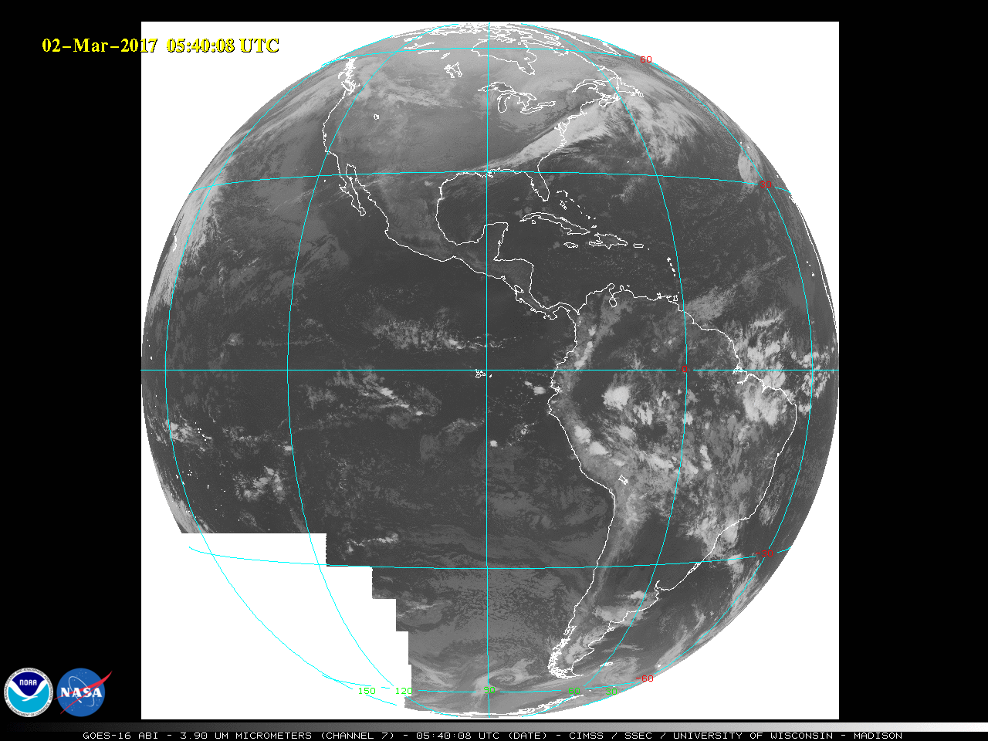
“cookie monster”

Slide 75
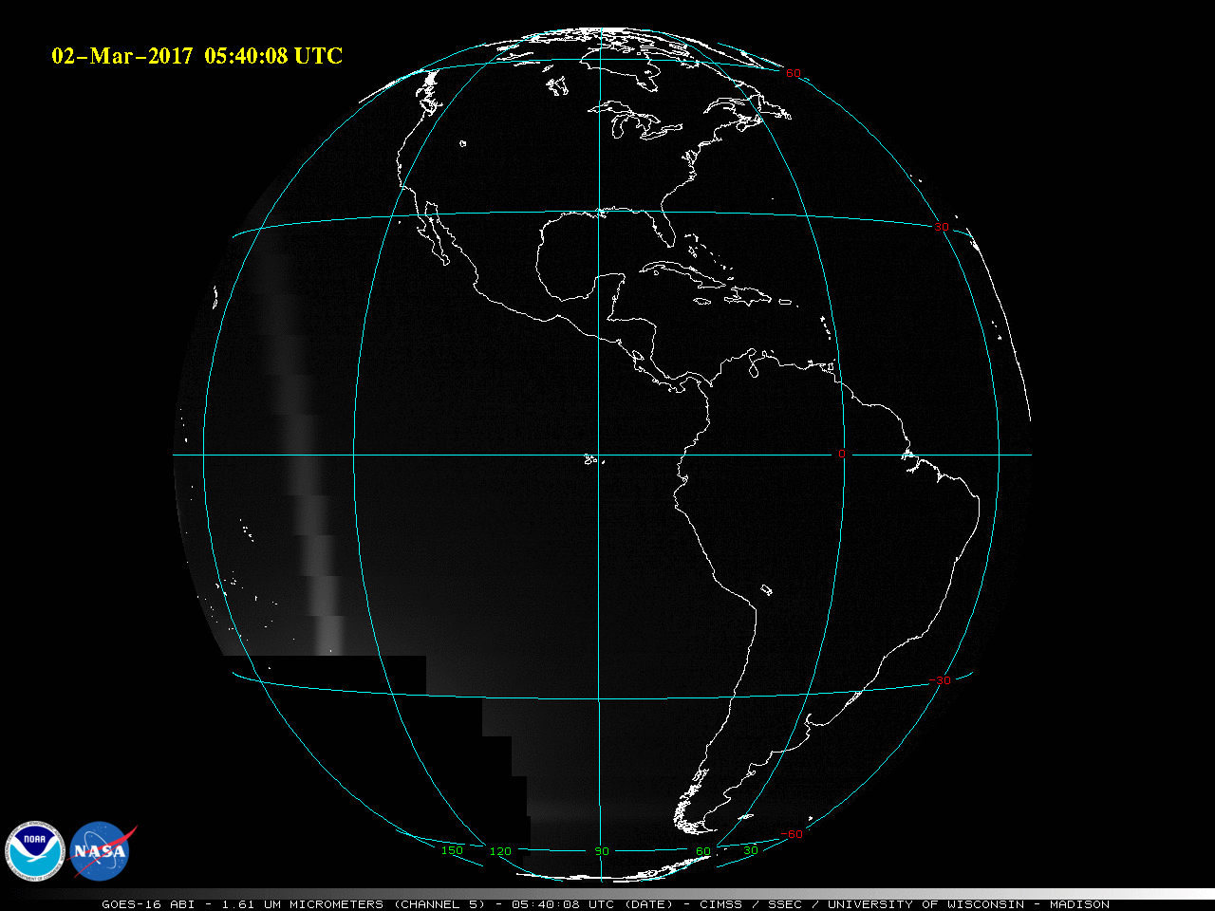

Slide 76
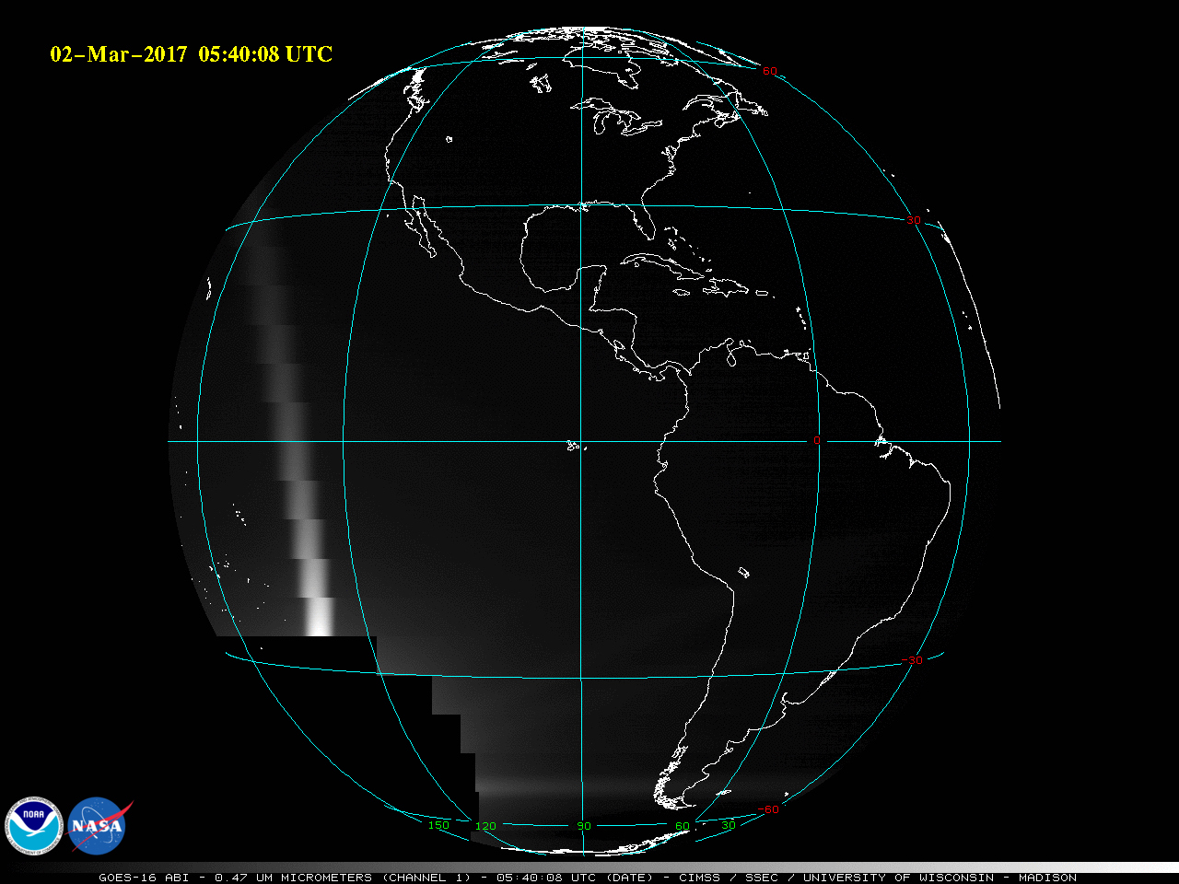

Slide 77
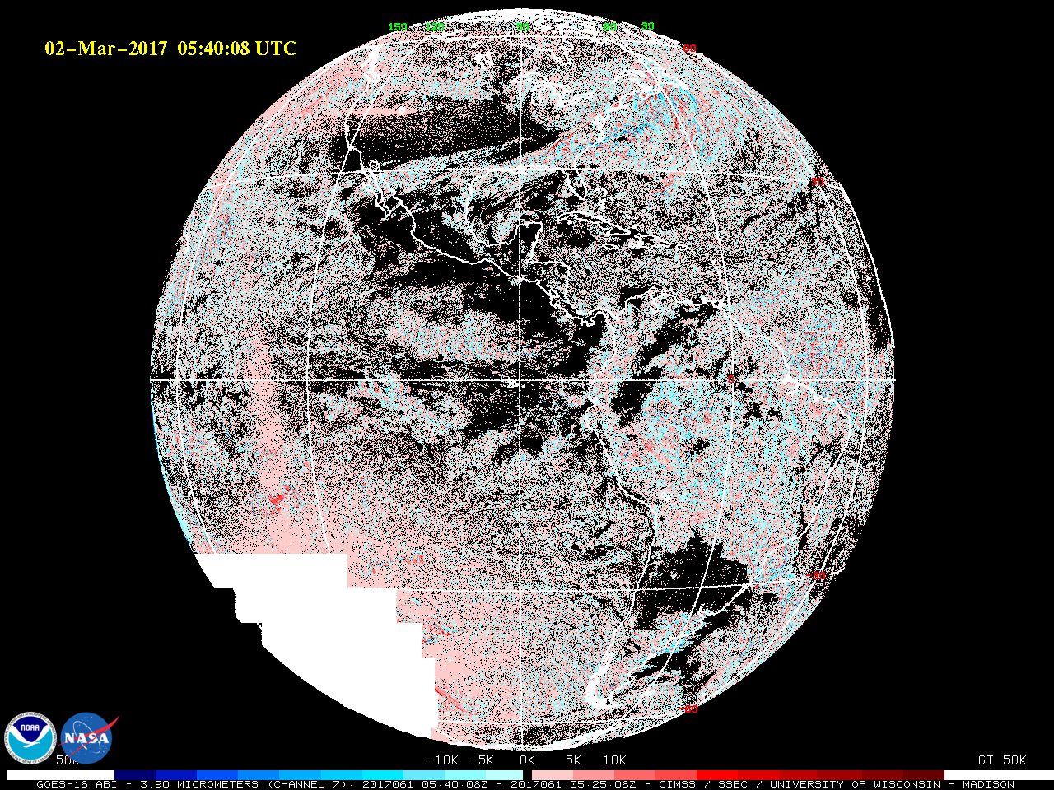
3.9um Brightness Temperature Difference Image (5:40UTC-5:25UTC)

Slide 78
“cookie monster”

Slide 79
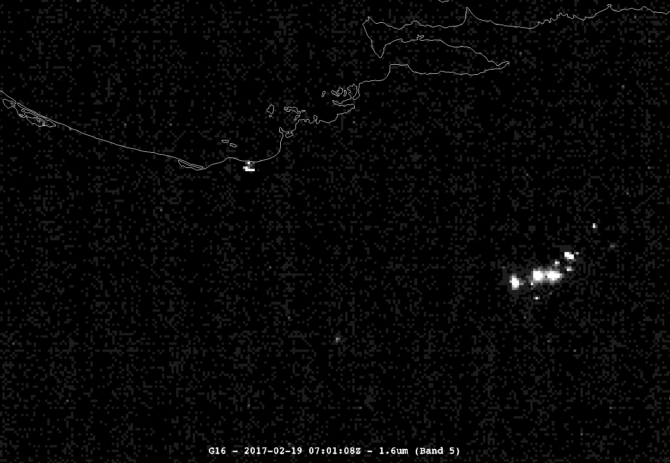
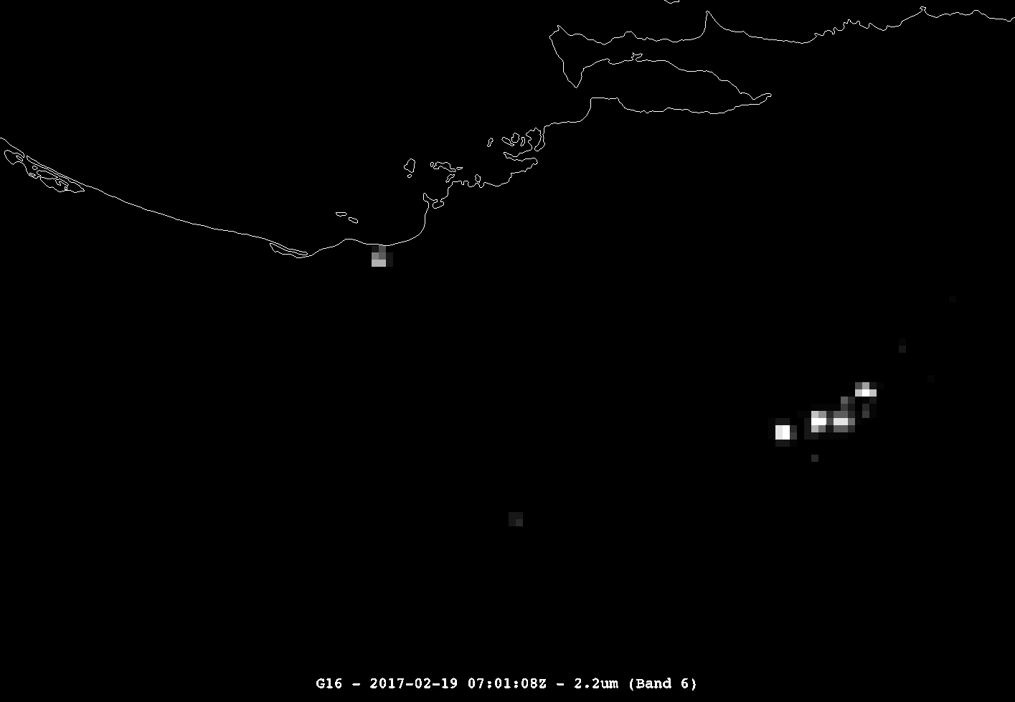
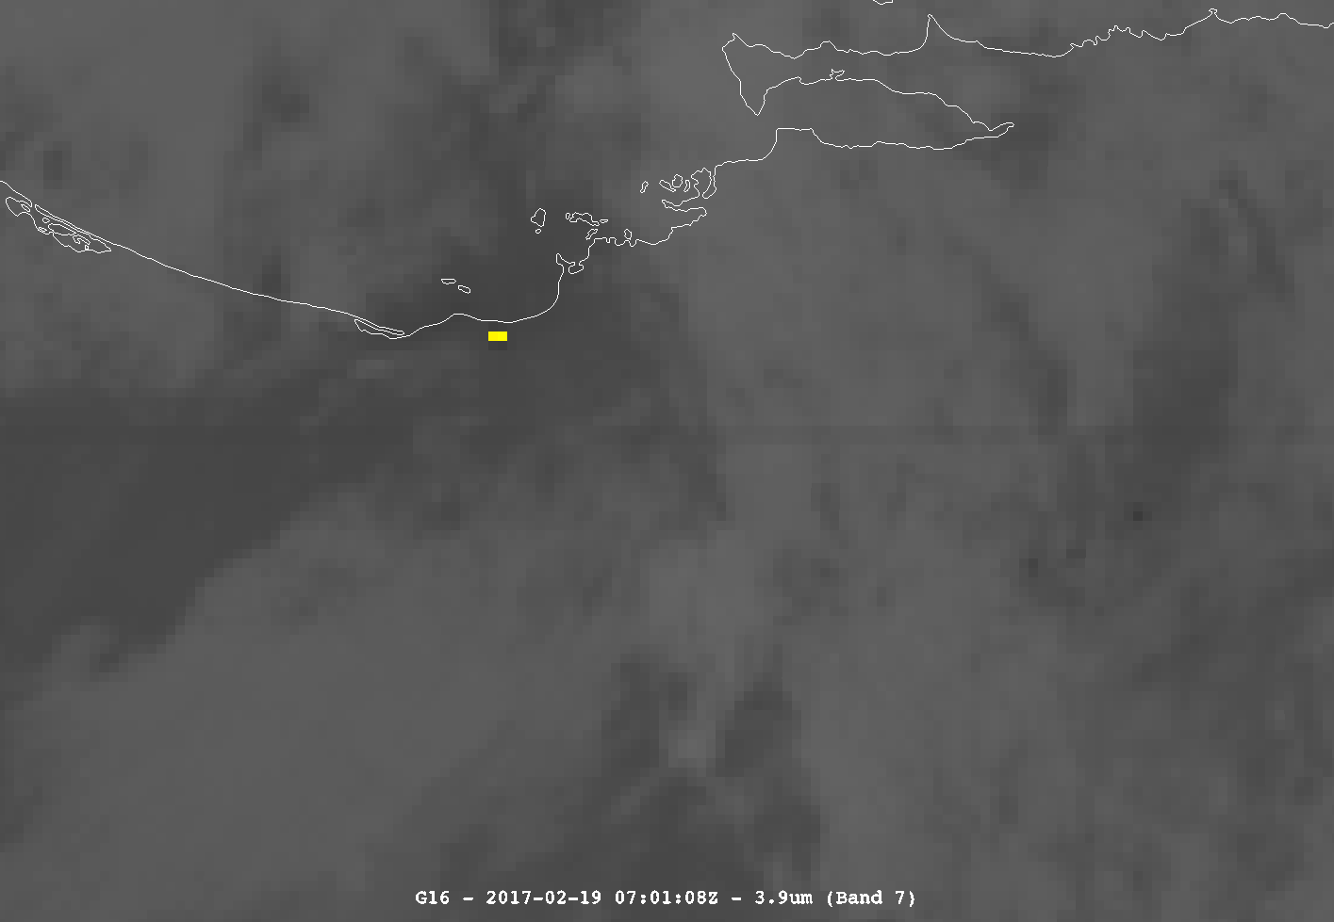
Imagery: near –IR uses at night
Refineries/Fires (bands 5, 6, 7)
Northern coast of Venezuela….
Refinery
Fires
William Straka, CIMSS
Notes:
refinerys_fires_Venezuela

Slide 80
Inconsistent Central Wavelengths
The central wavelengths stored in the CMIP files are different between the single band files and the corresponding bands in the multi-band file.
Band | Single Band Wavelength | Multi-band File Wavelength
1 | 0.47 | 0.47
2 | 0.64 | 0.64
3 | 0.865 | 0.865
4 | 1.378 | 1.378
5 | 1.61 | 1.61
6 | 2.25 | 2.25
7 | 3.89 | 3.9
8 | 6.17 | 6.185
9 | 6.93 | 6.95
10 | 7.34 | 7.34
11 | 8.44 | 8.5
12 | 9.61 | 9.61
13 | 10.33 | 10.35
14 | 11.19 | 11.2
15 | 12.27 | 12.3
16 | 13.27 | 13.3
This is metadata stored as a variable in L1b and L2 CMIP files.
The variable names between single band files and multiband files are different…
In a single band file it appears as:
band_wavelength
In a multi-band file it appears as:
band_wavelength_C01 (e.g., for channel 1)
Fixed implemented, needs final confirmation

Slide 81
Multiband Downscaling to 2km
Multiband downscaling method from ½ or 1km to 2km is now included in the files:
  CMI_C01:downsampling_methoid = "average" ;
  CMI_C02:downsampling_methoid = "average" ;
  CMI_C03:downsampling_methoid = "average" ;
  CMI_C05:downsampling_methoid = "average" ;
Method listed in files is incorrect. The files are being sub-sampled (the corner of 2x2 in a 1km band 1, for example).
  If method changes, manually entered in metadata.
ADR 357

Slide 82
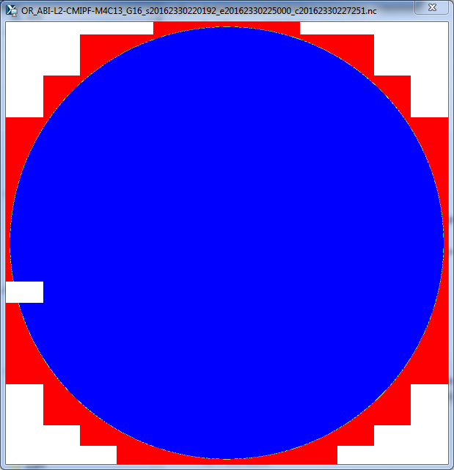
DQF Inconsistent In Space
WR 2190 (DO.06.00) and 3971 (In analysis)
Different DQF values in “space”
Valid range of DQF for L2 CMIP is 0 to 3. The white parts of this image are DQF=-1
Missing chunk of data has same DQF as unscanned portions of space.
Displayed with ncview

Slide 83
DQF Metadata Misleading
CMIP Full Disk Band 09 on May 22 at 07:15:27.1UTC
OR_ABI-L2-CMIPF-M3C09_G16_s20171420715271_e20171420726043_c20171420726122.nc
byte DQF(y, x) ;
DQF:_FillValue = -1b ;
DQF:long_name = "ABI L2+ Cloud and Moisture Imagery brightness temperature data quality flags" ;
DQF:standard_name = "status_flag" ;
DQF:_Unsigned = "true" ;
DQF:valid_range = 0b, 3b ;
DQF:units = "1" ;
DQF:coordinates = "band_id band_wavelength t y x" ;
DQF:grid_mapping = "goes_imager_projection" ;
DQF:flag_values = 0b, 1b, 2b, 3b ;
DQF:flag_meanings = "good_pixel_qf conditionally_usable_pixel_qf out_of_range_pixel_qf no_value_pixel_qf" ;
DQF:number_of_qf_values = 4b ;
DQF:percent_good_pixel_qf = 0.9999939f ; DQF=0 Almost 100% DQF=0
DQF:percent_conditionally_usable_pixel_qf = 2.e-07f ; DQF=1
DQF:percent_out_of_range_pixel_qf = 1.e-07f ; DQF=2
DQF:percent_no_value_pixel_qf = 0.f ; DQF=3 No DQF=3

Slide 84
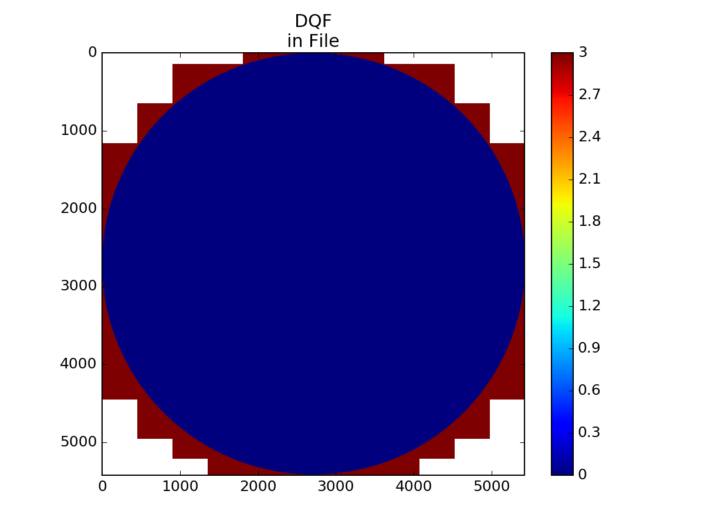
DQF for Band 09
May 22 at 07:15:27.1UTC
DQF is missing where it is white

Slide 85
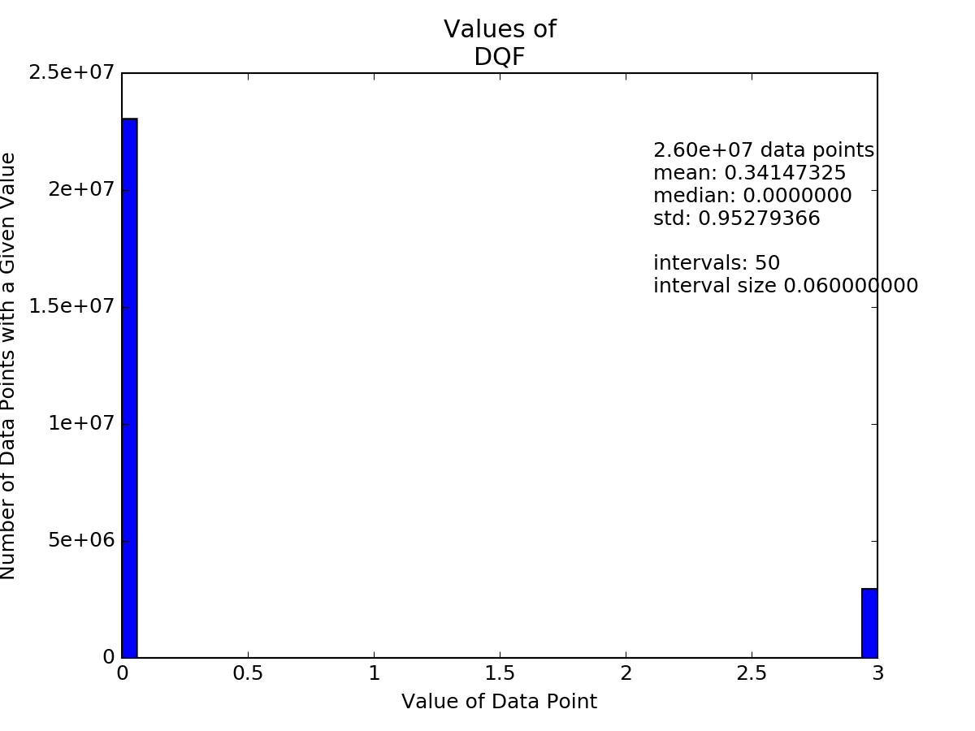
DQF for Band 09
May 22 at 07:15:27.1UTC
L2 PUG states that “In the case of gridded data products on the ABI fixed grid, the value of
the denominator used in calculating this percentage is the number of data points where the source data for
the data points can be geolocated (i.e., on-earth).”
Will this be confusing for users down the road? (Not everyone will read the PUG or would find this).
Maybe rename to:
“geolocated_percent_good_pixel_qf”
Or “percent_good_pixel_qf_on_earth”
There are 5424x5424=29,419,776 Pixels
23,046,120 (~78%) of them are DQF=0 (not 99%)
4 (~1.4e⁻⁷%) of them are DQF=1
2 (~6.8e⁻⁸%) of them are DQF=2
2,960,146 (~10%) of them are DQF=3 (not 0%)
3,413,504 (~12%) of them are DQF=Missing

Slide 86
Different Start Times
WR3892 (In Analysis)
On occasion the 16 bands will not have the same start time.
  OR_ABI-L1b-RadF-M3C01_G16_s20170320106247_e20170320117013_c20170320117060.nc
  OR_ABI-L1b-RadF-M3C02_G16_s20170320106246_e20170320117013_c20170320117048.nc
This is a L1b radiance example, but the problem persists into corresponding CMIP files.

Slide 87
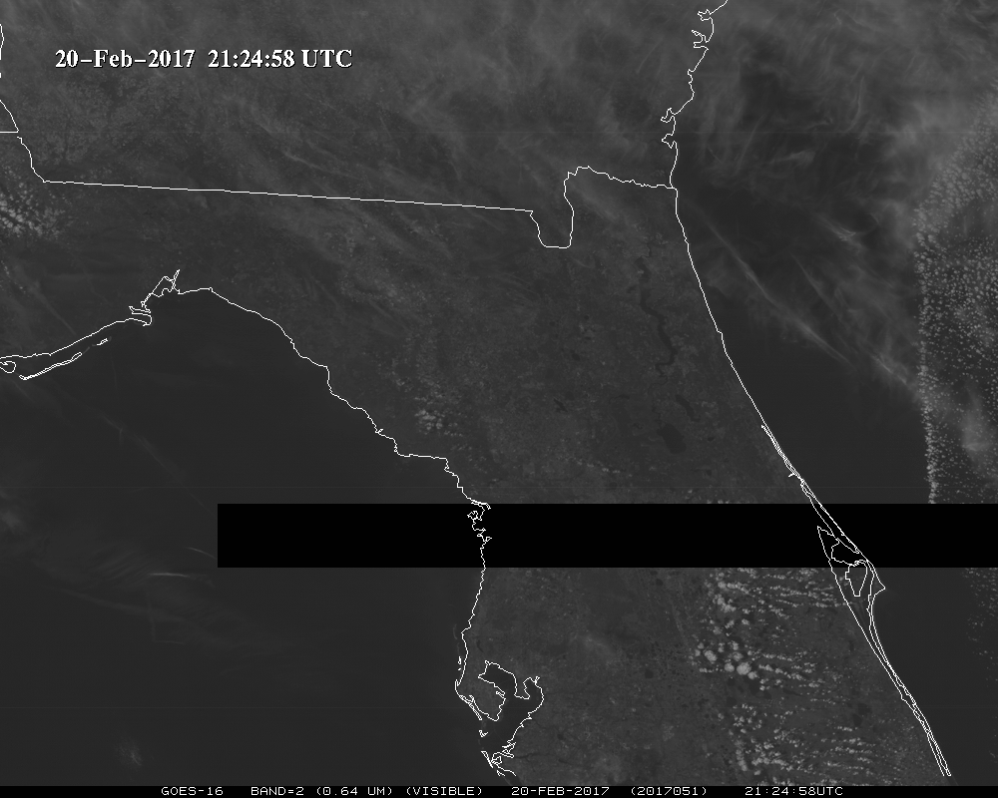
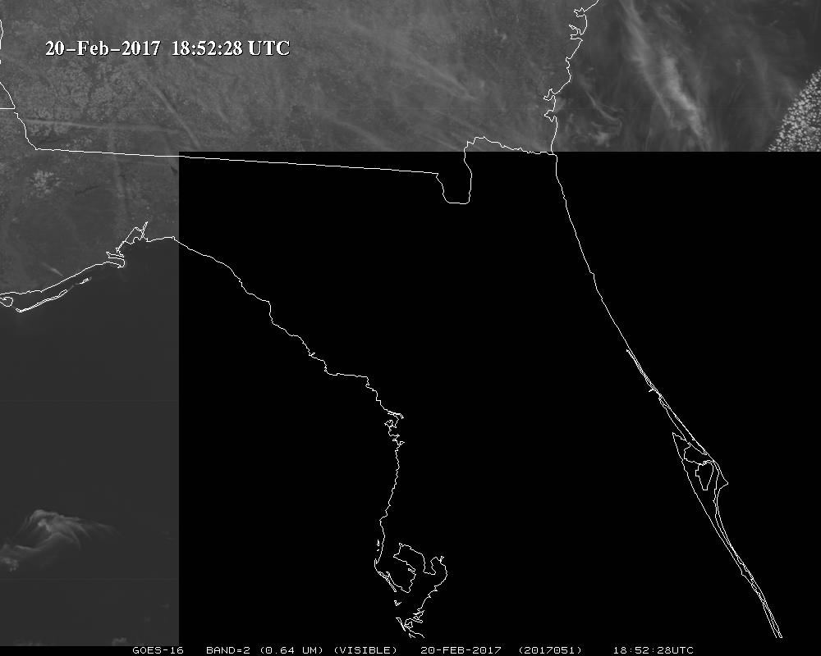
Missing “Chunks”
Missing “Chunks” of Data
Known issue due to terrestrial GRB; will be resolved once GRB-RF is enabled with ABI data

Slide 88
15 Minute Cal Anomaly (PICA)
There is a 15 minute periodicity to calibration that affects both CONUS and MESO
  Chad Gravelle and others noticed it in water vapor imagery.
  Field Campaign noticed it with MESOs
  Does not seem to affect Full Disks
  On the order of 0.1K
Shown in the next slides as image differences in CONUS over consecutive scans in time for the 16 panels….

Slide 89
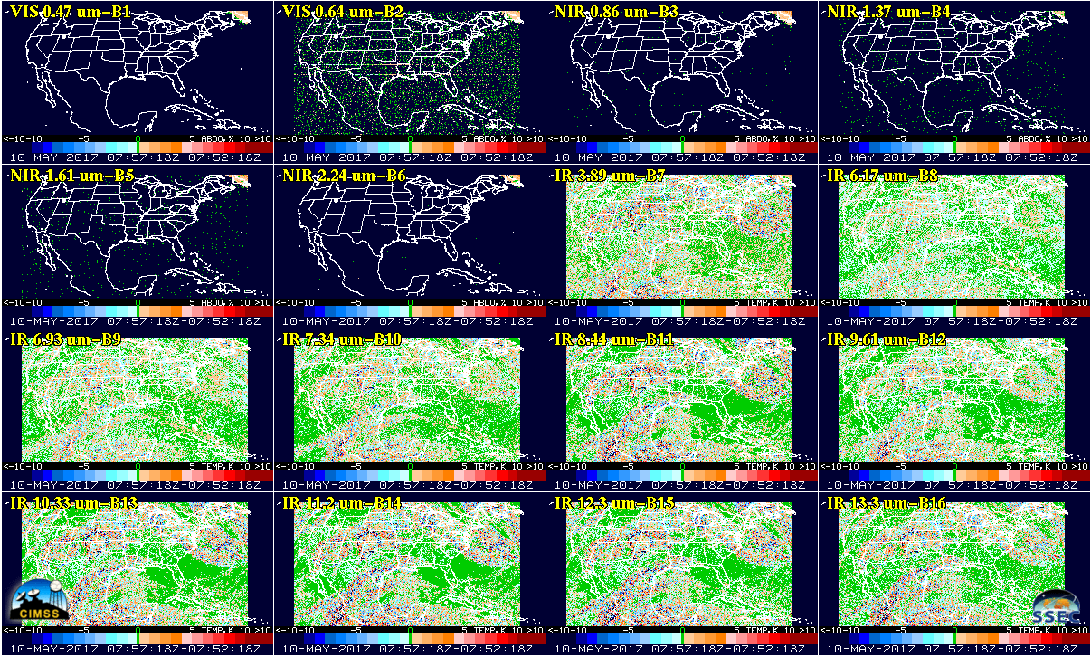
ABI Band Differences in time, consecutive CONUS scans, all 16 bands
7:57:18 – 7:52:18 UTC on 10 May 2017
Differences that are green are +/- 0.05K
Notes:
07:57:18 UTC – 07:52:18 UTC 10May2017

Slide 90
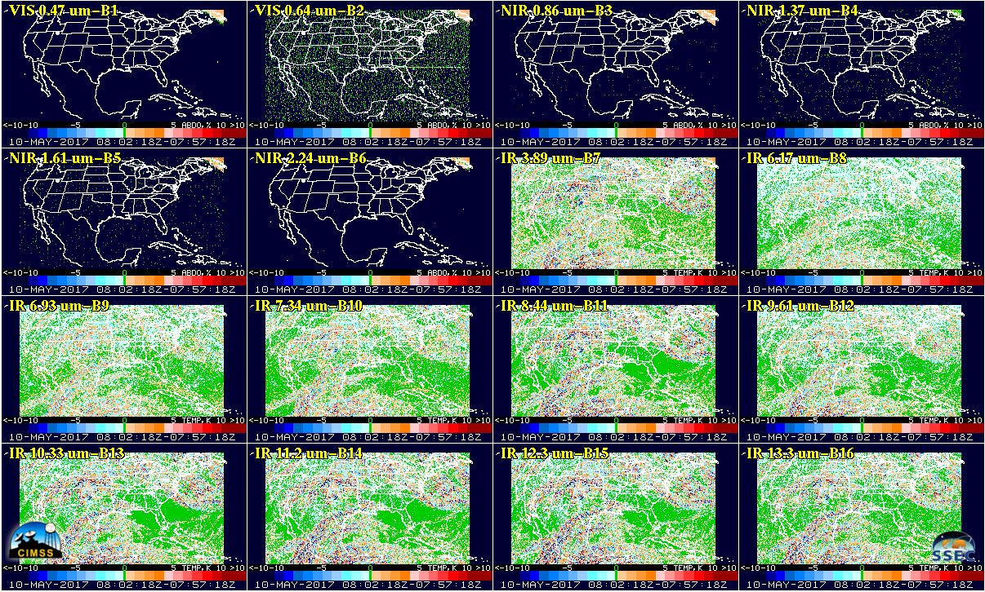
ABI Band Differences in time, consecutive CONUS scans, all 16 bands
8:02:18 – 7:57:18 UTC on 10 May 2017
Differences that are green are +/- 0.05K
Notes:
08:02:18 UTC – 07:57:18 UTC 10May2017

Slide 91
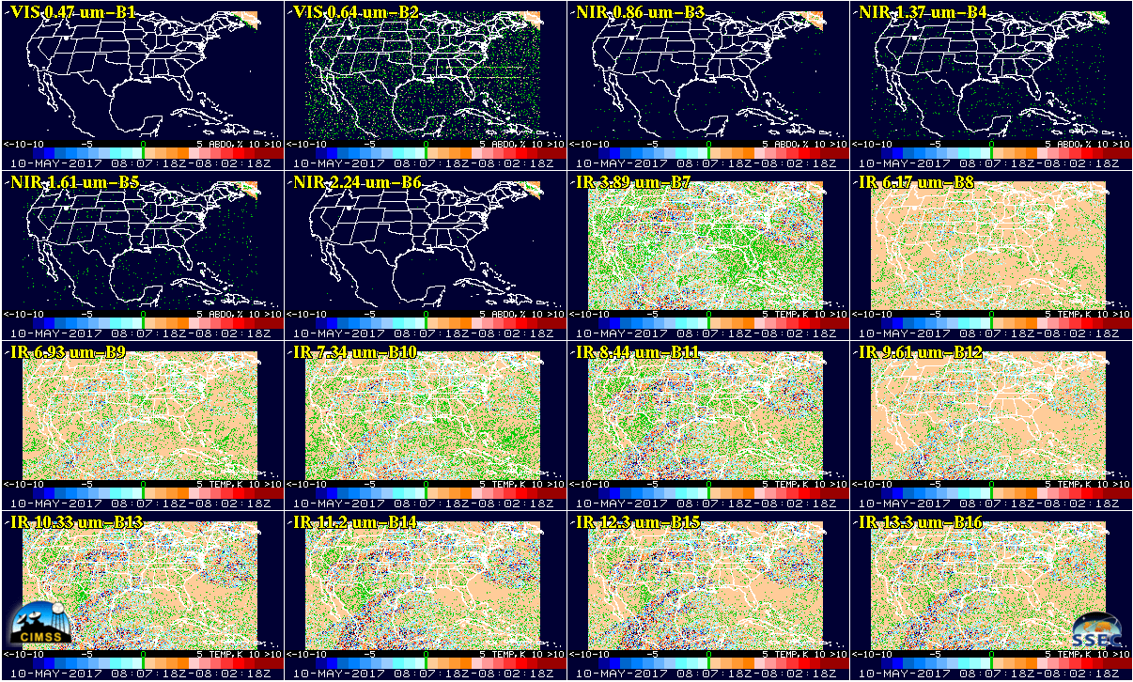
ABI Band Differences in time, consecutive CONUS scans, all 16 bands
8:07:18 – 8:02:18 UTC on 10 May 2017
Differences that are “butterscotch” are +/- .05 to +1.05K
Notes:
08:07:18 UTC – 08:02:18 UTC 10May2017

Slide 92
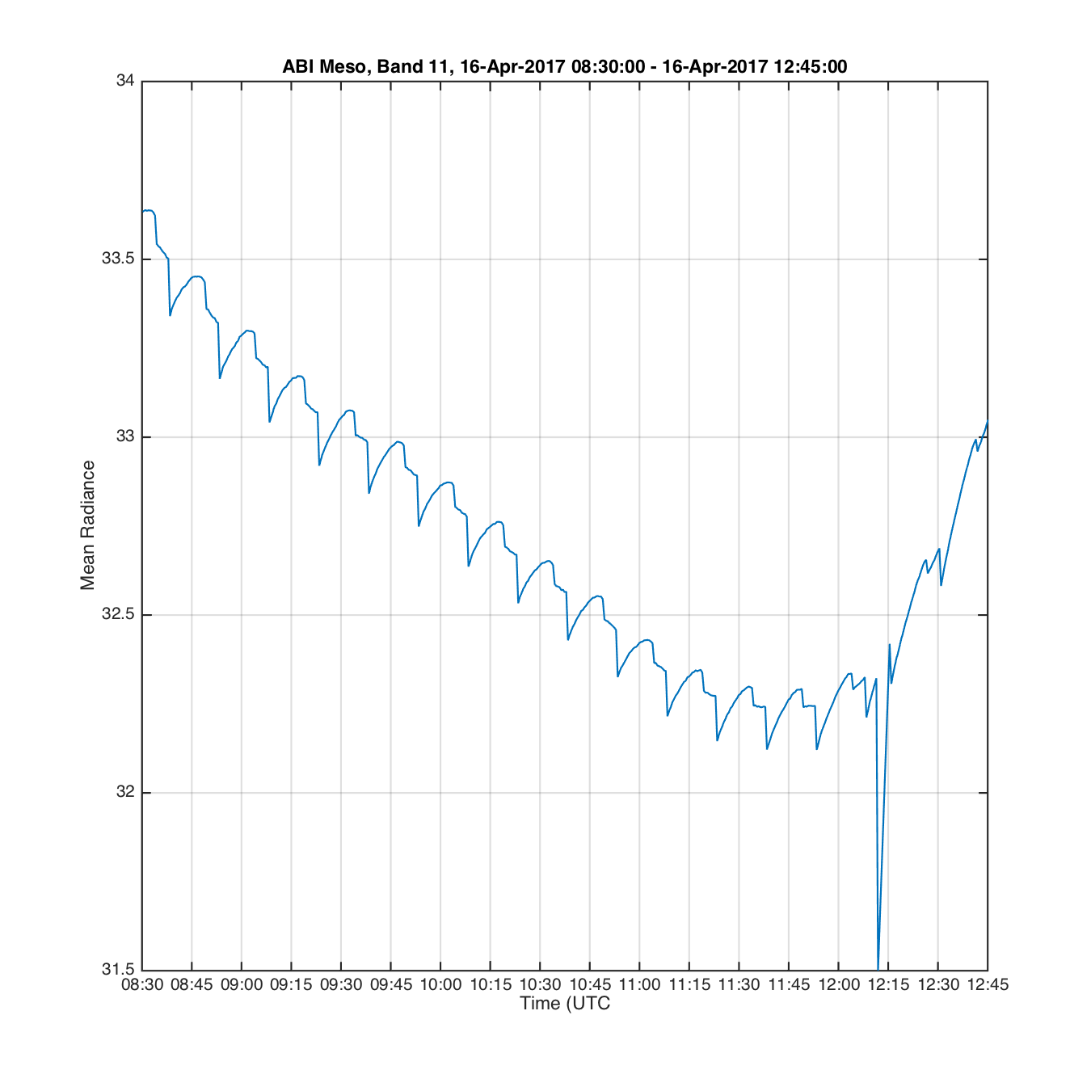
Preliminary Field Campaign Results
Mean Radiances for Mesoscale scans on 16 Apr, considering only pixels with DQFs=0 & 1.
Note that in Mode 3 the FD start times are nominally at :00, :15, :30, :45

Slide 93
Max Inconsistent
Sometimes the min/max/mean/std stored in the file are not consistent with values derived from the data stored in the file.
  This could be related to the fact that these values are calculated “on the fabric” and not from the CMI file actually?
  Example:
    OR_ABI-L2-CMIPF-M3C02_G16_s20171431730271_e20171431741037_c20171431741106.nc
      max_reflectance_factor:valid_range = 0.f, 1.f
      max_reflectance_factor = 1.043138

Slide 94
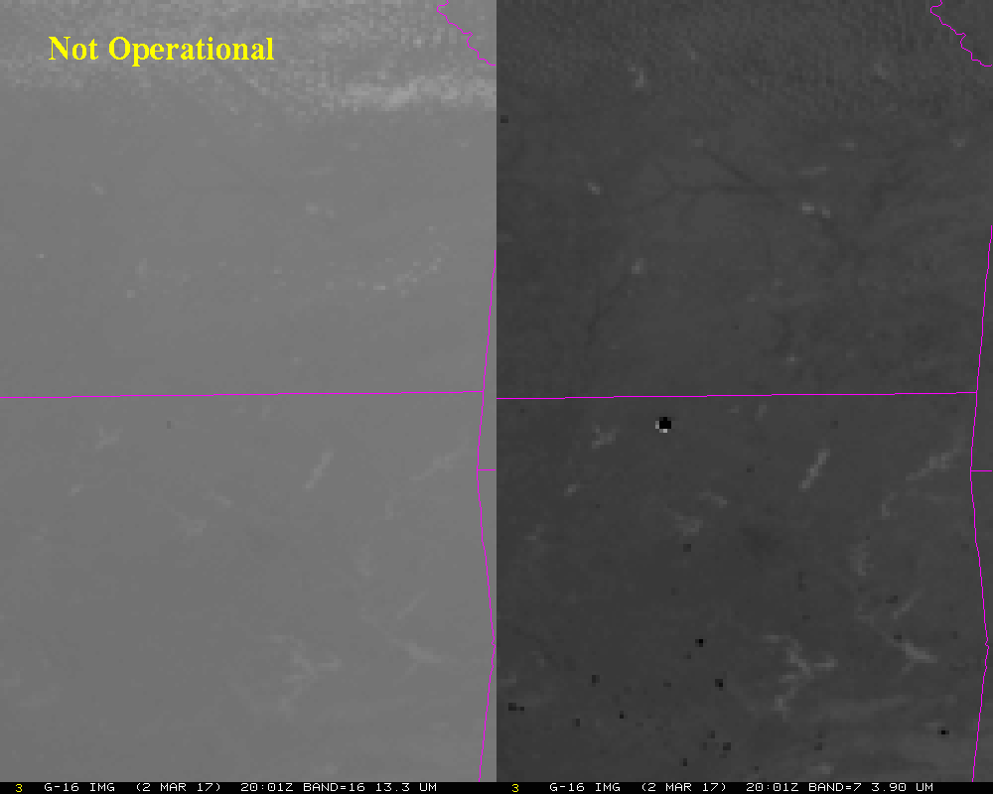
Fire Creates Artificially Cold Pixel?

Slide 95
Scan Start Times “Slip”
The 18:00:xx.x file from day to day slips some seconds.
  This is going to confuse users, cause problems with reprocessing, and make it difficult to find the “same” image from day to day.
  Full Disk “18Z” images…
  IMGLIST GOES16A/FD.-19 TIME=18 18:06
  Image file directory listing for:GOES16A/FD
  Pos Satellite/ Date Time Center Band(s)
  sensor Lat Lon
  --- ------------- ------------ -------- ---- ---- ------------
  480 G-16 IMG 15 MAY 17135 18:00:22 0 89 1-16
  217 G-16 IMG 14 MAY 17134 18:00:37 0 89 1-16
  123 G-16 IMG 13 MAY 17133 18:00:25 0 89 1-16
  27 G-16 IMG 12 MAY 17132 18:00:37 0 89 1-16
  IMGLIST: done

Slide 96

Sample of Issue After a Restart

Slide 97
SCMI Remapped
Examples shown previously in Provisional slides.
This issue is being worked currently with NWS

Slide 98

GRB Metadata Sent Too Soon
When the metadata arrives for a file, that is supposed to be the indicator that the entire file has been delivered….

Slide 99

No Swath Times in Metadata
Imagery team has requested this in the past and still thinks it’s a good idea for cal/val and user community.
There are no swath start times in L1b and L2 files.
  This was requested in Imagery ATBD

Slide 100
Risks to Reaching Full Validation
Risk Name | Description | Impact | Mitigation and Schedule
Inconsistent between L1b and CMI values | The CMI values are currently not being accurately converted from L1b radiances for bands 1-6 | High | TBD
NWS Using Imagery Operationally | Striping, co-registration(?), navigation issues, missing data, missing chunks of images, inconsistent start times for 16 bands, etc. all may be issues the NWS deems unacceptable to using operationally. | Medium | Many L1b issues (cal and INR) go to image quality and need to be fixed over time.

Slide 101

Imagery RIMP
A core assumption of the RIMP is that the AWG teams are fully funded

