Slide 1
GOES-16 ABI
Cloud and Moisture Imagery in NWS
NWS Update for Full-Validation PS-PVR
June 1, 2018

Slide 2
GOES-16 Cloud and Moisture Imagery in AWIPS-2 and N-AWIPS
Fielded AWIPS-2 baseline handles ingest/decode/store/display/purge of ABI Imagery
  All ABI channels, all sectors (AWIPS derives RGBs and channel differences)
  WFOs/RFCs/RHQs receive SCMI for AWIPS-2 via SBN (since March 2, 2017)
  Examples are shown in the following slides (AWIPS-2/CAVE screenshots)
Fielded N-AWIPS baseline handles ingest and display of ABI Imagery
  All channels, all sectors
  Projected McIDAS Area files
  NCEP Centers receive CMI (for AWIPS and N-AWIPS) via GRB, with SBN as backup (since March 1, 2017)
  Backup slides summarize current NWS ABI product posture

Slide 3
AWIPS-2 Visualization and Exploitation
16+ months of evolutionary improvements of GOES-16 ABI processing and rendering in NWS
Satellite Enhancement Team (SET) review and approval process
  Collaborative activity among NWS regional/field reps, cooperative institutes, NWS HQ (OBS/TOWR-S Team) and GOES-R Program Office
  Defined menu structures, enhancement tables, RGB and difference definitions
Orderly deployment of 15 “RPM” updates to regional and national forecast offices
  OBS/TOWR-S team coordinates and executes agile RPM process which accelerates changes into AWIPS (with baseline incorporation once functionality stabilizes)
AWIPS/N-AWIPS refinements and training continue

Slide 4
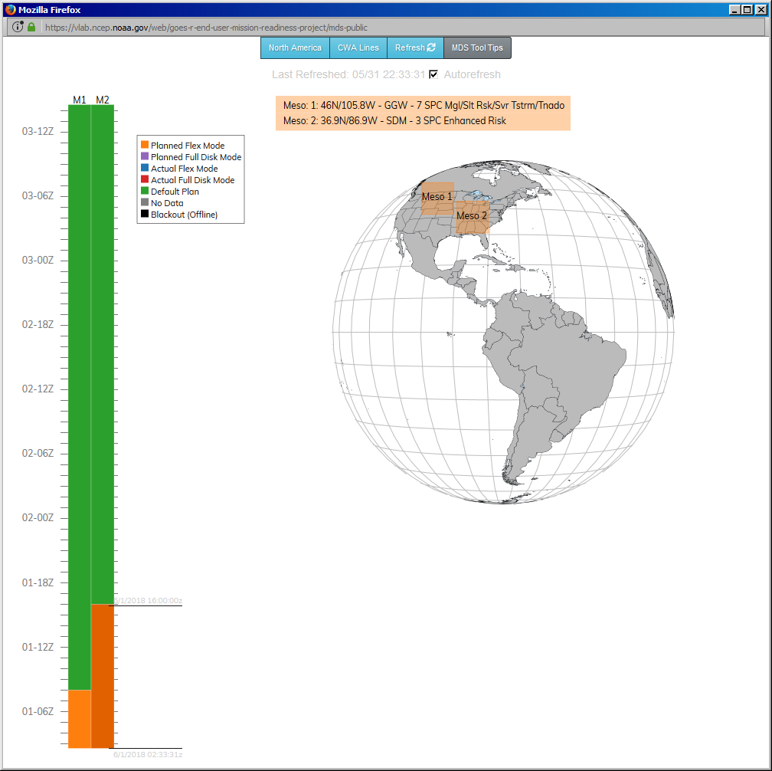
Exploitation of GOES-16 ABI Mesos in NWS
Initial process and tool for meso exploitation developed prior to GOES-16 T2O
Meso Domain Scheduler (MDS, also known as Meso Mission Manager, MMM) encourages and facilitates meso collaboration and utilization
Standard Operating Procedure documents mission priorities and the NESDIS/NWS meso-request process
NWS Governance of ABI/Meso process successfully transitioned to NWS Operations Division (Spring 2018)
    MDS/MMM tool and process supported by OBS/TOWR-S team
    Process evolution continues

Slide 5
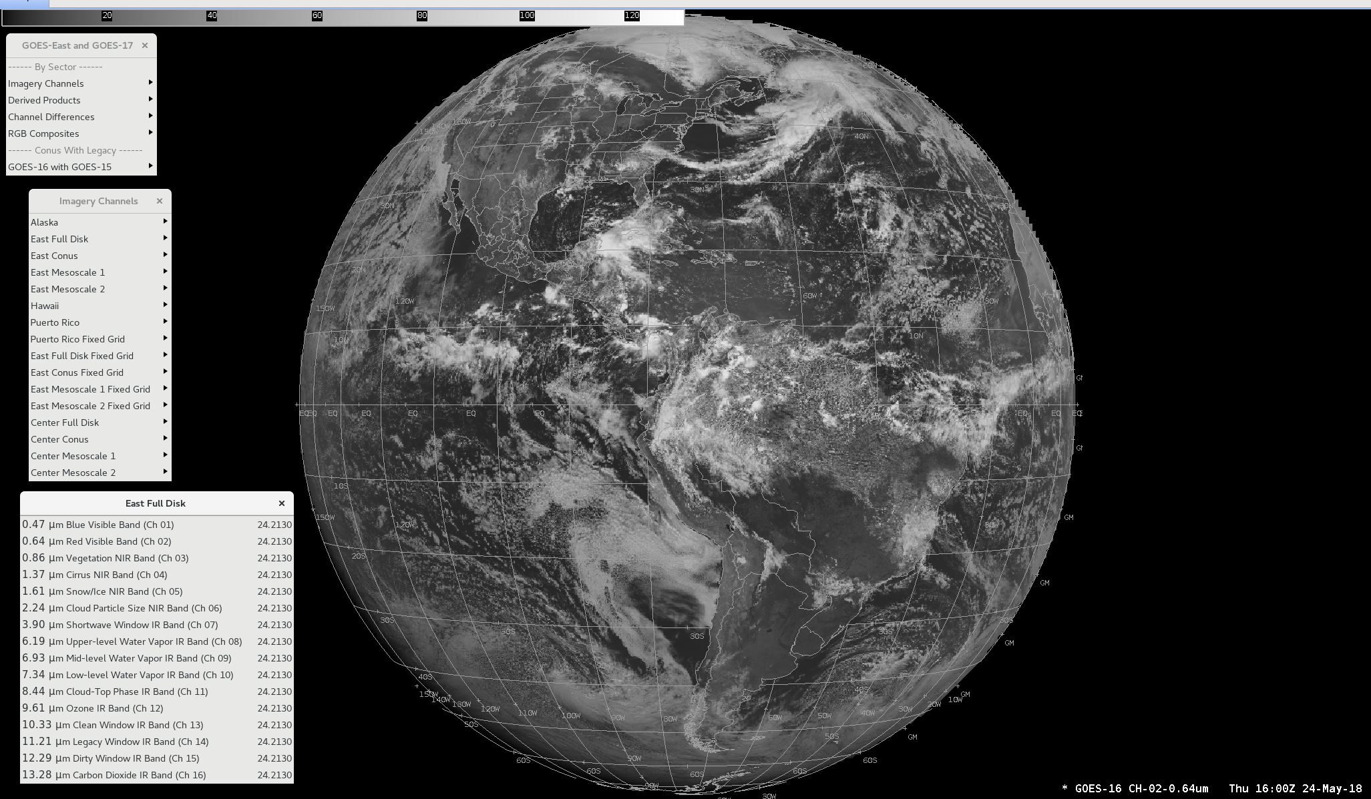
AWIPS example: 0.64µm East Full Disk

Slide 6
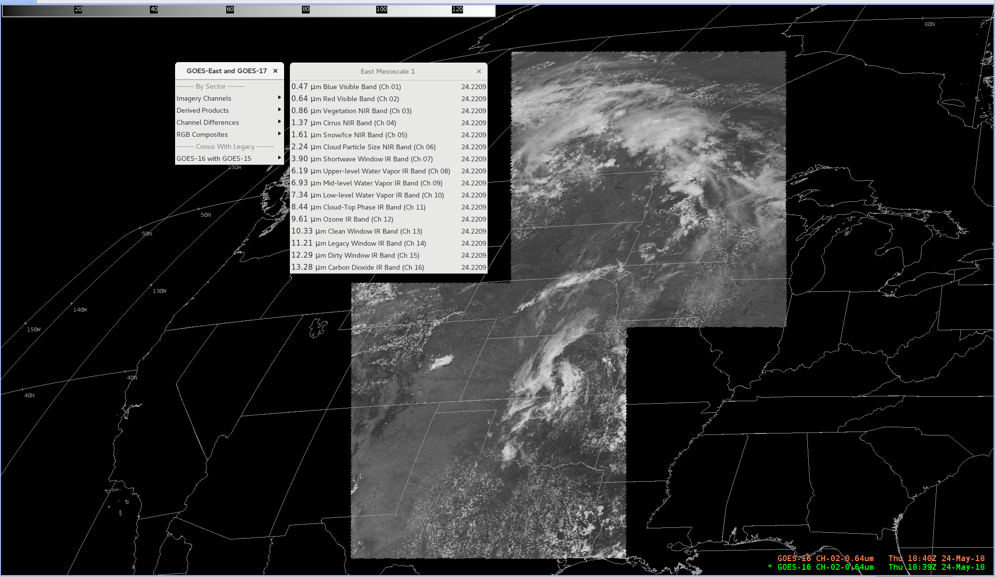
AWIPS example: 0.64µm Mesoscale Sectors

Slide 7
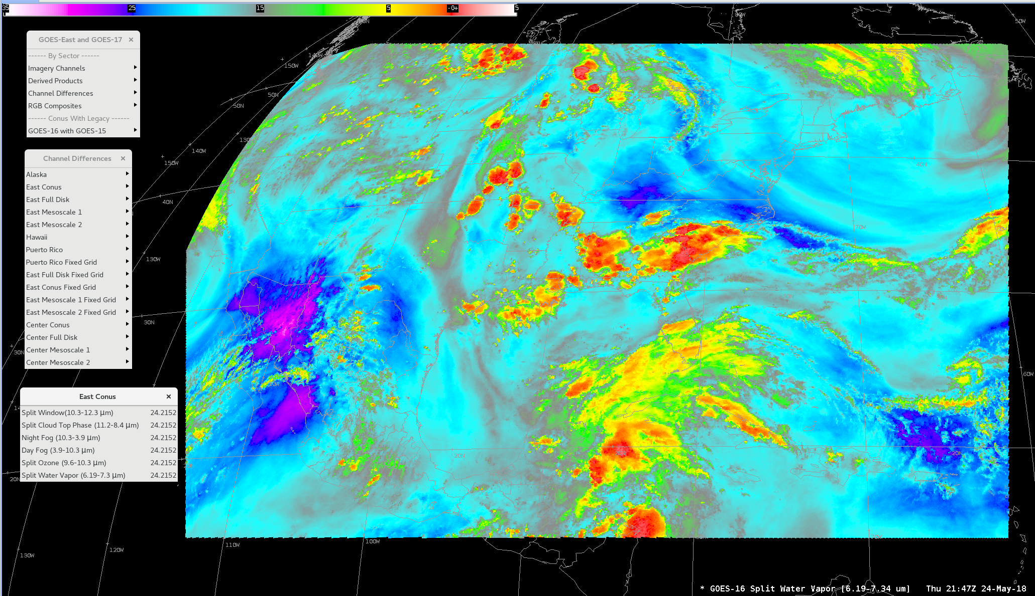
AWIPS example: Split Water Vapor Channel Difference

Slide 8
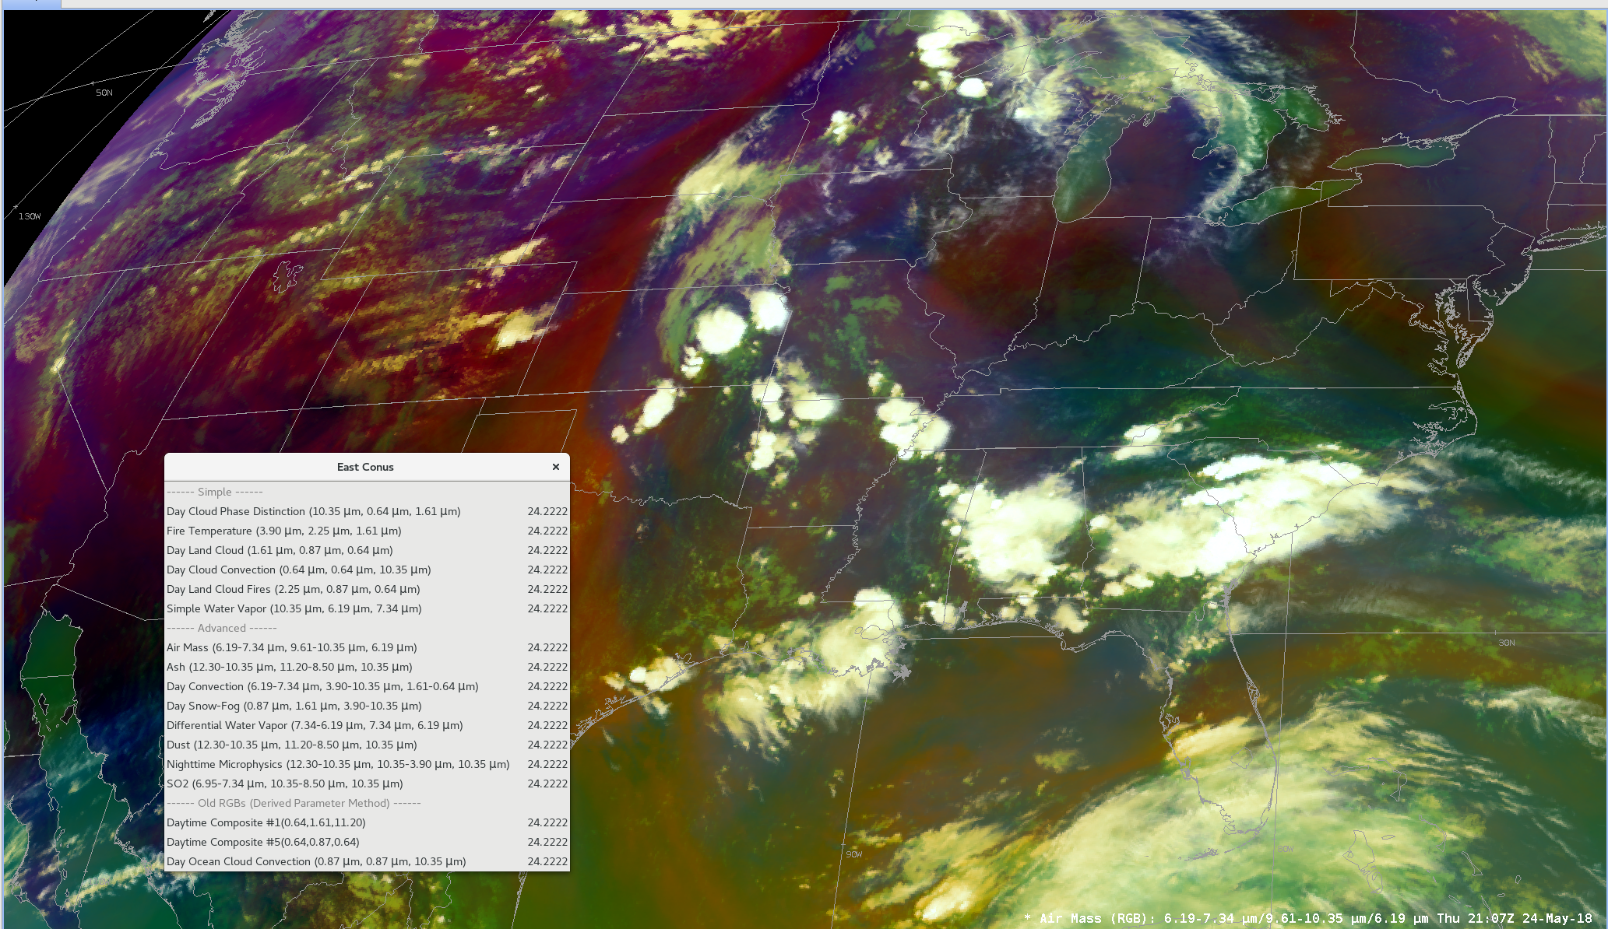
AWIPS example: Air Mass RGB

Slide 9
Noteworthy Items (1 of 2)
SCMI projected 3.9µm (band 7) Imagery: Cold Pixels appear next to very hot pixels (NWS OTE TTR 36)
Streaky lines (“striping”) (NWS OTE TTR 18). NESDIS is aware and working.
Received numerous requests to extend the Northern ECONUS farther northward
  Relocation from 89.5 deg. to 75.2 deg provided better coverage just north of CONUS
Projected imagery is sometimes degraded (shows significant pixelation) in basin-wide views, but disappears upon zoom-in, and warrants further investigation
  NWS internal issue, will be worked within AWIPS
Notes:
Mission impacts

Slide 10
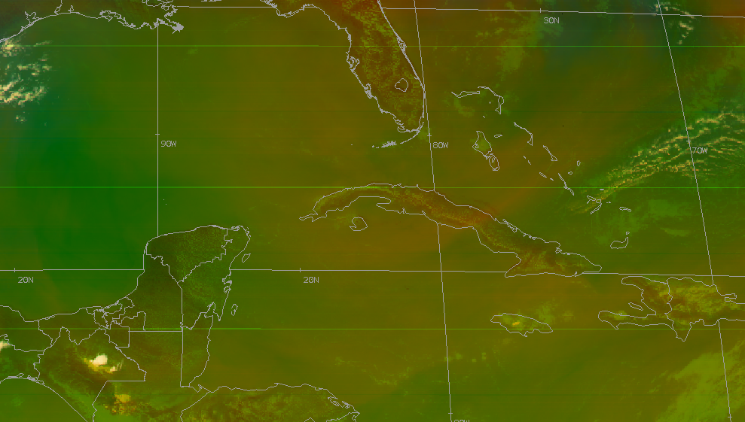
Air Mass RGB (May 2018 Fixed Grid Sample)
Example of striping shown in Air Mass RGB, based upon fixed grid sample tiles

Slide 11
Noteworthy Items (2 of 2)
“Checkerboard” display occurs in AWIPS for (non-Full Disk) channel differences and RGBs utilizing bands of differing spatial resolution
  RGBs impacted
  Day Convection (see next slide)
  CIMSS Natural Color
  Channel Differences impacted
  Split Fire (2.2-1.6µm)
  Split Snow (1.6-0.64µm)
  Split Vegetation (0.64-0.87µm)
Notes:
Mission impacts

Slide 12
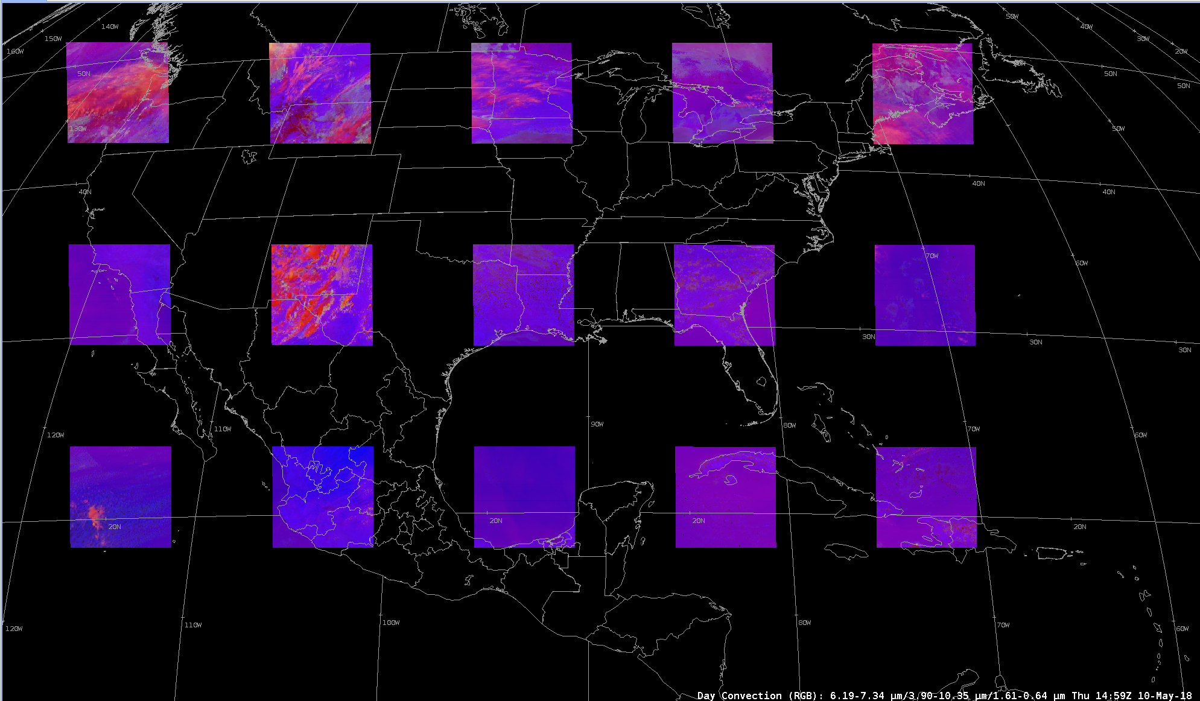
Day Convection RGB (SCMI Fixed Grid Samples)
Current spatial alignment of tiles results in “checkerboard” in AWIPS for (non-Full Disk) channel differences when channel resolutions vary
For derived parameters to work, tiles must align spatially
Tile size must vary as a function of spatial resolution
  1024x1024 (0.5km) should correspond to a 512x512 (1km), which should correspond to a 256x256 (2km) tile
  All need the same northwest pixel origin, with appropriate resolution-based offset
AWIPS/CAVE Screen Shot - “Checkerboard” Problem

Slide 13
Summary Assessment
GOES-16 ABI imagery is successfully operational in NWS
NWS/OPPSD GOES-16 Operational Test and Evaluation (OT&E) Team conducted assessment, gathered feedback, summarized/reported results, and their Test Review Group voted to recommend SCMI for operational deployment on April 26, 2018
NWS requests continued GOES-R Program attention on GOES-16 ABI fixed grid transition, correction of “checkerboard” issue, and other product refinements

Slide 14
Thanks!
Questions?

Slide 15
Back-up Slides
Current NWS GOES-16 ABI Product Posture
(excerpted from OBS/TOWR-S update slides)

Slide 16
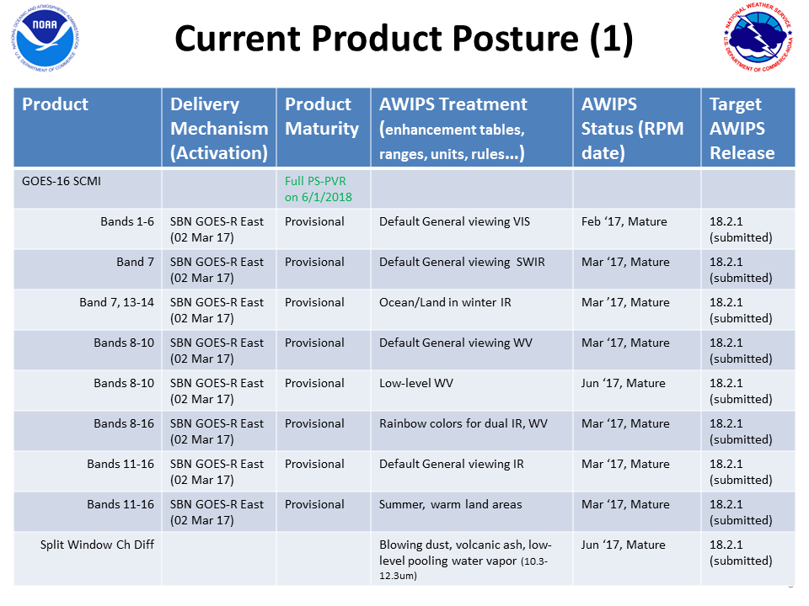

Slide 17
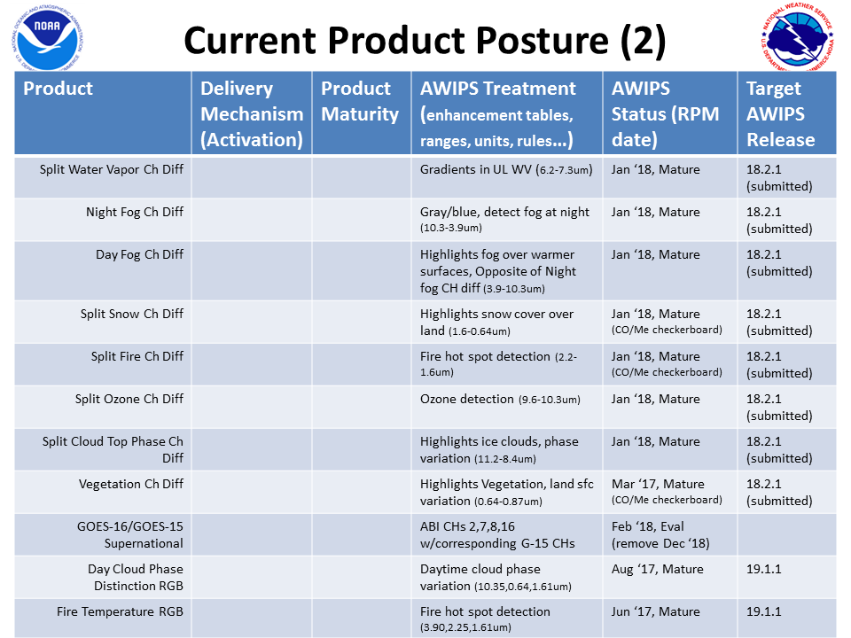

Slide 18
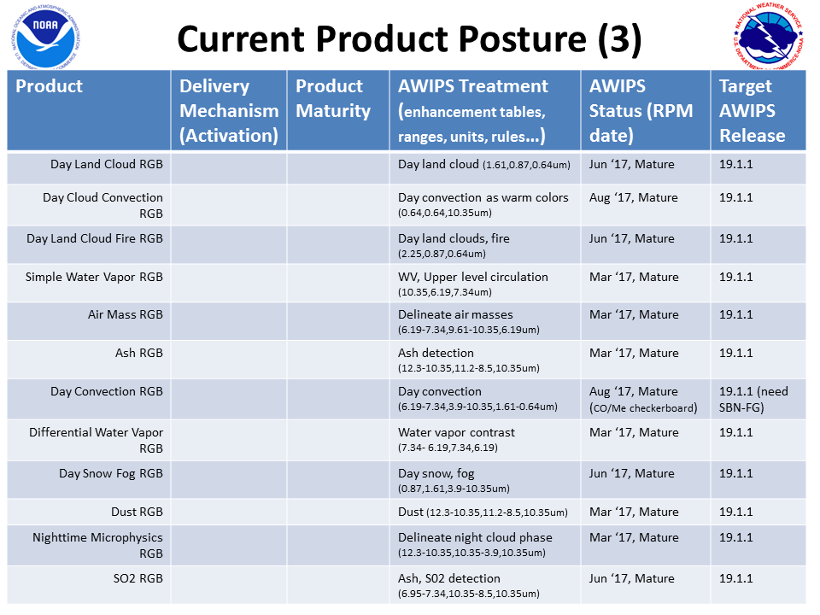

Slide 19
