Slide 1
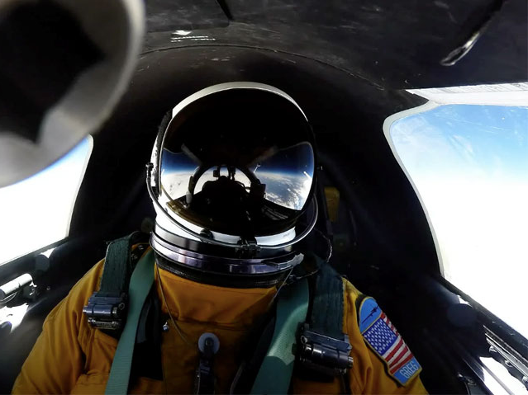
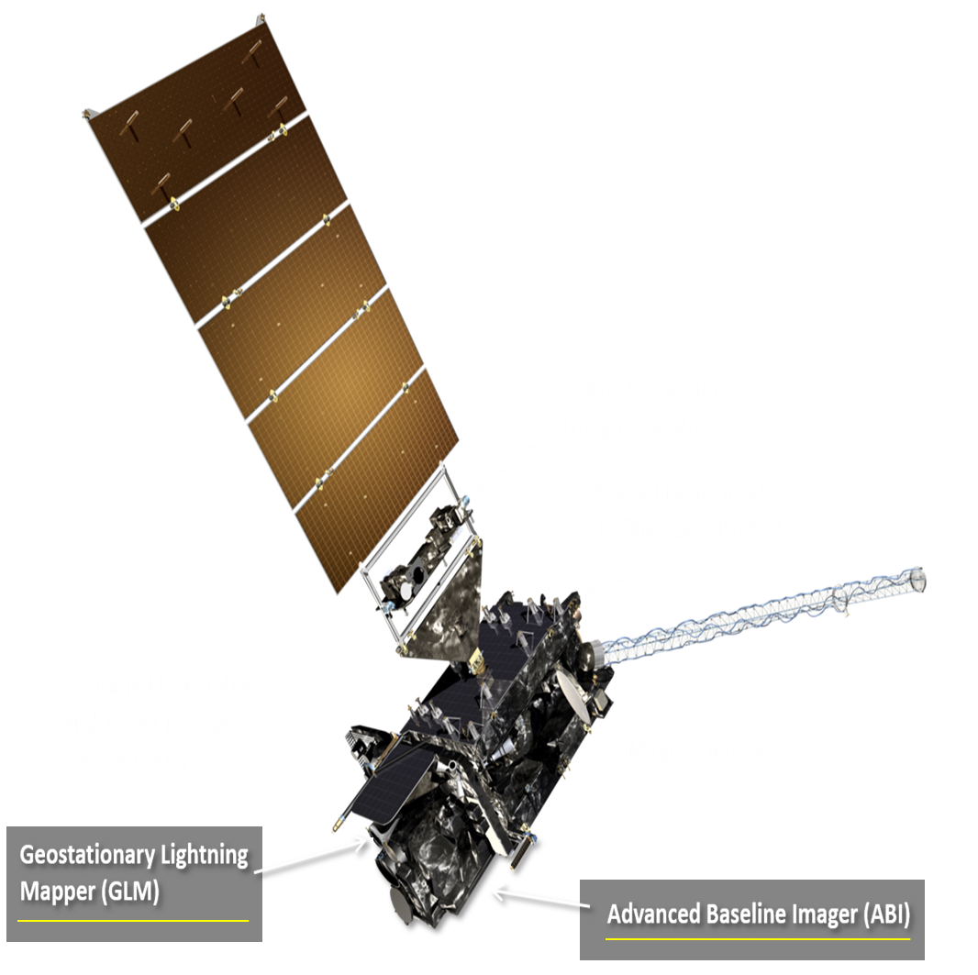
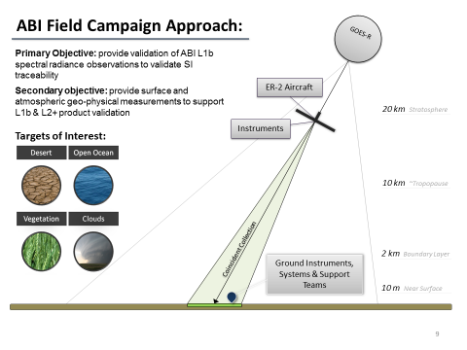
GOES-R Airborne Science Validation Field Campaign Overview
Goal of the GOES-R field campaign was to support post-launch validation of ABI & GLM L1b & L2+ products:
  High-altitude NASA ER-2 platform coordinated with ground based reference data over several Earth targets:
  March 21 – May 17, 2017
  Primary objective: all detector independent validation of ABI spectral radiance observations
  Validation analysis coordinated through an ABI field campaign analysis working group (Program Science, CWG, Univ. Wisc., JPL, NASA/GSFC)
GOES-R Spacecraft
ABI Performance Metrics:
Reflective Solar Bands (RSB)
  5 % radiometric uncertainty
Thermal Emissive Bands (TEB)
  1 K radiometric uncertainty

Slide 2
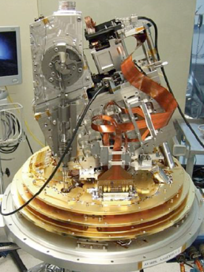
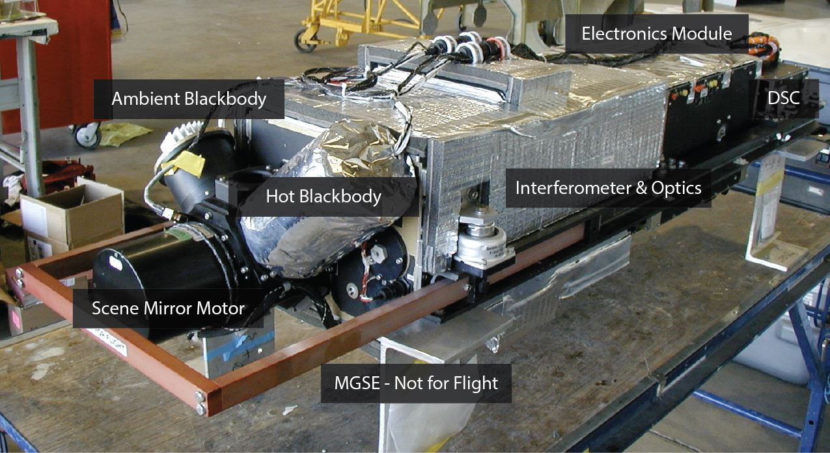
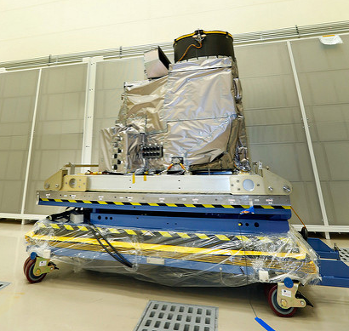
ABI Primary Validation with SI Traceable Airborne Instruments
AVIRISng
S-HIS
ABI
Instrument | Spectral Range | Spatial Resolution | Swath Width | Radiometric Uncertainty
AVIRISng (JPL) | 0.38 – 2.51 µm (480 bands) | 20 m | ~11 km | 3 % (SI Traceability to NIST via FEL Lamp)
ABI Reflective Solar Bands | 0.47 – 2.25 µm (6 bands) | 500 m, 1 km, or 2 km | 500 km | <5 % (SI Traceability ​NIST calibrated transfer sphere​ & FEL Lamp)
S-HIS (Univ. of Wisc.) | 3.33 – 17.24 µm (4607 channels) | 2 km | 40 km | 0.04 K (k=1: over ABI bands and scene temperatures of interest) (SI Traceability NIST TXR)
ABI Thermal Emissive Bands | 3.9 – 13.3 µm (10 bands) | 2 km | 500 km | <1 k (SI Traceability NIST TXR)

Slide 3
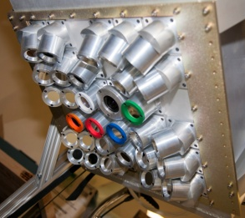
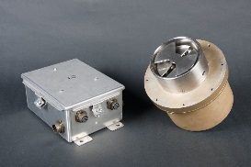
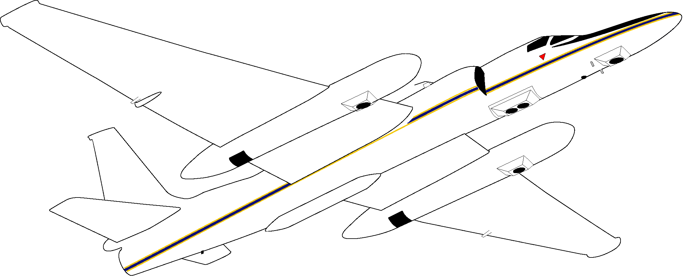
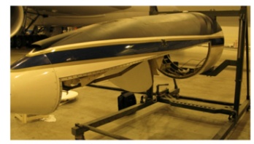
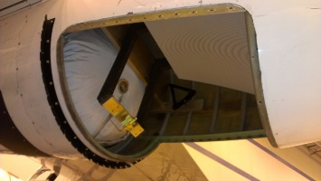
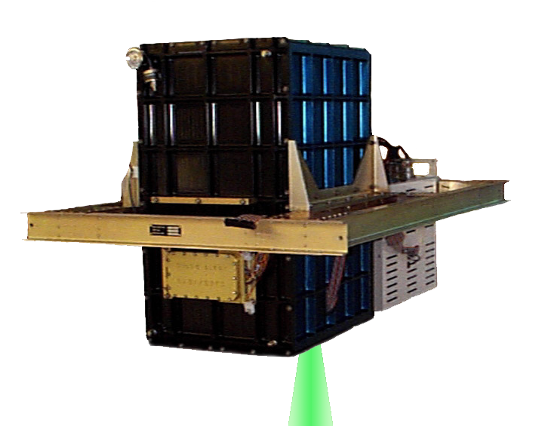
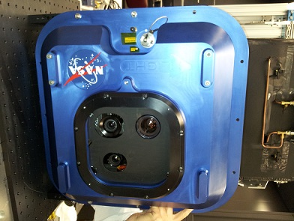
GOES-R Field Campaign ER-2 Based Instruments
AVIRIS-NG
LIP
LIP
FEGS
INMARSAT
EXRAD
CRS
S-HIS
GCAS
CPL
LIP

Slide 4
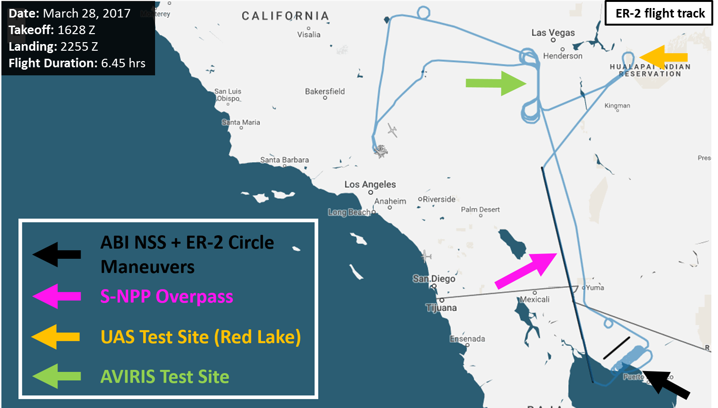
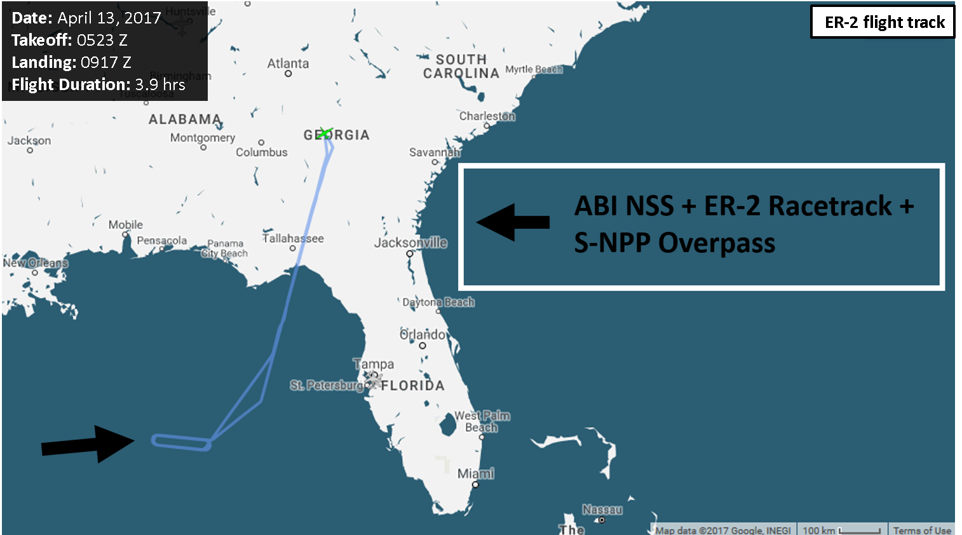
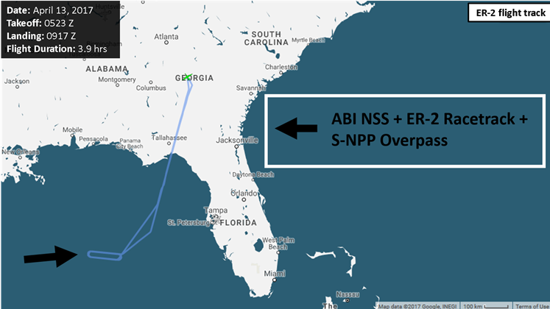
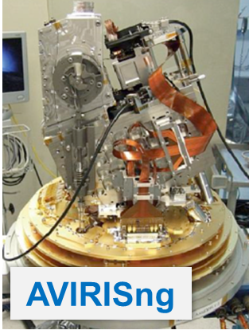
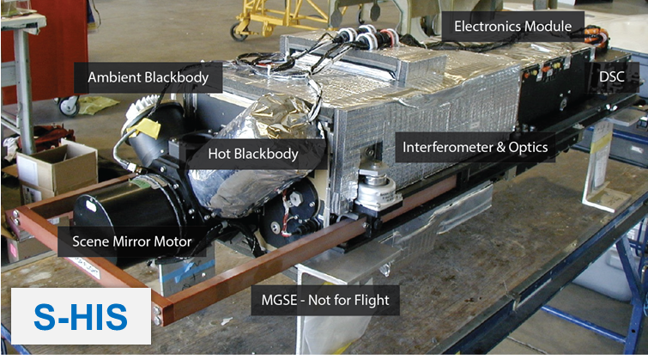
ABI Primary Validation Flights
Fully coordinated: 90 minutes of continuous ABI North-South Scan (NSS) collections concurrent with the ER-2 aircraft based reference sensors over ideal Earth targets
Ocean Mission
Desert Mission

Slide 5
Independent Absolute Validation of ABI Reflective Solar Bands (RSB) All Detectors
ABI NSS vs AVIRISng Comparison (March 28, 2017) – Band Average Results
ABI RSB SI traceability was independently validated (all detectors)
ABI Ch 2 showed larger biases than expected (consistent with previous findings)
ABI Ch 6
ABI Ch 1
ABI Ch 2
ABI Ch 3
ABI Ch 5

Slide 6
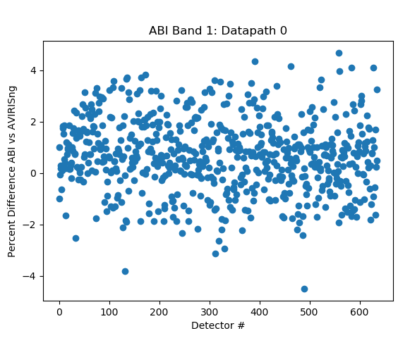
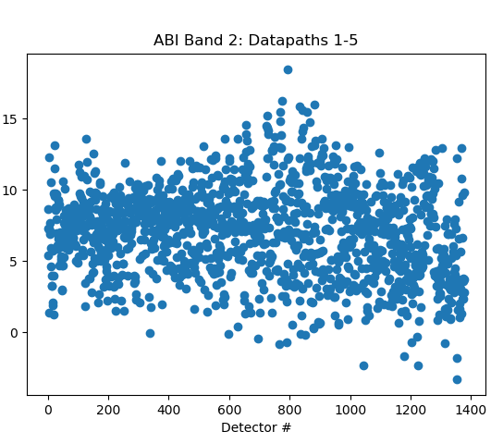
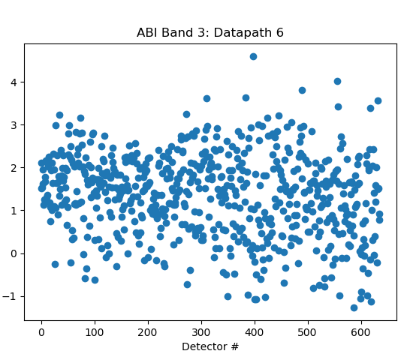
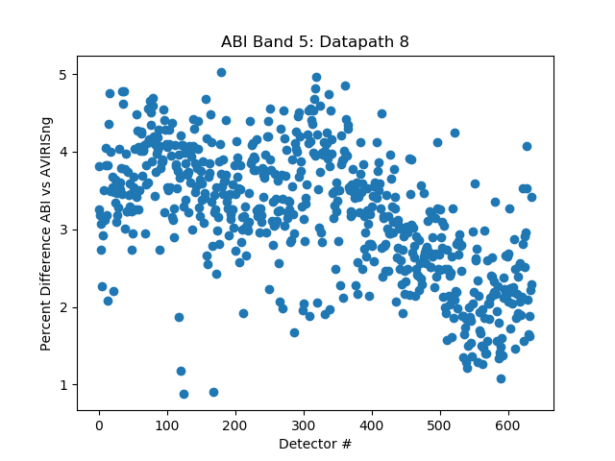
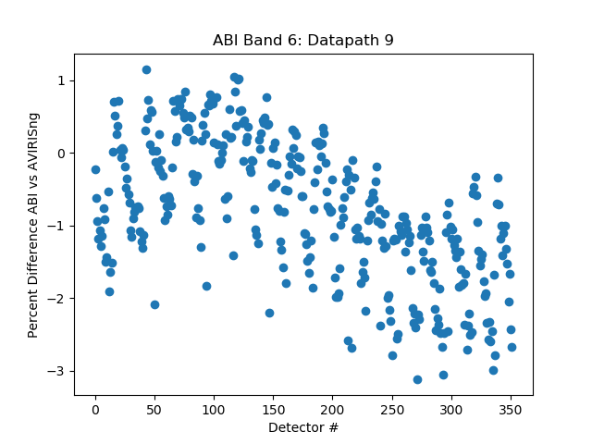
ABI Independent Detector-Level Validation Results:
Sonoran Desert March 28, 2017
ABI Channel 1
ABI Channel 2
ABI Channel 3
ABI Channel 5
ABI Channel 6
ABI detector-level performance showed inter-channel variability ≤ 3 % (k=1) for each channel
Ch 5 & Ch 6 demonstrate some systematic effects to be further investigated

Slide 7

ABI & VIIRS Intercomparison Using AVIRISng as a Reference
March 23, 2017 – Sonoran Desert Mission
ER-2 & S-NPP coincident & collocated nadir overpass of the Sonoran Desert:
Collection provided validation of all NOAA next generation imagers on the same flight
M1
M2
M3
M4
M5
M7
M8
M10
M11
Bias
VIIRS Bands (M1 to M11)

Slide 8
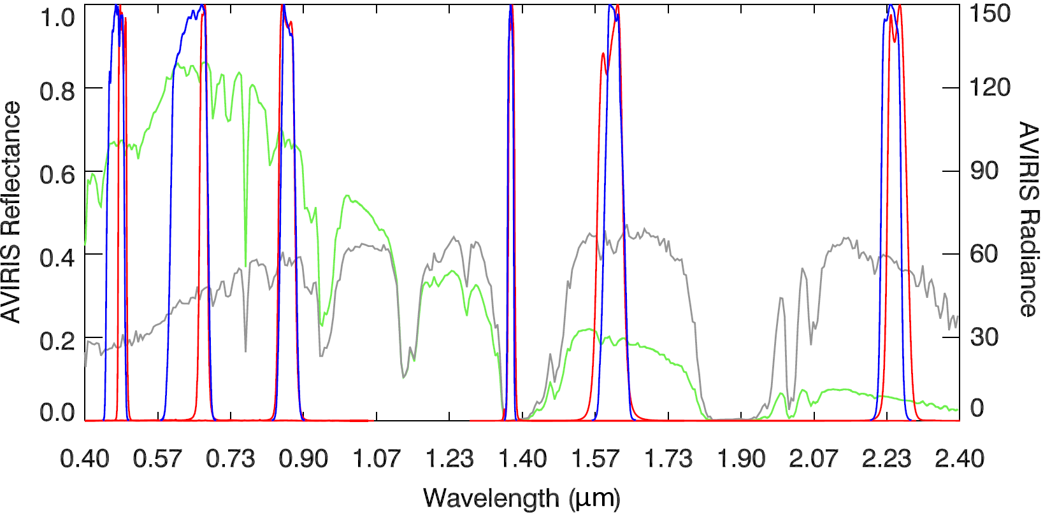
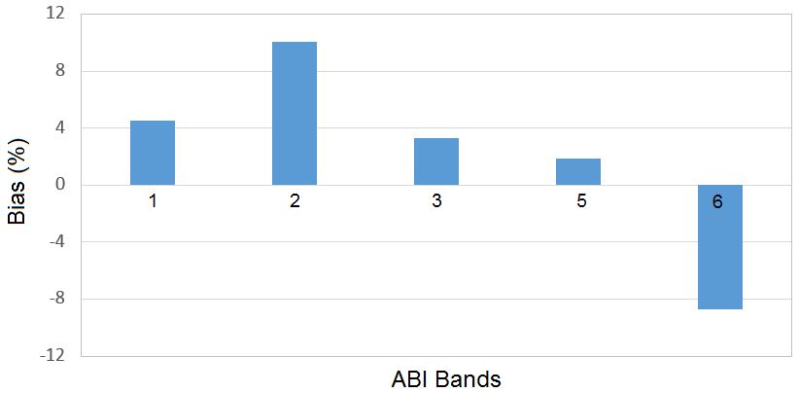
ABI & VIIRS Inter-comparison Using AVIRISng as Reference
VIIRS
ABI
Radiance
(W/[m2-sr-µm])
ABI bias relative to S-NPP VIIRS
Reflectance
VIIRS Data
ABI Bands (µm) | Observed Bias (%) | Spectral Bias using AVIRIS (%) | Actual Bias (%)
1 (0.450 - 0.490) | 4.63 | 0.12 | 4.51
2 (0.590 - 0.690) | 9.65 | -0.44 | 10.09
3 (0.846 - 0.885) | 2.95 | -0.33 | 3.28
5 (1.580 - 1.640) | 1.37 | -0.52 | 1.89
6 (2.225 - 2.275) | -3.35 | 5.38 | -8.73
Bias= (ABI bias relative to AVIRIS) – (VIIRS bias relative to AVIRIS)
AVIRISng is used as a reference standard to compare ABI with VIIRS.
Spectral differences between ABI & VIIRS are taken into account using AVIRISng radiance spectra.
Comparison results consistent with biases previously reported between ABI & S-NPP/VIIRS:
  Investigating larger than expected bias in band 6 – may be related to GEO-LEO collocation pixels used

Slide 9
Preliminary Independent Absolute Validation of ABI Thermal Emissive Bands (TEB)
ABI NSS Data vs S-HIS Comparison (April 13, 2017) – Band Average Results
GOES-R Field Campaign ER-2 Based Instruments
3.90 μm
6.19 μm
6.95 μm
7.34 μm
8.50 μm
9.61 μm
10.35 μm
11.20 μm
12.30 μm
13.30 μm
ABI TEB SI traceability independently validated (obs vs obs) with biases ≤ 1 K
Analysis does NOT YET account for atmospheric contributions above the aircraft (20 km to TOA) which should reduce biases in most channels
CH7
CH8
CH9
CH10
CH11
CH12
CH13
CH14
CH15
CH16
Notes:
Impacts due to viewing altitude are channel dependent (Simulated contributions range from near negligible to 8+ K -- Ex: +/- 0.15 K (Ch 8) to +/- 8.5 K (Ch 12)

Slide 10
ABI Independent Detector-Level Validation Results:
Gulf of Mexico April 13, 2017 - Brightness Temperature Difference [K] (ABI – S-HIS) Rel. 300 K BB
ABI Channel 7
ABI Channel 8
ABI Channel 9
ABI Channel 10
BT Diff. ABI – S-HIS [K]
ABI Channel 11
ABI Channel 12
ABI Channel 13
ABI Channel 14
Ozone Ch. – Atm. above the aircraft not yet accounted for
BT Diff. ABI – S-HIS [K]
ABI Channel 15
ABI Channel 16
ABI detector-level inter-channel performance was found to be band dependent with some systematic effects to be further investigated in some channels
BT Diff. ABI – S-HIS [K]

Slide 11
Independent Validation Summary
  GOES-R ABI detector-level SI traceability has been independently validated post-launch (AVIRISng & S-HIS as references):
    Reflective Solar Bands: bias to reference ≤ 5 % (except ABI Ch.2: ~7% bias)
    Thermal Emissive Bands: bias to reference ≤ 1 K
Deep dive analysis is on-going by multiple teams
Open data access policy:
  Data portal - https://goes-r.nsstc.nasa.gov/home/
  Long-term archive at NCEI/CLASS
Lessons learned:
  Demonstrated the utility of ABI North-South Scans (NSS) to characterize & validate on-orbit detector-level performance
  Recommend that GEO-LEO validation inter-comparison results include a histogram of collocation pixels used (i.e. which detectors used) to track detector-level impacts to ensure traceability
These collections & data sets are unprecedented in geostationary Earth observation & mark a major achievement towards the post-validation of the GOES-R series instruments

