Slide 1
Peer Stakeholder-Product Validation Review (PS-PVR) For the Provisional Maturity of GOES-16 ABI L1b Products
June 1, 2017
GOES-R Calibration Working Group (CWG)
B. Efremova, R. Iacovazzi, V. Kondratovich,
H. Qian, X. Shao, X. Wu, H. Yoo, F. Yu, L. Zhu

Slide 2
Outline
Review of Beta Maturity
Product Quality Evaluation
General approach
Glance of the past, current, and future
IR Calibration
VNIR Calibration
Image Navigation and Registration (INR)
Provisional Maturity Assessment
Path to Full Validation Maturity
Issues and status
PLPT
Risks
Summary and Recommendations
Backup – Highlights of Individual PLPT

Slide 3
Review of Beta Maturity
GOES-16 ABI L1b Products Provisional PS-PVR

Slide 4
Advanced Baseline Imager (ABI)

Slide 5
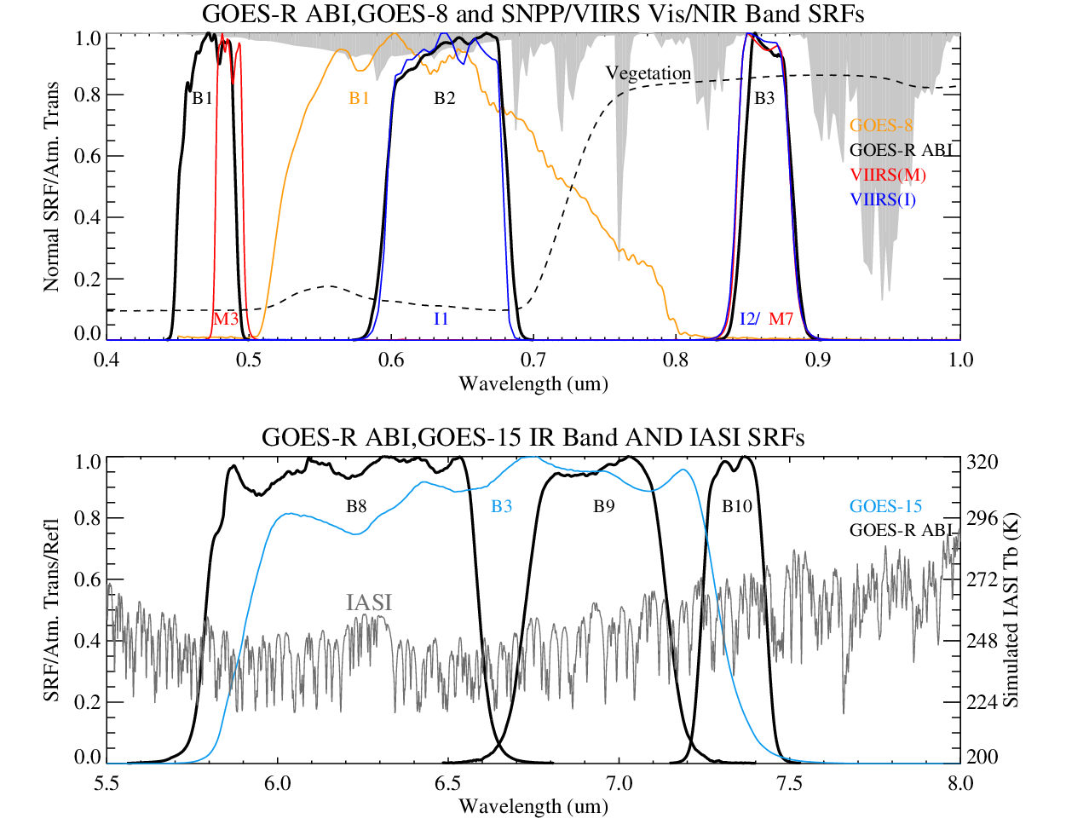
Improvements
Three times more channels
From 5 bands to 16 bands.
Four times finer resolution
IR bands from 4-km to 2-km;
Visible band from 1-km to 0.5 km
Five times faster scan
Full Disk scan from 26 min to 5 min
Six times better quality
Radiometric requirements
SNR for Visible from 100(TBR) to 300
NEdT for IR from 0.35K to 0.1K
Spectral requirements
Narrower by ~half to optimize applications
3×4×5×6 = 100s times performance improvement.

Slide 6
Challenges
100s times more detectors
Massive arrays of detectors
Uniformity, striping
Stitching
Redundancy
Coordinate all those detectors
New paradigm of INR, from “point-aim-shoot” to “shoot-point-process”
Kalman filter, Re-sampling
Onboard calibration for VNIR
Non-trivial to move to geostationary platform
These challenges are directly related to PLAR users experience – INR, VNIR calibration, and striping.

Slide 7
Path to Provisional
Resolve issues (WR)
Complete Post-Launch Product Tests (PLPT).
Watch for risks

Slide 8
Update of WRs Registered Before Beta Maturity (Page 1 of 2)
Product | WR | Description | Build
Radiances | 1552 | Discrepancy in detector rows | DO.04.04
Radiances | 2190 | Different DQF values for "processed space pixels" | DO.06.00
Radiances | 2283 | ABI L1b Calibration Defects (set 2) | DO.05.00
Radiances | 2311 | ABI L1b Algorithm CSC ADD | DO.05.00
Radiances | 2374 | ABI L1b OMAS uses default timestamps incorrectly | DO.05.00
Radiances | 2670 | ICT statistics in Inst_Cal files correction | DO.04.04
Radiances | 2689 | Lunar cal products have wrong instrument ID | DO.05.00
Radiances | 2931 | Missing 5 channels of ABI L1beta | DO.05.00
Radiances | 3305 | Increasing size of saved space look samples | DO.05.00
Radiances | 3408 | SCT calibration coeff not migrated after event | DO.05.00
Radiances | 3452 | Esun variable update | DO.04.04
Legend
Green: Completed
Blue: Upcoming Change In DO Build Release, or DO Build Release Results to be Validated by CWG
Red: Not Completed and Not in Upcoming DO Build Release

Slide 9
Update of WRs Registered Before Beta Maturity (Page 2 of 2)
Product | WR | Description | Build
Radiances | 3600 | Update Spacecraft APID151 handling | DO.05.00
Radiances | 3619 | Create INST_CAL_ENG files – Did not fix problem. | DO.04.03
Radiances | 3641 | ABI Image Navigation using S/C orbit/attitude data | DO.07.00
ABI | 3663 | FTE Scanner Cal file not created during FTE calibration PLT | DO.04.04
Radiances | 3668 | ABI Detector Select Map offsets written incorrectly | DO.06.00
ABI | 3680 | FTE coefficients from GS different from PLEIADES results | Closed
Radiances | 3698 | ABI Inst_Cal_ENG files out-of-order | DO.07.00
ABI | 3746 | Scan mirrors in park position could overheat the ICT | In_Analysis
Radiances | 3773 | Incorrect CDRL 79 resampling kernel implementation | DO.05.00
Radiances | 3776 | CRTM coefficient updates | DO.05.00
ABI | 3785 | ABI Loop Heat Pipe 2 not operating normally | Closed
Radiances | 3786 | ABI L1Beta imagery does not set radiance fill values properly | DO.06.00
ABI | 3803 | ICTs getting hotter than control heaters | Closed
Radiances | 3804 | Bad Radiance-to-Brightness Temperature Conversion Coeff | DO.04.04
Radiances | 3805 | Update radiance-to-brightness temp coefficients | DO.05.00
Radiances | 3824 | Error locating IR star scene | DO 04.03.01
Radiances | 3832 | Switching ABI Meso scenes cause L1b data loss | DO 04.03.01
Radiances | 3888 | ABI imagery shifted after executing desert monitoring timeline | DO.06.00
Radiances | 3892 | ABI L1b filename issue | DO.06.00
Radiances | 3894 | Missing Line 102 in B06 lunar L1alpha images | On-hold
Radiances | 3898 | Anomalous pattern in channel navigation residuals | Closed
Radiances | 3913 | Telemetry in ABI-Inst-Cal-Eng empty | DO.05.00
ABI | 3933 | Vehicle attitude rate induced shear in ABI navigated images | Closed
ABI | 3936 | Gyro rate spikes pass through GNC filter; Kalman errors | FSW 10 June
Radiances | 3953 | The azi nav grids for GOES-16 L1beta swaths are incorrect | DO.06.00
Radiances | 3971 | L1b space pixels marked with “no_value_pixel” in DQF | DO.06.00

Slide 10
Path to Provisional – PLPT
Types of PLPT:
Definitive, once for all.
Continuous, with interim reports at Provisional and Full Validation.
Data collection before Handover and data analysis afterward.
Summary of Status:
Individually, PLPTs are at various stage toward final completion.
Collectively, PLPTs are adequate to support Provisional PS-PVR.
Difference from Post-Launch Acceptance Review (PLAR)
Performance of ABI instrument, tend to use the better L1B data from Post Launch Enhanced Image And Data Evaluation System (PLEIADES)
Quality of ABI L1B data, tend to routinely use all data from Ground System (GS)
Well documented. Will discuss in detail at request.

Slide 11
Path to Provisional – PLPT
Test ID | Short Title | Lead | Status
ABI-L1b-PLPT-001 | IR Validation IASI CrIS | Yu | On Schedule
ABI-L1b-PLPT-002 | IR Validation CRTM | Efremova/Qian | On Schedule
ABI-L1b-PLPT-003 | ZRDQ Performance | Shao | On Schedule
ABI-L1b-PLPT-004 | VNIR Validation VIIRS | Yu | On Schedule
ABI-L1b-PLPT-005 | VNIR Validation Sonora | Yu | On Schedule
ABI-L1b-PLPT-006 | VNIR Validation RVS | Yu | On Schedule
ABI-L1b-PLPT-007 | Monitoring | Iacovazzi | Minor Delay
ABI-L1b-PLPT-008 | AD Converter | Efremova/Wu | Completed
ABI-L1b-PLPT-009 | Low Light SNR | Efremova/Wu | Minor Delay
ABI-L1b-PLPT-010 | Image Navigation | Kondratovich | On Schedule
ABI-L1b-PLPT-011 | Image Registration | Kondratovich | On Schedule
ABI-L1b-PLPT-012 | Image Stitching | Kondratovich | On Schedule
ABI-L1b-PLPT-013 | VNIR Validation DCC | Yu | On Schedule
ABI-L1b-PLPT-014 | Detector Uniformity Stability NSS | Padula/Wu | On Schedule
ABI-L1b-PLPT-015 | Validation SNO NSS | Padula/Wu | On Schedule
ABI-L1b-PLPT-016 | L2 Validation Support NSS | Padula/Wu | Completed
ABI-L1b-PLPT-017 | Lunar NSS | Yu | On Schedule
ABI-L1b-PLPT-018 | Detector Uniformity Investigation | Efremova/Wu | Minor Delay
ABI-L1b-PLPT-019 | Initial Solar Calibration | Efremova/Wu | On Schedule
ABI-L1b-PLPT-020 | IR Spatial Uniformity | Efremova/Wu | Major Delay

Slide 12
Path to Provisional – Risks
Risk Name | Description | Impact | Mitigation and Schedule
Mission Data | IF CWG lack many critical meta data | THEN CWG cannot function properly | Raise awareness Work with Ground and vendor.
Operation Stability | IF corrections for known anomalies cannot be implemented timely | THEN the operation will not reach steady state for evaluation | Raise awareness Work with Ground and vendor.
GRATDAT | IF GRATDAT cannot process the ABI data beyond L1-alpha | THEN CWG cannot perform several PLPTs. | Work with PRO and developer. Develop capability within CWG.

Slide 13
Path to Provisional – Risks
Risk Name | Description | Impact | Mitigation and Schedule
Mission Data | IF CWG lack many critical meta data (unavailable, empty, incomplete, incorrect, and misrepresented) | THEN CWG cannot function properly (IR calibration has been affected) | Raise awareness Work with Ground and vendor.
Operation Stability | IF corrections for known anomalies cannot be implemented timely (has been unstable for VNIR calibration and especially for INR) | THEN the operation will not reach steady state for evaluation (evaluate what were in reality) | Raise awareness Work with Ground and vendor.
GRATDAT | IF GRATDAT cannot process the ABI data beyond L1-alpha (improved over time, but some were too late and some still inadequate) | THEN CWG cannot perform several PLPTs. (delayed some analyses that are not due anyway. Did not affect critical data collection including Field Campaign) | Work with PRO and developer. Develop capability within CWG.

Slide 14
Product quality assessment
GOES-16 ABI L1b Products Provisional PS-PVR

Slide 15
General Approach
Evaluate Performance and Detect Anomaly
Validation, or Product (L1b) Quality Monitoring
Reports from users in the field
Identify Root Cause
Radiometric and geometric calibration via off-line science code.
Instrument Performance Monitoring
Resolve Anomaly
Combination of calibration and validation
Collaboration with users
Coordination with Ground

Slide 16
Top Level Evaluation
 | Past Performance | Current Status | Future Outlook
IR Calibration | Accurate and stable. Acceptable noise, dynamic range, bias, and diurnal stability from beginning. Critical issues: None. | Performance has been good and stable without critical issues. Major remaining issues: PICA Midnight (space look shift?) | Good start Lack of hands-on experience, due to lack of INST-ENG data.
VNIR Calibration | Accurate, but unstable Critical issues: Initial bias Banding and striping 10% bias | Critical issues have been resolved. Overall performance acceptable. B02 bias well known. Major remaining issues: B02 differs from prelaunch ~7% B02 jumped ~4% Striping (nonlinearity?) Decouple solar cal and update | Team expertise. Good understanding of major issues. Good instrument. Need to work on some hard core problems that may require algorithm change
INR | Often inaccurate and unstable. Good first light navigation – good foundation without Kalman filter. Kalman filter works under favorable conditions. Critical issues: Ingest of star data, esp. IR Continuity of coregistration files Gyro spike RDP | Critical issues have been resolved. Recent performance becomes acceptable. Major remaining issues: Stability Large NS navigation accuracy (update RDP). CCR (Channel-to-Channel Registration) | Team expertise. Concept of KF-based INR strategy has been demonstrated. Good understanding of major issues. Corrections are in various stages of implementation in GS. This has been expected as the difficult problem.

Slide 17
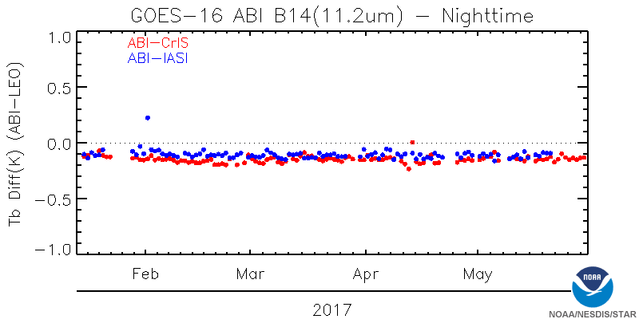
IR Calibration
The most common, important, and widely used
On-orbit Calibration Accuracy | B07 | B08 | B09 | B10 | B11 | B12 | B13 | B14 | B15 | B16
Required (K) | 1 | 1 | 1 | 1 | 1 | 1 | 1 | 1 | 1 | 1
Performance Baseline (K) | 0.87 | 0.64 | 0.66 | 0.65 | 0.61 | 0.61 | 0.62 | 0.64 | 0.68 | 0.71
On-Orbit (K) | -0.19 | -0.32 | -0.32 | -0.24 | -0.24 | -0.21 | -0.21 | -0.14 | -0.12 | -0.28
Notes:
Performance Baseline from PORD082 results

Slide 18
IR Calibration
Issue | Cause | Status
Striping | Incorrect BDS | Resolved Feb 19.
Periodic IR Calibration Anomaly (PICA) | Space look timing and position? | Under Investigation
Minor discontinuity around noon and midnight | Space look side shift? | Under Investigation
Precise, accurate, and stable (though not yet long term).

Slide 19
VNIR Calibration
Sol Cal anomaly in mid-Feb
Sol Cal anomaly 3/16 – 4/28
Reasonably accurate, but not quite stable.

Slide 20
VNIR Calibration
 | B01 | B02 | B03 | B04 | B05 | B06
Required | 5% | 5% | 5% | 5% | 5% | 5%
Perf. Baseline | 3% | 3% | 3% | 4% | 3% | 3%
On-Orbit | 4.2% | 7.3% | 1.7% | -5.0% | 4.5% | -0.2%
Pre-Launch | -0.9% | 7.2% | 1.2% | -8.7% | 1.8% | 3.4%
Notes:
Performance Baseline from PORD082 results, rounded to integer percent. Actual values from Performance Baseline report:
B01: 2.71%
B02: 2.53%
B03: 2.39%
B04: 3.77%
B05: 2.74%
B06: 2.71%

Slide 21
VNIR Calibration
Issue | Cause | Status
Large bias, all bands. | Outdated LUT | Resolved Jan 15.
Banding and striping, all bands. | Reversed order in a LUT | Resolved Mar 16.
~10% brighter since Mar 16. | Incorrect integration time | Resolved Apr 29.
Solar cal stability | Not at the fixed sidereal time. | In progress
Solar cal stability | No human-in-the-loop | In progress
Stray light at night | No requirement. | In progress
B02 ~4% brighter since Mar 16. | Operational? | Under Investigation
Striping | Nonlinear cal coefficients? | Under Investigation
B02 is ~7% brighter than prelaunch | Unknown | Under Investigation
Precise, accurate, and becoming stable.

Slide 22
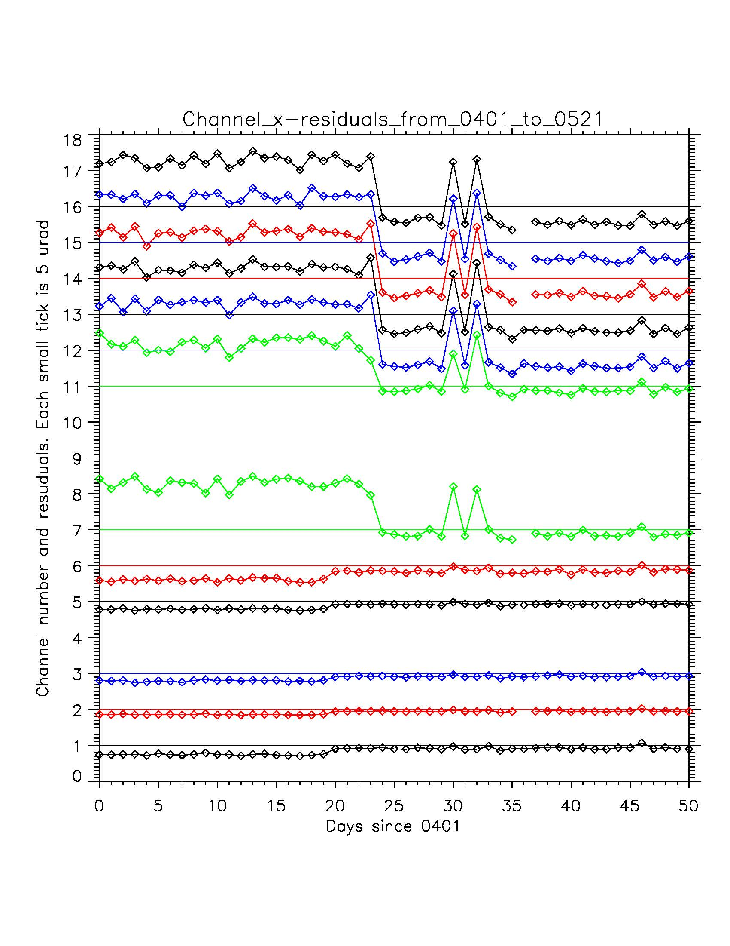
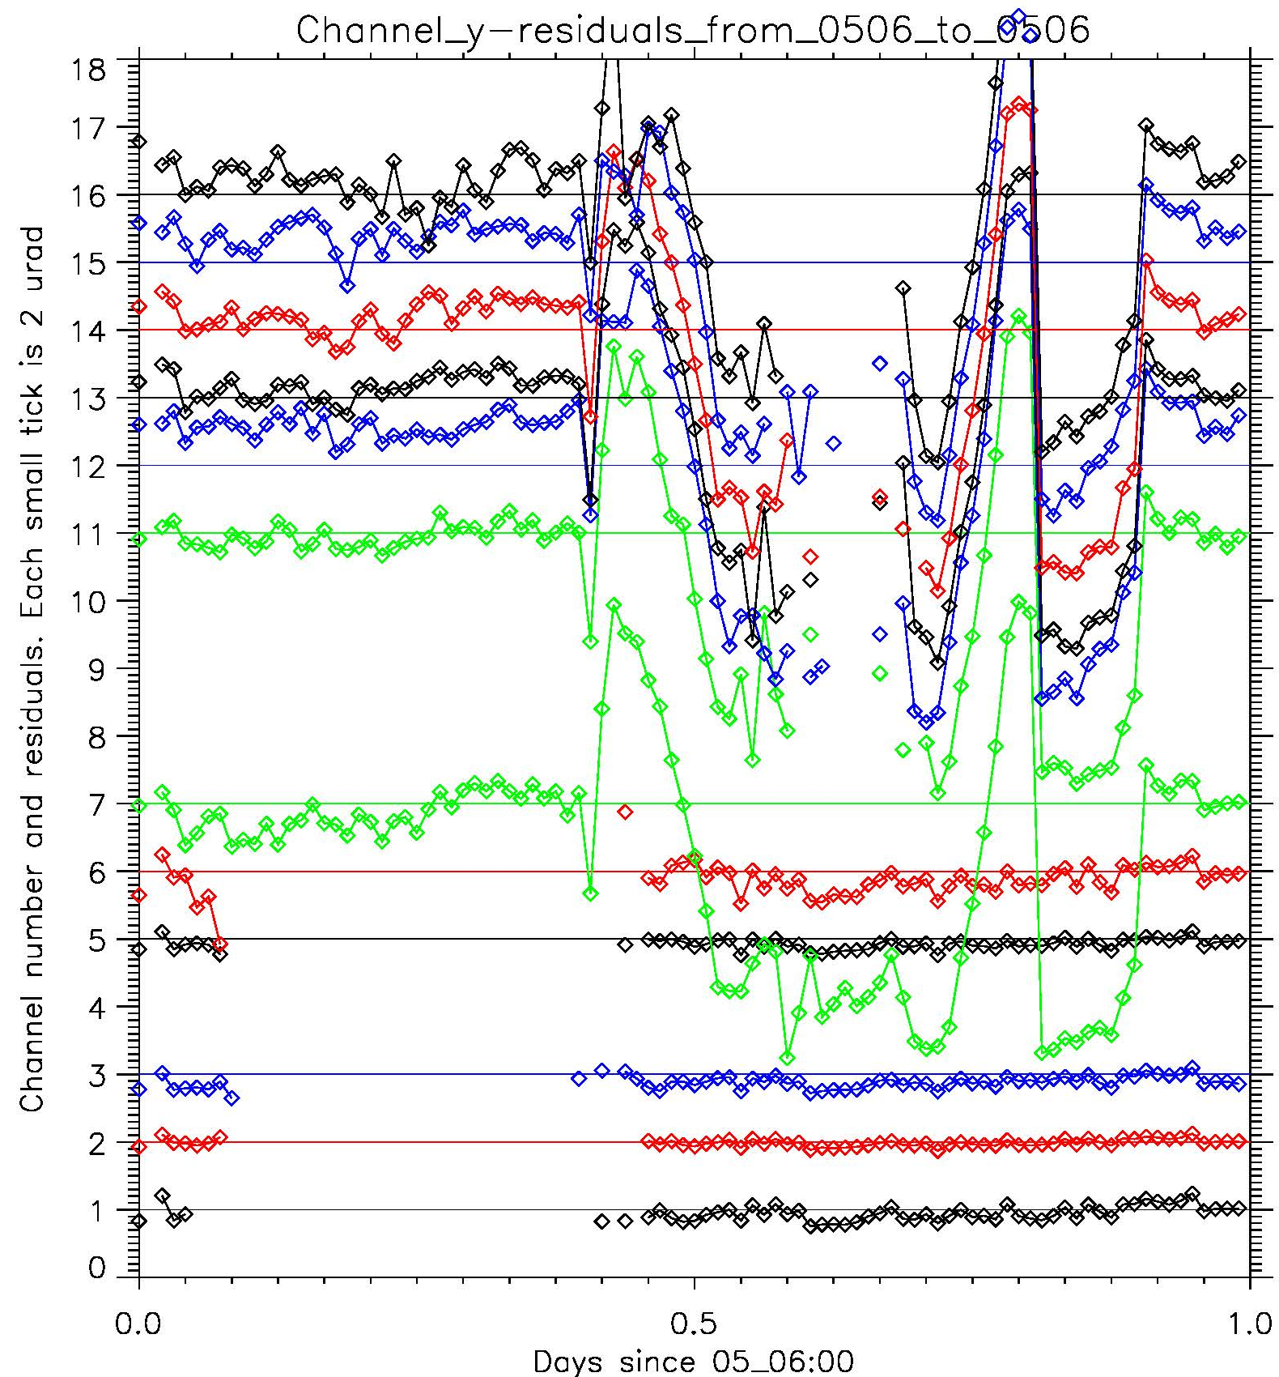
INR: Navigation (x-direction)

Slide 23
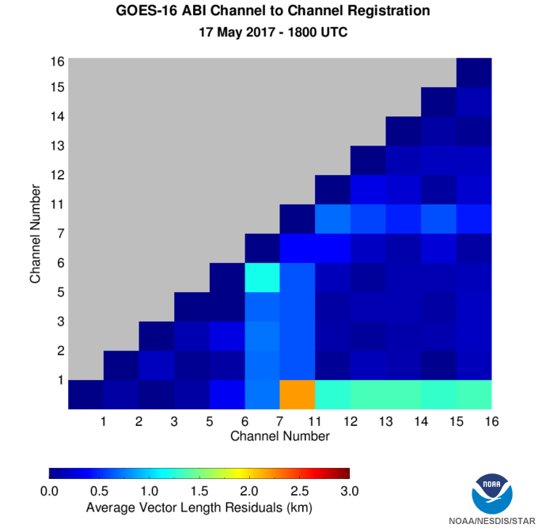
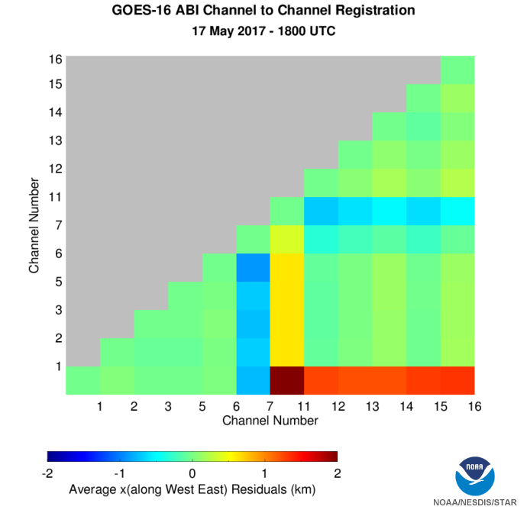
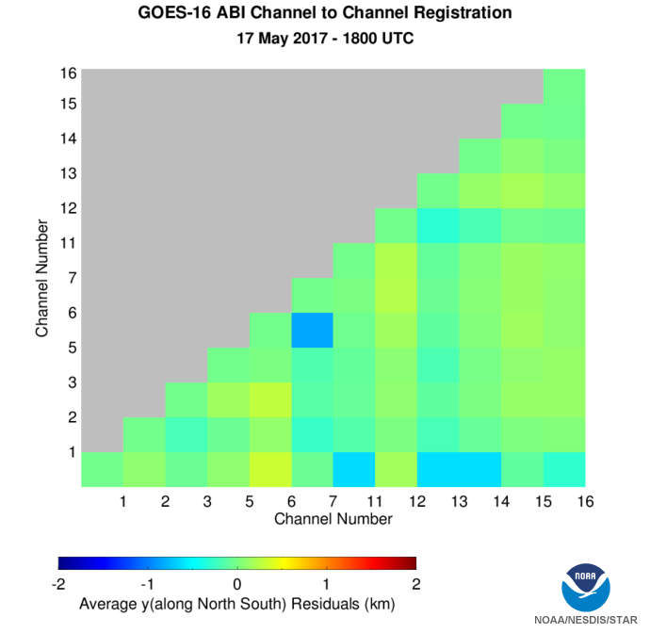
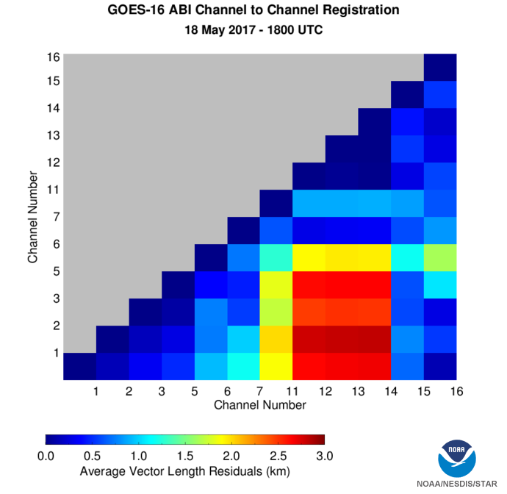
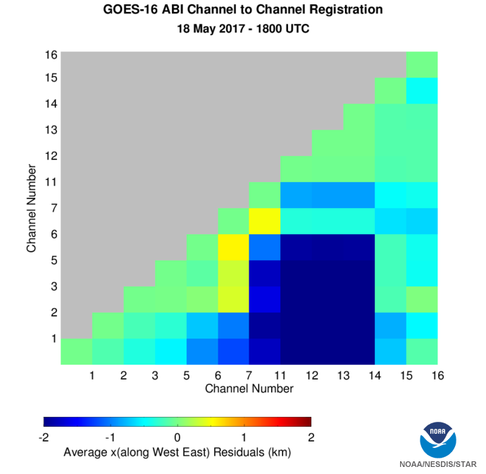
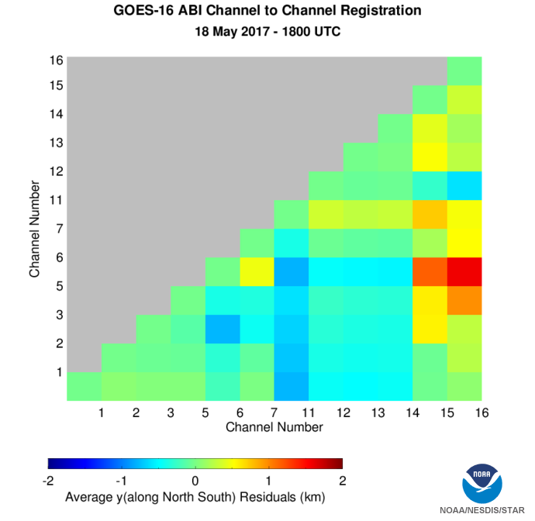
INR: Channel-to-Channel
Sometimes acceptable, but not stable.
Notes:
Legend: Vector length of Channel-to-Channel Registration residuals is color-coded from 0 to 84 urad. Colors are applied to the squares defined by participating channels. X- and Y-residuals are displayed in the range from -56 to +56 urad.
Lower row shows retrieval uncertainties. They are less than 1 km, mostly less than 0.5 km.
Observations: Inter-FPA CCR is still out of range because of large LWIR x-residuals.

Slide 24
INR
Dates | Event | Comments
Jan 08 – Jan 14 | First Light for B01-B03 (Jan 08), then all bands (Jan 14). | Satisfactory initial INR without KF, indicating good S/C GNC & alignment
Jan 15 – Feb 20 | KF with inadequate star data ingest, especially for IR. | Deteriorated INR due to non-converging KF.
Feb 13 | EPP Lock release, reduced jitter. | Improved SSR for B02, especially N-S direction.
Feb 20 – Mar 27 | Star data ingest stabilized. | Improved INR overall.
Mar 27 – Apr 24 | Automatic and frequent KF reset | Deteriorated INR due to non-converging KF.
Apr 21 – Present | Maintained the continuity of coregistration files | Improved INR overall.
June 5-6 | Gyro spike Flight Software update | Improve stability.
In Near Future | Delta-RDP | Reduce image rotation
Notes:
GS: Ground System.
KF: Kalman filter
RDP: Relative Detector Position.
S/C: Space Craft.
GNC: Guidance, Navigation, and Control.
SSR: Swath-to-Swath Registration.

Slide 25
INR
Less mature than calibration overall, as expected.

Slide 26
Provisional Maturity Assessment
GOES-16 ABI L1b Products Provisional PS-PVR

Slide 27
Provisional Validation
Preparation Activities | Assessment
Validation activities are ongoing and the general research community is now encouraged to participate. | Validation activities are ongoing. The general research community has been participating and providing feedback.
Severe algorithm anomalies are identified and under analysis. Solutions to anomalies are in development and testing. | Operational and algorithm anomalies have been identified. Critical ones have been resolved; others in various stages of implementation; a few under investigation.
Incremental product improvements may still be occurring. | Incremental product improvements are expected.

Slide 28
Provisional Validation
End State | Assessment
Product performance has been demonstrated through analysis of a small number of independent measurements obtained from select locations, periods, and associated ground truth or field campaign efforts. | This has been demonstrated.
Product analysis is sufficient to communicate product performance to users relative to expectations (Performance Baseline). | This has been communicated in PS-PVR.
Documentation of product performance exists that includes recommended remediation strategies for all anomalies and weaknesses. Any algorithm changes associated with severe anomalies have been documented, implemented, tested, and shared with the user community. | These have been documented, for example test report and ReadMe file.
Testing has been fully documented. | Testing has been fully documented in PLPT Report.
Product is ready for operational use and for use in comprehensive cal/val activities and product optimization. | We concur.

Slide 29
Recommendation
CWG believes that the GOES-16 ABI L1b products has reached the Provisional Maturity as defined by the GOES-R Program.

Slide 30
Path to full Validation Maturity
GOES-16 ABI L1b Products Provisional PS-PVR

Slide 31
Impacting Radiometric Calibration ADRs/WRs Page (1 of 2)
ADR# | WR# | Short Description | Status | Expected Closure
193 | 3773 | Incorrect CDRL 79 resampling kernel implementation | AART | DO.05.00.00
208 | 3824 | Band 12 striping | CWG | DO.04.03.01
209 | 3831 | ABI thermal channel space view anomalies | CWG | WR In-analysis
226 | 4016 | Swapped order of solar diffuser K-coefficients | AART | OCCR Fix and DO.05.00 BL
254 |  | Positive radiance bias (9%) in ABI B02 | CWG | Update 1JUL17
288 |  | ABI-Mode3 CONUS thermal IR radiance variation | CWG | Update 1JUL17
289 | 4005 | Band02 striping | CWG | DO.05.00.01
290 | 2710 | ABI solar cal time deviates from best opportunity | AART | Hold until post-MM.05.00 test
299 |  | Cold bias around Fire | CWG | Update 1JUL17
301 |  | Discontinuity of 4% in Channel 2 gain | CWG | Update 1JUL17

Slide 32
Impacting Radiometric Calibration ADRs/WRs Page (2 of 2)
ADR# | WR# | Short Description | Status | Expected Closure
331 |  | Clipped or missing ABI moon images | CWG | Revisit 19JUN17
343 | 4564 | Incorrect "t" (time variable) values in Lunar L1alpha B02 files | AART | WR In-analysis
360 | 4602 | ABI CDRL-0079-2F calibration data books PFM | AART | LUTs delivered 24MAY17
362 |  | Band-07 striping | AART | Revisit 6JUN17

Slide 33
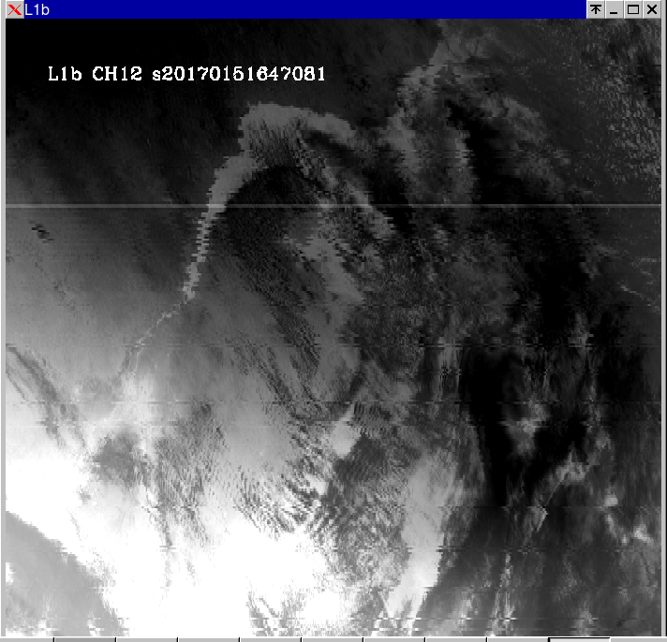
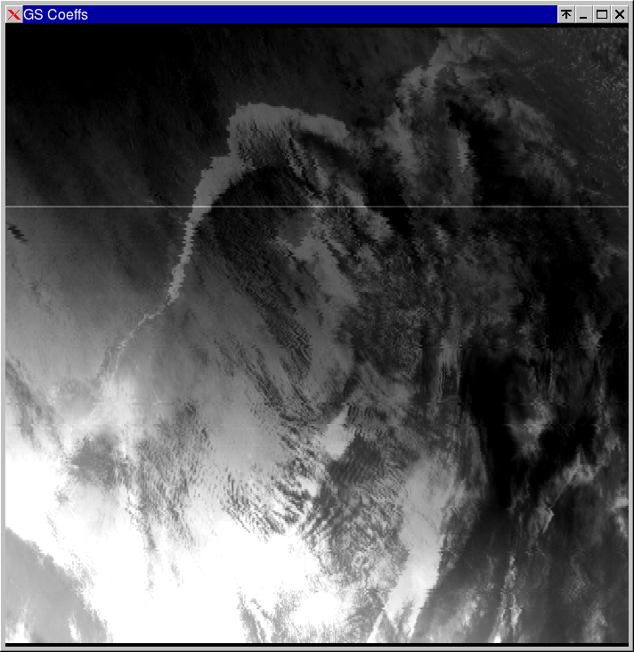
ARD-208: Band-12 Striping
L1b Jan 15 2017 16:47Z
L1alpha offline cal - GS coefficients
D#234

Slide 34
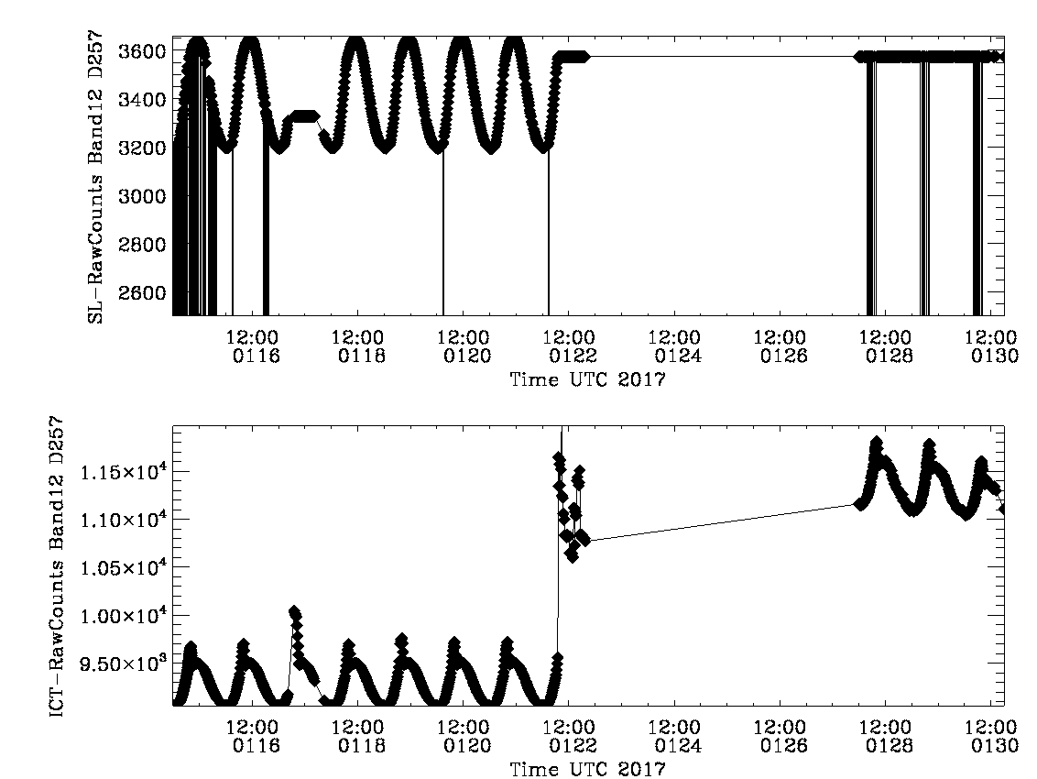
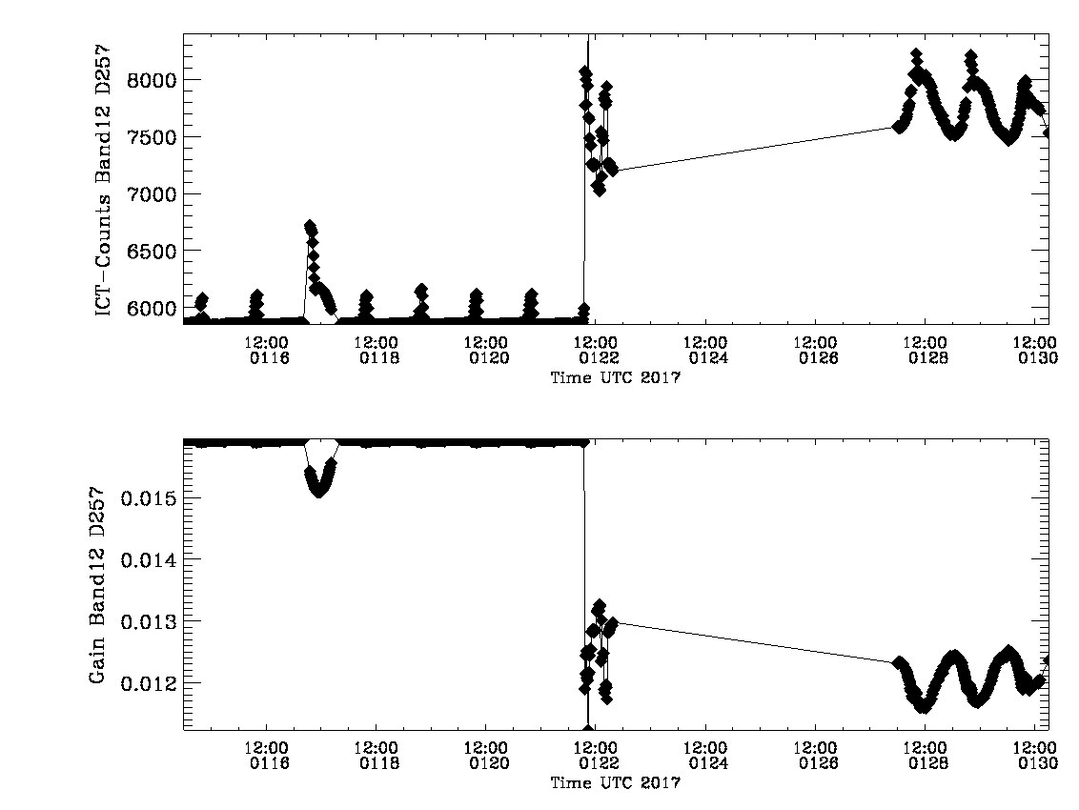
ADR-209 ABI Thermal Channel Space View Anomalies
“Spacelook_mean” anomaly on Jan 17 creates a gain anomaly for all detectors of all thermal channels of over 5% for some channels
“spacelook_mean”= 3573.4688
34
“gain”

Slide 35
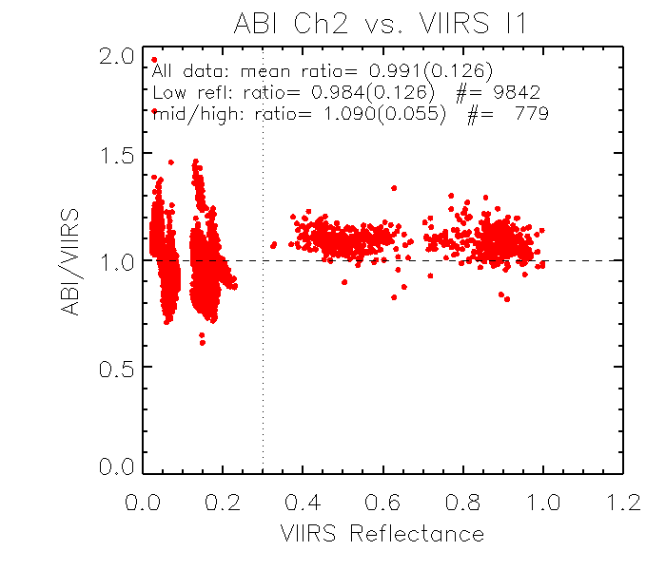
ADR-254 Positive Radiance Bias (9%) in ABI B02
ABI vs. VIIRS Collocated Reflectance Ratio (Feb 19-25, 2017)

Slide 36
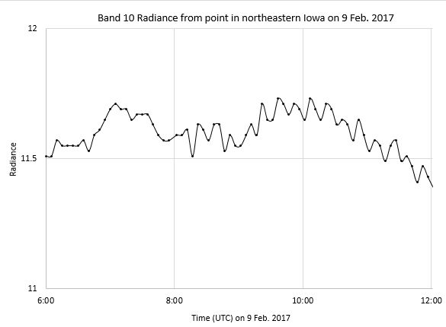
ADR-288 ABI-Mode3 CONUS Thermal IR Radiance
RAMMB Example of Periodic IR Calibration Anomaly (PICA)

Slide 37
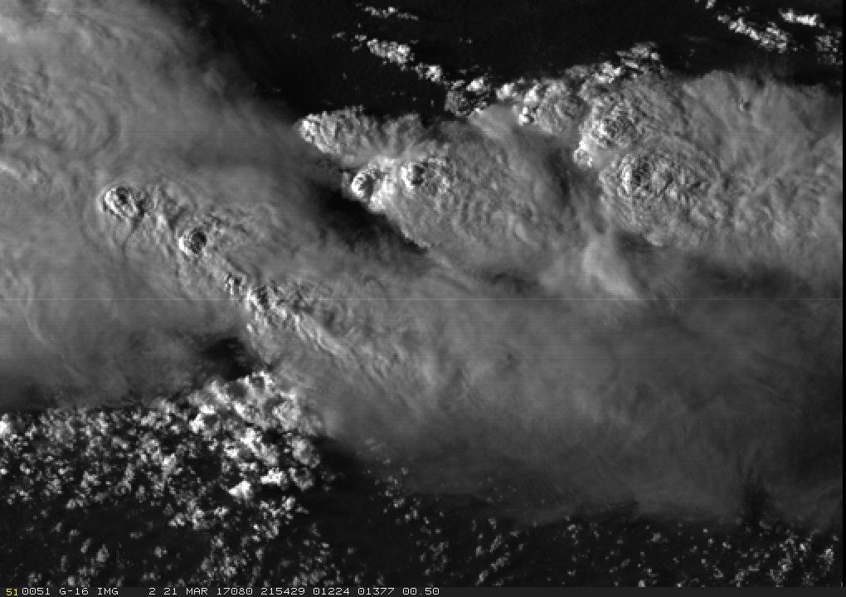
ADR-289 Band02 Striping
Less extreme stripes do exist and can be seen most easily with relatively large reflectances
Some stripes more significant than others
Band 2
21 March 2017
Mitigation: WR4005 in patch DO.05.00.01 (to be released with DO.05.00.00)

Slide 38
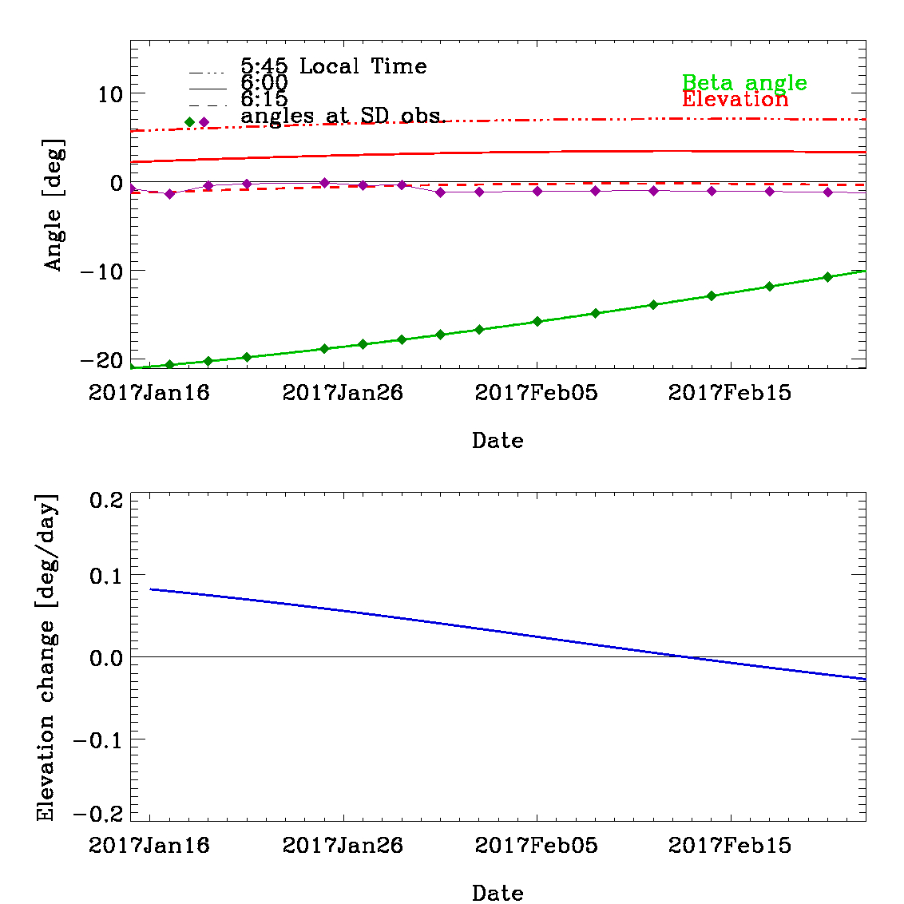
ADR-290 ABI Solar Cal Time Deviates from Best Opportunity
Mitigation: MM.05 update allows for SCT to occur at fixed local (satellite) solar time. To be tested.
Tested Geometry
On-orbit Observation

Slide 39
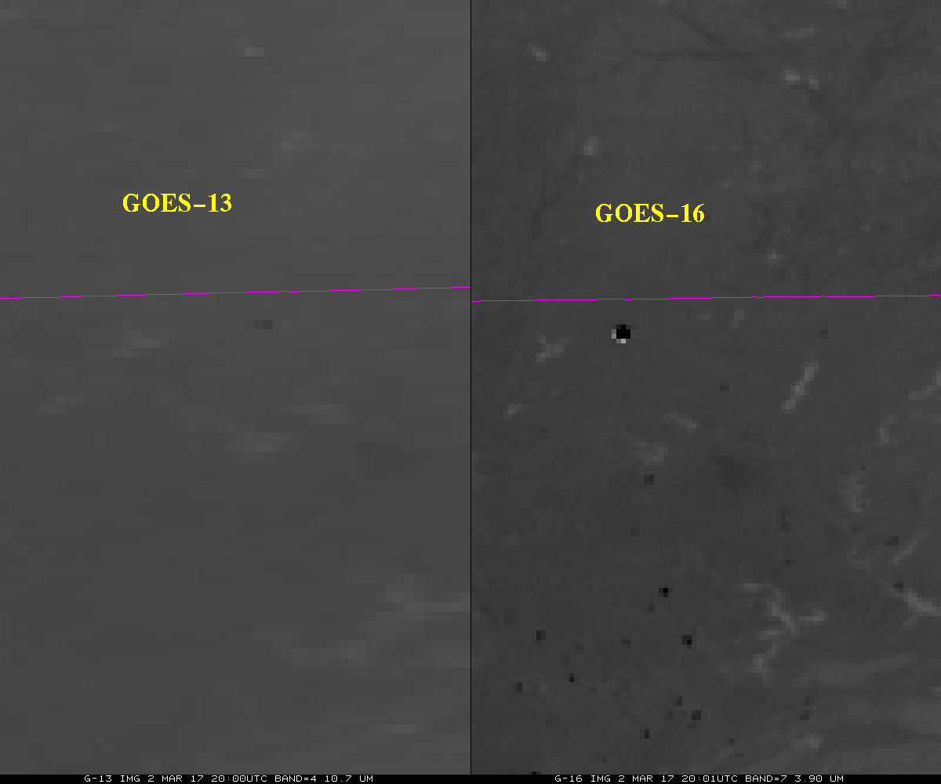
ADR-299 Cold Bias Around Fire
Cold bias is observed in channel 7 (3.9 micron) image (inverted grayscale).

Slide 40
ADR-301 Discontinuity of 4% in Channel 2 Gain
11%
11%
11%
4% discontinuity after Mar 16th.
ADR286, WR4301

Slide 41
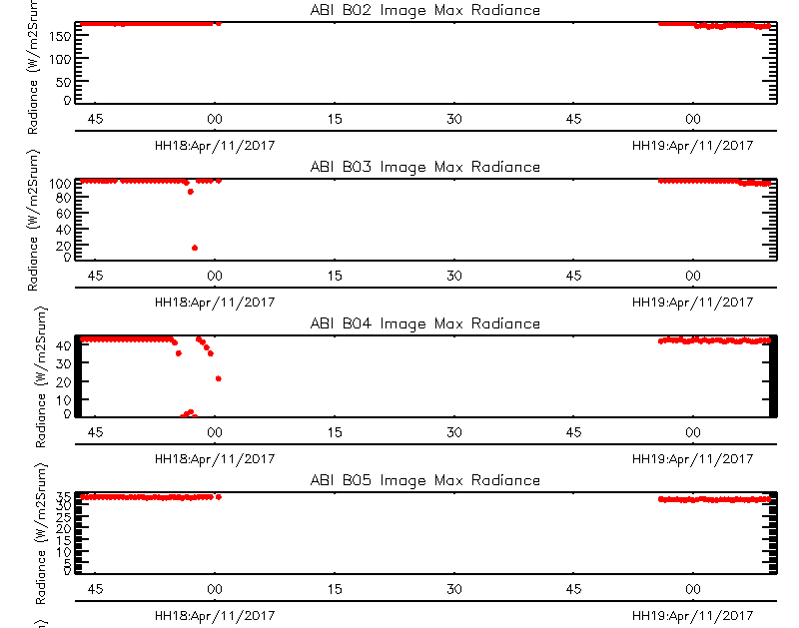
ADR-331 Clipped or Missing ABI Moon Images
April 11, 2017
Earth Occultation
Mitigation: More frequent meso center shifts during June 2017 tracing

Slide 42
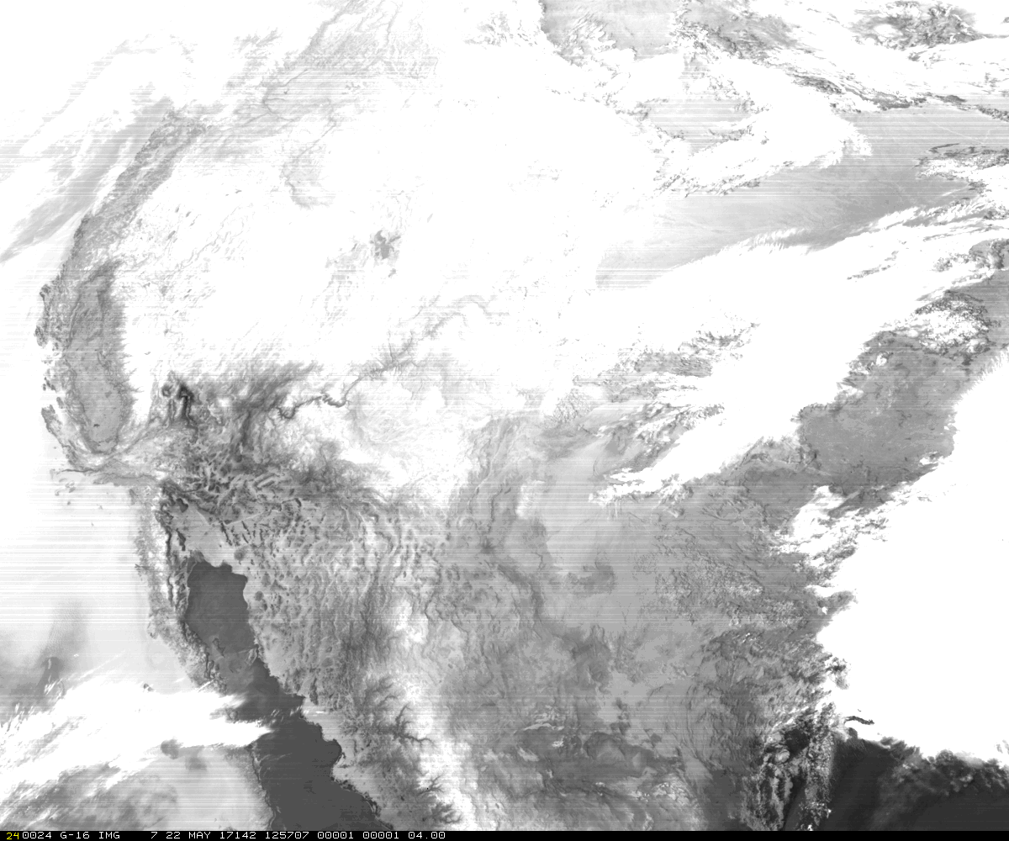
ADR-362 Band07 Striping
GOES-16 Band 7 Image from 22 May 2017 at 12:57:07 UTC

Slide 43
Impacting Geometric Calibration ADRs/WRs
ADR# | WR# | Short Description | Status | Expected Closure
275 | 4187 | Anomalous EW navigation biases | AART | DO.06.00
294 | 4304 | Recurring swings in ABI image navigation | AART | DO.06.00
295 | 4304 | Anomalous FFR errors in MWIR and LWIR Channels | AART | DO.06.00
296 | 4304 | Large SSR errors in ABI MWIR and LWIR channels | AART | DO.06.00
300 | 3888 | Large navigation error in ABI MESO scan | AART | New Residual WRs Will be Needed for PP
319 |  | Large nav error in ABI MESO scan after empty frame | CWG | TBD
351 |  | Large NS swings in ABI image navigation | AART | TBD

Slide 44
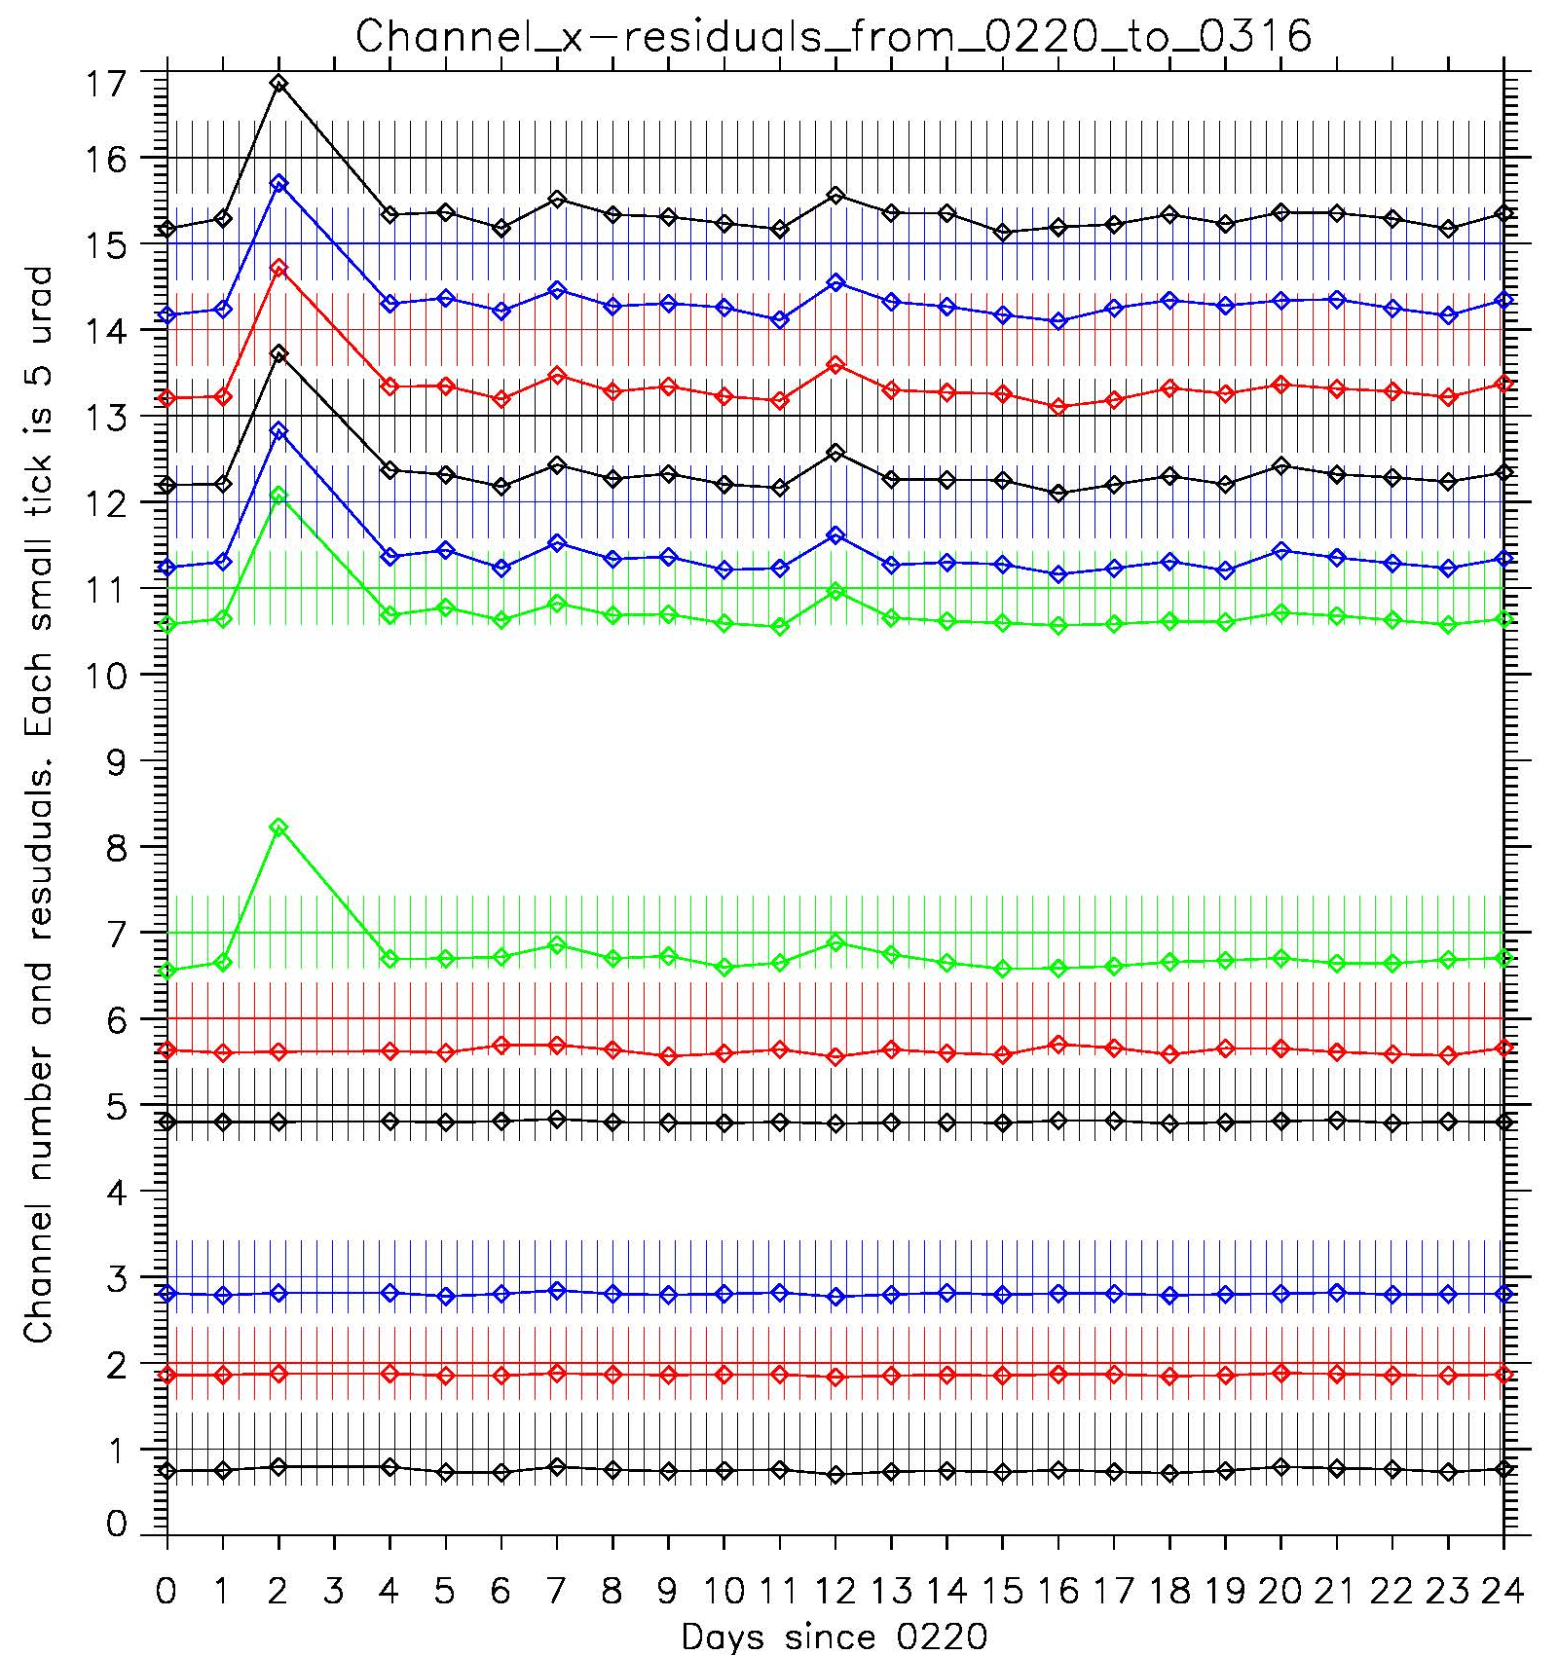
ADR-275 Anomalous EW Navigation Biases
Channel X-Residuals (East-West)
Legend:
- X-residuals for all window channels are plotted at different heights corresponding to the channel number.
- Zero residual corresponds to the straight horizontal line. Positive residuals deviate upward, negative – downward. The distance between lines correspond to 50 μrad (≈ 2 km).
Different colors are used to distinguish neighboring lines. Green is used for MWIR channels.
Vertical bars outline PORD requirement of ±21 μrad

Slide 45
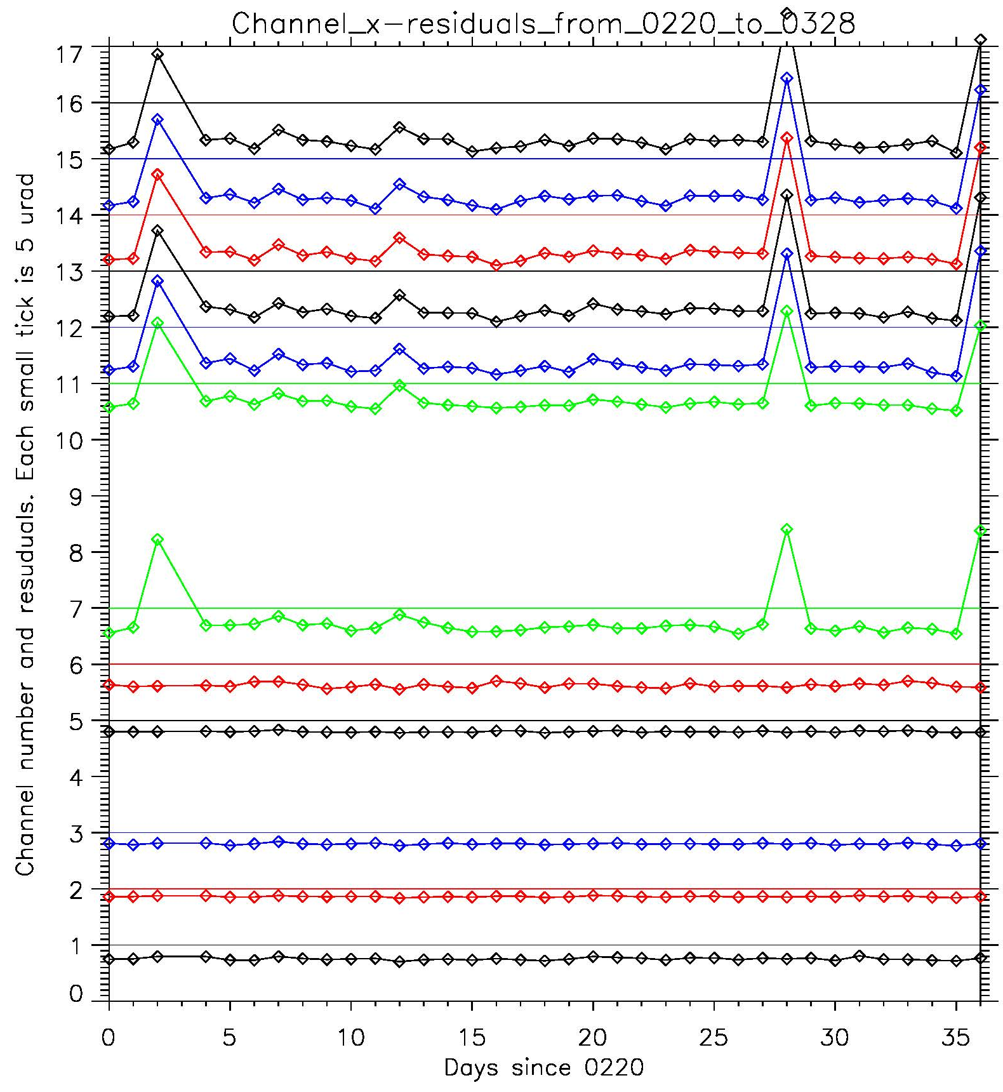
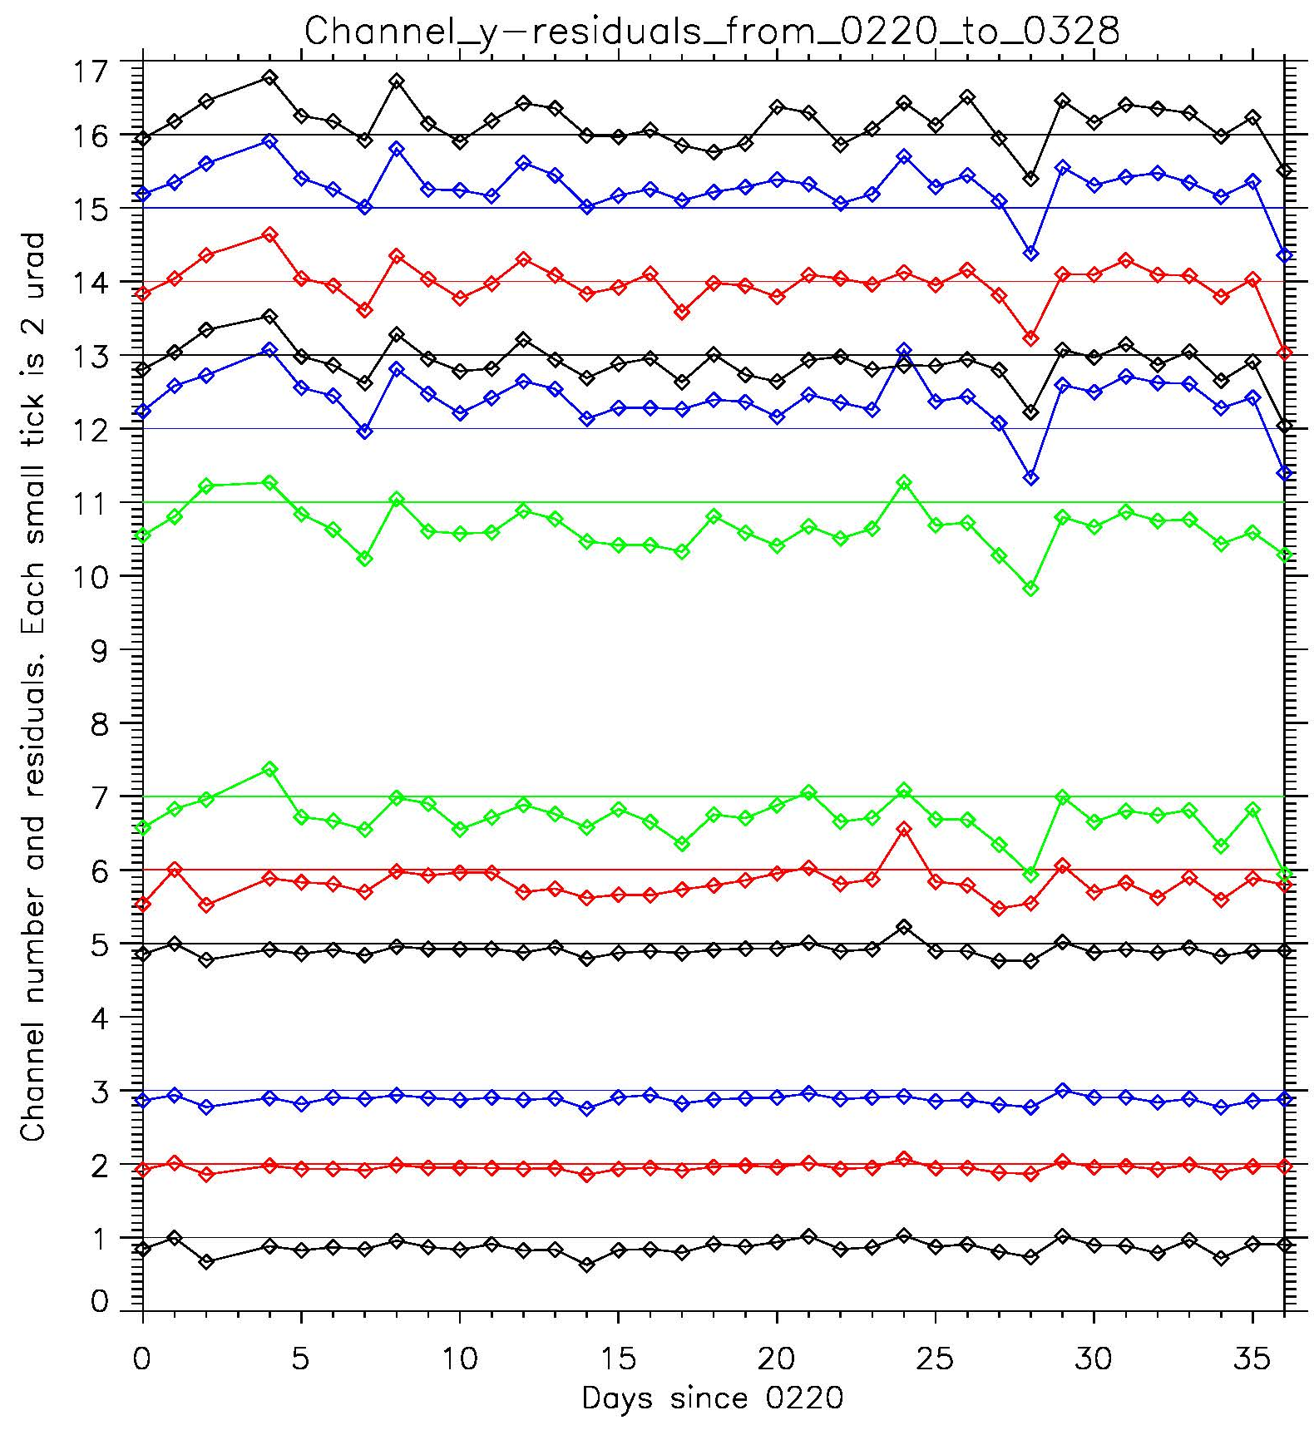
ADR-294 Recurring Swings in ABI Image Navigation
X-Residuals (East-West)
Y-Residuals (North-South)
Legend:
- X-residuals for all window channels are plotted at different heights corresponding to the channel number.
- Zero residual corresponds to the straight horizontal line. Positive residuals deviate upward, negative – downward. The distance between lines correspond to 50 μrad (≈ 2 km).
Different colors are used to distinguish neighboring lines. Green is used for MWIR channels.
Vertical bars outline PORD requirement of ±21 μrad

Slide 46
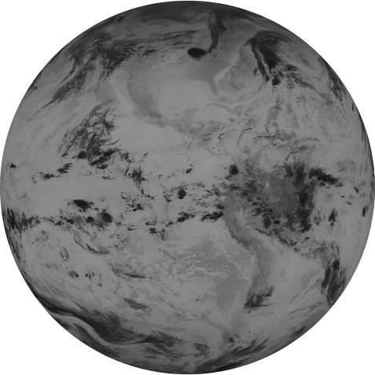
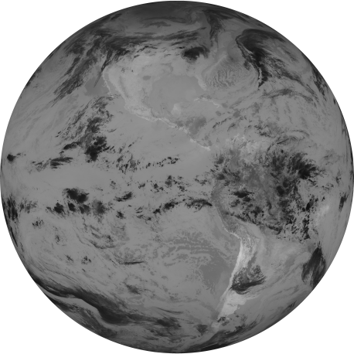
ADR-295 Anomalous FFR Errors in MWIR and LWIR Channels
FD Image Distortion at Anomaly onset, March 20 11:36 UTC
11:21 UTC
11:36 UTC
11:51 UTC
Channel 14
Channel 6
Channel 11
11:36 UTC
11:36 UTC
X-residual change in the MWIR and LWIR channels leads to a partial (March 20 11:36) or complete (February 22 and March 27 19:00) image distortion.
VNIR channels are not distorted, though they suffer the same damage/outage as the MWIR and LWIR channels.

Slide 47
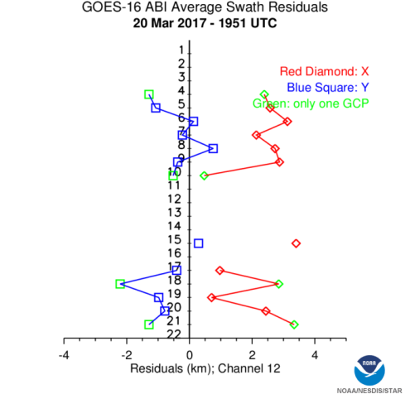
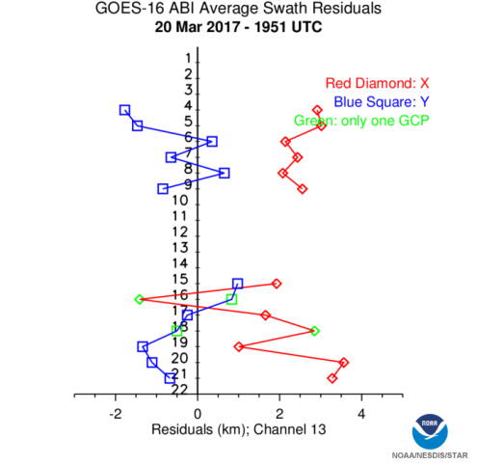
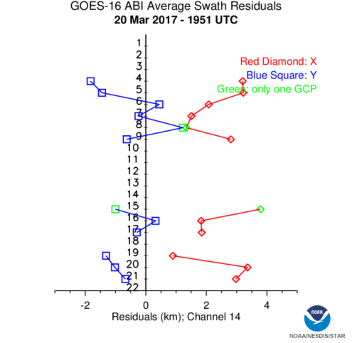
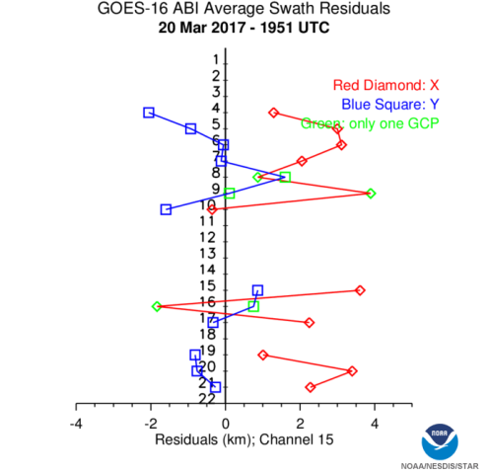
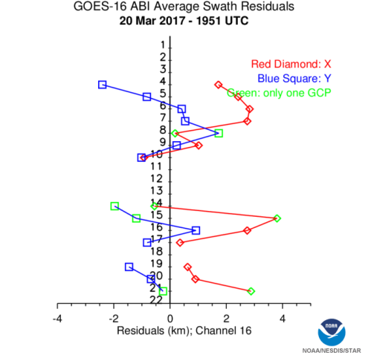
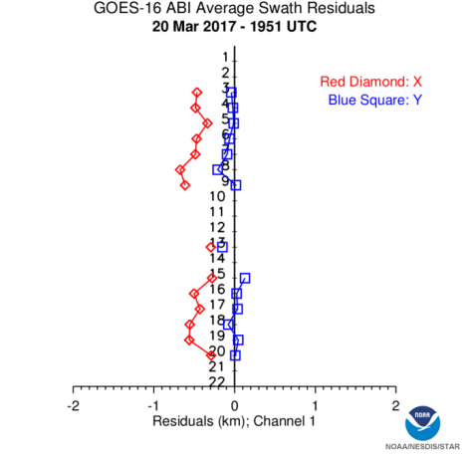
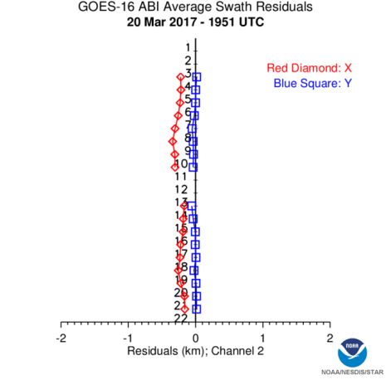
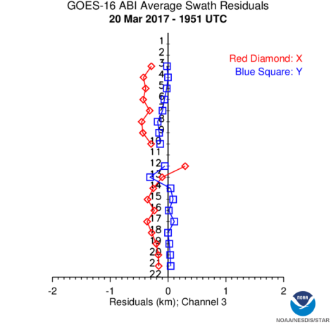
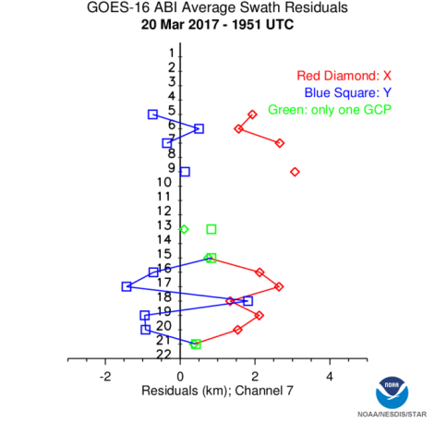
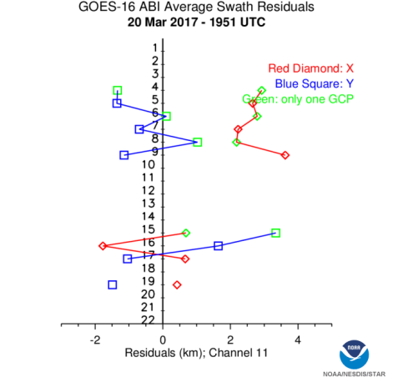
ADR-296 Large SSR Errors in ABI MWIR and LWIR Channels
Swath Residual Behavior, Navigation-Swing Anomaly, March 20 19:51 UTC
LWIR
Channel 12
Channel 13
Channel 14
Channel 15
Channel 16
VNIR
Channel 1
Channel 2
Channel 3
MWIR
Channel 7
Channel 11
Legend: Landmark residuals are averaged by swaths and plotted with respect to the vertical line with swath numbers on it. Red diamonds denote x-residuals, blue squares are y-residuals. If a swath contains only one working landmark, it is plotted green.

Slide 48
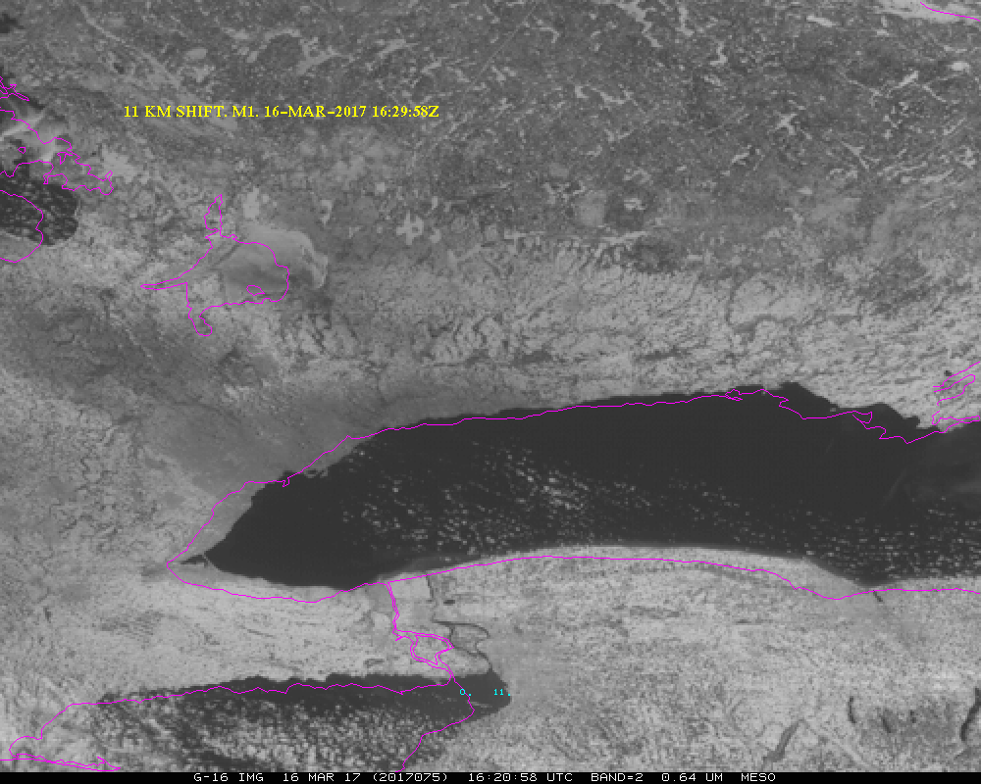
ADR-300 Large Navigation Error in ABI MESO Scan
GOES-16 Band 2 Image from 16 March 2017 at 16:20:58 UTC

Slide 49
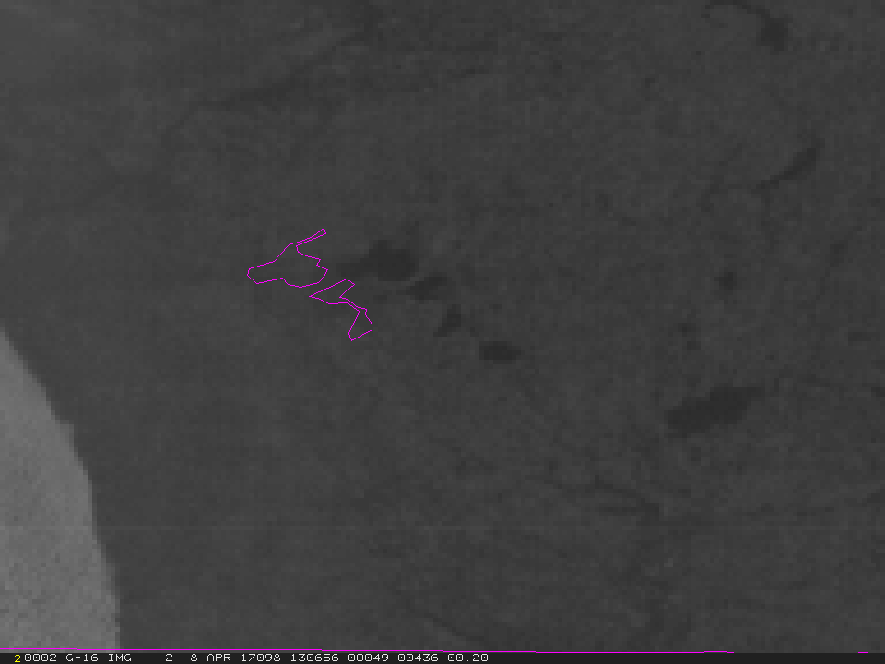
ADR-319 Large Navigation Error in ABI MESO Scan After Empty Frame
GOES-16 Band 2 Image from 8 April 2017 at 13:06:56 UTC

Slide 50
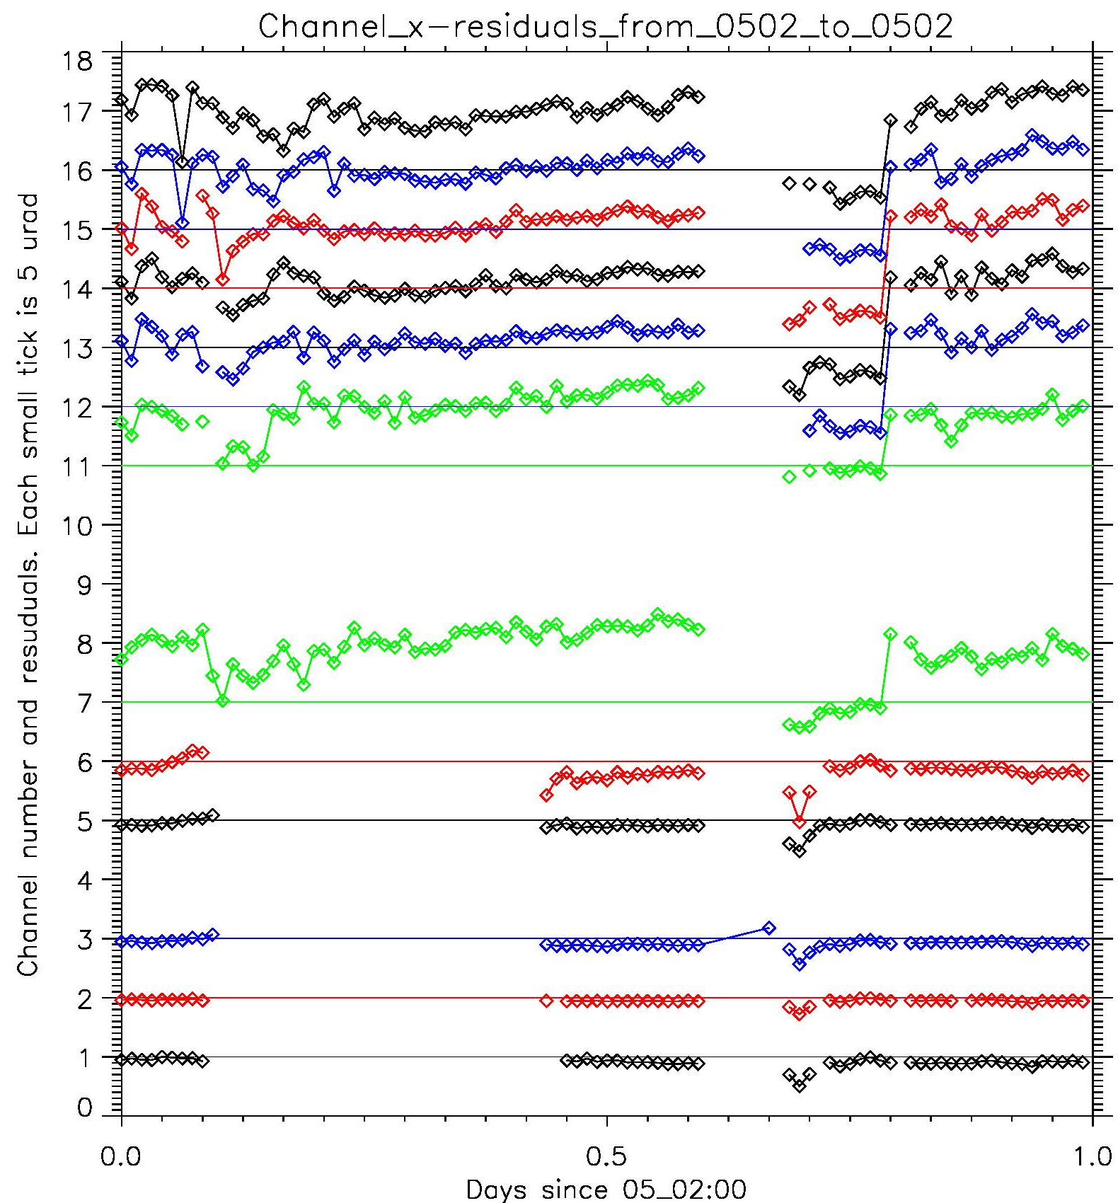
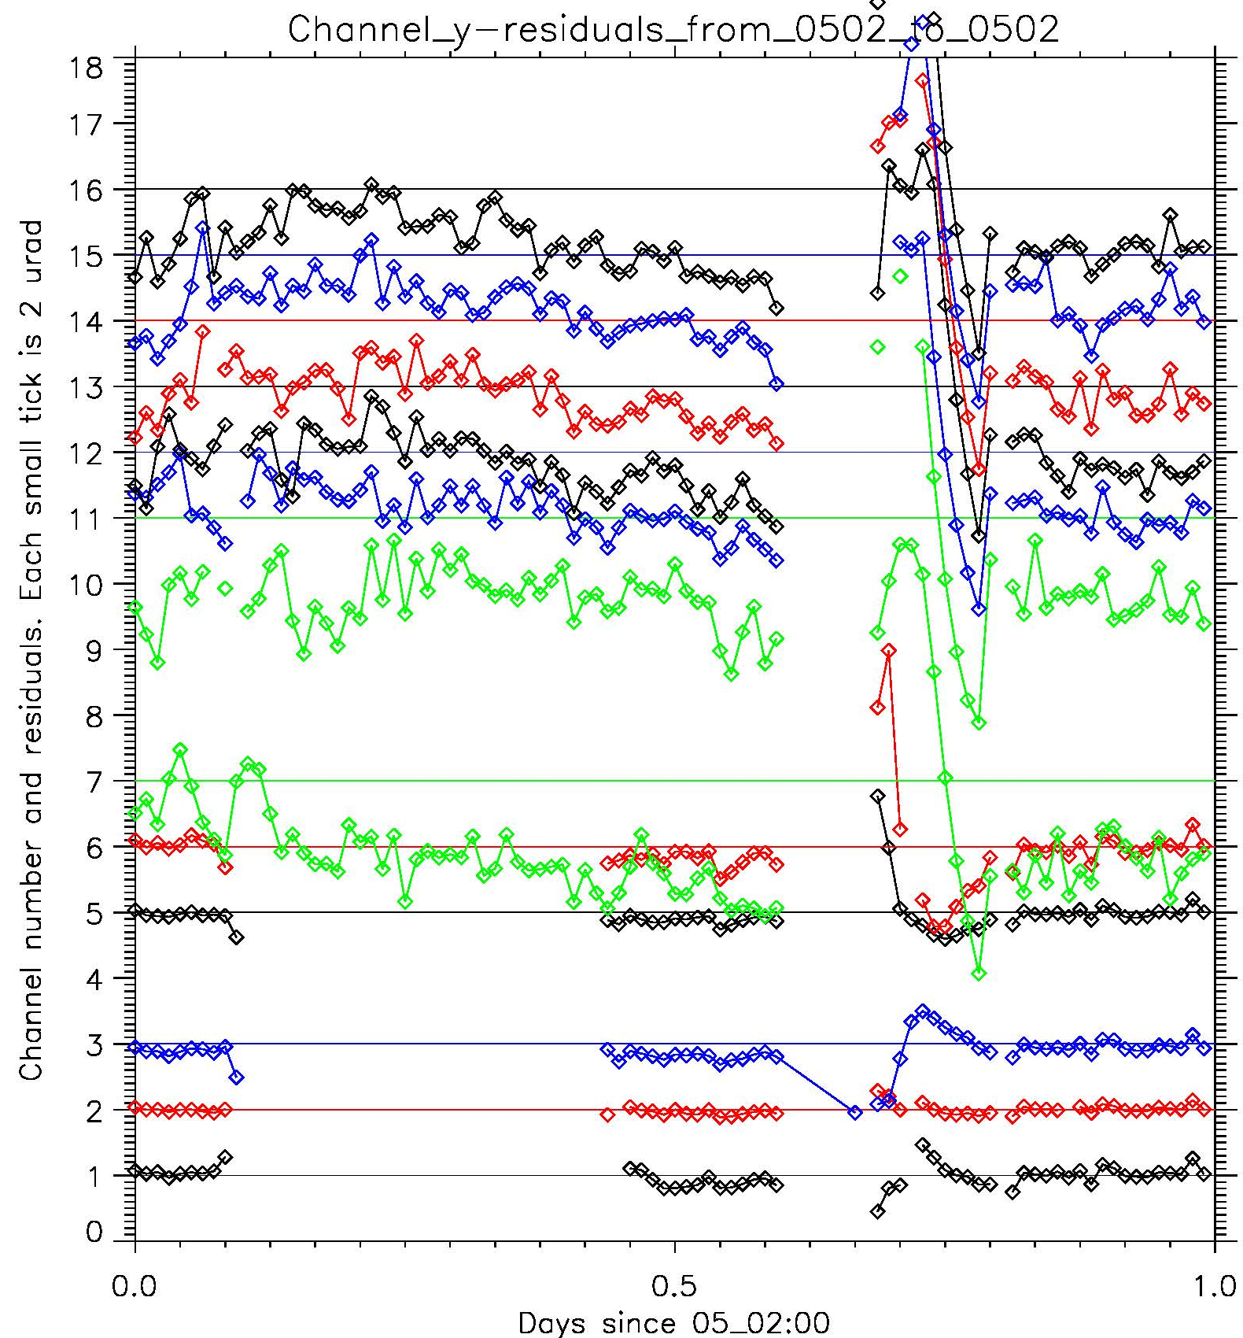
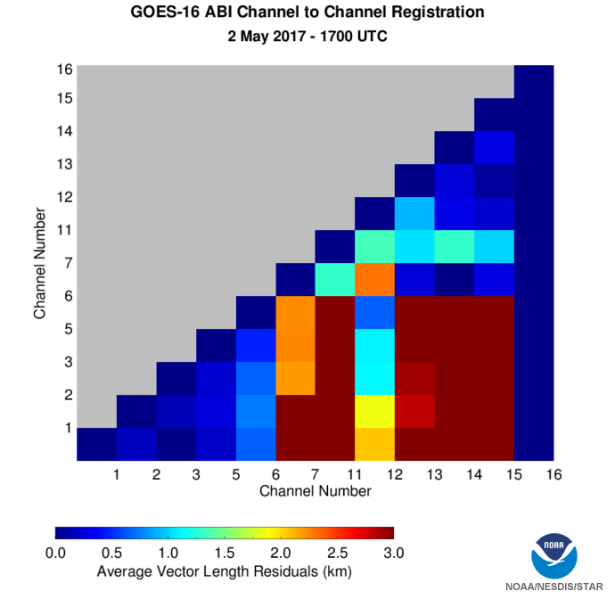
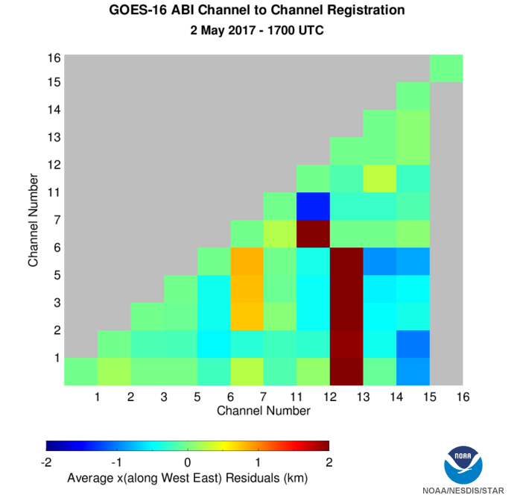
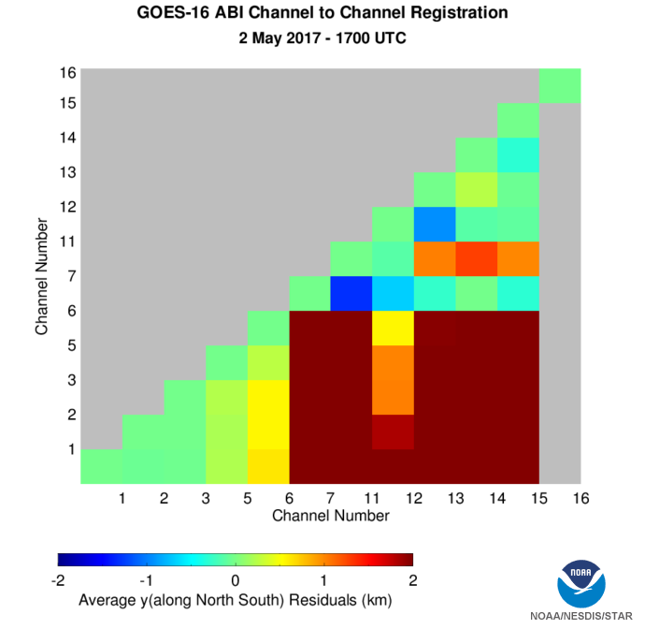
ADR-351 Large NS Swings in ABI Image Navigation
May 2, 2017
Navigation Residuals
Channel-to-Channel Registration

Slide 51
Impacting Instrument Monitoring ADRs/WRs
ADR# | WR# | Short Description | Status | Expected Closure
188 | 3305 | Increase the number of Spacelook samples saved in Instrument Calibration Data files | AART | DO.05.00
292 | 4293 | ABI INST-CAL Offset Field irregularities | AART | DO.06.00
303 | 4345 | ABI M3/M4 INST-CAL Data Not Sent to PDA | AART | DO.06.00
345 |  | ABI Ch 2 INST-CAL File Size Inflation | AART | DO.05.00

Slide 52
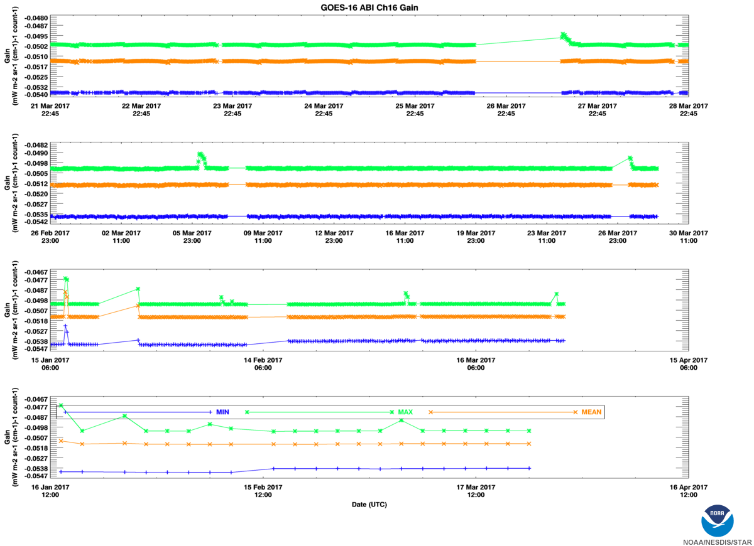
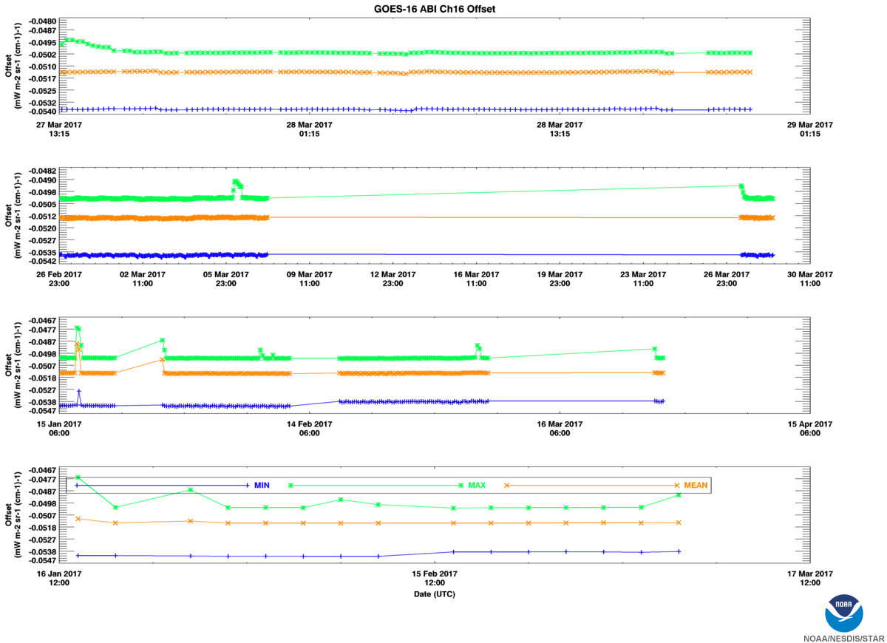
ADR-303 ABI INST-CAL Offset Field Irregularities
ABI CH-16 Min, Max and Mean Offset (repeat of gain except for long outage)
ABI CH-16 Min, Max and Mean Gain

Slide 53
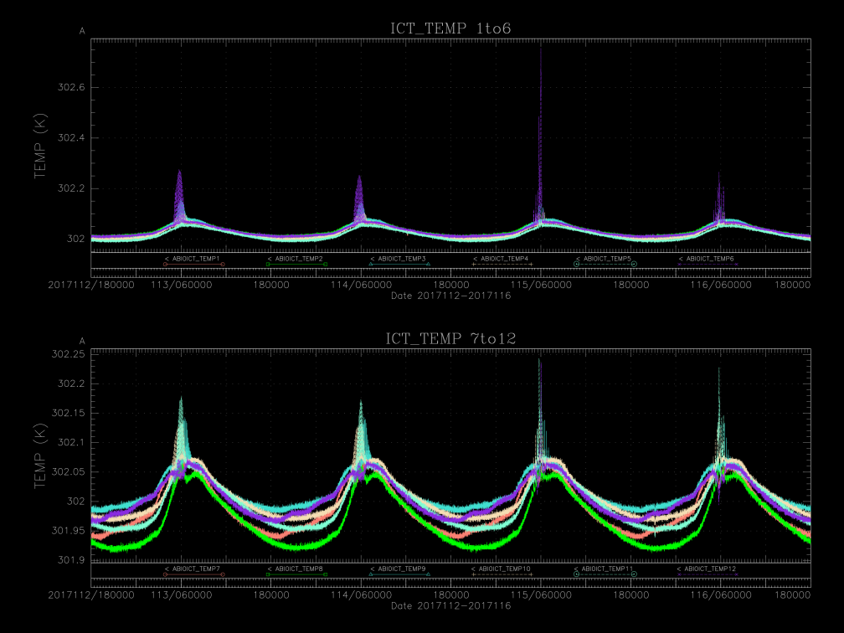
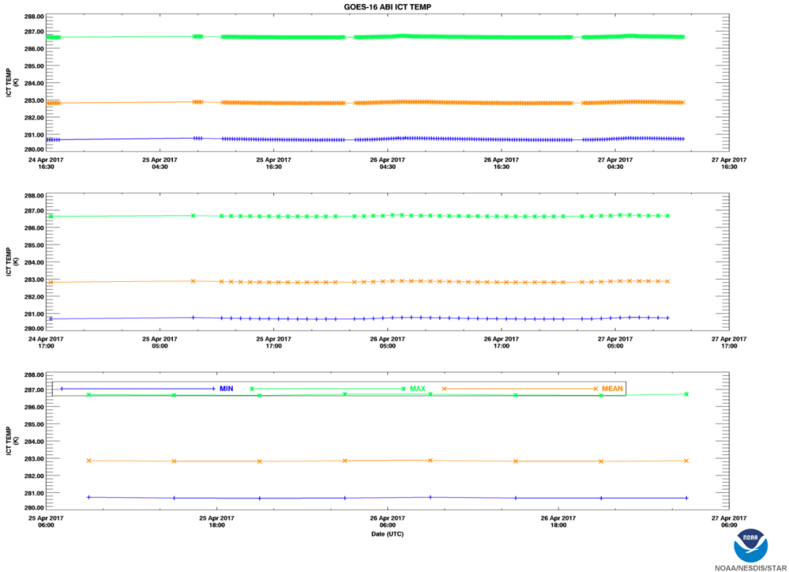
ADR-319 ABI M3/M4 INST-CAL Data Not Sent to PDA
CASSIE Internal Cal Target Output: Mean: ~302K Range: ~ 0.25K
INST-CAL Internal Cal Target Output: Mean: ~283K Range: ~ 6.0K

Slide 54
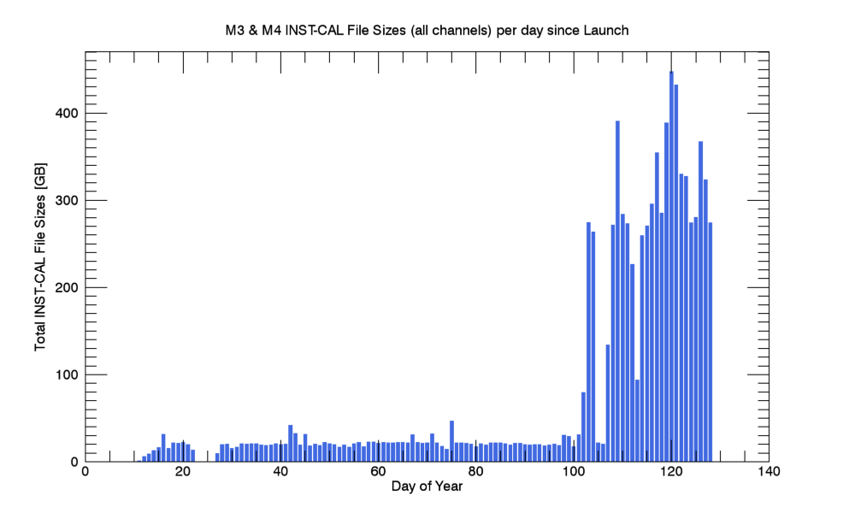
ADR-345 ABI Ch 2 INST-CAL File Size Inflation
ABI Mode-3 and Mode-4 INST-CAL File Sizes (all channels) Per Day Since Launch

Slide 55
Path to Full Validation – PLPT
Test ID | Short Title | Status
ABI-L1b-PLPT-001 | IR Validation IASI Cries | On Schedule
ABI-L1b-PLPT-002 | IR Validation CRTM | On Schedule
ABI-L1b-PLPT-003 | ZRDQ Performance | On Schedule
ABI-L1b-PLPT-004 | VNIR Validation VIIRS | On Schedule
ABI-L1b-PLPT-005 | VNIR Validation Sonora | On Schedule
ABI-L1b-PLPT-006 | VNIR Validation RVS | On Schedule
ABI-L1b-PLPT-007 | Monitoring | Minor Delay
ABI-L1b-PLPT-008 | AD Converter | Completed
ABI-L1b-PLPT-009 | Low Light SNR | Minor Delay
ABI-L1b-PLPT-010 | Image Navigation | On Schedule
ABI-L1b-PLPT-011 | Image Registration | On Schedule
ABI-L1b-PLPT-012 | Image Stitching | On Schedule
ABI-L1b-PLPT-013 | VNIR Validation DCC | On Schedule
ABI-L1b-PLPT-014 | Detector Uniformity Stability NSS | On Schedule
ABI-L1b-PLPT-015 | Validation SNO NSS | On Schedule
ABI-L1b-PLPT-016 | L2 Validation Support NSS | Completed
ABI-L1b-PLPT-017 | Lunar NSS | On Schedule
ABI-L1b-PLPT-018 | Detector Uniformity Investigation | Minor Delay
ABI-L1b-PLPT-019 | Initial Solar Calibration | On Schedule
ABI-L1b-PLPT-020 | IR Spatial Uniformity | Major Delay

Slide 56
Path to Full Validation – PLPT
Test ID | Short Title | Status
ABI-L1b-PLPT-021 | SRF Verification | Data Collected
ABI-L1b-PLPT-022 | OOB Response | Data Collected
ABI-L1b-PLPT-023 | Polarization | Not started
ABI-L1b-PLPT-024 | Cal-to-Cal Repeatability | Not started
ABI-L1b-PLPT-025 | Linearity | Not started
ABI-L1b-PLPT-026 | Ghosting | Data Collected
ABI-L1b-PLPT-027 | Field Campaign – Aircraft | Data Collected
ABI-L1b-PLPT-028 | Field Campaign – Surface | Data Collected
ABI-L1b-PLPT-029 | VNIR Verification – Rayleigh | Substantial
ABI-L1b-PLPT-030 | VNIR Verification – Uyuni | Substantial
ABI-L1b-PLPT-031 | BDS | Data Collected
ABI-L1b-PLPT-032 | VNIR SNR & Dynamic Range | Data Collected
ABI-L1b-PLPT-033 | IR Cal Stability | Not started
ABI-L1b-PLPT-034 | MTF | Data Collected
ABI-L1b-PLPT-035 | Coherent Noise | Not started
ABI-L1b-PLPT-036 | IR SNR & Dynamic Range | Data Collected

Slide 57
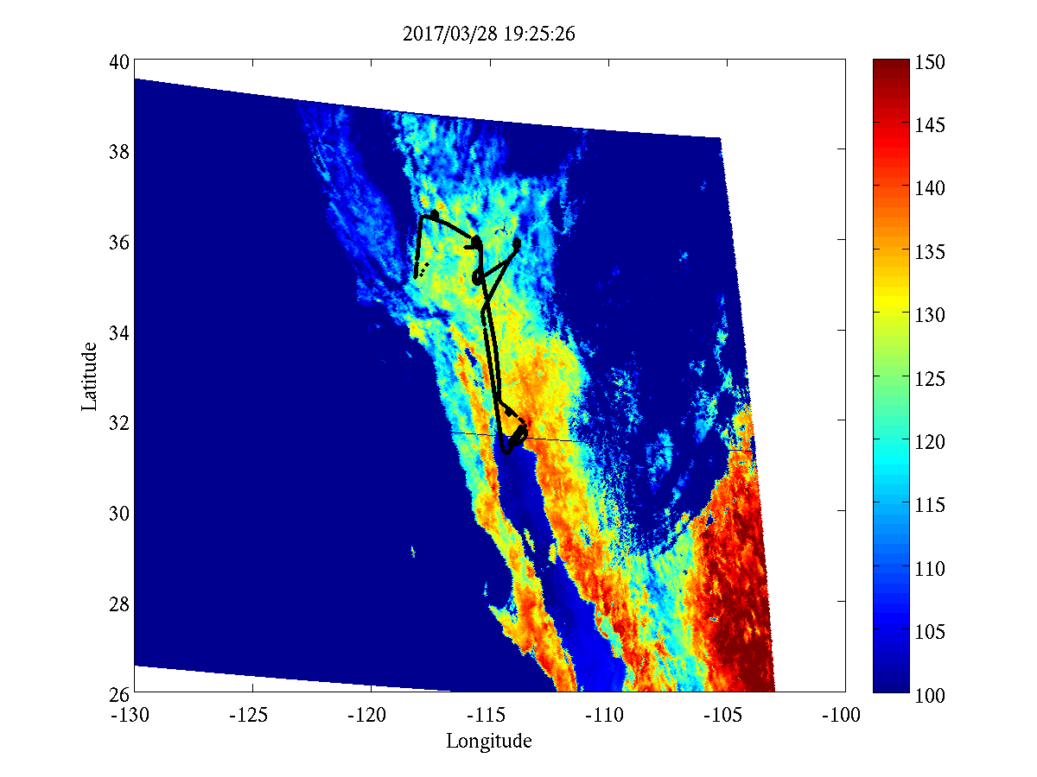
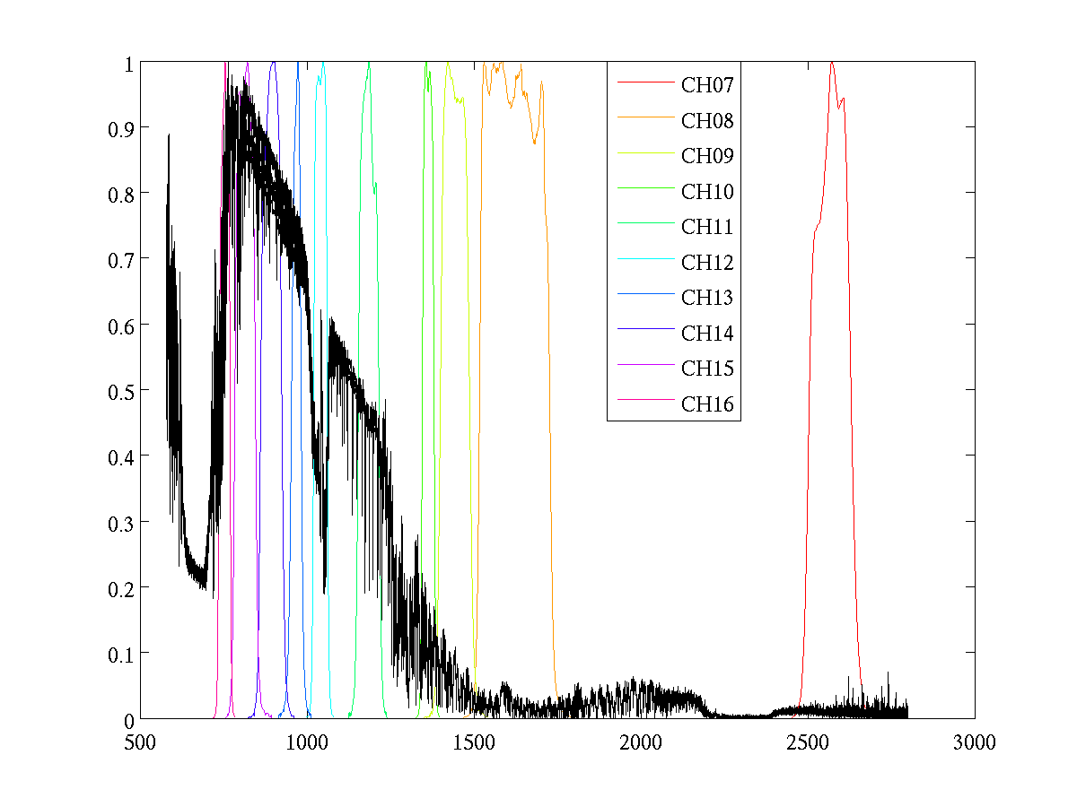
GOES-16 ABI and S-HIS Comparison Field Campaign, Mar 28, 2017
ABI B14 L1-Beta MESO
ER2 Trajectory
ABI SRF & Normalized S-HIS Rad.
Normalized
S-HIS Radiance
Wavenumber
ABI Mode 25
ER2 Trajectory

Slide 58
GOES-16 ABI and S-HIS Comparison for CH14 Matching during Field Campaign on Mar. 28, 2017
Overall Comparison
Radiance
Time
With screening
S-HIS BT (k)
“+” shows location of ER2 with Ch14 Radiance Difference between ABI and SHIS < 1%
Mostly matched over the land and ocean with uniform scene (due to INR uncertainty in ABI since there is no INR calibration for ABI Mode 25)
Large amount of matched validation points with BT difference < 1K for ABI CH14
ABI BT (k)
BT Difference (k)
ABI BT (k)

Slide 59
GOES-16 ABI and S-HIS Comparison for Multi-ABI Channel Matching during Field Campaign on Mar. 28, 2017
S-HIS Spectrum
Multiple-Location
Identified six locations (white circles) along ER2 trajectory with matched ABI and SHIS radiometric performance
Overall assessment: BT of ABI CH07 to CH16 between ABI and SHIS agree within 0.45K except CH12
CH12 needs further validation
SHIS-ABI BT Difference (K)
ABI Channels

Slide 60
Summary of Early Field Campaign Analysis
S-HIS data from Field Campaign are to be used to validate the radiometric calibration of ABI IR channels.
Preliminary analysis shows that brightness temperature differences between ABI and S-HIS for all IR bands (except for B12 at 9.6 µm) are within 0.45K.
Caveats – The following have not been accounted for:
INR error due to the lack of Kalman Filter for special scan
FOV difference between S-HIS and ABI
Absorption and emission by the atmosphere above ER-2, in particular for CH12 due to stratospheric O₃ absorption.

Slide 61
GOES-16 ABI L1b PLPT-029: Rayleigh Scattering Calibration Summary
Full Validation Success Criteria | Provisional Maturity Status
Monitoring and Validation of Band 1 Radiance Stability and Accuracy | Pass – Reveals PLPT 10% deviations in observed to simulated radiance signal due to gain changes
Monitoring and Validation of Band 2 Radiance Stability and Accuracy | Fail – observed to simulated radiance signal eclipse by dependence on sun-scene-satellite angle
Ability to produce or improve true color images with ABI data | Not Started
ABI L1b Data Used in Test: (15 January – 20 April 2017)
Valid Rayleigh scattering calibration locations from a study performed by Fougnie et al. (2002) for GOES-16 at its test location of 89.5º West longitude
Site Name | Lat Min | Lat Max | Long Min | Long Max
Scene-0 Pacific Southeast | 35º S | 31º S | 124º W | 116º W
Scene-3 Atlantic North | 17.5º N | 21.5º N | 60º W | 52º W
Scene-8 Costa Rica Dome | 13.5º N | 17.5º N | 120º W | 112º W
Future Rayleigh Scattering Developments Towards Full Validation:
Accumulate much larger sample size over the course of the year
Limit range of sun-scene-satellite angle in analysis to reduce variability
Begin analysis leading to improved true color images

Slide 62
Path to Full Validation – Risks
Risk Name | Description | Impact | Mitigation and Schedule
Mission Data | IF CWG lacks many critical meta data | THEN CWG cannot function properly | Raise awareness Work with Ground
Operation Stability | IF corrections for known anomalies cannot be implemented timely | THEN the operation will not reach steady state for evaluation | Raise awareness Work with Ground

Slide 63
Summary & Recommendations
GOES-16 ABI L1b Products Provisional PS-PVR

Slide 64
Summary
Reviewed progress since Beta Maturity
Evaluated ABI L1b Product Quality
General Approach
Past Performance, Current Status, and Future Outlooks
IR Calibration, VNIR Calibration, and INR
Assessed Provisional Maturity per GOES-R Program
Outlined the Path to Full Validation Maturity
Issues and status
Risks

Slide 65
Recommendation
CWG believes that the GOES-16 ABI L1b products has reached the Provisional Maturity as defined by the GOES-R Program.

Slide 66
Backup slides
GOES-16 ABI L1b Products Provisional PS-PVR

Slide 67
PLPT-010 Navigation residuals are assessed every 15 minutes

Slide 68
PLPT-010 Daily trending of Navigation residuals

Slide 69
PLPT-010 WIFR and FFR

Slide 70
PLPT-010 Kalman Filter (KF) Performance monitoring

Slide 71
PLPT-010 User Inputs
71

Slide 72
INR
Coregistration of window channels with help of landmarks
Direct coregistration of all channels

Slide 73
INR
To date, this PLPT paid major attention to swath registration problem in ABI images.
73

