Slide 1
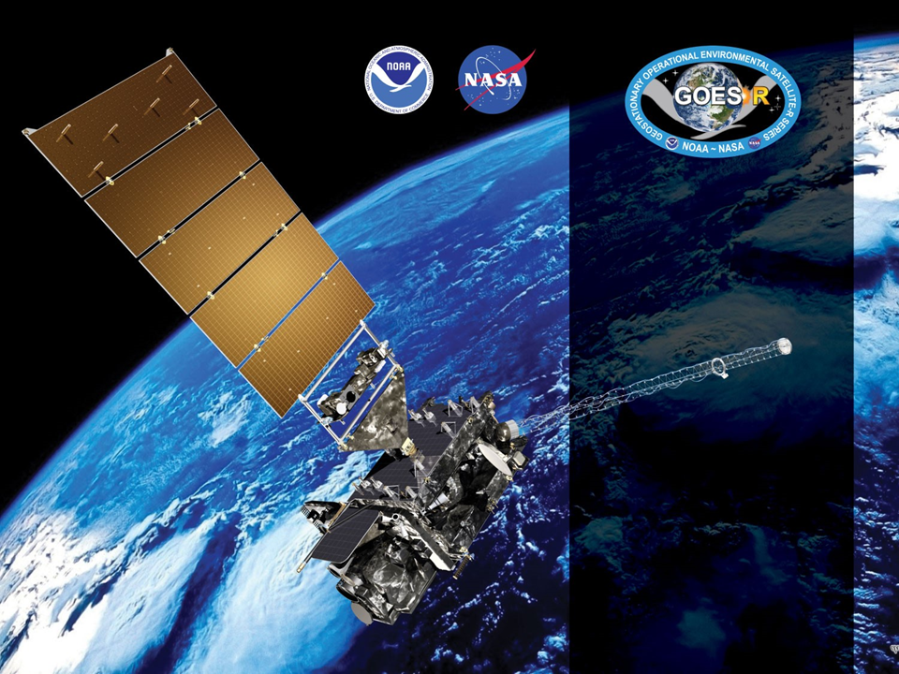
GOES-16 ABI L2+ SST
Provisional PS-PVR
March 9, 2018
GOES-R AWG
Alexander Ignatov*,
Boris Petrenko, Maxim Kramar, Yury Kihai, Irina Gladkova, Matt Pennybacker, Olafur Jonasson, Xinjia Zhou, Kai He, Yanni Ding
*NOAA NESDIS STAR
GST Inc, CSU CIRA, CCNY

Slide 2
Agenda
Product Overview
Specs/Requirements
NOAA SST Monitoring System
Β-Review & Path to Provisional
Provisional Maturity Assessment
Conclusion & Path to Fully Validated/Operational
Summary and Recommendations

Slide 3
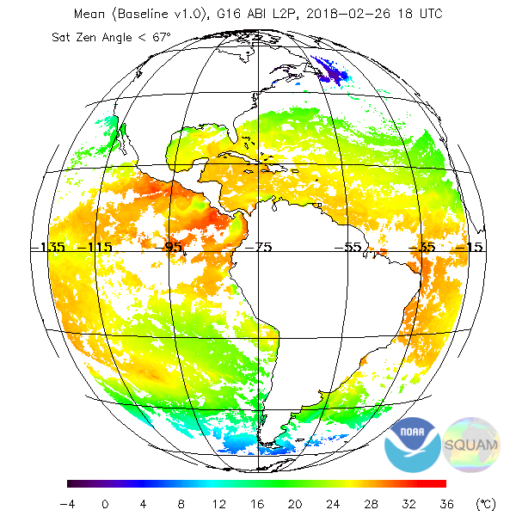
Product Overview
Baseline SST Product:
  Uses Binary Cloud Mask “Conf. Clear” from Cloud Team as well as individual cloud tests
  Additionally Performs SST QC
  Regression trained against quality controlled in situ data
  Uses 11(8.5µm), 13(10.3µm), 14(11.2), &15(12.3µm) bands
Processed are all 15min FD data and aggregated into 1hr composites
Only L2 product is available (no gridded L3 produced)
Open ocean only (no internal water)
No downstream products affected by SST
Example 1hr composite SST FD Image
on 26 Feb 2018 @18UTC

Slide 4
GOES-R SST specs
Vs. JPSS and Himawari-8 specs
Instrument | Measurement range | Accuracy⁽¹⁾ | Precision⁽²⁾
GOES-R (F&PS) | 271 to 313 K | ±3.1 K* | 1.0 K*
JPSS | 271 to 313 K | ±0.2 K | 0.6 K
H8 | 271 to 313 K | ±0.2 K | 0.6 K
^{(*)} Ocean. Quantitative for LZA<=67º; Qualitative at LZA>67º
⁽¹⁾ Accuracy = Global Bias of (SST - in situ SST)
⁽²⁾ Precision = Global Standard Deviation of (SST - in situ SST)
The MRD specs for ABI SST are much more liberal and inconsistent with those for VIIRS and AHI. They do not meet users’ requirements, needs, or expectations
Specs for JPSS/VIIRS and H8/AHI meet users’ expectations & needs, and NOAA SST products meet these specs. This review evaluates SST product against more stringent JPSS/H8 specs

Slide 5
NOAA SST Monitoring System

Slide 6
NOAA SST Monitoring
Visualization of validation and comparisons with global Level 4 (L4) fields, Canadian Meteorological Center (CMC) in the NOAA SST Quality Monitor (SQUAM; www.star.nesdis.noaa.gov/sod/sst/squam/; Dash et al., 2014)
Validation against QC’ed in situ SSTs from NOAA In situ SST Quality Monitor (iQuam; www.star.nesdis.noaa.gov/sod/sst/iquam/; Xu, Ignatov, 2014)
Visualization of regional imagery in the ACSPO Regional Monitor for SST (ARMS; www.star.nesdis.noaa.gov/sod/sst/arms/; Ding et al, 2016)
The three SST validation subsystems are fully established, documented & well utilized by the SST community (e.g., Group for High Resolution SST, GHRSST)
Consistent QC/Val/Evaluation methodologies applied to various in situ & satellite SSTs, produced by NOAA (from JPSS, POES, H8, GOES-R) and partners, to facilitate selection of best fit-for-purpose product to meet users’ needs

Slide 7
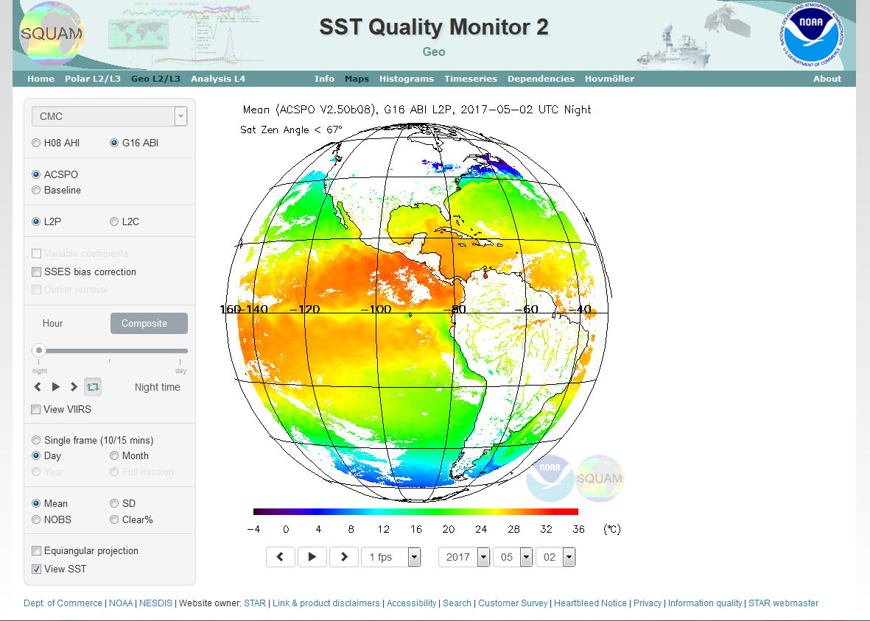
SST Quality Monitor
(SQUAM)
www.star.nesdis.noaa.gov/sod/sst/squam/
SQUAM monitors NOAA & partners SSTs globally, against in situ and L4 analyses

Slide 8
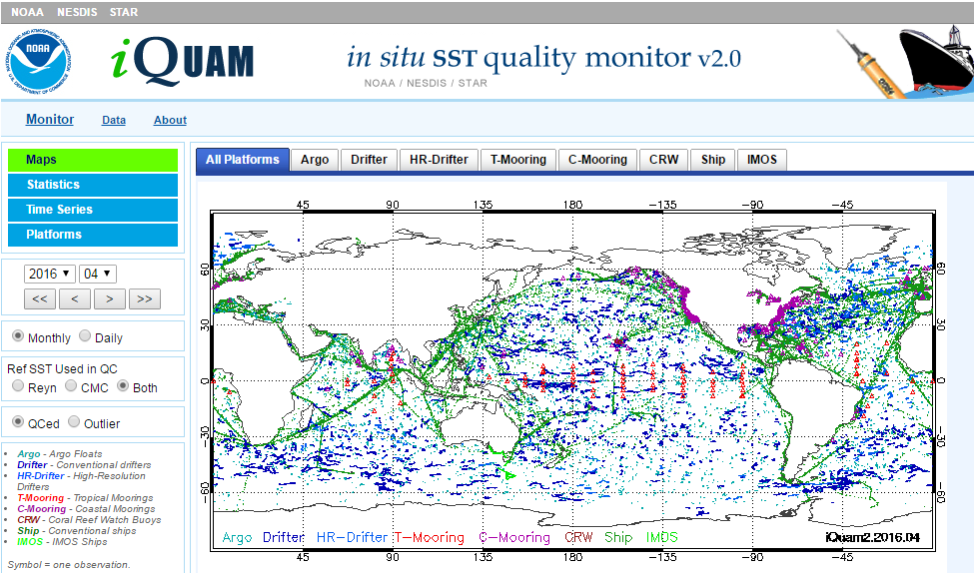
In situ SST Quality Monitor (iQuam)
www.star.nesdis.noaa.gov/sod/sst/iquam/
iQuam applies uniform QC to in situ SSTs (drifters, moorings, Argo, ships) & serves to users

Slide 9
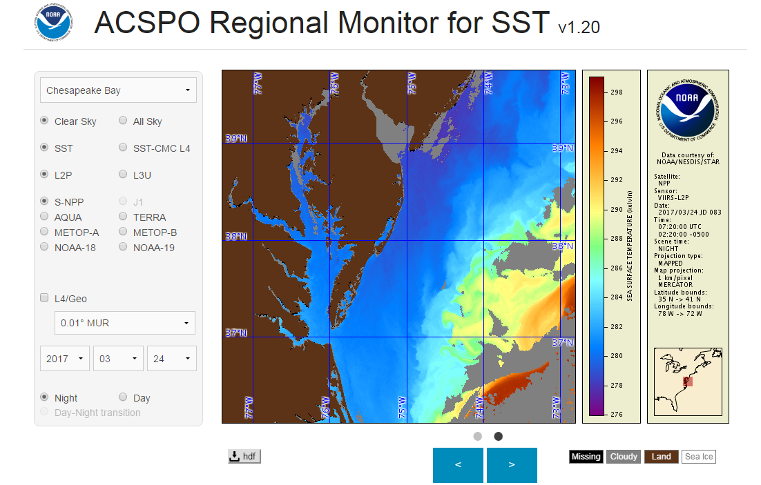
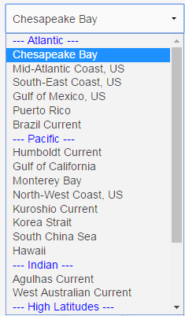
ACSPO Regional Monitor for SST (ARMS)
www.star.nesdis.noaa.gov/sod/sst/arms/
27 regions
ARMS monitors several L2-L3-L4 SST regionally and checks them for cross-consistency

Slide 10
Summary of Beta Review
In May 2017 & Path to Provisional

Slide 11
Beta Review (May 2017)
End State (Fully achieved at the time of β-review)
  Product made available to users to gain familiarity with data formats & parameters
  Product may still contain significant errors
  Product is not optimized for operational use
Summary of β-findings & Path to Provisional
The product contained significant errors and did not meet the specs (even the liberal GOES-R specs)
Five major issues were identified & ADRs submitted. Today, three of them are fixed + Two in work
Next slide summarizes the issues and their status

Slide 12
SST ADRs/WRs as of Beta Review
Pre-Launch
Title | Description | Beta Status | Planned Mitigation | Current Status
WR1698 | Sea Surface Temperature Fill Value incorrect | In_Test | DO.05 | RESOLVED
WR1561 | Add SST Bias as an Intermediate Product | In_Test | DO.05 | RESOLVED
WR3225 | Ocean L2: SST Metadata Issues-ADR 170 | In_Work | DO.06 | RESOLVED
Post-Launch
Title | Description | Beta Status | Planned Mitigation | Current Status
WR2944 | SST L2 Product not being generated | In_Test | DO.05 | RESOLVED
ADR270 | Negative bias in SST | In_Analysis | TBD | RESOLVED
ADR271 | SST diurnal cycle offset | In_Analysis | TBD | RESOLVED
WR3207 | SST DQF appears to be incorrect | In_Work | DO.06 | IN PROGRESS
ADR269 (WR4214) | Anomalies in SST Product | In_Work | DO.06 | IN PROGRESS
Notes:
PRO Fills this In

Slide 13
Remaining ADRs Unresolved Since β:
Large Outliers Still Present
but Significantly Reduced
PRO Team knows the root cause
& working on fixes

Slide 14
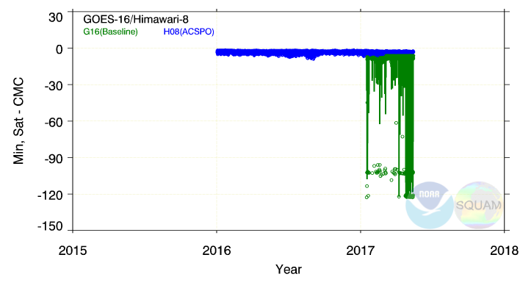
(Example from β-Review)
min (G16 L2 – CMC L4) SST
Only SST pixels with QF = “Very Good” are monitored in SQUAM
Image on 2017-02-11T20:51 corresponding to these minima is shown on the next slide
Some pixels (marked as “very good”) report SST ~100K colder than CMC or in situ SST. The source of such anomalies is unknown

Slide 15
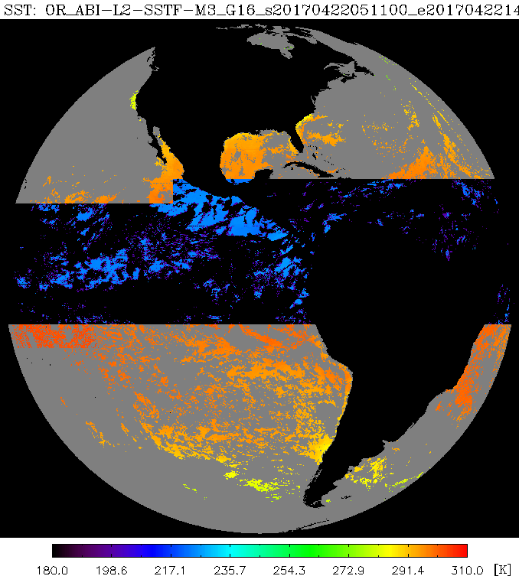
(Example from β-Review)
Very cold SST marked as “very good”
11 February 2017, 20:51 UTC
SST s with “Very Good” QF may be
colder than background SST by 100 K
The source of such anomalies is unknown. Ticket submitted

Slide 16
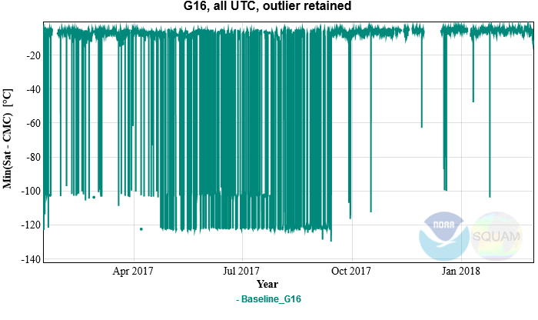
Up-to-Date Time Series of
Min (G16 L2 – CMC L4) SST
Only SST pixels with QF = “Very Good” are monitored in SQUAM
The problem was first reported in Mar 2017 under ADR269
“Black-outs” occurred almost every single day up until Sep 2017
The outages have reduced in Sep 2017, but still occur occasionally

Slide 17
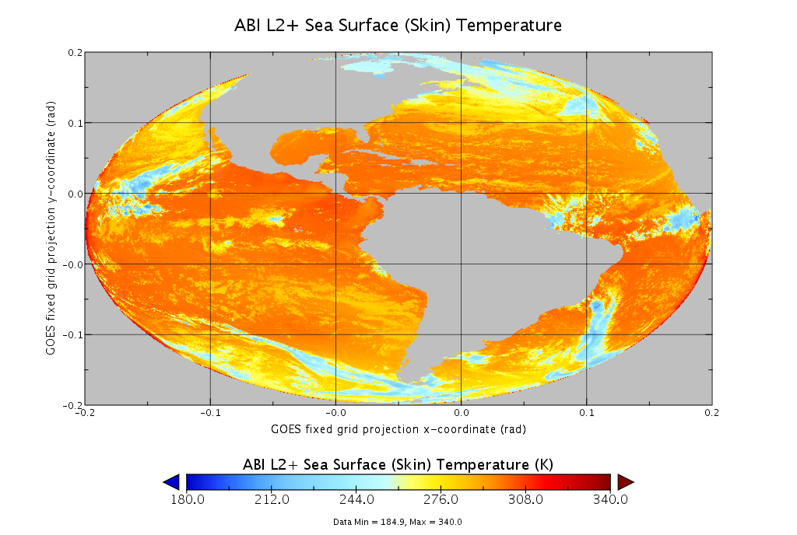
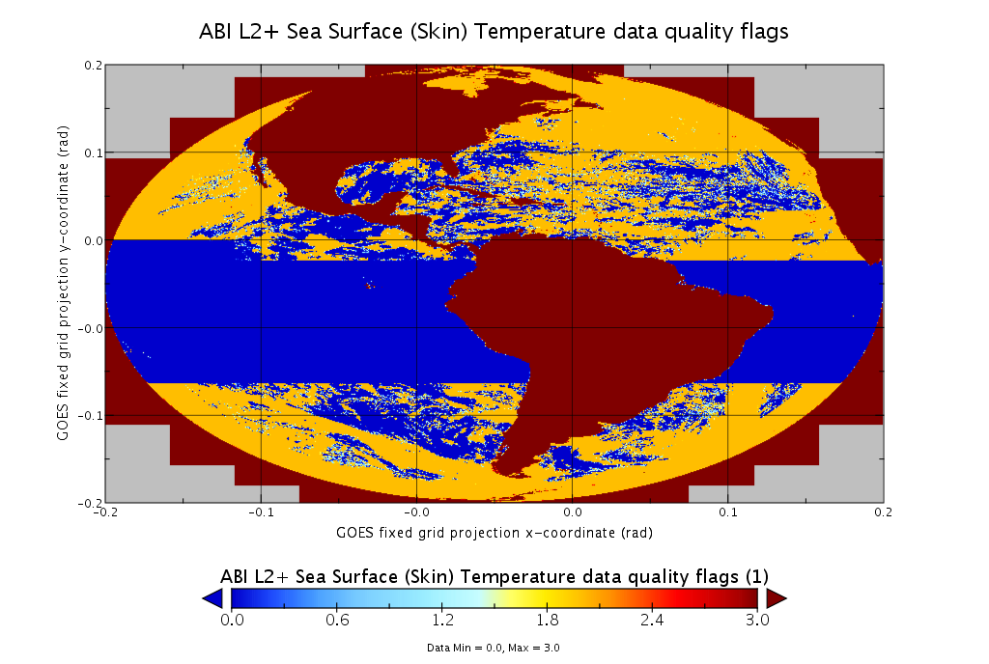
Most recent occurrence
on 23 Feb 2018
OR_ABI-L2-SSTF-M3_G16_s20180541700396_e20180541756160_c20180541800261.nc
Latest ADR269 anomaly. Composite SST is shown but anomaly is also present in instantaneous DO.05 SST. Also time_bounds=9.969209968386869E36 (ADR 509).

Slide 18
Provisional
Maturity Assessment

Slide 19
Definition of Provisional
From SST RIMP
Activities
                VAL and QA ongoing. General research community encouraged to participate
                Severe algorithm anomalies identified & under analyses. Solution to anomalies are in development/testing
                Incremental product improvements may still be occurring
                Users engaged in the customer forums. Users’ feedback is assessed
End State
  Product performance demonstrated through analysis of a large, but still (seasonally, regionally, etc.) limited, number of independent measurements
  Analyses are sufficient for limited qualitative determination of product fitness-for-purpose
  Documentation of product performance exists & includes remediation strategies for all anomalies & weaknesses
  Analyses are sufficient to communicate product performance to users relative to expectations
  Product is ready for test operational use / comprehensive Cal/Val / optimization

Slide 20
Specific Objectives
of SST Provisional Review
Assess Accuracy & Precision of the SST product over a large/wide range of representative conditions, which may still be limited seasonally
SST meets its documented requirements (±0.2K mean bias, and 0.6K RMSD wrt. in situ data)* for view zenith angles ≤67º
Remediation strategies are in place for known issues
Product is ready for evaluation for potential operational use and for potential use in scientific publications
* Stringent JPSS/H8 specs are used, instead of liberal GOES-R MRD specs. Currently, SST product meets these stringent specs, most of the time

Slide 21
PLPT Events: Provisional Maturity
Beta
PLPT ID | Descriptive Title | % Complete | Results | AWG POC
ABI-FD_SST01 (M3), ABI-FD_SST02 (M4) | Verify that SST product is generated for every hour and that SST is retrieved within the full expected domain and falls within the expected measurement range | 100 | Complete | Ignatov
ABI-FD_SST03 (M3, M4) | Determine the extent to which the SST product generated for every hour in cloud-free areas, meets the Mission Requirements Document (MRD) specifications for accuracy and precision | 100 | Complete | Ignatov
Provisional
PLPT ID | Descriptive Title | % Complete | Results | AWG POC
ABI-FD_SST04 (M3, M4) | Assess the accuracy & precision of ABI SST product. Verify if it (1) meets MRD specs for a limited (not seasonally representative) number of independent measurements; and (2) is ready for operational use. Or, identify fixes to the ABI sensor performance, clear-sky mask (CSM) or SST algorithm to make the SST product ready for operational use | 100 | Complete | Ignatov
21

Slide 22
Focus Period
for Provisional Assessment

Slide 23
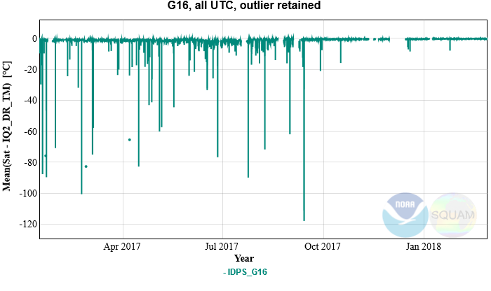
Mean Bias wrt. in situ SSTs
Focus of this Review:
Oct 2017 – present
G16 Drift
Beta Review
Product Improved
Each data point = 1hr FD statistic (1.5-3 thousand match-ups)
The number of large outliers has substantially reduced but occasionally, those are observed. After the drift, drop-outs have occurred 6 times

Slide 24
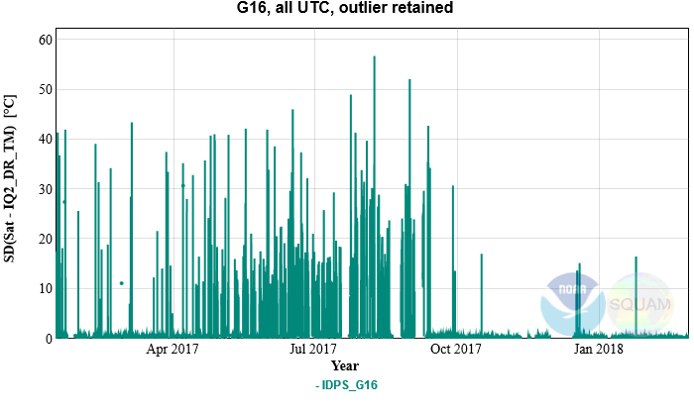
Std Dev. wrt. in situ SSTs
Focus of this Review:
Oct 2017 – present
Each data point = 1hr FD statistic (1.5-3 thousand match-ups)
G16 Drift
Beta Review
Product Improved
The number of large outliers has substantially reduced but occasionally, those are observed. After the drift, drop-outs have occurred 6 times

Slide 25
Current G16 SST
Performance

Slide 26
GOES-R SST specs
Vs. JPSS and Himawari-8 specs
Instrument | Measurement range | Accuracy⁽¹⁾ | Precision⁽²⁾
GOES-R (MRD) | 271 to 313 K | ±3.1 K | 1.0 K
JPSS | 271 to 313 K | ±0.2 K | 0.6 K
H8 | 271 to 313 K | ±0.2 K | 0.6 K
⁽¹⁾ Accuracy = Global Bias of (SST - in situ SST)
⁽²⁾ Precision = Global Standard Deviation of (SST - in situ SST)
The G16 SST Performance will be evaluated against JPSS/H8 specs which hopefully, will be eventually reconciled
Most recently, the baseline SST meets these stringent specs, most of the time (except the “black-outs” which are being fixed)

Slide 27
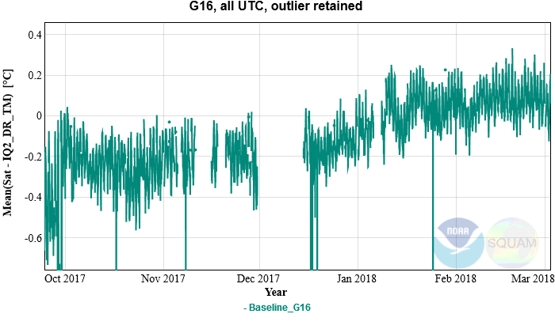
Mean Bias wrt. in situ SSTs
Each data point = 1hr FD statistic (1.5-3 thousand match-ups)
Specs: ±0.2K
Residual -0.2K Bias Fixed
SST Algorithm Revisited
Since Jan 5, the SST product bias is largely within specs
Several large drop-outs are due to the ADR269 which is being fixed by PRO

Slide 28
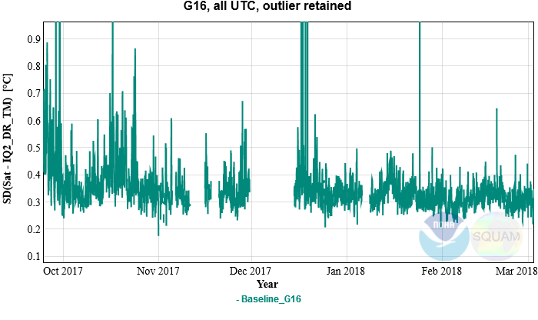
Std Dev. wrt. in situ SSTs
Each data point = 1hr FD statistic (1.5-3 thousand match-ups)
Specs: 0.6K
SST Algorithm Revisited
Residual -0.2K Bias Fixed
Since Jan 5, the SST product SD is within specs, with a decent margin
Several large drop-outs are due to the ADR269 which is being fixed by PRO

Slide 29
Diurnal Cycle:
Substantially Improved

Slide 30
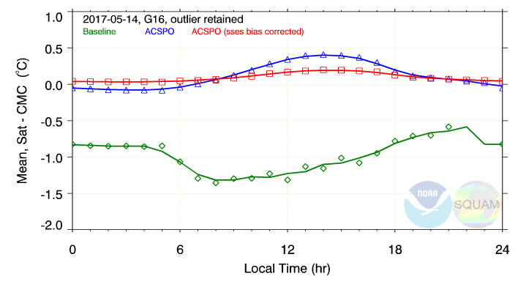
(From β-Review)
Daily Diurnal Cycle: 14 May 2017
Baseline & H8-like SSTs averaged over the FD for one day on 14 May 2017
H8-like “sub-skin” SST shows diurnal cycle with amplitude ~0.5K, with max reached ~14 LT.
The Baseline SST shows irregular and incorrect diurnal cycle

Slide 31
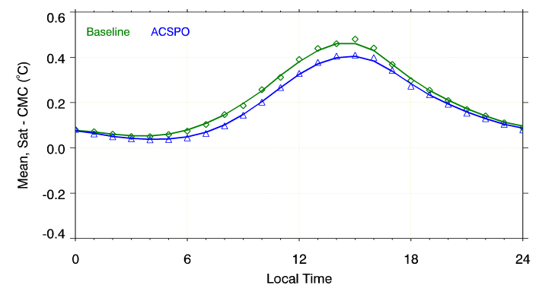
Current Provisional Review
Daily Diurnal Cycle: 1 Feb 2018
Baseline & ACSPO SSTs averaged over the FD for one day on 1 Feb 2018
Baseline SST shows realistic & consistent with ACSPO diurnal cycle (Residual differences are due to recently updated coefficients in ACSPO)

Slide 32
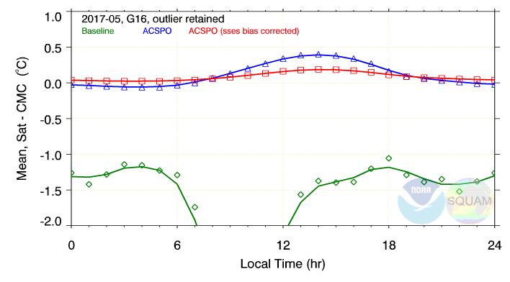
(From β-Review)
Monthly Diurnal Cycle: May 2017
On 14 May 2017, baseline SST did not have the -100K outliers. Monthly average diurnal cycle for May 2017 with -100K shows larger anomalies
Similar anomalies also seen in all prior months from Jan – Apr 2017

Slide 33
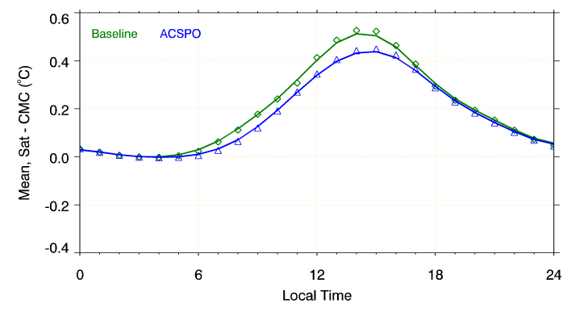
Current Provisional Review
Monthly Diurnal Cycle: Feb 2018
Baseline & ACSPO SSTs averaged over the FD for one month of Feb 2018
Baseline SST shows diurnal cycle that is realistic & consistent with ACSPO (Residual differences are due to recently updated coefficients in ACSPO)

Slide 34
SST Near-Uniformly Validates Against
in situ Data Across Full Diurnal Cycle

Slide 35
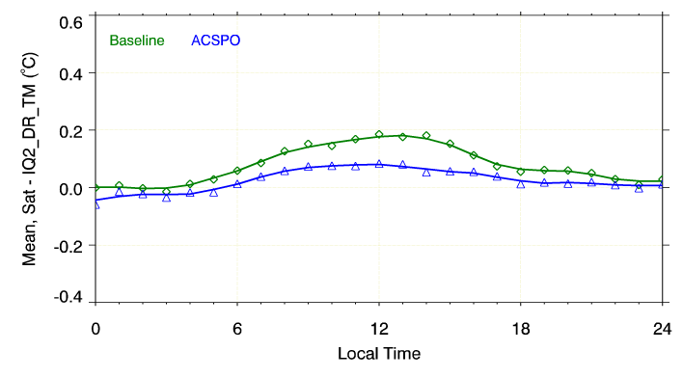
Monthly Validation vs. in situ: Feb 2018
Specs: ±0.2K
Overall, baseline SST is within specs across the full diurnal cycle
Satellite Skin SSTs are a little warmer than in situ bulk during the daytime

Slide 36
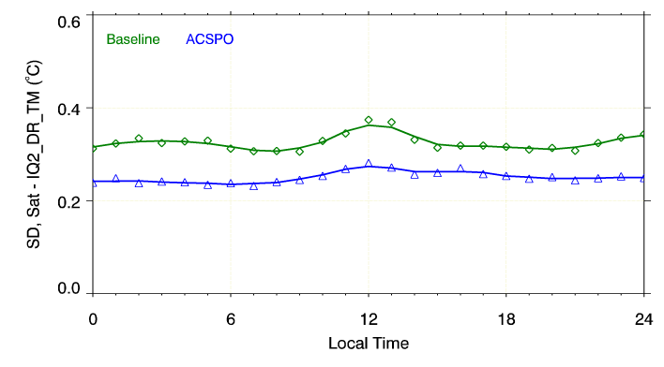
Monthly Validation vs. in situ: Feb 2018
Specs: 0.6K
Satellite SSTs meet specs across the full diurnal cycle, with a good margin
The performance is largely uniform across the full diurnal cycle

Slide 37
Post-β ADRs/WRs
& Their Status

Slide 38
ADRs/WRs towards Provisional and Resolution Status
Title | Description | Status | Mitigation
ADR495 | Incorrect attributes and values in NC-files | Closed | Team verified change in PR 06.04
ADR509 | Corrupted File Name and DQF | Closed | The incorrect filenames are symptoms of other ADRs (269,489) - Consolidated
ADR398 | Good DQF values all the way out to limb | Closed | Team verified change in PR 06.04
ADR489 | Java heap space error | Closed | 1/11/18: java heap space error fixed
ADR542 | Negative Bias | Closed | correction implemented/verified 1/9/18
WR1544 | Ocean SST bias is not written out as an IP | Closed | Filed by PRO
WR2944 | Product may not be generated on schedule | Closed | Filed by PRO
WR3207 | SST generated w/missing blocks w/best QF | In Work | Filed by PRO
ADR579 WR5753 | SST over Great Lakes | In Analysis | Under investigation (filed by PRO)
ADR489/269 | Corrupted File Names and DQF | In Analysis | ADR489 closed; ADR 269 remains open
ADR509,269 WR4214 | Corrupted "time_bounds" variable | In Analysis | Currently under investigation by PRO
ADR-608 | Corrupted file names & “time_bounds” | In Analysis | Currently under investigation by PRO
ADR577 WR5752 | Aperiodic data flow | In Analysis | Currently under investigation by PRO
ADR611 | Excessive fill data in products | In Analysis | 2/26/18: Bring back AART in 3 weeks
ADR-TBD | No L1b data for shown Start Time | ? | 3/1/18: more analysis needed before sending to AART
ADR-TBD | No information about DO version in files | ? | 3/5/18: Filed with AWG
Notes:
PRO Fills In

Slide 39
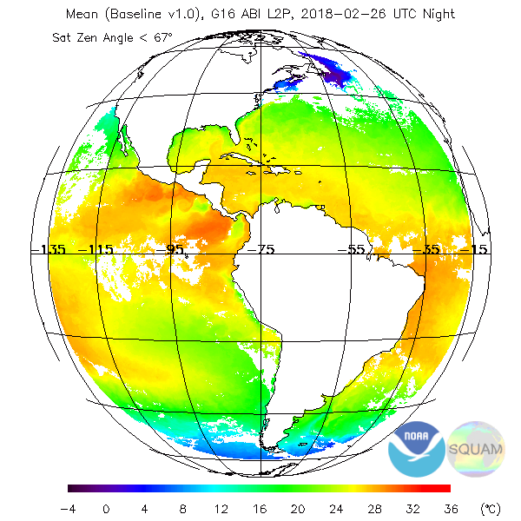
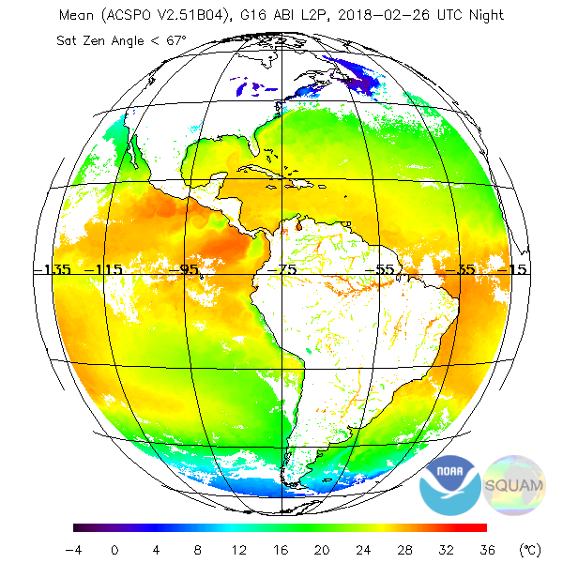
Open ADRs: ADR579
No SST Reported Over Internal Waters
Baseline SST is not retrieved/reported over internal waters (In 2010, STAR code & ATBD included internal waters)
The ACSPO enterprise system retrieves/ reports SST over internal waters
Baseline
ACSPO

Slide 40


Open ADRs: ADR269
Blocks with Highest Quality SST
2018-02-23 T17:00
Anomaly ADR 269 is still present: OR_ABI-L2-SSTF-M3_G16_s20180541700396_e20180541756160_c20180541800261.nc
Also, time_bounds=9.969209968386869E36 which is unreasonable value (ADR 509).

Slide 41
Open ADRs: ADR509
Wrong Time Stamp/Time Bounds
Wrong start time stamp in the file name (170 cases have been counted). Below is one example.
2017-11-05: OR_ABI-L2-SSTF-M3_G16_s20000011200000_e20173091711150_c20173091712450.nc
Wrong values of “time_bounds” variable - Scan start and end times in seconds since epoch (2000-01-01 12:00:00). 81 cases have been counted. Below is one example.
Date : File name : time_bounds[0] time_bounds[1]
2018-02-23 : OR_ABI-L2-SSTF-M3_G16_s20180541700396_e20180541756160_c20180541800261.nc : 9.96920996838687e+36 9.96920996838687e+36
Note that data in many of ADR 509 anomalous files show anomaly addressed in ADR 269.
Open ADRs: ADR608
Identical Start/End & Wrong Time bounds
Start and end time are the same in file names (38 cases have been counted).
Wrong values of “time_bounds” variable - Scan start and end times in seconds since epoch (2000-01-01 12:00:00).
Date : File name : time_bounds[0] time_bounds[1]
2018-01-07 : OR_ABI-L2-SSTF-M3_G16_s20180070045398_e20180070045398_c20180070100026.nc : 9.96920996838687e+36 9.96920996838687e+36

Slide 42
Open ADRs: ADR577
Aperiodic Data Flow
The Baseline L2 SSTF (hourly composite) data flow is not periodic. Generally, the files have the start time difference of an hour. But frequently, the difference is larger or smaller than an hour. One example is shown below. The anomaly occurs almost every day at the same time.
OR_ABI-L2-SSTF-M3_G16_s20173311400… L1b data exist to make instantaneous SST
1415 – L1b data exist to make instantaneous SST
1430 – L1b data exist to make instantaneous SST
1445 – L1b data exist to make instantaneous SST
OR_ABI-L2-SSTF-M3_G16_s20173311500… L1b data exist to make instantaneous SST
1515 – L1b data exist to make instantaneous SST
1530 – L1b data exist to make instantaneous SST
OR_ABI-L2-SSTF-M3_G16_s20173311545… L1b data exist to make instantaneous SST
1600 – L1b data exist to make instantaneous SST
1615 – L1b data exist to make instantaneous SST
1630 – L1b data exist to make instantaneous SST
OR_ABI-L2-SSTF-M3_G16_s20173311645… L1b data exist to make instantaneous SST
1700 – L1b data exist to make instantaneous SST
1715 – L1b data exist to make instantaneous SST
1730 – L1b data exist to make instantaneous SST
1745 – L1b data exist to make instantaneous SST
OR_ABI-L2-SSTF-M3_G16_s20173311800… L1b data exist to make instantaneous SST
60 m
45 m
60 m
Although the interval is one hour, the start times are not a round hour.
75 m
The Baseline Composite SST data flow is irregular though all M3 15-minutes L1b data exist. Therefore, the irregularity is not caused by possible irregularity in L1b data flow.

Slide 43
Open ADRs: No ADR assigned yet
No L1b data exist for shown “Start Time”
No L1b data for shown Start Time
OR_ABI-L2-SSTF-M3_G16_s20173241730391_e20173241841085_c20173241843340.nc
OR_ABI-L2-SSTF-M3_G16_s20173481515413_e20173481611180_c20173481615147.nc
OR_ABI-L2-SSTF-M3_G16_s20173550230432_e20173550326199_c20173550330237.nc
OR_ABI-L2-SSTF-M4_G16_s20173631100224_e20173631100224_c20173631107124.nc
Open ADRs: No ADR assigned yet
No information about DO version in file names/global attributes
No information about DO version in files: Currently, there is no info in L2 files about a product (code) version. There is no way for user to attribute recent changes implemented, when, etc

Slide 44
Path to Full Maturity

Slide 45
Path to Full Maturity
Keep conducting the same PLPTs & improving product
  Create match-ups w/high-quality L4 analyses and in situ data & display in SQUAM, to guide products improvements
  Adjust algorithms, as needed (recalculate SST coefficients, tweak parameters in SST QC, etc)
  Work with NOAA, National and International (GHRSST) users & partners, solicit feedback, and improve product
  Work towards product easy access and archival
Explore the NOAA Enterprise Algorithm, to provide users best fit-for-purpose service and products, and best satisfy their needs
Notes:
can add as many slides as needed. Large importance

Slide 46
Baseline vs. Enterprise SST
Feature | Baseline | Enterprise
Algorithm | 2010 ACSPO⁽¹⁾ v1.20 (“SEVIRI”) | 2018 ACSPO⁽¹⁾ v2.51 (“AHI/ABI”)
Bands used for SST | Reconciled w/ACSPOv2.41 | Day & Night: 8.6, 10.4, 11.2, 12.3 μm
Switch between day/night | Reconciled w/Enterprise | One algorithm ensures consistent diurnal cycle
Availability to users | PDA (To be archived in CLASS) | PDA (To be archived in PO.DAAC)
Clear-Sky Mask | Framework “One-size-fits-all” | Optimized for SST, consistent w/JPSS/H8
Internal Waters | No | Yes
Gridded L3U Product | No | Yes (consistent w/VIIRS/AVHRR/AHI/MODIS)
Output File Format | No-GDS2 | GDS2⁽²⁾ – Critical for International SST users
SSES⁽³⁾ | No | Yes. Minimizes local SST biases & global SDs
1hr Compositing/Collation | Composite (propagates cloud) | Collated (minimizes cloud leakages)
Potential Improvements | Challenging | Ongoing (e.g. adding fronts in ACSPO 2.60)
Science Maintenance/Val | Unique (Costly/Less Efficient) | Unified (Enterprise Processes)
Reprocessing | No provision | Ongoing (for G16/ABI & H8/AHI)
Consistent w/NOAA SSTs | No | Yes (w/VIIRS/AVHRR/AHI/MODIS)
⁽¹⁾ ACSPO | Advanced Clear-Sky Processor for Oceans – NOAA Enterprise SST System
⁽²⁾ GDS2 | Group for Hi-Res SST (GHRSST) Data Spec v2.0 – SST community standard
⁽³⁾ SSES | Single Sensor Error Statistics – in-pixel estimates of SST bias and standard deviation (required by GDS2 format and by modelers, including NCEP)

Slide 47
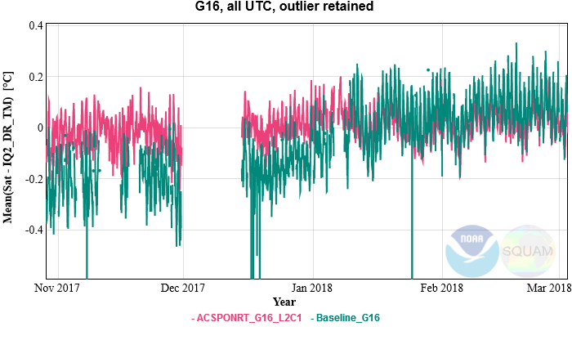
Mean Bias wrt. in situ SSTs
Each data point = 1hr FD statistic (1.5-3 thousand match-ups)
Specs: ±0.2K
Biases wrt. in situ are largely within the JPSS/H08 specs, for both products

Slide 48
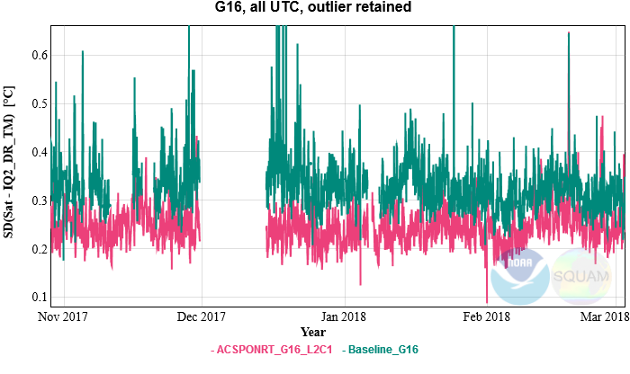
Std Dev. wrt. in situ SSTs
Specs: 0.6K
Each data point = 1hr FD statistic (1.5-3 thousand match-ups)
The SD wrt in situ are largely within JPSS/H8 specs, for both products

Slide 49
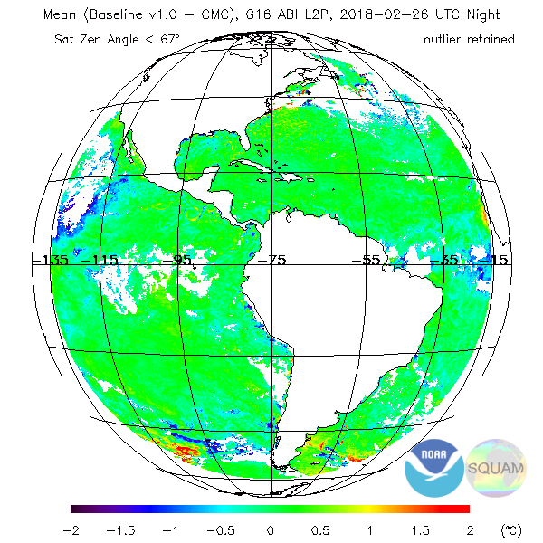
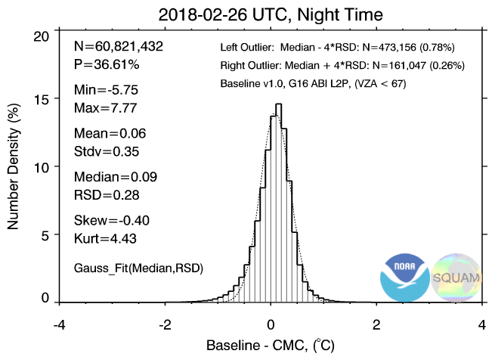
Compare with CMC L4:
Night Composite 26 Feb 2018
Long left tail in SST histograms
Cloud leakages (both cold and warm) most often occur around cloud edges, and along (some, not all) coastlines
Fixing those is likely an expensive effort, involving analyses of clear-sky mask in conjunction with SST QC

Slide 50
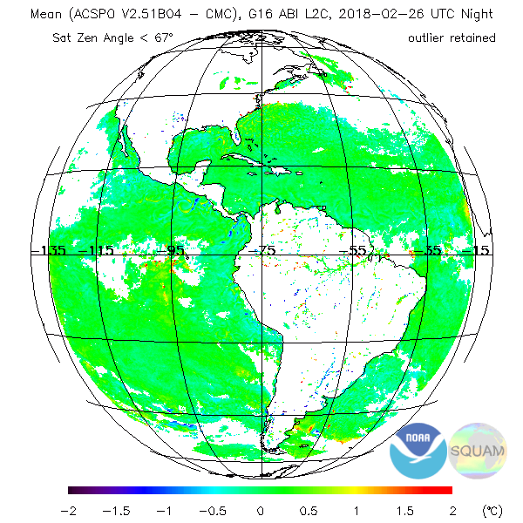
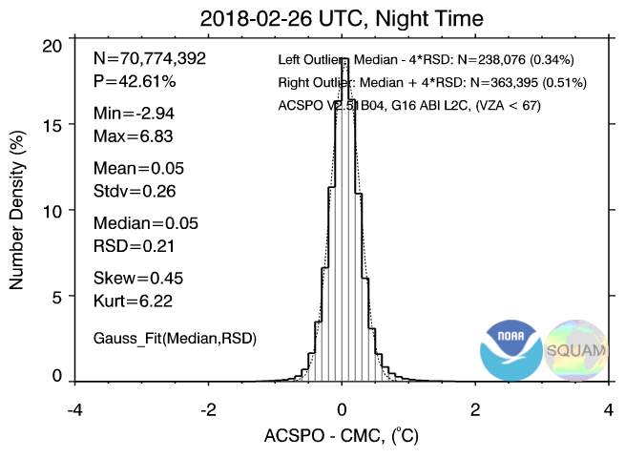
Compare with CMC L4:
ACSPO Composite 26 Feb 2018
No long left tail in SST histograms
Some residual cloud & SST depression around cloud edges also seen in ACSPO, but at much reduced scale
This comes at the expense of slightly reduced SST domain, but the areas screened out are indeed cloud

Slide 51
ABI SST Users
Baseline
  AWIPS/WFOs
ACSPO L2P/L3U: Requested/Looked at the Data (PDA pull)
  NOAA Geo-Polar Blended L4 SST (Eileen Maturi, Andy Harris, John Sapper)
  NOAA OPC (Bob Daniels, Fran Achorn)
  NOAA OAR GLERL (George Leshkevich – Great Lakes)
  PO.DAAC (Ed Armstrong, Wen-Hao Li, Tim McKnight)
  NOAA EMC HYCOM/NCODA (Ilya Rivin, Jim Cummings)
  NOAA Coast Watch – all nodes (Veronica Lance – Central, Ron Vogel – East Coast, Joaquin Trinanes – Caribbean, Dale Robinson – W. Coast, Melanie Abecassis – Pacific)
  Australian Bureau of Meteorology (Helen Beggs, Chris Griffin, Pallavi Govekar)
ACSPO L2P/L3U: Inquired/Expressed Interest (No routine pull yet)
  CSU/NHC (Galina Chirokova, Mark De Maria, Monica Bozeman)
  NOAA West Coast Ocean Forecast System (Alexander Kurapov)
  Canadian Met Centre (CMC) L4 (Dorina Surcel-Colan)
  NAVO (Bruce McKenzie)
  Danish Met Institute (Jacob Høyer)
  JMA (Yukio Kurihara)

Slide 52
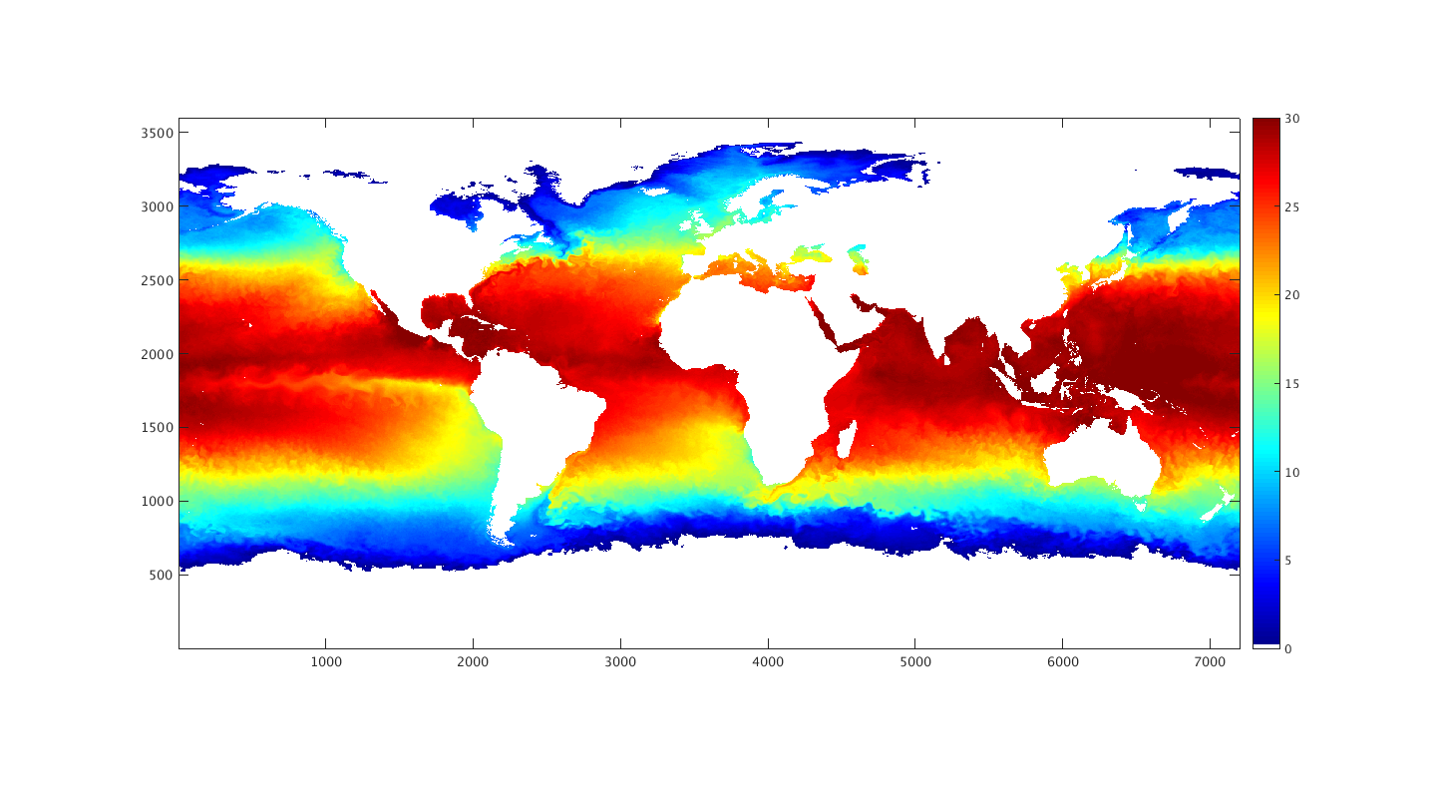
Geo-Polar Blended SST Analysis
(Example of 20 Oct 2017)
Result after ~14 days of G16 ACSPO SST assimilation
Courtesy E. Maturi, A. Harris, J. Sapper

Slide 53
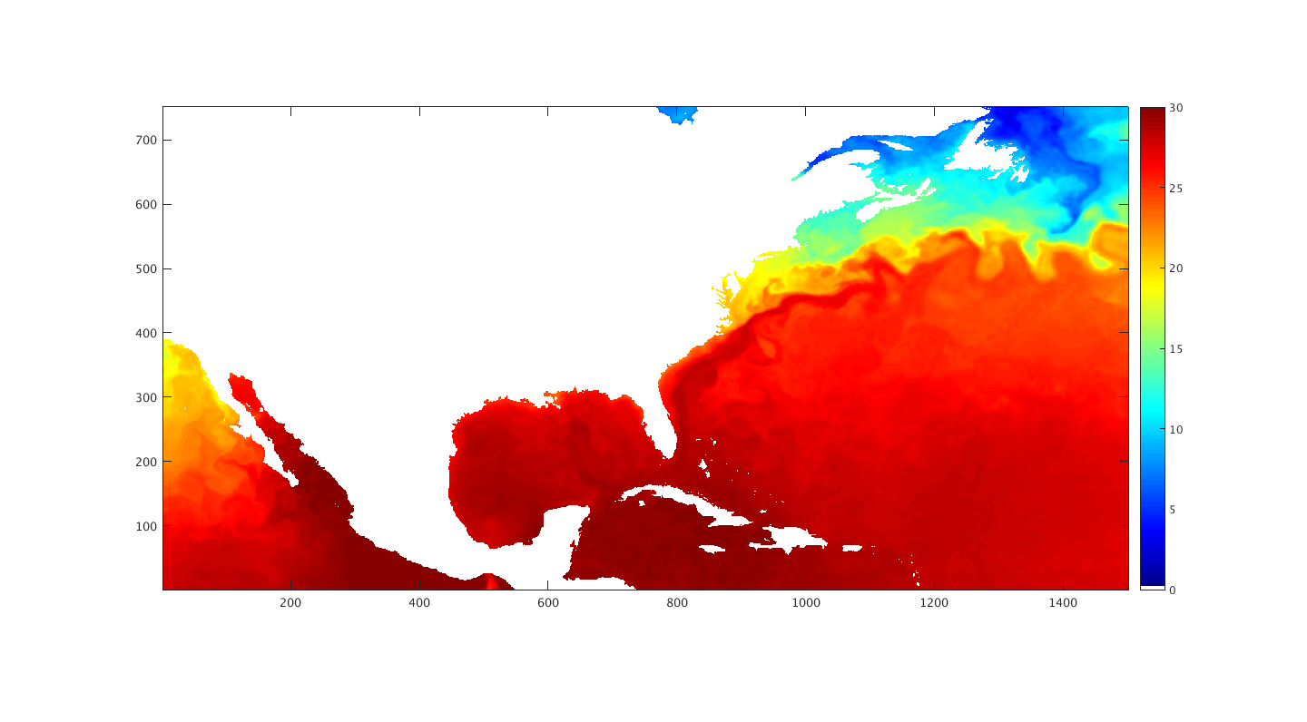
Geo-Polar Blended SST Analysis
(Example of 20 Oct 2017)
Good Feature Resolution in High-Gradient Areas
Courtesy E. Maturi, A. Harris, J. Sapper

Slide 54
Geo-Polar Blended SST Analysis
Summary
G16 SST assimilates into NOAA Geo-Polar Blended SST Analysis without significant issues
  SSTs and bias correction fields seem reasonable
NOAA Geo-Polar Blended SST Analysis does have better feature resolution than Met Office OSTIA L4 product
  See SQUAM L4 validation online
Courtesy E. Maturi, A. Harris, J. Sapper

Slide 55
Conclusion

Slide 56
Recommendation
For SST Provisional Maturity
Product performance has been demonstrated through a large, but still seasonally limited, number of independent measurements. The analysis is sufficient for limited qualitative determinations of product fitness-for-purpose, and the product is potentially ready for testing in operational use
AWG SST Team therefore recommends that the Baseline SST Product be transitioned to Provisional status at this time
All tests appear to work
Major flaws can be attributed to known issues that will soon be resolved
Long term (at least 5 months) validation was done successfully, in the full retrieval domain (Full Disk)
So far, L1B issues are not impacting SST performance significantly
PASSED

Slide 57
Summary
AWG recommends that the G16 SST Product be transitioned to Provisional status at this time
We recommend fixing the following issues before Full Validation
  Fix large QF/SST outages (ADR 269)
  Fix wrong Time Stamps/Bounds in file names/attributes
  Fix Aperiodic Data Flow
  Include info on algorithm version in files global attributes
User Feedback will determine if these issues will impact Full Validation Maturity
We will work with users interested in NOAA enterprise product to facilitate data access & use

