Slide 1
GOES-16 Sea Surface Temperature in AWIPS-2
NWS/OBS Update to Provisional PS-PVR Group 4a
March 9, 2018

Slide 2
GOES-16 Sea Surface Temperature in AWIPS-2
Fielded AWIPS-2 systems currently ingest and display SST
  Applies DQF (value 0) to retain good quality pixels
NWS transmission via SBN commenced on January 17, 2018
NWS Central Region requested inclusion of Great Lakes
  ADR has been opened to add DEEP_INLAND_Water to processing
NWS Satellite Enhancement Team collaboration on display configurations
  Prepared new colormap/style rules (-5 to 35C / 23 to 95 F)
  Breakpoint highlights tropical cyclone formation threshold (25.5C - 27C)
  Default selection depicts both degF and degC (can toggle between/sample)
  Enhancements fielded across NWS in early February
Sample AWIPS2/CAVE screenshots are in the following 2 slides

Slide 3
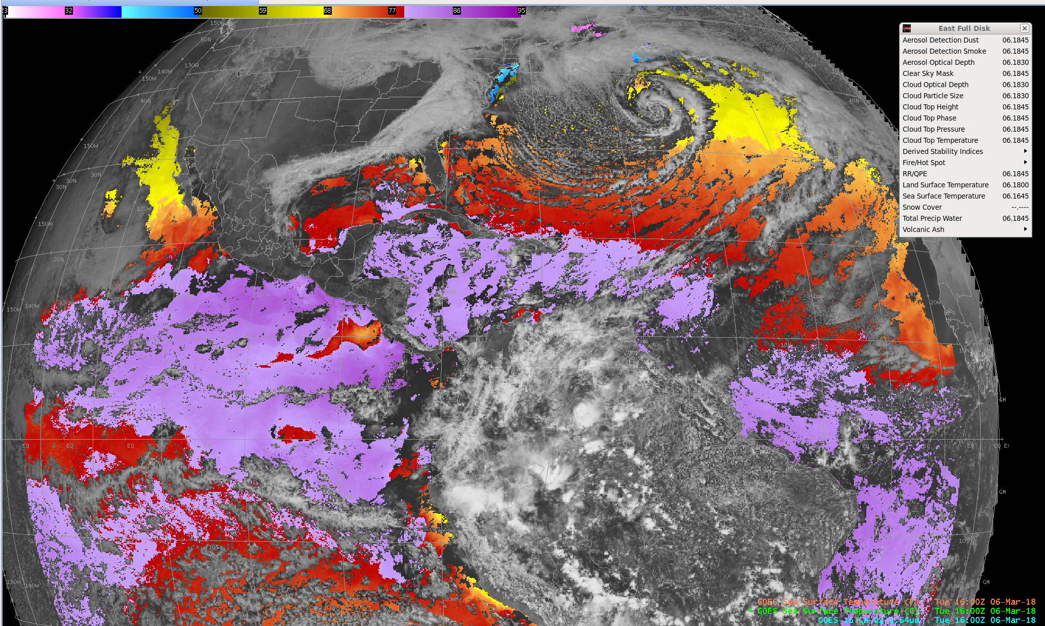
GOES-16 SST and CH-02 Imagery
14:22 Z 13 Feb 2018

Slide 4
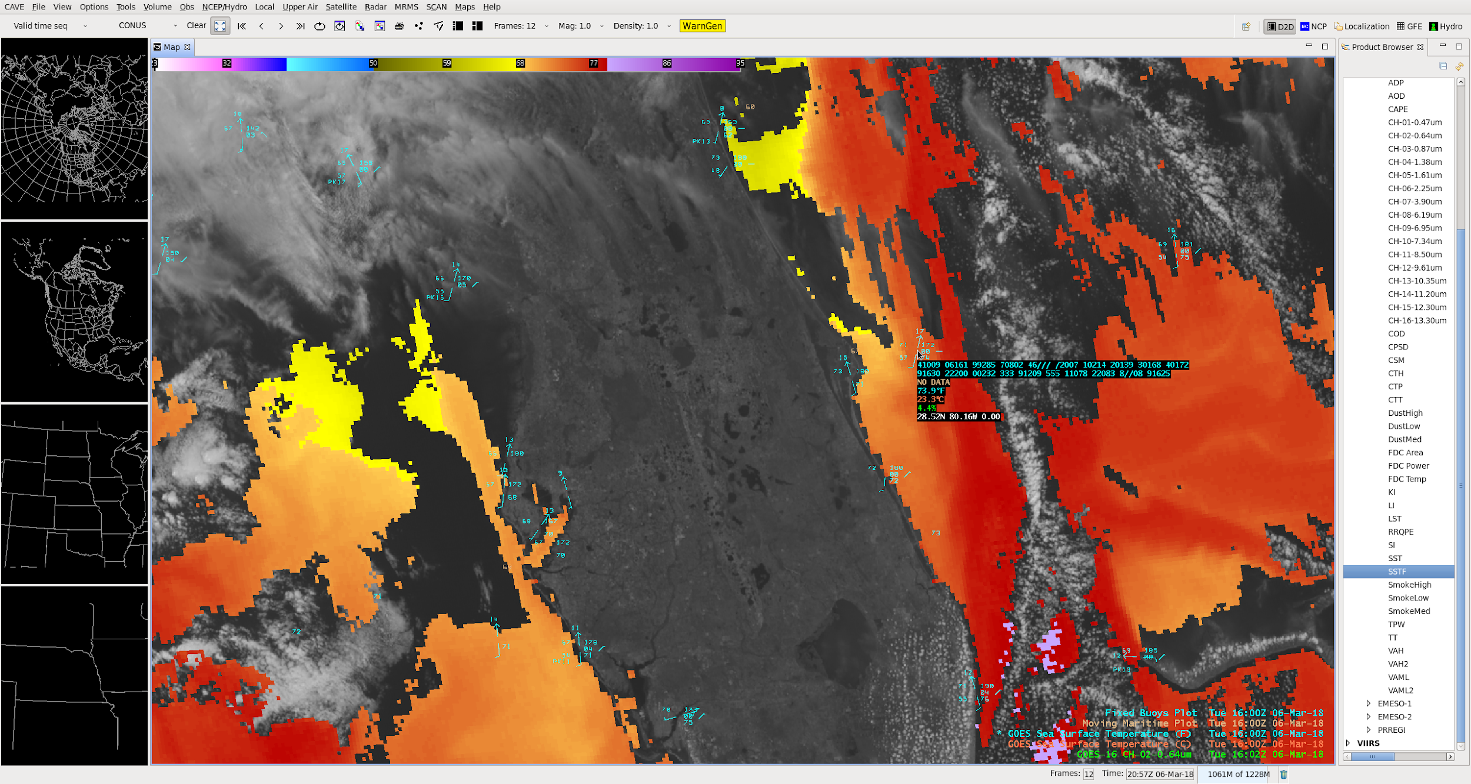
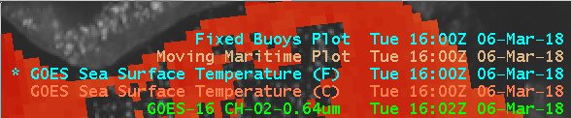
GOES-16 SST Zoom-in (Florida)
Cursor readout shown:
Buoy: 74F
ABI SST: 73.9F (23.3C)

Slide 5
Questions?

