Slide 1
PS-PVR for Vol Ash
Jamie Kibler
Washington Volcanic Ash Advisory Center Manager
July 20, 2018

Slide 2
The Benefits of vol Ash Product
Analysts are able to identify the ash/aerosol cloud in the RGB imagery. RGB imagery in full resolution looks good.
The ability to get an estimate on the height in different color shades and sample the ash for a definitive height is beneficial. This is not available in our main platform – N-AWIPS.
The ash product in AWIPS-II will be of benefit down the road if SAB makes the switch over to the platform. The potential to have everything in one system is time saving and cost efficient.
RGBs looks much better in AWIPS-II than N-AWIPS (no Ash product in N-AWIPS).

Slide 3
The Issues of vol Ash Product
SAB analysts are not able to get alerts by email or in AWIPS-II when there is an eruption that we may have missed.
The most recent version is not available in AWIPS-II. It’s difficult to compare new version vs old version vs VOLCAT webpage
AWIPS-II is not (N-AWIPS) SAB’s platform for issuing advisories. Difficult to translate back and forth for moderate to large eruption
Difficult to determine Ash vs SO2
SAB Analysts are more familiar with Mcidas, N-AWIPS and VOLCAT website.
Need a guide on AWIPS-II since most of our analysts are not familiar with the platform and we have only been looking at the full resolution product for 2 months. Finding the product is not as intuitive as N-AWIPS

Slide 4
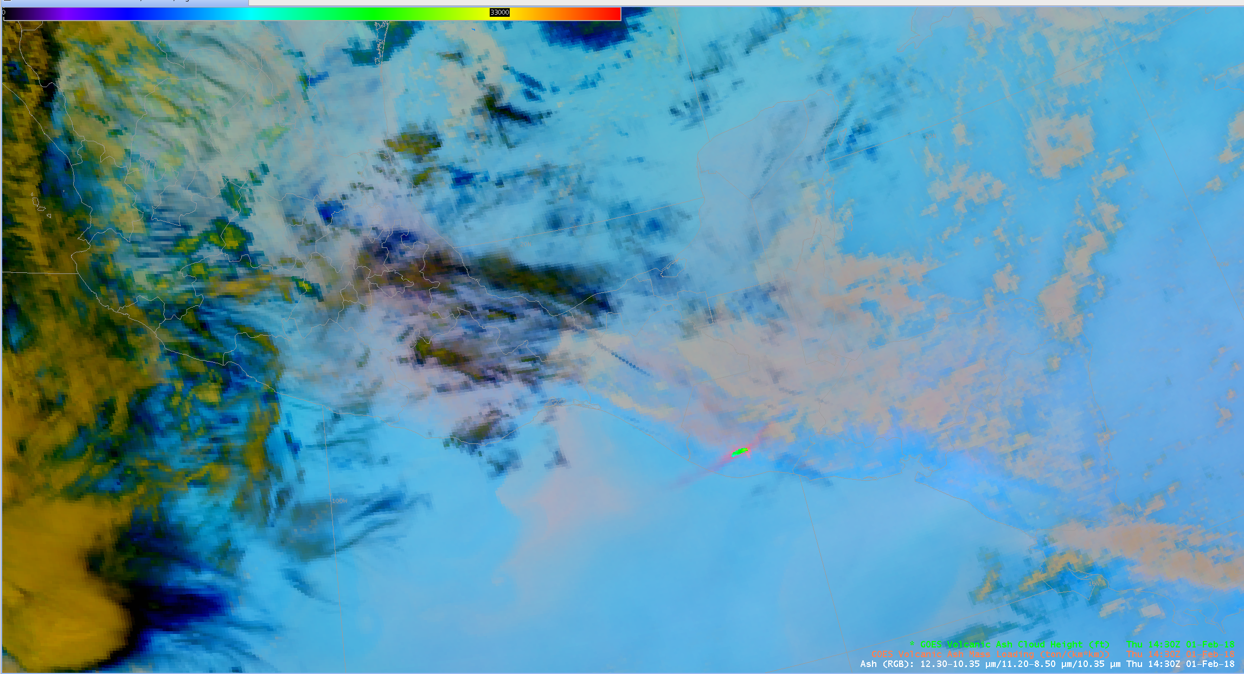

Slide 5
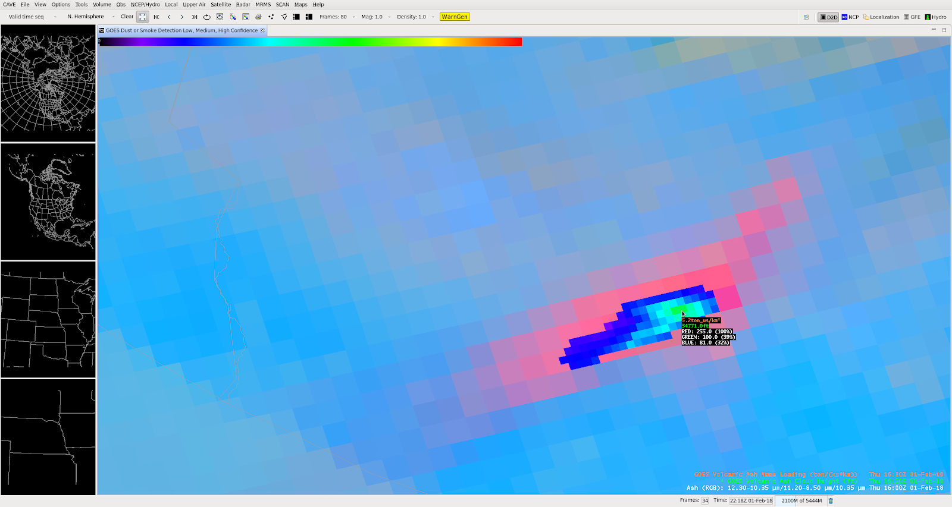

Slide 6
Conclusion PS-PVR for Vol Ash
Recommend keeping the product in AWIPS-II. If SAB makes the switch over to AWIPS-II in the future we will be able to overlay imagery with other ancillary products to produce Volcanic Ash Advisories and Volcanic Ash Graphics.
Recommend if possible to update the algorithm to the latest version and have the ability to do this on a bi-yearly process.
Recommend a training guide for AWIPS-II users who are not as familiar on the platform would be great. SAB and maybe the NCEP Centers.

Slide 7
Thanks
Jamie Kibler
Jamie.Kibler@noaa.gov
NESDIS/NOAA/OSPO/SPSD/SAB
Washington VAAC

