Slide 1
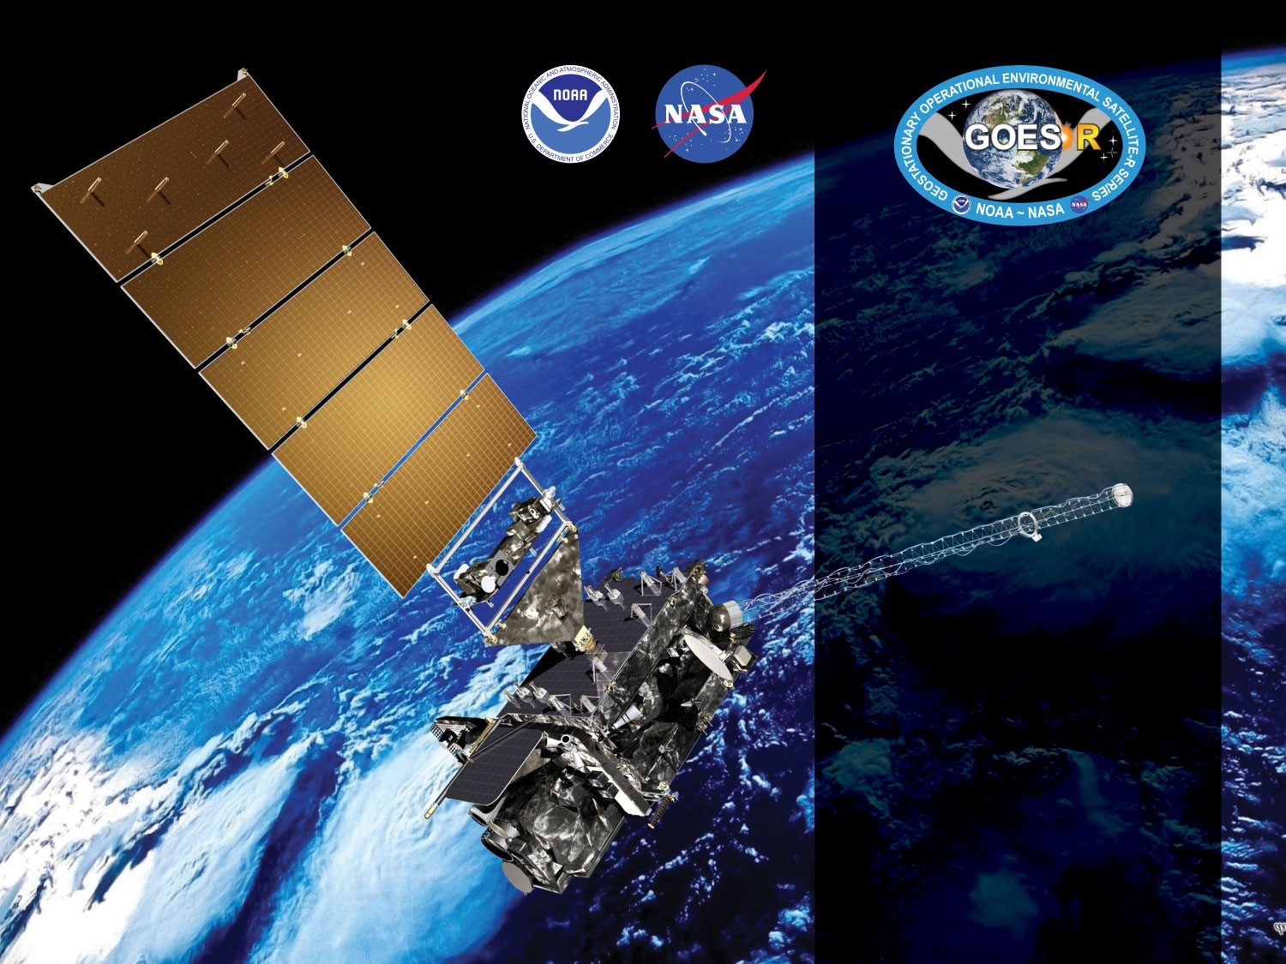
GOES-16 ABI L2+ Volcanic Ash Height and Loading (VAH)
Provisional PS-PVR
July 20, 2018
Michael Pavolonis*, Justin Sieglaff, Jason Brunner
GOES-R AWG
NOAA/NESDIS/STAR*
CIMSS

Slide 2
Agenda
Review of Beta Maturity
Provisional Validation Product Maturity Assessment
Path to Full Validation Maturity
Summary and Recommendations

Slide 3
Review of Beta Maturity
GOES-16 Volcanic Ash L2 Products Provisional PS-PVR

Slide 4
PLPTs Under Review
Beta
PLPT ID | Descriptive Title | % Complete | Results | AWG POC
ABI-FD_VAH01 | Verify Product is generated every 15 min for FD for M3 | 100 | Complete | AWG
ABI-FD_VAH02 | Verify ash confidence is generally low (via quality flags) for every 15 min for FD for M3 | 100 | Complete | AWG
ABI-FD_VAH03 | Verify product is generated every 15 min for FD for M4 | 100 | Complete | AWG
ABI-FD_VAH04 | Verify ash confidence is generally low (via quality flags) for every 15 min for FD for M4 | 100 | Complete | AWG
ABI-FD_VAH05 | Early quantitative assessment of product for M3 and M4 | 100 | Complete | AWG
PS-PVR BETA granted on 8 June 2017

Slide 5
Requirements
Measurement accuracy of 3 km for ash top height
Measurement accuracy of 2.0 tons/km² (2 g/m²) for ash mass loading.
Measurement precision of 2.5 tons/km² (2.5 g/m²) for ash mass loading

Slide 6
Cadence for verification
Mode | Mode 3 | Mode 4
Scan Type | FD | FD
Scan Freq | 15 min | 5 min
VAAF - Ver Freq | 15 min | 15 min

Slide 7
Risks to Reaching Provisional
Risk Name | Description | Impact | Mitigation and Schedule
Incorrect CRTM coefficients | The incorrect CRTM coefficients are being used in the GS. | Minor | Fixed in 2017
LUT updates | LUT for retrievals will need to be updated | Minor | An updated LUT was provided in 2017
Missing data blocks during M4 testing | Large portions of the L1b data are missing during M4 causing large areas of “invalid” (fill) pixels | Major | Fixed in 2018
Use of band 14 | A Himawari-8 based analysis showed that the volcanic ash algorithm performs better when band 13 is used in lieu of band 14. This issue has been known about since 2015. | Major | This issue was addressed with an algorithm software update that was implemented on 31 October 2017
Insufficient range of volcanic activity and geographic sampling | So far, only relatively minor ash emissions from tropical volcanoes have been observed by GOES-16. A broader range of activity over a broader range of locations is needed to truly characterize the performance of the volcanic ash products | Major | Supplement GOES-16 analyses with Himawari-8 analyses. Many new GOES-16 cases have also been analyzed.
Insufficient CALIOP observations of volcanic ash | CALIOP observations of volcanic ash are generally rare and accumulation of sufficient pixel counts for validation is a concern | Major | Supplement GOES-16 analyses with Himawari-8 analyses

Slide 8
Upstream Algorithm Issues
Upstream Issue | Description | Impact | Algorithm Implications
ABI L1b - INR | Issues remain with ABI L1b INR issues associated with navigation and co-registration issues | Major | Cloud edges and convective clouds will be mistaken for high confidence ash
ABI L1b - Stripping | Image stripping is present in some imagery data | Minor | Regions of striping may be misclassified as high confidence ash
ABI L1b - Calibration Issues | Calibration is still being evaluated on the system | Medium | Accurate measurements and clear sky simulations are needed for bands 10, 11, 14,15, and 16. The clear sky bias in band 11 is larger than expected. The cause is still being investigated.
ABI L1b - GRB | Missing blocks of data in M4 due to terrestrial GRB issues | Major | Algorithm will produce invalid data in regions of missing blocks
All of the L1b issues have become far less frequent and do not pose a significant risk to achieving provisional status

Slide 9
Provisional Validation Product Maturity Assessment
GOES-16 Volcanic Ash L2 Products Provisional PS-PVR

Slide 10
Requirements for FULL Validation
VAH: Assess the accuracy and precision of the Volcanic Ash product over a large and wide range of representative conditions sufficient to verify all Volcanic Ash requirements.
  The requirements for measurement accuracy and precision must be met.
  Proving the adequacy of the Volcanic Ash product must consider at least some real volcanic ash cases

Slide 11
PLPTs Under Review
PROVISIONAL
Test ID | Test Title
ABI-FD_VAH06 | Assess the accuracy and precision of the Volcanic Ash product over a large and wide range of representative conditions.
AWG Volcanic AshTeam will conduct these tests to further evaluate the L2 volcanic ash height and mass loading product quality.
Full test plans and procedures are given in the INST Readiness, Implementation, and Management Plan (RIMP v1.0; 416-R-RIMP-0333)

Slide 12
Requirements
PROVISIONAL
Assess the accuracy and precision requirements (no downstream impacts to assess).
If accuracy and precision are not met, document reasons why as an ADR.
Remediation strategies in place.
Product ready for potential operational use.

Slide 13
Application of PLPT Quantitative Analysis Tests to each Domain
VAH output is only generated every 15 min (regardless of Mode) and is only generated for the full disk sector.
Analysis Method | FD
Visual Inspection
Time Series Stability
Manual Analysis
Wind Analysis
Lidar Analysis
Vicarious validation (e.g. previous validation efforts)
13

Slide 14
Visual Inspection and Long Term Stability

Slide 15
Qualitative Success Definitions
PASSED
Specifications are met for product cadence and creation.
PARTIAL-PASSED
Specifications are close to being met for product cadence and creation. Example: Products created with missing blocks.
FAILED
Specifications are far from being met for product cadence and creation.

Slide 16

PLPT ABI-FD_VAH01 - 05:
VAH Full Disk Mode 3: January 12, 2018
PASSED
The L1b dropout issue has improved significantly.

Slide 17
PLPT ABI-FD_VAH01 - 05:
VAH Full Disk Mode 4: February 17, 2018
PASSED
The L1b dropout issue has improved significantly.

Slide 18
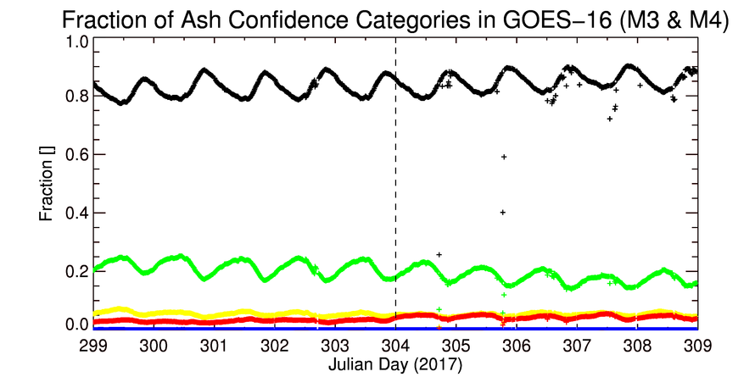
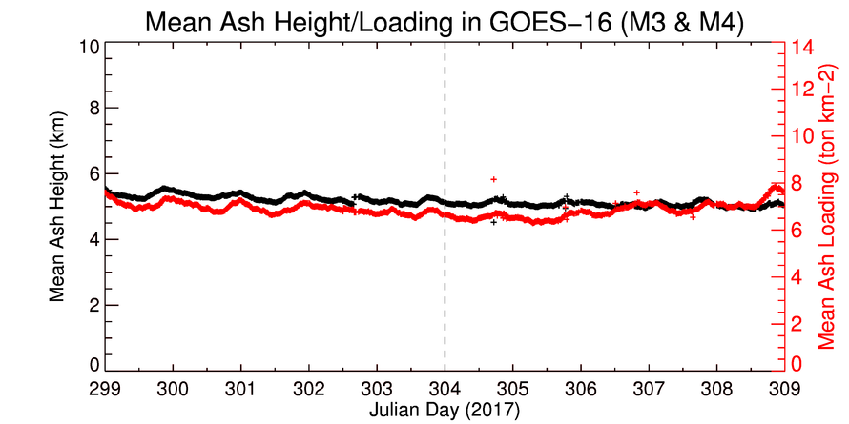
Time Series of Volcanic Ash Output
Ash Confidence Legend
Not Ash
Very Low Confidence
Low Confidence
Moderate Confidence
High Confidence
Time series of the ash confidence fraction (top) and ash retrievals (bottom) for GOES-16 (Modes 3 and 4)
Time period is October 25-November 4, 2017 (Band 13/14 swap was implemented Oct 31 (Day 304)
Overall and diurnal trends are consistent with expectations. Compromised/missing L1b is responsible for the large deviations.
PASSED
Notes:
Shows the fraction of GOES-16 pixels for each ash confidence category (top) and ash height and mass loading (bottom). Algorithm is stable, as expected.

Slide 19
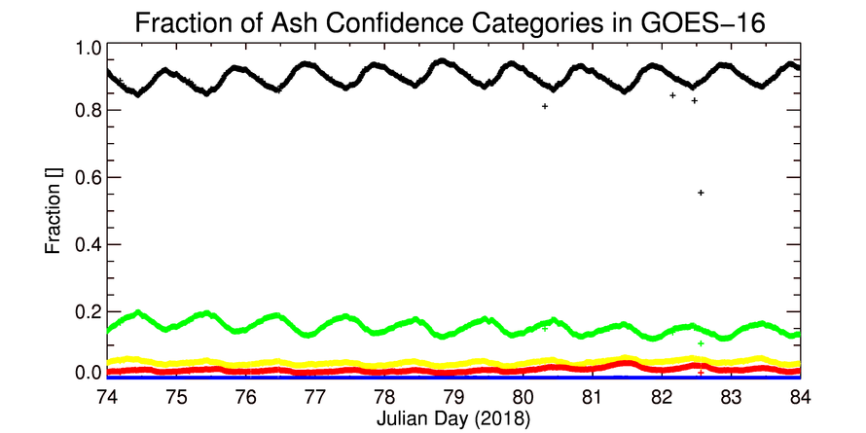
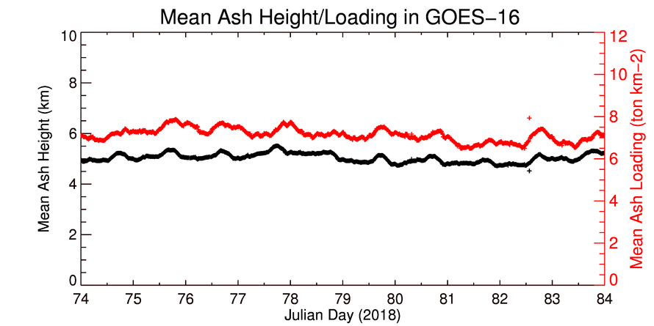
Time Series of Volcanic Ash Output
Ash Confidence Legend
Not Ash
Very Low Confidence
Low Confidence
Moderate Confidence
High Confidence
Time series of the ash confidence fraction (top) and ash retrievals (bottom) for GOES-16
Time period is March 15-24, 2018
Overall and diurnal trends are consistent with expectations. Compromised/missing L1b is responsible for the large deviations.
PASSED
Notes:
Shows the fraction of GOES-16 pixels for each ash confidence category (top) and ash height and mass loading (bottom). Algorithm is stable, as expected.

Slide 20
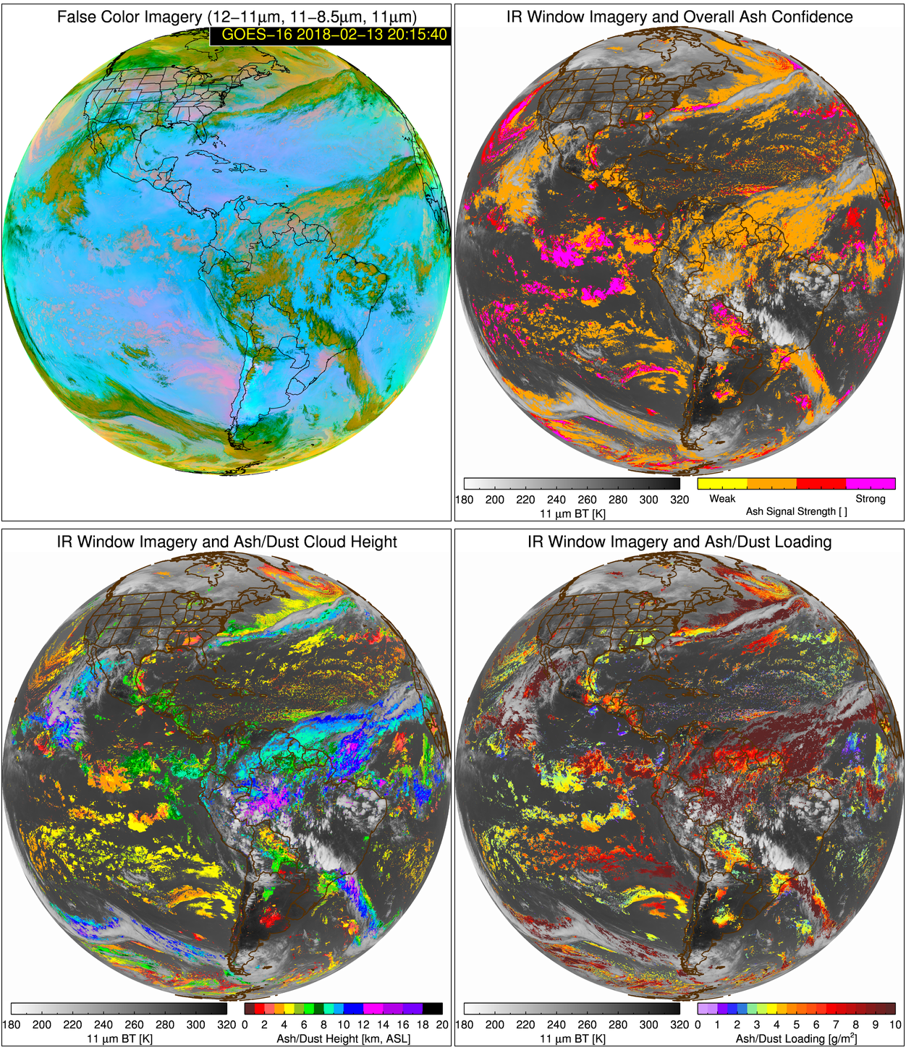
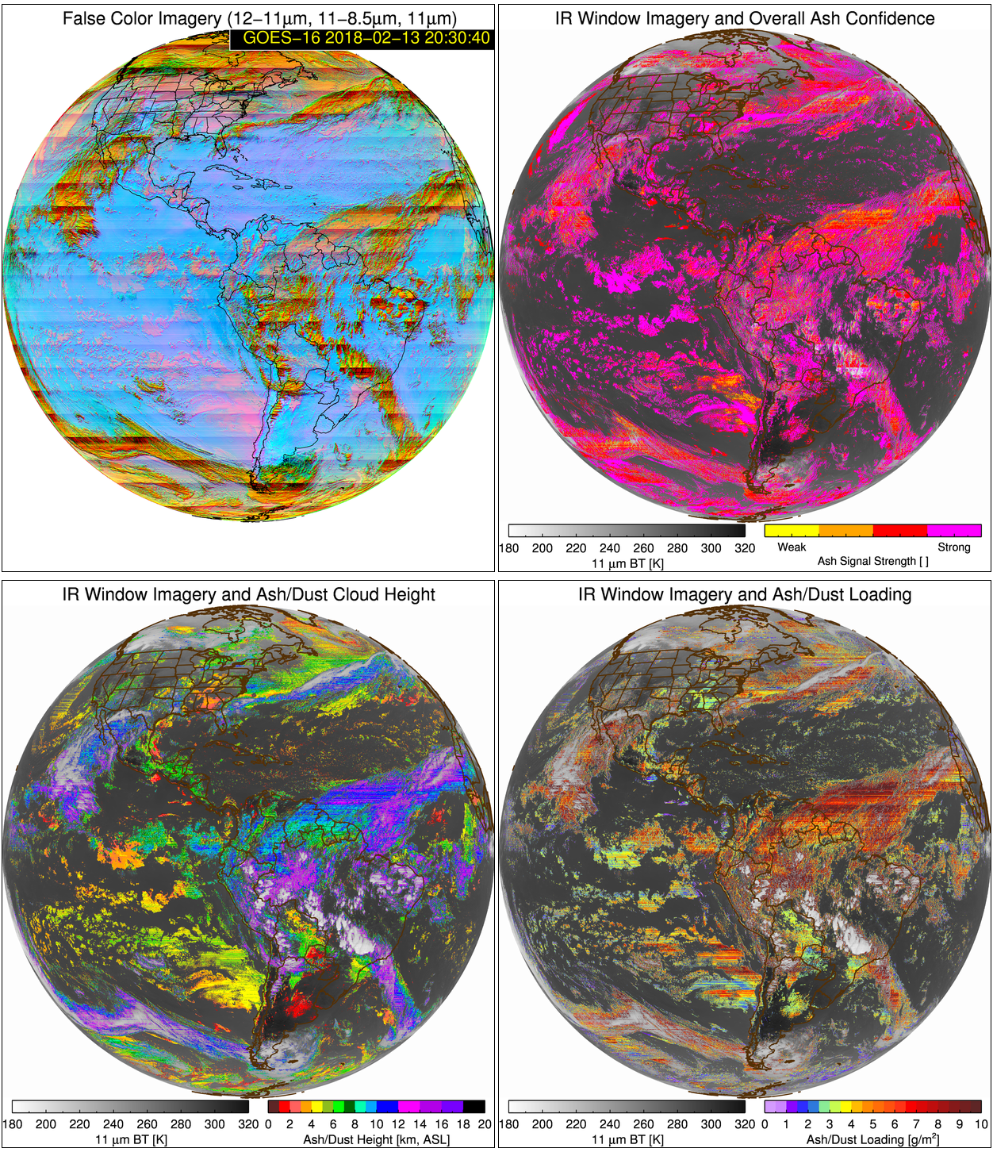
Impact of Poor Quality L1b
Most issues that involve one or more of the 8.5, 10.4, 12, or 13.3 μm bands will have a significant impact of the volcanic ash products.

Slide 21
Quantitative Evaluation of Volcanic Ash Products

Slide 22
Validation Challenges
Volcanic eruptions, within the GOES-16 full disk, are common (nearly everyday), however most produce very “small” ash clouds (in terms of number of pixels)
Completely independent observations of ash clouds, suitable for validation, are very rare
  Ash top height: Lidar (very accurate)
  Ash mass loading: Lidar (factor of 4 uncertainty), Aircraft (factor of 2 uncertainty)
Thus, human expert based analyses must also be deployed
Notes:
-Direct measurements of mass loading do not exist

Slide 23
Quantitative Success Definitions
PASSED
Specifications are met when volcanic ash is the highest cloud layer.
PARTIAL-PASSED
Specifications are close to being met when volcanic ash is the highest cloud layer.
FAILED
Specifications are far from being met when volcanic ash is the highest cloud layer.

Slide 24
Manual Analysis

Slide 25
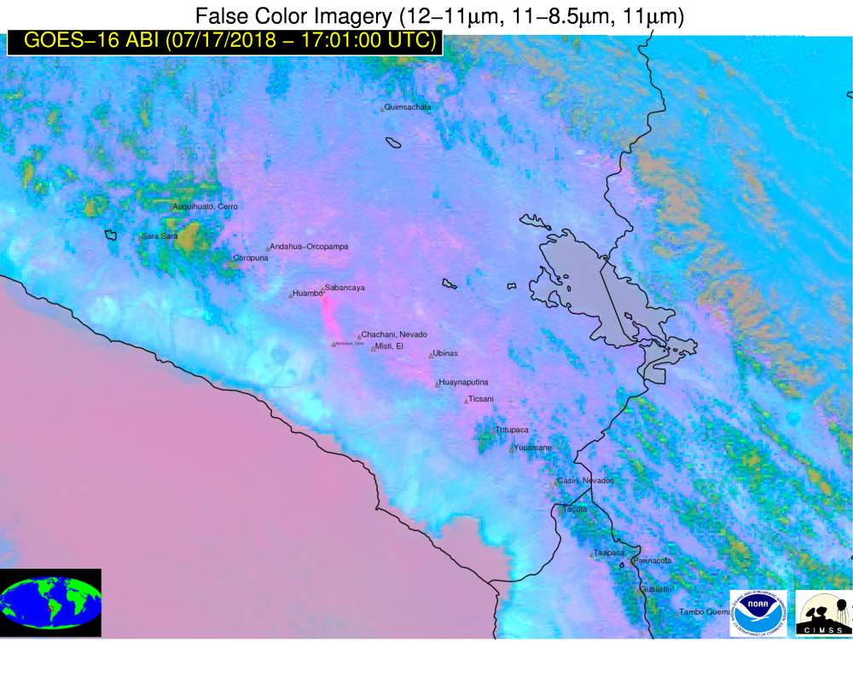
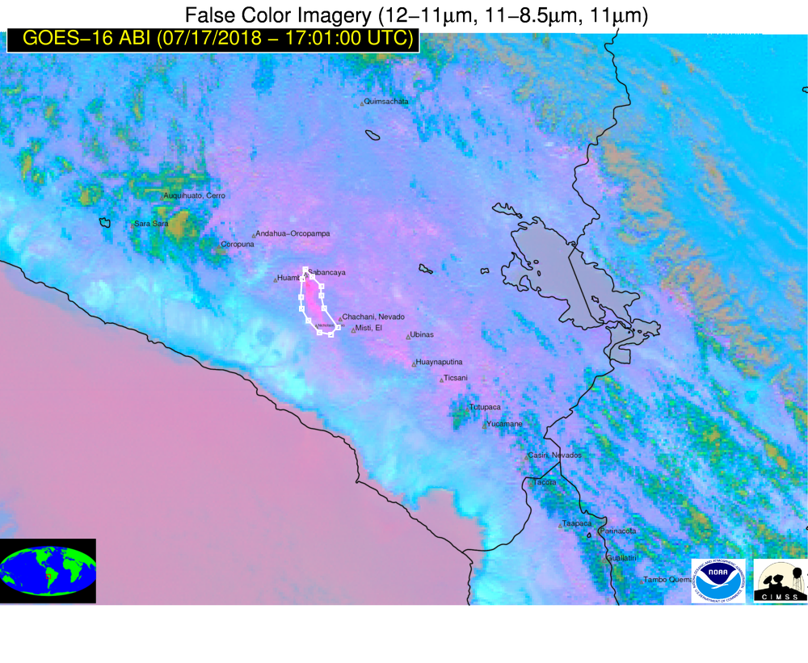
Manual Analysis of Ash Presence
Polygon vertices are exported to a database
A web-based tool allows us to extract ash contaminated pixels using manual analysis of false color imagery

Slide 26
Intensive Analysis of GOES-16 Volcanic Cases
21 volcanic ash cases analyzed since ABI Channel 13 band swap was implemented (31 Oct 2017)
Ash clouds from a variety of western hemisphere volcanoes were included
  12 Popocatepetl (Mexico)
  3 Fuego (Guatemala)
  3 Sabancaya (Peru)
  1 Reventador (Ecuador)
  2 Turriabla (Costa Rica)
The diurnal cycle is sampled
Most ash pixels are over land (more challenging than water surfaces)

Slide 27
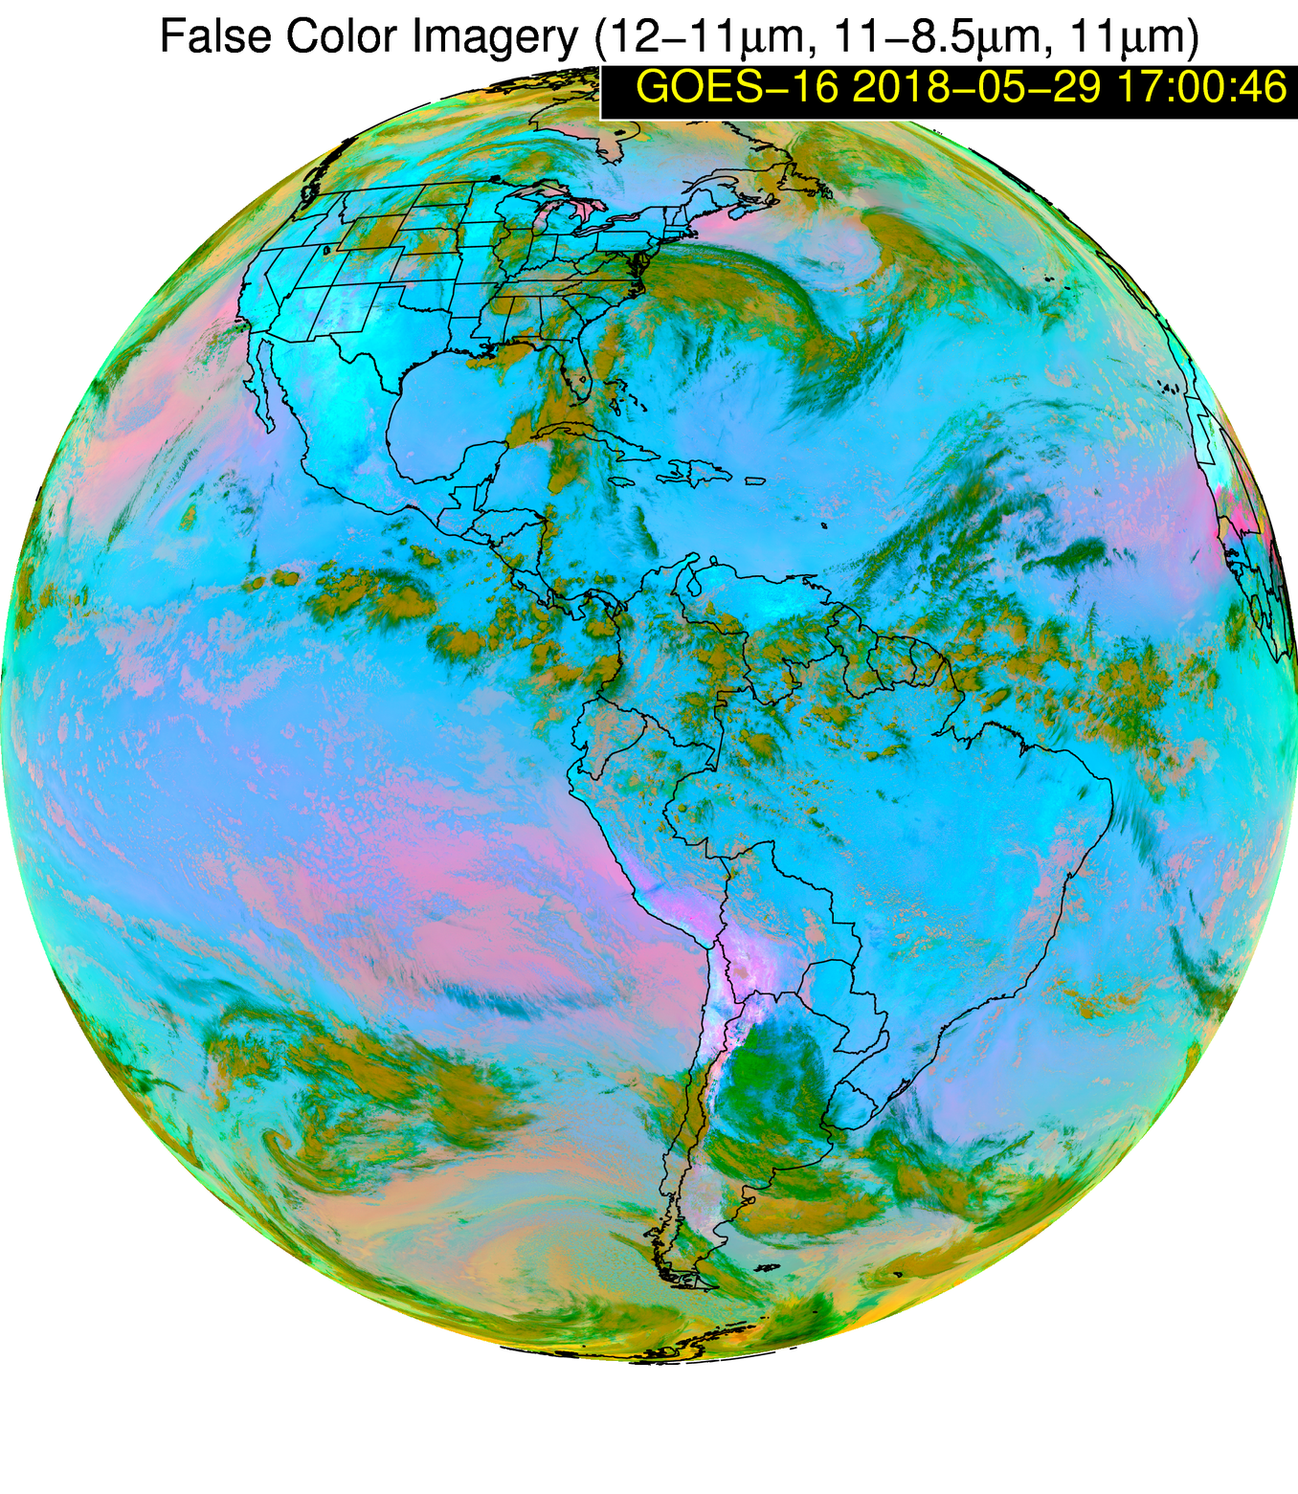
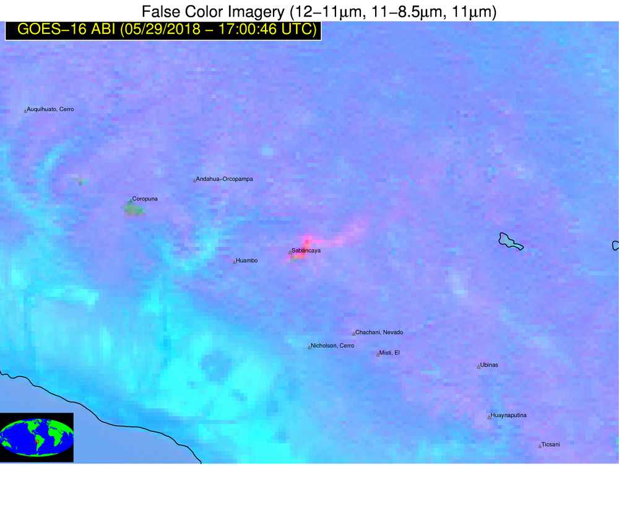
Ash Detection:
Finding a Needle in a Haystack
Image Resolution: Native/11
Image Resolution: Native x 8
Ash

Slide 28
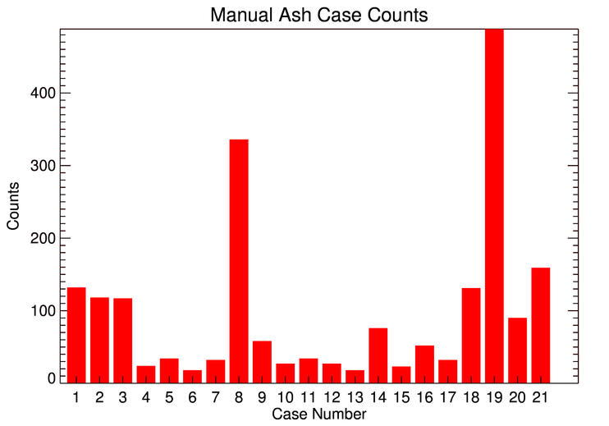
Ash Detection:
Finding a Needle in a Haystack
The most commonly occurring ash clouds only encompass 500 pixels or less at a given time (see bar chart to the left)
The GOES-16 full disk contains ~23 million Earth view pixels at the 2 km resolution
Thus, the number of non-ash pixels is typically at least 5 to 6 orders of magnitude greater than the number of ash pixels, at any given time
Pixel Count
Pixel counts for a sampling of ash clouds observed by GOES-16

Slide 29
Ash Detection Assessment:
Manual Hourly Analysis
May 28/29 2018 Sabancaya (Peru)
Areas of volcanic ash were manually extracted from each image

Slide 30
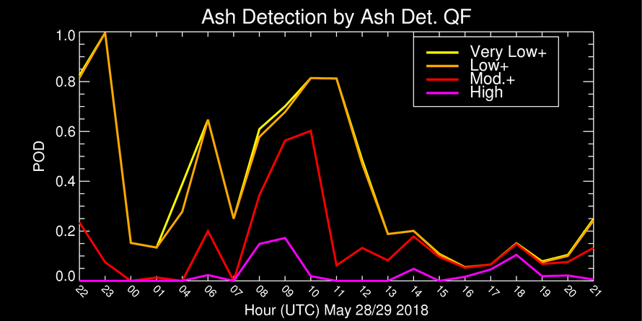
Ash Detection Assessment:
Manual Hourly Analysis
May 28/29 2018 Sabancaya (Peru)
Strong diurnal signal is due to changing background conditions.
The ash cloud encompasses all ash detection categories (simple filtering by confidence is generally not effective)
Notes:
02, 03 and 05 UTC are omitted because no discernable volcanic ash could be analyzed.

Slide 31
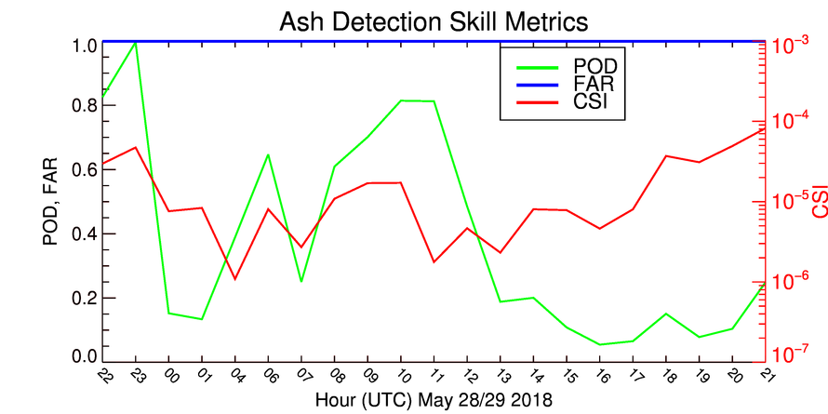
Ash Detection Assessment:
Manual Hourly Analysis
May 28/29 2018 Sabancaya (Peru)
POD is using very low ash confidence and higher confidence.
Small CSI (~ 10⁻⁴ to 10⁻⁶) is due to the large number of false alarm pixels within full disk.
Notes:
02, 03 and 05 UTC are omitted because no discernable volcanic ash could be analyzed.

Slide 32
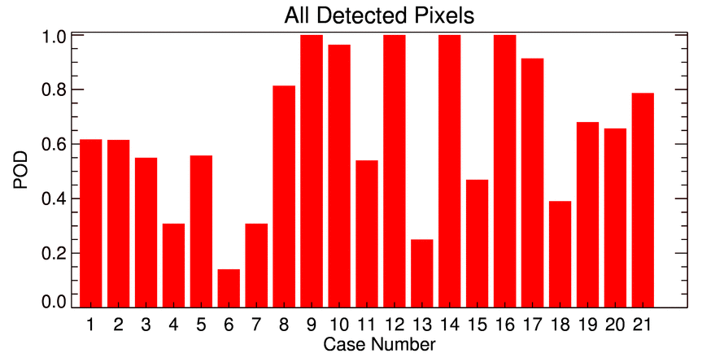
Ash Detection Assessment:
Sampling of Various Volcanic Events

Slide 33
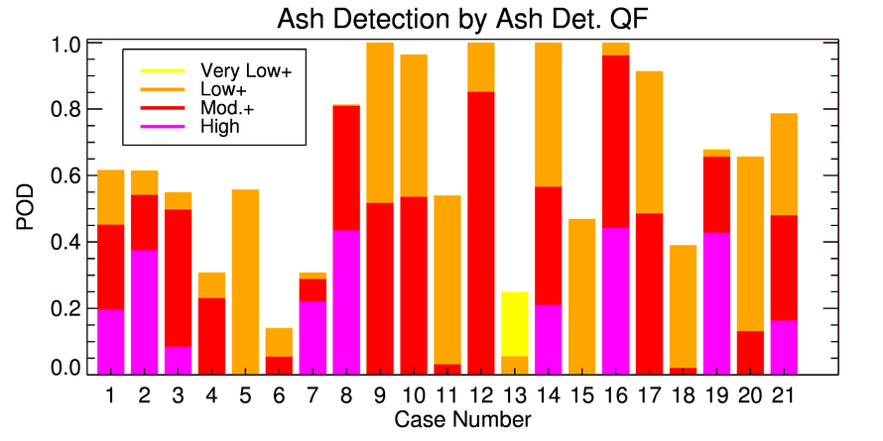
Ash Detection Assessment:
Sampling of Various Volcanic Events

Slide 34
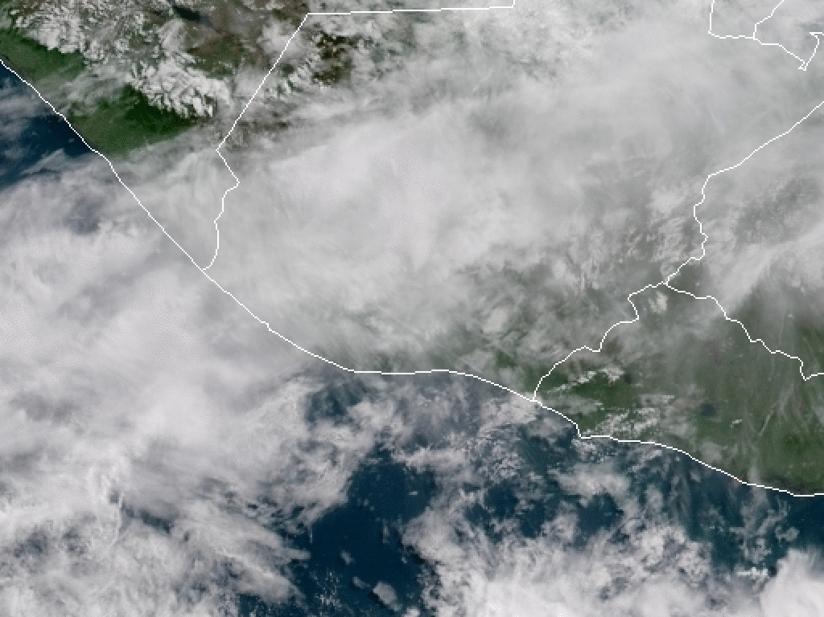
Fuego – 3 June 2018

Slide 35
Ash Detection Assessment
Fuego Volcano Eruption
3 June 2018
No ash from Fuego was detected because the combination of large optical depth and the presence of ice made the cloud indistinguishable from meteorological convection in the infrared. Only complex mitigation actions can address the issue.
Notes:
Mitigation: time trends in thermal anomalies + time trends in IR (10 minute data?) + GLM

Slide 36
Wind Analysis

Slide 37
Wind Analysis
As outlined in validation plan, given rare CALIPSO observations of volcanic ash in the GOES-16 domain, alternative validation methods are necessary to compliment the CALIOP/GOES-16 analysis.
Detection: manual analysis using RGB imagery loops. Used to assess detection and constrain height and mass loading validation statistics.
Height: Use false color image movies to extract ash cloud motion (speed and direction). Use radiosonde to assign the satellite derived motion a height range (only cases where vertical shear is sufficient to constrain height to a ~1 km layer were used)
Mass Loading: Satellite-derived mass loading is a strong function of the assigned cloud height. Thus, the cloud motion derived height range can be used to compute a highly representative range of “truth” mass loading.
Notes:
-Remember, direct measurements of mass loading do not exist

Slide 38
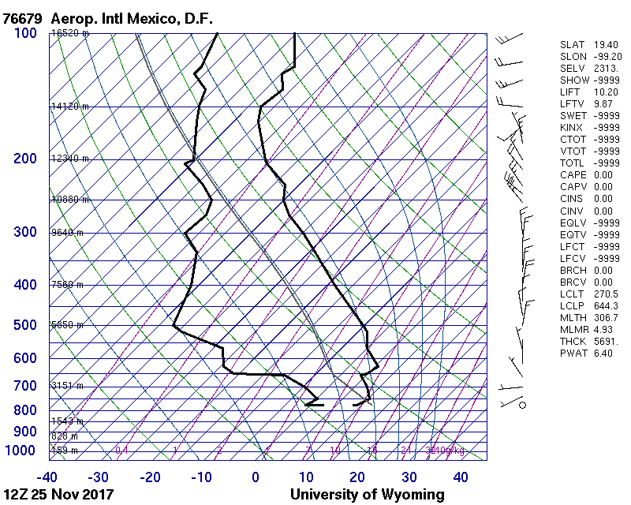
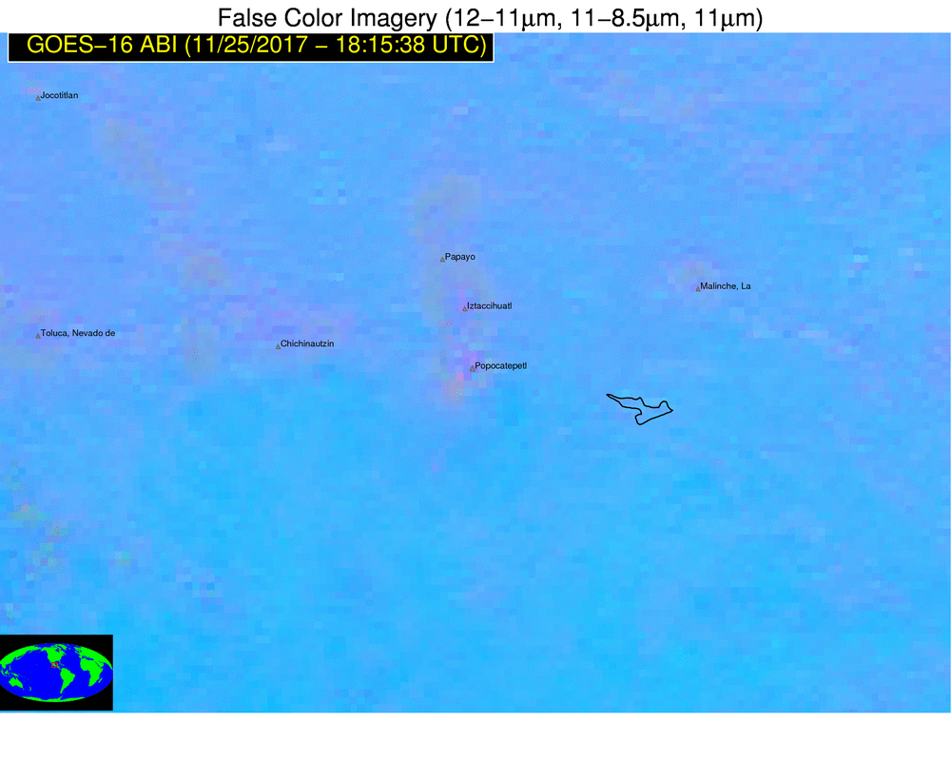
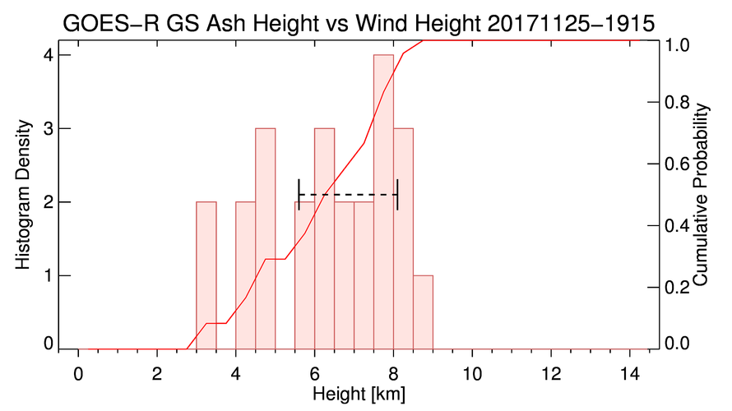
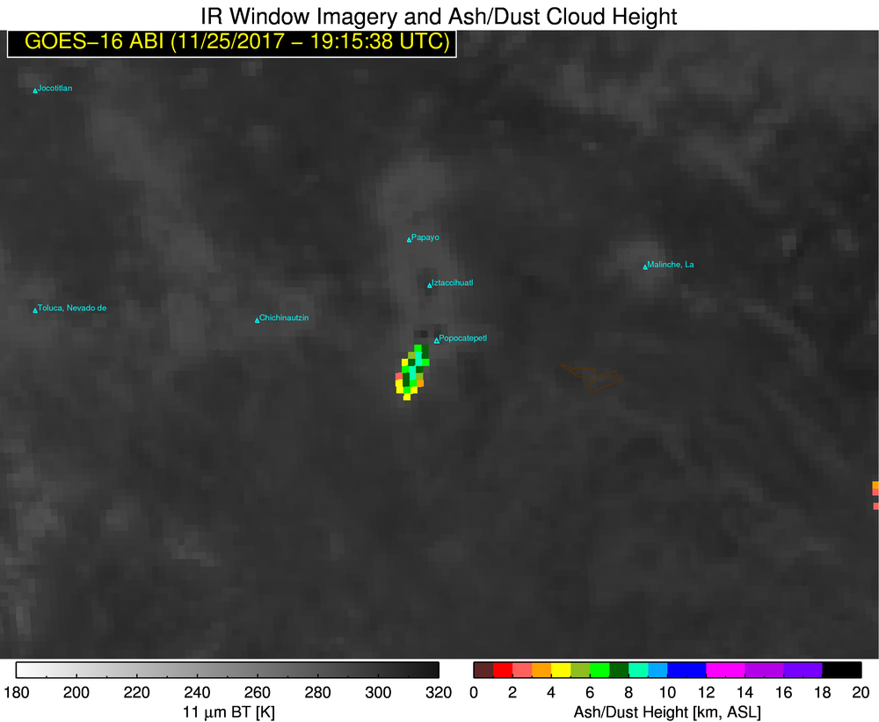
Wind Analysis
Motion from GOES-16 loop:
17 knots @
32 degrees
Ash

Slide 39
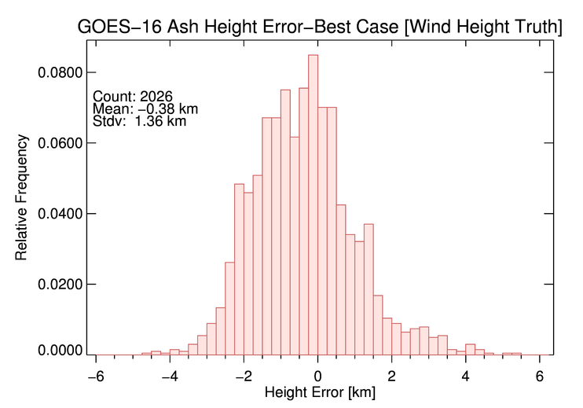
Wind Analysis - Height
PASSED
Mean Difference (accuracy): -0.38 km (within 3 km spec)

Slide 40
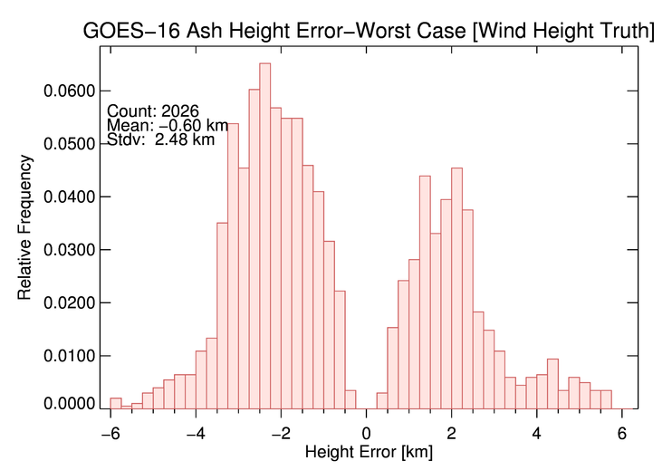
Wind Analysis - Height
PASSED
Mean Difference (accuracy): -0.60 km (within 3 km spec)
Notes:
Using the 21 cases, the mean ash height bias is -0.38 km. This BEST case error assumption, uses the smallest error between the top and bottom of the manually assessed wind-height layer.

Slide 41
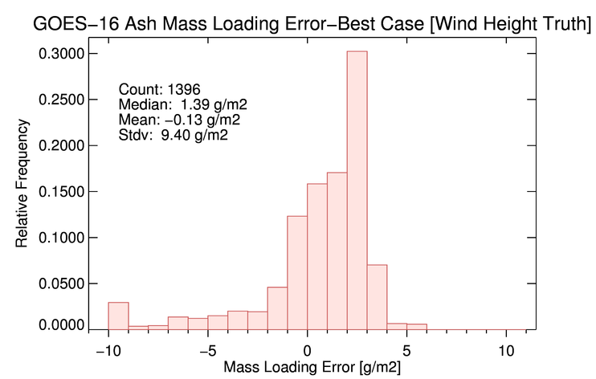
Wind Analysis - Loading
IQR of absolute diff: 1.92 g/m²
PASSED
Median Difference (accuracy): 1.39 g/m² (within 2 g/m² spec)
Interquartile range (precision): 1.92 g/m² (within 2.5 g/m² spec)

Slide 42
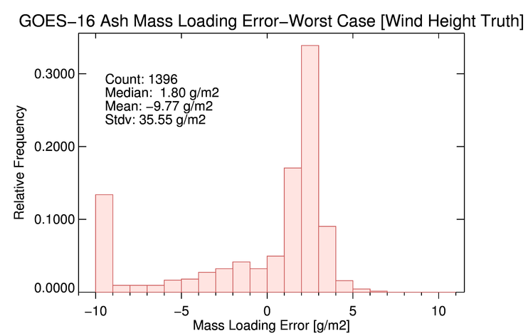
Wind Analysis - Loading
IQR of absolute diff: 1.64 g/m²
PASSED
Median Difference (accuracy): 1.80 g/m² (within 2 g/m² spec)
Interquartile range (precision): 1.64 g/m² (within 2.5 g/m² spec)

Slide 43
Lidar Analysis and Vicarious Validation

Slide 44
Lidar Validation
GOES-16 has yet to observe a large, long-lived, ash cloud. Thus, there are little to no CALIOP observations of ash observed by GOES-16.
However, Himawari-8 has observed several larger, long-lived, ash clouds with CALIPSO overpasses.
We applied the baseline GOES-R algorithm to Himawari-8 (we previously showed that the Ground System and our local processing system produce similar results).
We utilize the methods described in Pavolonis et al. (2013) to compare the baseline height and loading products to CALIOP.

Slide 45
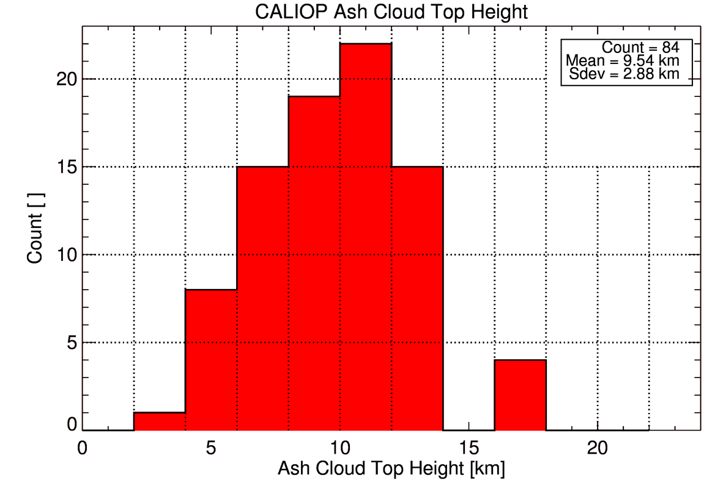
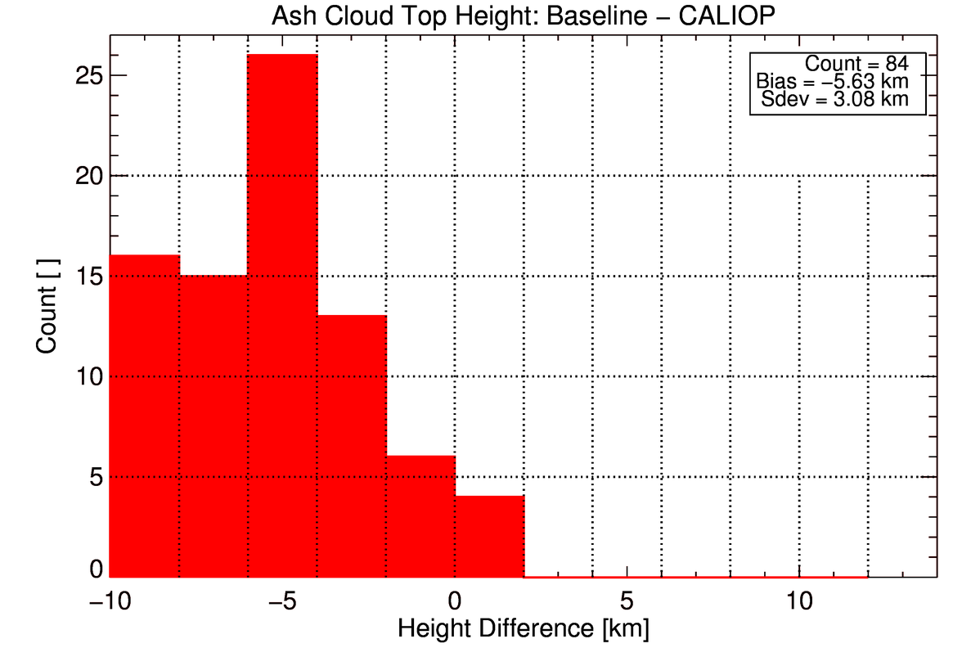
Lidar Analysis - Height
CALIOP Ash Cloud Height
Baseline - CALIOP
Most clouds observed by CALIOP were above 8 km and well dispersed
FAILED
Mean Difference (accuracy): -5.63 km (outside of 3 km spec)

Slide 46
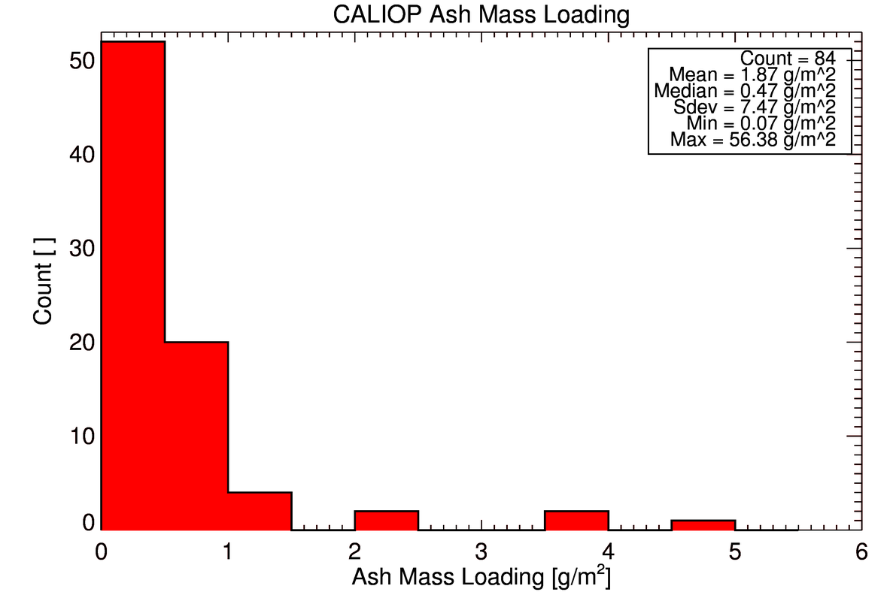
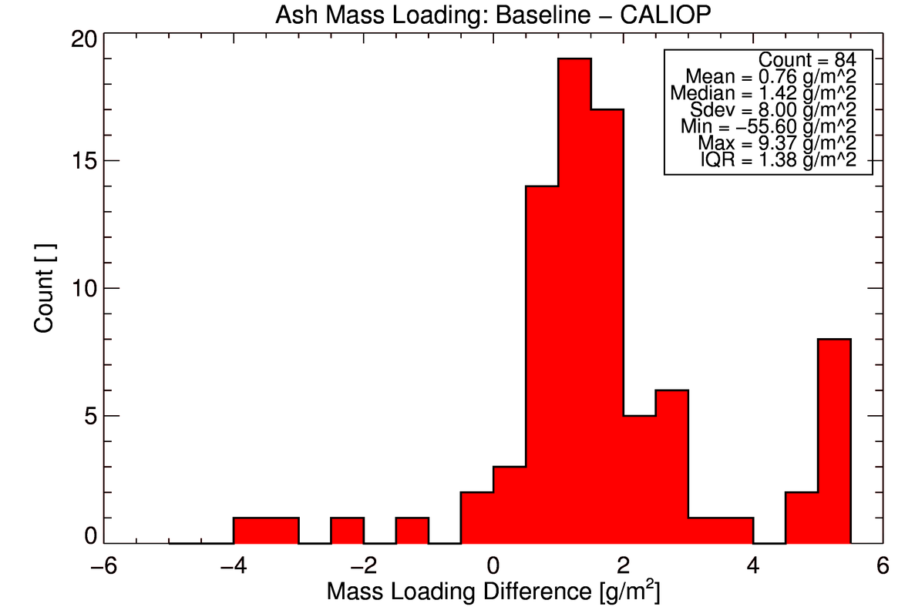
Lidar Analysis - Height
CALIOP Mass Loading
Baseline - CALIOP
Most clouds observed by CALIOP were above 8 km and well dispersed
PASSED
Median Difference (accuracy): 1.87 g/m² (within 2 g/m² spec)
Interquartile range (precision): 1.38 g/m² (within 2.5 g/m² spec)

Slide 47
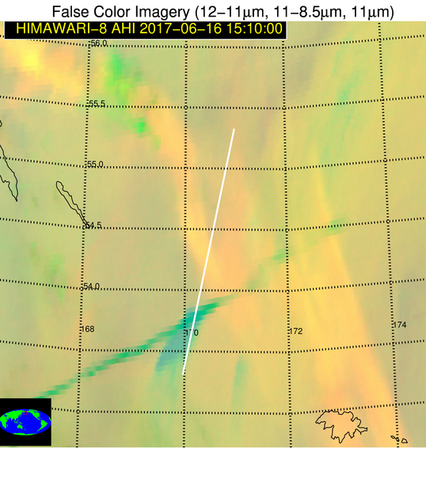
Sheveluch (Russia)
6 June 2016
well dispersed ash
The dispersed ash is very optically thin (enhanced in AHI by large viewing angle) and the baseline ash cloud height is greatly underestimated. Due to radiative closure, the mass loading is overestimated.
contrail
well dispersed ash
contrail
There is no simple mitigation action for this issue that is common to all retrieval algorithms. Mitigation is only possible with the use of automated cloud tracking.

Slide 48
Vicarious Validation :
Past Experience
Independent observations of ash clouds are so rare that validation must should take into account previous related experiences, even if associated with different satellites.
WMO sponsored assessment
Pavolonis et al. 2013 analysis

Slide 49
http://cimss.ssec.wisc.edu/meetings/vol_ash15/
http://www.wmo.int/pages/prog/sat/documents/SCOPE-NWC-PP2_VAIntercompWSReport2015.pdf
Notes:
-Inter-comparison analysis is most thorough validation of ash height and mass loading ever performed. A comparably comprehensive assessment during the GOES-16 PLPT is simply not possible.

Slide 50
WMO Inter-comparison:
Ash Height Validation
0.82 km < CALIOP
Correlation: 0.58
N: 698
1.23 km < CALIOP
Correlation: 0.00
N: 427
0.74 km < CALIOP
Correlation: 0.58
N: 1987
UKMO
EUMETSAT
NOAA
Eyjafallajökull: Comparison of ash cloud top height derived from three real-time relevant geostationary algorithms to spaceborne lidar (CALIOP) results in decent agreement

Slide 51
WMO Inter-comparison:
Ash Mass Loading Validation
Factor 3-4 > FAAM
N: 83
Factor 7-8 > FAAM
N: 117
Factor 2-3 > FAAM
N: 238
UKMO
EUMETSAT
NOAA
NOAA mass loading is nearly within the uncertainty of the aircraft estimates

Slide 52
Lidar Comparisons
Height
Loading
Pavolonis et al., 2013 presented a robust validation of the baseline GOES-R volcanic ash retrieval algorithm using CALIOP. Both the height and the loading, derived from SEVIRI, were found to be within the accuracy specifications.
Passed

Slide 53
Issues and Status
ADRs Addressed
One open ADR:
ADR 257 – maximum value in netcdf files is 260 g/m² instead of 50 g/m²
This issue does not impact product usability or validation since the ABI cannot distinguish between 50 and 260 g/m².
Notes:
No impact on the product.

Slide 54
Provisional Maturity Assessment
GOES-16 Volcanic Ash L2 Products Provisional PS-PVR

Slide 55
Provisional Validation
Preparation Activities | Assessment
Validation activities are ongoing and the general research community is now encouraged to participate. | Validation activities are ongoing. The general research and user community has been participating and providing feedback.
Severe algorithm anomalies are identified and under analysis. Solutions to anomalies are in development and testing. | The algorithm is working as designed in 2008. The band 13/14 swap resolved the earlier observed deviations from expected performance.
Incremental product improvements may still be occurring. | No planned incremental improvements as volcanic ash remote sensing science has evolved significantly since the baseline algorithm was developed in 2008.

Slide 56
Provisional Validation
End State | Assessment
Product performance has been demonstrated through analysis of a small number of independent measurements obtained from select locations, periods, and associated ground truth or field campaign efforts. | This has been demonstrated.
Product analysis is sufficient to communicate product performance to users relative to expectations (Performance Baseline). | This has been communicated in PS-PVR.
Documentation of product performance exists that includes recommended remediation strategies for all anomalies and weaknesses. Any algorithm changes associated with severe anomalies have been documented, implemented, tested, and shared with the user community. | These are documented in this slide deck and will be documented in a separate report and ReadMe file.
Testing has been fully documented. | Testing will be documented in a PLPT Report.
Product is ready for operational use and for use in comprehensive cal/val activities and product optimization. | Operational usage is OK (no harm), but the operational value is minimal due to the nature of the requirements and the outdated science.

Slide 57
Recommendation
AWG Aviation Team believes that the GOES-16 Volcanic Ash Height and Mass Loading L2 products have reached the Provisional Maturity as defined by the GOES-R Program.

Slide 58
Path to Full Validation Maturity
GOES-16 Volcanic Ash L2 Products Provisional PS-PVR

Slide 59
Issues and Status
ADRs Needing Resolution for Full VAL
ADR | Title | Status | Build
 |  |  | --

Slide 60
Issues and Status
Other Actions Needed for Full VAL
Action | Title | Desired Implementation Date into OE
No new ADR’s are planned because, overall, the requirements are being met and:
1). Volcanic ash validation requires a long time period of data from the same algorithm due to the rare nature of independent observations of volcanic ash and the rarity of very large eruptions
2). Far more complex approaches have been demonstrated for operational usage (including multi-sensor fusion)

Slide 61
Full Validation PLPTs
Test ID | Test Title
ABI-FD_VAH07 | Assess the accuracy and precision of the Volcanic Ash product over a large and wide range of representative conditions sufficient to verify all Volcanic Ash requirements.
AWG Volcanic Ash Team will conduct these tests to further evaluate the L2 volcanic ash height and mass loading product quality.
Full test plans and procedures are given in the INST Readiness, Implementation, and Management Plan (RIMP v1.0; 416-R-RIMP-0333)

Slide 62
Path to Full Validation – Risks
Risk Name | Description | Impact | Mitigation and Schedule
Insufficient validation data | CALIOP observations of volcanic ash within the GOES-16 disk have been elusive and GOES-16 has yet to observe a large, long-lasting (> 12-24 hours), ash cloud | Moderate | Leverage Himawari-8 and continue to utilize the wind analysis techniques

Slide 63
Summary & Recommendations
GOES-16 Volcanic Ash Products Provisional PS-PVR

Slide 64
Summary (1)
The AWG Aviation Team recommends that GOES-16 Baseline Volcanic Ash products be transitioned to Provisional status at this time
A detailed analysis showed that:
  The ash cloud height product is comfortably within spec for near source volcanic clouds/plumes.
  For ash cloud height, out of spec performance is most likely to occur in highly dispersed volcanic ash (this is expected).
  Ash mass loading naturally spans many orders of magnitude, so while some very large errors will occur, overall the mass loading product was found to be within the accuracy and precision specifications.

Slide 65
Summary (2)
Much has changed over the last 10 years or so.
  Algorithm advances (machine learning, temporal, multi-sensor, complex spatial analysis, and better radiative transfer and measurement inversion) now allow for automated eruption alerting and cloud tracking
  Satellites, like GOES-16, can identify eruptions much earlier, but the data volume limits the effectiveness of manual analysis alone
  Aviation stakeholders want quantitative products that support risk based decision making (see ICAO and WMO)
  Dispersion and transport models can now ingest satellite-derived products
While the baseline algorithm is likely to meet the requirements for full validation, it is inferior to more complex systems (e.g. VOLCAT) that have been established and continue to rapidly evolve. We will continue to meet our GOES-R AWG responsibilities while seeking a better long term operational solution.
Notes:
-The demand for quantitative products is as strong as ever

Slide 66
Recommendation
AWG Aviation Team believes that the GOES-16 volcanic ash L2 products have reached the Provisional Maturity as defined by the GOES-R Program.

Slide 67
Backup Material

