Slide 1
GOES-16
Volcanic Ash Product in AWIPS-2
NWS/OBS Update to Provisional PS-PVR
July 20, 2018

Slide 2
GOES-16 Volcanic Ash: Detection and Height in AWIPS-2
Fielded AWIPS-2 baseline plugin handles ingest and display
  Separate display buttons for Volcanic Ash Mass Loading and Height
  Baseline applies retrieval flag (RET_DQF), overall good quality pixels
TOWR-S updated site configurations via a field-wide RPM on June 20, 2018
  Replaced RET_DQF w/the detection quality flag (DET_DQF) mask
  Uses mask values for overall good quality/high confidence (0), as well as moderate confidence single layer ash (8)
  Will transition updates to the AWIPS-2 baseline (19.1.1/Apr ‘19, 19.2.1/Jul ‘19)
NWS transmission via the SBN started January 17, 2018
VAAC is using product (see presentation by Jamie Kibler)

Slide 3
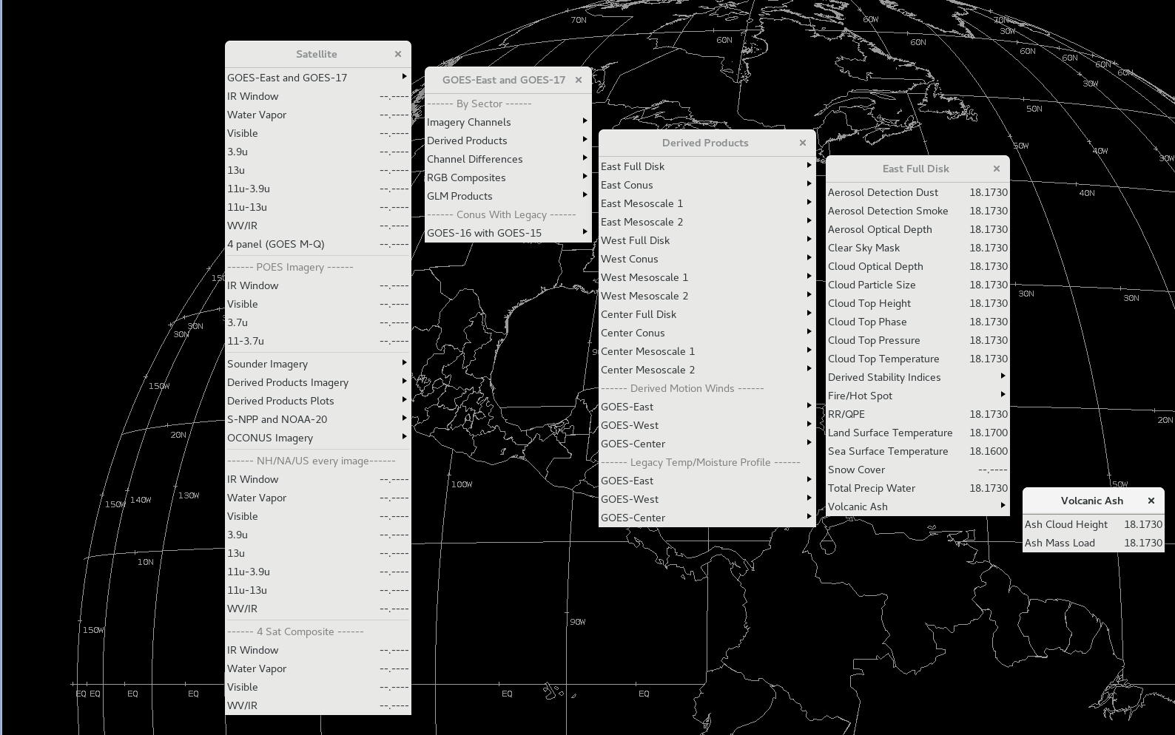
GOES-16 Volcanic Ash Product Menus

Slide 4
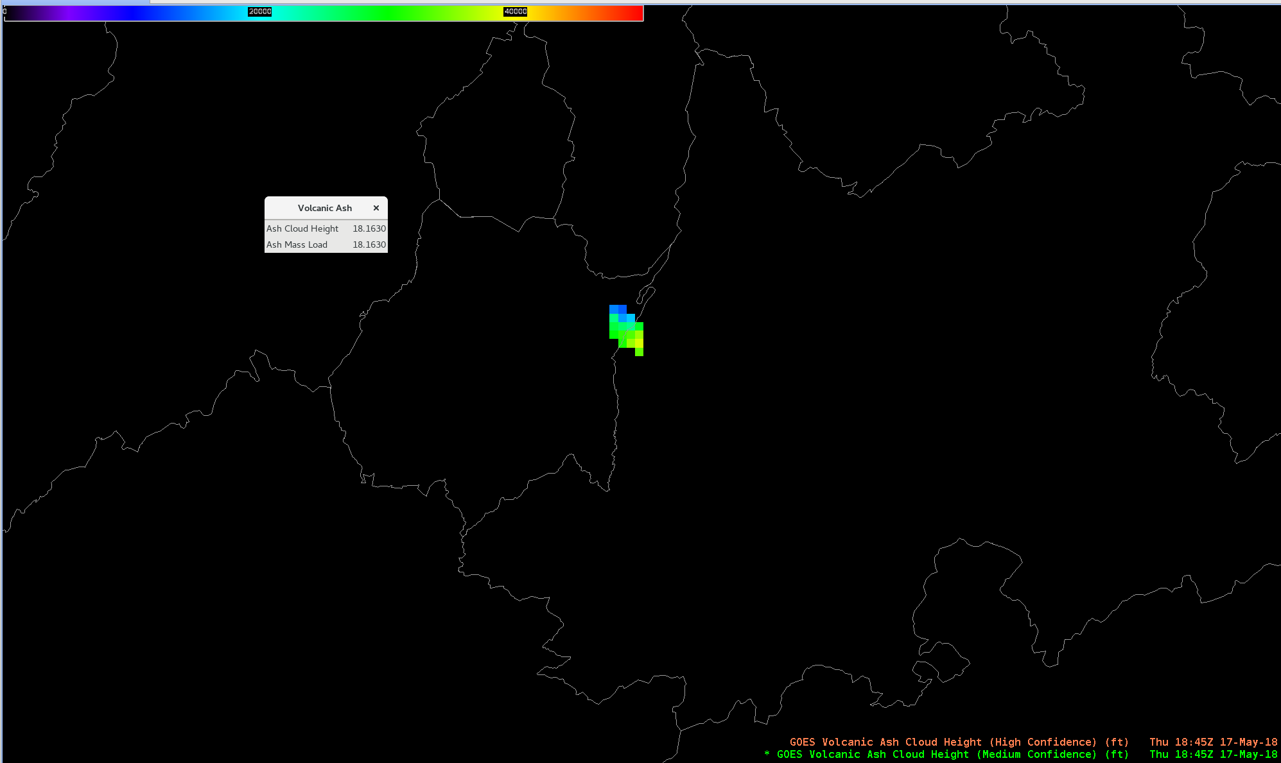
GOES-16 Volcanic Ash Height (1)
Popocatepetl, Mexico
18:45 UTC May 17, 2018

Slide 5
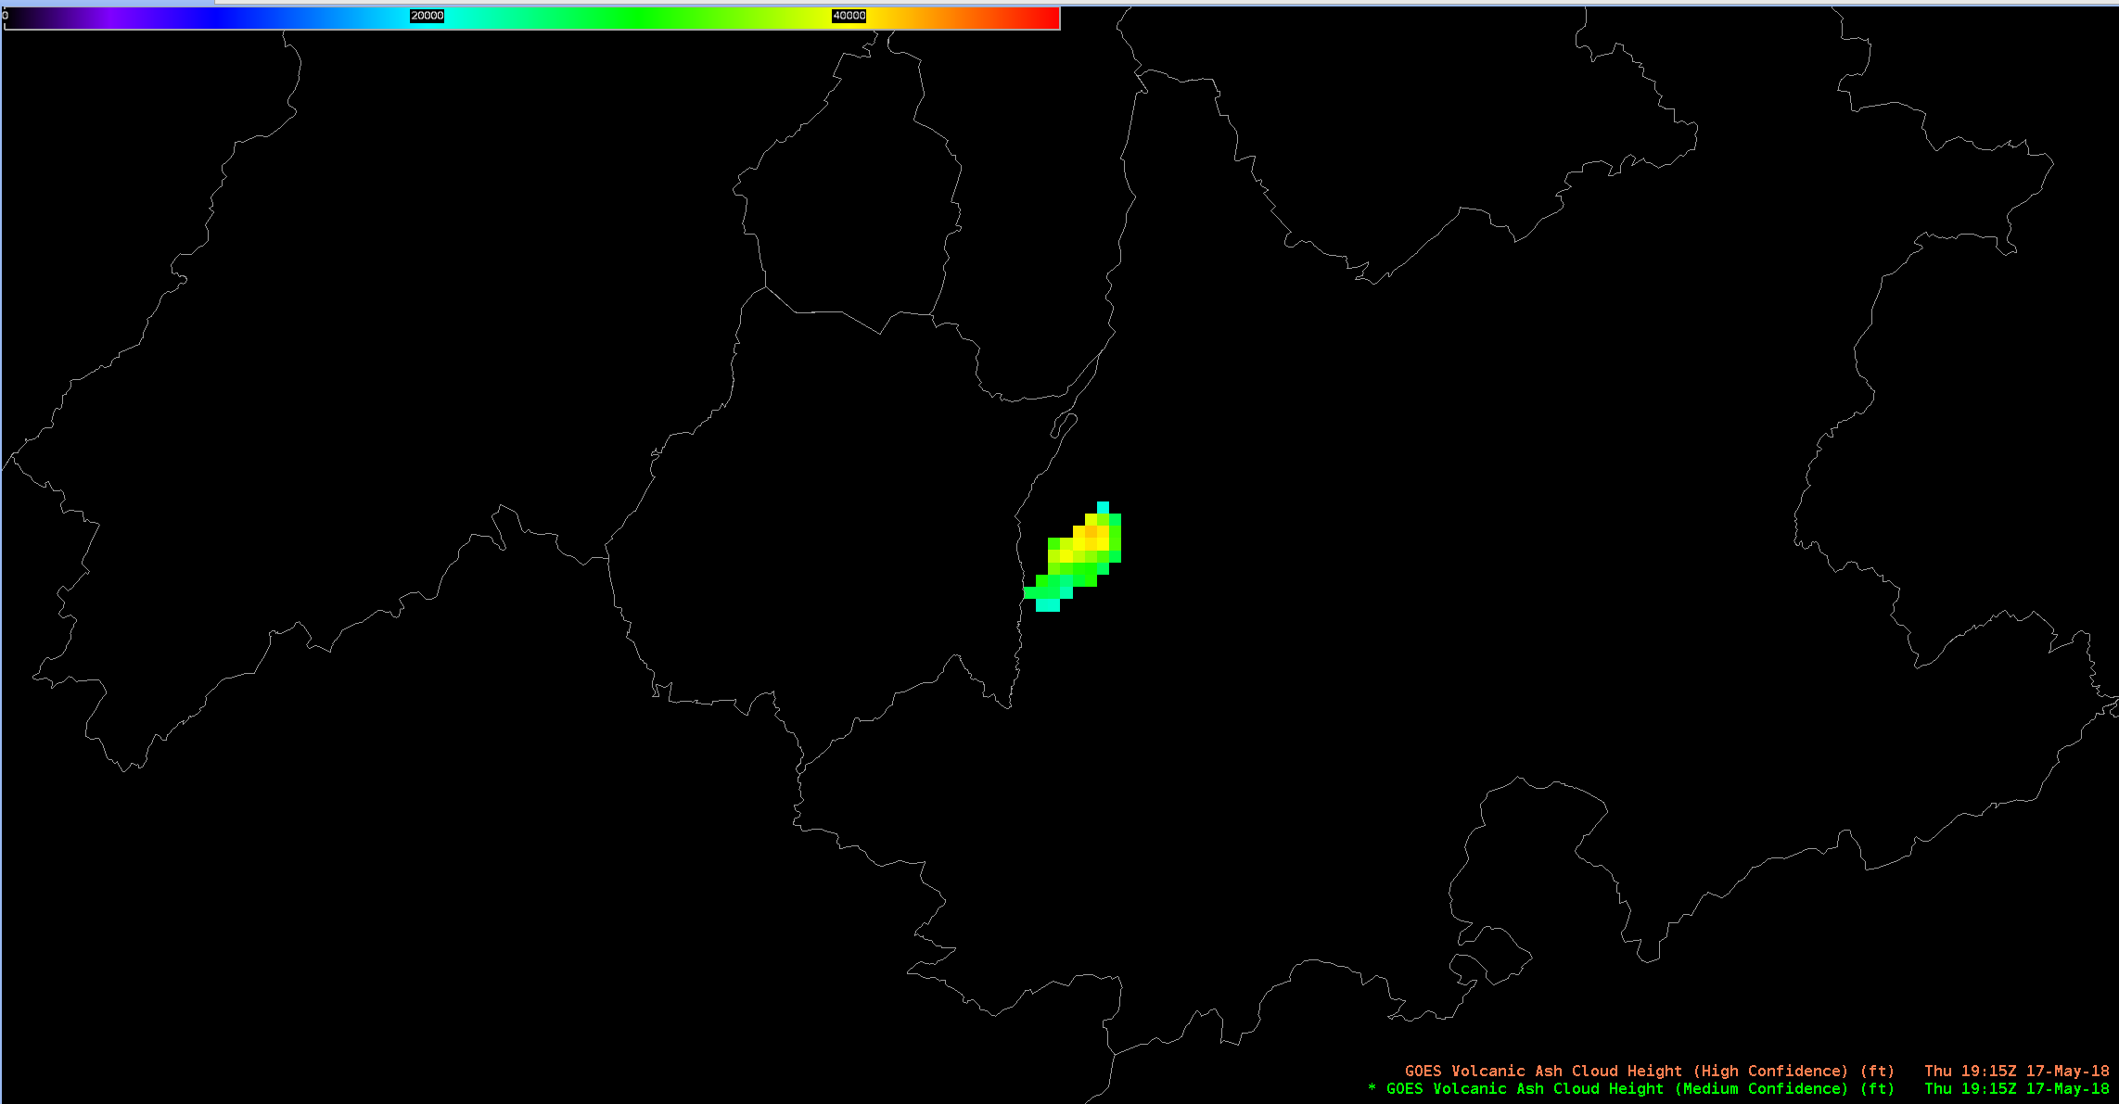
GOES-16 Volcanic Ash Height (2)
Popocatepetl, Mexico
19:15 UTC May 17, 2018

Slide 6
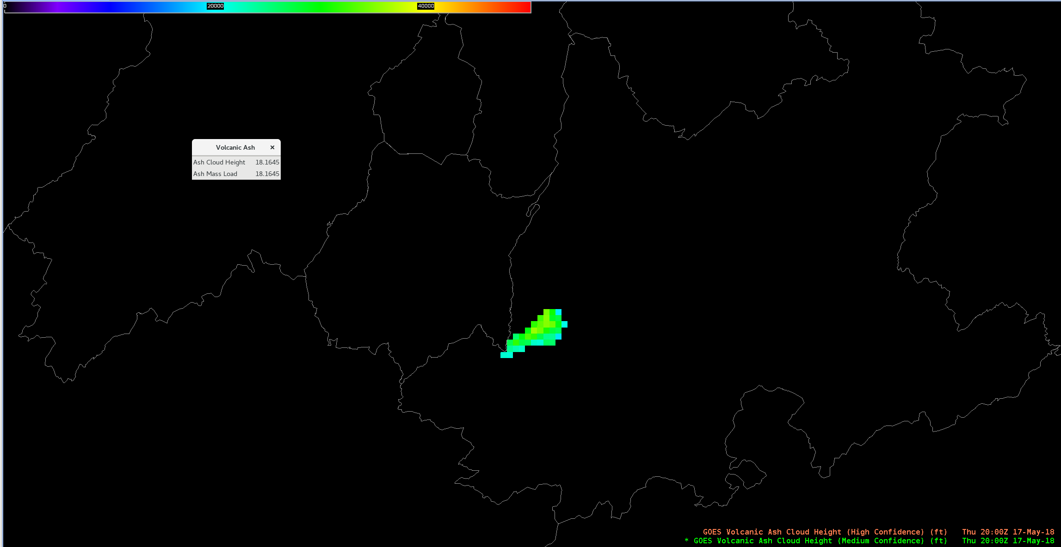
GOES-16 Volcanic Ash Height (3)
Popocatepetl, Mexico
20:00 UTC May 17, 2018

Slide 7
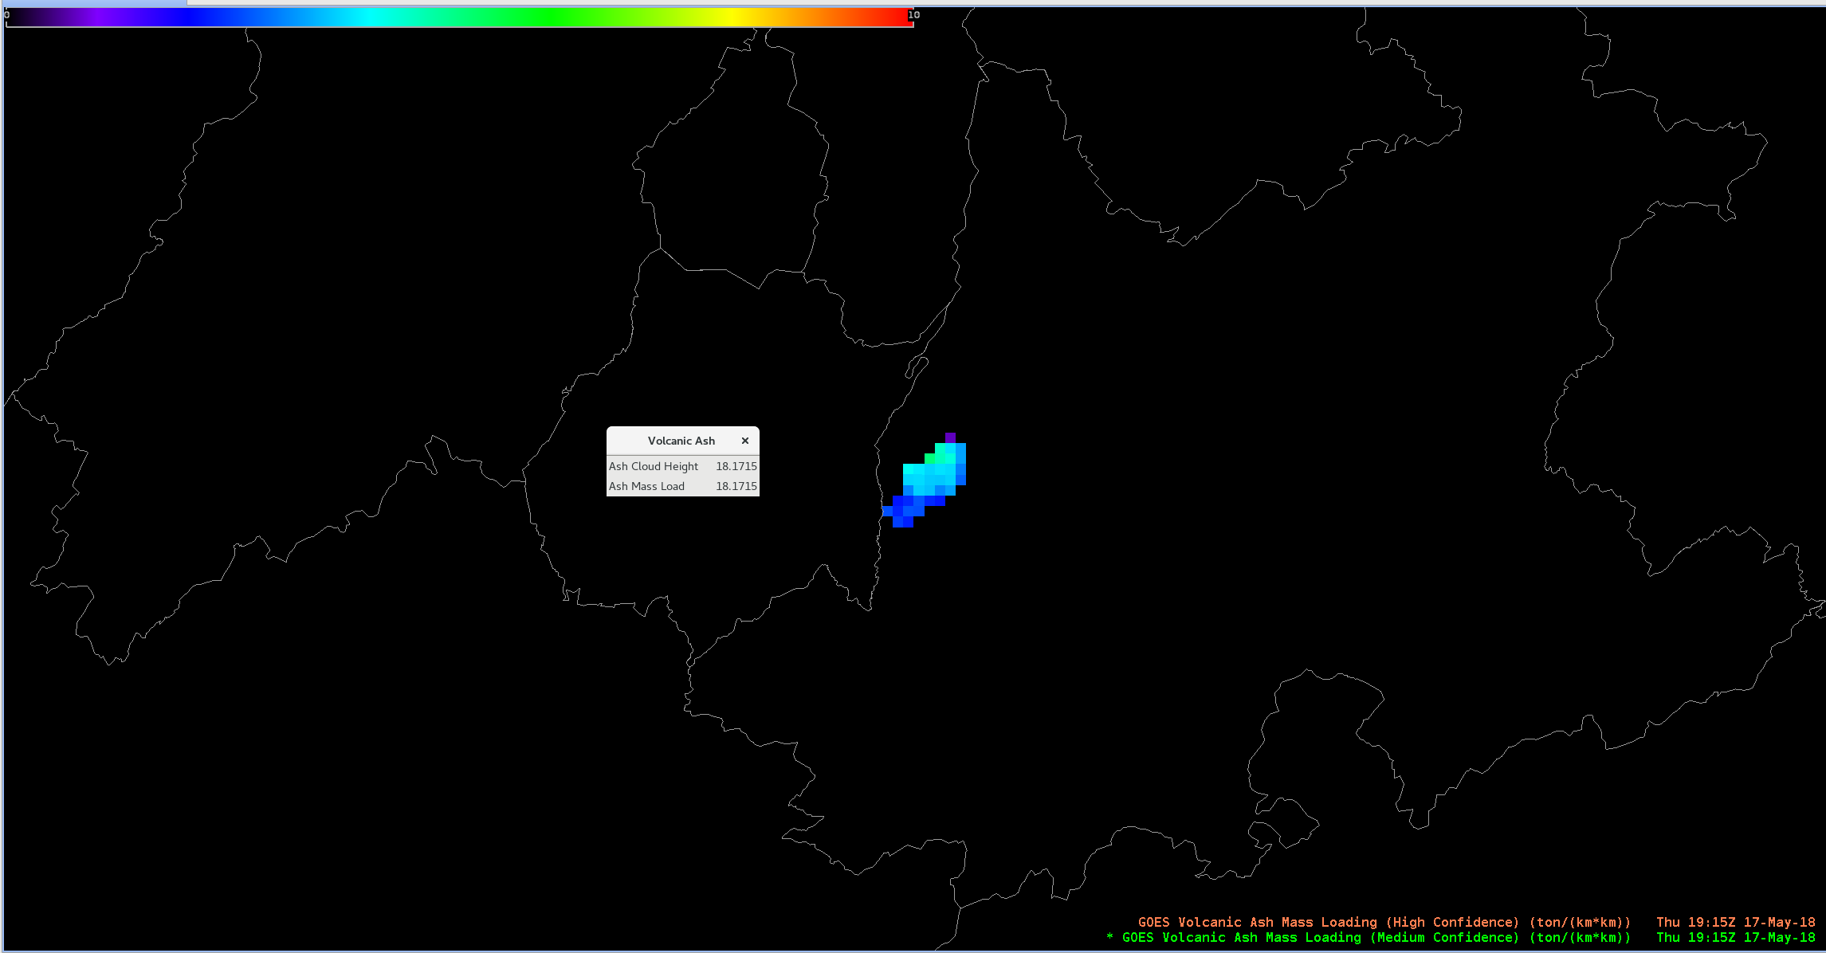
GOES-16 Volcanic Ash Mass Loading (1)
Popocatepetl, Mexico
19:15 UTC May 17, 2018

Slide 8
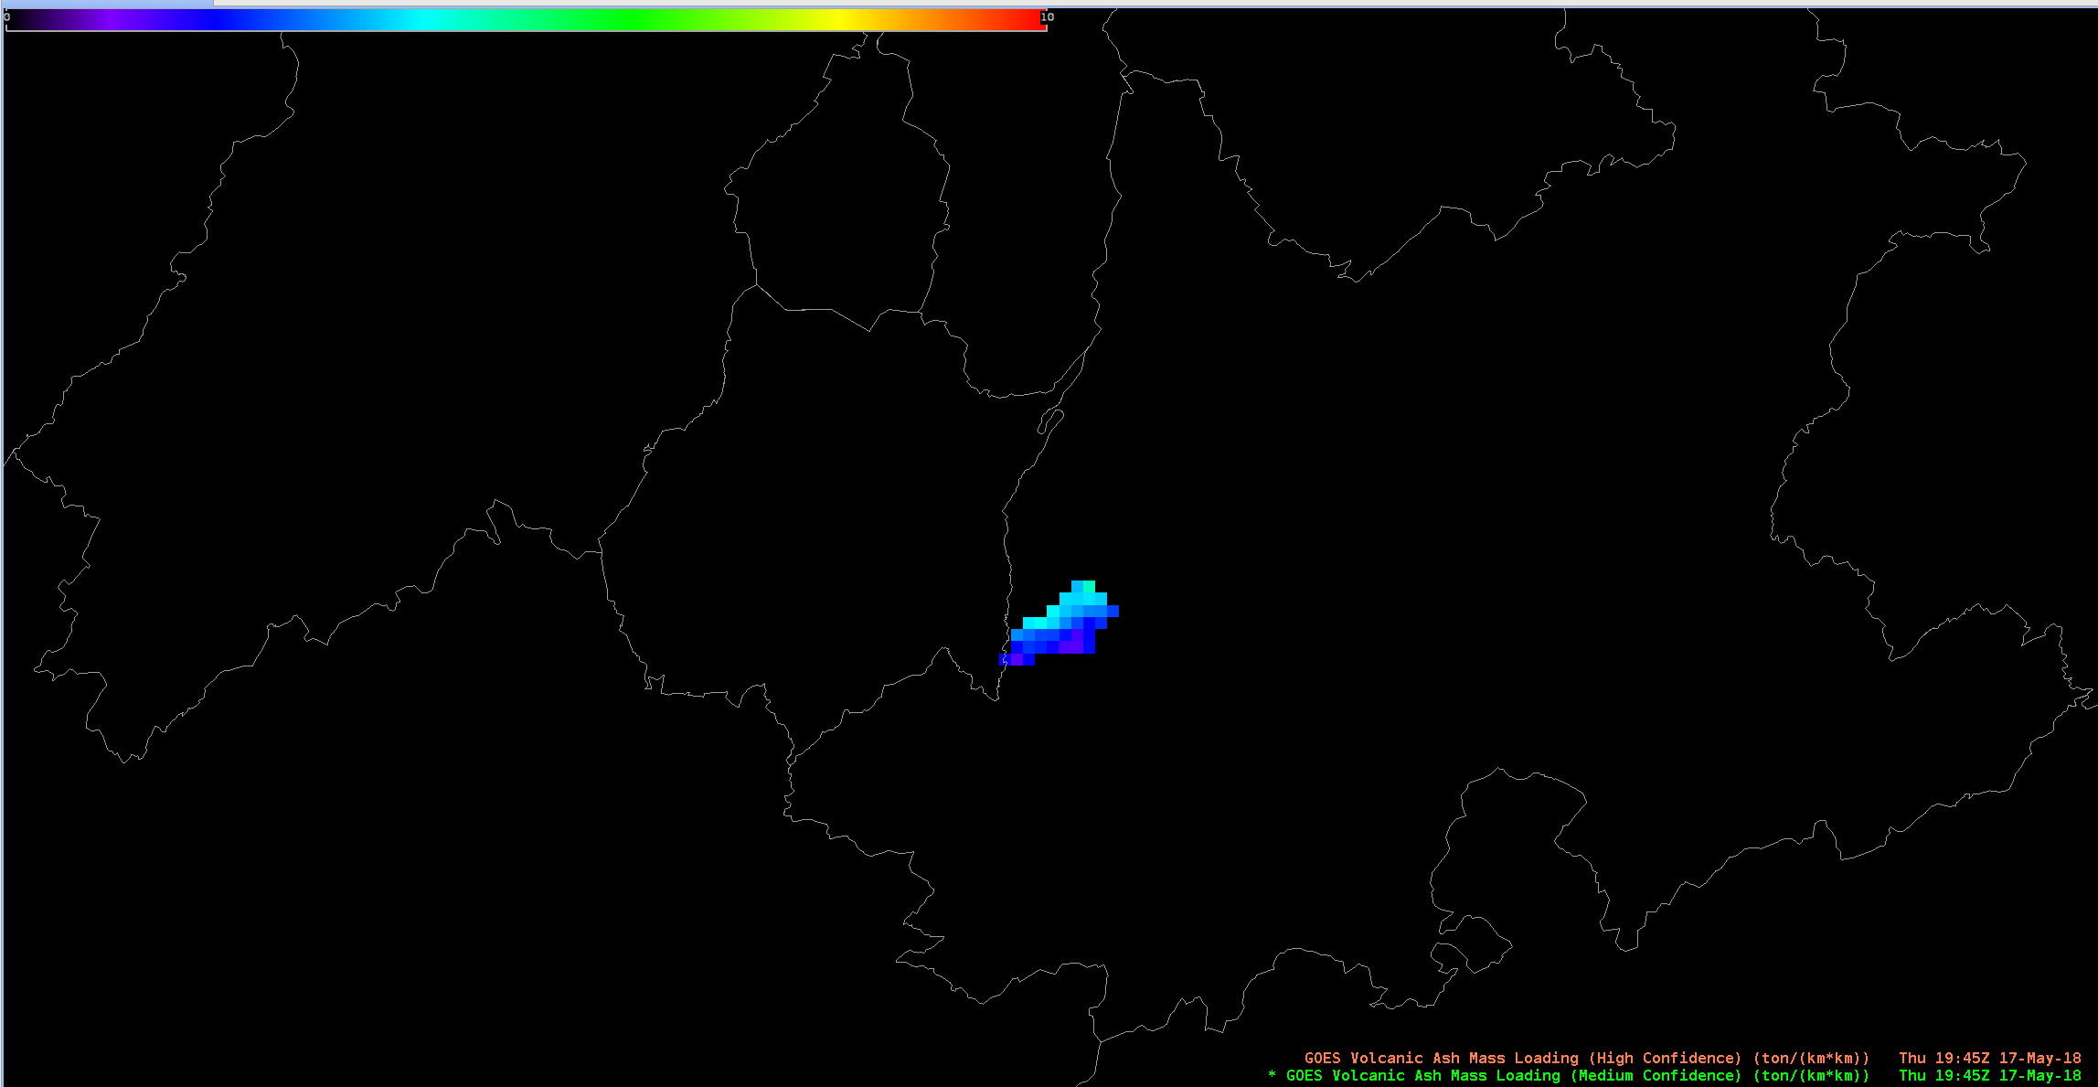
GOES-16 Volcanic Ash Mass Loading (2)
Popocatepetl, Mexico
1945 UTC May 17, 2018

Slide 9
Questions?

