Slide 1


Peer Stakeholder-Product Validation Review (PS-PVR)
GOES-16 L1b Provisional Maturity
for EXIS XRS
18 July 2018
GOES-R Calibration Working Group (CWG)
Presenter: Janet Machol - NOAA NCEI and U. Colorado CIRES
Acknowledgements:
U. of Colorado LASP: F. Eparvier, D. Woodraska, T. Eden, S. Mueller,
R. Meisner, M. Snow, A. Jones, T. Woods, T. Redick, ....
NCEI/CIRES: S. Codrescu, W. Rowland, and M. Tilton
Other: Rodney Viereck, Matt Garhart,....

Slide 2
Outline
Quick Summary 3
Instrument and Products Overview 4
Review of Beta Maturity 8
L1b Product Quality 13
GPA issues 14
Post-launch Product Tests (PLPTs) 15
Instrument Issues 31
Comparison to Performance Baseline 33
Summary of Remaining Issues 39
Provisional Maturity Assessment 42
Path to Full Validation 47
Backup - Details 50

Slide 3
Quick Summary
Initial testing using L0 data has provided most cal values.
GOES-16 behavior is similar to GOES-17.
No surprises.
Studies done with L1b, L2, and LASP-L0-processed data.
GPA: many ADRs submitted, many resolved, some remain.
Instrument: new LUTs, many issues resolved, some remain.
All PLPT tests:
Provisional Validation Product Maturity Assessment.
ADR = Algorithm Discrepancy Report
LUT = Look Up Table
PASSED
PASSED
Notes:
Define PASS

Slide 4
EXIS

Slide 5
EUV and X-Ray Irradiance Sensors (EXIS)
X-Ray Sensor (XRS)
  Monitor solar flares
    communications and navigation
    potential for SEP events
Extreme Ultraviolet Sensor (EUVS)
Sun Pointing Sensor (SPS)
  Used for alignment (quad diode, 3.5° FOV)
EUVS
XRS
SPS
EXIS was designed, built and tested by the Laboratory for Atmospheric and Space Physics (LASP) at the University of Colorado.
Notes:
mention how long measured

Slide 6
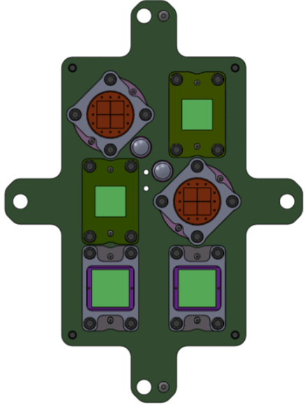
X-Ray Sensor (XRS)
2 soft X-ray wavelength bands
  A is 0.05-0.4 nm
  B is 0.1-0.8 nm
12 diodes total
  Silicon photodiodes with Be filters
  A1, B1 - low solar activity
  A2, B2 - solar max/flare
  2 dark
Main products
  X-ray flux time series
    1 sec and averaged (L2)
  flare event detection (L2)
  flare location on solar disk (L2)
A2:
Solar max
/flare
A1:
Solar min
B1:
Solar min
B2:
Solar max
/flare
Dark
Dark
Notes:
scaled to match previous XRS bandpasses

Slide 7
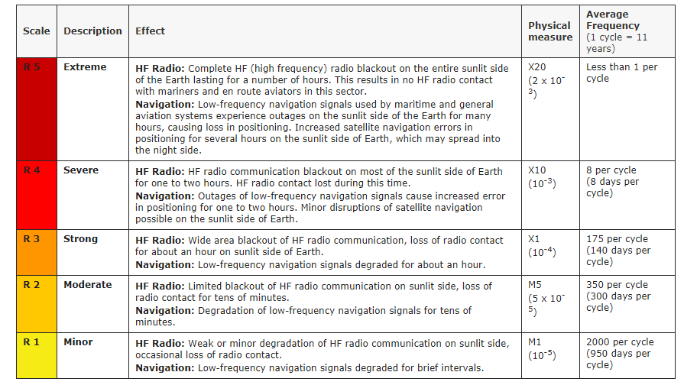
SWPC Radio Blackout Warnings
flare index from XRS-B1
Notes:
scaled to match previous XRS bandpasses

Slide 8
Review of Beta Maturity

Slide 9
GPA Issues at Beta
to be resolved prior to Provisional Status
Identified Pre-launch
ADR | Title | Notes | Status
148 | Add CROTA roll angle | ADR 590 will fix | CLOSED; not resolved
158 | Resolve time stamp errors | DO 06.03 | fixed for XRS; difficult to test for EUVS
174 | Add high resolution EUVS data | DO 07.00 ADR will fix this | OPEN
Identified Post-launch
ADR | Title | Notes | Status
462 | Replace Mg II line fit |  | CLOSED
247 | EUVS LUT updates not working |  | CLOSED
204 | Remove unsigned variable attributes |  | CLOSED
228 | Filename timestamps mismatch |  | OPEN
430 | Eclipse flags set too late. |  | CLOSED

Slide 10
Instrument Issues at Beta
to be resolved prior to Provisional Status
Title | Description | Status | Mitigation
Dark value for XRS-B1 | Offpoint measurements have not provided a dark value for B1 due to electron contamination. | CLOSED | Continue to use the pre-flight value. Continue to examine quarterly offpoints. New: Monitor low X-ray fluxes relative to electron contamination.
Spikes in data | Spikes in count data, likely due to particles. More frequent on some detectors than others. | CLOSED | Resolved for XRS with a L2 median filter algorithm. (Slides 11-12)
Electron contamination | At low X-Ray flux levels and high electron fluxes, the XRS A1 and B1 fluxes are artificially high due to electrons. | OPEN | Algorithm work in progress for a L2 fix. (Slide 32)
EUVS-C decline | The EUVS-C signal appears to be declining. | CLOSED | Trend is slow enough to not require mitigation. Will continue to monitor.
Changes for future PLTs | A list of requested changes for PLTs for GOES-S and beyond has been created by LASP. | CLOSED | "Lessons Learned and Improvements" presented to MOST. Requests were implemented by Flight.

Slide 11
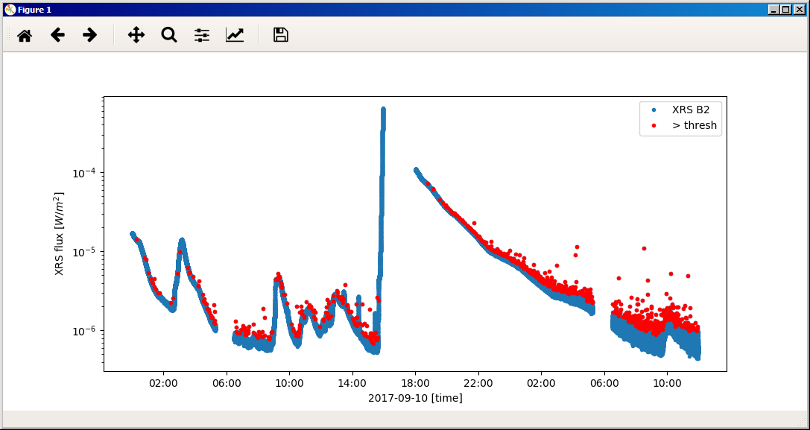
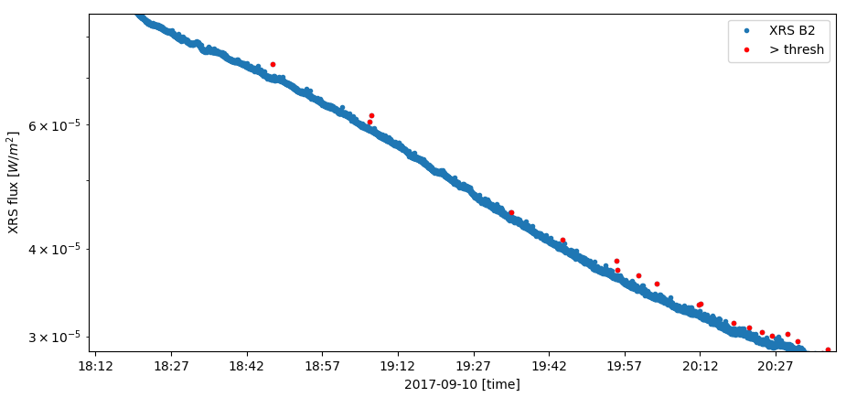
Particle spikes are removed in L2 (1/2)
10⁻⁴
10⁻⁵
Flux [W/m²]
10⁻⁶
Red points are spikes due to high energy particles
Flux [W/m²]
11

Slide 12
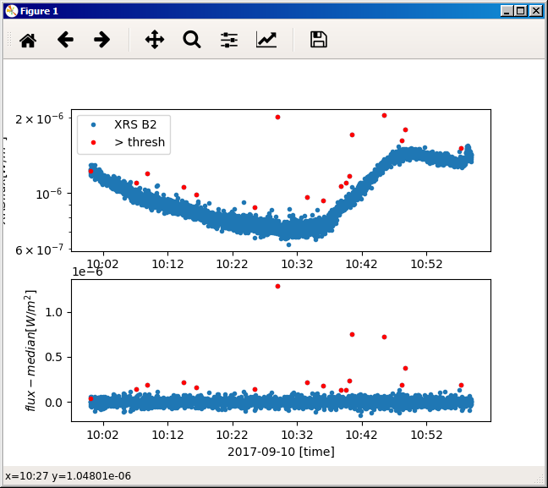
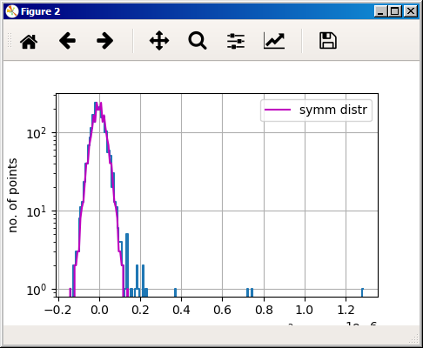
Particle spikes are removed in L2 (2/2)
Procedure to flag spikes to be implemented in L2 processing
Finds spikes in XRS data including during SEP events.
Does not require any fits or data besides XRS fluxes.
Will never mark more than a fraction of points as spikes.
Spike condition: flat_flux > f_{noise} * noise + f_{flux} * flux
  f_{noise} = 1.05, f_{flux} = 0.01
noise limit
(mirror image of max dev)
spikes
1e-6
offset from median [W/m²]
12

Slide 13
L1b Product quality assessment

Slide 14
GPA Issues
11 ADRs for XRS
  Also 13 ADRs for EUVS
  >50 ADRs resolved including ~20 in DO 06.03
All issues apply to both GOES-16 and -17
ADR | Issue | * | Description / Impacts | Delivery date
228 | Wrong times in file names |  |  | ? ( DO 06.03)
590 | EXIS roll angle, time variable |  | for flare location. | ?
730 | Yaw flip flag |  | for electron contamination | ?
267, 510, 536 |  |  |  | DO 07.00
176 |  |  |  | DO 08.00
517, 612, 670 |  |  |  | ?
203, 397? | L1b dropouts, num L0 errors < 0 |  | fixes need to be tested | DO 06.03
* Impact on status:
Minor Impact
Moderate Impact
Major Impact

Slide 15
Post-Launch Product Tests
Test ID | Test Title | Operator | Pass/ Fail | Status
08 | XRS B1-B2 Crossover Threshold | LASP | [1] | in progress
09 | XRS A1-A2 Crossover Threshold | LASP | [1] | in progress
10 | XRS Ratio – Threshold Assessment | LASP | [1] | in progress
11 | NOAA XRS Scaling Factors | LASP | [1] | in progress
12 | XRS L1b Uncertainties | LASP | [1] | complete
13 | XRS Flare Location Comparison (L1b) | NCEI | [2] | in progress
14 | XRS/EUVS/Mg II Inter-Satellite Comparisons (L1b) | NCEI | [3] | in progress
Provisional Success Criteria:
[1] XRS L1b product data are available and analysis is complete.
[2] Solar flare responses are observed in all 4 elements of the quad-diodes.
[3] There is no pass/fail on the result itself of this cross-comparison.
Test plans and procedures are described in Appendix A.2 in the EXIS Readiness, Implementation, and Management Plan (RIMP v1.1; 416-R-RIMP-0316)

Slide 16
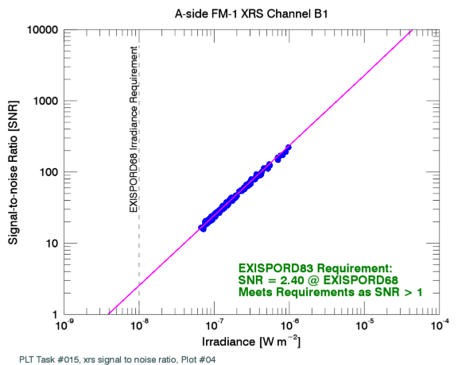
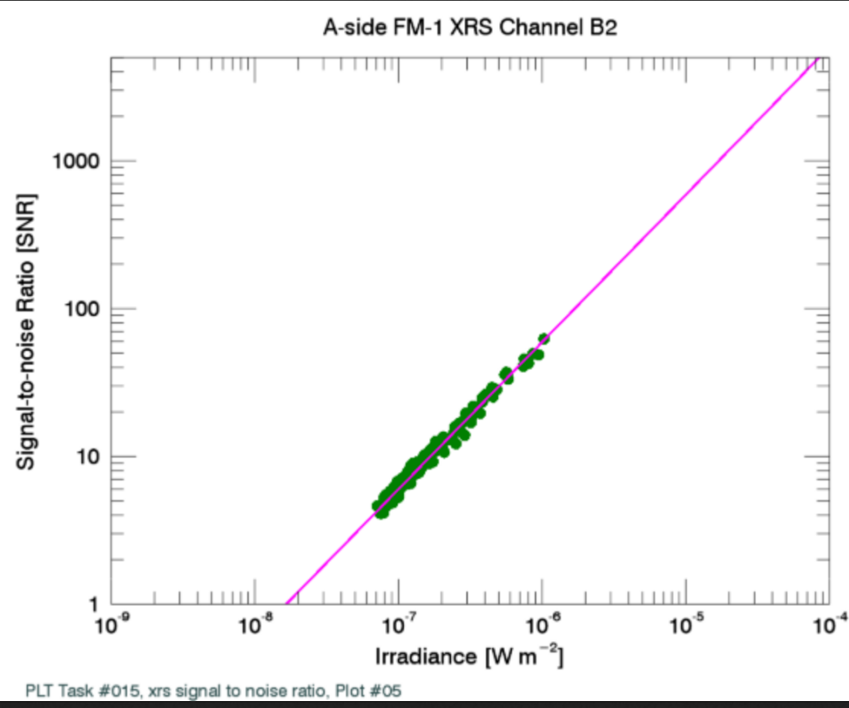
#8: XRS B1-B2 Crossover Threshold (1/2)
Determine flux level where the primary channel switch from the low-flux diode (B1) to high flux diodes (B2)
Pre-flight choice was 10⁻⁶ W/m² (C1 class).
XRS Channel B1
XRS Channel B2
SNR
SNR
10⁻⁶ W/m² crossover threshold
10⁻⁶ W/m² crossover threshold
Irradiance [W m⁻²]
Irradiance [W m⁻²]
Notes:
thrash!
Same considerations for channel A except saturation

Slide 17
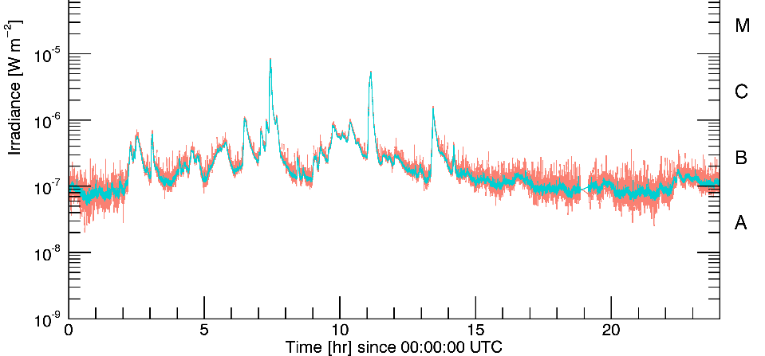
#8: XRS B1-B2 Crossover Threshold (2/2)
B1
B2
threshold
21 January 2017
Considerations
  B1: saturates at 6.4x10⁻⁴ W/m², has more electron contamination
  B2: noise is higher, more impacted by SEP events.
  Potential 'thrashing' back and forth when signal near threshold.
  Impacts on channel ratios and event detection.
Short term: 10⁻⁶ W/m² (C1 class), but PLPT #10 chooses 10⁻⁴.
Long term: Use hysteresis w/higher flux threshold (L2).
Notes:
thrash!
Same considerations for channel A except saturation

Slide 18
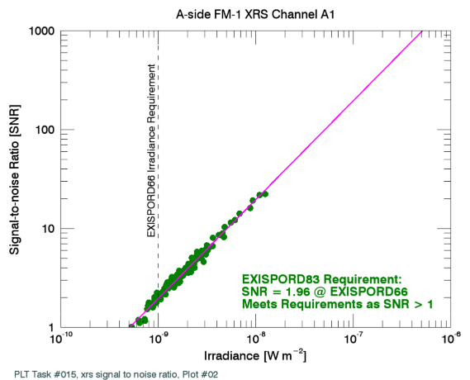
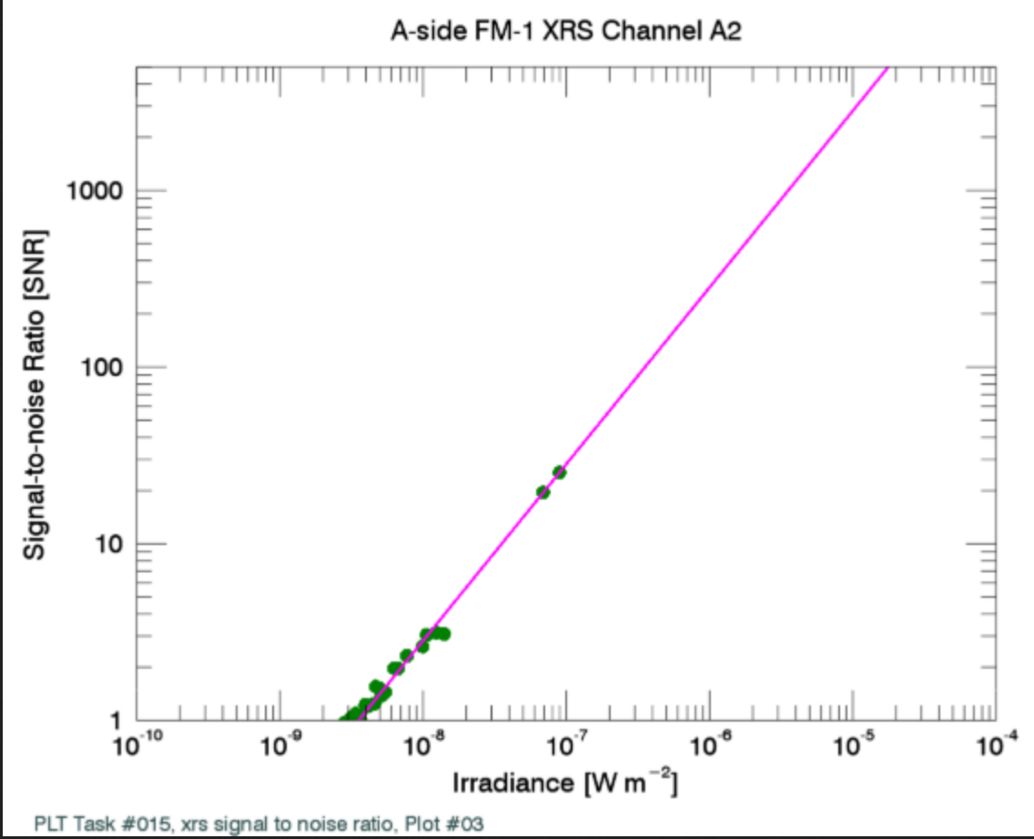
#9: XRS A1-A2 Crossover Threshold
Same considerations for Channel A as for Channel B.
A1 saturates near 7x 10⁻⁵ W/m².
Short term: 10⁻⁶ W/m², but PLPT #10 chooses 10⁻⁵ W/m².
Long term: -- Use hysteresis at high flux level (in L2)
XRS Channel A1
XRS Channel A2
SNR
SNR
10⁻⁶ W/m² crossover threshold
SNR
10⁻⁶ W/m² crossover threshold
Irradiance [W m⁻²]
Irradiance [W m⁻²]
Notes:
For G17 saturation of XRS-A is around 9.2e-4 W/m^2. That’s probably close to the same number for all FMs.

Slide 19
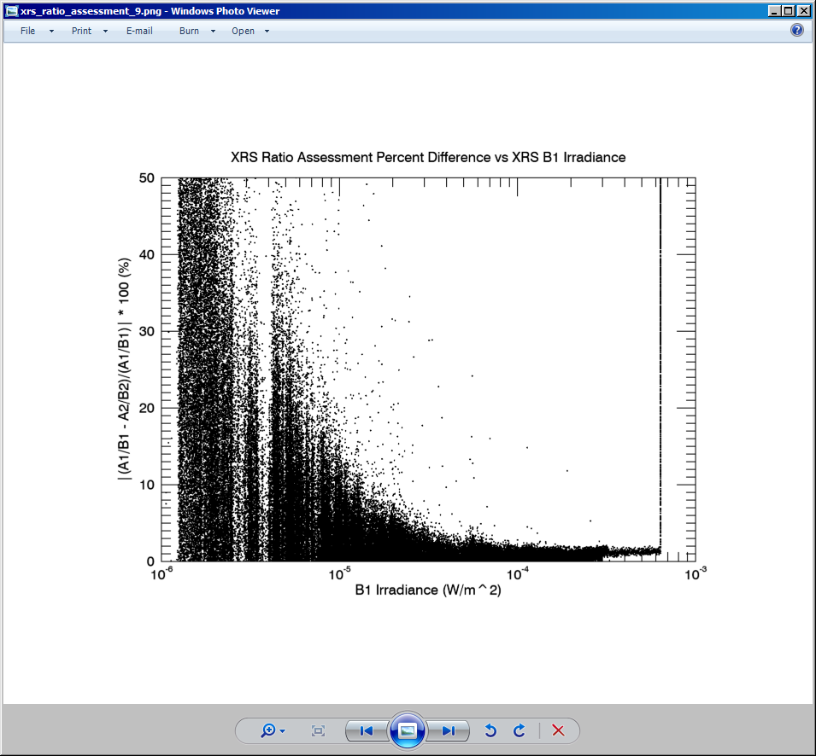
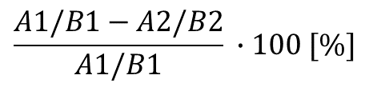
#10: XRS Ratio – Threshold Assessment
Find sensitivity of the XRS ratio to the XRS crossover thresholds.
SWPC operations uses 1 minute X-ray fluxes for M+ class flares.
During a flare, 1-s ratio is used to monitor flare increase. (L2)
Results: Move thresholds to A1: 10⁻⁵ W/m², B1: 10⁻⁴ W/m². LUT change
$$\frac{A1/B1−A2/B2}{A1/B1} ∙100 [\%]$$
flare class:
M X
10⁻⁶ 10⁻⁵ 10⁻⁴ 10⁻³
B1 irradiance [W/m²]

Slide 20
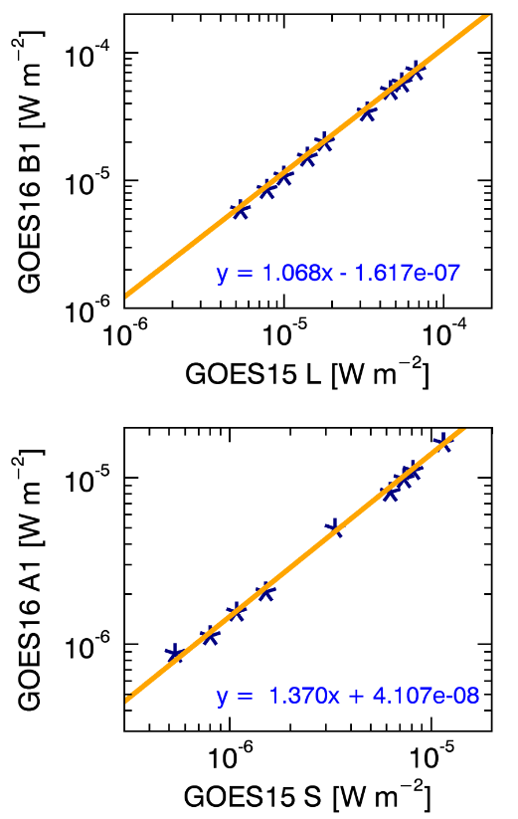
#11: NOAA XRS Scaling Factors
Objective: Determine the scaling needed to adjust EXIS XRS irradiances to the NOAA historical X-ray record.
Fit peaks w/ B1 > 5∙10⁻⁶ W/ m².
ChB1: G16 / G15 = 1.07
ChA1: G16 / G15 = 1.37
  ratio is 1.34 when all data is plotted (not shown).
Essentially same for B2 and A2.
June 18 SDO rocket underflight may help to explain Channel A.

Slide 21
#12: XRS L1b Uncertainties (1/3)
Objective: Determine the uncertainty in the XRS L1b fluxes.
Three different days, with varied levels of solar activity, were examined.
Results (σ_{E} /E @ flare-class threshold levels)
  B1: B 7.1%; C 2.6%; M 2.5%; X 2.5%
  A1: B 9.0%; C 2.4%; M 2.2%; X 2.2%

Slide 22








#12: XRS L1b Uncertainties (2/3)
$$g=$$
Diode gain (fC/DN)
Diode Current:
$$C= \frac{g\left(S−S_{0}\right)}{∆t}$$
$$S,S_{0}=$$
Diode, dark signal (DN)
$$∆t=$$
Integration time (sec)
$$σ_{C}=C{\left[{\left(\frac{σ_{g}}{g}\right)}^{2}+{\left(\frac{σ_{S}}{S−S_{0}}\right)}^{2}+{\left(\frac{σ_{S_{0}}}{S−S_{0}}\right)}^{2}+{\left(\frac{σ_{∆t}}{∆t}\right)}^{2}\right]}^{1/2}$$
Relative Uncertainty:
Flux:
$$F= \frac{C}{R}$$
Diode Responsivity (Amps m² W⁻¹)
$$R=$$
$$σ_{F}=F{\left[{\left(\frac{σ_{C}}{R}\right)}^{2}+{\left(\frac{{Cσ}_{R}}{R^{2}}\right)}^{2}\right]}^{1/2}$$
Relative Uncertainty:
Not included: SURF systematic issues, FOV, degradation, ...

Slide 23
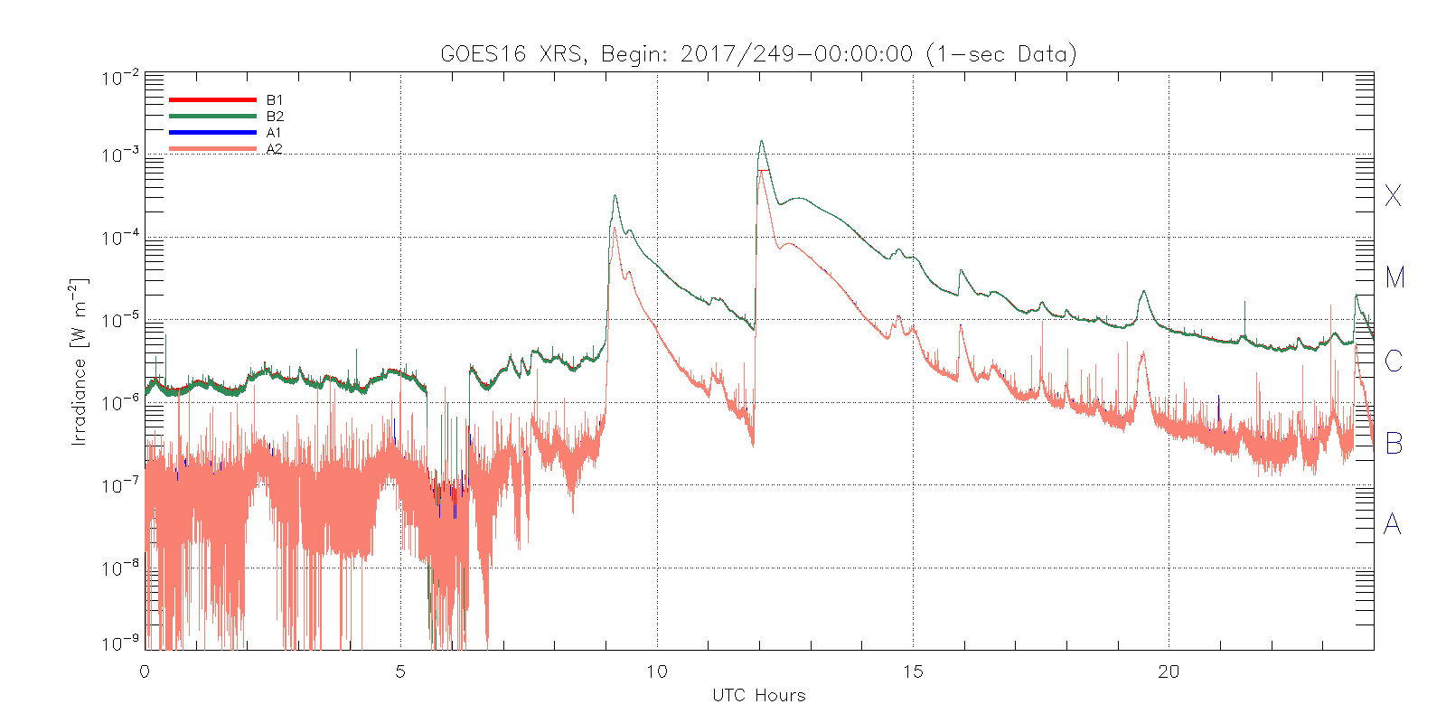
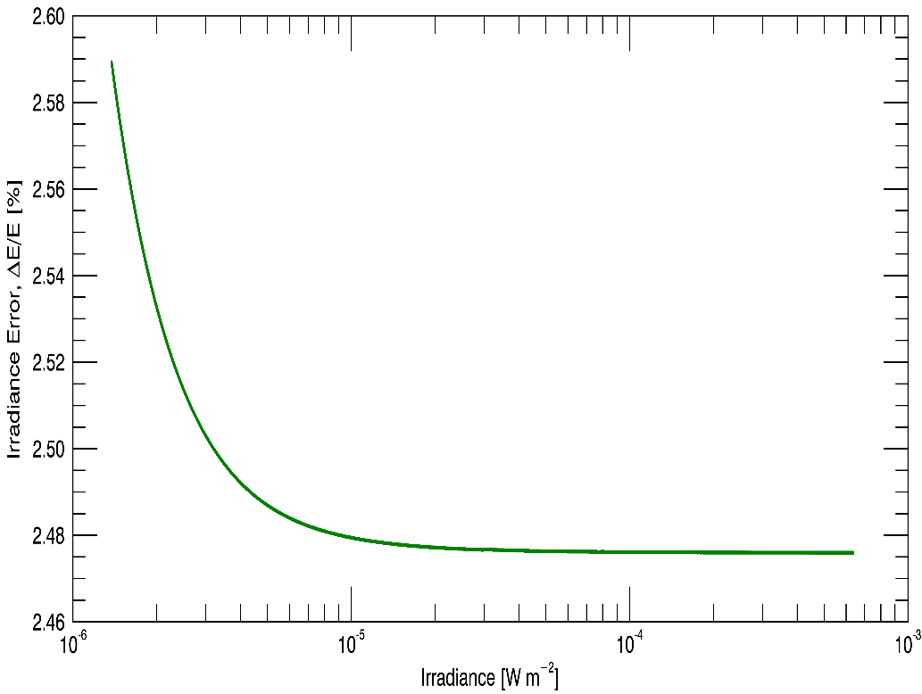
#12: XRS L1b Uncertainties (3/3)
Flux uncertainty as a function of flux.
Get S, σS.
Apply uncertainty equations.
Flux [W/m²]
time [hr]
Uncertainty, ΔF/F [%]
10⁻⁶
10⁻⁵
10⁻⁴
10⁻³
Flux [W/m²]

Slide 24
#13: XRS Flare Location Comparison (1/3)
Verify that XRS quad diode measurements can be used to estimate flare location. (L2 algorithm)
X_{flare} = ([(Q₂ - Q_{2B}) + (Q₄ - Q_{4B})] - [Q₁ - Q_{1B}) + (Q₃ - Q_{3B})]) / (ΣQ - ΣQ_{B})
Y_{flare} = ([(Q₁ - Q_{1B}) + (Q₂ - Q_{2B})] - [Q₃ - Q_{3B}) + (Q₄ - Q_{4B})]) / (ΣQ - ΣQ_{B})
Q_{i} = corrected current for diode i
Q_{iB} = background current for diode i

Slide 25
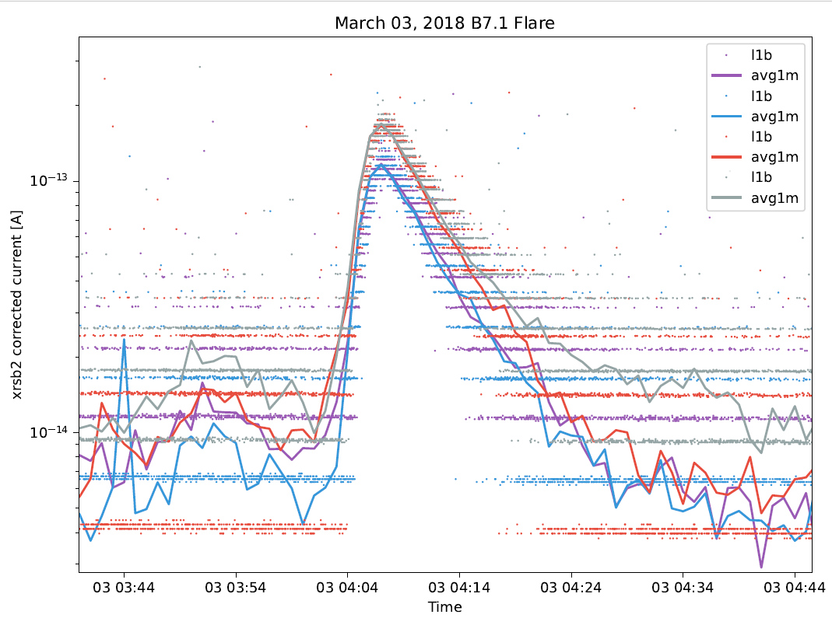
#13: XRS Flare Location Comparison (2/3)
Provisional Success Criteria: Solar flare responses are observed in all 4 elements of the quad-diodes.
Lines are 1-min
averages of the quad diode currents, showing that each diode observes the flare.
Notes:
RHESSI: LEO, launched in 2002; X-ray imager;

Slide 26
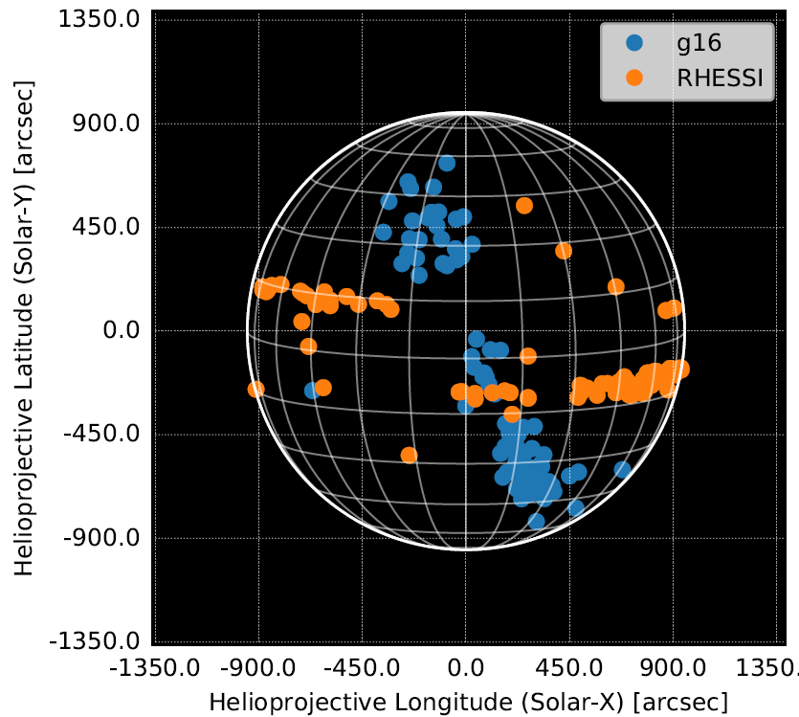
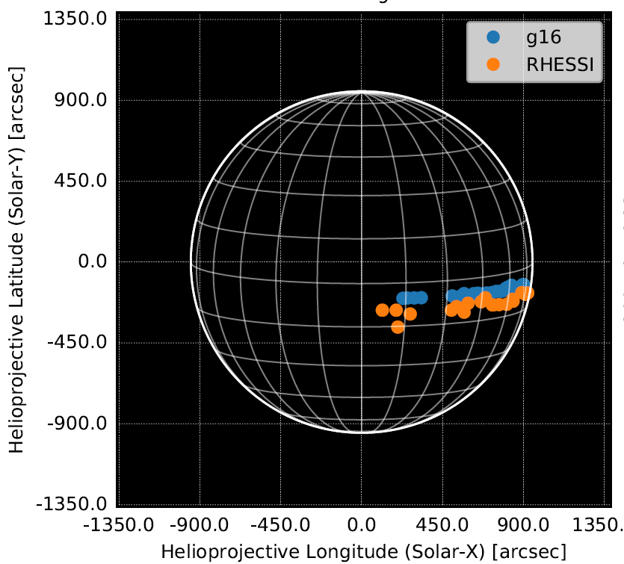
#13: XRS Flare Location Comparison (3/3)
Compare flare locations: RHESSI, GOES-16, Sept. 2017
Full Success Criteria: Derived solar flare location is found to be within 5 arc minutes (X class flare) of the accepted position.
121 flares
(1) Look only at larger flares: > 10⁻⁵ W/m² (2) Adjust parameters: backgrounds, FOV, rotation angle, X- and Y-offsets.
26 flares
30 arcmin
Notes:
RHESSI: LEO, launched in 2002; X-ray imager;

Slide 27
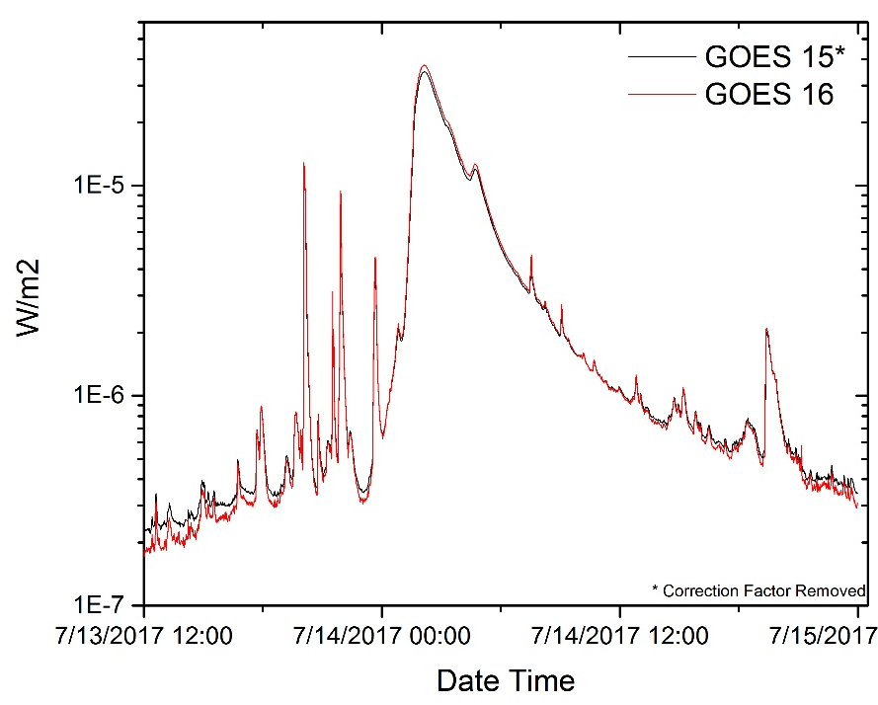
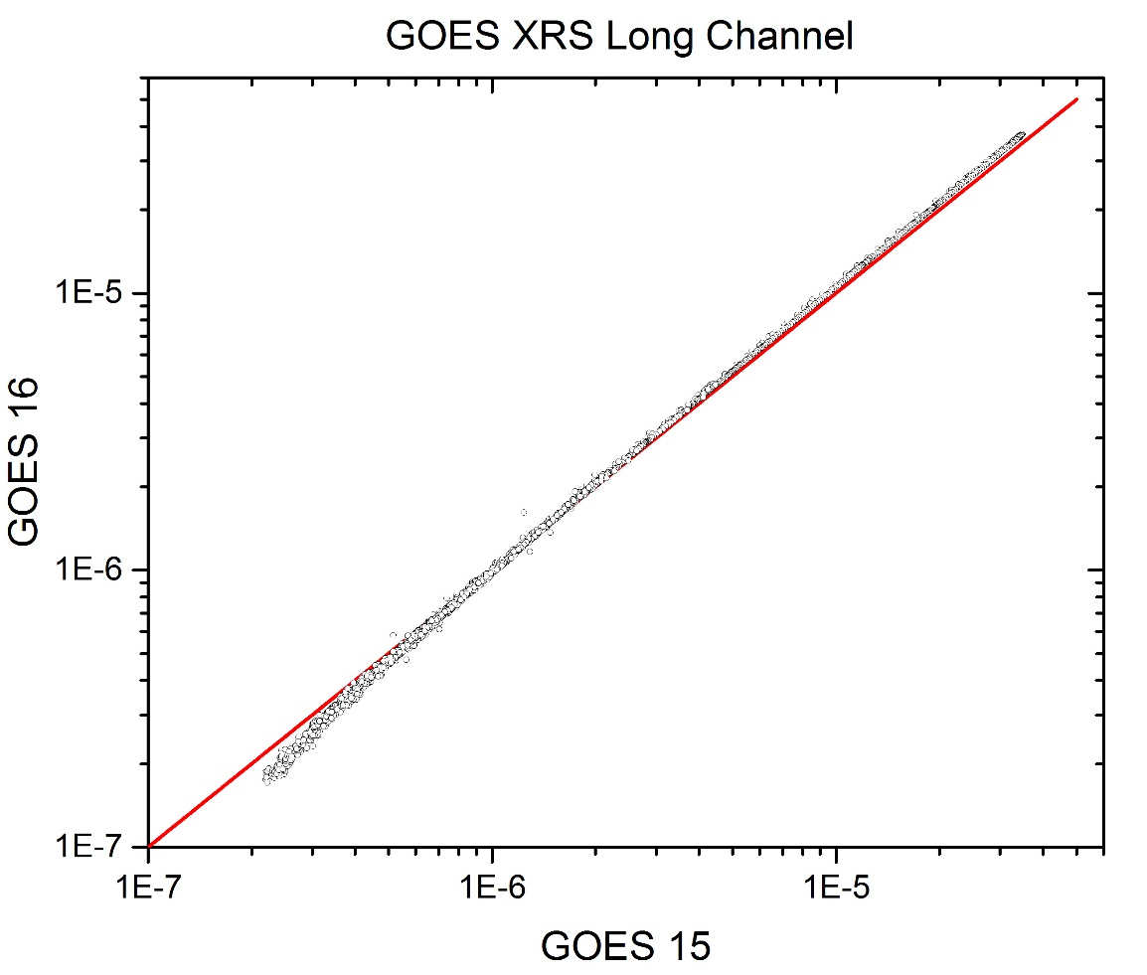
#14: Inter-Satellite Comparisons (1/4)
GOES-16 XRS-B vs GOES-15 during 13 - 14 July 2018

Slide 28
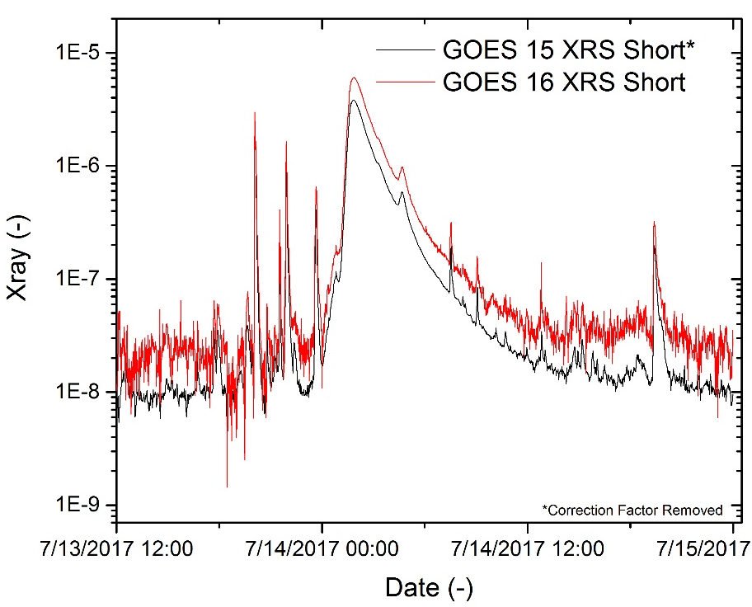
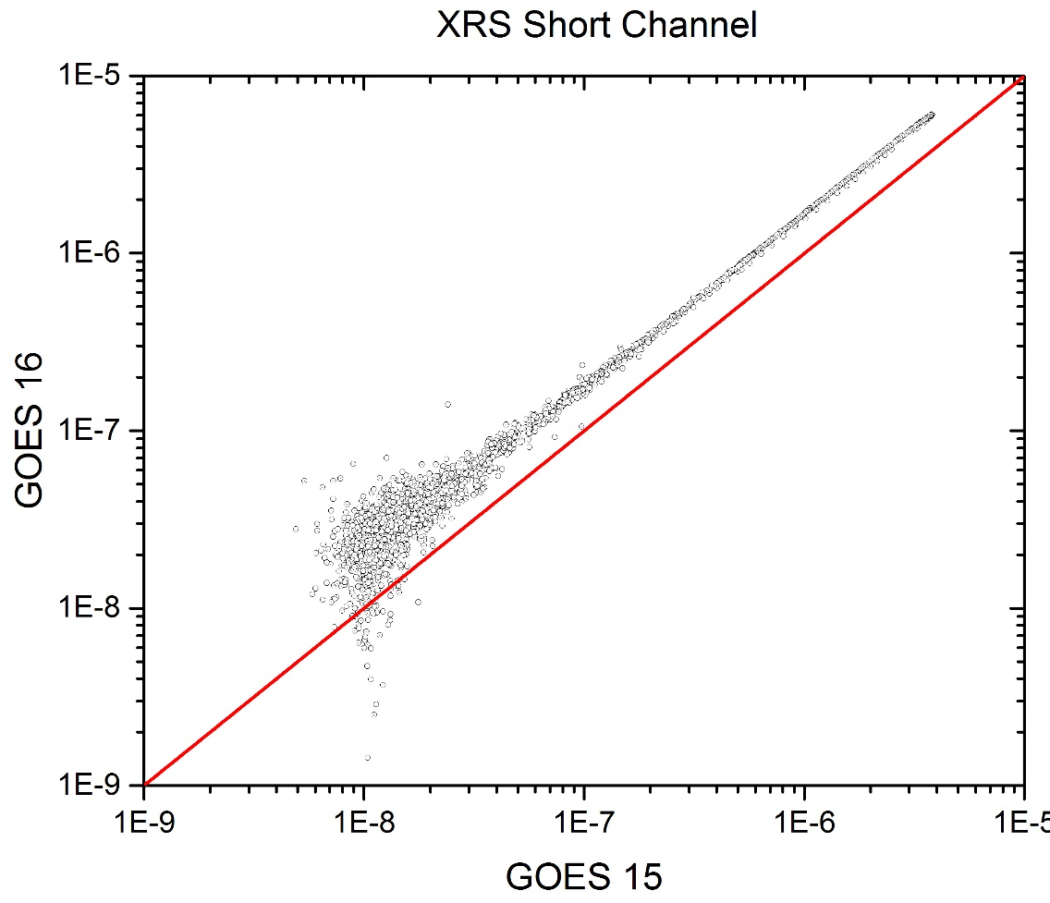
#14: Inter-Satellite Comparisons (2/4)
GOES-16 XRS-A vs GOES-15 during 13 - 14 July 2018

Slide 29
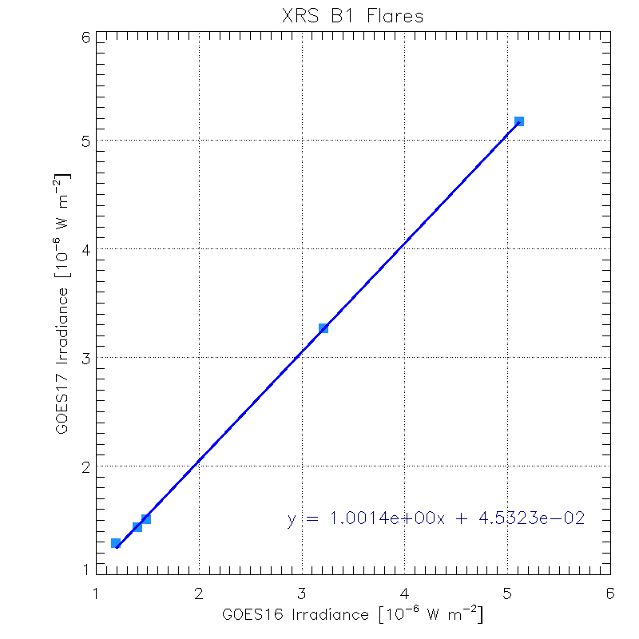
#14: Inter-Satellite Comparisons (3/4)
GOES 16 vs GOES 17
Five C-class flares.
Slope of 1.0014 suggests both XRS sensors respond similarly to these flares.

Slide 30
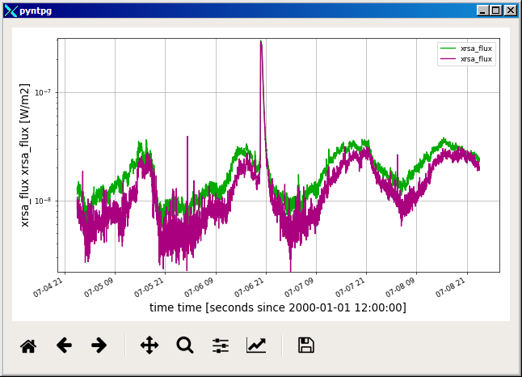
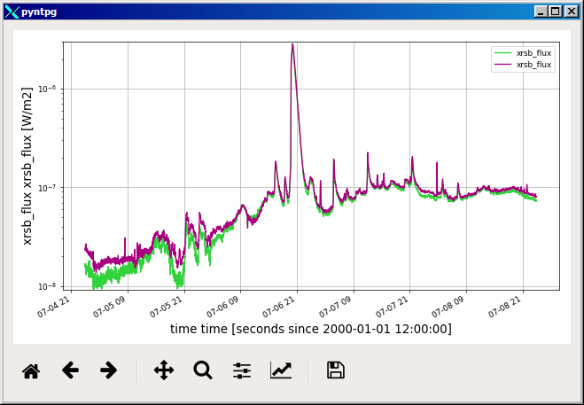
#14: Inter-Satellite Comparisons (4/4)
GOES 16 vs GOES 17 from 4-8 July 2018
  Plots: L2 1-min averages derived from L1b
GOES-16
GOES-17
10⁻⁷
XRS-A
10⁻⁸
Very low signals.
GOES-17
backgrounds
still need
some adjustment.
GOES-16
GOES-17
10⁻⁶
XRS-B
10⁻⁷
10⁻⁸

Slide 31
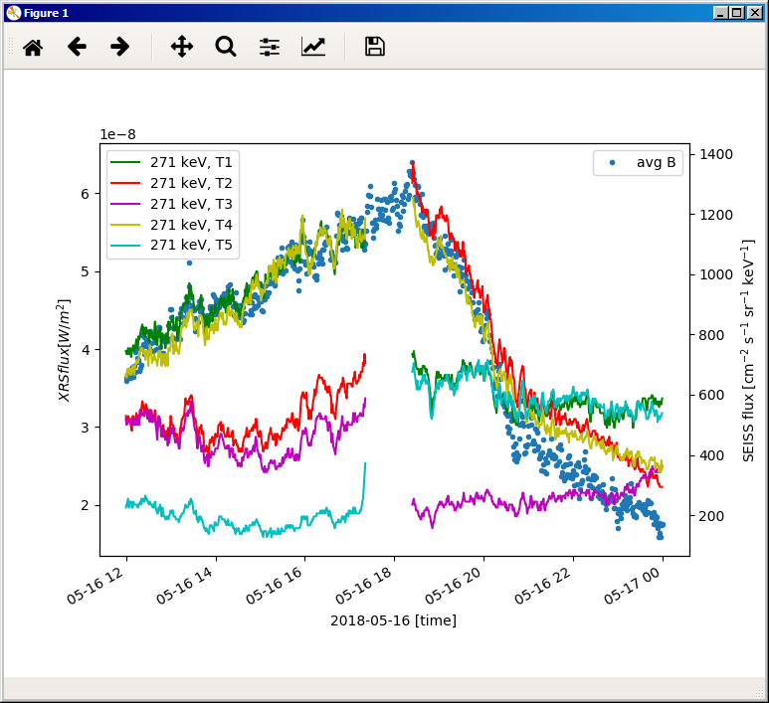
Instrument Issue: Electron Contamination
Contamination can be correlated to SEISS.
Correction will be made in L2.
XRS-B
After yaw flip:
T2, T4 primary
Before yaw flip:
T1, T4 primary
yaw flip

Slide 32
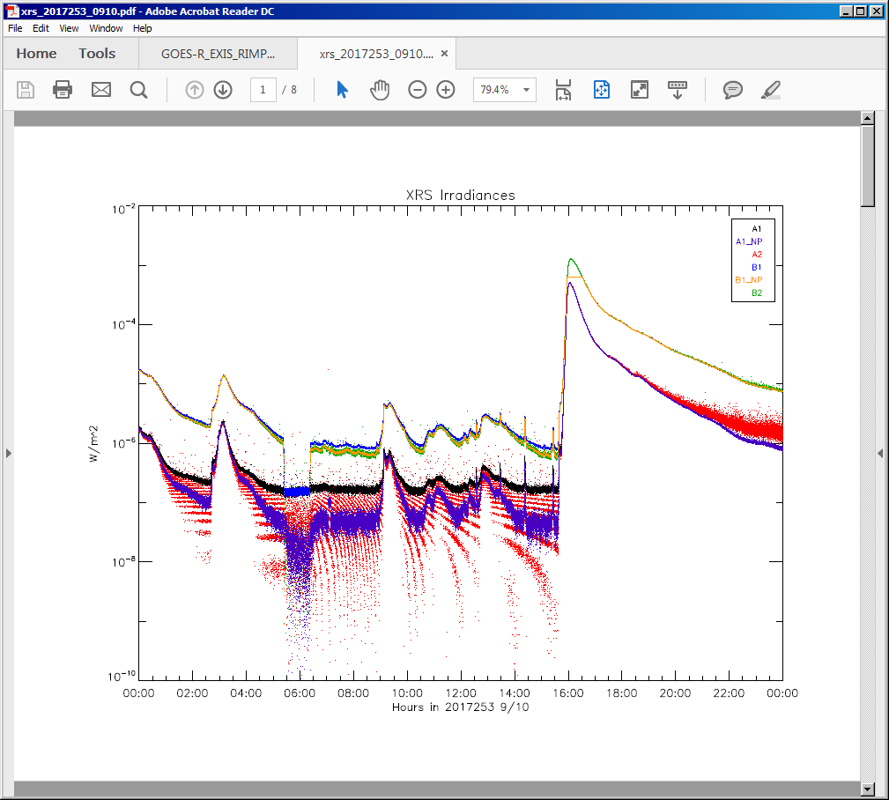
Instrument Issue: Dark Radiation Coefficients
Signal is higher in A2 than A1 in SEP event.
B2
B1
A2
Flux [W/m²] -- log scale
A1
CDRL 80 flux equation has a correction terms to account for SEPs; e.g.:
C_{rad, A1} = k_{A1} <C_{Dark, rad}>
Need to determine k_{i}
Time

Slide 33
Comparison to Performance BaseLINE

Slide 34
Performance Baseline
MRD ID | Description | Status | Related PLPTs | Source of Values in Validation Table
2036 | XRS Pointing Knowledge/Mapping Uncertainty | pass | none | upper bound on uncertainty is: sqrt(σ_{SPS}² + σ_{roll_angle}²) = 43 arcsecs where σ_{SPS} = SPS pointing uncertainty = 43 arcsecs σ_{roll_angle} = 0.16 arcsecs (See Slide 36)
2037 | XRS Product Measurement Range | pass | none | Essentially no new values measured on orbit. Range minimum is uncertainty due to noise (See Slide 37) range maximum is: flux equivalent of 989,000 DN (ASIC counter saturation)
2038 | XRS Product Measurement Accuracy | pass | none | Not measured on orbit. Validated pre-launch.
2041 | XRS Product Measurement Precision | pass | none | Essentially no new values measured on orbit. P = Precision = 1 DN equivalent at a typical temperature (14.227° C). A: 8.68x10⁻¹⁰ W/m², B: 6.06x10⁻¹⁰ W/m² M = MRD minimum measurable flux (MRD2037) A: 5.0x10⁻⁹ W/m², B: 2x10⁻⁸ W/m² Percent precision = P/(20 x M)*100 (Factor of 20 from MRD 2038).
2042 | XRS Long-term Stability | pass | -14** | Relative to GOES-15, XRS is currently stable. (See Slide 38) Future monitoring: (1) GOES-16 vs. other GOES satellites, (2) ASIC gain calibrations, (3) FOV mappings, and (4) cruciform scans.
* EXIS782 in LASP doc 133198-B, SPS Test & Verification Report, Feb 2013
** PLT-14 XRS/EUVS/Mg II Inter-Satellite Comparisons (L1b)

Slide 35
Performance Baseline
Quantity | MRD Requirement | MIT/LL Predicted Performance |  |  | Value at Provisional
MRD2036: Product Pointing Knowledge/Mapping Uncertainty
Mapping Uncertainty | < 2 arcmin | < 66 arcsec |  |  | <43 arcsecs
MRD2037: Product Measurement Range XRS
Product Measurement Range XRS A | 5x10⁻⁹ to 5x10⁻⁴ W/m² | 1.20x10⁻¹⁰ to 8.1356x10⁻³ W/m² |  |  | 4.47x10⁻⁹ to 7.379x10⁻² W/m²
Product Measurement Range XRS B | 2x10⁻⁸ to 2x10⁻³ W/m² | 1.85x10⁻¹⁰ to 1.47x10⁻² W/m² |  |  | 5.84x10⁻⁹ to 5.095x10⁻² W/m²
MRD2038: Product Measurement Accuracy
Product Measurement Accuracy XRS A | < 20% at 20X min flux |  | < 9.56% |  | Not measured on orbit.
Product Measurement Accuracy XRS B | < 20% at 20X min flux |  | < 13.65% |  | Not measured on orbit.
MRD2041: Product Measurement Precision
Product Measurement Precision XRS A | 2% |  | 0.10% |  | 0.87%
Product Measurement Precision XRS B | 2% |  | 0.36% |  | 1.5%
MRD2042: Long-term Stability
Long-term Stability (over mission) | < ±5% or ability to track |  |  | Ability to track. | Current trend is flat. Ability to track.

Slide 36
Roll Angle Error (for MRD 2036)
σ_{roll_angle_SUVI} is the upper bound on the SUVI roll angle uncertainty. It is the upper the bound is the roll angle offset that gives the minimal measurable SUVI offset from AIA (0.15 pixel) at the limb. (Dan Seaton)
σ_{roll_angle_SUVI} = 0.02° (0.02° = 72 arcsecs)
σ_{roll_angle} is the uncertainty in EXIS mapping/pointing
due to the roll angle. It has an upper bound based
on the impact at the limb.
σ_{roll_angle} = R_{Sun} x tan(0.01°)
= 0.0026 arcmin
= 0.16 arcsec
2σ_{roll_angle}
R_{Sun} = 15 arcmin
= 0.25°
σ_{roll_angle_SUVI} = 0.02°
limb of Sun

Slide 37
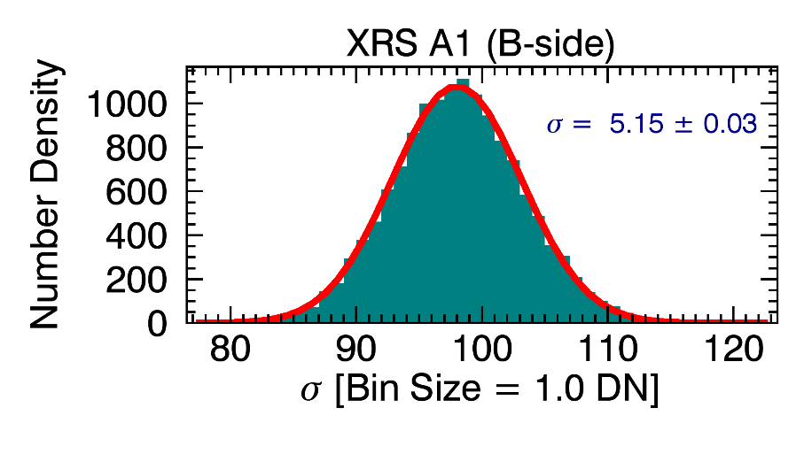

Uncertainty for XRS-A1 and -B1 (for MRD 2036)
Plots show AXUV-100 Noise Distributions for measurements made during off-points*.
Uncertainties of 1 standard deviation given by σ.
Mean values indicate average dark count which is not used here.
counts
counts
Convert σ[DN] to σ[W/m²] to get σ_{A1} and σ_{B1}
A1: 1 DN = 8.68e-10 W/m² B1: 1 DN = 6.06e-10 W/m²
σ_{A1} at 1 DN = 5.15 * 8.68e-10 W/m² σ_{B1} at 1 DN = 9.63 * 6.06e-10 W/m²
= 4.47e-9 W/m² = 5.84e-9 W/m²
* Plots from the Post-environmental SURF Tests: Nominal Temperature (2013/063)

Slide 38
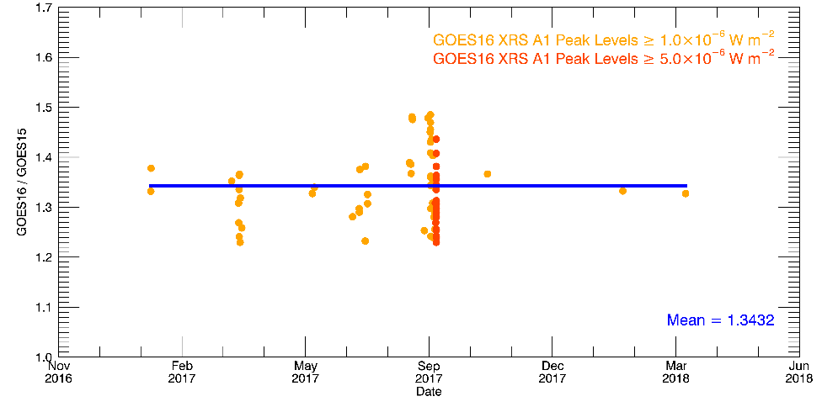
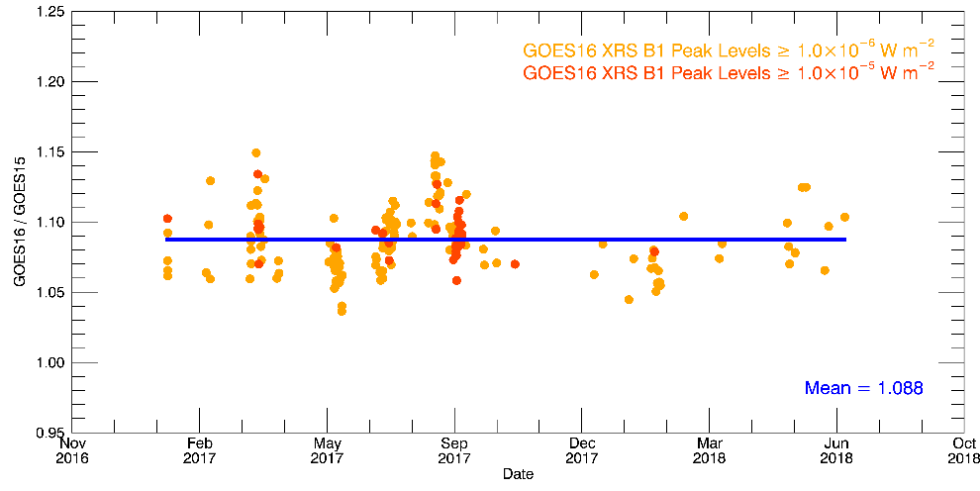
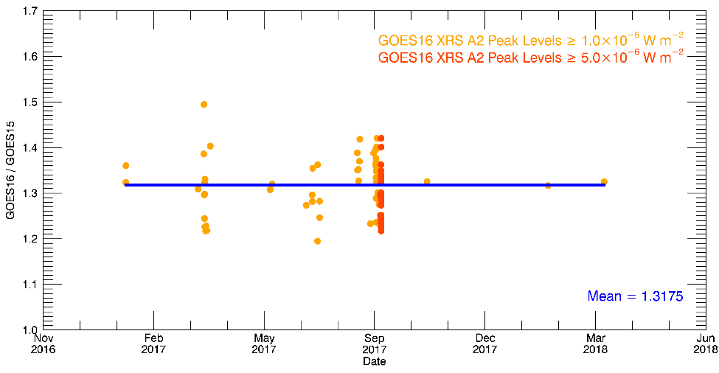
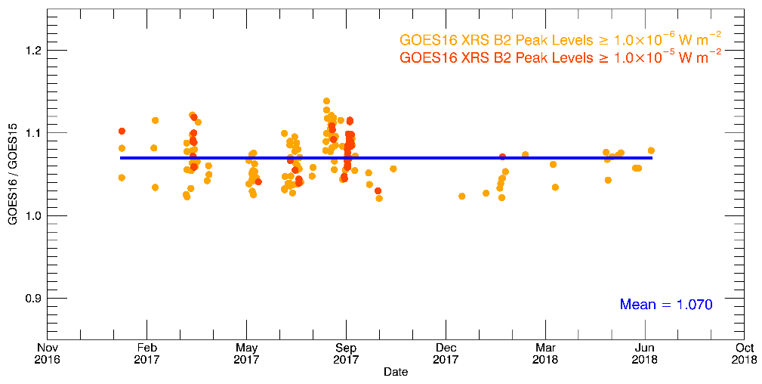
Stability of GOES-16 relative to GOES-15 (for MRD 2042)
GOES-16 is currently stable: ratios of XRS channels for GOES-16 / GOES-15 are flat.
Plots are GOES-16/GOES-15 for 2017/021 - 2018/221.
A1
B1
A2
B2

Slide 39
Summary of Remaining issues

Slide 40
XRS L1b data generation issues
The following issues are issues due to discrepancies in the L1b data processing codes.
ADR | Impact | Issue | Description | Comments to Users
228 | medium | incorrect times in file names | start times in file names and time range are 1 s late | Use time stamps for times.
590 | medium | roll angle incorrect | roll angle is incorrect | Do not use SUVI_CROTA variable. Value will be fixed and variable will be renamed SPP_to_Sun_roll_angle.
730 | medium | yaw flip flag incorrect | yaw flip flag is set incorrectly | Do not use yaw_flip_flag variable. GOES-16 had no yaw flips prior to the date of this document (August 2018).
176 | minor | time stamp metadata | metadata needs statement that time stamps are center time | --
517 | minor | data gaps | small but routine data gaps | --
536 | minor | underuse of SPS angles | too few SPS angles used in SPS angle averages | --
612 | minor | alg_container metadata | change attributes to 'not in use' | Do not use alg_container variable.
670 | minor | lunar transit flag not set | lunar transit flag is not set | --

Slide 41
XRS other scientific issues
# | Issue | Description | Comments to Users
1 | XRS electron contamination fix | The XRS flux signal at low X-ray fluxes and high electron fluxes is contaminated by the electron signal. | This will be fixed in the L2 data. Until this is fixed, the low XRS fluxes should not be used for scientific analysis.
2 | XRS choice of high/low channel as primary | The XRS primary channels (either A1 or A2 and either B1 or B2) are currently switched at fixed thresholds. | Fixed thresholds potentially result in rapid switching between the primary channels. Current thresholds are: A1: 10⁻⁵ W/m², B1: 10⁻⁴ W/m². Fix will be to add hysteresis to the switching for the primary channels.
3 | XRS-A is larger by 34% on GOES-16 than on GOES-15. | XRS-A: GOES-16/GOES-15 = 1.34 | The source of this discrepancy is unknown and is under investigation. The fluxes from GOES-8 through GOES-15 have all agreed.
4 | Dark radiation coefficients are set to 0 | The dark radiation coefficient is used to correct the signal for proton contamination during SEP events. It is currently not being applied. | Analysis to determine this term is in progress. Signals will be artificially high during SEP events, especially in the A2 and B2 channels.
5 | Dark counts | Improve dark counts with values from periods of lowest electron fluxes. Applies to all channels except B1. | This will be done soon. Impact will be to slightly increase fluxes, but this will only be noticeable for the lowest XRS-A fluxes.

Slide 42
Provisional maturity Assessment

Slide 43
Provisional Maturity Definition
Validation activities are ongoing and the general research community is now encouraged to participate.
Severe algorithm anomalies are identified and under analysis. Solutions to anomalies are in development and testing.
Incremental product improvements may still be occurring.
Product performance has been demonstrated through analysis of a small number of independent measurements obtained from GOES-15.
Product analysis is sufficient to establish product performance relative to expectations (Performance Baseline).
Documentation of product performance exists that includes recommended remediation strategies for all anomalies and weaknesses. Any algorithm changes associated with severe anomalies have been documented, implemented, and tested.
Testing has been fully documented.
Product is ready for operational use and for use in comprehensive cal/val activities and product optimization.

Slide 44
Provisional Validation (1/2)
Preparation Activities | Assessment
Validation activities are ongoing and the general research community is now encouraged to participate. | Validation activities are ongoing. Results have been discussed with SWPC. Release of data by NCEI will enable research community participation.
Severe algorithm anomalies are identified and under analysis. Solutions to anomalies are in development and testing. | There are no severe algorithm anomalies.
Incremental product improvements may still be occurring. | Product improvements will result from the resolution to issues given on the slides titled "XRS L1b data generation issues" and "XRS scientific issues"

Slide 45
Provisional Validation (2/2)
End State | Assessment
Product performance has been demonstrated through analysis of a small number of independent measurements obtained from select locations, periods, and associated ground truth or field campaign efforts. | XRS flux measurements have been compared with measurements from GOES-15. Instrument was calibrated at NIST.
Product analysis is sufficient to communicate product performance to users relative to expectations (Performance Baseline). | Yes, product performance will be communicated to users via the Readme.
Documentation of product performance exists that includes recommended remediation strategies for all anomalies and weaknesses. Any algorithm changes associated with severe anomalies have been documented, implemented, tested, and shared with the user community. | The PUG and CDRL80 require some updates. This presentation details major remaining issues and remediation strategies. The Readme will summarize remaining issues and strategies. Strategies have been discussed extensively with SWPC and agreed to by them.
Testing has been fully documented. | This presentation, PLT reports, and PLPT reports.
Product is ready for operational use and for use in comprehensive cal/val activities and product optimization. | Yes (for NCEI).

Slide 46
Summary and Recommendations
All sensors are performing very well.
Calibration LUTs have been updated. Further updates will occur.
Observed issues are similar to those for GOES-17.
Promising paths toward diagnoses and fixes of issues have been identified.
Some issues will prevent Full status unless resolved.
NCEI-CO recommends that FM1 EXIS L1b data be transitioned to Provisional status at this time.

Slide 47
Path to FUll Validation

Slide 48
Risks for Full Status
Issue | * | Notes
LZSS downloads with CAC-authentication |  | L0 should be in CLASS in September
New issues found during continued monitoring
* Likelihood:
Unlikely
Possible
Likely

Slide 49
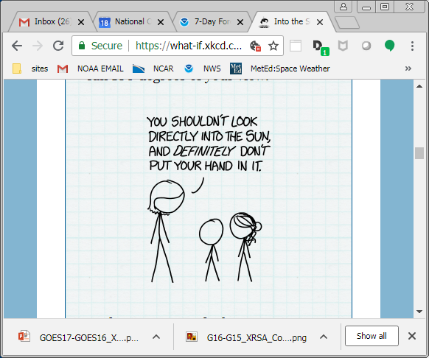
Path to Full Validation
Data analysis with L1b, L2, and locally processed L0 data.
Identify and resolve instrument issues including those listed in the Summary of Remaining Issues slides.
Analyze daily, weekly and quarterly calibrations.
Provide updated calibration tables.
Verify L1b revisions.
https://what-if.xkcd.com/115/
Notes:
hope for some flares! SEP events.

Slide 50
backup slides

Slide 51
EXIS Calibrations
Nominal Weekly - 90 s comparison with secondary
  EUVS - A, -B Measure and trend darks and gain.
  EUVS-A Measure and trend primary filter changes.
  EUVS - A, -B, -C Measure and trend flatfield.
  EUVS -C Measure and trend primary channel offset.
Quarterly cruciform
  XRS, EUVS-A, -B, -C Measure and trend FOV map
  XRS, SPS Measure and trend internal gain, dark
Quarterly other
  XRS, EUVS-A, -B Measure radiation k factors
  SPS Check for radiation sensitivity
  EUVS-C Check radiation filtering, Mg II scaling.
  XRS Find cross-over thresholds for A1-A2 and B1-B2. Check impact on ratios.
  XRS Determine NOAA scaling, L1b uncertainties.
  EUVS L1b model baseline and uncertainties.
  EUVS Check for bootstrap relationships and degradations.
Longterm comparisons
  XRS compare flare locations from XRS and SUVI
  XRS, EUVS compare measurements with other satellites

