Slide 1
GOES-16 GLM Implementation in NWS
NWS/OBS Update to Full Validation PS-PVR
November 1, 2018

Slide 2
Outline
NWS GLM Implementation Team
Currently Fielded products in AWIPS-2
Gridded GLM Products Description
Laboratory/Testbed Activities
NWS Field-wide Operational Roll-out
Outreach Materials - Quick Guide and Videos
  Training and Orientation Materials
Gridded GLM Products in AWIPS2 (CAVE/D2D)
Migrating GLM into NWS Operations (3 Phases)
GLM Applications in NWS Operations
Next Steps for GLM Implementation in NWS
Suggestions for GLM Improvement and Further Exploration
Summary
Notes:
High quality retrieval flag

Slide 3
NWS GLM Implementation Team
Infusion of GLM into NWS is an ongoing collaboration including these key participants:
  NESDIS/STAR, GLM Working Group Lead (Scott Rudlosky)
  OAR/NSSL Hazardous Weather Testbed (Kristin Calhoun, Tiffany Meyer)
  Texas Tech (Eric Bruning)
  NASA SPoRT (Geoffrey Stano, Kevin McGrath)
  NWS/NCEP Aviation Weather Center (Josh Scheck, Amanda Terborg)
  NWS Office of Science & Technology Integration, Operations Proving Ground
  (Matt Foster, Chad Gravelle, Jack Richardson, Kim Runk)
  NWS Office of Observations (Brian Gockel, Joe Zajic, Lee Byerle, Eric Guillot)
  NWS Office of Central Processing, AWIPS Program Office (Steve Schotz,
  Scott Jacobs, Kevin Conaty, Ana Rivera)
  NWS Analyze Forecast and Support Office (Greg Schoor)
Team carried out conceptual development, software development, testing/evaluation of processing/distribution/display configurations, documentation, outreach and deployment
Notes:
High quality retrieval flag

Slide 4
Currently Fielded GLM Products in AWIPS-2
The current GOES-16 GLM product available across the majority of NWS sites:
  GOES-16 Flash Extent Density (FED) Grid over the CONUS
  Derived from GLM L2 (from NWS GRB antenna downlink)
  One- and five-minute grids, both updated/distributed every minute containing the most-recent one- or five-minute summation
  An “IOC” product-- only the first step!
Fielded AWIPS-2 baseline GOES-R plugin handles ingest and display of gridded GLM products (more detail in upcoming slides)
NWS CONUS-wide* roll-out of FED occurred Summer 2018
  Uses non-baseline distribution path (more detail in upcoming slides)
Approx. 21 NWS field sites participated in an extended eval starting on
June 19th, 2018, including four additional GLM parameters:
  One- and five-minute average flash area
  One- and five-minute total optical energy
* NWS CONUS field slides receiving GLM FED include Weather Forecast Offices (WFOs) and some River Forecast Centers (RFCs)

Slide 5
GLM Gridded Products Description (1)
GLM Flash Extent Density (FED) grids are produced on the Aviation Weather Center ISatSS* for distribution via terrestrial LDM to NWS WFOs and some RFCs on the CONUS
ISatSS* uses the "glmtools" python package written by Eric Bruning at Texas Tech to compute one-minute FED
  Each Event in a one minute observation period is collected, mapped to its parent Flash, and assigned to a point on the GOES-16 ABI CONUS fixed grid array
  The FED is a count, for each pixel in the CONUS fixed grid, of the number of Flashes that had an Event located in that pixel
  If a Flash had multiple events take place in a single pixel, its FED contribution is still one
* ISatSS - Integrated Dissemination Program Satellite Support Subsystem (a software application)

Slide 6
GLM Gridded Products Description (2)
The ISatSS ‘Points into GLM Grids’ (PiGG) application executes the ‘glmtools’ code to:
  generate the minute-by-minute FED fields
  accumulate them into a sliding five minute array that updates once per minute
  packages the one- and five-minute arrays into an 8km resolution compressed netCDF4 file that is compatible with the AWIPS-II GOES-R imagery plugin
Prior to FED grid generation, another ISatSS application uses a “furthest from image center" technique to filter any given 20-second input L2+ file down to 25,000 Events. This is required to maintain latency performance in the face of glint blooming (spurious) Events
Notes:
High quality retrieval flag

Slide 7
Laboratory/Testbed Activities
Foundational Work Helping Guide GLM Toward NWS Operations
The gridded GLM products were demonstrated/evaluated at the NSSL Hazardous Weather Testbed, in several NWS contexts, during Spring 2018 before the broader NWS rollout. See examples on following slides:
Convective evolution and rapid storm development
Lightning Safety and Aviation Applications

Slide 8
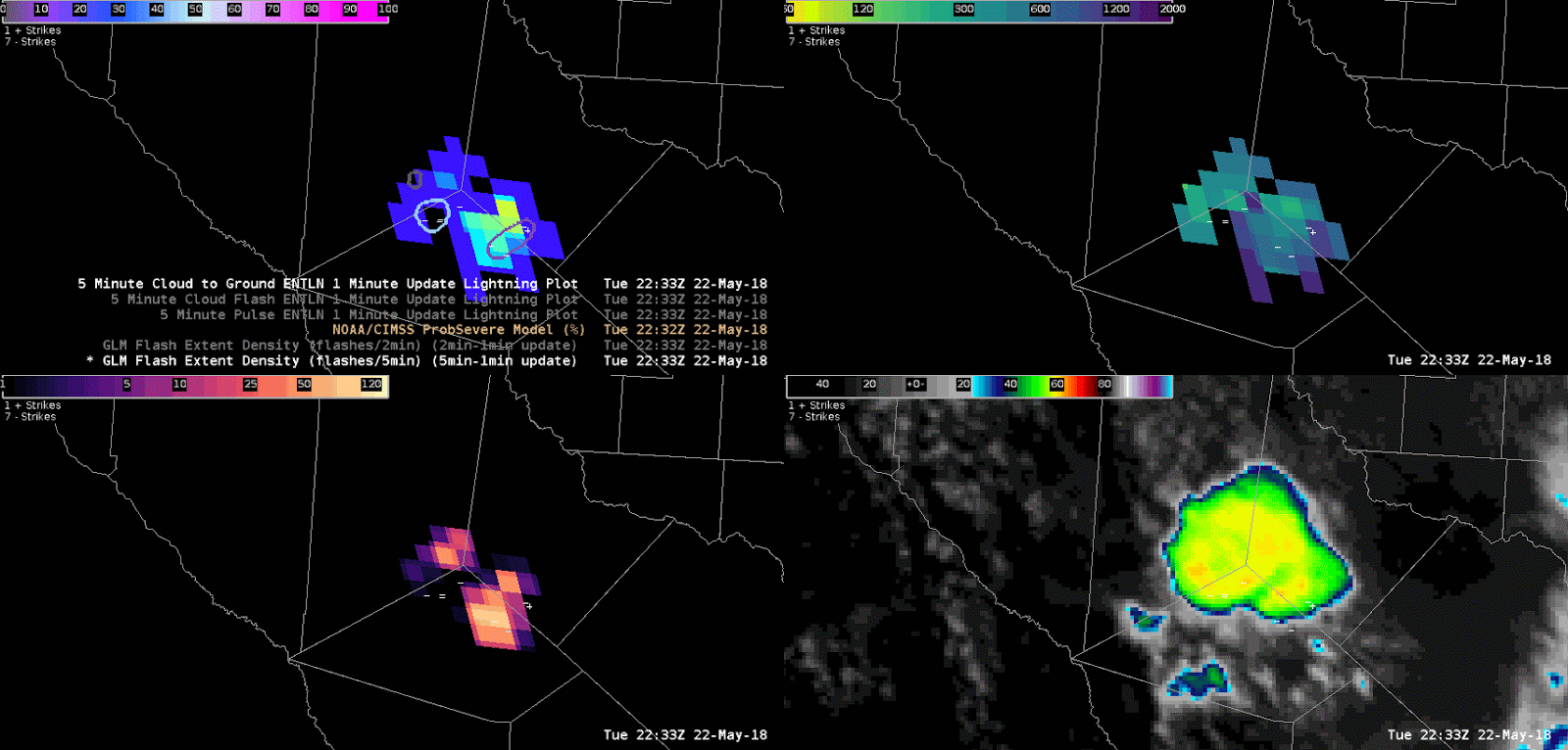
Application Examples at HWT (1)
Hazardous Weather Testbed: Convective Evolution and Rapid Storm Development
  Forecasters at the HWT found the gridded products useful in terms of diagnosing both the development and the decay of convective storms during ongoing severe events. The products also helped them pinpoint storms that were quickly becoming severe, which aided their decisions during warning operations.
AWIPS Display - FED (top left), Average Flash Area (AFA, top right), Total Optical Energy (TOE, bottom left), and ABI clean IR Window (bottom right)
“GLM was my primary tool used in deciding to issue a warning based on an increasing trend I began to notice around 2230Z. Between 2230 & 2250 [FED] increased from 10 to 30 & [TOE] from 50 to over 100... At the same time I noticed a cooling trend on cloud tops on the GOES 16 clean window IR which added even more confidence to the lightning data that this storm would continue to intensify.” – HWT evaluator

Slide 9
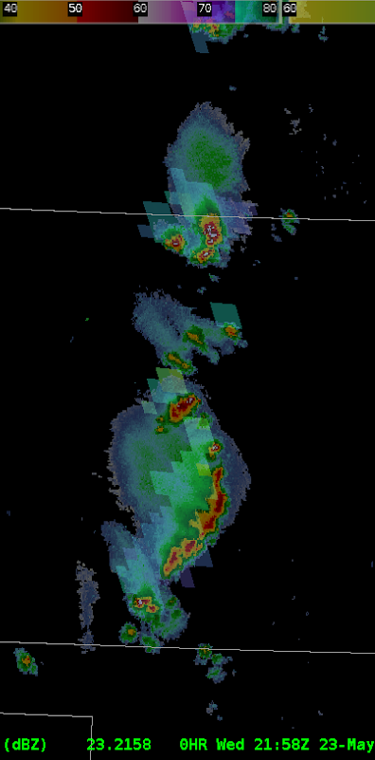
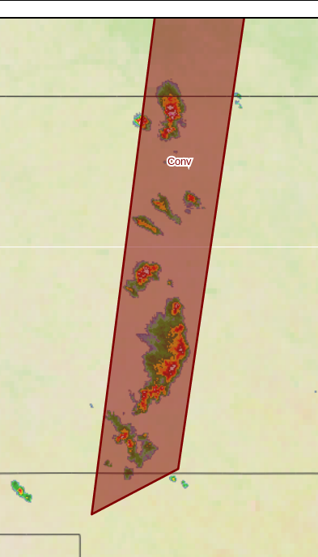
Application Examples at HWT (2)
Hazardous Weather Testbed: Lightning Safety & Aviation Applications
  Several HWT forecasters asserted that GLM gridded products (specifically AFA) capture the areal extent of lightning better than ground-based networks. They proposed that this information would be invaluable to forecasters in terms of issuing severe advisories, communicating lightning threats to the public, and debriefing emergency personnel.
“One thing that GLM data is going to change for aviation forecasters at the Aviation Weather Center, CWSUs, etc. is Convective SIGMET (C-SIG) and CWA size… As GLM data becomes available to aviation forecasters, I think it is going to open some eyes as to just how much areal extent to lightning there can be in individual t-storms & t-storm clusters/lines/line segments. Consider the following example, which compares GLM average flash area to a C-SIG (again, valid for up to 2 hrs) in NE/KS/N OK. Clearly, the areal coverage of the lightning will extend beyond the boundaries of the C-SIG soon” –Thomas Bell

Slide 10
GLM Field-Wide Rollout
Final stages of GLM FED development and Summer 2018 roll-out informed by:
  Beta site (~12 NWS sites) and HWT testing events held in Spring 2018
  Feedback from Extended Evaluation sites (additional ~9 sites Jun-Jul 2018)
  Functional and performance evaluation/testing by GLM working group at NWS OPG, and in NWS labs
For AWIPS deployment, used Redhat Package Manager (RPM) configuration file, which was pushed out to CONUS NWS sites on June 19th, 2018
  Close coordination with AWIPS/NCF, who staged the RPMs for activation at each site
  Included a separate RPM for Extended Eval sites to evaluate average flash area and total optical energy
VLab, Videos, TOWR-S updates, and TOWR-S Chatroom for outreach and deployment coordination
  https://vlab.ncep.noaa.gov/web/geostationary-lightning-mapper/training?inheritRedirect=true
Team contacted all NWS CONUS WFOs and most RFCs, to assist and facilitate with activation/deployment which finished Aug 24, 2018 (114 confirmed users)
(Some NWS/vlab pages access controlled)
Notes:
High quality retrieval flag

Slide 11
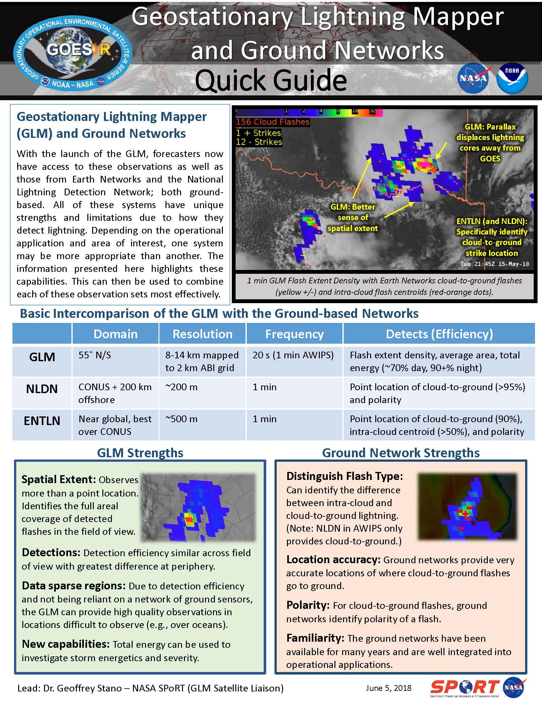
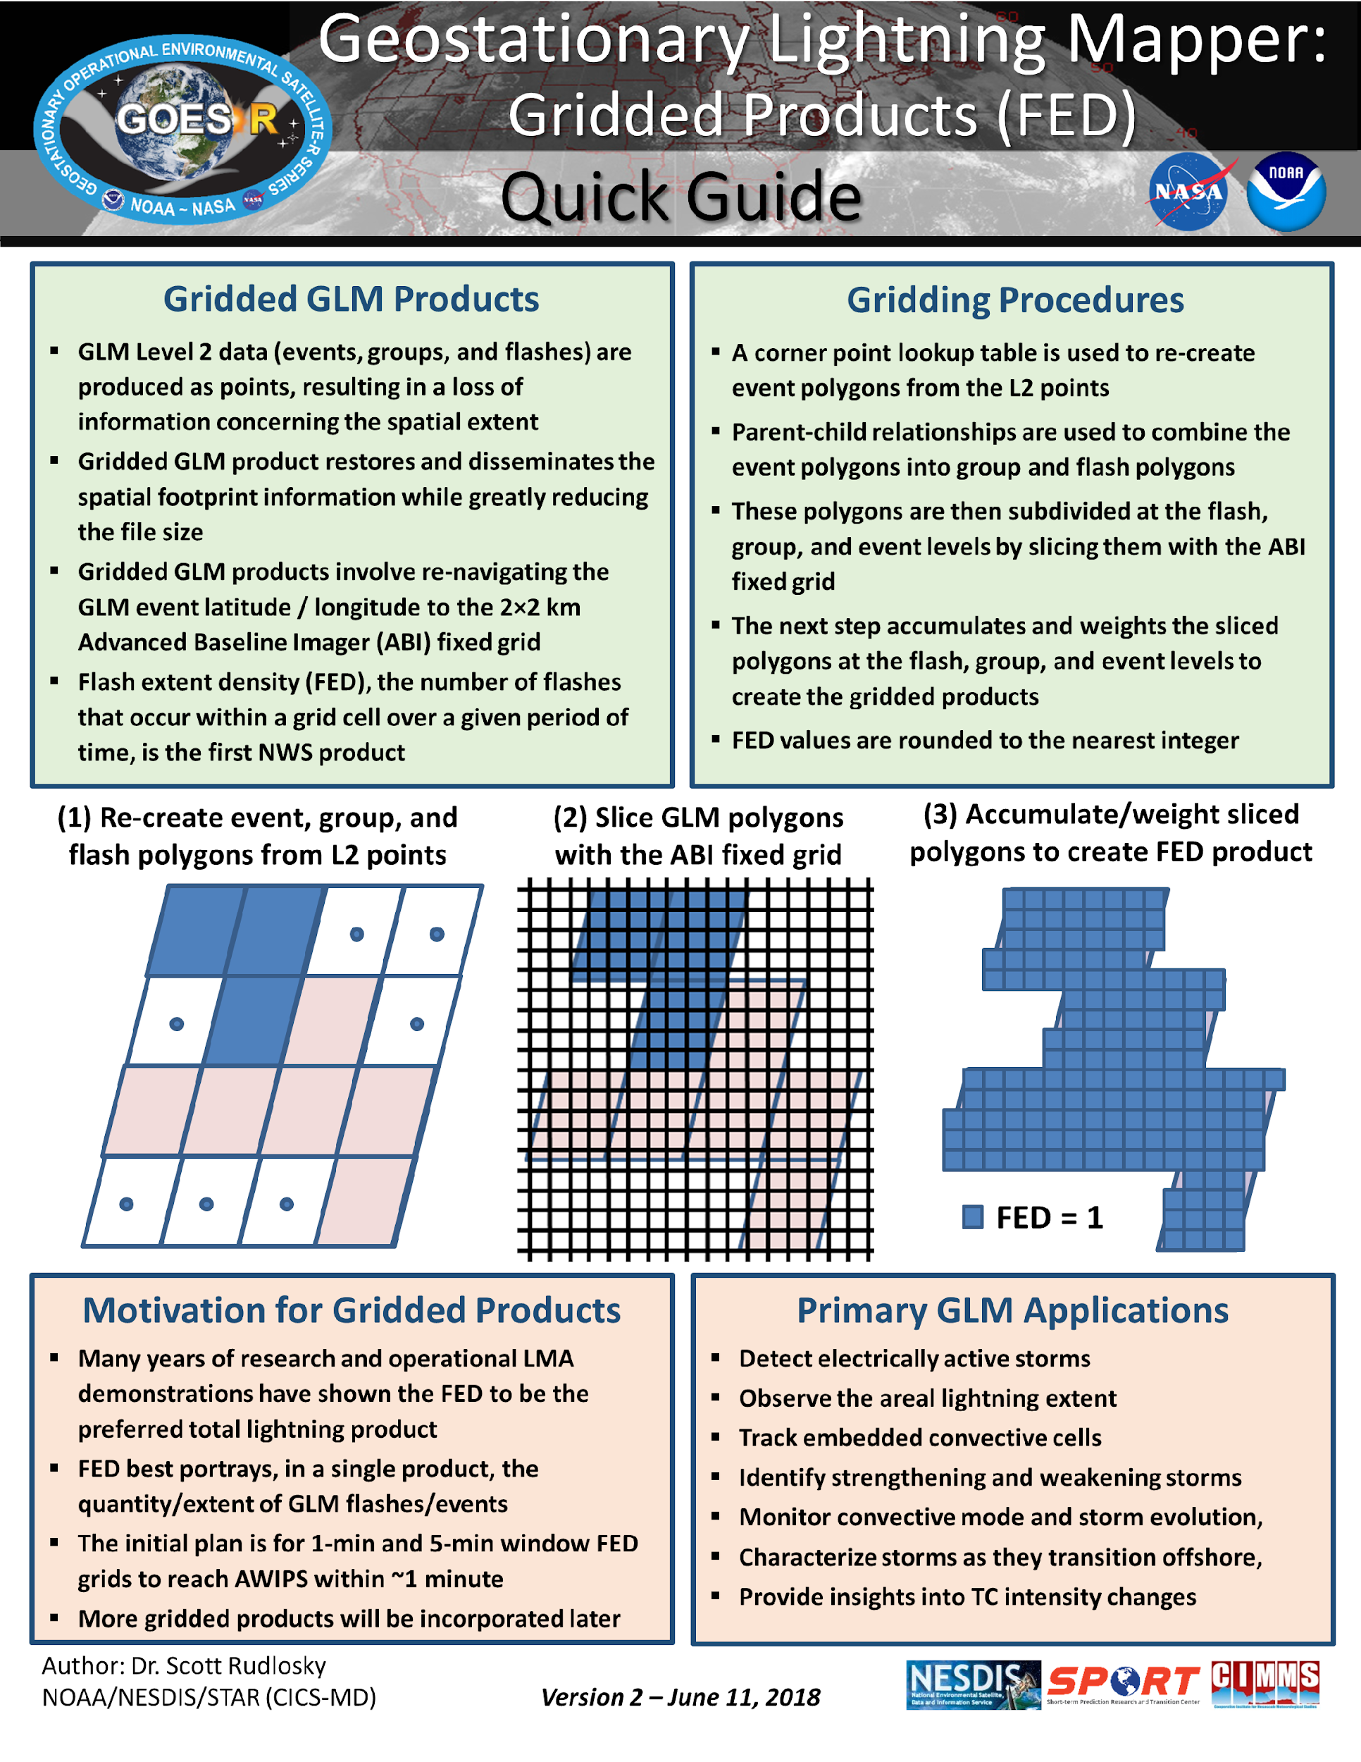
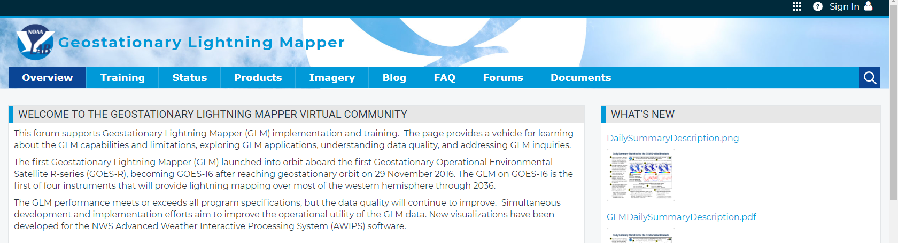
GLM Training/Orientation Materials
Developed six quick guides and briefs:
  Definitions and Detection Methods
  GLM Gridded Products
  GLM Data Quality
  GLM AFA and TOE
  GLM Applications
  GLM and Ground Based Networks
GLM Virtual Lab Webpage:
  Training
  Product Description
  Imagery Examples
  Blog and FAQ
https://vlab.ncep.noaa.gov/documents/3553989/3558863/GLM_Quick_Guide_Gridded_Products_June_2018.pdf/c52912d7-035c-7697-3caf-21a40192f102
(Some NWS/vlab pages access controlled)
Notes:
High quality retrieval flag

Slide 12
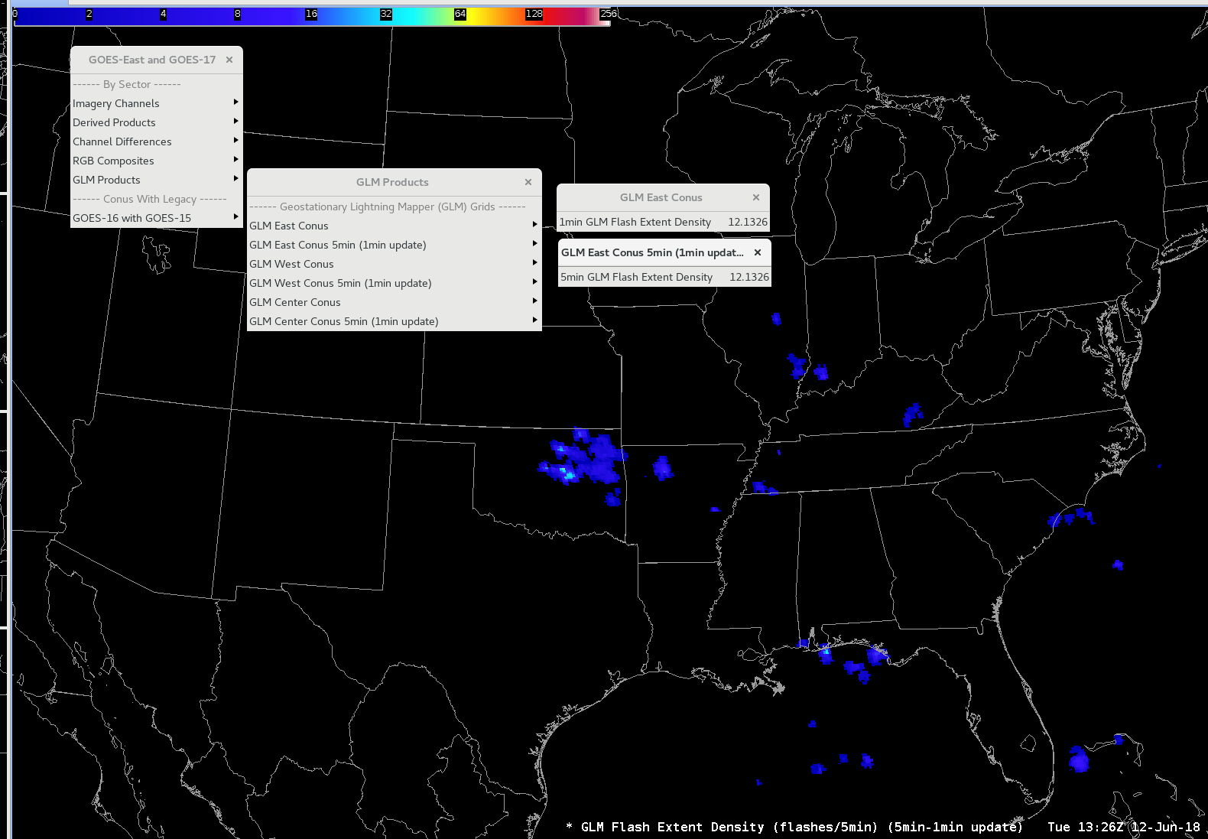
GLM Flash Extent Density (FED) Grid in AWIPS-2 CAVE D2D

Slide 13
Migrating GLM FED into NWS Operations
(Three Phases)

Slide 14
Sample Migration - GLM FED Grids
Phase One (Today): Product Generation via AWC/ISatSS
GRB
STAR
FTP
early release
AWC
ISatSS
CRH
WFOs/
CWSUs/
RFCs
GRB
NHC
ISatSS
ERH
GRB
SPC
ISatSS
SRH
tgrb
NAPO
Porch
NAPO
ISatSS
WRH
GRB
IDP-B
ISatSS
OPG
IDP-C
ISatSS
NCO
Data
Flow
GRB
SBN
sftp
ftp
tcp
ldm*
GOES-R
Ground
Segment
IDP-Dev
ISatSS
PDA
scmi
NCF
SBN
* LDM via terrestrial networks
derived and polar

Slide 15
Sample Migration - GLM FED Grids
Phase Two (CY2019 Q1): Product Generation via IDP/ISatSS
GRB
STAR
FTP
early release
AWC
ISatSS
CRH
WFOs/
CWSUs/
RFCs
GRB
NHC
ISatSS
ERH
GRB
SPC
ISatSS
SRH
tgrb
NAPO
Porch
NAPO
ISatSS
WRH
GRB
IDP-B
ISatSS
OPG
IDP-C
ISatSS
NCO
Data
Flow
GRB
SBN
sftp
ftp
tcp
ldm*
GOES-R
Ground
Segment
IDP-Dev
ISatSS
PDA
scmi
NCF
SBN
* LDM via terrestrial networks
derived and polar

Slide 16
Sample Migration - GLM Grids
Phase Three (Longer Term): Product Generation & Distribution via NESDIS
GRB
STAR
FTP
early release
AWC
ISatSS
CRH
WFOs/
CWSUs/
RFCs
GRB
NHC
ISatSS
ERH
GRB
SPC
ISatSS
SRH
tgrb
NAPO
Porch
NAPO
ISatSS
WRH
GRB
IDP-B
ISatSS
OPG
IDP-C
ISatSS
NCO
Data
Flow
GRB
SBN
sftp
ftp
tcp
ldm*
GOES-R
Ground
Segment
IDP-Dev
ISatSS
PDA
scmi
NCF
SBN
* LDM via terrestrial networks
derived and polar

Slide 17
GOES-16 GLM: Applications in NWS Operations
The initial gridded GLM products (flash extent density, average flash area, and total optical energy) provide NWS forecasters with a new perspective on lightning activity.

Slide 18
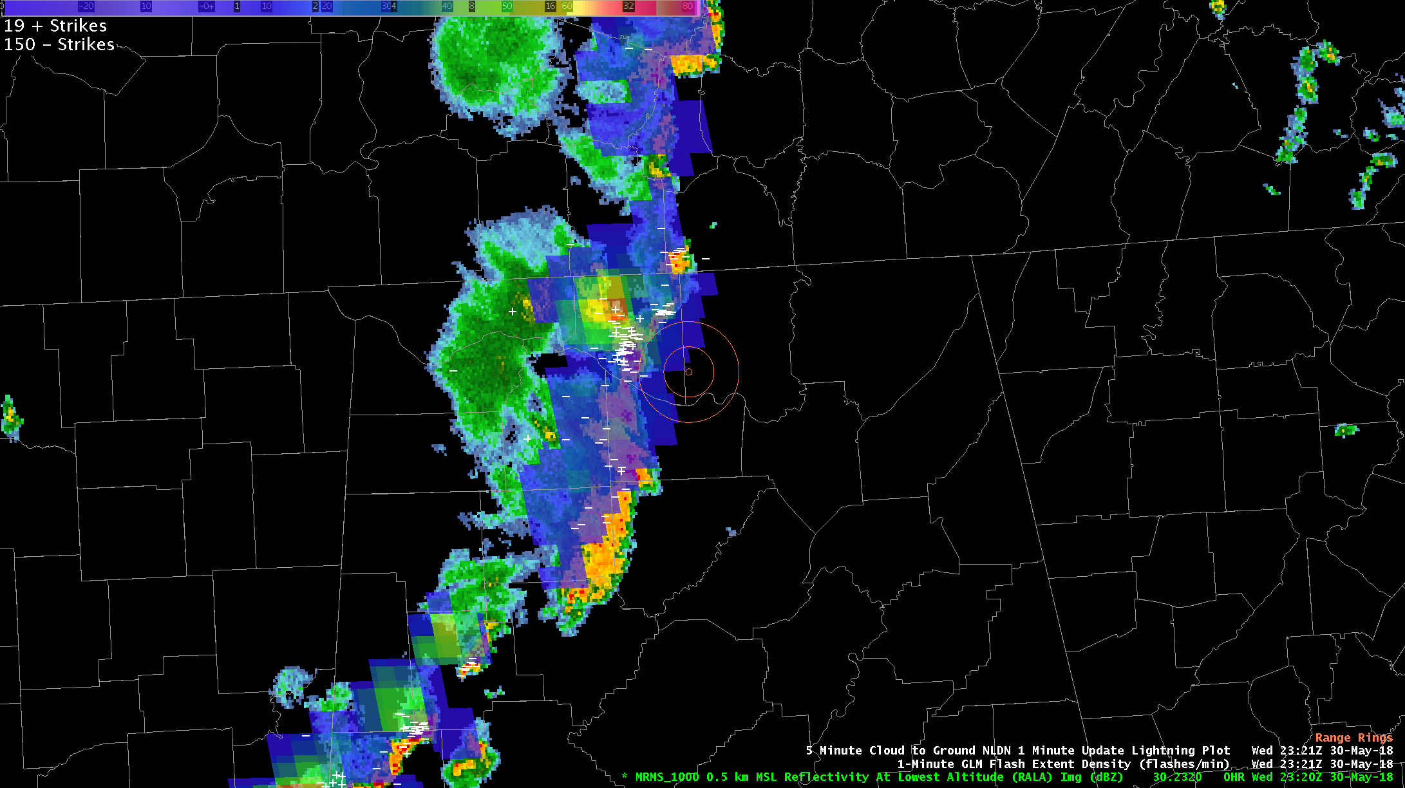
WFO Huntsville: Maintain an Airport Weather Warning
Storms approaching Huntsville International Airport
GLM flash extent density overlaid on MRMS Reflectivity at Lowest Altitude with NLDN cloud-to-ground flashes (white).
Yellow rings are 5 and 10 nm from airport.
Airport Weather Warning based on lightning within 10 and 5 nm (yellow rings)
NLDN showing active lightning approaching the airport
GLM provided insight, but NLDN was primary lightning data used
2321 UTC

Slide 19
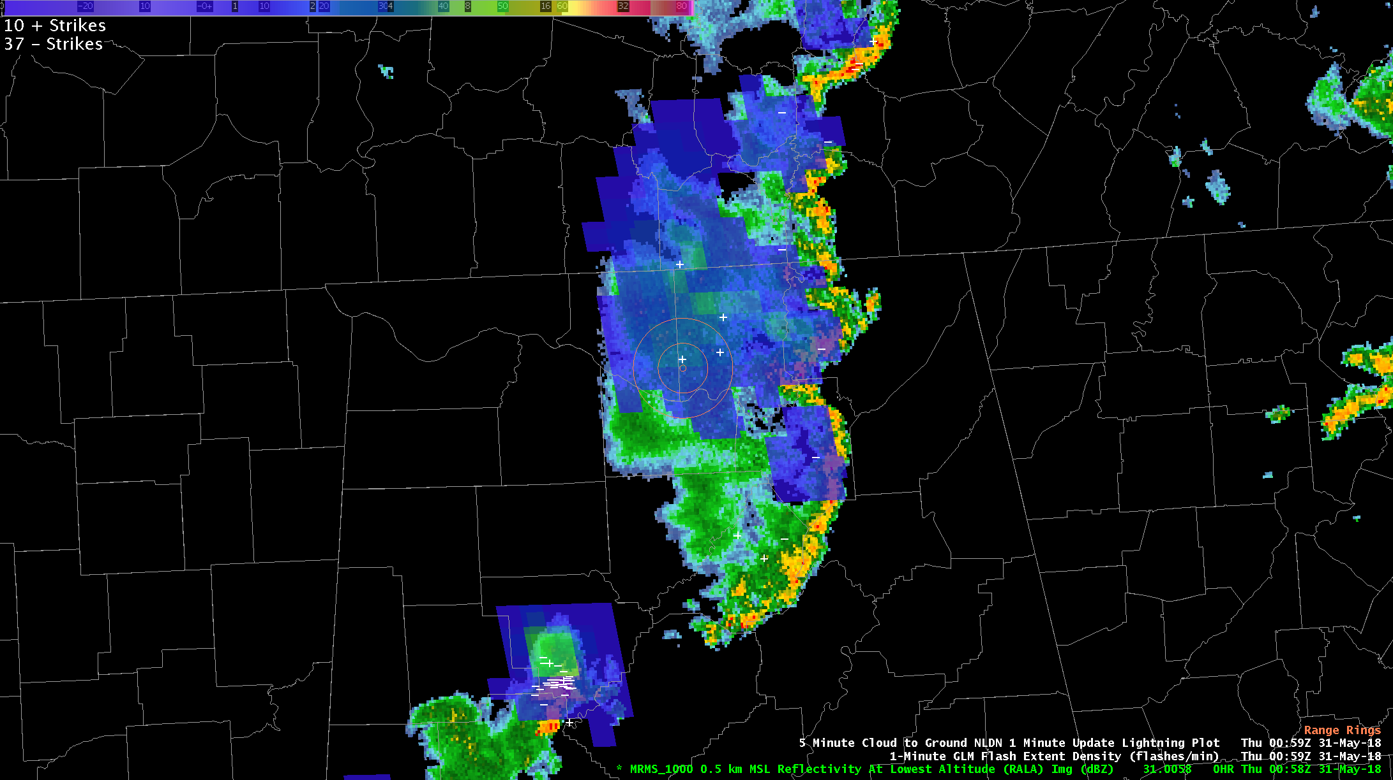
WFO Huntsville: Maintain an Airport Weather Warning
GLM flash extent density far more useful later in the event
GLM flash extent density overlaid on MRMS Reflectivity at Lowest Altitude with NLDN cloud-to-ground flashes (white).
Yellow rings are 5 and 10 nm from airport.
Storms had pushed well east of airport
Convection weakening and overall lightning activity decreased
However, GLM played significant role in identifying long flashes in trailing stratiform region
GLM showed lightning continuing over the airport
GLM illustrated the threat simply and effectively
0059 UTC

Slide 20
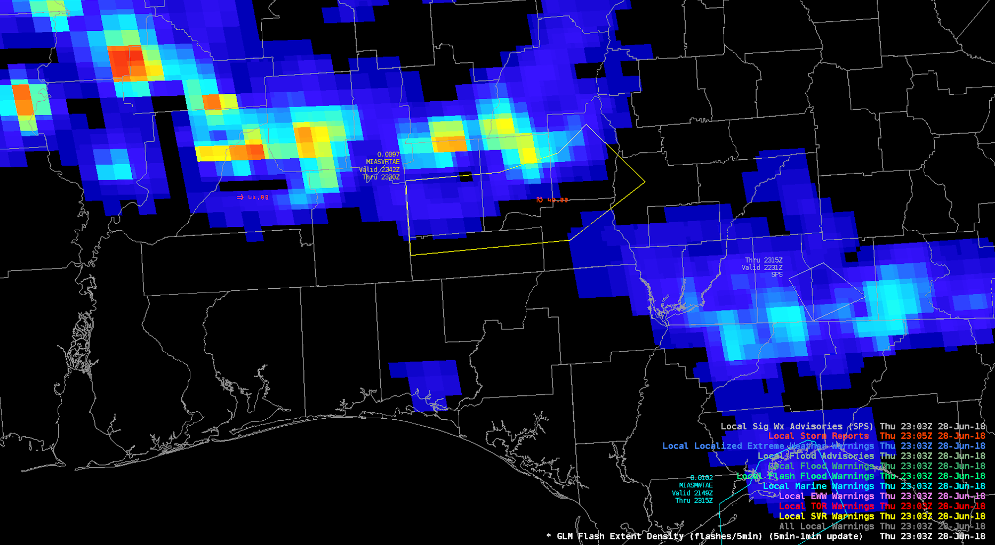
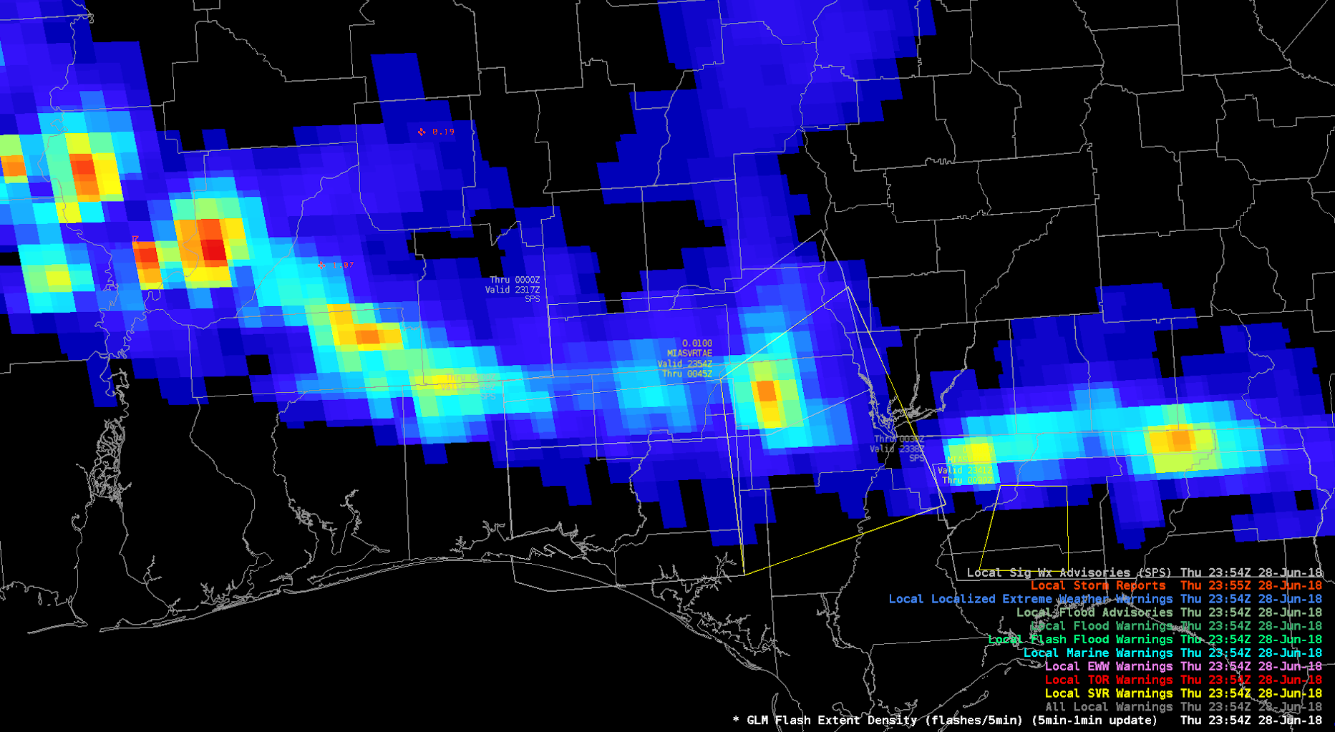
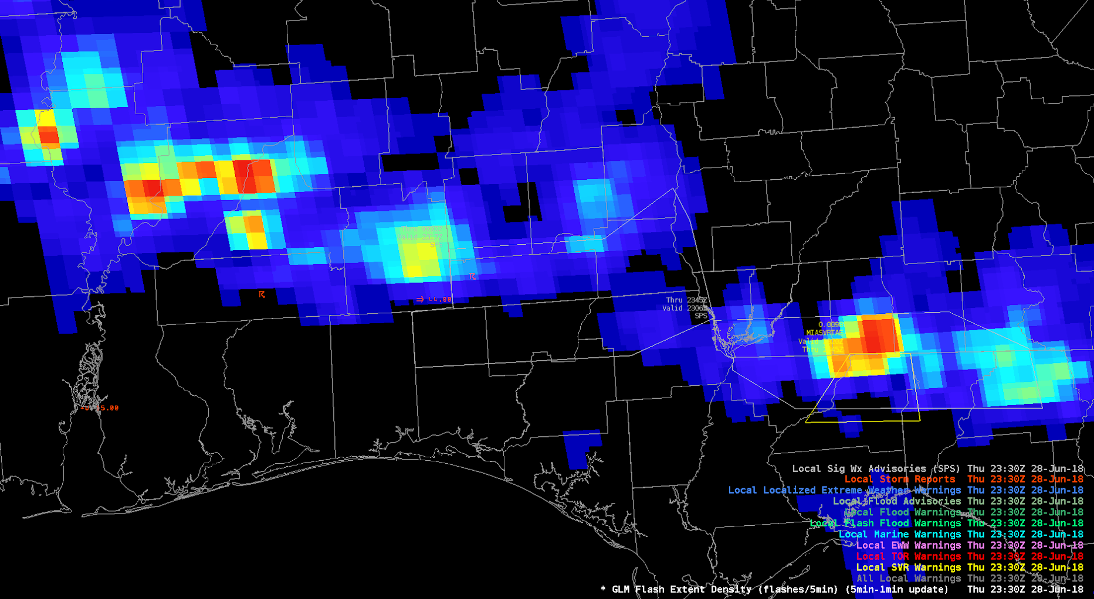
WFO Tallahassee: Warning Decision Support
A
2303 UTC
C
2354 UTC
5 min FED
B
2330 UTC
Previously severe storms approaching the Gulf Coast
GLM noted weakening at 2303 UTC (A)
Forecasters provided special weather statements versus warnings.
By 2330 UTC (B) storms began to re-intensify
Forecasters shifted back to issuing severe weather warnings
Storms continued to intensify through 2354 UTC (C), leading to additional warnings

Slide 21
GOES-16 GLM: Impacts to NWS Operations
NWS forecasters shared feedback via blog posts that are grouped and summarized on the GLM Vlab Webpage:*
https://vlab.ncep.noaa.gov/web/geostationary-lightning-mapper/blog
NWS forecaster feedback will continue to help drive GLM innovation and exploitation

Slide 22
Next Steps for GLM Implementation Across NWS (1 of 2)
Complete migration of FED product generation and data flows to national-baseline systems
Complete assessment of “Extended Evaluation” products and begin migration/T2O of any mature products:
  Average Flash Area (one- and five-min products)
  Total Optical Energy (one- and five-min products)
Explore and evaluate additional GLM/derived products
  30-min accumulated FED every 1-min
  Flash and Centroid Density products (1 and 5-min)
Extend geographic coverage of existing NWS GLM products beyond CONUS to meet NCEP/Center and Off-CONUS requirements
Notes:
High quality retrieval flag

Slide 23
Next Steps for GLM Implementation Across NWS (2 of 2)
Augment NWS forecaster systems (e.g., AWIPS and N-AWIPS) for current and maturing GLM products
  Fuller integration of GLM products into NWS forecast/warning
  processes (either directly or via other derived products)
Roll-out GOES-17 GLM FED and other products via similar migration path as was done for GOES-16
  Rollout planned to begin Dec 2018
For proven GLM products, prepare SPSRB request(s) for implementation of product generation and distribution within NESDIS ground systems
Maintain bi-directional NWS/GOES-R communication as GLM products are evolved and improved
  Smooth out software updates
  Product additions or enhancements that warrant user awareness (and in some cases, training)

Slide 24
NWS Suggestions for GLM Improvements
Seeking continued mitigation of blooming artifacts associated with sun glint and solar intrusion (i.e., improved blooming filter)
Current scenario requires NWS-side filtering, sometimes discards good data,
and reduces confidence in product
Computational load of NWS-side FED grid-creation could be reduced if the GLM L2 product included the focal plane x/y corresponding to each Event (as well as pixel lat/lon)

Slide 25
Areas for Further GOES-R/NWS Joint Exploration
Further investigation into methods for conveying product quality (and whether/how to include in NWS-bound product)
Continued exploration and refinement of approaches for addressing parallax and geolocation/positioning of GLM products (e.g., “lightning ellipsoid” and “tropopause height” assumptions)
  possibly preferable to provide “uncorrected” mapping (as ABI imagery is uncorrected)
  NWS goal is that sensor data from different sources can be somehow systematically co-located

Slide 26
Summary/Recap of NWS Feedback
The GOES-16 GLM FED grid-- a derivative of the GLM L2 product-- was implemented across most NWS/CONUS field sites during CY2018
GLM FED product is available on NWS field-forecasters’ AWIPS workstations, and is having confirmed positive impacts
GLM FED implementation activity, though partly non-standard and incomplete, has been a successful migration/T2O project
Much additional work needed for more-comprehensive infusion of GLM data into NWS operations

Slide 27
Thank You!
Questions/Comments?

