Slide 1


Peer Stakeholder-Product Validation Review (PS-PVR)
GOES-16 Magnetometer (MAG)
L1B Provisional
User Perspective
29 August 2018
Presenter: Howard Singer - NOAA/NWS Space Weather Prediction Center

Slide 2
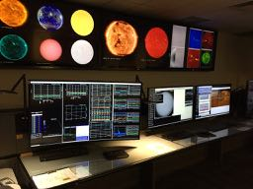
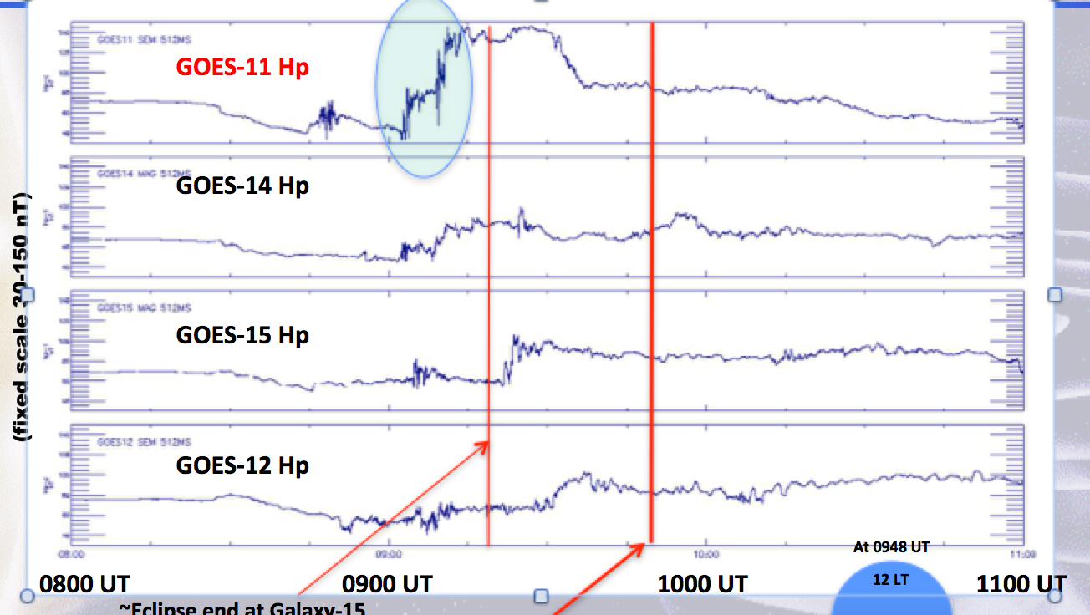
Operational Uses of the GOES-R Series
Magnetometer Data
An Essential Measurement for Current and Future Space Weather Operations
  National Space Weather Action Plan identifies the geostationary magnetic field as one of the baseline observations required for space weather operations
  Space Weather Prediction Center
  Space Weather Forecast Office
  GOES Magnetometer and Particle Data
  GOES 11 Magnetometer Data
  Key to Understanding 8-month Galaxy 15 Outage

Slide 3
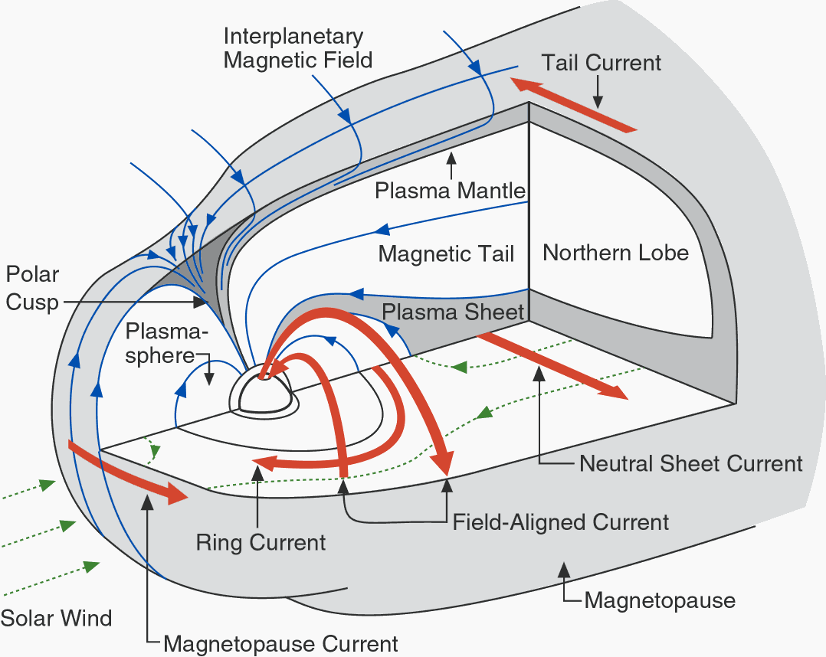

The GOES Magnetometer Measures all the Key Current Systems in the Magnetosphere That Influence Space Weather
SOLAR WIND – INDUCED ELECTRIC CURRENTS
FLOWING IN THE MAGNETOSPHERE
P
N
Typical GOES Location
at noon and midnight
(relative to magnetospheric boundaries)
E

Slide 4
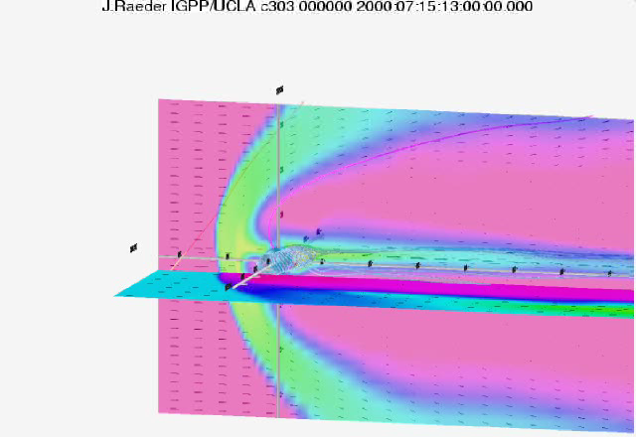
GOES 8 During July 2000 Geomagnetic Storm
Model movie illustrating extreme changes in magnetic field and plasma environment at geosynchronous in response to changes in solar wind driving on a minute-by-minute time scale.
J. Raeder/UCLA Movie

Slide 5
Magnetometer: Operational Use Summary
Providing forecasters and the public with situational awareness of the level of geomagnetic disturbances
Contributing to energetic particle products that use the orientation of the magnetic field for specifying the radiation belts and using in radiation belt models supporting satellite users
Utilizing for real-time, operational validation of the Geospace model that supports power grid operations
Detecting magnetopause crossings and alerts for the detection of solar wind shocks and sudden impulses at Earth
Supporting sounding rocket launch decisions
Conducting research for understanding the space environment and producing future products
Developing techniques for new operational applications (e.g. wave-particle interactions needed by radiation belt models)
Providing data to NESDIS NCEI archives and one of the most used data sets by the scientific community (through NCEI and NASA)

Slide 6
Magnetometer Measured Impacts at Earth-Some Examples
Solar Wind Shocks and Sudden Impulses
  When these impact Earth, large disturbances in Earth’s magnetic field can cause geomagnetically induced currents (GICs) in power grids
  Forecasters use DSCOVR to give warnings, but GOES magnetometer shows impact at Earth and contributes to alerts
Magnetopause Crossings
  Satellite operators have utilized GOES magnetometer data to understand when their satellite, normally in Earth’s magnetosphere, is located in an extremely different plasma and field environment (e.g. affects on torquer coils)
Storms and Substorms
  Forecasters use changes in the orientation of the geosynchronous observed magnetic field as an indication of the potential for the release of stored energy and subsequent injections of energetic particles that can cause spacecraft charging and particle precipitation into the auroral zone affecting HF radio wave propagation
Satellite Anomalies
  GOES-11 magnetometer data were key to understanding the environmental conditions related to the 8-month outage of Galaxy 15

Slide 7
Monthly Plot Illustrating Space Weather Features: Dirunal Variation, Solar Wind Pressure Increase, Field-Aligned Current, Tail Stretching
Solar Wind Pressure Increase
Noon
1 day
Midnight
Tail stretching
P
N
E
Field-Aligned Current Indication

Slide 8
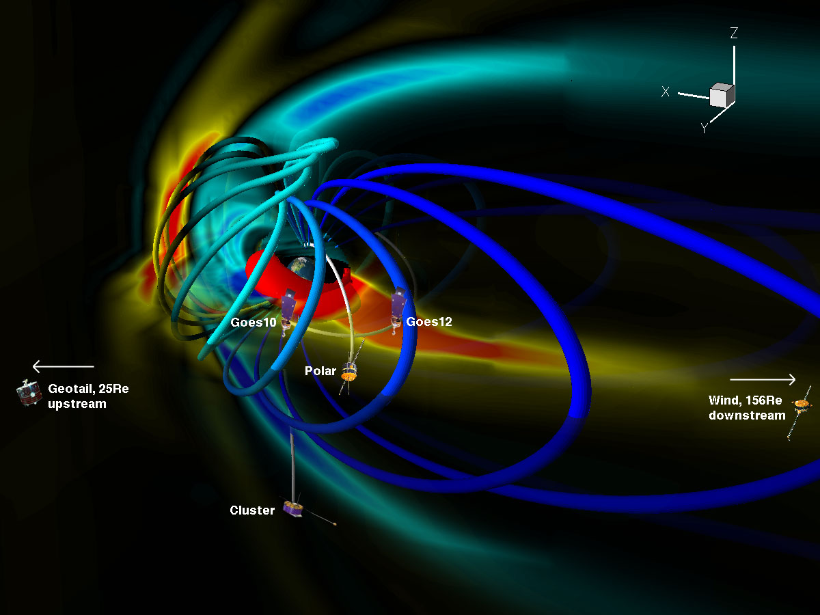
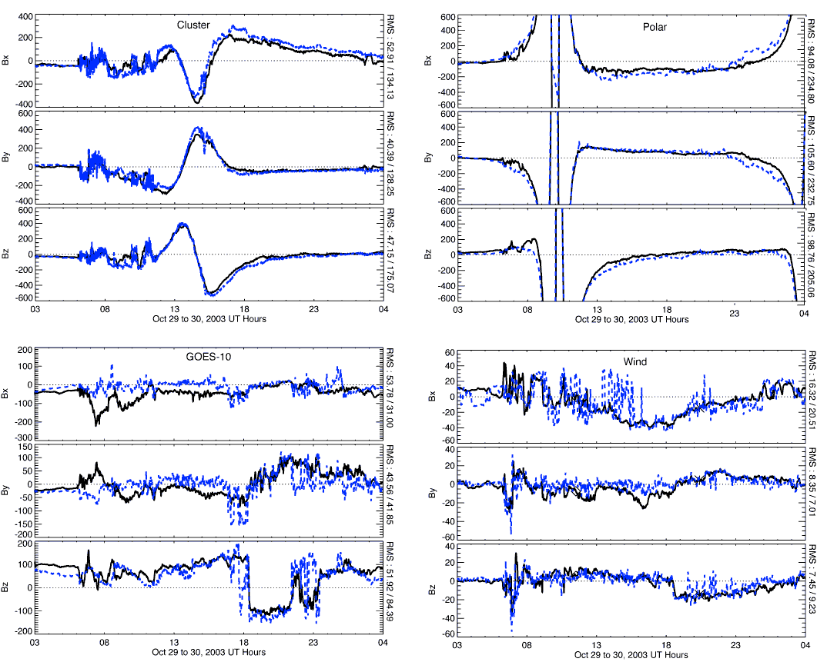
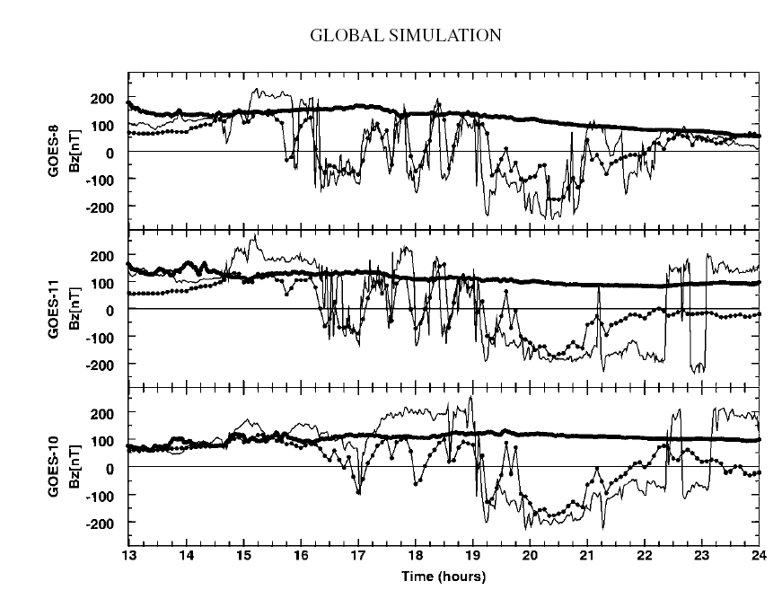
Magnetometer Data Needed
for Space Weather Models
The geosynchronous magnetic field is used to validate models and eventually may be assimilated into models.
The magnetic field data will be used for real-time validation of the Geospace model now in SWPC operations supporting the power grids and other space weather customers.
CISM: Huang et al.
U. Mich. Gombosi et al.
U. Of Michigan (Gombosi et al.)
Multiple groups of MHD modelers rely on the GOES magnetic field data for validating their models.
UNH: Raeder et al.

Slide 9
MAG (outboard) is performing satisfactorily for operations, with the following considerations:
  SWPC supports transitioning of MAG to Provisional status, understanding that continued mitigation and validation effort is needed.
  SWPC concurs with NCEI plans for mitigating, where possible, the following magnetometer issues:
Thermal electric magnetic contamination affecting accuracy and noise requirements
  Mitigation: use outboard mag for operations (less impact than inboard); requires monitoring and calibration updates
DC magnetic contamination
  Calibration removed unexpected 70 nT offset; requires monitoring and continual validation
Heater duty cycle contamination
  Mitigation: Change duty cycle frequency to minimize the contamination signal
Analog to Digital Converter (ADC) contamination
  Magnetic field count values show a preferred counts. Will limit some scientific uses
Inadequate Temperature compensation
  Diurnal and seasonal temperature effects. Mitigation: improved characterization of diurnal, seasonal and long-term changes
Arcjet firing contamination
  Arcjet firing contamination for about 1-2 hours every 4 days. Mitigated by arcjet flag. Implemented but requires evaluation

Slide 10
SWPC is highly appreciative of the work and contributions provided by NCEI, as well as the support provided by NASA, NOAA, LM and the entire GOES project.
SWPC concurs with NCEI’s recommendation for MAG to transition to provisional status, with the understanding that testing, tuning, and assessment are still required.

