Slide 1
Peer Stakeholder-Product Validation Review (PS-PVR) For the Provisional Maturity of GOES-16 MAG L1b Product
August 29, 2018
GOES-R Calibration Working Group (CWG)
Presenter: Paul Loto’aniu
Contributors: Sam Califf
NOAA NCEI / CIRES
This review incorporates results from NASA, PLTs, and MIT.

Slide 2
Outline
MAG Overview
Instrument Description and Products
Review of Beta Maturity
Product Quality Evaluation
Summary of MAG Anomalies
PLPTs Supporting Assessment for Provisional Status
Provisional Maturity Assessment
Path to Full Validation Maturity
Summary and Recommendations

Slide 3
MAG OVERVIEW
GOES-16 MAG L1b Product Provisional PS-PVR

Slide 4
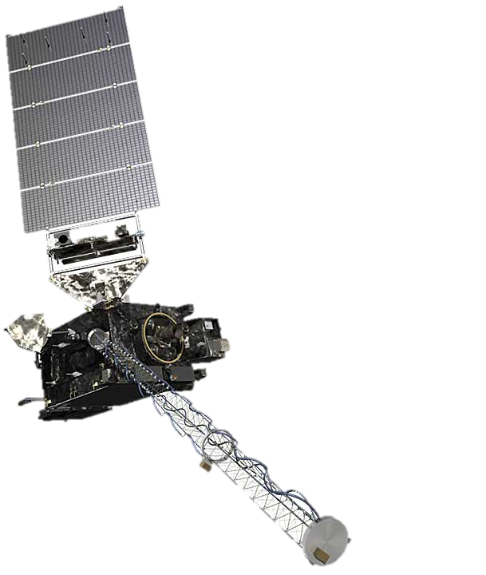
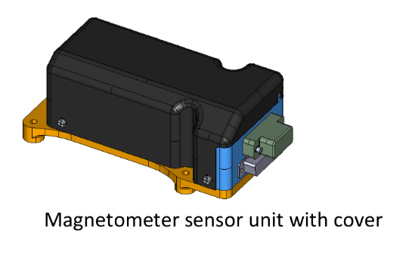
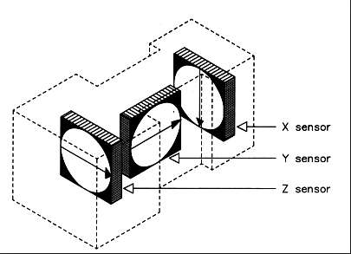
Instrument Description
Requirements similar to previous GOES series
Characteristics | GOES 8-12 | GOES 13-15 | GOES R-U
3-axis fluxgates | 2 | 2 | 2
Sampling Rate | 2 Hz | 2 Hz | 10 Hz
Low-Pass Filter Cutoff | 0.5 Hz | 0.5 Hz | ~2.5 Hz
Boom Length | 3 m | 8.5 m | 8.5 m
0.3 nT noise requirement.
0.016 nT digital resolution requirement.
1.7 nT accuracy performance requirement (waiver from 1 nT).
Two boom-mounted fluxgate magnetometers - Inboard MAG (IB) 6.3 m from boom base and Outboard MAG (OB) 8.5 m from the base.
Sensor units built by Macintyre Electronic Design Associates (MEDA) Inc, in Virginia, under contract from the instrument vendor Lockheed Martin.
Inboard MAG
Outboard MAG

Slide 5
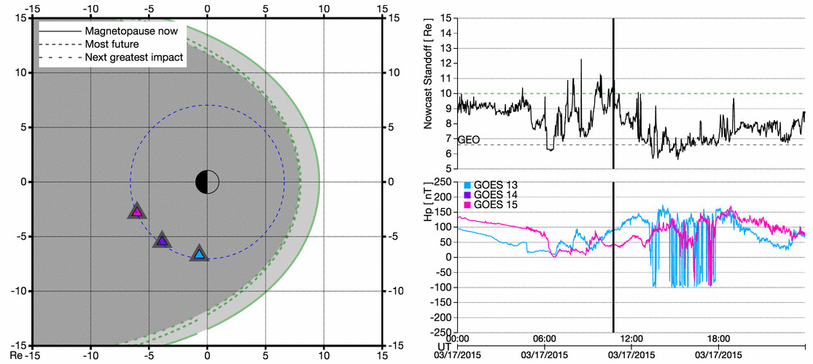
Example GOES-R Era Product
Magnetopause Crossing
Introduction
5

Slide 6
REVIEW OF BETA MATURITY (MAG Beta PS-PVR, May. 2017)
GOES-16 MAG L1b Product Provisional PS-PVR

Slide 7
PRE-BETA MAG PLTs
Event | Description | Start | End
1 | GOES-R Launch | 19 Nov 2016
2 | Power On and Boom Deployment | 7 Dec 2016 | 7 Dec 2016
3 | PLT-MAG-002 - Health Test 1-2 | 8 Dec 2016 | 16 Feb 2017
5 | PLT-MAG-001 - Calibration Maneuver 1-5 | 27 Jan 2017 | 22 Feb 2017
6 | PLT-MAG-003 – Sensitivity to Interference* | 7 Dec 2017 | closed
7 | PLT-MAG-004 – Sensor difference/ratio* | 7 Dec 2017 | closed
*Post-Beta PLTs

Slide 8
MAG Instrument/GPA Issues Identified for Provisional PS-PVR
Title | Description | Status | Mitigation
Magnetometer IB and OB do not meet success criteria of MAG-002 Magnetometer Difference | The MAG-004 PLT failed because the difference between OB and IB was greater than expected and varied diurnally and seasonally. Root causes are thought to thermoelectric effect and/or bad temperature compensation. | OPEN | ADR429, WR3643, DO.07.00 (ADR449 AND ADR450)
ADC preferred counts/quantization issue | Analog to digital conversion results in larger than expected quantization steps and preferred values in the MAG L1b data. | CLOSED | WR3643
Space weather eclipse_flag flags do not capture all possible states | Eclipse flag needs to be updated to four states, 0: no eclipse, 1: penumbra preceding full eclipse, 2: umbra (full eclipse), 3: penumbra following full eclipse. This mainly affects Inboard MAG and hence is not required for provincial. | OPEN | ADR430, WR4164
Arcjet Firing Flag | Arcjet firing is a significant form of contamination and a flag should be provided that allows us to flag the data during these periods as unusable. | OPEN | ADR449
IB sensor in shadow | When IB sensor is shadowed by spacecraft subsystem there is a significant change in the IB sensor observations. Create a flag that states when IB sensor is in shadow. This mainly affects Inboard MAG and hence is not required for provincial. | OPEN | ADR450
Needed for provisional.
Was originally needed for provisional but now needed for full validation

Slide 9
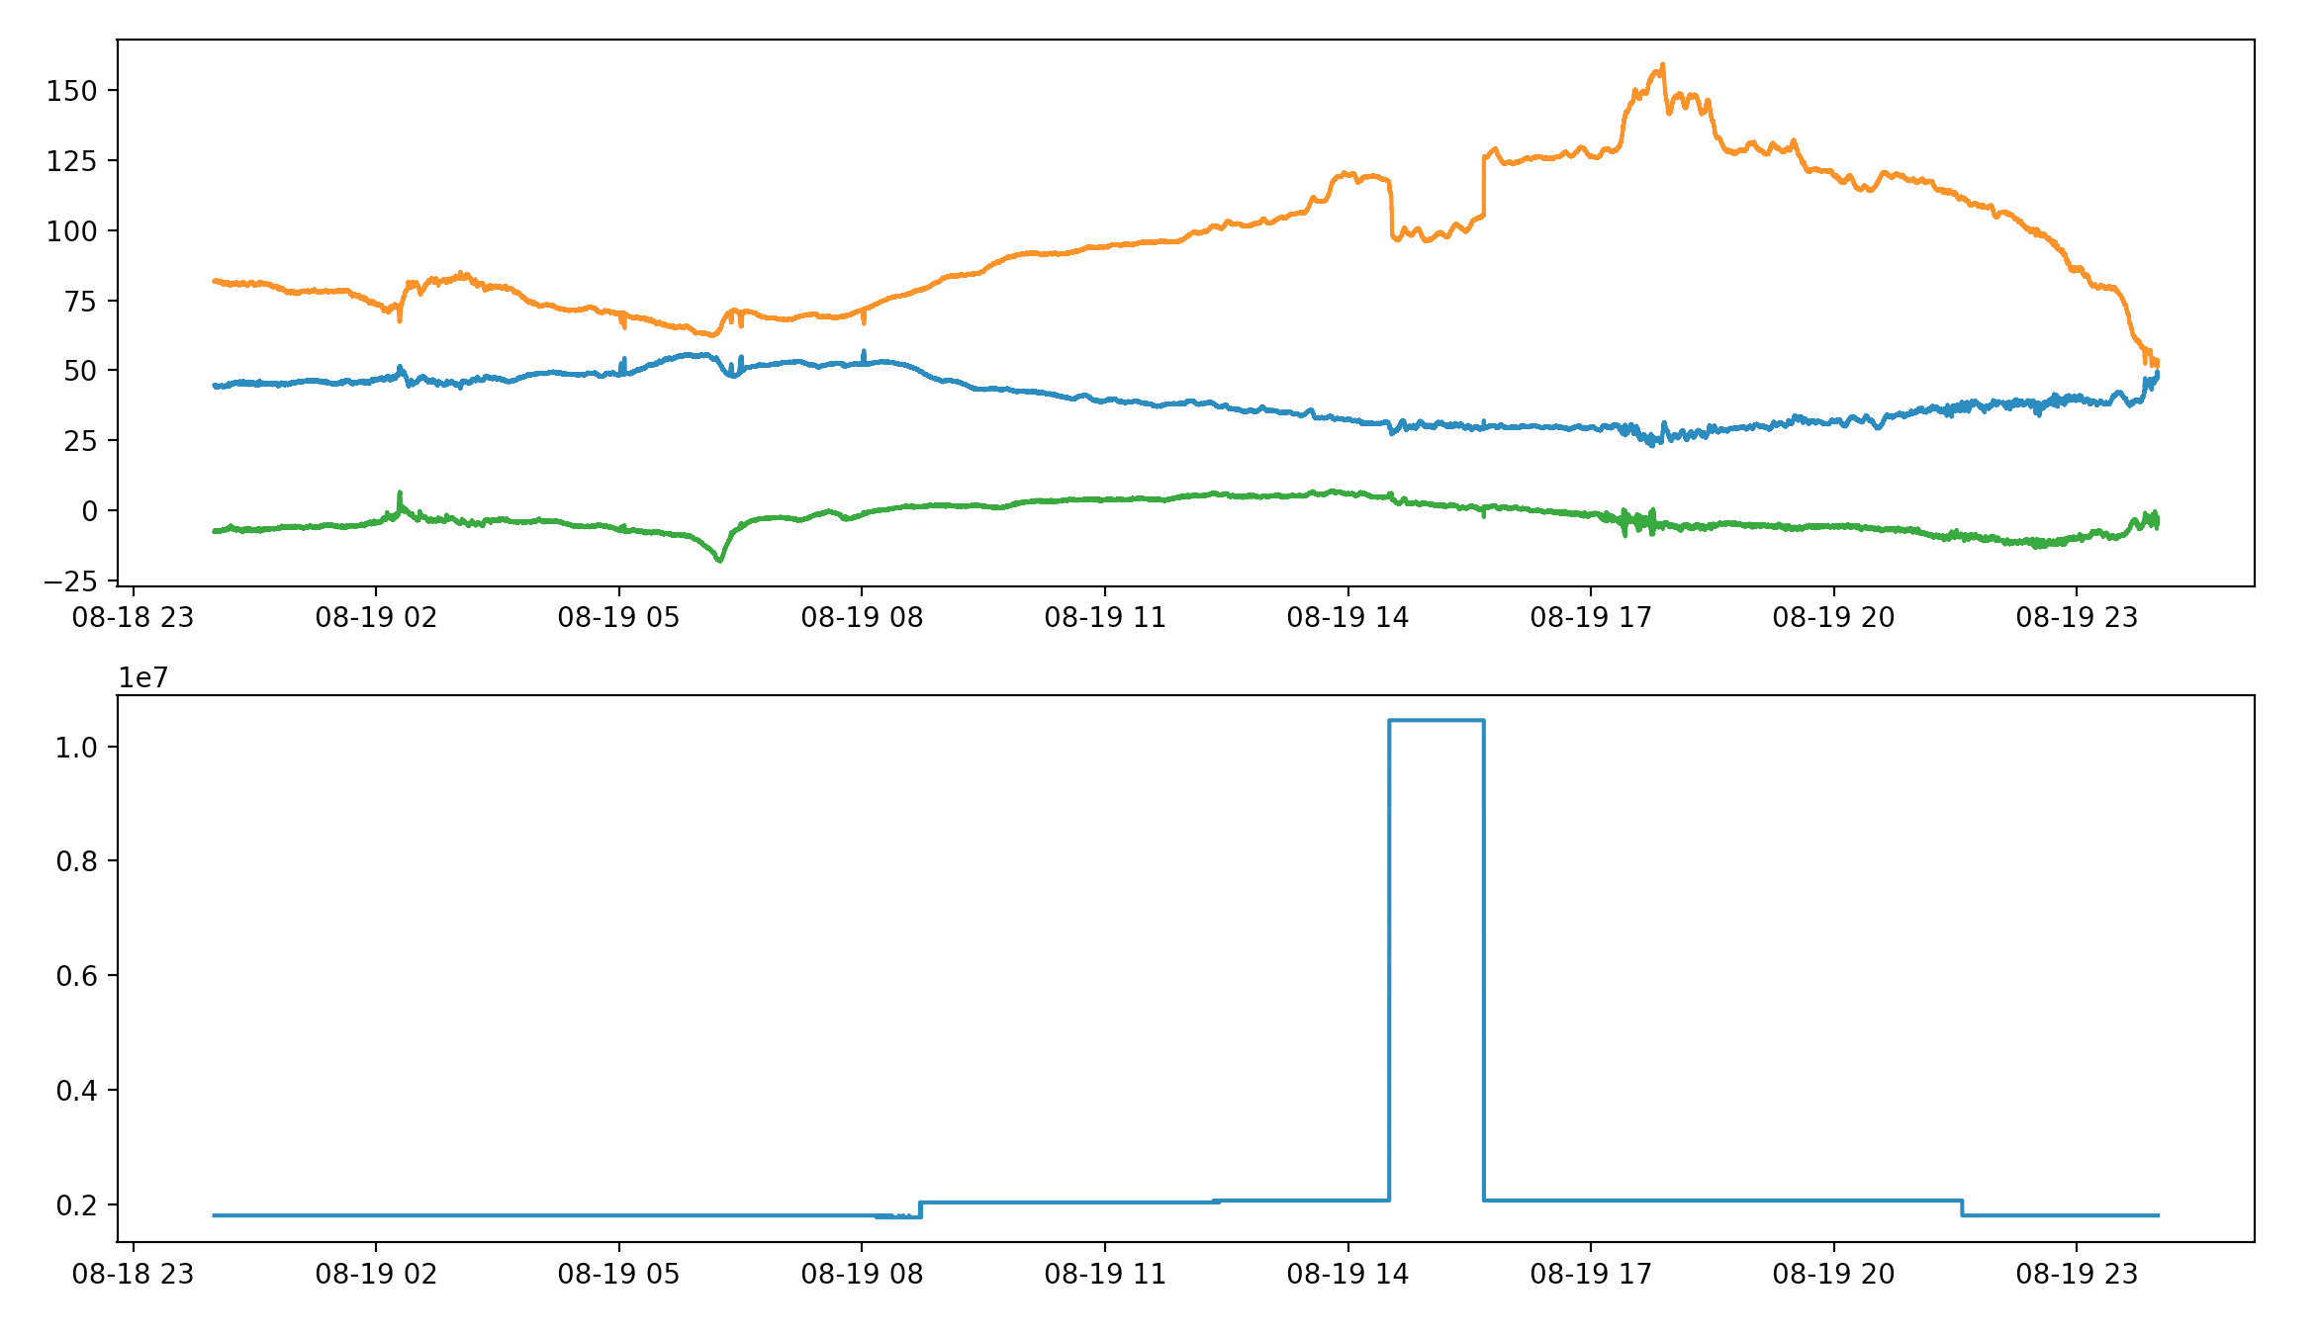
Verification of ADR 449
Arcjet firing flag in L1b
Magnetic Field in EPN
Data Quality Flags
Spacecraft arcjets fired
The flag is in the L1b files as required for provisional. However, NCEI has not validated this flag quantitatively and the ADR remains open.

Slide 10
PRODUCT QUALITY EVALUATION
GOES-16 MAG L1b Product Provisional PS-PVR

Slide 11
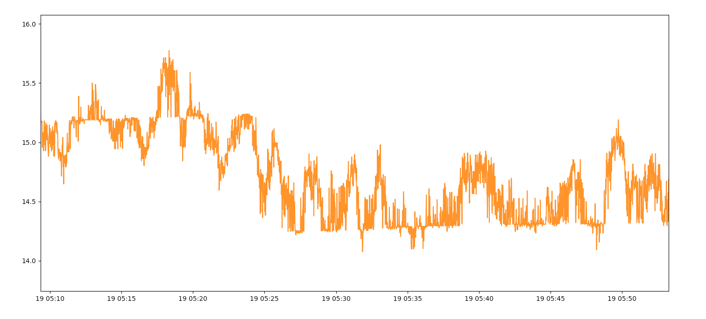
Summary of MAG anomalies
Analog to Digital Conversion
GOES-16 MAG L1b
N-component of the magnetic field
Data for 19 August 2018
Magnetic Field in EPN
Preferred counts
Fields Strength (nT)
UT
This issue cannot be fixed through ADRs/WRs. Instead, NCEI studying affect on future operational products and scientific usability of the data.

Slide 12
Summary of MAG anomalies
Arcjet Firing and Correction
Magnetic field time series plot shows field changes when arcjets fire (see light-blue curve in red-box region to left).
Magnetic Field in EPN
Ground is implementing a correction algorithm designed by Flight that corrects the arcjet effect in the L1b data.
This algorithm is needed for full validation, but knowledge of this algorithm helps us get to provisional.
NCEI will be validating the correction algorithm over next 6-12 months.

Slide 13
Summary of MAG anomalies
MAG Thermal Issues
Solar angle dependent sensor response – NCEI will undertake research to understand this issue and how best to compensate for it. Data needed for 2-3 years to give good seasonal coverage and repeatability.
Thermal dependent biases / Bias stability – Large DC biases and bias variations derived from calibration maneuver combined with thermal issues give us concern about bias stabilities in the future. NCEI will continuously monitor and trend over multiple years to understand thermal dependency. Annual calibration maneuver is important and recommended.

Slide 14
Summary of MAG anomalies
MAG Thermal Issues
MAG operating temperature – Operating temperature was increased from 20 C to 35 C, but evidence now suggests it should be decreased again. Very recently decided to return to 20 C. However, NCEI will be monitoring how temperature setpoint of the MAG sensors affect performance.
Inadequate Temperature Compensation – Linearized compensation curve for one of the axes improved things, but compensation still not adequate. NCEI will investigate different temperature compensation curves.

Slide 15
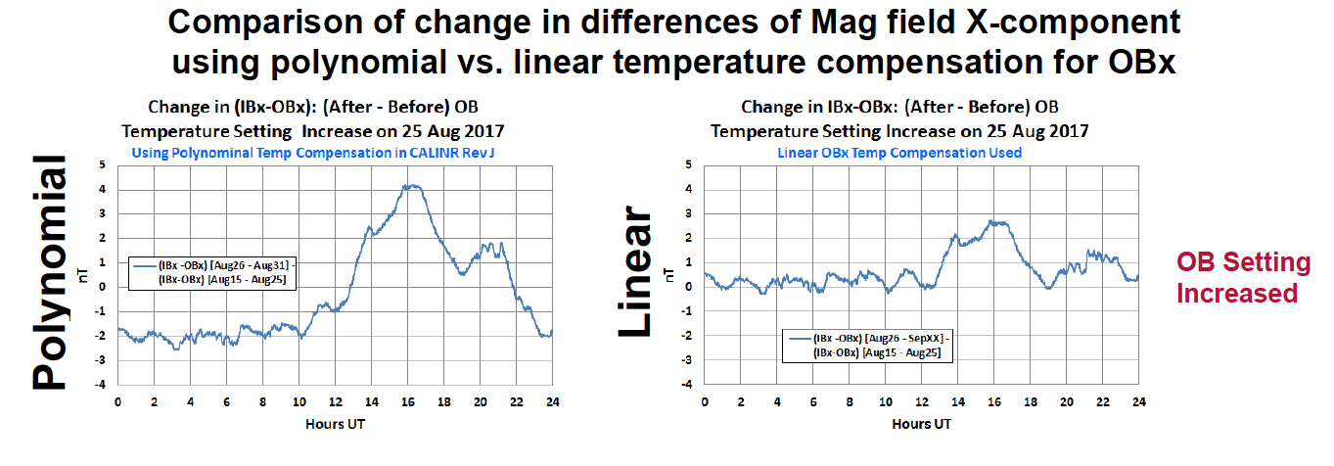
Temperature Compensation
Magnetic Field in EPN
Courtesy of MIT-LL
The original temperature correction curves are high-order polynomials.
Study by MIT-LL found that for the X-axis of the outboard sensor, sensor response is better if the curve is linear.

Slide 16
Summary of MAG anomalies
MAG Thermal Issues
There are times when variations between the inboard and outboard sensors are mainly due to the inboard sensor.
And other times when both sensors seem to be contributing significantly to the variability.
NCEI have ongoing investigations to determine the thermal variability of the MAG and how to correct for it.
E-component
June-Aug 2017
P-component
Sept-Nov 2017
Magnetic Local Time

Slide 17
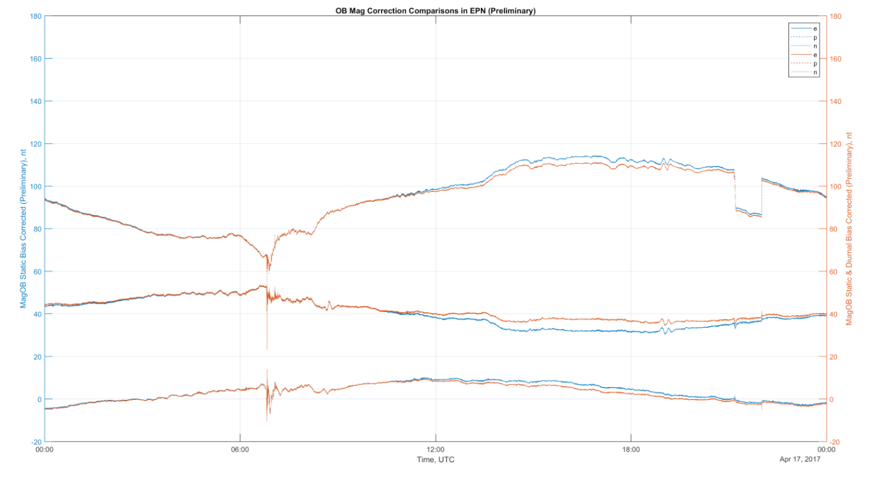
Summary of MAG anomalies
Solar Angle Effect
OB MAG corrected for solar angle diurnal effects
Correction algorithm developed by Flight based on simple voltage-based electrical model
UTC on April 17 2017
Courtesy of Flight
Algorithm developed by Flight to take into account solar angle suggests that upward of ~5 nT diurnal changes are caused by this angle.
NCEI will soon start investigations to study this algorithm in more detail and study the solar angle dependency of the MAG sensor and its affects on data science quality.

Slide 18
Summary of MAG Anomalies
Arcjet Firing creates a baselines shift in MAG values.
Arcjet firing flag has been implemented in L1b.
Arcjet firing correction algorithm will be implemented in L1b.
Thermal/Temperature Issues.
Thermal issues on GOES-16 MAG are significant and will persist for the duration of the mission. NCEI work and research have started to study how to correct for these issues both diurnally and seasonally. This work will continue well beyond Full validation.
L1b issues fixed
ADR 591/ADR 219/WR 3903 - MAG Data/Timestamps Drop Outs - CLOSED.
ADR 192/WR3802 - Incorrect S/C position information reported in MAG L1b - CLOSED.
ADR145/ WR3429 - MAG Add IB and OB measurements in 4 coordinate frames - COSED.
WR3589 - MAG Instrument Calibration Data Temperatures Always 0 Degrees C - CLOSED.
WR4528/ WR4491 - s2000 in date/time stamp of L1b product files – CLOSED.

Slide 19
Summary of MAG Anomalies
L1b issues fixed Continued….
ADR228/WR3961 Space Weather L1b data record 'time' mismatch - CLOSED in DO.06.03
ADR621/WR6099: Disable 1.6Hz filter, PRO Type 1 - completed as part of PR.06.12

Slide 20
MAG PLPTs Supporting Provisional Maturity
Name | Description
PLPT-MAG-001 | Comparison to quiet (and active) field models
PLPT-MAG-002 | Cross-satellite intercalibration
PLPT-MAG-003 | Intercalibration per Magnetic Local Time (MLT)
PLPT-MAG-004 | Diurnal/Eclipse effects
These PLPTs are more often used together for data analysis
Name | Description
PLPT-MAG-009* | Noise performance*
*Additional analysis we are undertaking because of instrument post launch performance issues

Slide 21
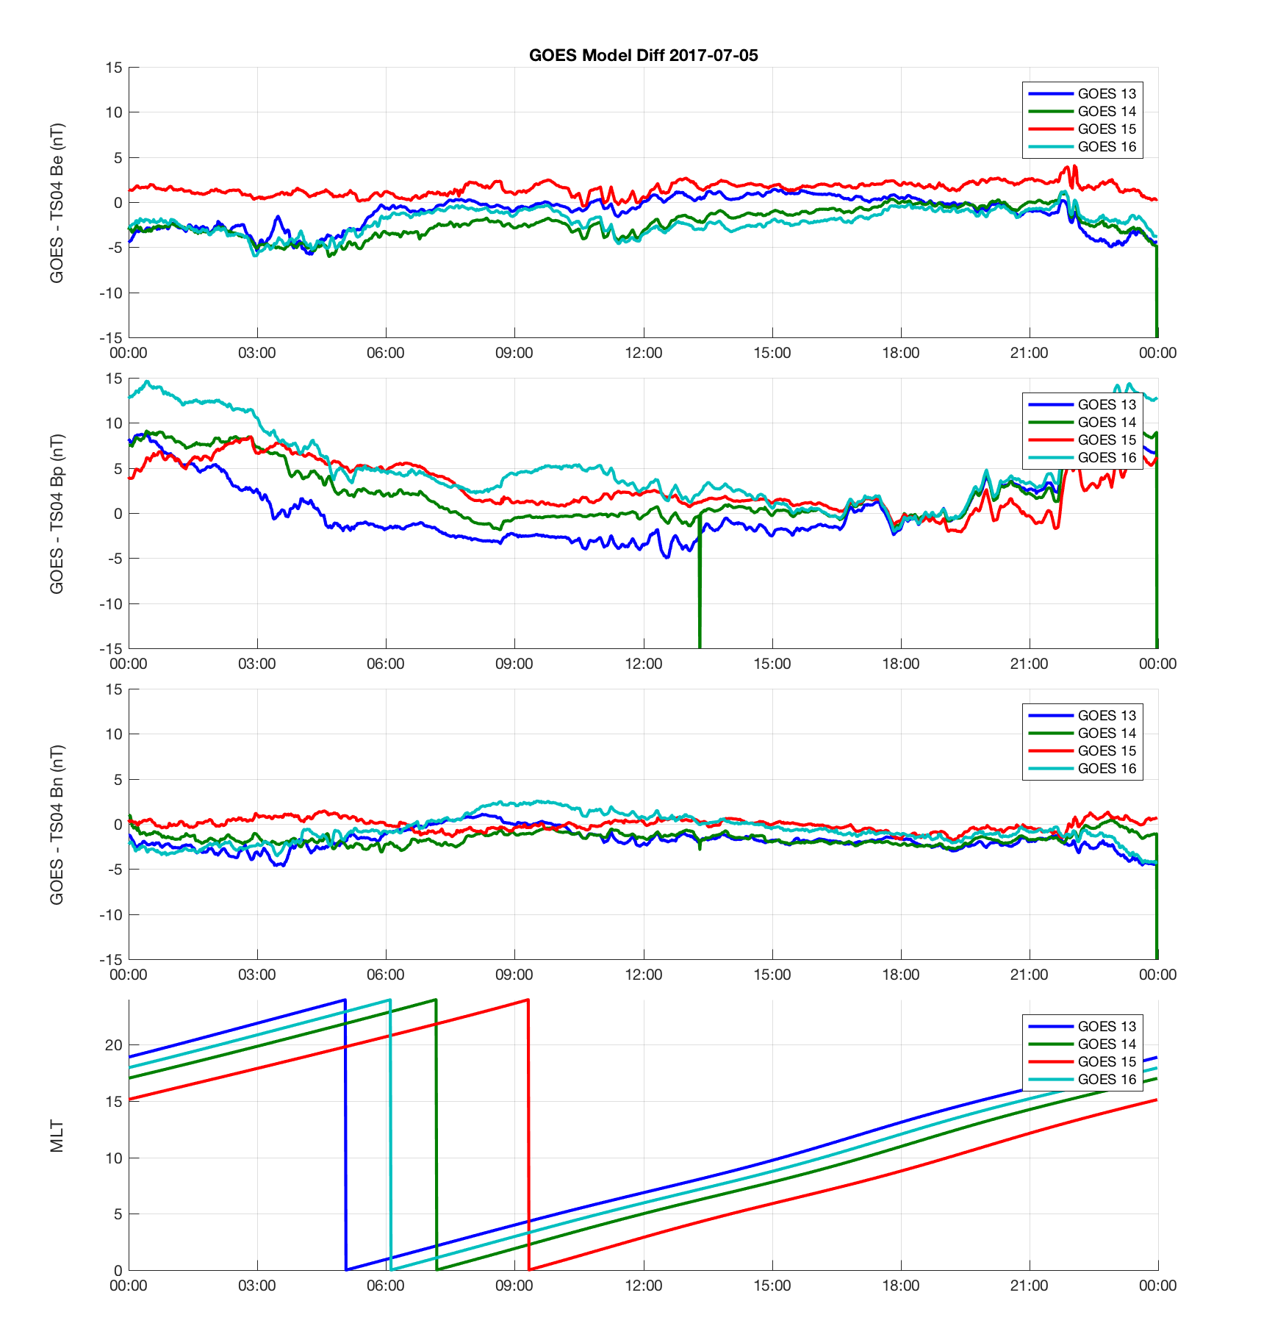
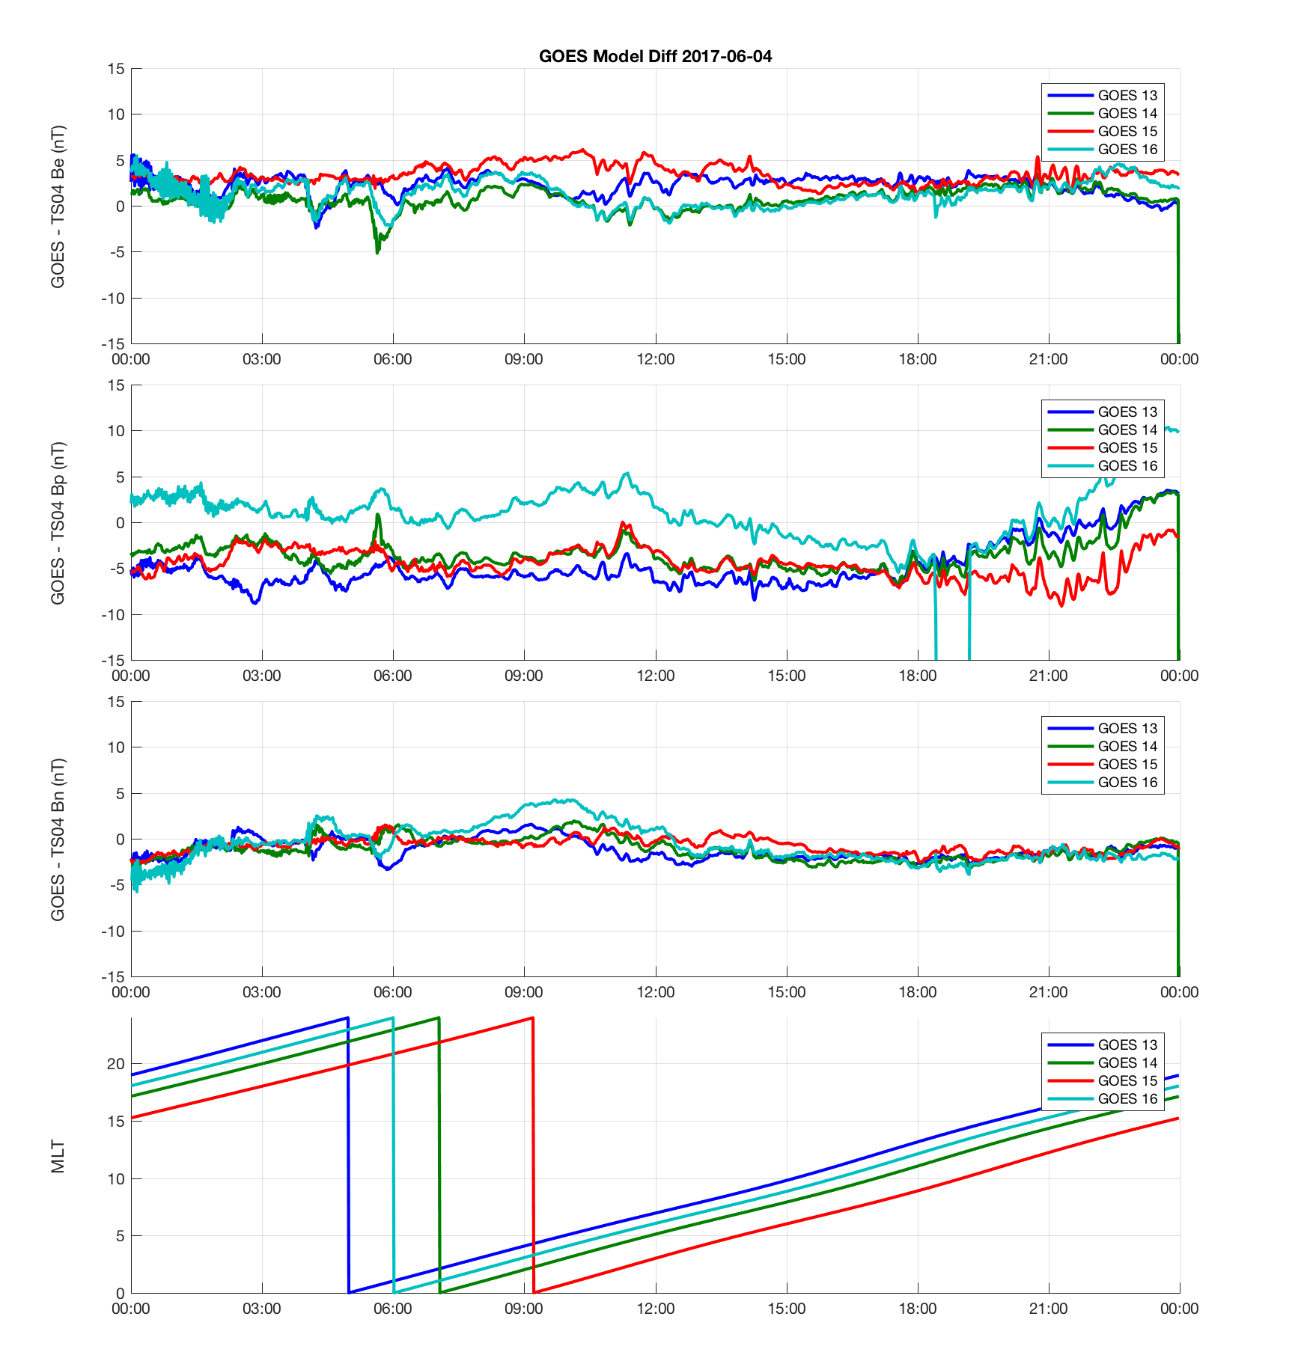
PLPT-MAG-001
Comparison to TS04 Model
GOES - TS04, 5th May 2017
GOES - TS04, 4th June 2017
There are significant times when GOES-16 MAG does not do perform as well as the other GOES when comparing to TS04 magnetic field model, particularly in the P-component.
This suggests that GOES-16 MAG is not as accurate as the GOES-NOP MAGs.

Slide 22
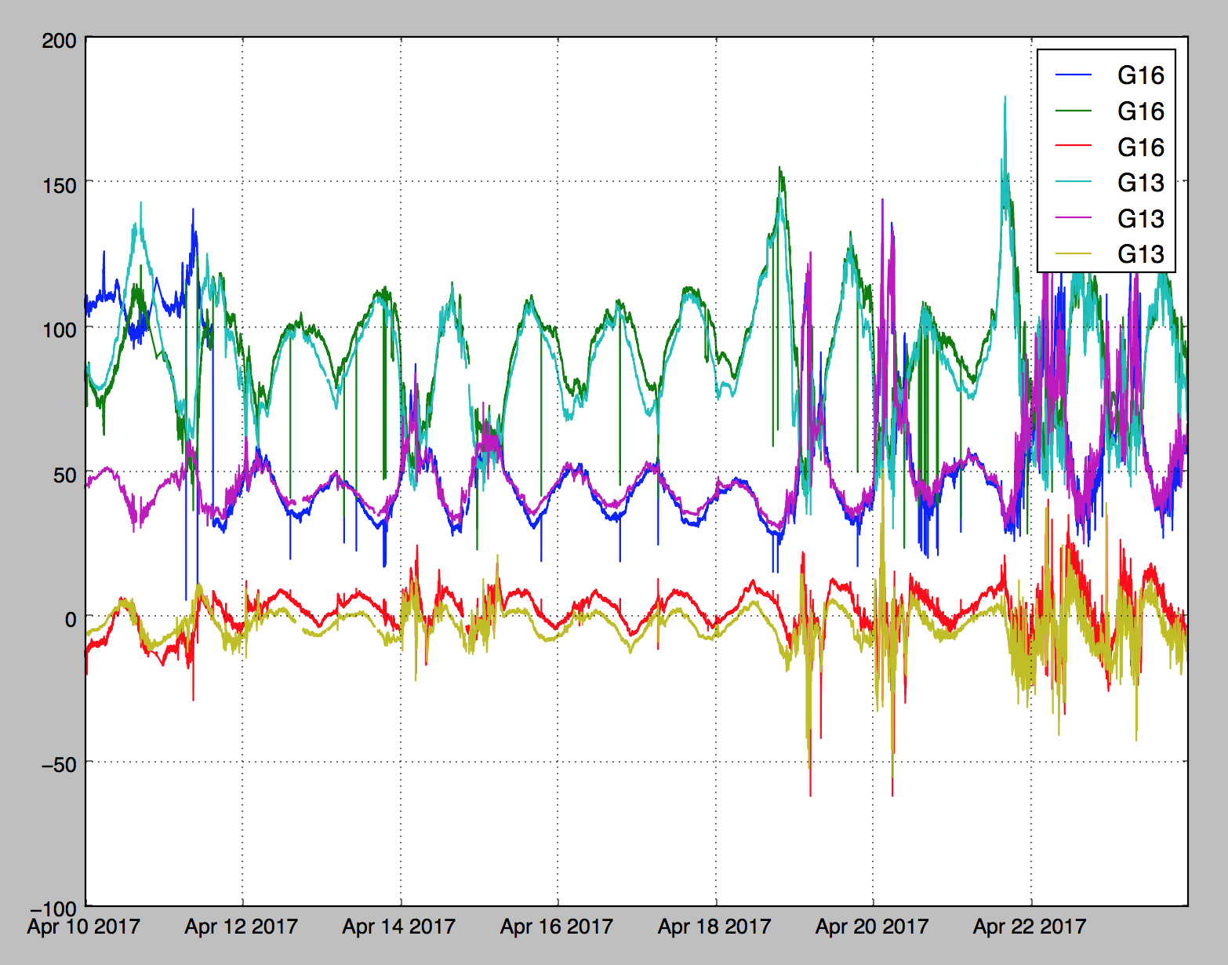
PLPT-MAG-002 Cross-satellite intercalibration
The MAG LUT with post launch average maneuver values went into operation around 1546Z April 11, 2017.
April 10-23 2017
G16 outboard MAG and G13 MAG in EPN coordinates
Calibration applied
Poleward
P-component
Earthward
E-component
Magnetic Field Strength (nT)
Eastward
N-component
After calibration, G16 outboard MAG and G13 MAG closer.
After calibration, the outboard MAG data was found to follow the general trends observed by nearby satellites.
This result indicates that GOES-16 outboard MAG was able to observe major space weather variations.

Slide 23
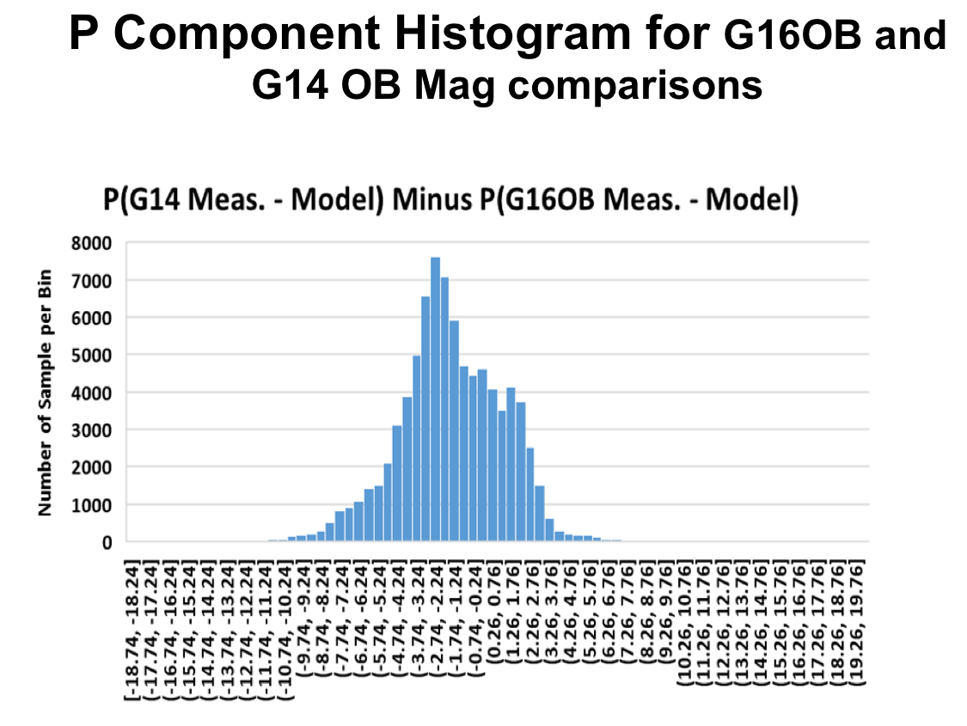
PLPT-MAG-002 Cross-satellite intercalibration
MIT-LL study suggest the statistical accuracy of GOES-16 outboard MAG without std. dev. is about 2.3 nT.
NCEI is also undertaking a long term study to determine this accuracy. Long term is needed because of the thermal issues affecting accuracy.
2.3 nT bias
Courtesy MIT-LL

Slide 24
PLPT-MAG-002 Cross-satellite intercalibration
MIT-LL study suggests an accuracy std. dev. of about +/- 4 nT.
Again, NCEI is also undertaking a long term study to determine this accuracy. Long term is needed because of the thermal issues affecting accuracy.
Courtesy MIT-LL

Slide 25
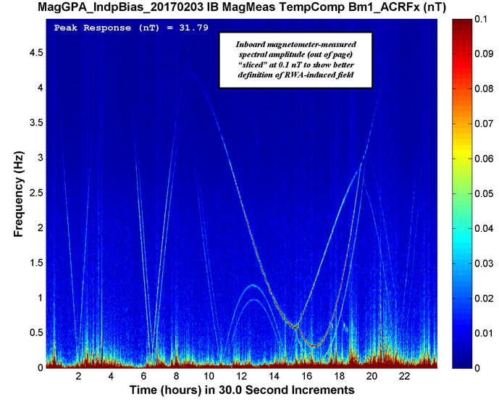
PLPT-MAG-009 Noise Performance
Noise contributions:
Sensor: 0.1 nT
Reaction Wheels: 0.1 nT
ADC preferred counts: 0.3-0.5 nT
Heaters: Still in analysis (0-0.5 nT)
Reaction Wheels
Courtesy of LM
ADC preferred counts

Slide 26
PROVISIONAL MATURITY ASSESSMENT
GOES-16 MAG L1b Product Provisional PS-PVR

Slide 27
Provisional Validation
Preparation Activities | Assessment
Validation activities are ongoing and the general research community is now encouraged to participate. | Validation activities are ongoing. Results have been discussed with SWPC. Release of data by NCEI will enable research community participation.
Severe algorithm anomalies are identified and under analysis. Solutions to anomalies are in development and testing. | Inboard MAG sensor will not be used in operations. Arcjet Flag implemented (ADR449) Arcjet correction algorithm currently being implemented (ADR610) Thermal issues related to heater and solar angle still a major concern for NCEI and this will be studied by NCEI to determine corrections and impacts on science quality of data.
Incremental product improvements may still be occurring. | Product improvements will result from steps to mitigate anomalies listed in “Path to Full Validation” charts below.
L2+ only: Users are engaged in the Product Feedback Forums (PFF) and user feedback is assessed. | NCEI continues to be engaged with SWPC for feedback on MAG L1b data quality.

Slide 28
Provisional Validation
End State | Assessment
Product performance has been demonstrated through analysis of independent measurements obtained from select locations, periods, and associated ground truth or field campaign efforts. | GOES-16 MAG L1b has been compared to GOES-13, 14 ,15 and 17. GOES-16 MAG L1b has been compared to Op77, T89 and Ts04 magnetic field models. The above were undertaken across different local times. Analysis ongoing.
Product analysis is sufficient to communicate product performance to users relative to expectations (Performance Baseline). | Yes, to the limited extent that NCEI has had to undertake quantitative analysis. Analysis is ongoing.
Documentation of product performance exists that includes recommended remediation strategies for all anomalies and weaknesses. Any algorithm changes associated with severe anomalies have been documented, implemented, tested, and shared with the user community. | PUG was updated to reflect some changes. E.g., Arcjet flag details. There are also documentation of recommended remediation in NASA, MIT-LL and NCEI presentations including this one.
Testing has been fully documented. | In this presentation and supplemental materials.
Product is ready for operational use and for use in comprehensive cal/val activities and product optimization. | Yes

Slide 29
PATH TO FULL VALIDATION MATURITY
GOES-16 SGPS L1b Product Provisional PS-PVR

Slide 30
Path to Full Validation
ADRs/WRs to be resolved prior to Full Validation.
PLPTs to be conducted prior to Full Validation.
Performance Baseline status.
Risks to getting to Full, both from L1b product definition and user (SWPC) feedback

Slide 31
ADRs/WRs Impacting Full Validation of MAG L1b
ADR#40 | WR# | Short Description | Status | Expected Closure
610 | 3643 | Arcjet correction | In_implementation / In_validation | DO.07.00.00
449 | 3643 | Arcjet flag | In_validation
450 | TBA | IB shadow flag | In_validation
430 | 4164 | Eclipse flag | In_validation
204 | 5134 | Reformat L1b variables with _unsigned attribute- | In_work | DO.07.00.00
267 | 5370 | LUT Filenames not Traceable to Metadata | In_Analysis | DO.07.00.00
565 | 5637 | MAG in EPN coords does not match LM algorithm | In_work | DO.07.00.00
Note: Not all GOES-16 MAG L1b variables have been validated. E.g., most of the error flags have not been validated. Additional ADRs may come from more detailed analysis of L1b files.

Slide 32
Path to Full Validation - PLPTs
Name | Description
PLPT-MAG-001 | Comparison to quiet (and active) field models
PLPT-MAG-002 | Cross-satellite intercalibration
PLPT-MAG-003 | Intercalibration per Magnetic Local Time (MLT)
PLPT-MAG-004 | Diurnal/Eclipse effects
PLPT-MAG-006 | Temperature effect compensation*
PLPT-MAG-007 | Thermal electric effect compensation*
PLPT-MAG-008 | Accuracy stability determination*
PLPT-MAG-009 | Noise performance*
*Post-Beta PLPTs
Need to update RIMP v1.0

Slide 33
MAG Performance Baseline Status
Assessment at Provisional
MRD ID | Description | Related PLPTs | Status
2019 | MAG Product Measurement Accuracy | -01, -02, -03, -04, -05 | PLPTs underway (currently meets waivered requirements)
2022 | MAG Product Measurement Precision | -09 | PLPTs underway (currently does not meet requirements)

Slide 34
Performance Baseline Validation Status
MRD2019: Product Measurement Accuracy
Quantity | MRD Requirement | Performance Baseline | PLPT Measurement
Product Measurement Accuracy: | 1 nT (per axis; original, waived) 2.3 ± 4.0 nT (per axis; for a 250 nT field; life of mission, excluding arcjet burning, assuming annual MAG cal maneuvers) | Vendor's analysis indicates: (3σ_{x},3σ_{y},3σ_{z})=(1.64,1.68,1.54) nT one year after initial cal maneuver (3σ_{x},3σ_{y},3σ_{z)}=(6.50,6.51,6.47) nT at EOL if no cal maneuvers after PLT | 2.3 ± 4.0 nT (per axis). Still in analysis
MRD2022: Product Measurement Precision
Quantity | MRD Requirement | Performance Baseline¹ | PLPT Measurement
Product Measurement Precision: | ≤ 0.016 nT (per axis) | One bit resolution = 0.016 nT/axis. Precision ≥ sensor noise level = 0.100 nT/axis
¹This requirement has flowed down to the magnetometer instrument to mean that the magnetic field shall have a resolution of 0.016 nT per axis. Based on the MRD definition of precision, the product with vary by at least the noise level of the sensor.
~ 0.5 -1.0 nT
Still in analysis

Slide 35
Path to Full Validation – Risks
Risk Name | Description | Impact | Mitigation and Schedule
Inadequate Temperature Compensation | Temperature calibration curves do not adequately calibrate data. | Variations due to temperature in the data. Impacts accuracy of L1b. | Linearized compensation curve for one of the axes improved things, but compensation still not adequate. NCEI will investigate different temperature compensation curves.
MAG operating temperature / Heater affecting observations | Operating temperature was increased from 20 C to 35 C, but evidence now suggests it should be decreased again. | Affects accuracy and could increase degradation of sensor. | Very recently decided to return to 20 C. However, NCEI will be monitoring how temperature setpoint of the MAG sensors affect performance.
Solar angle dependent sensor response | Temperature dependency of sensors means solar angle relative to spacecraft changes the accuracy of the instrument. | Affects accuracy. | NCEI will undertake research to understand this issue and how best to compensate for it. Data needed for 2-3 years to give good seasonal coverage and repeatability. This work will go beyond Full validation.

Slide 36
Path to Full Validation – Risks
Risk Name | Description | Impact | Mitigation and Schedule
Bias stability | Large DC biases and variations from calibration maneuver combined with thermal issues give us concern about bias stabilities in the future. | Will degrade accuracy of instrument. | NCEI will continuously monitor and trend over multiple years to understand thermal dependency. Annual calibration maneuver is important and recommended.
If outboard sensor fails or performance significantly degraded | Since outboard sensor will not be used in operations, failure or significant performance degradation in outboard sensor will make operations with GOES-16 impossible. | Will degrade accuracy of instrument or result in non-operational instrument | NCEI will study the inboard sensor in order to find corrections algorithm that allows it to be used in operation in the event that outboard sensor fails or degrades.
Arcjet flag and correction | Analysis of how well the arcjet flag and correction algorithm worked over next months could show flag and algorithm did not work so well. | Risk MAG L1b not getting through Full validation | NCEI will undertake detailed analysis of the arcjet flag and correction outputs after implementation in L1b product. If there is an issue, research another correction algorithm and implement it.

Slide 37
SUMMARY & RECOMMENDATIONS
GOES-16 SGPS L1b Products Provisional PS-PVR

Slide 38
Summary and Recommendations
Main issues identified:
Arcjet fring – flag implemented and correction algorithm being implemented
Continuing thermal issues affecting accuracy.
Recommend that path to full validation include researching solar angle dependency, heater influence and temperature compensation of MAG L1b. This research and investigation should identify the path forward to determining correction schemes and algorithms. However, final determination of appropriate algorithms and implementation will be beyond Full validation.
Recommend investigations into the usability of the MAG data, given thermal issues, in both operations and in science research that would lead to new operational products.
Recommend annual calibration maneuvers to check stability of the biases.

Slide 39
Summary and Recommendations
The inboard MAG sensor performance is not sufficient for used in operations. However, the inboard sensor should continue to be used to investigate the performance of the outboard sensor, and its performance should be improved in case the outboard sensor performance significantly degrades.
Overall the outboard MAG sensor is performing well, but there are continuing thermal issues and the sensor must be closely monitored and trended against thermal variables both diurnally and seasonally.
NCEI recommends MAG L1b for transition to provisional status with the understanding that investigations and research are ongoing and needed into understanding how the MAG thermal issues are impacting the quality of the observations including future possible correction algorithms. These investigations may lead to new ADRs.

