Slide 1
G16 EHIS Full Validation PS-PVR SWPC Overview
The EHIS data will support aviation and satellite operations. EHIS requirements were derived from a user-requirements workshop held in 2002 to define future GOES measurement needs.
Helium measurements have been made continuously since the early GOES. The measurement of ions heavier than Helium is a new capability.
Helium is an input to the aviation-radiation model run by the FAA, which is being transitioned to operational use at SWPC. This will support an International Civil Aviation Organization (ICAO) advisory for radiation on civil aviation flights.
Heavy ion measurements (Helium to Iron) were also recommended to support satellite anomalies, launch decisions, and environmental databases for satellite design.

Slide 2
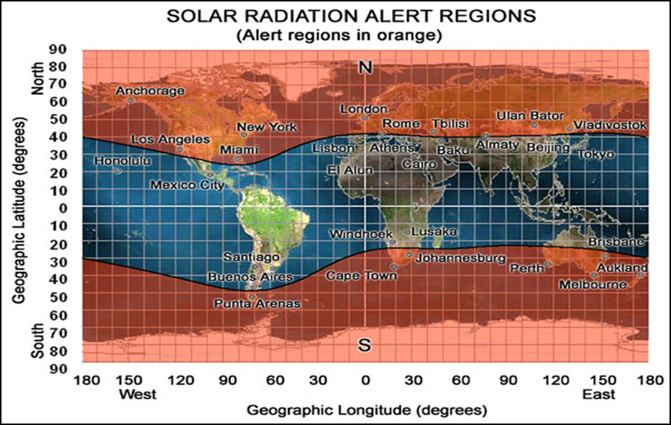
Primary Uses of EHIS Data
Satellite industry:
  Satellite anomaly resolution and design guidelines
Aviation industry:
  Radiation advisories
Human space exploration use is anticipated
FAA Solar Radiation Alert for aircraft altitudes - October, 2003

Slide 3
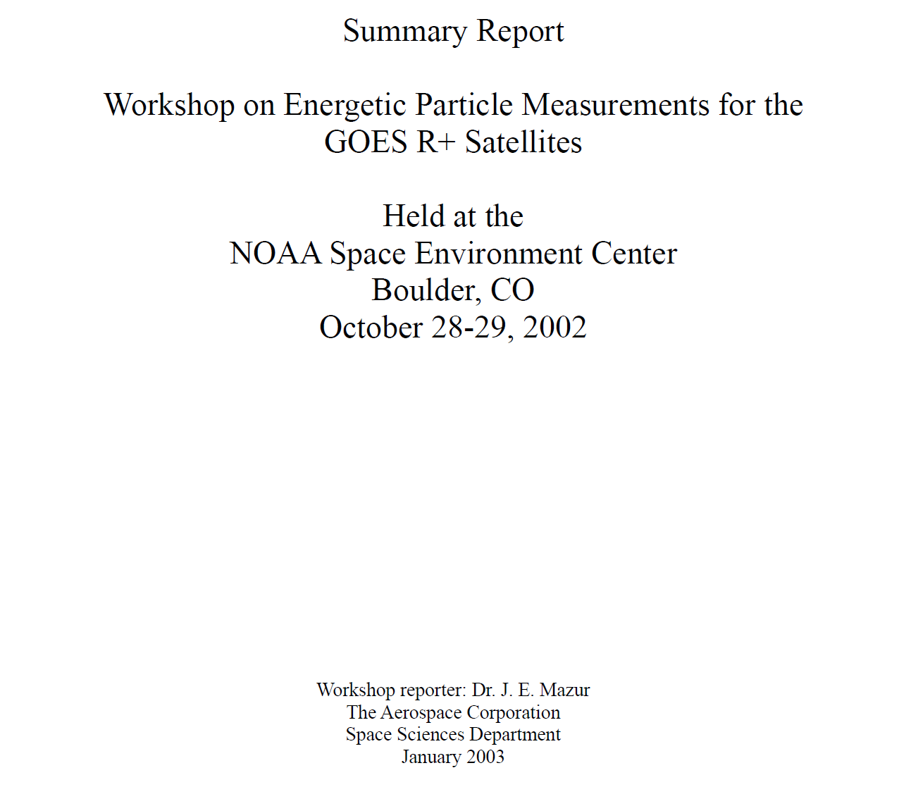
GOES-R Requirements Gathering Process

Slide 4
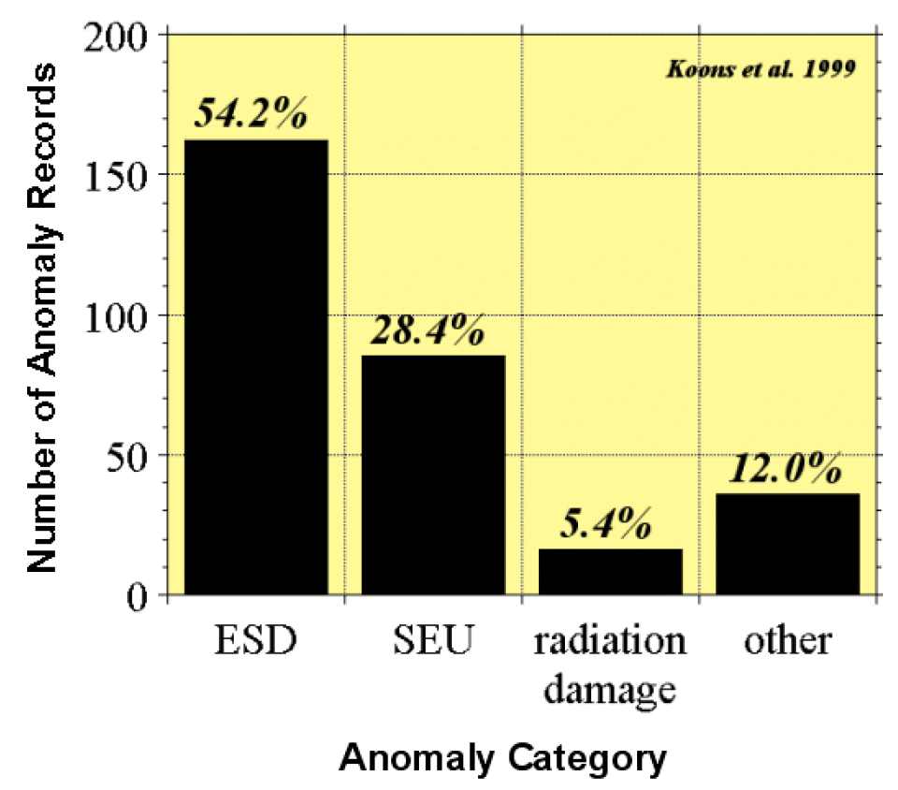
GOES-R+ Workshop Recommendations
Compilation of databases of spacecraft anomalies attributed to the space environment
Study sponsored by the National Security Space Architect
Workshop recommended heavy ion measurements to support “…spacecraft anomaly investigations, decisions for launches of vehicles with single-event effect (SEE) susceptibilities, and archival data for the generation of environmental models.”

Slide 5
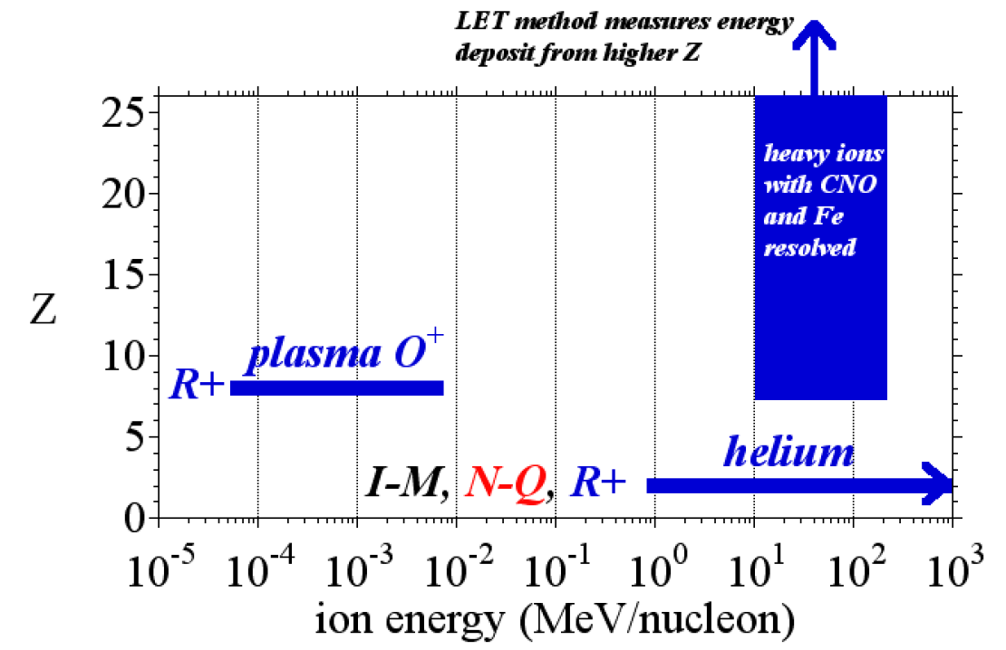
GOES-R+ Workshop Recommendations
Workshop recommendations for heavy ion measurements on GOES-R+

Slide 6
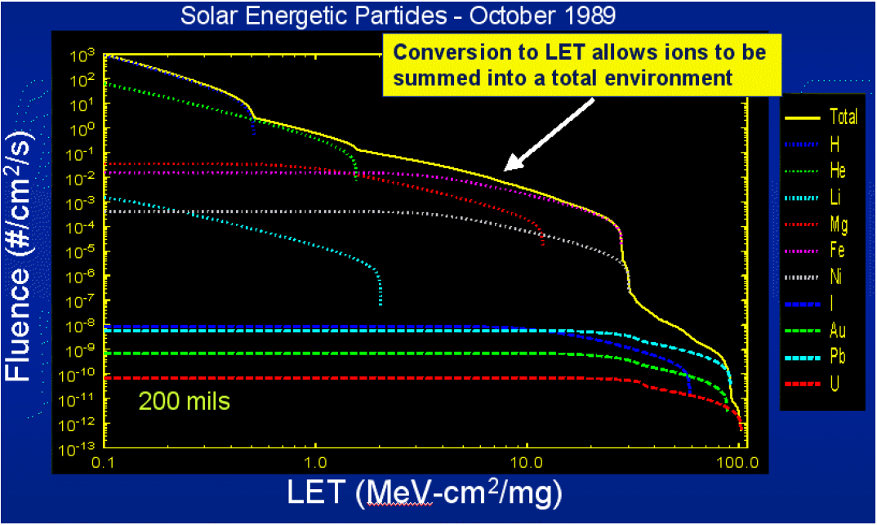
GOES-R+ Workshop Recommendations
Janet Barth, NASA
Workshop attendees “…pointed out the need for improved specification of the high-energy and high-Z SEP environment, but expressed in units of LET (MeV/mg-cm2) most useful to the spacecraft design and testing communities.”

Slide 7
G16 SGPS Full Validation PS-PVR SWPC Summary
The EHIS data are required to support aviation operations, satellite operations, and potentially future human and robotic exploration.
Helium data are a legacy GOES product, and the heavier ions are a new capability.
SWPC concurs with NCEI’s assessment of the EHIS L1b data.
SWPC recommends that Helium data be made available from the SGPS instrument to support current operations.
SWPC agrees with NCEI’s assessment that continued refinement of the on-orbit tables by UNH is needed, and SWPC looks forward to the development of the Level-2 Linear Energy Transfer (LET) product.
SWPC is highly appreciative of the dedication and diligence of UNH, ATC, NCEI, and the GOES program for addressing the EHIS issues. We look forward to the work that will address the remaining issues.

