Slide 1
Peer Stakeholder-Product Validation Review (PS-PVR)
For the Provisional Maturity of GOES-16 SEISS
EHIS L1b Product
July 11, 2018
GOES-R Calibration Working Group (CWG)
Presenter: Juan Rodriguez
Contributors: Athanasios Boudouridis, Brian Kress
NOAA NCEI / CIRES
This review incorporates results from University of New Hampshire’s PLT and post-PLT efforts.

Slide 2
Outline
Review of Beta Maturity
Product Quality Evaluation
  General approach
  Major Issues Remaining
Provisional Maturity Assessment
Path to Full Validation Maturity
  Issues and status
  PLPT
  Risks
Summary and Recommendations
Backup – Details of Individual PLPTs

Slide 3
Energetic Heavy Ion Sensor (EHIS)
MRD 3.3.6.1.1 Energetic Heavy Ions
Primary purpose: measure fluxes of solar energetic particles (SEPs) and galactic cosmic rays (GCRs) responsible for Single Event Effects (SEE) in electronics
Single solid-state telescope using angle-detecting inclined sensor (ADIS) system to discriminate heavy ions by atomic number (Z)
L1b cadence is 5 minutes
Most recent CDRL79 release: SEISS-D-EH079-1, Rev E (25 October 2017)
  Contains constants used in L1b CALINR file aka LUT
Most recent EHIS FM1 LUT: EHIS_CALINR_Parameters-V1.1.h5 (14 Dec 2017)
inclined detectors
scintillator
Credit: SEISS-D-SY079_EHIS_CALTIM_Update-1-6-14

Slide 4
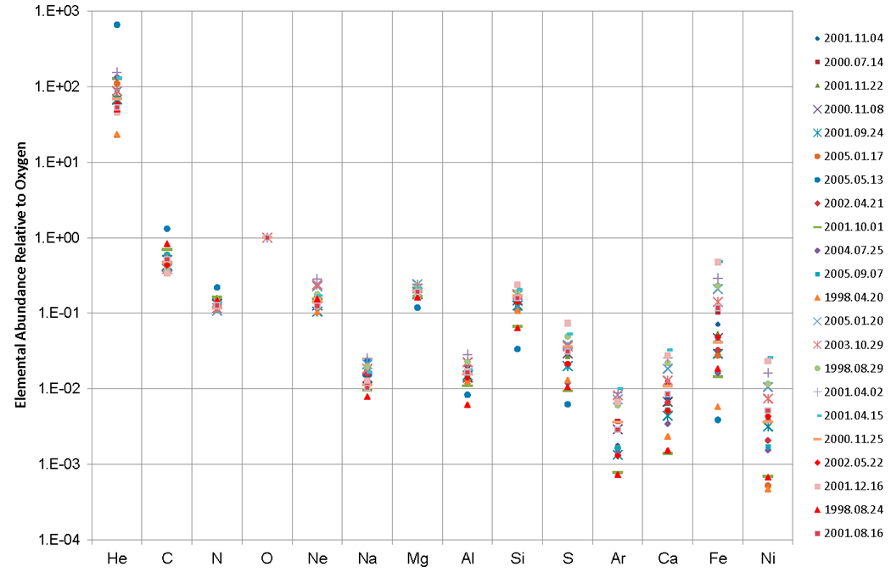
Abundances of Solar Heavy Ions Relative to Oxygen (12-60 MeV/n)
Heavy ion abundances cannot be extrapolated accurately from hydrogen (proton) or helium (alpha particle) observations.
Relative Abundances of Heavy Ions (12-60 MeV/n) in 22 SEP Events from Solar Cycle 23 (ACE SIS data) [Bharath et al., 2013, https://ams.confex.com/ams/93Annual/webprogram/Paper216161.html]

Slide 5
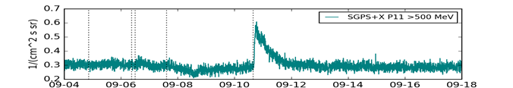
SEPs vs. GCRs
September 2017
SEP event
GCRs
Forbush decrease
GCRs
Solar Energetic Particle (SEP) events are sporadic, duration ~ days
  If large enough, trigger SWPC’s real-time solar radiation storm alerts (SGPS)
  Heavy ion fluxes and event fluences used in upset calculations (EHIS)
Galactic Cosmic Rays (GCRs) vary slowly (solar cycle ~ 11 yrs)
  Very low flux levels but nonetheless pose an SEE hazard
  Measurements used to improve GCR flux models that are used in statistical predictions of upset rates (EHIS)

Slide 6
EHIS Processing Overview
Rates | Priority 3 | Priority 2 | Priority 1
Species | H | He | C-Cu
Detection Method | Energy Deposition, Coincidence Logic | Energy Deposition Coincidence Logic | Energy Deposition, Angle of Incidence (ADIS), Coincidence Logic
L1b Algorithm | Divide by G*dE | Divide by G*dE | Perform Maximum Likelihood (ML) Fit to Histogram, Divide by G*dE
L0 Cadence | 3 s | 3 s | 60 s
L1b Cadence | 300 s | 300 s | 300 s
Can L1b be summed to improve statistics? | Yes | Yes | No. Poisson statistics lost in ML fit. Often only an upper limit. Must sum P1 rates and histograms prior to applying ML fit.
Bottom line: for Carbon and heavier ions, calculation of SEP event fluences and GCR fluxes requires reprocessing EHIS data from L0

Slide 7
ADIS Theory: Histogram
From Connell et al., NIMS A, v. 837, pp. 11-15, 2016
These equations are coded in EHIS flight software in order to sort heavy ions by Z (atomic number)
Uses flight science tables (e.g., alpha, kappa) derived from beam calibrations
Produces a 600 x 5 (ZCAL*20 x energy) histogram reported in L0 every minute
  ZCAL is the estimate of nuclear charge (Z)
  Histogram bin widths are 0.05e (Z = bin number / 20)

Slide 8
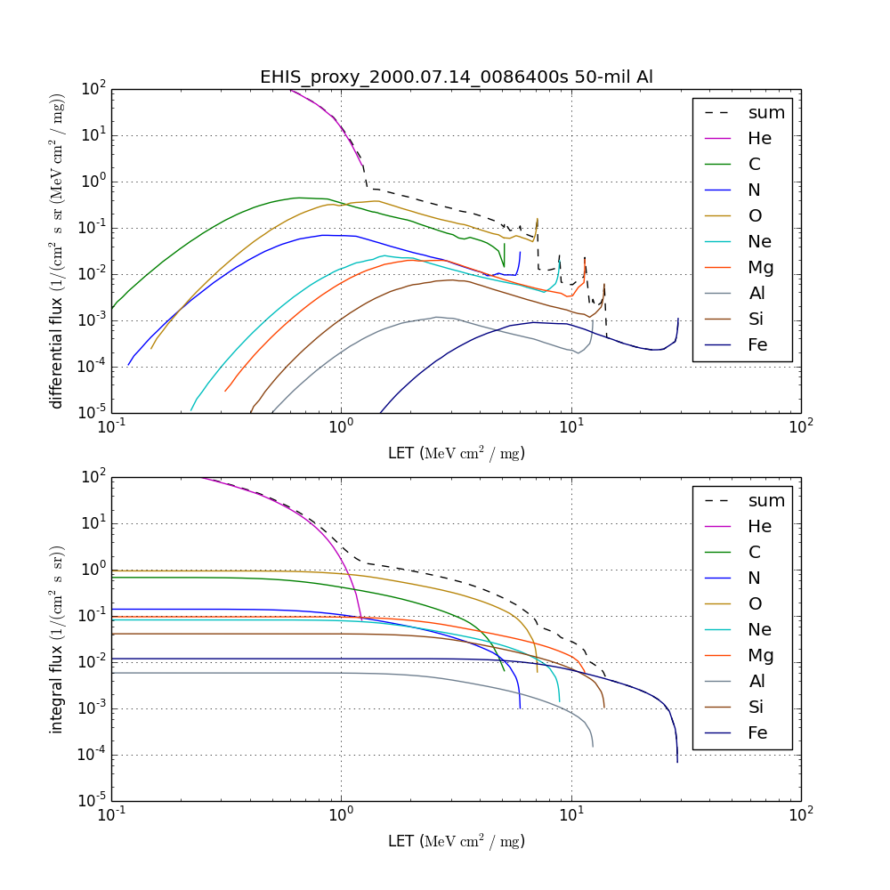
EHIS L1b Data Drive New L2 Linear Energy Transfer (LET) Product
SEE hazard increases with increasing LET
Objectives of L2 LET Algorithm:
  Implement original motivation for EHIS: to express heavy ion fluxes in units of LET in silicon for the spacecraft design and testing communities (single-event effects (SEEs))
  Provide a 1-D real-time estimate of LET in silicon for situational awareness, under shielding characteristic of robotic spacecraft (50, 100, 500 mil Al)
  Be readily adaptable for use in retrospective (e.g., hourly, daily, event, solar rotation) LET estimates
  Transform EHIS spectra from
  ions / [cm² s sr (MeV/n)] to
  ions / [cm² s sr (MeV cm² / mg)]

Slide 9
Review of Beta Maturity
GOES-16 EHIS L1b Product Provisional PS-PVR

Slide 10
Path to Provisional
Risks and associated ADRs needing resolution for Provisional
PLPT overview
Additional risks identified after Beta PS-PVR

Slide 11
Paths to Provisional: Risks at Beta PS-PVR
Risk Name | Description | Impact | ADR/WR | Mitigation and Schedule | Status
EHIS Integerization of Maximum Likelihood Fit | IF integerization of ML fit is not resolved, THEN EHIS L1b heavy ions will be inaccurate | Medium | WR2246 (closed) | 1. ATC/UNH or NCEI will compare their L1b with GS L1b | Reported complete by Harris but not validated by ATC or NCEI. Identified as a watch item at PS-PVR.
EHIS Initial Peak Area Calculation | IF bin numbers < 60 not removed from initial peak area calculation, THEN EHIS L1b heavy ions will be inaccurate | High. Affects SEISS.20 LET | WR2247 (closed) | 1. Ground reported fix: WR2247, DO.05 2. ATC/UNH or NCEI will check fix | Reported complete by Harris but not validated by ATC or NCEI.
EHIS Statistical Error Calculation Defect | IF lower statistic bound is not calculated correctly, THEN EHIS L1b heavy ions will be inaccurate | High. Affects SEISS.20 LET | WR2255 (closed) | 1. Ground reported fix: WR2255, DO.05 2. ATC/UNH or NCEI will check fix | Reported complete by Harris but not validated by ATC or NCEI. There is evidence in L1b files that this has been fixed.
EHIS H1 Channel Contamination | IF electron contamination not removed, THEN EHIS H1(P) channel fluxes will be inaccurate | High. Affects SEISS.20 LET | 428 (WR 5471) (closed) | WR3908: 1. ATC/UNH to update EHIS flight tables (done) 2. Updated EHIS flight tables to be uploaded (done 10 Mar) 3. ATC/UNH to update GPA LUT to be consistent with new thresholds (done –other H and He channels affected) 4. Delivered LUT to be installed in DE (done – did not work) 5. Install fixed & redelivered LUT in early January | Flight tables uploaded successfully on 10 March 2017, e- contamination greatly reduced. EHIS LUT updated by ATC/UNH and delivered. Revised LUT delivered 8 Jan 2018, installed in DE, effect verified by NCEI 17 Jan 2018, installed in OE 26 Jan 2018.
Updates since Beta PS-PVR are in green.

Slide 12

Changes to FM1 EHIS Tables Resulting from PLT
Date | Rationale | Changed | L0 | L1b
10 Mar 2017 | Logic changes: remove ~1.5-6.0 MeV electron contamination in H1; remove noisy D2A trigger level from logic (affects H & He). | Flight science tables | x | x
20 Jun 2017 | Incorporate on-orbit PLT calibration results (ZCAL, prime trigger condition) | Flight science tables | x | x
26 Jan 2018 | Bring L1b in line with FSW table changes | Ground LUT in OE (ADR 428) |  | x
Notes for FM2:
1. FM2 launched with same logic as FM1 configured on 10 Mar 2017 -- removed electron contamination from the start. However, FM2 does not have a noisy D2A. Removal of D2A from logic complicates the H and He energy passbands. Consider reconfiguring FM2 logic to only address electron contamination.
2. Make sure to coordinate GPA LUT change to be simultaneous with incorporation of PLT results into flight tables.

Slide 13
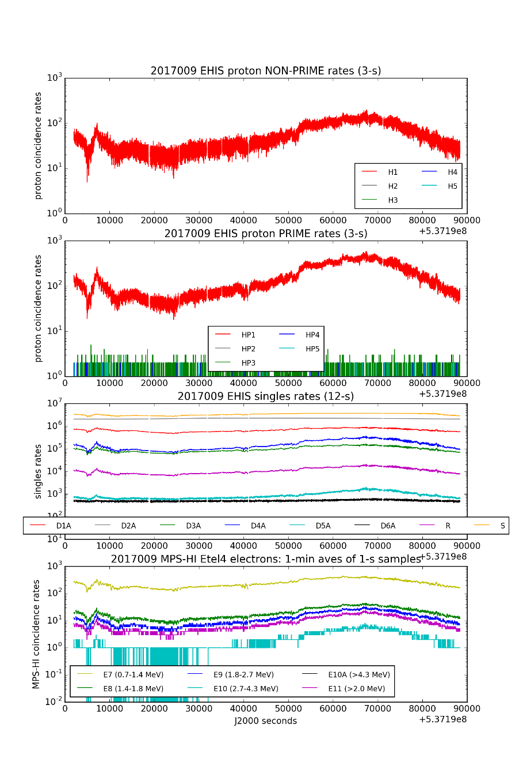
EHIS H1/H1P Channel Contamination Solved by Logic Change
January 9, 2017 (full day)
H1 and H1P channels are designed to measure 10-31 MeV protons
At first light, variations characteristic of trapped radiation belt electrons were apparent in the H1(P) rates
UNH revised the FSW SciCnfg Table, uploaded 10 March 2017 (0852:31 UT)
  Changed H1 rate logic from from D1A+D2A+D3A+D4A to D1A+D2A+D3A+D4ABC, which excluded ~1.5-6.0 MeV electrons from this channel
  Moved A-Level Discriminators up, away from noise floor
  Removed noisy D2A trigger level from all logic
  This affected geometrical factors and band energies for H and He rates, requiring change to GPA LUT
H1-H5 rates
H1P-H5P rates
Singles rates
MPS-HI Etel4 rates (E7-E11)

Slide 14
Path to Provisional - PLPTs
Title | Activity | Data Needed | Success Criteria
A.2.4 SEP Channel Cross-Comparison [PLPT-SEI-004] | On-orbit cross-calibration of EHIS with SGPS above 10 MeV, and with GOES 13-15 EPEAD. | One Solar Energetic Particle (SEP) event. | [Provisional] Differences quantified on data taken through Provisional phase.
A.2.6 Backgrounds Trending [PLPT-SEI-006] | Evaluate EHIS backgrounds in terms of expected galactic cosmic ray (GCR) fluxes. The analysis of EHIS heavy ion data will require long-term averages of L0 histograms. The analysis of EHIS proton and alpha particle rates as well as rates from the other two instruments could convert L1b fluxes back to counts, but it would be less ambiguous simply to average the L0 count rates. | Two months of continuous data. | [Provisional] Natural backgrounds preliminarily correlated with solar protons and GCRs.
EHIS PLPTs from RIMP v 1.0 (02 June 2016)
Note: data requirements for Full Validation have been exceeded in Provisional analysis
  A.3.3: 2 SEP events required vs. 4 SEP events analyzed
  A.3.5: 4 months of data required vs. 5.5 months analyzed
Provisional success criteria require quantification of calibration differences without necessarily resolving them
  Success requires sufficient analysis to reveal the important issues that need to be pursued in Full Validation phase

Slide 15
Path to Provisional: Risks Identified Since Beta PS-PVR
Risk Name | Description | Impact | ADR | WR | Mitigation Approach and Status
Inaccurate SWx Instrument_ID Fields | G16 EHIS identified as ‘FM2’ in L1b global variables (metadata). IF instrument_ID not fixed, THEN users could misinterpret data. | Medium | 342 | 4502 | Fix scheduled for DO.06.03. Needed for Full validation. Results evaluated in DE – G16 EHIS now identified correctly as ‘FM1’
Three EHIS Flags not Read Correctly | IF Science Processing Status (SPS) flags are not read correctly, THEN EHIS L1b data will be inaccurate. | High | 582 | 5762 | Fix scheduled for DO.06.03. Needed for Provisional validation. Results evaluated – key fix made for Provisional status. Residual issue may be addressed for Full.
GOES-16 EHIS unexpected low fluxes from lowest energy helium channels | IF root cause of low helium fluxes not identified and fix implemented, THEN EHIS helium fluxes will be inaccurate during largest SEP events. | High | -- | 6113 (Flight) | NCEI checked for potential GPA cause first. Uncovered ADR 582 - insufficient to explain error. ATC/UNH investigating possible hardware causes of problem
High risks were identified as a result of NCEI PLPT A.2.4 based on observations during 10 September 2017 SEP event, which occurred well after FM1 PLT had been completed.

Slide 16
ADR 582: EHIS HFR_Flag, IFC_Flag, SCC_Flag
Harris/AER Algorithm Description Document describes HFR_Flag as follows:
  0 = no high flux rate conditions exist; L1b algorithm uses non-Prime rates for this minute (and Non-Prime DTC LUT, etc.)
  1 = high flux rate conditions exist; L1b algorithm uses Prime rates for this minute (and Prime DTC LUT, etc.)
  Reported in L1b (every minute):
    0 during entire event
In contrast, in NCEI’s reading of L0, HFR_Flag set to 1 during entire event
  Confirmed by instrument vendor (UNH)
IFC_Flag should have been set to 1 shortly after 1800 UT on 11 Sept 2017
  Flag not set in L1b
SCC_Flag not tested during period analyzed by NCEI, but probably affected by this problem as well
See SEISS CDRL43 Rev P, Tables 8-57 and 8-59
HFR_Flag
IFC_Flag
SCC_Flag
From SCI-PEC ‘Science Processing Status’ (SPS) 16-bit word:
1000000000000000 = 32768 High Flux Rate
0100000000000000 = 16384 In-Flight Calibration
0010000000000000 = 8192 Science Configuration Change
During this period (10-13 Sept 2017), the SPS word is always (with one exception – when IFC is ON) equal to 32768. When IFC is ON, this value is 49,152.
Note: unlike the other quantities in SCI-PEC (Table 8-57), this SPS word must not be decompressed

Slide 17
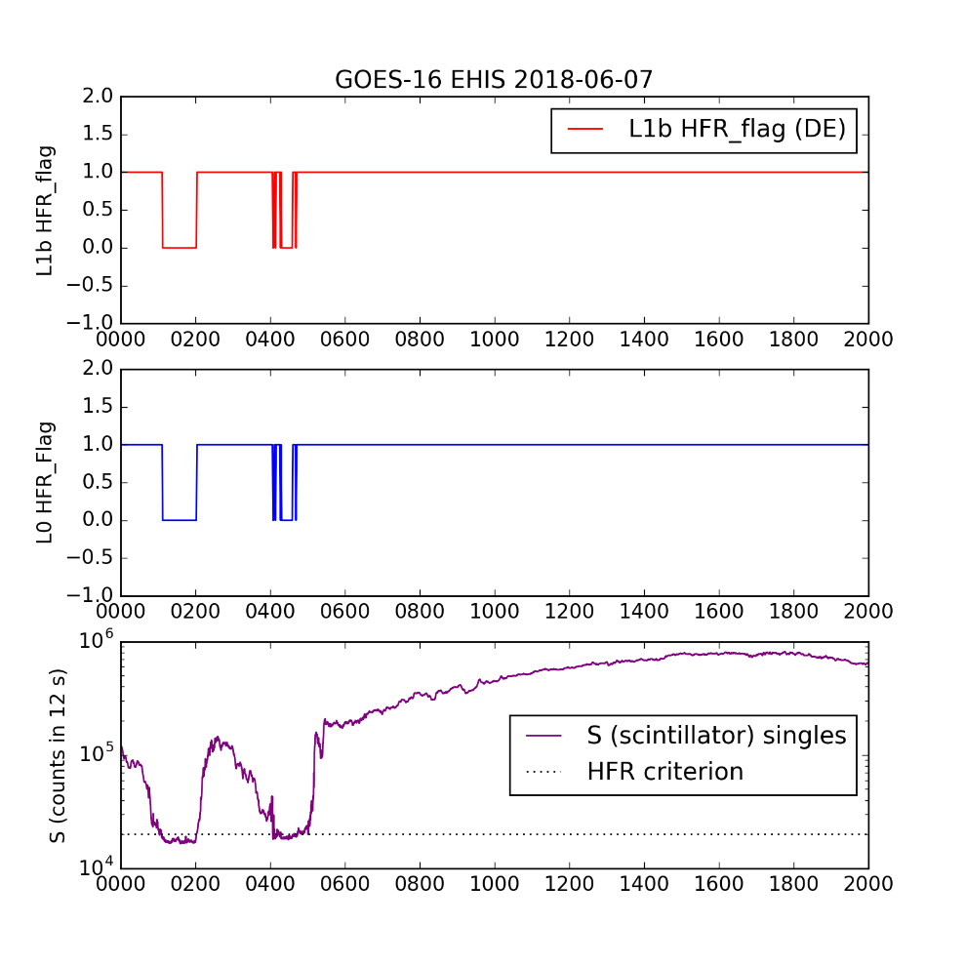
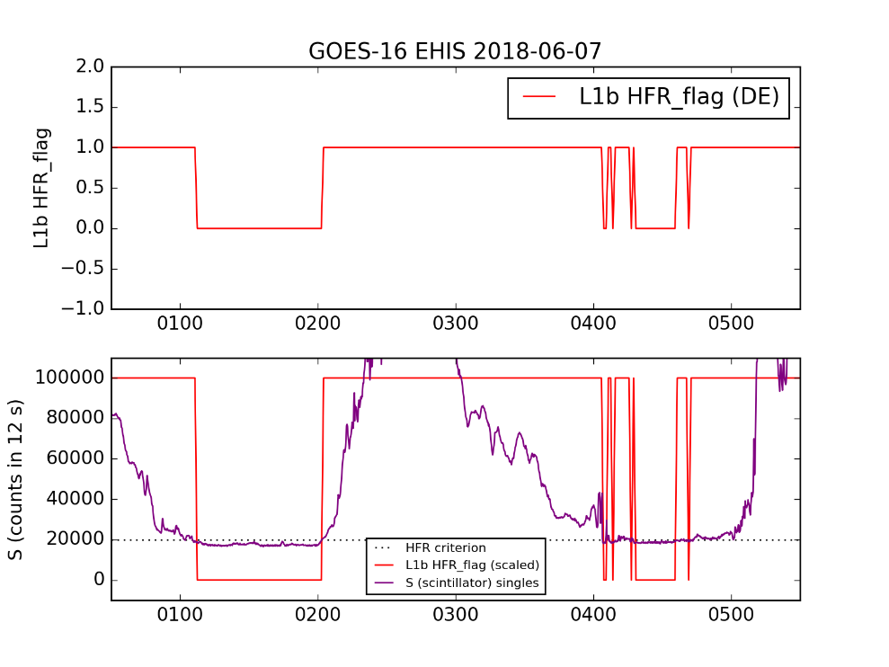
ADR 582: Verification in DE
HFR_flag now set correctly. Needed for Provisional Status.
Scintillator counts usually dominated by radiation belt electrons (>1.8 MeV)
HFR_flag now set correctly in DE. On 07 June 2018, switched from ON to OFF (i.e., Prime to Non-Prime) during dropouts in radiation belt electron fluxes striking the Scintillator

Slide 18
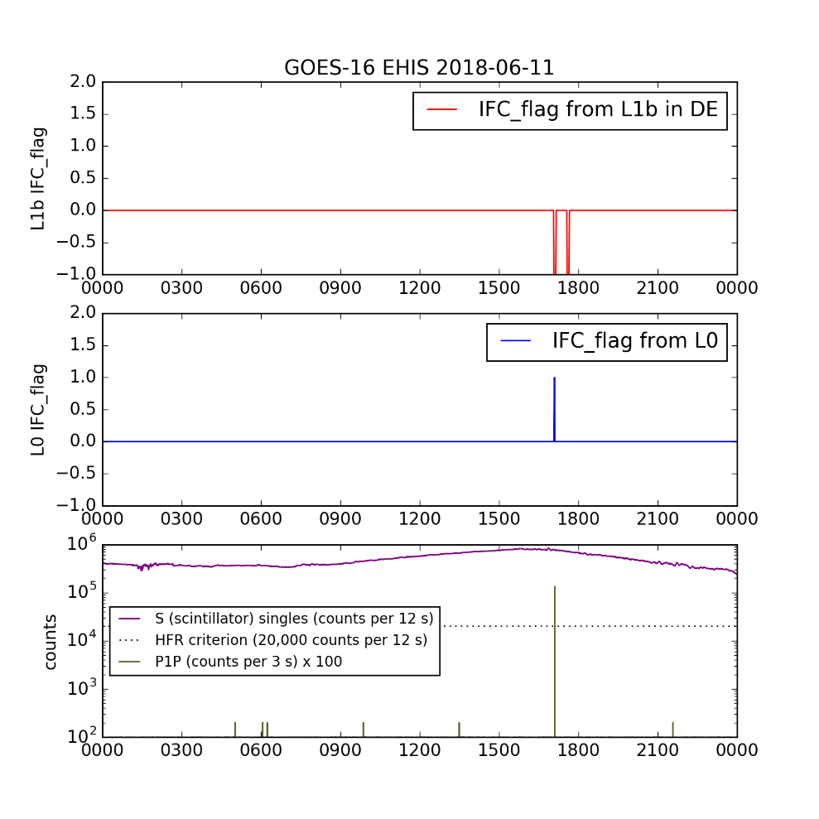
ADR 582: Verification in DE
IFC_flag not set to 1 during IFC; rather, set to -1 (fill). Adequate for Provisional Status.
Rather than IFC flag being set to 1, the data (including time stamps and flag values) were replaced with fill values
  Five 1-min flags in each 5-min L1b file
IFC_flag in L0 set for one minute, L1b data replaced with fill values for 5 minutes
May recommend refining this for Full validation
  Keep time stamp, set IFC_flag to 1, omit affected minute from 5-min average

Slide 19
Product quality assessment
GOES-16 EHIS L1b Product Provisional PS-PVR

Slide 20
Top Level Evaluation
 | Status at Beta PS-PVR (10 Feb 2017) | Current Status (11 July 2018) | Future Outlook
Hydrogen (proton) flux | H1 severely contaminated by MeV radiation belt electrons | Electron contamination removed from H1 by Mar ’17 flight table change. SEP event fluences low with respect to SGPS and GOES-13, -15 | Spectral analysis using temperature-sensitive bandpasses may resolve this issue
Helium (alpha particle) flux | He fluxes only observed at GCR levels | HE1 and HE2 fluxes are ~5x low with respect to GOES-13 and -15 during 10-14 Sept 2017 SEP event but not others. Possible hardware issues being investigated by UNH | Investigation may indicate need for a logic change
Heavy ions | Heavy ion fluxes only observed at GCR levels, very sparse | SEP fluxes ~2-3x low with respect to ACE SIS | Not obvious which instrument is more accurate – EHIS absolute calibration was painstaking, SIS calibration emphasized relative isotopic composition
Until the occurrence of the July and Sept 2017 SEP events, EHIS could only be evaluated with GCR fluxes (e.g., UNH PLT On-orbit Cal)
The stressing SEP event starting 10 Sept 2017 revealed issues that could not be identified previously
Even so, the heavy ion fluxes in the 1-4 (of 5) highest energy channels did not increase significantly above GCR levels in these SEP events

Slide 21
Use of Reprocessed Data in PLPT
The incorrect reading of the High Flux Rate (HFR) flag by the Ground L1b code means that most of the EHIS L1b data prior to DO.06.03 are invalid
SEP events are sporadic – none during DO.06.03 DE period
  DO 06.03 data from DE were used to verify that ADR 582 was successfully addressed
We have reprocessed L0 data using software that has been demonstrated to reproduce L1b results
This demonstrated equivalence enables us to perform PLPT using reprocessed EHIS data
The reprocessed data used in PLPT:
  5-minute averages of helium fluxes from July and September 2017 SEP events
  Event averages of heavy ion fluxes from July and September 2017 events
  >5-month average of GCR fluxes

Slide 22
PLPTs for Provisional
PLPT-SEI-004: Solar Energetic Particle (SEP) Cross-Comparison
PLPT-SEI-006: Backgrounds

Slide 23
PLPT-SEI-004:
Comparison Data Sets
GOES-16 SGPS: protons (hydrogen), alphas (helium)
  Alpha (helium) channels not processed by L1b
  Converted to fluxes using approximate GFs and nominal energies
  Primarily to quantify energy-dependent east-west differences at G16
    EHIS looks radially outward; geomagnetic cutoff effects should be intermediate
GOES-13, -15 EPEAD: protons (hydrogen), alphas (helium)
  Effective energies based on cross-calibrations with IMP-8 GME [Sandberg et al., 2014; ESA Solar Energetic Particle Environment Modelling (SEPEM) project]
  Proton energies validated by cross-calibration with STEREO [Rodriguez et al., 2017]
ACE Solar Isotope Spectrometer (SIS): ‘gold standard’ for solar heavy ions
  For heavy ion comparisons (note: GF~40 cm² sr vs. EHIS 0.44-1.67 cm² sr )
  Top 3 SIS channels overlap with two lowest-energy EHIS channels
  At L1 nearly 21 years
    Helium degraded since Dec. 2015, loss of >13.6 MeV/n channels
    Top 2 energy channels: 10-30% discrepancy between the two SIS telescopes for C-Fe during September 2017 events

Slide 24
PLPT-SEI-004: Helium

Slide 25
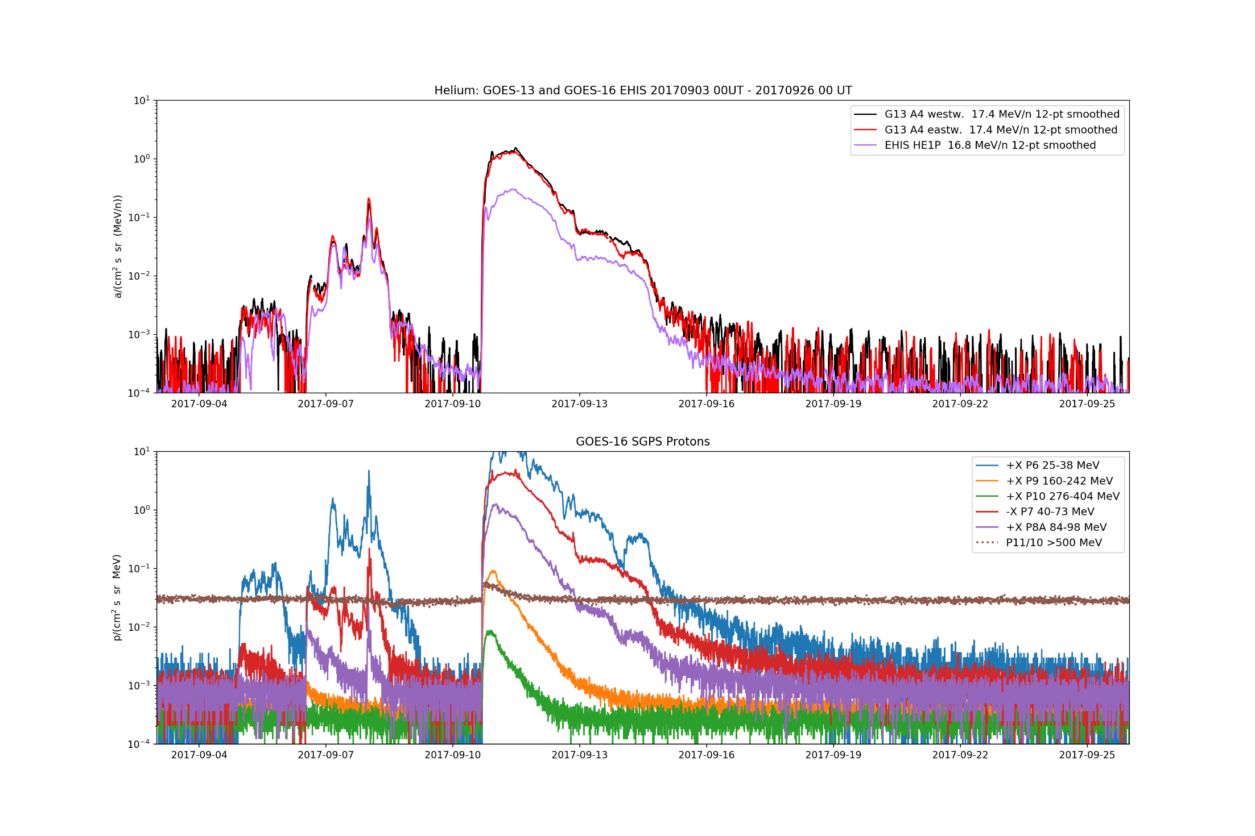
The Problem: Agreement Between EHIS and GOES-13 Helium Degrades as >80 MeV Proton Flux Increases

Slide 26
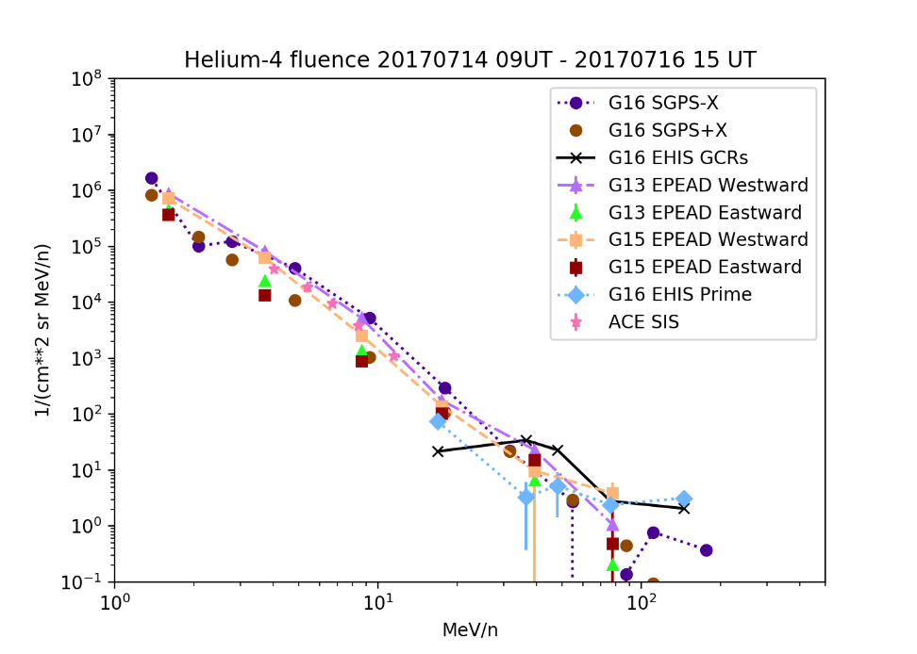
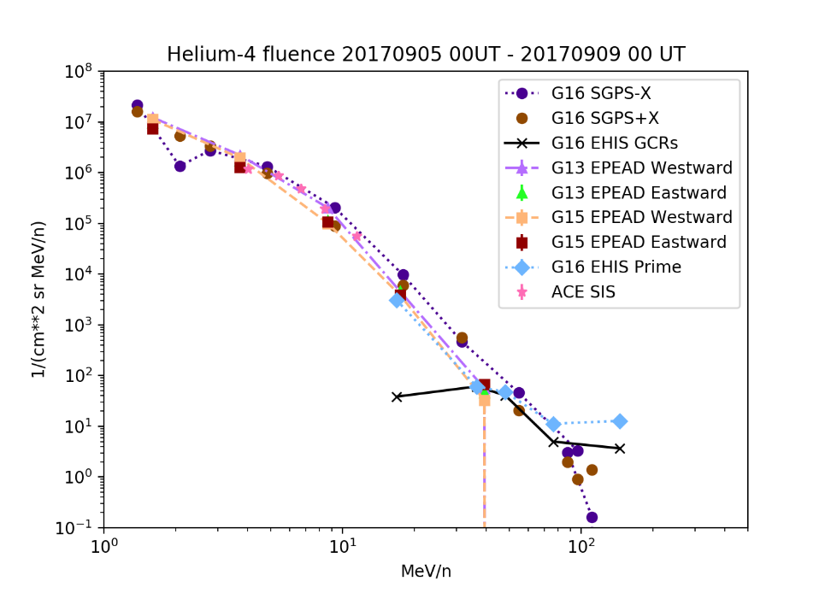
Helium fluence spectra:
7/14-16 and 9/5-8
SGPS-X A2 is low
EHIS HE1P and HE2P agree with G13 and G15
EHIS HE1P agrees with G13 and G15
Pre-event backgrounds (GCRs) subtracted from all spectra

Slide 27
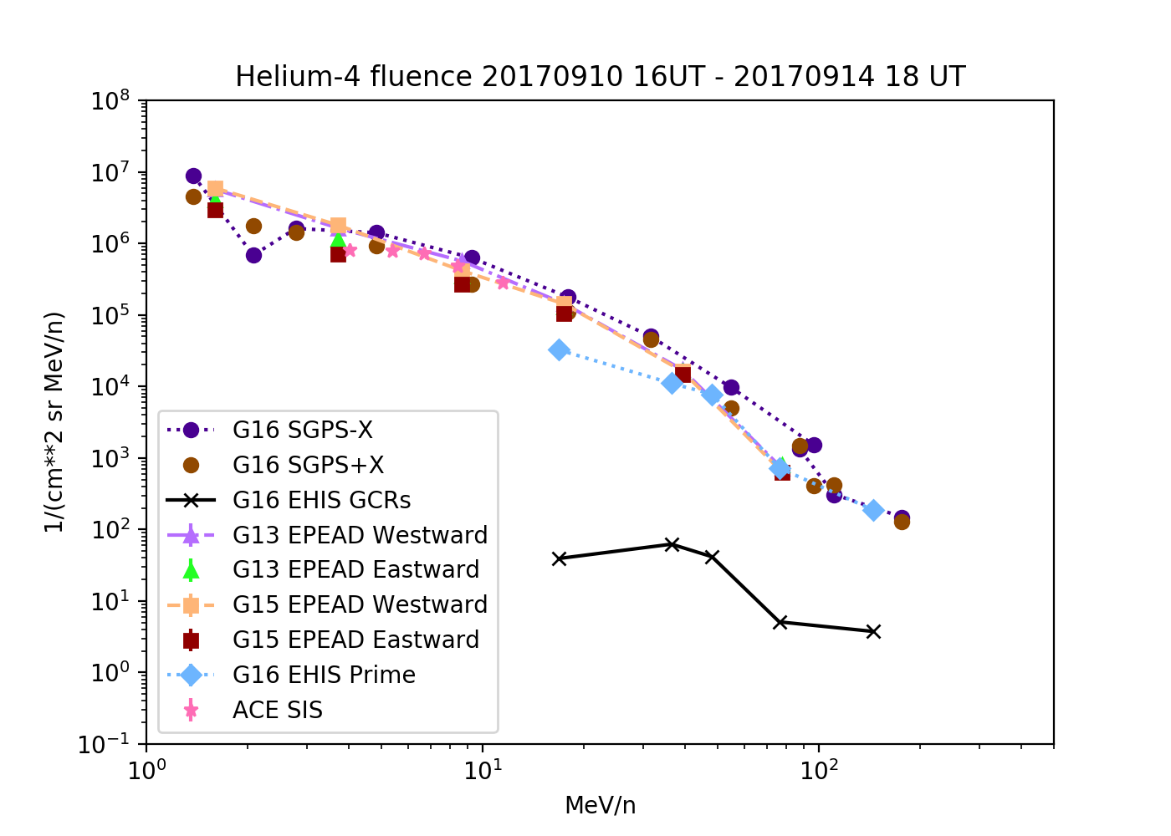
Helium fluence spectra:
9/10-14
EHIS HE1P and HE2P fluences suppressed
Pre-event backgrounds (GCRs) subtracted from all spectra

Slide 28

Search for Root Cause of HE1 Flux Discrepancy
Possible Cause | Ruled Out Because
HFR_flag read incorrectly | Flag was incorrectly read (ADR 582), but differences between Prime and NonPrime quantities can’t fully explain discrepancy (see ‘L1b Rates Deep Dive’ in Backup Charts)
Incorrect implementation of rates algorithm in L1b | Deep dive analysis showed that algorithm was correctly implemented apart from HFR_flag
Contamination correction for He fluxes is overcorrecting | The correction is small, even when H fluxes are large; ~3x maximum briefly at onset of event
Excessive dead-time (due to scintillator) | Would affect all He channels equally
Priority 2 He counts being rejected in favor of Priority 1 (heavy ion) | Would affect all He channels equally
He misidentified as H | Unlikely. Physics of energy deposition generally result in the opposite (H misidentified as He)
Elevated H fluxes cause false rejection of He counts | Under investigation

Slide 29
UNH’s Plan
Logic Changes
  We will be modeling the changes in the logic and their affect on protons and helium, with an emphasis on whether helium can be misidentified as protons (which contamination has not been modeled previously). Also we will verify that the modified logic conditions will not allow for a particle to be identified by two separate criteria (e.g. a single particle identified as both a helium and a heavy ion – which would cause the particle do be non-included in the helium rates.)
Correlative Studies with SGPS, EHIS and GOES-13
  We will be comparing SGPS and GOES-13 proton fluxes with EHIS proton fluxes and similarly with helium fluxes. We will be correlating SGPS and GOES-13 proton fluxes with EHIS helium fluxes. Emphasis will be on the EHIS HE1 rates. This will allow for a determination of all the possible conditions where correlations exist with low EHIS HE1 rates.
PHA events for HE1
  We will be analyzing EHIS PHA helium events in order to determine if there is a systemic bias against finding helium in any energy range, particularly focusing on the two logic conditions that comprise the EHIS HE1 rate. This could identify on-orbit variations from the model predictions.

Slide 30
Summary of PLPT-SEI-004: Helium
EHIS helium flux agreement with other satellites depends on proton flux levels
  Good agreement in July 14 and September 4-8 events
  EHIS helium fluxes are systematically low in largest (September 10-14) event with respect to GOES-13 and -15
  Prime fluxes calculated using L1b algorithm
Path forward:
  Hardware issue under investigation by UNH
  Full validation will use more sophisticated analysis:
    Spectral correction based on full bandpass shapes
    UNH/ATC will deliver temperature-dependent bandpasses consistent with revised on-orbit logic
PARTIAL PASS. HARDWARE ISSUE UNDER INVESTIGATION

Slide 31
PLPT-SEI-004: Heavy Ions
(carbon to iron)

Slide 32
Priority 1 (Heavy Ion) Histogram Deep Dive
Summed all 1,440 Prime histograms from 10 Sept. 2017 (day 253)
  Dominated by SEP event (GLE) starting ~1618 UT
Analyzed summed histogram following CDRL80 Rev F algorithm
  Used ‘EHIS_CALINR_Parameters-V1.1.h5’ dated 12/14/2017, delivered 1/8/2018
Significant issue revealed:
  Accumulated Gaussian centers for C, N, O, Ne, Mg seem significantly off from Prime peak positions from latest LUT

Slide 33
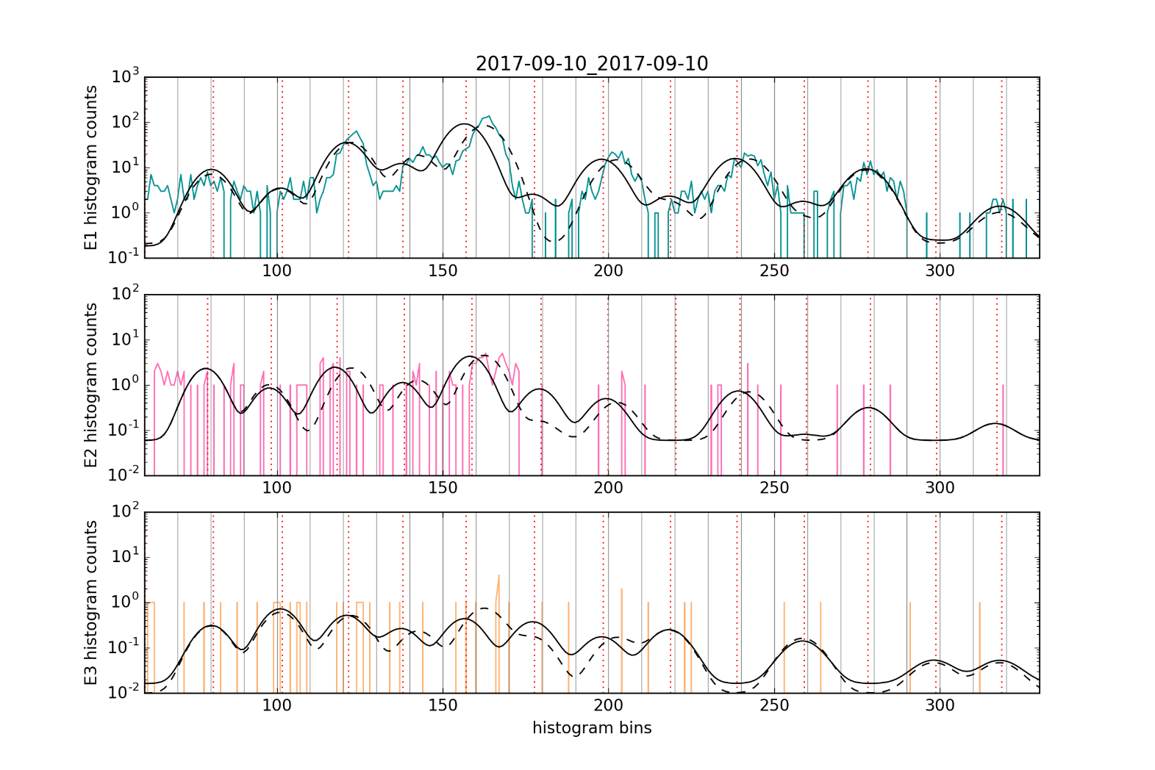
Fits to Priority 1 histogram – low Z range
Vertical gray lines: every 10 bins
Vertical red dotted lines: LUT peak centers
Solid Gaussian fit: performed with LUT peak centers
Dashed Gaussian fit: performed with adjusted peak centers
C N O Ne Mg Si S
Species | E1 | E2 | E3 | Adjusted
C | 121.5 | 118 | 121.5 | 123
N | 138 | 138.4 | 138 | 143
O | 157 | 158.7 | 157 | 163
Ne | 198.4 | 199.8 | 198.4 | 203
Mg | 238.7 | 239.6 | 238.7 | 243

Slide 34
Comments on peak positions
Silicon was used by UNH to on-orbit-calibrate the low-Z alpha-kappa range (PLT report SEISS-TR-SY121-11)
  GCR fluxes were sparse during ~4-month test period
The LUT peak centers for C, N, O, Ne, and Mg seem to be significantly off (systematically low) compared to accumulated 1-day histogram
  Si and S LUT peaks seem to be accurate by comparison with histogram
The Nitrogen fit is strongly affected by the adjusted (increased) peak positions (54% increase in Gaussian area: A = 145 -> A = 224)
  This is an important case since N is relatively abundant
High-Z alpha-kappa: Fe and Ca seem to be in the right place in E1
UNH is continuing to refine on-orbit calibrations using PHA
Provisional PLPT results use NCEI-adjusted peak positions for C, N, O Ne and Mg

Slide 35
EHIS – SIS Cross-Comparison
In terms of Poisson statistics, EHIS is at a factor of ~25-100 disadvantage vs. SIS
Therefore, comparison performed using event fluences
  Fluence = flux * time (seconds)
  Standard technique
  SIS: ACE Science Center Level-2 one-hour average fluxes converted to fluence and summed over event period
  EHIS: L1b algorithm applied to L0 histograms and Priority 1 rates that have been summed over event period
Error bars:
  SIS: 1-sigma Poisson statistics (usually obscured by plotting symbol)
  EHIS: 1-sigma upper and lower errors from L1b algorithm
    ‘Upper limit’ fluxes masked out, not shown
Elements evaluated: C, N, O, Ne, Mg, Si, S, Fe
Did not subtract pre-event GCR background: retrieved fluxes are combination of SEP and GCR

Slide 36
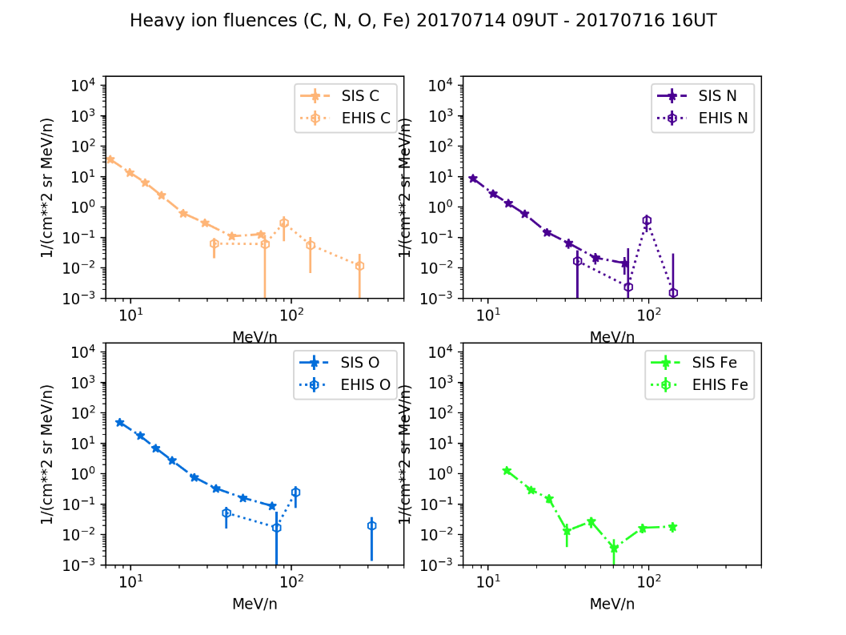
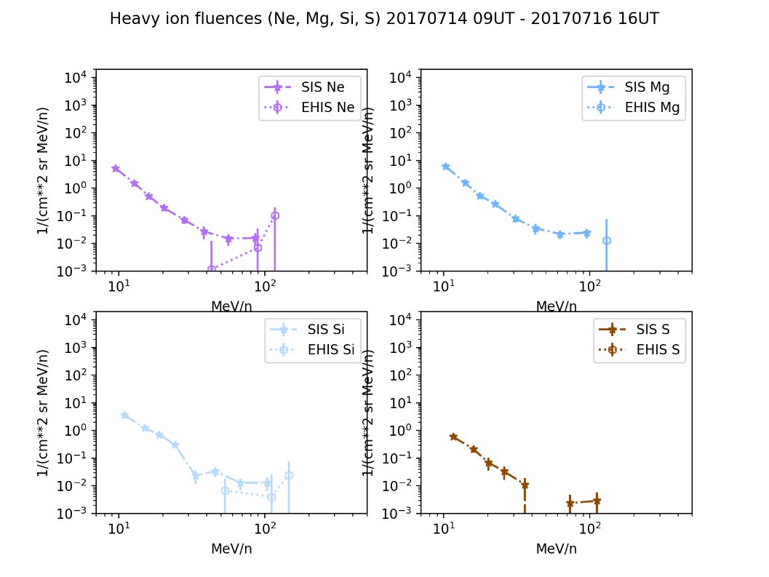
14-16 July 2017

Slide 37
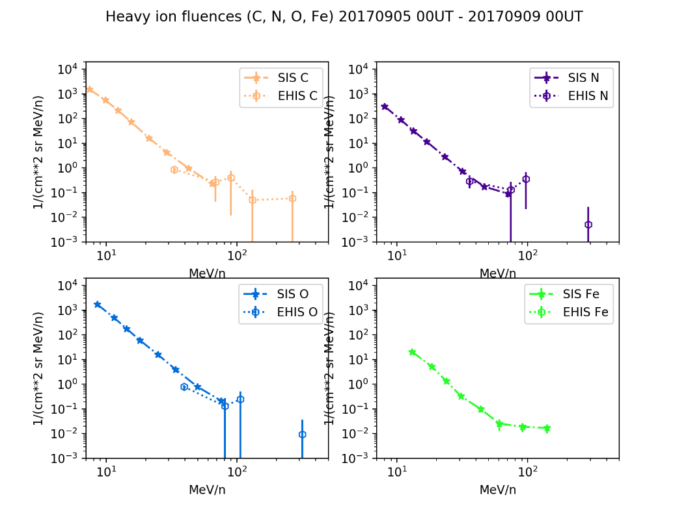
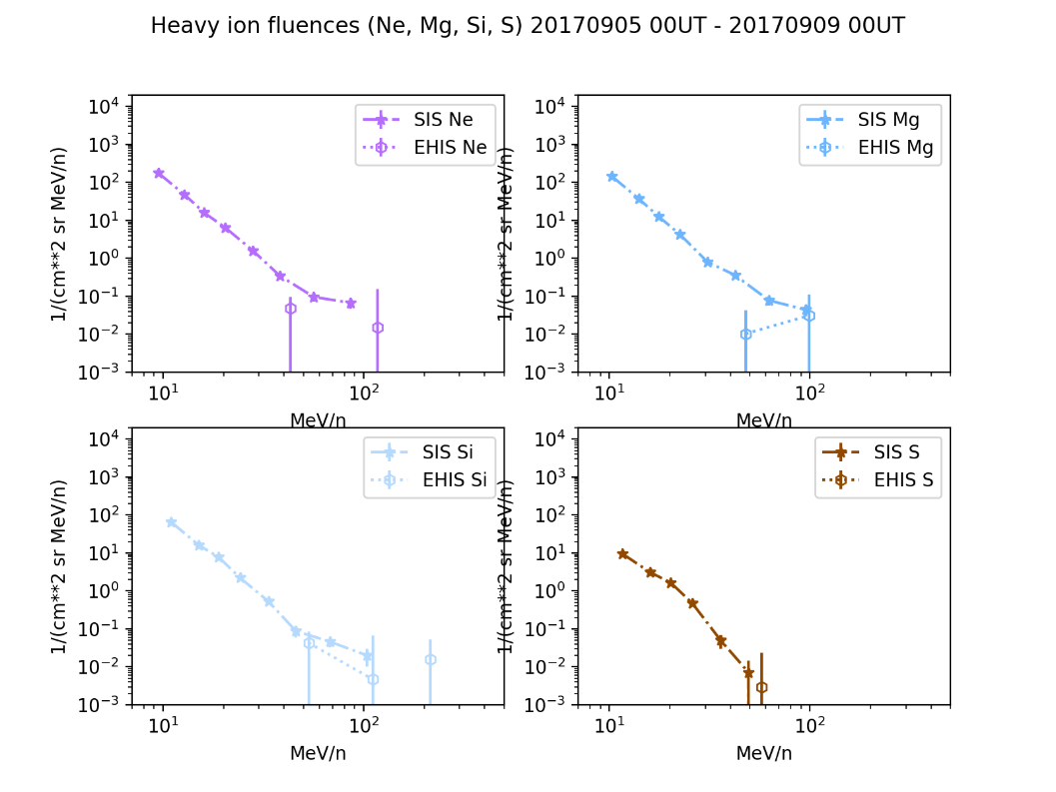
5-8 September 2017

Slide 38
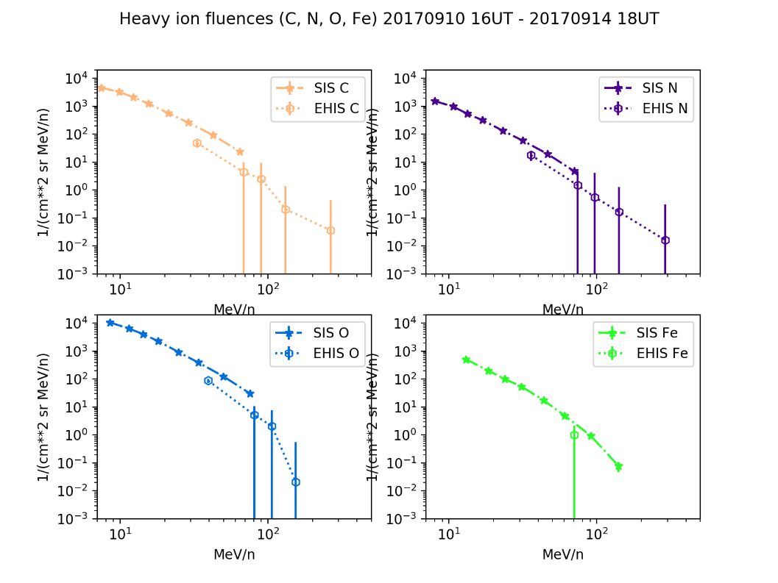
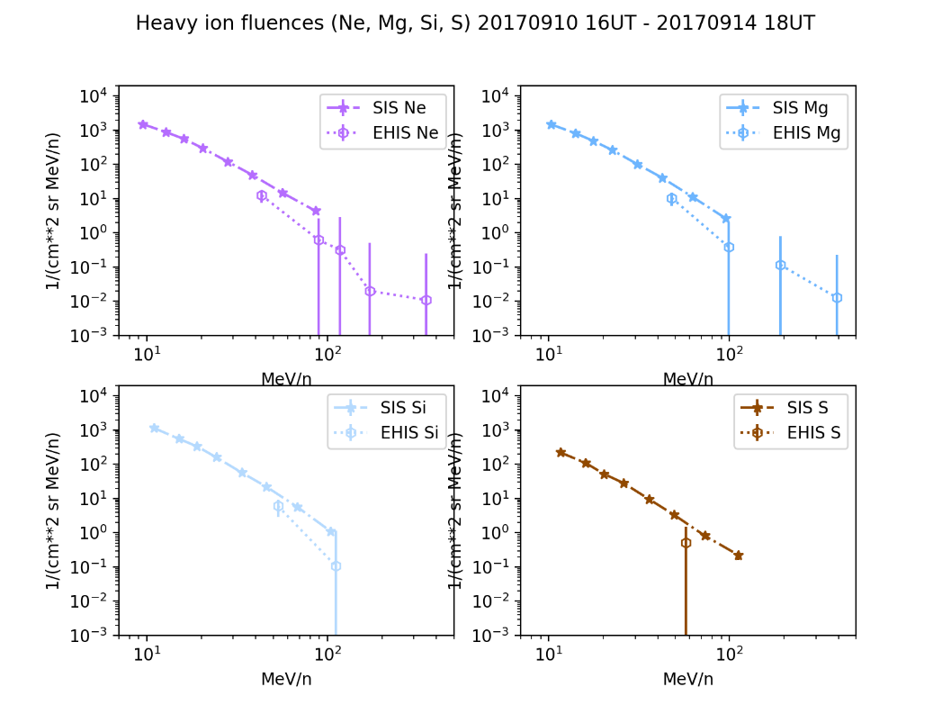
10-14 September 2017

Slide 39
Summary of PLPT-SEI-004:
Heavy Ions
The July and September 2017 SEP events were small for the purpose of heavy ion cross-comparisons
Even in the 10-14 Sept 2017 event, only the lowest-energy EHIS channel had ample counts (when summed over the event)
EHIS fluxes are systematically low but within a factor of 2-4 of SIS fluxes
For a first comparison of two instruments with different designs & primary missions, this is a promising result
PASSED

Slide 40
PLPT-SEI-004: Hydrogen

Slide 41
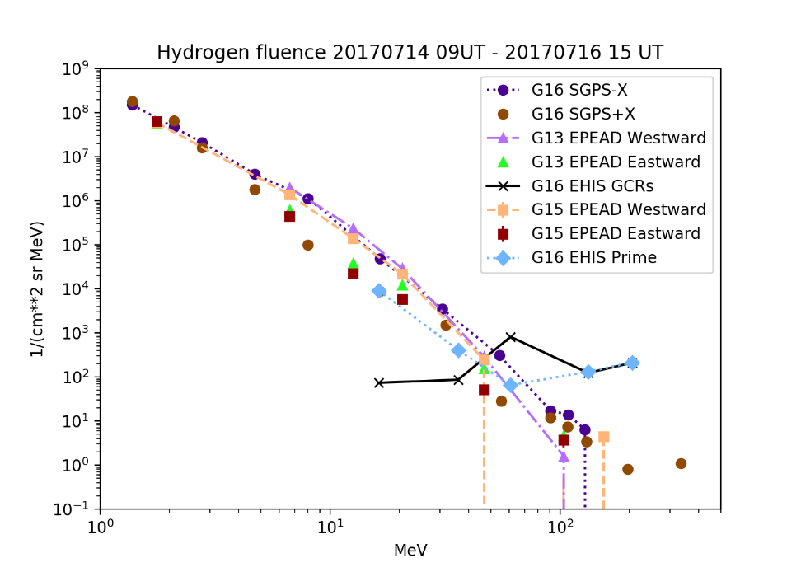
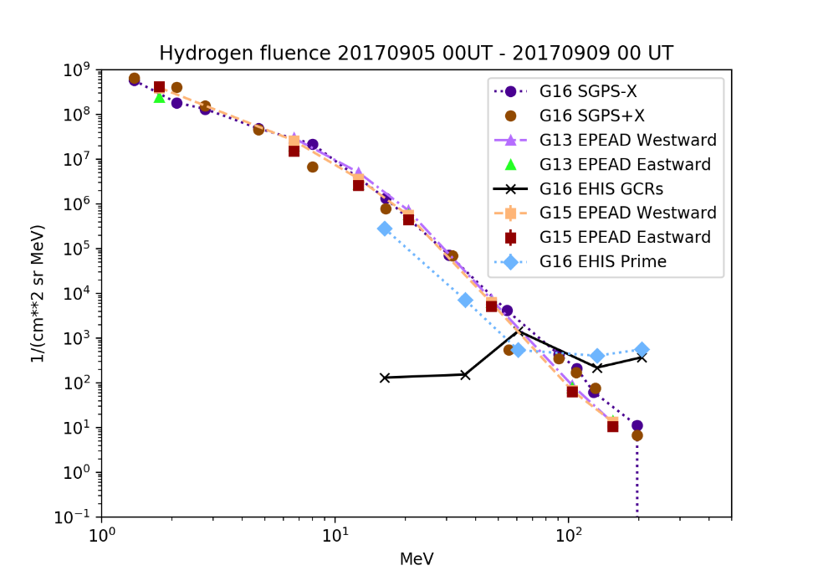
Hydrogen fluence spectra:
7/14-16 and 9/5-8
Pre-event backgrounds (GCRs) subtracted from all spectra

Slide 42
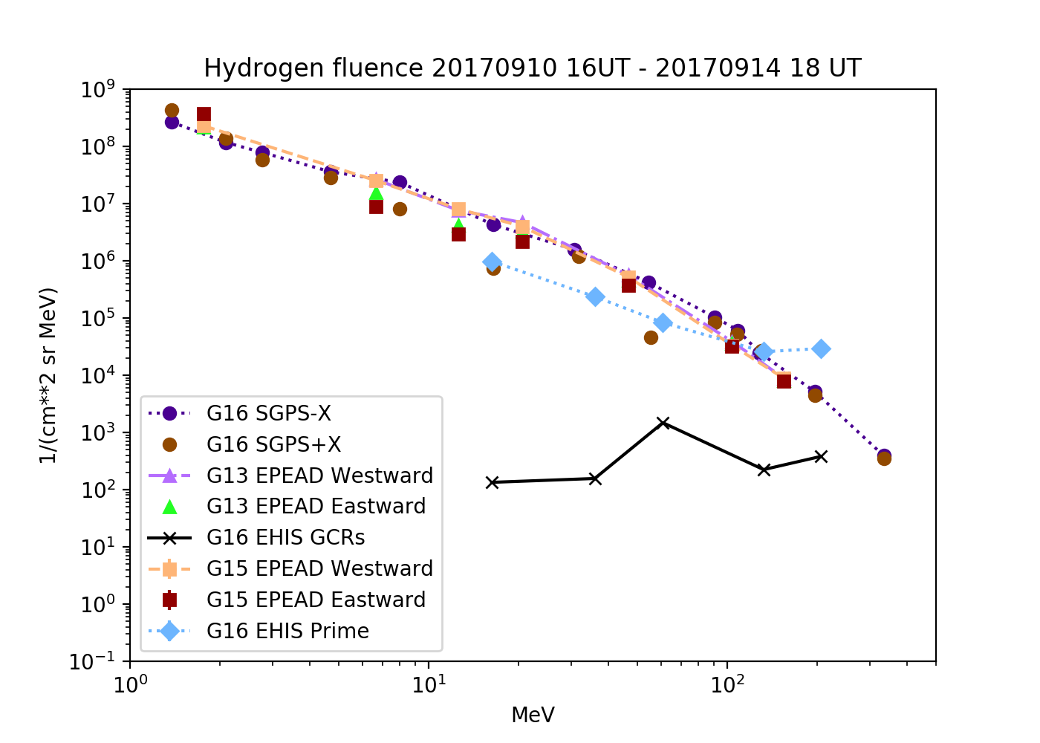
Hydrogen fluence spectra:
9/10-14
SGPS+X P5 and P7 are low
Pre-event backgrounds (GCRs) subtracted from all spectra

Slide 43
Summary of PLPT-SEI-004: Hydrogen
EHIS hydrogen fluxes in all events are systematically low with respect to SGPS and GOES-13 and -15
  Prime fluxes calculated using L1b algorithm
EHIS hydrogen flux calculations do not include a temperature correction
  Temperature sensitivity reduces fluxes over part of day – results in lower event fluence
Full validation will use more sophisticated analysis:
  Spectral correction based on full bandpass shapes and variable temperature
  UNH/ATC will deliver temperature-dependent bandpasses consistent with revised on-orbit logic
PASSED

Slide 44
PLPT-SEI-006
Evaluate EHIS backgrounds in terms of expected galactic cosmic ray (GCR) fluxes
Average months of data to construct average spectrum (GCR fluxes are slowly-varying)
Hydrogen (proton) and helium (alpha) rates:
  Average L0 rates or L1b fluxes over months
Baseline approach to analysis of EHIS heavy ion GCRs requires long-term averages of L0 histograms, followed by reprocessing following L1b algorithm
  This approach did not work, surprisingly
  Alternative approach exists – used by UNH

Slide 45
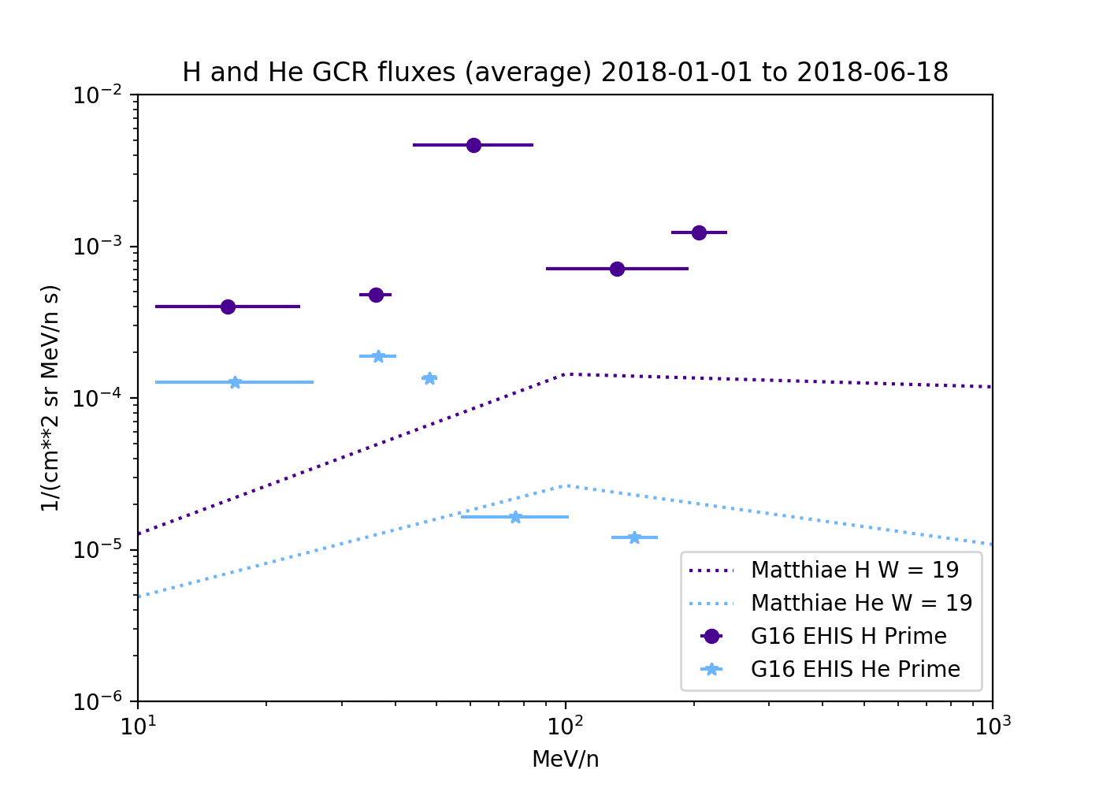
PLPT-SEI-006: H and He
5.5 months of H and He fluxes (no SEP events), averaged
Compared to Matthiä GCR model
  W=19 is pseudo-sunspot number based on Oulu neutron monitor count rates during this period
As expected, observed L1b fluxes are high with respect to model (see SGPS)
For Full validation, will follow SGPS approach by using full bandpass functions including high-energy tails

Slide 46
PLPT-SEI-006
When spectrum increases with energy (GCRs), high-energy contribution to count rates (outside nominal energy range) is substantial.

Slide 47
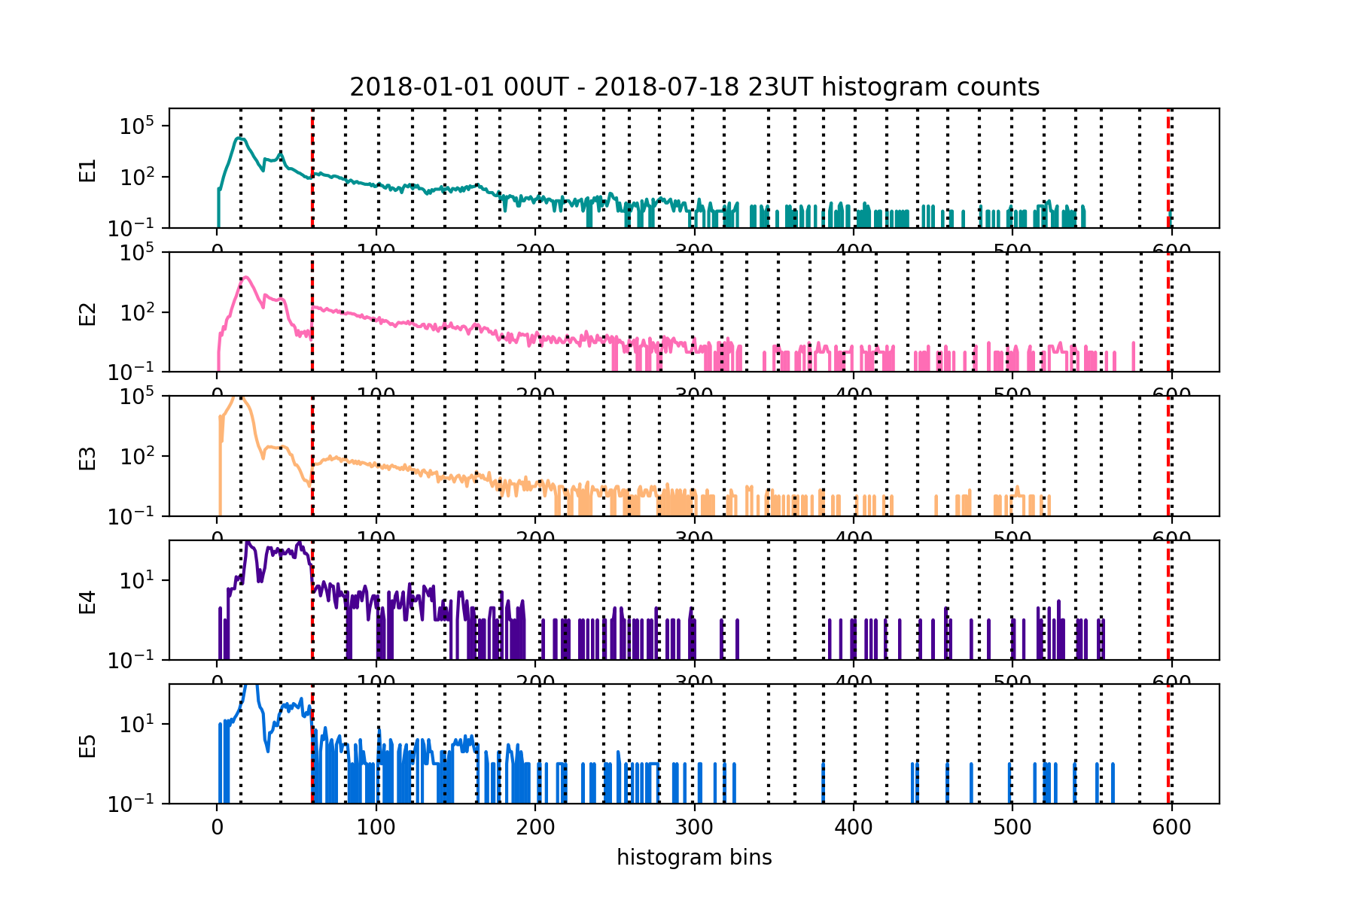
PLPT-SEI-006: Heavy Ions
A surprise: histogram of 5.5 months of heavy ion data cannot currently be used to retrieve GCR fluxes
Possible causes:
  Mostly Prime histograms – side entry (no scintillator in logic) increases backgrounds
  Shifts in the ADC-to-IFC zero-offset (pedestal) in the on-orbit FSW table – affects lighter ions more
Will need to repeat this using pulse-height analysis (using delivered PHA tool), as UNH does for its on-orbit calibration PLTs
GCR CNO histogram peaks dominated by elevated backgrounds (compare SEP histogram on chart 33)

Slide 48
PLPT-SEI-006: Assessment
PARTIAL PASS. NEED TO REDO HEAVY ION ANALYSIS USING PHA
H and He: L1b results are high with respect to model, as expected – reanalysis using full bandpasses planned for Full
Heavy ions (C-Fe):
  NCEI plan: use delivered PHA tool (SEISS-D-OT060-10) to analyze heavy ion fluxes, reconstruct GCR spectrum
  UNH plan: alpha-kappa table update using the 2017 SEP events for much better counting statistics – should make it possible to use histograms for GCR analysis
    Using the full on-orbit telemetry will increase the statistics of the rare and/or high energy heavy ions, of which there were VERY few at the end of the EHIS FM1 PLT period. Better slope-intercept values for the energy calculations and alpha-kappa values for the charge calculations will result.
    With the new alpha-kappa relationship, recheck the capacitor pedestals. These are especially important for the lighter heavy ions C, N and O, as an incorrect pedestal can make a significant difference in the energy determination.

Slide 49
Provisional Maturity Assessment
GOES-16 EHIS L1b Product Provisional PS-PVR

Slide 50
Provisional Validation
Preparation Activities | Assessment
Validation activities are ongoing and the general research community is now encouraged to participate. | Validation activities are ongoing. Results have been discussed with SWPC. Release of data by NCEI will enable research community participation.
Severe algorithm anomalies are identified and under analysis. Solutions to anomalies are in development and testing. | Correct performance of LUT was verified in OE. HFR_flag is now set correctly (DO 06.03 in DE). No other severe GPA anomalies have been identified.
Incremental product improvements may still be occurring. | Product improvements may result from continued investigation of H, He and C-Fe flux discrepancies

Slide 51
Provisional Validation
End State | Assessment
Product performance has been demonstrated through analysis of a small number of independent measurements obtained from select locations, periods, and associated ground truth or field campaign efforts. | Reprocessed EHIS fluxes compared with observations from other satellites (GOES-13, -15, ACE)
Product analysis is sufficient to communicate product performance to users relative to expectations (Performance Baseline). | Yes, to the limited extent that the Performance Baseline can be checked on-orbit.
Documentation of product performance exists that includes recommended remediation strategies for all anomalies and weaknesses. Any algorithm changes associated with severe anomalies have been documented, implemented, tested, and shared with the user community. | README will describe discrepancies and caveats at Provisional as well as peculiarities of the L1b product.
Testing has been fully documented. | This presentation.
Product is ready for operational use and for use in comprehensive cal/val activities and product optimization. | NCEI: Yes, heavy ions during SEP events. Significant data caveats for user community

Slide 52
Recommendation
NCEI believes that the GOES-16 EHIS L1b product has reached Provisional Maturity as defined by the GOES-R Program
  Currently, its strongest feature is its ability to measure heavy ion fluxes during SEP events, which is its key (and unique) space weather mission
Caveats:
    Helium HE1 and HE2 channels are low during large events – under investigation
    Temperature sensitivity of proton fluxes results in low event fluences (compared to SGPS, which is the primary solar proton instrument on GOES-R)
    GCRs are not derivable from Prime histogram data until on-orbit tables are modified – use PHA instead

Slide 53
Path to full Validation Maturity
GOES-16 EHIS L1b Product Provisional PS-PVR

Slide 54
Path to Full Validation
ADRs/WRs to be resolved prior to Full Validation.
PLPTs to be conducted prior to Full Validation.
Performance Baseline status.
Risks to getting to Full, both from L1b product definition and user (SWPC) feedback

Slide 55
ADRs/WRs Impacting Full Validation of EHIS L1b
ADR# | WR# | Short Description | Status | Expected Closure
267 | 5370 | LUT Filenames not Traceable to Metadata | ADR & WR In_Work | DO.07.00
414 | 4920 | Start and End Time Stamps for SEIS-L1b-EHIS | ADR & WR In_Work | DO.07.00 [PRO Type 1]
510 | 5483 | SWx L1b generation slowdown / stoppage | ADR & WR In_Work | DO.07.00
517 | 5484 | Small but routine L1b gaps, mostly for SEISS (EHIS, MPS-LO, MPS-HI) | ADR In_work / WR Hold | Possibly 06.03
703 | 6146 | Replace Be and B fluxes with fill values | ADR & WR In_Analysis | Not assigned [Pro Type 1]
TBD | TBD | Duplicate EHIS packets in L0 | TBD | TBD
ADR 517: EHIS data gaps approaching 1 hr (not due to L0) have been observed, so this is a real concern
  Problem seems to have been ameliorated (not eliminated) by DO 06.03

Slide 56
Time Stamps (ADR 414, DO.07)
Original ADR 414 issue (SEISS EHIS L1b Product End Time Equal to Start Time) was fixed, but there are residual issues:
  product_time should be the same as ELF(HCR)_StartStopTime
  HCR and PEC_StartStopTime are swapped
Variable | Start | Stop | Comment
product_time | 2017-09-25T00:59:31 | 2017-09-25T01:04:30 | 1 min later
HCR_StartStop_Time | 2017-09-25T00:58:31 | 2017-09-25T01:02:31 | Δ = 4 min, should be 5 min
PEC_StartStopTime | 2017-09-25T00:58:31 | 2017-09-25T01:03:30 | Δ = 5 min, should be 4
ELF_StartStopTime | 2017-09-25T00:58:31 | 2017-09-25T01:03:30
From EHIS ADD Rev F, p. 165, footnote 2: Also note that since the first PEC, HCR and ELF subpackets for the processing interval are all contained within the same CCSDS packet, all three start timestamps in the metadata will be identical. The HCR and ELF stop timestamps will also be identical (b/c both have a 1 Hz subpacket cadence), however the PEC stop timestamp will be 60s earlier than either HCR or ELF (b/c it has a 1/60 Hz subpacket cadence). This is for the nominal case where no CCSDS packets are missing during the 5-min. processing interval.

Slide 57
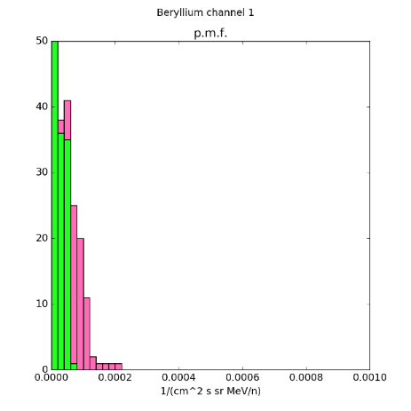
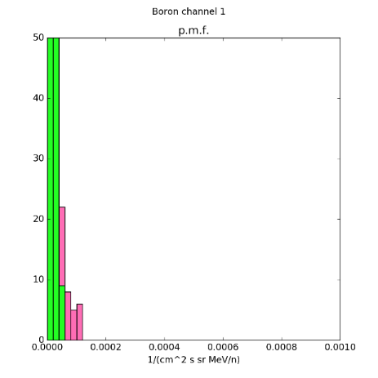
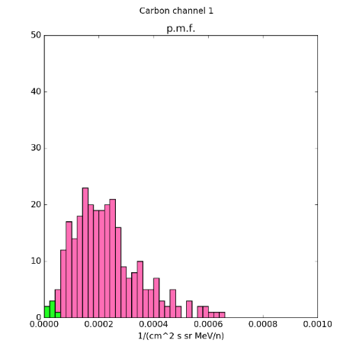
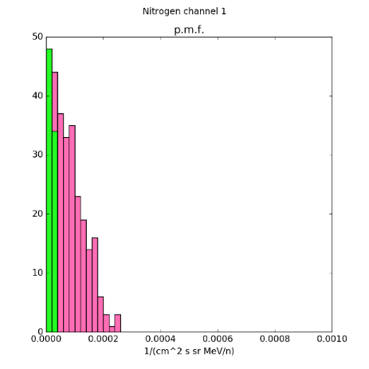
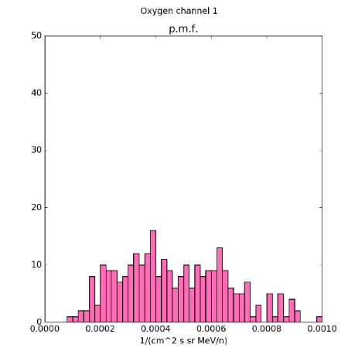
ADR 703: Replace L1b Be and B Quantities with Fill Values
Be
B
C
N
O
Histograms of L1b histogram fluxes (Z = 4-8; Be, B, C, N, O) in energy channel 1, 10-11 Sept. 2017
  Green bars correspond to ‘upper limits’ (fluxes equal to lower statistical error bound)
  ‘Significant’ fluxes in pink
L1b data indicate significant Be and B fluxes during SEP event
  Not physically realistic – solar-origin LiBeB never observed (destroyed in solar interior)
  These counts are due to slow He nuclei – transition between Priority 1 and Priority 2 rates is set in the middle of the boron (B) histogram range
Recommendation (for Full Validation):
  Replace contents of ‘BeCu’ L1b variables with dimension ‘element’ (size = 26) at indices 0 and 1 (in 0..25) with fill values: BeCu5MinuteDifferentialFluxes, BeCu5MinuteDifferentialEnergyBounds, BeCu5MinuteDifferentialFluxStatErrorsBounds, BeCu5MinuteDifferentialFluxInstErrors, BeCu5MinuteDifferentialFluxDQFs
  Definition of these variables should have started at C, not Be
  Does not affect ops – Be and B not used for L2 product – not part of MRD requirement
  GCR LiBeB can be found if you wait long enough by reprocessing PHA packets

Slide 58
L0 Duplicate Packets
Double packets present in some EHIS L0 files
Problem widespread in early days, but still present in 2018 data
First noticed in EHIS PEC/PHA packets, present also in EHIS HCR and ELF packets
L0 5-min netCDF files are double in size, suggesting issue present in all instruments
Interferes with EHIS L0 data processing, and variable aggregation into L0 daily files
Simple fix used, skip packet with identical time stamp to previous packet
Remaining issue: check if the two packets are identical or not

Slide 59
Path to Full Validation - PLPTs
Title | Activity | Data Needed | Success Criteria
A.3.3 SEP Channel Cross-Comparison [PLPT-SEI-004] | On-orbit cross-calibration of EHIS with SGPS above 10 MeV, and with GOES 13-15 EPEAD. | Two Solar Energetic Particle (SEP) events. | [Full] Differences quantified on data taken through validation phase.
A.3.5 Backgrounds Trending [PLPT-SEI-006] | Evaluate EHIS backgrounds in terms of expected galactic cosmic ray (GCR) fluxes. The analysis of EHIS heavy ion data will require long-term averages of L0 histograms. The analysis of EHIS proton and alpha particle rates as well as rates from the other two instruments could convert L1b fluxes back to counts, but it would be less ambiguous simply to average the L0 count rates. | Four months of continuous data. | [Full] Perform analysis during validation phase.
EHIS PLPTs from RIMP v 1.0 (02 June 2016) – continuation of Provisional
Data requirements for Full validation have been exceeded in Provisional analysis
  A.3.3: 2 SEP events required vs. 4 SEP events analyzed
  A.3.5: 4 months of data required vs. 5.5 months analyzed
Full validation will emphasize:
  More sophisticated calibration analysis, including use of full, temperature-dependent bandpass functions, and use of pulse-height analysis (PHA)
  Resolution of hardware issues revealed by Provisional PLPT analysis
A.3.3: unlikely to get more SEP events before solar minimum
A.3.5: tracking variation in heavy ion GCR fluxes through solar minimum is the most meaningful approach to Full validation – do this with GOES-T and -U
Compare with GOES-17 – set logic differently (keep D2A in logic) to compare performance

Slide 60
EHIS Performance Baseline Status
Assessment at Provisional
MRD ID | Description | Related PLPTs | Status
1978 | EHIS Orthogonality/Coverage | -04, -06 | PLPTs underway
1982 | EHIS Measurement Range | -04, -06 | PLPTs underway
1983 | EHIS Measurement Accuracy | -04, -06 | PLPTs underway
MRD1978: Orthogonality/Coverage
  Requirement: 1 direction
  Currently being met for all species
MRD1982: Measurement Range:
  Requirement: 10 -200 MeV/n 5 mass groups: H, He, (C,N,O), Ne-S, & Fe
  Comparisons with well-understood legacy data sets indicate that energy range and species range are being covered
MRD1983: Measurement Accuracy
  Requirements: @min flux <45%, @10X min flux < 25%
  Absolute accuracy cannot be verified on-orbit
  Comparisons with well-understood legacy data sets indicate discrepancies
    HE1P are 5-7x low when >80 MeV proton fluxes are elevated
    C-Fe SEP fluxes are 2-3x low with respect to SIS
    H fluxes are low with respect to SGPS as well as GOES 13 and 15
PASSED
PASSED
PARTIAL PASS

Slide 61
Path to Full Validation – Risks
Risk Name | Description | Impact | Mitigation and Schedule
HE1 channel | IF hardware issue causing suppressed HE1 fluxes is not understood | THEN HE1 fluxes will be low whenever >100 MeV p+ fluxes are above backgrounds | WR 6113 (Flight) ADR 727 (no known algorithmic fix)
Low C-Fe Fluxes | IF discrepancy between EHIS and SIS heavy ion fluxes is not understood | THEN EHIS data will not be trusted by the community | Confirm with PHA analysis Discuss with SIS scientists
Low H fluxes | IF discrepancy between EHIS and SGPS hydrogen fluxes is not understood | THEN EHIS data will not be trusted by the community | Off-line spectral analysis using temperature-dependent bandpasses
GCRs from histograms | IF GCRs cannot be retrieved from histograms | THEN GCR retrievals will have to rely on PHA analysis, which is not part of L1b baseline | UNH to reevaluate alpha-kappa coefficients using SEP observations NCEI to perform PHA using delivered tool
False Be and B fluxes | IF Be and B fluxes are not replaced with fill values | THEN someone will use them to draw false conclusions | ADR 703 WR 6146 (PRO Type 1)

Slide 62
Summary & Recommendations
GOES-16 ABI L1b Products Provisional PS-PVR

Slide 63
Summary
ADR 582: key algorithm fix for Provisional validation was successfully accomplished under DO.06.03
Heavy ion fluxes (C-Fe): event fluence low compared to ACE SIS, but it is not obvious which is more accurate
HE1 & HE2 channels: agreement with other satellites depends on proton flux levels – hardware logic under investigation
Hydrogen: event fluence low due to temperature sensitivity
Planned Provisional PLPTs completed
  No reliable results from heavy ion part of SEI-006 – will need to be redone using pulse-height analysis
  All are preliminary versions of PLPTs required for Full Maturity
Risks to reaching Full Maturity have been identified

Slide 64
Recommendation
NCEI believes that the GOES-16 EHIS L1b product has reached Provisional Maturity as defined by the GOES-R Program
  Currently, its strongest feature is its ability to measure heavy ion fluxes during SEP events, which is its key (and unique) space weather mission
Caveats:
    Helium HE1 and HE2 channels are low during large events – under investigation
    Temperature sensitivity of proton fluxes results in low event fluences (compared to SGPS, which is the primary solar proton instrument on GOES-R)
    GCRs are not derivable from Prime histogram data until on-orbit tables are modified – use PHA instead

Slide 65
Backup slides
GOES-16 EHIS L1b Product Provisional PS-PVR

Slide 66
Topics in Backup Slides
Scintillator counts and Prime trigger condition (ADR 582)
Conversion of SGPS alpha rates to fluxes
L1b Priority 2 & 3 rates deep dive
L1b Priority 1 rates deep dive
Heavy ion histograms and maximum likelihood fits

Slide 67
1. Scintillator counts and prime trigger condition (ADR 582)

Slide 68
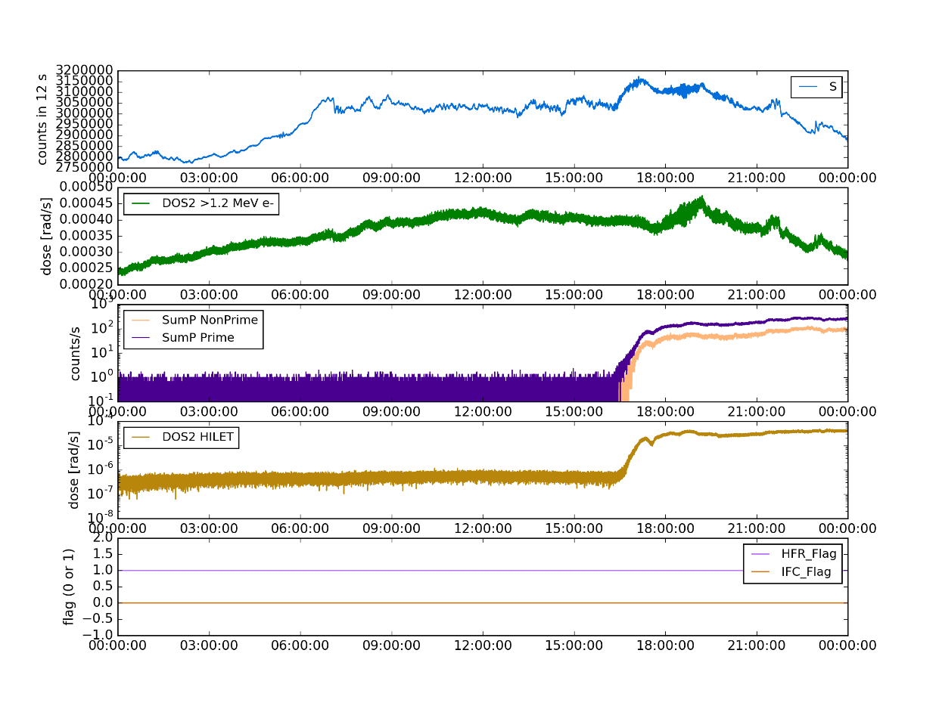
Scintillator Counts are a Combination of Electrons and Protons
10 September 2017
Scintillator S counts
MPS-HI Dosimeter 2 LOLET (>1.2 MeV e-)
EHIS sum of priority 1-3 rates
MPS-HI Dosimeter 2 HILET (>22 MeV p+)
HFR_Flag and IFC_Flag

Slide 69
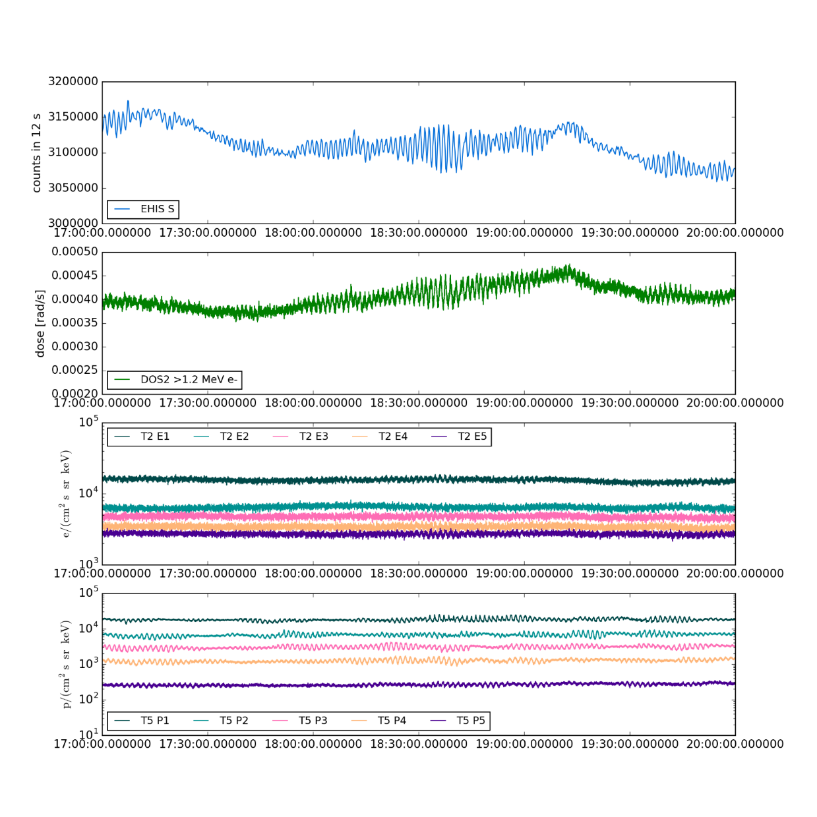
Oscillations in scintillator counts are consistent with electron flux response to ULF waves
10 Sept 2017, 17-20 UT
10 September 2017
Scintillator S counts
Dosimeter 2 LOLET (>1.2 MeV electrons)
MPS-HI Telescope-2 electrons, first 5 energies (~50-460 keV) [approx. field-aligned]
MPS-HI Telescope-5 protons, first 5 energies (~80-500 keV) [approx. field aligned]

Slide 70
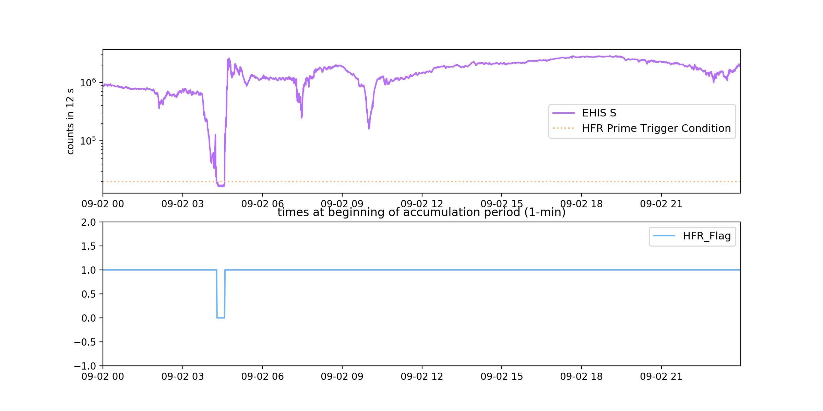
ADR 582: Prime Trigger Condition
September 2, 2017 (from L0)
electron drop-out

Slide 71
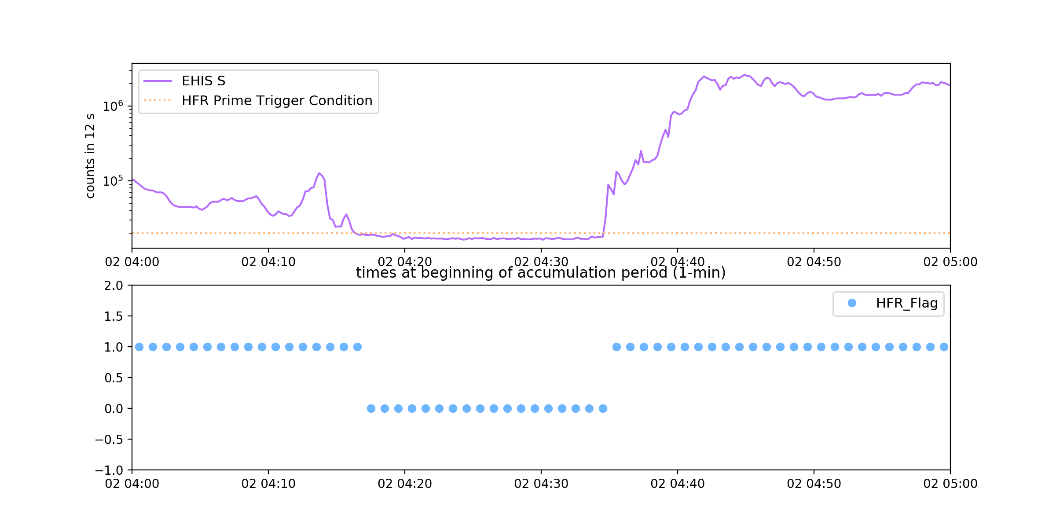
ADR 582: Prime Trigger Condition
September 2, 2017 (from L0) [detail]

Slide 72
2. Conversion of SGPS alpha rates to fluxes

Slide 73
Conversion of SGPS alpha rates to fluxes
Alpha particles = ⁴He²⁺
Need G and dE for each channel
Calculate dE from nominal channel lower and upper energies
Estimate G from proton calibrations:
  T1: 0.12 cm² sr = 70% of ‘Sullivan’ results based on UC Davis calibrations
  T2: 0.35 cm² sr = 70% of ‘Sullivan’ results
  T3: 1.4 cm² sr = 70% of ‘Sullivan’ results
  ‘Sullivan’ theoretical results delivered by ATC as part of CDRL79 Support Data
These G*dE should be good to well within an order of magnitude
  Have more confidence in T1 results
  ok for initial comparisons with EHIS and GOES-13
Channel | Lower Energy (MeV) | Upper Energy (MeV)
A1 | 4.0 | 7.6
A2A | 7.6 | 9.1
A2B | 9.1 | 13.6
A3 | 13.6 | 27.5
A4 | 27.5 | 50.0
A5 | 50.0 | 102.5
A6 | 100 | 160
A7 | 160 | 300
A8 | 300 | 500
A9F | 323 | 380
A10F | 395 | 500
A11F | 500 | 1000

Slide 74
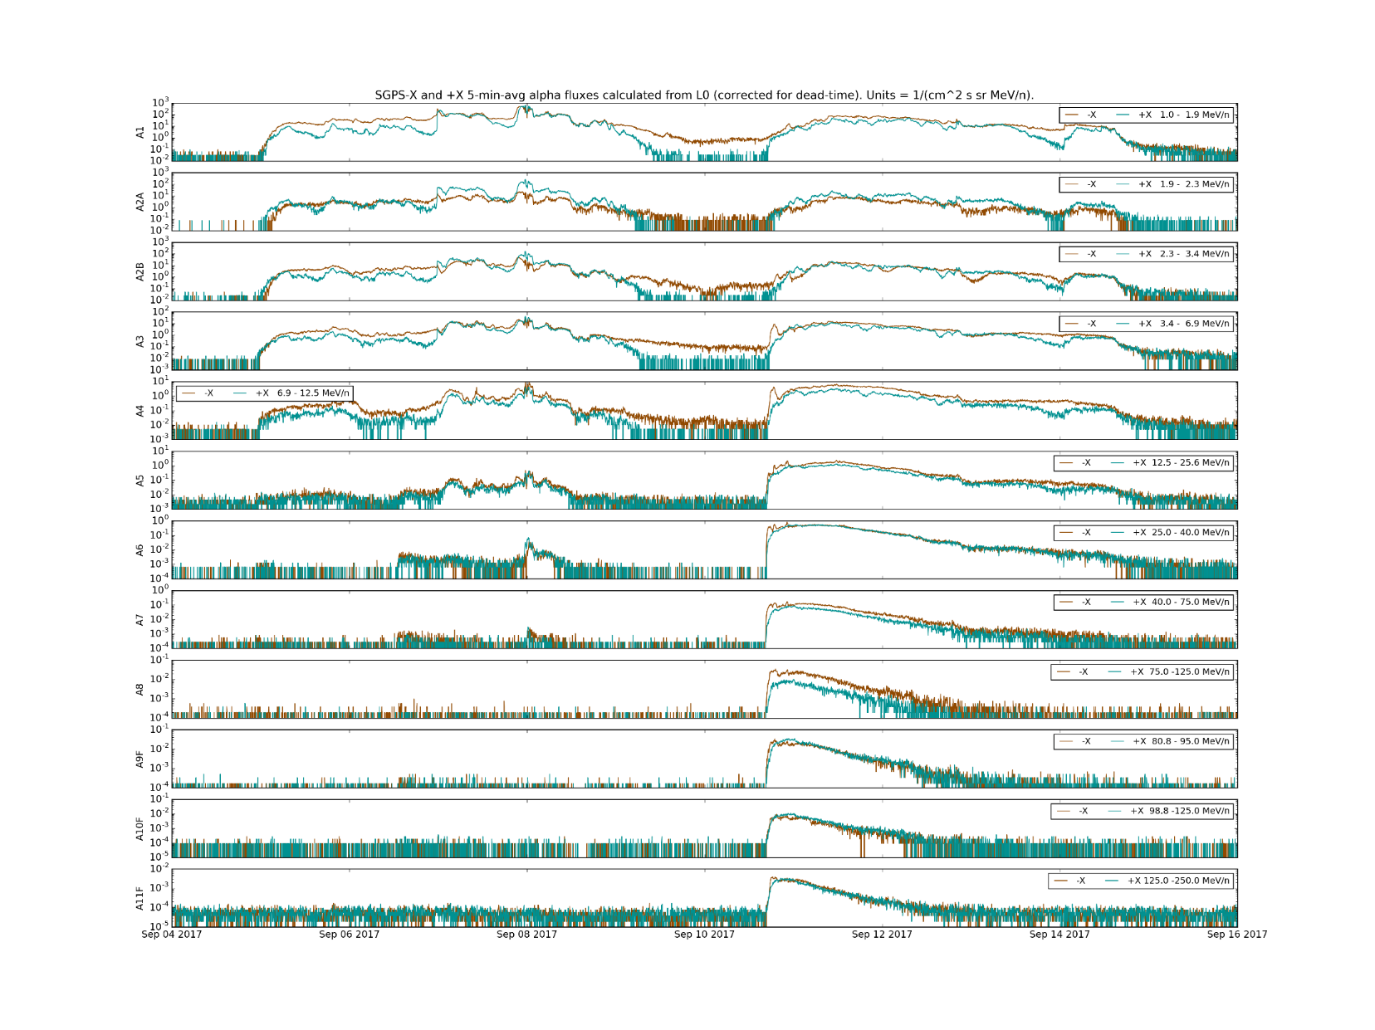
SGPS helium fluxes, 04-15 September 2017
SGPS Helium Fluxes, 04-15 September 2017

Slide 75
3. L1b Priority 2 & 3 Rates Deep Dive
(H and He)

Slide 76
L1b Rates Processing Deep Dive
Is there a problem with the L1b rates processing? (apart from the reading of the HFR_flag):
  Is there a problem with the implementation of the rate normalization? [No]
  Can incorrectly-read HFR_flag explain the cross-comparison discrepancy entirely? [No]
  Can NCEI reproduce the current L1b processing of the H and He rates? [Yes]
Performed on 10 September 2017 data

Slide 77
Rate Normalization / Upward Flux Correction
At January 2018 cal TIM, UNH suggested that the rate normalization as implemented in L1b should be checked
He and H rates (channels 4 and 5 only) are normalized as shown at right, using the Total P3 and Invalid P3 Event counts for H and Total P2 and Invalid P2 Event counts for He
Only Prime or Non-Prime PEC counts are available (as indicated by HFR_Flag)

Slide 78
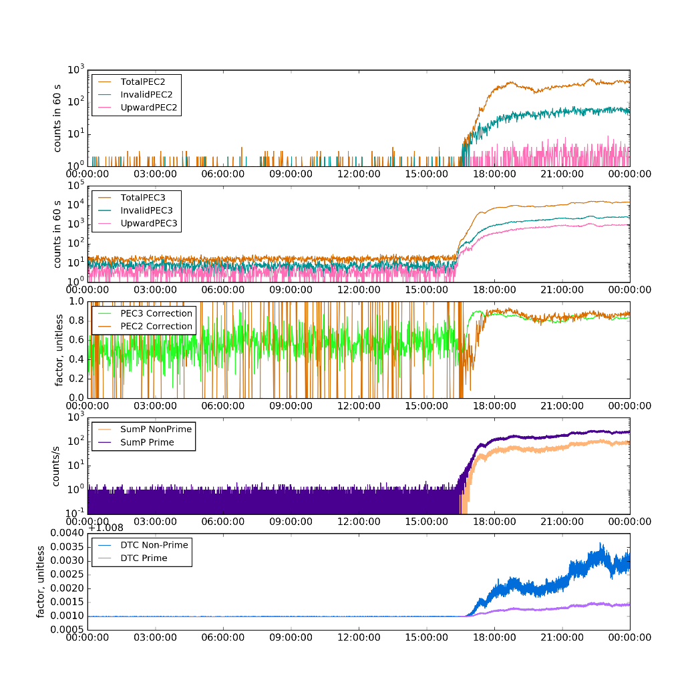
L1b Correction Magnitudes
10 September 2017
Top two panels show the Priority 2 [He] and Priority 3 [H] PEC rates
Middle panel shows the P2 and P3 corrections (multiplicative):
  ~80-90% during SEP event
  Difference between P2 and P3 is small except during first hour of event
  Note: we only have one of (Prime, NonPrime) depending on HFR_Flag
Bottom two panels illustrate the dead-time correction
  Based on SumP = (P1+P2+P3)/(3 seconds)
  Minimum magnitude (LUT) is 1.00898
  Maximum (Non-Prime) ~1.012
  Very small corrections based on SumP
1.00898
Large flux discrepancies are not due to differences between Prime and Non-Prime GPA corrections

Slide 79
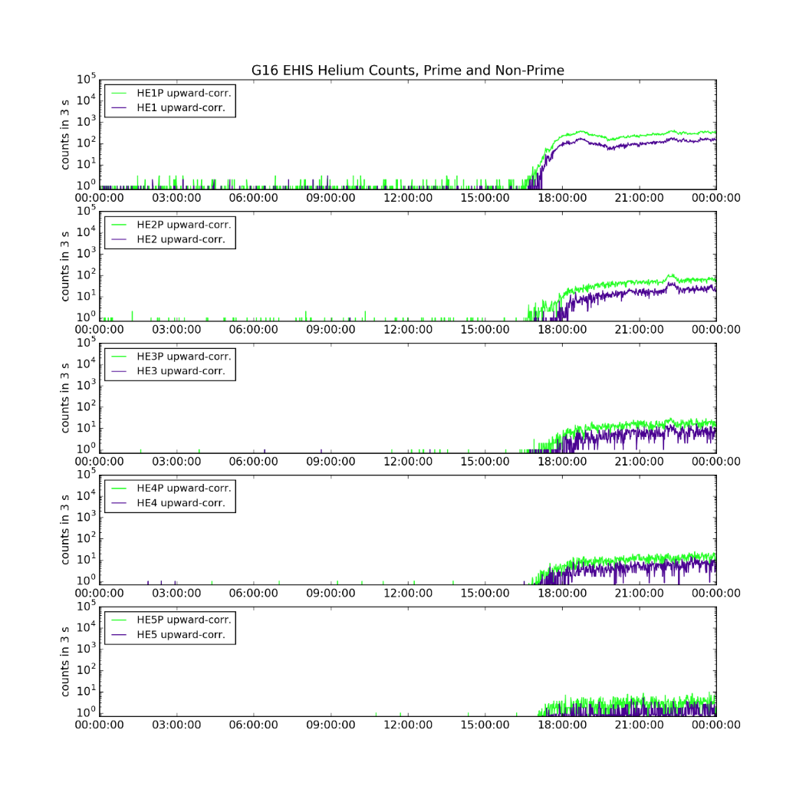
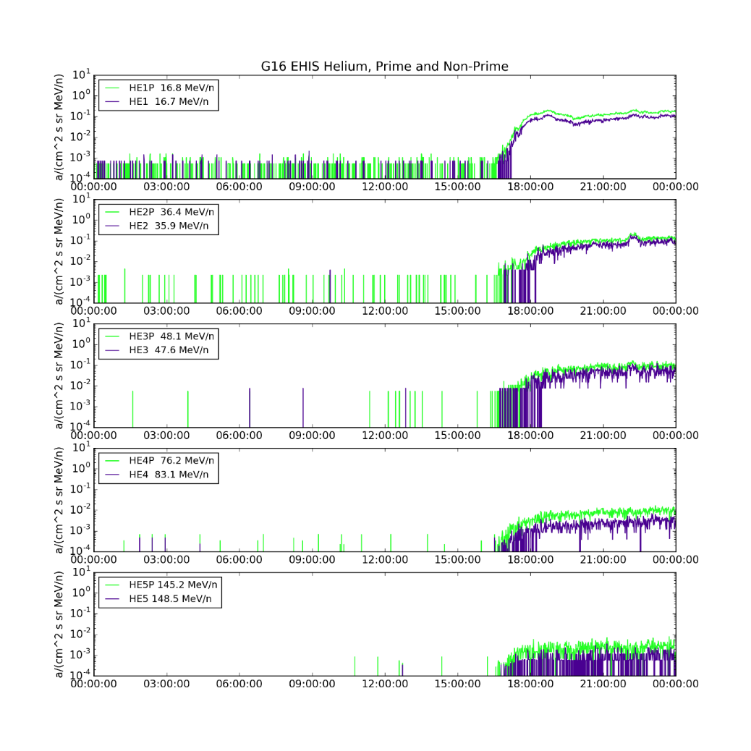
Helium Prime (Green) and Non-Prime (Purple) corrected counts (left) and fluxes (right) from 2017-09-10
Prime rates and fluxes generally greater than Non-Prime
Geometrical factors and energies make up some of the difference between corrected Prime and Non-Prime rates

Slide 80
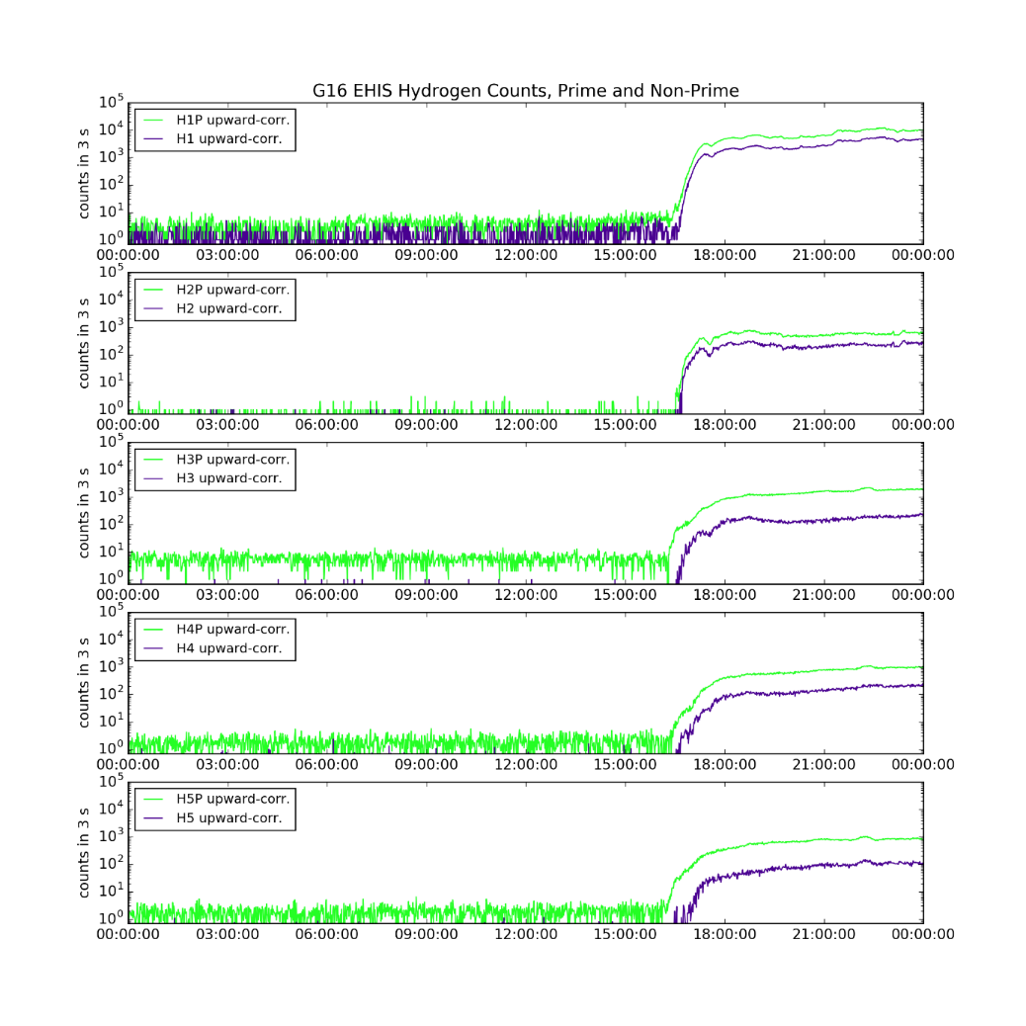
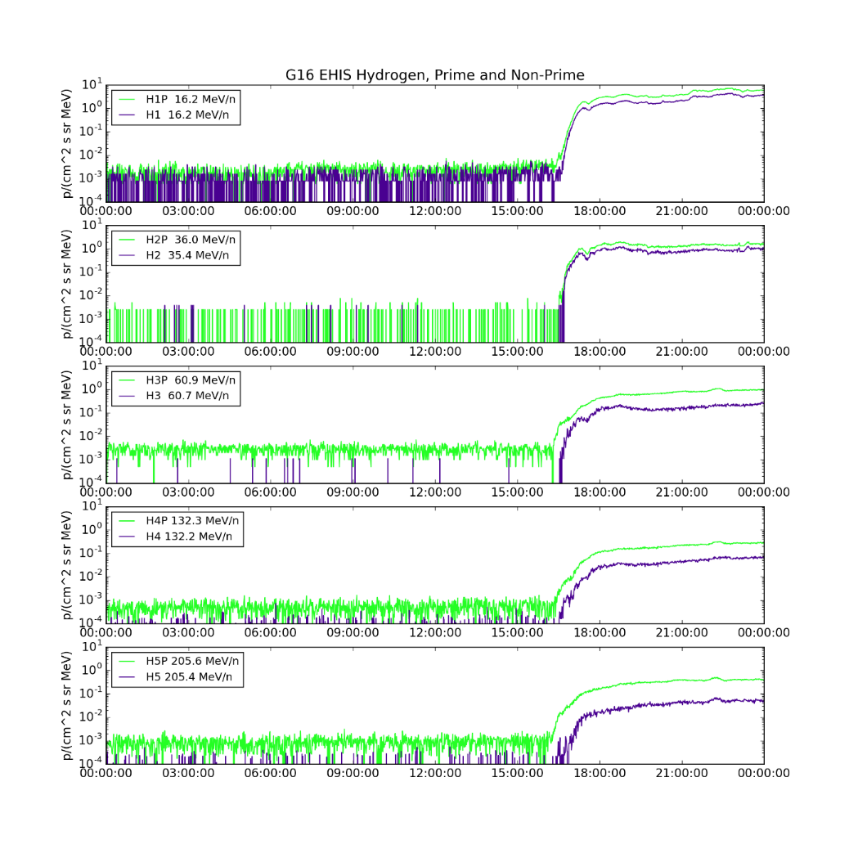
Hydrogen Prime (Green) and Non-Prime (Purple) corrected counts (left) and fluxes (right) from 2017-09-10
Prime rates and fluxes generally greater than Non-Prime
Geometrical factors and energies make up some of the difference between corrected Prime and Non-Prime rates

Slide 81
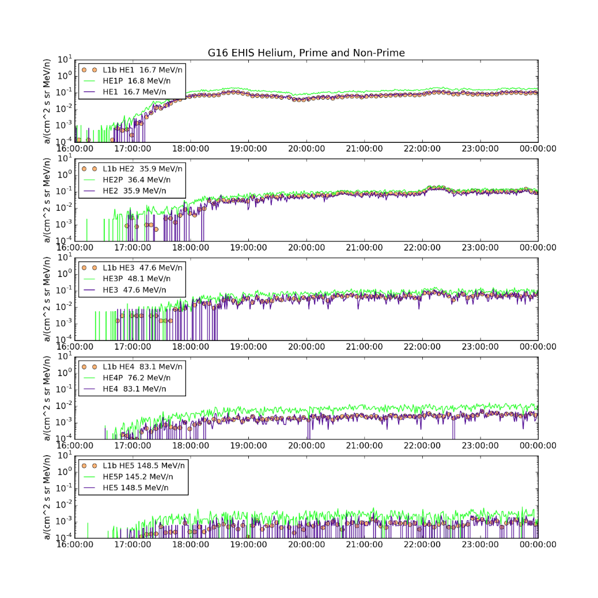
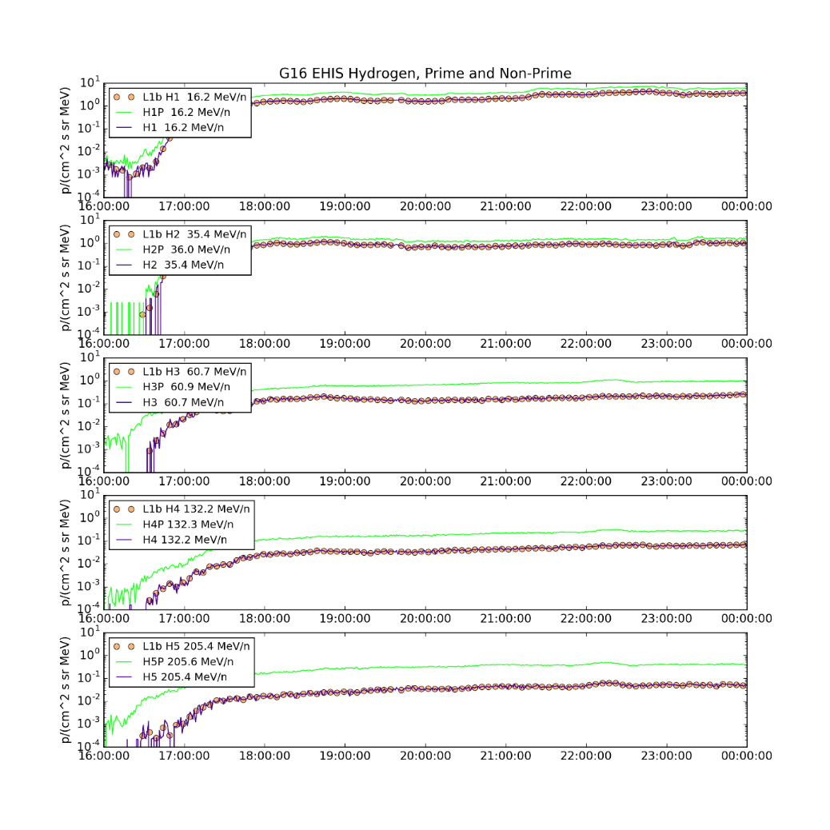
Comparison of Ground-calculated L1b fluxes (5-min) and NCEI-calculated fluxes (1-min) from 2017-09-10
L1b fluxes agree well with Non-Prime fluxes calculated by NCEI

Slide 82
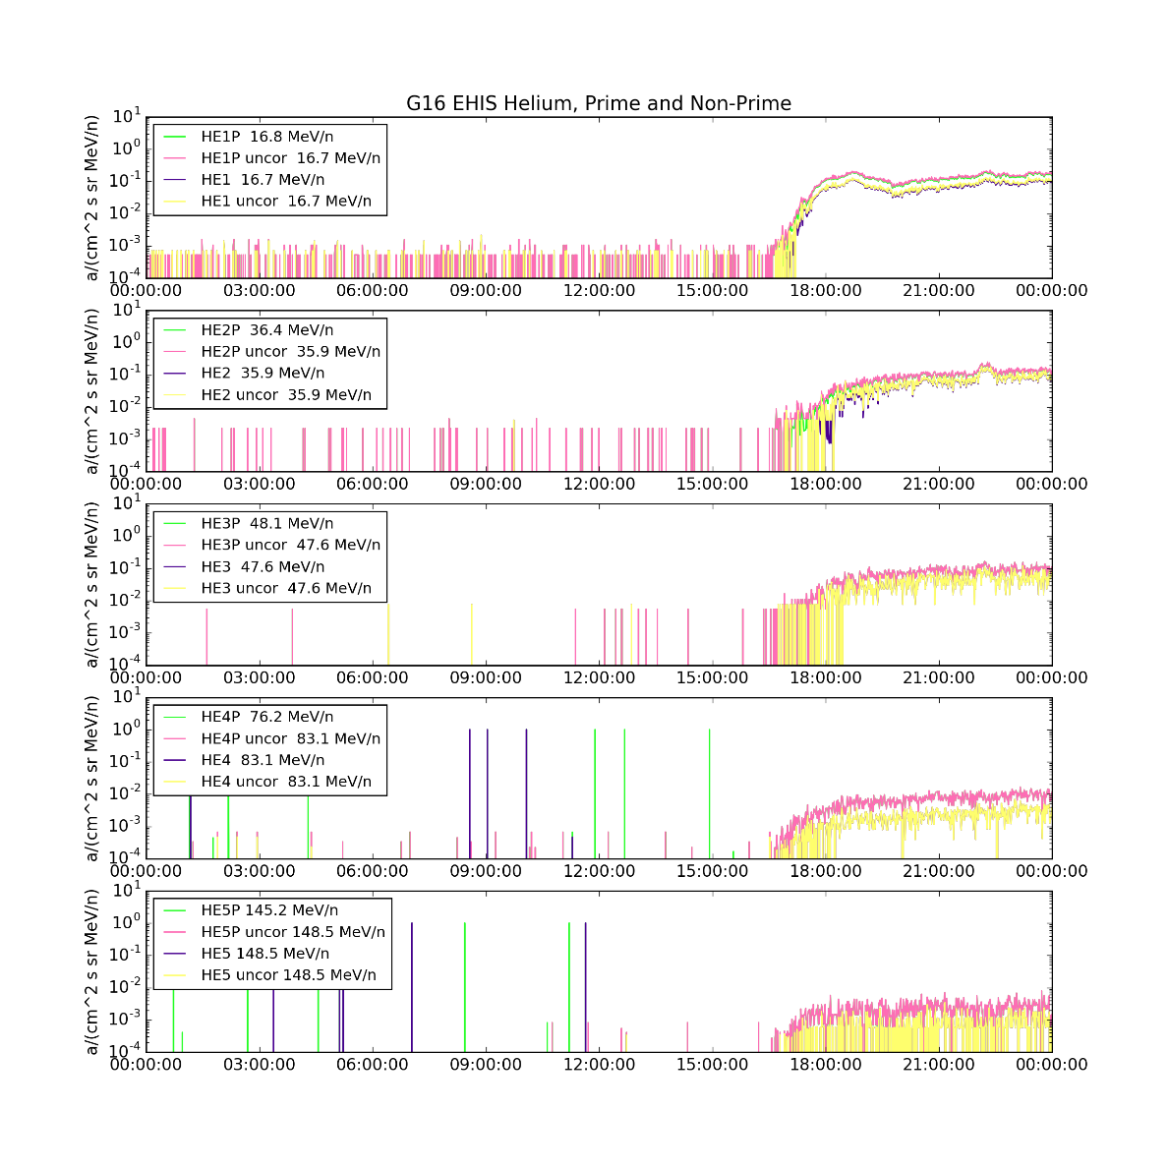
Contamination Correction Check
Beyond the first 1-2 hours of the SEP event on 10 Sept. 2017, the contamination correction is small

Slide 83
Conclusions from L1b Rates Deep Dive
Comparison indicates that Harris L1b code was calculating EHIS He and H fluxes correctly, assuming they were Non-Prime (which they weren’t)
  Hence need for ADR 582
Differences between Prime and Non-Prime fluxes are mostly due to differences in the counts
  Dead-time corrections are very small
  Multiplicative upwards corrections (Prime) for channels 4 and 5 are ~0.8-0.9 during SEP event for both Priority 2 and Priority 3
  Differences between Prime and Non-Prime fluxes are much greater for H than for He, especially at higher energies
    Incorrect HFR_flag can’t explain large helium discrepancy

Slide 84
4. L1b Priority 1 Rates Deep Dive
(heavy ions)

Slide 85
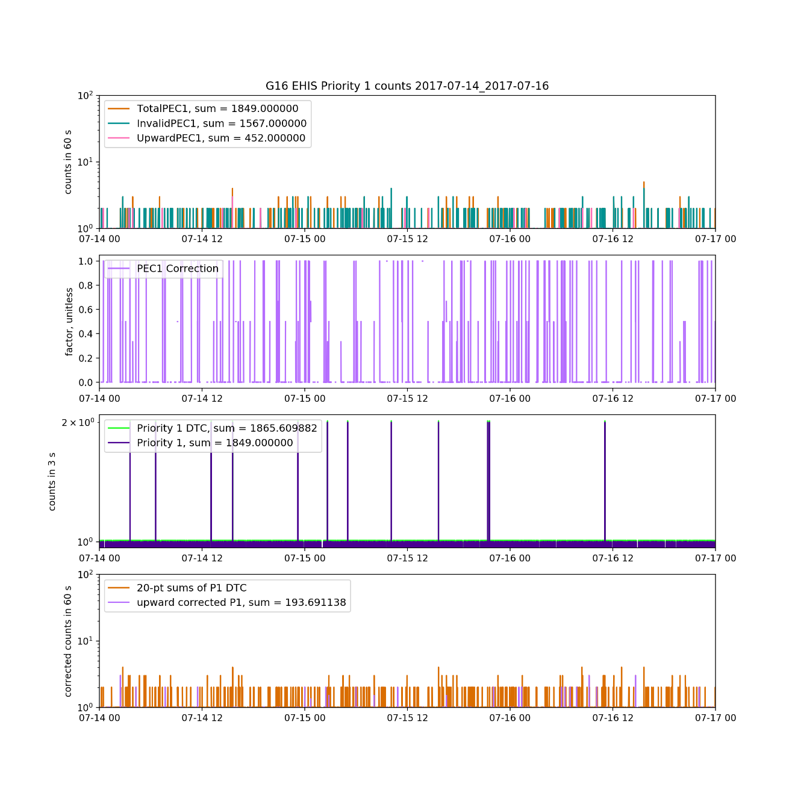
Priority 1 Counts: Upward Correction, 14-16 July 2017

Slide 86
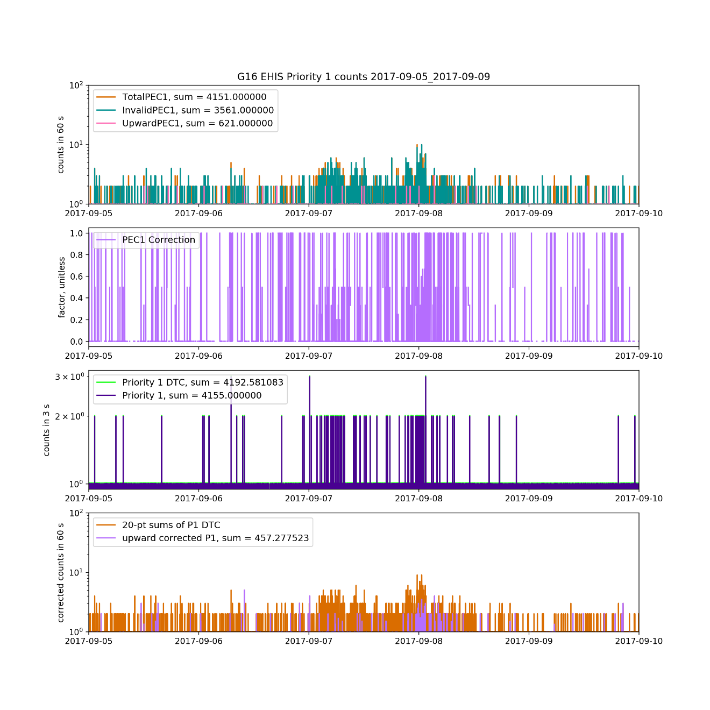
Priority 1 Counts: Upward Correction, 5-9 Sept. 2017

Slide 87
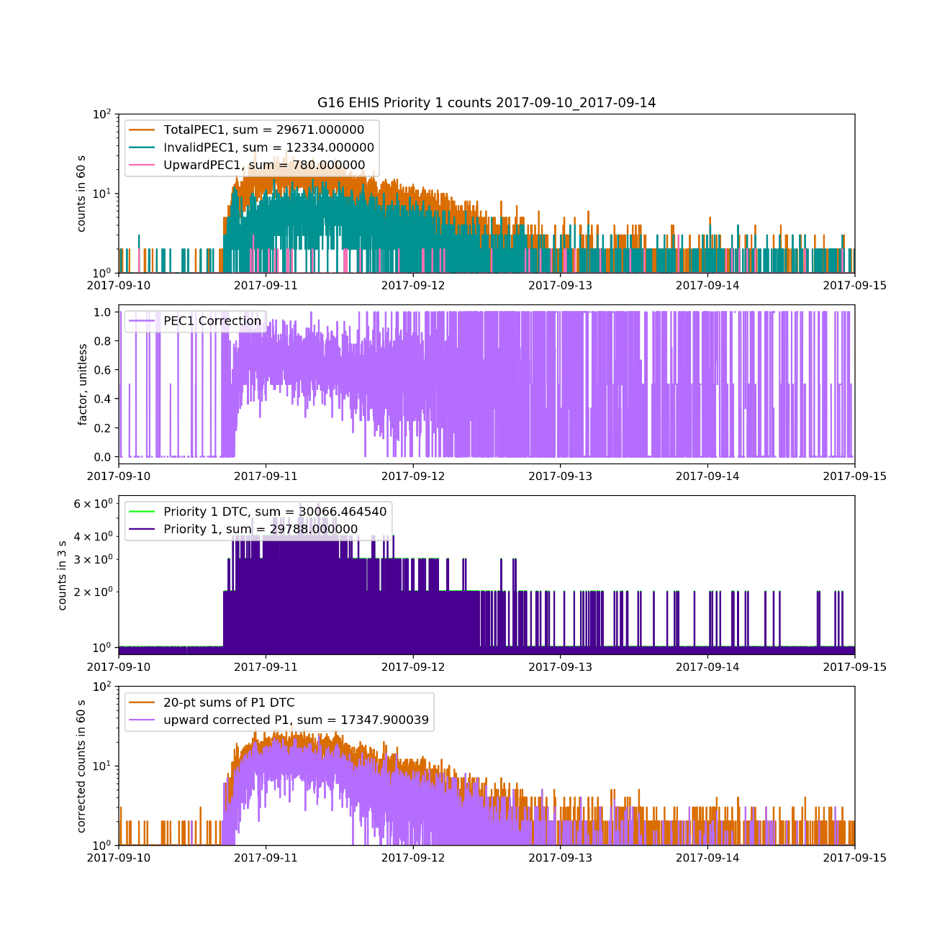
Priority 1 Counts: Upward Correction, 10-14 Sept. 2017

Slide 88
5. Heavy ion histograms and maximum likelihood fits

Slide 89
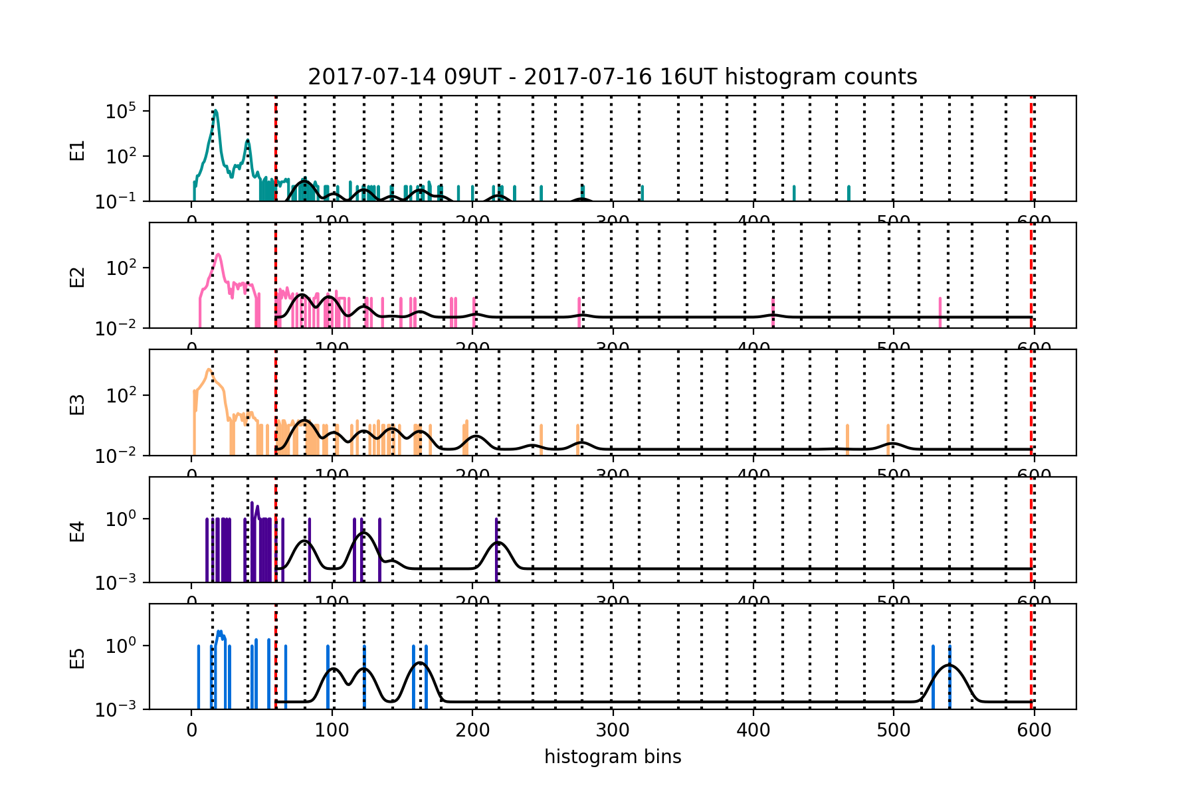
14-16 July 2017

Slide 90
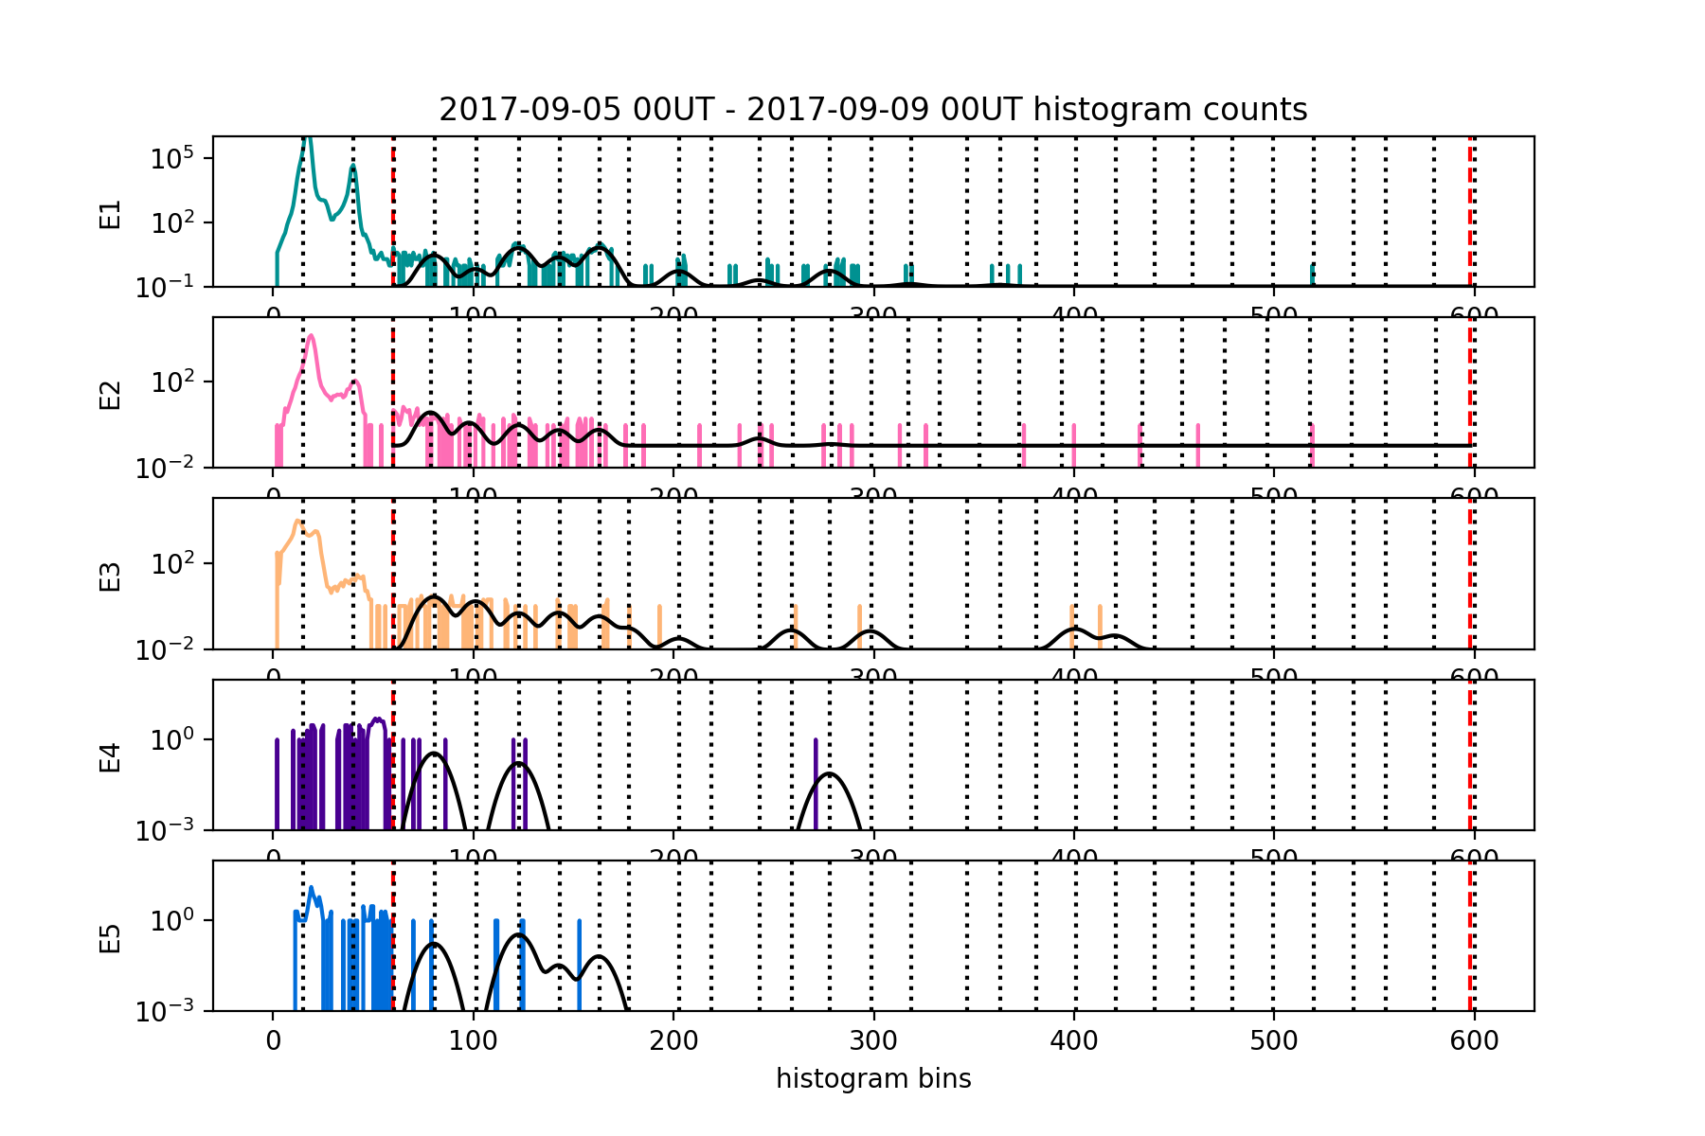
5-8 September 2017

Slide 91
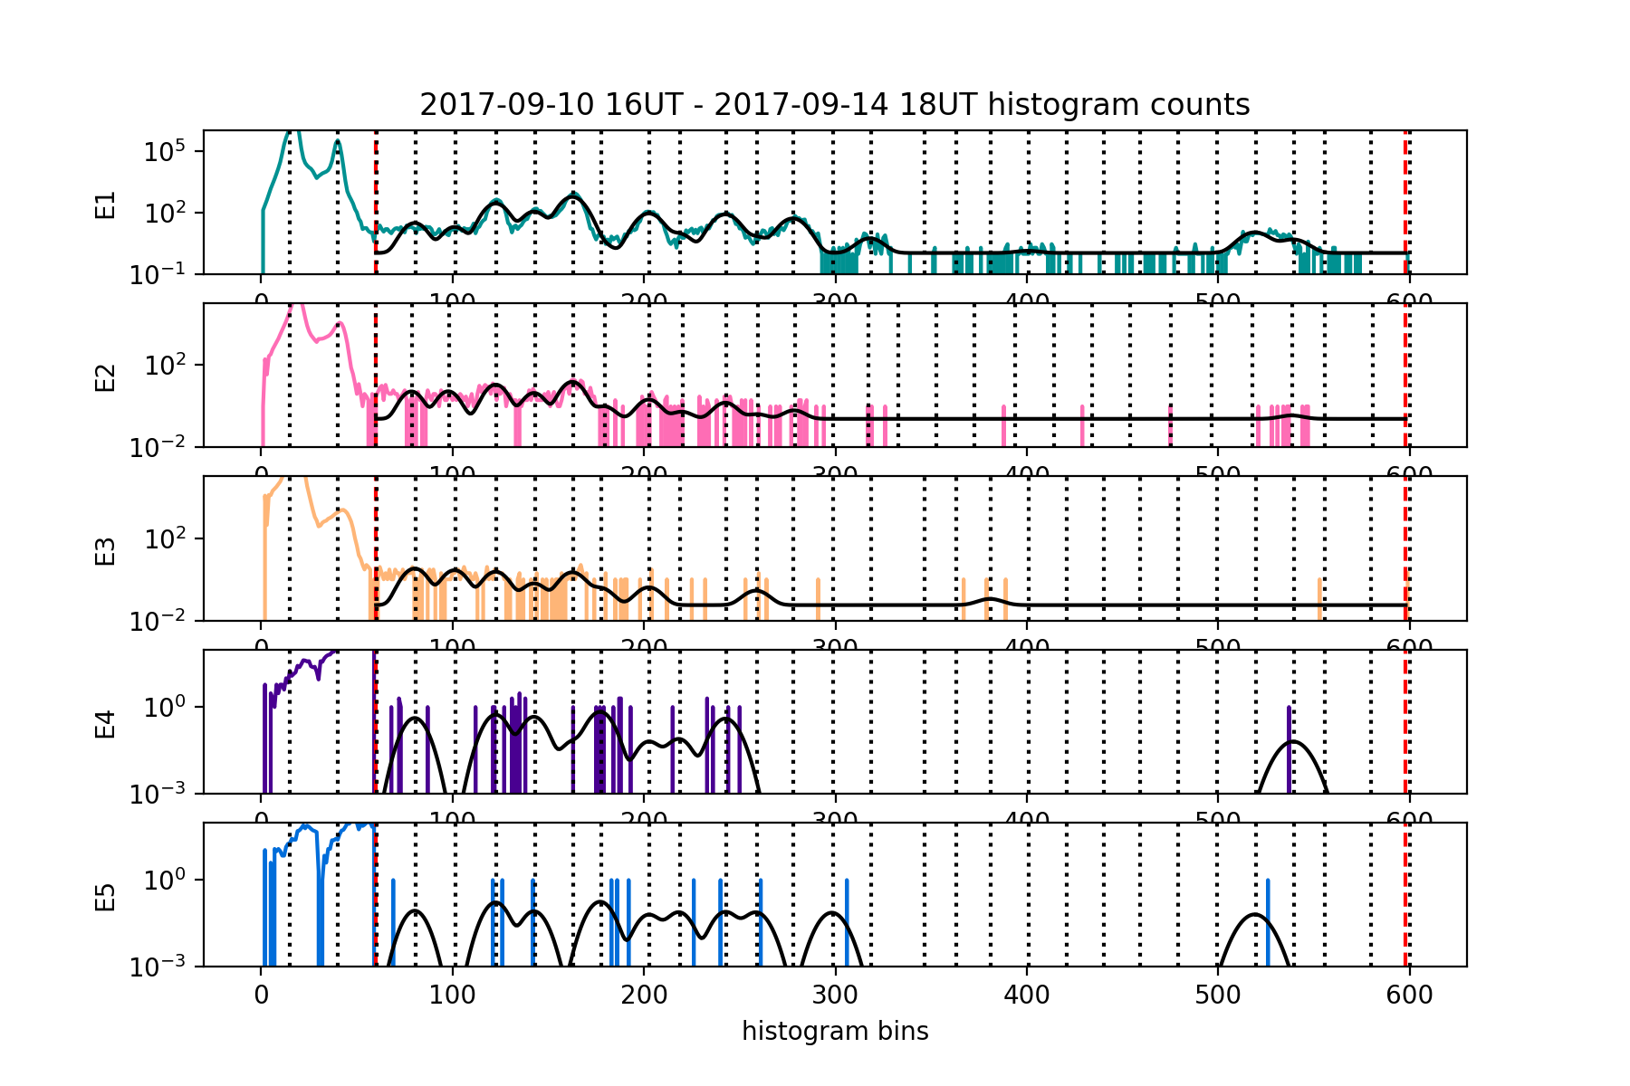
10-14 September 2017

