Slide 1
Peer Stakeholder-Product Validation Review (PS-PVR)
For the Provisional Maturity of GOES-16 SEISS
MPS-HI L1b Product
December 8, 2017
GOES-R Calibration Working Group (CWG)
Presenter: Juan Rodriguez
Contributors: Athanasios Boudouridis, Brian Kress, William Rowland, Meg Tilton
NOAA NCEI / CIRES
We thank Assurance Technology Corporation for their assistance in our cal/val efforts.

Slide 2
Outline
Review of Beta Maturity
Product Quality Evaluation
  General approach
  Major Issues Remaining
Provisional Maturity Assessment
Path to Full Validation Maturity
  Issues and status
  PLPT
  Risks
Summary and Recommendations
Backup – Details of Individual PLPT

Slide 3
Magnetospheric Particle Sensor –
High Energy (MPS-HI)
MRD 3.3.6.1.3 Magnetospheric Electrons and Protons: Medium and High Energy
Primary purpose: measure radiation belt particle fluxes in the energy range responsible for internal charging
5 electron telescopes and 5 proton telescopes
  30 deg full-width conical FOVs, centers separated by 35 deg
Each electron telescope:
  10 differential channels, 50 keV – 4 MeV
  2 integral channels, >2 MeV and >4 MeV (latter not part of L1b)
Each proton telescope:
  11 differential channels
  7 channels, 80 keV – 1 MeV (trapped)
  4 channels, 1-12 MeV (solar protons)
Two dosimeters (250 and 100 mil Al)
  Distinguish particles depositing < 1 MeV and >1 MeV
Credit: SEISS-TR-MH074-2 Rev C, Figure 3-1

Slide 4
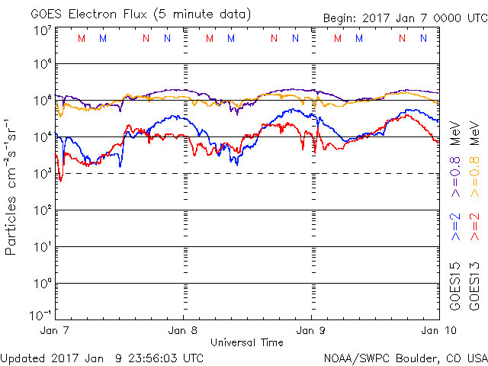
ALERT: Electron 2 MeV Integral Flux exceeded 1000pfu
SWPC alert at 1000 electrons/(cm² sr s) [pfu] was developed in consultation with the satellite industry
Based on GOES-East observations
  Fluxes systematically lower than at GOES-West by factor of 2.5 [Meredith et al., 2015]
First alert issued 18 May 1995
In this otherwise quiet solar cycle, MeV electron fluxes have been very elevated starting in 2015
  Primarily owing to the action of stream interaction regions (interface between solar wind of coronal hole and quiet sun origins) on the magnetosphere
Space Weather Message Code: ALTEF3
Serial Number: 2516
Issue Time: 2017 Jan 09 0501 UTC
CONTINUED ALERT: Electron 2MeV Integral Flux exceeded 1000pfu
Continuation of Serial Number: 2515
Begin Time: 2017 Jan 05 1520 UTC
Yesterday Maximum 2MeV Flux: 25537 pfu
www.swpc.noaa.gov/noaa-scales-explanation
Potential Impacts: Satellite systems may experience significant charging resulting in increased risk to satellite systems.

Slide 5
Review of Beta Maturity
GOES-16 MPS-HI L1b Products Provisional PS-PVR

Slide 6
Path to Provisional
Risks and associated ADRs needing resolution for Provisional
PLPT overview
Additional risks identified after Beta PS-PVR

Slide 7
Path to Provisional: Risks
Risk Name | Description | Impact | ADR | Mitigation Approach and Status
MPS-HI Reanalysis of FM1 Calibrations | IF FM1 MPS-HI ground-cal reanalysis not completed, THEN MPS-HI L1b and cal/val will be inaccurate | High | 407 | 1. ATC completed, documented and provided reanalysis of FM1 ground cal 23 Mar 17, supported multiple discussions with NCEI
MPS-HI L1b Electron Overcorrection | IF MPS-HI GS look-up table (LUT) not updated with accurate ground cal & diagonalized inverse matrix, THEN MPS-HI L1b will be overcorrected / inaccurate Note: affects differential channels E1S-E10 | High | 407 | 1. NCEI updated MPS-HI LUT using bowtie analysis based on reanalysis results, provided 28 Sep 17 2. Installed in DE early October, results confirmed by NCEI 3. Installed in OE early November, results re-confirmed by NCEI 14 Nov 17
MPS-HI Electron Channel Backgrounds | IF backgrounds in MPS-HI electron channels are not reduced, THEN MPS-HI L1b fluxes will be inaccurate (unusable by SWPC) Note: affects differential channels E9-E10 and integral channels E10a-E11 | High | 407, 427 | 1. NCEI evaluated whether L1b correction working as designed. Completed 20 Apr 17, revealed factor of 2 error in SGPS P11 (ADR427). 2. Background correction based on P11 completed 04 Aug 2017, incorporated into LUT (ADR407) 3. ADR427 fix applied in DE by 01 Nov 17, confirmed by NCEI 07 Nov 17 4. ADR427 fix undone unintentionally mid-November, awaiting PR.06.03 post-drift (Dec. 14)
Updates since Beta PS-PVR are in green.

Slide 8
Path to Provisional - PLPT
Title | Activity | Data Needed | Success Criteria
A.1.1 MPS-Hi Telescope Cross-Comparison [PLPT-SEI-002] | Inspect pitch-angle distributions (PADs) for geophysical realism. | One week of continuous data. (MAG and MPS-HI) | [Beta] PADs match science expectations as a function of local time and activity. [not performed by beta PS-PVR due to lack of adequate MAG data]
A.1.3, A.2.6 Backgrounds Trending [PLPT-SEI-006] | Model GCR spectra (e.g., NASA JSC Badhwar-O’Neill 2014) put through a forward model derived from MPS-HI instrument response functions to estimate MPS-HI channel fluxes for comparison with observations. | Two months of continuous data. (MPS-HI) | [Provisional] Natural backgrounds preliminarily correlated with solar protons and GCRs.
A.2.2 MPS-Hi Telescope Cross-Comparison [PLPT-SEI-002] | Determine the relative sensitivity/response among MPS-HI telescopes. | One month of continuous data. (MAG and MPS-HI) | [Provisional] Telescopes agree to within 25%.
A.2.4 SEP Channel Cross-Comparison [PLPT-SEI-004] | On-orbit cross-calibration of MPS-HI with SGPS 1-12 MeV protons, and with GOES 13-15 EPEAD. | One Solar Energetic Particle (SEP) event. | [Provisional] Differences quantified on data taken through Provisional phase.
A.2.5 Cross Satellite Comparison of Trapped Particles [PLPT-SEI-005] | Identify time periods when the two satellites should be measuring the same population, and compare results. To reach provisional maturity, comparisons involve plots of fluxes vs. energy in order to look for gross inconsistencies between sensors. | One month of continuous data. (MAG, MPS-HI) | [Provisional] Differences quantified on data taken through validation phase.
MPS-HI PLPTs from RIMP v 1.0 (02 June 2016)

Slide 9
MPS-HI Etel2 Risk
(identified after Beta PS-PVR)
Summary of observations:
  Noise:
    Etel2 threshold D3B-1 exhibited noise spikes on first day
    D3B-1 noise increased by 30 Jan, at which point Etel2 E11 became noisy
    Etel2 E11 noise subsided by 06 Feb
    Note: D3B-1 is not part of E11 logic (part of E1S-E8 logic), so serves as proxy here
  Unnatural oscillatory signal in E1 and E10a
  Time-varying backgrounds (unlike other telescopes)
Etel2 recovered by early April; currently a long-term watch item
  Etel2 data cannot be reprocessed prior to April using existing algorithms

Slide 10
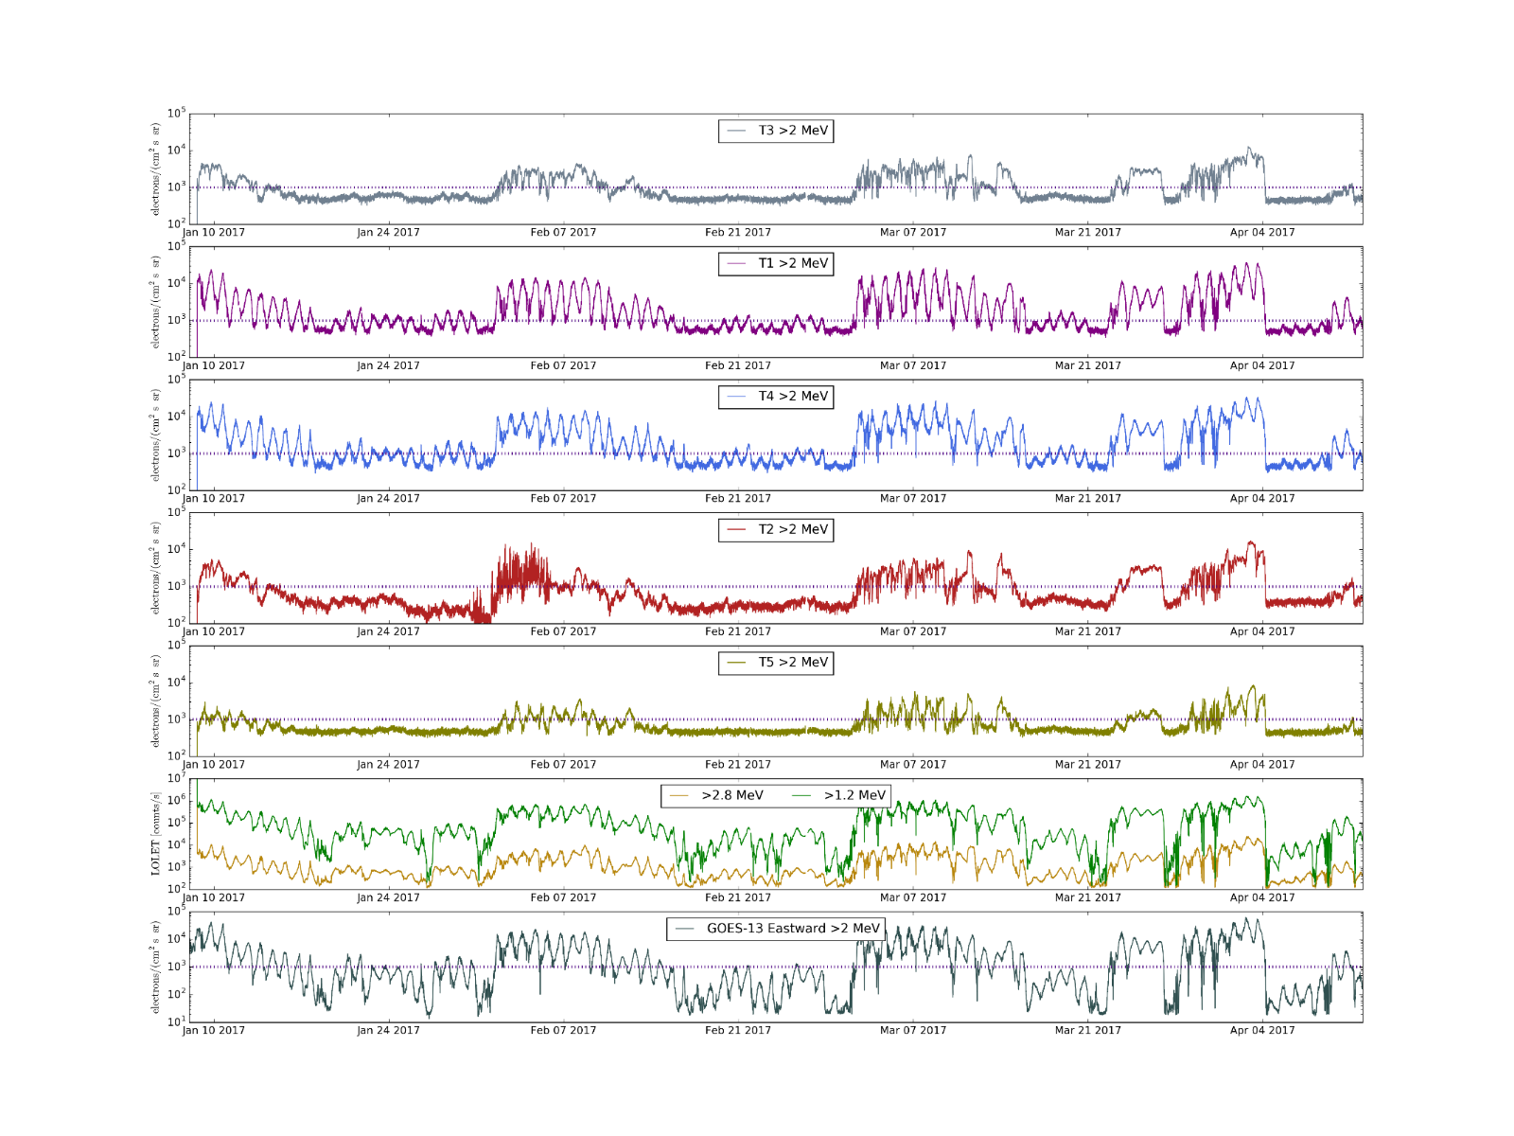
MPS-HI Etel2 Risk
(identified after Beta PS-PVR)
Pitch Angles
Based on typical pitch angles, T3 and T2 should observe similar fluxes.
In T2, noise burst in early February and lower/more irregular backgrounds indicate a problem.
T3
~135°
T1
~100°
T4
~65°
T2
~30°
T5
~5°
MPS-HI E11 (>2 MeV electrons), 8 Jan – 11 Apr 17
5-min average fluxes calculated from L0
Arranged top-to-bottom in telescope order from north-to-south
GOES-13 >2 MeV electron channel plotted at bottom
DOS LOLET
GOES-13
More details in backup charts

Slide 11
Product quality assessment
GOES-16 MPS-HI L1b Products Provisional PS-PVR

Slide 12
Top Level Evaluation
 | Status at Beta PS-PVR (10 Feb 2017) | Current Status | Future Outlook
Electron differential flux | Dropouts due to inversion matrix. Problem anticipated 3+ yrs ago Waiver (Feb 2015) led to NCEI being funded to develop new LUT with SWPC’s concurrence | Modified MPS-HI LUT installed and working properly in OE Comparison with G13 indicates reasonable agreement, with some areas of refinement needed | Cross-calibration results will be used to tweak cal coeffs in future LUT For FM2-FM4, NCEI will plan to prepare LUT earlier
Backgrounds (E9-E11) | Backgrounds too high in E11 for SWPC to use this channel for >2 MeV alerts Existing contamination correction coefficients are too small SGPS P11 fluxes used for correction are too low by 2x SGPS-X P9-P11 channels used in correction are too sensitive to temperature | Modified MPS-HI LUT installed and working properly in OE SGPS-X P11 temperature sensitivity has small effect on background removal Modified LUT provides adequate background correction P11 divide-by-two error (ADR427) fixed in DE but not in OE; OE introduction planned post-drift for PR.06.03 | Will verify OE after PR.06.03 installed As GCRs peak during solar min (next few years), will determine whether modified correction continues to track E9-E11 backgrounds SGPS-X P9-P10 temperature sensitivity will have to be fixed before they can be added to correction (LUT change); OR use P9-P11 from SGPS+X (code change)
Solar proton channels | Status not known due to lack of solar energetic particle (SEP) events | July and September SEP events reveal disagreement between SGPS and MPS-HI progressively increasing between 1 and 12 MeV No obvious reason for this discrepancy | Flight considering calibration of FM4 MPS-HI and SGPS together at Brookhaven Van de Graaf (MPS-HI protons not previously calibrated over 1-12 MeV)

Slide 13
History of Modified Look-up Table (LUT) (ADR 407)
Motivation
  NCEI had expressed concerned that, since matrix inversions are sensitive to systematic and random errors, L1b could give spurious results due to overcorrection (confirmed post-launch)
  (February 2015) Waiver led to NCEI being funded by S. Goodman to develop alternative method (approved by SWPC) that would only involve a LUT change
Preparation
  (Feb-May 2016) NCEI developed ‘bowtie’ analysis using ATC’s delivered Geant4 simulation results (one telescope’s worth) and CRRES spectra, tested it on proxy data
  (July 2015) ATC showed at calibration TIM that FM1 calibration data needed to be reanalyzed
  (March 2017) ATC provided reanalyzed calibration results to NCEI, based on combination of beam measurements and validated (scaled) Geant4 results
Creation
  (Mar-Sept 2017) NCEI synthesized reanalyzed calibration results (55 channel energy responses) into inputs for bowtie analysis, calculated bowtie results for all 5 telescopes
  (Sept 2017) NCEI converted bowtie results into modified HDF5 LUT that could be used without modifying existing code, provided to Ground 28 Sept 2017
    Modified LUT also includes revised background correction coefficients (different problem)
Verification
  Installed in DE early October, results verified by NCEI
  Installed in OE early November, results re-verified by NCEI 14 Nov 17
Without years of preparation, MPS-HI would not be ready for Provisional Maturity today.

Slide 14
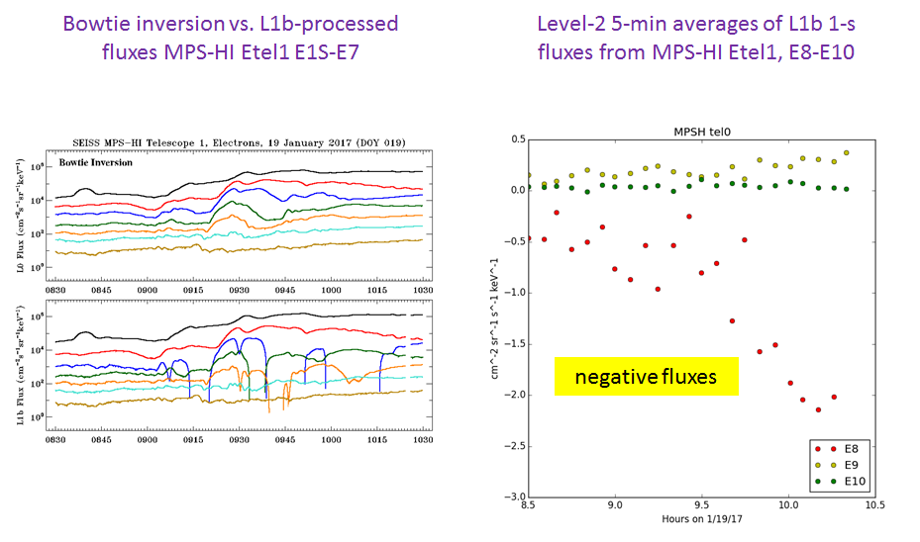
Examples of L1b overcorrection of MPS-HI electrons
Modified LUT: Motivation
Flux calculated from L0 using early version of new LUT
L1b results with old LUT
Artificial dropouts in flux

Slide 15
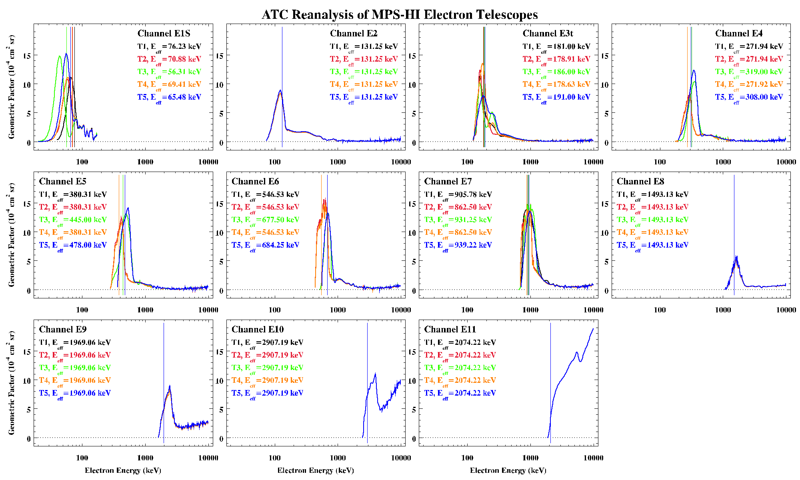
Modified LUT: Reanalyzed Channel Energy Responses
Data (reanalyzed beam measurements and Geant4 simulations) provided by ATC
Synthesized by A. Boudouridis (NCEI) into tabulated functions that can be used in bowtie analysis.

Slide 16
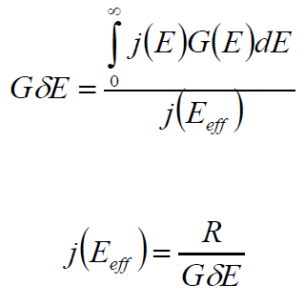
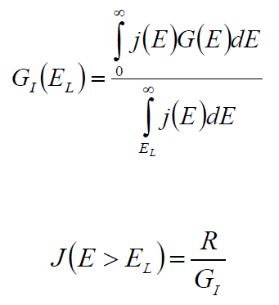
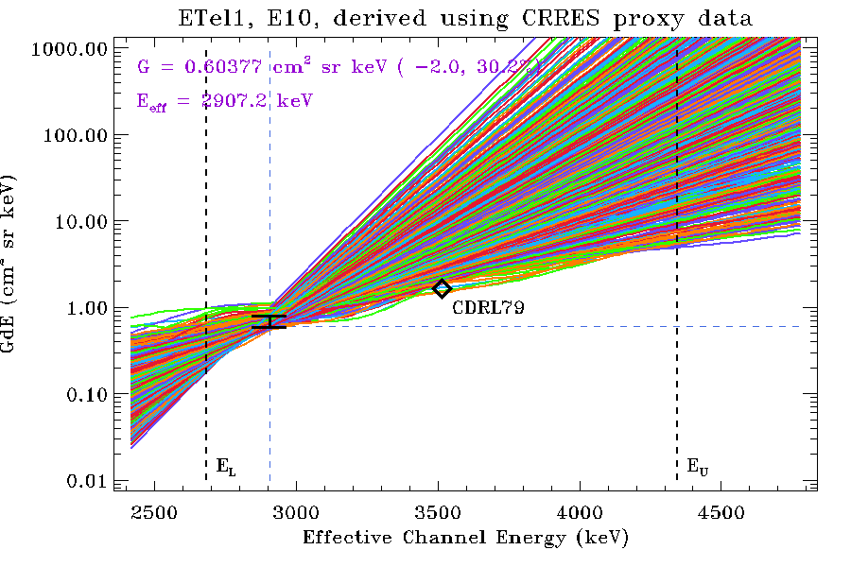
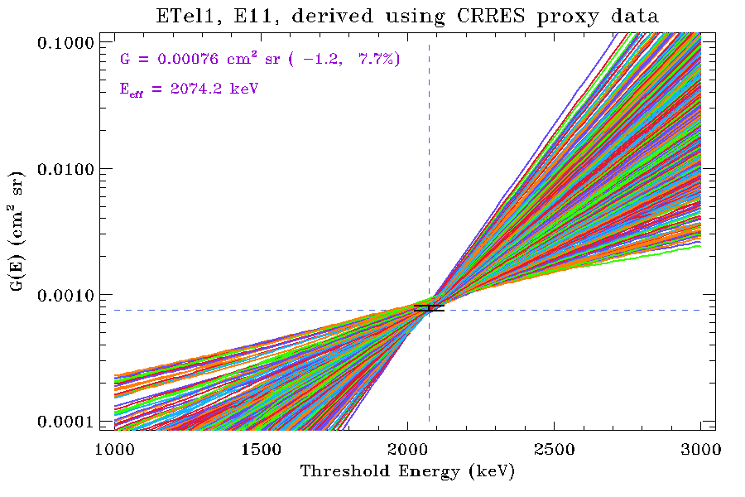
Modified LUT: Bowtie Method
Differential Channels
Integral Channels
Bowtie analysis, differential:
cm² sr keV
Bowtie analysis, integral: cm² sr
L1b processing (diagonalized)
L1b processing
Range in G due to natural variability at 5th and 95th percentiles
Effective energy found using non-linear minimization of (95%ile - 5%ile)
Curves: GdE vs. E_{eff} for 1000 randomly-selected CRRES spectra
Curves: G vs. E_{L} for 1000 randomly-selected CRRES spectra

Slide 17
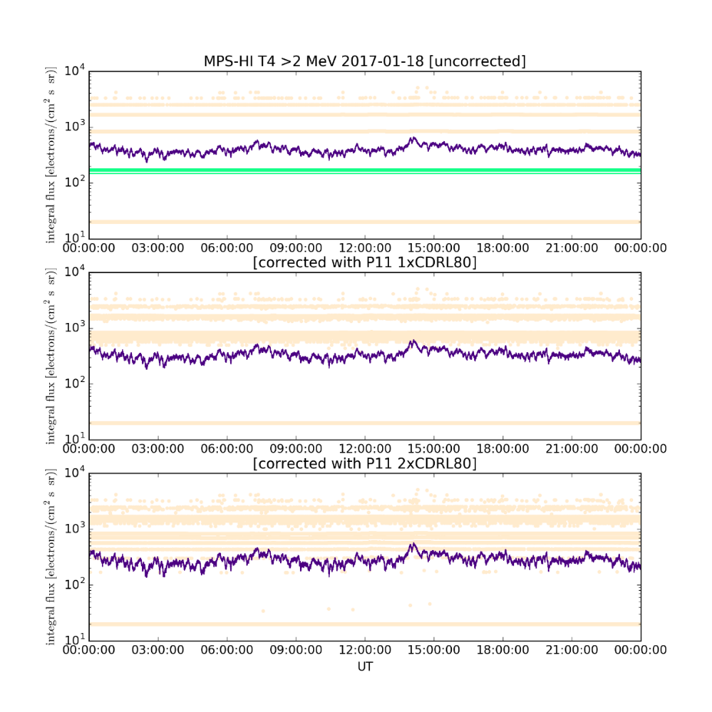
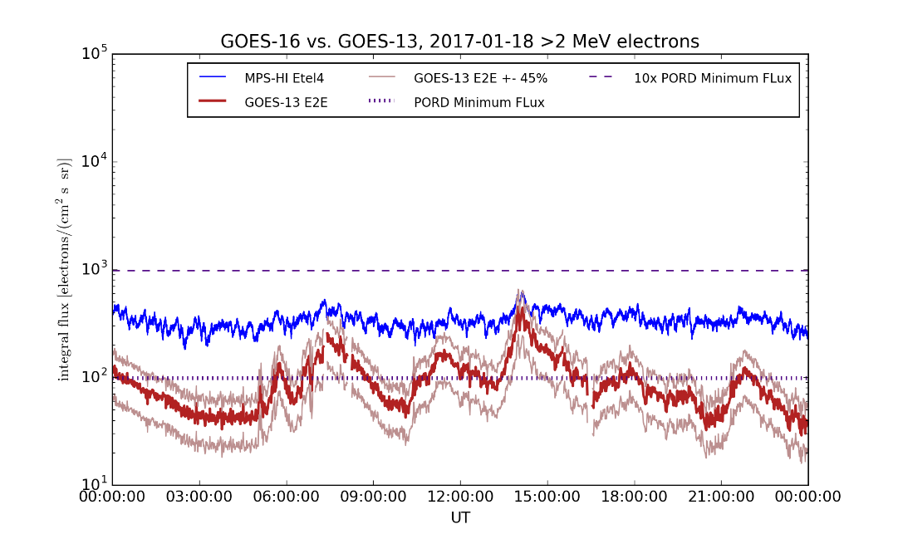
Modified LUT: Motivation due to Background Correction Problem
Pre-launch background correction has little effect, even with P11÷2 removed.
Comparison of GOES-13 and GOES-16 >2 MeV Channel, 18 January 2017
No contam. correction
Contam. Correction (CDRL80F, P11÷2)
Contam. Correction, P11÷1

Slide 18
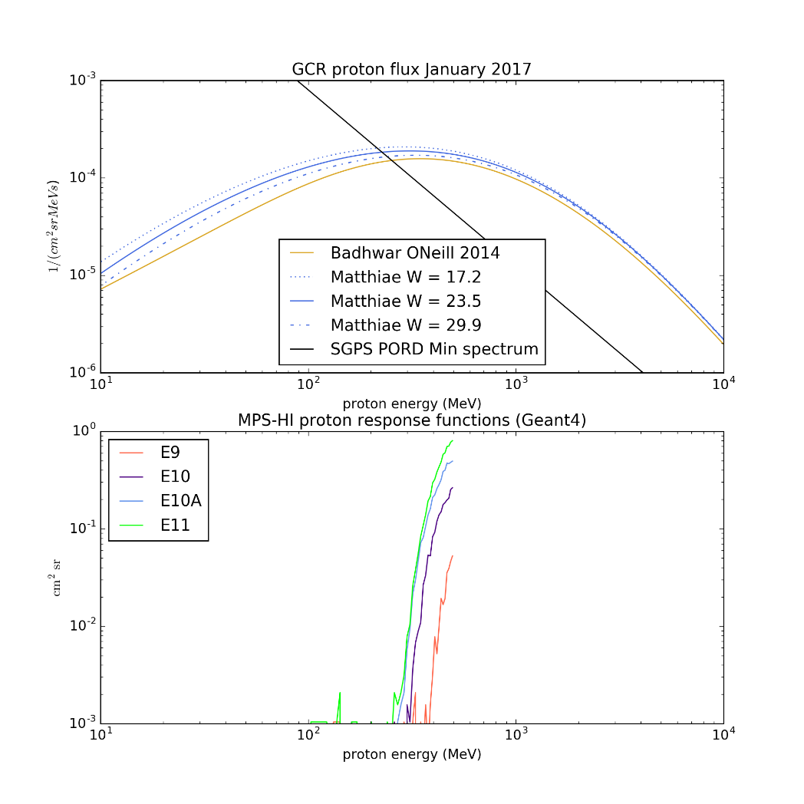
Cause of Background Correction Problem
CDRL80 correction uses SGPS P9, P10 and P11 with coefficients derived from proton responses of MPS-HI channels
Proton responses of MPS-HI channels E9-E11 are not characterized to sufficiently high energies under GCR-dominated conditions
Therefore, existing correction coefficients are too small

Slide 19
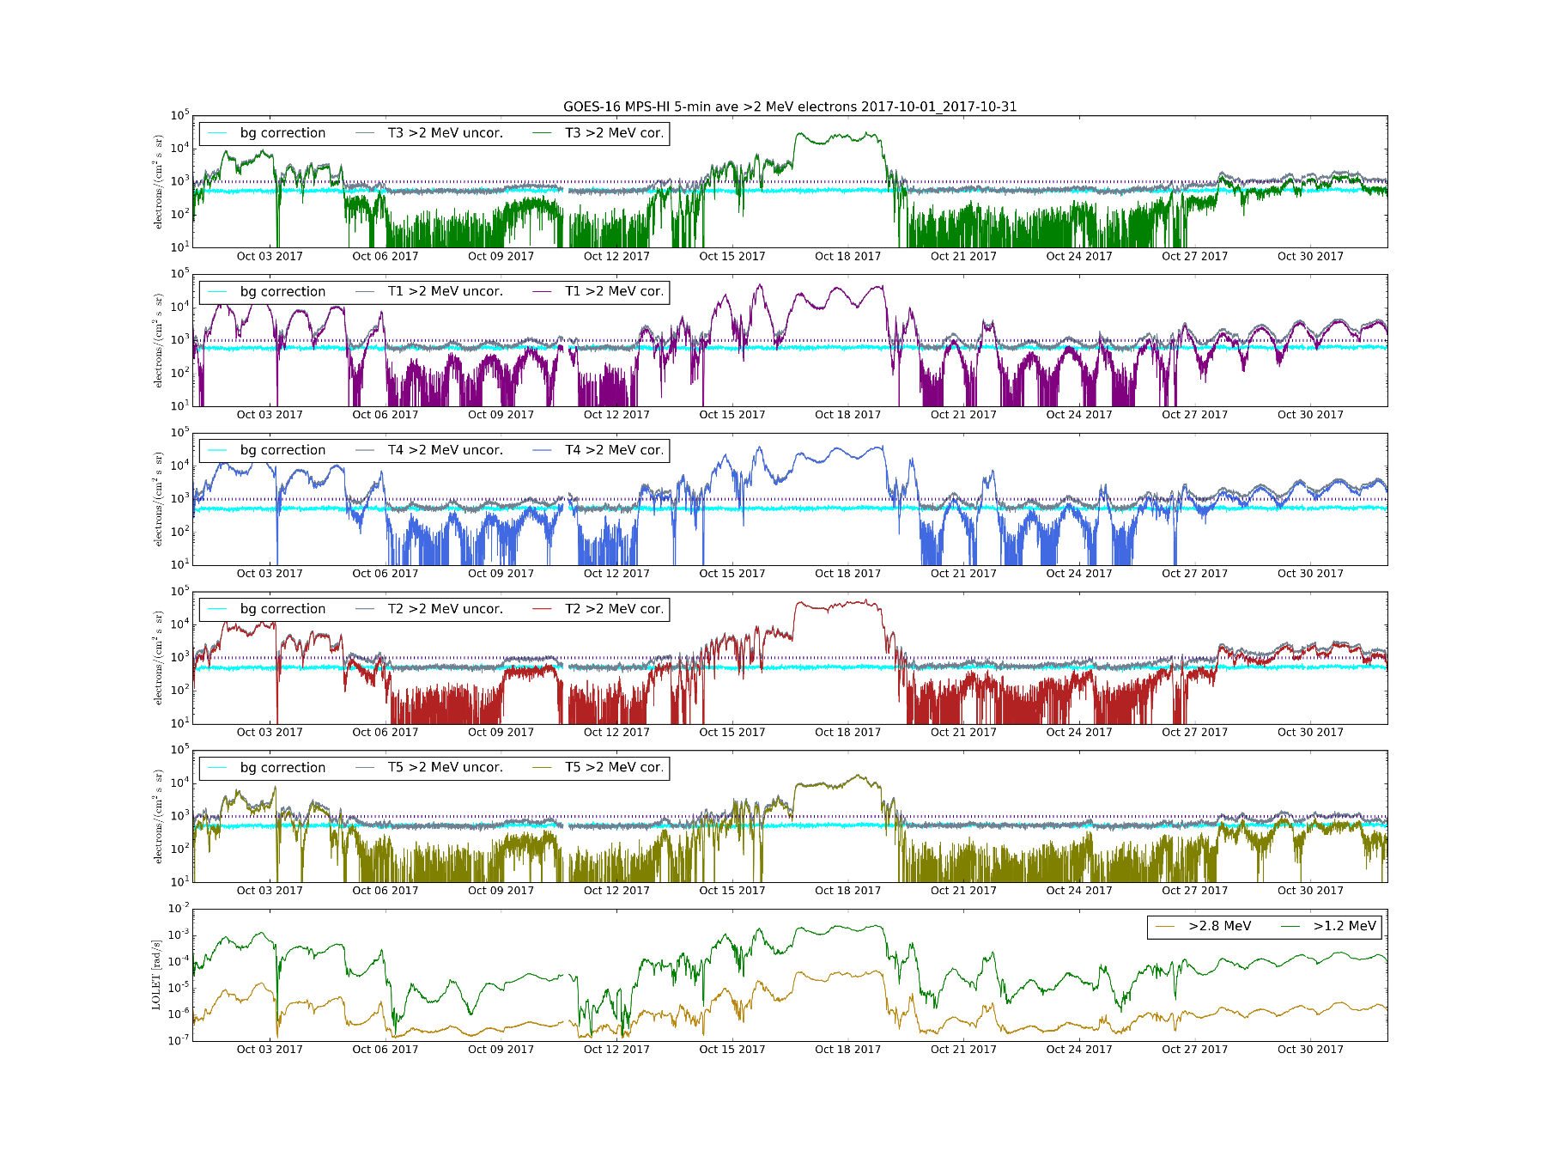
Modified LUT:
Background Correction
E11 (>2 MeV)
T3
T1
SWPC alert level very close to uncorrected background
T4
T2
T5
DOS
Background correction coefficients derived through a comparison of P11 and E9-E11 backgrounds over first several months of observations

Slide 20
ADR407: Verification of successful installation of modified MPS-HI LUT in OE
Goal: verify that MPS-HI LUT modified & delivered by NCEI was successfully installed in OE
  Data from 06 & 08 November 2017 (doys 311-312)
Compared to fluxes and flux errors calculated from L0 by NCEI
  MPS-HI and SGPS L0 data aggregated into separate day files by A. Boudouridis
  Note: only for this comparison, SGPS P11 is divided by 2 prior to ingest by MPS-HI algorithm in order to simulate conditions in OE as of 06 & 08 November
For each L1b file (30 samples per channel):
  Calculate ratio of OE to NCEI products (flux and flux error, both in flux units)
  Take mean and standard deviation of ratios
  This gives a mean and a standard deviation for each L1b file
  Ideally, mean = 1.0 and standard deviation = 0.0
Results are good: ratio mean = 1.0, stdev = 0.0 or ~1e-8 (latter observed when quantity involves special function such as square root)

Slide 21
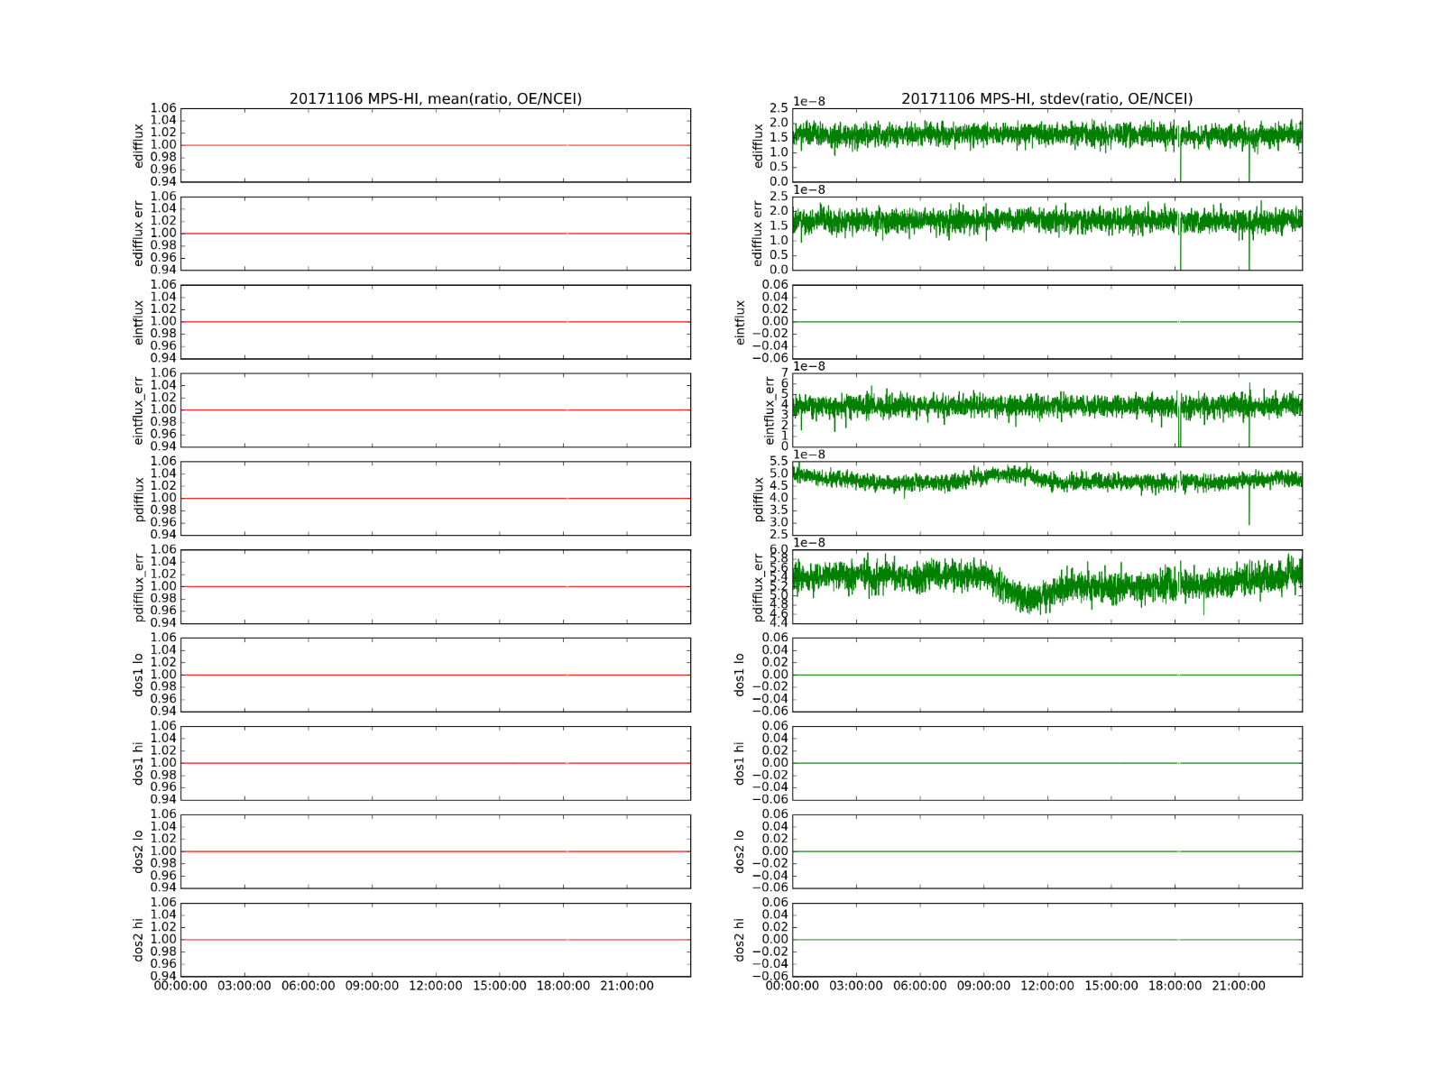
06 November 2017
ADR407: Verification of successful installation of modified MPS-HI LUT in OE
In general:
mean = 1.0
stdev ~ 1e-8 or 0

Slide 22
ADR427: Verification of successful fix in DE (PR.06.03)
Goal: verify removal of divide-by-two in calculation of P11 fluxes
DE data from 29 November 2017 (doy 333), 0000-1537 UT (PR.06.03)
Compared to fluxes and flux errors calculated from L0 by NCEI
  L0 data aggregated into separate day files by instrument by A. Boudouridis
For each L1b file (60 samples per channel):
  Calculate ratio of DE to NCEI products (flux and flux error, both in flux units)
  Take mean and standard deviation of ratios
  This gives a mean and a standard deviation for each L1b file and instrument (-X, +X) for T3 P11
  Ideally, mean = 1.0 and standard deviation = 0.0
Results are good: ratio mean = 1.0, stdev = 0.0 or ~1e-8 (latter observed when quantity involves special function such as square root)
Verification will have to be repeated after PR.06.03 is installed in the OE following GOES-16 drift.

Slide 23
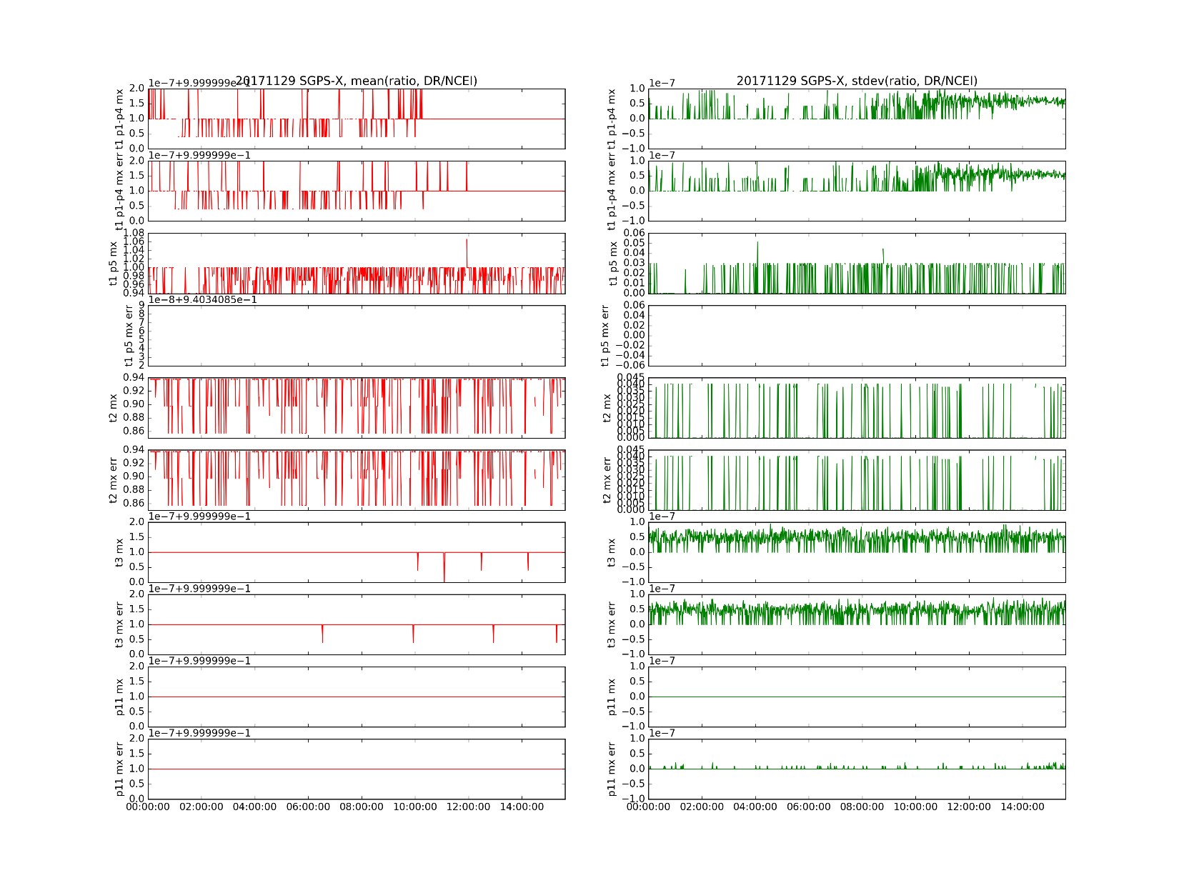
SGPS-X
29 Nov 2017
ADR427: Verification of successful fix in DE
T2 and T1 P5 issue covered by ADR491, does not affect MPS-HI
{
P11 –X ratio:
mean = 1.0, stdev ~ 1e-8
Similar results for SGPS+X (in backup charts)

Slide 24
Use of Reprocessed Data in PLPT
Due to late changes to OE (ADRs 407, 427), not enough data for PLPT prior to PS-PVR
We have reprocessed L0 data using software that has been demonstrated to reproduce L1b results consistent with Provisional maturity (see ADR407 and 427 artifacts)
This demonstrated equivalence allows us to perform PLPT using reprocessed MPS-HI data
The reprocessed data used in PLPT are 1-minute averages of data from 09 January – 31 October 2017 (SEISS instruments turned on 08 January 2017)

Slide 25
PLPTs for Provisional
PLPT-SEI-002: Expected Pitch-Angle Distributions and MPS-HI Telescope Cross-Comparison
PLPT-SEI-004: Solar Energetic Particle (SEP) Cross-Comparison
PLPT-SEI-005: Cross-Satellite Comparison of Trapped Particles
PLPT-SEI-006: Backgrounds

Slide 26
PLPT-SEI-002: Expected MPS-HI Pitch-Angle Distributions (PADs)
Sibeck et al., JGR, 92, 13,485, 1989
Quiet-time PAD expectations:
  ‘Normal’ near noon (peaked at pitch angle = 90°)
  ‘Butterfly’ near midnight (two peaks on either side of 90°)
Due to ‘drift shell splitting’ and negative radial flux gradients
  Drift paths near 90° are non-circular
West et al., JGR, 78, 1064, 1973

Slide 27
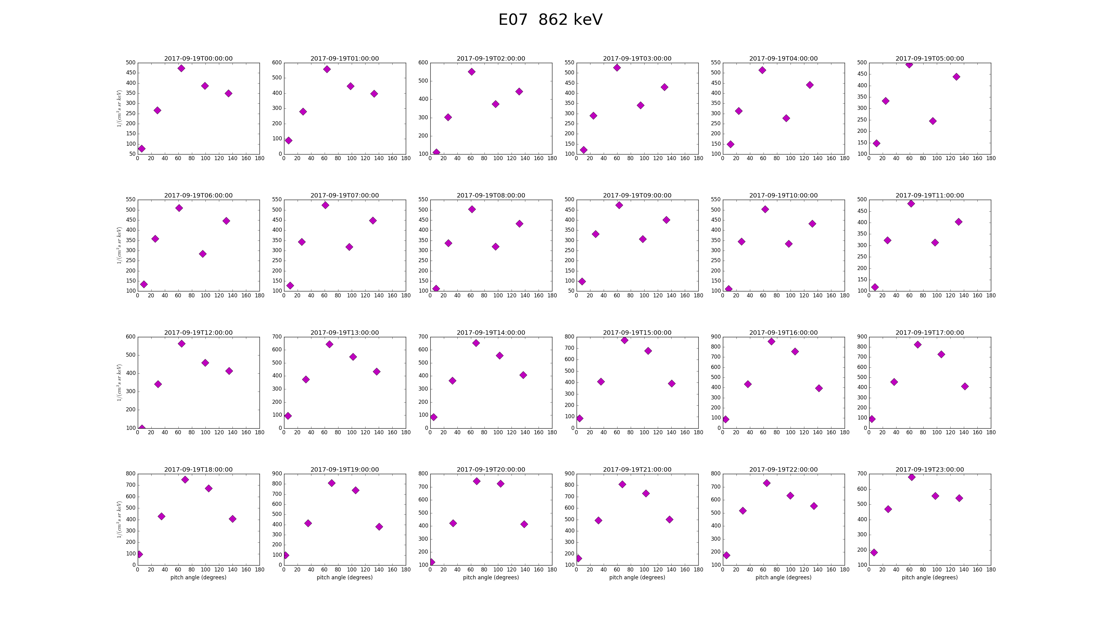
PLPT-SEI-002: MPS-HI Electron PADs (19 September 2017)
MIDNIGHT
0⁰ 90⁰ 180⁰
NOON
0⁰ 90⁰ 180⁰
See back-up slides for pitch-angle plots.

Slide 28
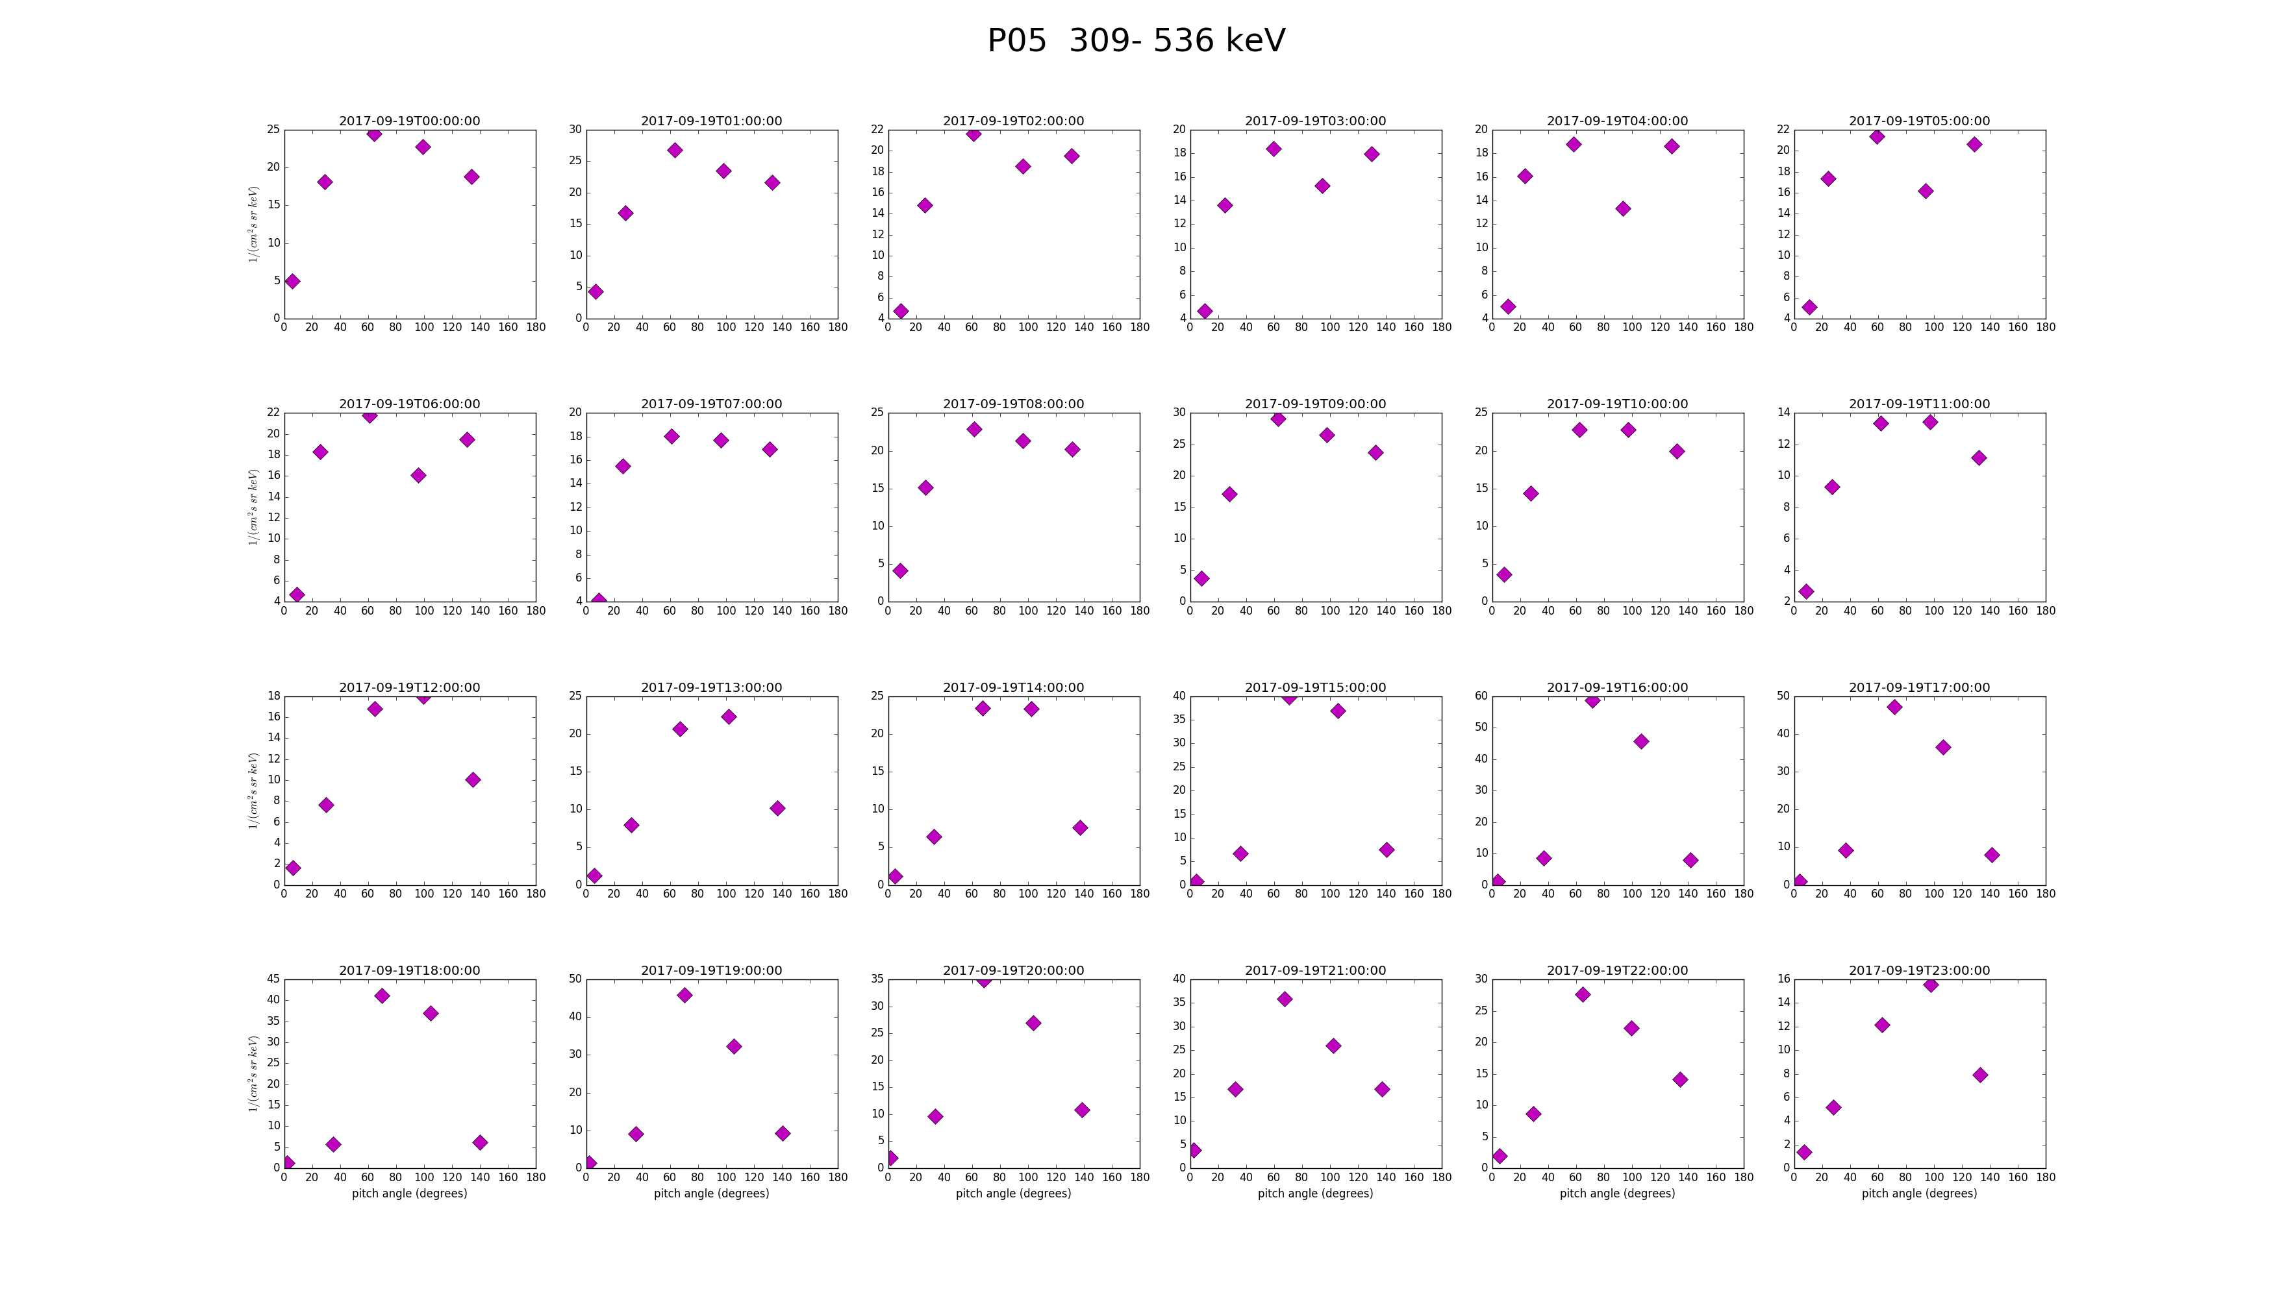
PLPT-SEI-002: MPS-HI Proton PADs (19 September 2017)
MIDNIGHT
0⁰ 90⁰ 180⁰
NOON
0⁰ 90⁰ 180⁰

Slide 29
PLPT-SEI-002: MPS-HI PADs Conclusions
Could not be performed by Beta PS-PVR (February) due to grossly incorrect L1b MAG rotation (corrected in April)
Pitch angle variations now qualitatively similar (shifted by an hour) to those on GOES-13 for MAGED and MAGPD telescopes looking in same directions (quality expected at Beta maturity)
Observing expected quiet-time PAD variations in local time
For Full Validation, expect improved accuracy through:
  MAG at Provisional Maturity
  MPS-HI telescope cross-calibrations (which rely on MAG)

Slide 30
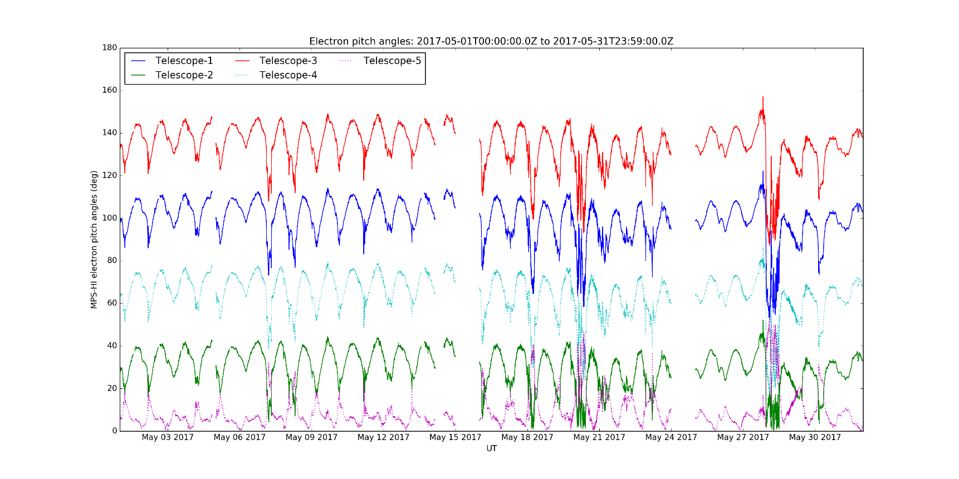
PLPT-SEI-002: MPS-HI Telescope Cross-Comparison: Method
Compares responses of MPS-HI telescopes when central pitch angle is the same
Under such conditions, telescopes should be measuring the same flux if effective energy is the same
Steps:
  Input MPS-HI fluxes and pitch angles calculated from MAG L1b BRF
  Identify whenever a pair of telescopes has pitch angles within 1 degree
    For some telescope pairs, need multiple months to get enough matches
  Report measured fluxes for each pitch angle match
  Estimate scaling factors optimally based on set of all matches (i.e. no reference telescope)
Ref: Rowland, W., and R. S. Weigel (2012), Intra-calibration of particle detectors on a three-axis stabilized geostationary platform, Space Weather, 10, S11002, doi:10.1029/2012SW000816.

Slide 31
PLPT-SEI-002: MPS-HI Telescope Cross-Comparison: Electrons
Scale factors for MPS-HI Electron Telescopes, May 2017
Caveats:
  Few pitch-angle matches (none for T3)
  MAG L1b data at beta maturity
  Variation in energies across telescopes not accounted for
Future improvements:
  Use multiple months of data
  Wait for MAG data to reach Provisional
  Use complement of pitch angles > 90⁰
  Account for known variation in energies
Blue: <10%, Green: 10-20%, Red: >20%

Slide 32
PLPT-SEI-002: MPS-HI Telescope Cross-Comparison: Protons
Scale factors for MPS-HI Proton Telescopes, May 2017
Caveats:
  Few pitch-angle matches (none for T1)
  MAG L1b data at beta maturity
Future improvements:
  Use multiple months of data
  Wait for MAG data to reach Provisional
  Use complement of pitch angles > 90⁰
  Account for known variation in P1 energies
Blue: <10%, Green: 10-20%, Red: >20%
Technique not applicable to solar proton channels P8-P11

Slide 33
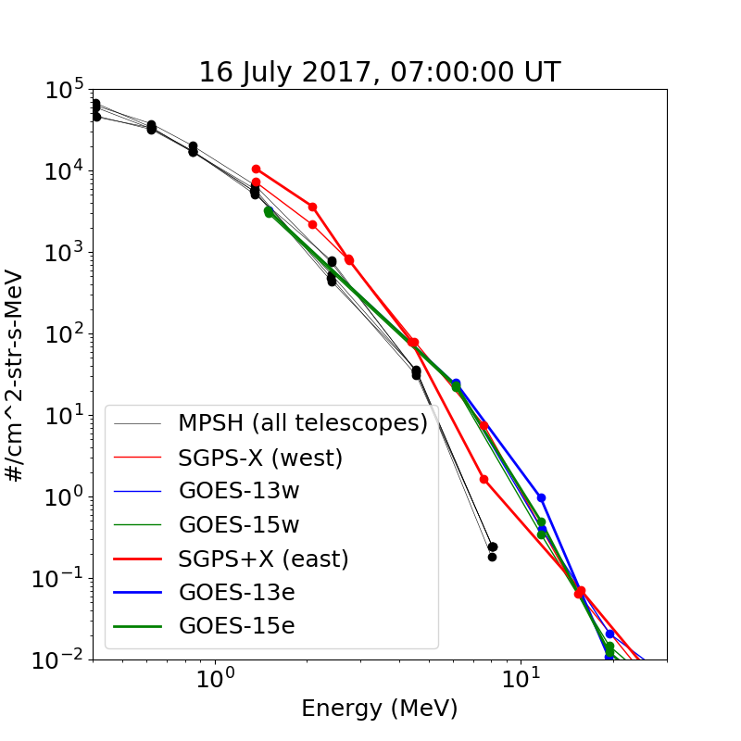
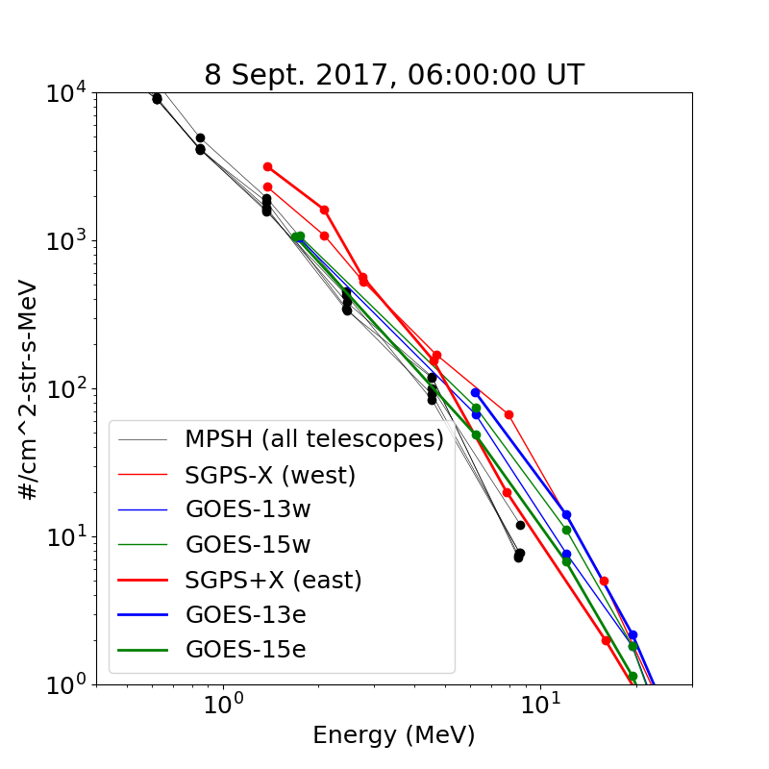
PLPT-SEI-004: SEP Channel Cross-Comparison (MPS-HI P8-P11)
SGPS, MPS-HI, GOES-13 and GOES-15 proton spectra from the July and Sept 2017 SEP events, during periods when an isotropic distribution is expected due to geomagnetic disturbance.
P8
P9
P10
P11
MPS-HI proton fluxes are typically lower than those measured by SGPS (esp. P11)
MPS-HI is in better agreement with GOES-13 and -15 near 1-2 MeV.
SGPS is in better agreement with GOES-13 and -15 at higher energies.
This is probably not an issue with the ground processing software.
GOES-13 and -15 fluxes have been cross-calibrated with higher-resolution NASA data.

Slide 34
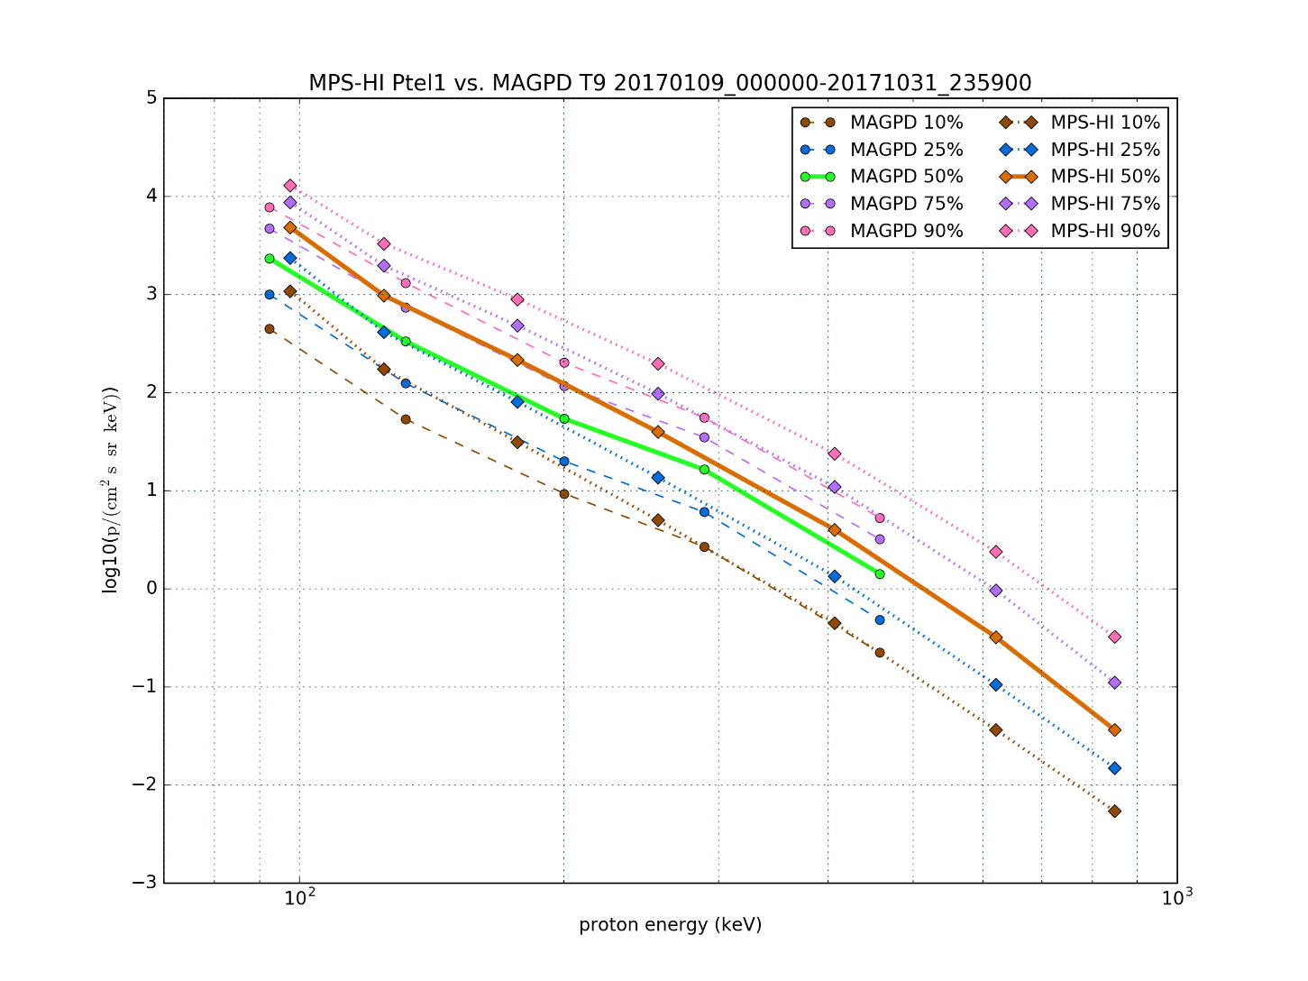
PLPT-SEI-005: Cross-Satellite Comparison of Trapped Particles
GOES-16 vs GOES-13 Protons
Telescope Order, North-to-South
MAGE/PD | MPS-HI E | MPS-HI P
9 | 3 | 1
6 | 1 | 4
1 | 4 | 2
8 | 2 | 5
7 | 5 | 3
MAGPD systematically low – due to radiation damage?
Lesson learned: There was no support to track GOES 13-15 sensor degradation.
Contamination in MAGPD by MeV electrons?
Bowtie analysis used on MAGPD.
See back-up charts for other Ptels.

Slide 35
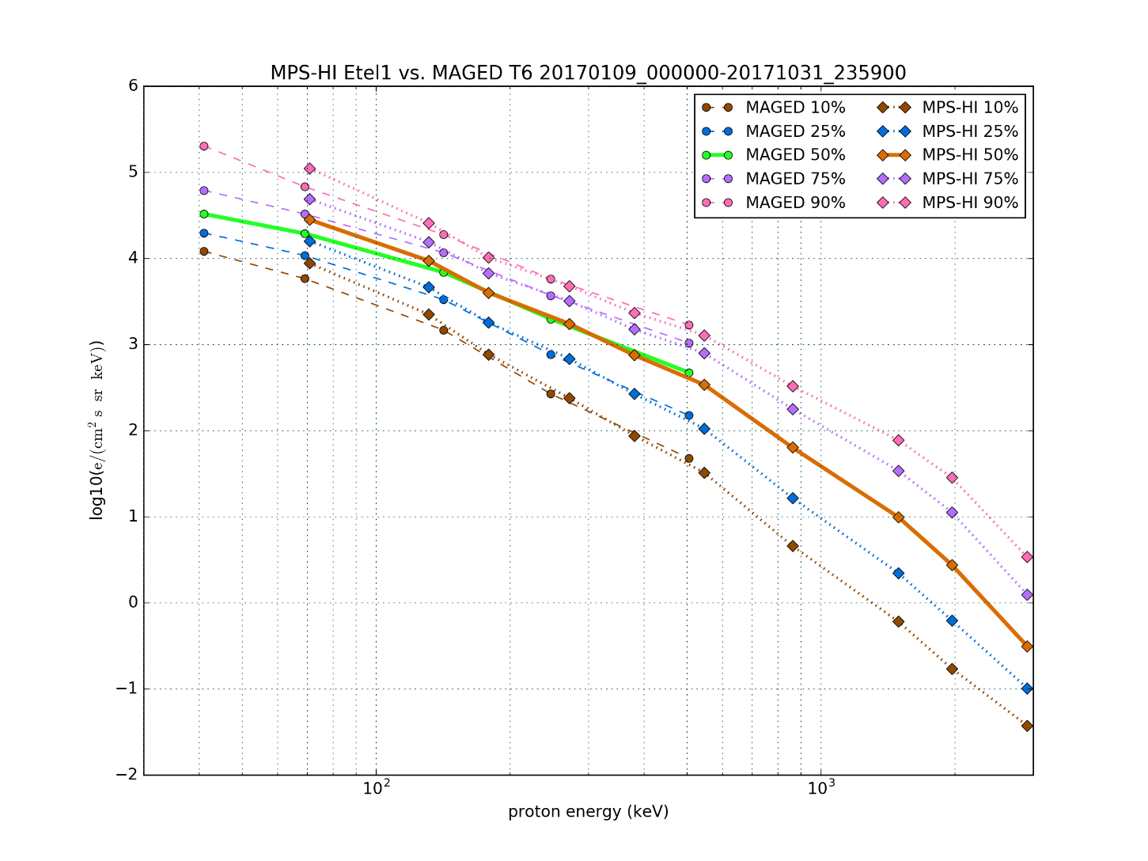
PLPT-SEI-005: Cross-Satellite Comparison of Trapped Particles
GOES-16 vs GOES-13 Electrons
Telescope Order, North-to-South
MAGE/PD | MPS-HI E | MPS-HI P
9 | 3 | 1
6 | 1 | 4
1 | 4 | 2
8 | 2 | 5
7 | 5 | 3
E1S high relative to MAGED
Good agreement >100 keV
Bowtie analysis used on MAGED.
See back-up charts for other Etels.

Slide 36
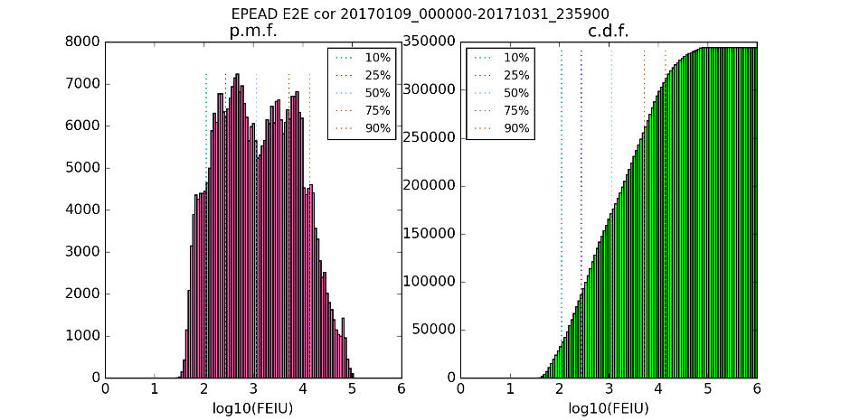
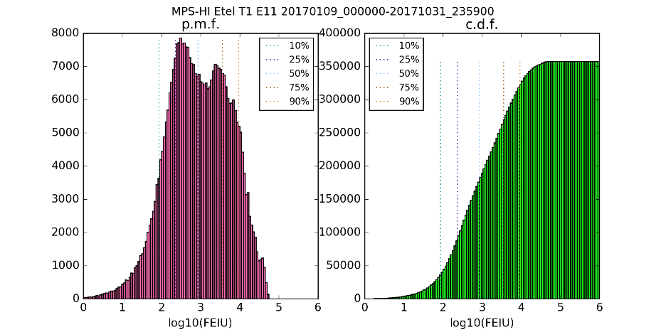
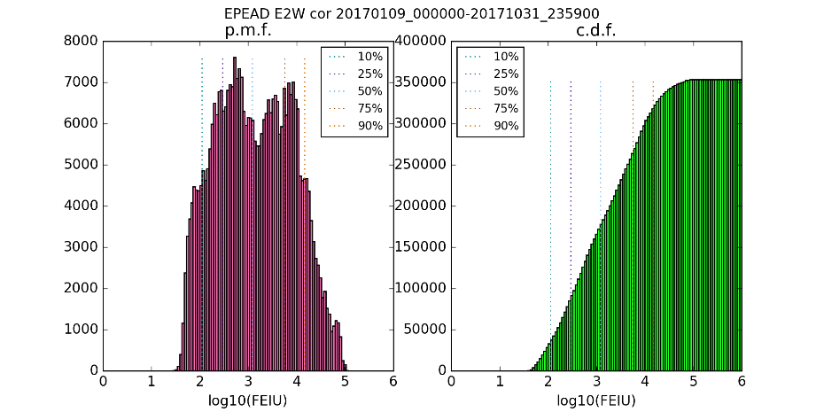
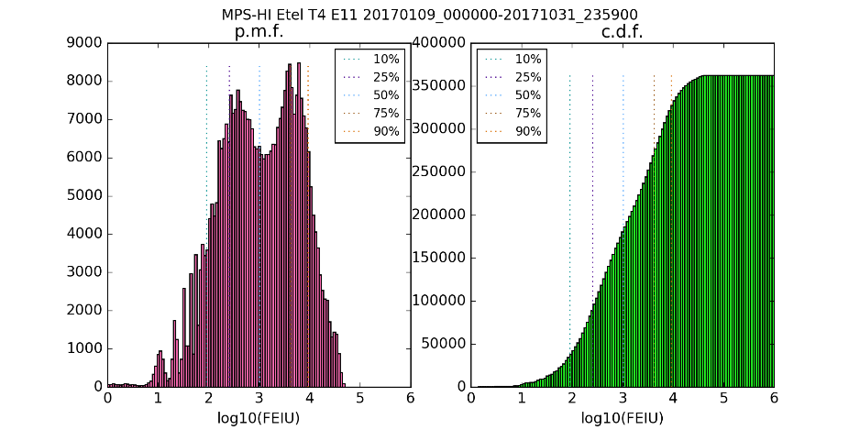
PLPT-SEI-005: Distributions of GOES-13 & -16 >2 MeV Electrons, 09 January-31 October 2017
Alert Level | G13 E2W | G13 E2E | G16 T1 E11 | G16 T4 E11 | Medians
1000. | 1209. | 1139. | 843. | 1017. | e/(cm² s sr)
GOES-13 EPEAD >2 MeV (E2) channels, W and E
GOES-16 MPS-HI >2 MeV (E11) channels, T1 and T4
Distributions depend on look direction and FOV width. EPEAD has much wider FOV than MPS-HI.

Slide 37
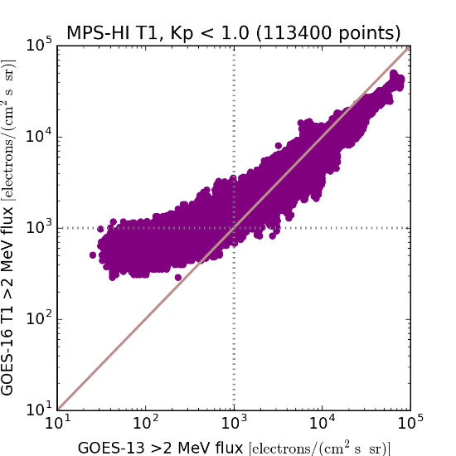
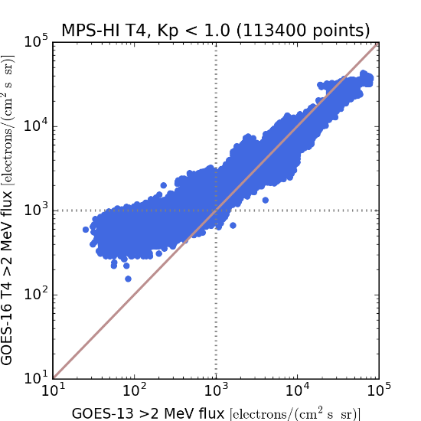
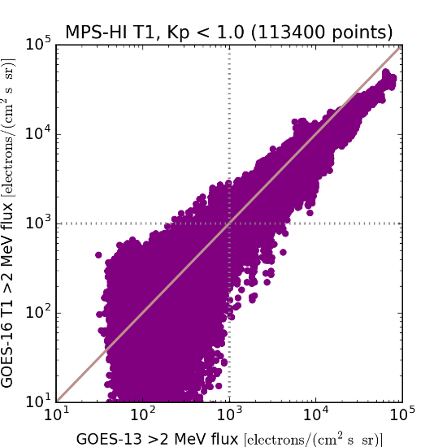
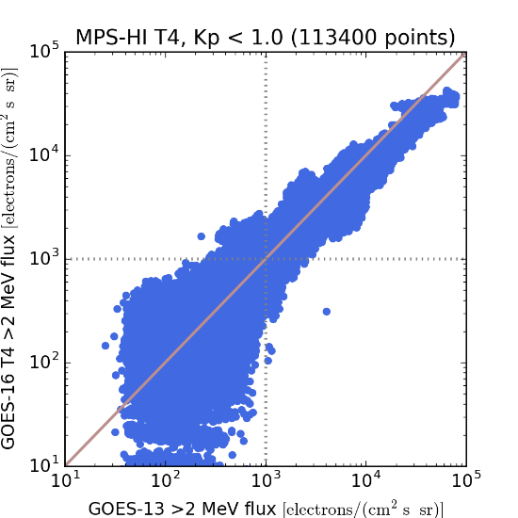
PLPT-SEI-005: GOES-16 vs. -13 >2 MeV Electrons (Telescopes 1 and 4),
9 January-31 October 2017, Kp < 1o
Backgrounds not removed
Backgrounds removed
Cross-comparisons over the first 10 months of GOES-16 operations show that MPS-HI Telescopes 1 and 4 provide comparable >2 MeV flux measurements to GOES-13, can be used as the basis for future alerts.

Slide 38
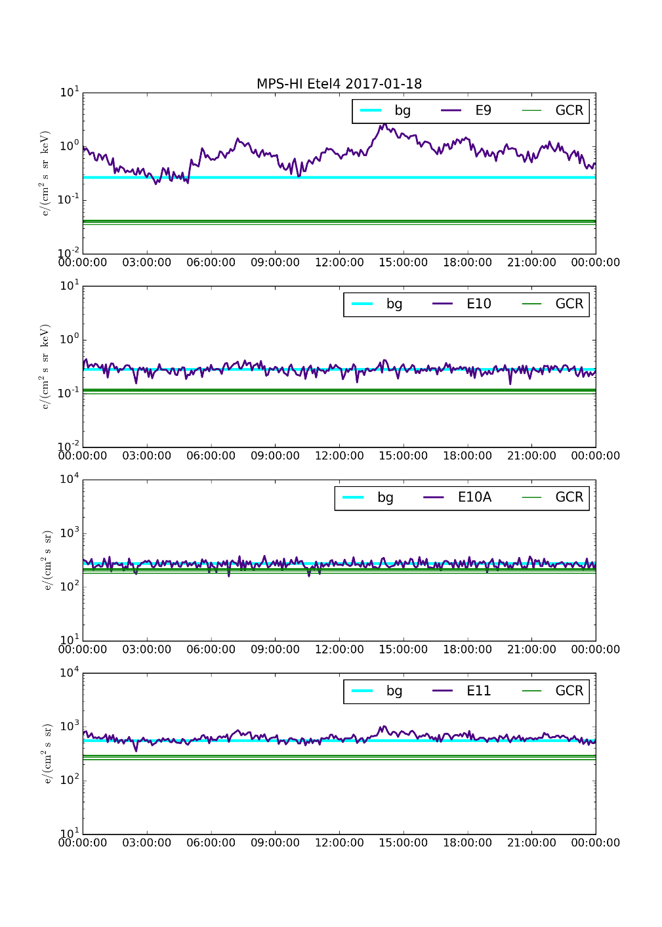
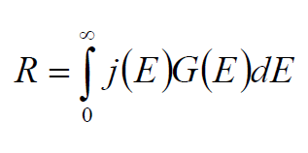
PLPT-SEI-006: Backgrounds
j(E)
G(E)
Assumed flat responses, 0.5-30 GeV
[crude assumption]
Background count rate
Geometrical factor
Model GCR flux
Model background counts lower than observed.

Slide 39
SWPC Overview
Terry Onsager (SWPC representative) will present SWPC’s overview at this point in the PS-PVR.

Slide 40
Provisional Maturity Assessment
GOES-16 MPS-HI L1b Products Provisional PS-PVR

Slide 41
Provisional Validation
Preparation Activities | Assessment
Validation activities are ongoing and the general research community is now encouraged to participate. | Validation activities are ongoing. Results have been discussed with SWPC. Release of data by NCEI will enable research community participation.
Severe algorithm anomalies are identified and under analysis. Solutions to anomalies are in development and testing. | Major anomalies fixed through LUT modification (ADR407) and correction to SGPS P11 calculation (ADR427). Correct performance of LUT verified in OE.
Incremental product improvements may still be occurring. | Incremental product improvements are expected, primarily through updated LUTs incorporating results of cross-cal.

Slide 42
Provisional Validation
End State | Assessment
Product performance has been demonstrated through analysis of a small number of independent measurements obtained from select locations, periods, and associated ground truth or field campaign efforts. | PLPTs performed on reprocessed MPS-HI fluxes from 09 Jan – 31 Oct 2017
Product analysis is sufficient to communicate product performance to users relative to expectations (Performance Baseline). | Yes, to the limited extent that the Performance Baseline can be checked on-orbit.
Documentation of product performance exists that includes recommended remediation strategies for all anomalies and weaknesses. Any algorithm changes associated with severe anomalies have been documented, implemented, tested, and shared with the user community. | Key issues affecting usability by SWPC have been fixed. Fixes have been discussed extensively with SWPC and agreed to by them.
Testing has been fully documented. | This presentation; memo on background correction.
Product is ready for operational use and for use in comprehensive cal/val activities and product optimization. | NCEI: yes.

Slide 43
Recommendation
NCEI believes that the GOES-16 MPS-HI L1b product has reached the Provisional Maturity as defined by the GOES-R Program
  Exception: The ADR427 fix already demonstrated in the DE should be demonstrated in the OE before Provisional Maturity is declared
  This will happen after PR.06.03 is installed in the OE following completion of GOES-16 drift to 75W (currently December 14)

Slide 44
MPS-HI Data Release Plans
After MPS-HI Provisional Maturity is declared, NCEI will:
  Aggregate MPS-HI L1b into 1-day files
  Make aggregated L1b files available to the public via immediate download
  Archive aggregated L1b files
NCEI strongly recommends NOT to release L1b data archived in CLASS prior to achieving Provisional Maturity
NCEI will reprocess MPS-HI L0 data to date using Provisional Maturity algorithm & LUT and release it to the public
  Make data available to the public in 1-day L1b aggregates and L2 1-month files of 1-min and 5-min averages
  Archive reprocessed files

Slide 45
Path to full Validation Maturity
GOES-16 MPS-HI L1b Products Provisional PS-PVR

Slide 46
Path to Full Validation
ADRs/WRs to be resolved prior to Full Validation.
PLPTs to be conducted prior to Full Validation.
Performance Baseline status.
Risks to getting to Full, both from L1b product definition and user (SWPC) feedback

Slide 47
ADRs/WRs Impacting Full Validation of MPS-HI L1b
ADR# | WR# | Short Description | Status | Expected Closure
267 | 5370 | LUT Filenames not Traceable to Metadata | In_Analysis | Not assigned
510 | 5483 | SWx L1b generation slowdown / stoppage | In_Analysis | Not assigned
517 | 5484 | Small but routine L1b gaps, mostly for SEISS (EHIS, MPS-LO, MPS-HI) | Submitted | Not assigned
These ADRs directly impact real-time use by SWPC through inaccuracy and unavailability.
The SGPS vs MPS-HI 1-12 MeV proton discrepancy is not due to an algorithm issue.

Slide 48
ADR 267: LUT Filenames not Traceable to Metadata
L2 algorithms need to know filename of LUT in real time, e.g. MPSHI_CALINR_Parameters-487073151.1.h5.ops
  For example:
    Calculation of errors for 1-min and 5-min averages requires knowledge of geometric factors used in L1b processing
    L2 software opens LUTs for this information
  Common need across all GOES-R SWx instruments
Currently, metadata contains: ‘L1b_processing_parm_version = OR_SEIS-L1b-PARM_v01r00.zip’, not names of actual .h5 LUTs
  On July 1: L1b_processing_parm_version = OR_SEIS-L1b-PARM_v01r00.zip
  On November 30: L1b_processing_parm_version = OR_SEIS-L1b-PARM_v01r00.zip
  So, name of zip file not updated despite revised MPS-HI LUT present on November 30
  Getting name of zip file, rather than a list of the .h5 files, is impractical for real-time use
Impact of LUT version disconnect between L1b and L2 processing is inaccurate L2 data
  SWPC expressed concern

Slide 49
ADR 510: Long-Duration MPS-HI Outages of Unknown Cause
Topic: GOES-16 SEIS-L1b-MPHS products and its delivery to PDA
Date/Time Issued: September 15, 2017 / 1840 UTC
Product(s) or Data Impacted: GOES-16 SEIS-L1b-MPHS Products
Date/Time of Initial Impact: September 15, 2017 / 1338 UTC
Date/Time of Expected End: September 04, 2017 / 1804 UTC
Length of Outage/Event: 4 hours, 26 minutes
Details/Specifics of Change: Product Outage: GOES-16 SEIS-L1b-MPHS products and its delivery to PDA.
Topic: GOES-16 SEIS-L1b-MPHS products and its delivery to PDA
Date/Time Issued: November 12, 2017 / 2206 UTC
Product(s) or Data Impacted: GOES-16 SEIS-L1b-MPHS Products
Date/Time of Initial Impact: November 12, 2017 / 0528 UTC
Date/Time of Expected End: November 12, 2017 / 1134 UTC
Length of Outage/Event: 6 hours, 6 minutes
Details/Specifics of Change: Product Degradation: GOES-16 SEIS-L1b-MPHS products and its delivery to PDA.
L1b outages can last multiple hours – unacceptable for real-time use by NWS SWPC forecast office
MPS-HI occurrences in the last 90 days:
  08-29-2017: Empty files from to 16:53:00 17:07:30 (~14 minutes). SEIS-L0 is normal.
  09-15-2017: Empty files for hours 12 - 18. SEIS-L0 is normal.
  10-01-2017: Empty files for hour(s) 21, 22, 23. SEIS-L0 data is normal.
  10-02-2017: Empty files for hour(s) 00 - 12. SEIS-L0 data is normal.
  11-12-2017: Empty files for hour(s) 05 - 11. SEIS-L0 data is normal.
Symptom:
  Small L1b file sizes received via PDA. Files become shorter and shorter until they are empty. Reflected in filename time stamps.
  In contrast, L0 record complete with normal file sizes.
  Problem not unique to MPS-HI
Recommendation:
  Put in place procedures to monitor and promptly restart processes when such failures occur, including overnight
  Conduct root cause investigation

Slide 50
Path to Full Validation - PLPT
Title | Activity | Data Needed | Success Criteria
A.3.1 MPS-Hi Telescope Cross-Comparison [PLPT-SEI-002] | Determine the relative sensitivity/response among MPS-HI telescopes. Account for differences in channel energy responses. | Three months of continuous data. (MAG and MPS-HI) | [Full] Telescopes agree to within 25%.
A.3.3 SEP Channel Cross-Comparison [PLPT-SEI-004] | On-orbit cross-calibration of MPS-HI with SGPS 1-12 MeV protons, and with GOES 13-15 EPEAD. | Two Solar Energetic Particle (SEP) events. | [Full] Differences quantified on data taken through validation phase.
A.3.4 Cross Satellite Comparison of Trapped Particles [PLPT-SEI-005] | Identify time periods when the two satellites should be measuring the same population, and compare results. Comparisons can be based on the satellites being within 15 degrees longitude (especially while G16 and G13 are side-by-side at 75W), or using a very long time period. | Three months of continuous data. (MAG, MPS-HI) | [Full] Differences quantified on data taken through validation phase.
A.3.4 Backgrounds Trending [PLPT-SEI-006] | Model GCR spectra (e.g., NASA JSC Badhwar-O’Neill 2014) put through a forward model derived from MPS-HI instrument response functions to estimate MPS-HI channel fluxes for comparison with observations. Watch for deviation between P11-based correction and actual backgrounds. | Four months of continuous data. (MPS-HI, SGPS) | [Full] Perform analysis during validation phase.
MPS-HI Full Validation PLPTs from RIMP v 1.0 (02 June 2016) are a continuation of those completed for Provisional. Green annotations based on experience with MPS-HI.

Slide 51
Performance Baseline Status
Assessment at Provisional
MRD ID | Description | Related PLPTs | Status
1996 | MPS-HI Orthogonality/Coverage | -02, -04 | PLPTs underway
2000 | MPS-HI Measurement Range | -02, -04 | PLPTs underway
2001 | MPS-HI Measurement Accuracy | -02, -04, -05, -06 | PLPTs underway
MRD1996: Data in 5 directions
  Currently being met for electrons and protons
  Etel2 is a watch item (noise)
MRD2000: Measurement Range
  Requirements: Electrons 50 keV to 4 MeV plus >2 MeV;
  Protons 80 keV to 10 MeV
  Currently, all channels are functional and exhibit characteristic variation in behavior w/ energy
  Ground cal & cross-cal with G13 indicate that energy measurement range is covered
    P8-P11 under investigation
MRD2001: Measurement Accuracy
  Requirements: @min flux <45%, @10X min flux < 25%
  Absolute accuracy cannot be verified on-orbit
  Provisional results of PLPT-02 indicate some inter-telescope differences greater than 25% -- to be revisited with a larger data set for Full Validation

Slide 52
Path to Full Validation – Risks
Risk Name | Description | Impact | Mitigation and Schedule
Solar proton channel disagreement | IF MPS-HI P8-P11 and SGPS P1-P5 are not both calibrated at BNL VdG | THEN root cause of large disagreement will not be understood | Program support ATC’s proposal to add MPS-HI calibration to planned effort at BNL VdG
Sensor Degradation | IF routine / long-term cal/val & science maintenance by NCEI not supported | THEN data may degrade, affecting SWPC & user community (e.g., background correction drift, noisy telescope, proton telescope degradation) | Cross-train existing NCEI staff to use ATC-delivered and NCEI tools Educate NESDIS and NWS on the need for this
Operational Outages | IF there are L1b product outages that last more than a few minutes | THEN SWPC’s ability to issue alerts will be negatively impacted | ADRs submitted (applies to multiple instruments) Need conops for prompt restart of degraded & stopped processes
Recommended MPS-HI Full Validation date is two months after remaining ADRs are resolved, results from BNL VdG calibration are reported, and MAG data reaches Provisional Maturity.

Slide 53
Summary & Recommendations
GOES-16 ABI L1b Products Provisional PS-PVR

Slide 54
Summary
ADR407: modified LUT installed & working in OE
  Geometric factors from bowtie analysis
  Increased background correction coefficients
ADR427: removal of SGPS P11 divide-by-two demonstrated in DE but not yet installed in OE
Results of modified LUT briefed to NWS SWPC
Planned Provisional PLPTs completed
  All are preliminary versions of PLPTs required for Full Maturity
Risks to reaching Full Maturity have been identified

Slide 55
Recommendation
NCEI believes that the GOES-16 MPS-HI L1b product has reached the Provisional Maturity as defined by the GOES-R Program
  Exception: The ADR427 fix already demonstrated in the DE should be demonstrated in the OE before Provisional Maturity is declared
  This will happen after PR.06.03 is installed in the OE following completion of GOES-16 drift to 75W (currently December 14)

Slide 56
MPS-LO Status: Risks to Reaching Provisional
Risk Name | Description | Impact | ADR | Mitigation and Schedule | Status
MPS-LO High Backgrounds | Excessively High backgrounds (subtracted from in-band/zone counts), result in negative fluxes. | MPS-LO fluxes in many zones and energy-channels are unusable. | 326 | 1. Energy dependent background subtraction (currently BGs are averaged over 15 energy channels, then subtracted) 2. Crosstalk correction (developed by ATC and described in FM2 CDRL79 Appendix D) 3. Include subtracted background in L1B output -- Allows NCEI to develop and implement an alternative background subtraction method in L2 processing. | Theoretical basis for 1 & 2 provided to AART. ADR 326 In_Analysis Delivery Date: TBD
Critical L1b algorithm change needed for MPS-LO provisional (ADR 326): Pass subtracted backgrounds (computed in L1b) through to L1b output so that alternative correction can be implemented in L2 processing.
MPS-LO expected to reach provisional status three months following implementation of ADR 326 in the operational environment.

Slide 57
SGPS Status: Risks to Reaching Provisional
Risk Name | Description | Impact | ADR | Mitigation and Schedule | Status
SGPS –X P9-P11 Non-Geophysical Variation due to temperature dependence | If diurnal variation is not corrected, Then SGPS –X P9-P11 L1b fluxes will be unusable. | High (affects SWPC Solar Particle event detection and S-scale alerts.) | 405 | Add SGPS temperatures to L1b, ATC has provided ‘cold’ bandpasses, NCEI will implement correction in L2. | In_Analysis Delivery Date: DO.06.02.00 Currently not scheduled.
SGPS-T2 L1b fluxes systematically low | Based on independent calculation of the expected values from L0 data by NCEI and ATC. | Medium (fluxes approx. 10% low.). Affects T1 P5 out-of-band correction. | 491 | Find and fix error in L1b processing. | In_Analysis Delivery Date: DO.06.03.00
Remove divide by two from SEISS SGPS P11 L1b processing | P11 incorrectly divided by 2 in CDRL80 | High (directly affects MPS-HI background correction) | 427 | Change implemented in Harris code and working in DE. | Verified in DE; to be implemented in OE.
Critical L1b algorithm change needed for SGPS provisional (ADR 405): Pass SGPS temperatures (in L0 data) through to L1b output. Correction appropriate for SWPC Solar Particle event detection will be implemented in L2 processing, needed for SWPC operational use.
SGPS expected to reach provisional status three months following implementation of ADR 405 in the operational environment.

Slide 58
EHIS Status: Risks to Reaching Provisional
EHIS expected to achieve Provisional status in March 2018 assuming revised LUT is installed in DE in early January and works properly.
Risk Name | Description | Impact | ADR/WR | Mitigation and Schedule | Status
EHIS Integerization of Maximum Likelihood Fit | IF integerization of ML fit is not resolved, THEN EHIS L1b heavy ions will be inaccurate | Medium | WR2246 (closed) | 1. ATC/UNH or NCEI will compare their L1b with GS L1b | Reported complete by Harris but not validated by ATC or NCEI. Identified as a watch item at PS-PVR.
EHIS Initial Peak Area Calculation | IF bin numbers < 60 not removed from initial peak area calculation, THEN EHIS L1b heavy ions will be inaccurate | High. Affects SEISS.20 LET | WR2247 (closed) | 1. Ground reported fix: WR2247, DO.05 2. ATC/UNH or NCEI will check fix | Reported complete by Harris but not validated by ATC or NCEI. Spurious Be and B counts need to be investigated.
EHIS Statistical Error Calculation Defect | IF lower statistic bound is not calculated correctly, THEN EHIS L1b heavy ions will be inaccurate | High. Affects SEISS.20 LET | WR2255 (closed) | 1. Ground reported fix: WR2255, DO.05 2. ATC/UNH or NCEI will check fix | Reported complete by Harris but not validated by ATC or NCEI. There is evidence in L1b files that this has been fixed.
EHIS H1 Channel Contamination | IF electron contamination not removed, THEN EHIS H1(P) channel fluxes will be inaccurate | High. Affects SEISS.20 LET | 428 (WR 5471) | WR3908: 1. ATC/UNH to update EHIS flight tables (done) 2. Updated EHIS flight tables to be uploaded (done 10 Mar) 3. ATC/UNH to update GPA LUT to be consistent with new thresholds (done –other H and He channels affected) 4. Delivered LUT to be installed in DE (done – did not work) 5. Install fixed & redelivered LUT in early January | Flight tables uploaded successfully on 10 March 2017, e- contamination greatly reduced. EHIS LUT updated by ATC/UNH and delivered. LUT did not function in DE due to some format discrepancies. Redelivery being discussed.
EHIS Missing L1b data | IF missing data problem not fixed, THEN up to ~1 hr of EHIS data can be missing in any given day | Medium | 517 (WR 5484) | 1. NCEI submitted ADR 517 after identifying issue (not due to L0 gaps) | In work.

Slide 59
Backup slides
GOES-16 ABI L1b Products Provisional PS-PVR

Slide 60
Topics in Backup Slides
MPS-HI Etel2 Noise Issue
Development of Bowtie Analysis Method
ADR 427 SGPS+X Verification
PLPT-SEI-002 Pitch Angle Plots
PLPT-SEI-005 Spectral Comparisons for MPS-HI Telescopes 2-5

Slide 61
1. MPS-HI Etel2 Noise Issue

Slide 62
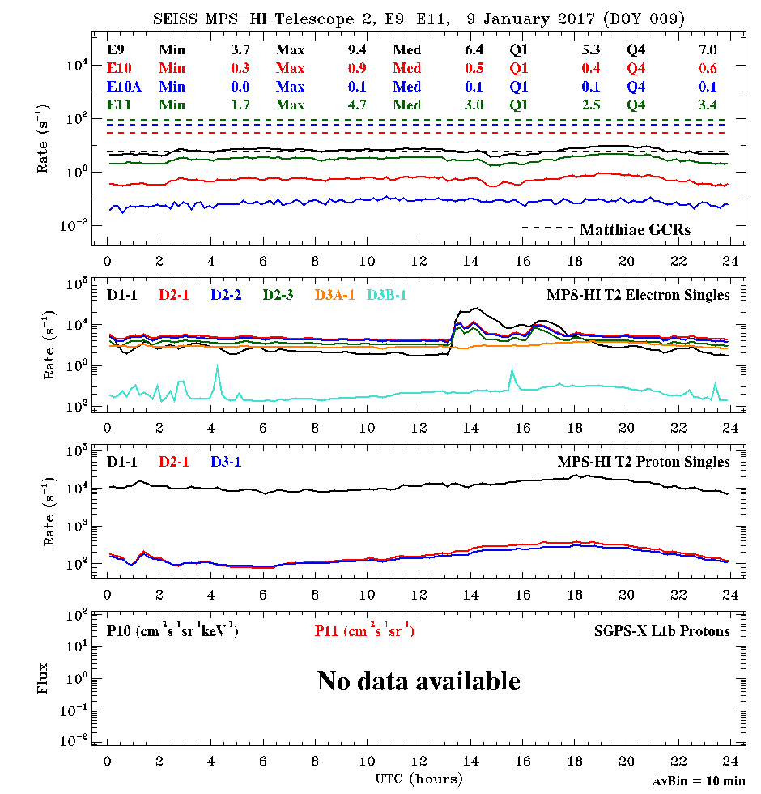
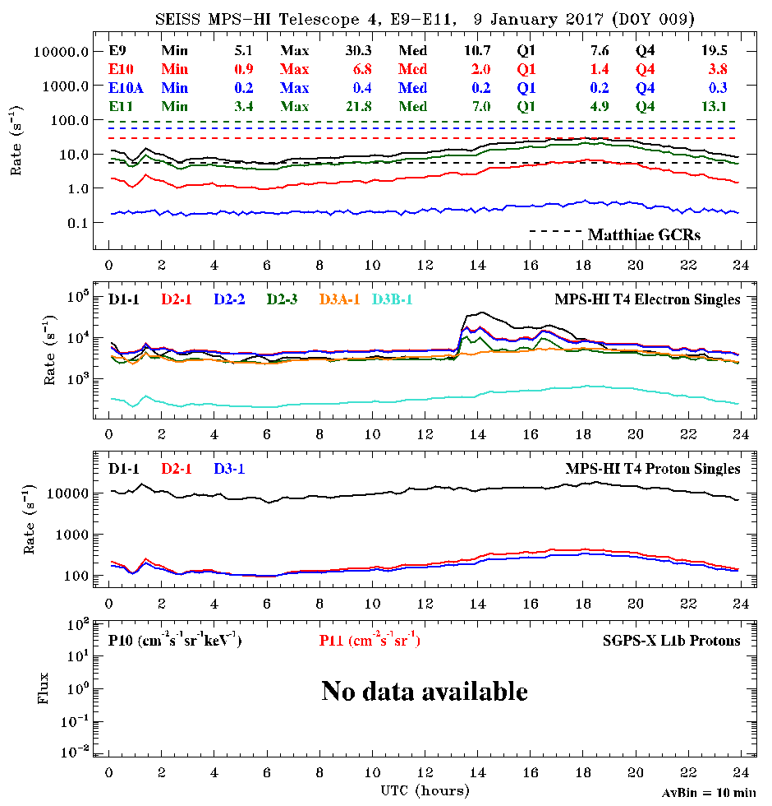
09 Jan: a few spikes in T2 D3B-1, no E11 effect
MPS-HI Etel2 Noise Issue
Telescope 2
Telescope 4
Telescope 4 provides a ‘well-behaved’ case for comparison

Slide 63
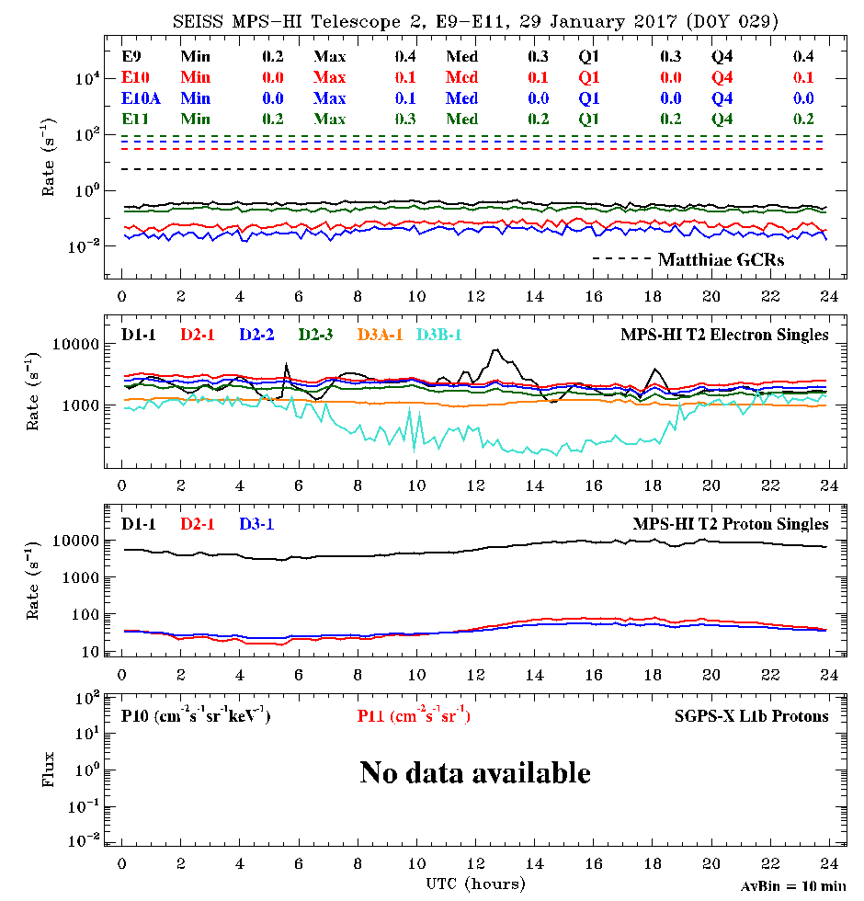
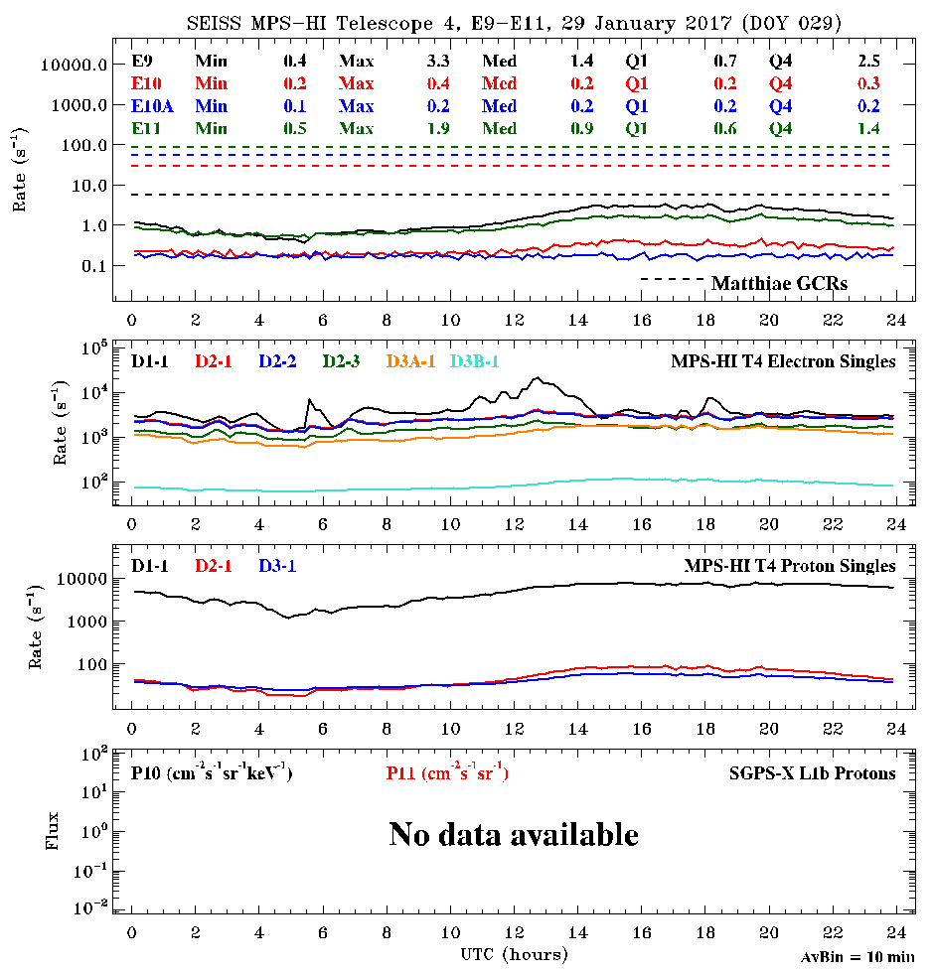
29 Jan: diurnal elevated noise pattern in T2 D3B-1 but no obvious E11 effect
MPS-HI Etel2 Noise Issue
Telescope 2
Telescope 4
Telescope 4 provides a ‘well-behaved’ case for comparison

Slide 64
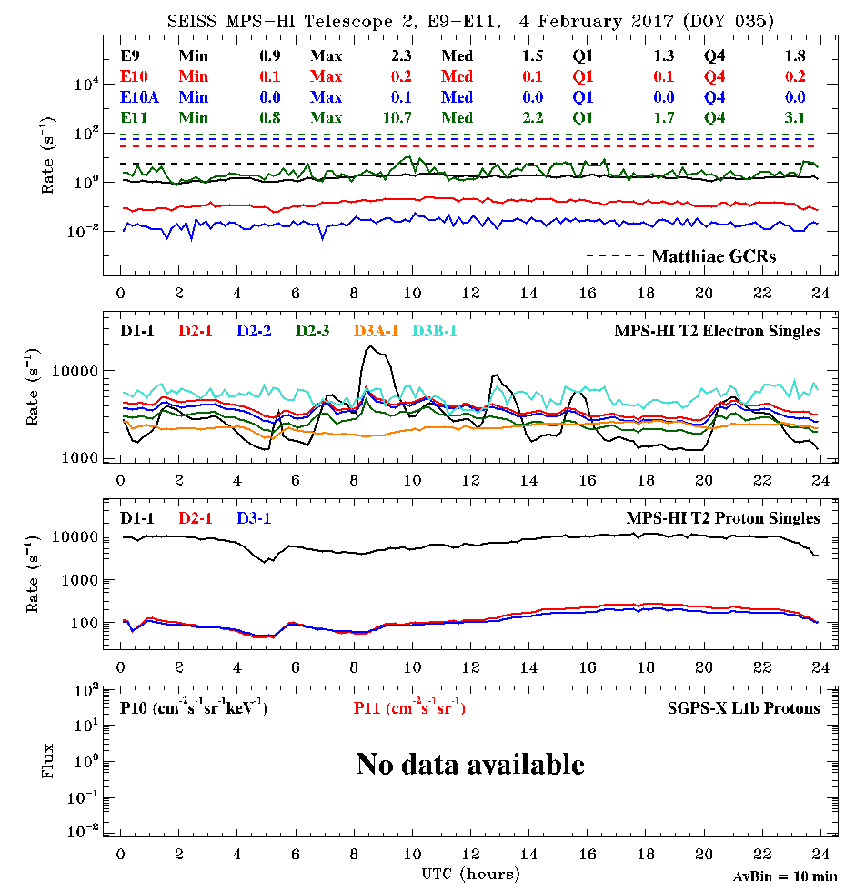
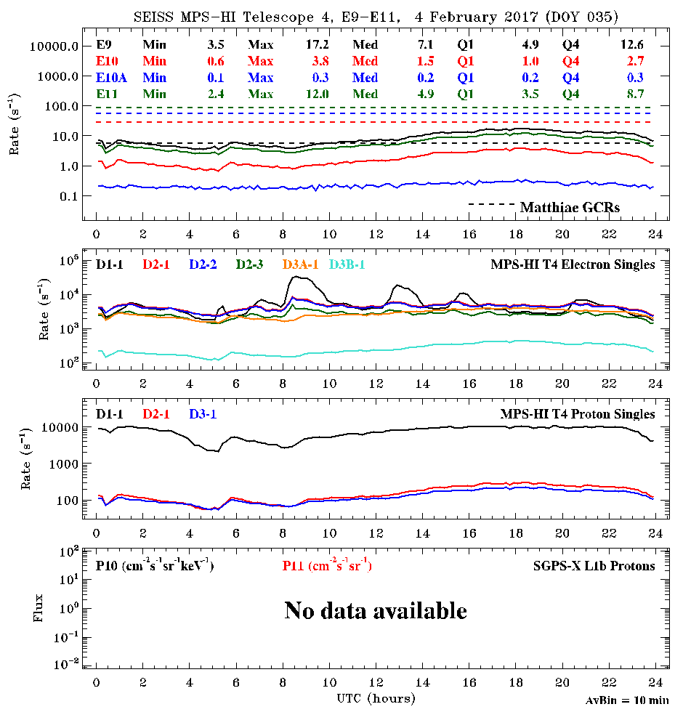
04 Feb 2017: noise continuously elevated in T2 D3B-1; E11 noisy
MPS-HI Etel2 Noise Issue
Telescope 2
Telescope 4
Telescope 4 provides a ‘well-behaved’ case for comparison

Slide 65
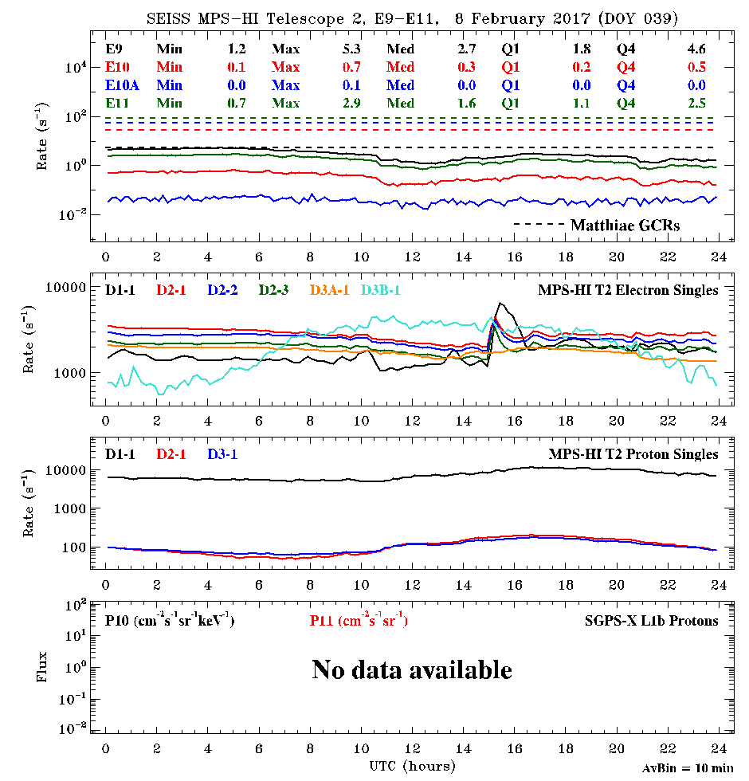
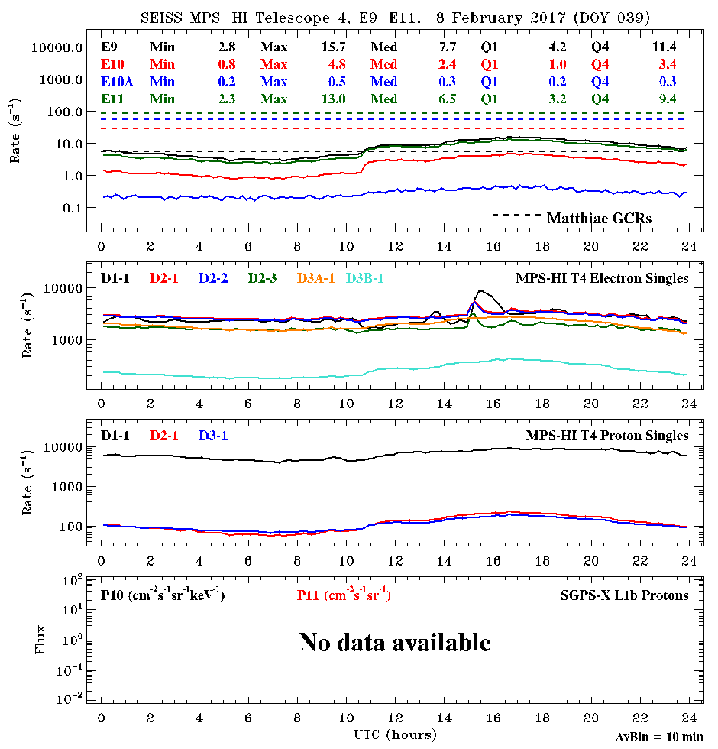
8 Feb: noise in T2 D3B-1 shows opposite diurnal variation, E11 no longer noisy
MPS-HI Etel2 Noise Issue
Telescope 2
Telescope 4
Telescope 4 provides a ‘well-behaved’ case for comparison

Slide 66
2. Development of a Bowtie Inversion Technique for Real-Time Processing of the GOES-R SEISS MPS-HI Electron Channels

Slide 67
Forward Model
Each channel has a geometrical factor (units cm² sr)
  Function of energy
  Derived by integrating channel effective area over angle assuming isotropic flux
  Effective area is measured in a beam or simulated using Geant4
The count rate R is the observable (L0)
The challenge is to unfold flux j(E) from the observations using characterization of broad energy channels
Count rate (L0)
Differential Flux (proxy or L1b)
Geometrical factor (calibration and simulations)

Slide 68
Motivation of Bowtie analysis
Inverse model based on the baseline calibration algorithm: Flux = R⁻¹_{ij} Counts
R_{ij} : Geometric factor matrix, derived from simulations/data and scaled/shifted based on electron measurements
Baseline algorithm has substantial errors in the electron flux determination, especially for channels E7-E10, E11
Attempt to replace R_{ij} with a diagonal array produced by the Bowtie technique
Yields an energy/geometric factor pair applicable to a wide range of energy spectra, and for which the geometric factor error is minimized
Use CRRES satellite proxy energy spectra (unlike previous applications using analytical spectra), properly extrapolated to low and high energies
Results of Bowtie analysis
Bowtie technique performs better than the baseline method overall
Baseline performs better, however, during the storm of 24 March 1991
Using a Bowtie set trained on the storm period yields better results, but the Bowtie set trained on the entire 1990-1991 CRRES data set does better overall
The results for the 1990-1991 Bowtie set improve with the addition of a switch between exponential and power-law extrapolation of the CRRES HEEF data

Slide 69
Inverse Model: Bowtie Method
Differential Channels
Integral Channel
Bowtie analysis, differential:
cm² sr keV
Bowtie analysis, integral: cm² sr
L1b processing (diagonalized)
L1b processing
Range in G due to natural variability at 5th and 95th percentiles
Effective energy found using non-linear minimization of (95%ile - 5%ile)

Slide 70
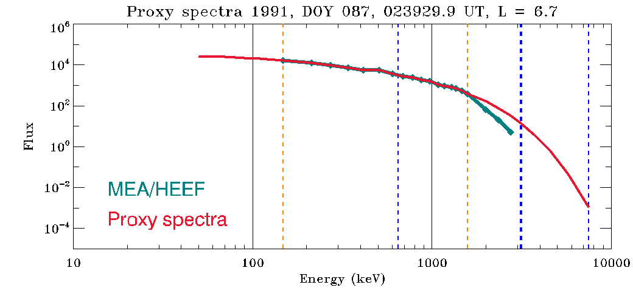
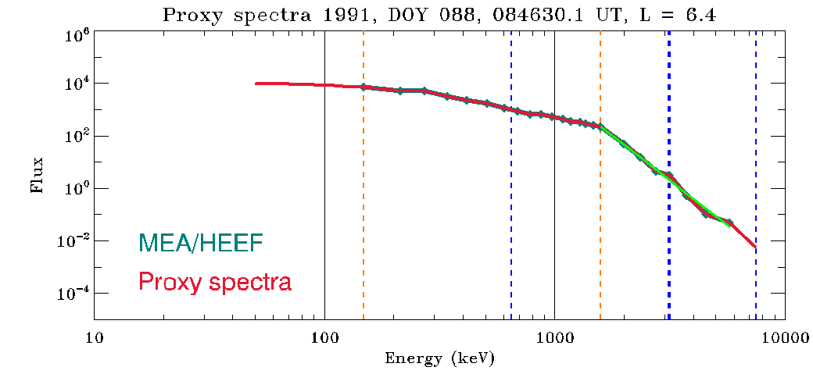
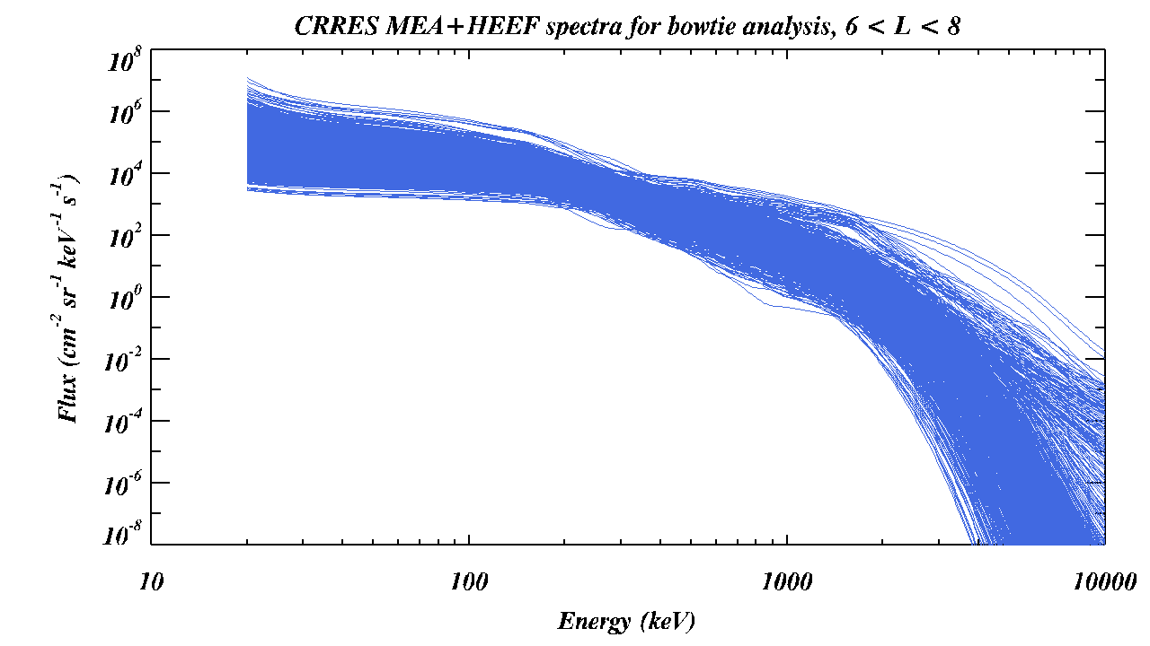
CRRES Spectra Used in Bowtie Analysis
Cross-calibrated CRRES Medium Electron Sensor A (MEA) and High Energy Electron Fluxmeter (HEEF) data set from ViRBO [Johnston, Lindstrom and Ginet, 2011; Johnston et al., 2014]
July 1990 – October 1991 in a geosynchronous transfer orbit
MEA: 148-1582 keV, 17 channels
  Higher resolution than MPS-HI
  Considered the ‘gold standard’
HEEF: 0.65-7.5 MeV, 11 channels
Use omnidirectionally averaged spectra between 6 ≤ L < 8 in which 1.6 MeV MEA and HEEF observations agree to within 2x
  Fit HEEF spectra ≥1.6 MeV to exponential or power-law spectra depending on lack or presence of data
  Extrapolate down to 50 keV by fitting exponentials to lowest-energy MEA channels
~80,000 such spectra in 1990-1991 – randomly select (& remove) 1000 spectra to use in bowtie analysis
CRRES spectra and MPS-HI geometrical factors interpolated to a common logarithmically-spaced grid of 501 points (20-10000 keV)
1000 randomly selected CRRES MEA + HEEF spectra from 1990-1991 used for bowtie analysis

Slide 71
Conversion of bowtie results to LUT

Slide 72
3. ADR 427 SGPS+X Verification

Slide 73
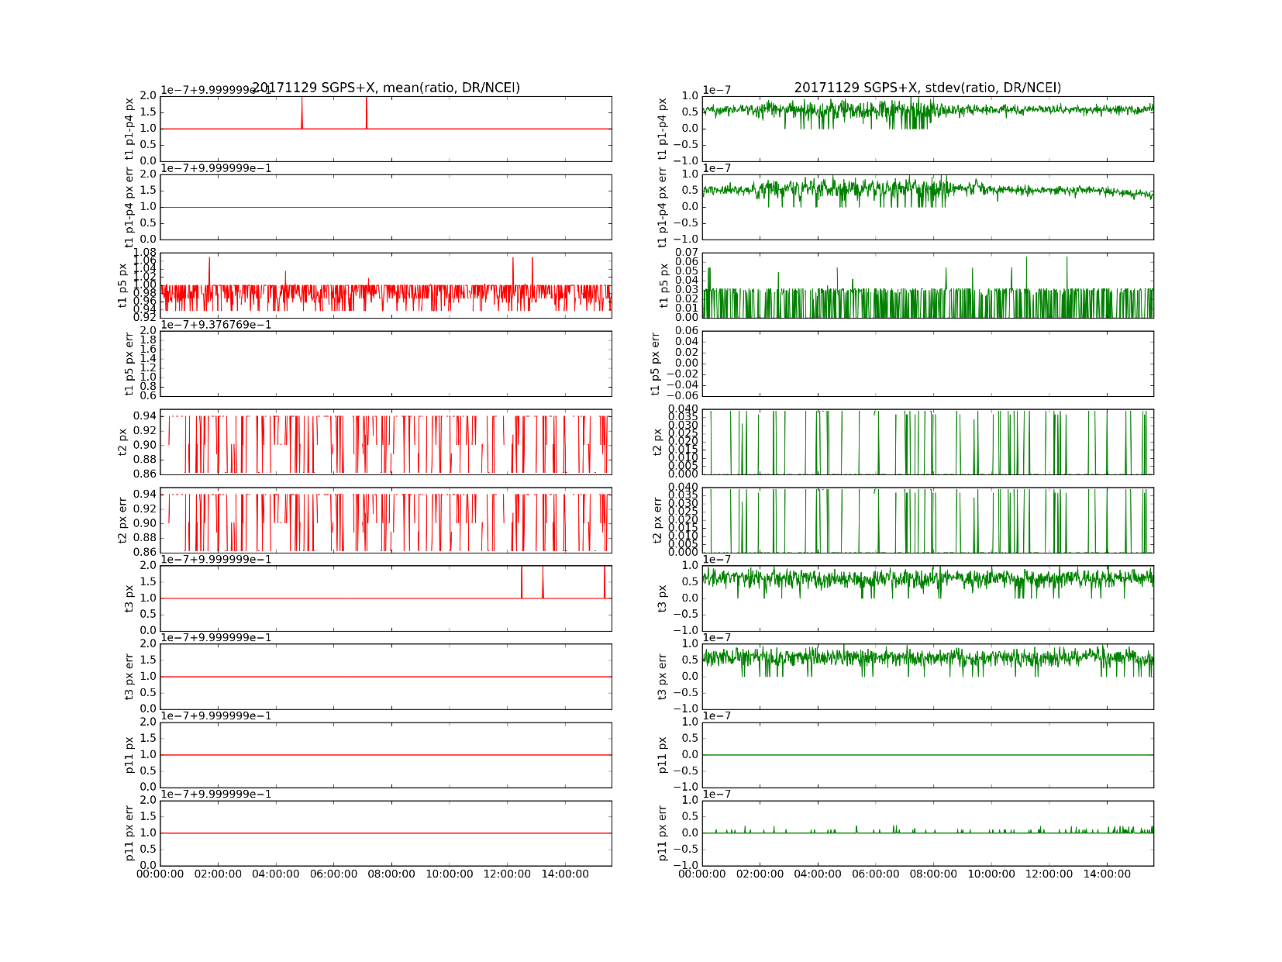
SGPS+X
29 Nov 2017
ADR427: Verification of successful fix in DE
T2 and T1 P5 issue covered by ADR491, does not affect MPS-HI
{
P11 +X ratio:
mean = 1.0, stdev ~ 1e-8

Slide 74
4. PLPT-SEI-002 Pitch Angle Plots

Slide 75
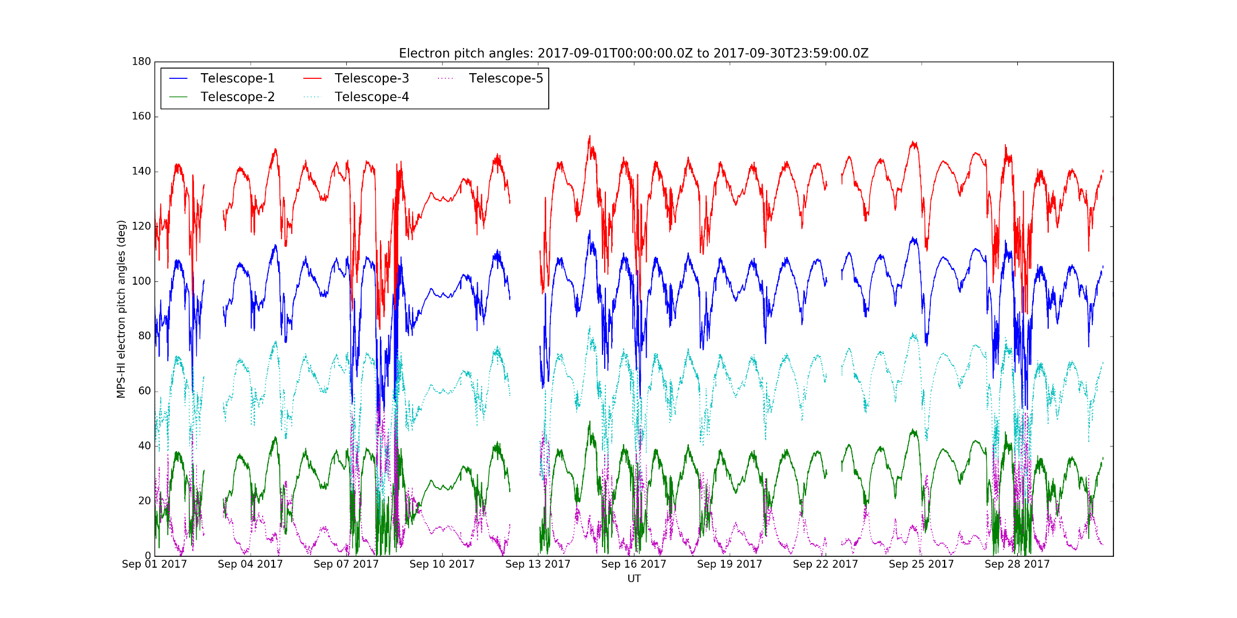
G16 MPS-HI Pitch Angles,
September 2017 (at 90⁰W)
Calculated from 1-min averages of MAG L1b in body-reference-frame coordinates

Slide 76
G13 MAGE/PD Pitch Angles,
September 2017 (at 75⁰W)
Telescope Order, North-to-South
MAGE/PD | MPS-HI E | MPS-HI P
9 | 3 | 1
6 | 1 | 4
1 | 4 | 2
8 | 2 | 5
7 | 5 | 3

Slide 77
5. PLPT-SEI-005 Spectral Comparisons for MPS-Hi Telescopes 2-5

Slide 78
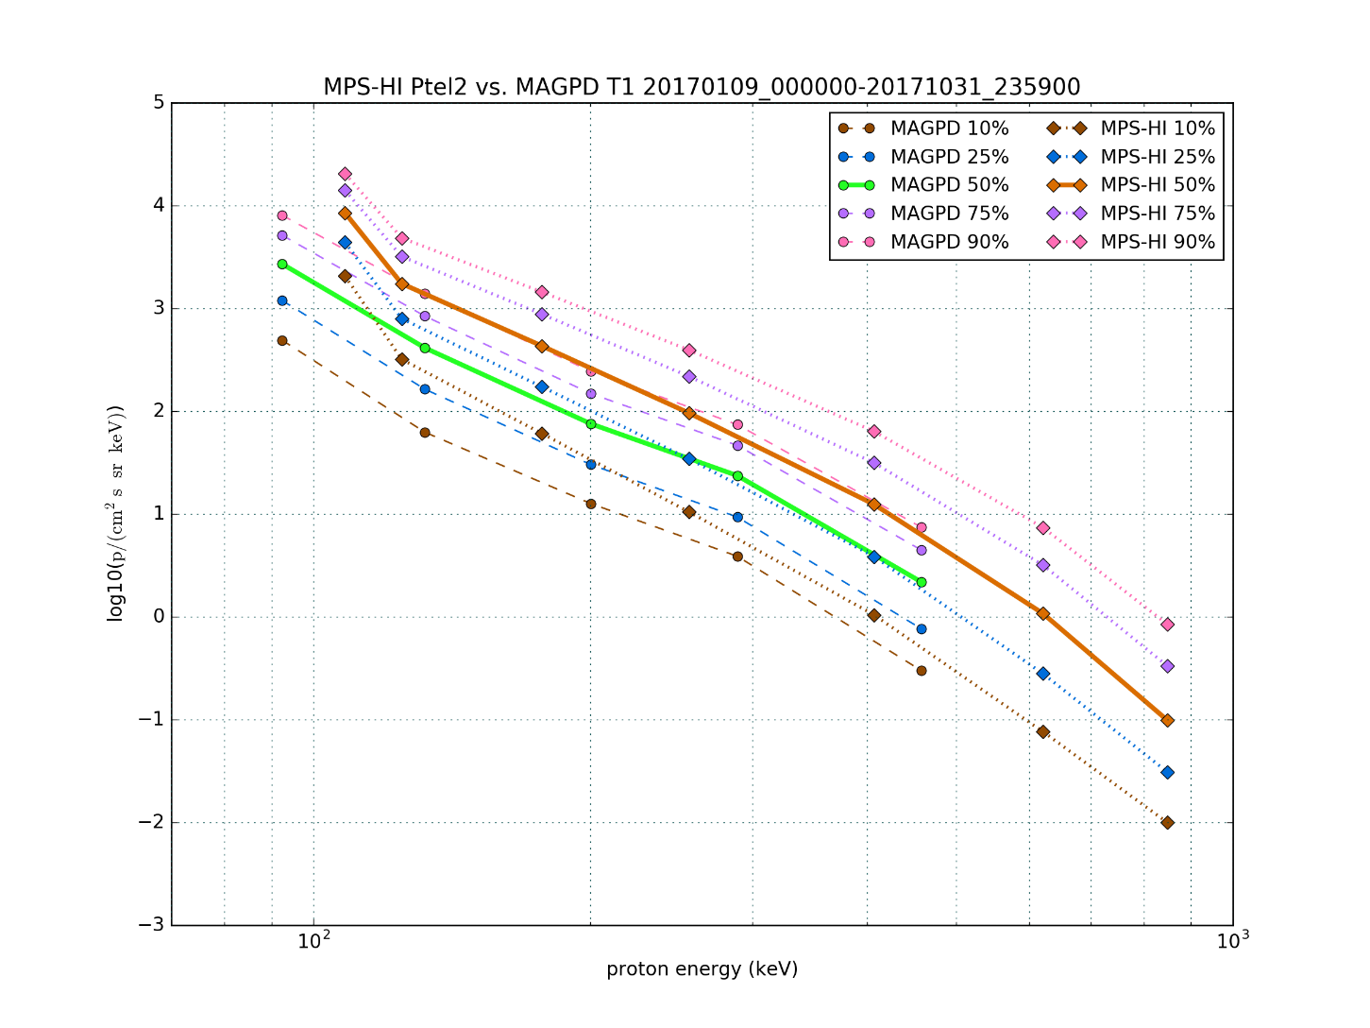
PLPT-SEI-005: Cross-Satellite Comparison of Trapped Particles
GOES-16 vs GOES-13 Protons
Telescope Order, North-to-South
MAGE/PD | MPS-HI E | MPS-HI P
9 | 3 | 1
6 | 1 | 4
1 | 4 | 2
8 | 2 | 5
7 | 5 | 3
MAGPD systematically low – due to radiation damage?
Contamination in MAGPD by MeV electrons?
Bowtie analysis used on MAGPD.

Slide 79
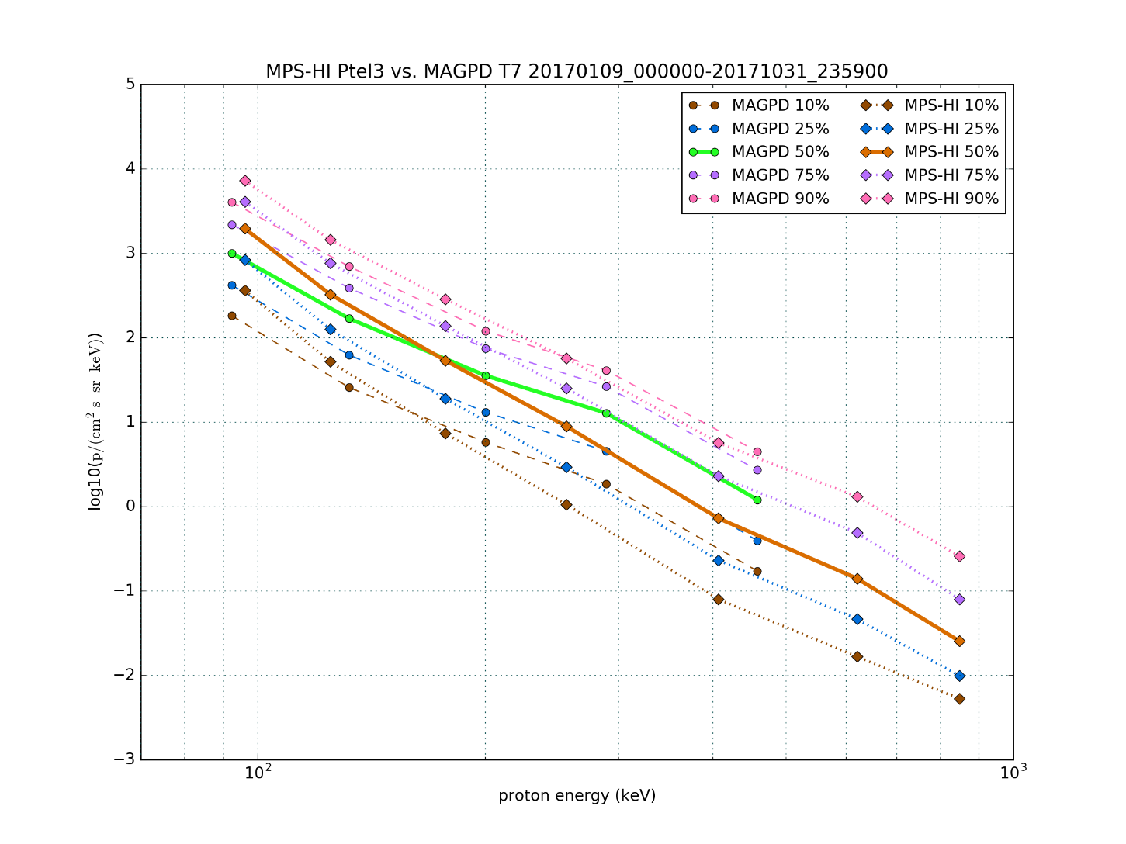
PLPT-SEI-005: Cross-Satellite Comparison of Trapped Particles
GOES-16 vs GOES-13 Protons
Telescope Order, North-to-South
MAGE/PD | MPS-HI E | MPS-HI P
9 | 3 | 1
6 | 1 | 4
1 | 4 | 2
8 | 2 | 5
7 | 5 | 3
MAGPD systematically low – due to radiation damage?
Contamination in MAGPD by MeV electrons?
Bowtie analysis used on MAGPD.

Slide 80
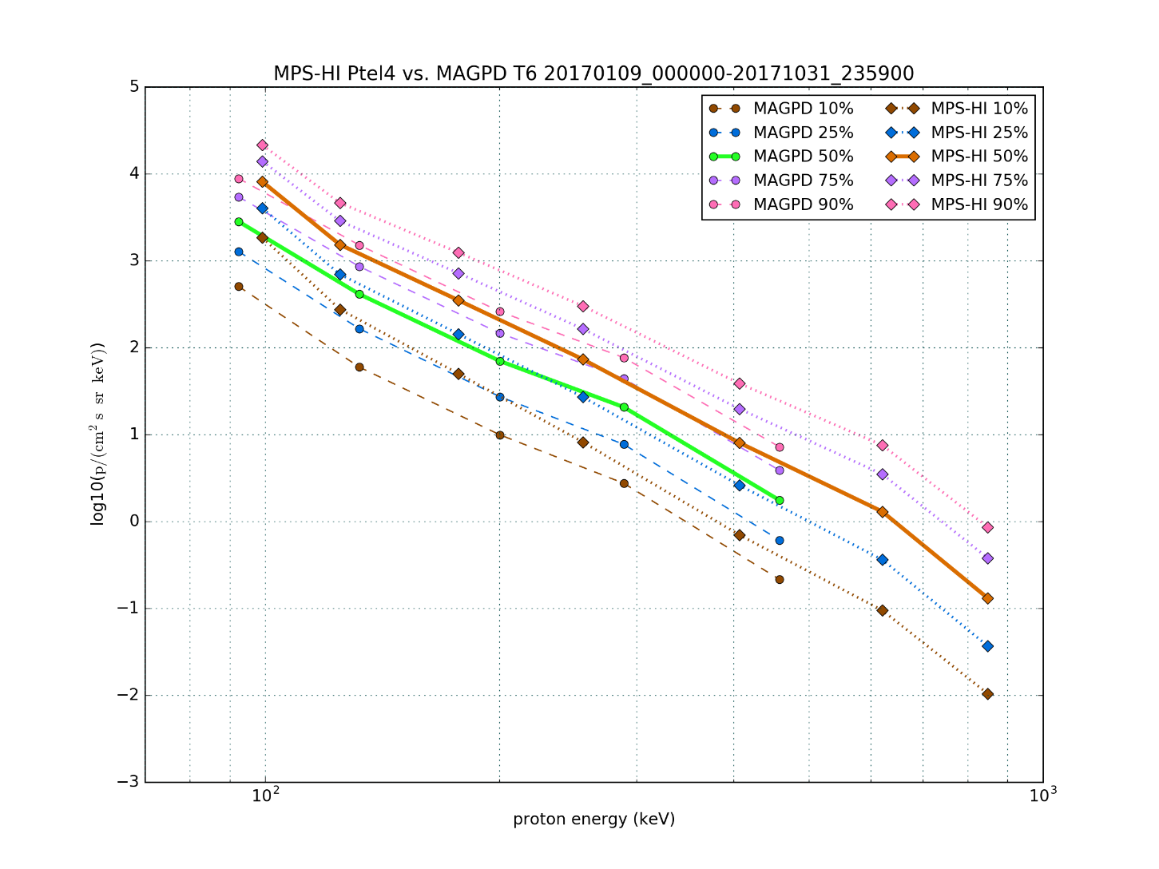
PLPT-SEI-005: Cross-Satellite Comparison of Trapped Particles
GOES-16 vs GOES-13 Protons
Telescope Order, North-to-South
MAGE/PD | MPS-HI E | MPS-HI P
9 | 3 | 1
6 | 1 | 4
1 | 4 | 2
8 | 2 | 5
7 | 5 | 3
MAGPD systematically low – due to radiation damage?
Contamination in MAGPD by MeV electrons?
Bowtie analysis used on MAGPD.

Slide 81
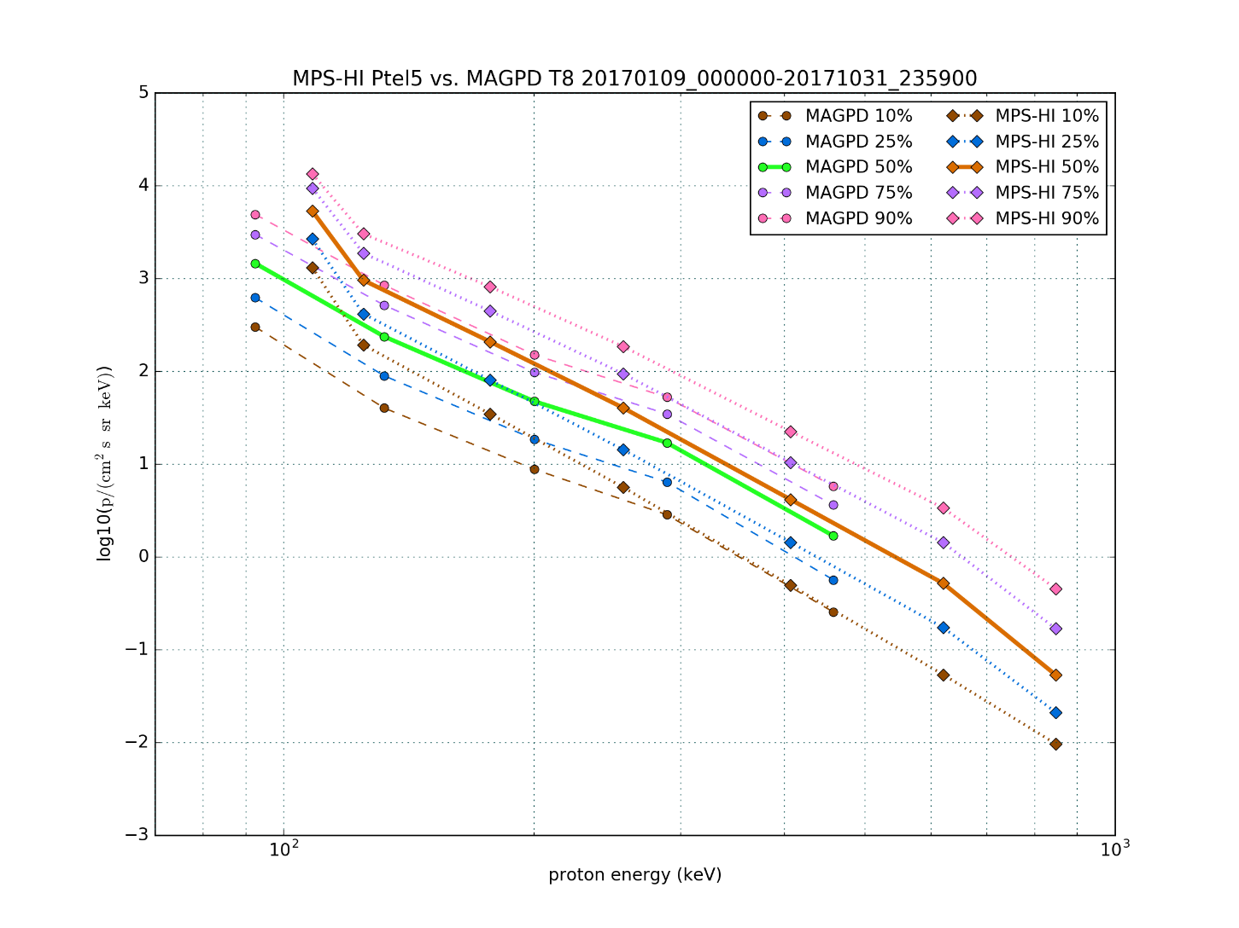
PLPT-SEI-005: Cross-Satellite Comparison of Trapped Particles
GOES-16 vs GOES-13 Protons
Telescope Order, North-to-South
MAGE/PD | MPS-HI E | MPS-HI P
9 | 3 | 1
6 | 1 | 4
1 | 4 | 2
8 | 2 | 5
7 | 5 | 3
MAGPD systematically low – due to radiation damage?
Contamination in MAGPD by MeV electrons?
Bowtie analysis used on MAGPD.

Slide 82
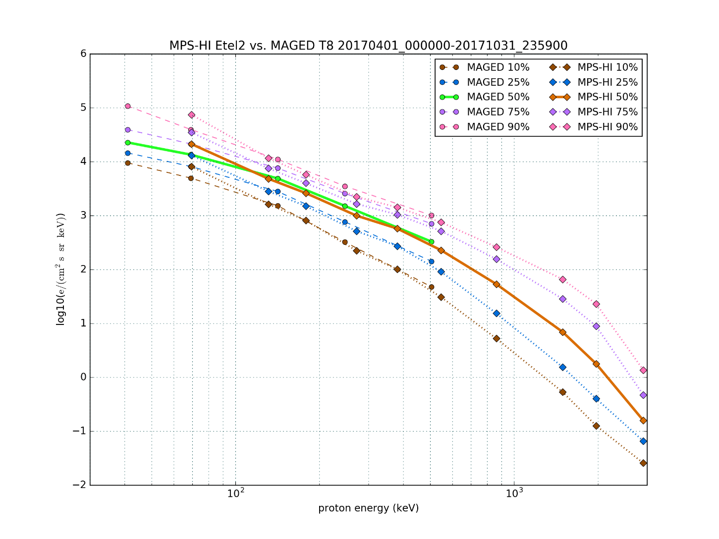
PLPT-SEI-005: Cross-Satellite Comparison of Trapped Particles
GOES-16 vs GOES-13 Electrons
Telescope Order, North-to-South
MAGE/PD | MPS-HI E | MPS-HI P
9 | 3 | 1
6 | 1 | 4
1 | 4 | 2
8 | 2 | 5
7 | 5 | 3
E1S high relative to MAGED
Good agreement >100 keV
Bowtie analysis used on MAGED.

Slide 83
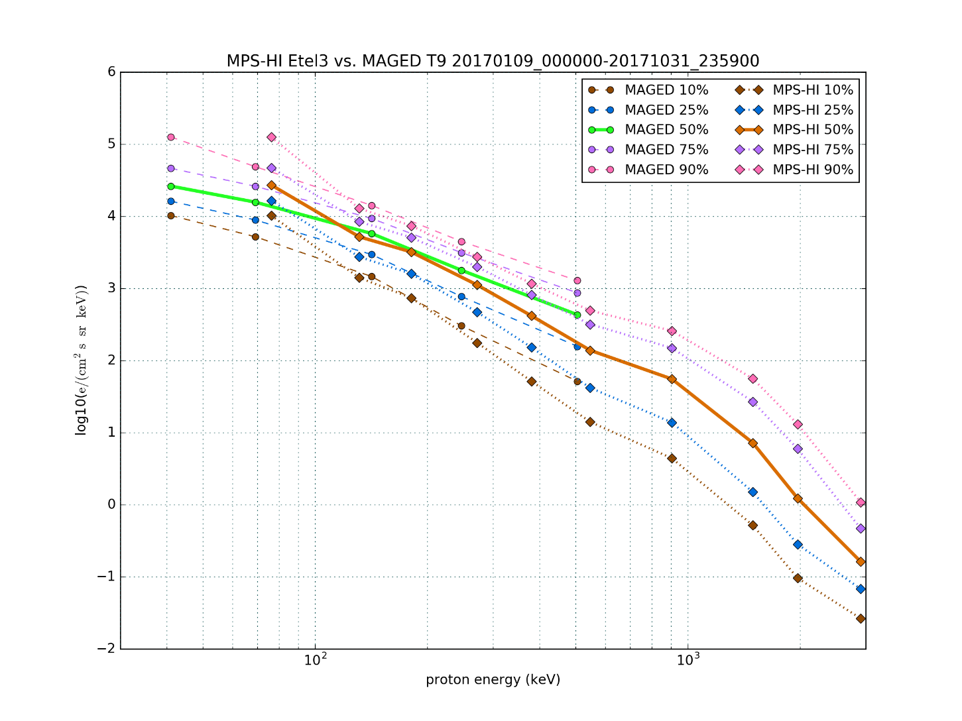
PLPT-SEI-005: Cross-Satellite Comparison of Trapped Particles
GOES-16 vs GOES-13 Electrons
Telescope Order, North-to-South
MAGE/PD | MPS-HI E | MPS-HI P
9 | 3 | 1
6 | 1 | 4
1 | 4 | 2
8 | 2 | 5
7 | 5 | 3
E1S high relative to MAGED
Bowtie analysis used on MAGED.

Slide 84

PLPT-SEI-005: Cross-Satellite Comparison of Trapped Particles
GOES-16 vs GOES-13 Electrons
Telescope Order, North-to-South
MAGE/PD | MPS-HI E | MPS-HI P
9 | 3 | 1
6 | 1 | 4
1 | 4 | 2
8 | 2 | 5
7 | 5 | 3
Dip in E3 supported by results of SEI-002
Bowtie analysis used on MAGED.

Slide 85

PLPT-SEI-005: Cross-Satellite Comparison of Trapped Particles
GOES-16 vs GOES-13 Electrons
Telescope Order, North-to-South
MAGE/PD | MPS-HI E | MPS-HI P
9 | 3 | 1
6 | 1 | 4
1 | 4 | 2
8 | 2 | 5
7 | 5 | 3
E1S high relative to MAGED
Good agreement >100 keV
Bowtie analysis used on MAGED.

