Slide 1
Peer Stakeholder-Product Validation Review (PS-PVR)
For the Full Maturity of GOES-16 and -17 SEISS MPS-LO L1b Product
October 28, 2020
GOES-R Calibration Working Group (CWG)
Presenter: Brian Kress
Contributors: Athanasios Boudouridis, Juan Rodriguez
NOAA NCEI / CIRES
This review incorporates results from Assurance Technology Corporation PLTs.

Slide 2
Outline
MPS-LO Overview
Instrument Status Overview
Product Quality Evaluation
  Instrument and GPA Anomalies and Resolution Status
  PLPTs Supporting Assessment for Full Status
Full Maturity Assessment
Summary and Recommendations

Slide 3
MPS-LO OVERVIEW
GOES-16 and -17 MPS-LO L1b Product Full PS-PVR

Slide 4
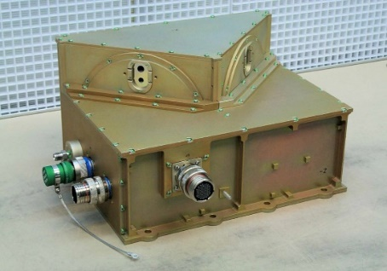
Space Environment In-Situ Suite (SEISS)
Magnetospheric Particle Sensor –
Low Energy (MPS-LO)
Magnetospheric Particle Sensor – Low Energy (MPS-LO):
    Electrostatic analyzers (2 per species)
    14 angular zones (12 unique), 2 background zones
    30 eV-30 keV electrons: 15 energies
    30 eV-30 keV ions: 15 energies
    L1b product: Low energy magnetospheric electron and proton fluxes (counts/cm²-s-str-keV)
    SW applications: GOES frame charging and spacecraft charging environment
Magnetic field vector from GOES tri-axial fluxgate magnetometer is essential for calculating pitch angle for each telescope / angular zone
GOES-16 SEISS sensors turned on 08 Jan 2017
GOES-17 SEISS sensors turned on 24 April 2018
SEISS MPS-LO designed, built, tested and calibrated by Assurance Technology Corporation (ATC)

Slide 5
MPS-LO Ion and Electron Counts in
14 Zones and 15 Energy-Channels
Energy Channels:
E1: 30,000 eV
E2: 18,300 eV
E3: 11,200 eV
E4: 6,280 eV
E5: 4,820 eV
E6: 2,550 eV
E7: 1,550 eV
E8: 950 eV
E9: 580 eV
E10: 350 eV
E11: 220 eV
E12: 130 eV
E13: 81 eV
E14: 49 eV
E15: 30 eV
Flux = counts (in L0 data) / instrument geometric factor
2 x 14 x 15 = 420 flux time-series in MPS-LO L1b data
Right Sensor
Head (RSH)
Left Sensor
Head (LSH)
Northward
Z6R (Z7R) and Z6L (Z7L) fluxes are expected to be the same due to overlapping fields of view.
30° Overlap in Coverage
-Z Anti-Earthward

Slide 6
A Few Comments About MPS-LO
NOAA’s first plasma instrument on GOES!
Measures thermal population (~1keV at geosynchronous)
Measuring the low energy component of a plasma is notoriously difficult – Plasma instruments are known to require special care.
Surface charging on spacecraft is associated with <50 keV electrons [NASA, “Mitigating in-space charging effects – a guideline,” NASA Technical Handbook NASA- HDBK-4002A, March 3, 2011].
Electrostatic discharge (ESD) due to spacecraft charging causes most of the environmentally related anomalies on spacecraft, and surface charging has caused the most serious anomalies, i.e., those that have resulted in the loss of the mission [Koons et al., 1999].
In addition to its operational use at SWPC, we are looking forward to making this data available to the science community.

Slide 7
MPS-LO Primary Operational Use
Data stream for NOAA-NWS SWPC
MPS-LO Density and Temperature Moments and Level of Spacecraft Charging
MAG L1b 1m averages
Level 1b
Level 2
SEISS MPS-LO L2 1m averages and the Density and Temperature Moments and Level of Spacecraft Charging algorithm are phase 2 algorithms. MPS-LO 5m averages is phase 3.
L2 densities and temperatures are also used in the L2 Magnetometer Magnetopause Crossing Detection algorithm as an indicator of magnetopause crossings at geosynchronous.
The L2 Moments algorithm identifies ion line signatures of SC charging and uses the ion line to determine the spacecraft potential:
When an ion line is not present, the L2 Moments routine uses an empirical relation between densities, temperatures, and level of charging to monitor SC charging.
1 sec.
Ion line
Backgrounds from heightened radiation belt fluxes
MPS-LO spectrogram of count rates from zone 4, with ion line signatures of spacecraft charging. The first ion line enhancement appears near 1 keV at ~5:30-6:30 UT during an eclipse period.
UT Hours
On 22 March 2017

Slide 8
INSTRUMENT STATUS OVERVIEW
GOES-16 and -17 MPS-LO L1b Product Full PS-PVR

Slide 9
Schedule of Previous Maturity Levels
GOES-16 SEISS sensors turned on 08 Jan 2017
GOES-17 SEISS sensors turned on 24 April 2018
Beta level (Vendor) PLTs and (NCEI) PLPTs completed
Beta level PS-PVRs
  G16 SEISS Beta PS-PVR 10 February 2017
  G17 SEISS Beta PS-PVR 10 August 2018
Provisional level PLPTs completed
Provisional level PS-PVRs
  G16 MPS-LO Provisional PS-PVR, March 29, 2019
  G17 MPS-LO Provisional PS-PVR, August 14, 2019
Full validation level PLPTs completed
Ongoing
  Weekly In-flight calibrations (IFCs)
  MCP HV optimizations every 6 mos. to yearly (vendor)
  continuing cal/val work (NCEI)

Slide 10
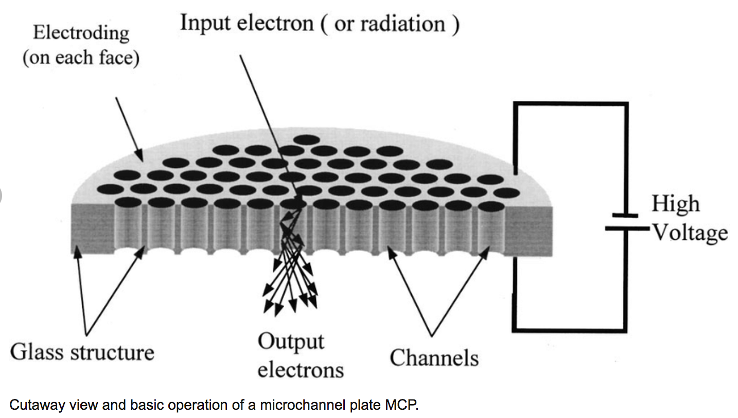

MPS-LO MCP HV Optimization/Adjustments
proton
Figure from Yi, W. (2001), Characteristic features of new electron-multiplying channels in a field emission display, J. Vac. Sci. Technol. B 19(6), 2247-2251.
$\sim$2000V
Optimize setting of high voltage (HV) bias across micro-channel plate (MCP) detector (type of electron multiplier).
Goal is to set HV low enough so as not to introduce excessive noise and crosstalk but high enough so that we operate in/near saturation (uniformity of charge exiting MCPs with individual particle hit).
MCP HV settings during ground calibration (CDRL79, SEISS-D-ML079-2.pdf)
  G16/FM1 HV at step 26 for both electrons and ions;
  G17/FM2 HV at step 27 for electrons and 26 for ions; initially operated at 25/26
MCP HV Settings On-orbit (e.g., step 25 is 2450. Volts)
  G16/FM1 EMCP/IMCP initially operated at steps 25/26; EMCP raised to step 26 on 6 Aug 2019 (SEISS-TR-Y121-1-13_MPSLO_HV_Optimization_Final.pdf)
  G17/FM2 EMCP/IMCP operated at steps 25/26.

Slide 11
Summary of MPS-LO Instrument and GPA Anomalies and Resolution Status (1)
High Backgrounds / Negative Fluxes
  Resolution strategy: ADRs 326, 763, 764 (all closed), plus empirical derivation and periodic update of background removal coefficients.
  Source of backgrounds not fully understood.
Interzonal Crosstalk
  G16/FM1 crosstalk seen in on-orbit data. No measured crosstalk correction coefficients. Analysis to estimate correction coefficients possible but not developed.
  G17/FM2 crosstalk measured in left sensor head electrons (LSHE) in ground/beam calibrations. Right and left sensor head crosstalk apparent in on-orbit data (slide 26). LSHE crosstalk correction coefficients determined in ground calibrations with EMCP HV at step 27. Currently at step 25.
  No associated ADRs
Continued →
* Unless noted with “G16/FM1” or “G17/FM2”, all instrument description and issues pertain to both MPS-LO units.

Slide 12
Summary of MPS-LO Instrument and GPA Anomalies and Resolution Status (2)
Evidence for significant error in absolute values of reported fluxes (e.g., seen in PLPT-SEI-003 MPS-LO Zone Cross-Comparison, slides 43 & 44) Possible sources are
  Gradual decrease in count rate due to declining MCP response (seen on slide 37).
  MCPs not operated in full saturation to reduce crosstalk and noise (e.g., slide 37 in SEISS-TR-Y121-2-15_MPSLO_HV_Optimization-Ops-3_FINAL).
  MCP HV setting different from ground/beam calibrations (slide 10).
  May be insufficient or too much background removal.
  No crosstalk correction.
Degraded performance of lower energy ion channels due to persistent high background counts (No known/planned fix)
In-flight calibration pulses (spikes) in science data (ADR 780, not closed)
Dropout in low energy electron channels during arc jet firing
(ADR 596, closed)
* Unless noted with “G16/FM1” or “G17/FM2”, all instrument description and issues pertain to both MPS-LO units.

Slide 13
MPS-LO Specific ADRs/WRs
To-date
ADR | WR | Short Description | Status | G16 | G17 | Expected Closure
NA | 3907 | Excessively high MPS-LO backgrounds | Open | √ | √ | 1. Allow MCPs to outgas 2. Re-run HV adjustment PLT with modified procedure. Goal: set HV at least one step lower on ion and electron MCPs.
326 | 5424 | MPS-LO GPA Changes | Closed | √ | √ | 1/18/2019 as part of DO.07.01.00
596 | 5800 | Make Arc Jet Flag available for SEISS MPS-LO | Verified | √ | √ | DO.09.01.00
763 | 6978 | G16 MPS-LO LUT Update | Closed | √ |  | DO.07.01.00
764 | 6979 | G17 MPS-LO LUT Update | Closed |  | √ | DO.07.01.00
780 | 6845 | GPA update for SEISS MPS-HI and MPS-LO L1b IFC leakage | In-work | √ | √ | DO.09.01.00
1009 | 7369 | G17 MPS-LO LUT Update | Closed |  | √ | (PR.08.03.04) 10/2/19
1114 | 8093 | G16 MPS-LO LUT Update | Closed | √ |  | DO.09.01.00
1124 | TBD | G17 MPS-LO LUT Update | Closed? |  | √ | TBD (likely with DO.09.02.00 on 10/27)

Slide 14
PRODUCT QUALITY EVALUATION
GOES-16 and -17 MPS-LO L1b Product Full PS-PVR
* All data presented herein is Ground Segment Level-1b unless otherwise noted.

Slide 15
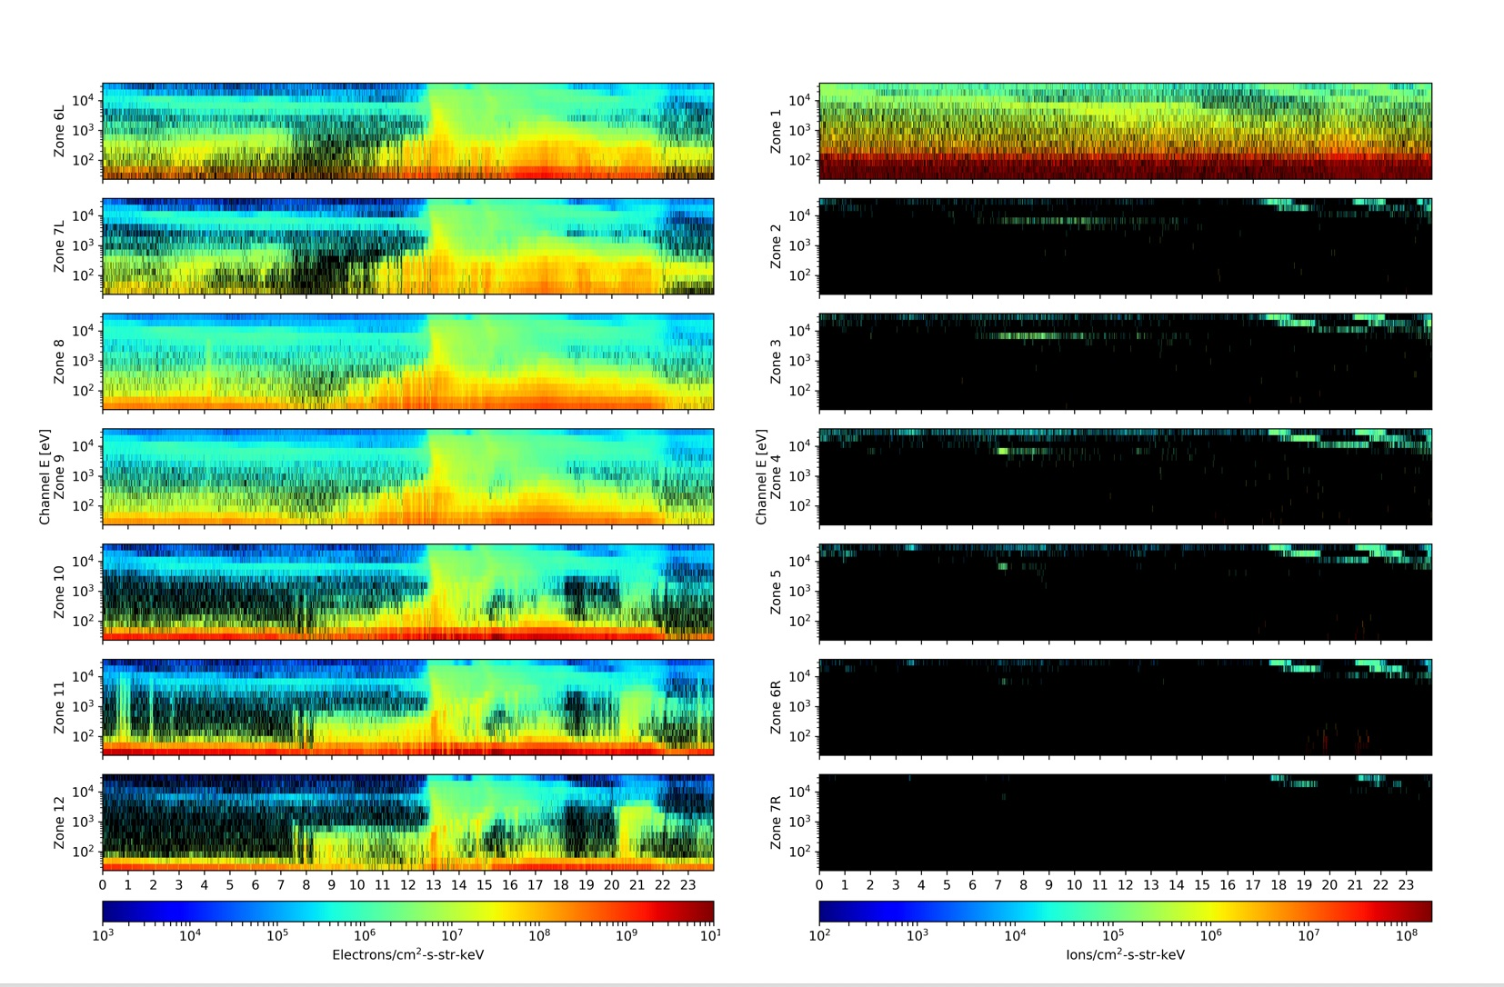
High Backgrounds/Negative Fluxes:
G17 MPS-LO L1b Fluxes on 4 Feb 2019
(Prior to implementation of ADR 326, MPS-LO GPA Changes)
Left Sensor Head Electrons
Right Sensor Head Ions
Black pixels indicate negative flux (non-physical), due to excessive background subtraction.
Negative flux (black pixels) due to high backgrounds: Corrected counts = total counts – background counts
Addressed by ADR326/WR5860 MPS-LO GPA Changes, in build DO.07.01.00,
and ADRs 763 and 764 (G16 and G17 MPS-LO LUT updates).

Slide 16
High Backgrounds/Negative Fluxes:
MPS-LO Background Removal
In-band
(electrons or ions)
Penetrating radiation / Backgrounds
~
Sweep voltage
(selects 15 energies)
BG
In-band
Illuminated zone accumulates
both in-band and BG counts
Unilluminated
Background
Zone
14 zones
(viewing directions)
Simplified background (BG) removal expression :
Corrected Counts = Total counts – BG Removal Coefficient x BG Counts
Pre- ADR326 CDRL80 expression has 4 BG removal coefficients, one for each species and sensor head, all were set to one in the launch version of the MPS-LO LUT. Analysis shows need for energy and zone dependent BG removal coefficients with values <1 for most energy-zone pairs. Need to characterize in-band vs. BG response for 14 zones x 15 energies for electrons and ions.

Slide 17

High Backgrounds/Negative Fluxes:
Three Actions Addressing MPS-LO Negative Fluxes
ADR326: Implement energy dependent background subtraction, previously energy-sweep averaged (Also involves non-trivial modification to error term – Complete description in ADR_326_Addendum_Revised_10-2-18.pdf.)
  $Currently: M_{m,k,i,j}=N_{m,k,i,j}^{tot.}−C_{m,k}{Avg_N}_{m,k}^{BG}$
  $Modify to: M_{m,k,i,j}=N_{m,k,i,j}^{tot.}−C_{m,k}N_{m,k,j}^{BG}$
ADR326: Generalization of background (BG) removal coefficient to include zone and energy dependence
  $C_{m,k}$ (2✕2) → $C_{m,k,i,j}$ (2✕2✕7✕15)
NCEI: Empirical derivation of BG removal coefficients (by demanding positive fluxes, averaged over some interval, using many months of data) and L1b processing G16 and G17 LUT updates (ADRs 763 and 764 ).
m = 1,2 for electrons and ions respectively.
k = 1,2 for right and left sensor heads.
r = 1-4 is species & sensor head group index,
for ions-R, ions-L, electrons-R, electrons-L.
i = 1-7 is zone index for 7 zones in each SH.
j = 1-15 is energy channel index.

Slide 18

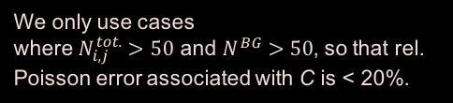
High Backgrounds/Negative Fluxes:
Empirical Determination of Background Removal Coefficients
The corrected counts M in a given zone and energy channel are the total counts N^{tot.} minus the counts from penetrating radiation
$M_{i,j}=N_{i,j}^{tot.}−C_{i,j}N^{BG}$,
where i and j are the is the zone and energy indices, respectively, and the counts in zone i due to penetrating radiation is assumed to be proportional to the counts in the associated (same species and sensor head) background zone N^{BG}.
If we demand that the flux averaged over some time-interval is non-negative, this places an upper bound on the background removal coefficient.
$${\overline{M}}_{i,j}={\overline{N}}_{i,j}^{tot.}−C_{i,j}{\overline{N}}^{BG}≥0 → C_{i,j}≤\frac{{\overline{N}}_{i,j}^{tot.}}{{\overline{N}}^{BG}}$$
where the overbar denotes an average over some time interval (e.g., 5 min. averages from 1s data). An upper bound for $C_{i,j}$ can be determined empirically by taking the minimum value of ${\overline{N}}_{i,j}^{tot.}/{\overline{N}}^{BG}$ attained over months of data
Set $C_{i,j}=Min\left[{\left(\frac{{\overline{N}}_{i,j}^{tot.}}{{\overline{N}}^{BG}}\right)}_{k}\right]$,
where k is index for the averaging interval, and we take minimum from many such intervals. An upper bound of 1 is also placed on the C coefficients.
We only use cases
where $N_{i,j}^{tot.}>50$ and $N^{BG}>50$, so that rel. Poisson error associated with C is < 20%.

Slide 19
High Backgrounds/Negative Fluxes:
Problem: Secular Change in MCP Response
All Zone 1 energy channels shown in this example.
Analysis period used for BG removal coefficients currently in LUT.
On average, Zone 1 N_{Tot.}/N_{BG} has gradually decreased about a factor of five since May 2017.
Background Coefficients will need to be periodically checked and updated
Colored diamonds to the left indicate minimum values of N_{Total}/N_{BG} found, within entire period shown.
BG removal coe. = 1 percentile value of N_{Total}/N_{BG}
New table values generated using data up to 2019 DOY 201 (not in LUT yet).
* Level-0 data used for evaluation of background removal coefficients.

Slide 20
High Backgrounds/Negative Fluxes:
Empirical Background Removal Coefficients
These tables are included in the current G16 MPS-LO LUT:
SeissMpsLoCalInrParameters(FM1A_PR_09_03_02)-652417800.0.h5
Ion Background Removal Coefficients
Electron Background Removal Coefficients
ADR326 MPS-LO GPA Changes included a LUT configuration change to accommodate the new table shown (2x2 table modified to 2x2x7x15). This updated LUT was provided by NCEI under ADR1114.

Slide 21
High Backgrounds/Negative Fluxes:
Empirical Background Removal Coefficients
These tables are included in the current G17 MPS-LO LUT:
SeissMpsLoCalInrParameters(FM2A_ADR1124)-653716700.0.h5 (in SOZ-DE test data)
Ion Background Removal Coefficients
Electron Background Removal Coefficients
ADR326 MPS-LO GPA Changes included a LUT configuration change to accommodate the new table shown (2x2 table modified to 2x2x7x15). This updated LUT was provided by NCEI under ADR1124.

Slide 22
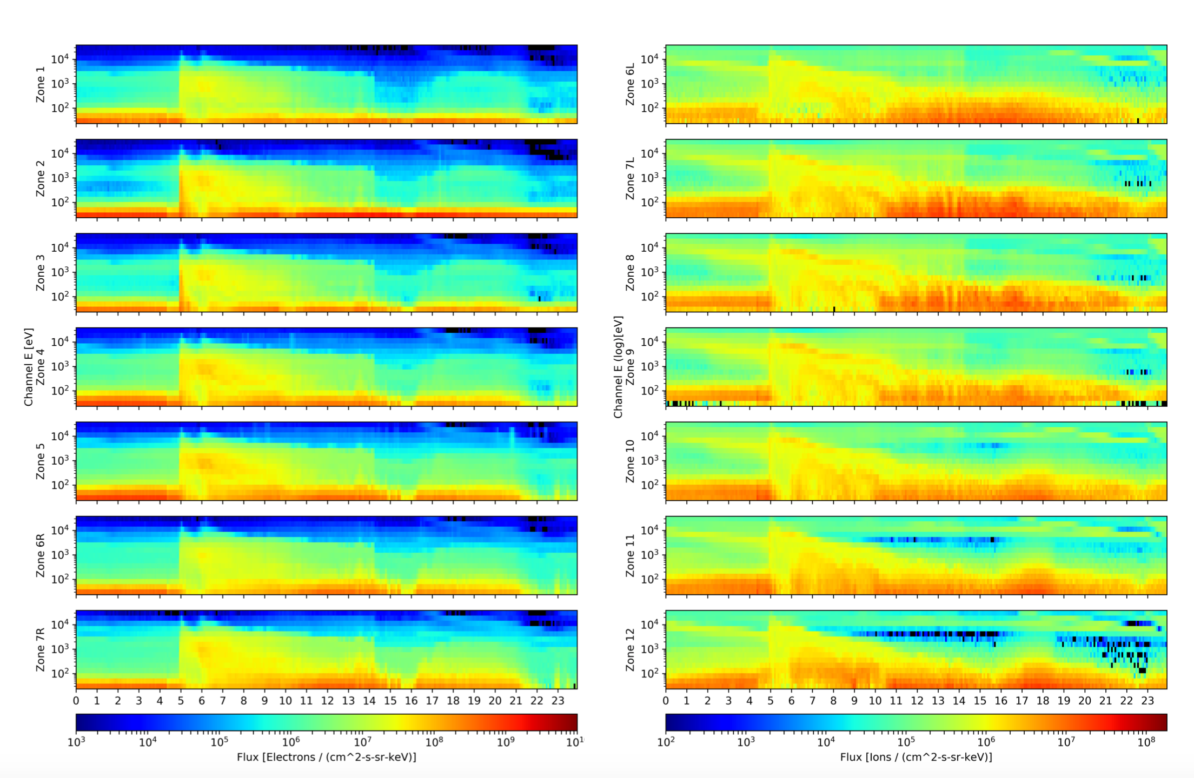
High Backgrounds/Negative Fluxes:
G16 Updated Background Removal
Right Sensor Head Electrons
Left Sensor Head Ions
Black pixels indicate negative flux (non-physical), due to excessive background subtraction.
Five-minute averaged L1b data on 7 Oct 2020 (background removal coefficients updated in Aug 2020 under ADR 1114).
The background removal coefficients are set to 1-percential of N_{tot.}/N_{BG}, so we expect ~1% black pixels.
Days with high radiation belt fluxes typically have many negative reported fluxes – Scheme for computing background removal coefficients may need to be revisited.

Slide 23
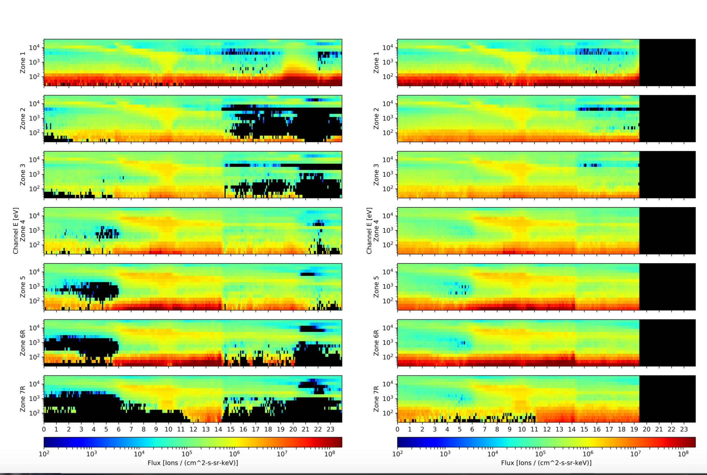
High Backgrounds/Negative Fluxes:
G17 Before and After LUT Update
L1b (Old LUT) Right Sensor Head Ions
SOZ-DE (New LUT) Right Sensor Head Ions
Data
Gap
Black pixels indicate negative flux (non-physical), due to excessive background subtraction.
Five-minute avg. L1b and SOZ-DE (test) data on 7 Oct 2020
SOZ-DE data processed with updated background removal coefficients (ADR 1124).
The background removal coefficients are set to 1-percential of N_{tot.}/N_{BG}, so we expect ~1% black pixels.

Slide 24
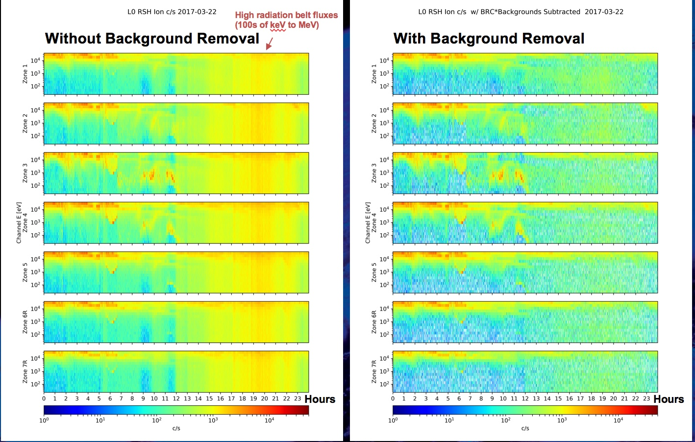
High Backgrounds/Negative Fluxes:
Background Removal Example
Example of background removal from G16/FM1 with empirically determined BG removal coefficients showing ion counts/sec., reprocessed from Level-0 data using 11 days of varying geomagnetic activity for determining BG removal coefficients.
Hours

Slide 25
Additional MPS-LO Anomalies
Interzonal Crosstalk
Effect of Arc Jet Firing
5m Period Signal of Unknown Origin in Lowest Energy Electron Channels
MPS-LO L1b In-flight Calibration (IFC) leakage
Effect of High Backgrounds on Low Energy Ions Measurement
Gradual Decline in MCP Response

Slide 26
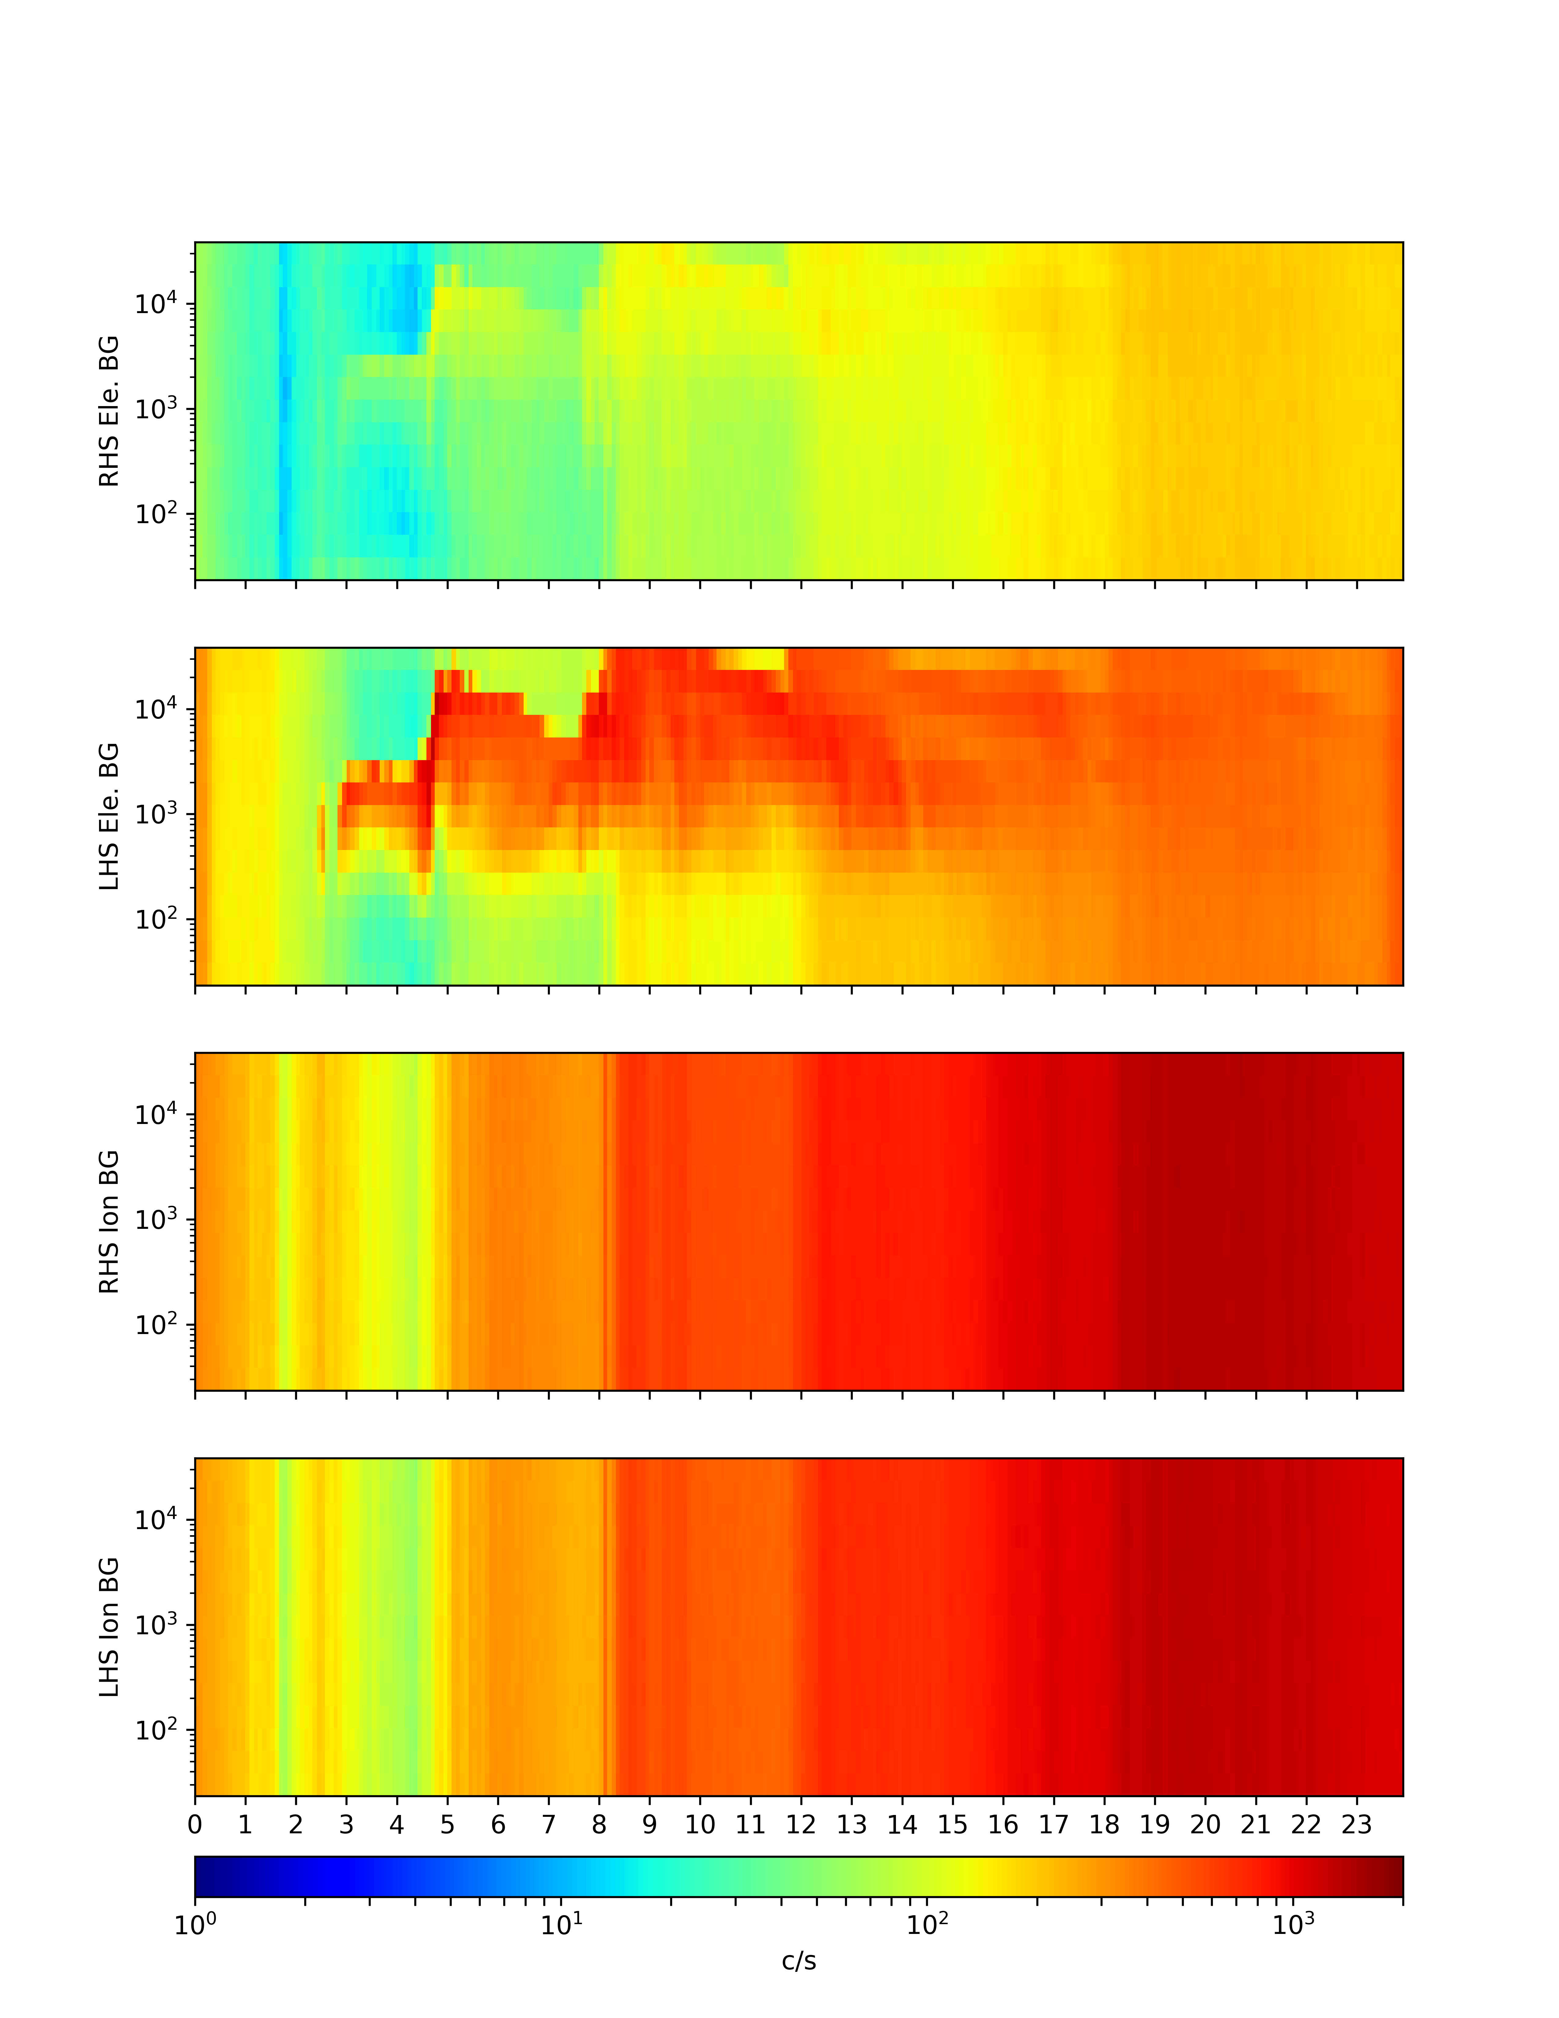
Crosstalk Between Zones Seen in
MPS-LO Background Zones
2 May 2019 G17 MPS-LO Backgrounds
Right sensor head
electron background zone
Energy-sweep dependent crosstalk from illuminated zones
Left sensor head
electron background zone
Right sensor head
ion background zone
Energy-sweep independent Backgrounds from heightened RB flux
Radiation Belt (RB) buildup on later half of 5/2/19, seen in G15 EPEAD electron flux
Left sensor head
ion background zone
Crosstalk apparent in energy-sweep dependent count rates in electron background zones in on-orbit L0 data. (Counts from penetrating radiation/particles should be independent of energy-sweep.)
Also note difference in response between electron background zones.

Slide 27

Crosstalk Correction
There is crosstalk between zones, including crosstalk into background zones.
Background-corrected count rate
$M_{i}=N_{i}^{tot.}−N^{BG}$
With assumption that crosstalk from one zone is distributed uniformly to other zones, by subtracting backgrounds (also containing crosstalk), we remove the crosstalk from the signal M (desirable).
However, some signal from the i^{th} zone (in background via crosstalk) is also subtracted from N^{tot.} (not desirable). The background-corrected flux is scaled up to compensate for this using the crosstalk correction factor 1 / (1 - k_{i}).
Crosstalk-corrected Flux: $F_{i}=\frac{M_{i}}{\left(1−k_{i}\right)G_{i}}$
The total counts include crosstalk from 6 other zones.
The BG counts include crosstalk from all 7 illuminated zones.
Full derivation of CT correction in Cross-Talk_and_Penetratating_Flux_Correction_Algorithm-Jan_2018_v1, ATC, 1/15/18

Slide 28
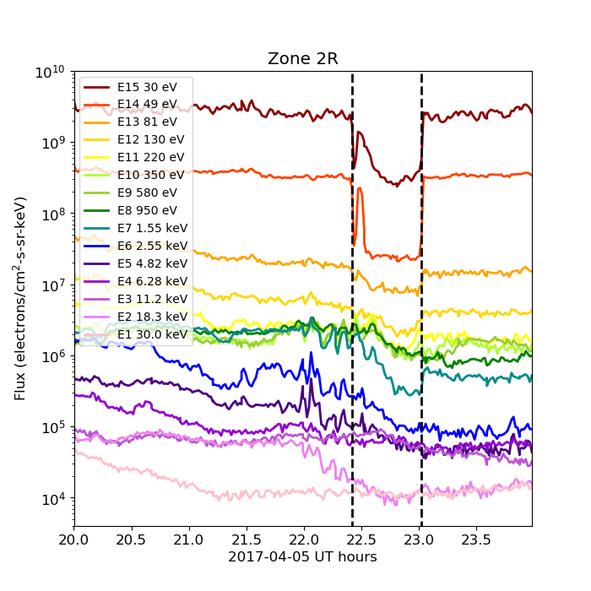
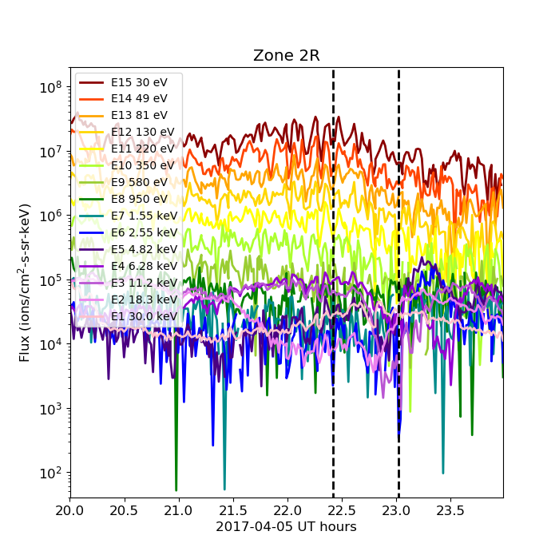
Effect of Arc Jet Firing
MPS-LO Electron and Ion time-series on 2017-04-05 showing the effect of arc jet firing (occurring between the vertical dashed lines). There is a drop in flux in the lowest electron energy channels. There is no discernable effect on the ion fluxes during the same period. In both cases fluxes from Zone 2R are shown. The Zone 2R viewing direction usually corresponds to pitch angles from near zero to ~20 deg.
Low energy electrons measured by MPS-LO are mainly photoelectrons emitted by the spacecraft. Since the [secondary] photoelectrons are removed in the L2 Moments code, this effect is benign. A request has been submitted to make the arc jet flag (created for MAG) available in MPS-LO L1b (ADR596/WR5800).

Slide 29
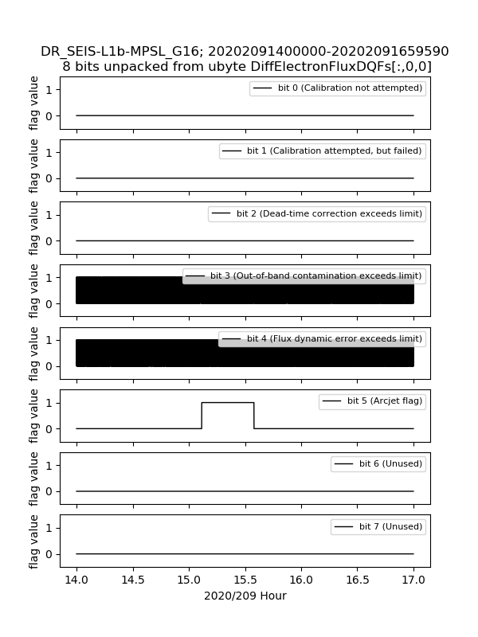
Arcjet Flag Verified in L1b
Arcjet firing on 27 July 2020

Slide 30
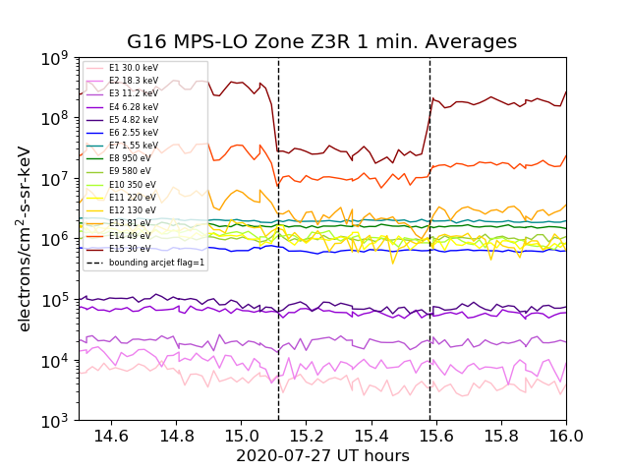
Arcjet Flag Set 1-2 Minutes After Effect Seen in MPS-LO L1b 1s Data
ADR596, Make Arc Jet Flag available for SEISS MPS-LO (DO.09.01.00 Content), will be closed.
The arcjet flag in the MPS-LO L1b data (DQF bit 5) is set about 1-2 minutes after it's effect appears in the MPS-LO data – A new ADR will be opened to address this.

Slide 31
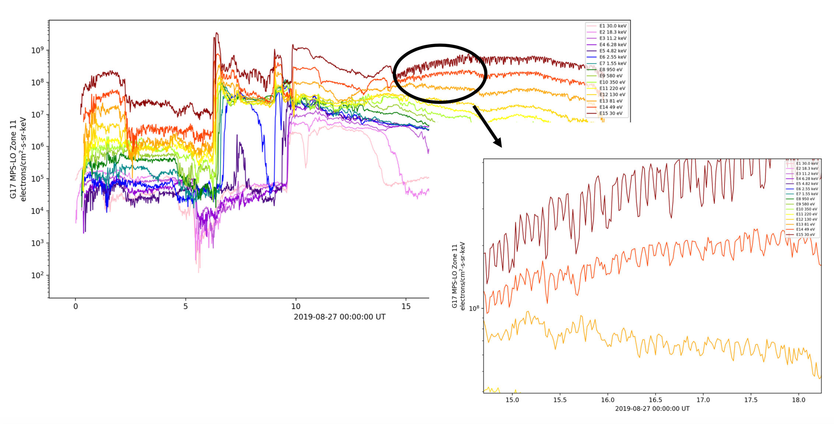

$≈$5 Min. Period Signal of Unknown Origin in Lowest Energy Electron Channels
Appears in both G16/FM1 and G17/FM2
Signal appears in photoelectrons produced by spacecraft, subject to spacecraft potential changes.
Additional analysis in ATC’s Report SEISS-TR-Y121-2-16_MPSLO_Recurrent_Noise_Signal

Slide 32
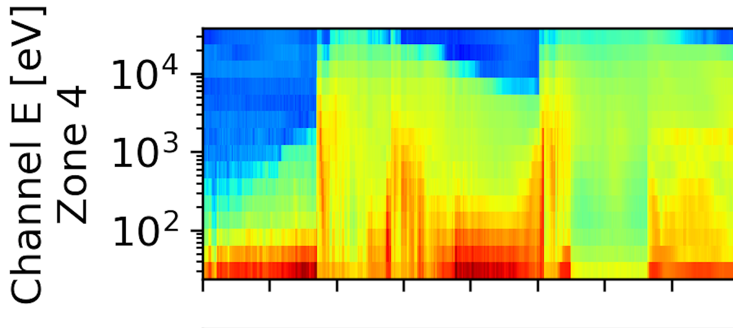
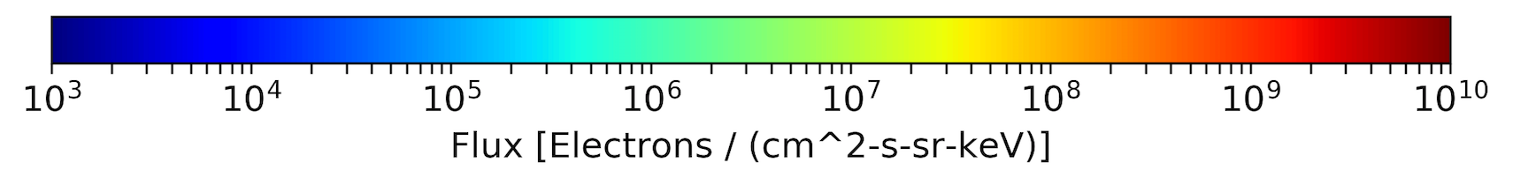
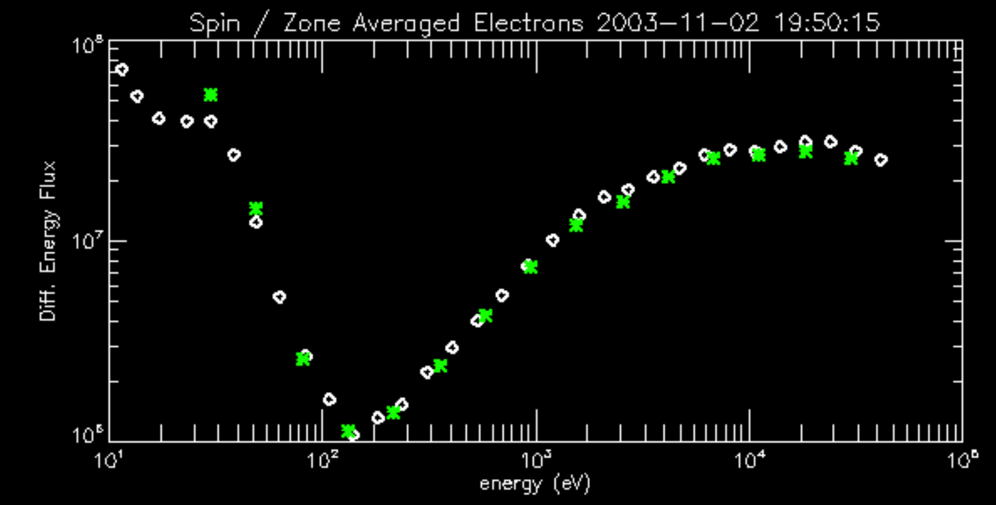
Spacecraft Photoelectrons
G16 MPS-LO on 22 March 2017
Lowest energy electron channels are usually dominated by photoelectrons produced by the spacecraft when sunlit.
The photo electrons are trapped in the vicinity of the spacecraft by a barrier potential [Whipple, E. C., Jr. (1976), Observation of photoelectrons and secondary electrons reflected from a potential barrier in the vicinity of ATS 6, J. Geophys. Res., 81, 715-719].
The photoelectron flux drops out during eclipse periods.
The Figure to the left shows electron spectra from LANL-02A MPA on 2 November 2003. Based on these data, the barrier potential is estimated to be -150 eV. MPA data provided courtesy of M. Thomsen, Los Alamos National Laboratory.
Eclipse
6 UT
Photoelectrons

Slide 33
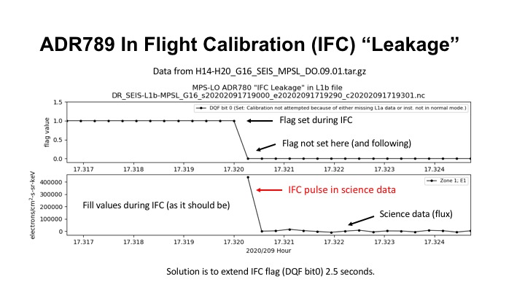
ADR 780 IFC Leakage
ADR780
  Violates accuracy requirement
Additional details on ADR780 IFC leakage in backup charts.

Slide 34
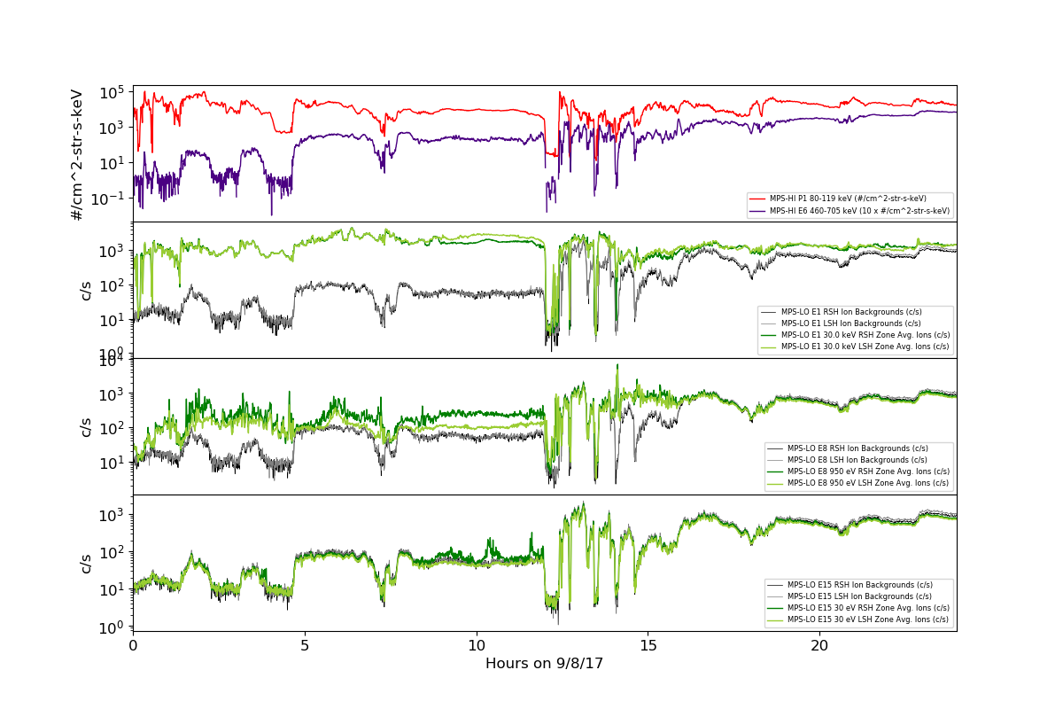
Effect of High Backgrounds on Low Energy Ions Measurement
G16 MPS-LO uncorrected and background Ion rates from L0 data
MPS-HI
P1 and E6
E1 (30 keV)
and
backgrounds
E8 dominated by backgrounds w/ RB buildup.
E8 (950 eV)
and
backgrounds
E15 dominated by backgrounds. Note similarity to MPS-HI E6 above
E15 (30 eV)
and
backgrounds

Slide 35
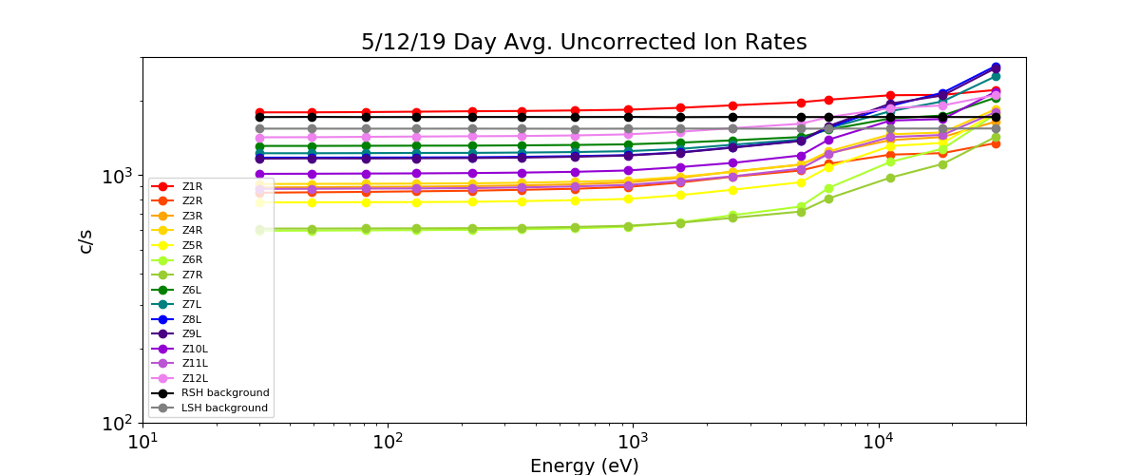
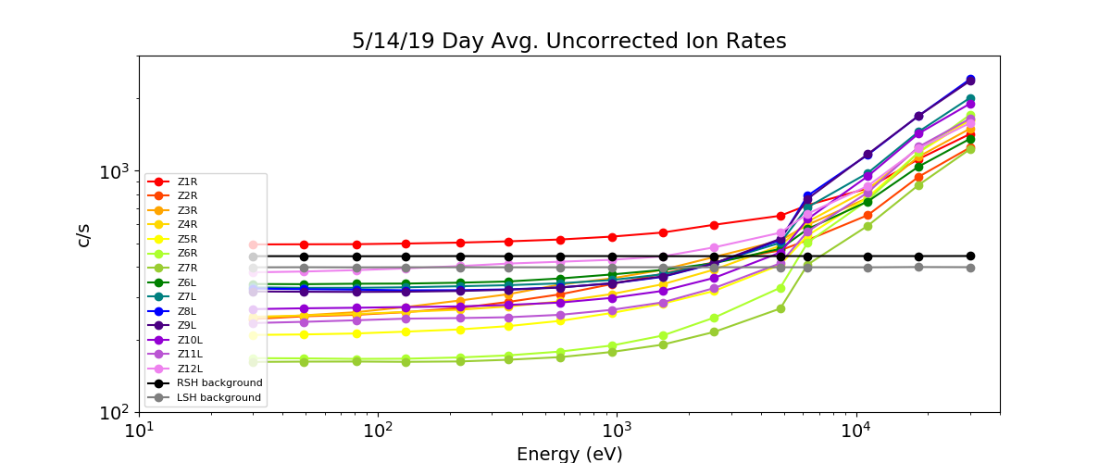
Effect of High Backgrounds on Low Energy Ions Measurement
G17 MPS-LO
Energy independent count rate at lower energies dominated by background counts.
Signal to background ratio low on days when backgrounds are high. No measurement below ~1 keV in this case.
Similar result for G16 MPS-LO
This is an instrument issue due to unexpectedly high background rates. There is no known resolution.
count rate
High radiation belts
(high backgrounds)
G17 MPS-LO
Geomagnetic storm day
(elevated ions)
count rate
* Backgrounds and uncorrected count rates from L0 data.

Slide 36
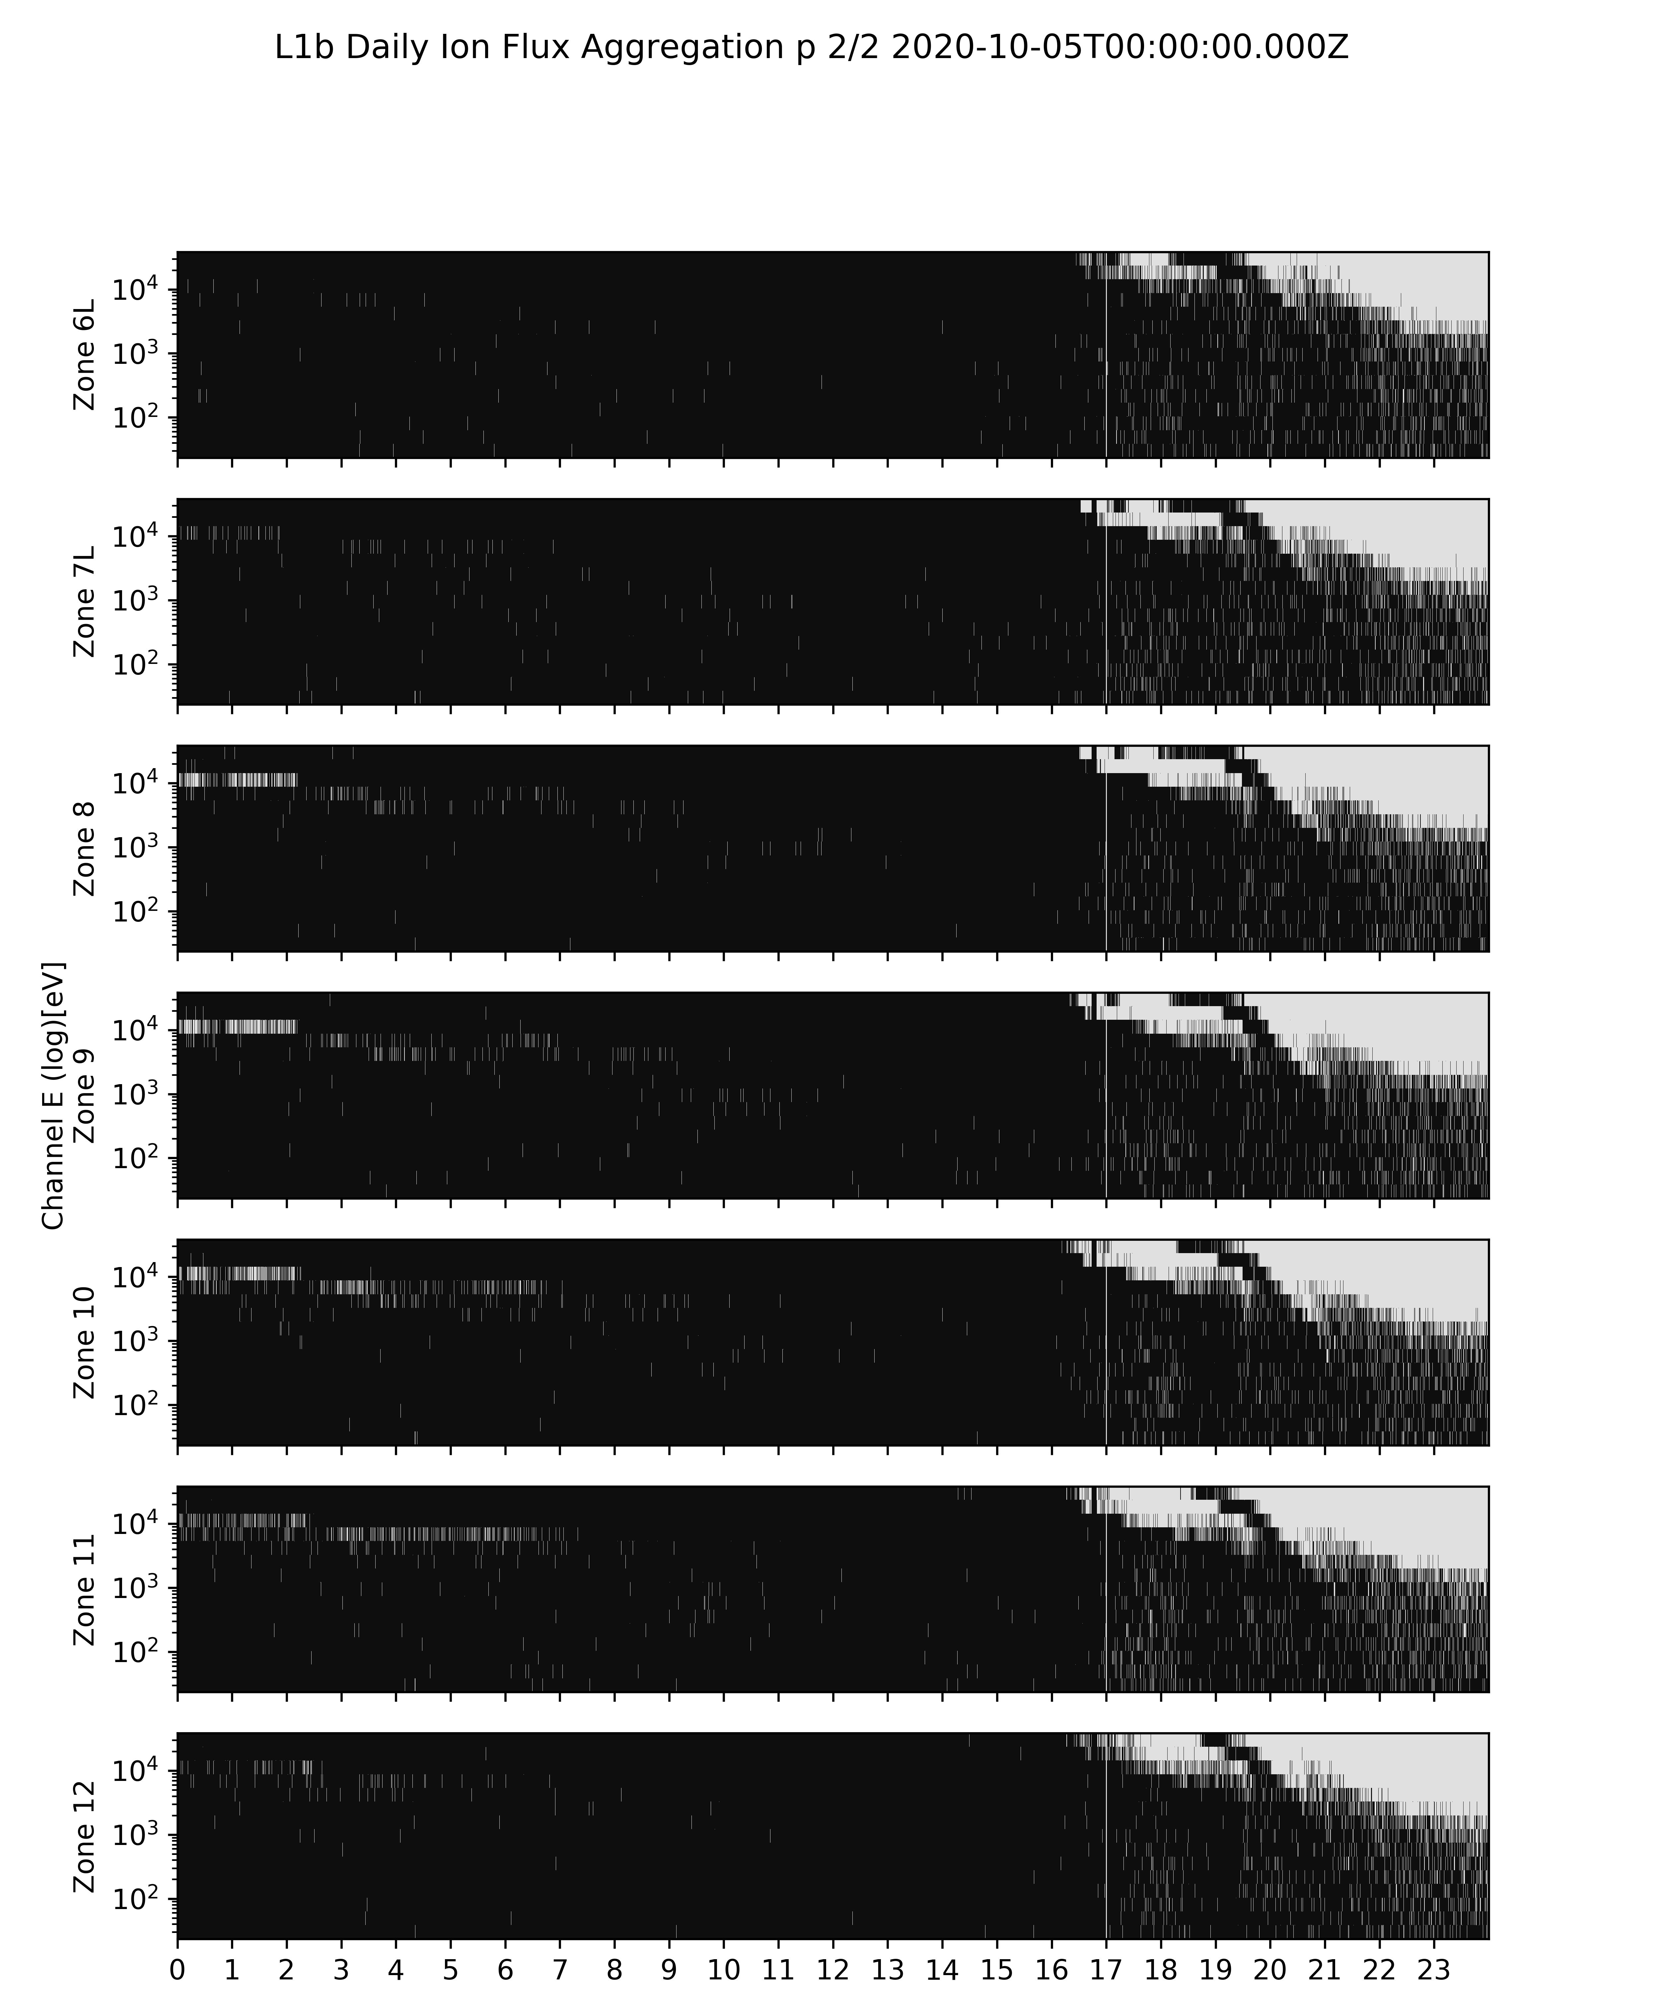
Effect of High Backgrounds on Low Energy Ions Measurement
Data quality flag bit 3 from G16 MPS-LO GS L1b data
Data quality flag bit 3
Not Set (white): Out-of-band contamination less than signal
Set (black): Out-of-band contamination greater than signal
i.e., flag is set when most N_total counts are from backgrounds: M_signal = N_total – N_backgrounds
* 5 October 2020 had relatively high radiation belt fluxes
UT Hours

Slide 37
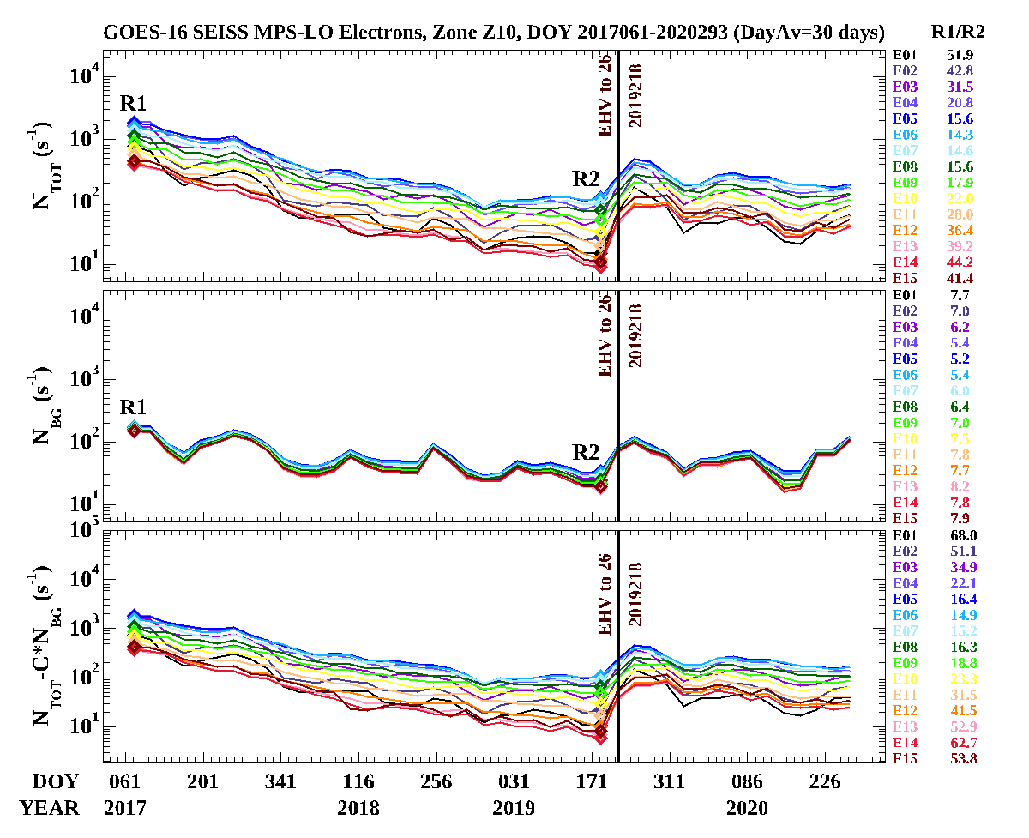
Secular Decline in MCP Response
Steady decline in MCP response since HV power on
EMCP HV step
25 → 26
Reported Flux x Geo. factor
* Backgrounds and uncorrected count rates from L0 data.
Decline in reported fluxes (bottom panel), here using constant background removal coefficient (C). Order of magnitude decline in reported fluxes using continuously updated C shown in backup slides.

Slide 38
  PLPTs Supporting Assessment for Full Validation Status
PLPT-SEI-003 MPS-Lo Zone Cross-Comparison
PLPT-SEI-005 Cross satellite Comparison of Trapped Particles
PLPT-SEI-006 Backgrounds Trending

Slide 39
Full Validation - PLPTs
Title | Activity | Data Needed | Success Criteria
A.3.2 MPS-Lo Zone Cross-Comparison [PLPT-SEI-003] | Perform a sanity check of PADs, determine the relative sensitivity/response among MPS-LO zones and determine relative inter-calibration factors for zone Z6L vs. Z6R and Z7L vs. Z7R, for each of 15 energies and for both electrons and ions. | Three months of continuous data. | Fully characterize differences in response among MPS-LO zones.
A.3.4 Cross Satellite Comparison of Trapped Particles [PLPT-SEI-005] | Inter-calibrate MPS-LO with similar measurements on other missions. | Magnetospheric Plasma Analyzer (MPA) data from Los Alamos National Laboratory satellites. | [Full] Differences quantified on data taken through validation phase.
A.3.5 Backgrounds Trending [PLPT-SEI-006] | (1) Trend daily/weekly minima from MPS-LO ion and electron background zones (ZGR and ZGL). (2) Correlate orbital variations in MPS-LO backgrounds with MPS-HI and SGPS measurements. | Four months of continuous data. | [Full] Perform analysis during validation phase.
Full PLPTs are ongoing continuations of Provisional PLPTs.
From RIMP v1.0 (02 June 2016).

Slide 40
PLPT-SEI-003: MPS-LO Zone Cross-Comparison – Method (1/4)
Compares fluxes measured by pairs of MPS-LO angular zones when central pitch angles (α) are the same or supplementary.
Under such conditions, zones should observe the same flux at the same energy
Steps:
  Input 1-min MPS-LO fluxes and pitch angles calculated from MAG BRF
  Identify whenever a pair of zones has pitch angles within 1 degree and pitch angles varying more slowly than 30 deg/minute
  Use supplementary angles of pitch angles > 90 degrees to have sufficient matches (assumes up- and down-going trapped fluxes are the same on a 1-minute timescale)
  Report observed fluxes for each pitch angle match
  Estimate scaling factors optimally based on set of all matches
B (magnetic field dir.)
Zone A look dir.
α
B
α
α
OR
α+90º
Zone A look dir.
Zone B look dir.
Zone B look dir.
Ref: Rowland, W., and R. S. Weigel (2012), Intra-calibration of particle detectors on a three-axis stabilized geostationary platform, Space Weather, 10, S11002, doi:10.1029/2012SW000816.
Partial pass

Slide 41
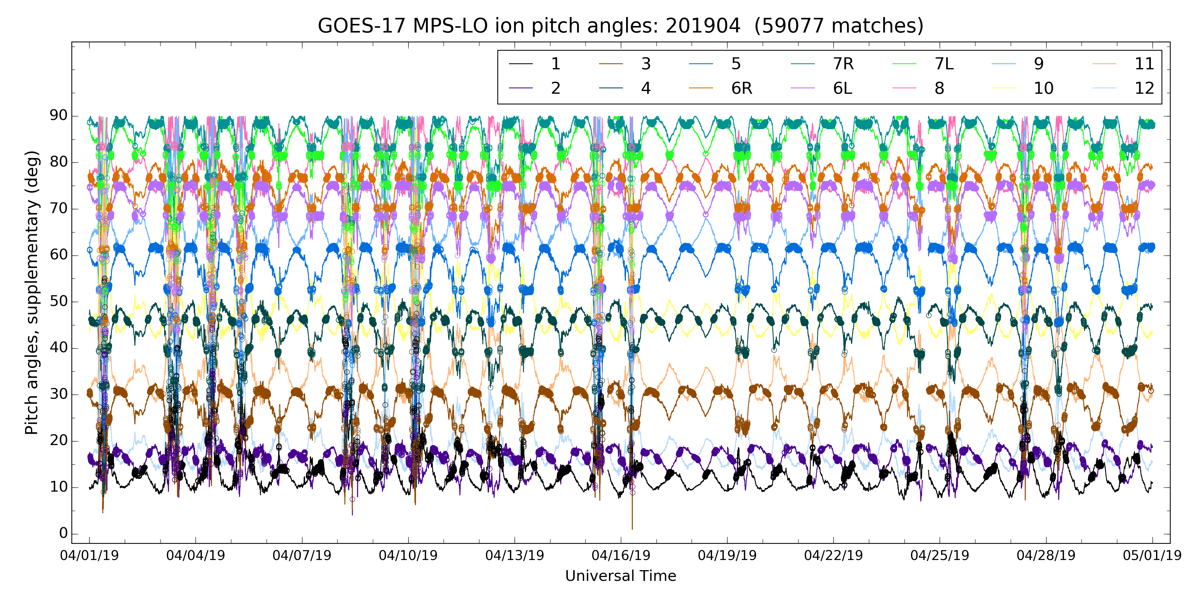
PLPT-SEI-003: MPS-LO Zone Cross-Comparison – Method (2/4)
Example: Ion Pitch Angles, April 2019 (supplementary angles of p.a. > 90 deg.)
90°
Zone
60°
30°
0°
Dots indicate pitch angle matches
1,000-10,000 matches per month per energy-zone pair
Partial pass

Slide 42

PLPT-SEI-003: MPS-LO Zone Cross-Comparison – Method (3/4)
Use Nelder-Mead method to minimize the following objective function: sum of squares of the following difference term (~30k terms [matches] in the sum per energy)
To reduce effect of statistical noise, use only matches where both fluxes correspond to at least 1000 counts/minute
A non-linear problem: need a good initial guess for the scale factors in order for the solution to converge
  1000-6000 iterations needed, depending on the energy and species
  2.5 (2.8) hours needed for three months, 14 zones, 15 energies of ions (electrons) on macOS 2.5 GHz Intel Core i7
Because they are only valid in a relative sense, scale factors must be normalized – here, normalized to those of Zone 8 (arbitrary choice)
$$R\left(m\right)=\frac{{SF}_{i}\left(m\right)J_{i}\left(m\right)−{SF}_{j}\left(m\right)J_{j}\left(m\right)}{{SF}_{i}\left(m\right)J_{i}\left(m\right)+{SF}_{j}\left(m\right)J_{j}\left(m\right)}$$
Ref: Rowland, W., and R. S. Weigel (2012), Intra-calibration of particle detectors on a three-axis stabilized geostationary platform, Space Weather, 10, S11002, doi:10.1029/2012SW000816.
Partial pass

Slide 43
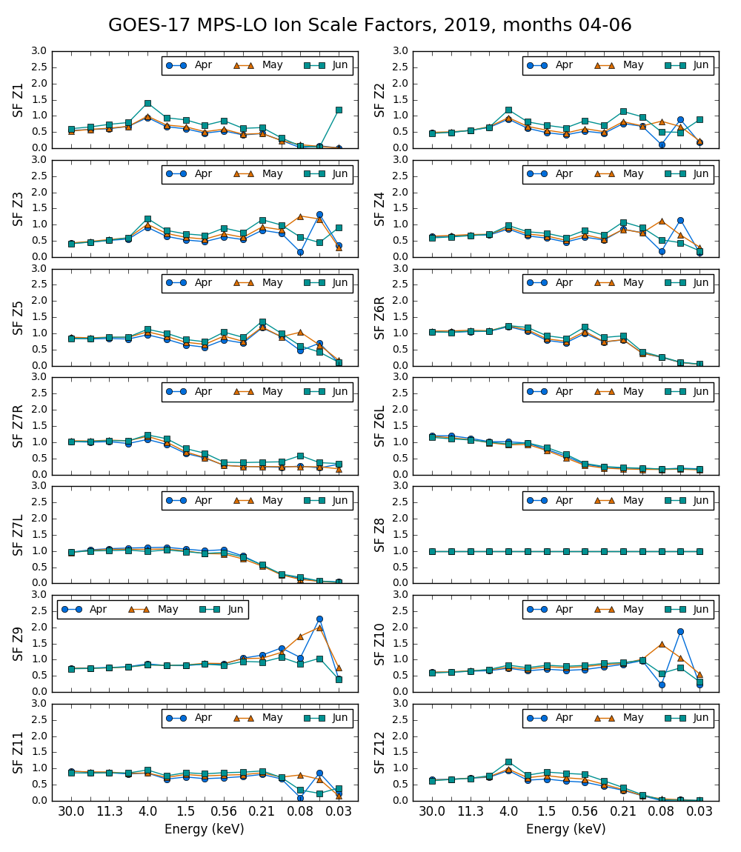
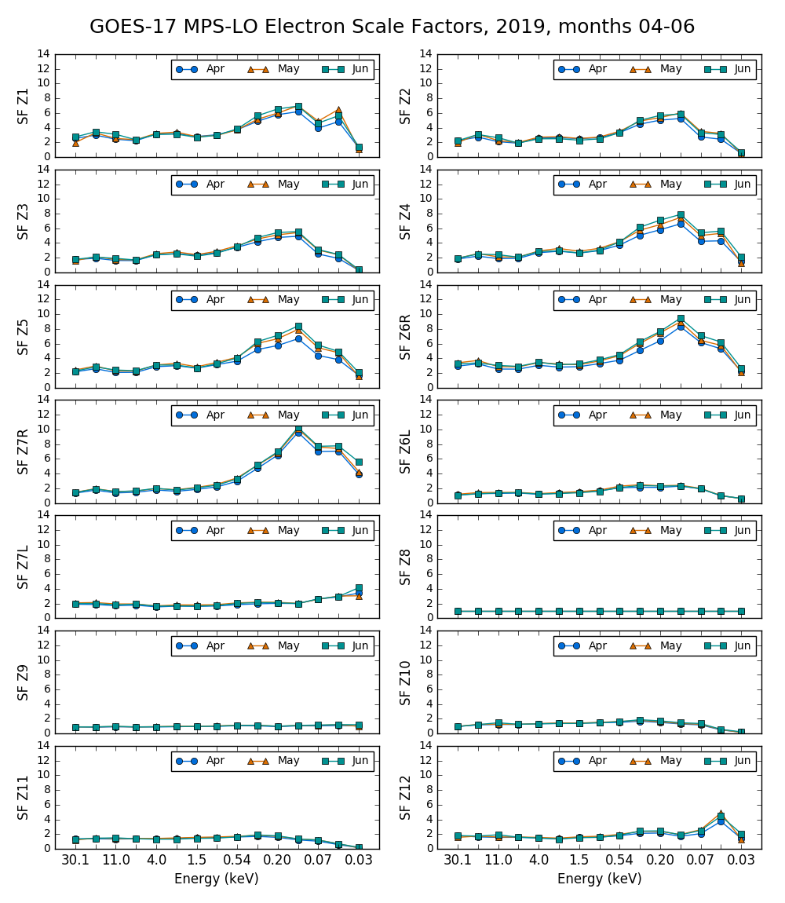
PLPT-SEI-003: MPS-LO Zone Cross-Comparison – Scale Factor Results (4/4)
Multiplicative scale factors plotted vs. energy channel for each zone
Marginal consistency month-to-month indicates need to do this on a monthly basis
Scaling of up to an order of magnitude needed for some zone-energy channels.
Partial pass

Slide 44
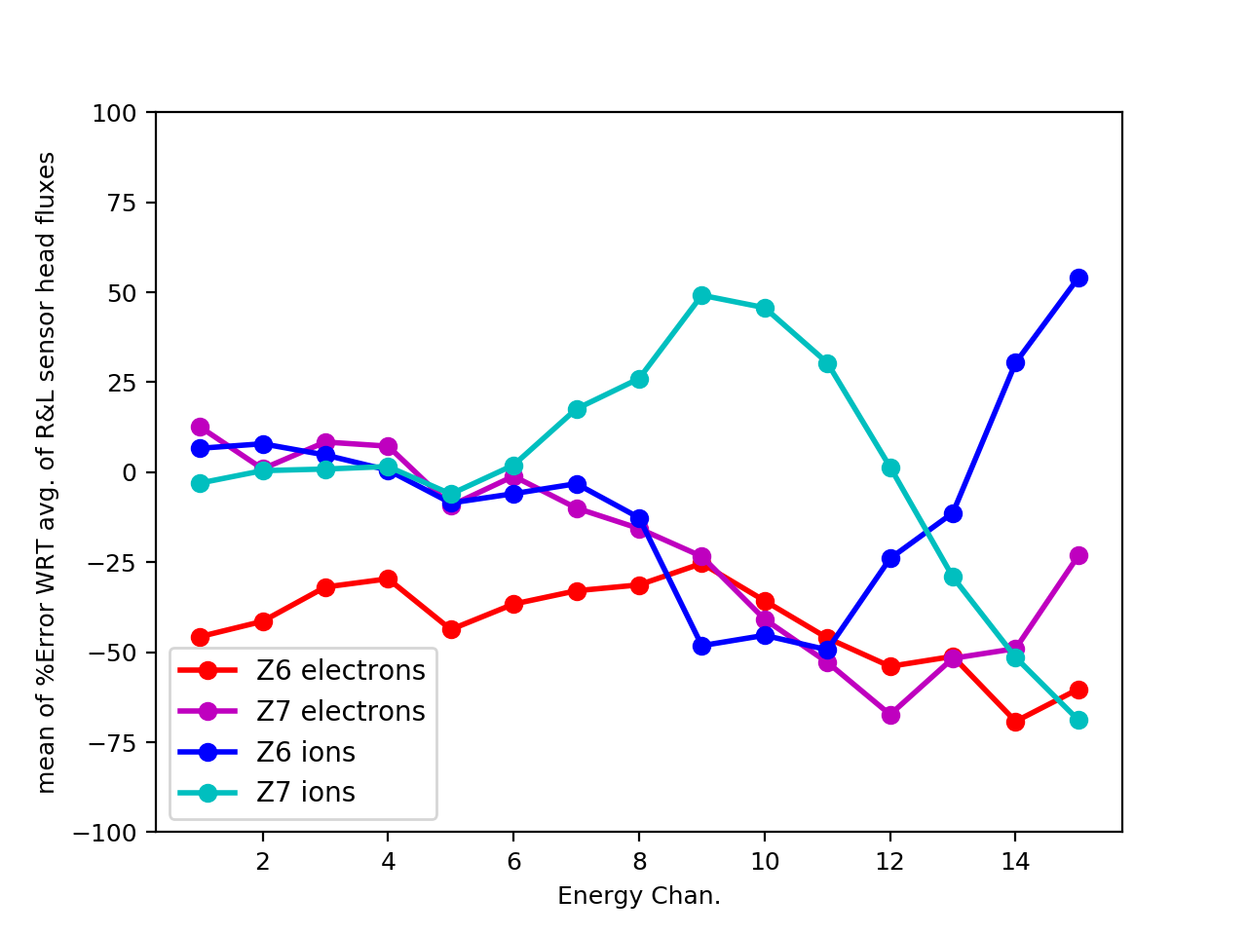
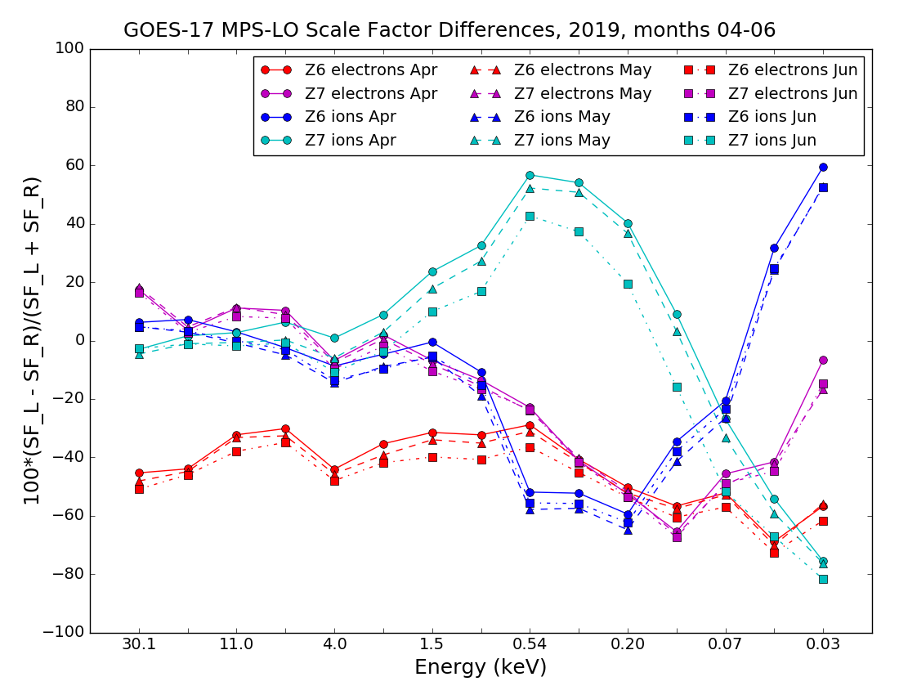
PLPT-SEI-003: MPS-LO Zone Cross-Comparison – Comparison of Overlapping Zones (5/4)
(Z6R with Z6L and Z7R with Z7L)
3-month mean of error of each overlapping zone with respect to average of overlapping pair
Error computed from Z6 and Z7 scale factors
determined with method described on previous slides
G17 MPS-LO April-July Z6 & Z7 mean errors
Using 3 months of 1 min. averaged fluxes, the percent error with respect to the avg. of the overlapping pair is calculated for each 1m sample (i.e., we split the difference, thus errors associated with the 2 overlapping zones are the same). Then, the mean value of errors from 3 months of 1 min. averages is calculated.
The error computed by comparing fluxes from overlapping zones (left figure) is in close agreement with error computed from the scale factors obtained by minimizing error associated with cross comparisons of all zones described on previous slides (right figure), showing verification of results by an independent method.
Partial pass

Slide 45
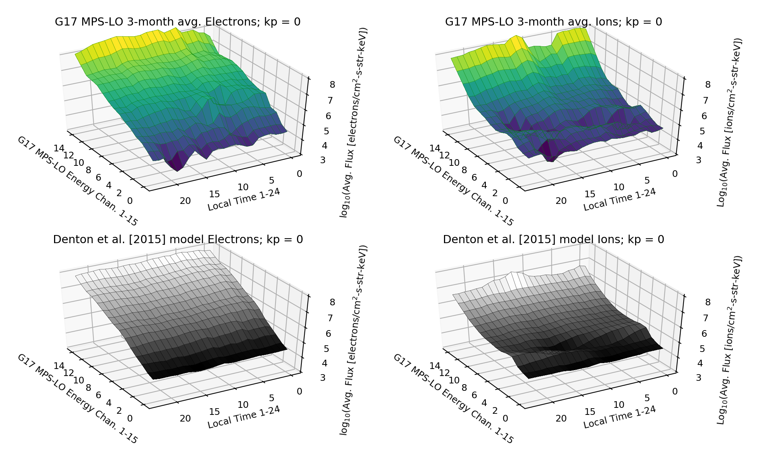
G17 PLPT-SEI-005 Cross satellite Comparison of Trapped Particles
Comparison of G17 MPS-LO April-June 2019 data with Denton et al. [2015; 2016] model, based on 1990-2007 observations from the Magnetospheric Plasma Analyzer (MPA) instruments on seven Los Alamos National Laboratory (LANL) satellites at GEO. MPS-LO fluxes are binned in local-time and Kp geomagnetic activity index, and then 3-month averaged, for comparison with Denton model.
Pass

Slide 46
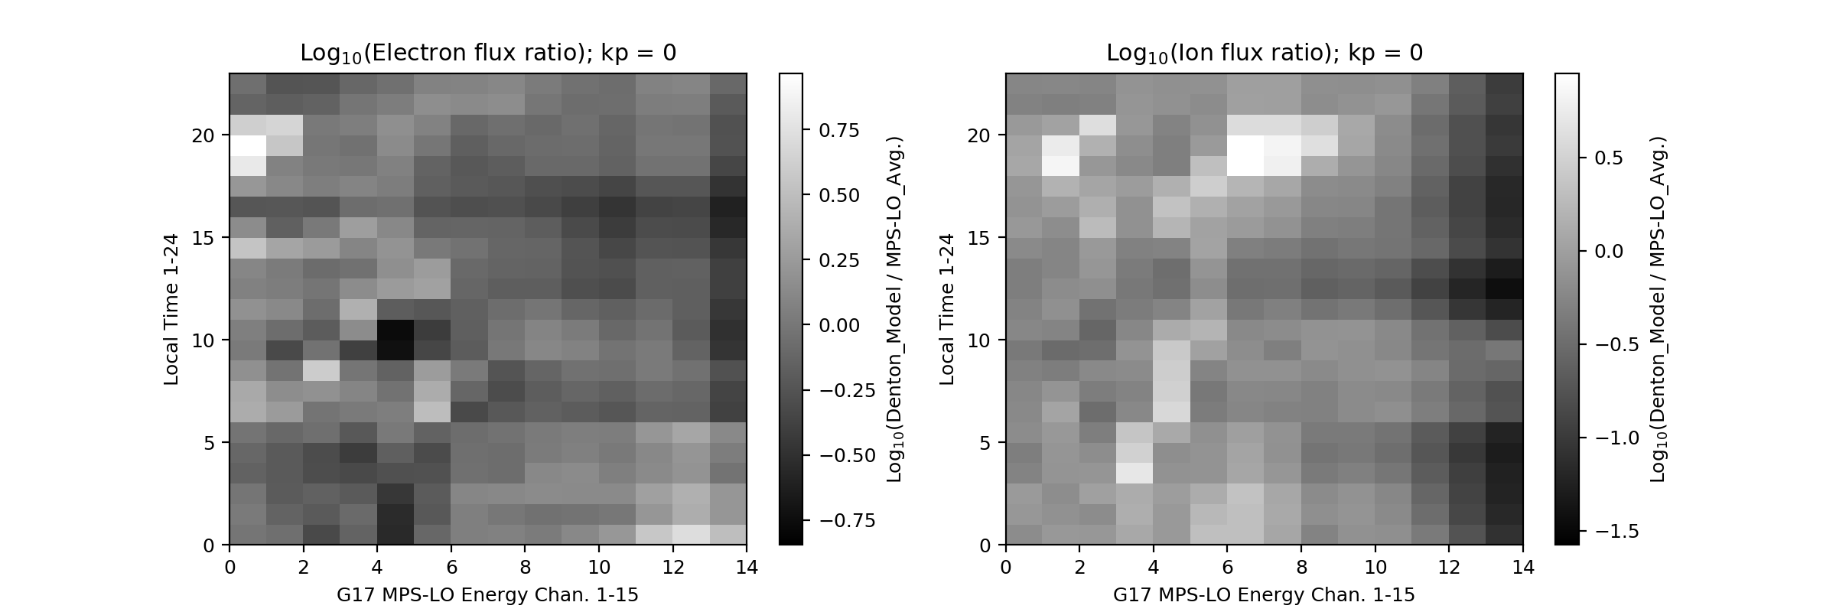
G17 PLPT-SEI-005 Cross satellite Comparison of Trapped Particles
G17 MPS-LO and Denton model electron fluxes differ up to an order of magnitude.
G17 MPS-LO ion fluxes up to factor of 30 higher than Denton model.
The Denton et al. [2015; 2016] model electron fluxes are up to an order of magnitude higher than the LT-Kp binned MPS-LO electron fluxes.
The MPS-LO ion fluxes are up to a factor of 30 higher than Denton model ion fluxes.
Not apples to apples comparison (3-months of MPS-LO data during solar min. vs. 1990-2007 MPA)
General trends in data are similar – Verification that MPS-LO is measuring environmental fluxes.
Pass

Slide 47
PLPT-SEI-006
Backgrounds Trending
Extensive analysis of backgrounds were performed for empirical determination of BG removal coefficients (e.g. slide 19).
Ratio of in-band to Background response characterized with determination of background removal coefficients.
Source of backgrounds is not fully understood (mainly radiation belt electrons, but at lower energies than expected).
  Simulations show that penetration of MPS-LO box by electrons should be limited >=MeV energies.
  There is good correlation between MPS-LO backgrounds and 100s of keV electrons (400-800 keV).
In general, in-band and background zone responses have been gradually decreasing since launch (e.g., slide 37).
Partial pass

Slide 48
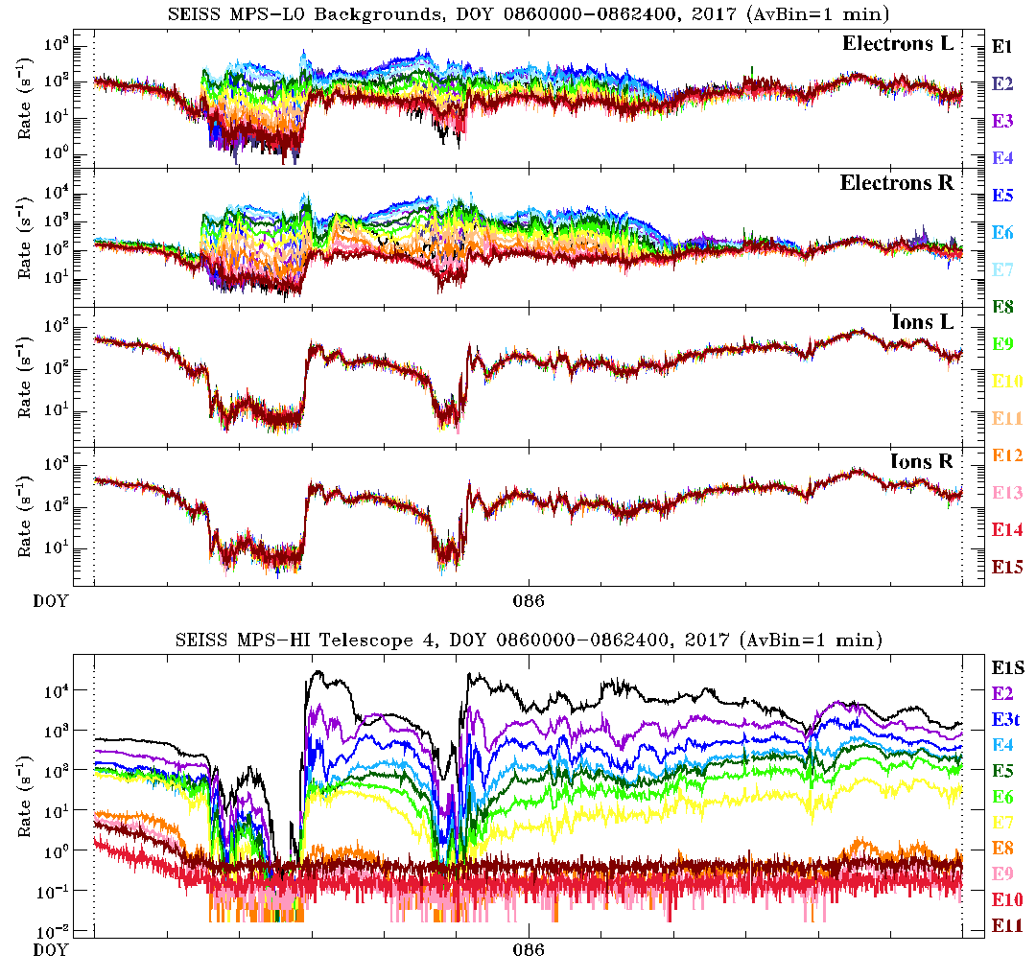
Correlations Between MPS-LO Backgrounds and MPS-HI Channel
4 background zones: Electrons L, Electrons R, Ions L, Ions R
15 energy channels: E1 at 30 keV, E15 at 30 eV
Plotted for day 086 of 2017, 0000-2400 UT
Plotted along all the MPS-HI electron channels (E1S-E11)
Similar daily correlation between MPS-LO backgrounds and MPS-HI, at least for the ion and low- energy electron MPS-LO backgrounds

Slide 49
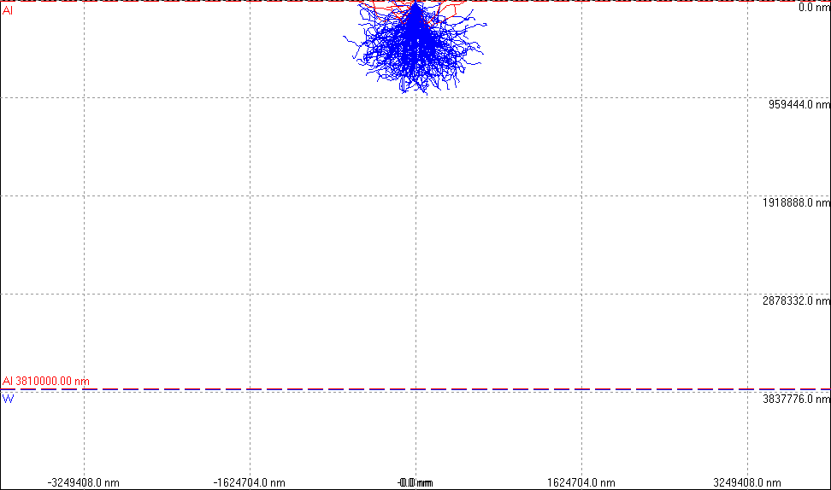
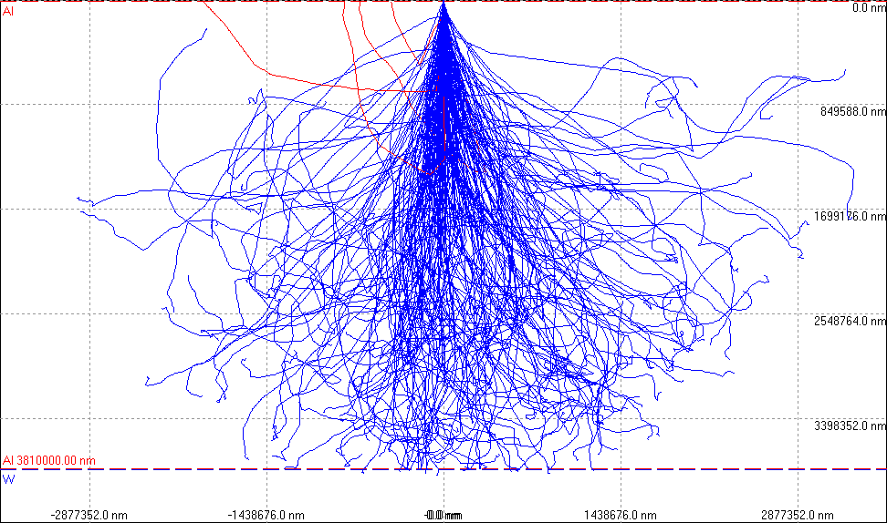
Simulated Electron Trajectories
(From ATC document MPS-LO vs MPS-HI Correlations)
600 keV electron paths in 200 mils of Al.
2000 keV electron paths in 200 mils of Al.
MPS-LO background zones are shielded from space by 200 mils (0.51 cm of Al and 80 mils (0.20 cm) of printed circuit board material (PCB).
Partial pass

Slide 50
Correlations Between MPS-LO Backgrounds and MPS-HI Channels
MPS-HI Channels
At lower electron energies and all ion energies, MPS-LO backgrounds are well correlated with MPS-HI 600-800 keV electrons.
MPS-LO backgrounds
Partial pass

Slide 51
FULL MATURITY ASSESSMENT
GOES-16 and -17 MPS-LO L1b Product Full PS-PVR

Slide 52
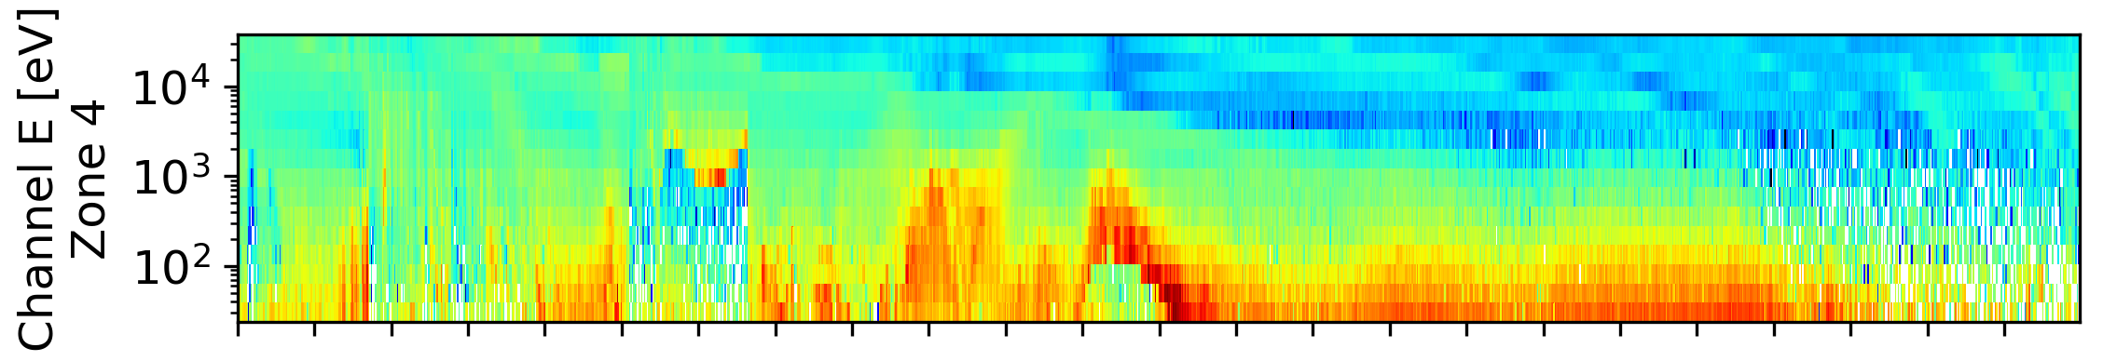
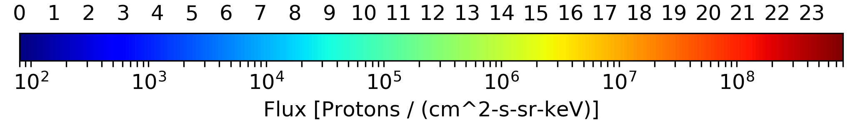

Spacecraft Charging Ion Line Signature
When GOES-16 is in eclipse and/or during periods of high ambient electron flux, it typically charges to a negative potential.
When the spacecraft is negatively charged, ions entering the MPS-LO detector are accelerated to energies at and greater than the magnitude of the spacecraft potential.
If there is a sufficient population of low energy ambient ions, an ion line peak in flux versus energy appears at the spacecraft potential in the MPS-LO data.
MPS-LO Electrostatic Analyzer $ΔΕ/Ε$ < 0.05 at 1keV.
22 March 2017
Ion line at 2.5 keV in eclipse
Non-eclipse ion line at 220 eV
UT Hours
GOES-16 MPS-LO flux spectrogram from zone 4 (pitch angles near 30º) on 22 March 2017, with ion line signatures of spacecraft charging. The first ion line enhancement appears near 1 keV at ~5:30-6:30 UT during an eclipse period. The subsequent ion lines are after the eclipse period at ~9:00-10:30 UT and ~11:00-12:00 UT.

Slide 53
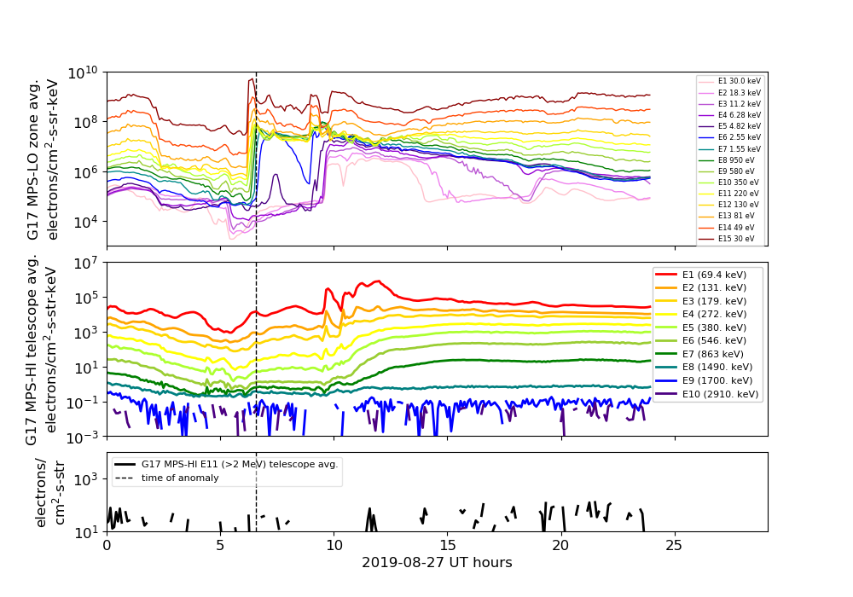
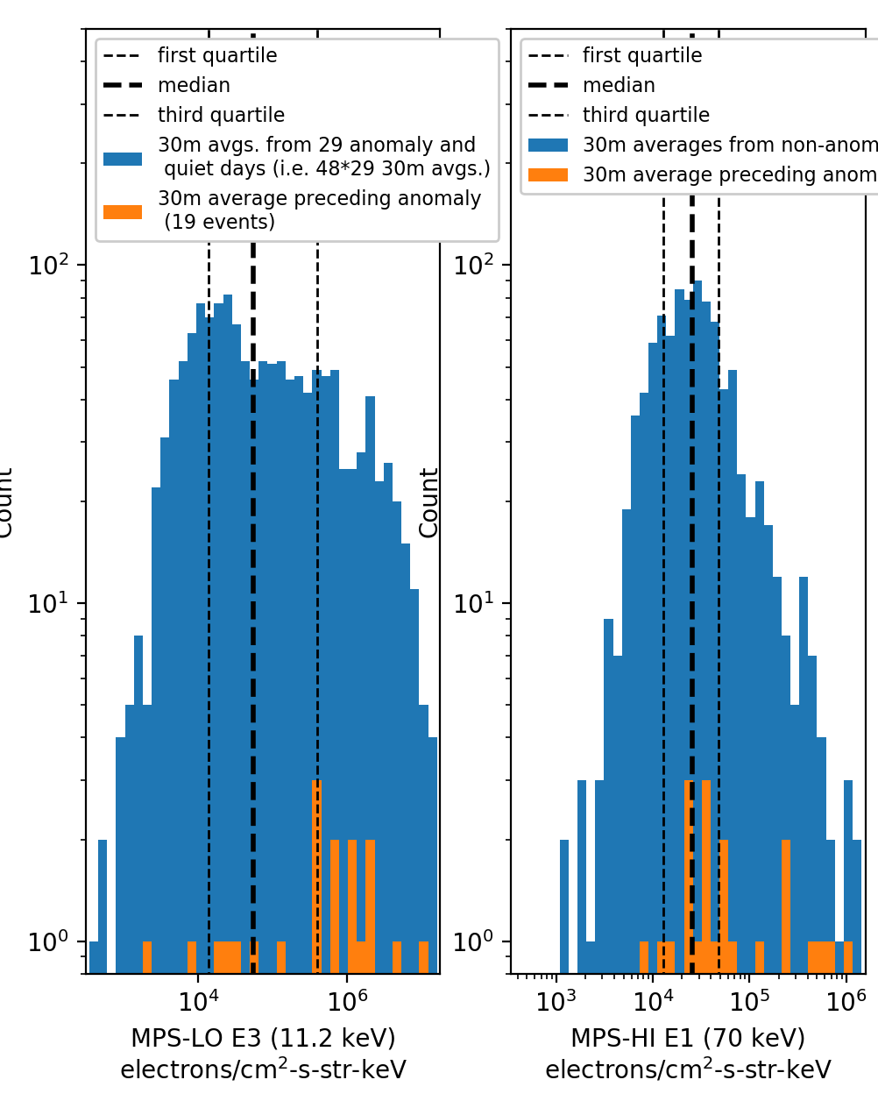
MPS-LO Surface Charging / Electrostatic Discharge (ESD) Anomaly Work
GOES-17 Star Tracker Optical Head 1 anomaly on 27-Aug-2019
at 06:33:43, thought to be due to surface charging / ESD
GOES-R program anomaly resolution work: Currently including 36 anomaly days, mainly involving Sun-pointing system Interface Unit (SIU) resets.

Slide 54
GOES-17 MPS-LO
Performance Baseline Status
Assessment at Full
MRD ID | Description | MRD Requirement | MIT/LL Predicted Performance Baseline | NCEI Assessment at Provisional | Related PLPTs | Status
1987 | MPS-LO Orthogonality/ Coverage | 5 directions | 14 directions (zones) | 14 directions (zones) | -03 | PASS
1991 | MPS-LO Measurement Range | 30 eV – 30 keV protons and electrons | 30 eV – 30 keV | 0.025-30.8 keV (electrons) 0.030-30.0 keV/q (ions) [values from CDRL79] | -05 | PASS
1992 | MPS-LO Measurement Accuracy | 45% @min flux, 25% @10x min flux | 420 separate accuracies (2 species x 14 angles x 15 energies); Worst case for 10x min flux: Electrons: 23%; Ions: 20% Worst case for min flux: Electrons: 40%; Ions: 38% (Based on ground cal.) | Absolute accuracy cannot be verified on-orbit. Results of PLPT-03 and factor of ~5 decline in MCP response (in some zones) indicate that 25% relative accuracy not currently achieved on-orbit. | -03, -05, -06 | Additional analysis and GF adjustment may bring measurement to within accuracy requirement.

Slide 55
Full Validation Assessment
Preparation Activities | Assessment
Validation, QA, and anomaly resolution activities are ongoing. | Validation activities are ongoing. Results have been discussed with SWPC. L1b data available at NCEI website enabling research community participation.
Incremental product improvements may still be occurring. | Work on science quality data will continue at NCEI ADR780 GPA update for MPS-LO L1b IFC leakage in-work.
Users are engaged and user feedback is assessed. | Product improvements will result from steps to mitigate known and yet to be discovered anomalies.
* GOES-R product maturity level preparation activities from 416-R-RIMP-0318 Version 1.0 06/02/2016,
Responsible Organization: GOES-R Ground Segment/Code 416

Slide 56
Full Validation Assessment
End State | Assessment
Product performance for all products is defined and documented over a wide range of representative conditions via ongoing ground truth and validation efforts. | FM1 & FM2 MPS-LO units ground/beam calibrated. Performance tests included in provisional PLPT results
Products are operationally optimized, as necessary, considering mission parameters of cost and schedule, as compared to user expectations. | Yes, given resources and time.
All known product anomalies are documented, and shared with the user community. | In L1b readme files and this PS-PVR presentation. PUG and/or CDRL80 will need to be updated to reflect changes, e.g., ADR326 MPS-LO GPA Changes.
Product is operational. | L1b going to PDA & GRB. Operationally usable but not operationally leveraged until Level-2 phase-2 products available at SWPC.

Slide 57
SUMMARY & RECOMMENDATIONS
GOES-16 and -17 MPS-LO L1b Products Full PS-PVR

Slide 58
Summary: MPS-LO
Instrument/GPA Open Issues
High Backgrounds / Negative Fluxes – Resolved with ADR 326, MPS-LO GPA Changes, and empirical derivation of background removal coefficients. Coefficients need to be updated periodically. Some aspects of empirical derivation still under development.
Interzonal Crosstalk – May be possible to develop empirical on-orbit analysis to estimate crosstalk correction coefficients.
Evidence for significant error in absolute values of reported fluxes – Geometric factors should be adjusted using a unified approach, including
  Results from PLPT-SEI-003: MPS-LO Zone Cross-Comparisons.
  Cross calibrations with other spacecraft (HOPE, MPA, GOES-R cross cal.)
  Comparisons between spectral fits to highest energy MPS-LO channels and lowest energy MPS-HI channels.
  Decline in MCP Response and changes in HV setting.
  Scale geometric factor to include crosstalk correction.
Degraded performance of lower energy ion channels due to persistent high background counts (No known/planned fix)
In-flight Calibration pulses (spikes) in science data (ADR 780, not closed)

Slide 59
Summary:
Additional Considerations
  MPS-LO uses the ion-line to identify SC charging and quantify the level of charging. If an ion line is not present, MPS-LO L2 processing uses an empirical relation between densities, temperatures, and level of charging to determine the SC level of charging.
  Significant error in absolute value of reported fluxes will degrade quality of temperatures and densities computed in Level-2 processing.
The empirical relation used to determine level of charging, obtained from reported densities and temperatures, will not be negatively impacted by error in the absolute value of reported fluxes.
G17/FM2 MPS-LO is currently performing as needed to fulfill an intended operational use, i.e., identifying SC charging and level of charging.
MPS-LO relative flux variations are valuable for anomaly resolution work.

Slide 60
Recommendations
NCEI recommends G17 MPS-LO L1b data for transition to Full Validation status.
Continue work on Instrument and GPA open Issues listed on slide 58, aimed at improving SWPC operational data and making science quality MPS-LO data available to the public.
    Continue performing HV optimization procedure every 6 months to 1 year. (Initial ATC recommendation to perform HV optimization every 6 months modified to once per year.)
Background removal coefficients will need to be updated regularly. We recommend performing empirical determination of background removal coefficients and MPS-LO LUT update following each HV optimization.
Monitor effect of changes in HV setting on observed count rates.

Slide 61
BACKUP SLIDES
GOES-16 and -17 MPS-LO L1b Products Full PS-PVR

Slide 62
G16 and G17 MPS-HI and MPS-LO L1b IFC leakage (ADR780)
MPS-LO problem description: in-flight Calibration (IFC) pulses are leaking into L1b fluxes in over half the electron and ion channels.
  Occurs at end of periods when MODE flag set to 4, used to mask IFCs
  Violates accuracy requirement
IFC mode status changes are out of sync with IFC pulser status:
  Sensors report that they are in IFC mode 1-second before the IFC starts
  Sensors report that they are back in Normal mode 1-second before IFC is completed
MPS-LO IFC tables cannot be changed
The agreed-to path forward is a ground software modification
  ATC recommends that, in the GPA software, the IFC mask should be extended for 2 seconds beyond the MODE = 4 (IFC mode) status.
  This will prevent IFC leakage without compromising the functionality of the IFC tables.
  Applies to MPS-LO, MPS-HI and SGPS
Thanks to Elizabeth Dawson (ATC) for her contributions to this information, including tech memo dated 07 November 2018

Slide 63
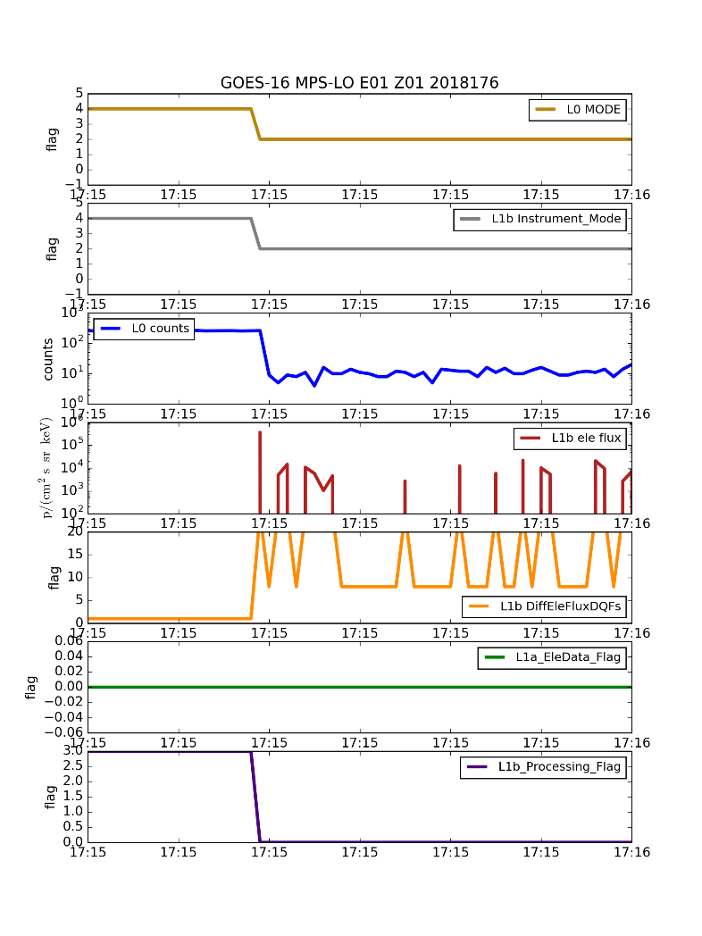
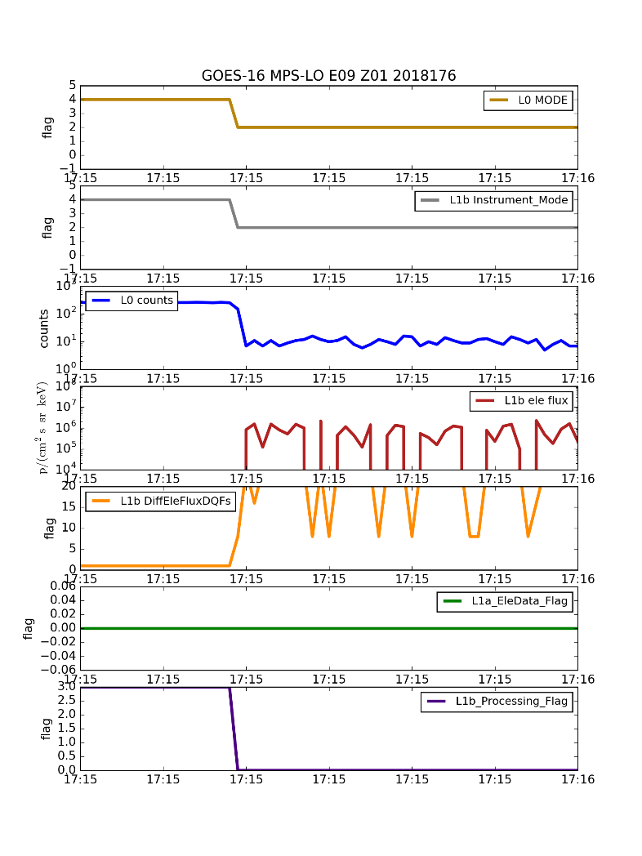
More than half of the MPS-LO electron and ion channels have IFC leaks
All angular zones are affected
Ion channels I1-I8 are affected
Electron channels E1-E8 are affected
Based on these plots, it is not clear why channels 9-15 are not affected since the pulse continues beyond the flag
IFC
IFC
?

Slide 64
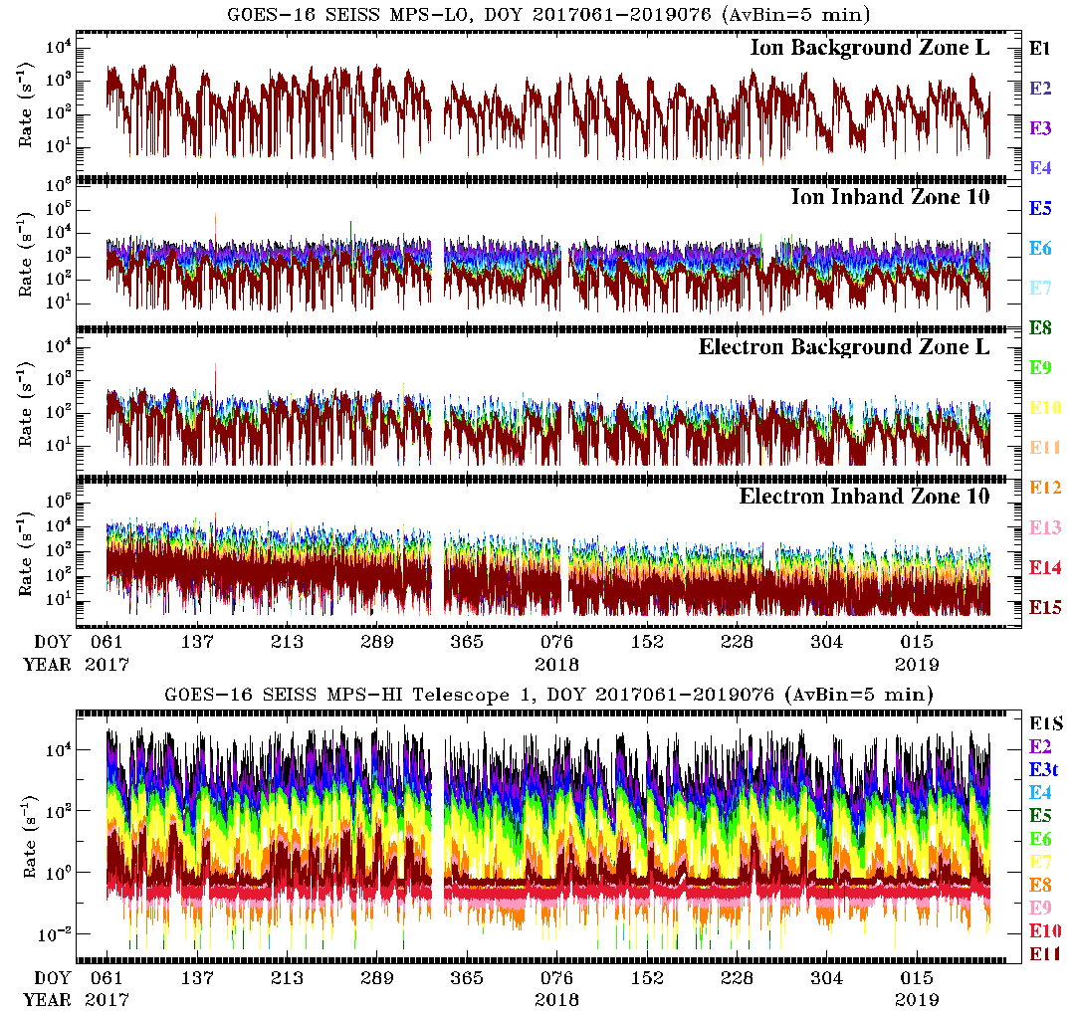
~2 Yrs. Of MPS-LO Backgrounds and MPS-HI Telescope 1

Slide 65
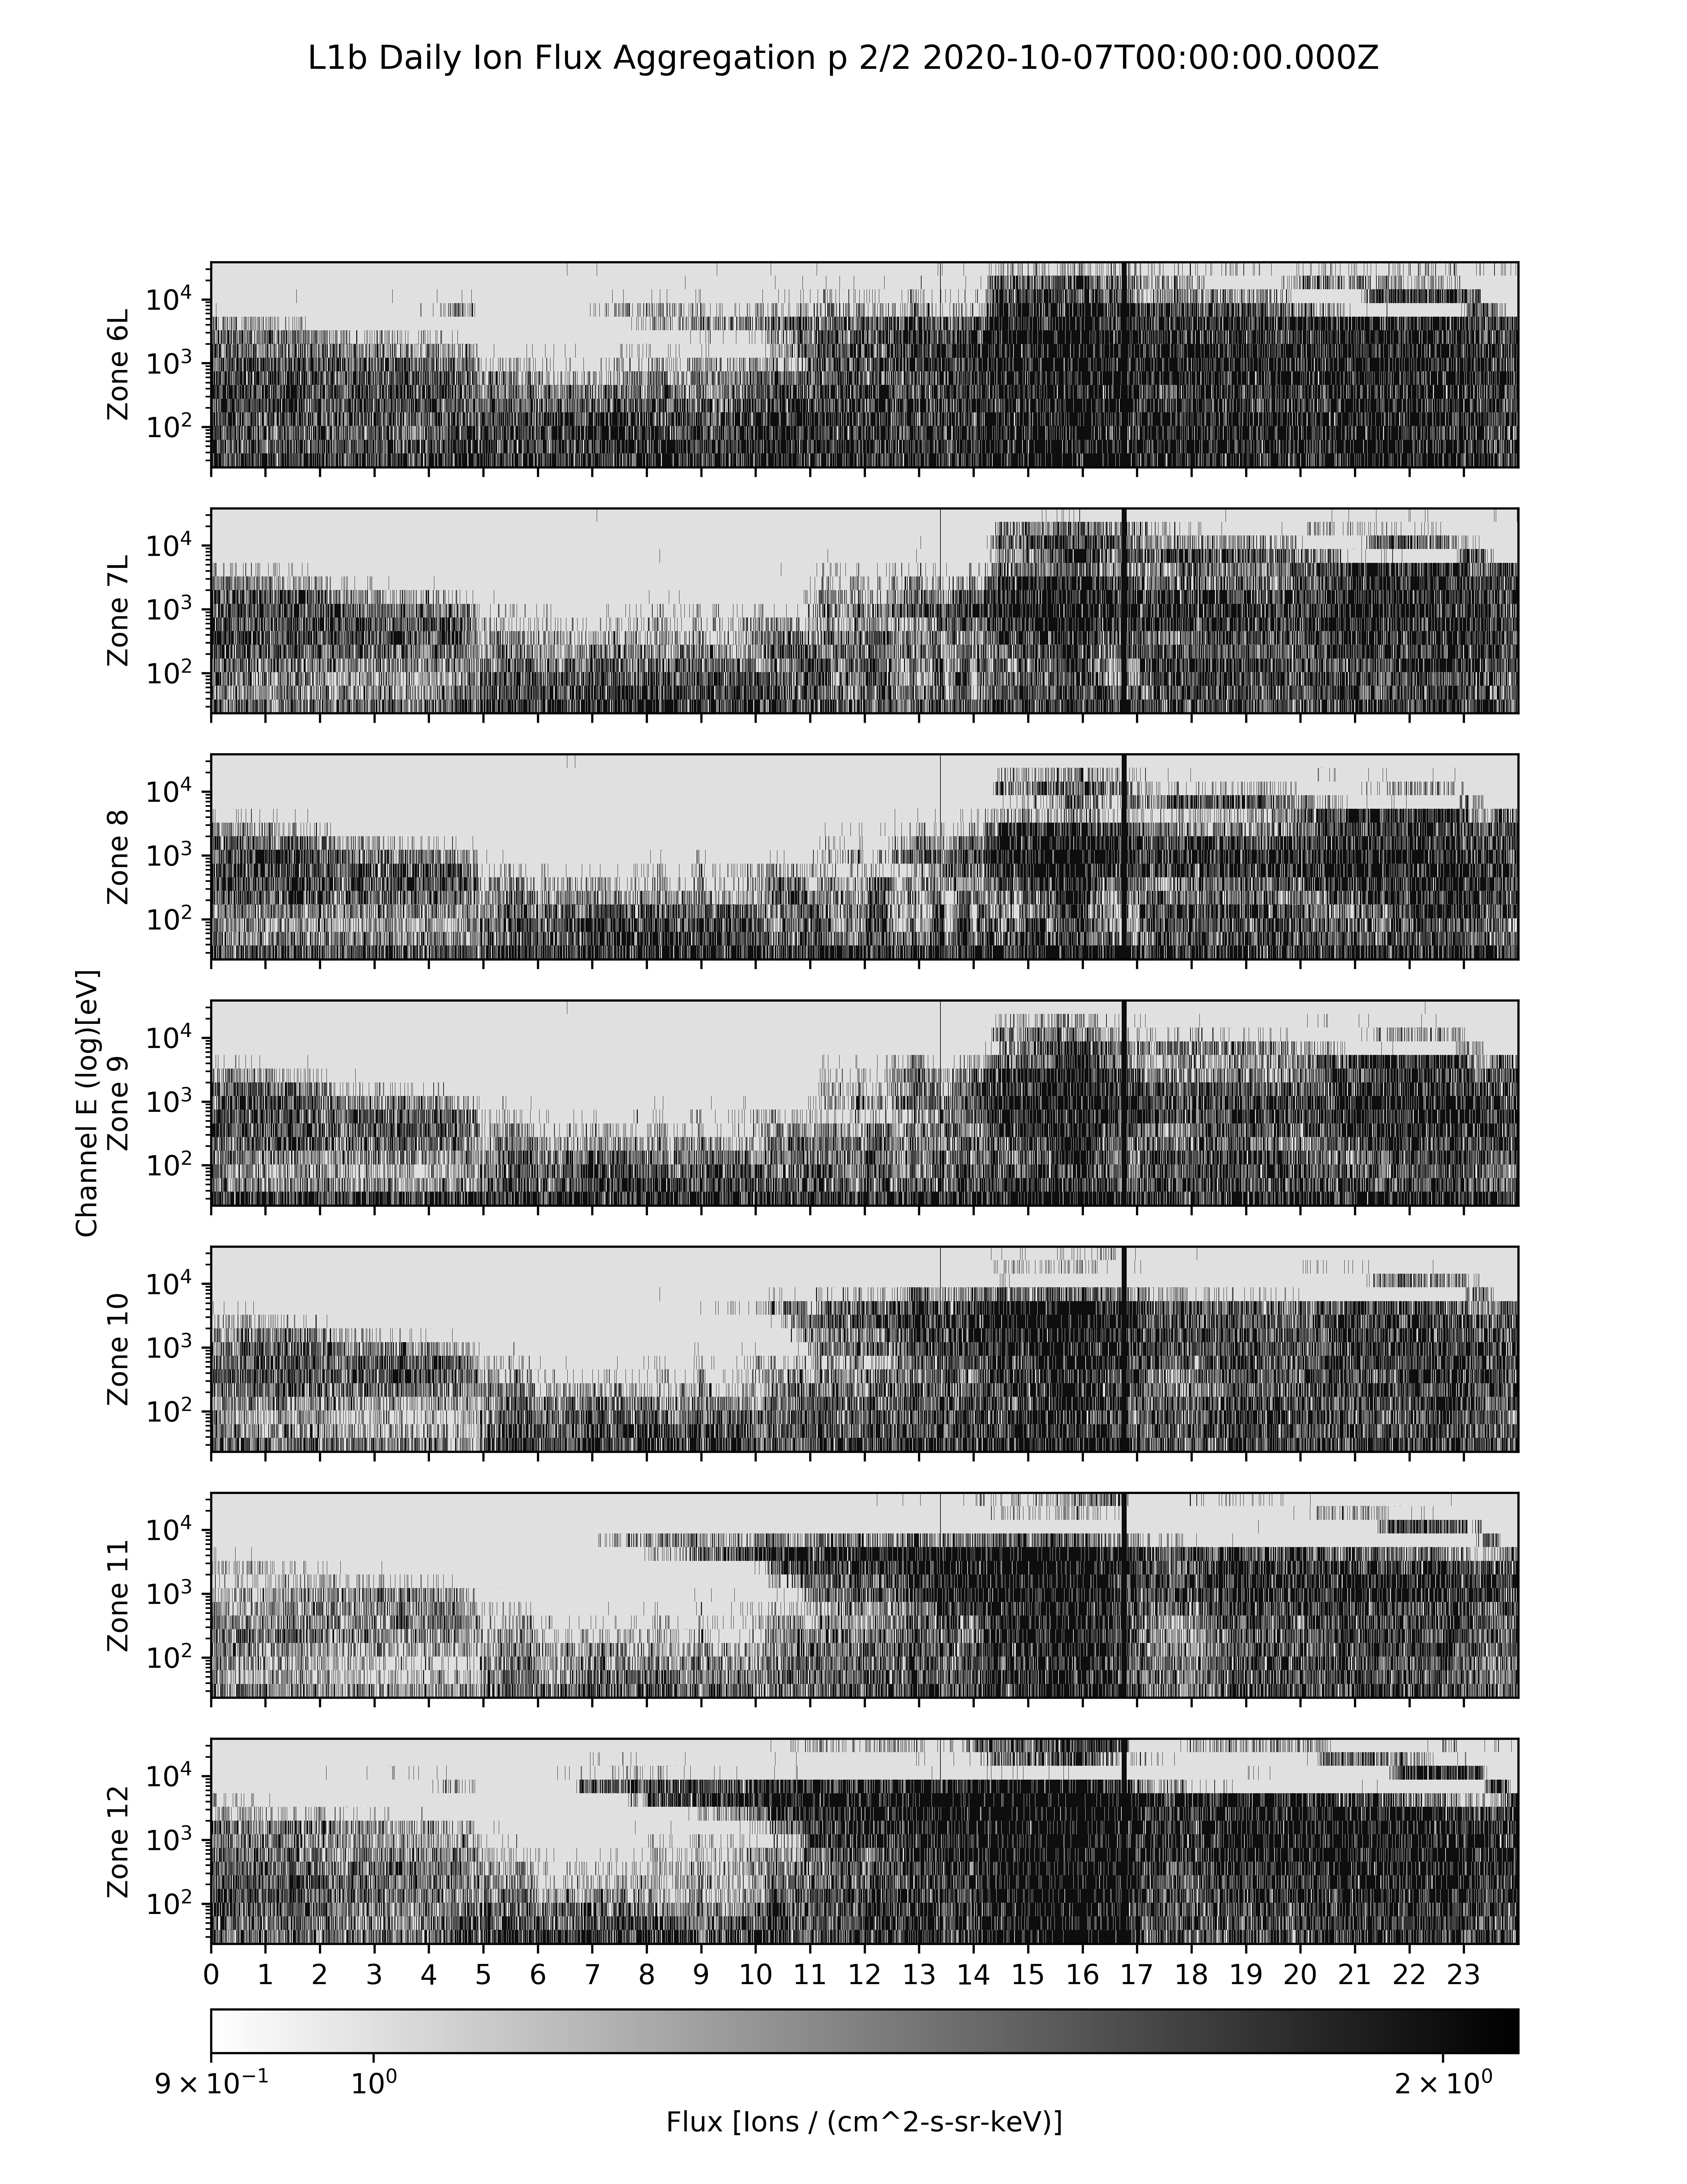
Effect of High Backgrounds on Low Energy Ions Measurement
Data quality flag bit 3 from G16 MPS-LO GS L1b data
Data quality flag bit 3
Not Set (white): Out-of-band contamination less than signal
Set (black): Out-of-band contamination greater than signal
i.e., flag is set when most N_total counts are from backgrounds: M_signal = N_total – N_backgrounds
* 7 October 2020 had relatively low radiation belt fluxes
UT Hours

Slide 66
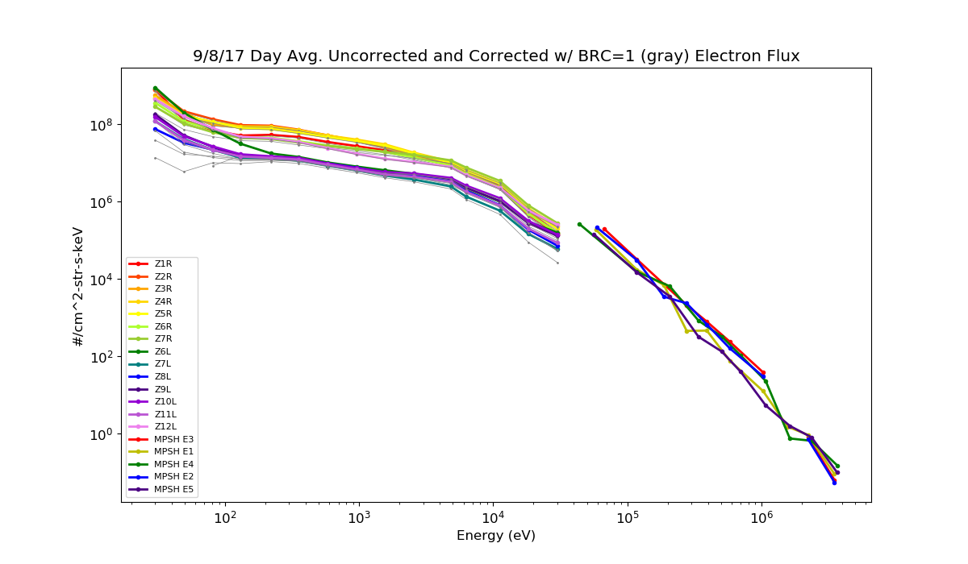
G16 MPS-LO and MPS-HI 1-Day Averaged Electron Spectra
MPS-LO
MPS-HI
Colors are uncorrected fluxes.
Corrected fluxes (in gray) are with energy-dependent backgrounds subtracted.
Dropouts/missing points indicate negative background subtracted fluxes.

Slide 67
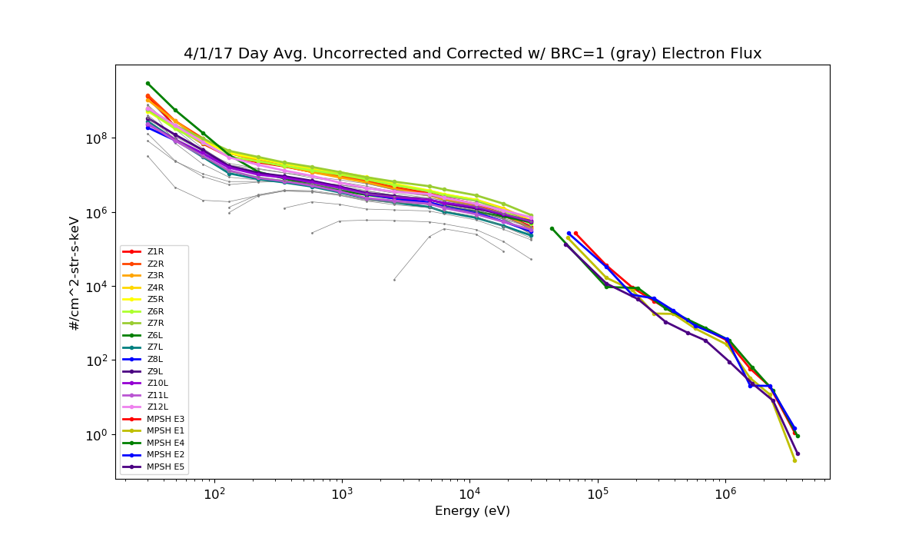
G16 MPS-LO and MPS-HI 1-Day Averaged Electron Spectra
MPS-LO
MPS-HI
Colors are uncorrected fluxes.
Corrected fluxes (in gray) are with energy-dependent backgrounds subtracted.
Dropouts/missing points indicate negative background subtracted fluxes.

Slide 68
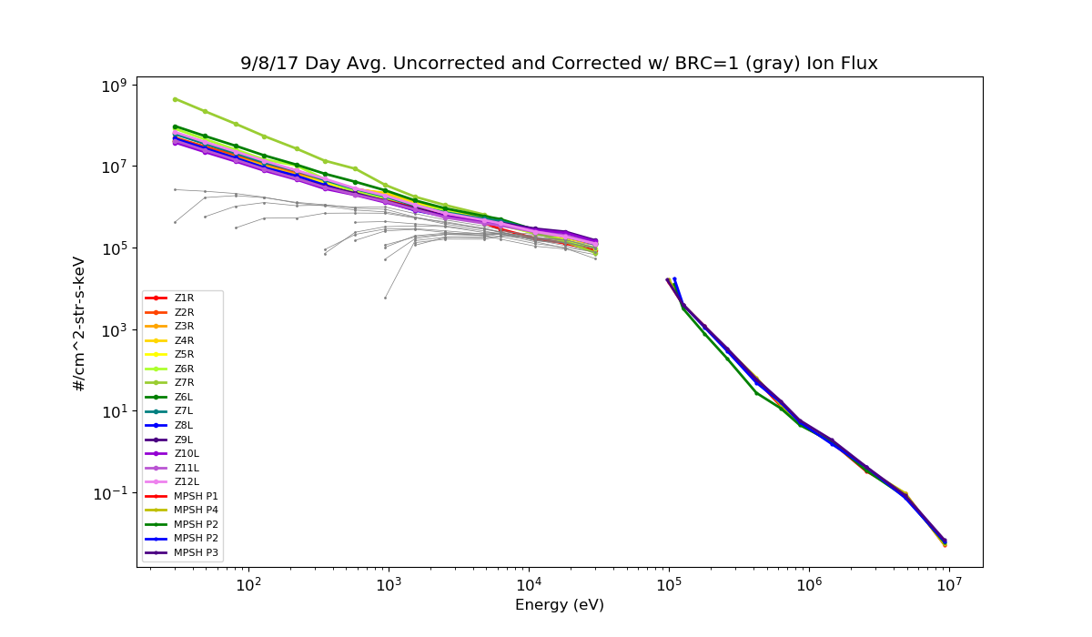
G16 MPS-LO and MPS-HI 1-Day Averaged Ion Spectra
MPS-LO
MPS-HI
Colors are uncorrected fluxes.
Corrected fluxes (in gray) are with energy-dependent backgrounds subtracted.
Dropouts/missing points indicate negative background subtracted fluxes.

Slide 69
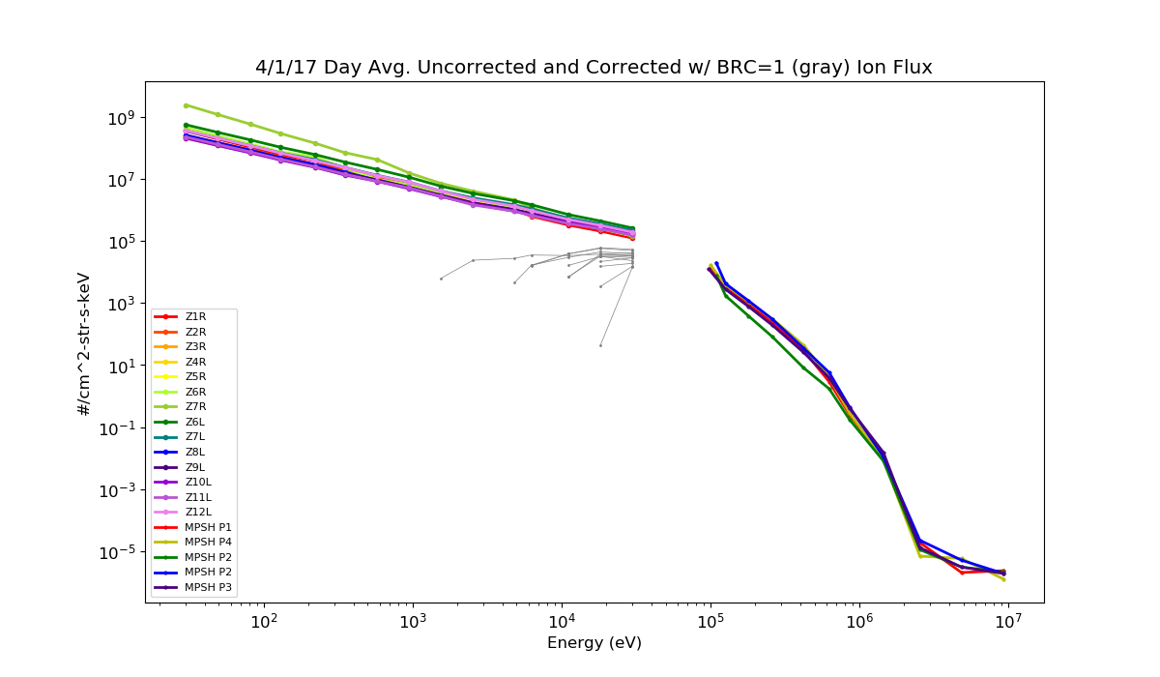
G16 MPS-LO and MPS-HI 1-Day Averaged Ion Spectra
MPS-LO
MPS-HI
Colors are uncorrected fluxes.
Corrected fluxes (in gray) are with energy-dependent backgrounds subtracted.
Dropouts/missing points indicate negative background subtracted fluxes.

Slide 70
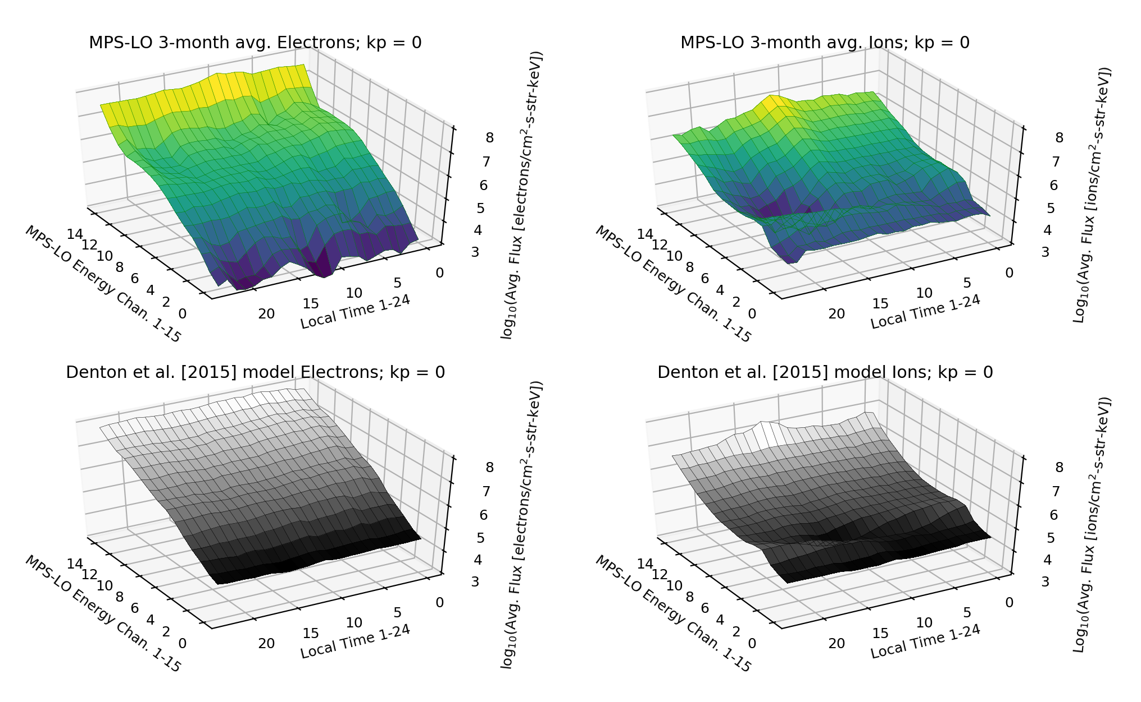
PLPT-SEI-005 Cross satellite Comparison of Trapped Particles
Comparison of G16 MPS-LO Sep-Nov 2018 data with Denton et al. [2015; 2016] model, based on 1990-2007 observations from the Magnetospheric Plasma Analyzer (MPA) instruments on seven Los Alamos National Laboratory (LANL) satellites at GEO. MPS-LO fluxes are binned in local-time and Kp geomagnetic activity index, and then 3-month averaged, for comparison with Denton model.
Pass

Slide 71
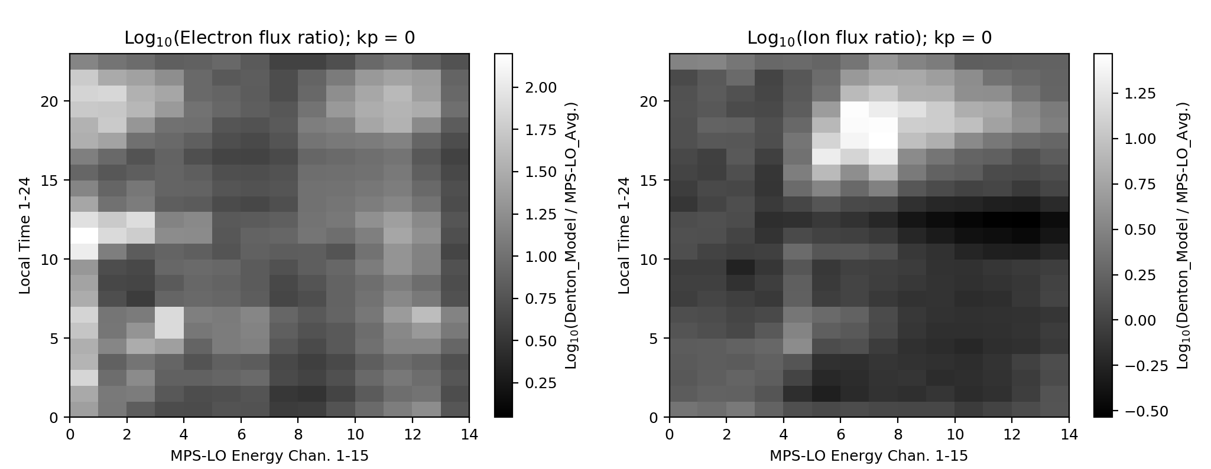
PLPT-SEI-005 Cross satellite Comparison of Trapped Particles
Denton model electron fluxes up to factor of 100 higher at highest energies.
Denton model ion fluxes up to factor of 30 higher.
The Denton et al. [2015; 2016] model electron fluxes are up to 2 orders of magnitude higher than the LT-Kp binned MPS-LO electron fluxes.
The Denton model ion fluxes are up to a factor of 30 higher than the MPS-LO ion fluxes.
Not apples to apples comparison (3-months of MPS-LO data during solar min. vs. 1990-2007 MPA)
General trends in data are similar – Verification that MPS-LO is measuring environmental fluxes.
Pass

Slide 72
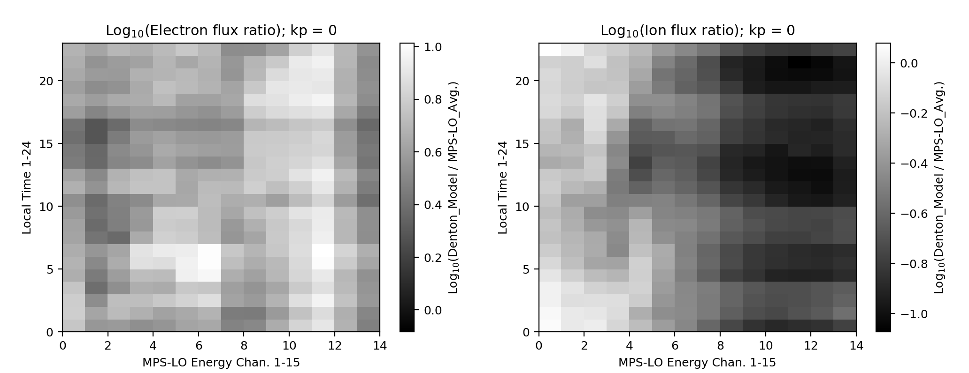
PLPT-SEI-005 Cross satellite Comparison of Trapped Particles
Denton model electron fluxes up to factor of 10 higher at highest energies.
MPS-LO ion fluxes up to factor of 10 higher.
Comparison without MPS-LO background removal.
In this case, the Denton model electron fluxes are up one order of magnitude higher than MPS-LO.
The MPS-LO ion fluxes are up to an order of magnitude higher than the Denton model Ion fluxes.
These results show that lower MPS-LO electron fluxes are not due to background subtraction alone. The lower MPS-LO ion fluxes, however, may be due to too much background subtraction.
G17 results in backup charts
Pass

Slide 73
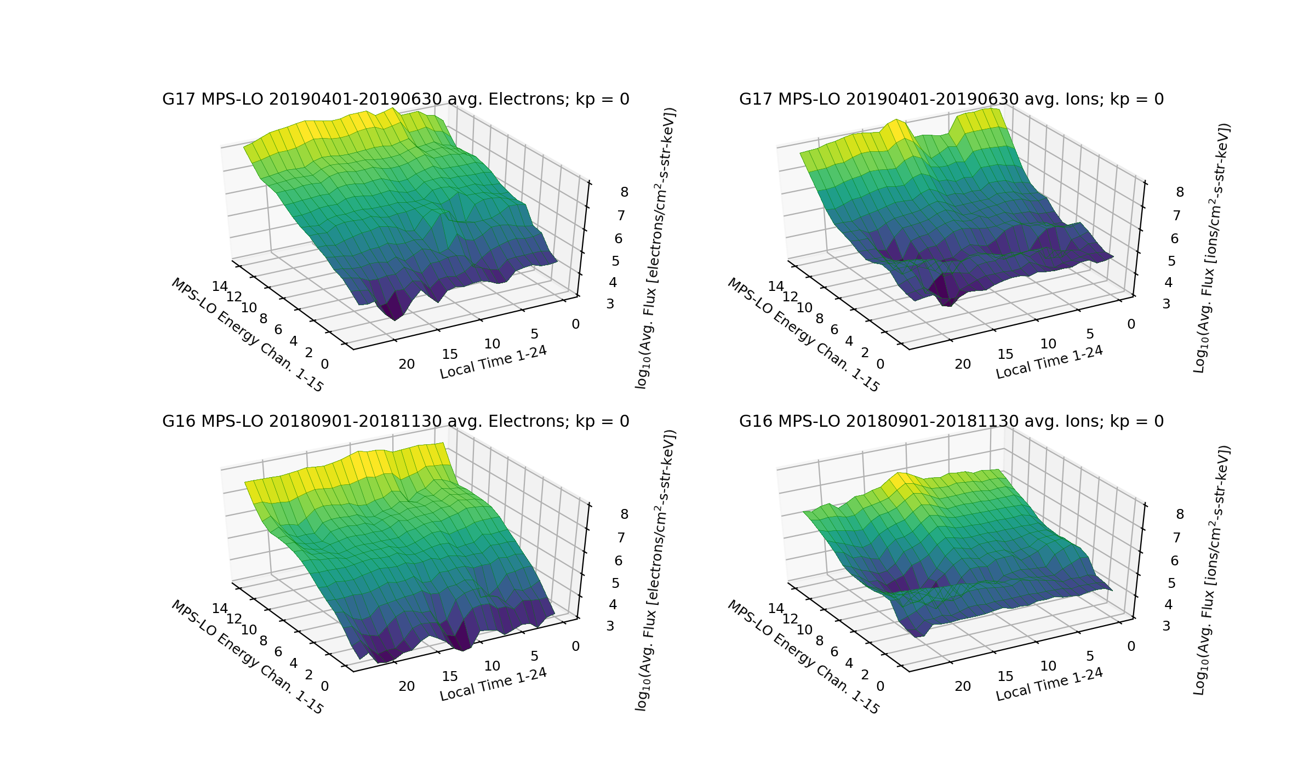
G16-G17 MPS-LO Comparison
Comparison of G16 MPS-LO September-November 2018 averaged data with G17 MPS-LO April-June 2019 averaged data. Fluxes are binned in local-time and Kp geomagnetic activity index, and 3-month averaged.

Slide 74
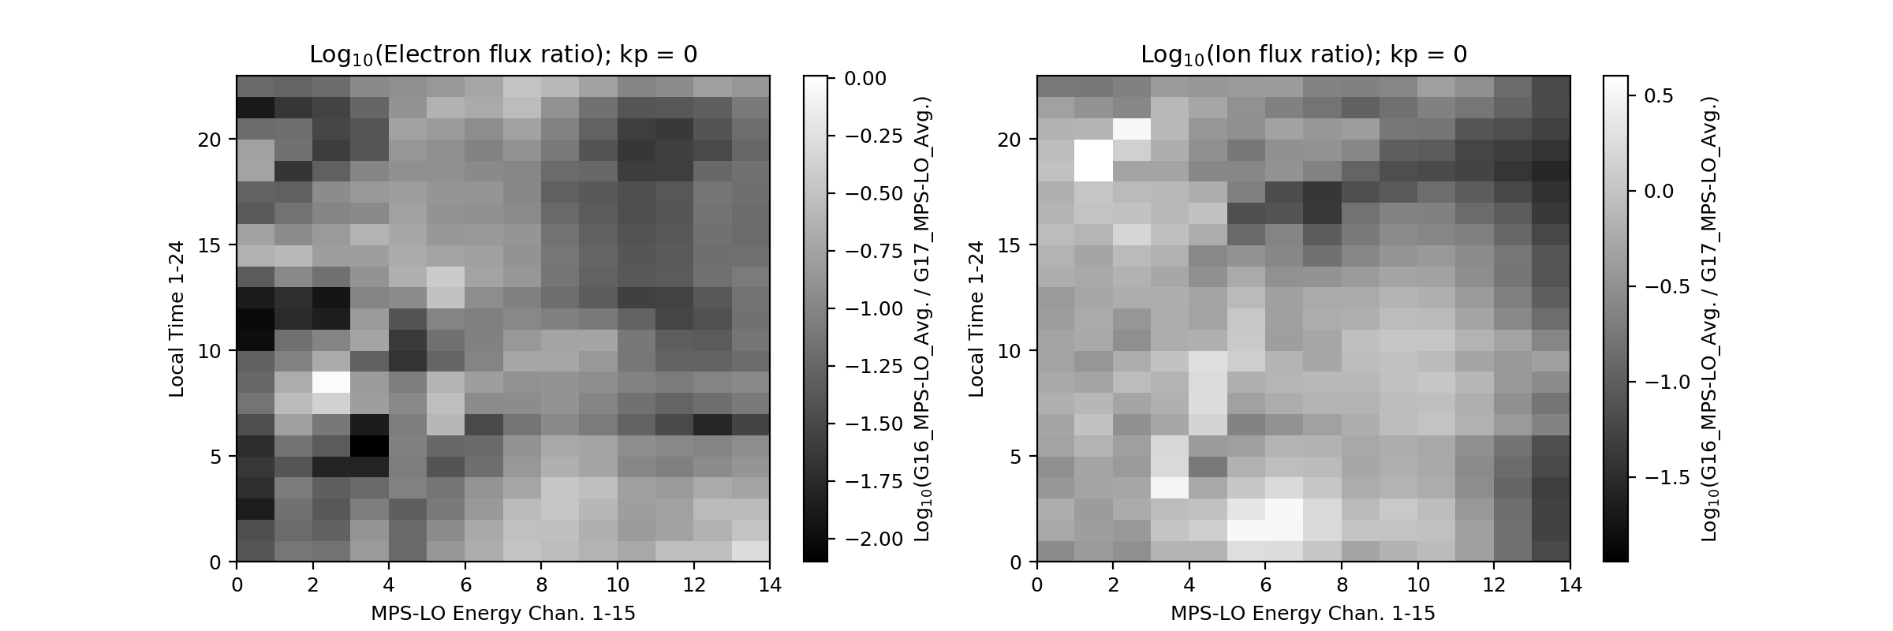
G16-G17 MPS-LO Comparison
The G17 MPS-LO 20190401-20190630 averaged fluxes are up to 2 orders of magnitude greater than G16 MPS-LO 20180901-20181130 averaged fluxes.
G16 MPS-LO reported fluxes are lower due to gradual decline in detector response since MCP HV power on.

Slide 75
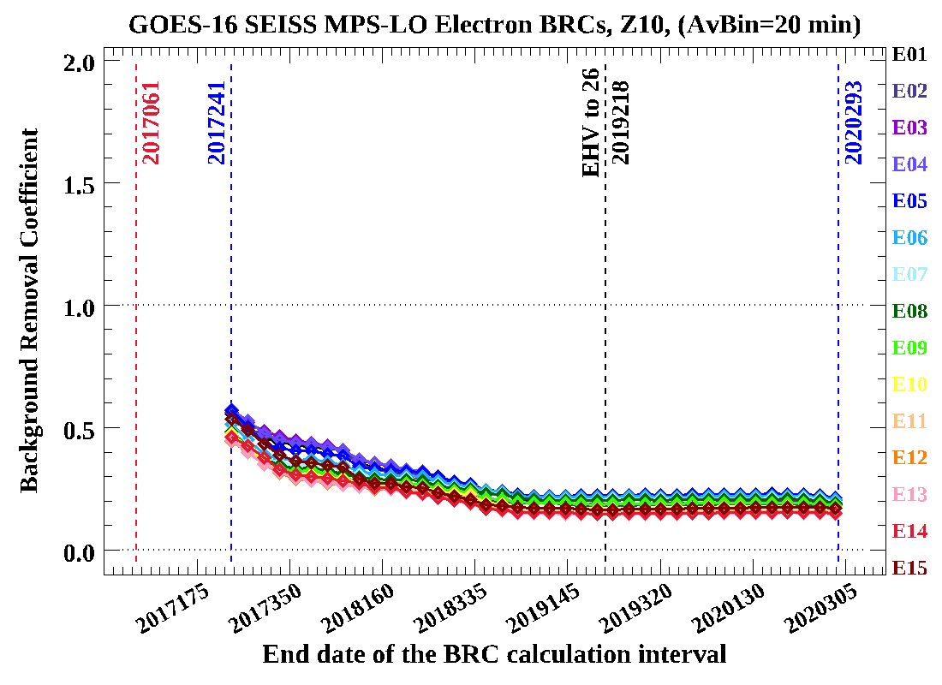
Decline in Reported Flux Using Time Varying BRC
Time Varying background removal coefficient (BRC)
In-band, Background and Corrected count rates
Back of envelope calc.
using varying BRCs
E5 corrected c/s at R1 (2017 DOY 61)
2000 - .5*180 = 1940 c/s
E5 corrected c/s at R2 (2019 DOY 171)
100 - .2*35 = 93 c/s

