Slide 1
G16 SGPS Full Validation PS-PVR SWPC Overview
The SGPS data are essential to support satellite launch and on-orbit operations, human and robotic exploration, aviation operations, and radio communication.
G16 SGPS has some anomalous channels with unknown root cause, but overall SGPS is performing well. Calibration and validation will continue beyond full validation, including analysis using data from future SEP events.
The following full validation maturity level end state is met: “Products are operationally optimized, as necessary, considering mission parameters of cost, schedule, and technical competence as compared to user expectations.” Other full validation end state criteria are also met.
SWPC concurs with NCEI’s recommendation for SGPS L1b to transition to full validation status.

Slide 2
Primary Uses of SGPS Data
Solar Radiation Storm Scale
One of three NOAA space weather scales.
Aviation industry:
HF radio blackout product
Radiation advisories
Satellite industry:
Satellite launch support
Satellite anomaly resolution and design guidelines
Human space exploration
Apollo era through International Space Station today
Human Space Exploration Initiative in the near future

Slide 3
Aviation Radiation Support
SWPC is one of three ICAO global centers providing space weather advisories for international aviation
Radiation services require proton energy above 500 MeV – Lower energies don’t reach Earth
GOES-R series replaced HEPAD instrument with a single >500 MeV channel
Excellent instrument performance demonstrates that accurate spectra can be calculated to sufficiently high energies (>1 GeV)

Slide 4
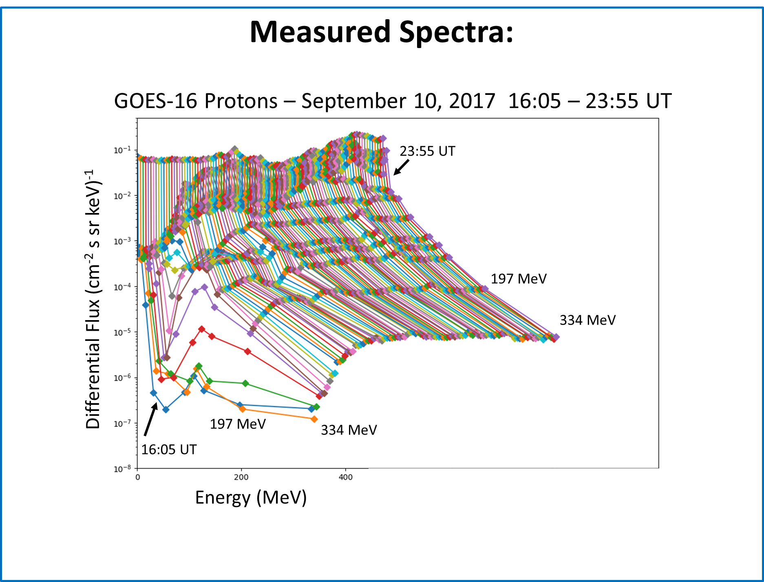
Measured Spectra During Solar Energetic Particle Event
Measured differential spectra up to ~334 MeV

Slide 5
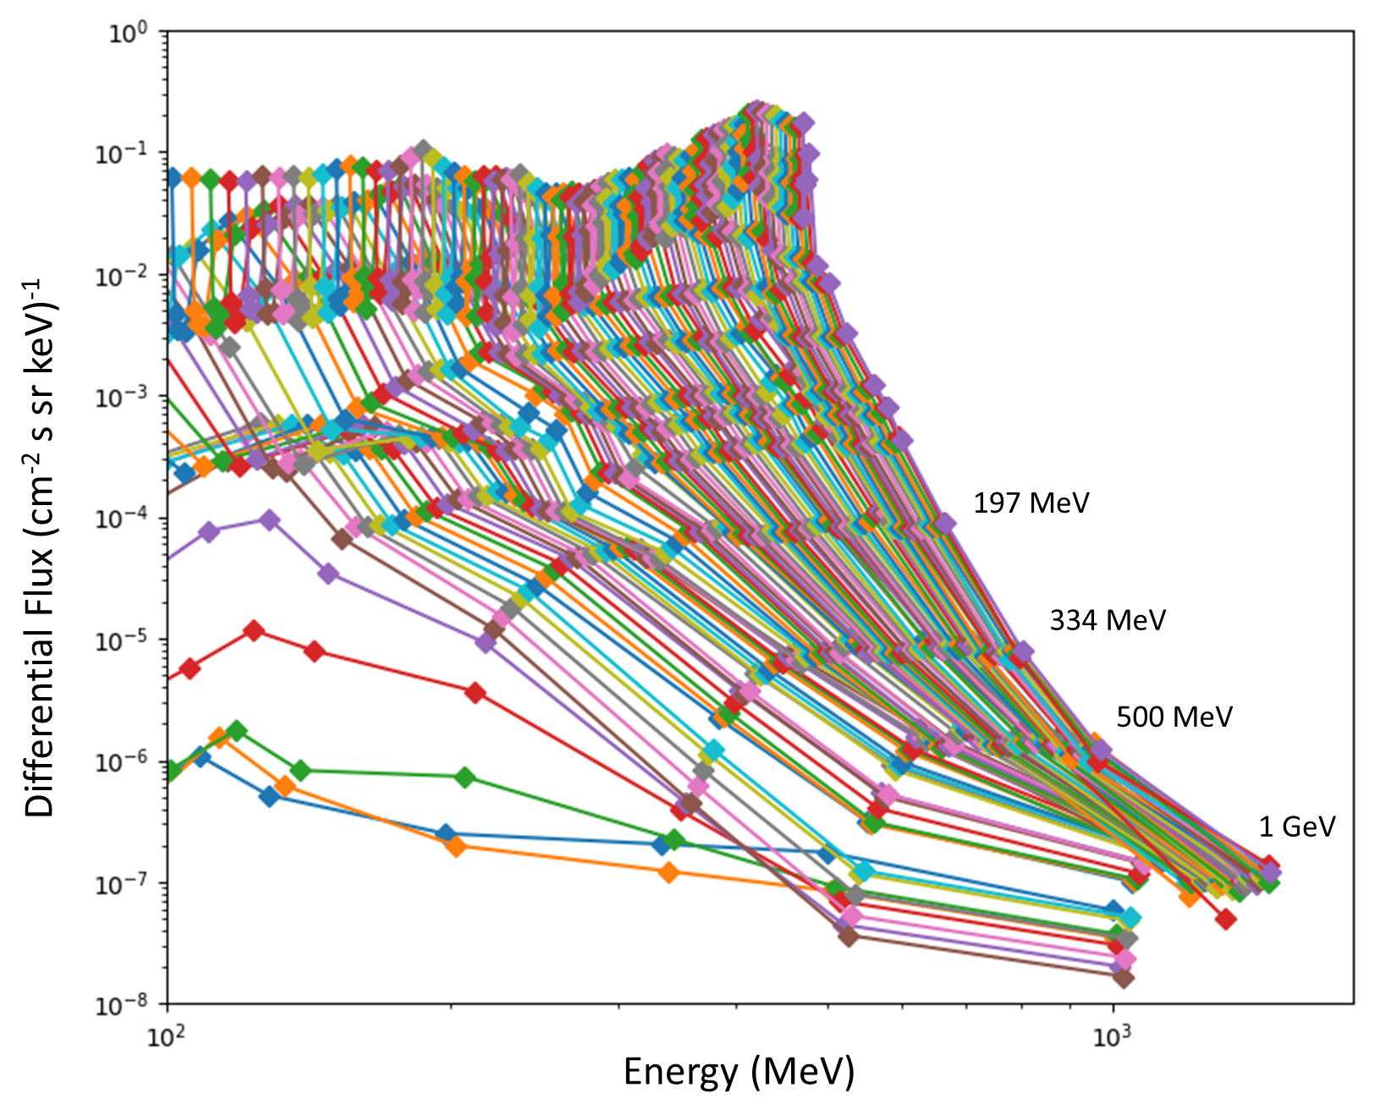
Extrapolated Spectra Using Differential and Integral Channels
GOES-16 Protons – September 10, 2017 16:05 – 23:55 UT
Comparison with spectra created by the FAA for their radiation product using GOES-15 data looks excellent. Effort is ongoing to improve the GCR background subtraction in the generation of these extrapolated spectra.

Slide 6
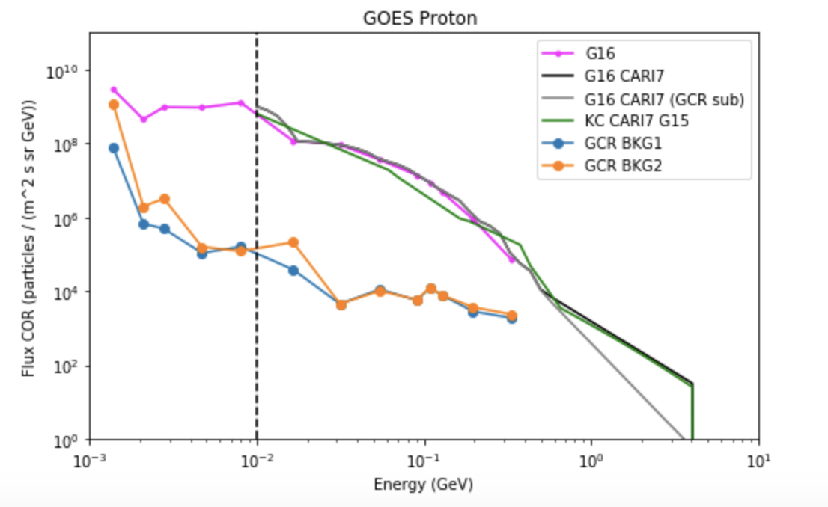
Comparison of GOES-16 and GOES-15 Spectra
Comparison with spectra created by the FAA for their radiation product using GOES-15. Effort is ongoing to improve the GCR background subtraction.

Slide 7
G16 SGPS Full Validation PS-PVR SWPC Summary
The SGPS data are essential to support satellite launch and on-orbit operations, human and robotic exploration, aviation operations, and radio communication.
GOES-16 SGPS proton data are operationally available in the Space Weather Prediction Center Forecast Office.
Although areas of improvement remain and only one proton event has occurred to exercise the instrument, we are confident that the SGPS data are of sufficient quality to meet SWPC’s primary operational needs.
SWPC concurs with NCEI’s recommendation for SGPS L1b to transition to full validation status.
SWPC is highly appreciative of the dedication and excellent work of ATC, NCEI, and the GOES program for reaching this level of maturity of the SGPS data.
We look forward to the continuing calibration and validation work that will address the remaining issues.

