Slide 1
Peer Stakeholder-Product Validation Review (PS-PVR) For the Provisional Maturity of GOES-16 SEISS SGPS L1b Product
July 11, 2018
GOES-R Calibration Working Group (CWG)
Presenter: Brian Kress
Contributors: Athanasios Boudouridis, Juan Rodriguez
NOAA NCEI / CIRES
This review incorporates results from Assurance Technology Corporation PLTs.

Slide 2
Outline
SGPS Overview
Review of Beta Maturity
Product Quality Evaluation
Summary of SGPS Anomalies
PLPTs Supporting Assessment for Provisional Status
Provisional Maturity Assessment
Path to Full Validation Maturity
Summary and Recommendations

Slide 3
SGPS OVERVIEW
GOES-16 SGPS L1b Product Provisional PS-PVR

Slide 4
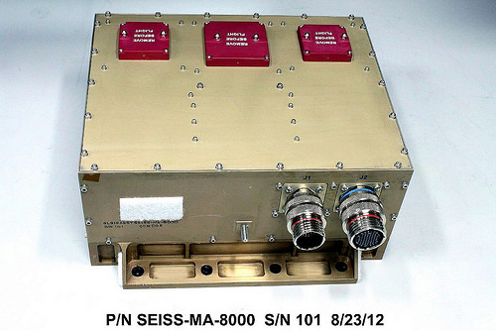
Space Environment In-Situ Suite (SEISS) Solar and Galactic Proton Sensor (SGPS)
2 Units, one looking East (+X) and one West (-X)
3 solid state telescopes on each unit
1-500 MeV protons in 13 differential channels, plus >500 MeV integral channel
4-500 MeV alphas in 12 energy bands
(not processed)
GOES-16 SEISS sensors turned on Jan. 8th 2017
SEISS SGPS designed, built, tested and calibrated by Assurance Technology Corporation (ATC)

Slide 5
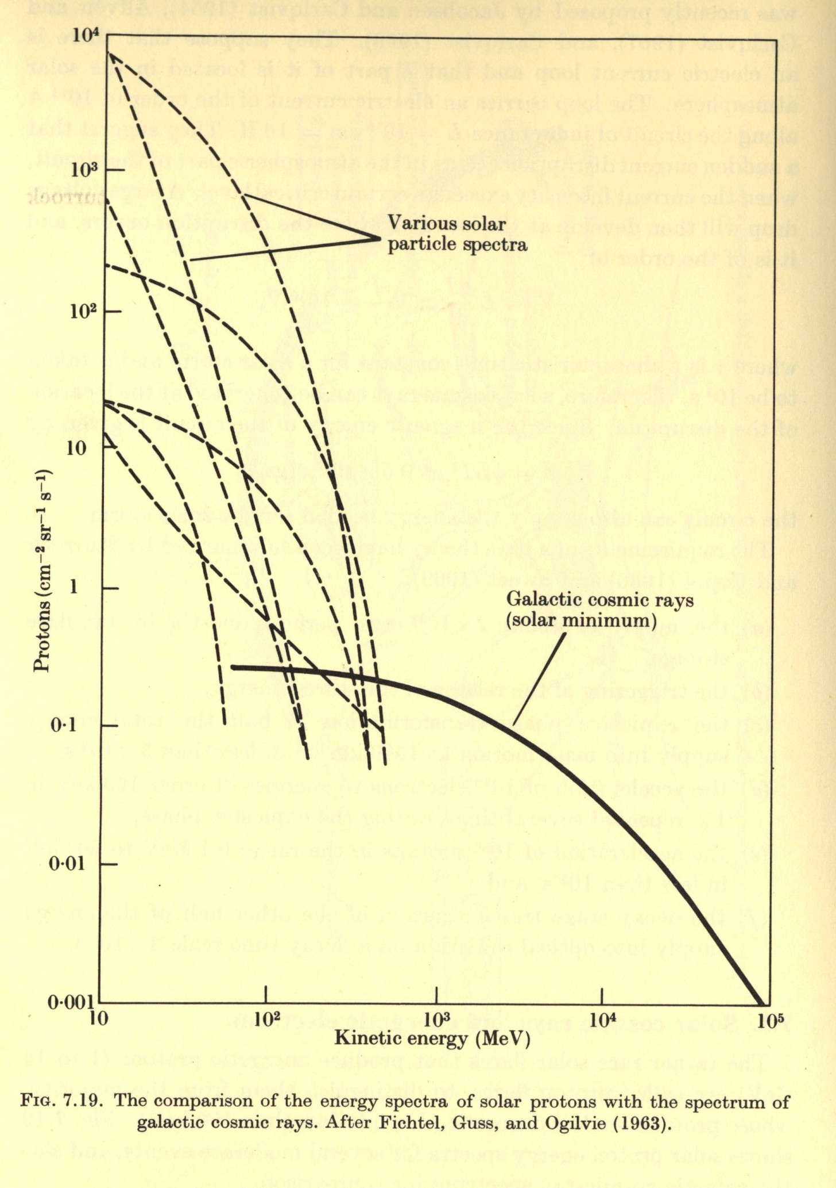
Introductory Material
Energetic Ions In Space
From Solar Terrestrial Physics,
Akasofu and Chapman, 1972.
GCRs (Galatic Cosmic Rays)
Always present in space
Energies up to and > 10¹¹ GeV
Flux ≈ 0.6 particles / cm² / sec
≈ 99.5% H & He
SEPs (Solar Energetic Particles)
Produced during Solar Particle Events (SPEs) lasting one to several days.
Mostly < 500 MeV protons
Flux up to 10⁵ particles / cm² / sec
Most are shielded by the earths magnetic field at latitudes < 60º.

Slide 6
SGPS Primary Operational Use
Data stream for NOAA-NWS SWPC Solar Proton Event Detection and Radiation Storm Alerts
Level 1b
Level 2
1 sec.
The NOAA Space Weather Scales communicate to the general public current and future space weather conditions and possible effects on people and systems.
Numbered levels, analogous to hurricanes, tornadoes, and earthquakes that convey severity.

Slide 7
REVIEW OF BETA MATURITY (SEISS Beta PS-PVR, Feb. 2017)
GOES-16 SGPS L1b Product Provisional PS-PVR

Slide 8
PRE-BETA SGPS PLTs
PLT ID | Descriptive Title | % Complete | Results | Delivered Vendor Report | CWG POC
G16-C-PLT-SEI-006 | SGPS+X Initial IFC Execution | 100 | Passed | SEISS-TR-Y121-5 _SGPS+X_IFC_PRELIMINARY, | Rodriguez
G16-C-PLT-SEI-006 | SGPS-X Initial IFC Execution | 100 | 13 thresholds missed or need further analysis | SEISS-TR-Y121-6_SGPS-X_IFC_PRELIMINARY | Rodriguez
G16-C-PLT-SEI-007 | Cross-Calibration of SGPS +X and -X | 100 | Steps in –X P9-P11 | SEISS-TR-Y121-10 _SGPS_CrossCal_PRELIMINARY | Kress
G16-C-PLT-SEI-008 | SGPS D3-D1 Logic Circuit Test | 100 | Passed | SEISS-TR-Y121-8_SGPSD3D1_PRELIMINARY | Boudouridis
SGPS Instrument/GPA Issues Identified at Beta PS-PVR
Title | Description | Status | Mitigation
Inconsistent order in SGPS-X and SGPS+X | [aka SGPS Binary Output Defect] Per PUG, in the ‘sensor unit’ dimension the SGPS variables should be ordered (-X, +X). Some variables are currently have the opposite ordering. | CLOSED | WR3423, DO.05.00
SGPS –X P9-P11 non-geophysical diurnal variation | P9, P10, and P11 channels in SGPS –X exhibit non-geophysical diurnal variation / step change every 12 hours. |  | Complete analysis of temperature-sensitive thresholds using IFC data Correlate variation with on-orbit temperature
NCEI-CO recommended that these issues be resolved prior to transition to Provisional.
There are 15 additional open WRs that should be resolved prior to Full Validation.

Slide 9
PRODUCT QUALITY EVALUATION
GOES-16 SGPS L1b Product Provisional PS-PVR

Slide 10
Summary of SGPS Anomalies
SGPS-X (West) L1b 5m averages
During Sep. 2017 Solar Proton Event
Temperature dependent Drops in SGPS-X T1 fluxes
GCR fluxes too high
SGPS-X T3 temperature dependence
L1b data dropouts
Temperature Dependence in SGPS-X T1 & T3 -- Instrument issue addressed with ADR 405 and correction algorithm downstream of L1b.
ADR 517, small but routine L1b gaps, mostly for SEISS.
GCR fluxes too high – Problem well understood, does not violate requirements.

Slide 11
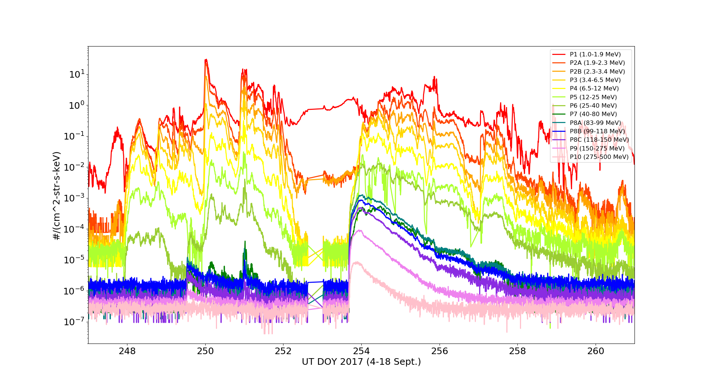
Summary of SGPS Anomalies
SGPS+X (East) L1b 5m averages
During Sep. 2017 Solar Proton Event
SGPS+X P7 too low (dark green)
Overcorrection (neg. fluxes) in SGPS+X P5
SGPS+X P7 approximately an order of magnitude low in L0 data. (Instrument issue, not understood.)
SGPS+X P5 negative fluxes (L1b processing issue, no ADR yet.)

Slide 12
Summary of SGPS Anomalies
Additional issues (Not seen in Sept. 2017 SPE figures – examples in following slides.)
Electron contamination in SGPS+X P5 – Instrument issue, could be addressed with correction scheme using MPS-HI fluxes. (No associated ADR.)
SEP Channel Cross-Comparison PLPT indicates some channels are not performing as characterized with beam calibrations (e.g., SGPS +X and -X P4 differ by about a factor of 4 during 16-17 July 2017 SPE). Geometric factors may need adjustment (No ADR, additional analysis needed).
L1b issues fixed in DO 06.03
SGPS T2 fluxes systematically low ($≈$10%), L1b processing error fixed
(ADR 491, CLOSED).
Remove divide by 2 from P11 L1b processing (ADR 427, CLOSED)
Inaccurate SWx Instrument_ID Fields (ADR 342, CLOSED)
Add temperatures to L1b data (ADR 405, CLOSED)

Slide 13
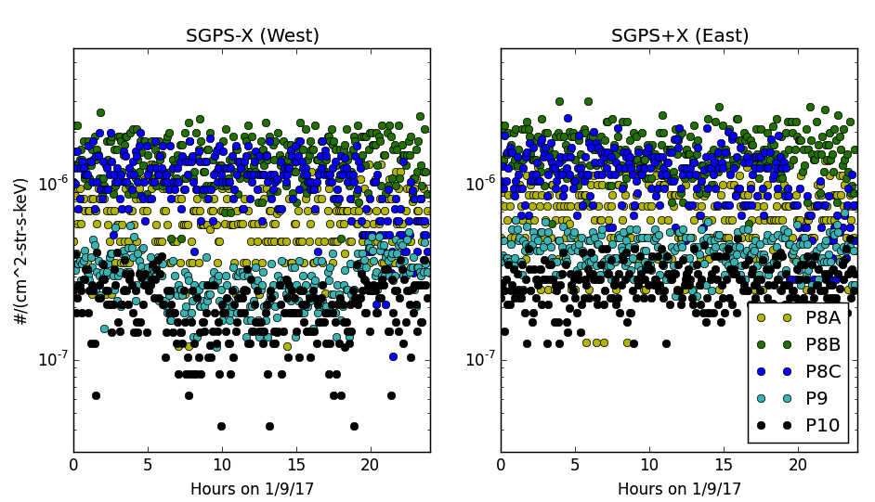
SGPS-X (West) Temperature Dependence
5m avg.
fluxes
transition
region
Temperatures
22 day averages of counts/sec in 1 deg. temperature bins between -20º and +30º C.
Here, P9 and P10 are shown as examples. There is also significant temperature dependence in response of P11, P1-P3,
and P5 channels.
transition
region

Slide 14
Temperature Correction Scheme
A rectangular function is used to model the energy channel response function and a power law is used to model the ambient spectrum
The total counts/sec. in the channel is the convolution of the channel response function and the ambient spectrum
$$C=\int_{E_{L}}^{E_{U}}{G_{0}}j_{0}E^{−γ}dE =G_{0}j_{0}\frac{(E_{U}^{1−γ}−E_{L}^{1−γ})}{1−γ}$$
A temperature and spectrum dependent correction is used to determine the counts expected in the fixed/calibrated channel (at 25ºC), given counts from temp. dep. chan.
$$C_{fixed}=X∗C\left(t\right),$$
where $X=\frac{G_{0}(t={25}^{o}C)[E_{U}^{1−γ}(t={25}^{o}C)−E_{L}^{1−γ}(t={25}^{o}C)]}{G_{0}\left(t\right)[{E\left(t\right)}_{U}^{1−γ}−{E\left(t\right)}_{L}^{1−γ}]}$
G(E)
Log j(E)
$$j\left(E\right)=j_{0}E^{−γ}$$
$$G_{0}$$
Energy
Log Energy
$$E_{L}$$
$$E_{U}$$

Slide 15
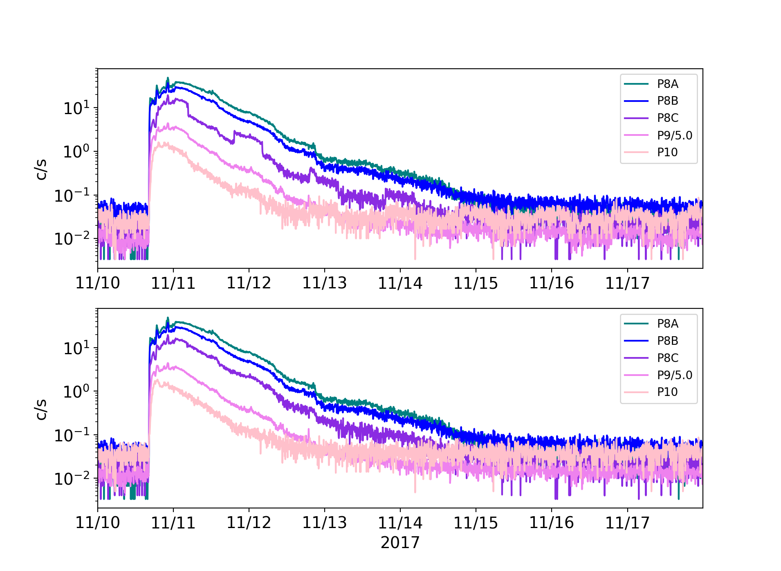
SGPS Temperature Correction
SGPS-X T3
Uncorrected
Corrected
SGPS-X T3 5 minute averaged counts per second during Sept. 2017 SEP event, showing uncorrected c/s in top panel and temperature corrected c/s in bottom panel.

Slide 16
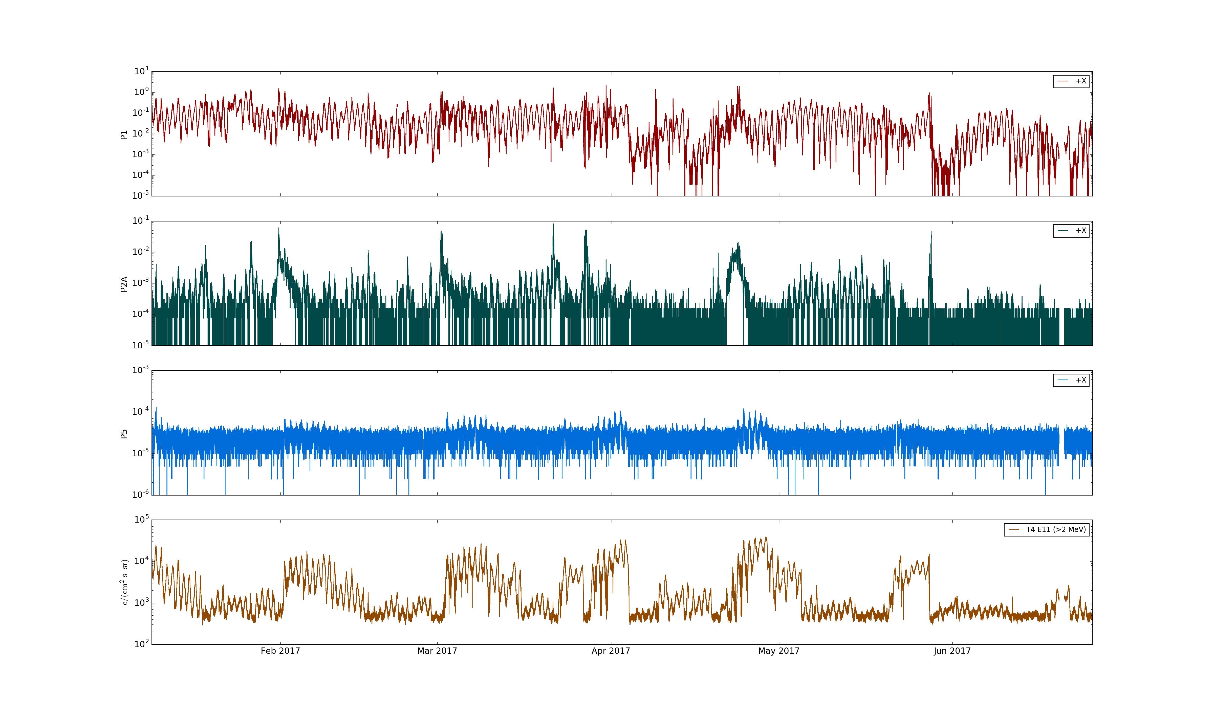
SGPS P5 Electron Contamination
SGPS+X
P1
(1-2 MeV)
CIR events in SGPS P2A
SGPS+X
P2A
(2-2.3 MeV)
Heightened SGPS P5 flux, delayed with respect to start of CIR event, due to contamination by radiation belt electrons.
SGPS+X
P5
(12-25 MeV)
MPS-HI
>2MeV
electrons
Feb. 2017
Mar. 2017
Apr. 2017
May 2017
June 2017
Top 3 panels: SGPS +X (east) P1, P2A, and P5 fluxes during Jan-June 2017. Bottom: MPS-HI E11 (>2MeV) showing enhanced radiation belt electron fluxes associated with CIR events.

Slide 17
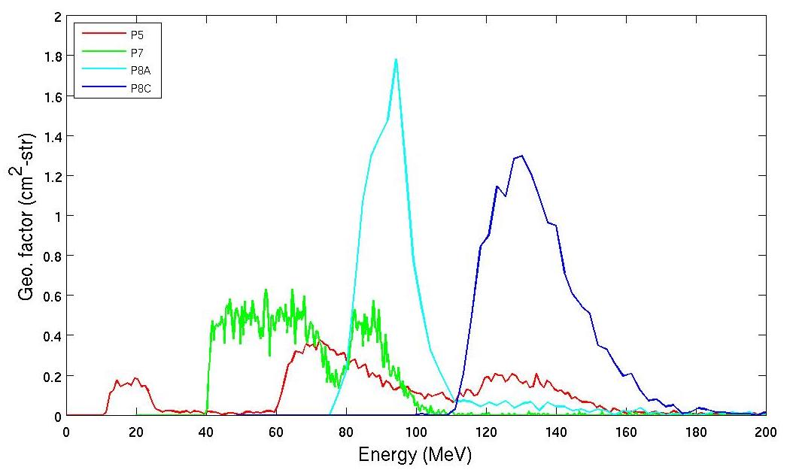
P5 Correction
In L1b processing, P7 and P8A are used to remove out-of-(energy)band contamination from high energy islands in P5 response function:
$${P5}_{corrected counts}={P5}_{total counts}−(α_{P7}∗P7_{flux} +α_{P8A}∗P{8A }_{flux})$$
In SGPS LUT, current values for alpha coefficients are $α_{P7}$=8366 and $α_{P8A}$=0
$α_{P7}$ and $α_{P8A}$ should be adjusted so that P5 is not over corrected, also, to minimize error in reported flux over the broadest possible range of SEP spectra.
Additional SPE data is needed to obtain good estimates for these parameters.
P5 out-of-band
high energy islands
P5 in-band

Slide 18
SGPS P4 and MPS-HI P11
Period with SW P_{dyn} > 10nP.
(west facing unit)
(east facing unit)
SGPS and MPS-HI 5m averaged fluxes during 16-17 Solar Particle Event. Fluxes from east and west facing units are expected to be the same during period of high solar wind dynamic pressure. SGPS +X and –X P4 differ by about a factor of 4 during 16-17 July 2017 SPE.

Slide 19
SGPS PLPTs Supporting Provisional Maturity
PLPT-SEI-001 SGPS D3-D1 Contamination Correction
PLPT-SEI-004 SEP Channel Cross-Comparison
PLPT-SEI-006 Backgrounds Trending

Slide 20
PLPT-SEI-001 SGPS D3-D1 Contamination
Difference in counts with D3-D1 circuit on vs. off are in agreement with expected ratio.
Comparison of SGPS+X and SGPS-X count rates from P7 and P8C with different on/off configurations of D3-D1 rear entry removal circuit.

Slide 21
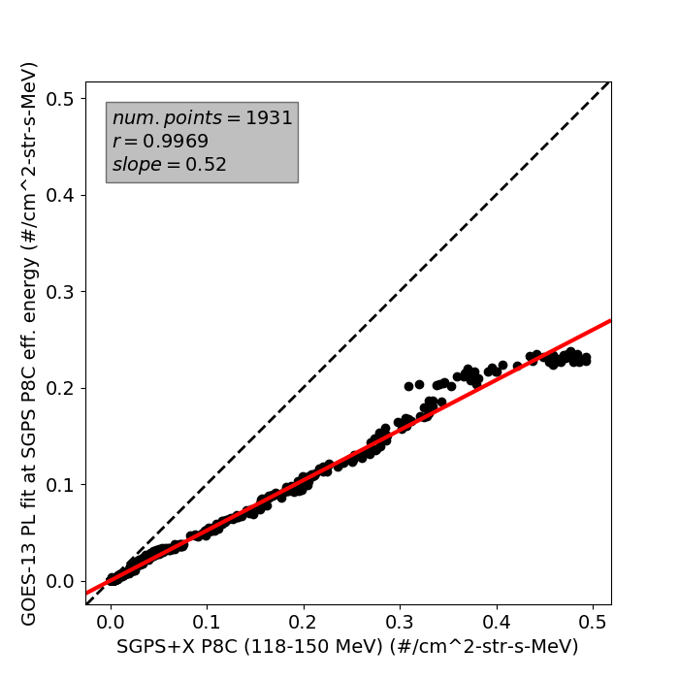
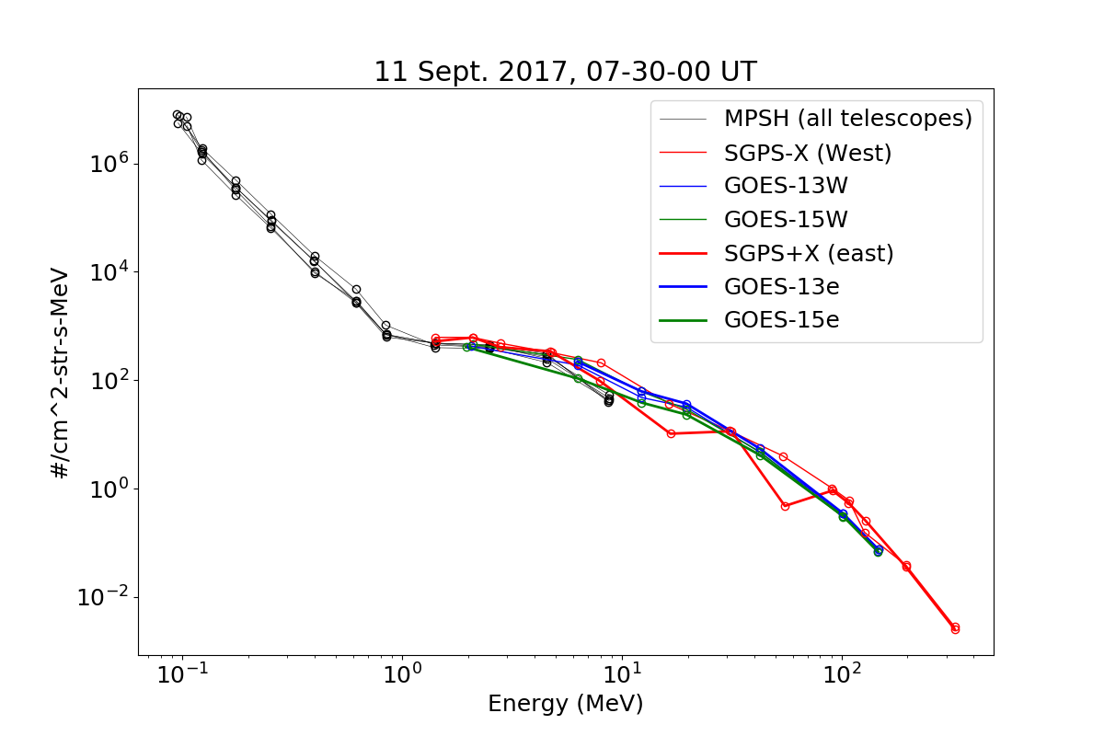
PLPT-SEI-004 SEP Channel Cross-Comparison
10-17 Sept. 2017
SGPS+X P5
(overcorrection)
SGPS+X P7
(anomalously low)
During the Sep 2017 SEP event, at T3 energies (83-500MeV), SGPS fluxes are about a factor of two higher than GOES-13 and -15 fluxes.
SEP Channel Cross-Comparison PLPT indicates numerous channels are not performing as characterized with beam calibrations (e.g., SGPS +X and –X P4 differ by about a factor of four during 16-17 July 2017 SPE). Geometric factors may need adjustment.

Slide 22
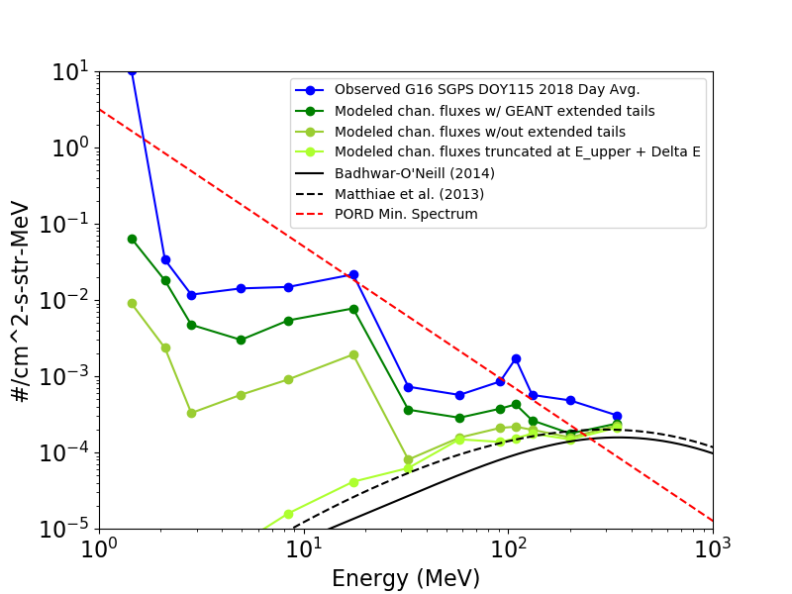
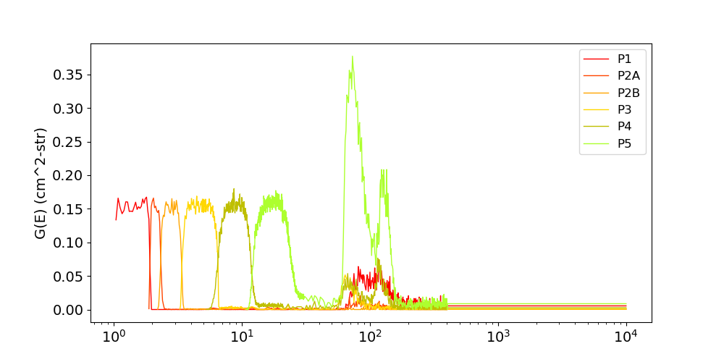
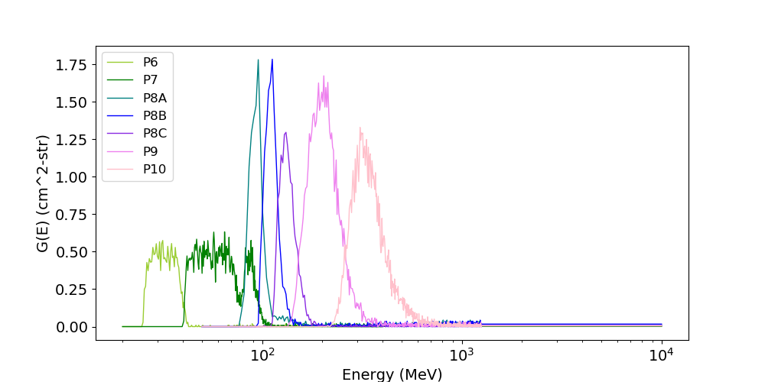
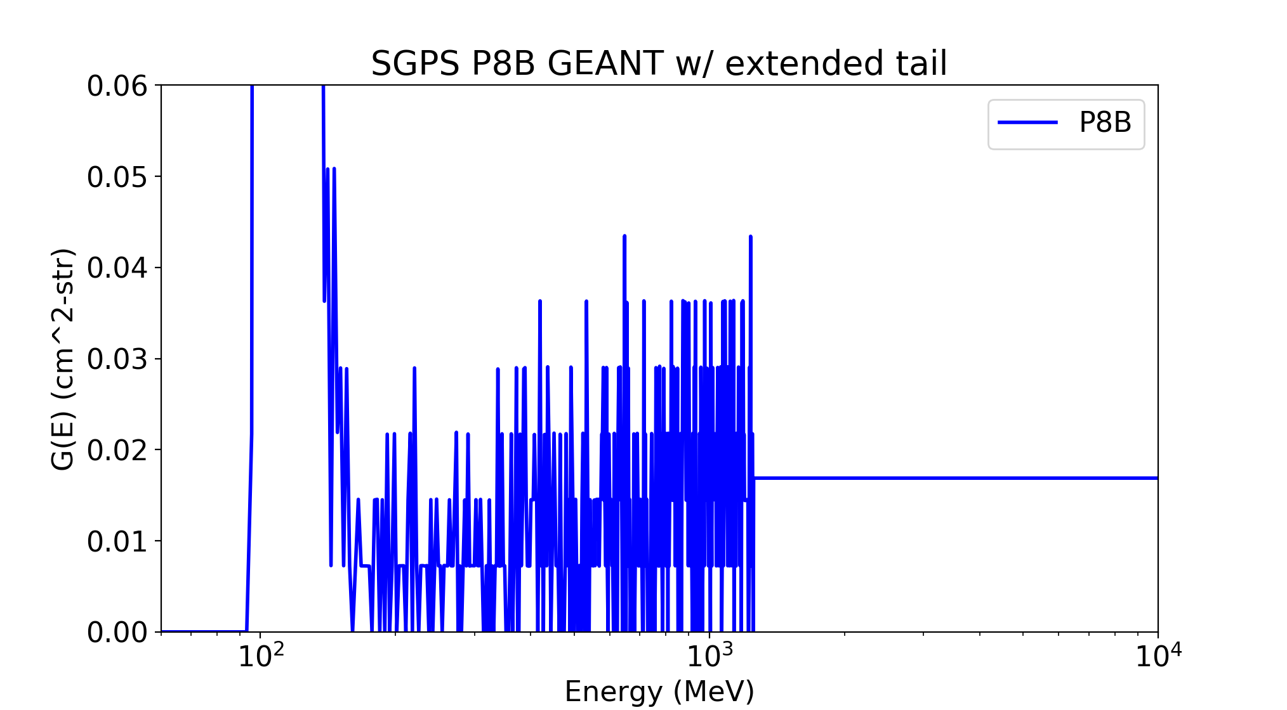
PLPT-SEI-006 Backgrounds Trending
GEANT (simulated) response functions
Observed vs. Modeled GCR Backgrounds
Calibrated channels
High energy islands
Model minimum
SEP spectrum
Calibrated channels
GCR models
Avg. of values above 10³ MeV used to estimate contribution up to 10⁴ MeV
Energy (MeV)
Source of SGPS backgrounds is GCR counts.
Reported GCR fluxes are significantly higher than accepted empirical models.
High GCR fluxes are due to high energy tail portion of response function, not part of calibrated channel.
Below PORD spectrum, do not violate requirements.

Slide 23
PROVISIONAL MATURITY ASSESSMENT
GOES-16 SGPS L1b Product Provisional PS-PVR

Slide 24
Provisional Validation
Preparation Activities | Assessment
Validation activities are ongoing and the general research community is now encouraged to participate. | Validation activities are ongoing. Results have been discussed with SWPC. Release of data by NCEI will enable research community participation.
Severe algorithm anomalies are identified and under analysis. Solutions to anomalies are in development and testing. | Error in SGPS T2 processing fixed - ADR491. Divide by 2 removed from P11 processing - ADR427. FM2 SGPS LUT dead-time correct for DO 06.03.00 - ADR 696 - PRO Type 1 No additional severe GPA anomalies identified.
Incremental product improvements may still be occurring. | Product improvements will result from steps to mitigate anomalies listed in “Path to Full Validation” charts below.

Slide 25
Provisional Validation
End State | Assessment
Product performance has been demonstrated through analysis of independent measurements obtained from select locations, periods, and associated ground truth or field campaign efforts. | SGPS fluxes compared with observations from MPS-HI, GOES-13, and -15. Both units (SN101 and SN102) ground/beam calibrated.
Product analysis is sufficient to communicate product performance to users relative to expectations (Performance Baseline). | Yes, to the limited extent that the Performance Baseline can be verified with one SPE.
Documentation of product performance exists that includes recommended remediation strategies for all anomalies and weaknesses. Any algorithm changes associated with severe anomalies have been documented, implemented, tested, and shared with the user community. | PUG and/or CDRL80 will need to be updated to reflect some changes, e.g., ADR427 Remove divide by two… Also, temperature correction scheme (downstream of L1b processing) does not fulfill all these requirements.
Testing has been fully documented. | In this presentation and supplemental materials.
Product is ready for operational use and for use in comprehensive cal/val activities and product optimization. | Readiness for operational use TBD

Slide 26
PATH TO FULL VALIDATION MATURITY
GOES-16 SGPS L1b Product Provisional PS-PVR

Slide 27
Path to Full Validation
ADRs/WRs to be resolved prior to Full Validation.
PLPTs to be conducted prior to Full Validation.
Performance Baseline status.
Risks to getting to Full, both from L1b product definition and user (SWPC) feedback

Slide 28
ADRs/WRs Impacting Full Validation of SGPS L1b
ADR# | WR# | Short Description | Status | Expected Closure
267 | 5370 | LUT Filenames not Traceable to Metadata | In_Analysis/In_Work | DO.07.00.00
517 | 5484 | Small but routine L1b gaps, mostly for SEISS | In_Work/Hold
TBA | TBA | SGPS P5 correction coefficients LUT update | Anticipated
ADR 267 LUT Filenames not Traceable to Metadata
L2 algorithms need to know filename of L1b LUT in real time, e.g., calculation of errors for 1-min and 5-min averages requires knowledge of geometric factors used in L1b processing.
Currently:
SGPS LUT Name: SGPS_CALINR_Parameters-487054736.1.h5
In L1b metadata: L1b_processing_parm_version = "OR_SEIS-L1b-PARM_v01r00.zip"
There is not a one-to-one mapping between the SGPS LUT name and L1b_processing_parm_version
ADR 517 Small but routine L1b gaps, mostly for SEISS
A recent example w/ empty (0 record) files from MPS-HI: From G16: OR_SEIS-L1b-MPSH_G16_s20181621701000_e20181621701000_c20181621703301.nc – has zero records OR_SEIS-L1b-MPSH_G16_s20181621701300_e20181621701300_c20181621704001.nc – has zero records
From G17: OR_SEIS-L1b-MPSH_G17_s20181621430300_e20181621430300_c20181621433001.nc – has zero records
OR_SEIS-L1b-MPSH_G17_s20181621441000_e20181621441000_c20181621443301.nc – has zero records

Slide 29
Path to Full Validation - PLPTs
Title | Activity | Data Needed | Success Criteria
A.3.3 SEP Channel Cross-Comparison [PLPT-SEI-004] | On-orbit cross-calibration of SGPS with EHIS above 10 MeV and MPS-HI with SGPS 1-12 MeV protons, and both SGPS units with GOES 13-15 EPEAD. | Two Solar Energetic Particle (SEP) events. | [Full] Differences quantified on data taken through validation phase.
A.3.5 Backgrounds Trending [PLPT-SEI-006] | Evaluate SGPS backgrounds in terms of expected galactic cosmic ray (GCR) fluxes. | Four months of continuous data. | [Full] Perform analysis during validation phase.
From RIMP v1.0 (02 June 2016)
Both PLPTs are ongoing continuations of Provisional PLPTs.
One SEP event in July 2017 and four in Sept. 2017, but only one with sufficient enhancement at energies >100 MeV for cross-calibration of SGPS T3.
Will also compare with GOES-17 during next SPE.

Slide 30
SGPS Performance Baseline Status
MRD ID | Description | Related PLPTs | Status
MRD2005 | Product Orthogonality/Coverage | -04, -06 | Ongoing
MRD2009 | Product Measurement Range | -04, -06 | Ongoing
MRD2010 | Product Measurement Accuracy | -04, -06 | Ongoing
MRD2005: Orthogonality/Coverage
Requirement: 2 directions
Currently being met
MRD2009: Measurement Range:
Requirement: Protons: 1 MeV - 500 MeV, > 500 MeV
SEP Channel Cross-comparisons with legacy instruments on GOES-13 and -15 indicate that energy range is being covered.
MRD2010: Measurement Accuracy
Requirements: 25% when flux level above background is greater than 10x minimum flux; 45% when flux level above background is between minimum flux and 10x minimum flux
Absolute accuracy cannot be verified on-orbit
Differences up to a factor of two are found for some channels in SEP Channel Cross-comparisons with GOES-13 and -15, excepting channels with known anomalies.

Slide 31
Path to Full Validation – Risks
Risk Name | Description | Impact | Mitigation and Schedule
SGPS-X T1 & T3 Temperature Dependence | Temperature dependent fluctuations in SGPS-X T1 & T3 count rates | Fluctuations may introduce false positives in Solar Proton Event Detection algorithm (Level 2). | ADR 405 (Closed) and post-L1b temperature correction scheme – Assess impacts on data accuracy and SPE detection prior to full validation.
SGPS+X P7 anomalously low | SGPS+X count rate low in L0 data – cause unknown. | Will degrade accuracy of reported fluxes and Solar Proton Event monitoring. | Possible adjustment of geometric factor.
SGPS+X P5 overcorrection in L1b processing | Overcorrection in SGPS P5 out-of-band removal | Will degrade accuracy of reported fluxes and Solar Proton Event monitoring. | Perform analysis (NCEI or ATC) and update coefficients in LUT. Should be done prior to full validation, but additional SEP events needed for adequate analysis.
Electron contamination in SGPS+X P5 | Electron contamination in SGPS+X P5 – full impact yet to be evaluated. | Will degrade accuracy of reported fluxes and Solar Proton Event monitoring. | Full impact of this needs to be evaluated and correction scheme developed if necessary.
Some channels not performing as characterized with beam calibrations | SEP Channel Cross-Comparison PLPT indicates some channels not performing as characterized with beam calibrations | Will degrade accuracy of reported fluxes and Solar Proton Event monitoring. | Geometric factors may need adjustment.
L1b data gaps/dropouts | Almost every day, a handful of L1b files are missing for SEISS's EHIS, MPSL, and MPSH instruments. | May lose critical Solar Proton Event data. | ADR 517 – No Delivery Date given.
Applies to all: Mitigation: Assess impacts on data accuracy and SPE detection prior to full validation.

Slide 32
SUMMARY & RECOMMENDATIONS
GOES-16 SGPS L1b Products Provisional PS-PVR

Slide 33
Summary
Main issues identified:
Temperature Dependence in SGPS-X T1 & T3
SGPS+X P7 count rate anomalously low
SGPS+X P5 overcorrection in L1b processing
Electron contamination in SGPS+X P5
Some channels not performing as characterized with beam calibrations –
Geometric factors may need adjustment.
L1b data gaps/dropouts
Path to full validation should include Investigation into cause and possible remediation of SGPS+X P7 anomalously low counts and SGPS+X P5 electron contamination.
SGPS+X P5 out-of-band removal coefficients should be adjusted so that P5 is not over corrected, also, to minimize error in reported flux over the broadest possible range of SEP spectra. The SGPS LUT will be updated with the new coefficients.
The temperature correction scheme needs to be further tested and tuned using data from Sept. 2017 and future Solar Particle Events.

Slide 34
Recommendations
Overall SGPS is performing well, but there are some anomalous channels with unknown root cause and/or path to resolution (e.g., SGPS+X P7)
The Solar Particle Event Detection code uses integral flux computed by fitting a power law to SGPS’s 13 differential channels plus the >500 MeV integral channel flux. Three steps to mitigate the effect of anomalous channels are
Temperature correction downstream of L1b processing.
Implement an option to remove any particular channel from the integral flux calculation and event detection in L2 processing.
Implement an option to use any combination of SGPS+X and SGPS-X channels in a single integral flux calculation and event detection.
(In current L2 processing, event detection is done separately for each unit.)
NCEI recommends SGPS L1b for transition to provisional status with understanding that additional testing and tuning of the SGPS temperature correction and SPE detection is needed.

Slide 35
BACKUP SLIDES
GOES-16 SGPS L1b Product Provisional PS-PVR

Slide 36
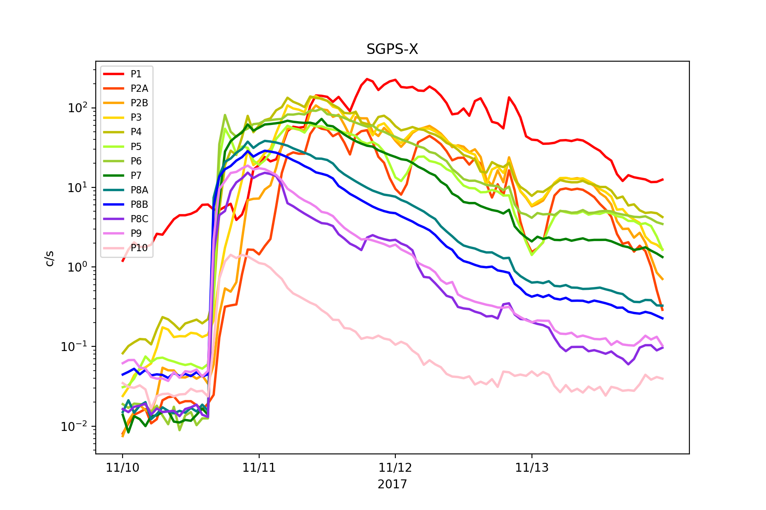
SGPS+X P7 Rates Too Low
During SEP event SGPS+X P7 count rate is about an order of magnitude lower in SGPS+X than in SGPS-X.
However, pre-event GCR P7 count rates are similar in +X and –X units.
Count rate is low in L0 data.
Cause is unknown.
Still in analysis –
Need to check singles rates.
Will also look at July 2017 SEP event.
P7

Slide 37
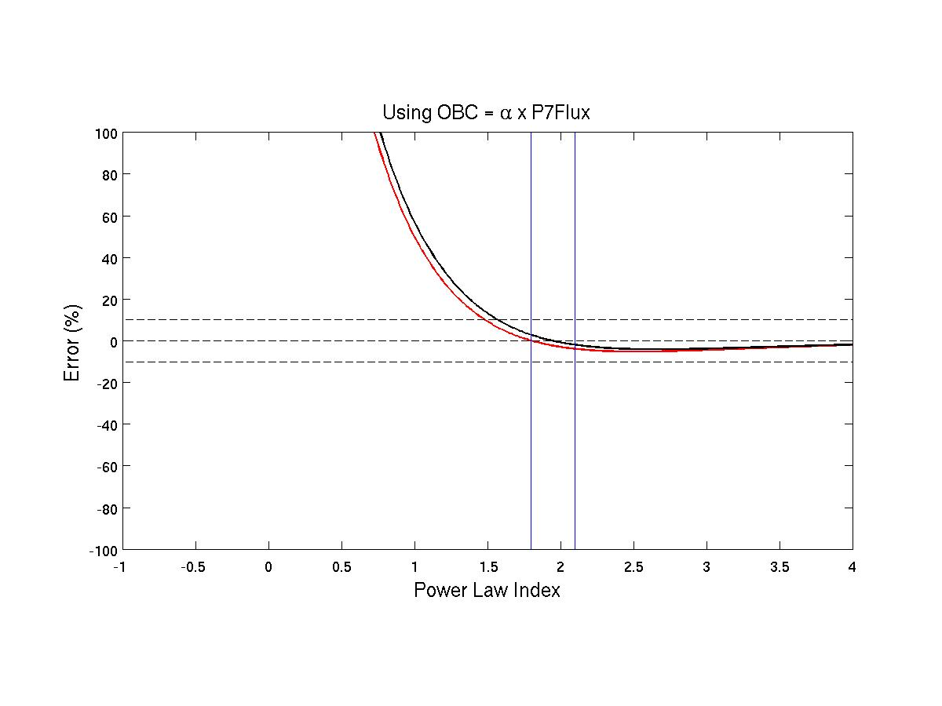
P5 Correction Using P7
Spectral index vs. % error in P5 counts using P7 channel only to remove all P5 out-of-band contamination above 40MeV. The red curve corresponds to the case where ‘alpha’ coefficient is set so that there is zero error at PORD min. The black curve is the case where alpha is set so there is zero error at the average of the PORD min and PORD max indices. The vertical lines at n=1.8 and n=2.1 are at the PORD min and PORD max indices respectively. The horizontal dashed lines are at -10%, 0%, and 10 % errors for reference.

Slide 38
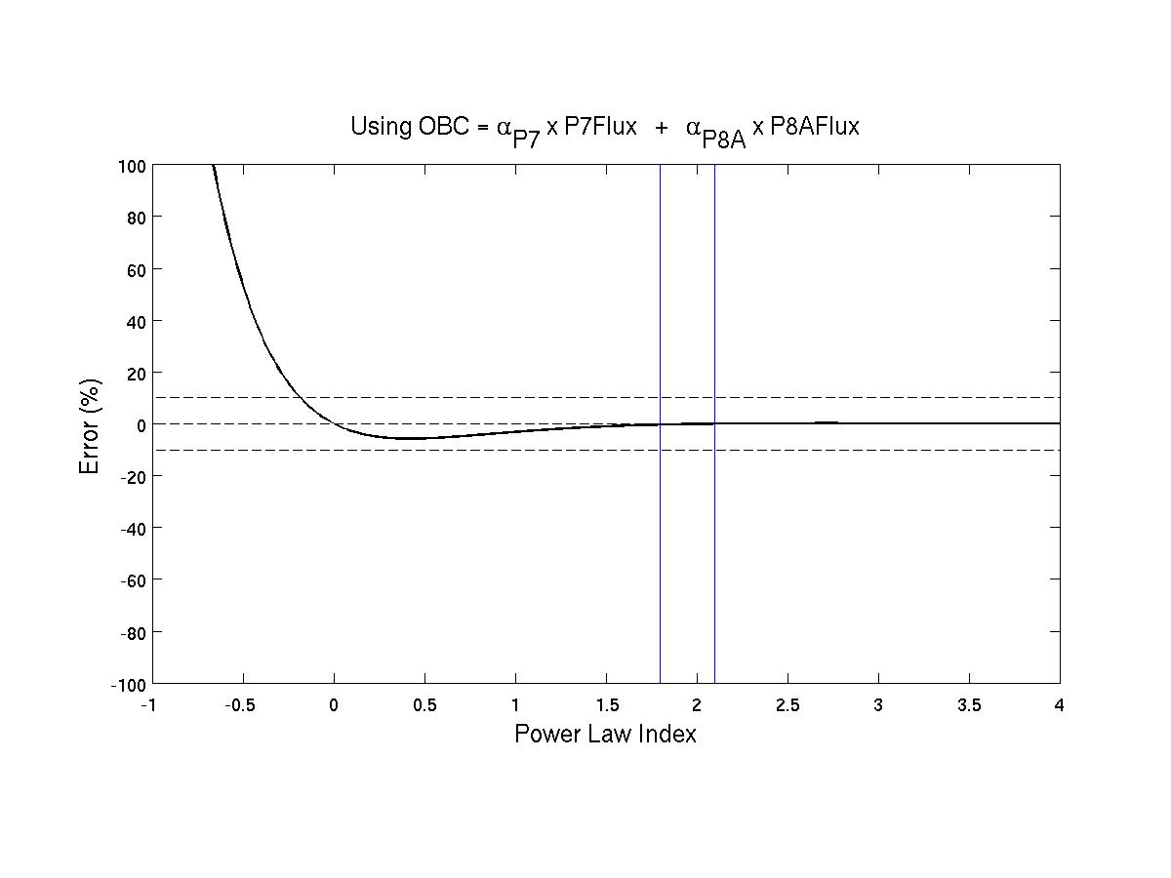
P5 Correction Using P7 & P8A
Spectral index vs. % error in P5 counts using P7 and P8A channels to remove out-of-band contamination. The alpha coefficients are set to alpha_P7=1.56 and alpha_P8A=12.5
(cm2-s-str-MeV) so that there is zero error at n=0 and n=2.1.

Slide 39
SGPS P1 and MPS-HI P8
(west facing unit)
(east facing unit)
Period with SW P_{dyn} > 10nP.
During geomagnetically quiet periods, the westward flux is higher then eastward flux, and MPS-HI flux lies in between.

Slide 40
SGPS P2 and MPS-HI P9
Interesting that MPSH P9 is very close to SGPS P2B.

Slide 41
SGPS P3 and MPS-HI P10

Slide 42
16-17 July 2017 SGPS & MPS-HI 1-12 MeV Channels Comparison Summary
SGPS-X P1 and MPS-HI P8 GFs are a little high or SGPS+X P1 is a little low.
SGPS-X P2A GF is a little high or SGPS+X P2A GF is a little low.
SGPS P2B and P3 GFs look good.
MPS-HI P9, P10, and P11 GFs appear to be significantly high, higher at higher energies. Or perhaps the channel energy boundaries are shifted with respect to their expected values.
SGPS-X P4 GF is too low or SGPS+X P4 GF is too high.

Slide 43
SEP Cross-cal. plots
SEP Cross-cal. plots (as on left side of slide 19) too numerous to include – available on request.

