Slide 1



GOES-16 Full Maturity PS-PVR
Solar UltraViolet Imager
5 November 2020
Jonathan Darnel, Daniel B. Seaton, Courtney Peck, Christian Bethge
GOES-R Calibration Working Group, University of Colorado, CIRES, NOAA-NCEI

Slide 2
Outline
Overview of the GOES-16 SUVI
Review of the GOES-16 SUVI Provisional Assessment
Evaluation of the GOES-16 Level-1b Product Quality
  Anomalies and Resolution
  PLPTs -Trending and Degradation
Summary of Product Status
  Top priority items
  Conclusion

Slide 3
Acronym, Defined
AART: Algorithm Action Review Team
ADR: Algorithm Discrepancy Report
AIA: Atmospheric Imaging Assembly
CCD: Charge-Coupled Device
EUV: Extreme Ultraviolet
EXIS: EUV and X-ray Irradiance Sensor
FITS: Flexible Image Transport System
LUT: Look-Up Table
MIT-LL: MIT Lincoln Laboratory
OMAS: Operational Metadata Aggregation Service
SDO: Solar Dynamics Observatory
SUVI: Solar UltraViolet Imager
VSO: Virtual Solar Observatory
WR: Work Request

Slide 4
GOES-16 SUVI Full Maturity PS-PVR
Overview of SUVI

Slide 5
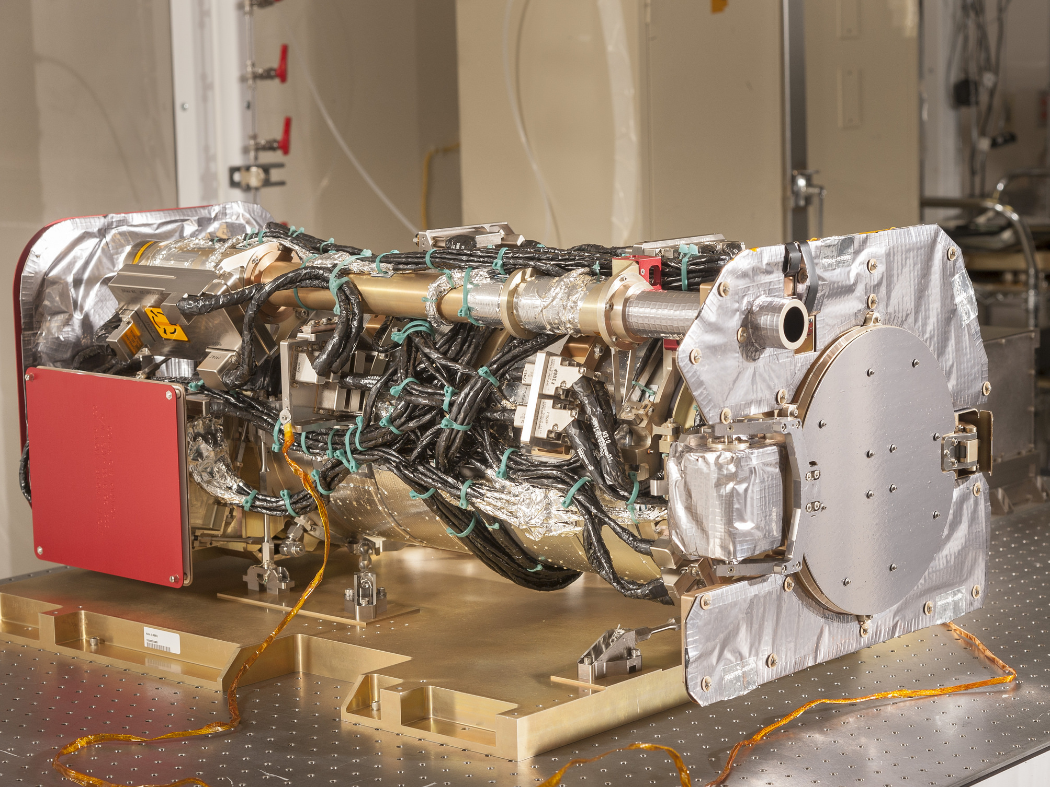
The SUVI Instrument

Slide 6
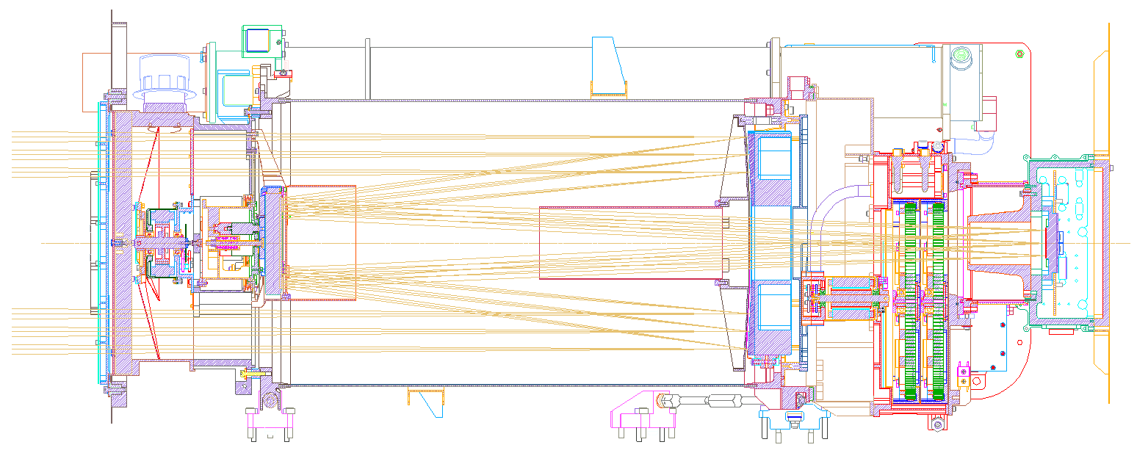
SUVI Overview
Entrance Filters
Focal Plane Filters
Aperture Selector
Secondary Mirror
Primary Mirror
CCD

Slide 7
Overview of SUVI
Key Instrument Performance Requirements
Pointing Accuracy: <3.0 arcmin
Pointing Knowledge: <2.5 arcsec
Field of view: >42×42 arcmin
Spatial resolution: <5 arcsec square pixels
Ensquared energy: >50% in 7×7 arcsec
(43% for 94 Å bandpass)
Six Channels: 94Å (FeXVIII), 131Å (FeVIII), 171Å (FeIX), 195Å (FeXII), 284Å (FeXV), 304Å (HeII)

Slide 8
Overview of SUVI
Key Instrument Operating Characteristics
1280×1280 pixel L1b Product Image
2.5 arcsec pixels, 53.3×53.3 arcmin FOV
14-bit CCD detector
Entrance aperture selector – 6 positions
2 Filter wheels:
  FW1: Open, Thin Al & Zr, Thick Al & Zr
  FW2: Glass, Open, Thin Al, Thin Zr, Thick Al
4-photodiode guide telescope for pointing

Slide 9
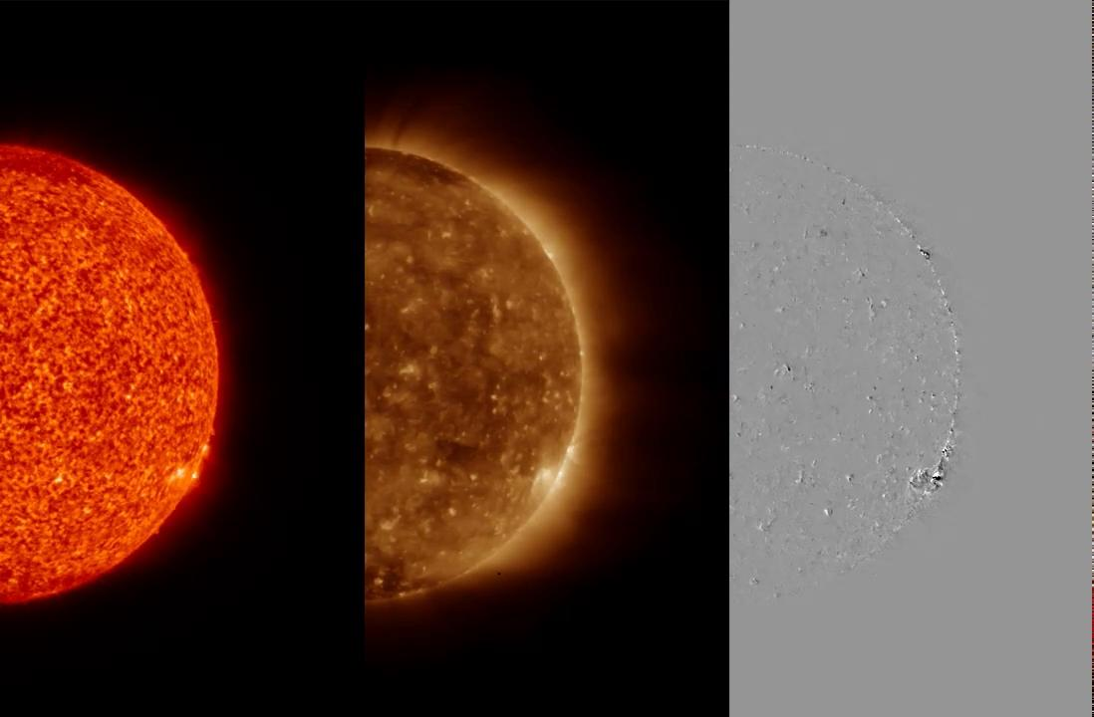
GOES-16 SUVI
Oct 16, 2020 (12:00 to 19:00 UT)
304Å
195Å
195Å
Difference images

Slide 10
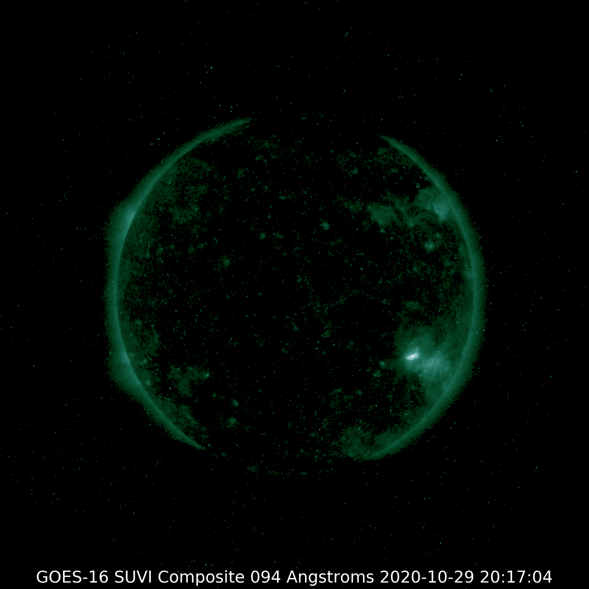
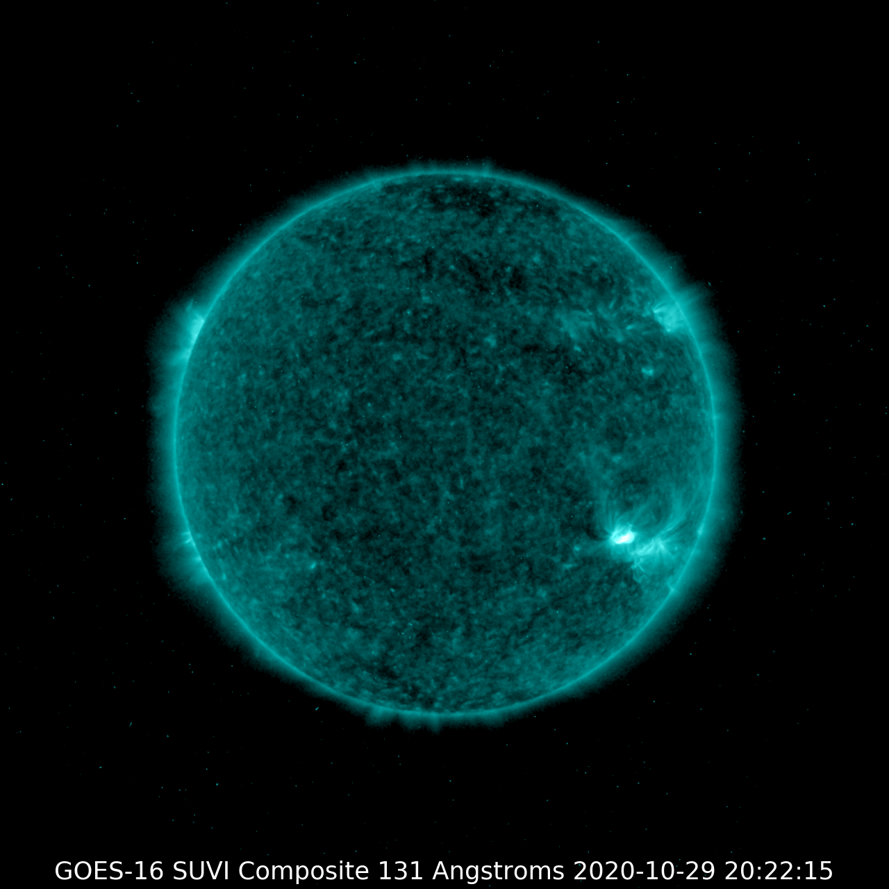
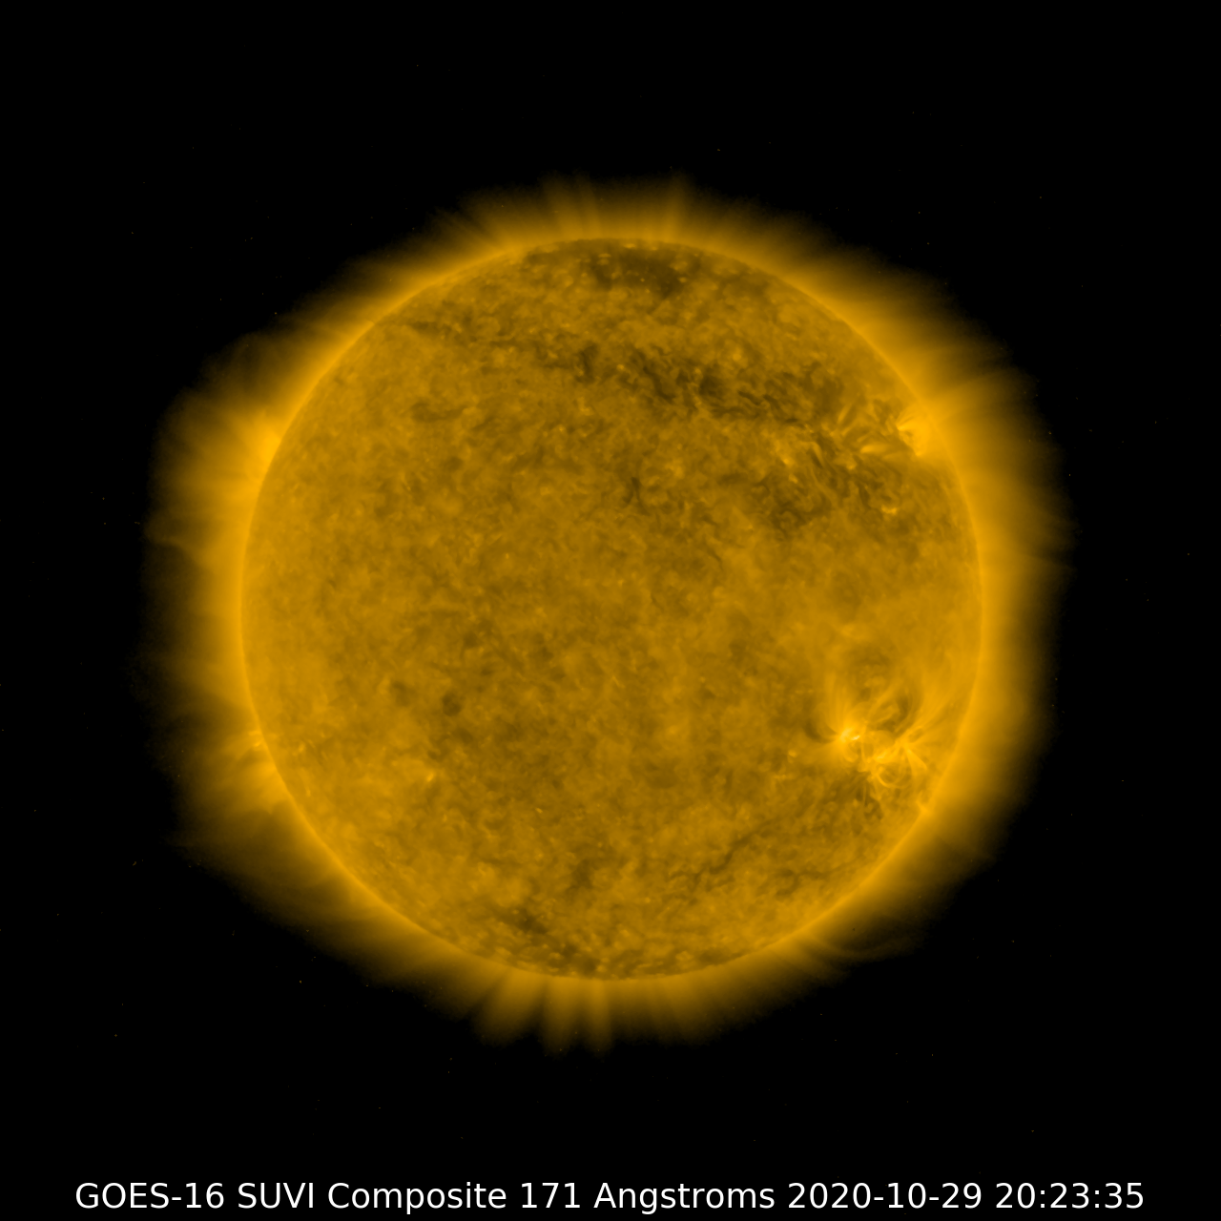
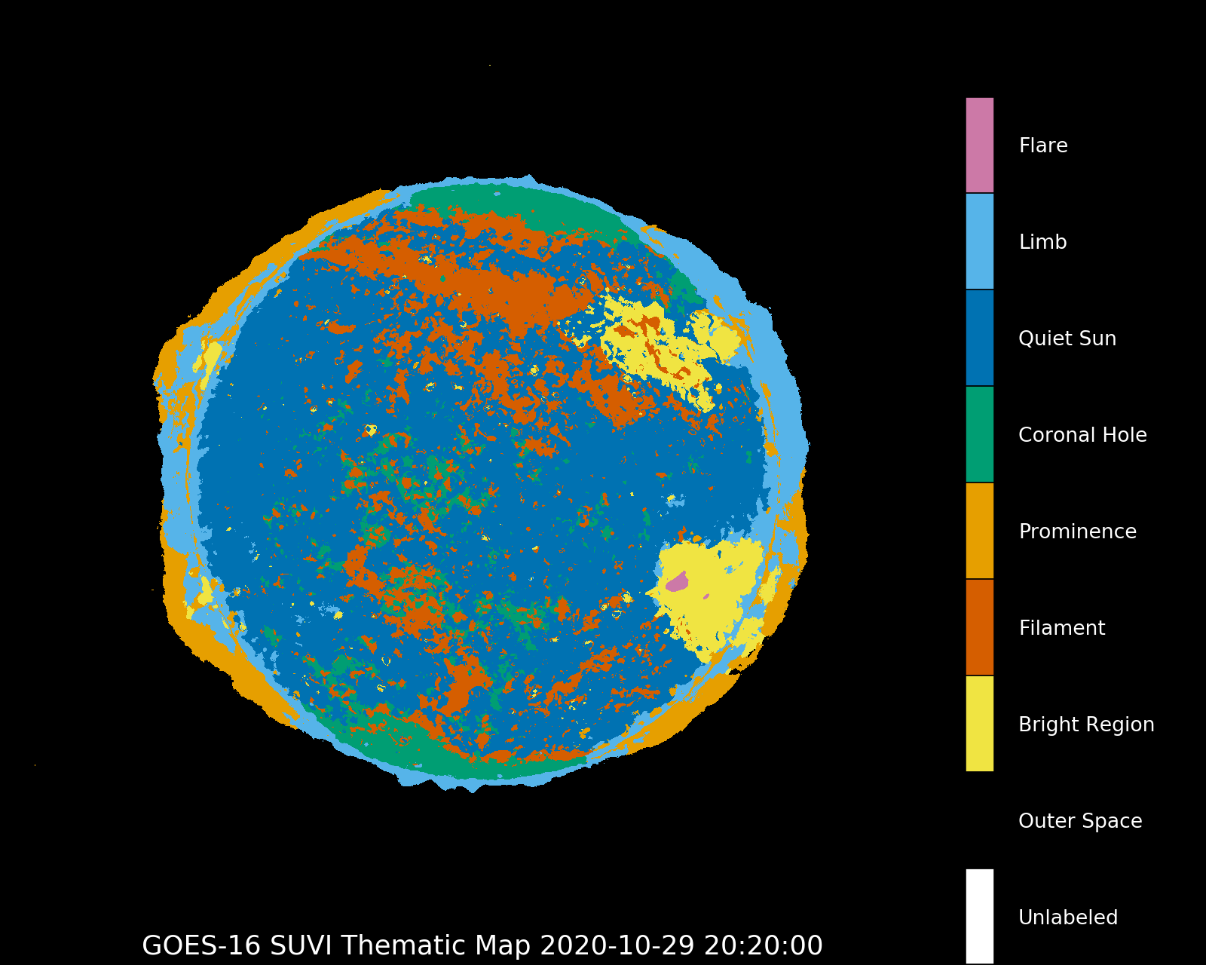
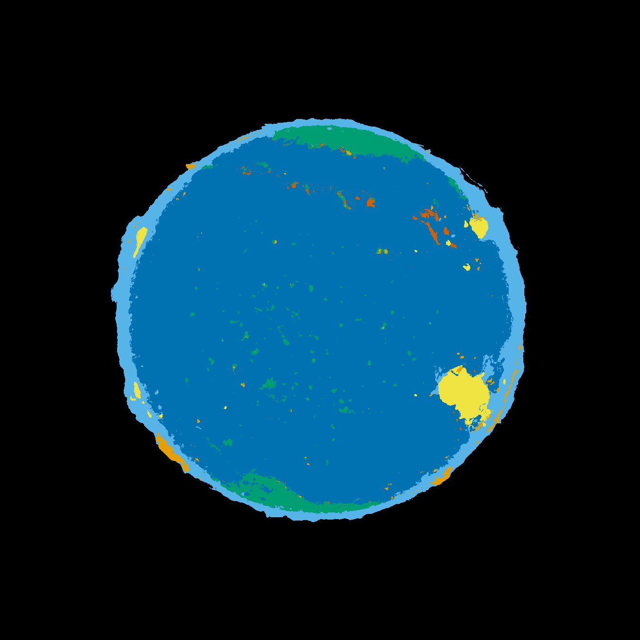
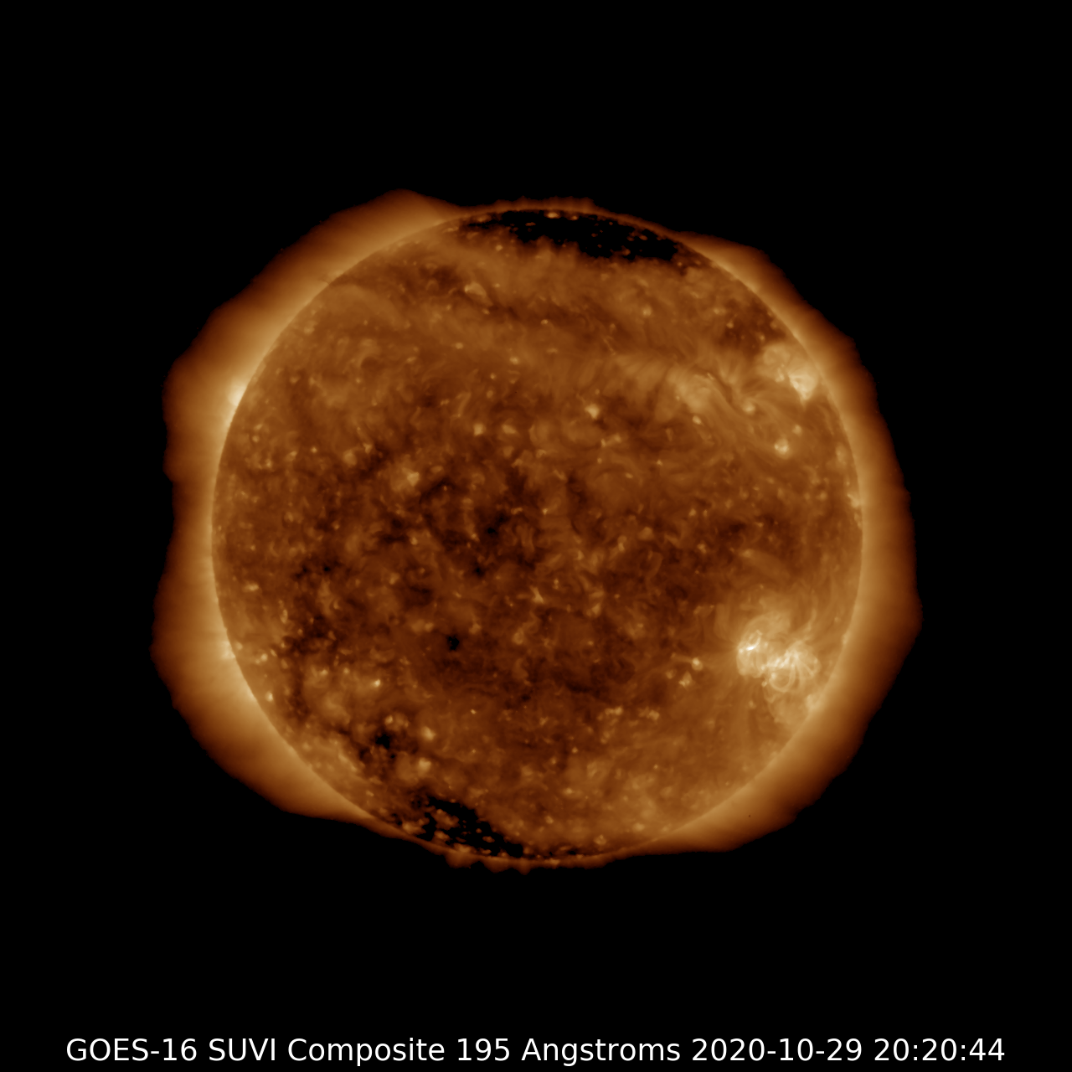
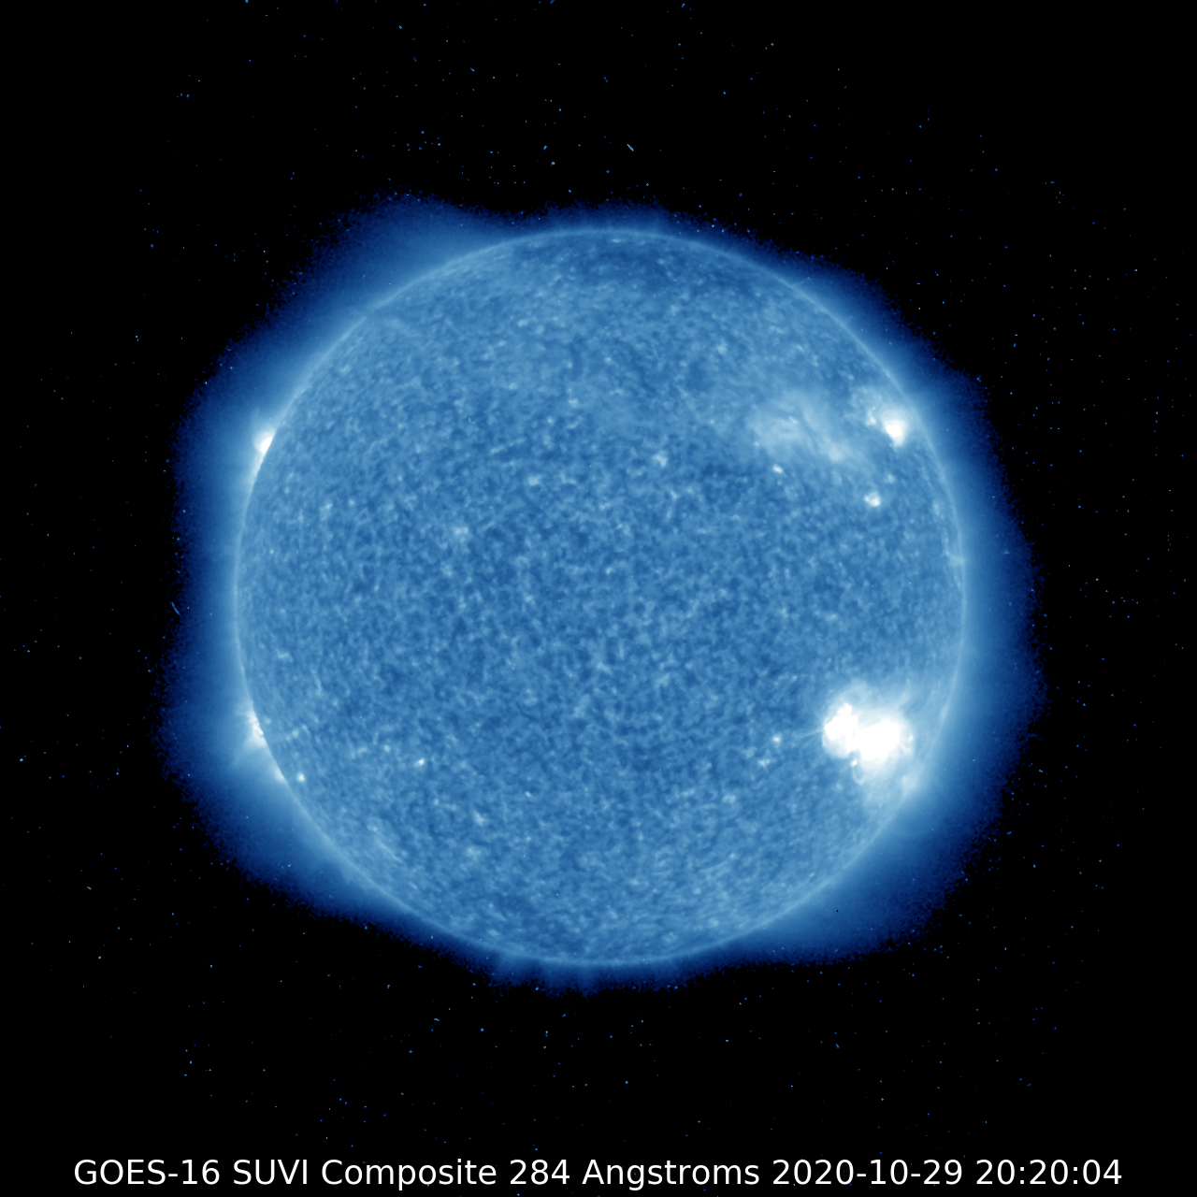
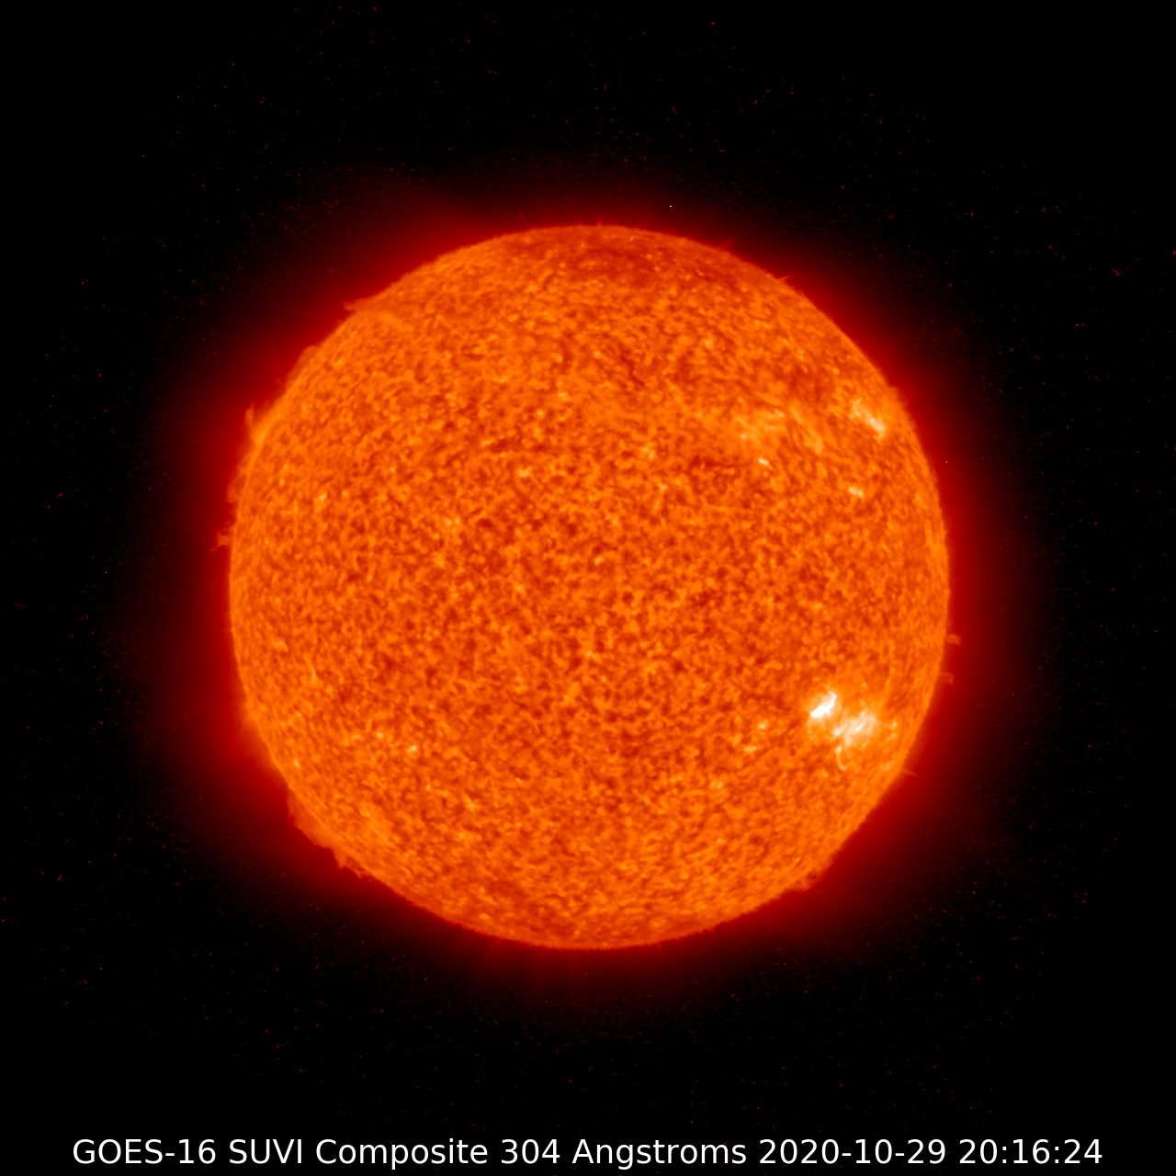
Overview of SUVI
Composite Images and Thematic Maps
Notes:
Title to emphasize SWPC L2 production

Slide 11
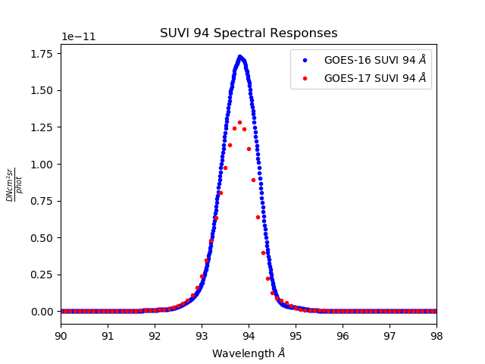
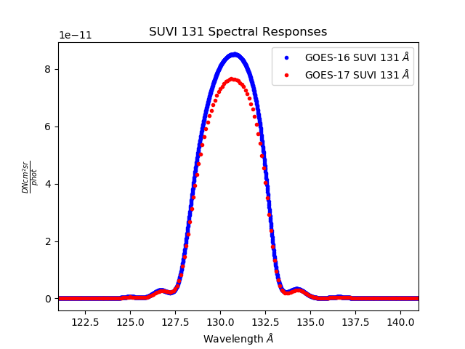
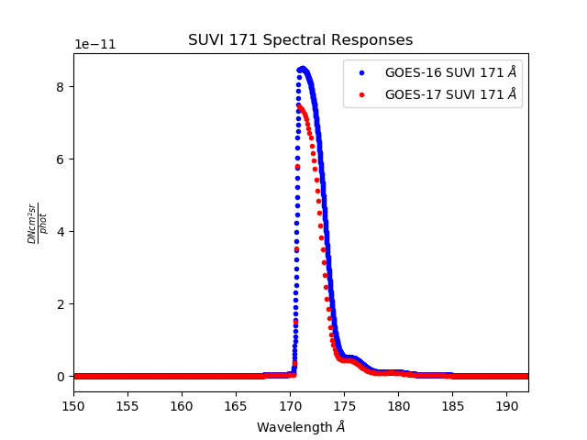
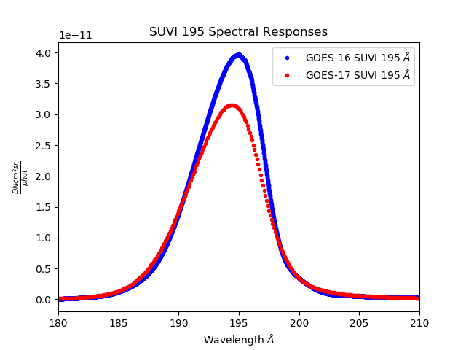
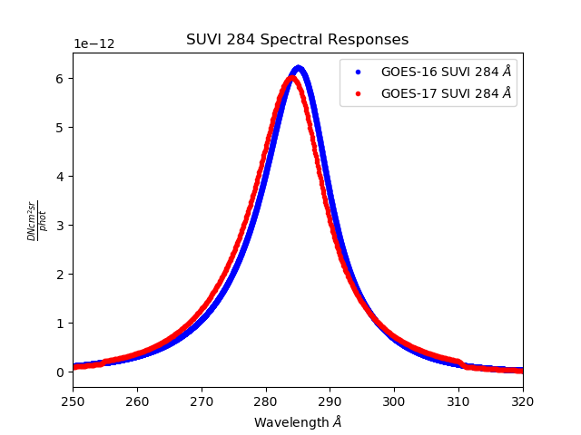
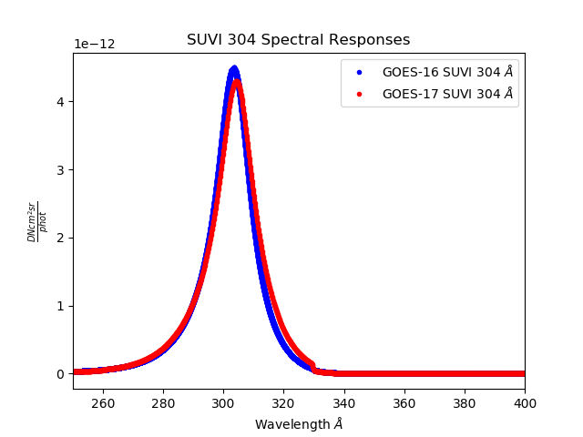
SUVI Spectral Response Functions

Slide 12
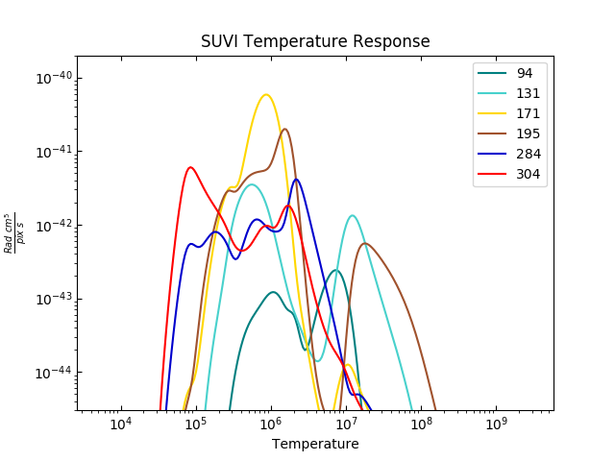

Slide 13
GOES-16 SUVI Full Maturity PS-PVR
Overview of Status at Provisional Maturity
(4 May 2018)

Slide 14
ADR | WR | Delivery | Description | Disposition | Priority | Resolution
Calibration and Image Processing Issues
313 | 4379 | - | CDRL79/80 Effective Area Discrepency | Impact to metadata and documentation. | - | Closed
415 | 4921 | DO.07.00.00 | Contamination Correction using short exposures | Obsolete by events | -
417 | 5519 | - | Unnecessary camera gain interpolation | No impact to product quality | - | Closed
588 | 6347 | - | Image scale/offset should be dynamic | Improves product accuracy and compression | - | Closed
664 | 5968 | - | Bad pixel table incorrectly oriented | Minor impact to data quality. | - | Closed
665 | 6617 | - | Bad pixel table requires update |  | Moderate | Closed
666 | 5969/6617 | - | Unexpected “blank” pixels in L1b | Minimal product impact | - | Closed
Navigation and Metadata Issues
663 | 6456 | - | Validate Sun-center position | Sun-center calculation could yield incorrect results in the event of a change to instrument or spacecraft status. | - | Closed
Usability Issues
523 | 5512 | MM.07.00.00 | Eliminate SpWx Dependency on APID 384 | No impact to product quality | Low | In Work
572 | 6055 | - | Remove LUT/OMAS Interdependency | Required for calibration maintenance simplicity. No impact to product quality. | - | Closed
614 | 5924 | - | Add Image Serial Number to L1b metadata | Import for product validation efforts | - | Closed
Notes:
665 just closed!

Slide 15
ADRs added after Provisional PS-PVR
ADR Number | WR Number | Delivery | Description | Priority | Disposition
712 | 6148 | - | SUVI CSYER1/2 were out of range | - | Closed
714 | 6345 | - | Remove automated SUVI contamination correction | - | Closed
1021 | 7364 | - | Level-1b Files do not follow FITS format standard | Low | In work
1048 | 7558 | - | DATE_OBS, DATE_END need exp_time subtracted | Low | In analysis
1065 |  | - | CDRL-80 Update | - | Closed
1032 | 7415 | - | SUVI Image Serial Number | - | Closed
1121 |  | - | SUVI Yaw Flip Navigation (impacts only G17 SUVI currently) | N/A | In analysis

Slide 16
ADR 714 (Closed)
A contamination degradation correction was being automatically applied to the SUVI L1b product. While this was as designed, but the approach is overly simplistic and had the potential to impact the L1b product in an inconsistent and unpredictable manner.
Resolution was accomplished by removing the automatic correction from the L1b algorithm.
Degradation will be determined by NCEI, and updated via calibration LUT.

Slide 17
ADR 1021 (In Work)
A deviation from the FITS format standard in the SUVI L1b product makes the SUVI L1b incompatible with much of the processing software in the scientific solar community.
Does not impact image product quality or SWPC operations
A simple fix to the generation of one keyword (“CONTINUE”) in the L1b product header would resolve this issue.

Slide 18
ADR 1032 (Closed)
Adding the Image Serial Number to the SUVI L1b product adds traceability through the Level-1b process.
No impact to operations or product quality

Slide 19
ADR 1048 (In Analysis)
Slight error to the product timestamps
SUVI Images downlink at 1 image/10 seconds
Timestamp error < 1 second
No significant impact to operations
There is a clear path to resolution

Slide 20
ADR 1065 (Closed)
Updates and corrections were added to SUVI CDRL-80 to bring it up to date

Slide 21
GOES-16 SUVI Full Maturity PS-PVR
Evaluation of Product
Quality

Slide 22
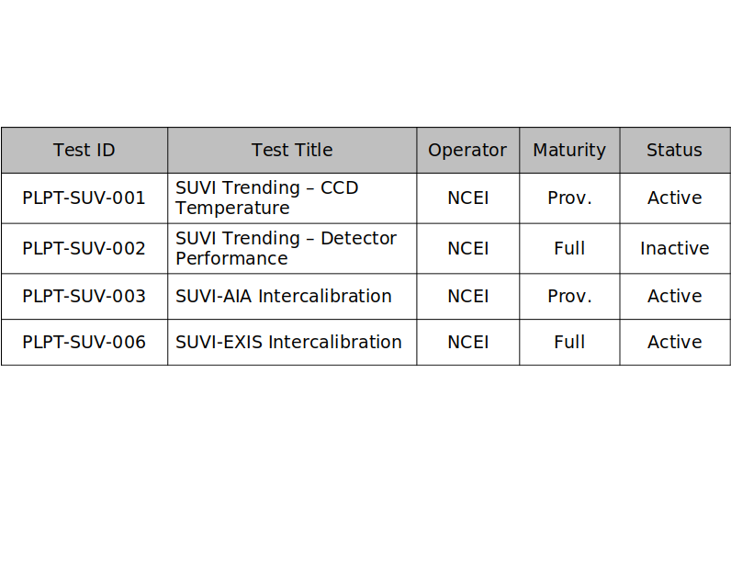
Active
Trending activities use Ground System generated L1b products when possible.
PLPT-SUV-002 requires the use of L0 CCSDS data.
PLPT-SUV-003/006 require reprocessing from L0 prior to 5/2018

Slide 23
PLPT-SUV-001: CCD Temperature Trending
Demonstrated ability to extract and trend the SUVI detector temperatures

Slide 24
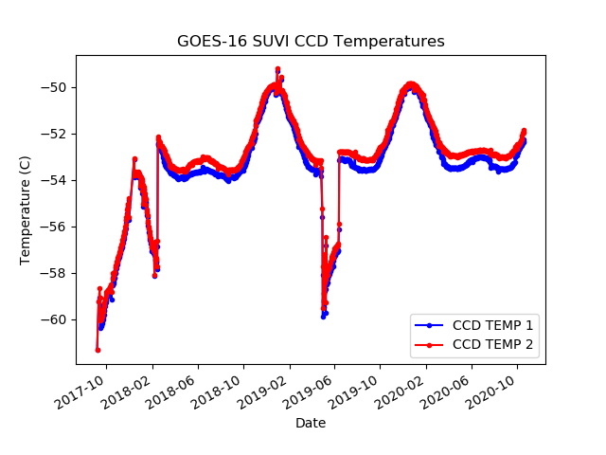
PLPT-SUV-001
SUVI CCD Temperature Trending

Slide 25
PLPT-SUV-002: Detector Performance
Extract key CCD characteristics and create trends to monitor the CCD performance
NCEI trends Dark Current, CCD Bias, and Read Noise.

Slide 26
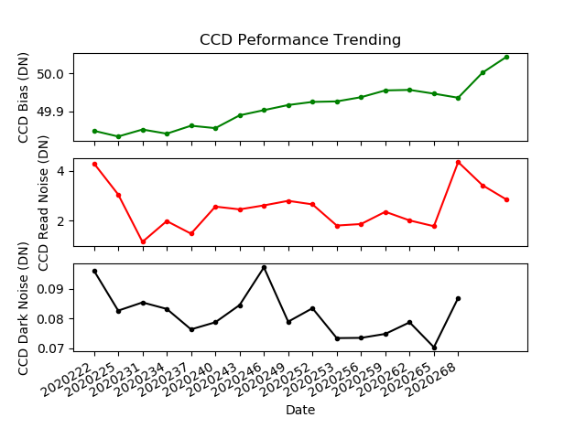
PLPT-SUV-002: Detector Performance
All detector performance quantities are very consistent over the time period shown.

Slide 27
PLPT SUVI-003: SUVI/AIA Intercomparison
Compares SUVI observations to the Atmospheric Imaging Assembly on NASA’s Solar Dynamics Observatory
Full image comparisons identify image defects/artifacts
Trend comparisons identify response degradation
Some differences in passbands between the two instruments introduce minor artifacts
Analysis is also supported by LM-ATC, LASP, Royal Observatory of Belgium, and others through international EUV solar instrument degradation working group
AIA has no 284 Å comparator channel

Slide 28
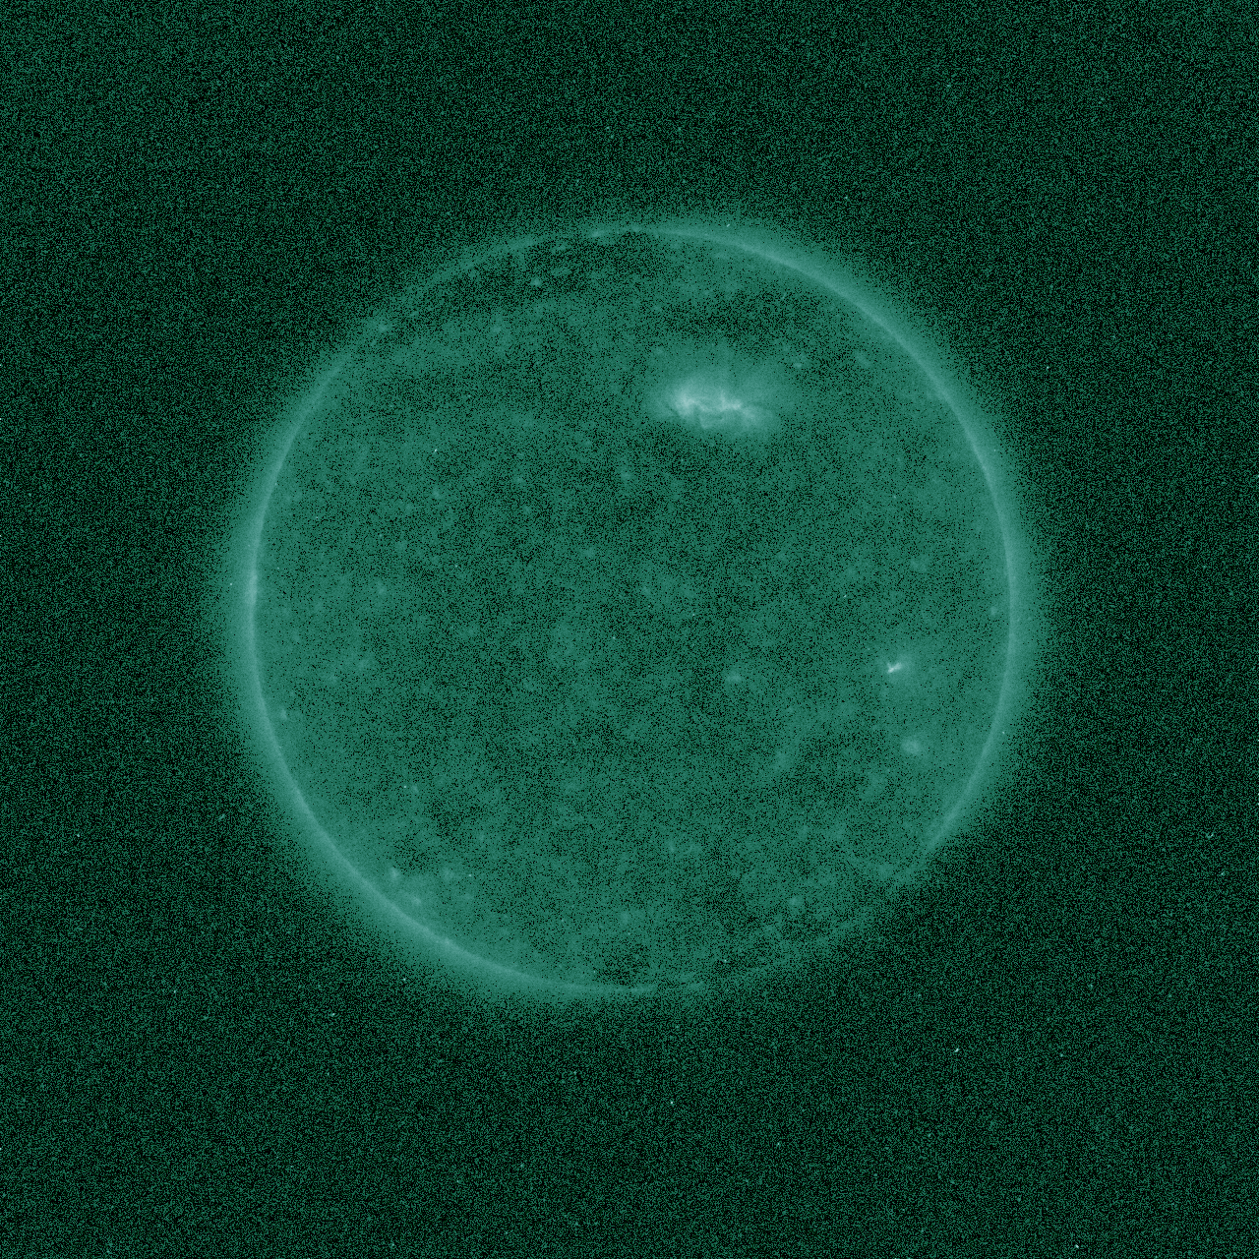
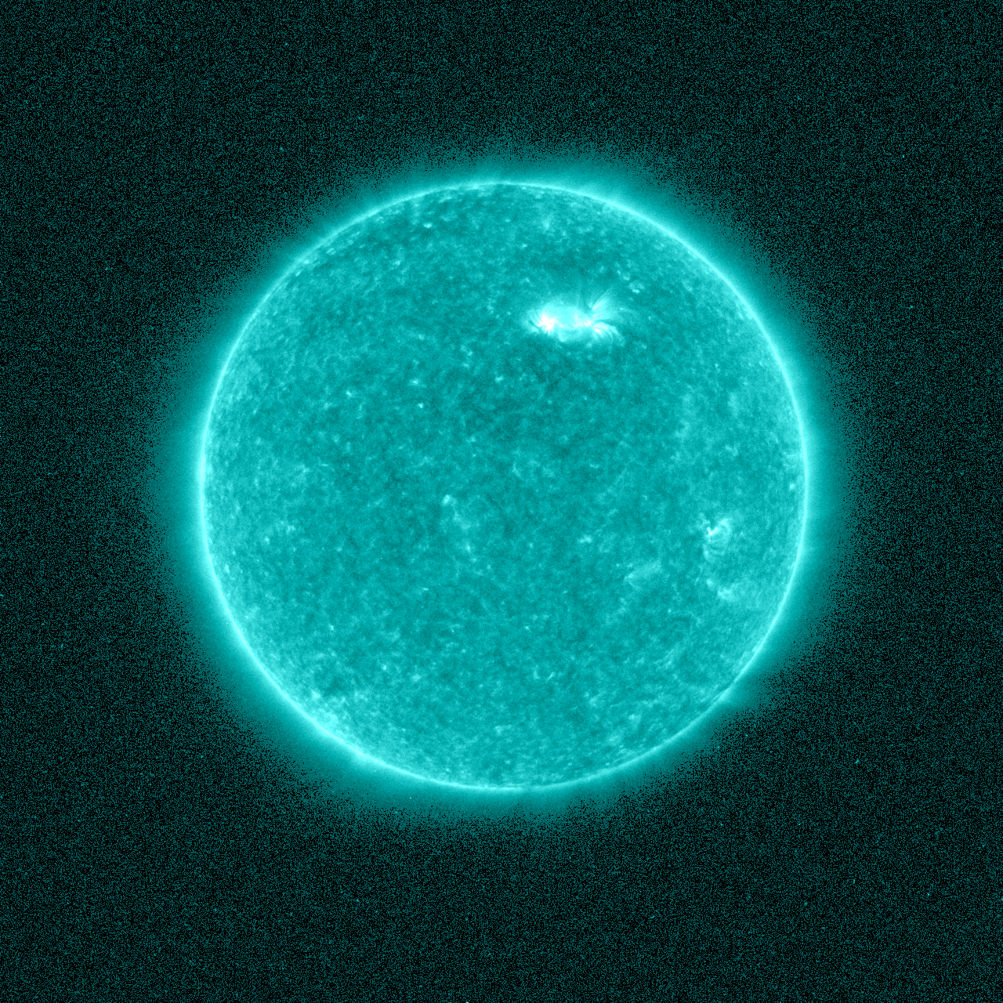
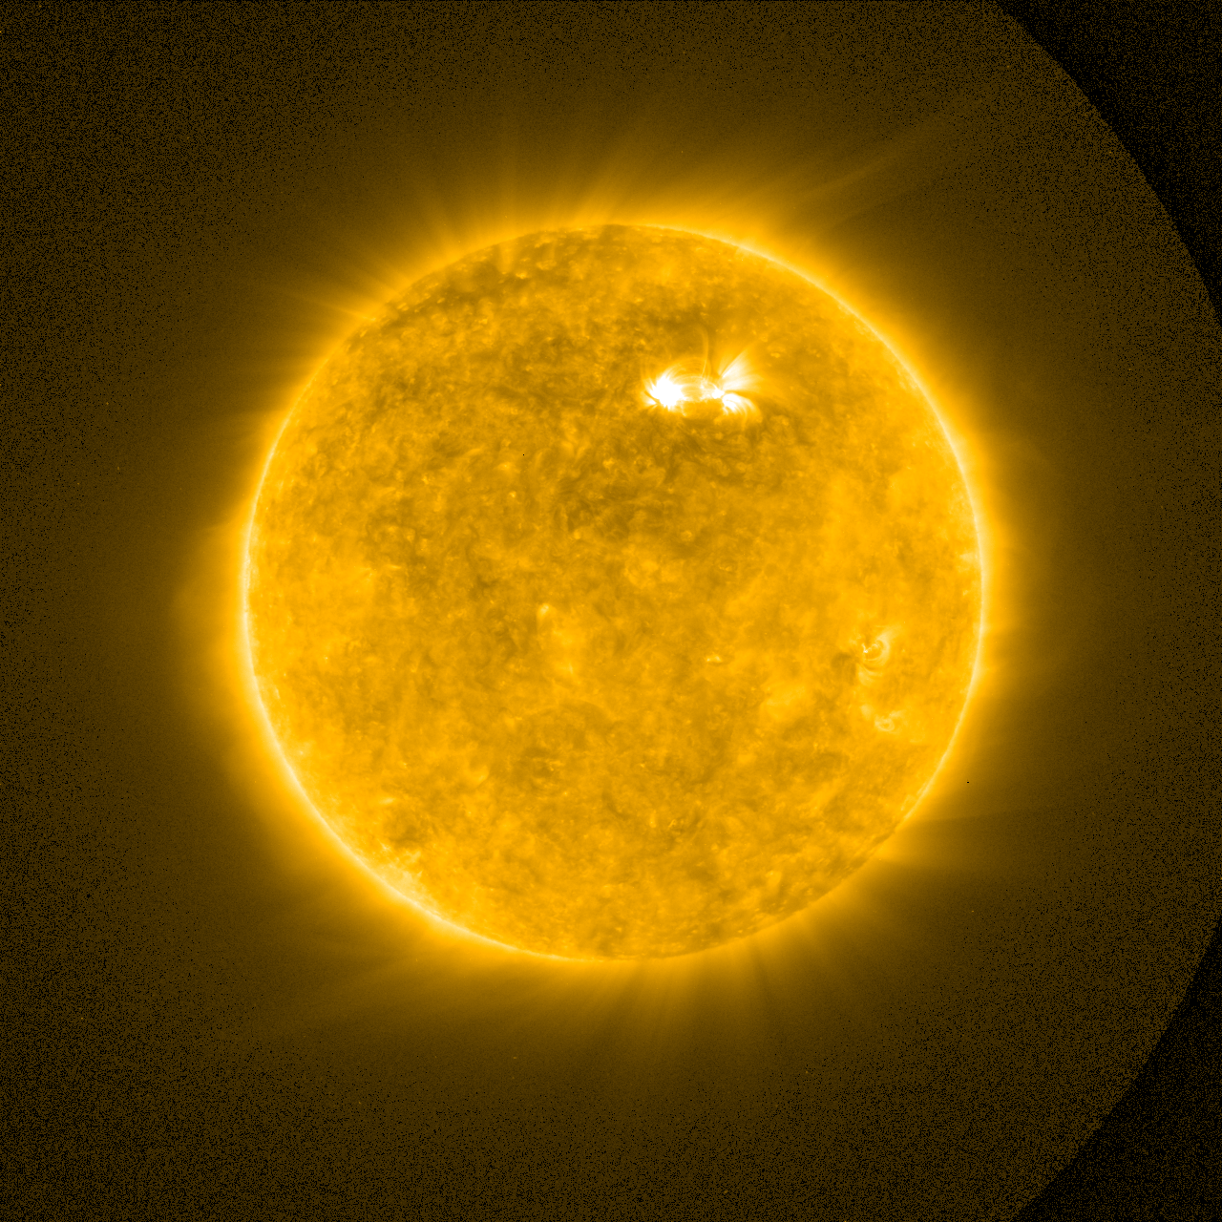
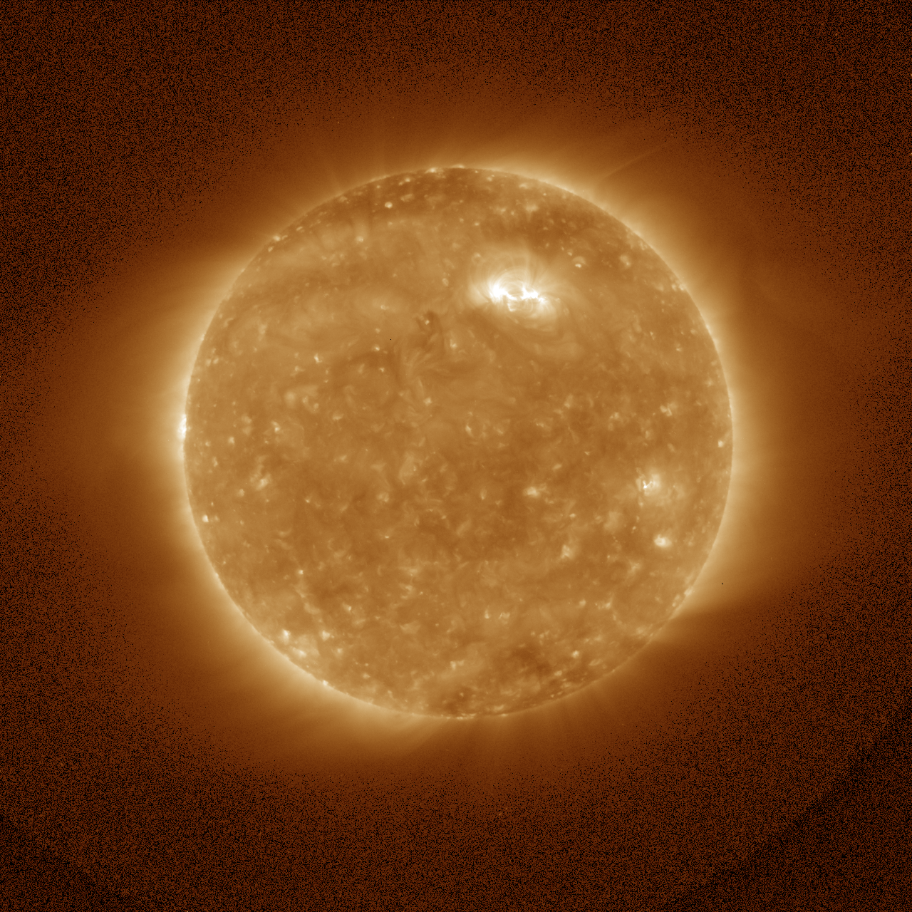
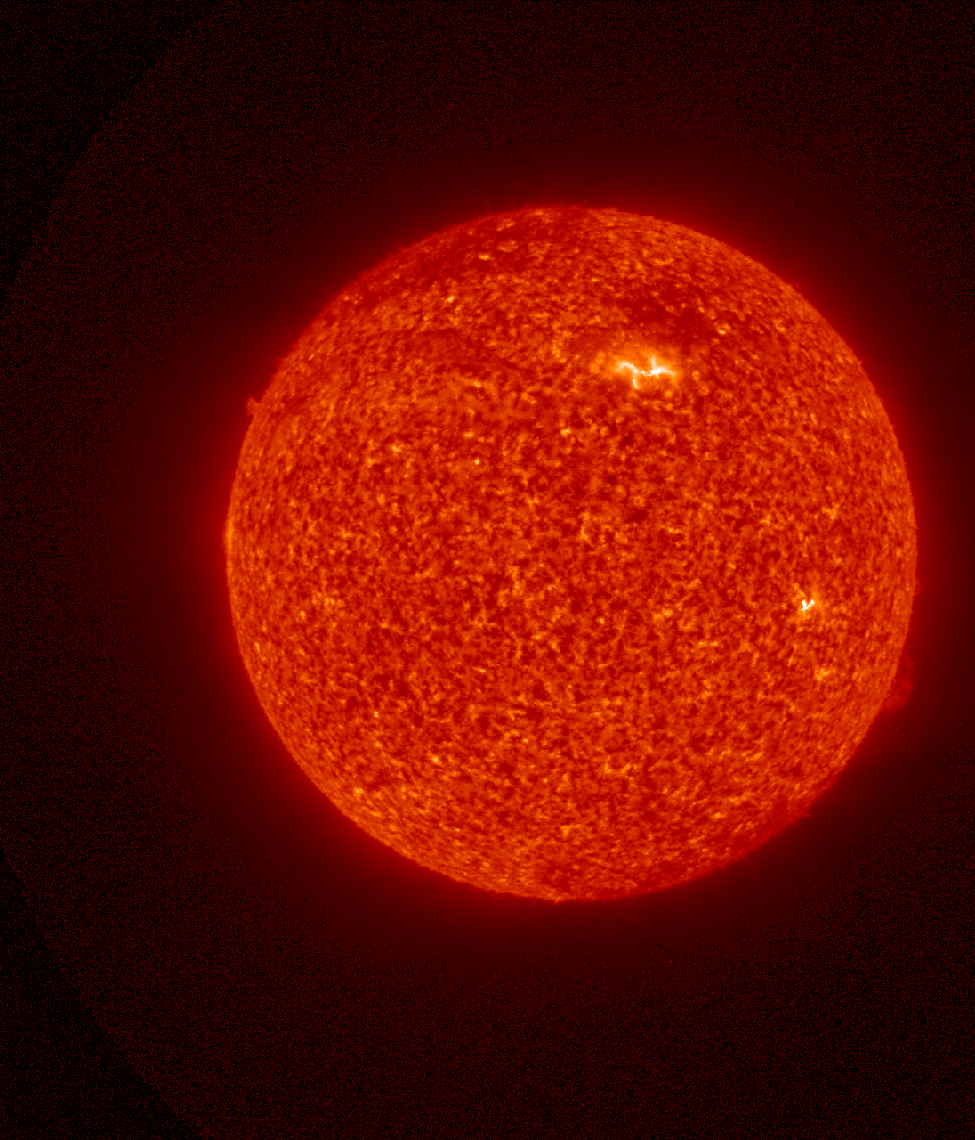
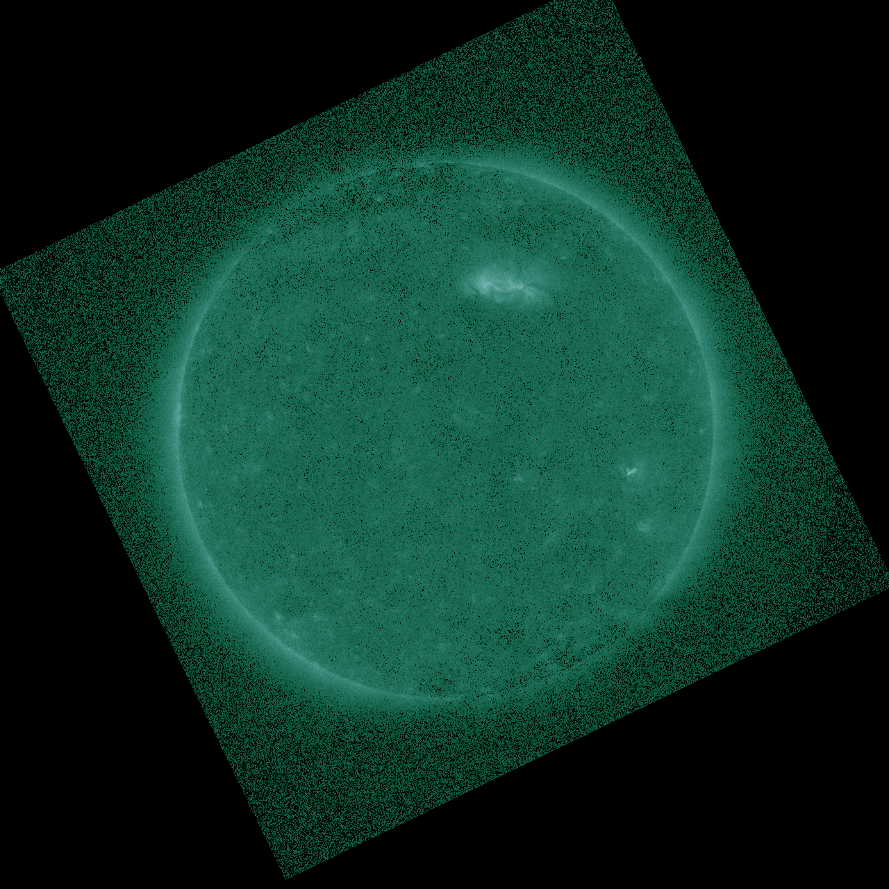
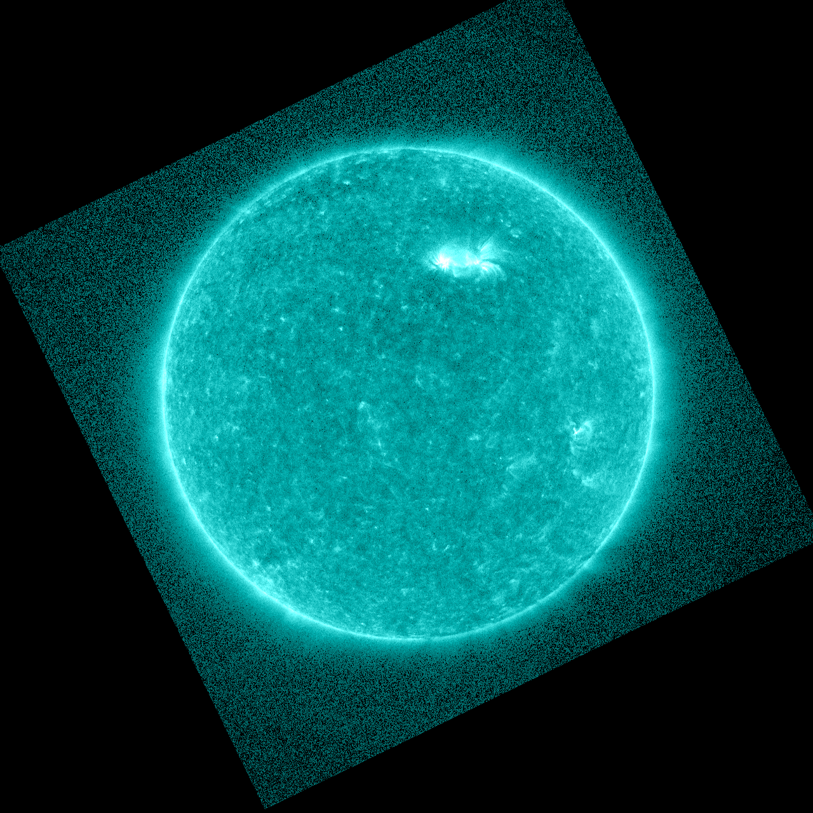
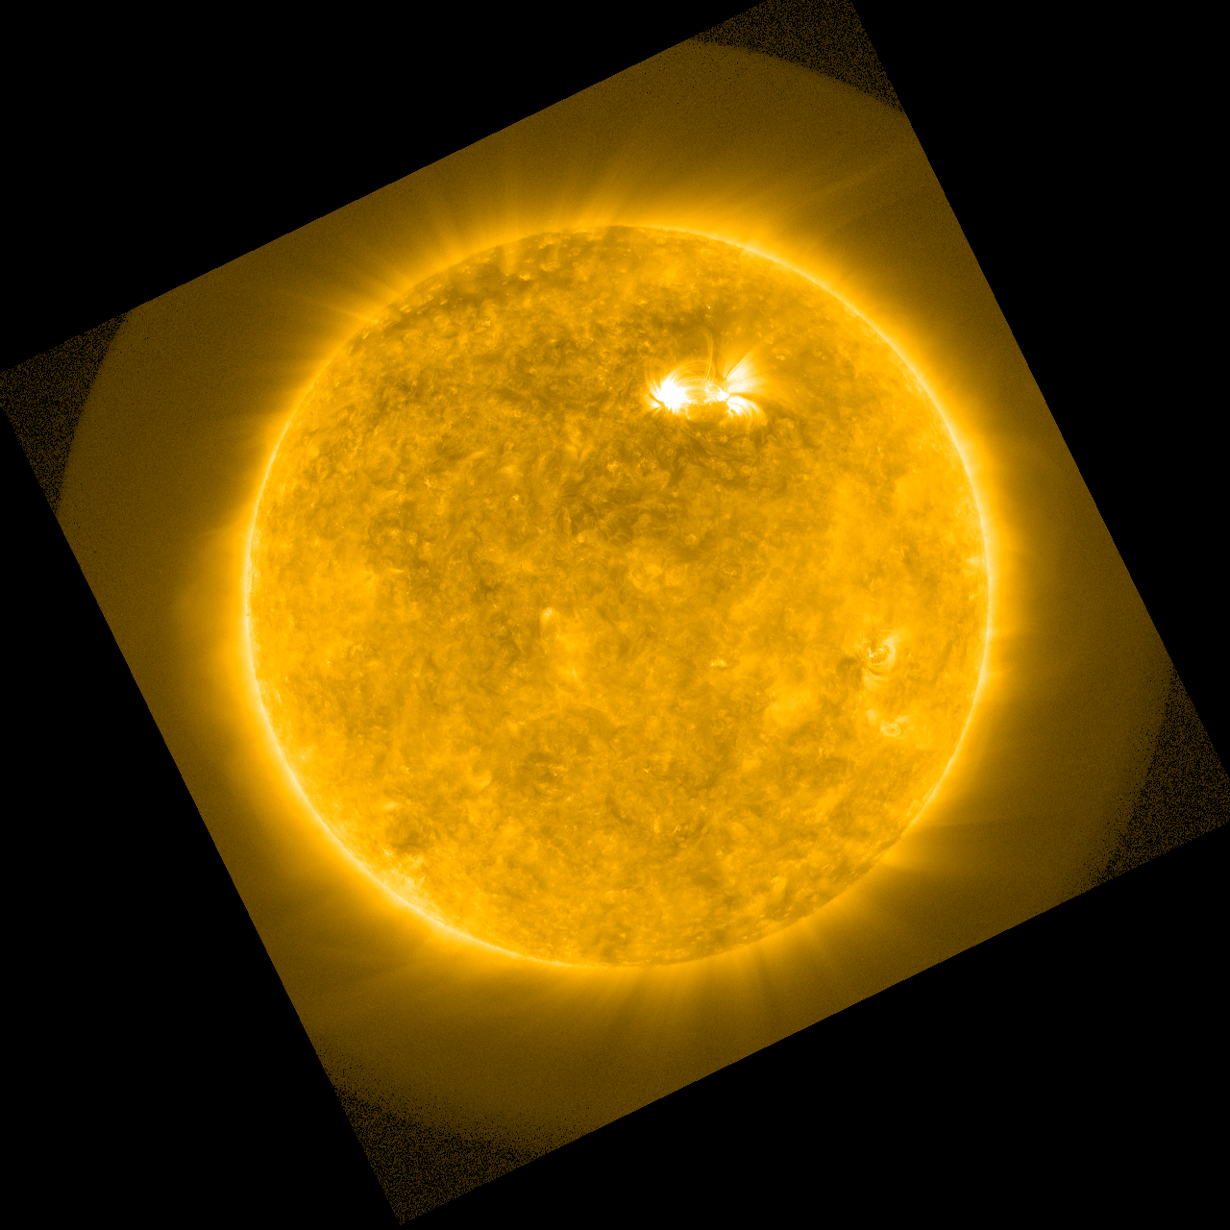
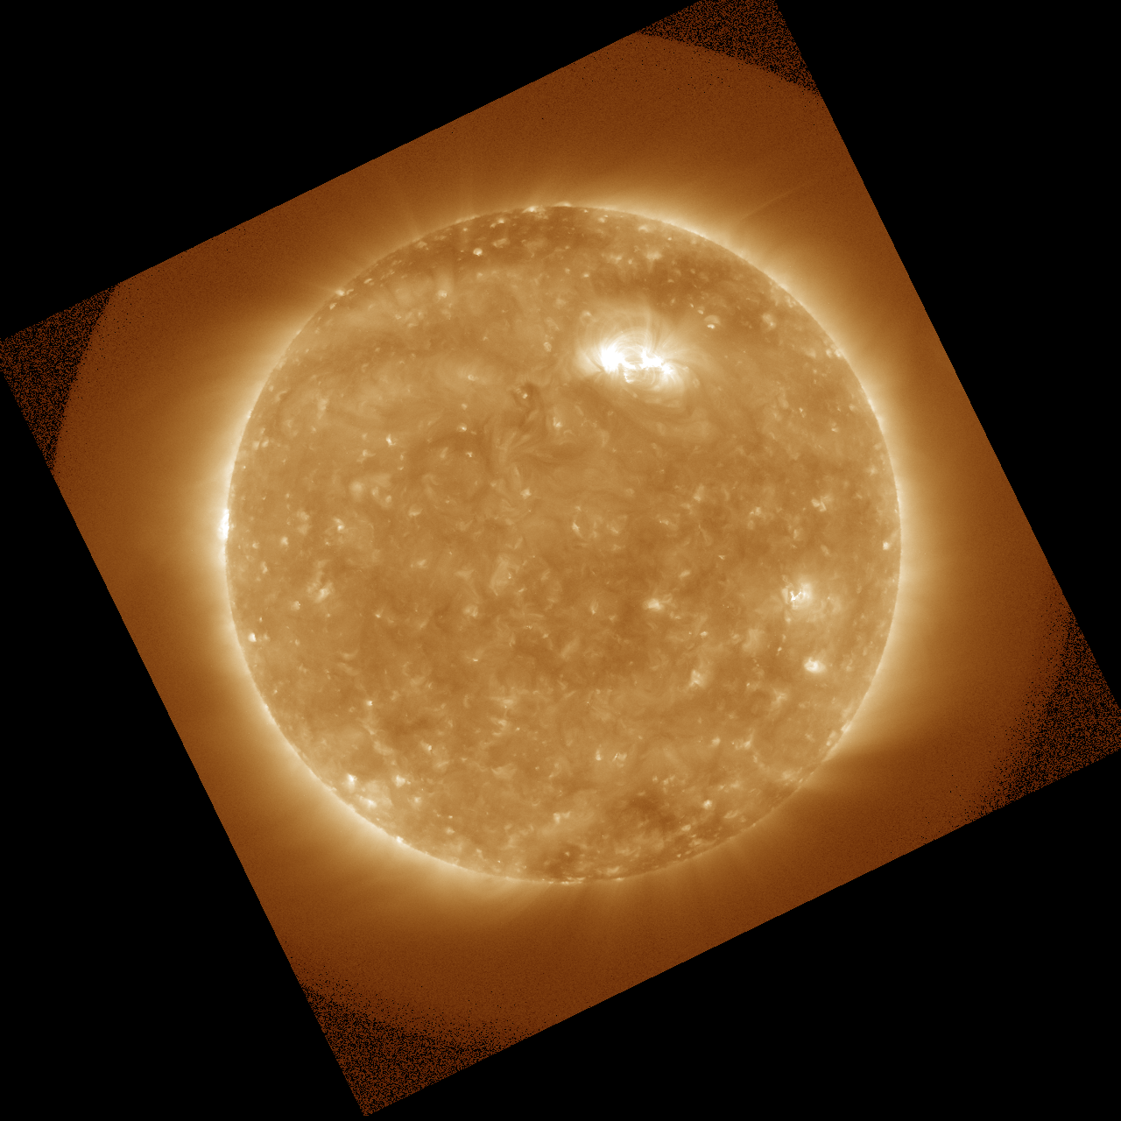
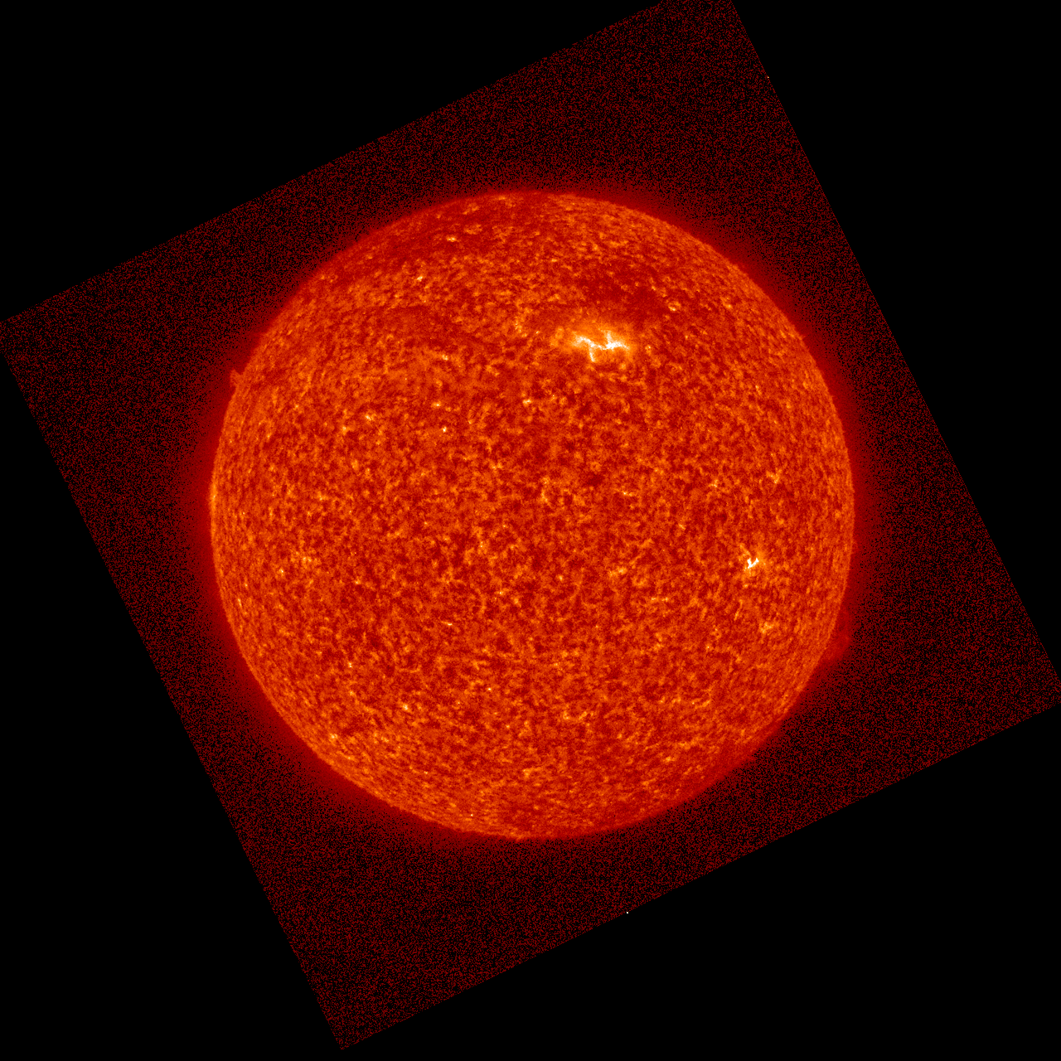
PLPT-SUVI-003: SUVI/AIA Intercalibration
Direct comparison of simultaneous images from SDO/AIA and GOES-16/SUVI can reveal image calibration issues as well is spatial defects.
SUVI
94 Å
131 Å
171 Å
195 Å
304 Å
AIA
2020 October 01 ~00:00 UT

Slide 29
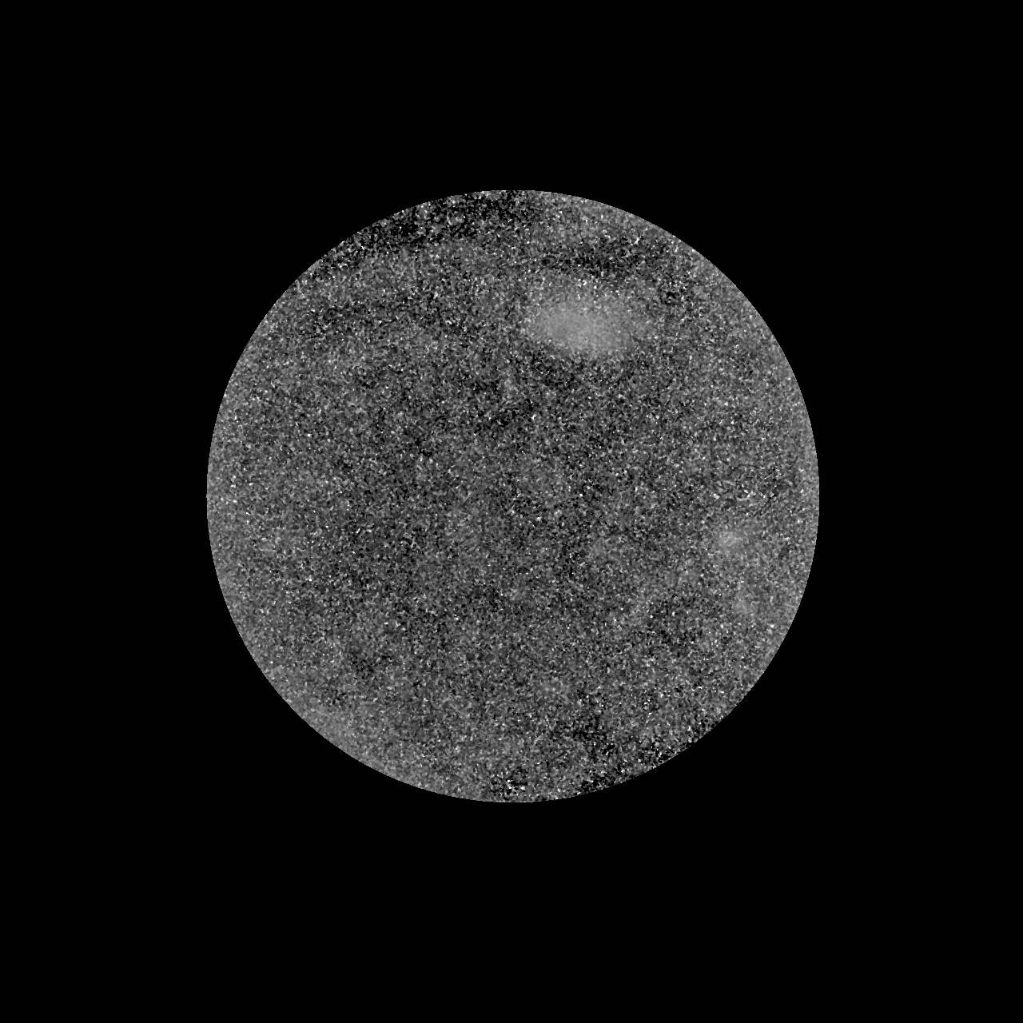
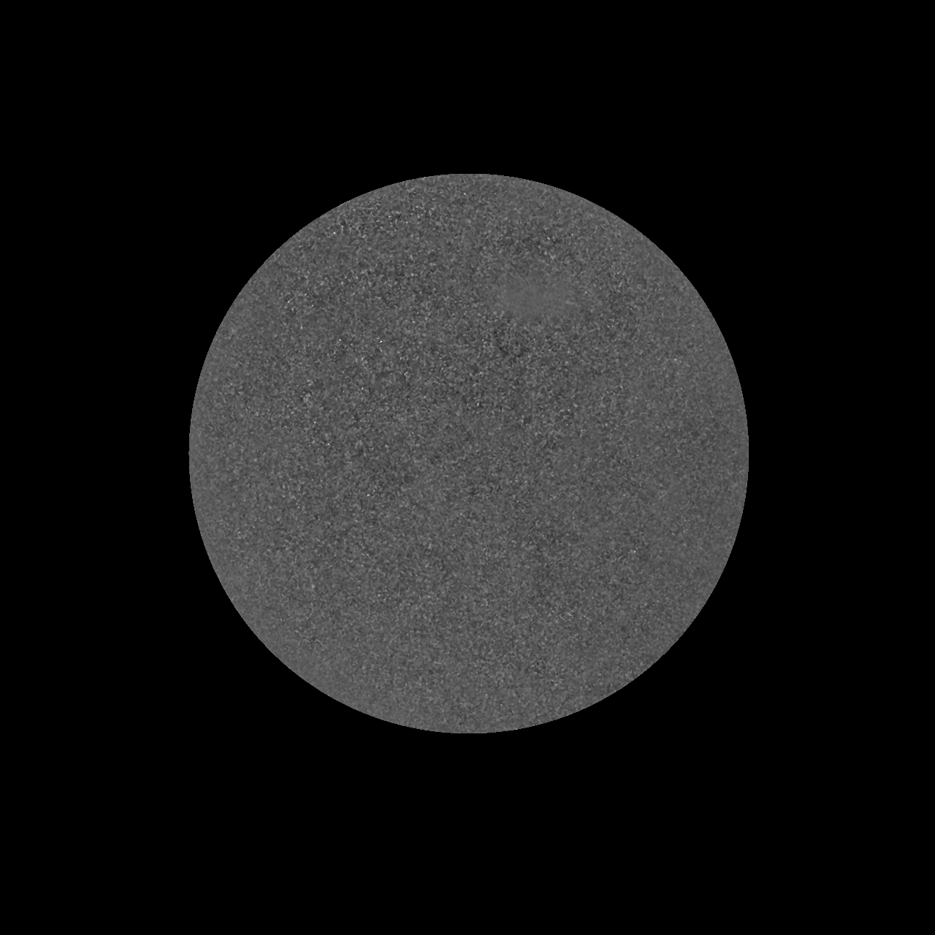
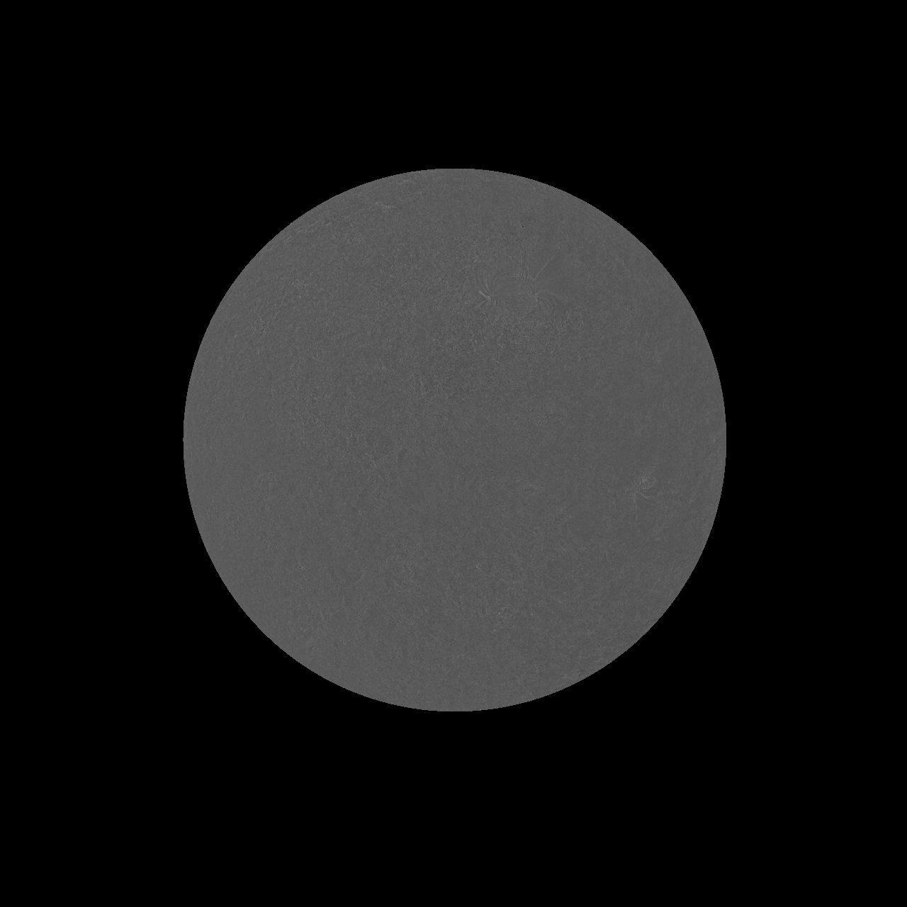
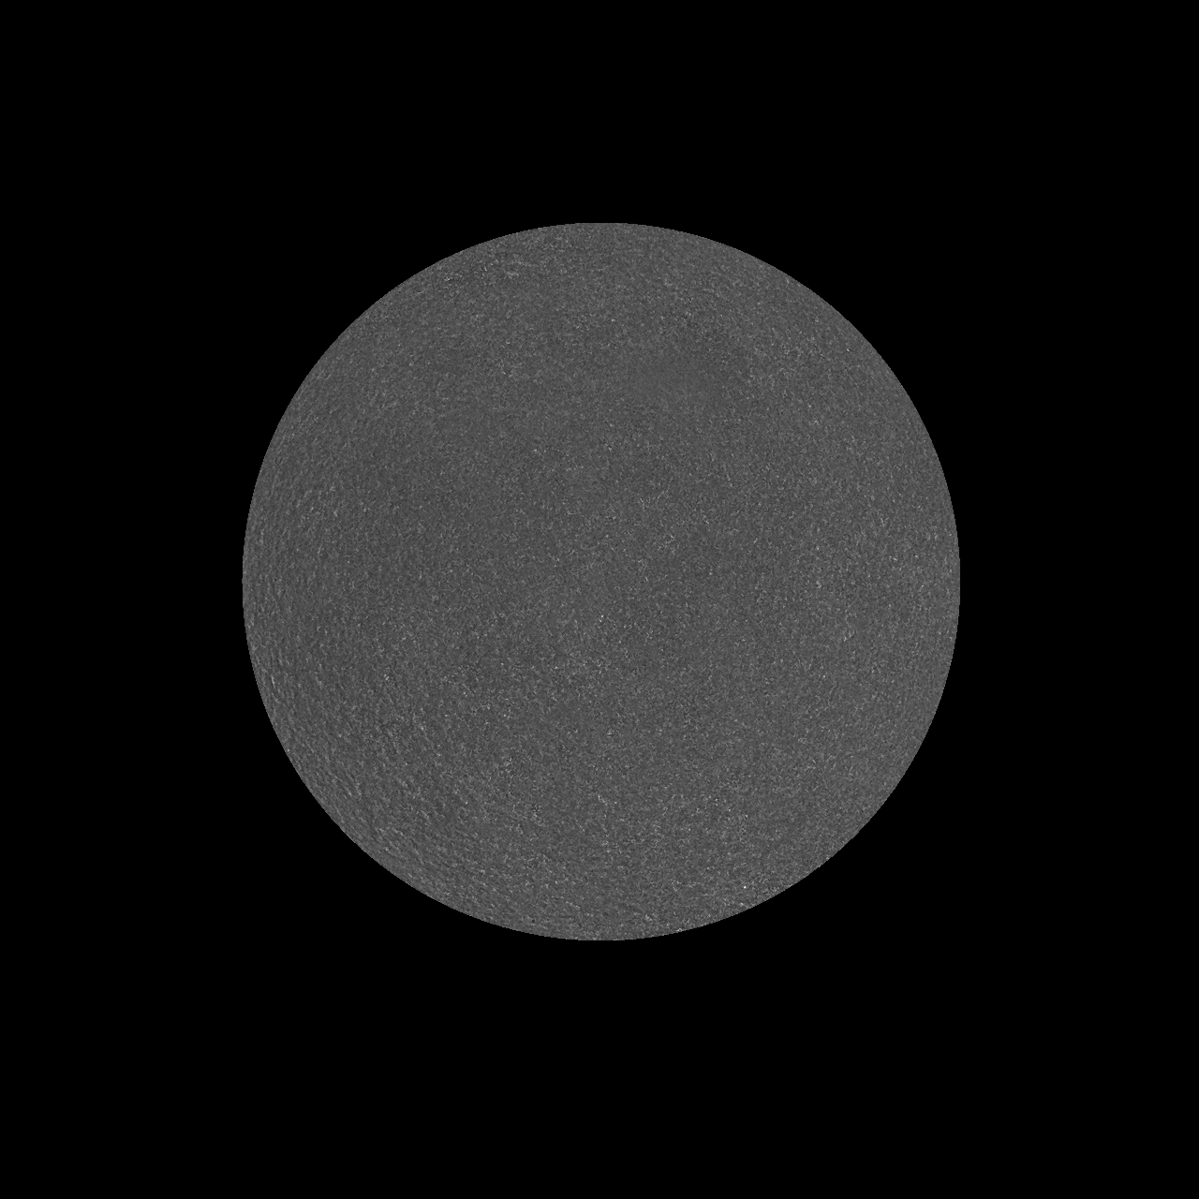
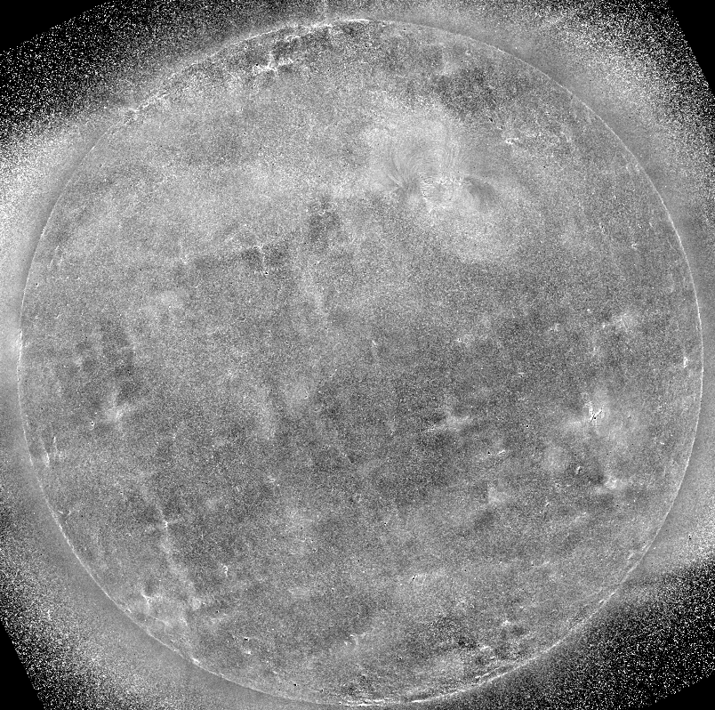
PLPT-SUVI-003: SUVI/AIA Intercalibration
Image ratios reveal flat response up to known passband differences and no large defects.
94 Å
131 Å
171 Å
304 Å
Very aggressive scaling of the 195 Å (SUVI) to 193 Å (AIA) bands reveals some passband differences and point spread function artifacts, but overall the images — even with our most significantly different passbands — agree very well.

Slide 30
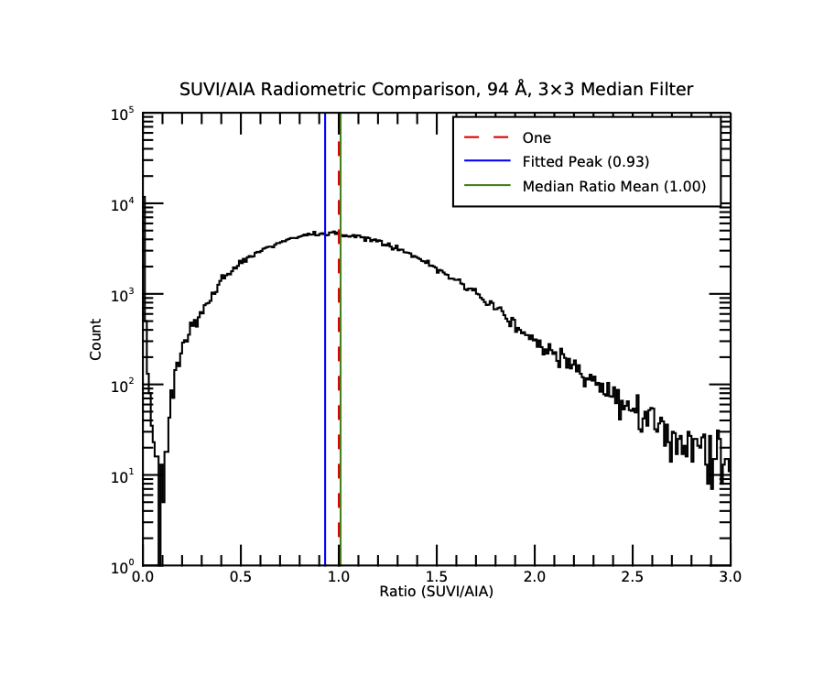
PLPT-SUVI-003: SUVI/AIA Intercalibration
Ratio histograms highlight any differences in response over range of radiances. Perfect intercalibration would yield a peak at 1.0. Useful for interpreting trending results.
94 Å: Has very low radiance at solar minimum, leading to noisy ratios, but overall behavior is reasonable.
AIA to SUVI passband differences are nontrivial.

Slide 31
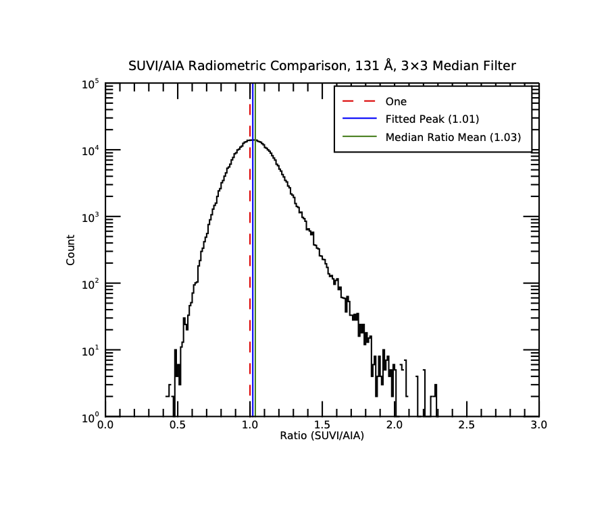
PLPT-SUVI-003: SUVI/AIA Intercalibration
Ratio histograms highlight any differences in response over range of radiances. Useful diagnostic for validity of trend analysis artifacts over the long term.
131 Å: Agreement is overall good.
AIA to SUVI passband differences are nontrivial, but mainly matter for hot, flare-only spectral lines, so are not evident in most ratios.

Slide 32
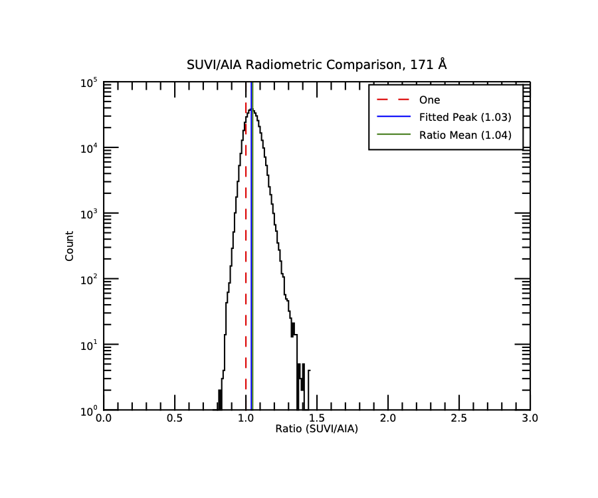
PLPT-SUVI-003: SUVI/AIA Intercalibration
Ratio histograms highlight any differences in response over range of radiances. Useful diagnostic for validity of trend analysis artifacts over the long term.
171 Å: Agreement is very good.
No significant passband differences, narrow variance in ratios.

Slide 33
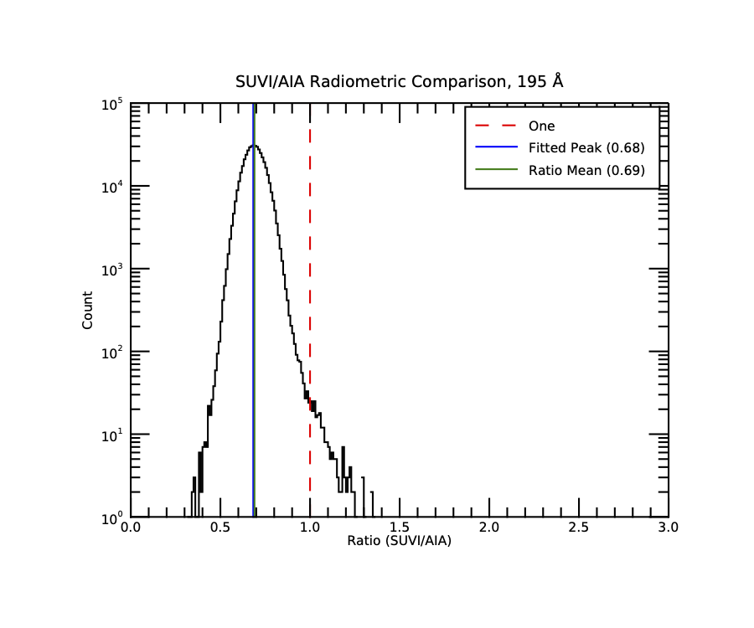
PLPT-SUVI-003: SUVI/AIA Intercalibration
Ratio histograms highlight any differences in response over range of radiances. Useful diagnostic for validity of trend analysis artifacts over the long term.
195 Å: Potential signs of degradation in this channel from ratios.
Passband differences are significant and ratios may reflect differences in underlying solar signal.
Expected performance ratio peak is about 0.9.

Slide 34
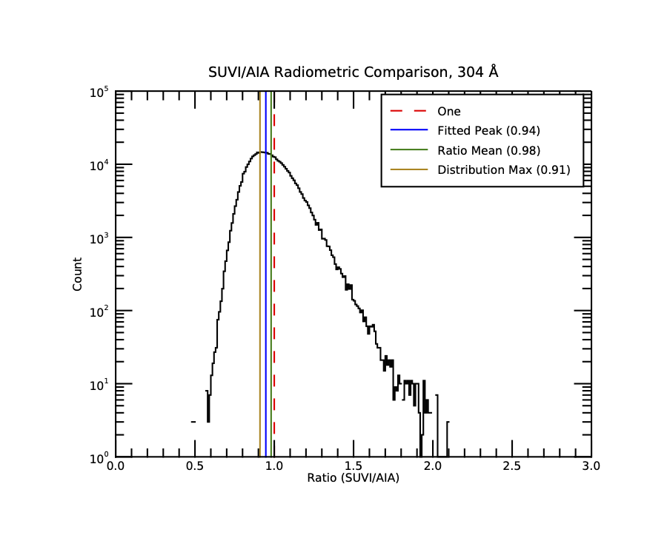
PLPT-SUVI-003: SUVI/AIA Intercalibration
Ratio histograms highlight any differences in response over range of radiances. Useful diagnostic for validity of trend analysis artifacts over the long term.
304 Å: Overall SUVI performance appears pretty good.
Nontrivial passband differences may contribute to spread in ratio.
AIA 304 Å channel is significantly degraded (>90%) so SUVI/AIA trending may be unreliable

Slide 35
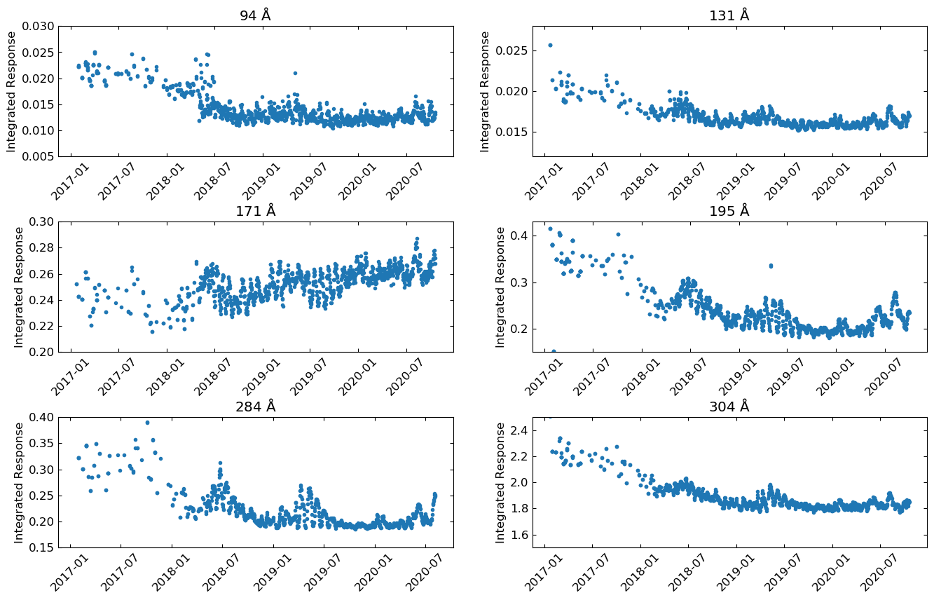
PLPT-SUVI-003: SUVI/AIA Intercalibration
GOES-16 SUVI Integrated Responses
Notes:
No external absolute reference!

Slide 36
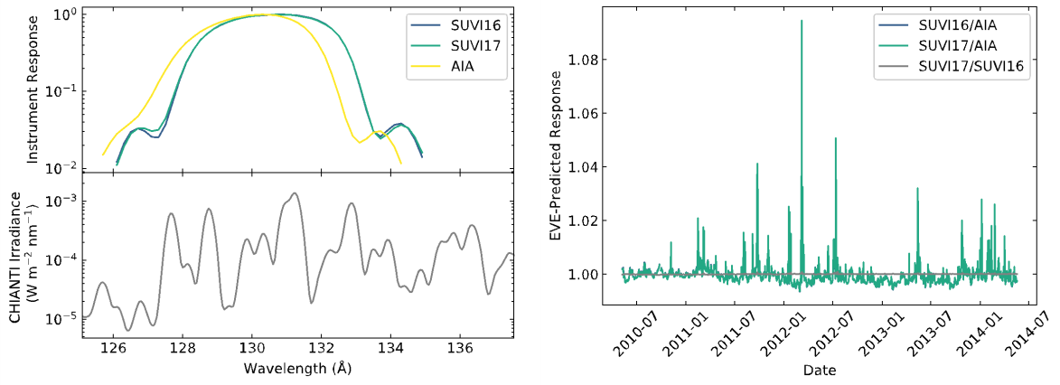
PLPT-SUVI-003: SUVI/AIA Intercalibration
GOES-16 SUVI 131Å Trending
Fe XXII Flare Line
SUVI and AIA agree the least in this channel with disagreements up to 10%. This is largely due to a flaring line seen more in SUVI channel than AIA

Slide 37
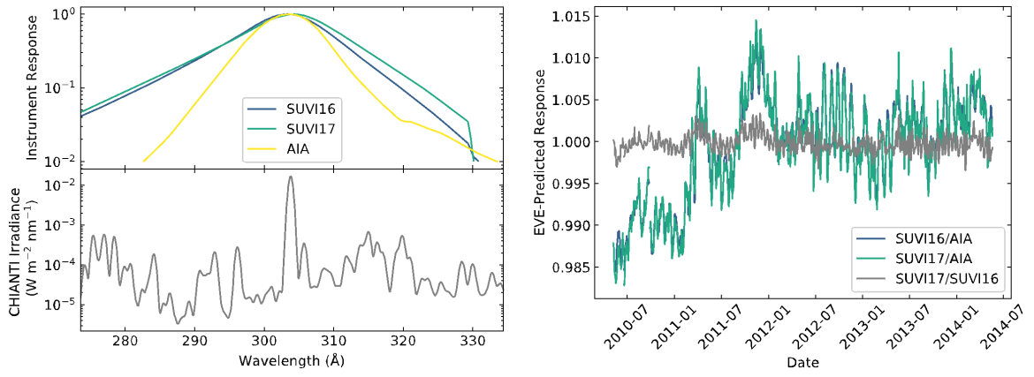
PLPT-SUVI-003: SUVI/AIA Intercalibration
GOES-16 SUVI 304Å Trending
The differences between the AIA and SUVI passbands result in differences, but differences remain with ~5%.

Slide 38
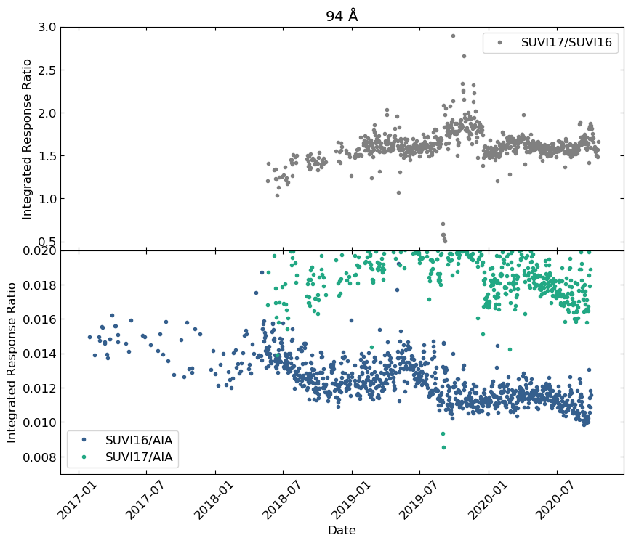
PLPT-SUVI-003: SUVI/AIA Intercalibration
94 Å
A slow but clear downward trend.
The 94 Å channel typically has very low signal in non-flare conditions.
The 94 Å channel suffers from CCD burn-in more than other channels

Slide 39
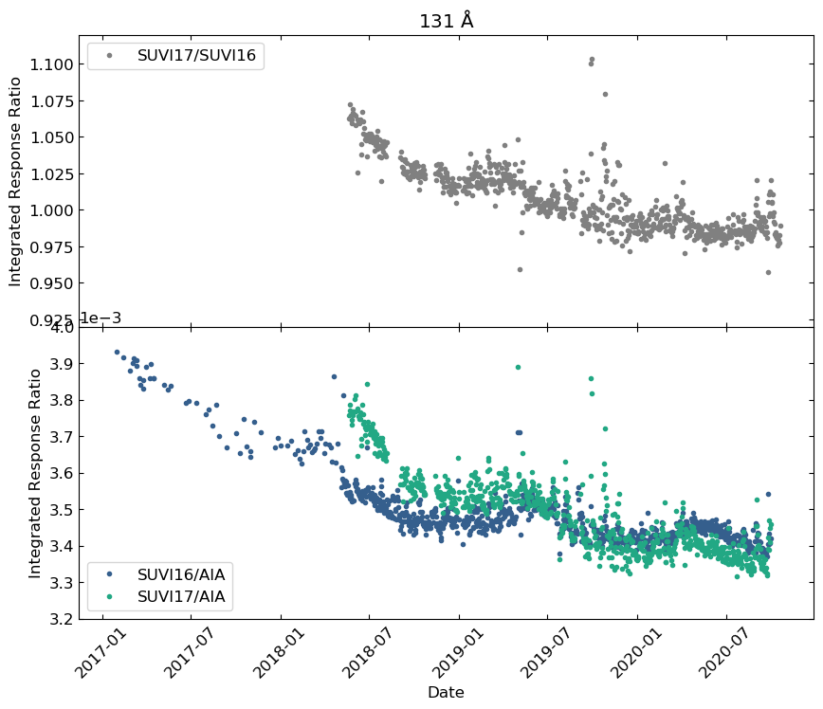
PLPT-SUVI-003: SUVI/AIA Intercalibration
131 Å
Roughly 13% degradation in this channel over ~4 years
~3.3% per year degradation
This channel shows clear difference in degradation rates between SUVI 16 and 17, where 17 degrades more quickly at the start of its mission than 16

Slide 40
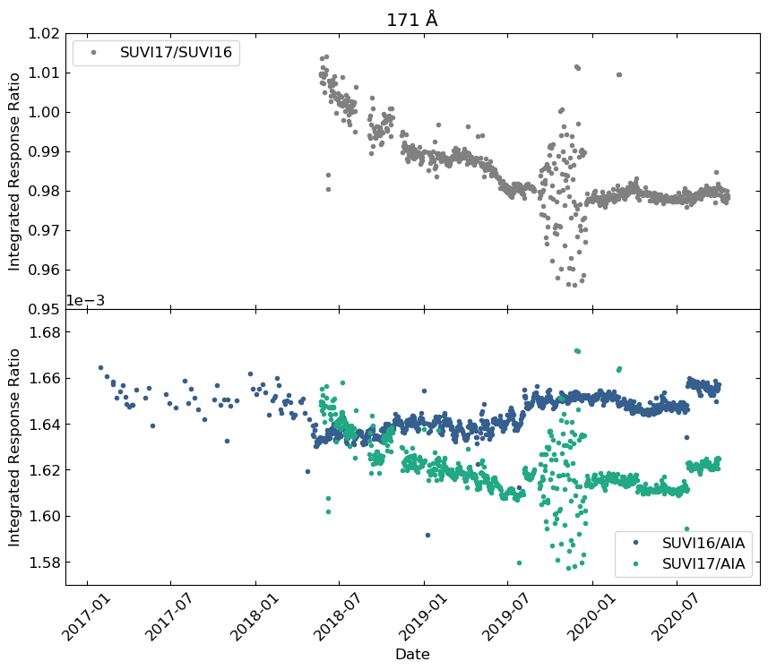
PLPT-SUVI-003: SUVI/AIA Intercalibration
171 Å
Degradation in this channel is minimal for both SUVI 16 and 17 and may not be discernible from fluctuations in the ratios
Jump in lower plot around 07/2020 is an AIA flatfield change, and is unrelated to SUVI performance

Slide 41
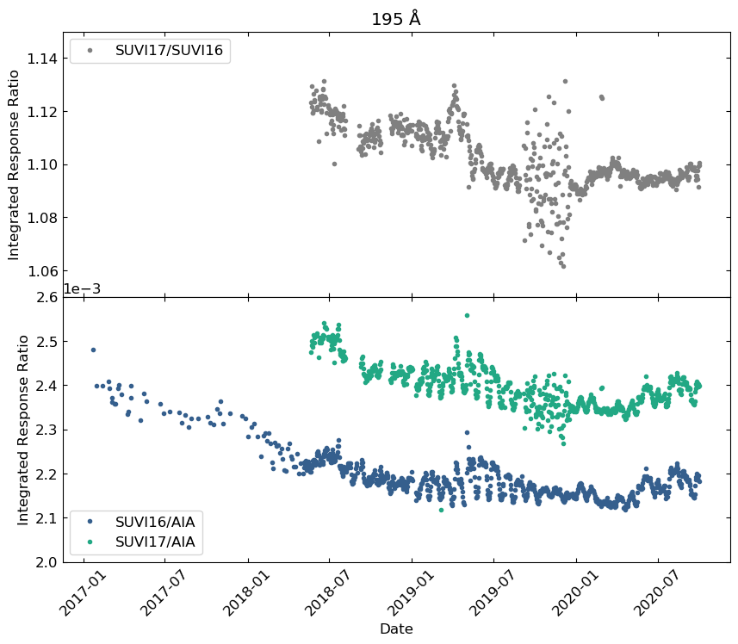
PLPT-SUVI-003: SUVI/AIA Intercalibration
195 Å
12% degradation over ~4 years
or ~3% per year

Slide 42
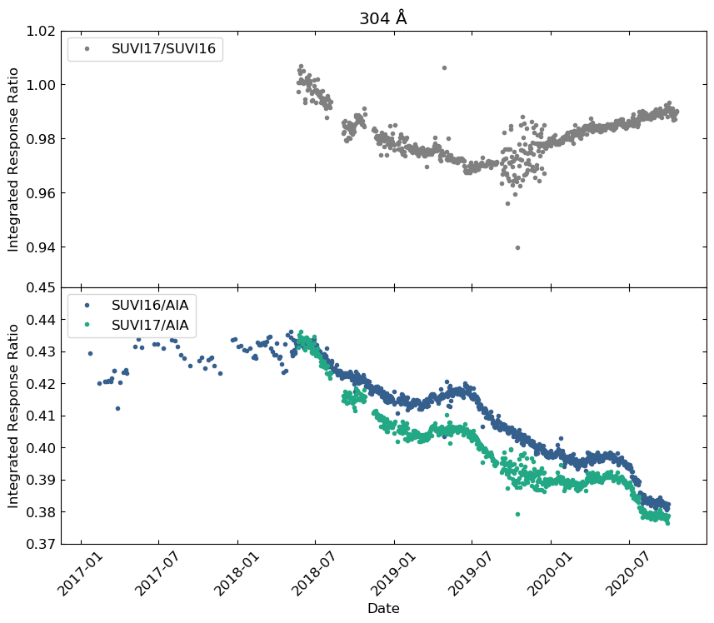
PLPT-SUVI-003: SUVI/AIA Intercalibration
304 Å
SUVI 16 experiences a lower degradation rate at around 20% over the first ~4 years
Agreement between SUVI 16 and 17 suggests similar degradation rates in the two instruments (5% per year)
Early data is a bit suspect (flat rather than decaying)

Slide 43
Further Supporting Evidence in Back-Up Slides

Slide 44
PLPT-SUV-006
SUVI-EXIS Intercomparison
Straight ratio comparison of EXIS-EUVSA 284 and 304Å spectral irradiance measurements to SUVI 284 and 304Å channels.
GOES-16 EXIS-EUVSA products reached Provisional Maturity on 25 September 2019, with critical fixes applied to the Ground System on 10 December 2019.
  Subsequent GS-produced Level-1b and NCEI-reprocessed data can be used for SUVI trending.
SUVI and EXIS are very different instruments, and work is needed to achieve an apples-to-apples comparison.

Slide 45
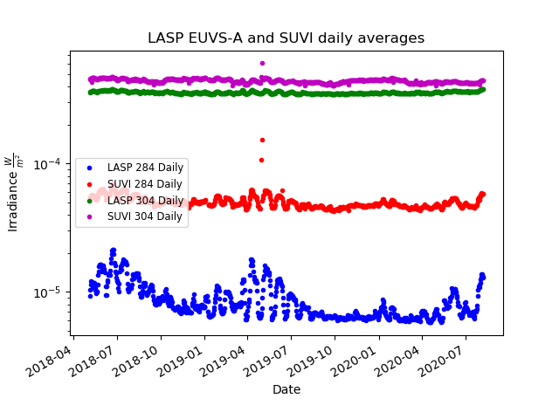
PLPT-SUV-006
SUVI-EXIS Intercomparison

Slide 46

PLPT-SUV-006
SUVI-EXIS Intercomparison

Slide 47

PLPT-SUV-006
SUVI-EXIS Intercomparison
SUVI/EXIS comparison of the 304 channel shows a slow degradation when compared to the SDO/AIA 304 channel.
Over the period shown, a degradation of ~9% has occurred (3.9% per year).
~14% over the mission-to-date (linear assumption)

Slide 48

PLPT-SUV-006
SUVI-EXIS Intercomparison
SUVI/EXIS comparison of the 284 channel shows almost a negligible amount of degradation
Over the period shown, a degradation of ~0.9% has occurred (0.38% per year).
~1.4% over the mission-to-date (linear assumption)

Slide 49
Summary of GOES-16 SUVI Degradation
Wavelength | Estimated Degradation Rate (per year) | Total Estimated Degradation
94 | 7% AIA | 30% AIA
131 | 3.3% AIA | 13% AIA
171 | ~0% AIA | 0% AIA
195 | 3% AIA | 12% AIA
284 | ~0.4% EUVS-A | 1.4% EUVS-A
304 | 5% AIA 3.8% EUVS-A | 20% AIA 14% EUVS-A
Notes:
Rocket underflights for SDO delayed due to COVID-19!

Slide 50
GOES-16 SUVI Full Maturity PS-PVR
Full Maturity Assessment

Slide 51
GOES-16 SUVI Performance Baseline Status
MRD ID | Description | Requirement | Results of NCEI Analysis | Status
2045 | Pointing Accuracy | 3’ | << 2.5” y, << 2.5” z | PASS
2046 | Product Pointing Knowledge | 2.5” | << 2.5” y, << 2.5” z | PASS
2052 | Long-term Stability (Product Measurement Precision in Radiance) | 30% | ≤ 30% | PASS
Pointing requirements are well met.
NCEI has demonstrated with trending that the degradation of instrument response is slow, stable, and correctible.
‹#›

Slide 52
GOES-R Full Maturity Criteria
Preparation Activity | Assessment
Validation, quality assessment, and anomaly resolution activities are ongoing. | NCEI continues to assess and diagnose issues with instrument performance and product quality. The anomaly resolution process is used as appropriate and involves NCEI’s participation in resolution and validation through the AART.
Incremental product improvements may still be occurring | Major product anomalies have been identified and resolved. Some minor product issues, though none with operation impacts. NCEI and MIT-LL are both working to further improve the SUVI L1b product.
Users are engaged and user feedback is assessed | NCEI engages with NWS/SWPC, and has ongoing efforts to engage scientific data disseminators such as VSO, SunPy, and Helioviewer.

Slide 53
GOES-R Full Maturity Criteria
End State | Assessment
Product performance for all products is defined and documented over a wide range of representative conditions via ongoing ground truth and validation efforts. | Long-term trending activities has allowed for the assessment of the GOES-16 SUVI across a variety of solar conditions. As allowed, the SUVI instrument are compared against other well-calibrated instruments including SDO rocket underflights.
Products are operationally optimized, as necessary, considering mission parameters of cost and schedule, as compared to user expectations. | Product optimization, such as LUT updates to calibration parameters, will occur as time and resources allow.
All known product anomalies are documented, and shared with the user community. | All known product anomalies are documented within this presentation and within the L1b README documents.
Product is operational. | Yes, and is operationally leveraged through IDP and SPADES L2 product generation.

Slide 54
GOES-16 SUVI Full Maturity PS-PVR
Summary of SUVI Product Status

Slide 55
Priorities for GOES-16 SUVI Level-1b
No impact to Operations or Full Validation Status:
  Update degradation correction coefficients
    Leverage SDO Rocket Underflight data as available (2021?).
  Further improvements and bug fixes to SUVI Level-1b metadata (ADR 1021, 1121)
  Define a process for updating the SUVI observing sequence that addresses SWPC’s operational needs going forward.

Slide 56
Summary of GOES-16 SUVI Readiness for Full Maturity Status
The GOES-16 SUVI is providing data to NWS/SWPC in an operational capacity.
Trending activities demonstrate that the GOES-16 SUVI instrument performance is understood and corrections to the instrument degradation can be applied.
NCEI is actively engaging with NWS/SWPC and the wider scientific community.
NCEI affirms that all known Ground System and instrumental issues prohibitive to Full Validation Maturity for the GOES-16 SUVI have been resolved.
NCEI affirms that all criteria for Full Validation Maturity have been met by the GOES-16 SUVI.
NCEI recommends to the Review Panel that the GOES-16 SUVI be considered for Full Validation Maturity Status.

Slide 57
Reference and Back-up Slides

Slide 58

94 Å
Degradation in this channel is roughly 30% over ~4 years
~7% degradation per year on average
94 light leak in 17 is apparent (see upper plot)

Slide 59

94 Å
Transparent dots show original data prior to correcting for inconsistent calibrations (effective area in LUT) and discontinuities due to mini bakeouts after instrument resets

Slide 60

131 Å
Transparent dots show original data prior to correcting for inconsistent calibrations (effective area in LUT) and discontinuities due to mini bakeouts after instrument resets

Slide 61

171 Å
Transparent dots show original data prior to correcting for inconsistent calibrations (effective area in LUT) and discontinuities due to mini bakeouts after instrument resets

Slide 62

195 Å
Transparent dots show original data prior to correcting for inconsistent calibrations (effective area in LUT) and discontinuities due to mini bakeouts after instrument resets

Slide 63

304 Å
Transparent dots show original data prior to correcting for inconsistent calibrations (effective area in LUT) and discontinuities due to mini bakeouts after instrument resets
Note: transparent dots overlap solid dots pre-2019

Slide 64


PLPT-SUVI-003: SUVI/AIA Intercalibration
GOES-16 SUVI 94Å Trending
Trending shows close agreement for this channel.

Slide 65

PLPT-SUVI-003: SUVI/AIA Intercalibration
GOES-16 SUVI 171Å Trending
Trending shows close agreement for this channel.

Slide 66


PLPT-SUVI-003: SUVI/AIA Intercalibration
GOES-16 SUVI 195Å Trending
The passband differences (top-left plot) result in less agreement (within 5%) between AIA and SUVI.

Slide 67

304 Å
AIA 304 channel degradation around 75% in first 4 years

