Slide 1
GOES-16 SUVI PS-PVR
SWPC User Perspective
Steven Hill
NOAA/NWS Space Weather Prediction Center

Slide 2
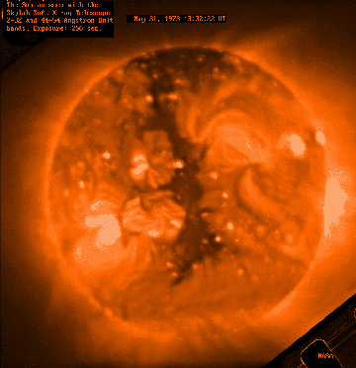
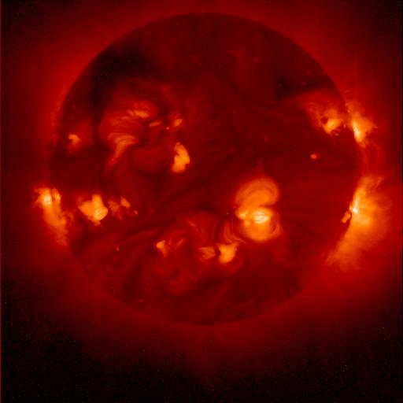
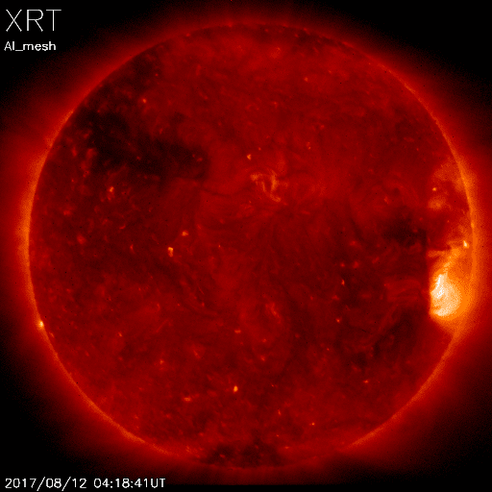
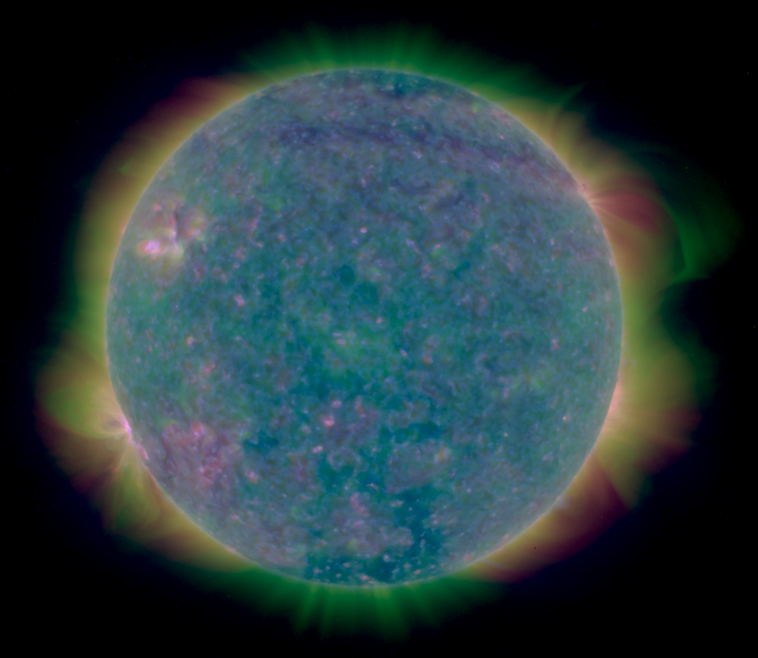
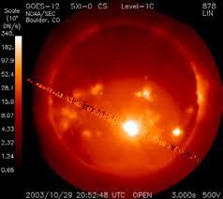
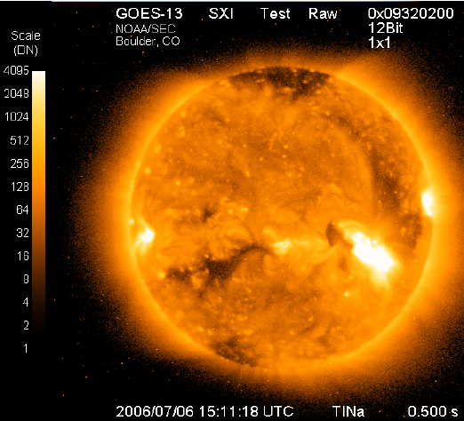
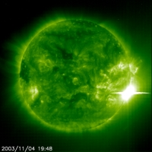
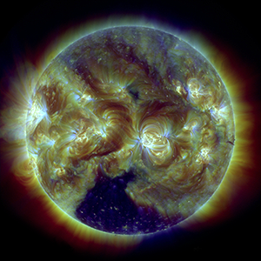
Heritage
Skylab
1973-74
Yokoh 1991-2001
Hinode
2006-
GOES 12
2001-2007
GOES 13-15
2006-2020
SUVI
Launched 2016
Operational 2020
SOHO EIT
1996-
SDO AIA
2010-
Notes:
First proposed GOES X-ray imager in 1970s
First formal study for what became GOES-12 SXI started in 1980s

Slide 3
Forecast Applications
Provide advance warning of solar activity
  “Over the horizon” look at active regions rotating onto the Earth-facing side of the sun
Provide warning of recurring geomagnetic storms
  Tracking coronal holes as they rotate across the solar disk
Provide warning of non-recurring geomagnetic storms
  Identify, locate, and characterize eruptions (flares, coronal mass ejections)
Provide warning of solar radiation storms
  Identify, locate, and characterize eruptions (flares, coronal mass ejections)
Assess solar flaring probability
  Intensity and complexity of solar active regions

Slide 4
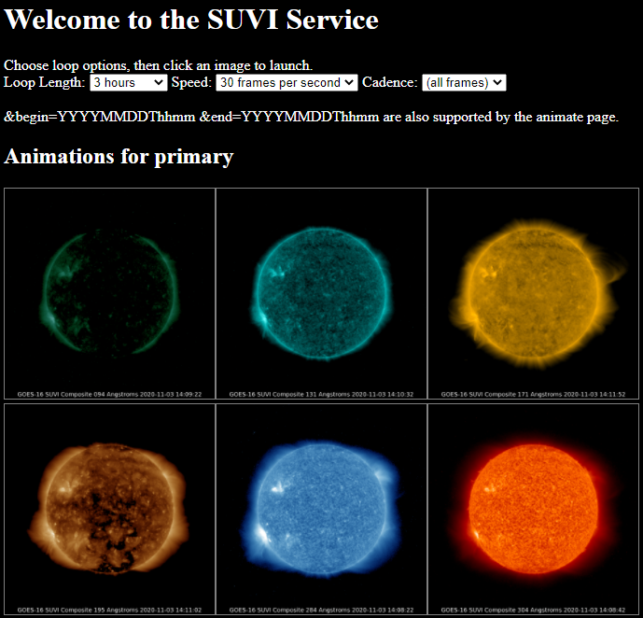
Data
Used primarily for situational awareness
Auto updating loops with selectable
  Duration: 3 hrs to 8 days
  Speed: 10 to 60 fps
  Cadence: 4 min to daily

Slide 5
Data Products
Product | Wavelength (nm) | Uses | Features and Temperature (K)
Composite Images | 9.4 | Flare location | Flares ~6x10⁶ K
 | 13.1 | Flare location | Flares ~6x10⁶ K and ‘hot’ flares ~15x10⁶ K
 | 17.1 | Active region characterization | Active regions ~6x10⁵ K
 | 19.5 | Active region characterization and flare location | Active regions ~1x10⁶ K and ‘hot’ flares ~20x10⁶ K
 | 28.4 | Coronal hole location and characterization | Coronal Holes (~2x10⁶ K)
 | 30.4 | Filament location and characterization | Filaments (~6x10⁴ K)
Thematic Map | All | Supervised pixel classifier | All
Notes:
SWPC doesn’t use the L1b products

Slide 6
GOES 16-17 SUVI Status
GOES 16 SUVI is now the primary EUV imager for operations
  GOES 17 SUVI provides secondary EUV imaging data via the non-operational IDP Dev data stream
  NASA’s SDO AIA imager also provides non-operational EUV imaging
Currently working to bring GOES 17 SUVI into operations on IDP
GOES 17 should be fully operational in summer of 2021

Slide 7
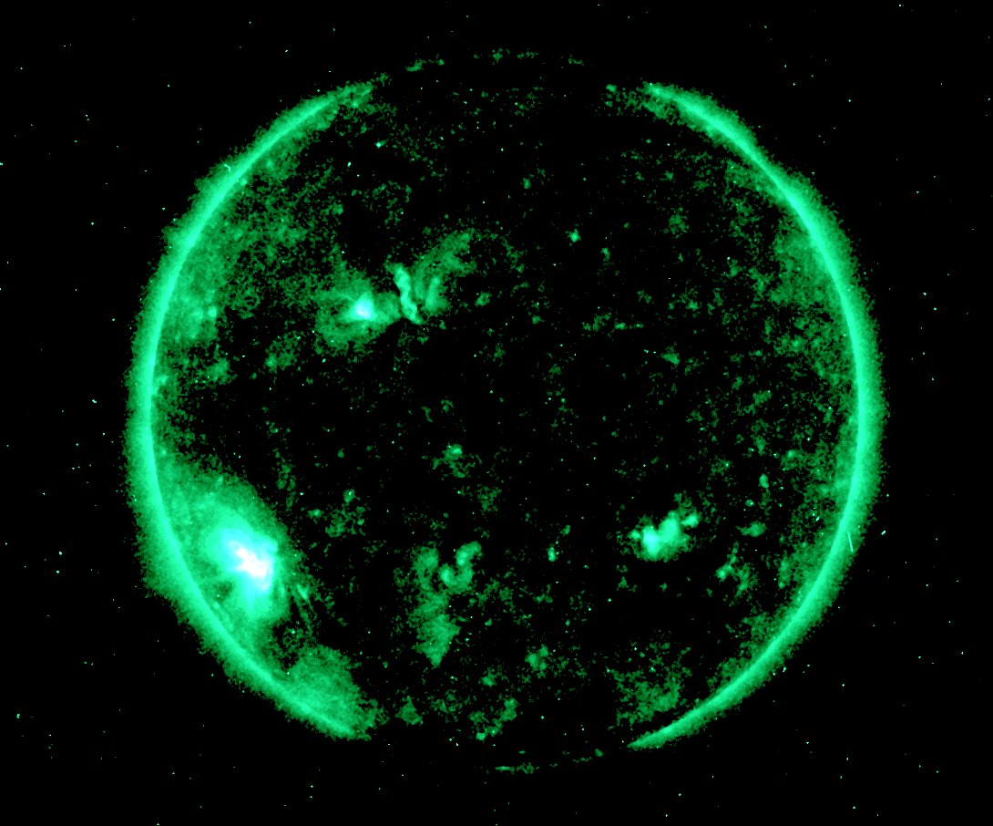
SUVI Issues: Sensor/Product Performance
Spiking (particle contamination)

Slide 8
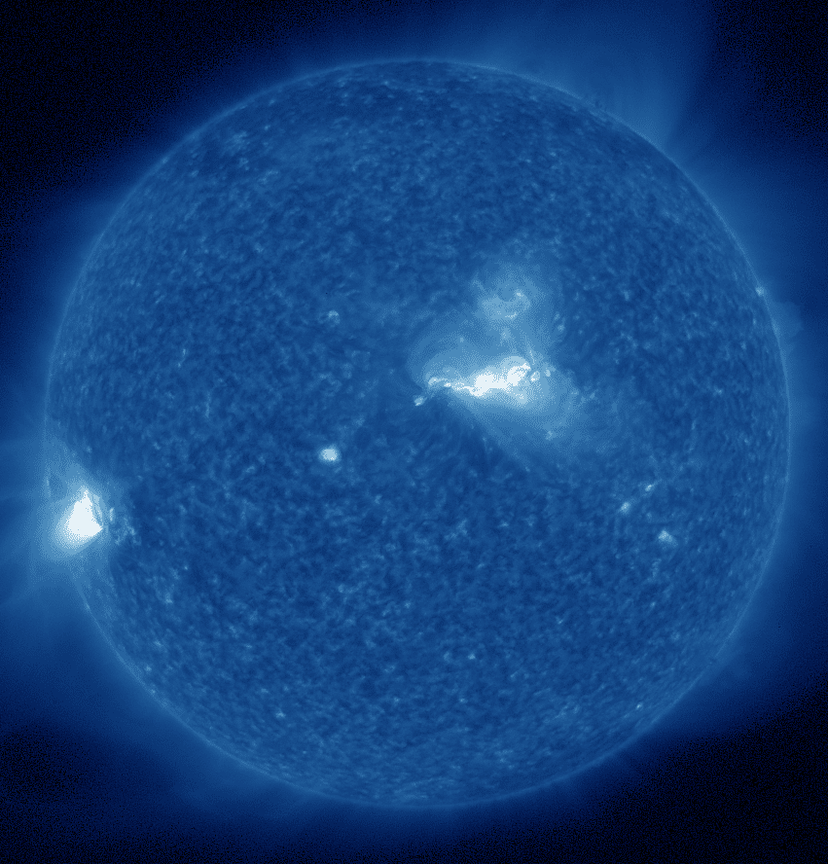
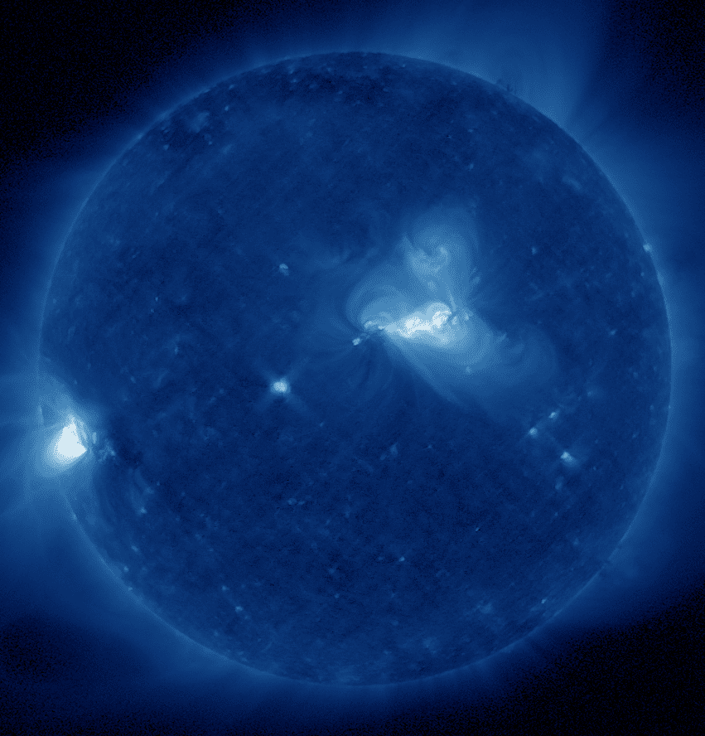
SUVI Issues: Sensor/Product Performance
30.4 - 28.4 cross-talk

Slide 9
SUVI Issues: Sensor/Product Performance
Thematic map product maturity and application
Current lack of secondary operational imager

Slide 10
Summary
GOES-16 SUVI is a success
  Minor product issues and meets the operational needs of SWPC
NCEI & Program overcame significant challenges with the early data stream

