Slide 1



Solar Ultraviolet Imager (SUVI)
Provisional PS-PVR
2018 May 4
Jonathan Darnel, Dan Seaton
GOES-R Calibration Working Group
CIRES, Univ. of Colorado & NOAA NCEI

Slide 2
AGENDA
SUVI Instrument Overview
Review of Beta Maturity
Product Quality Evaluation
  General approach
  Major Issues Remaining
Provisional Maturity Assessment
Path to Full Validation Maturity
  Issues and status
  PLPT
  Risks
Summary and Recommendations

Slide 3
Commonly-Used Acronyms (CUAs)
ADR : Algorithm Discrepancy Report
AIA : Atmospheric Imaging Assembly
CCD : Charged-Couple Device
EUV : Extreme UltraViolet
EXIS : EUV and X-ray Irradiance Sensor
FITS : Flexible Image Transport System
LUT : Look-Up Table
OMAS : Operational Metadata Aggregation Service
SDO : Solar Dynamics Observatory
SUVI : Solar UltraViolet Imager
WR : Work Request

Slide 4
SUVI Instrument & Products Overview

Slide 5
SUVI OVERVIEW

Slide 6
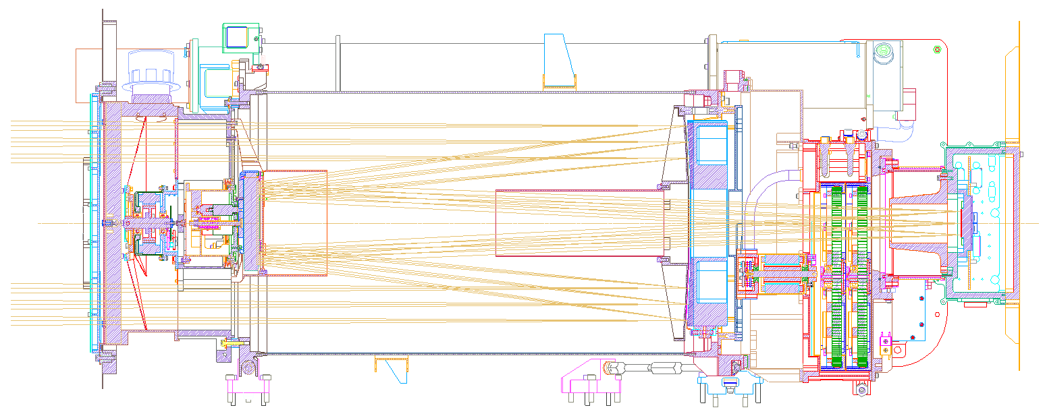
Entrance Filter
Primary Mirror
Secondary Mirror
Focal Plane Filters
CCD
Detector

Slide 7
Key SUVI Imager Requirements
Pointing knowledge: <2.5 arcsec
Pointing accuracy & stability: <0.5 arcsec
Field of view: >42×42 arcmin
Spatial resolution: <5 arcsec square pixels
Ensquared energy: >50% in 7×7 arcsec
  (43% for 94 Å bandpass)

Slide 8
Key SUVI Imager Characteristics
1280×1280 pixels
2.5 arcsec pixels, 53.5×53.3 arcmin FOV
14-bit CCD detector
Entrance aperture selector – 6 positions
2 Filter wheels:
  FW1: Open, Thin Al & Zr, Thick Al & Zr
  FW2: Glass, Open, Thin Al, Thin Zr, Thick Al
4-photodiode guide telescope for pointing

Slide 9
SUVI Channels

Slide 10
SUVI Spectral Response Functions
Computed using data from: SUVP-RP-11-2696_CDRL_079_FM1_FilterTransmissionFit.xlsx,
SUVP-RP-12-3699 -Rev B CDRL 074A Appendix - FM1_Throughput_Component_Data_V1.xlsx
Notes:
SUVI Response as a function of wavelength computed from several documents

Slide 11
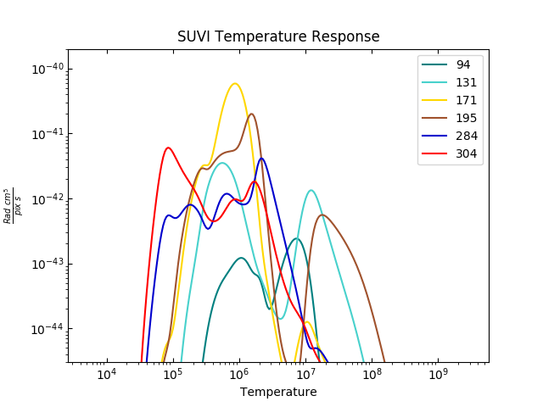
SUVI (Coronal) Temperature Response

Slide 12
File Formats:
netCDF vs. FITS
The SUVI L1b product is produced in both netCDF and FITS formats
The standard file format for the astrophysical community is FITS
NWS/SWPC and NCEI Level-2 algorithms expect FITS files
NCEI-CO considers the SUVI L1b FITS product as the standard

Slide 13
Review of Beta Maturity

Slide 14
Path to Provisional Maturity
Resolve major GPA concerns.
Verify solutions to issues raised during PLT are resolved.
Fully validate L1b after major outstanding calibration issues (darks, flats) are resolved.
Upload revised calibration tables.
Six PLPTs to validate instrument calibration and performance, intercalibrate with other instruments.
Daily, weekly and quarterly calibrations underway.
Provisional maturity date currently set August 16.
Ideally we would like to be ready to support observations of total solar eclipse on August 21.
Notes:
Four items totally complete, two are semi-complete. We obviously missed the provisional deadlines described here.

Slide 15
Risks to Reaching Provisional at Beta PS-PVR
ADR | WR | Delivery | Description | Disposition
 |  |  | Calibration & Image Processing Issues
223 | 5696 | — | Persistent negative pixel | Should be resolved by LUT update and ADR 665.
306 | 4364 | DO.06.00.00 | Dark subtraction not performed | Resolved.
307 | 3812 | DO.06.00.00 | Images are mirror-image reversed | Resolved.
309 | 4353 | — | Images require despiking for radiometric accuracy | Under discussion.
— | — | PR.06.09.00 | Placeholder flat fields contaminate images | Resolved by LUT update, see ADR 587.
 |  |  | Navigation & Metadata Issues
108 | 4358 | DO.06.00.00 | PCi_j matrix elements incorrectly calculated (Determines image orientation) | Resolved.
222 | 4248 | DO.06.02.00 | CRVAL metadata entries incorrect | Withdrawn.
225 | 5311 | DO.06.03.00 | Date fields missing on the first of every month in SUVI FITS products | Resolved. Can only be validated after the first new month after release of DO.06.03.00 to OE.
308 | Multiple | PR.06.10.03 | CRPIX (sun center pixel) incorrectly calculated | Resolved. See also ADRs 587, 662, and 663.
 |  |  | Usability Issues
311 | 4551 | DO.08.00.00 | Incomplete radiometric metadata | In work.
311 | 4551 | DO.08.00.00 | FITS metadata does not provide image units | In work.
15

Slide 16
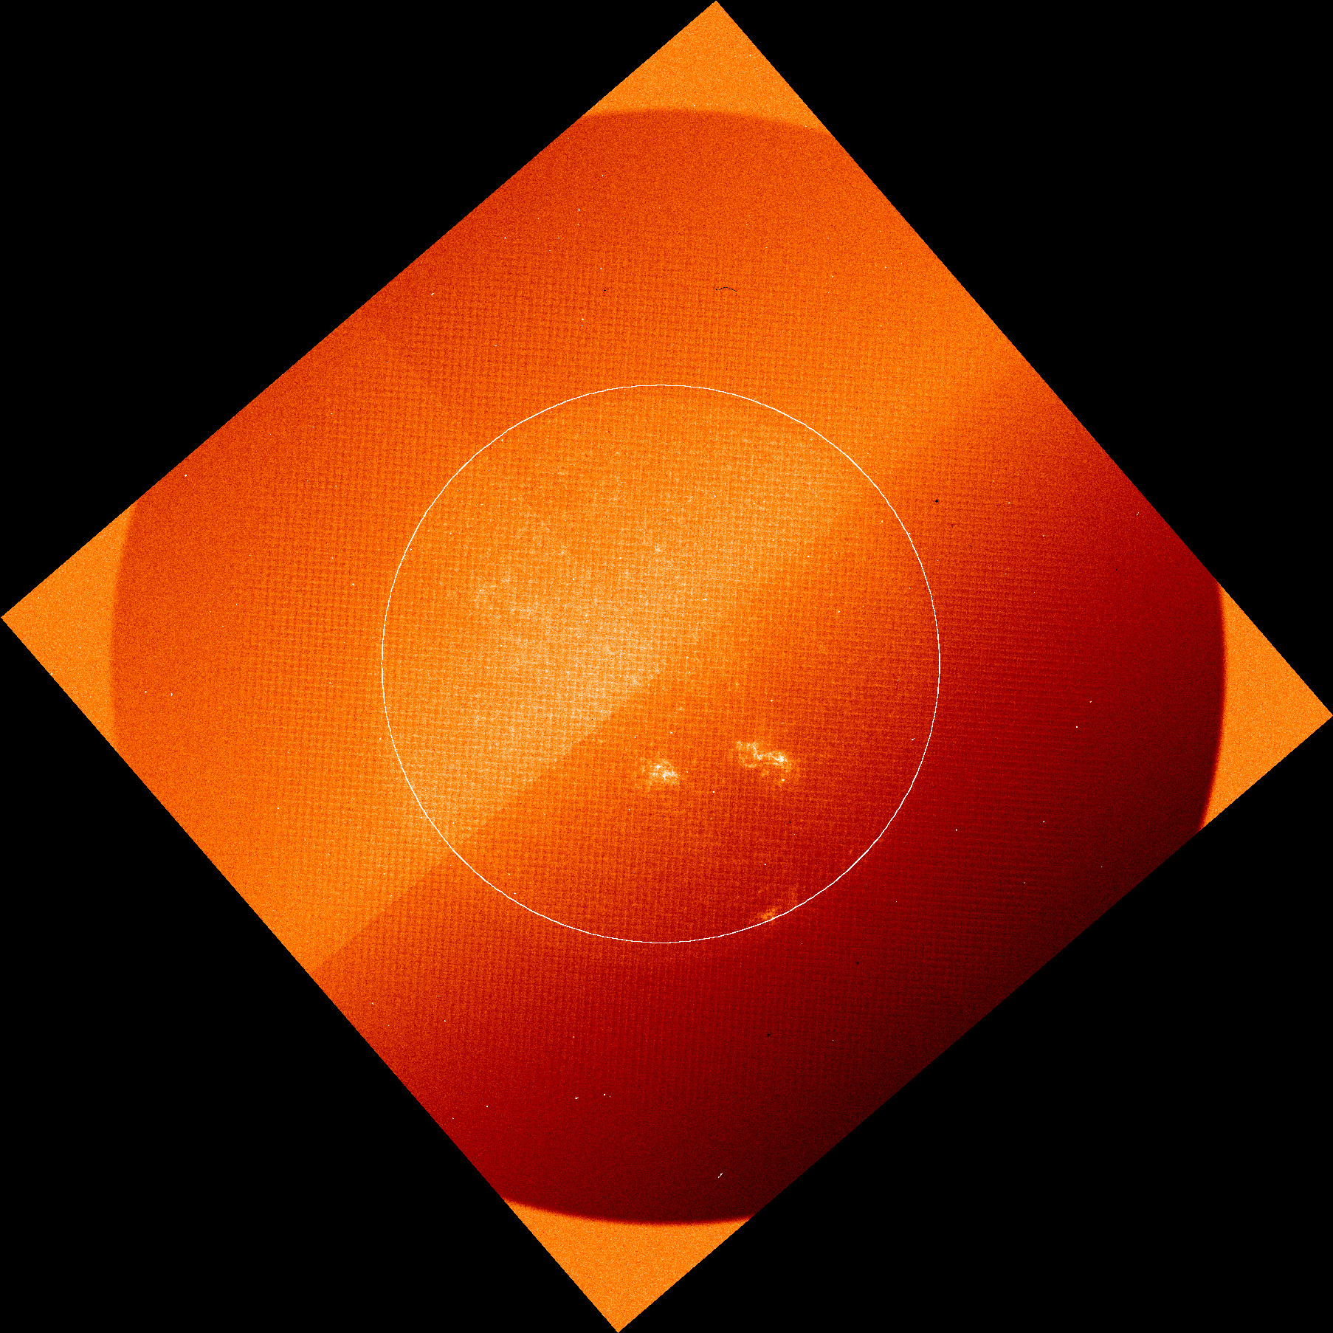
ADRs: 108, 306, 307, 308, & 309
ADR 306: Dark subtraction not performed
ADR 307: Images are mirror-image reversed
ADR 308: CRPIX (sun center location) not correctly calculated
ADR 108: PCi_j matrix elements incorrectly calculated
ADR 309: Images require despiking for radiometric accuracy
Unnumbered Issue: Placeholder flats in SUVI LUT contaminate images
N
Sample image from time of Beta PS-PVR

Slide 17
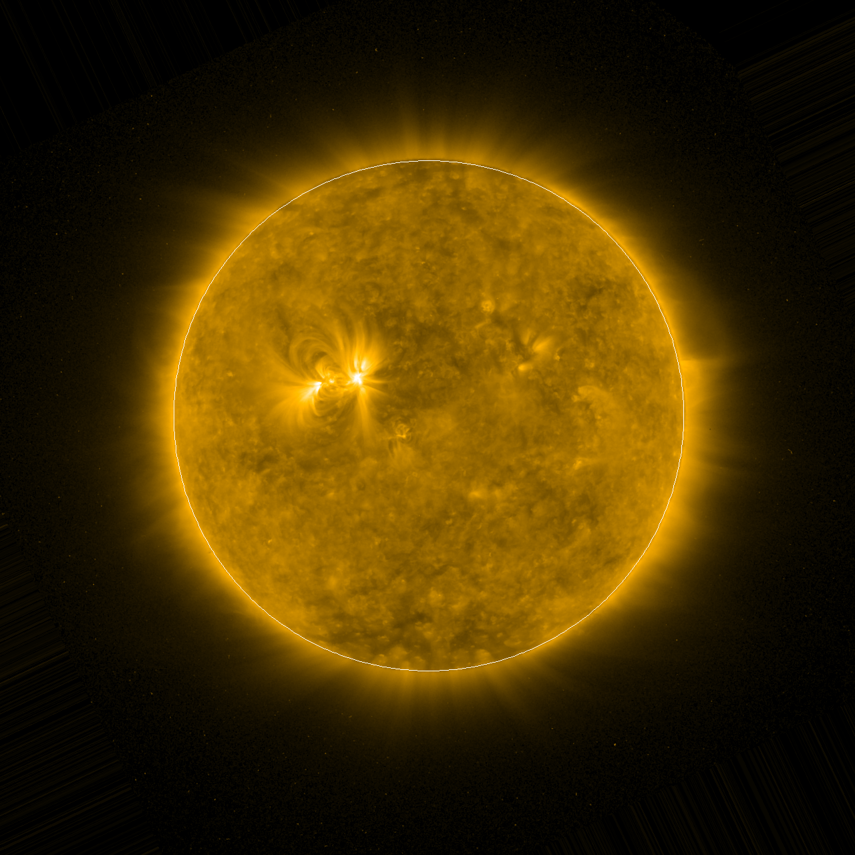
ADRs: 108, 306, 307, 308, & 309
ADR 306: Dark subtraction not performed
ADR 307: Images are mirror-image reversed
ADR 308: CRPIX (sun center location) not correctly calculated
ADR 108: PCi_j matrix elements incorrectly calculated
ADR 309: Images require despiking for radiometric accuracy
Unnumbered Issue: Placeholder flats in SUVI LUT contaminate images
N
Present-day GPA Image

Slide 18
Risks to Provisional Discovered after Beta PS-PVR
ADR | WR | Delivery | Description | Disposition
 |  |  | Calibration & Image Processing Issues
416 | 4609/ 5250 | PR.06.07.00 | Saturation Threshold calculated incorrectly (Error actually affected whole image calc.) | All radiometrics were incorrect as a the result of an typo in CDRL 080. Resolved.
418 | 4923 | PR.06.01.00 | Short exposure duration incorrectly calculated | Resolved.
587 | 5761 | PR.06.09.00 | SUVI LUT and Navigation Config update | Supported both calibration updates and fixes required for ADR 416, 662.
 |  |  | Navigation & Metadata Issues
584 | 5755 | PR.06.09.00 | CROTA (roll angle) 180° off | Resolved.
662 | — | PR.06.10.03 | CRPIX (sun center pixel) incorrectly calculated | Resolved.
18

Slide 19
ADR 416
Typo in CDRL 080 caused Quantum Efficiency to be multiplied into radiometric response (wrong) instead of divided (correct).
Error was discovered via validation of image saturation parameters, but affected all radiometric calculations.
Introduced error of 25–75% depending on channel into radiometric calculation.
Required code change & LUT/OMAS Config update to resolve.
Fix has been fully validated. See PLPT slides.

Slide 20
ADR 308, 662, 663
Sun-center location (CRPIX) was incorrectly calculated.
Fix required:
  Navigation config update to capture known guide telescope and pointing properties
  Code change to correct wrong sign and axes of guide telescope data in sun-center calculation
Possibility remains that calculation will fail in the event of a yaw flip or CCD amplifier change (see ADR 663).

Slide 21
Product Quality Assessment

Slide 22
Assessment Overview
 | Beta Status | Provisional | Full
INR | Known Errors | Corrections Applied and Validated | No Change Foreseen
Radiometrics | Known Errors | Corrections Applied and Validated. Degradation Trends Identified. | Provided adjustments to sequencing and contamination corrections are made
Usability | Known Errors and Incompatibilities | Some Corrections. Known Incompatibilities | Provided current metadata ADRs are completed

Slide 23
Post-Launch Product Tests Presented for Provisional
Test ID | Test Title | Operator | Maturity | Status
PLPT-SUV-001 | SUVI Trending – CCD Temperature | NCEI | Prov. | Active
PLPT-SUV-003 | SUVI-AIA Intercalibration | NCEI | Prov. | Active
PLPT-SUV-006 | SUVI-EXIS Intercalibration | NCEI | Full | Active
All test plans and procedures are given in the SUVI Readiness, Implementation, and Management Plan (RIMP v1.1; 416-R-RIMP-0319)
Notes:
PLPTs do not provide resolution to GPA issues, are solely for long-term trending. Only 001 can be run before L1b calibration issues are stabilized.

Slide 24
Preliminary PLPT-SUVI-001: SUVI CCD Temperature Trending
Demonstrate the ability to extract and trending SUVI CCD Temperatures

Slide 25
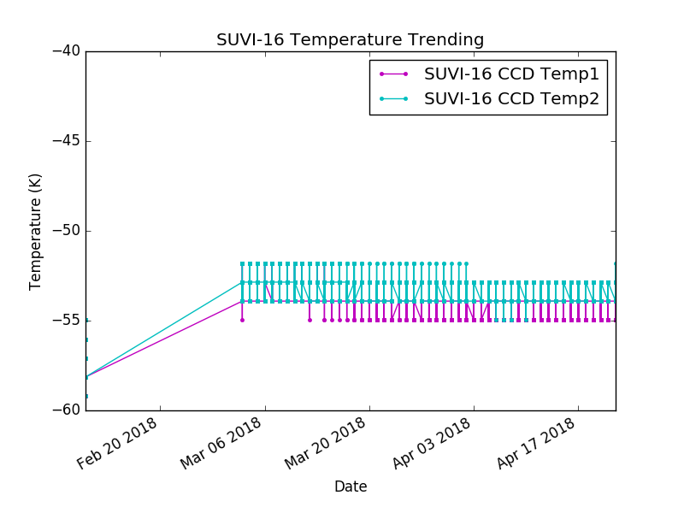
Preliminary PLPT-SUVI-001: SUVI CCD Temperature Trending

Slide 26
Preliminary PLPT-SUVI-003: SUVI-AIA Intercalibration
Full field performance comparison via AIA-to-SUVI transformation and ratio (assesses flat field, focus and point-spread-function, bad pixels, and other image artifacts).
Radiometric inter-comparison via SUVI/AIA ratio versus theoretical expectations based on SUVI/AIA spectral response functions.
To ensure sufficient signal-to-noise only on-disk pixels used for radiometric analysis.
Preliminary analysis uses L1b data from 2018 April 10. Radiometrics are good, CRPIX corrected by hand.

Slide 27
Preliminary PLPT-SUVI-003: SUVI-AIA Intercalibration
SUVI-AIA ratio expectations using SUVI pre-flight response functions (Thin/Open) filters and latest AIA response functions from December 2017.
Input spectrum is EVE/MEGS-A average from August 2011.
Passband | SUVI/AIA Ratio |  | Passband | SUVI/AIA Ratio
94 Å | 1.1765 |  | 195 Å | 1.0602
131 Å | 1.2545 |  | 284 Å | –
171 Å | 1.2264 |  | 304 Å | 1.1325

Slide 28
Preliminary PLPT-SUVI-003: SUVI-AIA Intercalibration
AIA degradation tracked via direct and proxy measurements: EVE/MEGS-A, EVE Sounding Rocket, Flare Irradiance Spectral Model (FISM).

Slide 29
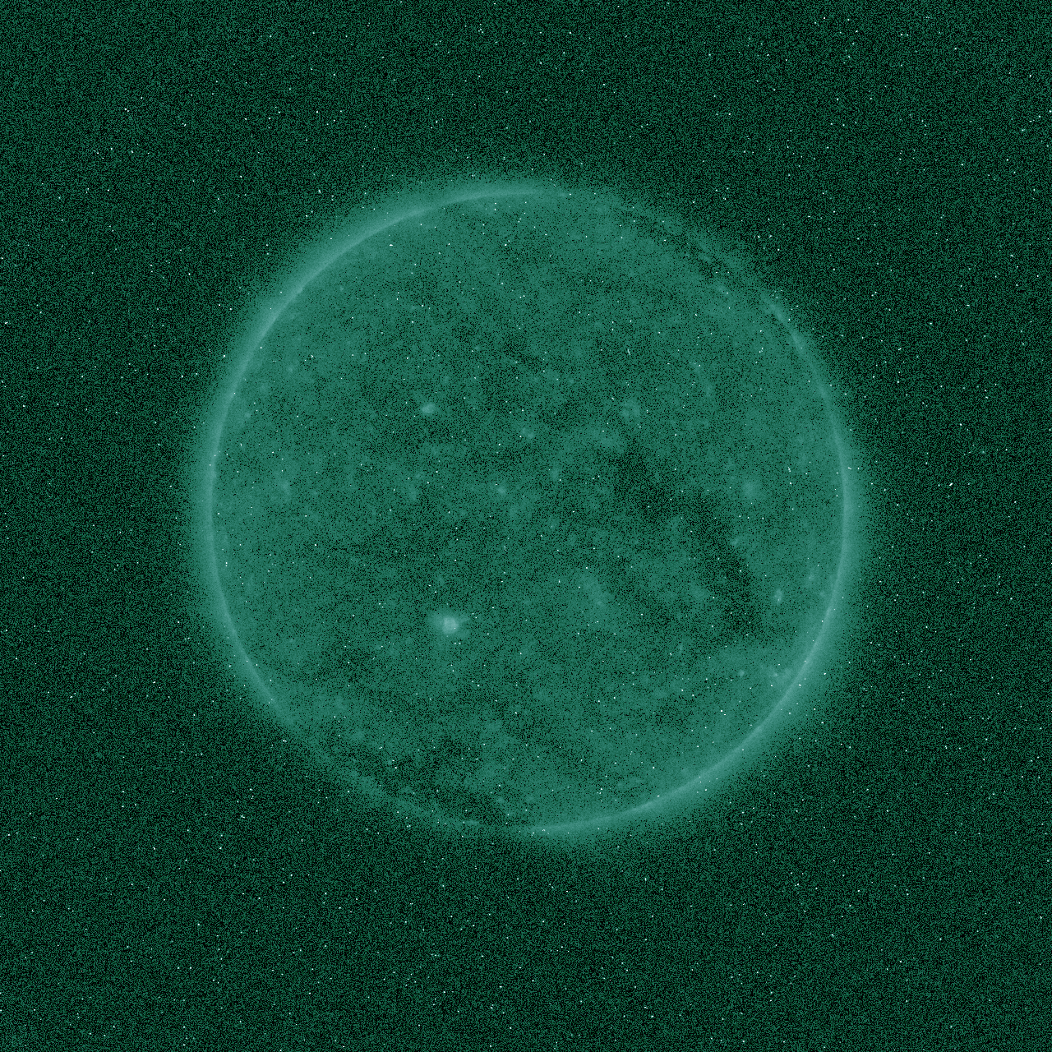
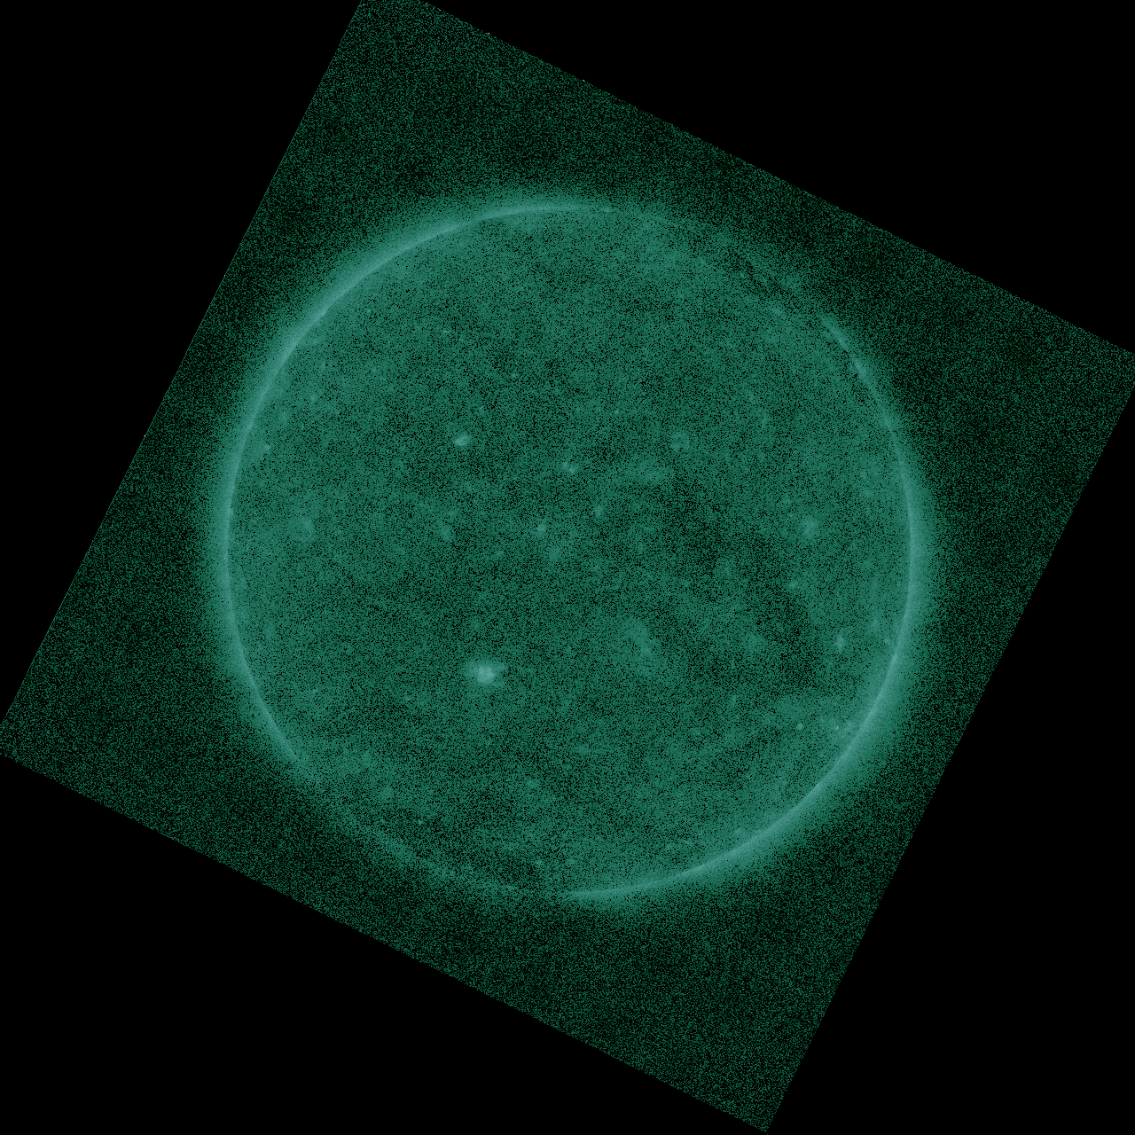
Preliminary PLPT-SUVI-003: SUVI-AIA Intercalibration
SUVI L1b 94 Å
AIA 94 Å

Slide 30
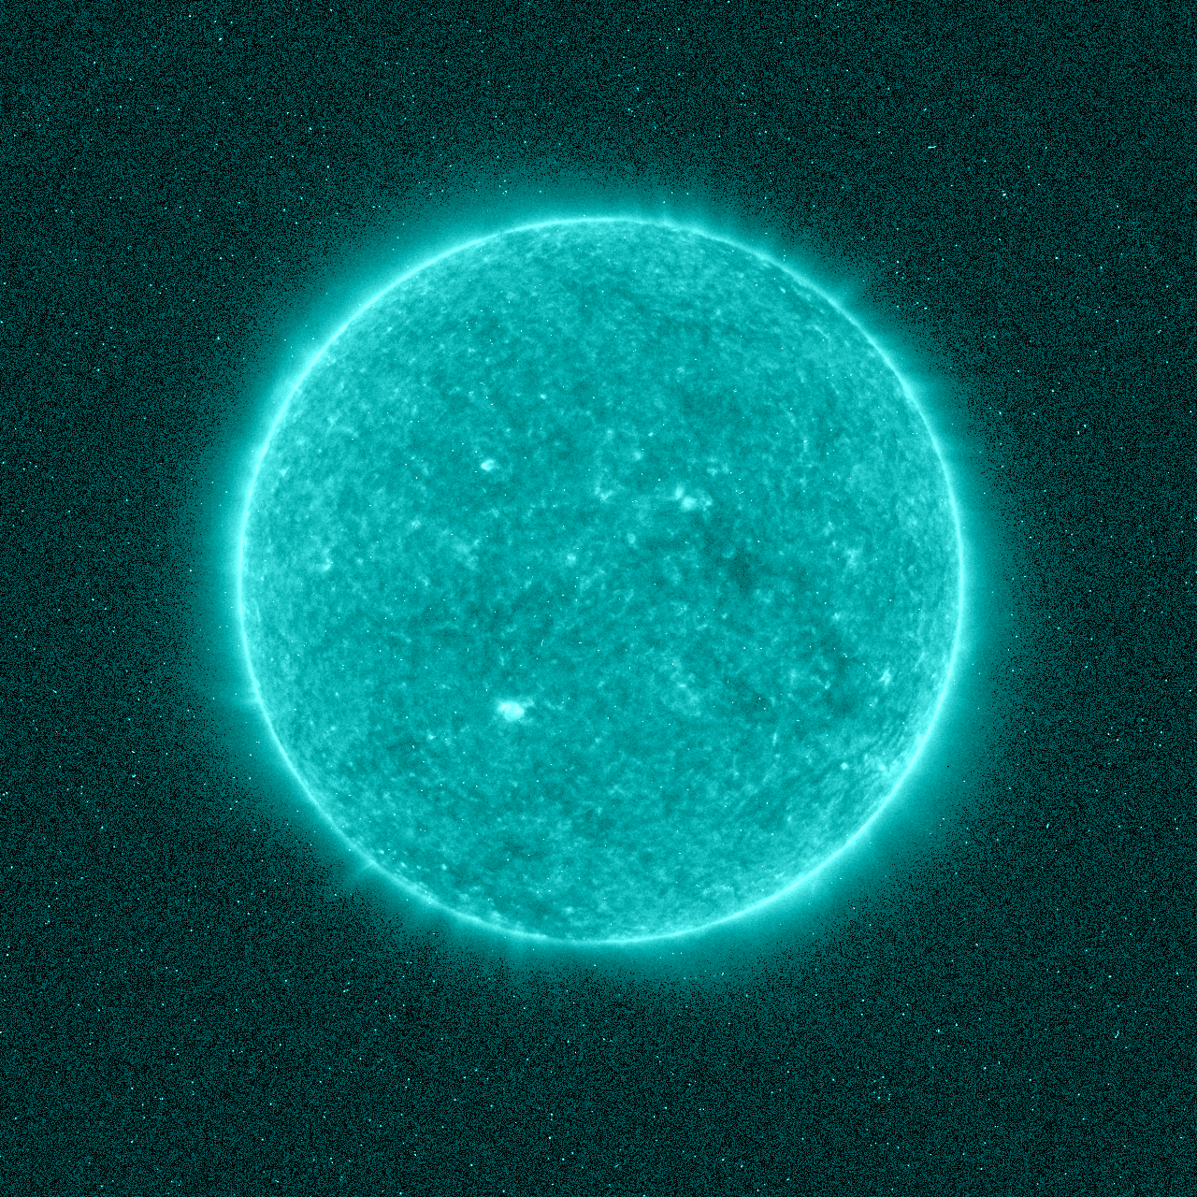
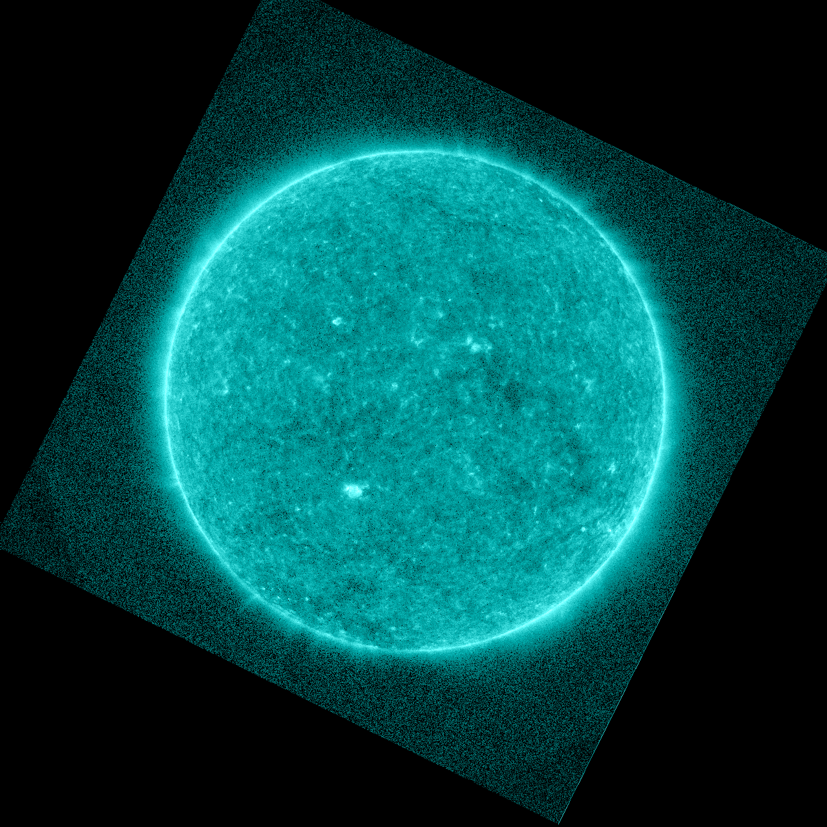
Preliminary PLPT-SUVI-003: SUVI-AIA Intercalibration
SUVI L1b 131 Å
AIA 131 Å

Slide 31
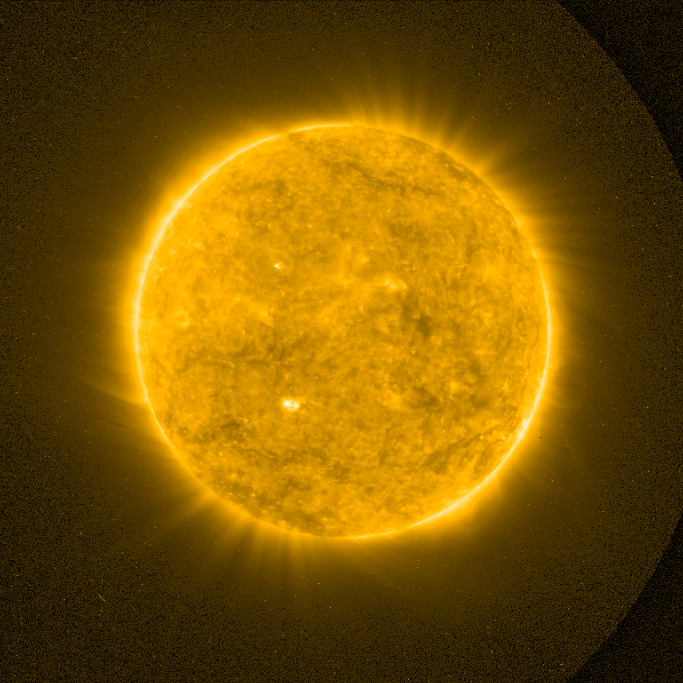
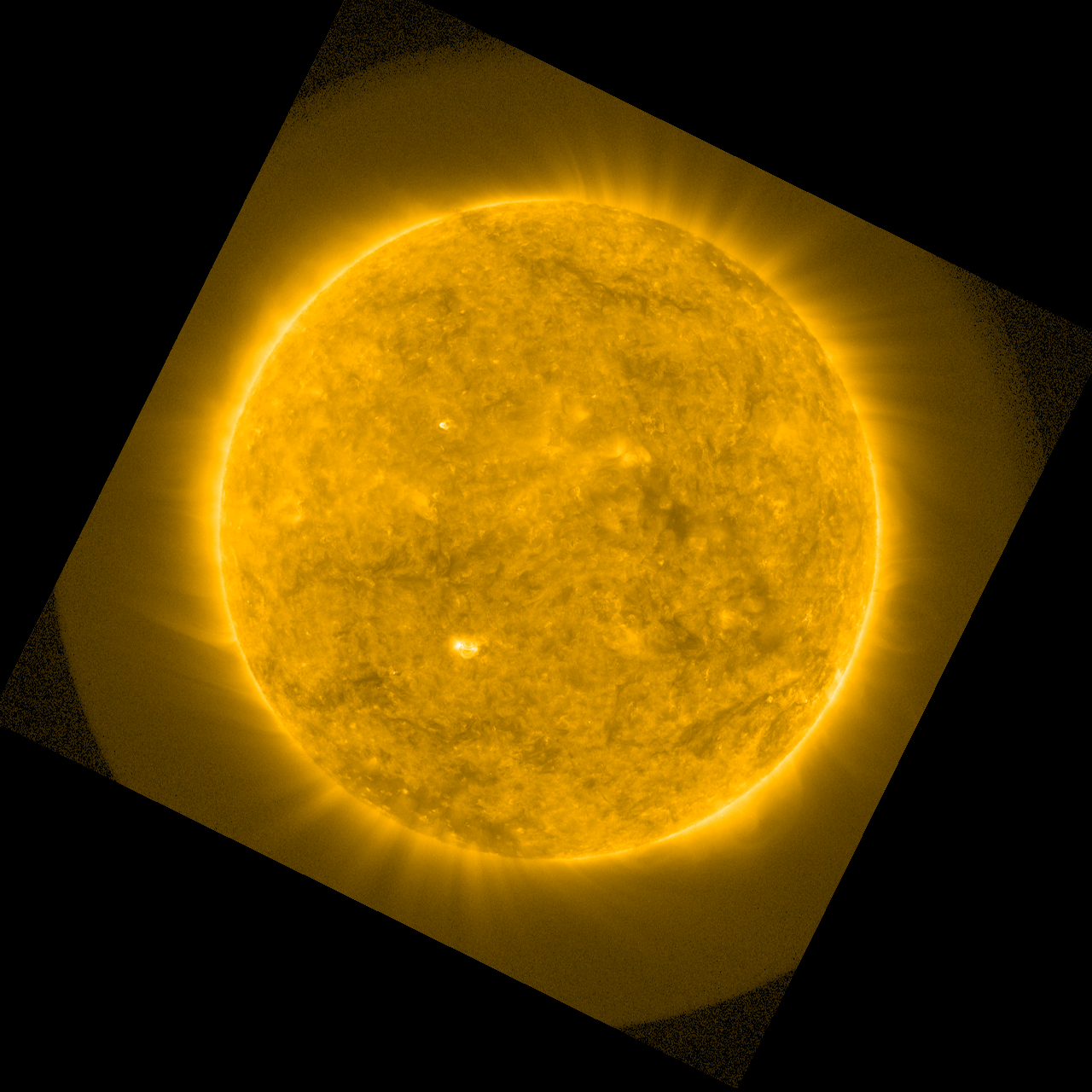
Preliminary PLPT-SUVI-003: SUVI-AIA Intercalibration
SUVI L1b 171 Å
AIA 171 Å

Slide 32
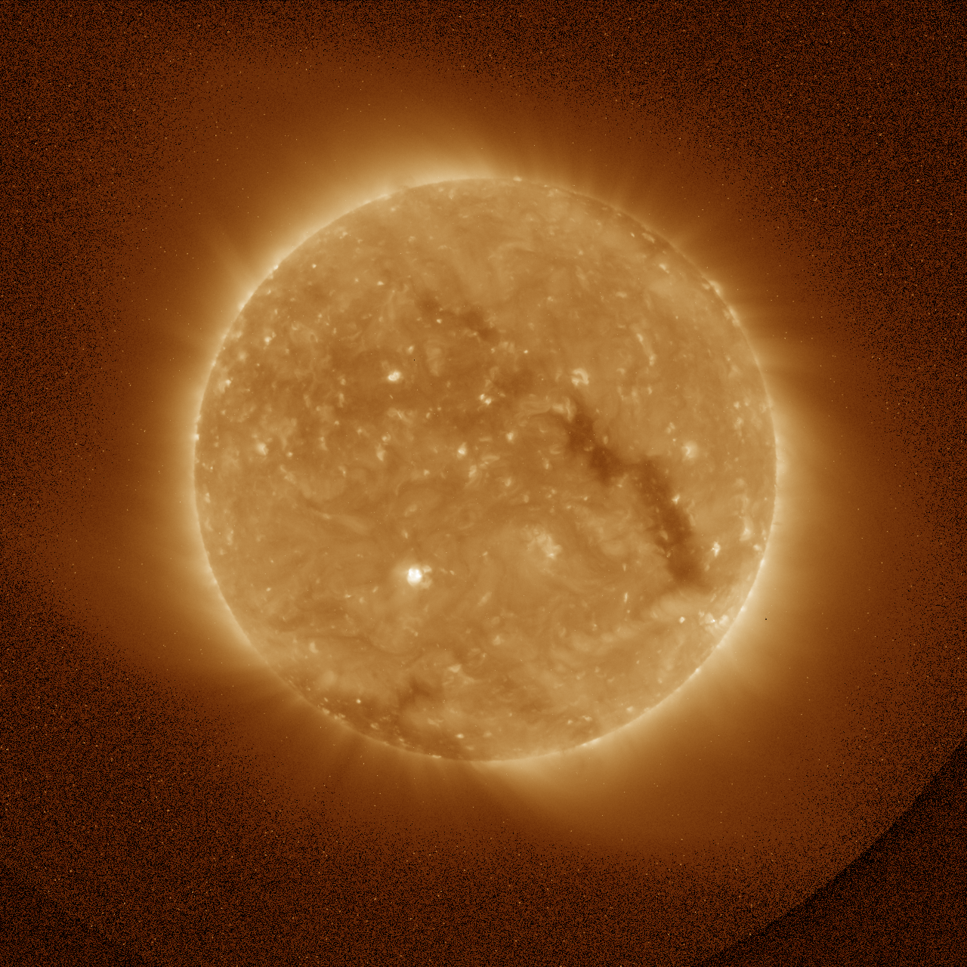
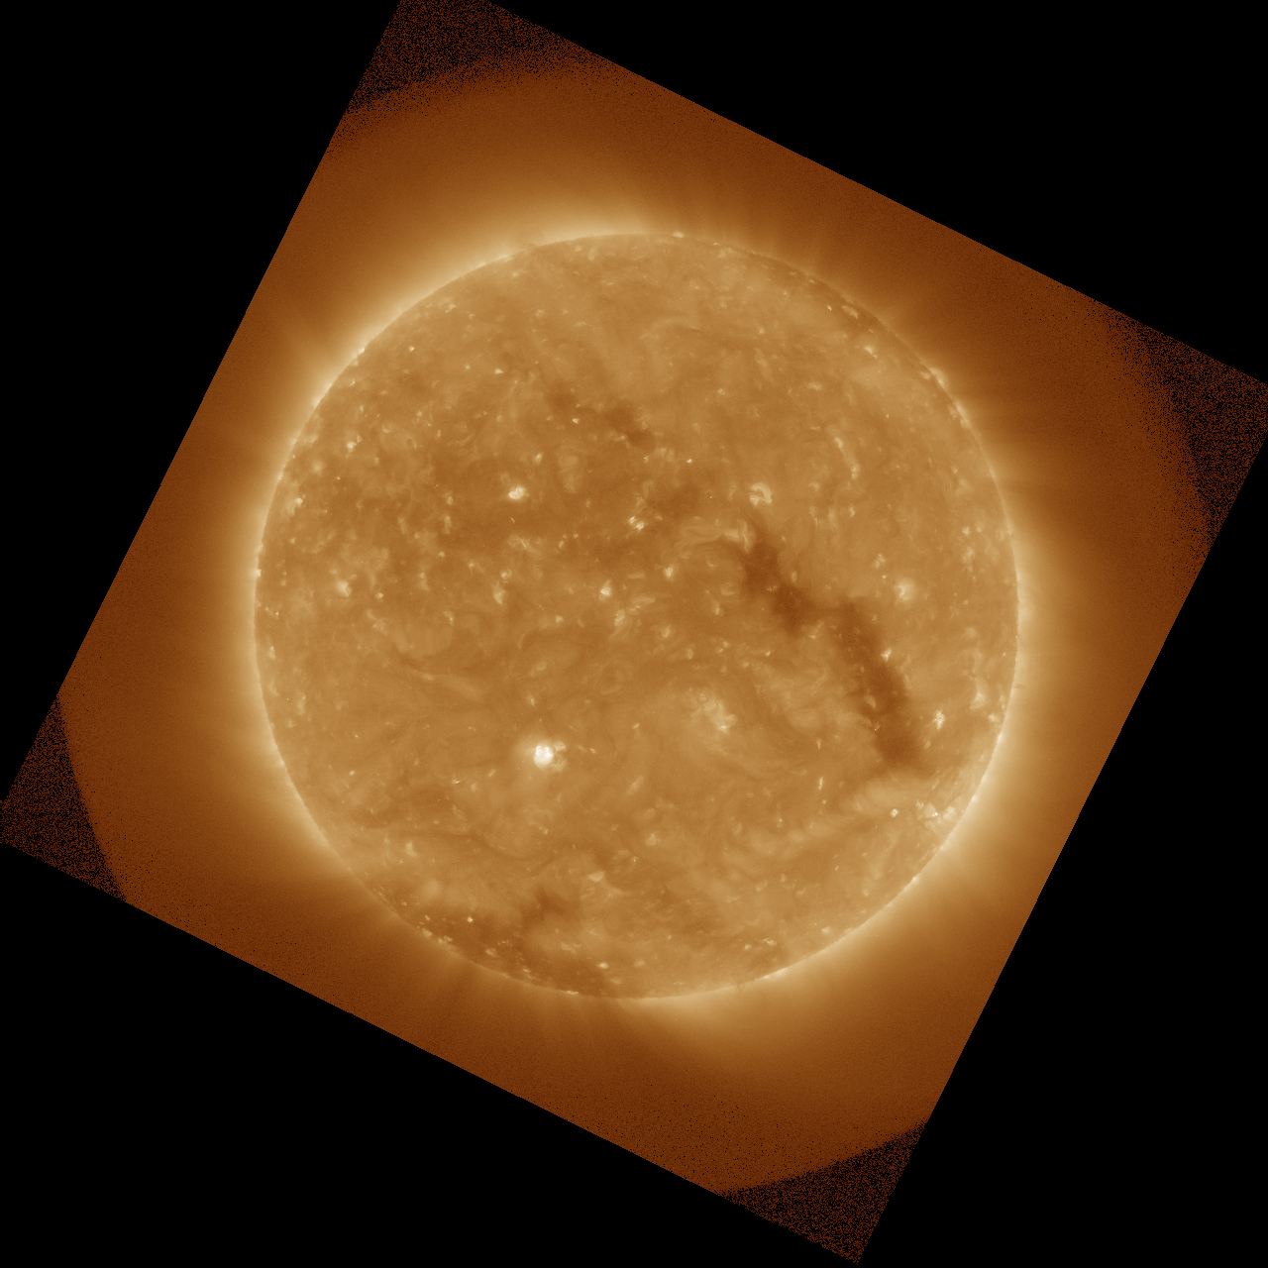
Preliminary PLPT-SUVI-003: SUVI-AIA Intercalibration
SUVI L1b 195 Å
AIA 195 Å

Slide 33
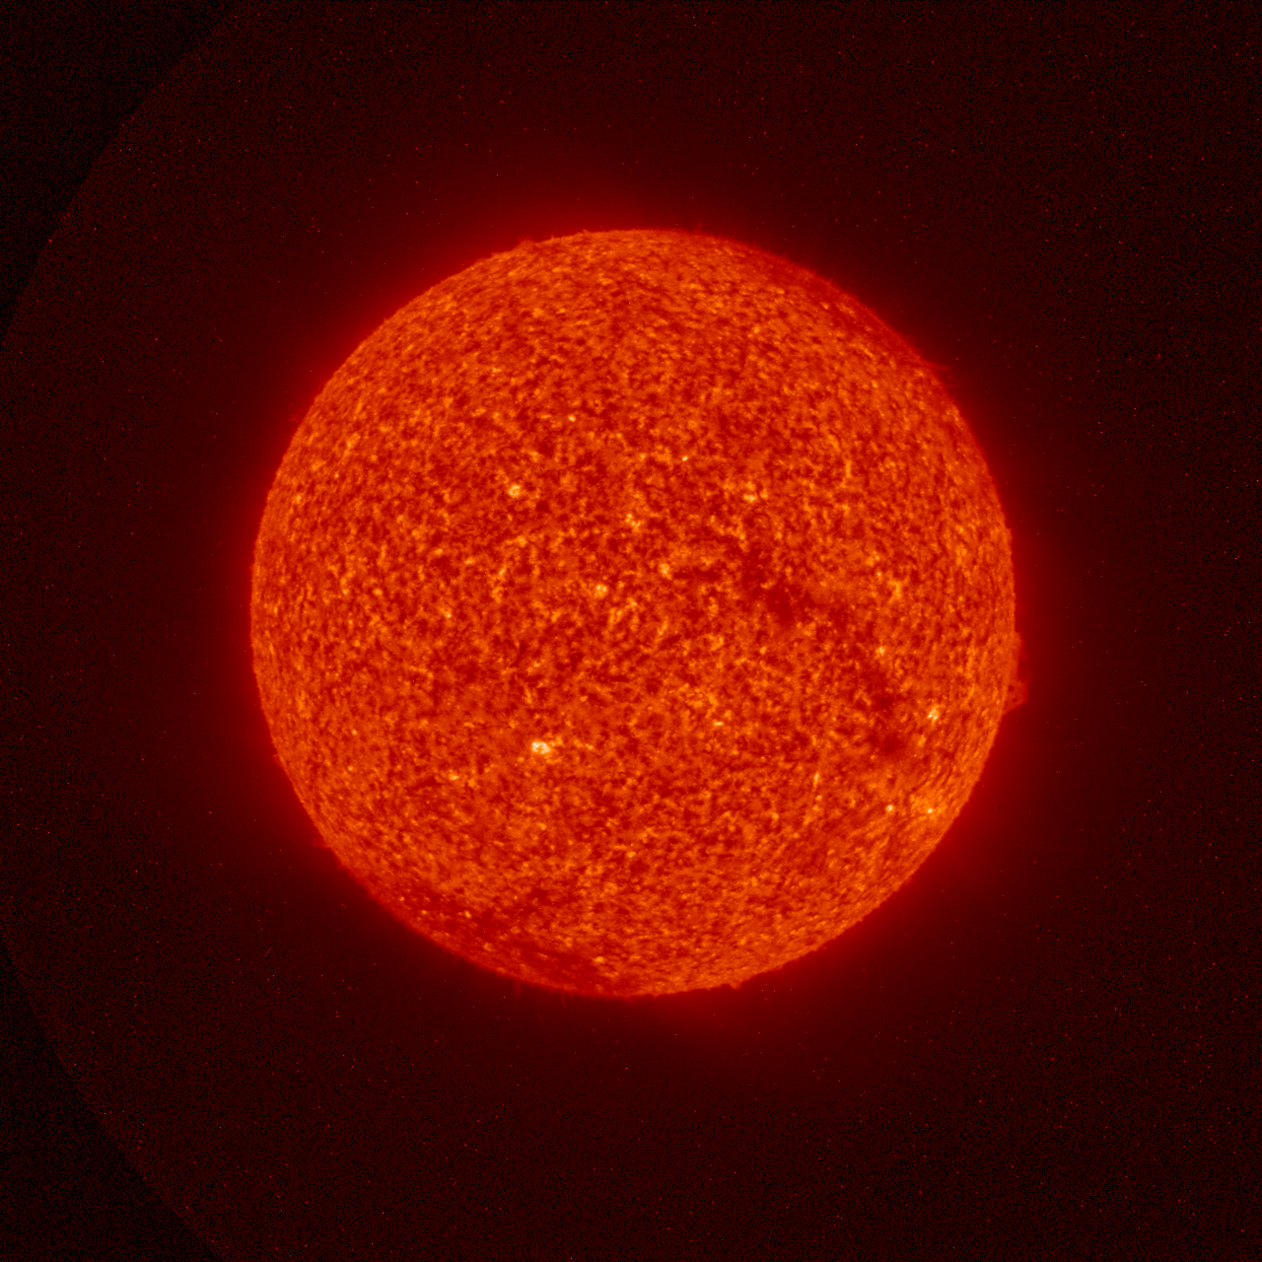
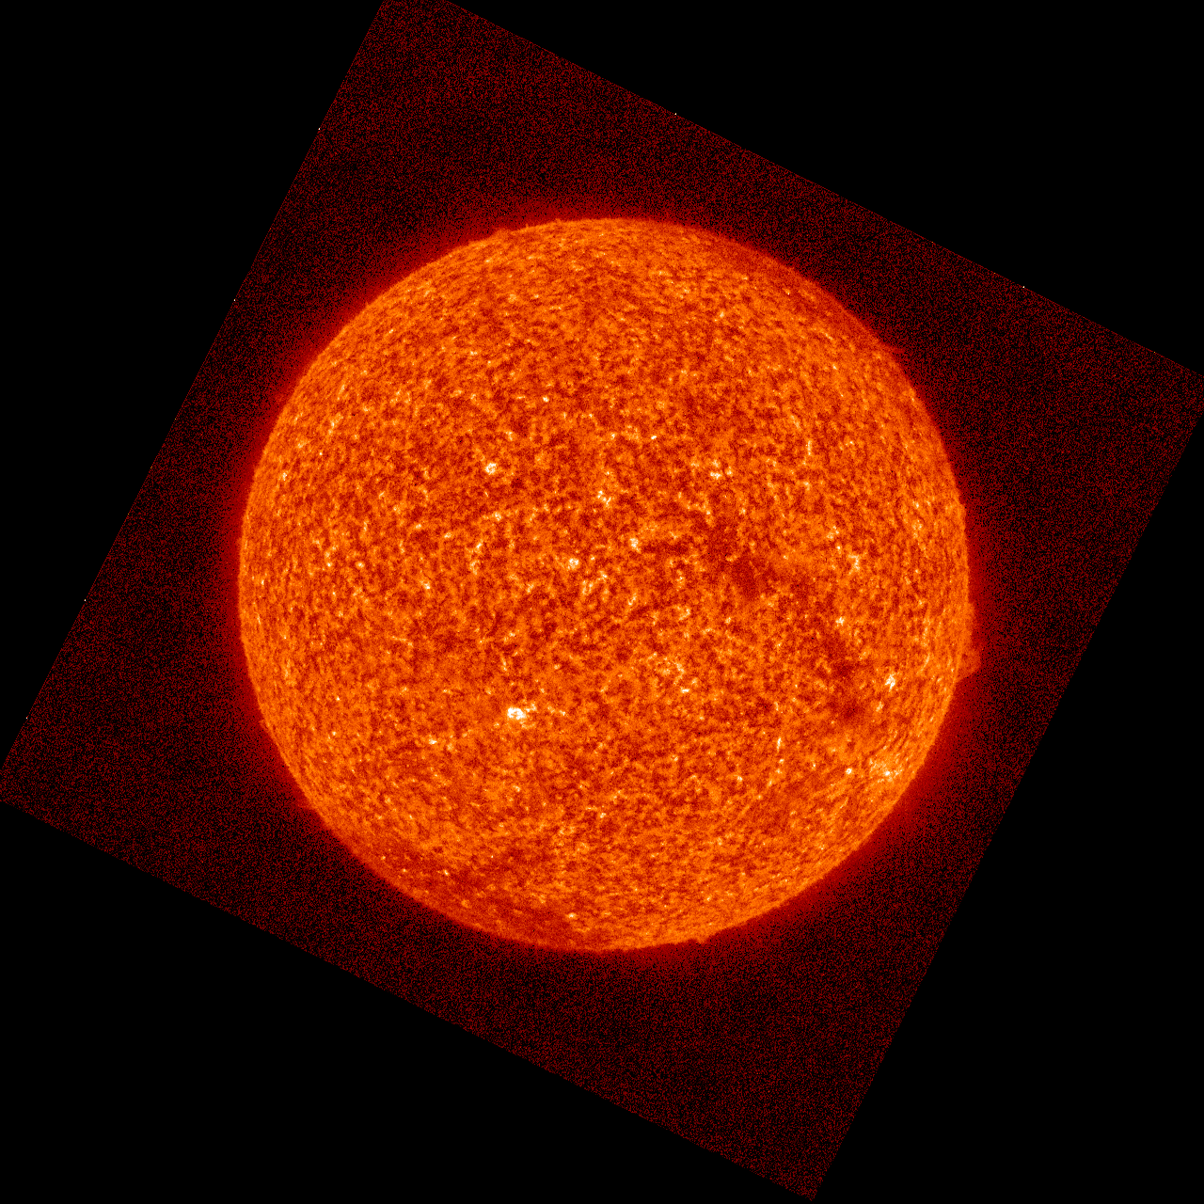
Preliminary PLPT-SUVI-003: SUVI-AIA Intercalibration
SUVI L1b 304 Å
AIA 304 Å

Slide 34
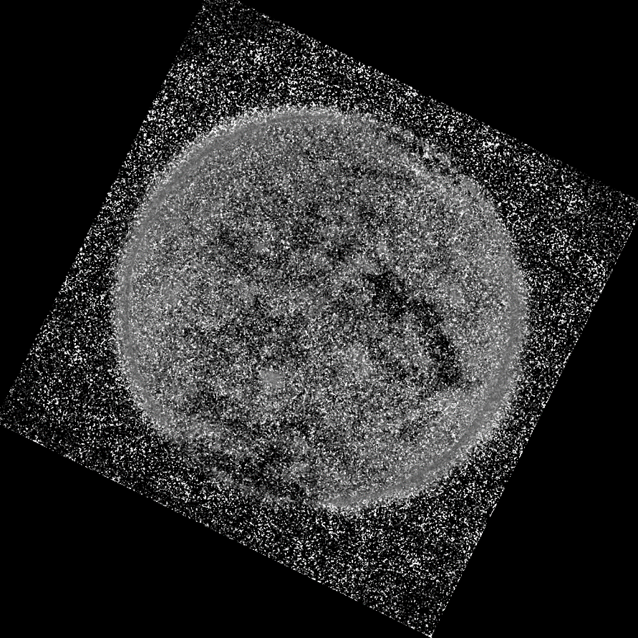
Preliminary PLPT-SUVI-003: SUVI-AIA Intercalibration
Expected 94 Å ratio: 1.1765

Slide 35
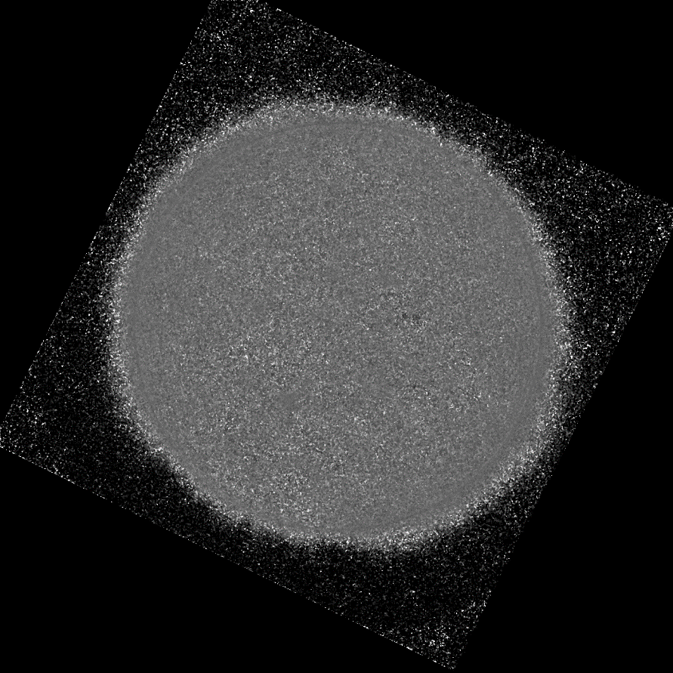
Preliminary PLPT-SUVI-003: SUVI-AIA Intercalibration
Expected 131 Å ratio: 1.2545

Slide 36
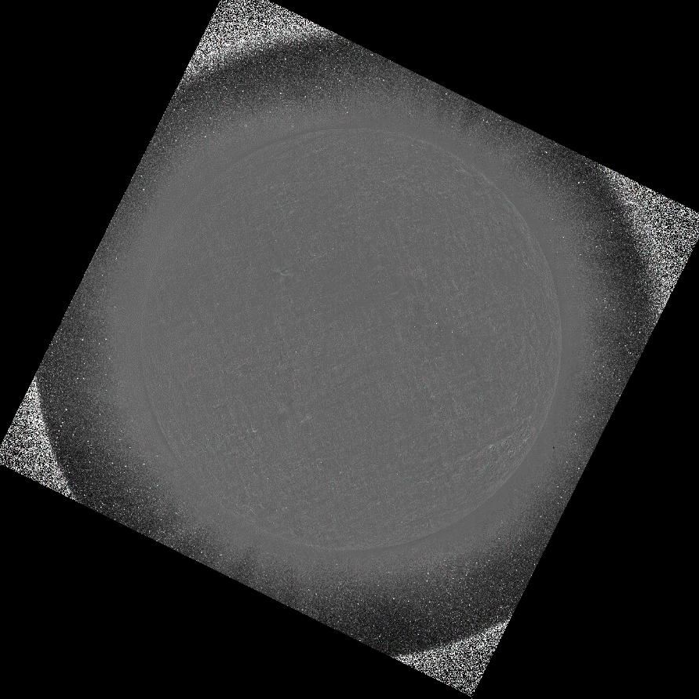
Preliminary PLPT-SUVI-003: SUVI-AIA Intercalibration
13010968
Expected 171 Å ratio: 1.2264

Slide 37
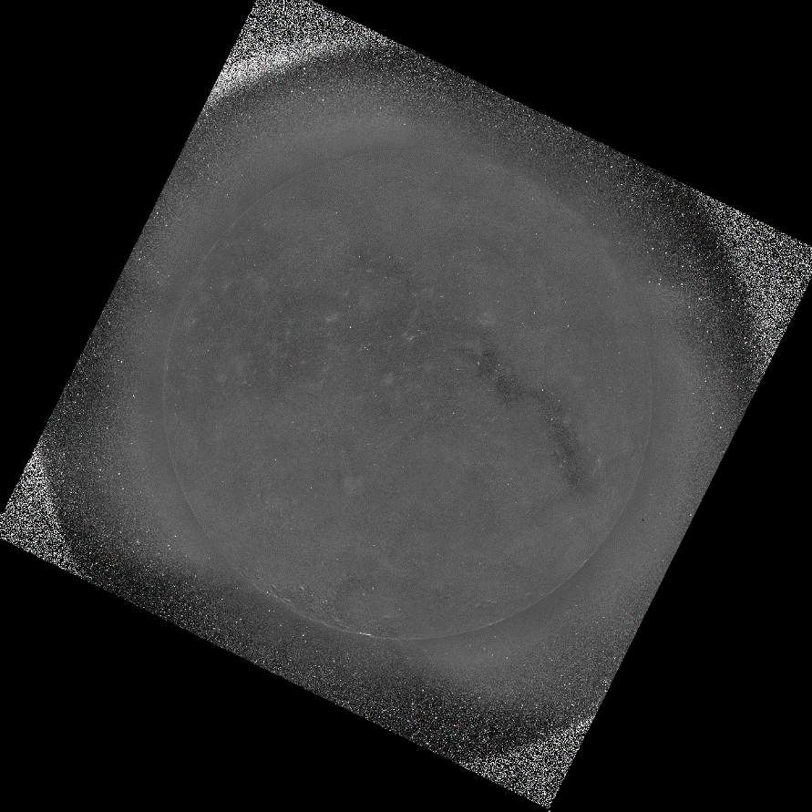
Preliminary PLPT-SUVI-003: SUVI-AIA Intercalibration
Expected 195 Å ratio: 1.0602

Slide 38
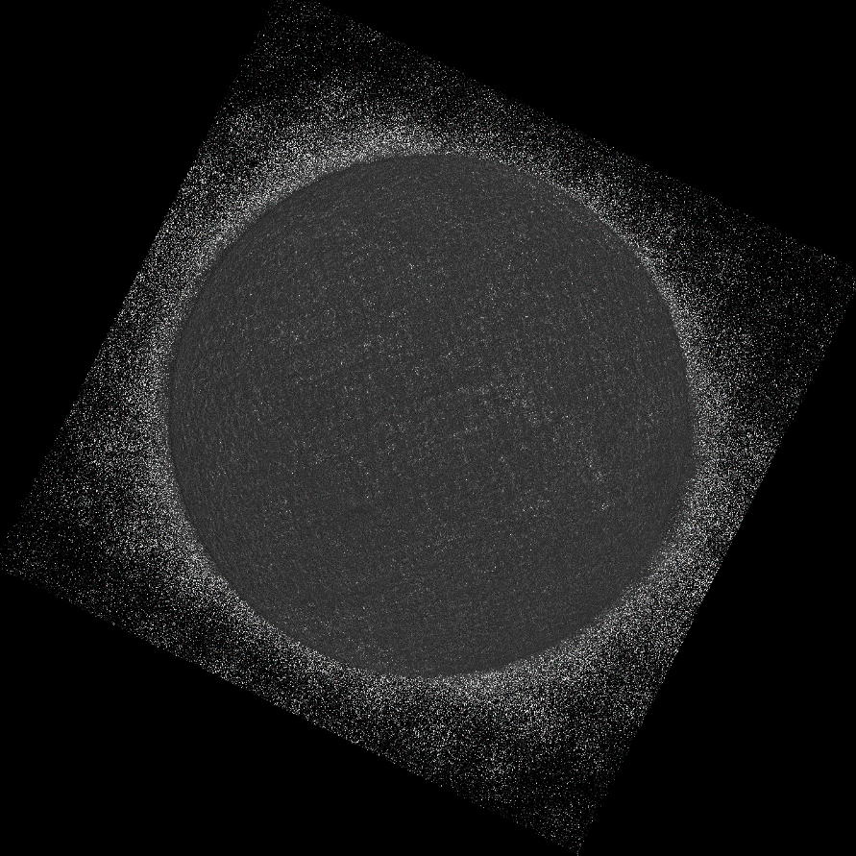
Preliminary PLPT-SUVI-003: SUVI-AIA Intercalibration
Expected 304 Å ratio: 1.1325

Slide 39
Preliminary PLPT-SUVI-003: SUVI-AIA Intercalibration
2017 April 1: 0.92
2017 November 1: 0.76
Expected 304 Å ratio: 1.1325

Slide 40
Preliminary PLPT-SUVI-003: SUVI-AIA Intercalibration
Summary: To the extent we can determine, SUVI looks to be in spec. The 304 Å channel shows possible degradation and requires a closer look.
Passband | SUVI/AIA Ratio Mean | SUVI/AIA Ratio Median | Theoretical Ratio
94 Å | 1.48 | 1.20 | 1.1765
131 Å | 1.21 | 1.20 | 1.2545
171 Å | 1.23 | 1.22 | 1.2264
195 Å | 1.06 | 1.06 | 1.0602
284 Å | — | — | —
304 Å | 0.68 | 0.60 | 1.1325

Slide 41
Preliminary PLPT-SUVI-006:
SUVI-EXIS Intercalibration
Straight ratio comparison of EXIS-EUVSA 284 and 304Å spectral irradiance measurements to SUVI 284 and 304Å channels.
GOES-16 EXIS products have not yet reached provisional maturity, and as of yet may not be suitable for this comparison
SUVI and EXIS are very different instruments, and work is needed to achieve an apples-to-apples comparison.
The ratios between SUVI and EXIS measurements are also the basis of the SUVI contamination correction.

Slide 42
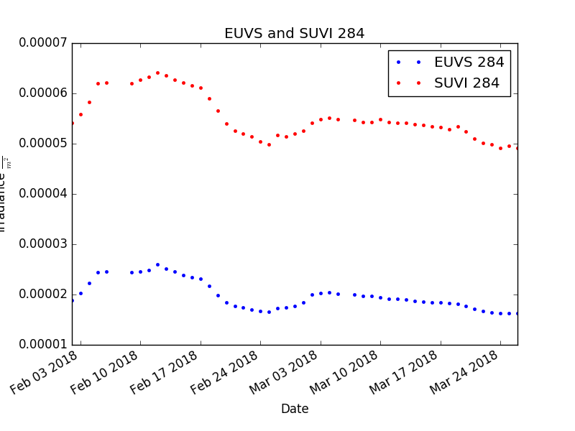
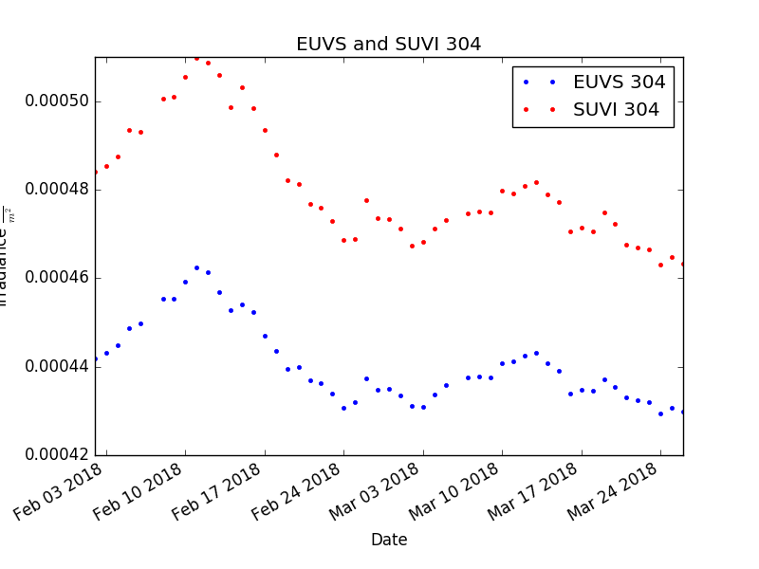
Preliminary PLPT-SUVI-006:
SUVI-EXIS Intercalibration
SUVI and EUVS measurements show similar trends.
Due to the broadband nature of the SUVI 284 and 304 channels, SUVI is measuring more than the discrete 284/304 lines.

Slide 43
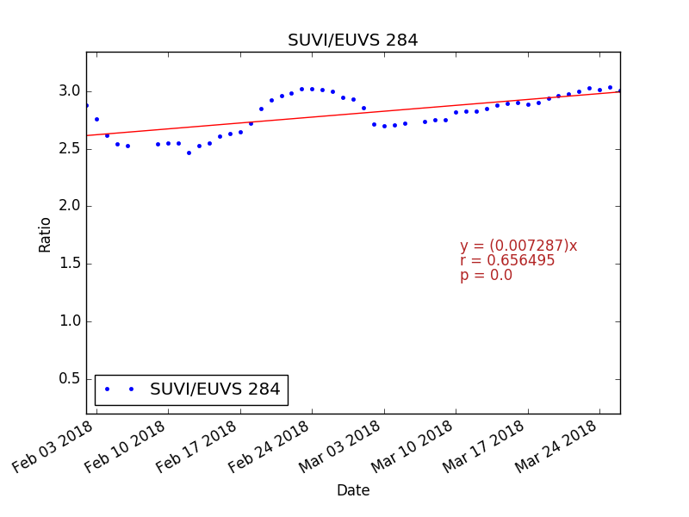
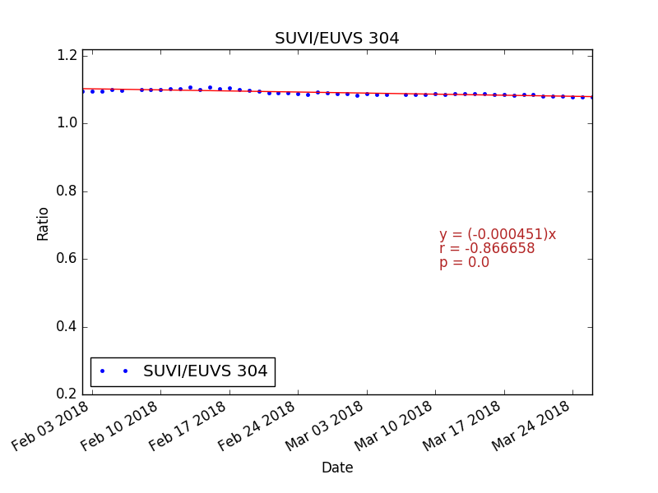
Preliminary PLPT-SUVI-006:
SUVI-EXIS Intercalibration
SUVI/EUVS 304 demonstrates a very consistent ratio.
SUVI/EUVS 284 does not. The SUVI 284 bandpass contains strong, off-peak “contaminant” emission lines.

Slide 44
Typical Solar Spectrum
He II
(Si XI)
Fe IX
Fe X
Fe XII
(Fe XXIV)
Fe XV
Fe X
(Fe XVIII)
Fe VIII
(Fe XXI)
Notes:
A typical spectrum with observed lines highlighted. Parentheses indicate lines that might be in the passband but are not present in this spectrum. Colors indicate approximate passband regions.

Slide 45
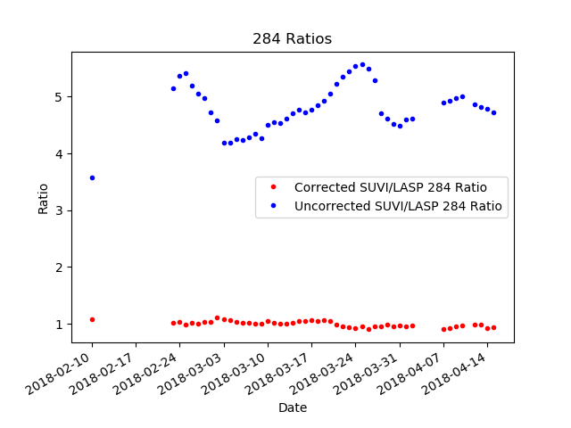
Preliminary PLPT-SUVI-006:
SUVI-EXIS Intercalibration
Correcting SUVI 284 using the EXIS 304 Irradiance measurements yields a promising result.

Slide 46
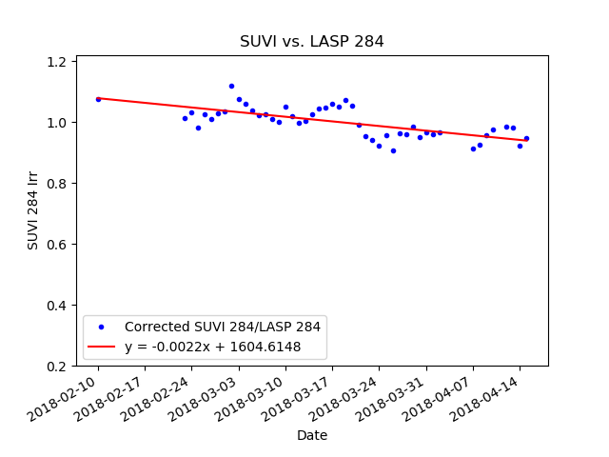
Preliminary PLPT-SUVI-006:
SUVI-EXIS Intercalibration
The SUVI/EUVS 284 ratio using the correction previously described still demonstrates a lot of variability.

Slide 47
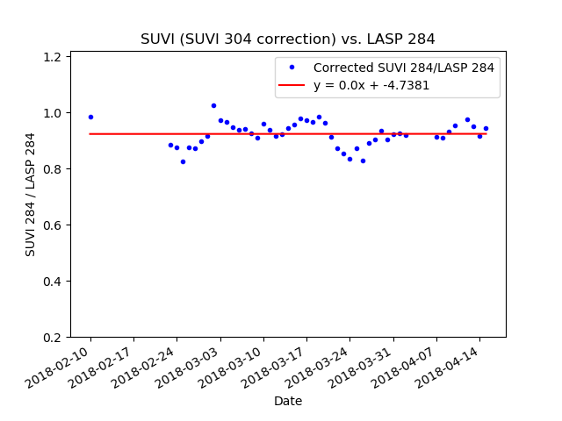
Preliminary PLPT-SUVI-006:
SUVI-EXIS Intercalibration
This result uses SUVI 284 corrected in a similar manner, but using the SUVI 304 measurements. Further investigation is warranted.

Slide 48
SUVI Performance Baseline Status
Assessment at Provisional
MRD ID | Description | Related PLPTs | Status
2045 | Pointing Accuracy | PLPT-SUV-003 | Validated
2046 | Product Pointing Knowledge | PLPT-SUV-003 | Validated
2052 | Long-term Stability (Product Measurement Precision in Radiance) | PLPT-SUV-003, PLPT-SUV-006 | Preliminary results. Ongoing investigation
MRD2045: Pointing Accuracy
  Requirements: ±3.0 arcmin (3 sigma) (N-S,E-W) of Sun Center;
  Stability during 60 seconds: ±2.0 arcsec (1 sigma), ±6.0 arcsec (3 sigma) (N-S, E-W)
MRD2046: Product Pointing Knowledge/Mapping Accuracy
  Requirements: ±2.5 arcsec
MRD2052: Long-term Stability (Product Measurement Precision in Radiance)
  Requirements: ±30%
  Absolute accuracy cannot be verified on-orbit

Slide 49
Product Maturity Assessment
Preparation Activities | Assessment
Validation activities are ongoing and the general research community is now encouraged to participate. | Validation activities are ongoing. Results have been discussed with SWPC. Release of data by NCEI will enable research community participation.
Severe algorithm anomalies and deficiencies are identified and under analysis. Solutions to anomalies are in development and testing. | A combination of corrections to the algorithm and LUT updates have resolved all Cal/INR critical ADRs excluding ADR309 (despiking)
Incremental product improvements may still be occurring. | Incremental product improvements are expected, primarily through updated LUTs incorporating results of cross-cal.

Slide 50
Product Maturity Assessment
End State | Assessment
Product performance has been demonstrated through analysis of a small number of independent measurements obtained from select locations, periods, and associated ground truth or field campaign efforts. | PLPTs discussed here demonstrate the product performance of the GOES-16 SUVI
Product analysis is sufficient to communicate product performance to users relative to expectations (Performance Baseline). | Yes.
Documentation of product performance exists that includes recommended remediation strategies for all anomalies and weaknesses. Any algorithm changes associated with severe anomalies have been documented, implemented, tested, and shared with the user community. | Key issues affecting usability by SWPC have been fixed. Fixes have been discussed extensively with SWPC and agreed to by them.
Testing has been fully documented. | This presentation, additional documentation to follow.
Product is ready for operational use and for use in comprehensive cal/val activities and product optimization. | NCEI: yes.

Slide 51
SUVI’s Path to Full Maturity
Critical ADRs, WRs, and risks to be resolved prior to Full Maturity.
PLPTs for Full Maturity
Comments on the status of the Performance Baseline

Slide 52
Risks and ADRs affecting Full
ADR | WR | Delivery | Description | Disposition
 |  |  | Calibration & Image Processing Issues
223 | 5696 | — | Persistent negative pixel | Should be resolved by LUT update and ADR 665.
309 | 4353 | — | Images require despiking for radiometric accuracy | Under discussion.
415 | 4921 | DO.07.00.00 | Contamination correction should not use short exposures | Obsolete by events.
417 | 5519 | — | Unnecessary camera gain interpolation | No major impact on product quality
588 | — | — | Image scale and offset need to be dynamic | No major impact to product quality, but would improve accuracy & compression.
664 | 5968 | — | Bad pixel table incorrectly oriented | Minor impact to product quality. Still in analysis.
665 | — | — | Bad pixel table requires update | Still in analysis.
666 | 5969 | — | Unexpected “blank” pixels in L1b | No major impact to product quality.
 |  |  | Navigation & Metadata Issues
225 | 5311 | DO.06.03.00 | Date fields missing on the first of every month in SUVI FITS products | Resolved. Can only be validated after the first new month after release of DO.06.03.00 to OE.
663 |  | — | Validate sun-center correction | Sun center calculation could yield incorrect results in the event of a change in instrument or spacecraft status.
52

Slide 53
Risks and ADRs affecting Full
ADR | WR | Delivery | Description | Disposition
 |  |  | Usability Issues
109 | 3012 | DO.08.00.00(?) | SUVI FITS Headers | In work.
311 | 4551 | DO.08.00.00 | Incomplete radiometric metadata | In work.
311 | 4551 | DO.08.00.00 | FITS metadata does not provide image units | In work.
313 | 4379 | — | CDRL 079/080 effective area discrepancy | Affects metadata and documentation, but not image radiometrics.
523 | 5512 | MM.07.00.00 | Eliminate SpWx dependency on APID 384 | No major impact to product quality
572 | 6605 | — | Remove LUT/OMAS interdependency | Required for calibration maintenance simplicity. No impact on product quality.
614 | 5924 | — | Add image serial number to metadata | Important for validation efforts, but no major impact to product quality
53

Slide 54
Post-Launch Product Tests for Full
Test ID | Test Title | Operator
PLPT-SUV-001 | SUVI Trending – CCD Temperature | NCEI
PLPT-SUV-002 | SUVI Trending – Detector Performance | NCEI
PLPT-SUV-003 | SUVI-AIA Intercalibration | NCEI
PLPT-SUV-004 | SUVI-EVE Intercalibration | NCEI
PLPT-SUV-005 | SUVI-EUVS Intercalibration | NCEI
PLPT-SUV-006 | SUVI-EXIS Intercalibration | NCEI
PLPT-SUV-007 | SUVI-EVE Underflight Intercalibration | NCEI

Slide 55
Ongoing PLPTs from Provisional
PLPT-SUV-001 (SUVI Trending – CCD Temperatures)
PLPT-SUV-002 (SUVI Trending – Detector Performance)
  If LTC cal is re-run
PLPT-SUV-003 (SUVI-AIA Intercalibration)
PLPT-SUV-006 (SUVI-EXIS Intercalibration)

Slide 56
Cancelled PLPTs:
PLPT-SUV-005
Would have established a trend between SUVI and GOES-NOP EUVS instruments.
GOES-NOP EUVS measurements will not persist beyond GOES-17 transition to GOES-West

Slide 57
SUVI-EVE Intercalibration
PLPT-SUV-004
Intercalibration with the EVE-ESP (Extreme Ultraviolet Spectrophotometer) instrument on-board NASA’s SDO satellite.
Trends similar to the SUVI-EUVS will be established
There is no perceived obstacle to this activity.

Slide 58
SUVI-EVE Underflight Calibration
PLPT-SUV-007 (New!)
There is a planned rocket underflight to track and update the calibration of the SDO instrumentation
There is a EUV spectrometer that covers the entire SUVI spectral range
Currently scheduled for June, 2018
Will allow for direct comparisons between instruments.
Imperative that GOES-16/17 SUVI & EXIS instruments be in normal operations during the rocket underflight

Slide 59
NCEI’s Recommendation
NCEI believes that the GOES-16 SUVI L1b product has reached the Provisional Maturity as defined by the GOES-R Program
  Caveat: The ADR225 fix cannot be verified until the 1st of the month after DO.06.03 is installed in the OE (currently mid-June, 2018)
  Consequence: SUVI L1b FITS data will be unusable on the 1st of every month until fix is deployed

Slide 60
SWPC Speaks…
Dr. Steven Hill, SWPC
NCEI team:
  Has really performed and dug into issues.
  Those issues have been communicated in a timely and effective way.
  SWPC perspectives have been included in all discussions on how to approach the issues.
SWPC concurs that the L1b products meet the criteria for provisional status.
  Pointing and radiometrics look great
  Have established a plan for Full Maturity
  We're really looking forward to seeing this data produced continuously
  We're preparing to integrate the resulting L2+ it into our development
  That effort will begin in earnest in June.

Slide 61
Summary and Conclusion
All ADRs/WRs critical to Provisional Maturity have been resolved and validated
  ADR225 and ADR309 are exceptions but should not be considered obstacles
We would like to thank the instrument vendor, ground system vendor, and the PRO-PASS team for all the help to reach this milestone.
NCEI-CO and SWPC recommend the GOES-16 SUVI L1b product for Provisional Maturity

