Slide 1
GOES-16 and-17 AOD, ADP in AWIPS
NWS/OBS update to GOES-17 Provisional PS-PVR
June 27, 2019

Slide 2
Overview of Aerosol Products in AWIPS
GOES-17
Aerosol products in evaluation at limited set of NWS test and field/evaluation sites via the AWIPS Data Delivery (DD) access method (i.e., tailorable end-user subscription to PDA delivers product directly to requesting NWS field office)
Preparing for operational test and evaluation with AWIPS DD access/distribution
Products not yet available in AWIPS on a continuous operational basis via SBN (may follow later)
All required software for NWS distribution is already in place

Slide 3
Overview of Aerosol Products in AWIPS
GOES-16
          AOD: good quality pixels are displayed. We intend to evaluate inclusion/addition of medium- and low- quality retrievals
          ADP: low, medium, high confidence Dust and Smoke are displayed
NWS transmission of GOES-16 AOD, ADP via the SBN :
  Aerosol Optical Depth (F, C) flowing since May 31, 2017
  Aerosol Detection (F, C, M) flowing since May 31, 2017
  * (ABI Sectors): F = Full Disk, C = CONUS and M = Meso
AWIPS examples are in the following slides

Slide 4
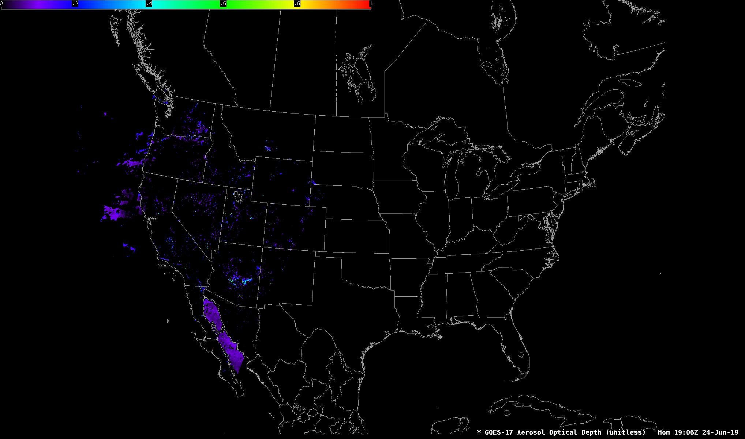
GOES-17 Aerosol Optical Depth (unitless) Mon 19:06Z 24-Jun-19

Slide 5
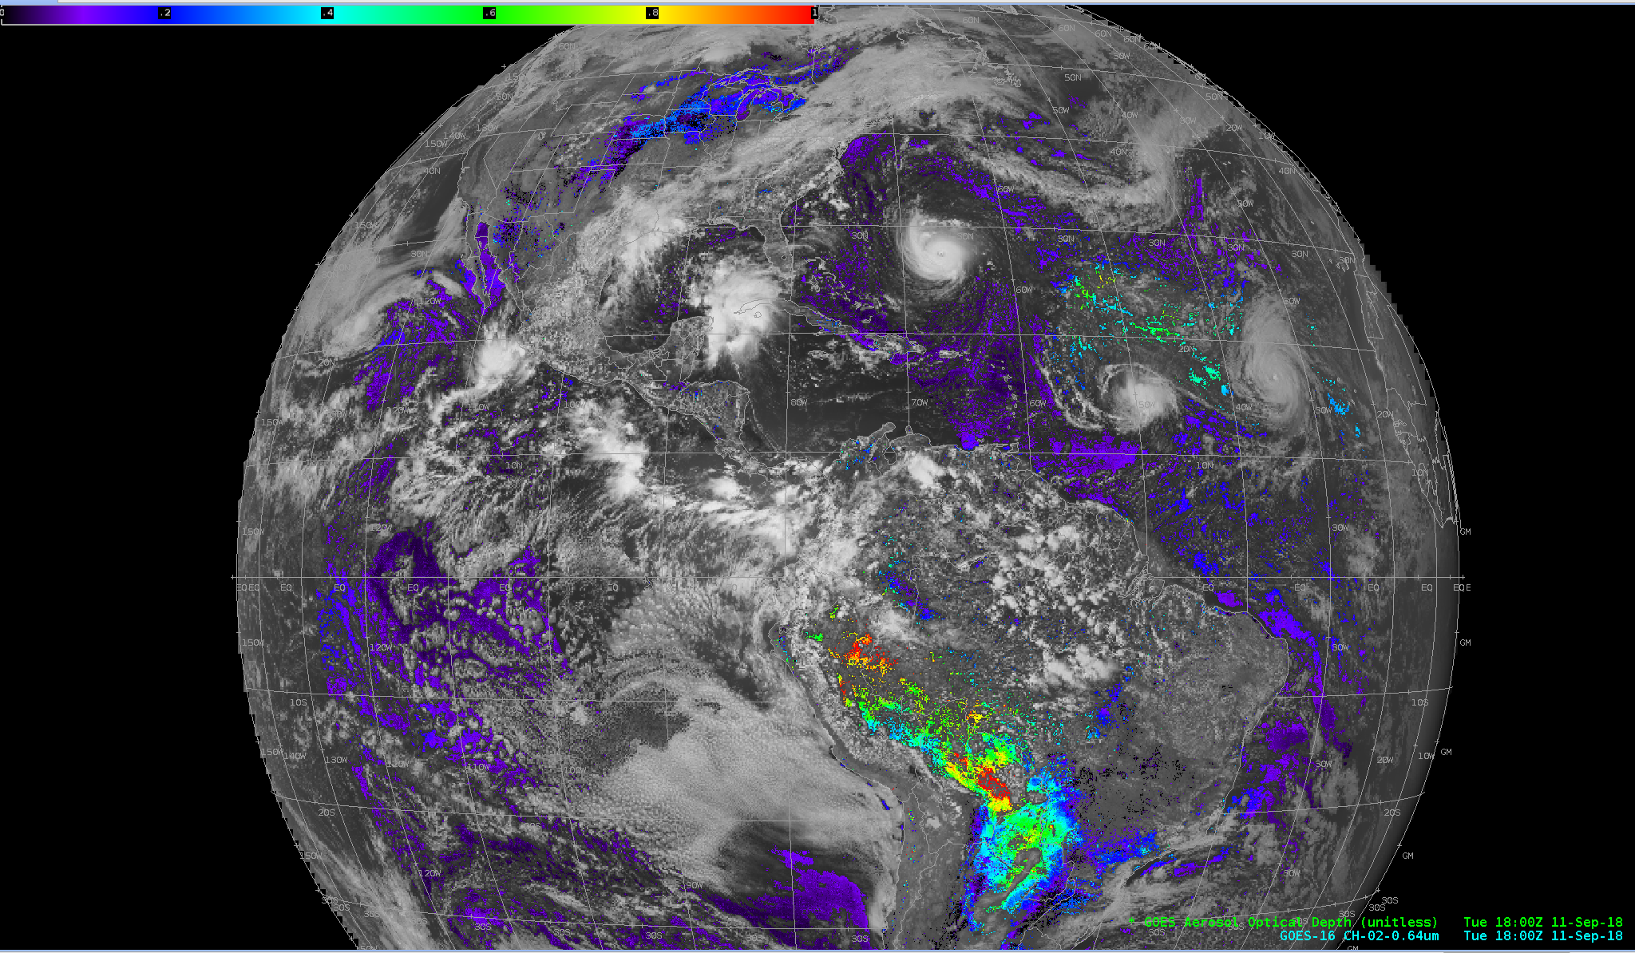
GOES-16 Aerosol Optical Depth, Full Disk

Slide 6
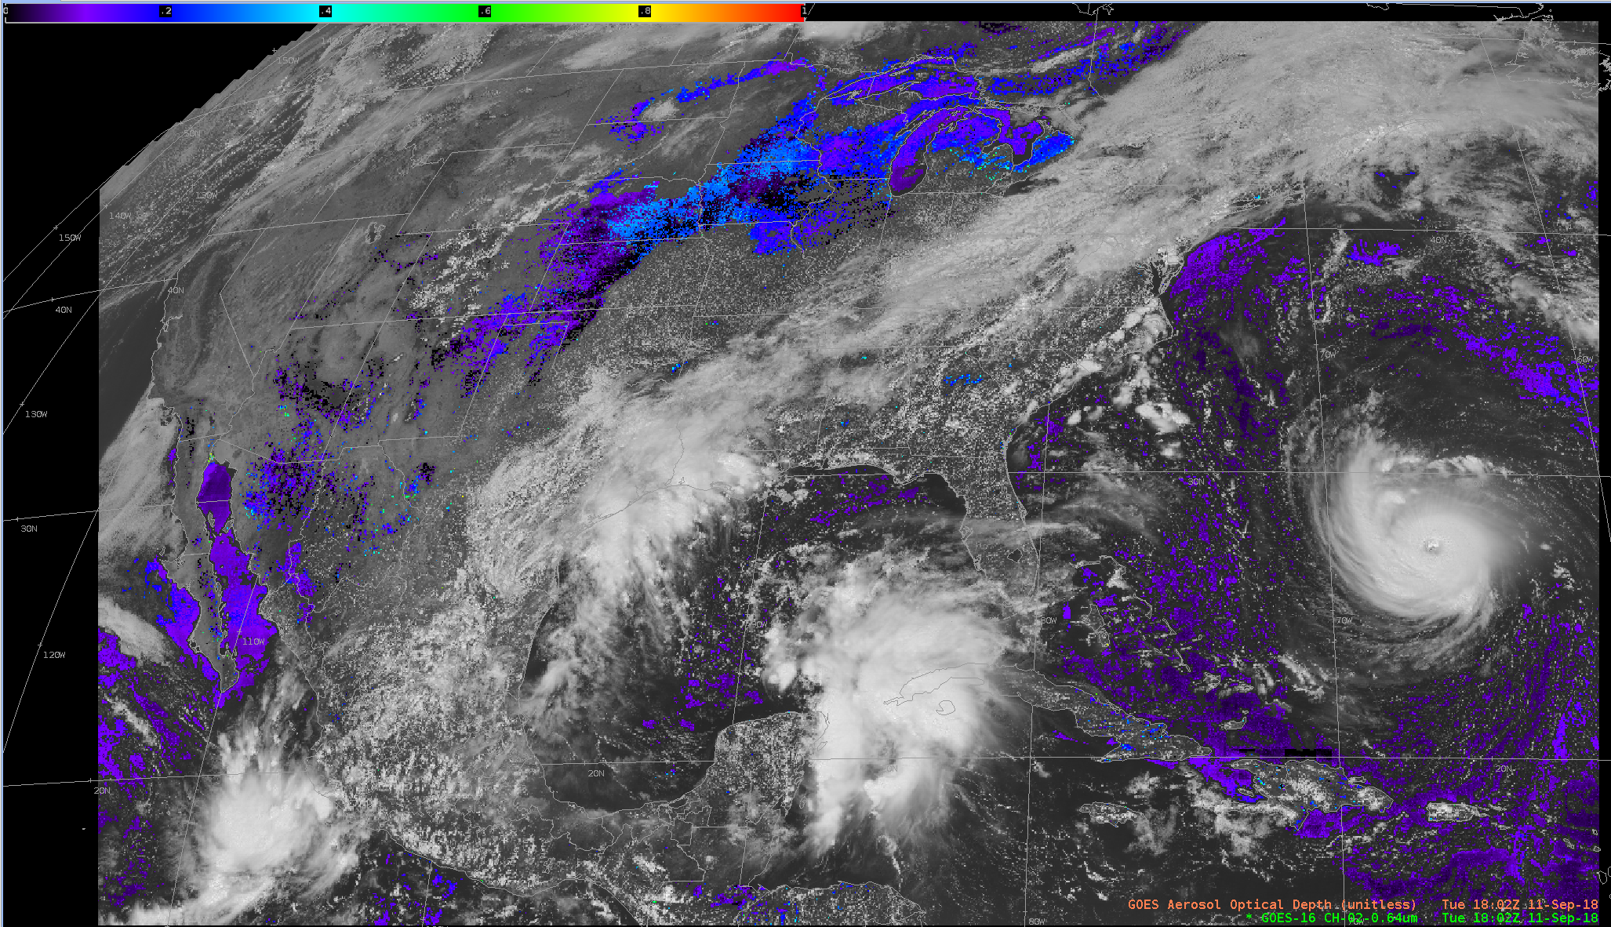
GOES-16 Aerosol Optical Depth, CONUS

Slide 7
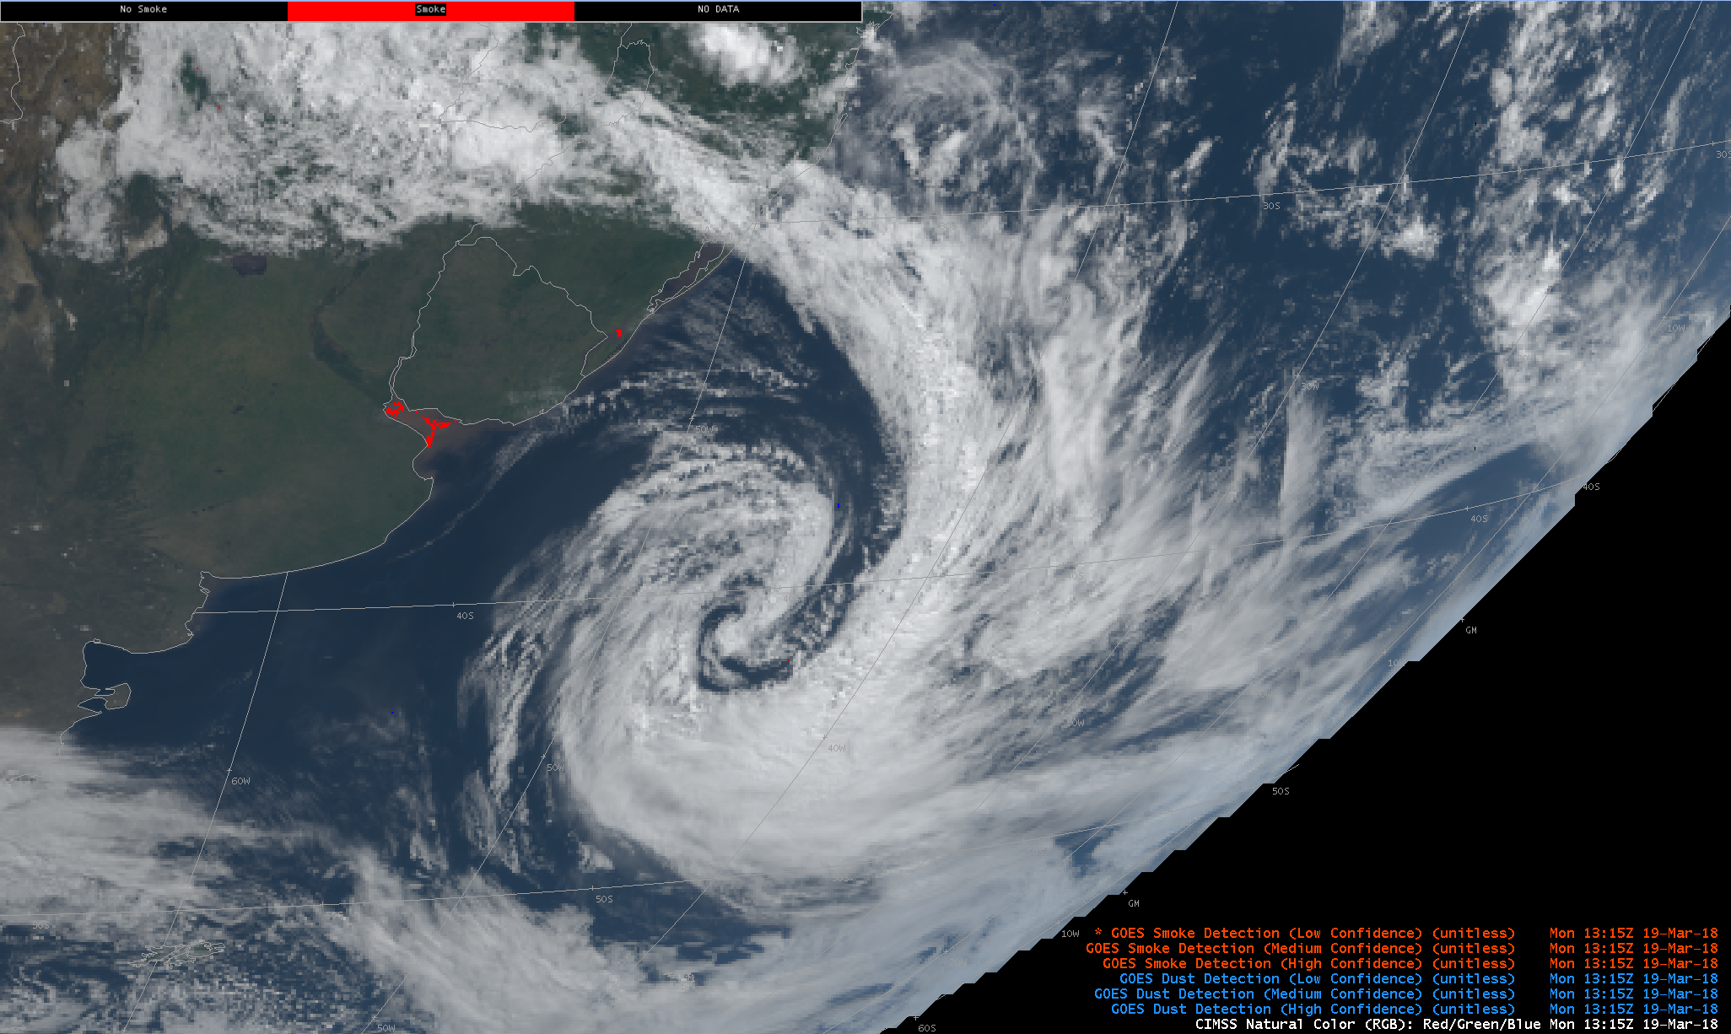
GOES-16 ADP (Smoke)
GOES-16 Smoke and Dust Product
Mon 13:15Z 19 Mar 2018
(Buenos Aires and East Coast of South America)

Slide 8
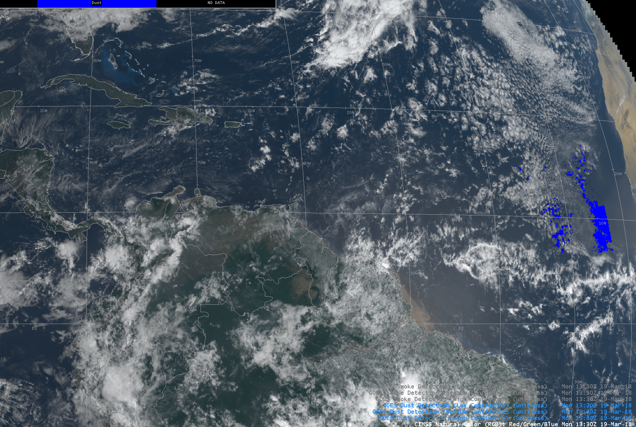
GOES-16 ADP (Dust)
GOES-16 Dust Product
Mon 13:30Z 19 Mar 2018

Slide 9
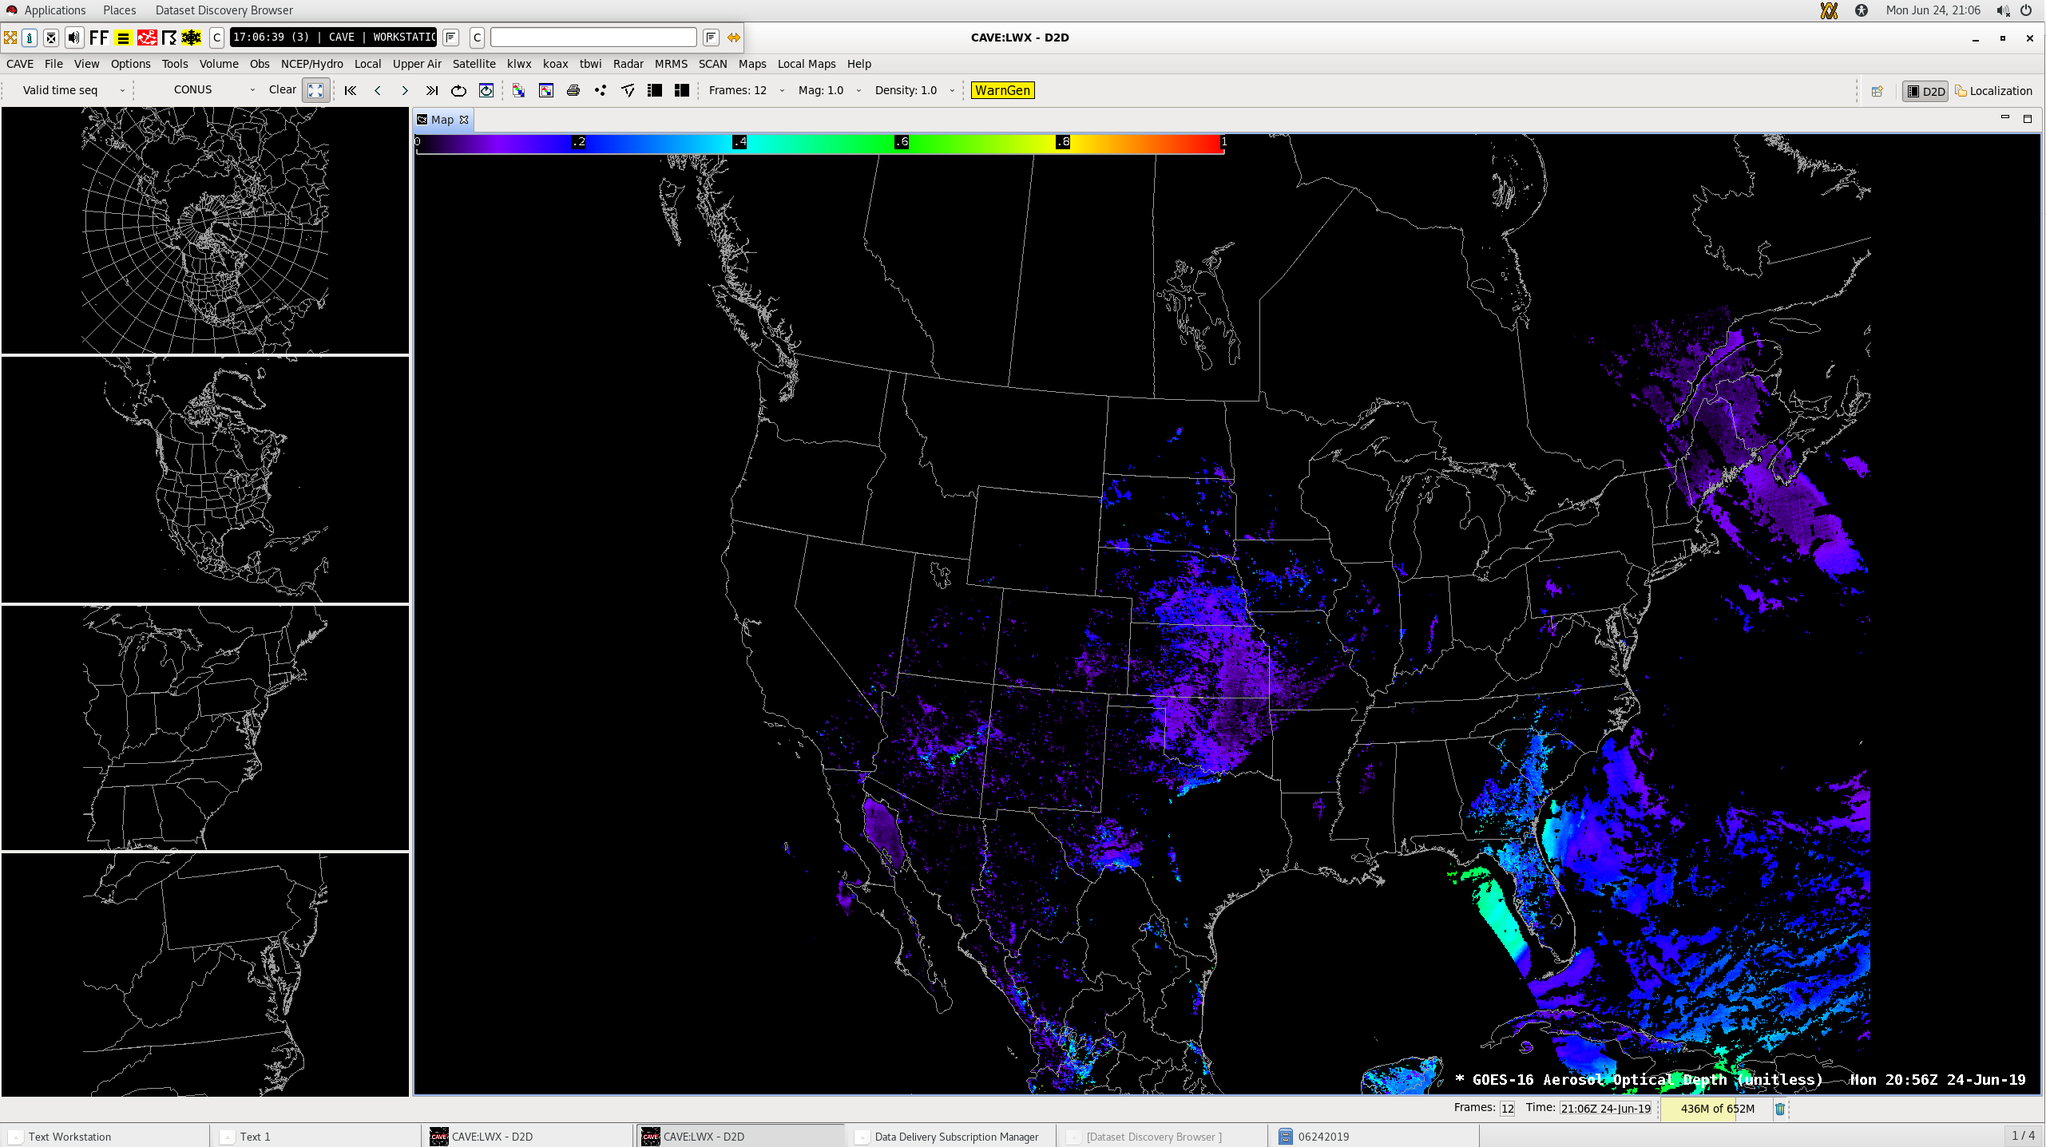
GOES-16 Aerosol Optical Depth (unitless) Mon 20:56Z 24-Jun-19

Slide 10
  Questions/Discussion

