Slide 1
GOES-16 LST, COD, CPSD in AWIPS-2
GOES-17 Provisional PS-PVR
June 13, 2019

Slide 2
Overview of Products in AWIPS
GOES-16 Fielded in AWIPS-2 (GOES-17 not yet fielded)
Style rules are modified to customize color maps, units, display ranges
NWS transmission of GOES-16 LST, COD, CPSD via the SBN (activation date):
Land Surface Temperature (F, C, M), May 31, 2017
Cloud Optical Depth (F, C), Jun 14, 2017
Cloud Particle Size Distribution (F, C, M), Jun 14, 2017
* ABI Sectors: F = Full Disk, C = CONUS and M = Meso
Examples of each are in the following slides

Slide 3
GOES-16 Land Surface Temperature
Notes:
0 .7 1.3 2 2.2 2.5
Inches
0-2.5 is range

Slide 4
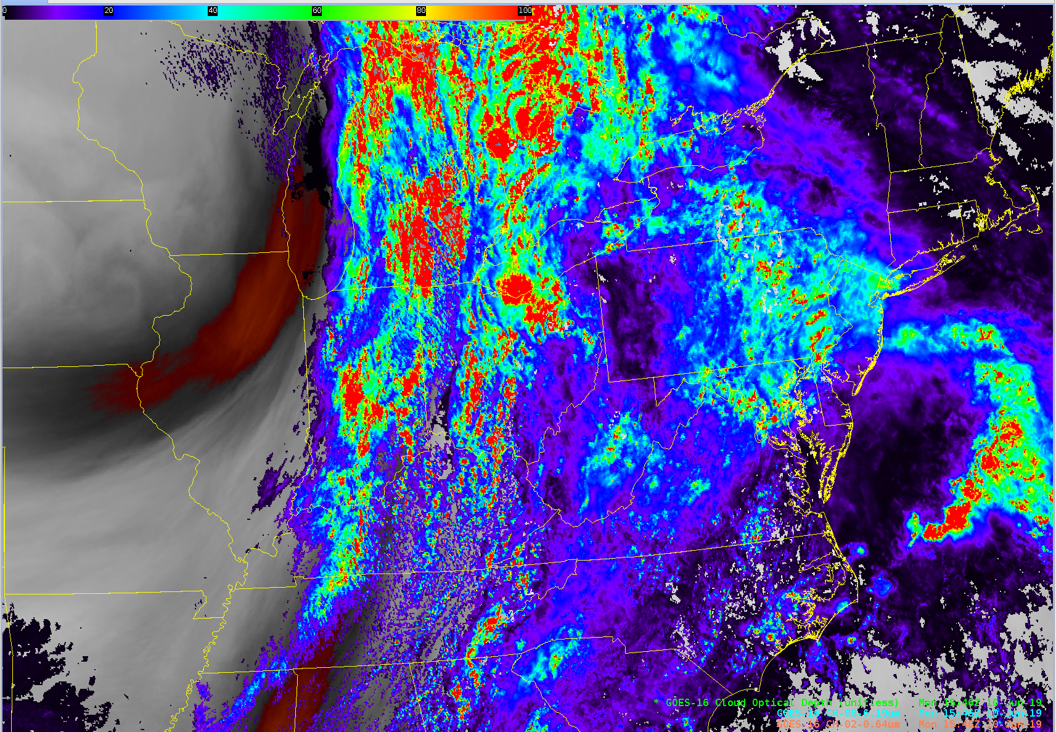
GOES-16 Cloud Optical Depth

Slide 5
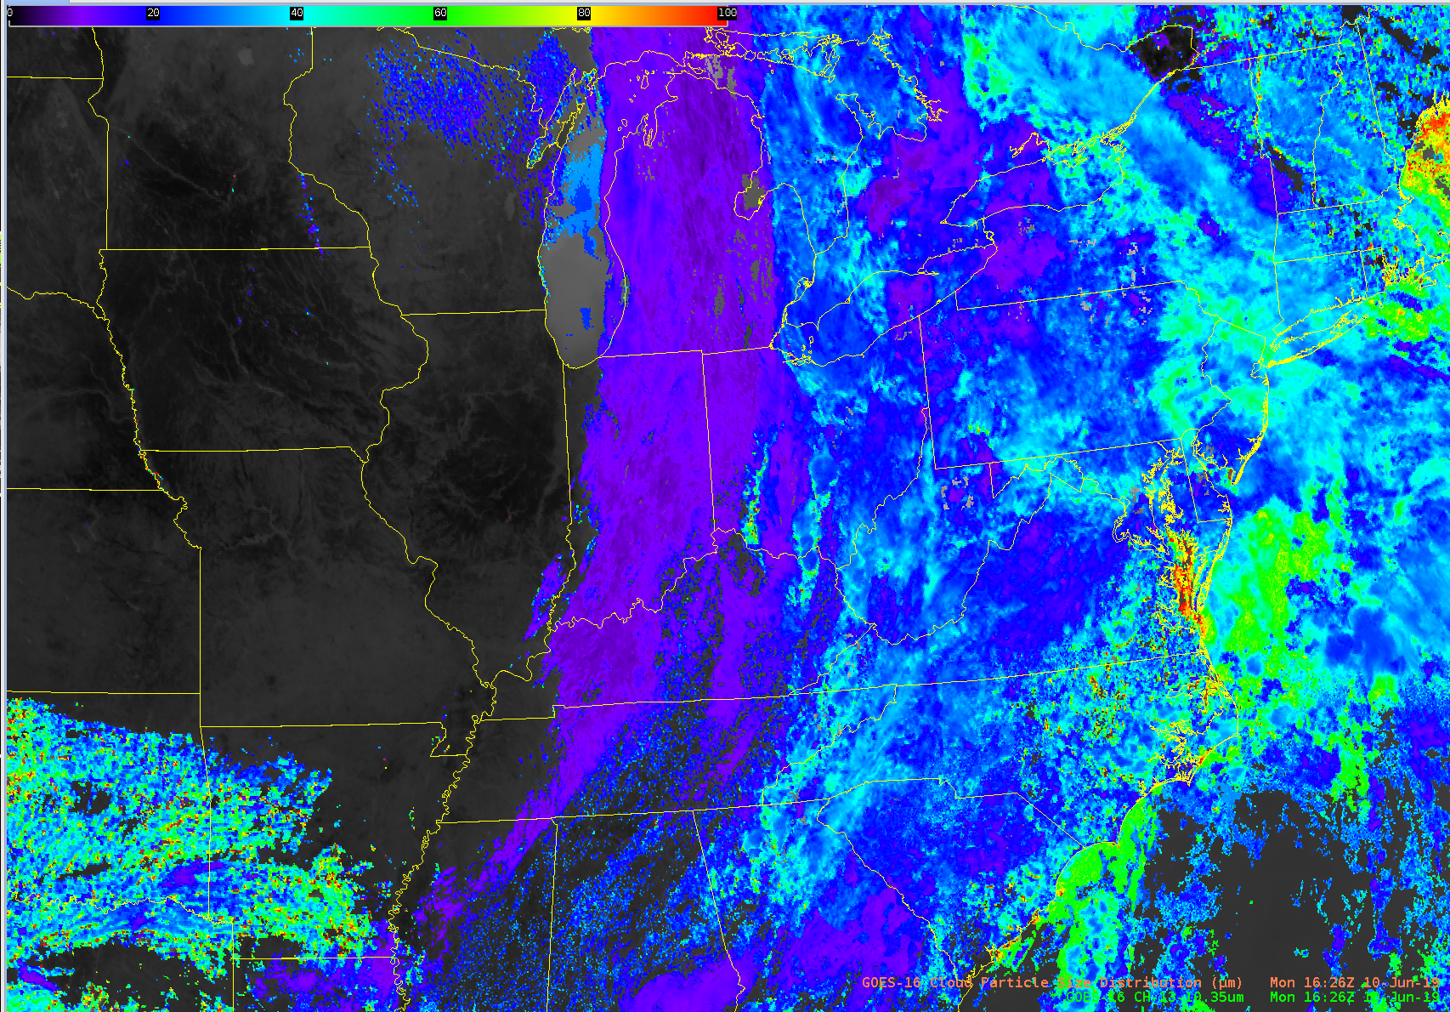
GOES-16 Cloud Particle Size Distribution

