Slide 1
Cloud Mask, Cloud Phase and Cloud Top Properties in AWIPS-2
Provisional PS-PVR
May 6, 2019

Slide 2
Cloud Mask, Phase, Top Properties in AWIPS-2
GOES-16 Fielded in AWIPS-2 (GOES-17 not yet fielded)
  Style rules are modified to handle display units
NWS transmission of GOES-16 Cloud Products via the SBN began May 31, 2017:
  Cloud Top Height (F, C, M)
  Cloud Top Pressure (F, C)
  Cloud Top Temperature (F, M)
  Clear Sky Mask (F, C, M)
  Cloud Top Phase (F,C,M)
* ABI Sectors: F = Full Disk, C = CONUS and M = Meso
Examples of each are in the following slides

Slide 3
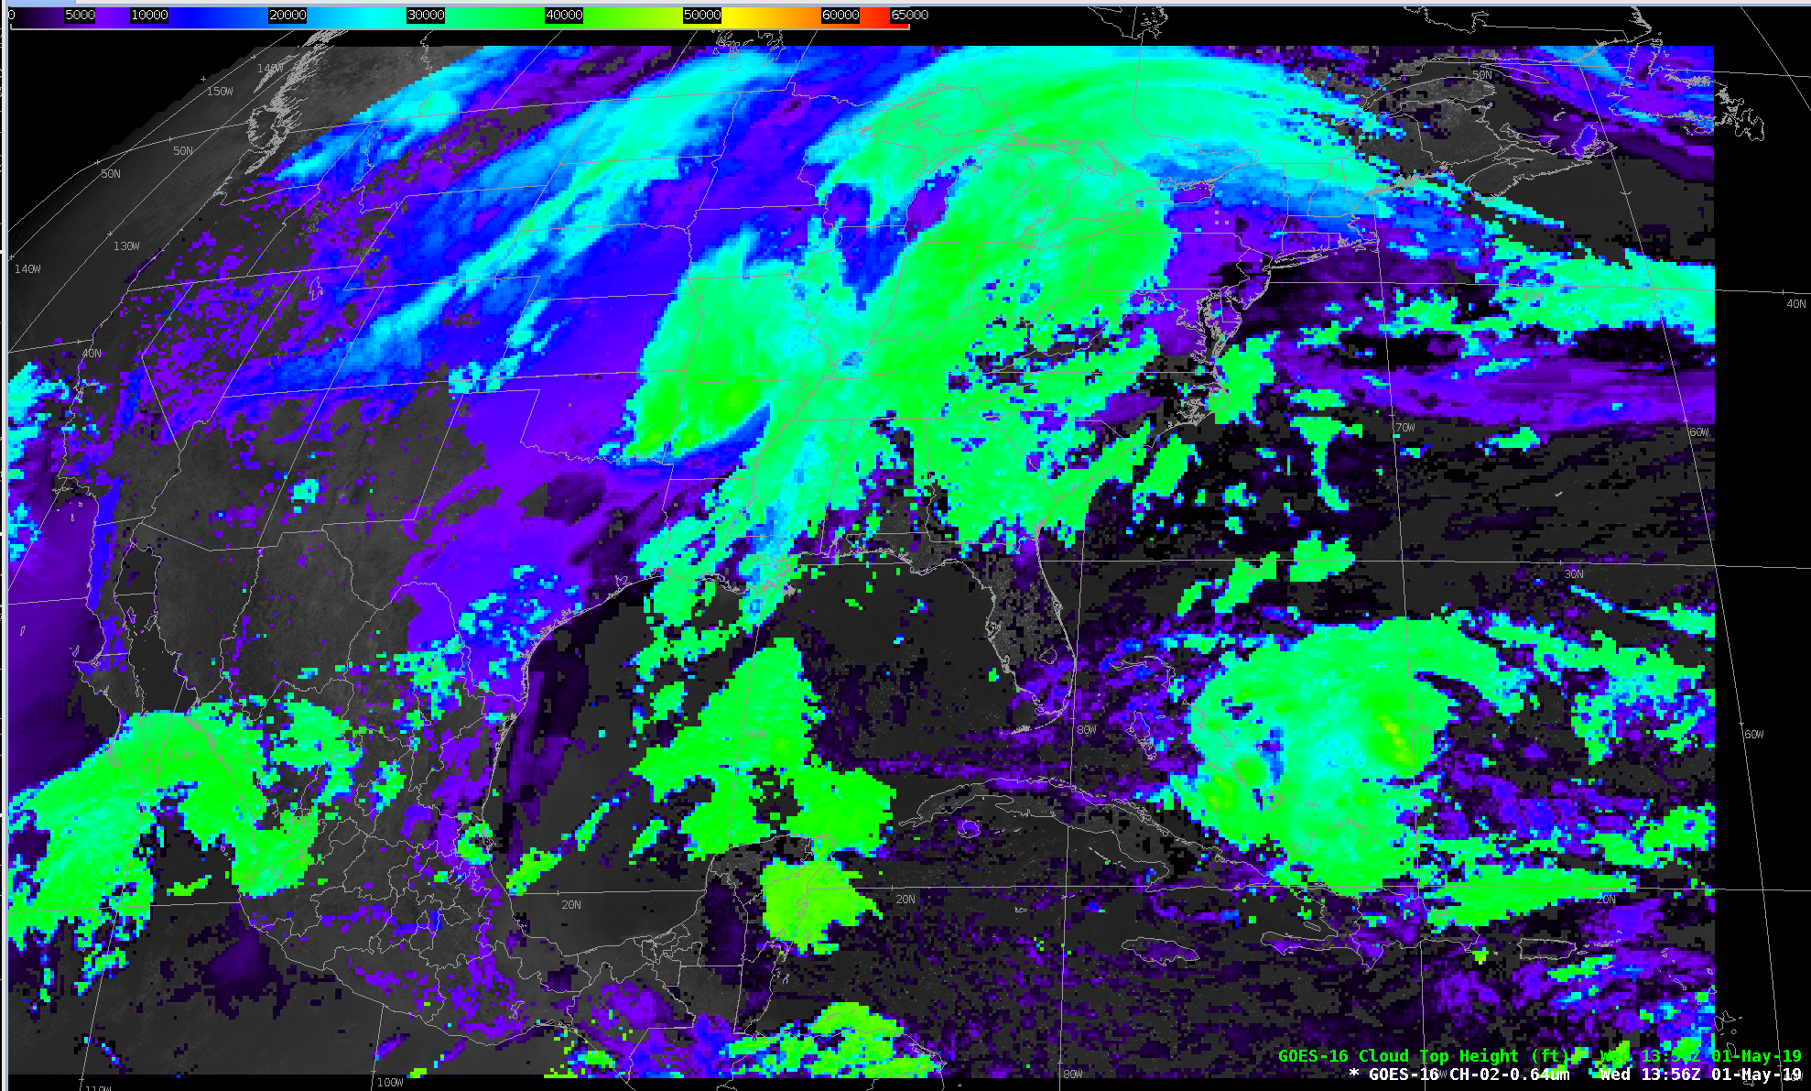
GOES-16 Cloud Top Height (Ft)
14:22 Z 13 Feb 2018

Slide 4
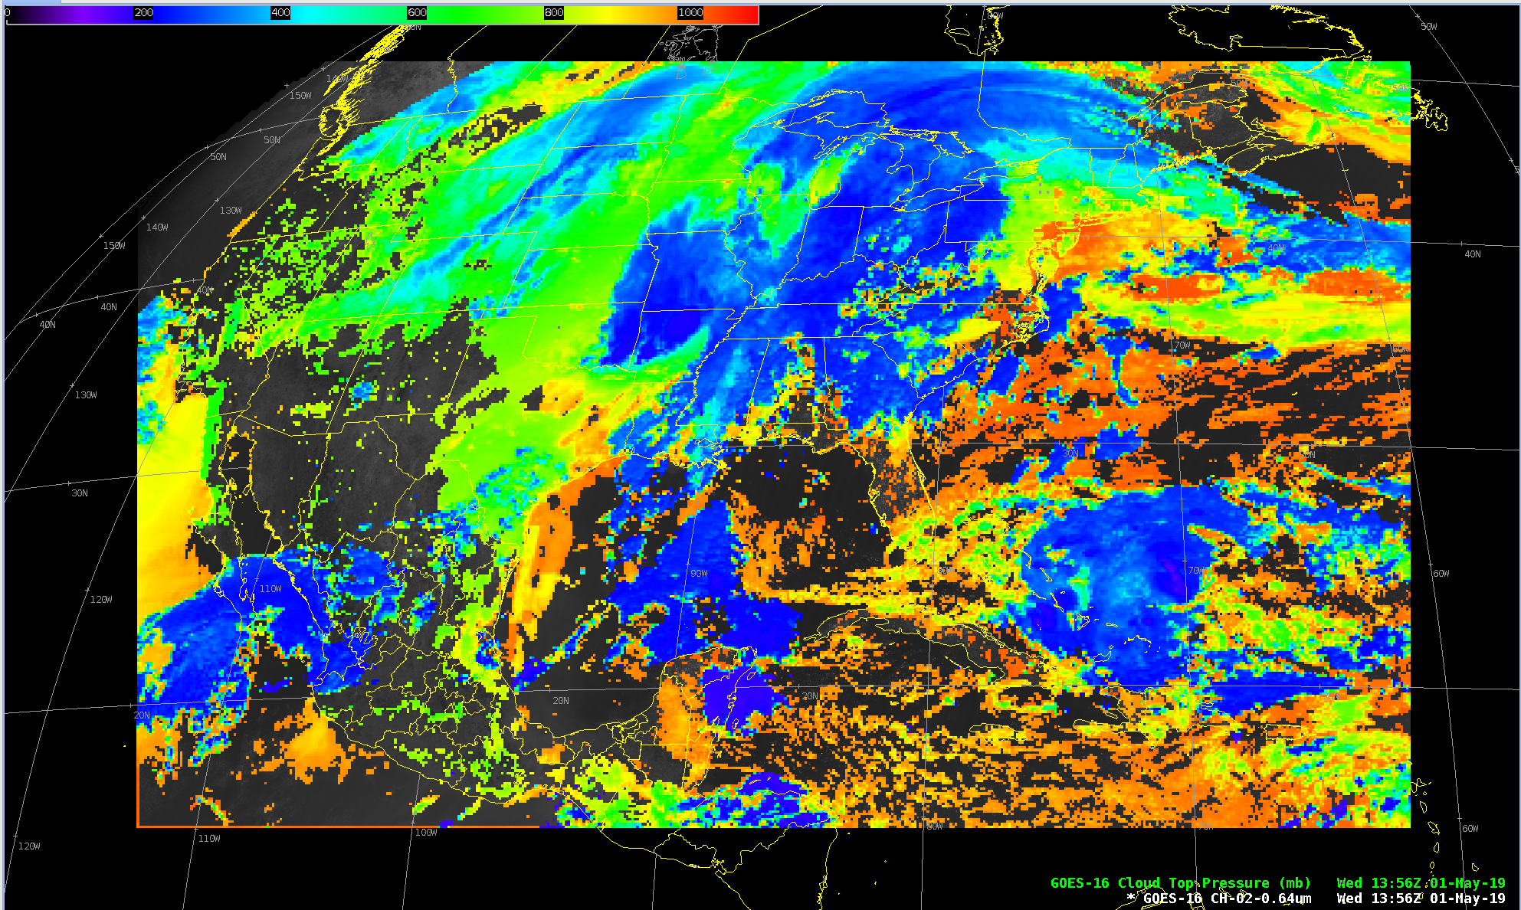
GOES-16 Cloud Top Pressure (hPa)
14:22 Z 13 Feb 2018

Slide 5
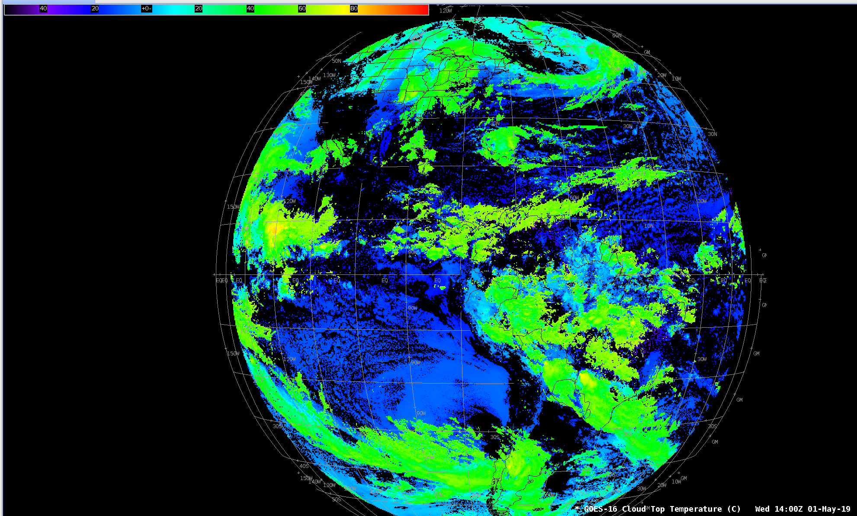
GOES-16 Cloud Top Temperature (degC)
14:30 Z 13 Feb 2018

Slide 6
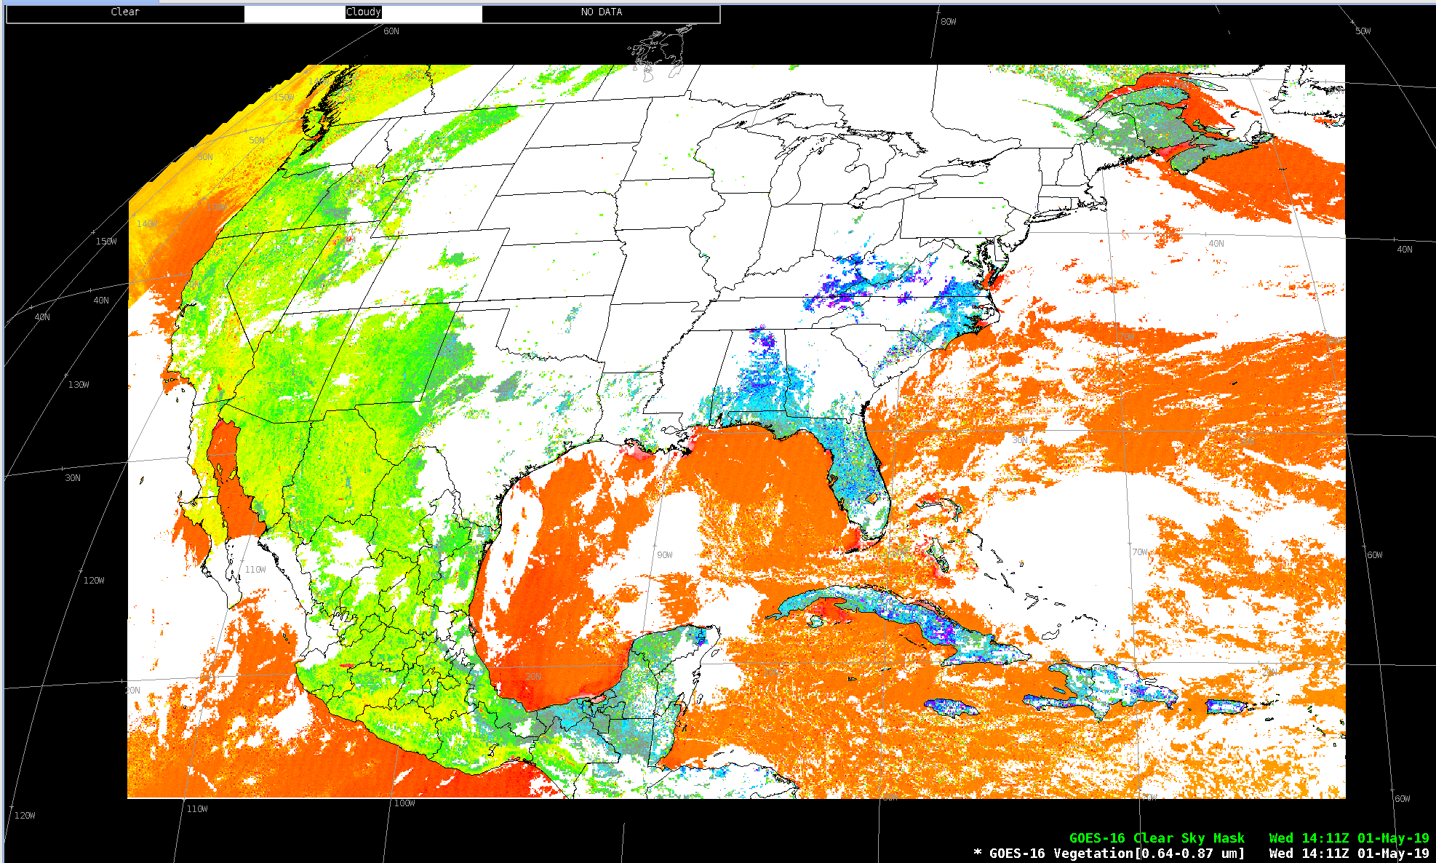
GOES-16 Clear Sky Mask (white) w/Vegetation Ch Difference

Slide 7
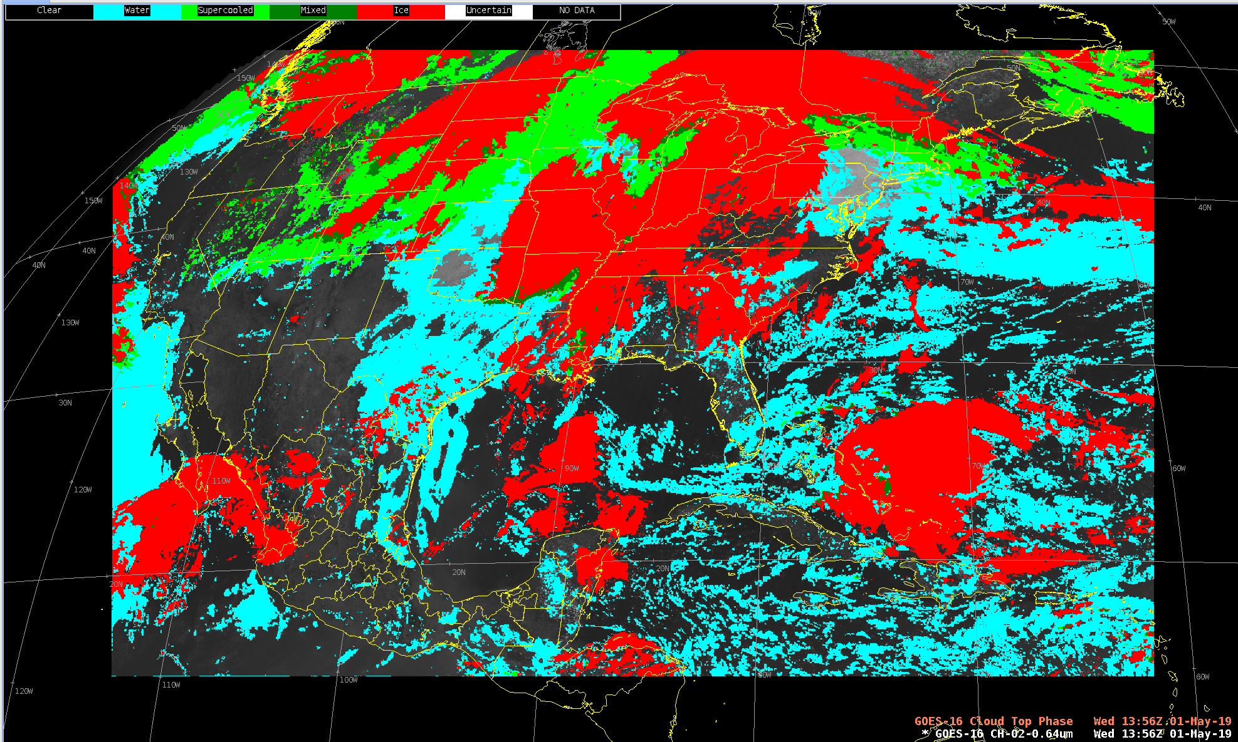
GOES-16 Cloud Top Phase

