Slide 1
NWS Update
GOES-17 ABI L1b & CMI Provisional PS-PVR
NOAA/NWS Office of Observations
November 28, 2018

Slide 2
Topics
GOES-17 CMI and SCMI in AWIPS and N-AWIPS
AWIPS Visualization and Exploitation of CMI/SCMI
AWIPS Menus and Screen Captures
MDS/MMM for ABI Meso Requests
Noteworthy Items So Far
GOES-17 SCMI Sectoring
Striping and LHP Issues
Mode 6 and Dual-Mode-4 Tests
Summary Assessment
NWS OT&E Activity
NWS Brief to GOES-17 ABI L1b & CMI Provisional PS-PVR

Slide 3
GOES-17 Cloud and Moisture Imagery in AWIPS and N-AWIPS
Fielded AWIPS baseline handles ingest/decode/store/display/purge of ABI Full Disk and PACUS Imagery
Mesoscale sector imagery in AWIPS involves manually-applied at-site mod so WMO headers are recognized (will be in AWIPS baseline in May 2019)
All ABI channels, all sectors (AWIPS-derived RGBs and channel differences)
WFOs/RFCs/RHQs receive SCMI for AWIPS via SBN (since November 15, 2018)
Examples are shown in the following slides (AWIPS screenshots)
Fielded N-AWIPS baseline handles ingest and display of ABI Imagery
All channels, all sectors
Projected McIDAS Area files
NCEP Centers receive CMI (for AWIPS and N-AWIPS) via GRB, with SBN as backup (since November 15, 2018)

Slide 4
AWIPS Visualization and Exploitation
21+ months of evolutionary improvements of GOES-16 ABI processing and rendering in NWS (e.g., fixed grid, plus many others), applied to GOES-17 ABI processing and rendering
Satellite Enhancement Team (SET) review and approval process
Collaborative activity among NWS regional/field reps, cooperative institutes, NWS HQ (OBS/TOWR-S Team) and GOES-R Program Office
Defined menu structures, enhancement tables, RGB and difference definitions
Orderly deployment of RPM updates to regional and national forecast offices
OBS/TOWR-S team coordinates and executes agile RPM process which accelerates changes into AWIPS (with baseline incorporation once functionality stabilizes)
AWIPS/N-AWIPS refinements and training continue

Slide 5
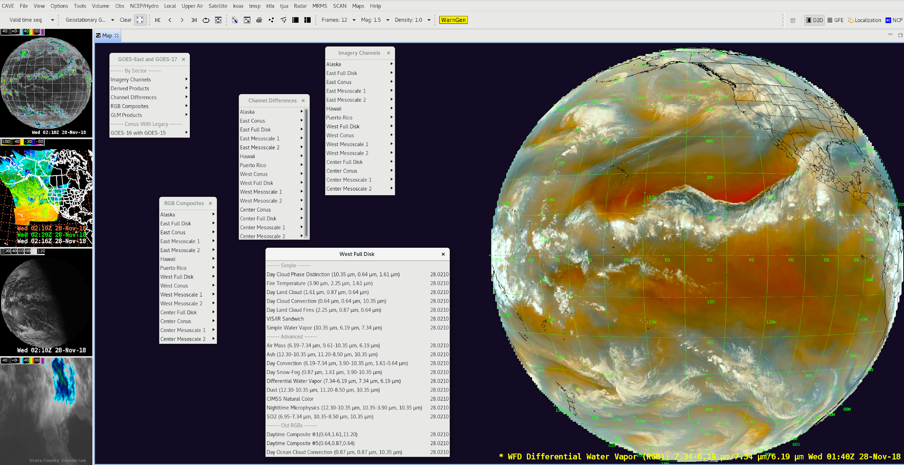
AWIPS/CAVE/D2D Menus for GOES-17

Slide 6
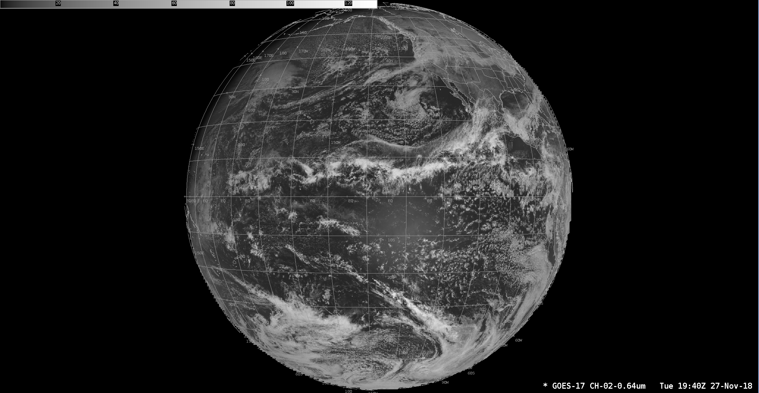
AWIPS/CAVE/D2D Example: GOES-17 ABI 0.64µm West Full Disk

Slide 7
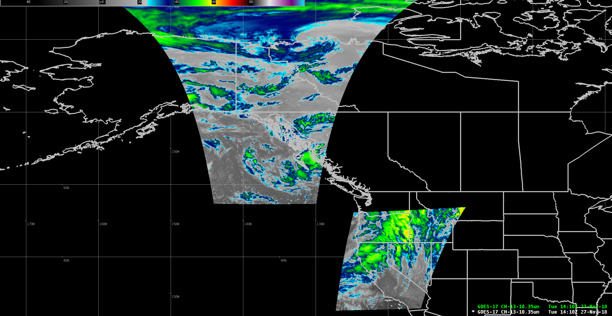
AWIPS Example: GOES-17 ABI 10.33µm Mesoscale Sectors

Slide 8
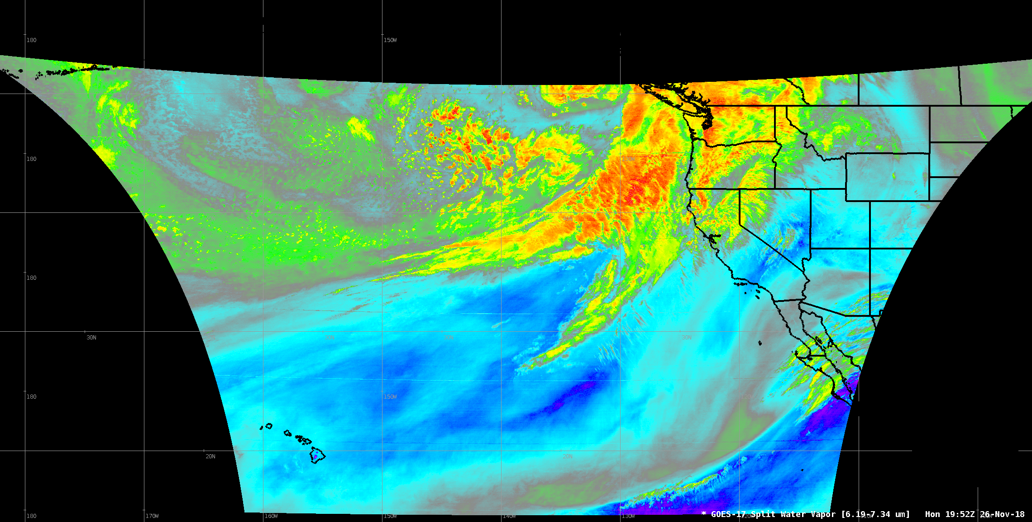
AWIPS example: Split Water Vapor Channel Difference

Slide 9
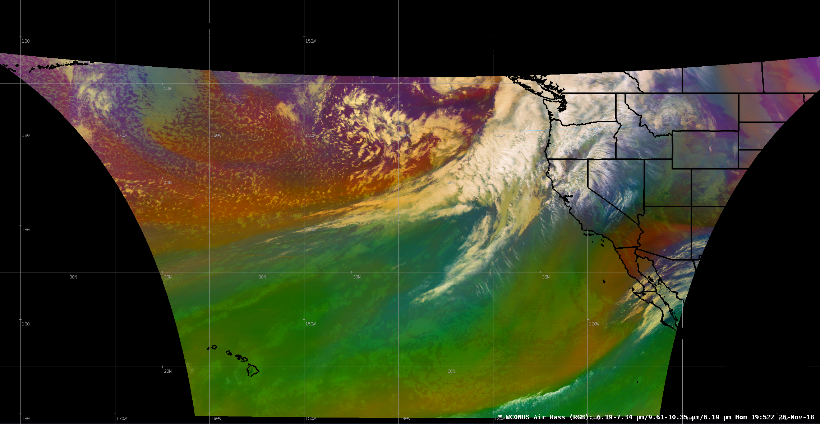
AWIPS example: Air Mass RGB

Slide 10
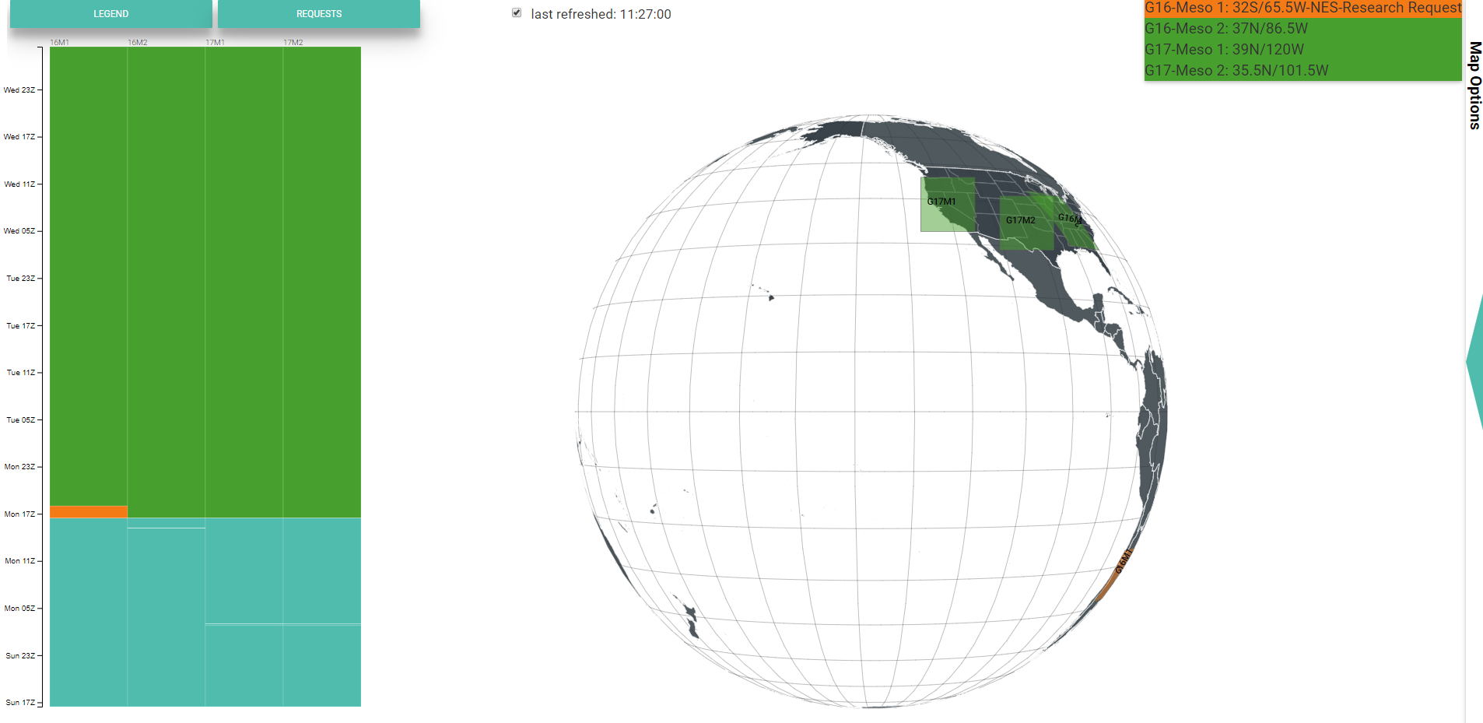
Exploitation of GOES-17 ABI Mesoscale Imagery at NWS
Mesoscale Mission Manager (MMM) Tool on NOAA Virtual Lab facilitates and encourages collaboration and utilization for mesoscale sector placement (tool sometimes called Meso Domain Scheduler (MDS))
Standard Operating Procedure documents mission priorities and the NESDIS/NWS meso request process
NWS Governance of ABI/Meso process managed by NWS Operations Division, MDS/MMM tool and process supported by OBS/TOWR-S team

Slide 11
Noteworthy Items (so far)
GOES-17 SCMI (the GS/NCF/SBN delivered imagery) was activated into NWS on the fixed grid
All CMI and SCMI sector coverages as expected displaying in AWIPS/N-AWIPS (though now, post-drift, active discussions about how to best use available sectors)
Geolocation in general has been good (though with infrequent exceptions after maneuvers)
Periods of degraded imagery
LHP (NWS LHP summary)
non-LHP (recent striping, especially in water vapor bands but also in other IR channels)
NWS is currently participating in GOES-17 Mode 6 test (November 27-30)
It is likely that NWS will request change to mode 6 in early 2019
NWS plans to participate in GOES-16/17 dual Mode 4 test on December 4th
NWS evaluation of the data continues (renewed interest with recent repositioning of GOES-17 to 137.2° W)
Notes:
Mission impacts

Slide 12
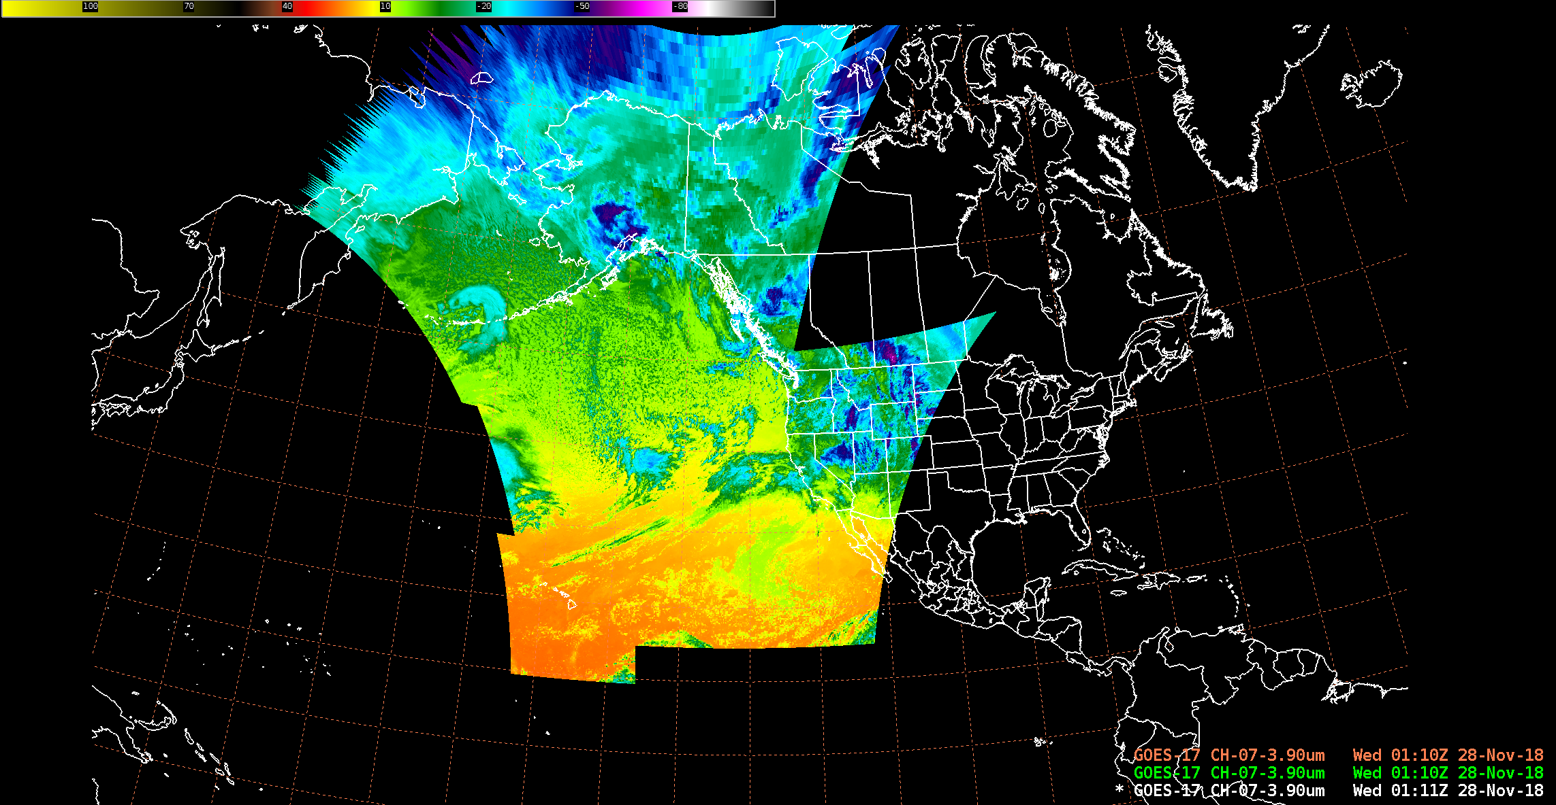
GOES-17 ABI SCMI Sectors in AWIPS*
Alaska
WCONUS
Hawaii
* excludes full disk and mesos

Slide 13
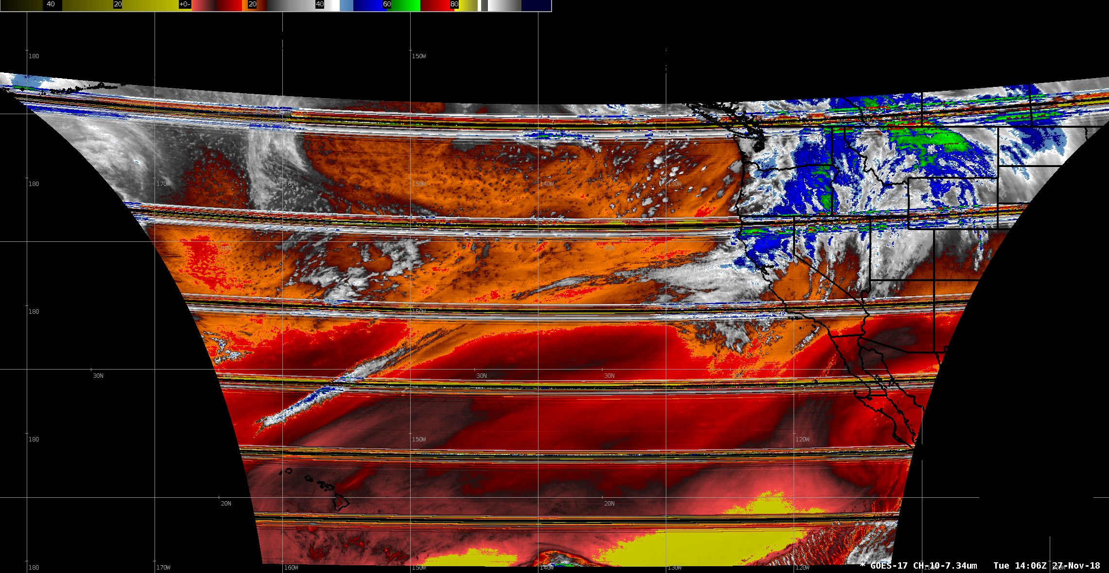
AWIPS example: 7.34µm Striping Probably Not Due to LHP
November 27, 2018
Striping affects some sites and mission areas more than others. One report: “...at times [the striping] renders the loops unusable from a distraction standpoint as dropouts can be for two or three frames and are over [my area of responsibility].”

Slide 14
GOES-17 Loop Heat Pipe from NWS Perspective
NWS Operations Proving Ground has disseminated training for all WFOs/RFCs/NCEP Centers regarding the LHP data issues and what to expect during specific times of the year
NWS/OBS TOWR-S team has contacted each WFO in the GOES-17 footprint to ensure they have taken the training, understand what they are seeing, and to answer any additional questions regarding the anomaly
TOWR-S team has set up and regularly uses a satellite-specific NWS/AWIPS chatroom to relay data issues to forecasters and also to receive reports of data issues
TOWR-S team has developed an automated process to monitor the degradation present in the ABI IR channels due to the LHP
NWS preparing for February 2019 LHP monitoring and surveying to assess and report LHP impact to NWS mission

Slide 15
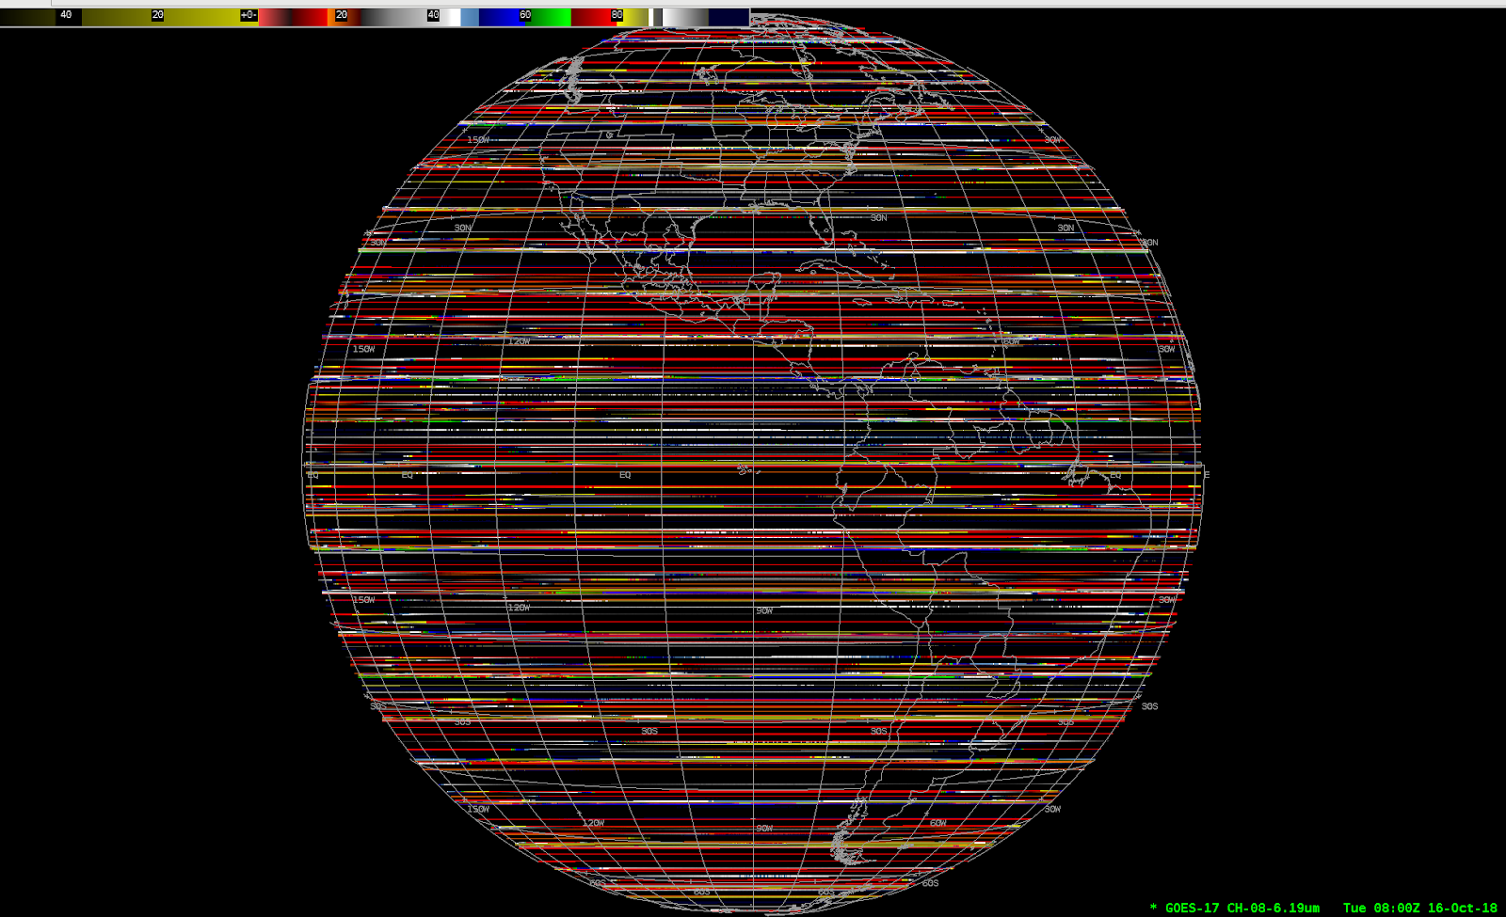
AWIPS example: 6.9µm LHP Degradation

Slide 16
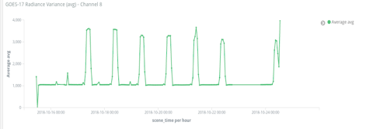
LHP Degradation Time-Series Graph*
GOES-17 Radiance Variance (avg) - Channel 8
4.00
3.00
2.00
1.00
Oct 16 Oct 18 Oct 20 Oct 22 Oct 24
* TOWR-S team developed and are employing monitoring/diagnostic tools for characterizing NWS-side LHP timing/effects

Slide 17
Summary Assessment
GOES-17 ABI imagery is being widely used across in NWS in a pre-operational mode; ABI visible, Near IR and window bands generally very good
NWS/OPPSD GOES-16/17 Operational Test and Evaluation (OT&E) Team is currently conducting an NWS assessment, gathering feedback, and summarizing reported results (more OT&E details on next slide.)
NWS requests continued NESDIS attention on:
Mitigating LHP-related L1b/CMI degradation (striping, corrupted and missing data), either directly or indirectly (e.g., extended GOES-15 operation and Himawari)
Effects of LHP and other striping on L2/derived products
Non-LHP-related striping (very noticeable problem today)
Cross-organizational change management (communicating changes in advance; upkeep of documentation e.g., GRB and L1b PUGs, ICDs, etc.)

Slide 18
NWS Operational Test & Evaluation Activity
NWS Test of GOES-17 involving 8+ NWS sites (mainly western CONUS, AK and HI)
Organized/coordinated by NWS OPPSD with NWS field staff involvement
Verifies and confirms end-to-end dissemination and display of GOES-17 imagery
Involves formal/uniform test procedures (but also allows for ad-hoc feedback)
Tracks and reports on product flows thru NWS networks to end users
Validates CMI, SCMI from GRB, NCF/SBN and products from PDA
Early OTE results help inform NWS future development (e.g., AWIPS software changes) and leadership on progress leading up to GOES West declaration
Later OTE activities (e.g., for GOES-17 L2 Products) extend into 2019

Slide 19
Thanks!
Questions?

