Slide 1
GOES Ice Products in AWIPS
NWS/Obs Update to Provisional PS-PVR
January 21, 2021

Slide 2
GOES Ice Products in AWIPS
Transmission of GOES-East and -West Ice Concentration (AICE), Ice Thickness (AITA), Ice Motion (AIM) to NWS forecast offices began in early December of 2020
  Routed via Local Data Manager (LDM) from AWC thru Regions, then to sites
    (non-operational data path)
Configurations for AWIPS ingest and display have been fielded to via TOWR-S Redhat Package Manager (RPM) version 20
  Available to all NWS Forecast offices, RFCs, Center Weather Service Units
Products are compatible with AWIPS w/two exceptions (changes in coord w/ GOES-R):
  AITA: updated the quality flag values to reflect metadata (e.g. 0=normal)
  AIM: re-packaged for ice motion vector displays
WFOs Duluth and Marquette are leading evaluation this Winter for Great Lakes
  Nick Langlieb, SOO at WFO Marquette, MI, presented at the Satellite Book Club seminar on Jan 21st: “GOES-R Ice Products and Potential Applications to Lakeshore Flooding” (recording to be available later today)
Examples of AWIPS displays are in following slides
Notes:
AICE - Ice Concentration product
AITA - Ice Age and Thickness
AIM - Ice Motion

Slide 3
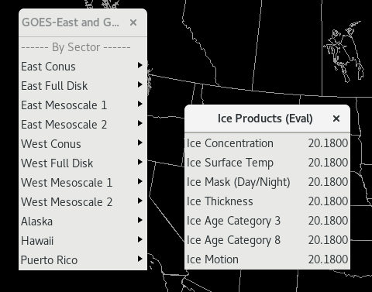
GOES Ice Products AWIPS Menus in TOWR-S RPM v20
AITA
Temporary processing with ISatSS:
  We update the DQFs for AITA to assign 0,1,2,3 as normal, nonretrievable, uncertain, bad
  We update the Ice Motion into AWIPS derived-motion-wind (DMW) format
Notes:
AICE - Ice Concentration product
AITA - Ice Age and Thickness
AIM - Ice Motion
DQF:flag_values = 0US, 1US, 2US, 3US ;
DQF:flag_meanings = "normal nonretrievable uncertain bad_data" ;

Slide 4
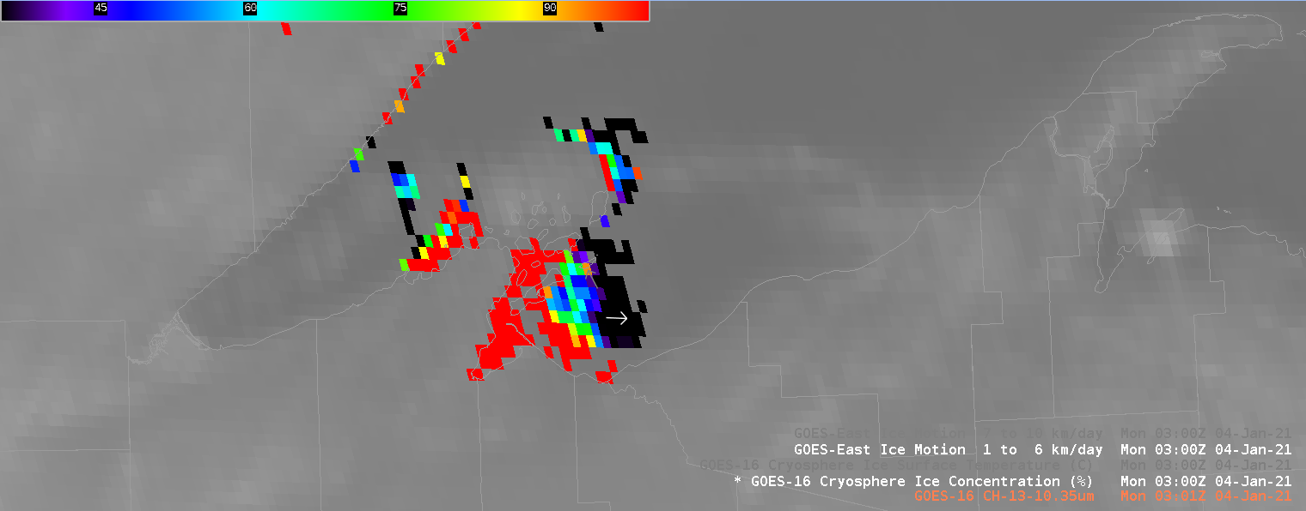
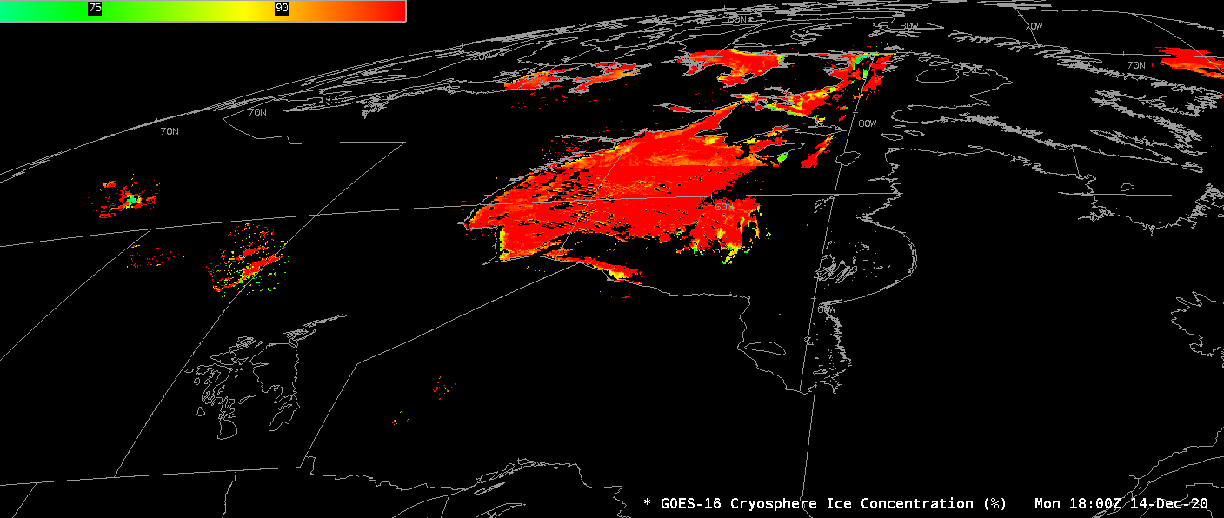
Ice Concentration (AICE)
Ice Concentration (%)

Slide 5
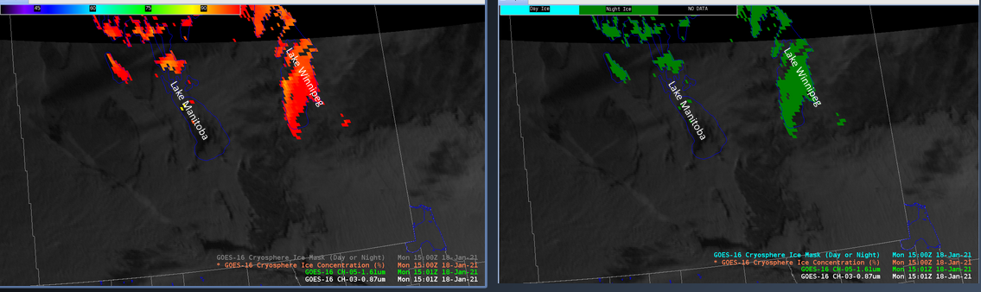
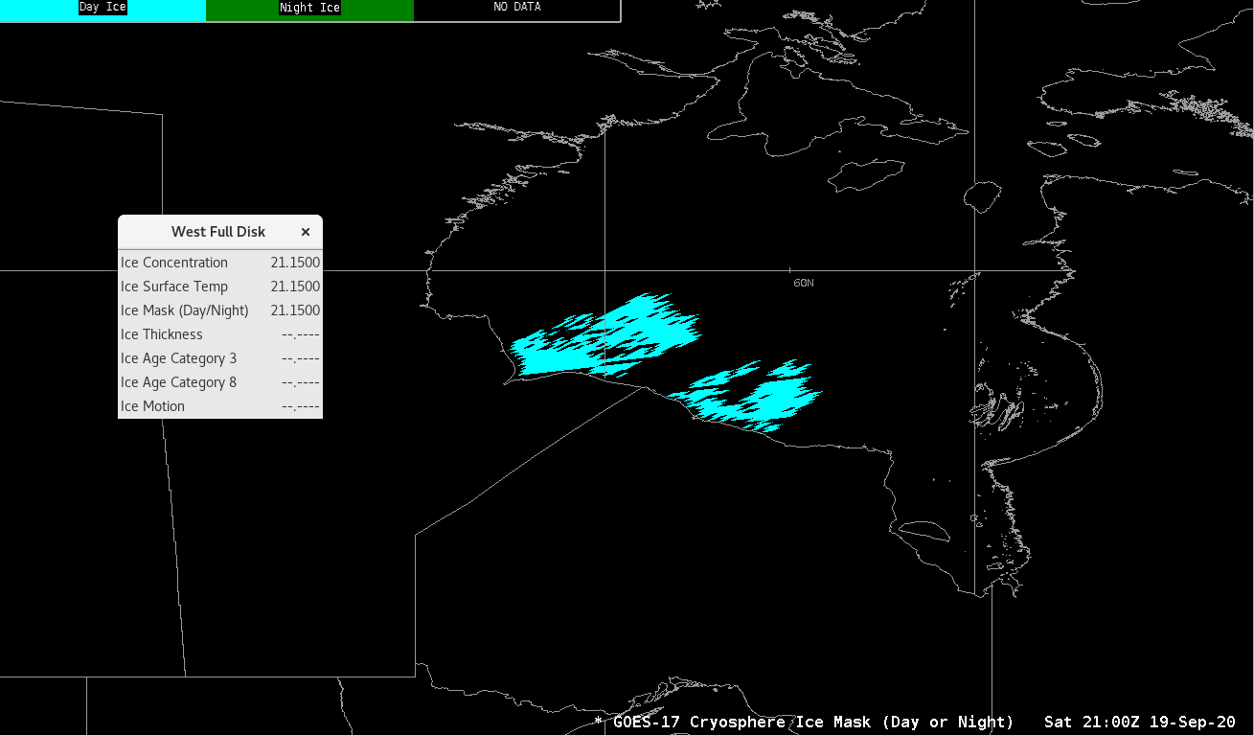
Ice Concentration and Ice Mask (AICE)
Ice Concentration (%)
Ice Mask (Day or Night)
Courtesy of Nick Langlieb, WFO MQT

Slide 6
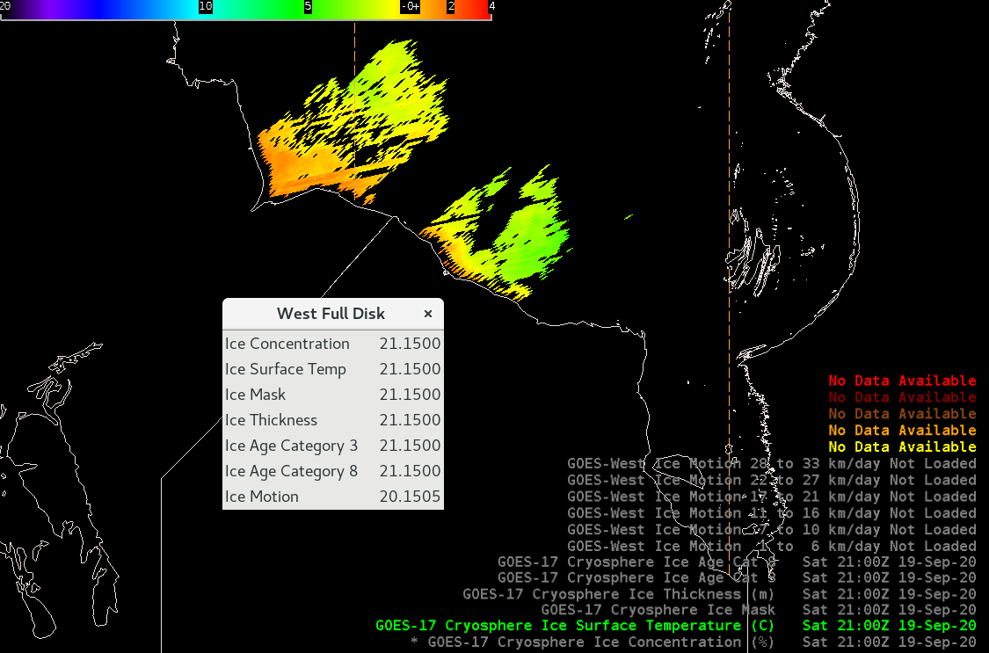
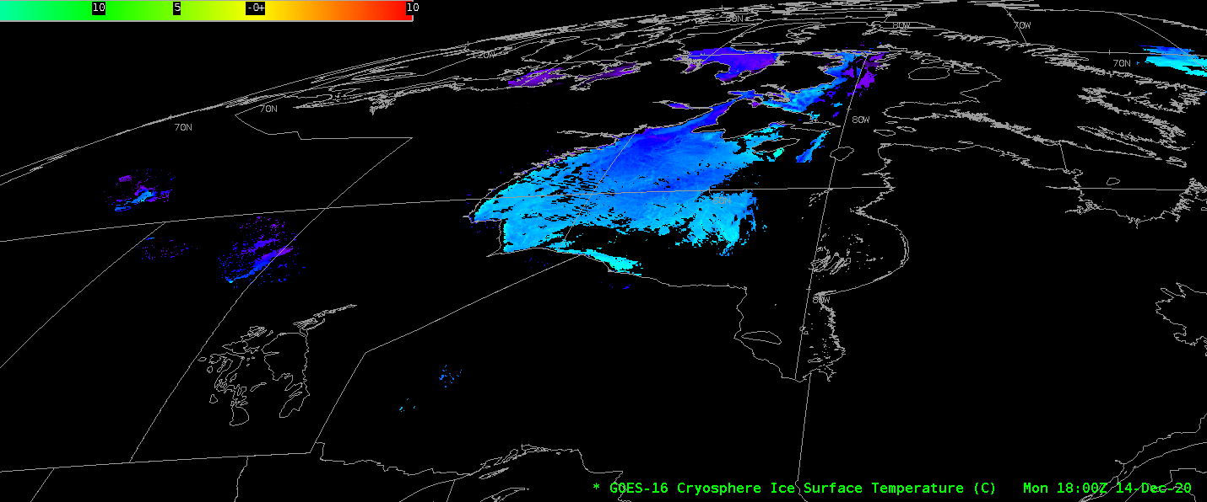
Ice Temperature (AICE)
Ice Temperature (C)

Slide 7
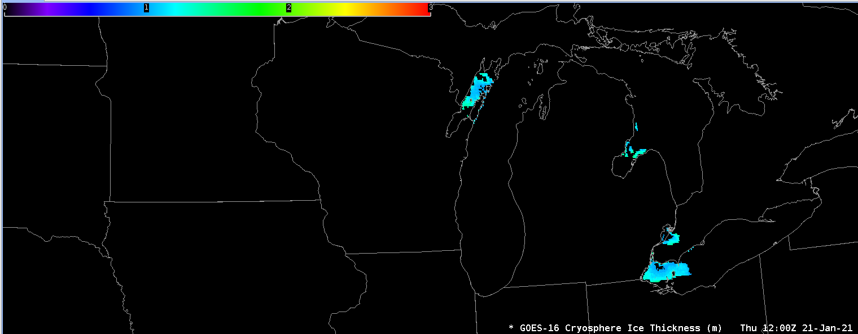
Ice Thickness (AITA)
Ice Thickness (m)
Notes:
DQF:flag_values = 0US, 1US, 2US, 3US ;
DQF:flag_meanings = "normal nonretrievable uncertain bad_data" ;

Slide 8
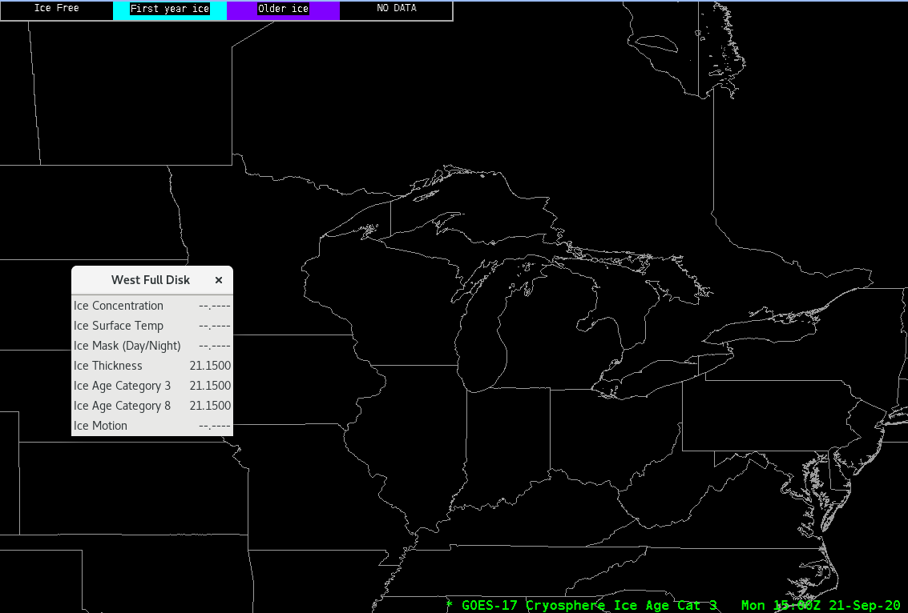
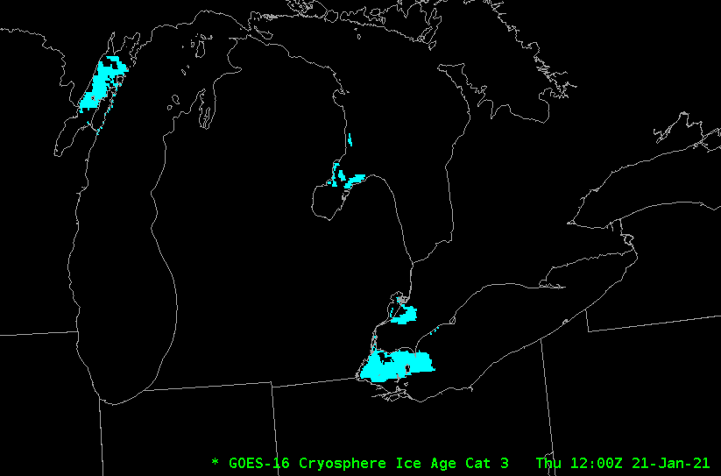
Ice Age Category 3 (AITA)
Ice Cat 3

Slide 9
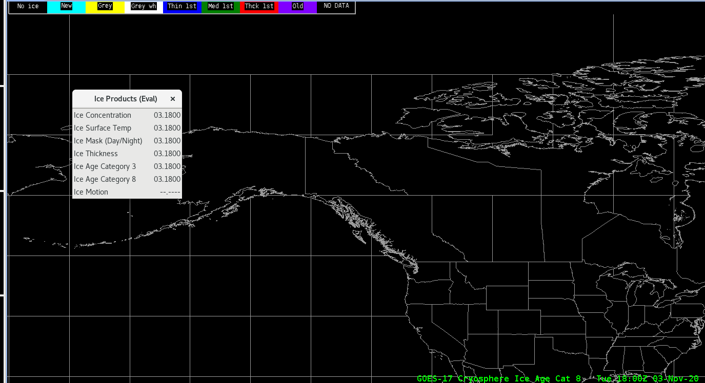
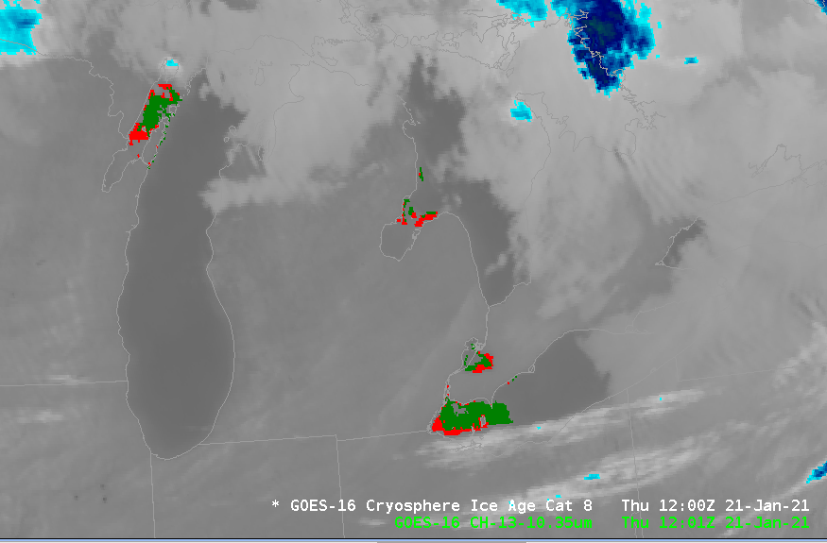
Ice Age Category 8 (AITA)
Ice Cat 8

Slide 10
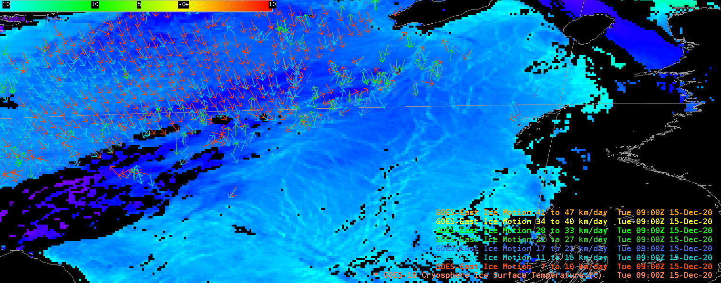
Ice Motion Plot (AIM)
Ice Motion (km/day) arrows colored by distance ranges plotted with Ice temperature (shaded)
  Ice Motion Fields: startLat, StartLon, SpeedFinal, DirFinal

Slide 11
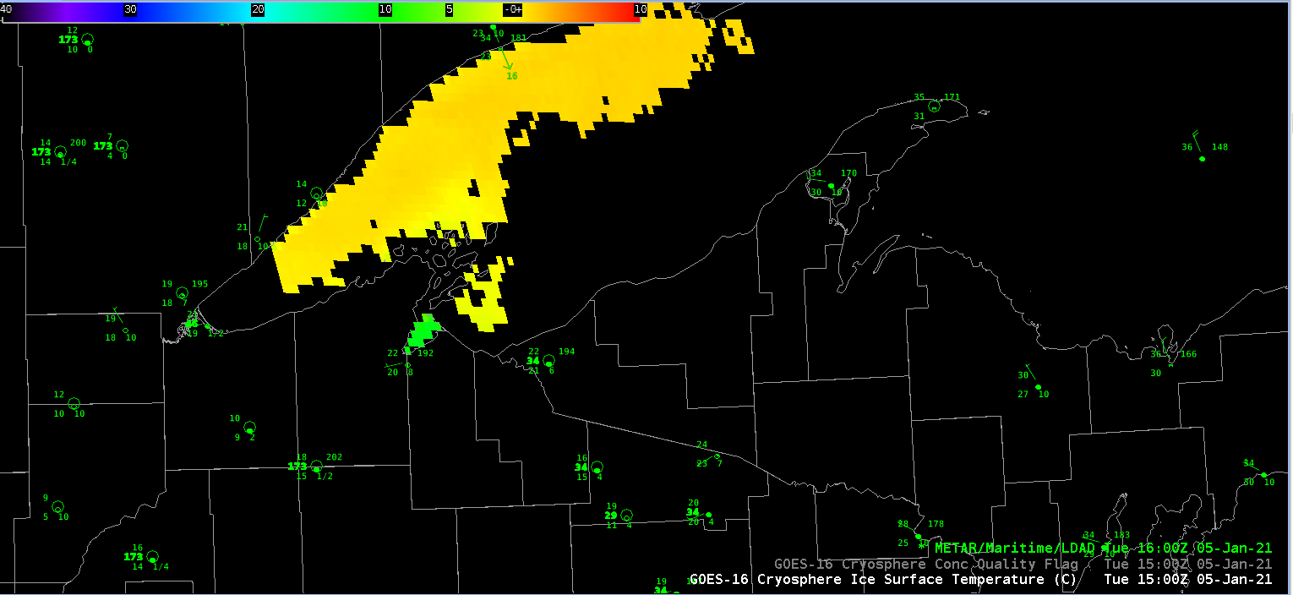
Lake Superior Ice Temperature on Jan 5th 2021
Courtesy of Nick Langlieb, WFO MQT - Compare with next slide

Slide 12
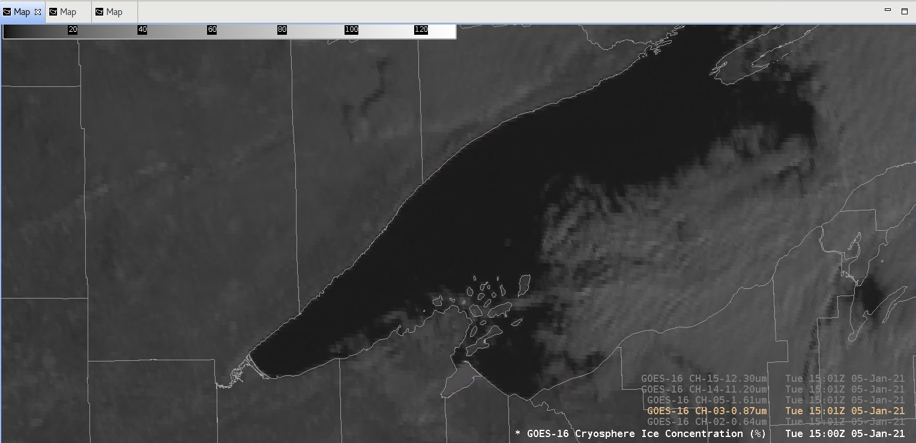
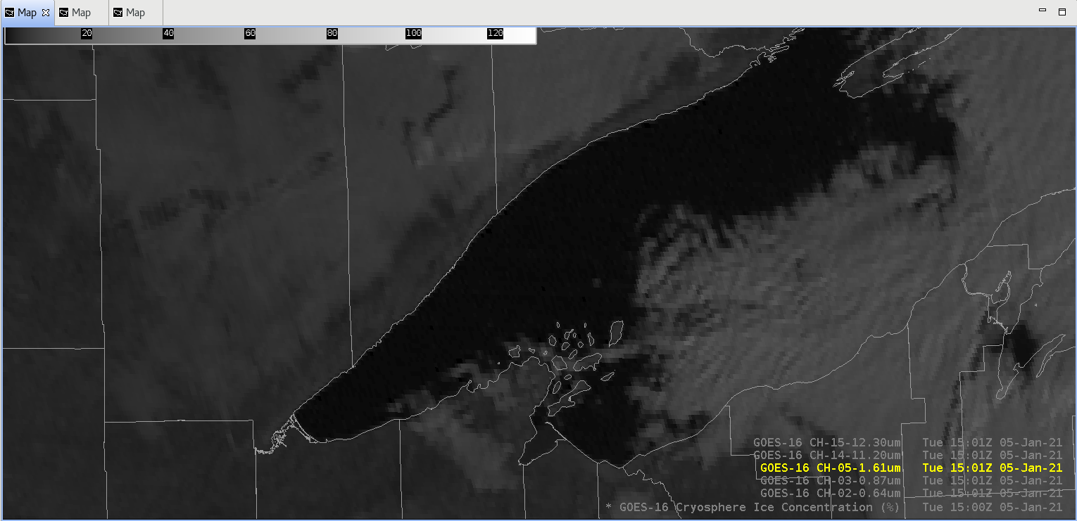
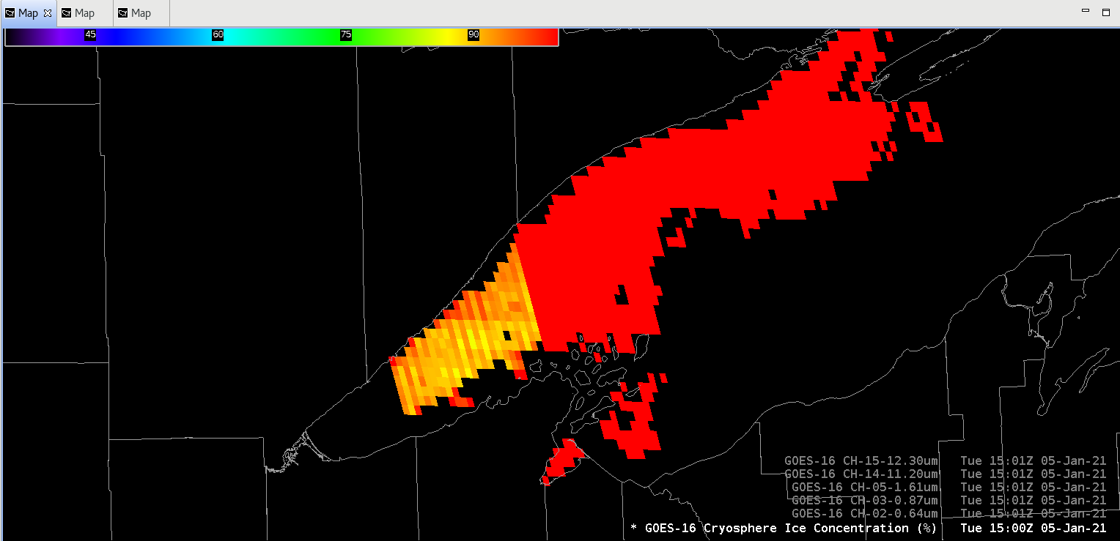
Example: Ice Concentration
R₁
NDSI= (R1- R2)/(R1+R2)
Significant differences in reflectance between R1 and R2
R₁
Band 3
0.86 ߎm
Band 5
1.61 ߎm
R₂
Courtesy of Nick Langlieb, WFO MQT

Slide 13
Application to Lakeshore Flooding?
(Presented by Nick Langlieb, WFO MQT, at Sat’l Book Club seminar on Jan 21, ‘21)
Could the GOES-R ice products along with the existing polar orbiter ice products help us to better:
  Understand the evolution of the ice formation and breakup?
  Enhance messaging for IDSS and Lakeshore Flood products? (Where you have or do not have ice)

Slide 14
Next Steps
Winter Campaign (field evaluations) underway through April 2021
Possible minor product-adjustment requests (e.g., from evaluation), Spring 2021
NWS finalizes ice code changes and deploys software in AWIPS Spring/Summer 2021
NWS product T2O date ~Summer 2021 (pending product availability via PDA/AWIPS-DD)
Notes:
AICE - Ice Concentration product
AITA - Ice Age and Thickness
AIM - Ice Motion

